Slide 1
Pathology
437’s team work
Lecture (1): Cellular Injury

Slide 2
Objectives:
1- Understand the role of the different constituents of Central nervous system (CNS) cells in the disease status.
2- Understand the “injury” concept.
3- Explain the basic pathological descriptive terms used in CNS cellular injury.
3- Correlate the different patterns of cellular injury with some important clinical examples.
4- Understand the concept of reaction of neurons, astrocytes and other glial cells to injury.
5- Recognize the axonal injury in both CNS and Peripheral nervous system as well as the consequences and the pathological findings.
Key principles to be discussed:
The definition of and an example for each of the following terms:
- Markers of CNS Neuronal Injury: Acute neuronal injury, red neurons, intracellular inclusions and dystrophic neuritis.
- Cerebral edema, definition and types.
- Marker of Axonal injury: CNS - spheroids and central chromatolysis, Peripheral nervous system- Wallerian degeneration and segmental demyelination.
- Marker of Astrocytes reaction to injury: gemistocytic astrocytes, fibrillary astrocytes, Rosenthal fibers and Corpora amylacea.
- Other cells reaction to injury: Oligodendrocytes, Ependymal and Microglia (microglial nodules and neuronphagia).

Slide 3
Markers of neuronal injury
1. Red neuron
Within 12 hours of an irreversible hypoxic/ ischemic insult, acute neuronal injury becomes evident even on routine hematoxylin and eosin (H & E) staining:
– Initial microvacuolation followed by cytoplasmic eosinophilia
– Later, shrinkage of the cell body
– pyknosis of the nucleus
– disappearance of the nucleolus
– loss of Nissl substance
– intense eosinophilia of the cytoplasm ("red neurons“)
-Acute injuries typically result in : (like trauma or high blood pressure)
1-breakdown of the blood- brain barrier
2-variable degrees of cerebral edema
Red neurons Spheroids Chromatolysis

Slide 4
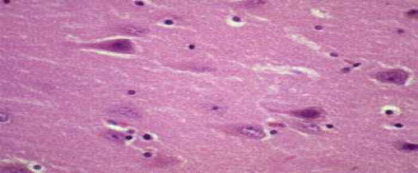
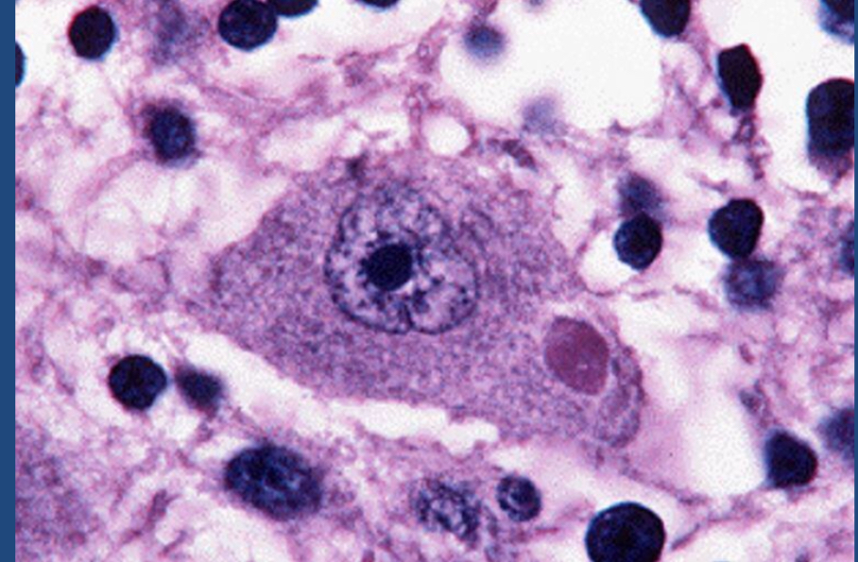
Markers of neuronal injury
*Further information about the previous slide :
Why we call it red neuron ? The red coloration is due to pyknosis or degradation of the nucleus and loss of Nissl bodies which are normally stained blue (basophilic) on hematoxylin & eosin staining . This leaves only the degraded proteins which stains red eosinophilic.
2. Intracellular inclusions :
What is it ? Nuclear or cytoplasmic aggregates of stainable substances, usually proteins, its an example of a cell reaction to an injury.
Example: Negri bodies in rabies, Lewy bodies in Parkinson, tangles in Alzheimer.
Negri Body
*Further information :
inclusions are stored nutrients, secretory products, and pigment granules. Examples of inclusions are glycogen granules in the liver and muscle cells, lipid droplets in fat cells, pigment granules in certain cells of skin and hair, water-containing vacuoles, and crystals of various types.
Sometimes they represent sites of viral multiplication in a cell and usually consist of viral capsid proteins. *dys means bad, trophy means nutrition or growth

Slide 5
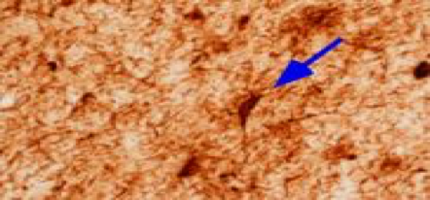
3.Dystrophic neurites :
What is it ? A neurite refers to any projection from the cell body of a neuron
Example ? In some neurodegenerative diseases ex: alzheimer's, neuronal processes become thickened and tortuous (twisted) ; these are termed dystrophic neurites
Negro=Black. It’s found in cytoplasm.
Rabies = Rabies virus is a neurotropic virus that causes rabies in humans and animals. Rabies transmission can occur through the saliva of animals )spreads through a bite from an infected animal. ( less commonly through contact with human saliva.
Remember!​ Neuritis:​ Inflammation of one or more nerves.

Slide 6
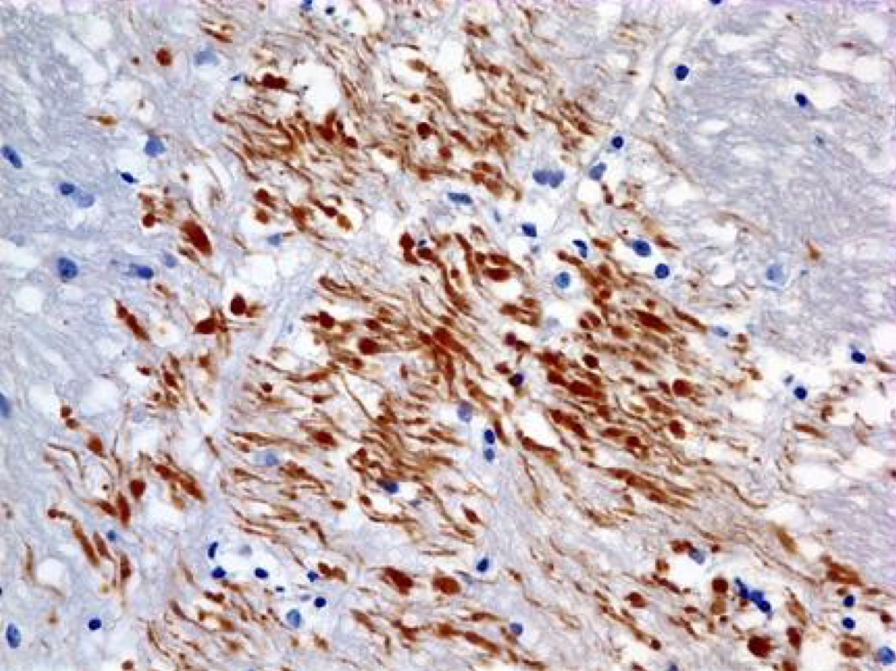
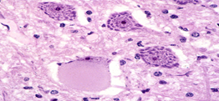
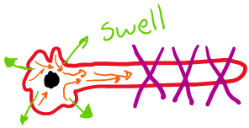
4- Axonal injury:
•What is it ? Injured axons undergo swelling (called spheroids) and show disruption of axonal transport.
•How can we see it? Evidence of injury can be highlighted by :
1- immunohistochemistry for axonally transported proteins such as amyloid precursor protein.
2) silver staining
•It leads to Central Chromatolysis, which is :
Immunostains with antibodies to Beta Amyloid Precursor Protein (BAPP) can detect the axonal lesions in 2-3 hours after the injury (diffuse axonal injury)
•dispersion of ​ Nissl substance​
(from the center of the cell to the periphery)
cell body enlargement and rounding
peripheral displacement of the nucleus
enlargement of the nucleolus
(remember! Here is the difference in red neurons it disappears), and dispersion of Nissl substance (from the center of the cell to the periphery, so-called central chromatolysis).

Slide 7
Diffuse axonal injury:
•Diffuse axonal injury (DAI) because of trauma can lead to coma. (May be associated with blood in brain and may not).
-As many as 50% of patients who develop coma shortly after trauma, even without cerebral contusions, are believed to have white matter damage and diffuse axonal injury. ‘Both’
--Widespread injury to axons within the brain can be very devastating
The movement of one region of brain relative to another is thought to lead to the disruption of axonal integrity and function.
Diffuse axonal injury is characterized by: the wide but often asymmetric distribution of axonal swellings that appears within hours of the injury and may persist for much longer¹
Diffuse axonal injury is best demonstrated with:
1)silver stains
2)immunohistochemistry for proteins within axons.
3)Immunostains with antibodies to Beta Amyloid Precursor Protein (BAPP) can detect the axonal lesions in 2-3 hours after the injury (diffuse axonal injury)

Slide 8
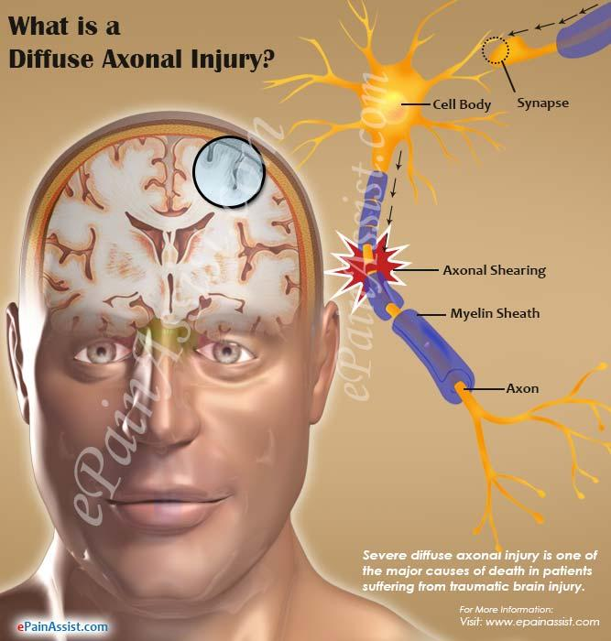
Diffuse axonal injury EXTRA NOTES:
1. How diffuse axonal injury happens?
For example if someone got in a very strong car accident, the brain will go and come back rapidly and hits the skull, this movement will cause the diffuse injury.
2. Some areas may be affected more than others, depending on what? جهه الصدمه يسار أو يمين
* Dr’s NOTES :
1) If the immunostain is positive = brown color. If the immunostain negative = blue color.
*positive when we have BAPP*
What is BAPP? Is a normal protein in the body but here it’s congested due to injury.
2)How to differentiate between the silver stain (or any stain) and the immunohistochemistry?
Immunohistochemistry (IHC) involves the process of selectively imaging antigens (e.g. proteins) in cells of a tissue section by exploiting the principle of antibodies binding specifically to antigens in biological tissues.
هي صبغه بتصبغ فقط. Stain اللي حطيناها معه. بينما الـ coloration

Slide 9
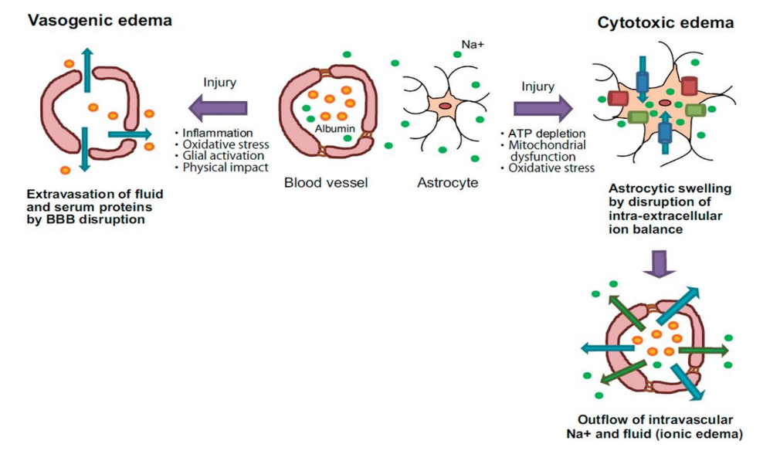
Cerebral Edema:
Is the accumulation of excess fluid within the brain parenchyma
Two types, which often occur together particularly after generalized injury:
A)Vasogenic edema: Related to blood vessels | B) Cytotoxic edema: Due to infection, tumor, toxins
-The integrity of the normal blood-brain barrier is disrupted, allowing fluid to shift from the vascular compartment into the extracellular spaces of the brain. - HOW? It can be either localized (e.g., increased vascular permeability due to inflammation or in tumors) or generalized. | -An increase in intracellular fluid secondary to neuronal and glial cell membrane injury, as might follow generalized hypoxic-ischemic insult or after exposure to some toxins.
*Edema: Increase volume in the brain > Herniation > It will go and compress the brainstem > *what do we have in brainstem? Reticular formation in midbrain* → Respiratory and cardiovascular areas will be affected > Cardiac respiratory arrest.
*So, we have to open the brain immediately فتحه صغيره بالرأس عشان يطلع الدمto make the blood go out and save her\his life. There is No time for investigations because He\She will be dead by that time.
*Cytotoxic edema: During an ischemic stroke, a lack of oxygen and glucose leads to a breakdown of the sodium-calcium pumps on brain cell membranes, which in turn results in a massive buildup of sodium and calcium intracellularly. This causes a rapid uptake of water and subsequent swelling of the cells.

Slide 10
Astrocytes in injury & repair:
Astrocytes are the principal cells responsible for repair and scar formation in the brain, a process termed gliosis.
Do we have fibrosis in the brain? No. There’re two situations where you can have fibrosis in the brain: 1) Penetrating injury > surgery in the frontal lobe. 2) Abscess > because of the destruction of blood-brain barrier.
In response to injury:
Astrocytes undergo both hypertrophy and hyperplasia.
The nucleus enlarges and becomes vesicular, and the nucleolus is prominent
The previously scant cytoplasm expands to a bright pink, somewhat irregular swath around an eccentric nucleus, from which emerge numerous stout, ramifying processes (gemistocytic astrocyte).
In settings of long-standing gliosis, astrocytes have less distinct cytoplasm and appear more fibrillar (fibrillary astrocytes).
There is minimal extracellular matrix deposition:
Unlike the repair after injury elsewhere in the body, fibroblasts participate in healing after brain injury only to a limited extent (usually after penetrating brain trauma or around abscesses).
gemisto = to fill up /Ramifying = branch out. /Stout= overweight, fleshy / Scant = little or no
/Swath = a broad strip or area of something (border) / eccentric = abnormal

Slide 11
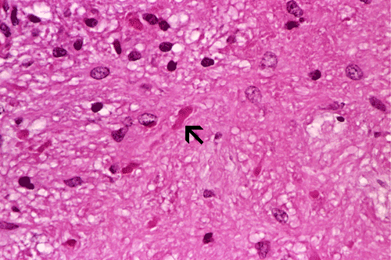
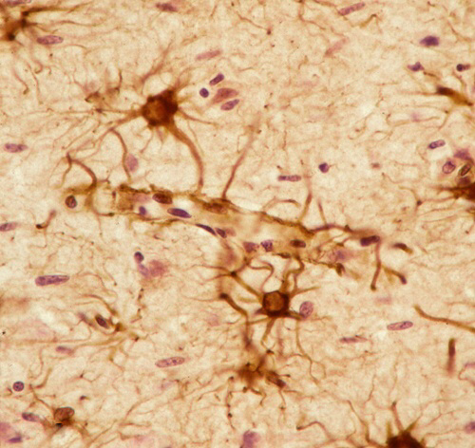
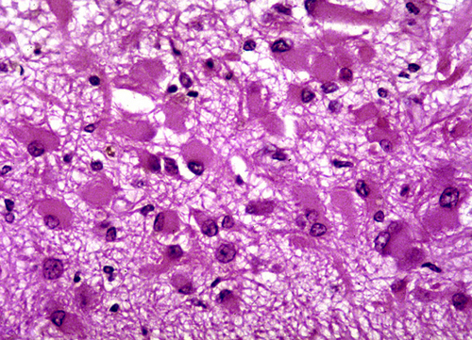
Rosenthal fibers are thick, elongated, brightly eosinophilic protein aggregates that can be found in astrocytic processes in chronic gliosis and in some low-grade gliomas. Which tumor exhibits Rosenthal fibers? Pilocytic astrocytoma.
Further information :
Rosenthal fibers : is a thick, elongated proteins, worm-like and eosinophilic In the ultrastructure of astrocytes you will find that they are composed of proteins the same ones in rosenthal fibers thus when gliomas occur or a chronic gliosis within time the astrocytes are going to give the rosenthal fibers that grow inside them and your going to be able to see it with microscopy
Glial fibrillary acidic protein (GFAP) ‘immunostain’
Reactive astrocytes are bigger when injury happens
They are star-shaped
Gemistocytic gliosis

Slide 12
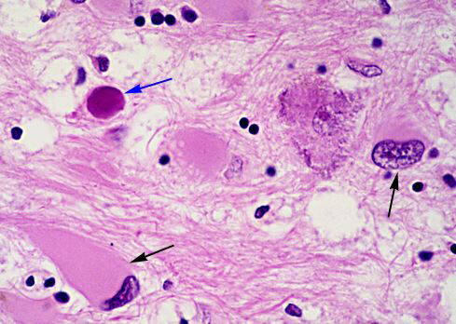
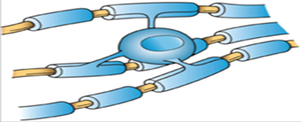
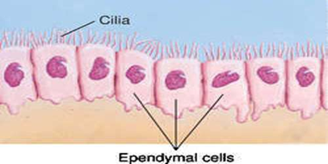
#Oligodendrocytes in Injury and Repair :
Produce myelin.
Exhibit a limited spectrum of specific morphologic changes in response to various injuries.
In progressive multifocal leukoencephalopathy , viral inclusions can be seen in oligodendrocytes, with a smudgy, homogeneous-appearing enlarged nucleus.
#Ependymal cells in Injury and Repair:
Line the ventricular system and the central canal of the spinal cord.
Certain pathogens, particularly cytomegalovirus (CMV), can produce extensive ependymal injury, with typical viral inclusions.

Slide 13
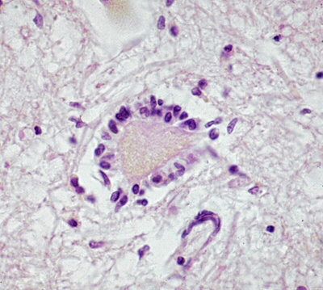
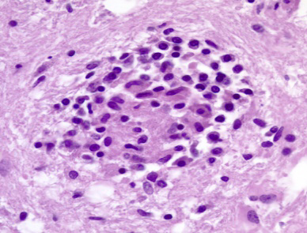
Microglia in Injury and Repair:
What are they? Long-lived cells derived from the embryonic yolk sac function as the phagocytes of the CNS.
When activated, they proliferate and become more evident
They may be recognizable as activated macrophages in areas of:
Demyelination
Organizing infarct.
Hemorrhage
They develop elongated nuclei (rod cells) in neurosyphilis or other infections.
When these elongated microglia form aggregates at sites of tissue injury, they are termed microglial nodules.
Similar collections can be found congregating around portions of dying neurons, termed neuronophagia (e.g. viral encephalitis).
Neuronophagia
Microglial nodule

Slide 14
# Markers of peripheral nerve injury :
Most peripheral neuropathies can be subclassified as either axonal or demyelinating , even though some diseases exhibit mixed features.
⬤ Axonal neuropathies :
⬤ Segmental demyelination :
Demyelinating neuropathies are characterized by damage to schwann cells or myelin with relative axonal sparing , resulting in abnormally slow nerve conduction velocities .
Demyelination typically occurs in individual myelin internodes random ; this process is termed segmental demyelination .
Morphologically , demyelinating neuropathies show a relatively normal density of axons and features of segmental demyelination and repair > > recognized by presence of axons with abnormally thin myelin sheaths and short internodes .
Caused by insults that directly injure the axon .
The entire distal portion of an affected axon degenerates .
Axonal degeneration is associated with secondary myelin loss a process sometimes referred to as Wallerian degeneration .
Regeneration takes place through axonal regrowth and subsequent remyelination of the distal axon
The morphologic hallmark of axonal neuropathies is a decrease in the density of axons , which in electrophysiologic studies correlates with a decrease in the strength of amplitude of nerve impulses

Slide 15
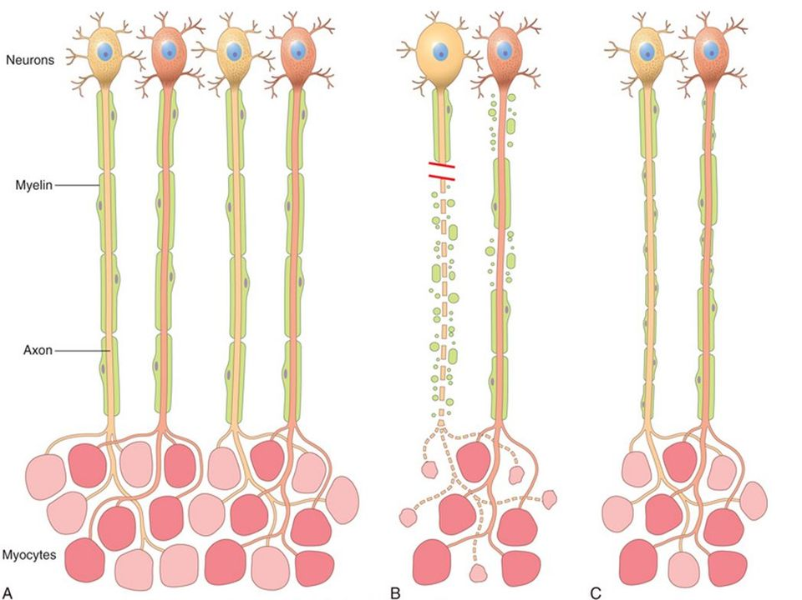
# Markers of peripheral nerve injury :
A, In normal motor units, type I and type II myofibers are arranged in a “checkerboard” distribution.
B, Acute axonal injury (left axon) by contrast, acute demyelinating disease (right axon) produces random segmental degeneration, while sparing the axon.
C, Regeneration of axons after injury (left axon) allows connections with myofibers to re-form, but the new internodes are shorter and the myelin sheaths are thinner. Remission of demyelinating disease (Right axon) allows remyelination to take place, but the new internodes also are shorter and have thinner myelin sheaths.

Slide 16
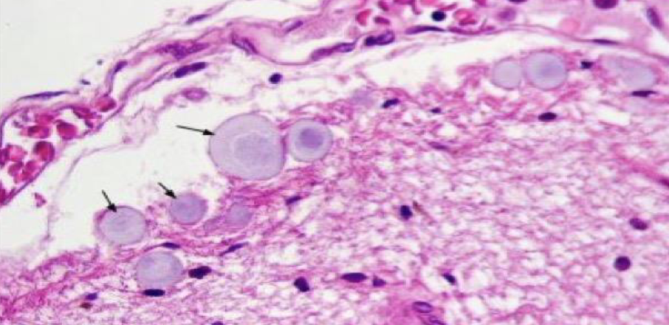
Homework
- Define Corpora amylacea?
Corpora amylacea are small hyaline masses of unknown significance found in the prostate gland, pulmonary alveoli and neuroglia.
- Where and when they are deposited in the CNS? In the brain, corpora amylacea are contained in foot processes of astrocytes and are usually present in subpial (under the pia matter) location and around blood vessels. They are derived from degenerate cells or thickened secretions and occur more frequently with advancing age. While their significance is unknown, they can be used to identify these organs microscopically

Slide 17
Questions
6- The morphological part of axonal neuropathies? A- Increase in density of axons. B- Decrease in density of axons. C- Increase in axonal velocity. D- Decrease in axonal velocity. Correct answer: B 7- Red neuron appears within ............ of an irreversible hypoxic/ischemic insult. A- 6 hours B- 4 hours C- 16 hours D- 12 hours Correct answer: D 8- The integrity of the normal blood brain barrier is disrupted in: A- Cytotoxic edema B- Vasogenic edema C- both A and C D- None of the above Correct answer: B 9- What is the significance of Corpora amylacea? A- They Enhance the neuronίs function. B- They are used to identify the organs they grow on microscopically. C- They calcificate and cause further impairment of the neurons. Correct answer: B 10- The termed referred to a collection of microglial cells found congregating around portions of dying neuron in: A- Microglial nodules. B- Hemorrhage. C- Neuronophagia. D- A and C. Correct answer:C
1- Glial fibrillary acidic protein (GFAP) are usually seen in: A- oligodendroglioma B- Astrocytoma c- ependymoma d- meningioma correct answer: B
2- In progressive multifocal leukoencephalopathy, viral inclusions can be seen in: A- astrocyte B- microglial cells C- ependymal cells D- oligodendrocytes Correct answer: D 3- microglia is derived from: A- Yolk sac B- Bone marrow C- Adipose tissue Correct answer: A 4- Wallerian degeneration is: A- Axonal degeneration B- Demyelination C- Secondary myelin loss D- Both A and C Correct answer: D 5- During axonal injury the nucleolus is: A- Prominent. B- Unaffected. C- Disappeared. D- Enlarged. Correct answer: D

Slide 18
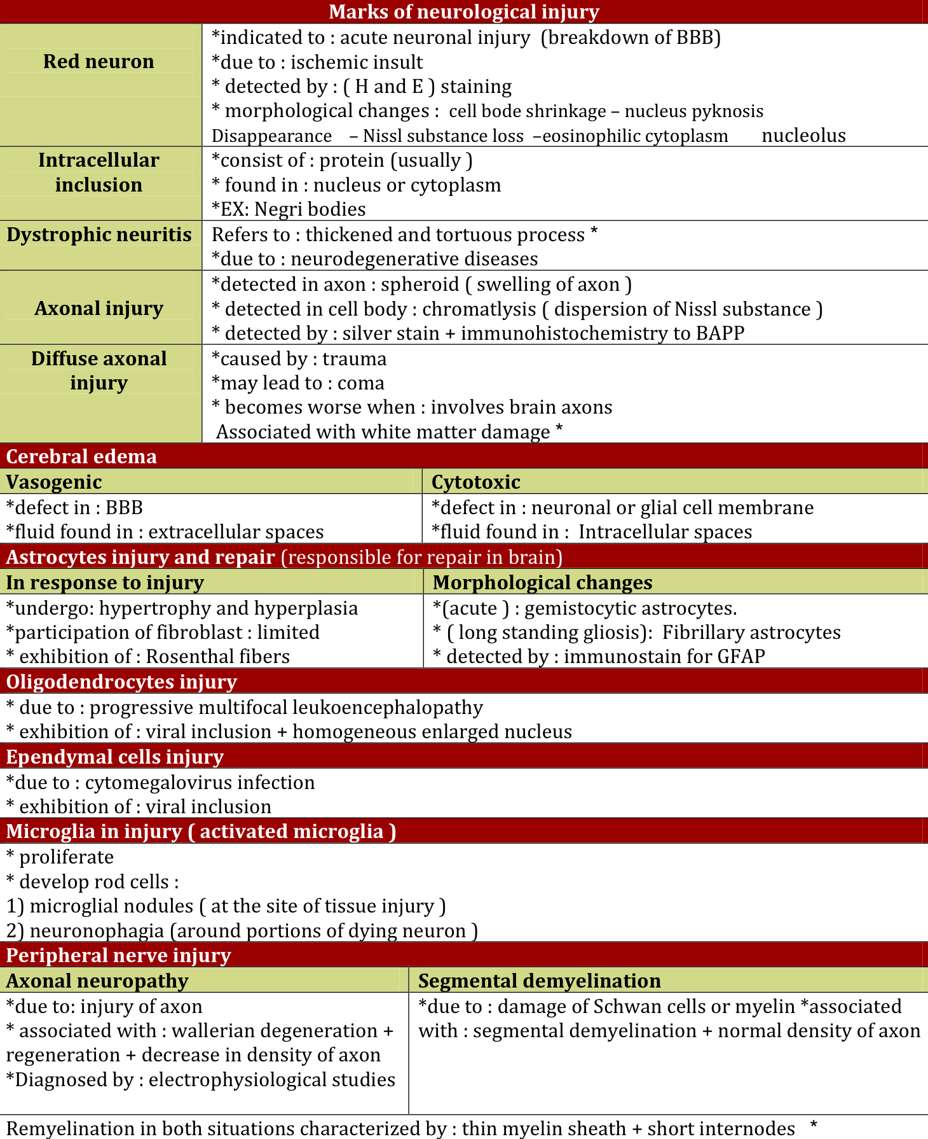
Summary (436)

Slide 19
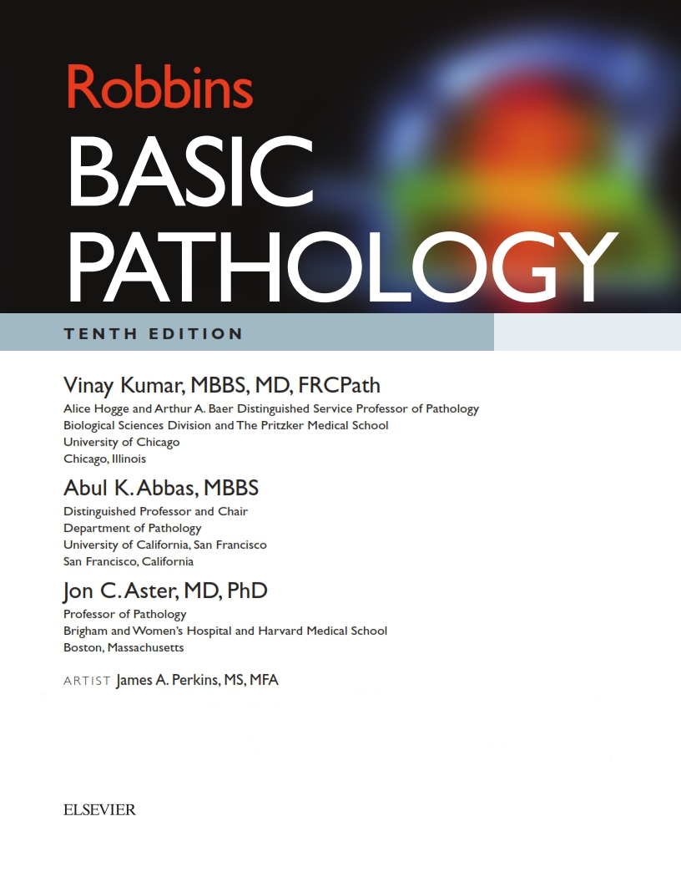
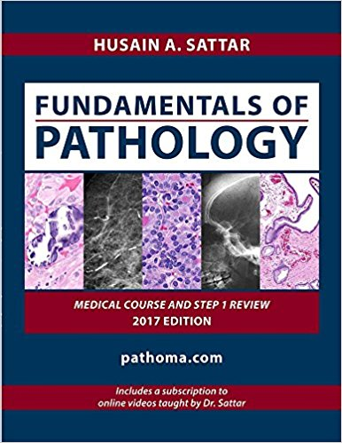
كل الشكر والتقدير للجهود العظيمة من قبل أعضاء فريق علم الأمراض الكرام:
قادة فريق علم الأمراض :
بثينة الماجد
منصور العبرة
أعضاء فريق علم الأمراض :
بندر الجماز
راكان الغنيم
عبدالعزيز العبدالكريم
سعود الغفيلي
محمد المحيميد
تركي الشمري
سلطان بن عبيد
علي شحادة
فايز الدرسوني
وجدان الشامري
مشاعل القحطاني
Kindly contact us if you have any questions/comments and suggestions:
EMAIL: pathology437@gmail.com
TWITTER : @pathology437
References:
-Slides

