Slide 1
Pathology
437’s team work
Lecture (2 + 3): tumors of cns .

Slide 2
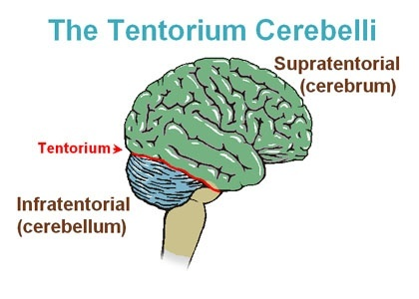
#Introduction
The annual incidence of CNS tumors ranges from 10 to 17 per 100,000 individuals for intracranial tumors and 1 to 2 per 100,000 individuals for intraspinal tumors.
About one half to three-fourths are primary tumors, and the rest are metastatic
Tumors of the CNS make up a larger proportion of childhood cancers, accounting for as many of 20% of all pediatric tumors.
**Important note by Dr.khalidi the most common type of intracranial brain tumors in clinical practice are metastatic which are up to 50 %
in adults : mostly supratentorial.
In childhood : tumors are likely to arise in the posterior fossa
Tumors of the nervous system have unique characteristics:
These tumors do not have morphologically evident premalignant or in situ stages comparable to those of carcinomas*. Or dysplasia
2. Even low-grade lesions may infiltrate large regions of the brain, leading to serious clinical deficits, inability to be resected, and poor prognosis.
3. The anatomic site of the neoplasm can influence outcome independent of histologic classification due to local effects (e.g., a benign meningioma may cause cardiorespiratory arrest from compression of the medulla). يعني مهما كان نوع التيومر بسيط موقعه ممكن يسبب مشاكل لان الجهاز العصبي جداً حساس
4. Even the most highly malignant gliomas rarely spread outside of the CNS.
*Staging, which is defined as the extension degree to other tissues, doesn’t exist in CNS tumors. Unlike grading, which is very important in CNS tumors.

Slide 3
General manifestations: depends on the location.
Classification: May arise from:
Seizures, headaches, vague symptoms. ¹
Focal neurologic deficits related to the anatomic site of involvement 2
Rate of growth may correlate with history ³
1* Why?​ Tumors usually compress the surrounding area and while we are sleeping more fluid will be to the brain and it can’t return to the body as fast as normal due to the presence of the tumor and that’s called (hydrocephalus ) increasing the intracranial pressure which causes headache.
2* for example: tumors in the frontal loop may cause changes in personality and in the occipital loop it can affect the vision
3* Like when we have one month history we should be worried!
1) Cells of the coverings (meningiomas).
2) Cells intrinsic to the brain (gliomas, neuronal tumors, choroid plexus tumors).
3) Other cell populations within the skull (primary CNS lymphoma, germ-cell tumors 4 ).
4) They may spread from elsewhere in the body (metastases)5.
Dr.Maria's notes :
4-germ cells are embryological remnants that can give rise to tumors in the base of the skull and is called germinoma
5- tumors can metastasize from the rest of the body and reach the brain but they never metastasize from the brain to the the body

Slide 4
Gliomas :
WHAT ARE THEY ? Gliomas are type of CNS tumors arising from the glial cells. They’re classified as:
Gliomas
Astrocytomas
Oligodendrogliomas
Ependymomas
*Dr.maria’s note :
-nowadays it has become clear that the gliomas are classified according to molecular classification with histological finding . For example when we find EGFR gene mutation we think of Glioblastoma.
Astrocytomas
1) Fibrillary¹ Astrocytoma: | 2) Pilocytic Astrocytoma : (Grade I)
4th to 6th decade ‘Adults’ | Children and young adults
Commonly cerebral hemisphere “Supratentorial” | Commonly found in cerebellum “Infratentorial”, 4th ventricle, and around the pituitary gland
Variable grades: Diffuse astrocytoma (Grade II) Anaplastic astrocytoma (Grade III) Glioblastoma (Grade IV) | - (Grade I) - Relatively benign, meaning we don't expect Atypia, necrosis, and no mitosis and it’s considered as well-circumscribed cerebellar mass.
Dr.maria’s note :
1- smaller and thicker processes, more cellular than pilocytic astrocytoma
features of the grades:
Grade I: no Atypia, necrosis or mitosis
grade II: more cellular, a little atypia in the nucleus
grade III: more cellularity, more Atypia and mitosis
grade IV: Necrosis and vascular proliferation
The diffuse gliomas constitute the vast majority of gliomas that occur in adults, and include diffuse astrocytomas and oligodendrogliomas.

Slide 5
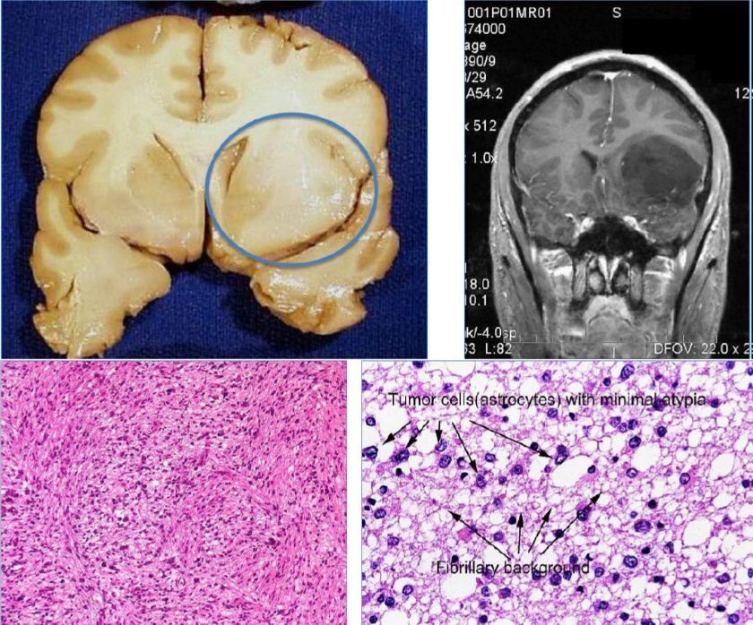
1) Fibrillary Astrocytoma:
Well differentiated : | Less differentiated (higher-grade) : | Less differentiated (higher-grade) :
diffuse astrocytoma (WHO grade II) | Anaplstiac astrocytoma (WHO grade III) | Glioblastoma (WHO grade IV)
Static or progress slowly (mean survival of more than 5 years) | - | With treatment, mean survival of 8-10 months
Moderate cellularity | More cellular | -
Variable nuclear pleomorphism. | -Greater nuclear pleomorphism. – Mitosis | All the features of anaplastic astrocytoma, plus: Necrosis and/or vascular or endothelial cell proliferation *
non-demarcated, can be seen as thickening of the white matter |  | can be seen as a space occupying lesion
* Dr.alkhaldi note: proliferation here means thickening of the endothelial layer, NOT increase in the number of layers

Slide 6
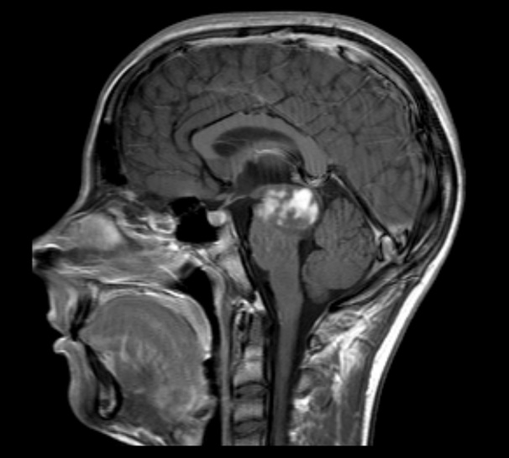
2) Pilocytic Astrocytoma:
Pilocytic Astrocytoma:
▪ Often cystic, with a mural nodule¹. ▪ Well circumscribed². ▪ "Hairlike’’³ pilocytic processes that are GFAP positive. ▪ Rosenthal fibers⁴ & hyaline granular bodies are often present. ▪ Necrosis and mitoses are typically absent.
1- Cyst with central solid compartments
2- which means it can easily be resected
3-hairlike = long and thin
4- thick eosinophilic proteins in the processes of the astrocytes
*Rosenthal fibers here are to differentiate between pilocytic and diffuse astrocytoma, BUT remember they can also be seen in chronic gliosis.
#Important note from Robbins:
midbrain gliomas:
arise most commonly from : brainstem, especially the pons
caused by : a mutation in histone H3

Slide 7
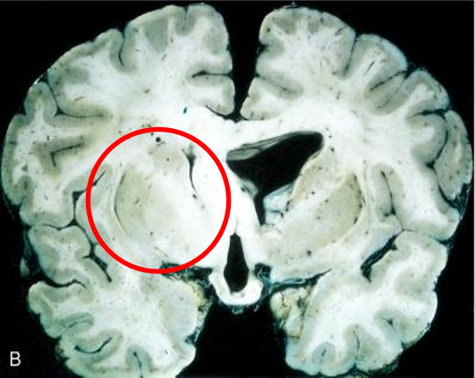
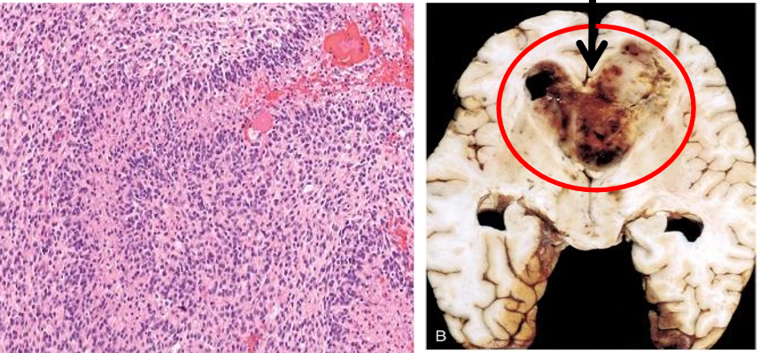
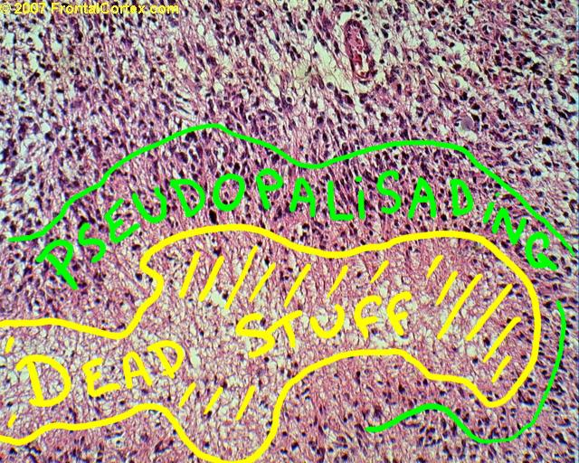
Diffuse astrocytoma :
Grossly :
Note that diffuse astrocytoma are poorly demarcated
*Because cells of malignant astrocytes sneak out between normal cells. Which makes complete removal of the tumors difficult !
*extra but important !
GBM “Glioblastoma Multiforme
Grossly:
necrotic hemorrhagic infiltrating mass ,space occupying lesion
Histology :
1-Pseudopalisading necrosis ( صفوف كاذبة)
2- Vascular proliferation
(thickness of endothelium not the
increase in vessels)
3- hemorrhage
4- variation from region to region is characteristic : some area seen white and firm some areas are soft and yellow ( result from the necrosis
Butterfly appearance
Palisading is when tumor cells line up next to each other, around the central pale area, which represents necrotic tissue. Look at the picture below

Slide 8
Astrocytoma mutations
lower- grade astrocytomas*3
Primary glioblastomas
Secondary glioblastomas *1
Mutations in the isoforms of the metabolic enzyme isocitrate dehydrogenase (IDH1 and IDH2)
amplification of the epidermal growth factor receptor (EGFR ) gene
share p53 mutations that characterizes low-grade gliomas *2
dr.maria note :
1* secondary glioblastoma : the tumor did not start as glioblastoma but it transformed/progressed to glioblastoma
2* for example if the patient has low grade astrocytoma “eg: grade 2” then it transformed/ progressed to glioblastoma he will have both p53 mutation and IDH1 and IDH2. because it start as primary = mutations in IDH1 and IDH2 then progressed to secondary glioblastoma = P53 mutation
3* includes grade II (diffuse astrocytoma) and Oligodendroglioma, NOT grade I (pilocytic astrocytoma).

Slide 9
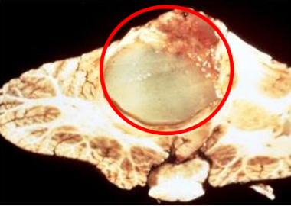
Oligodendrogliomas
B) Oligodendrogliomas ( Malignant tumor ):
▪ The most common genetic findings are loss of heterozygosity codeletion for chromosomes 1p and 19q. ▪ Affects Adults in Fourth and fifth decades. ▪ Cerebral hemispheres mainly in frontal and temporal lobes (supratentorial in the brain cortex), with a predilection for white matter. WHY ? ​ because oligodendrocytes are present in white matter ▪ Better prognosis than do patients with astrocytomas (5 to 10 years with treatment). Grade II oligodendroglioma has better prognosis than grade II diffuse astrocytoma. ▪ Anaplastic form grade III prognosis is worse than the conventional type grade II Oligodendroglioma only has 2 grades, II & Ill ▪ Imaging reveals: Calcified tumor in white matter. May present with seizures.

Slide 10
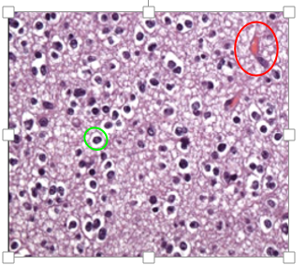
Morphology of Oligodendrogliomas: :
:
In oligodendroglioma tumor cells have round nuclei, often with a cytoplasmic halo (Fried egg pattern).
Blood vessels in the background are thin and can form an interlacing pattern (Chicken wire pattern).
Calcification, present in as many as 90% of these tumors.
What additional features are needed for anaplastic oligodendroglioma?

Slide 11
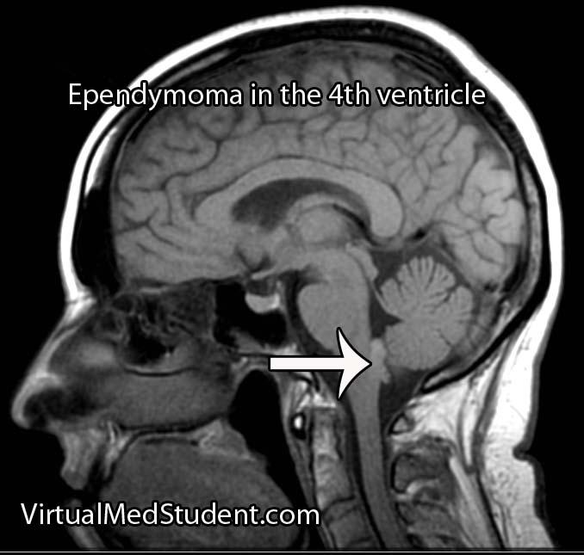
#Ependymomas :
C) Ependymomas: (Malignant tumor)
▪ Most often arise next to the ependyma-lined ventricular system (especially the 4th ventricle) including the central canal of the spinal cord. So, may present with hydrocephalus. ▪ Occurs in the first two decades of life. Common in children in the posterior fossa. ▪ Typically occur near the fourth ventricle. ▪ In adults, the spinal cord is their most common location *Dr. Khaldi’s note: *imp* This type is more common in Children and young adults, the central canal of the spinal cord is its most common location in adults. Ependymoma is grade II, the anaplastic type is grade III

Slide 12
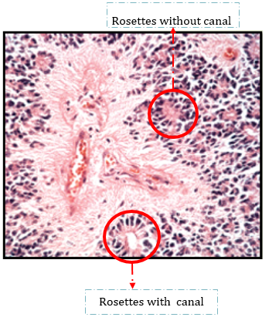
Morphology of Ependymoma:
Tumor cells may form round or elongated structures ( rosettes, canals) more frequently present are perivascular pseudorosettes in which tumor cells are arranged around vessels with an intervening zone containing thin ependymal processes.
Anaplastic ependymomas show increased cell density, high mitotic rates, necrosis and less evident ependymal differentiation
Dr. Khaldi’s + Dr.maria’s notes:
True rosettes have lumen “canal” (but can’t have vessels) مسوين فتاحية ورده :)
True rosettes also could also arranged together without canal أيضا مسوين فتاحية وردة
False (psuedo-rosettes) don’t have a lumen, they may have vessels فتاحية وردة حول البلود ليزلي

Slide 13
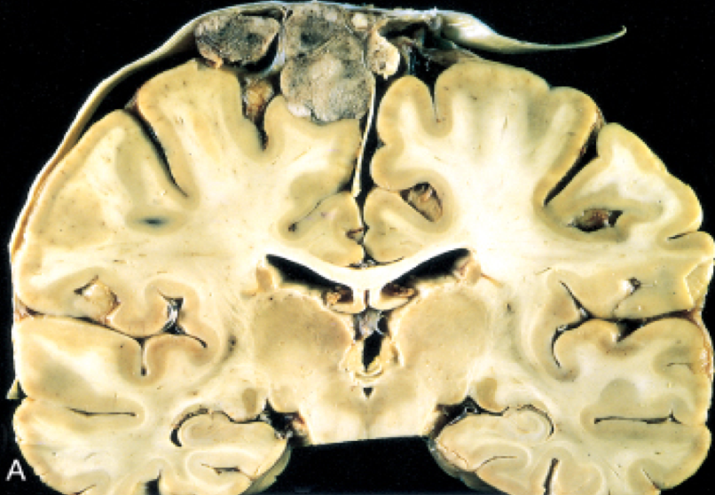
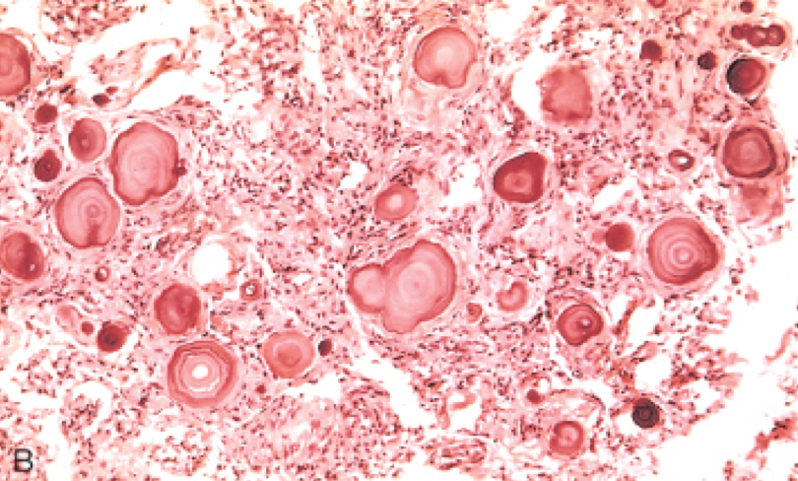
Meningioma: grade I
*If meningioma invades brain, it becomes grade II
common in | Benign Tumor usually in Adults (women)
Origin | Meningothelial cell of the arachnoid. (They arise from the arachnoid but attached to dura mater.)
Invasion | Although most meningiomas are easily separable from underlying brain, some tumors infiltrate the brain.→ increased risk of recurrence. ​ (may present with seizure).
Gross appearance | parasagittal multilobular meningioma attached to the dura with compression of the underlying brain.
Microscopic appearance | ● Whorled pattern of cell growth(حلزوني الشكل) ● Psammoma bodies. ● Atypical meningiomas: ​(more pleomorphism, mitosis and increased cellularity).
Subtypes | Main subtypes (grade I): - Meningothelial - Fibroblastic - Transitional - Psammomatous - Secretory
Even grade I can cause problems, it depends up on the size and location of the tumor
Solid, easy separated from brain parenchyma. .
Also note: -Atypical meningiomas (grade II) -Anaplastic (malignant) meningiomas (grade III)
*Notes from robbins :
Meningothelial : named for the whorled clusters Also called syncytial
Fibroblastic : with elongated cells and abundant collagen
Transitional : with features of both 1 + 2
Psammomatous : with numerous psamomas bodies
Secretory : glandlike spaces contain eosinophilic materials

Slide 14
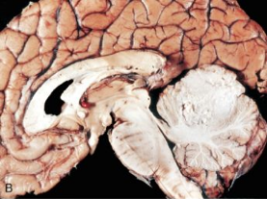
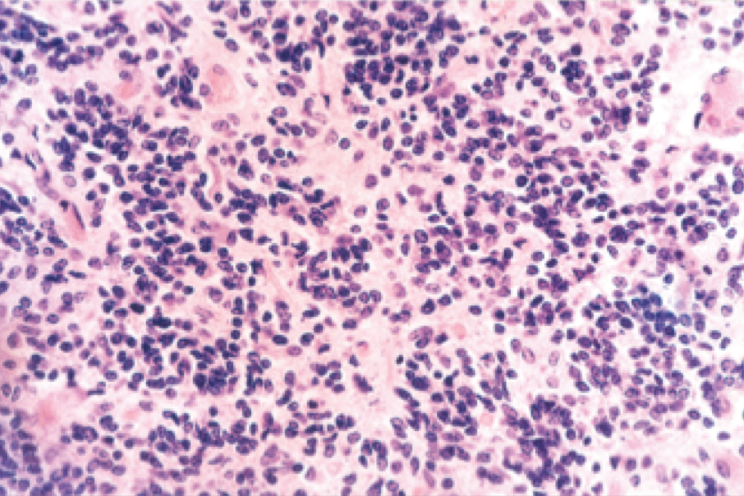
Medulloblastoma:
Affect who and where : | Children, exclusively in the cerebellum(posterior fossa )
Type and prognosis : | Neuronal and glial markers may be expressed, but the tumor is often largely undifferentiated. The tumor is highly malignant, and the prognosis for untreated patients is dismal “poor”; however, it is exquisitely radiosensitive. Why its poor ? because its rapid growth and spreads by CSF. With total excision and radiation, the 5-year survival rate may be as high as 75%. With total excision and radiation, the 5-year survival rate may be as high as 75
Gross appearance: | ● showing medulloblastoma with ​ destruction of the superior midline cerebellum.. ● largely undifferentiated. ● Neuronal and glial markers may be expressed
Microscopic appearance : | Small, round and blue cell little cytoplasm with hyperchromatic nuclei. mitoses are abundant The tumor is extremely cellular. Necrosis No certain type of differentiation.
Poorly differentiated , very aggressive tumor in pediatric age.
Dr.AlKhaldi notes :
*it is grade 4.
*it is very sensitive to radiotherapy even though it’s grade 4.

Slide 15
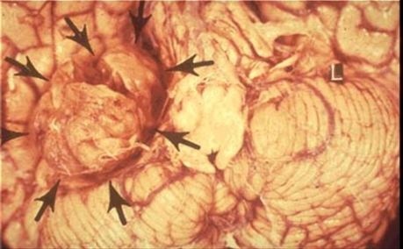
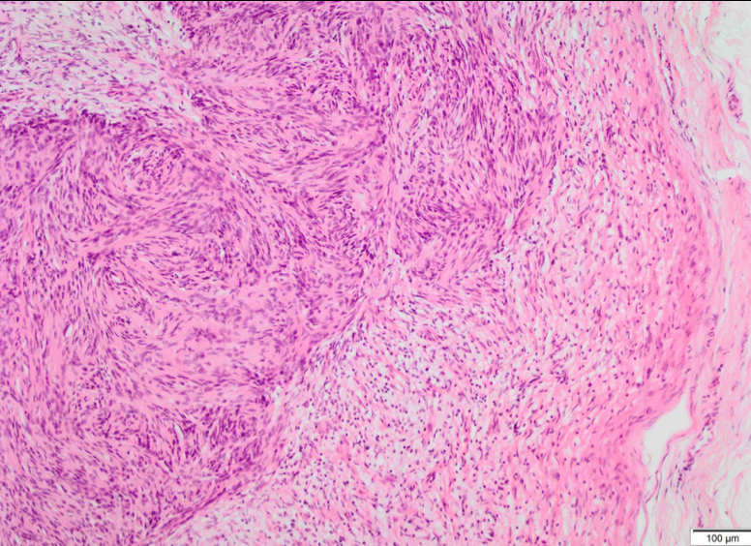
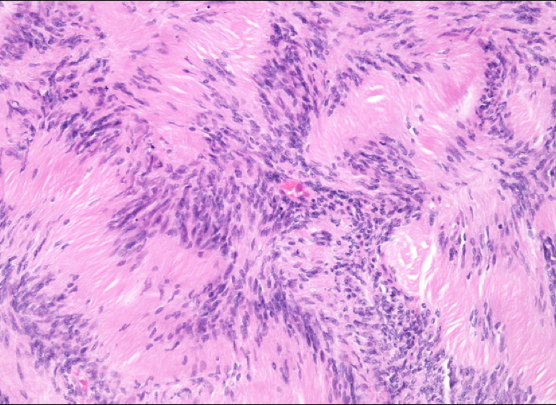
Schwannoma:
Affect who and site ? | Affects : Sporadic(one and random) schwannomas are associated with mutations in the NF2 gene. Bilateral acoustic schwannoma is associated with NF2 syndrome *Extra from robbins : Affected patients carry a dominant loss of function mutation of the Merlin gene on chromosome 22. - But What is Merlin Gene ? a cytoskeletal protein that functions as a tumor suppressor. Some cases have recently been linked to loss-of-function mutations in a tumor suppressor gene on chromosome 22 that encodes a protein that regulates chromatin structure SITE : In the CNS, they are often encountered within the cranial vault in the cerebellopontine angle, where they are attached to the vestibular branch of the eighth nerve causing tinnitus(ringing) and hearing loss. Could happen outside the CNS. Attached to the nerve but can be separated from it.
Type ? | Benign. Grade I.
Gross appearance ? | Most schwannomas appear as circumscribed masses abutting an adjacent nerve.
Microscopic appearance ? | Biphasic pattern: cellular Antoni A pattern and a less cellular Antoni B pattern | Nuclear-free zones of processes that lie between the regions of nuclear palisading(مصفوفة) are termed Verocay bodies.

Slide 16
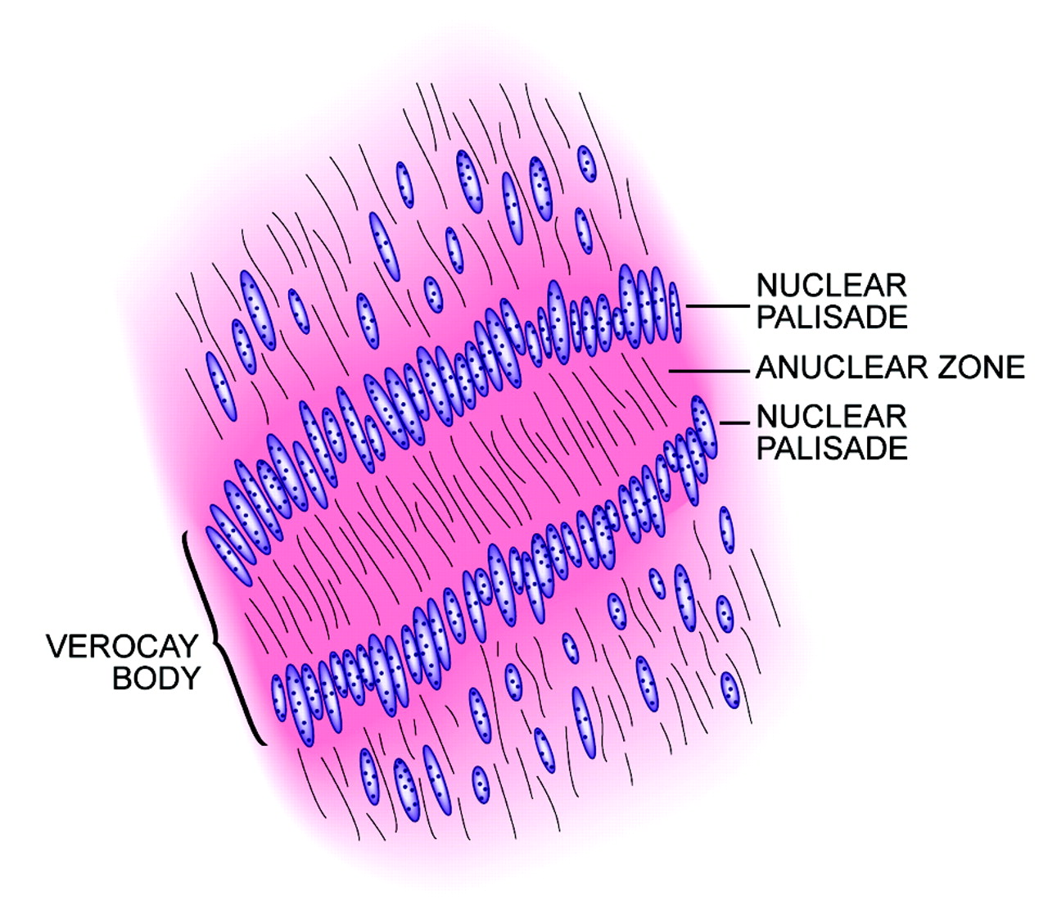
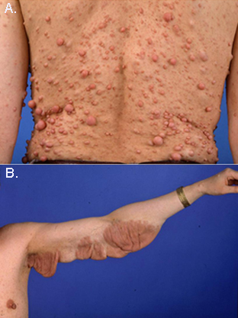
Neurofibroma:
Dr.Alkhaldi notes
*not CNS tumor (peripheral).
*can be confused with neurofibroma .
*schwannoma can be easily cut unlike the neurofibroma because it’s within the nerve itself.
*If it bilateral schwannoma it’s a diagnostic feature of NF2 syndrome .
explanation for the verocay body
Neurofibromas are benign tumors of peripheral nerve
Examples: (cutaneous neurofibroma in pic A) or in peripheral nerve (solitary neurofibroma).
These arise sporadically or in association with type 1 neurofibromatosis, rarely malignant.
Plexiform neurofibroma(diagnostic feature for NF1 syndrome) : mostly arising in individuals with NF1 Syndrome, with a potential malignant transformation.(pic B)
Neurofibromas : cannot be separated from nerve trunk (in comparison to schwannoma). therefore it’s difficult to be removed surgically

Slide 17
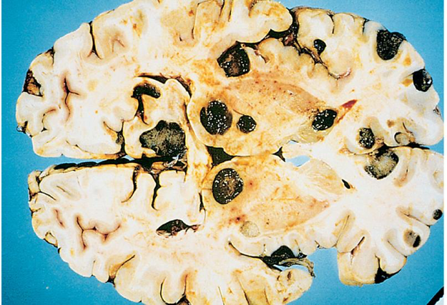
Metastatic Tumors:
About half to three-quarters of brain tumors are primary tumors, and the rest are metastatic(up to %50 of all CNS tumors).
Lung(common), breast, skin (melanoma), kidney, and gastrointestinal tract are the most common primary sites for metastases.
The metastatic deposits are usually multiple, sharply demarcated masses with a surrounding edema.

Slide 18
Homework!
Describe the inheritance pattern and the main features of:
Type 1 Neurofibromatosis
Type 2 Neurofibromatosis
Which one of these two syndromes, has a propensity for the neurofibromas to undergo malignant transformation at a higher rate than that observed for comparable tumors in the general population?
Neurofibromatosis Type 1.
Neurofibromatosis | Type 1 | Type 2
Inheritance pattern | An autosomal dominant disorder caused by mutations in the tumor suppressor neurofibromin, encoded on the long arm of chromosome 17 (17q). | A dominant loss of function mutation of the merlin gene on chromosome 22.
Main features | Learning disabilities. Seizures. Skeletal abnormalities. Vascular abnormalities with arterial stenoses. Pigmented nodules of the iris (Lisch nodules) Pigmented skin lesions (axillary freckling and café au lait spots) in various degrees. | Presence of bilateral vestibular schwannomas.

Slide 19
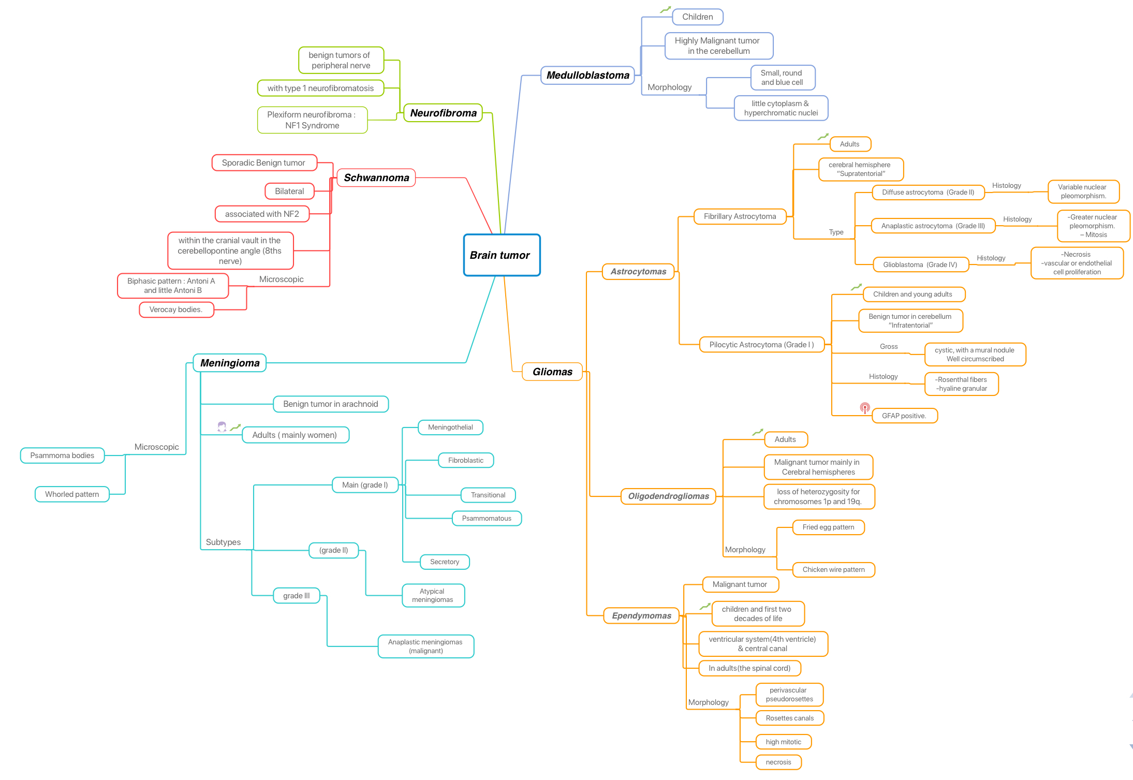
Important Keywords - Dr.maria :
*هذه الخريطة تحتوي على جميع الkeywords اللتي نبهت عليها دكتورة ماريا
Special thanks to Ahad!

Slide 20
#Summary pathoma:
CNS TUMORS I. BASIC PRINCIPLES A. Can be metastatic (50%) or primary (50%) B. Metastatic tumors characteristically present as multiple, well-circumscribed lesions at the gray-white junction. 1. Lung, breast, and kidney are common sources. C. Primary tumors are classified according to cell type of origin (e.g., astrocytes, meningothelial cells, ependymal cells, oligodendrocytes, or neuroectoderm). D. In adults, primary tumors are usually supratentorial. I. Most common tumors in adults are glioblastoma multiforme, meningioma, and E. ln children, primary tumors are usually infratentorial. I. Most common tumors in children are pilocytic astrocytoma, ependymoma, and medulloblastoma. F. Primary malignant CNS tumors are locally destructive, but rarely metastasize. II. GLIOBLASTOMA MULTIFORM£ (GBM) A. Malignant,high-grade tumor of astrocytes. B. Most common primary malignant CNS tumor in adults C. Usually arises in the cerebral hemisphere; characteristically crosses the corpus callosum ('butterfly' lesion) D. Characterized by regions of necrosis surrounded by tumor cells (pseudopalisading) and endothelial cell proliferation; tumor cells are GFAP positive. E. Poor prognosis III. MENINGIOMA A. Benign tumor of arachnoid cells B. Most common benign CNS tumor in adults I. More commonly seen in women; rare in children C. May present as seizures; tumor compresses, but does not invade, the cortex. D. Imaging reveals a round mass attached to the dura. E. Histology shows a whorled pattern psammoma bodies may be present. IV. SCHWANNOMA A. Benign tumor of Schwann cells B. Involves cranial or spinal nerves; within the cranium, most frequently involves cranial nerve Vlll at the cerebellopontine angle (presents as loss of hearing and tinnitus) C. Tumor cells are S-100 positive. D. Bilateral tumors are seen in neurofibromatosis type 2. V. OLIGODENDROGLIOMA A. Malignant tumor of oligodendrocytes B. Imaging reveals a calcified tumor in the white matter, usually involving the frontal lobe; may present with seizures C. 'Fried-egg' appearance of cells on biopsy

Slide 21
#Summary pathoma:
VI. PI LOCYTIC ASTROCYTOMA A. Benign tumor of astrocytes B. Most common CNS tumor in children; usually arises in the cerebellum C. Imaging reveals a cystic lesion with a mural nodule D. Biopsy shows Rosenthal fibers (thick eosinophilic processes of astrocytes) and eosinophilic granular bodies; tumor cells are GFAP positive.
VII. MEDULLOBLASTOMA A. Malignant tumor derived from the granular cells of the cerebellum (neuroectoderm) B. Usually arises in children C. Histology reveals small, round blue cells; Homer-Wright rosettes may be present. D. Poor prognosis; tumor grows rapidly and spreads via CSF. 1. Metastasis to the cauda equina is termed 'drop metastasis.'
VIII. EPENDYMOMA A. Malignant tumor of ependymal cells; usually seen in children B. Most commonly arises in the 4th ventricle; may present with hydrocephalus C. Perivascular pseudorosettes are a characteristic finding on biopsy.
IX. CRANIOPHARYNGIOMA A. Tumor that arises from epithelial remnants of Rathke's pouch B. Presents as a supratentorial mass in a child or young adult; may compress the optic chiasm leading to bitemporal hemianopsia
C. Calcifications are commonly seen on imaging (derived from "tooth-like" tissue). D. Benign, but tends to recur after resection
special thanks to renad alfirm !

Slide 22
Quiz :
1- A 41-year-old female presented with one-week history of blurred vision. A physical examination revealed relative afferent pupillary defect and decreased visual acuity of the left side. The MRI showed that the small nodular mass, passing through the superior orbital fissure, extended from the cavernous sinus to the intraorbital region, and the mass was compressing the optic nerve. Histopathological examination of the tumor revealed areas of hypercellularity (Antoni type A) showed nuclear palisading, forming verocay bodies. Hypocellular areas (Antoni type B) showed edema and cystic degeneration. Which of the following is the most appropriate diagnosis? a- Meningioma b- Glioblastoma c- Schwannoma d- Neurofibroma
2- A 40-year-old man, who rarely has headaches, now has been experiencing headaches for the past 6 months. He had a seizure 1 day ago. On examination, there are no remarkable findings. MRI of the brain shows a circumscribed 3-cm mass in the right parietal centrum semiovale, with areas of cystic change, calcification, and possible hemorrhage. The mass is removed and consists of sheets of uniform cells with round, central nuclei and moderate clear cytoplasm (fried egg appearance). The cells are GFAP-positive by immunohistochemistry. The patient receives adjuvant radiation and chemotherapy, and there is no recurrence. a- Oligodendroglioma b- Glioblastoma multiform c- Meningioma d- Fibrillary Astrocytoma
3- where are fibrillary astrocytomas Located? a- dural convexities; arachnoid cells b- spinal cord c- cerebellum d- cerebral hemispheres
4- what are the microscopic findings of medulloblastoma? a- small round blue cells b- Antoni A pattern c- sheets of fried egg cells d- rosettes, and pseudorosettes
1- c 2- a 3- d 4- a

Slide 23
Quiz :
5- what are the microscopic findings of ependymomas? a- Fried egg appearance b- psammoma bodies c- rosettes, and pseudorosettes d- Rosenthal fibers
6- What defines Glioblastoma Multiform? a-Mutation of DHL1 and DHL2 b-Nuclear morphism and mitosis c-tumor cell necrosis d-Cystic with mural nodule
7- where are Medulloblastomas usually they located? a- cerebellum b- cerebral hemispheres c- cerebellopontine angle
d- near the 4th ventricle
8- A 10-yo boy has had persistent headaches for the past three months. On P.E., he is afebrile. He has an ataxic gait. MRI (with contrast) of the brain shows a 7- cm cystic mass in the right cerebellar hemisphere. cerebral ventricles are enlarged. a lumbar puncture is performed: CSF protein is elevated, but glucose is normal. The cerebellar mass is removed and evaluated pathologically. The mass has a thin cyst wall and contains gelatinous material and a mural nodule. Microscopic analysis shows GFAP-positive cells with Long, hair-Like processes. what is the appropriate diagnosis? a- Medulloblastoma b- Ependymoma c- Oligodendroglioma d- Pilocytic Astrocytoma
9- What is the mutation related to primary glioblastoma? A- growth factor receptor (EGFR ) gene. B- p53 mutation C- IDH1 and IDH2 3- MET mutation
5- c 6- c 7- a 8- d
9- a

Slide 24
Quiz :
10- What is the mutation related to oligodendroglioma? A- growth factor receptor (EGFR ) gene. B- 1p and 19q C- IDH1 and IDH2 3- P53 mutation
11- A 45 year old woman with 6 month history of worsening headaches developed now unilateral ansomia. She has also developed obsessive anxiety about her health and her children. A left subfrontal 5-cm mass is resected and has the microscopic appearance shows whorld nests of cells with abundant pink cytoplasm. What is the most likely diagnosis? A- blastocerebelloma B- meningioma C- brain metastasis D- ependymoma
12- A 35 year-old man develops hearing loss in the left ear, incoordination in movements and tinnitus. The microscopic examination shows biphasic pattern with nuclear-free zones. What is the most likely diagnosis and the gene affected? A- Schawannoma,NF2 syndrome B- Schwannoma, NF2 gene C- Neurofibroma, NF1 gene D- Neurofibroma, NF1 syndrome
13- A 38-year old woman has a1-year history of increasing frequent headaches that crescendo with her menstrual cycle. The headache now is worsening with here recent pregnancy. Her MRI shows a circumcised mass in the parasagittal region that is impinging on the frontal lobe. What is the most likely diagnosis? A- pilocytic astrocytoma B- medulloblastoma C- meningioma D- Glioblastoma
10- B
11- B
12- B
13- C

Slide 25
كل الشكر والتقدير للجهود العظيمة من قبل أعضاء فريق علم الأمراض الكرام:
قادة فريق علم الأمراض :
بثينة الماجد
منصور العبرة
أعضاء فريق علم الأمراض :
رناد الفرم
منيرة المسعد
غرام جليدان
عهد القرين
ليلى الصباغ
مجد البراك
شيخة الرويس
بتول الرحيمي
بلقيس الراجحي
مها بركه
مها العمري
نورة القاضي
مشاعل القحطاني
الجوهرة الشنيفي
رزان الزهراني
رهام الحلبي
ريناد الغريبي
دانة القاضي
لين الحكيم
وجدان الشمري
غادة الحيدري
Kindly contact us if you have any questions/comments and suggestions:
EMAIL: pathology437@gmail.com
TWITTER : @pathology437
Robbins basic pathology
Pathoma
Dr’s slides

