Slide 1
Pathology
437’s team work
Lecture (4): Multiple Sclerosis

Slide 2
Objectives:
- Appreciate the critical role of myelin in maintaining the integrity of the CNS system. - Understand the pathogenesis and the clinic-pathological features of multiple sclerosis as the classical and the commonest example of CNS demyelinating diseases.
Key principles to be discussed:
- Myelin function - The differences between CNS and PNS Myelin - Primary Demyelinating disease classification - Multiple sclerosis: definition, epidemiology, pathogenesis and clinicopathological features; with special emphasis on CSF analysis findings, morphology and distribution of MS plaques.

Slide 3
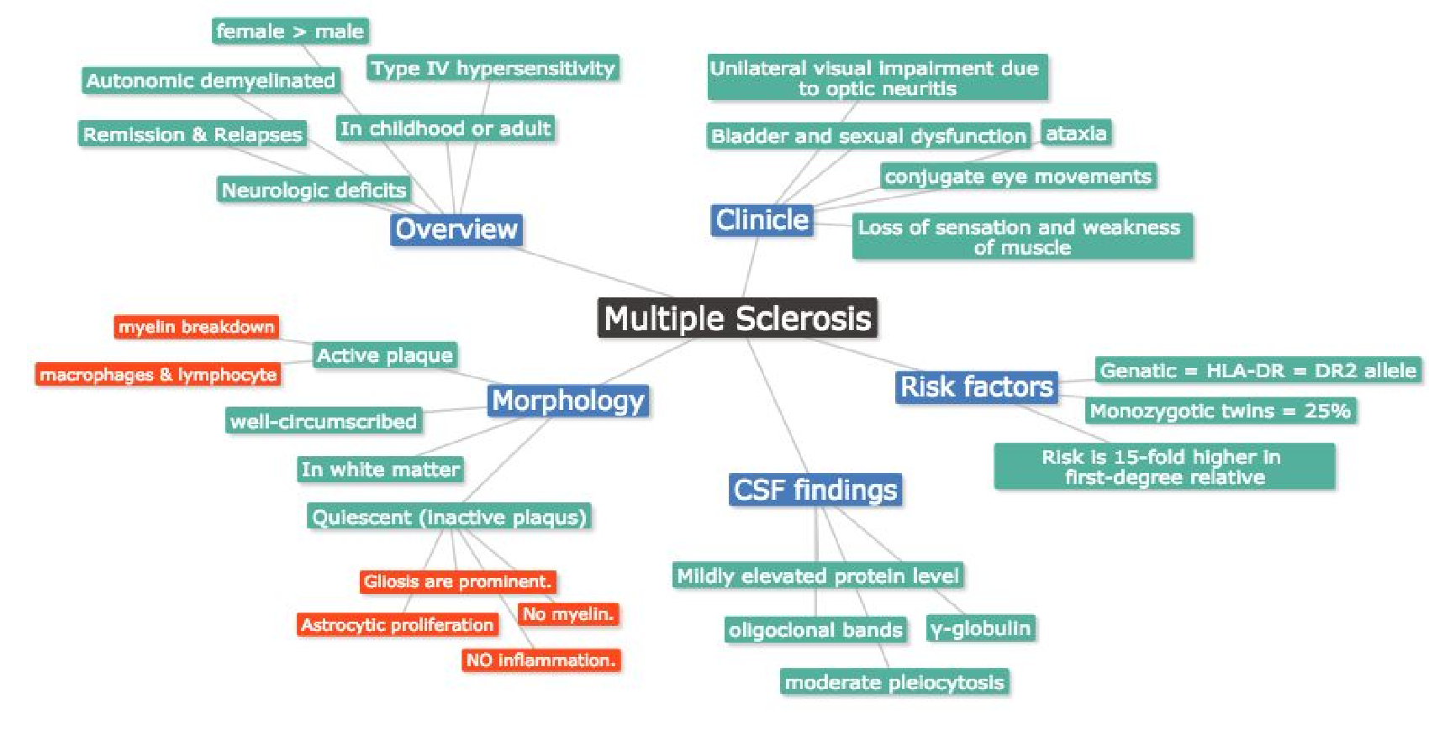
Lecture outline :

Slide 4
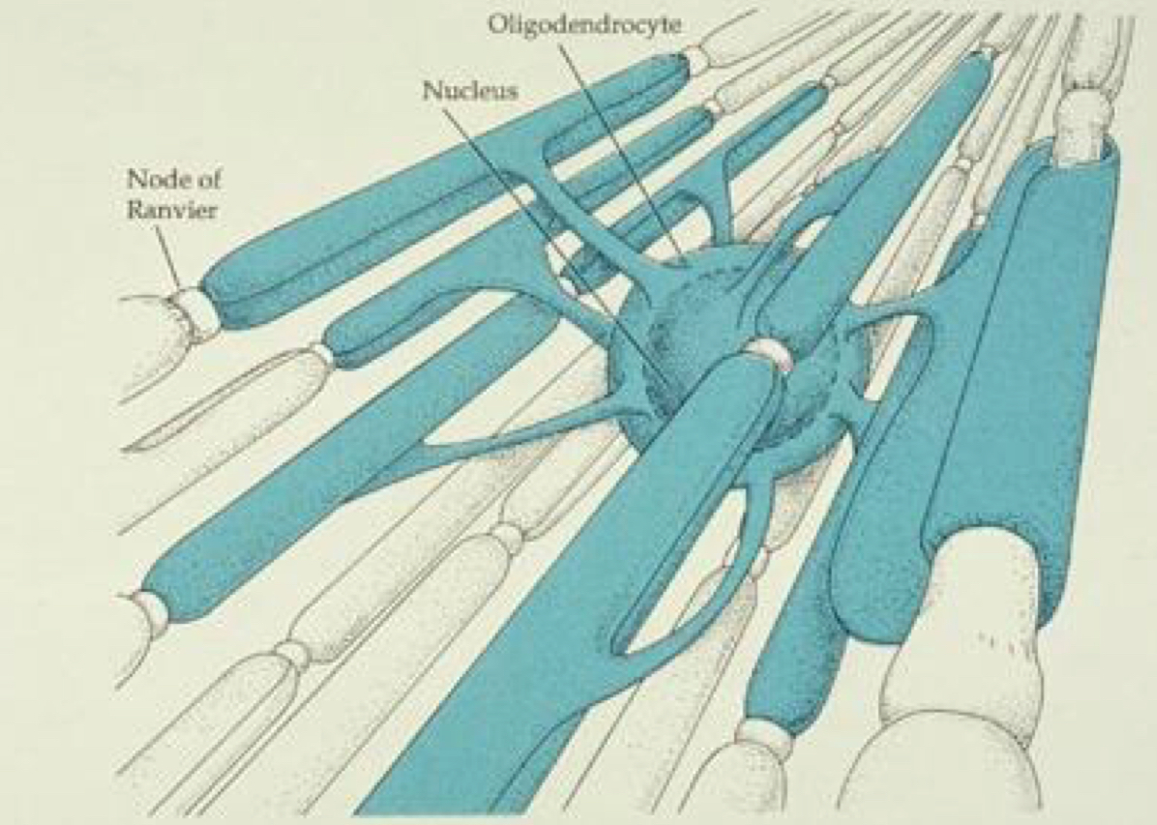
#Myelin:
#What is myelin ? Myelin consists of multiple layers of the specialized plasma membrane of oligodendrocytes (in the CNS), with most of the cytoplasm excluded.
#Facts about Myelin :
Although myelinated axons are present in all areas of the brain ( so even in grey matter but in small amount..بسبب أطراف الاكسون في القراي ماتر, ( they are the dominant component in the; therefore, most diseases of myelin are primarily white matter disorders. white matter
An oligodendrocyte extends processes toward many different axons and wraps a segment of roughly a few hundred microns of axon. As in picture above
Each of these segments is called an internode, and the gaps between internodes are known as nodes of Ranvier.
What is the function of myelin?
Improving the speed and efficiency of conduction.

Slide 5
The differences between CNS and PNS
Central nerves (CNS ) | peripheral nerves ( PNS )
myelin is made by oligodendrocytes | myelin is made by Schwann cells
many internodes comes from a single oligodendrocyte | each cell contributes to only one internode
*Most diseases of CNS myelin do not significantly involve the peripheral nerves, and vice versa Why ? Because The specialized proteins and lipids are also different.
• The natural history of demyelinating diseases is determined:
in part, by the limited capacity of the CNS to regenerate normal myelin
degree of secondary damage to axons that occurs as the disease runs its course.
What is “natural history of a disease”?
The natural history of disease is the course a disease takes in individual from its pathological onset (inception) until its eventual resolution through complete recovery or death.
*What does that mean?​ ​ At the beginning of the disease symptoms will appear mild, then they will stop for a period of time (no symptoms = ​ Remission​ ). After that there will be residual symptoms (​ Relapses​ ) & they will worsen because the CNS capacity for regeneration destructed myline is limited (also it Takes a long time for regenerate).
*So MS relapsing-remitting type cause damage for a certain amount of time the oligodendrocytes will fix the damage but it will not be healed completely,this cycle continues and the symptoms will get worse with time
* الشخص المصاب تظهر عليه اعراض متنوعه في بدايه الحاله تكون خفيفه ثم كل ما ترجع ترجع أقوى : مثل يبدأ عنده ضباب الرؤيا بعدها تختفي ويعيش كأنه ماعنده شيء ثم بعد فتره ترجع بأقوى! مثل حاله الضباب ترجع ومعها مثلاً صعوبه قويه بالنظر أو عرض جديد مثل صعوبه بالبلع

Slide 6
#Primary Demyelinating disease general classification:
#Two broad groups:
Demyelinating diseases of the CNS | Dysmyelinating diseases of the CNS
• acquired conditions characterized by preferential damage to previously normal myelin. • commonly result from immune-mediated injury. • also viral infection of oligodendrocytes as in progressive multifocal leukoencephalopathy. • drugs and other toxic agents. | • myelin is not formed properly or has abnormal turnover kinetics. • associated with mutations affecting the proteins required for formation of normal myelin or in mutations that affect the synthesis or degradation of myelin lipids. • the other general term for these diseases is leukodystrophy.
*Once normal myelin, then it’s damaged
*The myelin itself is abnormal. “Genetic or familial”
#Multiple sclerosis:
What is it ? Multiple Sclerosis is an autoimmune demyelinating disorder characterized by distinct episodes of neurologic deficits, separated in time, attributable to white matter lesions that are separated in space.
•Prevalence : The most common demyelinating disorders (prevalence of 1 per 1000 persons in most of the United States and Europe).
•Incidence: It becomes clinically apparent at any age, although onset in childhood or after age 50 years is relatively rare. Women are affected twice as often as men. * د. ماريا : لو عندنا توأم و اكتشفنا ان واحد منهم مصاب الثاني عنده احتماليه 150% يكون فيه المرض بس ما اكتشفنا! وراح تظهر له الاعراض بعدين

Slide 7
#Multiple sclerosis:
In most individuals with MS the illness shows relapsing and remitting episodes of neurologic deficits. The frequency of relapses tends to decrease during the course of the illness, but there is a steady neurologic deterioration in a subset of patients.
•ايش يعني هذا الكلام ؟ الإنتكاسات تقل كل ما ٌتقدم بالعمر لكن مع كل انتكاسة تتدهور حالة المريض أكثر من قبل
- Relapsing: attack by lymphocyte.
Remitting: regeneration by the body (renewing of myelin).
Extra
#Pathogenesis:
environmental factors
genetic factors
Like other autoimmune diseases, MS is believed to be caused by a combination of
How ? These factors results in a loss of tolerance of self proteins (antigen) ​ → Antigen presenting Cell comes and activates T cells, mainly Th1 and Th17 → ​ T cell cross BBB​ ​ → ​ Type IV hypersensitivity → ​ infiltrate of ​ ​ lymphocytes, macrophages by IFN-γ ,B Cells and plasma cells produce antibody​ ​ → ​ demyelination. Some injury to the axons themselves does occur sometimes.

Slide 8
Pathogenesis
characterized by the presence of demyelination out of proportion to axonal loss, but some injury to axons does occur
Toxic effects of lymphocytes, macrophages, and their secreted molecules have been implicated in initiating the process of axonal injury, sometimes even leading to neuronal death.
المقصد من الكلام : مو شرط يكون فيه انفولفمينت للأكسون ولكن في احياناً ما يكون فيه إنجري للأكسون وأحياناً أخرى يكون للخلية بكبرها !
Experimental allergic encephalomyelitis:
-Is an animal model of MS in which demyelination and inflammation occur after immunization with myelin, myelin proteins, or certain peptides from myelin proteins.
-In this model, the lesions are caused by a T cell-mediated delayed type hypersensitivity “type 4” reaction to myelin proteins, and the same immune mechanism is thought to be central to the pathogenesis of MS.
#Risk factors :
The risk of developing MS is 15-fold higher when the disease is present in a first-degree relative.
The concordance rate for monozygotic twins (التوأم المتشابه) is approximately 25%, with a much lower rate for dizygotic twins (الغير متشابة) .
A significant fraction of the genetic risk for MS is attributable to HLA-DR variants, the DR2 allele being the one that most significantly increases the risk for developing MS

Slide 9
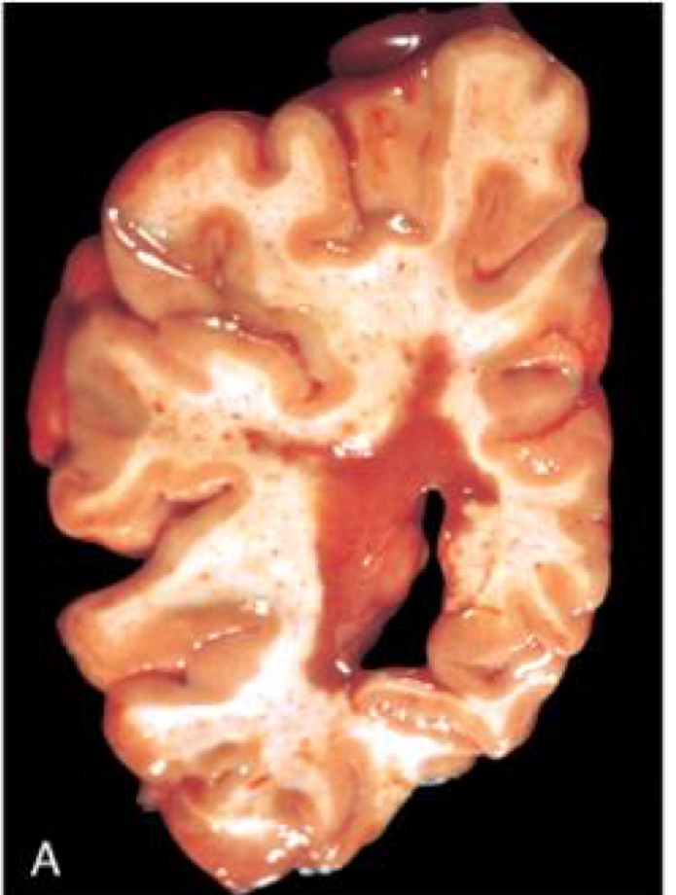
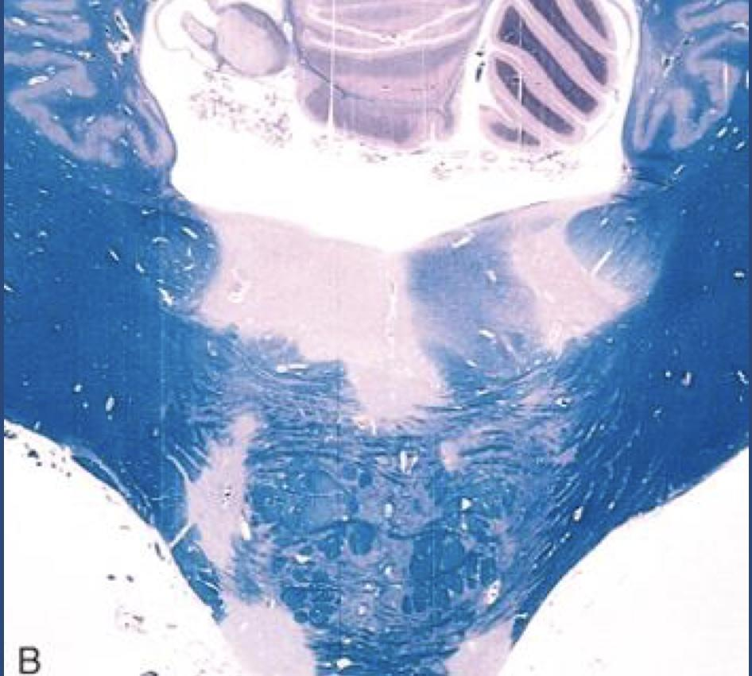
Morphology
#GROSS :
MS is a white matter disease And Affected areas show:
Well circumscribed
Slightly depressed
Glassy
Grey tan
Irregularly shaped lesions.
These characteristics are called ( Plaques )
They occur beside ventricles and they are frequent in
the optic nerves and chiasm, brain stem,ascending and
descending fiber tracts, cerebellum and spinal cord.
The lesions have sharply defined borders at the microscopic level.
#Microscopic appearance :
In an (active plaque) there is evidence of ongoing myelin
breakdown with abundant macrophages containing myelin
debris. = so there is a loss of myline
Lymphocytes, plasma cells and macrophages are present, mostly as perivascular inflammatory cuffs.
Axons are relatively preserved, although they may be reduced in number. = secondary axonal injury
Dr.maria’s note : you will see apoptosis of oligodendrocytes
__________________________________
When plaques become quiescent (inactive plaques), the inflammation mostly disappears, leaving behind little to no myelin.
Instead, astrocytic proliferation and gliosis are prominent.
*Luxo fast blue-periodic stain

Slide 10
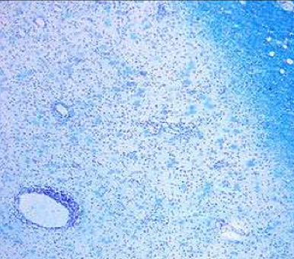
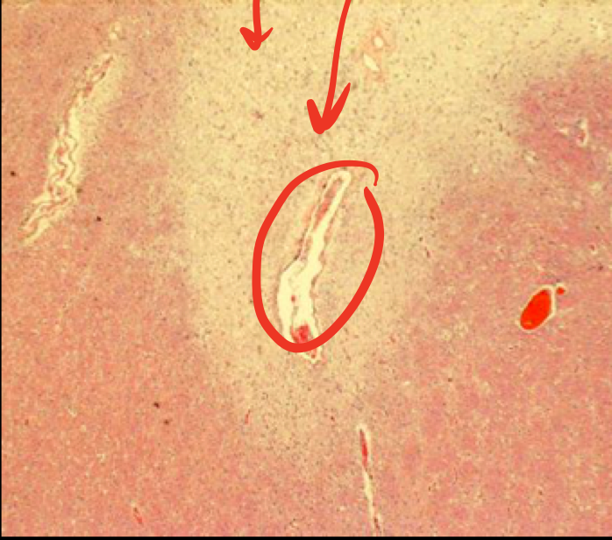
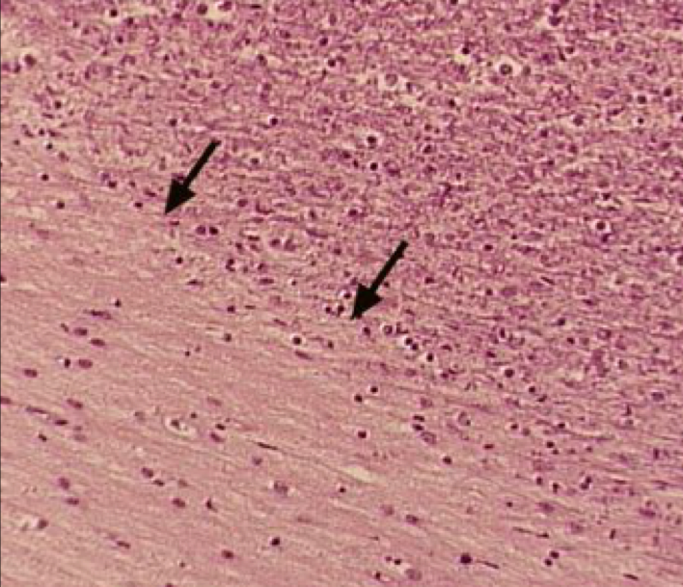
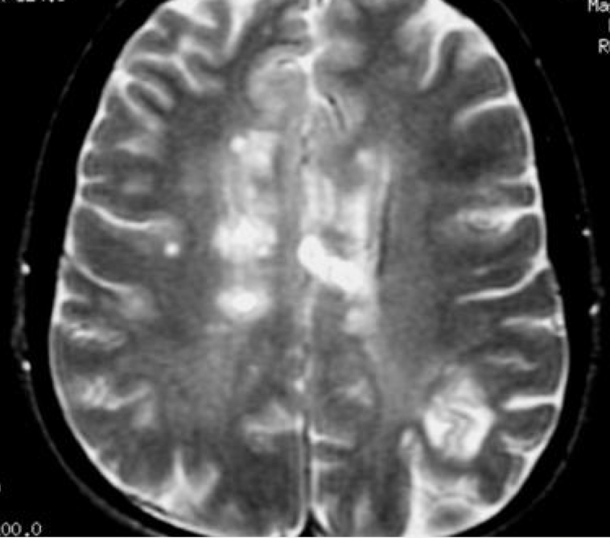
Morphology
This is a myelin stain (luxol fast blue/PAS) of an early lesion.
The lesion is centered around a small vein which is surrounded by inflammatory cells.
H&E stained section from a patient with a long-standing MS.
An old (inactive) lesion is centered around a vein with very little inflammation. = يعتبر المرض الآن في حاله كامده لكن بالتهاب قليل
Loss of myelin can be seen even without special stains (it is lighter pink than the normal white matter around it). = لأن مثل ما قلنا هذا المريض عنده المرض من فتره طويله فالمايلن حقه اختفى
Dr.maria’s note : so you can see in the picture a very pale area “ red circle” that represent a TOTAL LOSS OF MYLINE !
1
An MS plaque showing a pale plaque almost devoid of myelin. There is a decrease in oligodendrocytes “apoptosis of oligodendrocytes” and increase in the astrocytic nuclei which is characteristic of old MS lesions.
Dr.maria’s note :
-“in area 1” – you can find oligodendrocytes but no astrocytes.
- “ in area 2” you can find astrocytes and gliosis but no oligodendrocytes عشانها خلاص ماتت وجت بدالها الاستروسايت وسوت القلايوسسز=
Myelin
2
No Myelin
Lesions on MRI appear as bright yellow spots on the white matter.

Slide 11
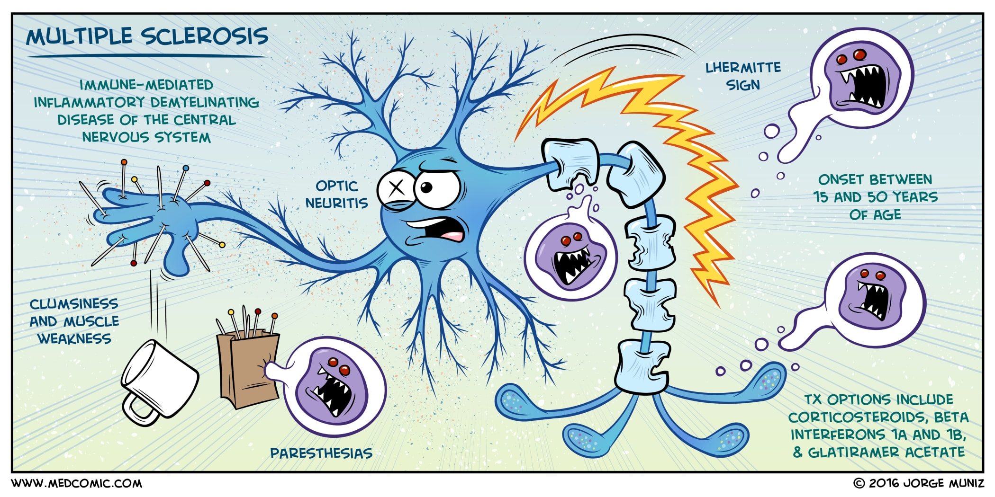
# Clinical Features:
• the course of MS is variable
MS lesions can occur anywhere in the CNS -< may induce a wide range of clinical manifestations .
• Commonly there are Multiple episodes of new symptoms (relapses) followed by episodes of recovery (remissions) ; typically , the recovery is not complete .
• The consequence of this pattern of relapsing-remitting disease in the gradual , often stepwise , accumulation of increasing neurologic deficits .
• certain patterns of neurologic symptoms and signs are commonly observed
- Unilateral visual impairment occurring over the course of a few says is frequent initial manifestation of MS (due to involvement of the optic nerve “ optic neuritis “)
►when this occurs as the first event , only a minority ( 10% to 50% ) go to develop full-blown MS

Slide 12
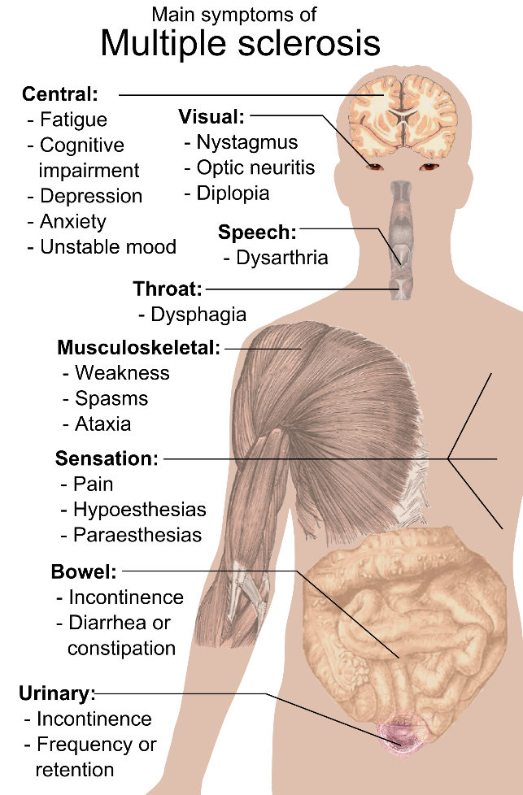
# Clinical Features:
• involvement of the brain stem produces cranial nerve signs and ataxia¹ , and can disrupt conjugate eye movements .
• spinal cord lesions give rise to motor and sensory impairment of trunk and limbs , spasticity , and difficulties with the voluntary control of bladder function .
• Changes in cognitive function can be present , but are often much milder than the other findings .
•In any individual patient it is hard to predict when the next relapse will occur ; most current treatments aid to decrease the rate and severity of relapses rather than recovering lost function . مافيه علاج يحل المرض إلى الان لكن فيه علاجات تخفف تكرار الازمه المرضية
*Dr.maria note :
There is an unidentified environmental (ما فيه شيء محدد) factors that triggers MS : stress - flu – pregnancy ..etc
1* Ataxia describes the lack of muscle coordination when a voluntary movement is attempted. It may affect any motion that requires muscles to work together to perform a function, from walking to picking up an object to swallowing.
*Extra don’t memorize it!

Slide 13
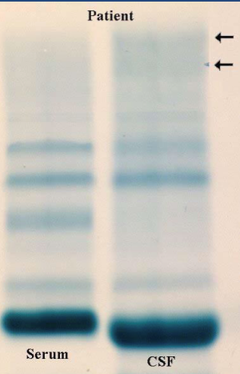
CSF findings :
• it shows mildly elevated protein level with an increased proportion of γ-globulin .
• In one-third of cases there is moderate pleocytosis .
• When the immunoglobulin is examined further , most MS patients show oligoclonal bands , representing antibodies directed against a variety of antigenic targets .
• These antibodies constitute a marker for disease activity .

Slide 14
#Pathoma - summary
DEMYELINATING DISORDERS
I. BASIC PRINCIPLES A. Myelin insulates axons, improving the speed and efficiency of conduction. l. Oligodendrocytes myelinate the central nervous system. 2. Schwann cells myelinate the peripheral nervous system. B. Demyelinating disorders are characterized by destruction of myelin or oligodendrocytes; axons are generally preserved.
III. MULTIPLE SCLEROSIS A. Autoimmune destruction of CNS myelin and oligodendrocytes 1. Most common chronic C S disease of young adults (20- 30 years of age); more commonly seen in women 2. Associated with HLA -DR2 3. More commonly seen in regions away from the equator B. Presents with relapsing neurologic deficits with periods of remission (multiple lesions in time and space). Clinical features include 1. Blurred vision in one eye (optic nerve) 2. Vertigo and scanning speech mimicking alcohol intoxication (brainstem) 3. Internuclear ophthalmoplegia (medial longitudinal fasciculus) 4. Hemiparesis or unilateral loss of sensation (cerebral white matter, usually periventricular) 5. Lower extremity loss of sensation or weakness (spinal cord) 6. Bowel, bladder, and sexual dysfunction (autonomic nervous system) C. Diagnosis is made by MRI and lumbar puncture. 1. MRI reveals plaques (areas of white matter demyelination). 2. Lumbar puncture shows increased lymphocytes, increased immunoglobulins with oligoclonal IgG bands on high resolution electrophoresis, and myelin basic protein. D. Gross examination shows gray-appearing plaques in the white matter E. Treatment of acute attacks includes high -dose steroids. 1. Long-term treatment with interferon beta slows progression of disease.

Slide 15
Questions
1- Progressive multifocal leukoencephalopathy is caused by a/an? A. Auto-immune reaction
B. Viral infection C. Hypersensitivity reaction D. Bacterial infection
2- Myelin is not formed properly or has abnormal turnover kinetics, is a feature of? A. Demyelinating diseases of cns B. Leukoencephalopathy C. Leukodystrophy D. None of the above
3- The frequency of relapses in MS tends to …………. during the course of illness? A. Increase B. Decrease C. remain the same
4- Mutation in which of the following genes may lead to MS ? A. HLA-DR B. HLA-B C. HLA-C
5- Which of the following is a prominent feature of inactive plaque ? A. Ongoing myelin breakdown B. Abundant macrophages C. Astrocytic proliferation D. Lymphocytes and monocytes are present
6- The most common initial manifestation of MS is? A. Exercise induced weakness B. Unilateral optic neuritis C. Paresthesia D. Tingling sensation of face
7- MS symptoms may be caused by: A. Damage to myelin (the sheath covering the nerve fibers) B. Damage to axons (the nerve fibers themselves) C. Both A & B D. Neither
8- MS is totally based on?
A.Environmental factors
B.Genetic Factors
C. Both
9- Macrophages are activated by the release of?
A.IL-6
B.IL-2
C.IFN-γ
10- Which of the following cells are not seen during an inflammatory process?
A.T Cells
B.B Cells
C.Macrophages
D.Neutrophils
Answers:
1.B 2.C 3.B 4.A 5.C 6.B 7.C 8.C 9.C 10.D

Slide 16
كل الشكر والتقدير للجهود العظيمة من قبل أعضاء فريق علم الأمراض الكرام:
قادة فريق علم الأمراض :
بثينة الماجد
منصور العبرة
أعضاء فريق علم الأمراض :
بندر الجماز
طارق العلوان
محمد المحيميد
تركي الشمري
علي شحادة
فايز الدرسوني
وجدان الشامري
مشاعل القحطاني
Kindly contact us if you have any questions/comments and suggestions:
EMAIL: pathology437@gmail.com
TWITTER : @pathology437
References:
-Slides

