Slide 1
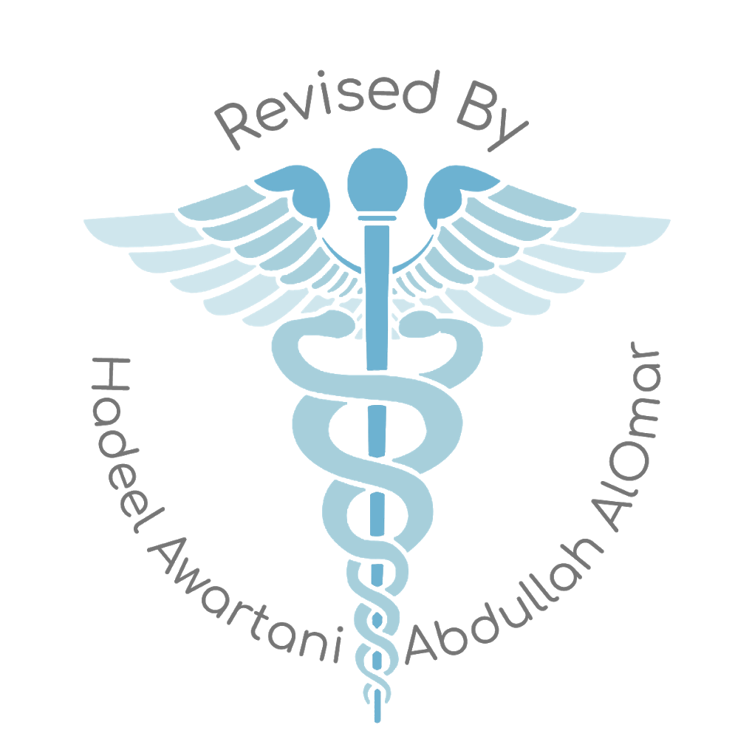
Pathology
437’s team work
Lecture (5+6): cerebrovascular accidents .
*العاكفين على الكتب ، الذين يرفعون الجهل عن أنفسهم وعن أمتهم ، أخلصوا نواياكم .. فالمجدُ لكم !

Slide 2
Objectives:.
Explain the concepts of brain “Hypoxia”, “Ischemia” and “Infarction”.
Understand the pathogenesis of thrombotic and embolic stroke and be able to identify clinical risk factors.
Identify the causes and consequences of subarachnoid and intracerebral hemorrhage.
Build a list of the different causes that can lead to cerebrovascular accident.
Lecture outline:
Helpful overview video about stroke from osmosis. 5:51

Slide 3
Do you remember these terms ? ;)
Introduction :
Cerebrovascular diseases: the broad category of brain disorders caused by pathologic processes involving blood vessels.
The three main pathogenic mechanisms are:
(1) Thrombotic occlusion
(2) Embolic occlusion
(3) Vascular rupture.
Cerebrovascular disease is the third leading cause of death (after heart disease and cancer) in the United States.
It is also the most prevalent neurological disorder in terms of both morbidity and mortality.
Can be fatal or can cause permanent disorders
Recall :
-Hypoxia:​ ​ Deficiency in the amount of ​ oxygen​ reaching the tissues.
-Ischemia:​ An ​ inadequate blood supply​ to an organ or part of the body.
-Infarction: ​ Obstruction of the blood supply to an organ or region of tissue, causing ​ local death of the tissue.
*Ischemia causes hypoxia which causes infraction
Necrosis

Slide 4
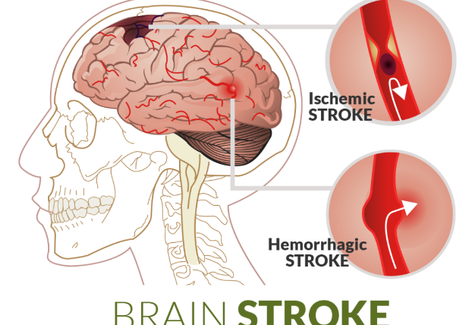
*Robbin’s note :The brain is a highly oxygen-dependent tissue that requires a continual supply of glucose and oxygen from the blood. Although it constitutes no more than 2% of body weight, the brain receives 15% of the resting cardiac output and is responsible for 20% of total body oxygen consumption.
The brain may be deprived of oxygen by several mechanisms:
Functional hypoxia, in: | Ischemia, either transient or permanent:
a) A low partial pressure of oxygen. (e.g. High Altitude). b) Impaired oxygen-carrying capacity. (e.g. severe anemia, carbon monoxide poisoning) c) Inhibition of oxygen use by tissue.¹ (e.g. cyanide poisoning) | a) A reduction in perfusion pressure, as in hypotension. b) Vascular obstruction. c) Both.
Or cardiac arrest
Such as atherosclerosis
Stroke:
It is the clinical term for a disease with acute onset of a neurologic deficit as the result of vascular lesions, either hemorrhage or loss of blood supply.
* 1- the partial pressure of the Oxygen is okay and there is sufficient blood supply to the tissue but the cells can’t take up the oxygen because there tissue poisoning, usually by cyanide. we call this type of hypoxia Histotoxic hypoxia.

Slide 5
# Thrombotic stroke VS Embolic stroke:
Thrombotic stroke:
What is it ? | Thrombosis:​ Formation of blood clot (thrombus) inside a blood vessel, obstructing the flow of ​ b​lo​od​ .
Note that: | The majority of thrombotic occlusions causing cerebral infarctions are due to atherosclerosis.
The most common sites of primary thrombosis: | The carotid bifurcation. Between internal and external carotid arteries The origin of the middle cerebral artery. At either end of the basilar artery.
Thrombotic occlusions usually are superimposed on atherosclerosis Plaque, accompanied by anterograde extension (occurring in a forward direction of blood flow), fragmentation, and distal embolization.
Embolic stroke:
What is it ? | Embolism: ​ Intravascular solid, liquid, or gaseous mass that is carried by the blood to a site distant from its point of origin
Note that : | Embolic infarctions are more common than thrombosis.
Sources of emboli include: | a- Cardiac mural thrombi ¹​ (more frequent)​ : Myocardial infarct. Valvular disease. Atrial fibrillation. ³ b- Arteries, (often atheromatous plaques within the carotid arteries or aortic arch) c- Paradoxical emboli ², particularly in children with cardiac anomalies. d- Emboli associated with cardiac surgery. e- Emboli of other material (tumor, fat⁴, or air) Fat emboli comes from bone fractures
_{Notes from Robbins:}
*Emboli tend to lodge where vessels branch or in areas of stenosis, usually caused by atherosclerosis.
*Thrombotic occlusions causing small infarcts of only a few millimeters in diameter, so-called “lacunar infarcts,” occur when small penetrating arteries occlude due to chronic damage, usually from long-standing hypertension

Slide 6
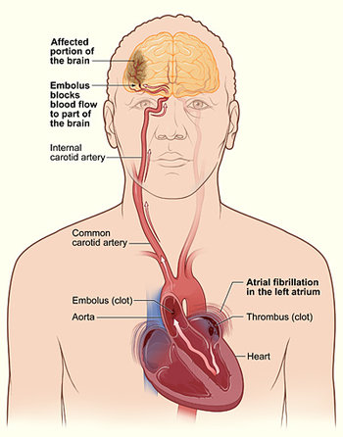
# Dr.Amani’s explanation about the previous slide :
*1- Mural thrombi are thrombi that adhere to the wall of the heart/large blood vessel and restrict blood flow in the heart “without blocking it” then it will travel to the small arteries in the brain and it will block it causing ischemia -< hypoxia -< infraction ( stroke ) .
*Why is the Cardiac mural thrombi is the most common source ? Because it directly goes from the left atrium to the left ventricle through the arteries to the brain. “ without passing to lungs “ so it will take less time تذكروا ان الدم باليسار جاي من الرئه فيه اوكسجين وراجع للقلب وينضخ للجسم علطول فلما يكون بالجزء اليسار من القلب ثرومبس علطول دايركت بتروح للمخ فعشان كذا احتماليه أنها تنتقل عاليه .
*Deep vein thrombosis “DVT” is not a common way to cause stroke why? Because it should first goes to the right atrium to the right ventricle to the lungs then comes back to the left atrium then left ventricle then from the heart to the brain ☺ شايفن المشوار that’s way it’s very rare ! Unless if there is ventricular OR atrial septal defect!
*يعني عشان تزيد احتماليه ال DVT لازم يكون فيه فتحه بالقلب بين الجزء الايسر والايمين تخلي الثرومبس تنتقل من البطين أو الاذين الايسرمباشره للايمن ومنها للمخ! هذي الحاله نسميها Paradoxical emboli
*2- So what is Paradoxical emboli ? also called a crossed embolism, refers to an embolus which is carried from the venous side of circulation to the arterial side because of ventricular OR atrial septal defect
*3- What is Atrial fibrillation and how does it cause stroke ? Its irregular heartbeat that causes poor blood supply and blood clot that can travel to the brain and causes stroke .
*4- when large bones break, fat from the bone marrow, which is made up of fatty cells, seeps into the bloodstream. This fat creates clots (fat emboli) that obstruct blood flow

Slide 7
The territory of distribution of the middle cerebral arteries most frequently affected by embolic infarction. WHY?
Due to the size
the direct blood flow from internal carotid artery into the middle cerebral artery
Stroke Clinical presentation:
It is very important to recognize the warning signs of stroke and to get immediate medical attention if they occur! If the brain damage sustained has been slight, there is usually complete recovery, but most survivors of stroke require extensive rehabilitation.
Depends on which part of the brain is injured, and how severely it is injured. Sometimes people with stroke have :
*Severity of clinical manifestations is not the same in all the patients , some will have very severely affected which usually leads to irreversible damage and some they can recover (severity of symptoms depends on size,location)
Sudden acute onset
Sometimes people have a ​ headache but stroke can also be completely ​ painless
​The most common is weakness or paralysis of one side of the body with partial ( half of segment so only some of the tracts are lost )or complete ( all segment = all tracts ) loss of voluntary movement or sensation in a leg or arm.
There can be speech problems and weak face muscles, causing drooling.
Numbness or tingling is very common
A stroke involving the base of the brain (Cerebellum) can affect balance, vision, swallowing, breathing and even unconsciousness
In cases of severe brain damage there may be deep coma, paralysis of one side of the body, and loss of speech, followed by death or permanent neurological disturbances after recovery

Slide 8
#Global Cerebral Ischemia:
What is it ? Widespread ischemic/hypoxic injury occurs when there is a generalized reduction of cerebral perfusion, usually systolic pressures less than 50mmHg.
Causes include:Acute decrease in blood flow:
severe hypotension not hyper!
shock
cardiac arrest
The clinical outcome varies with the severity of the insult:
If mild → may be only a transient postischemic confusional state, with eventual complete recovery.
In severe global cerebral ischemia → widespread neuronal death occurs, irrespective of regional vulnerability. If the patient survives, he could suffer from one of: NEXT SLIDE ;)
*Dr’s note :
-The whole brain suffering and not sufficient blood coming! If you don't know how to do CPR it will lead to global cerebral ischemia!!
-Why does severe hypotension and shock and cardiac arrest causes global Ischemia ? It really makes sense because these factors will totally stop the blood supply to the whole brain so all the brain cells we be hypoxic and die .

Slide 9
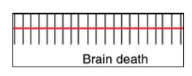
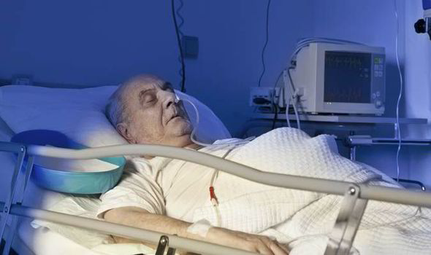
#Vegetative state VS respirator brain :
​ 1. Persistent vegetative state (​ Disorders of consciousness​ )= غيبوبة مستمره | 2. Respirator brain
Individuals who survive in this state often remain severely impaired neurologically and deeply comatose. , but they might be aware | "​ brain death​ ," including evidence of: a. Diffuse cortical injury (isoelectric, or "flat," EEG). b. Brain stem damage including: absent reflexes and respiratory drive
 | When patients with this irreversible pervasive form of injury are maintained on mechanical ventilation, the brain gradually undergoes an autolytic process = تحلل الدماغ!!
Sensitivity to ischemia: brain cells vary by their vulnerability
Neurons are much more sensitive to hypoxia than glial cells.
The most susceptible to ischemia of short duration are:
Pyramidal cells of the hippocampus.
Purkinje cells of the cerebellum.
Pyramidal neurons in the neocortex.
Respirator brain :
-Same as vegetative state + brain stem invlovment = can’t breath
-All the neurons are dead, patients maintained on ventilation machine المريض ما يقدر يتنفس لوحده

Slide 10
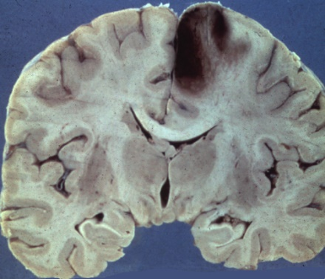
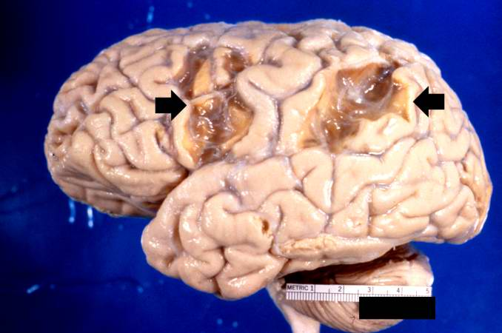
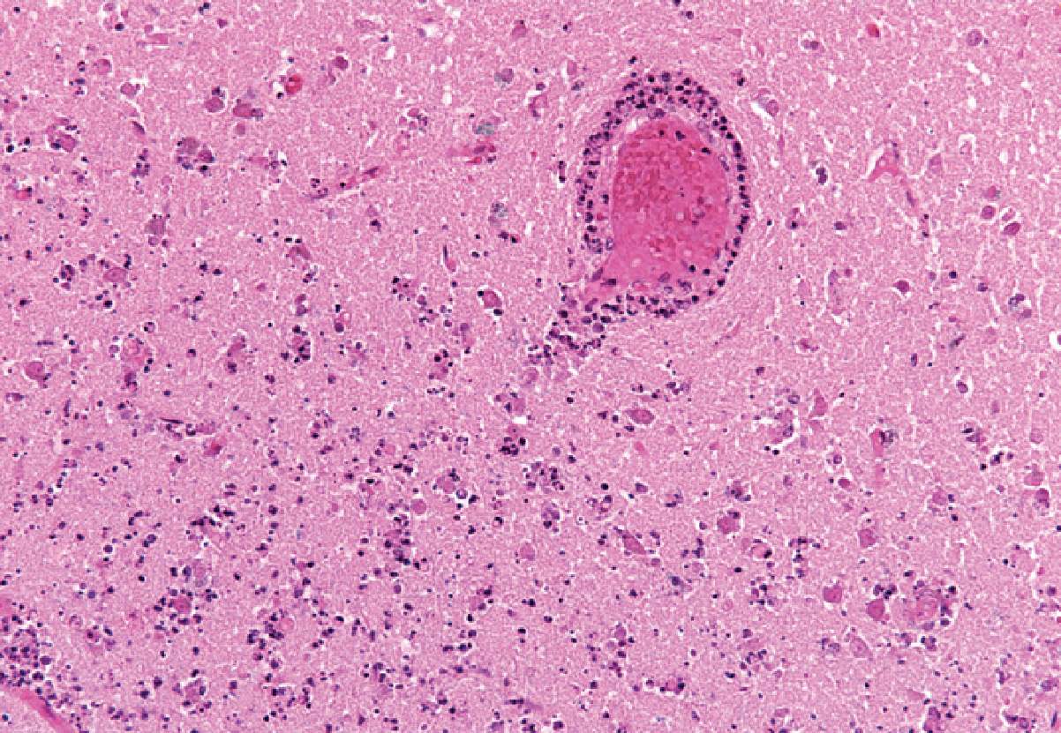
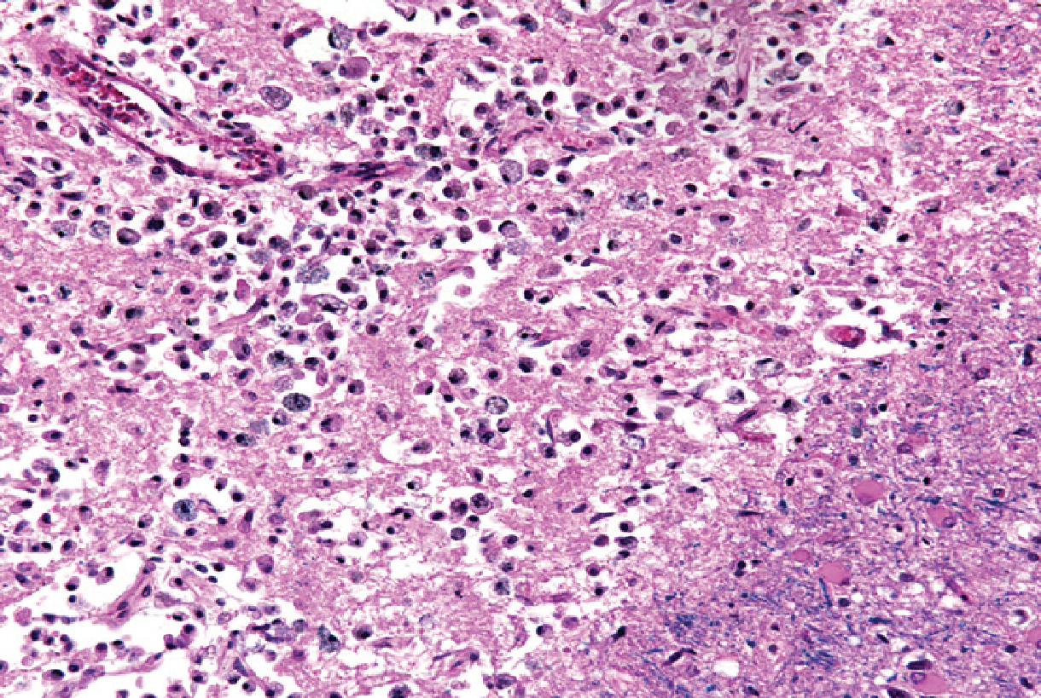
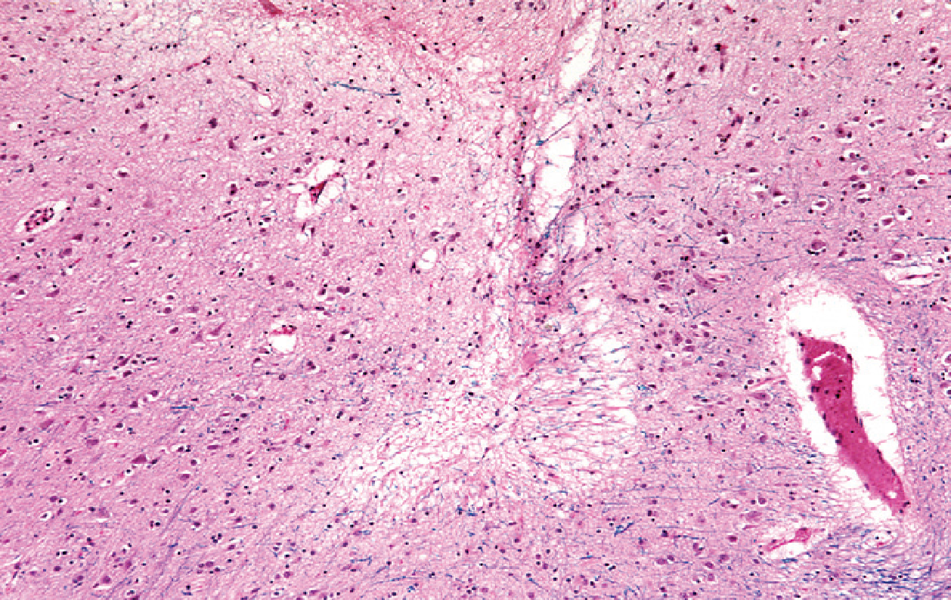
Gross pathology: “seen post Mortem in autopsies “
● The brain is swollen, with wide gyri and narrowed sulci. *dr.Amani’s : the brain is swollen because of the edema caused by the inflammation .
● The cut surface shows poor demarcation between gray and white matter.
Microscopically, infarction shows:
Early changes | Subacute changes | Repair
12 to 24 hours after the insult | 24 hours to 2 weeks | After 2 weeks
Red neurons, characterized initially by microvacuolization →cytoplasmic eosinophilia, and later nuclear pyknosis and karyorrhexis. “First feature of true ischemia” *Pyknosis: nuclear shrinking *Karyorrhexis: nuclear fragmentation | The reaction to tissue damage begins with infiltration by neutrophils.(always) Liquefactive necrosis of tissue, influx of macrophages, vascular proliferation reactive gliosis. *Proliferation of astrocytes. Gliosis start by this stage. Remmber no fibrosis or granular tissue in CNS | Removal of all necrotic tissue loss of organized CNS structure and gliosis. *residual gliosis. قديم *No fibrosis, no granular tissue. Repair just ends in space (cavity)
Infiltration of a cerebral infarction by neutrophils begins at the edges of the lesion where the vascular supply is intact.
By day 10, an area of infarction shows the presence of macrophages and surrounding reactive gliosis.
Old intracortical infarcts are seen as areas of tissue loss with a modest amount of residual gliosis.

Slide 11
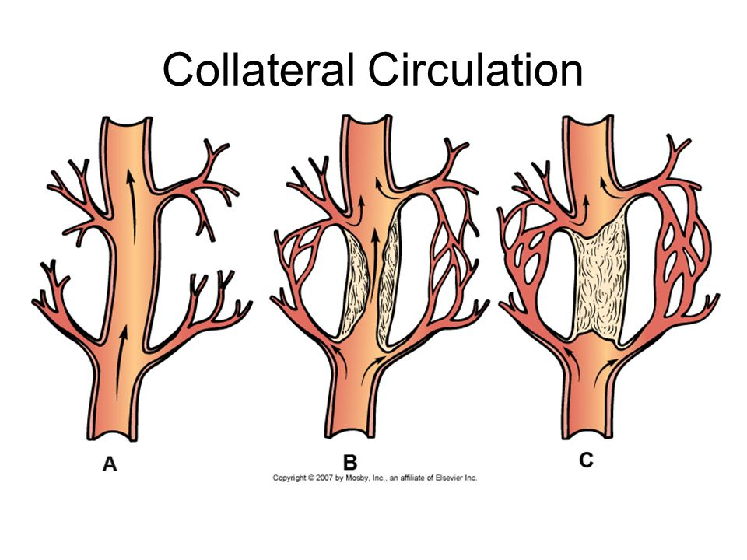
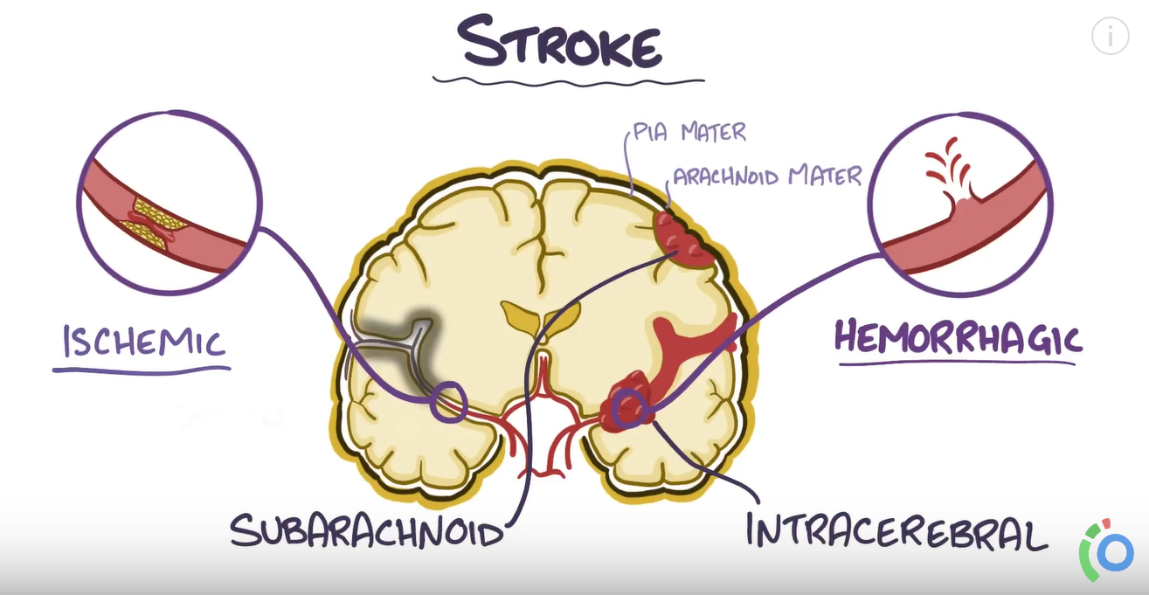
#Focal Cerebral Ischemia:
Cerebral arterial occlusion​ ​ → ​ focal ischemia​ → ​ infarction​ of distribution of the ​ compromised vessel​
= The major source of collateral flow is the circle of Willis.
Partial collateralization is also provided over the surface of the brain through cortical-leptomeningeal anastomoses
In contrast, there is little if any collateral flow for the deep penetrating vessels supplying structures such as: “so they are affected first -even in case of hypertension - and the damage will be more”
Thalamus
Basal ganglia
Deep white matter.
It’s determined by modifying variables :
collateral flow
The size
location
Shape
of the
infarct
Extent
of Tissue
damage
Infarcts can be divided into two broad groups based on their macroscopic “gross” and corresponding radiologic appearance:
Non hemorrhagic infarcts => result from acute vascular occlusions ¹
Hemorrhagic infarcts => which result from reperfusion of ischemic tissue²
either through collaterals or after dissolution of emboli,
often produce multiple, sometimes confluent petechial hemorrhages
If fibrosis → Epilepsy.

Slide 12
# Extra explanation :
Both of hemorrhage and non- hemorrhage cause ischemia!! but the difference is in the non hemorrhagic infarcts the lesion will be pale because there is no blood on the other hand the hemorrhagic infarct will have ischemic lesion + there is a blood on top of it.
*Non-hemorrhage : It's usually due to lack of collateral flow or due to thrombosis because it mostly happens due to rupture of atherosclerotic plaque and because the plaque is there each time thrombus lysis the plaque will make new one.
= يعني لو كان عندنا اثيروسكلروسس وصار له rupture بتنتقل الثرومبس حقته لما توصل للsmall blood vessels in the brain وتسوي لنا non-hemorrhage thrombus الجسم بيحاول يحلل الثرومبس هذه.. لكن طالما أن الاثيروسلكروسس موجود بيتطلع لنا ثرومبس جديدة كل شوي مهما حاول الجسم يحللها + غالبا تكون بالاماكن اللي مافيها collateral flow عشان كذا تكون ناشفه ☺
*hemorrhage : It happens when the tissue regains the blood supply after the ischemia!! How ? Either by the breakage of the thrombus, Or it can happen if some collaterals were able to supply the area, so we will find an hemorrhage on top of infarction.
= يعني بشكل عام ممكن يصير نزيف بحالتين : إما نفس الثرومبس اللي بالمخ تكسرت وطلع منها الدم أو الدم جاء من الcollateral flow فراح تشوف ثرومبس فوقها دم . + عشان كذا غالبا ً تكون بالاماكن اللي فيها collateral flow
_____________________________________________________
*The absence of oxygen and nutrients from blood during the ischemic period creates a condition in which the restoration of circulation results in inflammation and oxidative damage through the induction of oxidative stress rather than (or along with) restoration of normal function. “Important”
*It is important to know what is the type of infarct: because the treatment depends on the type :
In Case of non hemorrhagic infarction we give the patient thrombolytic treatment شيء يكسرها
while if there was hemorrhage, thrombolytics could kill them. لان من الاساس فيه نزيف تخيل تزود القابليه للنزيف!

Slide 13
Gross pathology​ ​ (Non-hemorrhagic infarct):
The first 6 hours: | By 48 hours: | From 2 to 10 days: | From 10 days to 3 weeks:
Irreversible injury little can be observed. example: if the patient die and we take biopsy in the first 6h we see nothing. | The tissue becomes pale, soft, and swollen the corticomedullary junction becomes indistinct. “Not defined boundaries of the lesion because of the edema and swelling” | The brain becomes gelatinous and friable the previously ill-defined boundary between normal and abnormal tissue becomes more distinct ”well demarcated” as edema resolves in the adjacent tissue that has survived. | The tissue liquefies, eventually leaving a fluid-filled cavity and cyst lined by dark gray tissue Usually it's gliosis under the microscope , which gradually expands as dead tissue is removed by macrophages. *If fibrosis → Epilepsy.
Large, discolored focally hemorrhagic lesion
Infarct with punctate hemorrhage , consistent with reperfusion injury
Old cystic infarct with surrounding gliosis

Slide 14
Microscopic appearance ​ (Non-hemorrhagic infarct) :
After the first 12 hours: | Until 48 hours: | Then: | After several months:
Red neurons and both cytotoxic and vasogenic edema predominate. There is loss of the usual characteristics of white and gray matter structures. Endothelial and glial cells, mainly astrocytes, swell, and myelinated fibers begin to disintegrate. “Giosis”. | There is some neutrophilic emigration followed by mononuclear phagocytic = macrophages cells during the ensuing 2 to 3 weeks.* Macrophages containing myelin breakdown products “from the breakdown of neurons “ or blood may persist in the lesion for months to years. | As the process of phagocytosis and liquefaction proceeds, astrocytes at the edges of the lesion progressively enlarge, divide, and develop a prominent network of protoplasmic extensions. “Reactive gliosis” | The striking astrocytic nuclear and cytoplasmic enlargement recedes A few glial cells will stay forever
*During the first several days neutrophils infiltrate the area of injury, but these are replaced over the next 2–3 weeks by macrophages.
Healing process – after several months cont. :
In the wall of the cavity: astrocyte processes form a dense feltwork of glial fibers admixed with new capillaries and a few perivascular connective tissue fibers.
In the cerebral cortex: the cavity is delimited from the meninges and subarachnoid space by a gliotic layer of tissue, derived from the molecular layer of cortex.
The pia and arachnoid: are not affected and do not contribute to the healing process.

Slide 15
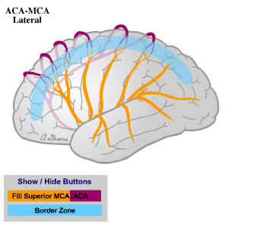
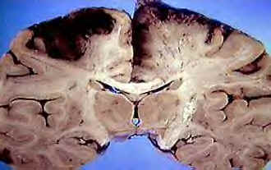
Microscopic appearance ​ (hemorrhagic infarct):
Notes :
*Robbins’s note : how it Results ? from reperfusion of ischemic tissue either through collaterals or after dissolution. The microscopic picture and evolution of hemorrhagic infarction parallel those of ischemic infarction, with the addition of blood extravasation and resorption.
Parallel ischemic infarction.
Blood extravasation and resorption.
In persons receiving anticoagulant treatment, hemorrhagic infarcts may be associated with extensive intracerebral hematomas is a localized collection of blood outside the blood vessels
Border zone ("watershed") infarcts:
What is it ? Wedge-shaped areas of infarction that occur in those regions of the brain and spinal cord that lie at the most distal fields of arterial perfusion.
In the cerebral hemispheres, the border zone between the anterior and the middle cerebral artery distributions is at greatest risk.
Damage to this region produces a band of necrosis over the cerebral convexity a few centimeters lateral to the interhemispheric fissure.
Border zone infarcts are usually seen after hypotensive episodes.
*dr.Amani’s explanation :
ببساطه هي ابعد منطقه من المخ عن الblood vessles يعني بتكون اكثر منطقه احتماليه تصير infraction

Slide 16
#Intracerebral (Intracranial) hemorrhage :
Hemorrhages within the brain (intracerebral = dr.amani’s : we also call it intraparenchymal) can occur secondary to:
*Hemorrhages associated with the dura (in either subdural or epidural spaces) make up a pattern associated with trauma * will be discussed in on another lecture.
Subarachnoid Hemorrhage :
Hypertension and other forms of vascular wall injury​ (e.g. vasculitis).
Structural lesion such as ​ Arteriovenous malformation​ ​ and cavernous malformation.
Intraparenchymal tumor.
Cerebral amyloid angiopathy
From Robbins:
Cerebral amyloid angiopathy (CAA) is a disease in which the same amyloidogenic peptides as those found in Alzheimer disease deposit in the walls of medium- and small-caliber meningeal and cortical vessels. The amyloid confers a rigid, pipe-like appearance and stains with Congo red. Amyloid deposition weakens vessel walls and increases the risk for hemorrhages, which differ in distribution from those associated with hypertension. CAA-associated hemorrhages often occur in the lobes of the cerebral cortex (lobar hemorrhages). In addition to these symptomatic hemorrhages, CAA also results in small (<1 mm) cortical hemorrhages (microhemorrhages).
What is it ? is a life-threatening type of stroke caused by bleeding into the subarachnoid space.
What are the causes ?
Rupture of a saccular (berry) aneurysm ¹ -The most frequent cause of clinically significant.
Vascular malformation.
Trauma ² - in which case it is usually associated with other signs of the injury.
Rupture of an intracerebral hemorrhage into the ventricular system. ³
Hematologic disturbances.
Tumors ⁴
*Dr.Amani explanation :
1* : will be explained on the next slides.
2*: trauma usually causes epidural and subdural hemorrhage. لانها اقرب لخارج الرأس فالاصابه فيها غالبا اكثر.
3* : ببساطه نفسه النزيف اللي بالانتراكرنيال بينشتر ويدخل بالسباركنويد سبيس
4*: because usually tumors result in the formation of a new blood vessels (angiogenesis) which are weak blood vessels and tend to rupture.

Slide 17
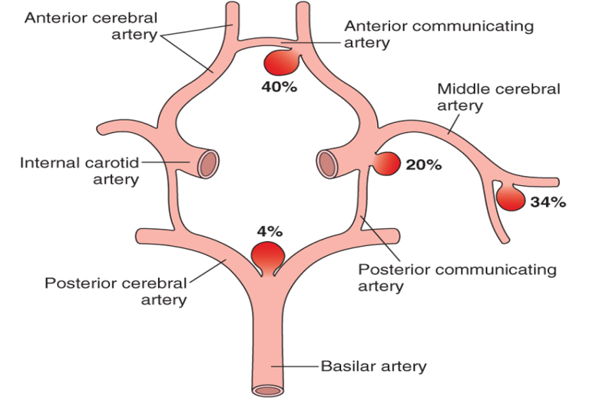
How can aneurysm happen ? Rupture can occur at any time, but in about one-third of cases it is associated with acute increases in intracranial pressure, such as with straining at stool or sexual orgasm.
Is it considered as congenital disease? multiple aneurysms exist in 20% to 30% of cases. Although they are sometimes referred to as congenital, they are not present at birth but develop over time because of underlying defects in the vessel media.
Symptoms :
Blood under arterial pressure - <is forced into the subarachnoid space. - < individuals are stricken with sudden, excruciating headache (classically described as "the worst headache I've ever had") (known as a thunderclap headache)
Rapidly lose consciousness
Prognosis : Between 25% and 50% of individuals die with the first rupture, although those who survive typically improve and recover consciousness in minutes, prognosis worsens with each episode of bleeding.
Where ? About 90% of saccular aneurysms occur in the anterior circulation near major arterial branch points. Multiple aneurysms exist in 20% to 30% of cases.
Dr. amani’s notes :
-What is aneurysm ? It‘s a weak spot on a blood vessel wall that causes an outward bulging, likened to a bubble or balloon.
- الانيورزم يكون غالباً باسباب جينيه فيولد الشخص عنده ( فقط ضعف بالblood vessels بدون الانتفاخ) فيكون عنده اكثر احتماليه للاصابات .. فمثلاً لو صار للشخص عنده زياده بالintracranial pressure علطول الblood vessels الضعيفه تتأثر وتطلع على برا كأنها بالون ( بدأ يظهر عرض الانيروزم ) وهذا الانيورزم عنده قابليه انه ينقطع ويطلع نزيف خصوصا بمنطقه subarachnoid

Slide 18
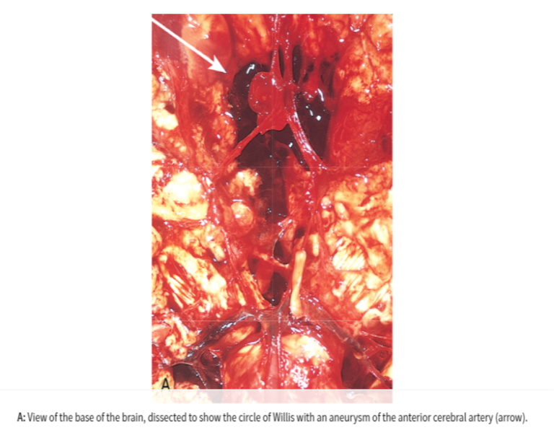
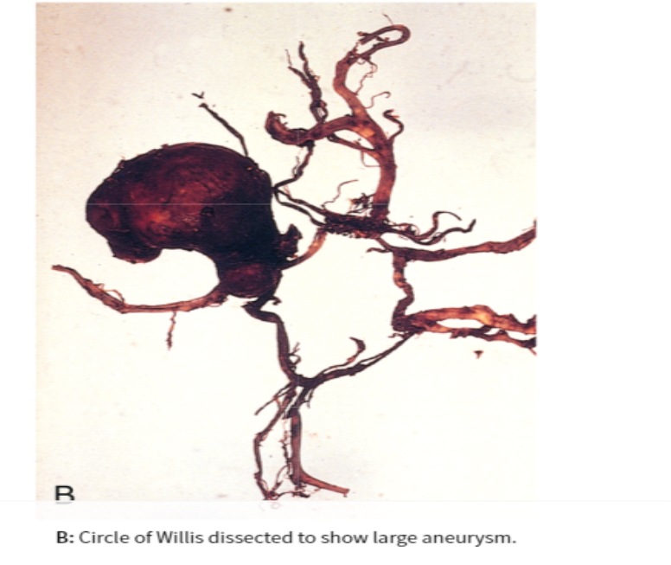
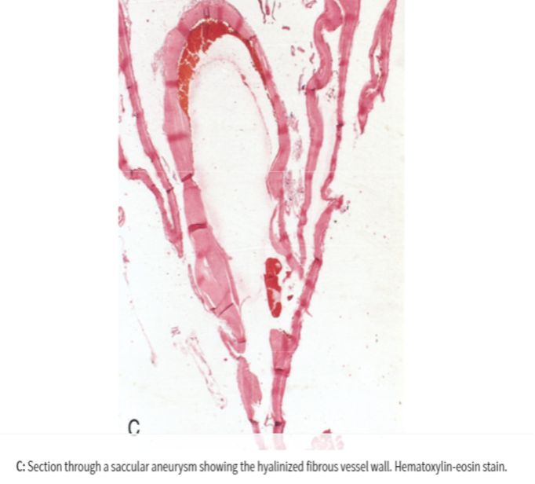
Recurrent ? Recurrent bleeding is common in survivors; ​ (it is currently not possible to predict which individuals will have recurrences of bleeding)​ .
Is there any risk factors of aneurysm rupture ? Yes, The probability of aneurysm rupture increases with the size of the lesion, such that aneurysms greater than 10 mm (1cm) have a roughly 50% risk of bleeding per year, ​
*There is an increased risk of aneurysms in patients with autosomal dominant polycystic kidney disease, as well as those with genetic disorders of extracellular matrix proteins (e.g., Ehler-Danlos syndrome)
Sequelae : Early period after a​ subarachnoid hemorrhage ​ have risk → ​of additional ischemic injury from vasospasm involving other vessels.
In the healing phase of subarachnoid hemorrhage, occur:
*These sometimes leading to obstruction of CSF flow as well as interruption of the normal pathways of CSF resorption lead to hydrocephalus.
Meningeal fibrosis.
Scarring
Robbins: A saccular aneurysm is a thin-walled outpouching of an artery. Beyond the neck of the aneurysm, the muscular wall and intimal elastic lamina are absent, such that the aneurysm sac is lined only by thickened hyalinized intima. The adventitia covering the sac is continuous with that of the parent artery. Rupture usually occurs at the apex of the sac, releasing blood into the subarachnoid space, the substance of the brain, or both.

Slide 19
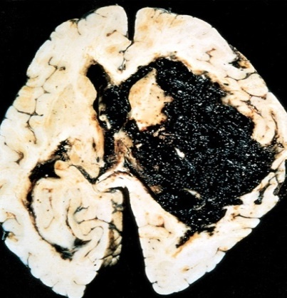
# Hypertensive Cerebrovascular Disease: Very common. Silent killer!
Overview : is the most important contributing risk factor for stroke and cerebrovascular diseases as it can change the structure of blood vessels and result in atherosclerosis.
Hypertension causes several changes, including:
Cerebral hemorrhage. Massive hypertensive hemorrhage rupturing into a lateral ventricle.
hyaline arteriolar sclerosis in arterioles​ (​ ​ weaker than normal vessels and become more vulnerable to rupture. )
chronic hypertension is associated with the development of ​ minute aneurysms​ (​ Charcot-Bouchard microaneurysms​ ) in vessels that are less than 300 µm in diameter , which may rupture
Hypertension affects the ​ deep penetrating arteries ​ and ​ arterioles that supply the ​ basal ganglia and hemispheric white matter and the brain stem

Slide 20
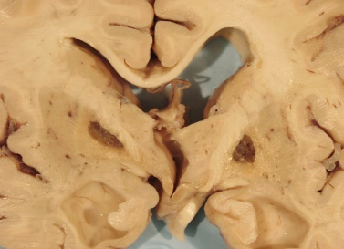
The most important effects of hypertension on the brain include:
Massive hypertensive intracerebral hemorrhage : | (discussed earlier, most important)
Lacunar infarcts : | Lacunes or Lacunar infarcts are: ●Small cavitary infarcts ● Most commonly in deep gray matter (basal ganglia and thalamus), internal capsule, deep white matter, and pons. ● Consist of cavities of tissue loss with scattered lipid-laden macrophages surrounding gliosis. ● Depending on their location in the CNS, lacunes can either be silent or cause significant neurologic impairment
Slit hemorrhage : | ● Rupture of the small-caliber penetrating vessels lead to development of small hemorrhages. ● In time, these hemorrhages resorb, leaving behind a slit like cavity surrounded by brownish discoloration (iron from blood)
Acute hypertensive encephalopathy : | ● A clinicopathologic syndrome: defined as diffuse cerebral dysfunction including headaches, confusion, vomiting, and convulsions, sometimes leading to coma ● Does not usually remit spontaneously ● May be associated with an edematous brain, with or without transtentorial or tonsillar herniation.​ ● Microscopically​ : ​ Petechiae and fibrinoid necrosis of arterioles in the gray and white matter

Slide 21
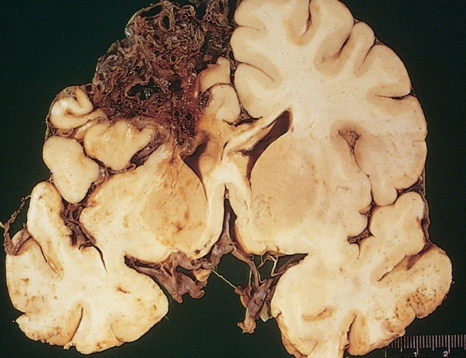
# Vasculitis:
# Vascular Malformations:
What is it ? It is infectious arteritis of small and large vessels, which leads to a variety of inflammatory processes involving blood vessels and may compromise blood flow and cause cerebral infarction
Previously in association with syphilis and tuberculosis
Now more commonly occurs in the setting of immunosuppression and opportunistic infection (such as toxoplasmosis, aspergillosis, and CMV encephalitis)
Systemic forms of vasculitis, such as polyarteritis nodosa, may involve cerebral vessels and cause single or multiple infarcts throughout the brain.
Primary angiitis of the CNS:
What is it ? An inflammatory disorder that involves multiple small to medium-sized parenchymal and subarachnoid vessels
It’s effects ? Affected individuals manifest a diffuse encephalopathic clinical picture, often with cognitive dysfunction
Treatment : Improvement occurs with steroid and immunosuppressive treatment.
Classified into four principal types based on the nature of the abnormal vessels:
Arteriovenous Malformations (AVMs)
Cavernous Malformations
Capillary Telangiectasis
Venous Angiomas
Most commonly manifest between the ages of 10 and 30 years with seizures, an intracerebral hemorrhage, or a subarachnoid hemorrhage.
AVMs, the most common of these, affect males twice as frequently as females.
The risk of bleeding makes AVM the most dangerous type of vascular malformation.
Multiple AVMs can be seen in the setting of hereditary hemorrhagic telangiectasia, an autosomal dominant condition often associated with mutations affecting the TGFβ pathway.
Arteriovenous Malformation

Slide 22
#So what can cause or contribute to a stroke ?
Hypertension and Atherosclerosis and Heart diseases
#Explanation :
-How hypertension causes stroke ? High blood pressure can lead to stroke because it damages blood vessels slowly over time and triggers the formation of clots in the blood vessels in the brain.
-How does sickle cell anemia causes stroke ? a type of red blood cell that sticks to the walls of blood vessels and
blocks blood flow to the brain
-dr.amani’s note : how does Amyloid causes stroke ? Amyloid is an abnormal protien which will stick to the wall of the blood vessels and make it weak -< low blood supply to the brain -< stroke .
# Other causes of stroke ?
*Smoking could cause stroke how؟
Cigarette smoke contains toxic chemicals, such as carbon monoxide, which can damage the cardiovascular system and increase blood pressure
*Diabetes
Thrombophilia, e.g. Sickle cell anemia
Embolic diseases and Venous thrombosis
Systemic hypoperfusion, Global hypoxia, e.g. shock
Vascular malformations
* Do you know ? Brain tissue ceases to function if deprived of oxygen for more than 60 to 90 seconds and after approximately three minutes, will suffer irreversible injury possibly leading to death of the tissue.
Vasculitis
Amyloid angiopathy (leptomeningeal and cortical vessels)

Slide 23
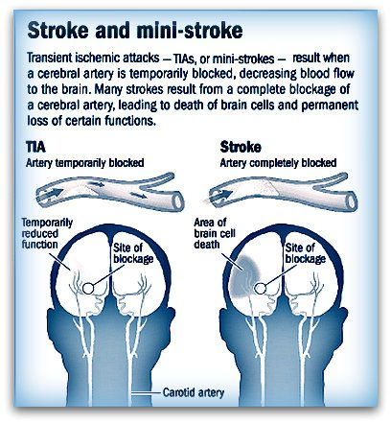
# Homework !
# What are the risk factors of stroke?
#Define​Transient ischemic attack:
its like a stroke, similar symptoms, but usually lasting only a few minutes and causing no permanent damage.

Slide 24
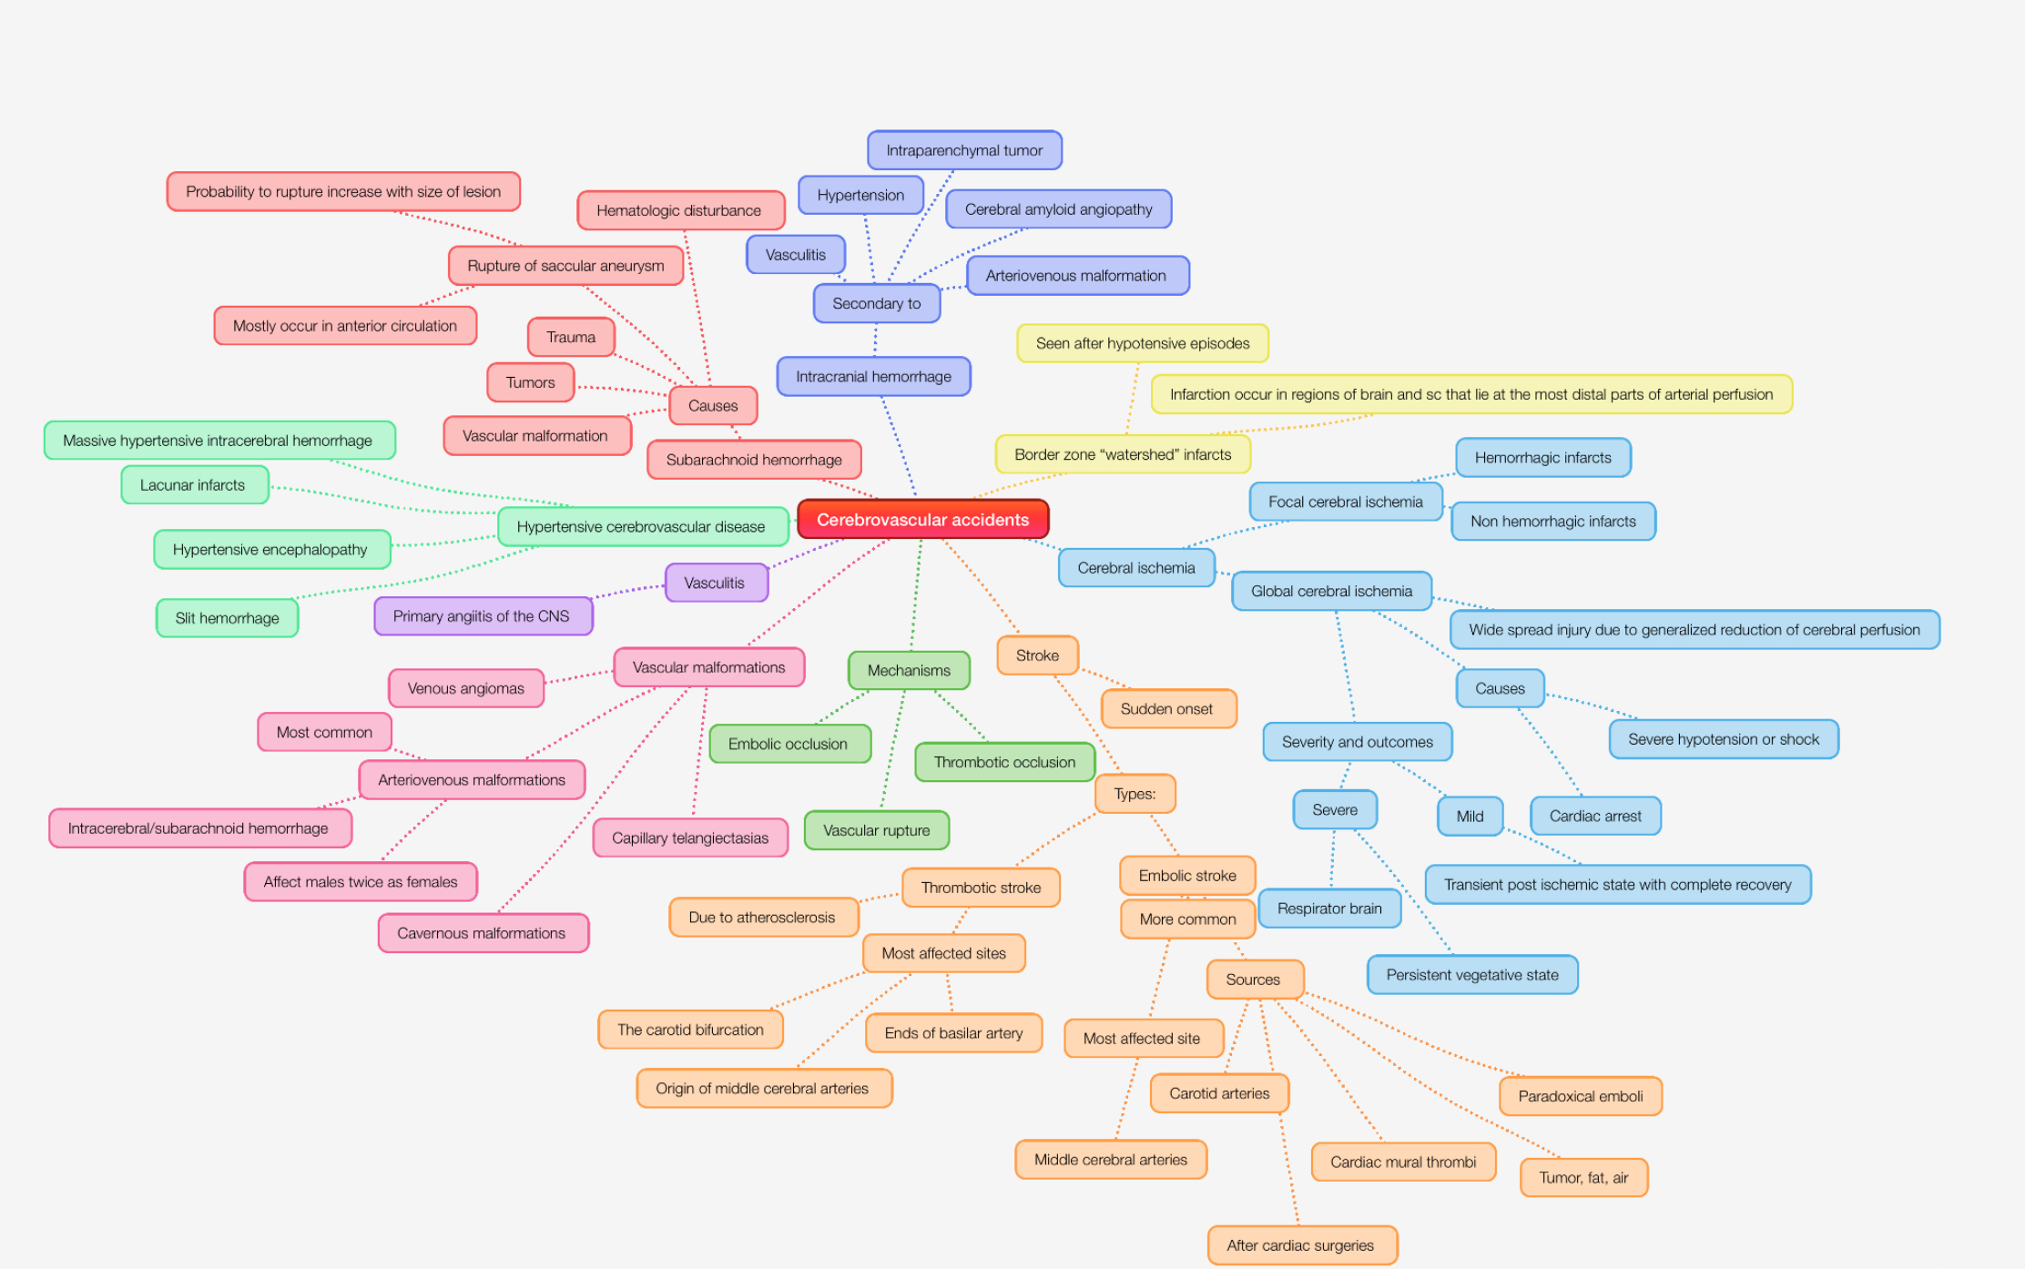
# Mind Map :

Slide 25
Summary pathoma:
CEREBROVASCULAR DISEASE I. BASIC PRINCIPLES A. Neurologic deficit due to cerebrovascular compromise; major cause of morbidity and mortality B. Due to ischemia (85% of cases) or hemorrhage (IS% of cases) I. Neurons are dependent on serum glucose as an essential energy source and are particularly susceptible to ischemia (undergo necrosis within 3-5 minutes). II. GLOBAL CEREBRAL ISCHEMIA A. Global ischemia to the brain B. Major etiologies 1. Low perfusion (e.g., atherosclerosis) 2. Acute decrease in blood flow (e.g., cardiogenic shock) 3. Chronic hypoxia (e.g., anemia) 4. Repeated episodes of hypoglycemia (e.g., insulinoma) C. Clinical features are based on duration and magnitude of the insult. I. Mild global ischemia results in transient confusion with prompt recovery. 2. Severe global ischemia results in diffuse necrosis; survival leads to a 'vegetative state. 3. Moderate global ischemia leads to infarcts in watershed areas (e.g., area lying between regions fed by the anterior and middle cerebral artery) and damage to highly vulnerable regions such as i. Pyramidal neurons of the cerebral cortex (layers 3, 5, and 6) leads to laminar necrosis ii. Pyramidal neurons of the hippocampus (temporal lobe)-important in long term memory iii. Purkinje layer of the cerebellum-integrates sensory perception with motor control Ill. ISCHEMIC STROKE A. Regional ischemia to the brain that results in focal neurologic deficits lasting > 24 hours I. If symptoms last< 24 hours, the event is termed a transient ischemic attack (TIA). B. Subtypes include thrombotic, embolic, and lacunar strokes. l. Thrombotic stroke is due to rupture of an atherosclerotic plaque. i. Atherosclerosis usually develops at branch points (e.g., bifurcation of internal carotid and middle cerebral artery in the circle of Willis). ii. Results in a pale infarct at the periphery of the cortex 2. Embolic stroke is due to thromboemboli. i. Most common source of emboli is the left side of the heart (e.g., atrial fibrillation). ii. Usually involves the middle cerebral artery iii. Results in a hemorrhagic infarct at the periphery of the cortex 3. Lacunar stroke occurs secondary to hyaline arteriolosclerosis, a complication of hypertension. i. Most commonly involves lenticulostriate vessels, resulting in small cystic areas of infarction ii. Involvement of the internal capsule leads to a pure motor stroke. iii. Involvement of the thalamus leads to a pure sensory stroke. C. Ischemic stroke results in liquefactive necrosis. I. Eosinophilic change in the cytoplasm of neurons (red neurons) is an early microscopic finding (12 hours after infarction). 2. Necrosis (24 hours), infiltration by neutrophils (days 1-3) and microglial cells (days 4-7), and gliosis (weeks 2-3) then ensue. 3. Results in formation of a fluid-filled cystic space surrounded by gliosis

Slide 26
Summary pathoma:
IV INTRACEREBRAL HEMORRHAGE A. Bleeding into brain parenchyma B. Classically due to rupture of Charcot-Bouchard microaneurysms of the lenticulostriate vessels l. Complication of hypertension; treatment of hypertension reduces incidence by half. 2. Basal ganglia is the most common site. C. Presents as severe headache, nausea, vomiting, and eventual coma. V. SUBARACHNOID HEMORRHAGE A. Bleeding into the subarachnoid space B. Presents as a sudden headache (" worst headache of my life" ) with nuchal rigidity C. Lumbar puncture shows xanthochromia (yellow hue due to bilirubin breakdown). D. Most frequently (85%) due to rupture of a berry aneurysm; other causes include AV malformations and an anticoagulated state. l. Berry aneurysms are thin-walled saccular outpouchings that lack a media layer increasing the risk for rupture. 2. lost frequently located in the anterior circle of Willis at branch points of the anterior communicating artery 3. Associated with Marfan syndrome and autosomal dominant polycystic kidney disease
Special thanks to Renad Alfirm!

Slide 27
Questions
1) Which site is most likely to get affected by embolic ischemia
a. Either ends of Basilar artery
b. Middle cerebral arteries
c. Vertebral artery
d. Pontine arteries
2) Most susceptible to ischemia in short duration
a. Pyramidal cells of the precentral gyrus
b. Glial cells of the gray matter
c. Purkinje cells of cerebellum
d. Pyramidal cells of basal ganglia
3) Ruptured vessel in subarachnoid space, usually in an individual with an aneurysm, and trauma.
-interferes with CSF reabsorption, hydrocephalus results
-leads to vasospasms
a. SAH intervention
b. Intracerebral hemorrhage
c. Meninges
d. Subarachnoid hemorrhage
4) Seizures are more common in_____
a. Blockage or total occlusion
b. Uncontrolled hypertension
c. Blood vessel ruptures
d. Hemorrhagic strokes
b
c
d
d

Slide 28
Questions
5) A 65-year-old man with atherosclerosis presents to the emergency department (ED) for evaluation of a possible transient ischemic attack. He reports right arm weakness and unsteady walking. The patient also states that he had difficulty speaking for 10 minutes on the previous day. Which of the following is the most common cause of future stroke?
a. thrombotic stroke
b. embolic stroke
c. hemorrhagic stroke
d. lacunar infarcts
6) Charcot-Bouchard microaneurysm is responsible for?
a. Ischemic stroke
b. subarachnoid hemorrhage c. intracranial hemorrhage
d. all of them
7) Risk factors for a stroke include all of the following except:
a. physical inactivity
b. hypertension
c. Being overweight
d. Urethritis
8) Which of the following leukocytes is seen first in a patient with stroke?
a. eosinophil
b. Neutrophil
c. Macrophage
d. All of them
5) b
6) c
7) d
8) b

Slide 29
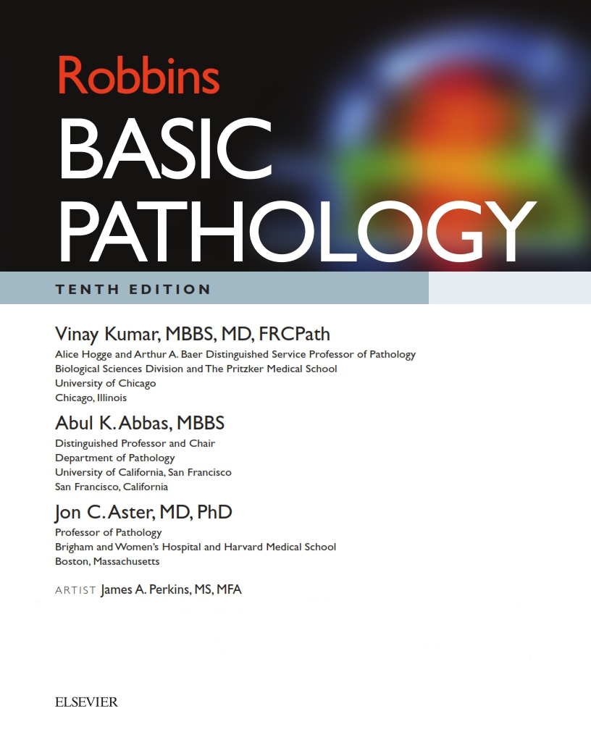
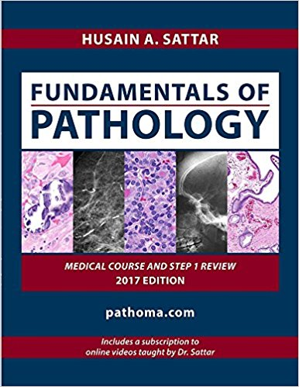
كل الشكر والتقدير للجهود العظيمة من قبل أعضاء فريق علم الأمراض الكرام:
قادة فريق علم الأمراض :
بثينة الماجد
منصور العبرة
أعضاء فريق علم الأمراض :
رناد الفرم
منيره المسعد
مجد البراك
شيخه الرويس
رهام الحلبي
ليلى الصباغ
غاده الحيدري
بتول الرحيمي
ريناد الغريبي
لين الحكيم
دانة القاضي
مها بركة
Kindly contact us if you have any questions/comments and suggestions:
EMAIL: pathology437@gmail.com
TWITTER : @pathology437
References:
-Slides

