Slide 1
Pathology
437’s team work
Lecture (7): Congenital Malformations & Hydrocephalus

Slide 2
Objectives:
- Know the common types of congenital malformations of the CNS and have a basic knowledge of their pathological features. - Correlate CNS normal development with the classification of congenital CNS malformations. - Appreciate the role of folate deficiency as an etiological factor in neural tube defects and understand the role of Alpha feto-protein measurement and ultrasound in antenatal diagnosis of neural tube defects. - Understand the various mechanisms that lead to the development of hydrocephalus. - List and classify the main causes of hydrocephalus.
Key principles to be discussed:
1] CNS congenital malformation incidence and introduction to the basic concepts behind the pathogenesis. These include genetic and environmental factors and the role of the stage of gestation development. - Definition and pathological changes in forebrain anomalies: - Megalencephaly, microencephaly and lissencephaly. - Microencphaly causes. - Definition and pathological changes in neural tube defects: - Meningomyelocele, spina bifida, anencephaly and encephalocele. - Pathogenesis with special emphasis on the role of folate and alpha fetoproteins and their clinical significance. - Definition and pathological changes in posterior fossa anomalies: - Arnold Chiari malformation. 2] Hydrocephalus: - Definitions of normal pressure hydrocephalus, noncommunicating hydrocephalus and communicating hydrocephalus - Pathophysiology and etiology.

Slide 3
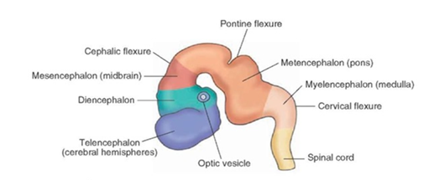
# Introduction to Congenital malformations.
The incidence of CNS malformations, giving rise to ​ mental retardation, cerebral palsy (group of permanent movement disorders that appear in early childhood)​ , or ​ neural tube defects, is estimated at 1% to 2%.
-Malformations of the brain are more common in the setting of multiple birth defects Because different parts of the brain develop at different times during gestation (and afterwards), the timing of an injury will be reflected in the pattern of malformation.
*Dr. maha note : the early injury give higher chance of damage, And more severe .
Prenatal​ ​ or​ perinatal​ ​ insults may either cause:
Pathogenesis and etiology :
Although the pathogenesis and etiology of many malformations remain unknown, both ​ genetic and environmental​ factors are clearly at play.
Failure of normal CNS development يولد بتشوه
Tissue destruction يولد سليم بعدين يصير فيه خلل
.
CNS malformation can be caused by Mutations affecting molecules in pathways of neuronal and glial :
1)Development. 2) Migration. 3) Connection.
.
toxic compounds Fetal alcohol syndrome ​or toxic drugs &​ infectious agents ​ are known to have​ ​ teratogenic effects HIV-1
From Robbins:
-Mutations affecting genes that regulate the differentiation, maturation, or intercellular communication of neurons or glial cells can cause CNS malformation or dysfunction.
-During gestation, the timing of an injury determines the pattern of malformation, with earlier events typically leading to more severe phenotypes.

Slide 4
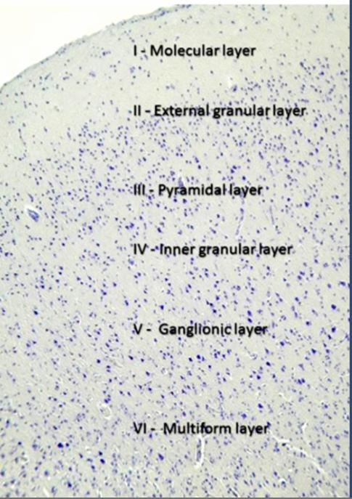
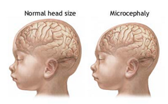
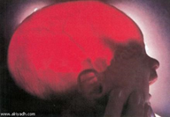
# Forebrain Malformations :
megalencephaly
microencephaly
Lissencephaly (agyria)
# What are they ?
1- megalencephaly:​ ​The volume of brain may be abnormally ​ large​ .
2- microencephaly (more common)​ :​ The volume of brain may be abnormally ​ small ​ and usually associated with small head (microcephaly)
# These two types can occur in a wide range of clinical settings, including:
a. Chromosome abnormalities.
b. Fetal alcohol syndrome.
c. Human immunodeficiency virus 1 (HIV-1) infection acquired in utero.
#These two types are associated with:
● Decreased number of neurons of cerebral cortex.
● Disruption of normal neuronal migration and differentiation during development which can lead to a disruption of the normal ​ gyration​ and ​ six-layered neocortical architecture. *dr.maha : in microcephaly there will be only 3 layers + الطبقات ما راح تكون بالترتيب الطبيعي لان المايقريشن حقها ماصار بالمكان الصح

Slide 5
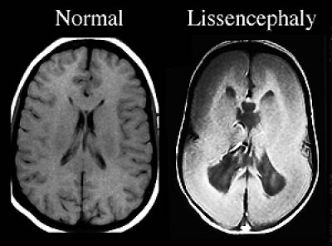
# Forebrain Malformations
megalencephaly
microcephaly
Lissencephaly (agyria)
#What is lissencephaly ?
•Lissencephaly (agyria) or, in case of more patchy involvement, pachygyria is characterized by an absence of normal gyration and a smooth-surfaced brain
– The cortex is abnormally thickened and is usually only four-layered
–Single-gene defects have been identified in some cases of lissencephaly.
Dr.maha keywords : No gyri + smooth surface + only four layers
From Robbins:
-Mutations in genes that control migration result in some malformations, like holopros- encephaly, where midline structures are absent. If the olfactory bulbs are absent, it’s called arrhinencephaly.
-Lissencephaly is anither example of gene mutations affecting migration.

Slide 6
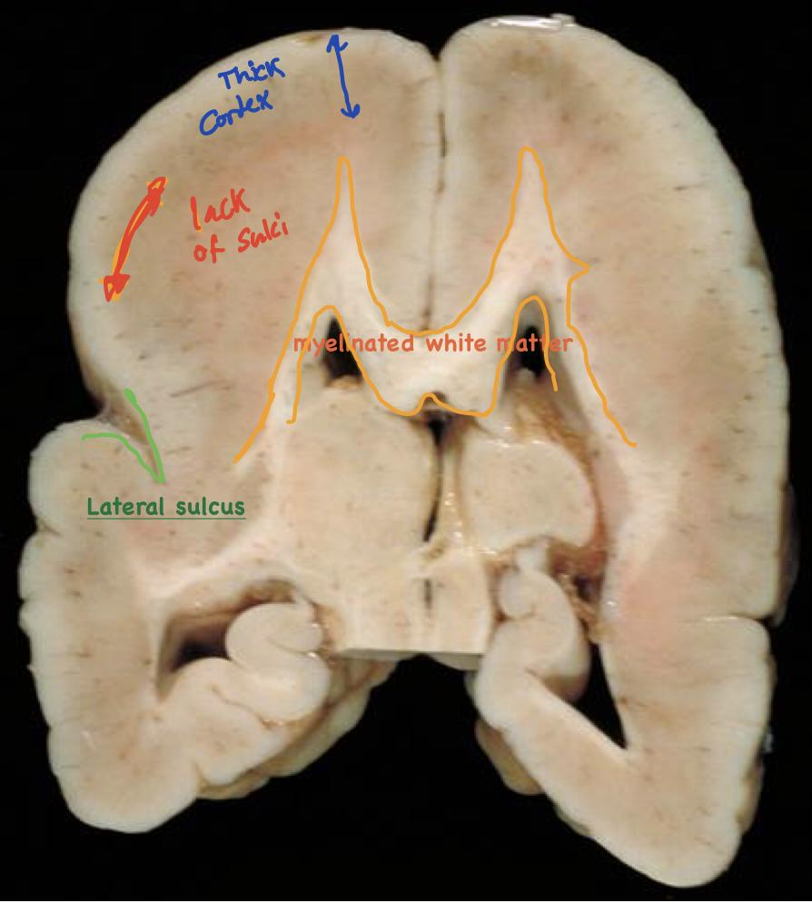
# Forebrain Malformations (cont)
- Cortical sulci are absent except, usually, for the Sylvian fissure (lateral sulcus)
- The cortex is thick and consists of the molecular and four neuronal layers
- The deepest of these layers is also the thickest and most cellular, presumably comprised of neurons that migrated a certain distance from the ventricles but failed to reach their normal destinations
- There is a small amount of myelinated white matter between the abnormal cortex and the ventricles

Slide 7
# Posterior Fossa Anomalies
The most common malformation in this region of the brain result in either misplaced or absent cerebellum. Typically these are associated with hydrocephalus*
# arnold-chiari malformation :
-What is it ?
Chiari malformations are structural defects in the base of the skull and cerebellum There are two types of chiari malformations (type two only included in the objective)
-HOW ?
Due to genetic mutations or a maternal diet that lacked certain nutrients -< the indented bony space at the base of the skull is abnormally small -< As a result, pressure is placed on the cerebellum which will be displaced cerebellum and downward of the vermis of the cerebellum -< this blocks the flow of the cerebrospinal fluid. -< could leads to hydrocephalus
-Types of arnold-chiari malformation – by D.maha arafah
arnold-chiari type 1: | arnold-chiari type 2:
Mild form | More severe
Usually there is no hydrocephalus = مافيه ضغط هنا لدرجه يسوي hydrocephalus | Associated with hydrocephalus
Not associated with lumbar myelomeningocele | associated with lumbar myelomeningocele
⦁ Increasing the space for the tissue through neurosurgery can alleviate the symptoms | Also the brain stem extend into the foramen magnum.
Extra from first aid

Slide 8
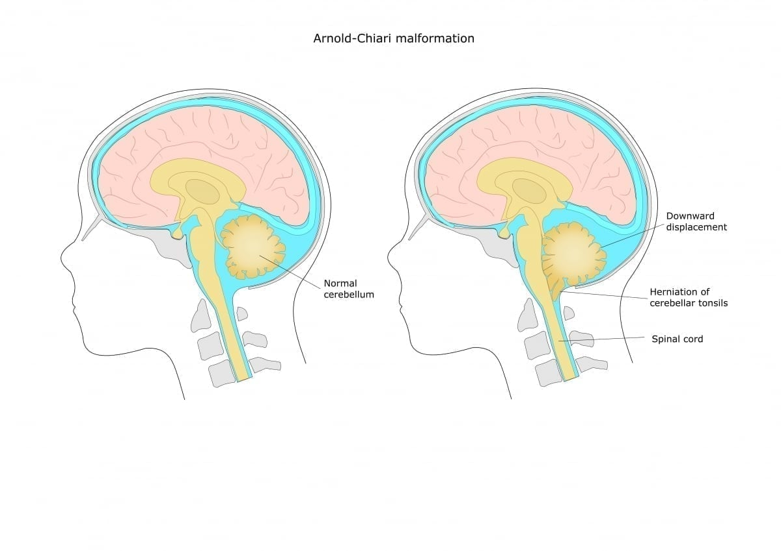
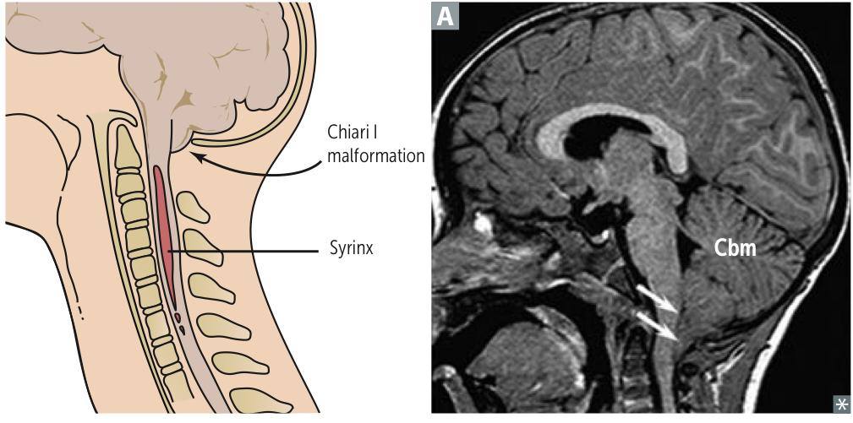
# arnold-chiari malformation :
The arnold-chiari malformation (Chiari type II malformation) consist of:
a smal l posterior fossa
a misshapen (تشوه خلقي) midline cerebellum
downward extension of vermis through the foramen magnum
Hydrocephalus
a lumbar myelomeningocele
Extra from first aid
From Robbins:
*Hydrocephalus is due to excess tissue in the magnum foramina, obstructing the flow of CSF.
-Chiari type I malformation is milder, only cerebellar tonsils extend through the foramen magnum.
-Dandy-Walker malformation, is characterized by an enlarged posterior fossa and absence of the cerebellar vermis.

Slide 9
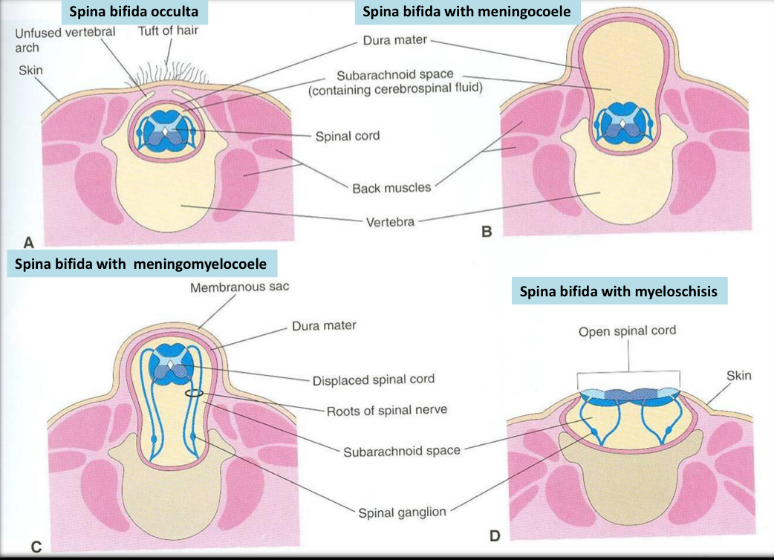
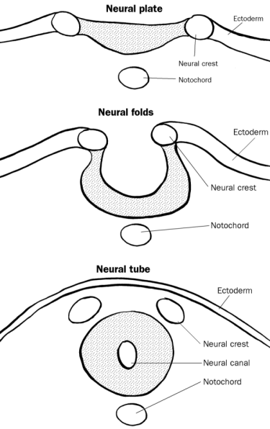
Neural tube defects
What is it ?Among the earliest stages in brain development is the formation of the neural tube, the inside of which will become the ventricular system and the wall of which will become the brain and spinal cord.
how does it happen ? Failure of a portion of the neural tube to close, or reopening after successful closure –< may lead to one of several malformations
Is there a risk factors ? YES, Folate deficiency during the initial weeks of gestation is a risk factor; prenatal vitamins are aimed, in part, at reducing this risk Pregnancy. That’s why Pregnant woman must take Folic acid!
All are characterized by abnormalities involving some combination of neural tissue, meninges, and overlying bone or soft tissues. Collectively, neural tube defects are the most frequent CNS malformations.
How can we diagnose it ? The combination of ultrasound and maternal screening for elevated α- fetoprotein has increased the early detection of neural tube defects.
The overall recurrence risk in subsequent pregnancies is 4% to 5%.
Extra
Neural tube defects examples: (next page)
From Robbins:
The most common defects involve the posterior end of the neural tube, from which the spinal cord forms. These can range from asymptomatic bony defects (spina bifida occulta) to spina bifida, a severe malformation consisting of a lat, disorganized segment of spinal cord associated with an overlying meningeal outpouching.

Slide 10
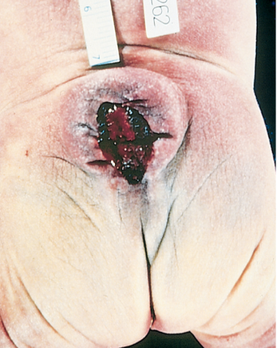
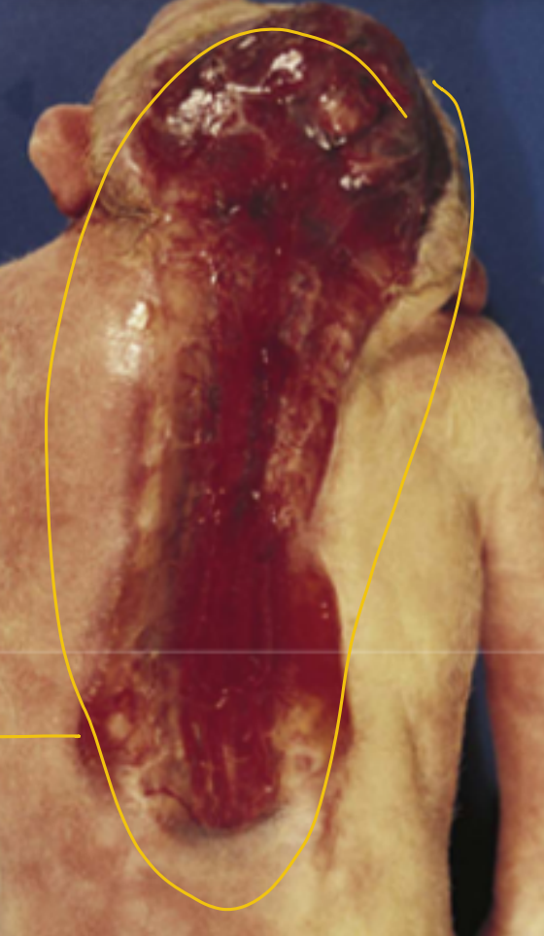
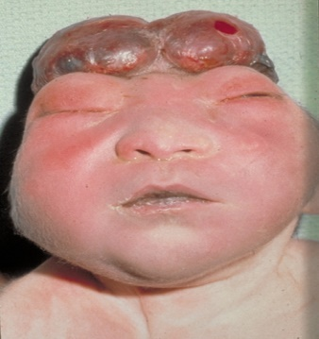
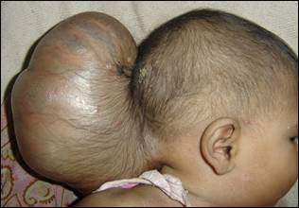
# Neural tube defects examples: (next page)
Myelomeningocele : | What is it ? is an extension of CNS tissue through a defect in the vertebral column. Region : They occur most commonly in the lumbosacral region. Deficits :Patients have motor and sensory deficits in the lower extremities and problems with bowel and bladder control. Symptoms: The symptoms derive from the abnormal spinal cord in this region, and are often compounded by infections extending from thin or ulcerated overlying skin. Cause : unknown. However, low levels of folic acid in a woman's body before and during early pregnancy appear to play a part.
Anencephaly: | What is it ? is a malformation of the anterior end of the neural tube, with absence of the brain and top of skull. (At the other end of the developing brain) Cause : same as Myelomeningocele Dr.maha : there is no brain nor skull
Encephalocele: | What is it ? is a diverticulum (An abnormal fluid filled sac) of malformed CNS tissue extending through a defect in the cranium It most often involves the occipital region or the posterior fossa Cause : the same.
*Dr.maha note :
when Myelomeningocele involve the whole spinal cord we call it diffuse neural tube defect

Slide 11
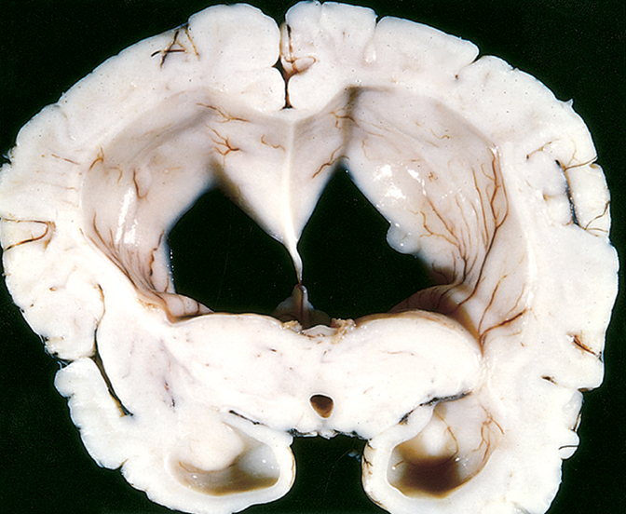
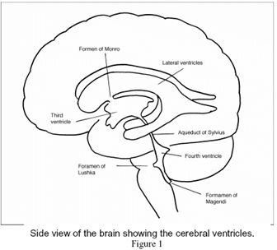
# Hydrocephalus :
What is it ? Is the accumulation of excessive CSF within the ventricular system.
*Dr.maha : in normal condition the CSF pressure is higher than the venous pressure which helps with drainage of CSF to the venous sinus.
# Physiology of CSF:
After being produced by the choroid plexus within the ventricles, cerebrospinal fluid (CSF) circulates through the ventricular system and exits through the foramina of Luschka and Magendie.
CSF fills the subarachnoid space around the brain and spinal cord, contributing to the cushioning of the nervous system within its bony confines. (to prevent friction الاحتكاك)
The arachnoid granulations are responsible for the resorption of CSF.
The balance between CSF generation and resorption keeps the volume of this fluid stable.
# What are the possible causes ?
Most cases occur as a consequence of impaired flow or impaired resorption of CSF.
In rare instances (e.g., tumors of the choroid plexus), overproduction of CSF may be responsible
extra:-

Slide 12
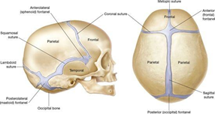
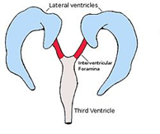
# Types of hydrocephalus:
# Hydrocephalus :
When hydrocephalus develops in infancy before closure of the cranial sutures –< enlargement of the head ¹
Hydrocephalus developing after fusion of the sutures >– expansion of the ventricles and increased intracranial pressure, without a change in head circumference. (محيط)
1 * (Macrocephaly because they have flexible sutures) (suture = junction)
extra:-
If there is an obstacle to the flow of CSF within the ventricular system, then a portion of the ventricles enlarges while the remainder does not.
Most commonly seen with masses at the foramen of Monro or aqueduct of Sylvius.
Noncommunicating hydrocephalus:
All of the ventricular system is enlarged; here the cause is most often reduced resorption of CSF.
Communicati.ng hydrocephalus.
extra:-

Slide 13
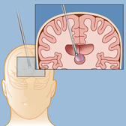
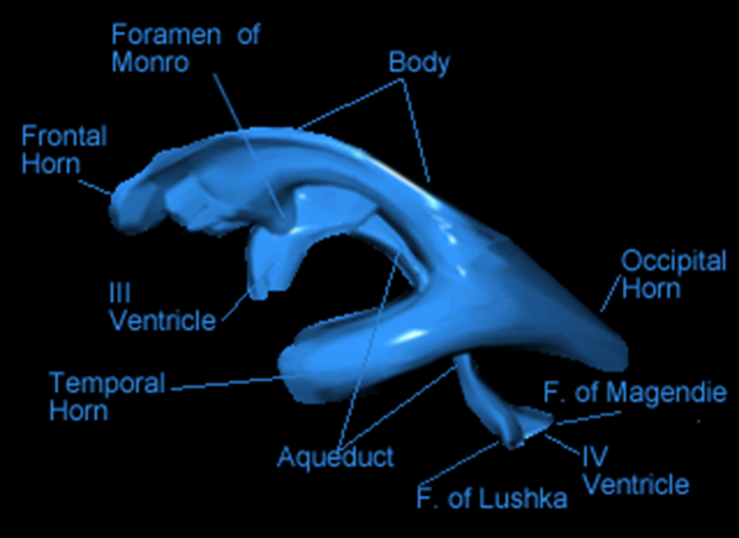
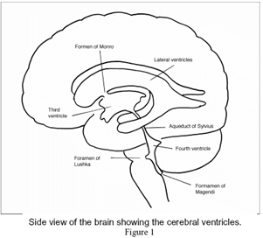
# What can cause hydrocephalus?
Hypersecretion of CSF
e.g. choroid plexus tumor
2) Obstructive hydrocephalus
–Obstruction of the foramina of Monro e.g. colloid cyst
–Obstruction of the third ventricle e.g. pilocytic astrocytoma
–Obstruction of the aqueduct e.g. aqueductal stenosis or atresia and posterior fossa tumors
–Obstruction of the foramina of Luschka or impairment of flow from the fourth ventricle (Chiari malformation, meningitis, subarachnoid hemorrhage, posterior fossa tumors) *dr.maha: herniation can cause this
–Fibrosis of the subarachnoid space e.g. meningitis, subarachnoid hemorrhage, meningeal dissemination of tumors.
3) Defective filtration of CSF:
postulated for low-pressure hydrocephalus
extra:- colloid cyst

Slide 14
Homework
Define: meningocele
Protrusion of the membranes of the brain or SC through a defect in the cranium or spinal column.
Define: polymicrogyria
Characterized by an increased number of irregularly formed gyri that result in a bumpy or cobblestone-like surface. These changes can be focal or widespread. The normal cortical architecture can be altered in various ways, and adjacent gyri often show fusion of the superficial molecular layer.
What is the difference between microcephaly and microencephaly?
Microcephaly: Small head
Microencephaly: Small Brain
Define: hydrocephalus ex vacuo
(you will study that with Alzheimer )
An enlargement of cerebral ventricles and subarachnoid spaces, and is usually due to brain atrophy (as it occurs in dementias).

Slide 15
#Summary :

Slide 16
#Summary :

Slide 17
Questions
1-A thick cortex with abnormal neuronal layering is seen in:
A.Pachygyria
B.Megalencepahly
C.Microencephaly
D.All of the above
Ans (A)
2-The most common cause of obstructive hydrocephalus in children is:
A. X-linked aqueductal stenosis
B. Meningitis
C. Tuberous sclerosis
D. Posterior fossa tumors
Ans(D)
3-The key feature of the Dandy-Walker Syndrome is:
A. Agenesis of the cerebellar vermis
B. Dilatation of the lateral ventricles
C. A large cisterna magna
D. Myelomeningocele
Ans(A)
4-Holoprosencephaly may be associated with all of the following except:
A. Fusion of the thalami
B. Fusion of the frontal lobes
C. Cerebellar hypoplasia
D. Absence of olfactory nerves
Ans(C)
5-Patients with the Chiari II malformation may have all of the following except:
A. Seizures
B. Paralysis of the lower extremities
C. Bladder incontinence
D. Bacterial ventriculitis
Ans(A)

Slide 18
6- Which of the following is a feature of forebrain malformation?
Abnormally thin cortex layer
Presence of all six layers of the cortex
Absence of cortical sulci
Complete loss of white matter
Answer: C
7- The inside of the neural tube form?
the spinal cord
The brain
The CSF
The ventricular system
Answer:D
8- Which region does an encephalocele involve?
Parietal region
occipital region
Temporal region
frontal region
Answer: B
9- Which of the following is a characteristic of arnold chiari 2 formation:
large posterior fossa
anencephaly
a lumbar myelomeningocele
loss of sylvian fissure
Answer:C
10- Example of obstruction of foramina of monro is:
colloid cyst
aqueductal stenosis
meningitis
pilocytic astrocytoma
Answer: A

Slide 19
كل الشكر والتقدير للجهود العظيمة من قبل أعضاء فريق علم الأمراض الكرام:
قادة فريق علم الأمراض :
بثينة الماجد
منصور العبرة
أعضاء فريق علم الأمراض :
فايز الدرسوني
راكان الغنيم
أحمد الصبي
سلطان بن عبيد
عبدالعزيز العبدالكريم
علي شحادة
سعود الغفيلي
سعد الفوزان
وجدان الشامري
Kindly contact us if you have any questions/comments and suggestions:
EMAIL: pathology437@gmail.com
TWITTER: @pathology437
References:
-Slides

