Slide 1
Pathology
437’s team work
Lecture (8): Degenerative Brain Diseases

Slide 2
Objectives :
Explain the basic pathological concepts of neurodegenerative disease, using Alzheimer’s and Parkinson disease as a classical example.
Know the definition of “dementia” syndrome.
List the possible causes of dementia.
Explain the basic pathological concepts of a neurodegenerative disease, using Alzheimer’s disease as a classical example.
Understand the major clinic-pathological features of Alzheimer’s disease. 6- Hypothesize the possible etiologies of Alzheimer’s disease.
List the causes of Parkinsonism. 8- Understand the major clinical and pathological feature of Parkinson disease.
important
Extra Explanation / Dr’s note
Examples
Terminology

Slide 3
# Degenerative brain disease:
What do we mean by “Degenerative” ? disorders characterized by the cellular degeneration of subsets of neurons that typically are related by function, rather than by physical location in the brain. It is characterized by affecting the type of the cell not location مو شرط تكون الخلايا جنب بعض، المهم ان لها نفس الوظيفة
for example : Alzheimer’s and Parkinson disease.
It cause symptoms that depend on the pattern of involvement of the brain:
although many degenerative diseases have primary targets, other brain regions are often affected later in the course of the illness for example if the neurodegenerative disorder start in the cerebral cortex later on it may involve the basal ganglia or any other region
result in loss of memory, language, insight, and planning, all components of dementia.
Hippocamp-al cortical neurons
result in movement disorders, these may be hypokinetic, as with Parkinson disease, or hyperkinetic, as with Huntington disease.
Neurons of the basal ganglia
result in ataxia
cerebellum
result in weakness.
Those that affect motor neurons
From Robbins:
-Most neurodegenerative diseases share a pathologic process, accumulation of protein aggregates, which serve as a histologic hallmark of specific disorders.
-These aggregates are resistant to degradation by normal cellular processes, they elicit an inflammatory response, and may be directly toxic to neurons.
-Activation of the innate immune system (complement) is a common feature of neurodegenerative diseases.

Slide 4
Dementia It is set of Clinical symptoms
What do we mean by “Dementia” ? development of memory impairment and other cognitive deficits severe enough to decrease the affected person’s capacity to function at the previous level despite a normal level of consciousness.
It arises during the course of many neurodegenerative diseases; it also can accompany numerous other diseases that injure the cerebral cortex. It can be related to degenerative diseases or can be associated with other non- degenerative diseases
Dementia is an increasing public health concern as the population ages. - Regardless of etiology, dementia is not part of normal aging and always represents a pathologic process.
Major cause of dementia | Examples
Primary Neurodegenerative Disorders | ⦁ Alzheimer disease. ⦁ Lewy body dementia. ⦁ Huntington disease.
Infections | ⦁ Prion-associated disorders (e.g. Creutzfeldt-Jakob disease). ⦁ HIV encephalopathy (AIDS dementia complex). ⦁ Progressive multifocal leukoencephalopathy.
Vascular and Traumatic Diseases | ⦁ Multi-infarct dementia. ⦁ Global hypoxic-ischemic brain injury. ⦁ Chronic subdural hematomas.
Metabolic and Nutritional Diseases | Thiamine deficiency (Wernicke-Korsakoff syndrome). ​ ​ is a degenerative brain disorder caused by the lack of thiamine (vitamin B1). related to alcoholism
Miscellaneous | ⦁ Brain tumors. ⦁ Neuronal storage diseases. ⦁ Toxic injury (e.g. mercury).
So remember! While Alzheimer's disease is considered as "degenerative"-that is, reflecting an underlying cellular degeneration of neurons in the brain- not all forms of dementia are degenerative
Dr.amani’s note
Parkinson’s patient might have dementia and we call it “ lewy body dementia, but NOT ALWAYS .

Slide 5
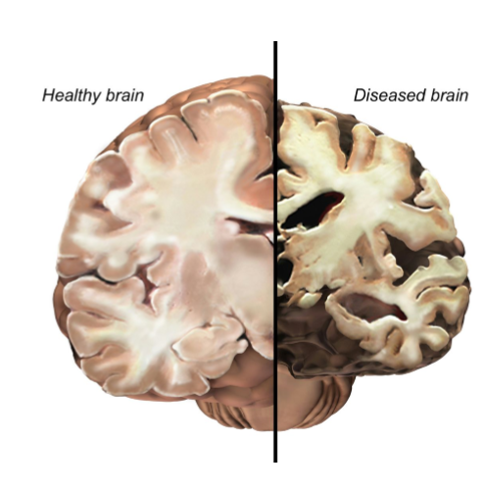
Alzheimer Disease:
#What is Alzheimer? It is The most common cause of ​ dementia in the elderly. It usually becomes clinically apparent as insidious يبدأ بأعراض خفيفة ثم تسوء impairment of higher intellectual function, with alterations in mood and behavior. Progress gradually
Later, there will be severe cortical dysfunction:
Progressive disorientation.
Memory loss.
Aphasia. Loss the ability to speak
Over the next 5 to 10 years, the patient becomes profoundly disabled, mute, and immobile.
Death usually occurs from ​ intercurrent pneumonia​ or other infections.
* Why the die usually by pneumonia? because of difficulty in swallowing caused by the disease, an individual inadvertently inhales food particles, liquid or even gastric fluids. ... There they multiply and grow, which leads to pneumonia
#Epidemiology :
when considered by age groups, the incidence of Alzheimer disease:
This increasing incidence with age has given rise to major medical, social, and economic problems in countries with a growing number of elderly. So ​the older the patient the more possible to get Alzheimer .
#how to diagnose alzheimer's?
Although pathologic examination of brain tissue remains necessary for the definitive diagnosis of Alzheimer disease, the combination of​ ​ clinical​ assessment and modern ​ radiologic​ methods allows ​ accurate diagnosis​ in 80% to 90% of cases. *Dr. amani : 100% accuracy by pathological features – by autopsy and we cant do it in alive Patient
3% for individuals 65 to 74 years old.
19% for 75 to 84 years
47% for 85 years or more

Slide 6
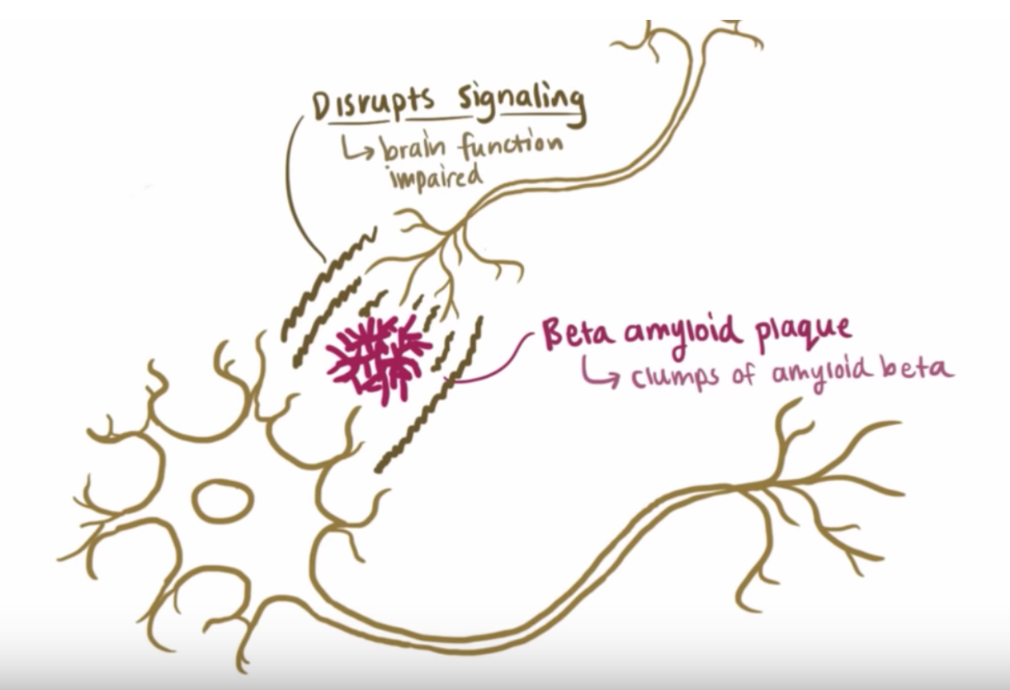
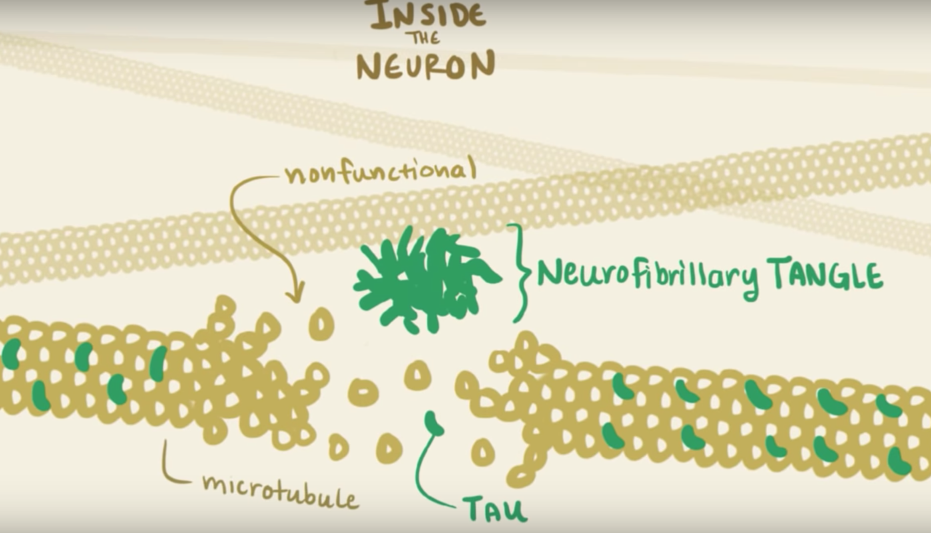
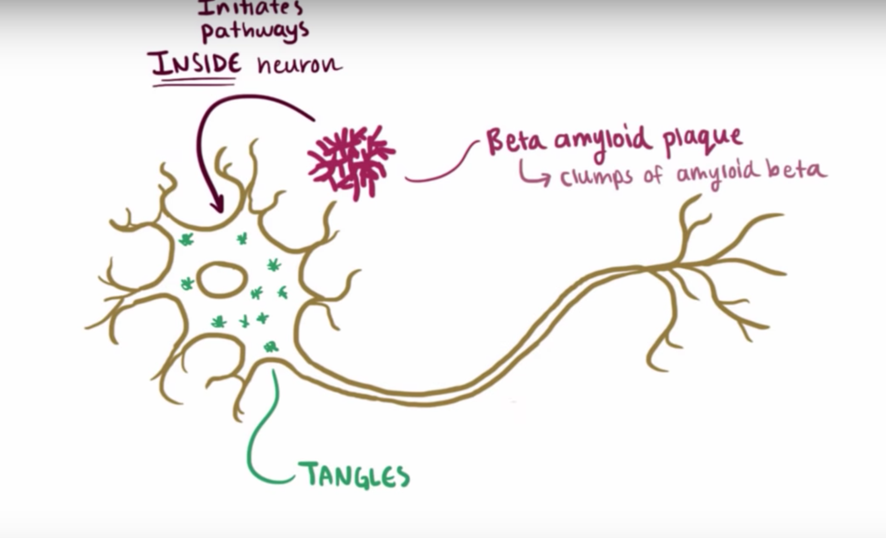
Pathogenesis overview:
*The story behind Alzheimer’s in an easy words:
the cause of Alzheimer disease isn’t completely understood but there are two major factors that play arole:
A- plaques:
in the neuronal cell membrane there is a protein called amyloid precursor protein (APP) which play a role in neuron growth and repair. and like any other protein it will be used then cleaved. APP has 2 pathways.
1- APP will be cleaved by alpha secretase and gamma secretase which will form a soluble complex and won't be accumulated “ normal pathway”
2- APP will be cleaved by beta secretase and gamma secretase which will form the beta amyloid ( A beta) => when more are formed it accumulates, becomes toxic and interferes with function of neuron and disrupts signaling => as they increase they form insoluble oligomers => forming Beta amyloid PLAQUES* extracellular “ abnormal pathway”
*الـ beta plaques هي نفسها الbeta amyloid protein بس لما تتراكم ترتبط مع بعضها وتكون بلاكس
* SO TO SUM UP : beta secretase => the enzyme which forms Beta amyloid from APP that causes Alzheimer's.
B- tangles:
inside the cell there is a protein called tau which is present in the microtubules and makes sure it doesn't break apart. somehow the formation of A beta plaques initiate hyperphosphorylation of tau protein => aggregation of hyperphosphorylated tau protein inside the cell “ neurofibrillary tangle”

Slide 7
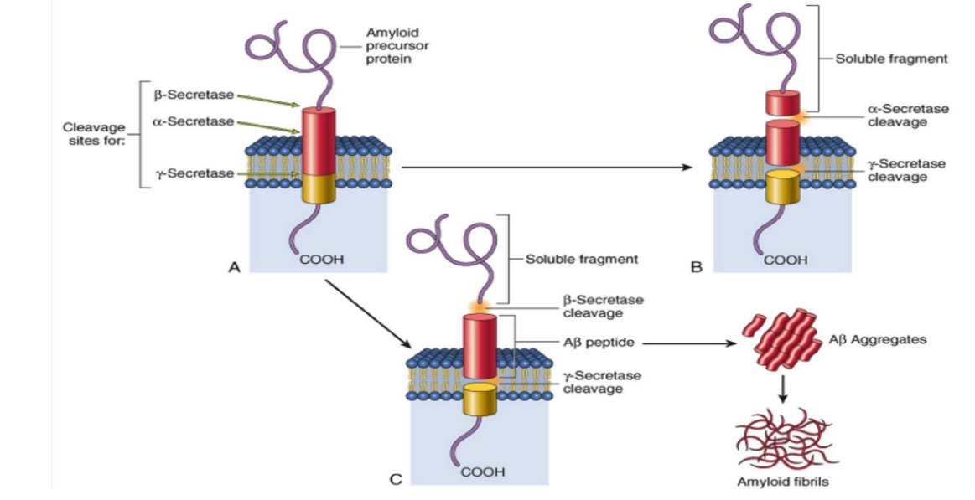
Pathogenesis:
Abnormal accumulation of certain proteins
Aβ peptide is derived from a larger membrane protein known as amyloid precursor protein (APP), which is processed in either of two ways:
The normal pathway : It can be cleaved by two enzymes, α-secretase and γ-secretase, in a process that prevents formation of Aβ. *The cleavage here forms a soluble fragments → NO Alzheimer → NO amyloid fibrils
Abnormal pathway : It can be cut by β-site APP-cleaving enzyme or called” by β-amyloid–converting enzyme (BACE) “and γ-secretase to generate Aβ *The Aβ deposits formed by the β, γ-secretase are insoluble, meaning they are not soluble in blood and cannot be secreted in the urine, and will aggregate in the brain!
* هو اصلا بشكل طبيعي موجود على غشاء الخلية APP يحصل له degradation و خلاص يصير soluble ويروح. لكن اذا تغير الانزايم الي يسوي له degradation يخلي الجزء الي كسره insoluble ويتجمع.
#Aβ peptide genesis and consequences in Alzheimer disease نفس الكلام متكرر لكن موجود بالسلاديز
Amyloid precursor protein cleavage by α-secretase and γ-secretase produces a harmless soluble peptide, whereas amyloid precursor protein cleavage by β-amyloid–converting enzyme (BACE) and γ-secretase releases Aβ peptides, which form pathogenic aggregates and contribute to the characteristic plaques and tangles of Alzheimer disease.

Slide 8
#What are the effects of Accumulation of Aβ on neurons and neuronal function?
Generation and accumulation of Aβ occur slowly with advancing age.
can ​ alter neurotransmission​ , and the aggregates can be​ toxic to neurons​ and synaptic endings.
Small aggregates of Aβ
also lead to neuronal death, elicit a local inflammatory response that can result in further cell injury, and may cause altered region-to-region communication through mechanical effects on axons and dendrites.
Larger deposits, in the form of ​ plaques
The presence of Aβ also leads neurons to​ hyperphosphorylate the microtubule binding protein “tau”. ¹
Hyperphosphorylation of tau
From Robbins:
-Aβ is highly prone to aggregation; it first forms small oligomers, and these eventually propagate into large amyloid fibrils. It is these aggregates that deposit in the brain and are visible as plaques.
1* Know more about TAU:
-Just like any other cell, neurons are held together inside by a cytoskeleton; the cytoskeleton gives a cell its shape, offers support, and facilitates movement through three main components: microfilaments, intermediate filaments, and microtubules. A special protein called TAU performs the function of stabilizing microtubules.
- In Alzheimer’s : Tau separates from the microtubules causing them to fall apart>> strands of this Tau combine to Form tangles inside the neuron>> disabling the transport system and destroying the cell>> neuron become disconnected from each other and eventually die.
How does this happen? it’s thought that Beta amyloid plaque initiates pathway INSIDE the neuron that activates protein kinase -> transfer a phosphate group to TAU -> TAU then change its shape and stops stabilizing the microtubules. -> TAU gets clump and tangled -> leads to the other characteristic finding: neurofibrillary tangle.

Slide 9
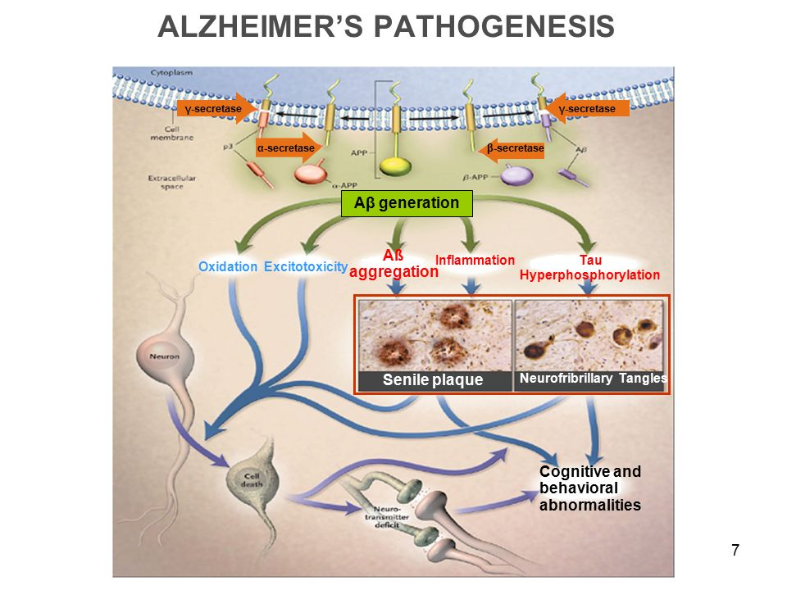
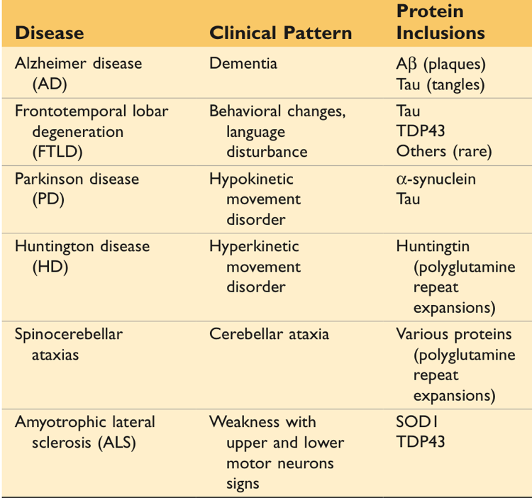
TAU protein :
With this increased level of phosphorylation by protein kinase, tau redistributes within the neuron from the axon into dendrites and cell body and aggregates into tangles.
This process also results in neuronal dysfunction and cell death. “ can lead to Apoptosis”
The anatomic distribution of these changes, which occur roughly in parallel, are responsible for the clinical signs and symptoms; they appear to develop well in advance of clinical presentation.
Extra from Robbins

Slide 10
#Mutations of Alzheimer :
In general, patients rarely become symptomatic before 50 years of age, but early onset can be seen with some of the heritable forms.
The search for genes associated with typical, sporadic Alzheimer disease is beginning to identify genetic associations that may provide new clues about the pathogenesis of the disease: بدأ العلماء بالبحث عن اسباب آليات المرض وكيفية حدوثه من جذوره وكانت النتائج كالتالي
Sporadic form (Most cases) | Familial form(at least 5% to 10% are ​)
What: occurring at irregular intervals in a population. | What: relating to or occurring in a family or its members.
How: by sporadic mutations & environmental risk factors. * تحدث طفره للشخص بدون ما يكتسبها من اهله فمثلا تحدث هذه الطفره من خلال عوامل بيئه | How: inheriting a dominant gene (mutated gene). *ينتقل من الاباء للابناء
Late onset | Early onset * لأنه اول ما انولد وهذه الطفره مكتسبها من اهله فغالبا تطلع علطلول
Example: 1) An allele of apolipoprotein ApoE4, chromosome 19 2) Mutated SORL1 | Examples : 1)by Mutations​ in ​ APP​ ​ (amyloid precursor protein)​ or in components of ​ γ-secretase​ : presenilin-1“chromosome 14 “ or presenilin-2 ”chromosome 1” *lead to early onset familial Alzheimer disease by increasing the rate at which Aβ accumulates.
2) Another gene, called SORL1*, has recently been found to also be associated with late-onset Alzheimer disease
How? ApoE4 may contribute to the deposition of Aβ, but how it does so is not known. *It helps break down beta Amyloid
How? Mutation in SORL1 → Deficiency of the SORL1 protein → may alter the intracellular trafficking of APP, shuttling it to a compartment where the Aβ peptide is generated by enzymatic cleavage, the net result being increased generation of this pathogenic peptide.
1)An allele of apolipoprotein, called ε4 (ApoE4)*, is associated with as many as 30% of cases, and is thought to both increase the risk and lower the age of onset of the disease.

Slide 11
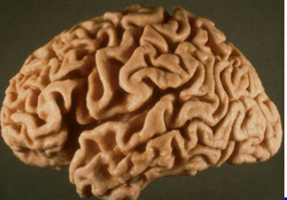
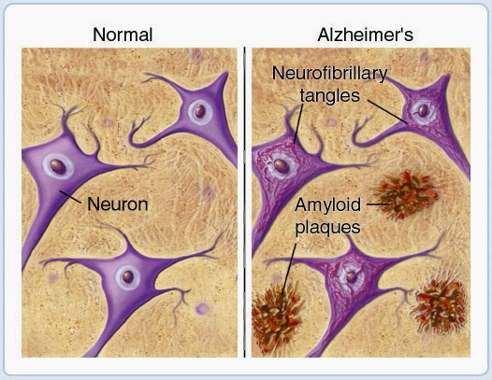
3) Alzheimer disease occurs in almost all patients with ​ trisomy 21 (Down syndrome)​ who survive beyond 45 years .
-How? The ​ APP gene is located on chromosome 21.
- (due to APP gene dosage effects).
The ​ APP gene is located on chromosome 21., and the risk of AD also is higher in those with an extra copy of the ​ APP gene, such as patients with trisomy 21 (Down syndrome) and persons with small interstitial duplications of ​ APP, presumably because this too leads to greater Aβ generation.
ببساطة لأن الجين المسؤول عن الAPP موجود اساساً بكروموسوم 21 ، ايش مشكلة الداون سندروم ؟ انه عنده زياده كرومسوم ب21 لذلك بيكون من فيه عدد إضافي من نسخ جين App فبتزيد عندهم فرصة حدوث البيتا اميلويد .
Morphology :
Macroscopic: | Microscopic:
-A variable degree of cortical atrophy with widening of the cerebral sulci that is most pronounced in the frontal, temporal, and parietal lobes. | -Plaques (a type of extracellular lesion)
-With significant atrophy, there is compensatory ventricular enlargement (hydrocephalus ex vacuo). | -Neurofibrillary tangles (a type of intracellular lesion.
Because these may also be present to a lesser extent in the brain elderly nondemented individuals, the current criteria for a diagnosis of Alzheimer disease are based on combination of clinical and pathologic features

Slide 12
There is a fairly constant pattern of progression of involvement of brain regions pathologic changes: Earliest in the entorhinal cortex → then spread through the hippocampal formation and isocortex → then extend into the neocortex.
Silver staining methods or immunohistochemistry are extremely helpful in assessing the true burden of these changes in a brain.
→ What is immunohistochemistry? Microscopic localization of specific antigens in tissues by staining with antibodies labeled with fluorescent or pigmented material.
Neuritic plaques: | Neurofibrillary tangles:
Focal, spherical collections of dilated, tortuous, silver-staining neuritic processes (dystrophic neurites), often around a central amyloid core. Plaques can be found in the hippocampus and amygdala as well as in the neocortex, although there is usually relative sparing of primary motor and sensory cortices until late in the course of the disease. The amyloid core contains Aβ. Aβ deposits can also be found that lack any surrounding neuritic reaction, termed diffuse plaques. | Bundles of paired helical filaments visible as basophilic fibrillary structures in the cytoplasm of the neurons that displace or encircle the nucleus. Tangles can remain after neurons die, then becoming a form of extracellular pathology. They are commonly found in cortical neurons, especially in the entorhinal cortex, as well as in other sites such as pyramidal cells of the hippocampus, the amygdala and the basal forebrain. A major component of paired helical filaments is abnormally hyperphosphorylated forms of the protein tau. Tangles are not specific to Alzheimer disease, being found in other degenerative diseases as well.

Slide 13
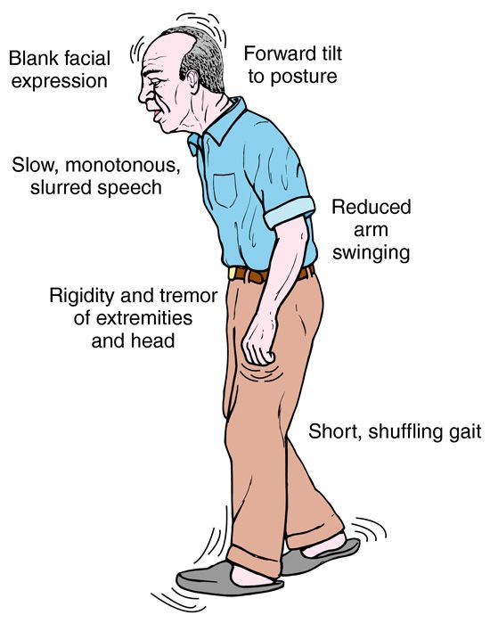
# Parkinsonism :
What is it ? It is a long-term degenerative disorder of the central nervous system that mainly affects the motor system. The symptoms generally come on slowly over time.
characterized by:
Diminished facial expression (masked facies).
Stooped posture
Slowness of voluntary movement. (bradykinesia)
Festinating gait (progressively shortened, accelerated steps).
Rigidity
"pill-rolling" tremor
ميل السبابة والإبهام للمس بعضهم وعمل حركة دائرية
So, motor disturbance that is seen in a number of conditions that share damage to dopaminergic neurons of the substantia nigra (in midbrain) or their projection to the striatum (caudate nucleus + putamen).
#Epidemiology of Parkinson’s:
6-8 decades.
Men more than women
More than 2% in North America develop disease
22/100,000 = crude prevalence rate in Saudi population

Slide 14
#Diagnosis of Parkinson's Disease :
# Parkinsonism :
Etiology: | Comment
Drugs that affect the neurons | Particularly dopamine antagonists and toxins that selectively injure dopaminergic neurons
Post-encephalitic parkinsonism | Associated with the influenza pandemic
Idiopathic Parkinson's disease (PD) | The most common neurodegenerative disease associated with parkinsonism
Other neurodegenerative diseases | Multiple system atrophy (MSA), Progressive supranuclear palsy (PSP), Corticobasal degeneration (CBD)
Head trauma – stroke | Rare
Extra from Robbins:
PD is associated with: characteristic neuronal inclusions containing α-synuclein.
MSA: α-synuclein aggregates are found in oligodendrocytes.
PSP and CBD associated with: tau-containing inclusions in neurons and glial cells.
It’s a Progressive parkinsonism.
Absence of a toxic or other known underlying etiology.
Clinical response to l-dihydroxyphenylalanine (l-DOPA) treatment Prodrug of dopamine.

Slide 15
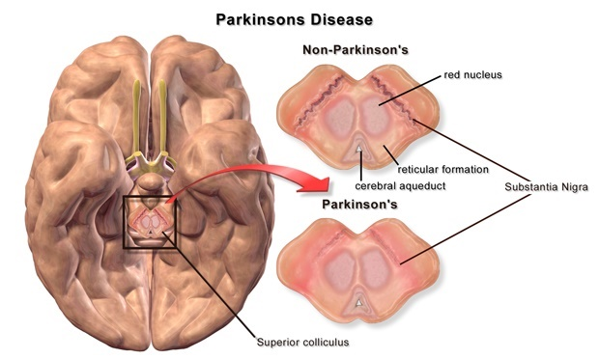
# Pathogenesis :
While most Parkinson disease is sporadic (ا(الأسباب الموجودة بالجدول السابق,there are both autosomal dominant and recessive forms of the disease.
Point mutations and duplications of the gene encoding α-synuclein, a protein involved in synaptic transmission, cause autosomal dominant PD.
Even in cases of Parkinson disease not caused by mutations in this gene, the diagnostic feature of the disease “the Lewy body” is an inclusion containing α-synuclein.
This (α-synuclein) is a widely expressed neuronal protein that is involved in synaptic transmission and other cellular processes.
How the alterations in sequence or protein levels result in disease? is unclear.
The presence of α-synuclein in the Lewy bodies has suggested that defective degradation of the protein in the proteasome might play a role.
This is supported by the identification of two other genetic loci for Parkinson disease:
Which involve genes encoding parkin (an E3 ubiquitin ligase)
UCHL-1 (An enzyme involved in recovery of ubiquitin from proteins targeted to the proteasome)
These two are responsible for degradation of α-synuclein

Slide 16
#What is Lewy bodies ?
#Morphology:
Macroscopic: | Microscopic:
Pallor of the substantia nigra and locus coeruleus. ​ . ​ Fig A&B | Loss of the pigmented, neurons in these regions. Associated with gliosis. Lewy bodies may be found in some of the remaining neurons.
Single or multiple, intracytoplasmic, eosinophilic, round to elongated inclusions that often have a dense core surrounded by a pale halo.
Ultrastructurally, Lewy bodies are composed of fine filaments, densely packed in the core but loose at the rim.
These filaments are composed of α-synuclein, along with other proteins, including neurofilaments and ubiquitin.
The other major histologic finding is Lewy neurites (neuronal processes), dystrophic neurites that also contain abnormally aggregated α-synuclein.

Slide 17
Treatment & Progression:
#Clinical Features:
Usually progresses over 10 to 15 years.
Eventual severe motor slowing to the point of near immobility.
About 10% to 15% of individuals with Parkinson disease develop dementia, the incidence increasing with advancing age.
Characteristic features of this disorder include a fluctuating course and hallucinations.
While many affected individuals also have pathologic evidence of Alzheimer disease, the dementia in other Parkinson disease patients is attributed to widely disseminated Lewy bodies in the cerebral cortex.
When dementia arises within 1 year of the onset of motor symptoms, it is referred to Lewy body dementia.
L-DOPA therapy is often extremely effective in symptomatic treatment, but it does not significantly alter the progressive nature of the disease
Over time, L-DOPA becomes less effective at providing the patient with symptomatic relief and begins to cause fluctuations* in motor function on its own.
Death is usually the result of intercurrent infection or trauma from frequent falls caused by postural instability.
*Motor fluctuations refer to a decline in the usual benefit from a dose of levodopa. Instead of the smooth, uninterrupted control of symptoms of Parkinson’s disease (PD) that levodopa offers early in the disease, symptoms return before the next dose is scheduled, or are only partially controlled by a given dose. Motor fluctuations usually develop gradually, after several years of successful treatment. Most people with PD will eventually experience motor fluctuations as their disease progresses.
Parkinson disease has been targeted for many novel therapeutic approaches.
Currently used neurosurgical approaches to Parkinson disease include the placement of lesions in the extrapyramidal system to compensate for the loss of nigrostriatal function or placement of stimulating electrodes - deep brain stimulation.

Slide 18
# Summary:
 | Alzheimer disease | Parkinson disease
 | Most common cause of dementia. Most cases are sporadic and less are familial. | Associated with motor disturbance that share damage to dopaminergic neurons of the substantia nigra or their projection to the striatum. Most cases are sporadic and less are familial.
Age group | Start at 60 → 70 years and the risk increase with aging 80 → 85 years. | 60 → 80 years.
Diagnosis based on | 1- Clinical assessment. 2- Radiologic methods. | 1- Clinical assessment. 2- Absence of a toxic or any underlying cause. 3- Clinical response to L-DOPA.
Pathogenesis | Aggregation of Aβ and Tau because an abnormal degradation of the APP (mutations in degradation). | Point mutations and duplications of the gene encoding ⍺-Synuclein. Abnormal degradation of ⍺-Synuclein.
Protein inclusion | 1- Aβ. 2- Tau. | ⍺-Synuclein.
Macroscopic features | 1- Cortical atrophy with widening of sulci and thinning of gyri. 2- compensatory ventricular enlargement (hydrocephalus ex vacuo). | Pallor of: 1- Substantia nigra. 2- locus ceruleus.
Microscopic features | 1- Plaques (extracellular). ☆ Neuritic plaques. Dystrophic neurites around a central amyloid core contain Aβ. ☆ Diffuse plaques. Contains only Aβ deposits. 2- Neurofibrillary tangles (intracellular). | 1- Loss of the pigmented, catecholaminergic neurons in these regions. 2- Gliosis 3- Lewy bodies. (intracytoplasmic). ☆ Lewy neurites. Dystrophic neurites contain abnormally aggregated ⍺-Synuclein.
Progression | 5 → 10 years. | 10 → 15 years.
Death result of | 1- Intercurrent pneumonia. 2- Other infections. | 1- Intercurrent infection. 2- Trauma.

Slide 19
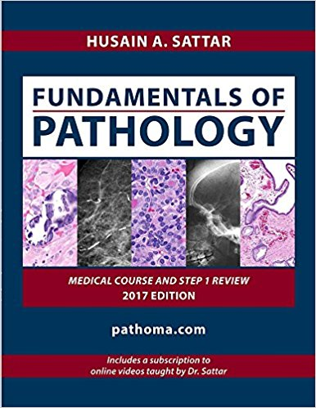
كل الشكر والتقدير للجهود العظيمة من قبل أعضاء فريق علم الأمراض الكرام:
قادة فريق علم الأمراض :
بثينة الماجد
منصور العبرة
أعضاء فريق علم الأمراض :
منيره المسعد
مجد البراك
ريناد الغريبي
غرام جليدان
رناد الفرم
ليلى الصباغ
نورة القاضي
مها العمري
- غاده الحيدري
Kindly contact us if you have any questions/comments and suggestions:
EMAIL: pathology437@gmail.com
TWITTER: @pathology437
References:
-Slides

