Slide 1
Drugs Related to Balance System
Objectives:
To differentiate between classes of drugs used to control or to prevent vertigo.
To hint on some disorders of balance.
To detail on some drugs used to control or to prevent vertigo.
Identify drugs that can precipitate vertigo.
Editing File

Slide 2
Drugs Related to Balance System
Vertigo Vs Dizziness:
Dizziness | Vertigo
- Used to express subjective patient complaints related to changes in sensation, movement, perception, or consciousness. - Lighted headedness: Symptom of feeling about to faint. | -Part of dizziness, complain in change in sensation of movement only (SPINNING). Types: Objective: object is moving while the patient is stationary. Subjective: patient is moving while surrounding is stationary. - BALANCE DISORDER (the individual will feel unsteady when standing or walking)
 | Symptoms
 | - SPINNING(Vertigo). - Confusion or disorientation. - Falling or feeling as if one is going to fall. - Nausea or vomiting. - Sweating. - Nystagmus (Abnormal eye movement).
Pathophysiology of vertigo (Extra):
As we know that vestibular system is used to maintain the balance
by detecting angular and linear acceleration of the head.
Sensory information from the vestibular system is then used to provide a stable visual image of the retina (while the head moves) & make adjustment in posture that are necessary to maintain balance.
Vertigo happens if there is abnormality in the vestibular system
or CNS structures that process signals from the semicircular canals.

Slide 3
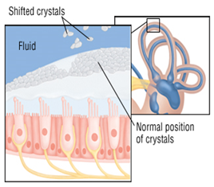
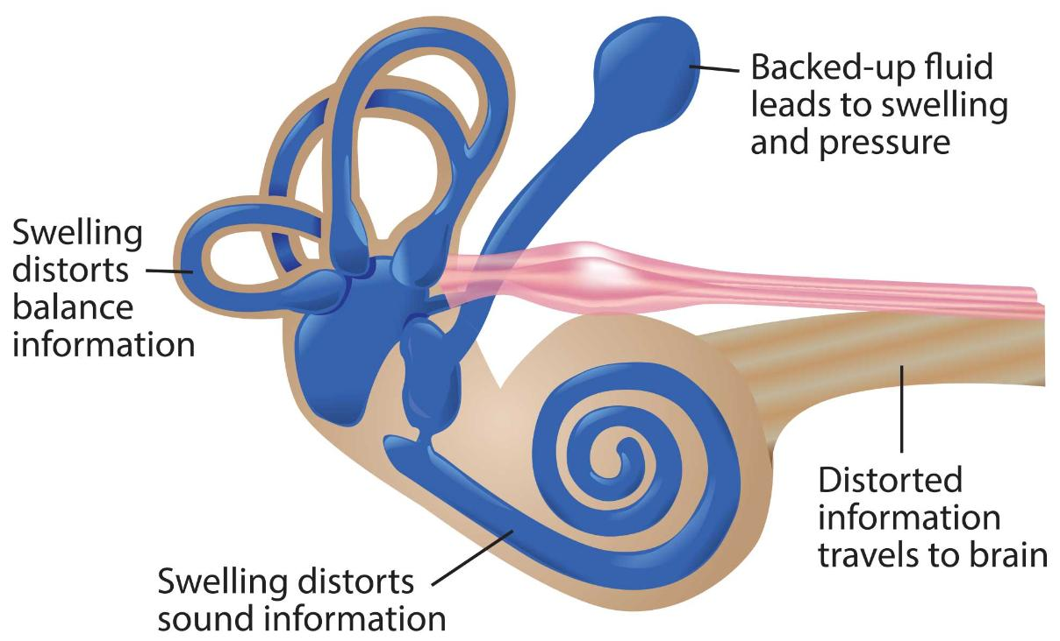
Drugs Related to Balance System
Balance disorders:
1- Benign paroxysmal positional vertigo (BPPV)
non fatal, happened suddenly, and triggered by head movement
a change in head position causes a sudden sensation of spinning.
2- Acute labyrinthitis
Inflammation of the balance apparatus of the inner ear, probably caused by a viral infection.
3- Ménière's disease
2:43 min
its cause is unknown = idiopathic
fluid accumulation in inner ear can cause swelling and pressure which will disturb the signaling information between inner ear and brain.
This causes repeated episodes of dizziness, usually with ringing in the ear & progressive low-frequency hearing loss
The symptoms of meniere’s disease might be caused by dislodgement of the crystals which are formed of calcium carbonate. they’re located within the margin of the three canals in the inner ear where they might enter the fluid which will cause imbalance and ringing in the ear.

Slide 4
Mind Map
Drugs Related to Balance System
Specific treatment
Symptomatic treatment
Prophylactic treatment
Involves targeting the underlying cause of the Vertigo (e.g. ear infection, use Antibiotics, or inflammation with anti-inflammatory drugs)
Involves controlling the acute symptoms and autonomic complaints
(e.g., vertigo and vomiting)
Aims to reduce the recurrence of specific vertiginous conditions.
1- Diuretics¹:
Except Loop diuretics.² “e.g: furosemide”
2- Corticosteroids³.
3- K & Ca²⁺ Channel Blockers⁴
→ Cinnarizine
→ Antihistamine
Vestibular suppressants
Antiemetics
Reduce the intensity of
vertigo and nystagmus
evoked by a vestibular
imbalance.
Used to control vomiting & nausea
Mnemonic!
Don’t Come Close because they are prophylactics, so you don't want the symptoms to come in the first place!
Don’t - Diuretics
Come - Corticosteroids
Close - Ca2+ Channel Blockers
1- Anti-cholinergics.
→ hyoscine
2- Benzodiazepines.
→ Lorazepam,
Clonzepam,
Diazepam
3- Betahistine.
1- Antihistamines.
→ dimenhydrinate
2- Phenothiazines.
→ prochlorperazine
3- Dopamine antagonists.
→ metoclopramide
→ domperidone

Slide 5
Vestibular suppressants
 | Anti-Cholinergics | Benzodiazepines | Betahistine
 | Hyoscine (scopolamine) | Lorazepam, Clonzepam, Diazepam
 | 1- Inhibit firing in vestibular nucleus neurons. 2- Reduce the velocity of vestibular nystagmus. | - Minimize anxiety and panic associated with vertigo | - It is a structural analog of histamine with: 1-Weak histamine H1 receptor agonist → By stimulating H₁ receptors located on BV in the inner ear→ local vasodilation and ↑ permeability → helps to reverse the underlying problem of endolymphatic hydrops. 2-More potent histamine H3 receptor antagonist properties → By blocking H3 receptors → ↑ the local concentration of histamine in the inner ear. - increases the level of serotonin in the brainstem → ↓ the activity of vestibular nuclei. -activation of presynaptic (H3)→inhibitory action → inhibit histamine release. -activation of postsynaptic(H1)→excitatory action →release histamine . -Betahistine→ will block H3→histamine release increased.
 | ____ | ____ | - Tablet or oral solution. - Rapidly and completely absorbed (Lipid soluble) - t½= 3-4 h. excreted in urine within 24h. - Low protein binding.
 | -sedation - motion sickness. Hyoscine = high = like in an airplane > motion sickness :) | - In small dosages useful for the management of acute vertigo. - used as anti depressant, anti seizure, anticonvulsants, and hypnotics | Meniere’s disease
 | - Dry mouth. - Blurred vision. - sedation. تعتبر جانب مضر لسائق السيارة مثلاً ,وتعتبر نافعة vertigo للخايف من | - Dependence. - Impaired memory. -increased risk of falling. | -Headache -Nausea. -GIT side effects. H1 agonist = cramps
 |  |  | - Pheochromocytoma ( Histamine is active= catecholamine= Active tumor) - Bronchial asthma. bronchoconstriction - History of peptic ulcer. H2 in stomach - Hypersensitivity reaction.
Drug
Mech. of action
Mnemonic!
minimize anxiety , “Dont Cry , Laugh”
D= Diazepam
C= Clonzepam
L=Lorazepam
P.K
Indications
how to remember that Betahistine is used for Merniere’s disease?
Merniere betahistine = مين ياي بيتنا هالحين ؟
ADRs
Mnemonic!
Balance Helps Cats Leap Down
Balance - Betahistine
Helps - Hyoscine
Cats - Clonzepam
Leap - Lorazepam
Down - Diazepam
C.I

Slide 6
Anti-emetics (مضادات التقيؤ)
 | Anti-histamines | Phenothiazines | Dopamine antagonists
 | Dimenhydrinate | Prochlorperazine | Metoclopramide Domperidone
 | - Block H1 receptors in CRTZ “chemoreceptor trigger zone “ CTRZ: it’s the vomiting center in brain. - Has a sedative effects. - Has a weak anticholinergic effects. (treats vertigo and vomiting) - ↓ Excitability in the labyrinth & blocking conduction in vestibular-cerebellar pathways | (stronger to prevent vomiting and cause depression) - Blocks dopamine receptors at CRTZ. - Antipsychotic, some sedation & antiemetic. | - Block DOPAMINE D2 receptors in the CRTZ of the medulla, resulting in potent central antinausea & antiemetic action - Has some sedative action. - Potent gastroprokinetic effect. GI يخفف ضغط ال
 | - Vertigo. - Prevent nausea & vomiting associated with Motion sickness.قبل السفر | - One of the Best antiemetics in vertigo. - has some vestibular suppressant action. (effects in brain) - Schizophrenia | ----
 | - Sedation. - Dizziness. - Anticholinergic side effects (e.g. dry mouth and blurred vision) | ---- | - Restlessness or drowsiness. - Extrapyramidal manifestations on prolonged use. يعطي نفس أعراض Parkinsons Dopamine is low
 | -Glaucoma→ bc of the anticholinergic effect →IOP. -Prostatic enlargement → bc anticholinergics cause urinary retention (block) | ----
Drug
Mech. of action
Indications
ADRs
Mnemonic!
Dizzy Minds Don’t Prance
Dizzy - Dimenhydrinate
Minds - Metoclopramide
Don’t - Domperidone
Prance - Prochlorperazine
C.I

Slide 7
K &Ca²⁺ channel blockers (prophylactic)
 | Cinnarizine
 | -Selective Ca²⁺ channel blocker(vascular smooth muscle relaxation). -Anti-Histamine, Anti-Serotonin and Anti-Dopamine . -↑ hydrostatic pressure on hair cells activates K⁺currents. Cinnarizine inhibits K⁺ currents → lessen vertigo and motion- induced nausea by dampening the over-reactivity of the vestibular hair cells. -It promotes cerebral blood flow → Improve memory especially in elderly pts.
 | - orally in tablet form. - Rapidly absorbed. - Low oral bioavailability due to hepatic first pass metabolism. - If administered IV in lipid emulsion, it has better bioavailability.
 | - Nausea and vomiting associated with motion sickness, vertigo and Meniere’s disease.
 | - Sweating. - Drowsiness. - Headache. - Muscle rigidity and tremor →same symptoms of Parkinson’s.
 | - Parkinsonism → bc they suffer from shortage of dopamine. - Car drivers. → bc of anti-histaminic effect → sedation.
Drug
Mech. of action
P.K
USES
ADRs
C.I
Drugs inducing vertigo
important to know each drug will have functional or structural effect.
Drugs producing damaging effects on structure or function
of labyrinthine hair cells & / their neuronal connections.
A- Vestibular toxins
B- Mixed ototoxins
Affect the balance.
Affect hearing & balance.
Alter function
1- Drugs altering fluid & electrolyte balance.
→ Diuretics. (not loop)
2- Drugs altering (Inhibit) vestibular firing (neuronal depressants).
→ Anticonvulsants, Antidepressants, Sedative hypnotics
Alcohol, Cocaine.

Slide 8
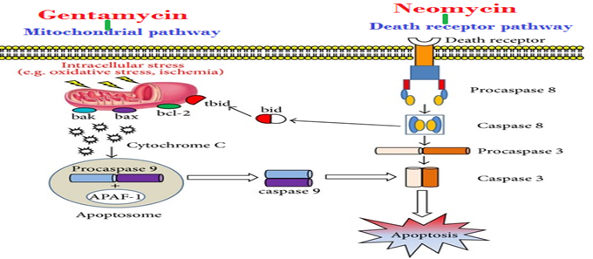
B- Mixed ototoxins → Affect balance & hearing
Altering Structure | Altering Function
Aminoglycoside antibiotics; - Gentamycin, - Neomycin, - Kanamycin, - Streptomycin. | - Quinine, chloroquine, quinidine → Anti-malarial drugs. - Nitrogen mustard → Anti-cancer drug. - Loop diuretics - NSAIDs - Tobacco
GentaMycin | - How functional derangement is induced by these drugs? ↓ Local blood flow → biochemical changes → ↓ electrochemical transduction → ↓ firing of impulse
Induce apoptosis by evoking free radicals → Mitochondrial Pathway.
NEomycin
Induce apoptosis by activating caspases → DEath Receptor Pathway. (protease enzymes)
we avoid aminoglycoside if there is an inner ear infection + vertigo

Slide 9
Questions
MCQs
1- Which of the following is most likely to induce parkinsonism-like extrapyramidal symptoms?
Hyoscine
Metoclopramide
Dimenhydrinate
Lorazepam
2- Which of the following agents decreases nausea and vomiting by blocking dopaminergic receptors in the chemoreceptor trigger zone (CTZ)?
Prochlorperazine
Lorazepam
Cinnarizine
Hyoscine
3- Which of the following is a selective Ca²⁺ channel blocker?
Cinnarizine
Dimenhydrinate
Gentamicin
Betahistine
4- Which of the following drugs is contraindicated in patients with glaucoma?
Clonazepam
Hyoscine
Cinnarizine
Dimenhydrinate
5- All of the following induce vertigo except?
Neomycin
Alcohol
Anticholinergics
Antidepressants
6- which of the following is contraindicated in parkinsonism?
Dimenhydrinate
Cinnarizine
Betahistine
Anticholinergics
7- which of the following is contraindicated in Pheochromocytoma
Betahistine
Hyoscine
benzodiazepines
metoclopramide

Slide 10
Questions
MCQs
8- One of the Best antiemetics in vertigo?
Betahistine
dimenhydrinate
metoclopramide
prochlorperazine
9- Meniere’s Disease caused by disorder of ?
outer ear
inner ear
tympanic cavity
tympanic membrane
10- patient came to the hospital with meniere’s disease, which one of the following drugs will be the drug of choice as prophylactic?
furosemide
cinnarizine
Dimenhydrinate
Betahistine
SAQ
1- What are the different pharmacological approaches in dealing with balance disorders? give an example for each.
Specific treatment for the underlying cause, e.g. Antibiotics. Symptomatic treatment to control the acute symptoms, e.g. Antiemetics. Prophylactic treatment to reduce the recurrence, e.g.: Corticosteroids.
2- drugs Used to control vomiting & nausea?
1- dimenhydrinate
2- prochlorperazine
3- metoclopramide
4- domperidone
3- list 3 of Cinnarizine ADRs?
1- Sweating
2- Muscle rigidity and tremor
3- Drowsiness
MCQs Answers:
1- B
2- A
3- A
4- D
5- C
6- B
7- A
8- D
9- B
10-B

Slide 11
Questions
Cases:
1- A patient complained of sweating and tremors after treatment for vertigo.
What is the drug he most likely used?
Cinnarizine
What is the mechanism of action?
Cinnarizine is a selective Ca²⁺ channel blocker, it inhibits K⁺currents. Inhibition of K⁺currents lessen the vertigo & motion-induced nausea by dampening the over-reactivity of the vestibular hair cells.
What are some other ADRs the drug might cause?
Drowsiness, headache , and muscle rigidity.
2- A 31 year old female had symptoms of meniere’s disease. after taking one tablet of the medication she developed hypersensitivity reaction and headache.
what is the drug she most likely used?
Betahistine
what is the mechanism of action?
- It is a structural analog of
histamine with:
1-Weak histamine H1 receptor agonist → By stimulating H₁ receptors located on BV in the inner ear→ local vasodilation and ↑ permeability → helps to reverse the underlying problem of endolymphatic hydrops. (accumulation of endolymph)
→ Reduce pressure in endolymph.
2-More potent histamine H3 receptor antagonist properties
→ By blocking H3 receptors in presynaptic nerve end → prevent reuptake of Histamine by H3 R → ↑ the local concentration of histamine in the inner ear
→ ↑ the direct H1-agonist activity.
- increases the level of serotonin in
the brainstem → ↓ the activity of vestibular nuclei.
other ADRs the drug might cause?
-GIT side effects.
-Nausea

Slide 12
Special thank for team 435
435 Team Members:

Slide 13
Team leaders:
Ghaida Saad Alsanad
Mohammed Aggeel Bahatheg
Team Members:
Alanoud Almansour
Aljoharah Alshunaifi
Ghada Almuhanna
Munira Alhadlg
Noura Alothaim
Rinad Alghoraiby
Rahaf Althnayan
Rotana Khateeb
Shahad Altayash
Abdullah Alomar
References:
- Doctors’ slides and notes.
- Pharmacology Team 435.
Special thank for team 435
@Pharma4370
Pharm437@gmail.com

