Slide 1
Drugs used for Parkinsonism
Objectives:
Recognize the symptoms and pathophysiology of parkinsonism.
Understand the pharmacology of drugs used for treatment of parkinsonism
Define pharmacokinetics, pharmacodynamics and side effects of different drugs used for the treatment of parkinsonism.
Editing File

Slide 2
To Understand better
Parkinson's Disease
A progressive neurodegenerative diseases disorder that occurs mainly in the elderly and can lead to disability unless effective treatment is provided.
Pathophysiology
This movement disorder occurs mainly due to dopamine/acetylcholine imbalance in basal ganglia (caudate nucleus, substantia nigra & corpus striatum) that is involved in motor control.
Dopamine pathway
Reward pathway | Motor pathway
DA is manufactured in nerve cell bodies located within the ventral tegmental area (VTA) and is released in the nucleus accumbens and the prefrontal cortex. | cell bodies in the substantia nigra that manufacture and release dopamine into the striatum.
In Parkinson’s disease
Predominance of Ach
Deficiency of dopamine
Parkinson's Disease
Character | Causes
Simplified by the acronym -TRAP- Tremors at rest. Rigidity of muscles. Akinesia or Bradykinesia (slowness in initiating and carrying out voluntary movements). Postural and gait abnormalities. Anxiety or depression. | It is an idiopathic disease but some causes may be: Genetic. Toxins (MPTP= methyl phenyl tetrahydropyridine). Head trauma. Cerebral anoxia. Oxidative stress Drug-induced Parkinson's disease e.g. antipsychotics like haloperidol. Dopamine antagonists as metoclopramide (antiemetic). i

Slide 3
Drug Treatment
Main approach
Minor approach
Muscarinic antagonists
e.g. benztropine, trihexyphenidyl
Drugs to increase dopaminergic activity.
Drugs to block cholinergic activity
Increase central DA synthesis
Inhibition of DA metabolism
DA receptor agonists
DA releaser: amantadine
(DA precursors):
L-dopa, L-dopa + Decarboxylase inhibitor.
- COMT inhibitors
(catechol-O-methyltransferase inhibitors)
-MAO-B inhibitors
Patients with Parkinson have deficiency of DA, to treat them we can’t give
only DA. Why? Dopamine is a polar can not cross the blood brain barrier →can not produce action.
Mild cases
Selegiline, Amantadine or Anticholinergics
Main treatment
Levodopa + Carbidopa
Adjuncts to Levodopa
All other medications
Drugs used in parkinsonism
Dopamine agonist → Bromocriptine
MAO-B inhibitors → Selegiline
Other useful drugs
Enhance dopamine release → Amantadine
It is a minor treatment, if he can not take dopamine → give him antimuscarinic drugs.
Like in patient with psychotic disease
Muscarinic receptor antagonist → Benztropine and trihexyphenidyl

Slide 4
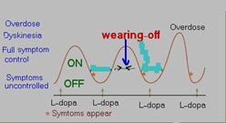
Drugs that increase dopaminergic activities (DA precursors)
 | Levodopa (L-dopa)
 | - It is a precursor of dopamine.L-dopa is a replacement therapy, it’s not prevent the progression of the disease - Is converted into dopamine via dopa decarboxylase (DC) peripherally and centrally. → Pathway of L-dopa - Dopamine formed peripherally is metabolized by MAO (monoamine oxidase) & COMT (catechol-o-methyltransferase enzymes). - 99% L-dopa is decarboxylated to give dopamine in gut and liver by decarboxylase enzyme to be only peripherally, make it polar enzyme . - 1% crosses BBB to form dopamine centrally. - Given orally (should be taken on empty stomach (especially proteins-). - Absorbed from the small intestine and taken up to CNS by active transport system. → So if we take a protein meal → uptake process done by competition process between the amino acids & L-dopa. - Short duration of action (t½ = 2 hs) → (fluctuation of plasma concentration).
 | Limitation of L-DOPA treatment: - Dyskinesia (involuntary movements occurs in 40 to 90% of patients) → due to fluctuating plasma levels of levodopa. (يعني تركيزه غير ثابت، يزيد وينقص) - The dyskinesia can be reduced by lowering the dosage; however, the symptoms of parkinsonism may then reappear. - Wearing-off effect (duration of “on” states becomes shorter) → - On-off phenomenon (On= improved mobility & Off=Akinesia or hypomobility) → bc of short T_{1\2} - Wearing off effect and on-off phenomena occur due to → progression of the disease and the loss of striatal dopamine nerve terminals.
Drug
Pharmacokinetics
معناها إن الأون إفكت حق الإل دوبا بدأ يقل
On: الدواء في therapeutic range
Off: الدواء قل تركيزه في الدم فقلت فعاليته؛ فتأثر المريض بالحركة. فلما يكون جالس ونقول له قم ما راح يقدر يقوم، ويبدأ يتلعثم في الكلام؛ كل هذا عشان تركيز الدواء قل وبالتالي قلت فعاليته في التحكم بالحركة.
Limitation
في المستطيل الأخضر، يعني إن الدواء في ال therapeutic range ويصير عندنا الon phenomenon
فوق المستطيل، بيصير تركيزه عالي في الدم، وتحت المستطيل يقل التركيز، ويصير عندنا الoff phenomenon
a body shamer say’s: leave = ! اتركوا الدبا dopa *Body shaming: the act of discriminating against other body types.

Slide 5
 | Levodopa (L-dopa) cont.
 | - Dopamine acts on dopaminergic receptors D1-D5 (G-protein linked receptors) - D1, D5 → Excitatory. - D2, D3, D4 → Inhibitory.
 | L-dopa is usually combined with carbidopa or benserazide (DC inhibitor). → Why? → because Carbidopa is a peripheral dopa decarboxylase inhibitor → prevent GIT & peripheral conversion of L-dopa to dopamine. → It acts only peripherally because it does not cross BBB → ↑ T1\2 => Why only peripherally? Because when it acts also centrally, we won’t take the benefit because L-dopa will not be degraded to produce dopamine. - Benefit of L-dopa + carbidopa combination: - Lowers the effective levodopa dose. - Increase availability of L-dopa to CNS. - Reduce side effects of L-dopa take L Dopa on empty stomach because if eaten with food may interfere with amino acid
 | - The most efficacious therapy. → 1st line treatment. - The best results of levodopa are obtained in the first few years of treatment. - L-dopa ameliorates all signs of parkinsonism particularly bradykinesia & rigidity but does not cure the disease. - Should not be used in parkinsonism associated with antipsychotic drug therapy.
 | - High proteins meals. (compensate on the same receptors ) - Pyridoxine (Vitamin B6). => ↓ effect of L-dopa due to ↑ peripheral metabolism by Vit.B6. - Non Selective MAO inhibitors (phenelzine). => Hypertensive crisis due to ↑ catecholamines => sever elevation of BP => Do not take MAOIs w\ any drug has catecholamine effects, because it will increase their level => hypersensitivity crisis. * tyramine has similar effect of MAO inhibitors.
 | Peripheral effects: - Anorexia, nausea, vomiting (due to stimulation of chemoreceptor trigger zone). → They are more common w\ combination of DC inhibitors. - Cardiac arrhythmias. → because of increased catecholamines peripherally. -Mydriasis → May occur and participate in acute glaucoma. - Orthostatic (postural) hypotension → w\ higher doses. - CNS effects: Mainly depression, delusions, confusion, insomnia, hallucinations.
 | - Patients with history of melanoma. Why? → L-dopa is a precursor of melanin → so it may activate malignant melanoma. - Psychotic patient. → bc it may exacerbate the mental disturbance. - Glaucoma (due to mydriatic effect).
Drug
P.D
prescription
Indications
Drug interaction
ADRs
C.I

Slide 6
Dopamine receptor agonists
Overview
Have longer duration of action than L-dopa (less likely to cause dyskinesias than levodopa)
Clinical use
As monotherapy, the dopamine agonists are less effective than levodopa. This can only be used as initial therapy for early stages of the disease. In advanced stages, dopamine agonists are used as an adjunct to levodopa, they may contribute to clinical improvement and reduce levodopa dosage needs. Lippincott: Dopamine agonists may delay the need to use levodopa therapy in early Parkinson disease and may decrease the dose of levodopa in advanced Parkinson disease.
Ergot derivatives: Bromocriptine, pergolide | Non ergot derivatives
Bromocriptine | Pramipexol
D2 agonist Is given orally T½ = 6-8 h. Longer than Levodopa (t½ =2 h) ButL-dopa more effective. Used for the treatment of: Parkinson’s disease Hyperprolactinemia (galactorrhea): a condition of elevated serum prolactin «هرمون الحليب», which induces infertility in women. Secretion of prolactin is under inhibitory control by dopamine. → كلما زاد البرولاكتين قل مستوى الدوبامين. Infertility in women. | D3 agonist Used alone as initial therapy or in combination with L-dopa. Is given orally, excreted unchanged in urine. Has the advantage of being free radicals scavenger.
Adverse effects
Similar to L-dopa: Nausea, vomiting, postural hypotension Cardiac arrhythmias Confusion, hallucinations, delusions Dyskinesias (less prominent).
Contraindications
Psychosis Peripheral vascular disease (only ergot derivatives, which cause severe vasoconstriction and may cause gangrene with high dosage) Recent myocardial infarction .

Slide 7
Amantadine
Characteristics
originally introduced as an antiviral. Action: -Increases dopamine release. → Also decrease the reuptake of DA. -Acts as an antagonist at muscarinic receptors -Antagonist at NMDA receptors (N-methyl-D-aspartate) (glutamate receptors) Administration: given orally with short half life. Excretion: most of the drug is excreted unchanged in the urine Efficacy: Less efficacious than L-dopa Tolerance develops to its therapeutic effect after 6-8 months. (tolerance is after 3-5 years for levodopa) Its benefits last only for short period and only used for L-dopa resistance (which is caused by variation in response among patients) Amantadine and the anticholinergics may exert additive effects on mental functioning. (A muscarinic receptor antagonist effect) Useful in the early stages of parkinsonism or as an adjunct to levodopa therapy. only when L-dopa not working
Adverse effects
Nausea, anxiety, insomnia, confusion, hallucinations (dopamine like side effects). Dry mouth, urinary retention (anticholinergic effects). Restlessness and hallucinations (NMDA antagonist). → NMDA is a type of glutamate receptors & glutamate is an excitatory neurotransmitter, antagonizing it will thus cause restlessness and hallucinations. Ankle edema, and livedo reticularis.
COMT Inhibitors (Catechol-O-methyltransferase) Inhibitors
 | Entacapone | Tolcapone
 | - Acts peripherally to inhibit COMT enzyme required for L-dopa degradation. - Usually given in combination with L-dopa and carbidopa to diminishes peripheral metabolism of L-dopa. | - Peripheral and central COMT inhibitor → More lipid soluble than entacapone. - More penetration into CNS. - Tole = Total = Central & peripheral
 | Used as adjuvant to L-dopa + carbidopa to: Decrease fluctuations Improve response Prolonged the ON-Time → يحسن حالة المريض لأن الدوبامين جالس وقت أكثر
 | - L-dopa side effects. - Orange discoloration of urine. | ---
COMT Inhibitors (Catechol-O-methyltransferase) Inhibitors
 | Entacapone | Tolcapone
 | - Acts peripherally to inhibit COMT enzyme required for L-dopa degradation. - Usually given in combination with L-dopa and carbidopa to diminishes peripheral metabolism of L-dopa. | - Peripheral and central COMT inhibitor → More lipid soluble than entacapone. - More penetration into CNS. - Tole = Total = Central & peripheral
 | Used as adjuvant to L-dopa + carbidopa to: Decrease fluctuations Improve response Prolonged the ON-Time → يحسن حالة المريض لأن الدوبامين جالس وقت أكثر
 | - L-dopa side effects. - Orange discoloration of urine. | ---
Drug
Drug
M.O.A
M.O.A
Indications
Indications
ADRs
ADRs

Slide 8
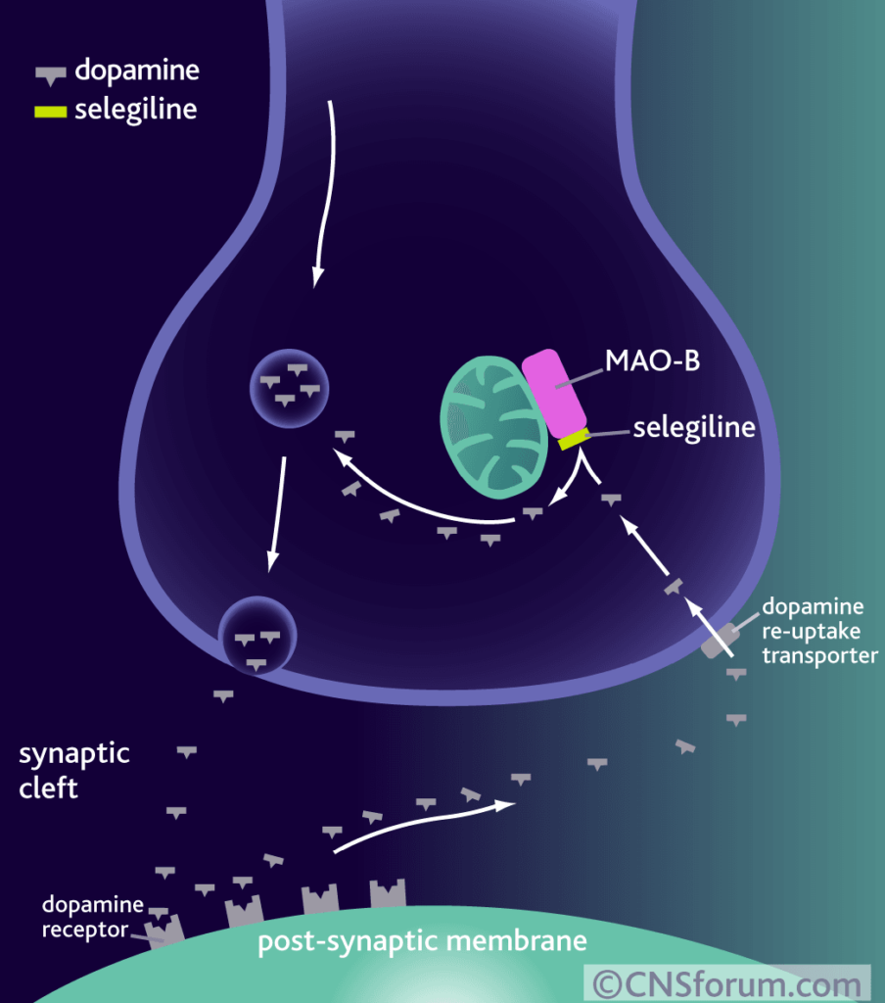
Monoamine oxidase-B (MAO-B) inhibitors
 | Selegiline
 | It is a selective irreversible inhibitor of MAO-B, an important enzyme for dopamine metabolism. * MAO-A → metabolize NE, 5-HT, DA The blockade of dopamine metabolism makes more dopamine available for stimulation of its receptors.
 | Selegiline may have neuroprotective effect due to: - Antioxidant activity against toxic free radicals produced during dopamine metabolism. - Metabolized to desmethyl selegiline, which is anti-apoptotic.
 | Adjunctive to levodopa/carbidopa in later-stage parkinsonism to: - Reduce the required dose of levodopa - Delay the onset of dyskinesia and motor fluctuations that usually accompany long-term treatment with levodopa.
 | At high doses: It may inhibit MAO-A → (hypertensive crises) → as a result, do not prescribe selegiline w\ drugs that increase the level of catecholamines and lead to hypertensive May cause insomnia when taking later during the day.
 | Should NOT be co-administered with: - Tricyclic Antidepressants - Selective serotonin reuptake inhibitors (this causes hyperpyrexia, agitation, delirium, coma.) → Serotonin toxicity. - Food restriction “low tyramine diet” is required. → increase release of E & NE → sever elevation in BP (cheese effect)
Drug
M.O.A
P.K
Indications
ADRs
C.I

Slide 9
Anticholinergic Drugs
 | Benztropine | Trihexyphenidyl
 | - Central muscarinic antagonist. - It has modest anti-parkinsonian action.
 | Improve tremor & rigidity. (but have little effect on bradykinesia. Provide benefit in drug-induced parkinsonism (due to antipsychotics). Used during early stage of the disease Used as an adjunct to levodopa therapy.
 | Cycloplegia Mydriasis Dry mouth Urinary retention Constipation At high doses: Confusion, Delirium & Hallucinations.
 | Prostatic hypertrophy Glaucoma Intestinal obstruction.
Drug
M.O.A
Indications
ADRs
C.I

Slide 10
Questions
MCQs
What is the most efficacious Drug in treatment of Parkinson’s?
Selegiline
Benztropine
Levodopa
Pramipexole
2. A patient with glaucoma developed Parkinson’s, which Drug should not be prescribed?
Levodopa
Entacapone
Pergolide
Pramipexole
3. Which of the following can be prescribed with the drug of choice to decrease dyskinesia?
Benztropine
Trihexyphenidyl
Tolcapone
Bromocriptine
4. A patient with advanced Parkinson’s needs an adjuvant drug added to her treatment. She has Raynaud’s disease. Which of the following should be prescribed?
Pramipexole
Bromocriptine
Pergolide
Amantadine
C
A
D
D

Slide 11
Questions
MCQs
5. A patient with advanced Parkinson’s was prescribed an adjunct to his therapy. He later developed livedo reticularis. Which of the following was he prescribed?
Pergolide
Amantadine
Pramipexole
Bromocriptine
6. Which of the following is a Peripheral side effect to L-dopa?
Anorexia
Delusions
Insomnia
Erectile dysfunction
7. Which of the following can cause hypertensive crisis in high doses?
Amantadine
Bromocriptine
Selegiline
Pergolide
8. Which of the following can be used with antipsychotics?
Levodopa
Carbidopa
Entacapone
Benztropine
B
A
C
D

Slide 12
Questions
SAQ
What features of Selegiline give it a neuroprotective effect?
Antioxidant activity against toxic free radicals produced during dopamine metabolism.
Selegiline is metabolized to desmethylselegiline, which is antiapoptotic.
Describe the action of L-dopa:
It is a precursor of dopamine (converted into dopamine peripherally and centrally) by the action of an enzyme called dopa decarboxylase (DC). 99% is metabolized peripherally by MAO and COMT and only 1% crosses the BBB.

Slide 13
Team leaders:
Ghaida Saad Alsanad
Omar Alsuhaibani
Team Members:
Sarah Alkathiri
Adel Alsuhaibani
Sultan Alnasser
Saif Almeshari
Abdullah Balubaid
References:
- Doctors’ slides and notes.
- pharmacology Team 435.
Special thank for team 435
@Pharma4370
Pharm437@gmail.com

