Slide 1
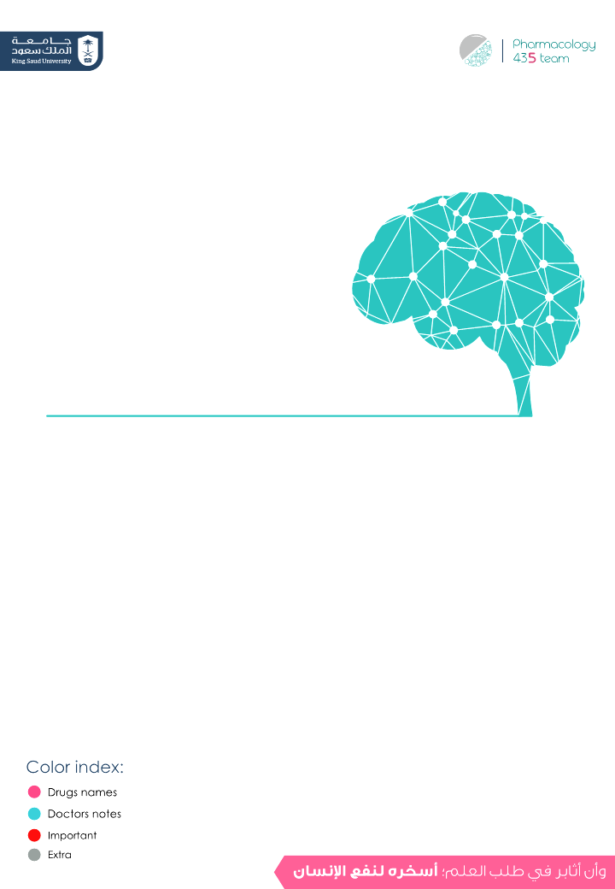
Drugs used in Meningitis
Objectives:
Describe briefly common types of meningitis.
Describe the principles of treatment.
List the name of antibiotics used for treatment of
meningitis.
Describe the mechanism of action & adverse effects of the individual drugs.
Editing File
‹#›

Slide 2
Meningitis
Definition:
Meningitis is an inflammation of the protective membranes
covering the brain and the spinal cord (meninges).
Causes:
1- Infectious
2- Non-infectious
Viruses no need for treatment
Bacteria (most important)
Fungal
spread of cancer to meninges
(malignant meningitis)
Inflammatory disease (SLE)
Trauma to head or spine
Bacterial meningitis:
- Is a serious , life threatening disease. because it's very close to body
- May lead to serious serious consequences without treatment (e.g. deafness, limb loss, epilepsy,paralysis,hydrocephalus & cognitive deficits ,stroke,seizures sepsis and even death,).
CAUSES OF BACTERIAL MENINGITIS:
- Streptococcus pneumoniae. (Pneumococcal)* 41% of cases
- Neisseria meningitides. (Meningococcal)* 18-20% of cases
- Haemophilus influenzae also
called (HiB)
* Most common cause
- Staphylococcus aureus.
- Pseudomonas aeruginosae
- Listeria monocytogenes.
- Mycobacterium Tuberculosis
→ (tuberculous meningitis)
Route of transmission:
- Most bacteria that cause this form of infection are spread through close personal contact, such as: coughing , sneezing & kissing,
- The pathogens spread from the respiratory tract to the
bloodstream (septicemia)and to the nervous system and cause
bacterial meningitis.

Slide 3
Symptoms of bacterial meningitis:
- High fever* - Acute onset of severe headache*
- Stiff neck* - Irritability
- Seizures - Vomiting
-photophobia sensitivity to - confusion
bright light. - nausea
-rash of purple discoloration
*Meningitis triad
TREATMENT PRINCIPLES:
Emergency hospitalization
Antibiotics
-Antibiotic selected must penetrate adequately into the CSF.
- low molecular weight & high lipid solubility are some of the
characteristics for drug that cross the BBB
- inflammation increase the penetration of medication
( lipid even polar drugs).
- Regimen chosen must have potent activity against known or
suspected pathogens & exert a bactericidal effect. (Empiric)
Measures for treatment of complications
-(symptomatic treatment)
Because meningitis can be deadly we start empiric therapy (Treatment without exact diagnosis) Immediately. antibiotics are given to a person before the specific microorganism causing an infection is known.
Empiric therapy may be changed after the culture sensitivity reports are available. Antibiotic selected must reach the meninges in a adequate quantities.
ليه نعطيه الempiric therapy وإحنا ما نعرف إيش الأورقانزم اللي سبب له المننجايتس؟
لأن هذي الحالة ممكن تكون مميتة لو ما لحقت على المريض، وعلى ما تطلع النتايج حقت الأورقانزم بتأخذ لها وقت ممكن المريض في هذا الوقت تسوء حالته وممكن يموت! لذلك لازم تلحق على مريضك، وتعطي أنتي بيوتك عنده wide spectrum عشان يغطي أغلب الأورقانزمز اللي منتشرة وغالبًا تسبب المننجايتس.
Signs and Symptoms of Meningitis

Slide 4
ANTIBIOTICS FOR TREATMENT OF BACTERIAL MENINGITIS:
Inhibitors of cell wall synthesis (Β-LACTAMS):
Penicillins.
Carbapenems.
Cephalosporins.
Prevention better than cure:
A) Haemophilus influenzae type B (Hib) bacterium,
a leading cause of bacterial meningitis in children.
So there is a New Hib vaccines — available as part of the routine childhood immunization schedule have greatly reduced cases of this type of meningitis.
B) Pneumococcal polysaccharide vaccine (PPSV) for older children and adults (protects against meningitis caused by S.pneumoniae)
C) Meningococcal conjugate vaccine ,people going to Hajj. (protects against meningitis caused by N. meningitidis)
Bacterial Meningitis Treatment & Prevention, 10:53 min

Slide 5
PENICILLINS
 | Penicillin G (benzylpenicillin) | Aminopenicillins
 |  | Amoxicillin | Ampicillin
 | Inhibit bacterial cell wall synthesis by inhibiting the peptidoglycan layer of bacterial cell wall (bactericidal). peptidoglycan inhibition → transpeptidase inhibition → drug is able to cross the BBB
 | Narrow → (not used as empiric) → These have greatest activity against gram-positive organisms, gram-negative cocci, and non- β-lactamase producing anaerobes - Click here to know the therapeutic applications. | Extended or wide (against gram +ve and –ve)
 | - Poor oral absorption → It destroyed by gastric acidity. - Short acting (4-6 hrs) - Half- life 30-60 min. - Given IV infusion. - β- lactamase sensitive (penicillinase sensitive) penicillin get destroyed the penicillinase which is produced by some organisms= they are susceptible to hydrolysis by β-lactamases | - They are acid stable (effective orally) in meningitis only pairenternally - Route of administration: I.V or I.M - Amoxicillin is better absorbed from the gut and not affected by food. However ampicillin is affected by food - Not active against pseudomonas aeruginosa.
 | --- | - Inactivated by β-lactamase enzyme. (now a days combination with B-lactamase inhibitors are available e.g. 1- Amoxicillin + Clavulanic acid = Augmentin given orally 2- Ampicillin + sulbactam = Unasyn. given IV - This combination is intended to: - Prevent enzymatic hydrolysis by β-lactamase. - Extend antimicrobial activity.
 | - Hypersensitivity (anaphylactic reaction) → make sure that patient doesn’t have allergy from the beta-lactam antibiotics before giving him the treatment.might be mild such as skin rash or severe anaphylactic reaction. must do skin test - Antibiotic-associated diarrhea (only if taken orally) → the normal flora died → Super infection mainly by clostridium difficile in colon. - Nephritis (with high doses (very rare)). → All penicillins are excreted by kidney - Super-infections or secondary infections (candidiasis, oral thrush) → normal flora died because the use of broad spectrum antibiotic - High dose in renal failure (seizure). → if there is high toxicity caused by renal failure → may cause seizure.
Drug
M.O.A
Spectrum
P.K
β-lactamase
ADRs

Slide 6
Cephalosporins (3rd generation)
 | Ceftriaxone , Ceftazidime & Cefotaxime
 | - Inhibit bacterial cell wall synthesis (bactericidal).
 | - Both of them are given by intravenous infusion.
 | - Highly effective against Gm –ve bacilli. - Anaerobic microbes. - Ceftazidime → against P. aeruginosa. - used for treatment of bacterial meningitis caused by pneumococci, meningococci, H.influenzae - Highly resistant to β- lactamases.→
 | 1- Allergy→ patients allergic to penicillins may be allergic to cephalosporins due to cross-reactivity (sensitivity) between penicillin and cephalosporins. 2- Thrombophlebitis (at site of injection). 3- Renal toxicity. 4- Super-infections. 5- GIT upset & diarrhea. → bc of broad spectrum
Drug
MOA
P.K
Bacterial Spectrum
عشان كذا هو ما يحتاج نعطي
معه بيتالاكتاميز انهبتور
ADRs
Carbapenems
 | Imipenem
 | - Inhibits bacterial cell wall synthesis (bactericidal).
 | - Not absorbed orally, taken by I.V. - Inactivated by dehydropeptidases in renal tubules to a nephrotoxic metabolites, so it is given with a dehydropeptidase inhibitor cilastatin for clinical use. → it is given by combination of imipenem + cilastatin. - Penetrates body tissues and fluids including CSF. (large volume of distribution) - Excreted primarily by the kidney. -Doses must be reduced in renal failure. -Half- life about 1 hr.
 | - Has a wide spectrum of activity (aerobic & anaerobic GM +ve & GM -ve bacteria, including pseudomonads). - Resistant to most β lactamases.
 | - Nausea, vomiting, diarrhea. (GIT upset) - Skin rash and reaction at the site of infusion. → bc they are beta-lactam. - High doses may cause seizure in patients with renal failure (important and common adverse effect). - Patients allergic to penicillins may be allergic to carbapenems due to cross-reactivity (sensitivity) between penicillin and carbapenems.
Drug
reserved for resistant cases and patients not responding to 3rd gen. cephalosporins
MOA
P.K
Bacterial
Spectrum
ADRs

Slide 7
Other inhibitor of cell wall synthesis
 | Vancomycin
 | It is active only against gram positive bacteria. (narrow spectrum) → can not be administered alone especially as an empiric therapy.
 | Cell wall inhibitor (bactericidal)
 | - Poorly absorbed orally. - Used orally to treat GIT infections caused by clostridium difficile e.g. pseudomembranous colitis. The only oral use for it - Given intravenously for the treatment of meningitis.
 | - Used when the patient is allergic to penicillins. - Used against Methicillin resistant S. aureus (MRSA).
 | 1- Phlebitis at site of injection. 2- Ototoxicity → rare, but the administration with another ototoxic or nephrotoxic drug, such as an aminoglycoside, increases the risk of these toxicities. 3- Histamine release (flushing of upper body) → red man (red neck) syndrome → not IgA mediated reaction. → you might administered antihistamine to prevent histamine effects such as diphenhydramine. 4- Nephrotoxicity 5- hypotension (minimized if injected slowly over 60 minutes).
 | Used in combination with 3rd generation cephalosporins for treatment of meningitis caused by penicillin resistant pneumococci.
 | May be combined with ampicillin or ceftazidime as an initial (empiric) therapy of meningitis in infant, elderly and immunocompromised patients.
Drug
Spectrum
MOA
P.K
Indications
ADRs
COMBINATION

Slide 8
Aminoglycosides (Gentamicin)
Mechanism of action:
Inhibit protein synthesis (30s subunit).
Bactericidal Bactericidal ( exclusive for aerobic G-bacteria )
Not absorbed orally
Given by injection i.v.
ADRs:
Ototoxicity*
Nephrotoxicity*
Neuromuscular blockade (very high dose)
*As vancomycin
- most antibiotic drugs that inhibit protein synthesis are bacteriostatic except aminoglycosides as their effect is dose dependent i.e.at a high dose they’re bactericidal but at a low dose they’re are bacteriostatic.
-contraindicated in:
1- combination with skeletal muscle relaxants
2- patients with myasthenia gravis
directly related to serum cons.
PREVENTION BETTER THAN CURE
Just read it!
Not important!!
Haemophilus influenzae type b (Hib) bacterium, is a leading cause of bacterial meningitis in children. Hib vaccines available as part of the routine childhood immunization schedule have greatly reduced cases of this type of meningitis.
Pneumococcal polysaccharide vaccine (PPSV) for older children and adults(protects against meningitis caused by S.pneumonia)
Meningococcal conjugate vaccine, used for people going to Hajj(protects against meningitis caused by N. meningitides)

Slide 9
Summary
 | Types | M.O.A | P.K | B-lactamase |  | S.E
 | Narrow spectrum: Penicillin G | Bactericidal Inhibit bacteria cell wall synthesis by inhibiting the peptidoglycan layer. | Poor oral absorption Given IV Against gram + | B-lactamase sensitive |  | Hypersensitivity (Anaphylactic reaction). Antibiotic associated diarrhea. Super-infection or secondary infection. Nephritis. Seizure in high does with renal failure. #in renal failure
 | Extended spectrum: (aminopenicillin): Amoxicillin – Ampicillin |  | Not active against pseudomonas areginosa Acid stable(given orally-IV-IM) Amoxicillin: not affected by food | B-lactamase sensitive Given by combination with B-lactamase inhibitors: -Amoxicillin+clavulanic acid -Ampicillin+sulbactum
 | Cefotaxime |  | Given IV Effective against gram - Used to treat meningitis caused by gram- Like:H.Influenzas & peneumococci | Resistant to B-lactamase |  | Allergy (cross sensitivity) Thrombophlebitis Renal toxicity Super-infection #in renal failure
 | Ceftriaxone
 | Ceftazidime (highly Effective against pseudomonas aeruginosa)
 | Imipenem |  | Wide spectrum of activity including pseudomonas aeruginosa. Given IV. Dose must be reduced in renal failure. |  |  | Seizure in high does with renal failure Allergy (cross sensitivity) #in renal failure
Vancomycin |  |  | Given IV in case of meningitis . Orally in case of GIT infection by clostridium difficile. Against gram + Against Methicillin resistant S.Aureus (MRSA). |  |  | Ototoxicity. Nephrotoxicity. Red man syndrome due to histamine release. Hypotension.
 | Gentamicin | Bactericidal Inhibit protein synthesis (30s subunit) | Not absorbed orally Given IV |  |  | Ototoxicity Nephrotoxicity Neuromuscular blockade C.I in patient with myasthenia gravis and with muscle relaxant
Penicillin
Cephalosporins
Bactericidal
Inhibit bacteria cell wall synthesis
Imipenem used in combination with cilastatin which is dehydropeptidase inhibitor to prevent accumulation of nephrotoxic metabolites
Carbapenems
Aminoglycoside

Slide 10
Questions
MCQs
1-which of the following is the drug of choice in cases of meningitis by pseudomonas aeruginosa ?
a- Penicillin G.
b-Ceftriaxone.
c- Amoxicillin + Clavulanic Acid.
d- Ceftazidime.
2-Salah was commenced on antibiotics but developed thrombophlebitis at the site of injection. which of the following is the most likely antibiotic to have caused this ?
a- Ceftriaxone
b - Ampicillin + Sulbactam
c- Gentamicin.
d- Penicillin G.
3-all of the following drugs are resistant to B lactamase except for :
a- Ceftriaxone.
b- Imipenem.
c- Ceftazidime.
d- Amoxicillin.
4- what is the mechanism of action of Cilastatin ?
a- B lactamase inhibitor.
b- inhibition of cell wall synthesis by inhibiting peptidoglycan layer.
c- decarboxylase enzyme inhibitor.
d- dehydropeptidase enzyme inhibitor.
5- Vancomycin taken orally can be used for the treatment of ?
a- meningitis.
b- sinusitis.
c- pseudomembranous colitis.
d- otitis media.

Slide 11
Questions
MCQs
6- which of the following drugs can be used in cases of Methicillin Resistant Staph Aureus infections ?
a- Ceftriaxone.
b- Imipenem
c-Vancomycin
d- gentamicin .
7- which of the following is the most common side effect of Vancomycin :
a- Red man syndrome.
b- seizures.
c- super-infections,
d- skin rash.
8- which of the following drugs is contraindicated in cases of Myasthenia gravis ?
a- Vancomycin.
b- Ceftriaxone.
c- Penicillin G.
d- Gentamicin.
MCQs answers:
1- d
2- a
3- d
4- d
5- c
6- c
7- a
8- d

Slide 12
Questions
SAQ
Ahmad , an 8 year old boy , was suffering from a high fever and neck stiffness . When he woke up in the morning he also had a sudden headache and he was abnormally sensitive to bright light. He went to the emergency room and he was diagnosed with bacterial meningitis.
what is the management approach in a case of bacterial meningitis?
1- emergency hospitalization.
2- I.V antibiotics ( start with empiric treatment )
3- Measures for treatment of complications of meningitis.
what are the different classes of antibiotics used in cases of meningitis?
In meningitis , bactericidal antibiotics must be used which are inhibitors of cell wall synthesis ( B lactams).
1- Penicillins.
2- Carbapenems.
3-Cephalosporins.
Ahmad was given Amoxicillin + clavulanic acid. describe this drug’s mechanism of action.
Mechanism of action : Inhibition of cell wall synthesis by inhibiting the peptidoglycan layer of the bacterial cell wall.
what is the reason behind the combination of clavulanic acid with Amoxicillin ?
Amoxicillin is B-Lactamase sensitive. it is combined with clavulanic acid ( B -Lactamase inhibitor) to :
1- prevent enzymatic hydrolysis by B-Lactamase.
2- Extend the antimicrobial activity.
give three side effects of this drug.
1- Hypersensitivity reaction.
2- super- infections ( candidiasis , oral thrush)
3-seizures if a high dose is given to a patient with renal failure.

Slide 13
Team leaders:
Ghaida Saad Alsanad
Omar Alsuhaibani
Team Members:
Sarah Alkathiri
Shahad Altayash
Alanoud Almansour
Rahaf Althnayan
Sara Alsultan
Munira Al-Hadlg
Noura Alothaim
Ghada Almuhanna
Adel Alsuhaibani
Sultan alnasser
References:
- Doctors’ slides and notes.
- Pharmacology Team 435.
Special thank for team 435
@Pharma4370
Pharm437@gmail.com

