Slide 1
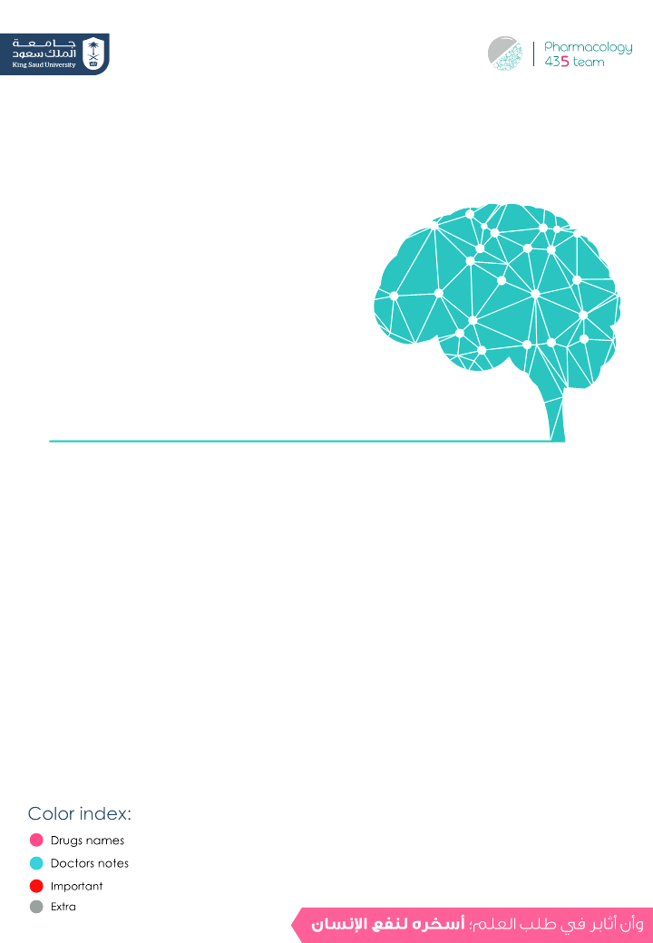
Drugs used in anxiety and panic disorders
Objectives:
Define different types of anxiety disorders.
Classify types of drugs used for treatment of anxiety.
Recognize the pharmacokinetics & pharmacodynamics
of different classes of anti-anxiety drugs.
Identify the specific clinical applications of each class of
anti-anxiety drugs.
Know side effects of different classes of anti-anxiety drugs.
Discuss the different characteristics of antianxiety drugs.

Slide 2
Introduction
Anxiety
Physical and emotional distress which interferes with normal life.
Emotional or psychological symptom
Physical or somatic symptoms
- Feeling tense
- Trouble concentrating
-Irrational (without reason) and excessive fear and worry
- Irritability
-Restlessness
Sympathetic symptoms:
- Sweating
- Tachycardia
- Shortness of breath
- Stomach upset
- Frequent urination or
diarrhea
- Sleep disturbances
(Insomnia)
- Fatigue
Types of anxiety
Post-traumatic stress disorder (PTSD) | Generalized anxiety disorder (GAD)
An anxiety disorder that affects people who have experienced a severe emotional trauma, such as rape or dramatic car accident, or even war. | Patients are usually and constantly worried about everything, health, money, work with no apparent reason.
Obsessive-compulsive disorder (OCD) | Phobias
An anxiety disorder in which people cannot prevent themselves from unwanted thoughts or behaviors that seem impossible to stop e.g. washing their hands | An intense, uncontrolled fear of a specific situation such as open spaces & heights
 | Panic disorder
 | Sudden, intense and acute attacks of anxiety in certain situations. Panic attacks cannot be predicted.
‹#›

Slide 3
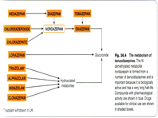
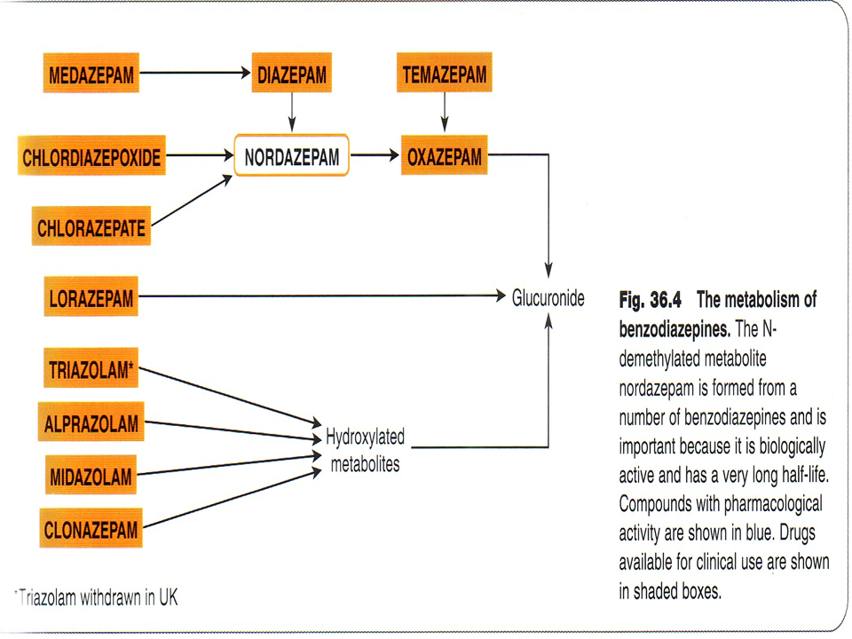
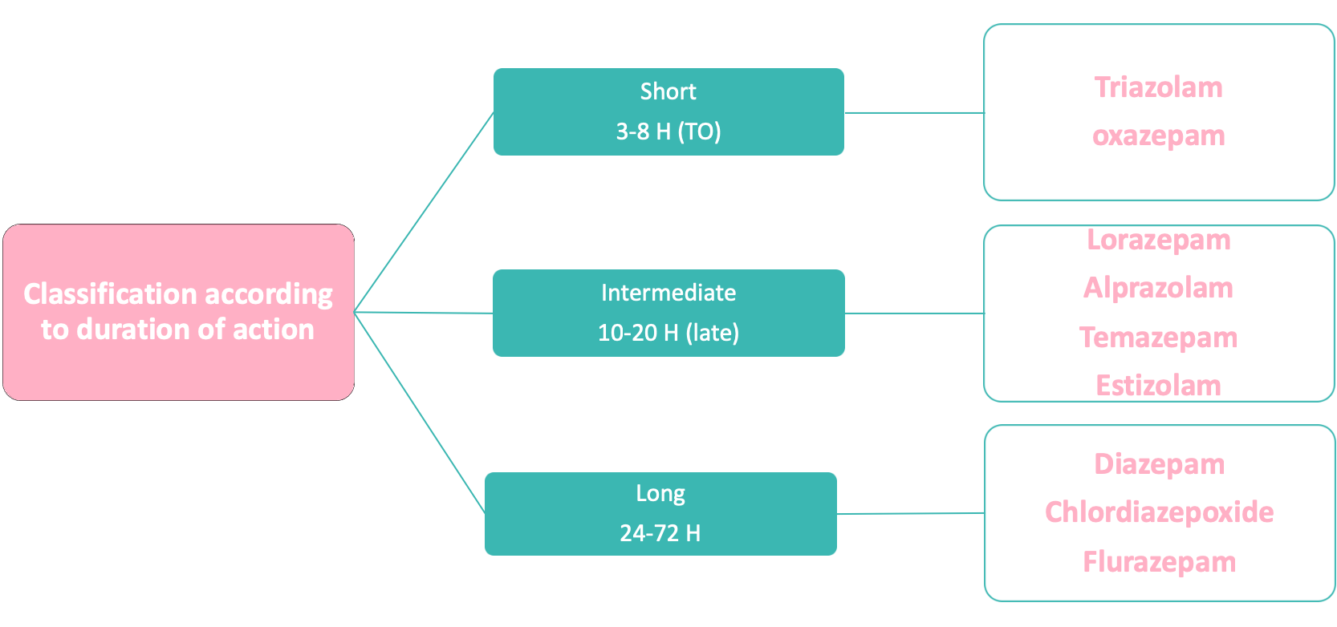
Overview of anxiety treatment
4:05 min
Benzodiazepines
suffix “zolam” or “zepam”
MOA
1-binding to BZ receptors in the brain enhance GABA action on the brain
GABA (γ-aminobutyric acid):is an inhibitory neurotransmitter
2- chloride channels opening → chloride influx to the cell
3-hyperpolarization → more difficult to depolarize →reduction of neural excitability.
 | are lipid soluble , widely distributed. cross placental barrier (Fetal depression). excreted in milk (neonatal depression). well absorbed orally , Chlordiazepoxide- Diazepam(IV only NOT IM) metabolized in the liver to active metabolites (long duration of action- cumulative effect) and excreted in urine.
P.K
3
Notes:
‹#›

Slide 4
Benzodiazepines
 | Depression of cognitive and psychomotor function skeletal muscle relaxing effect (diazepam) → by increasing presynaptic inhibition in the spinal cord anticonvulsant effect e.g. clonazepam, diazepam, lorazepam. Therapeutic doses have minimal depressant effects on: cardiovascular & respiratory systems | CNS depressants: - Anxiolytic action. - Sedation , Hypnotic action. = sleeping pills -Anterograde amnesia.→ temporary impairment of memory
 | Anxiety disorders: Short term relief of severe anxiety, General anxiety disorder, OCD, Panic disorder with depression Alprazolam (antidepressant effect) Benzodiazepines are fast acting typically bringing relief within (30mins – hour). Sleep disorders (Insomnia): Triazolam, Lorazepam, Flurazepam. → They tend to decrease the latency to sleep onset and increase Stage II of NREM sleep. Treatment of epilepsy: Diazepam – Lorazepam. In anesthesia: Pre-anesthetic medication (diazepam). Induction of anesthesia (Midazolam, IV) Alcohol withdrawal syndrome: (diazepam)
 | Psychological & physical dependence with continuous use. withdrawal symptoms:(insomnia, anorexia, anxiety, agitation,tremors,convulsion). Respiratory & cardiovascular depression in large doses only (toxic effects). cognitive impairment ataxia (motor incoordination) → impairment of driving ability anterograde amnesia hangover:(excess sedation , drowsiness , confusion) tolerance
Precautions
Pregnant women or breast-feeding. Dose reduction is recommended in Liver disease & old people
actions
Therapeutic uses
ADRs
Drug-Drug interaction
CNS depressants e.g. alcohol & antihistamine (1st generation) | increase effect of benzodiazepines (Additive effect)
Cytochrome P450 inhibitors e.g. cimetidine & erythromycin | increase t_{1/2} of benzodiazepines
CYT P450 inducers phenytoin & rifampicin | decreased t_{1/2} of benzodiazepines (all epileptic drugs are inducers)
flumazenil
M.O.A | - Selective, benzodiazepine receptor antagonist. bind compatitivly to GABA recptors replacing BDZ
P.K | - Injection (IV only) - Short plasma half life so repeated dosing is required.
- Benzodiazepines overdose (antidote) - Can precipitate withdrawal symptoms in benzodiazepines addicts
Notes:
‹#›

Slide 5
5HT-1A agonist Buspirone
M.O.A | acts as a partial agonist at 5HT-1A receptors pre-synapticaly inhibiting 5HT release -Adaptive changes after chronic treatment , reduction in 5HT2 receptors in cortex -Weak dopapamineD2 action , but not antipsychotic
P.K | rapidly absorbed orally slow onset of action (delayed effect) - T1/2 :(2-4)H undergoes extensive hepatic metabolism , it’s clearance is reduced by liver dysfunction
actions | Only anxiolytic No hypnotic effect. No muscle relaxant effect. No anticonvulsant action. No alcohol additive effect. it doesn’t impair memory and coordination. -Does not affect driving skills.
indications | - As anxiolytic in generalized anxiety disorders.
disadvan- tage / ADRs | Slow onset of action (delayed effect) GIT upset, dizziness, drowsiness Not effective in severe anxiety/panic disorders Drug interactions with CYT P450 inducers and inhibitors
drug interactions | - CYP450 3A4 Inhibitors (verapamil, diltiazem) → ↑ buspirone level - CYP450 3A4 Inducers (Rifampin) → 10 folds ↓ buspirone level. - MAOIs → increase BP.
precautions | - Pregnant women or breast-feeding. - Old people (>65) - Dose reduction is recommended in liver disease, old
-Minimal risk of dependence.
-No withdrawal symptoms
-No potentiation of other CNS depressants
-Minimal psychomotor & cognitive dysfunctions
selective sertonin reuptake inhiptors (SSRIs) Fluoxetine
M.O.A | acts by blocking uptake of 5-HT
P.K | -given orally -long half life
uses | Considered the first line of treatment for most anxiety disorders (panic disorder, OCD, GAD, PTSD, phobia), → because they are well tolerated, have low risk for dependency and abuse and low potential for overdose.
ADRs | 1- Delayed onset of action (weeks). 2- Nausea, diarrhea → GIT upset 3- SSRIs may cause weight gain or loss. 4- Sexual dysfunction
5- Dry mouth
6- Sleep disturbance or insomnia
7- Seizures

Slide 6
tricyclic antideprresant Doxepin - Imipramine - Desipramine
M.O.A | Act by reducing uptake of 5HT & NA
O.O.A | Delayed onset of action (weeks).
uses | 1- Used for anxiety especially associated with depression 2- Effective for panic attacks.
ADRs | Atropine like actions (dry mouth-blurred vision, tachycardia, urinary retention). α-blocking activity (Postural hypotension). Sexual dysfunction. Weight gain.
beta blockers Propranolol – atenolol
M.O.A | Act by blocking peripheral sympathetic system. → Reduce somatic symptoms of anxiety. Decrease BP & slow heart rate.
uses | - Used in performance or social anxiety. - Are less effective for other forms of anxiety.
ADRs | - Should be used with caution in asthma, cardiac failure, peripheral vascular disorders. → because of beta2 effect
Monoamine oxidase inhibitors (MAOIs) Phenelzine
M.O.A | Acts by blocking the action of MAO enzymes
P.K | Require dietary restriction avoid wine, beer, fermented foods and old cheese that contain tyramine.
uses | Used for panic attacks and phobia
ADRs | Dry mouth, constipation, diarrhea, restlessness, dizziness.

Slide 7
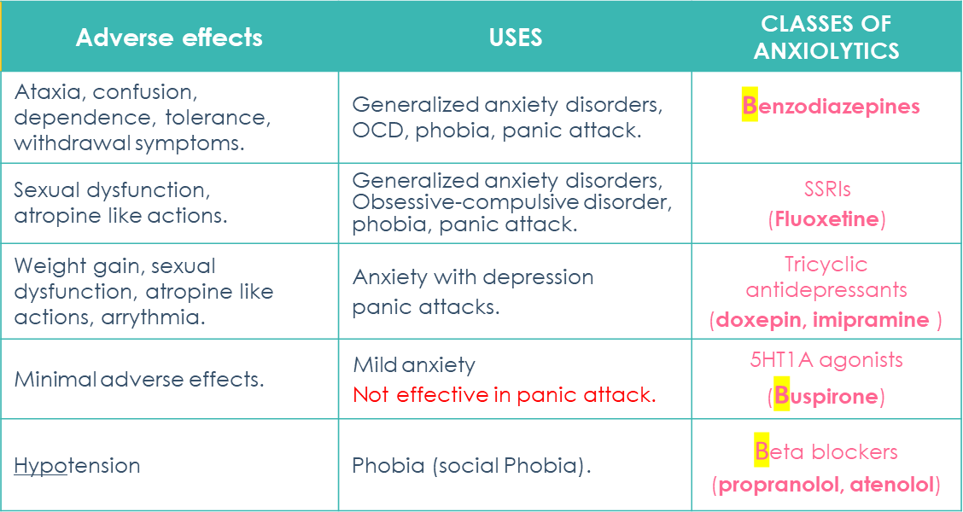
summary & Q
MCQs
1)Which one of the following drug cause muscle relaxant ?
A-Triazolam
B-Lorazepam
C-Diazepam
D-Alprazolam
2)Which one of the following drugs is used in performance and social anxiety?
A-lorazepam
B-fluoxetine
C-imipramine
D-propranolol
3)Which one of the following is considered the 1st line of treatment in most anxiety disorders ?
A-triazolam
B-atenolol
C-fluoxetine
D-buspirone
4)Which one of the following is used as an antidote to benzodiazepines overdose ?
A-flumazenil
B-atenolol
C-fluoxetine
D-buspirone
1-C
2-D
3-C
4-A
Notes:
‹#›

Slide 8
Team leaders:
Ghaida Saad Alsanad
Omar Alsuhaibani
Team Members:
Mohammed Alswoaiegh
Big thanks to Alanoud Almufarrej
References:
- Doctors’ slides and notes.
- pharmacology Team 435.
Special thank for team 435
@Pharma4370
Pharm437@gmail.com

