Slide 1
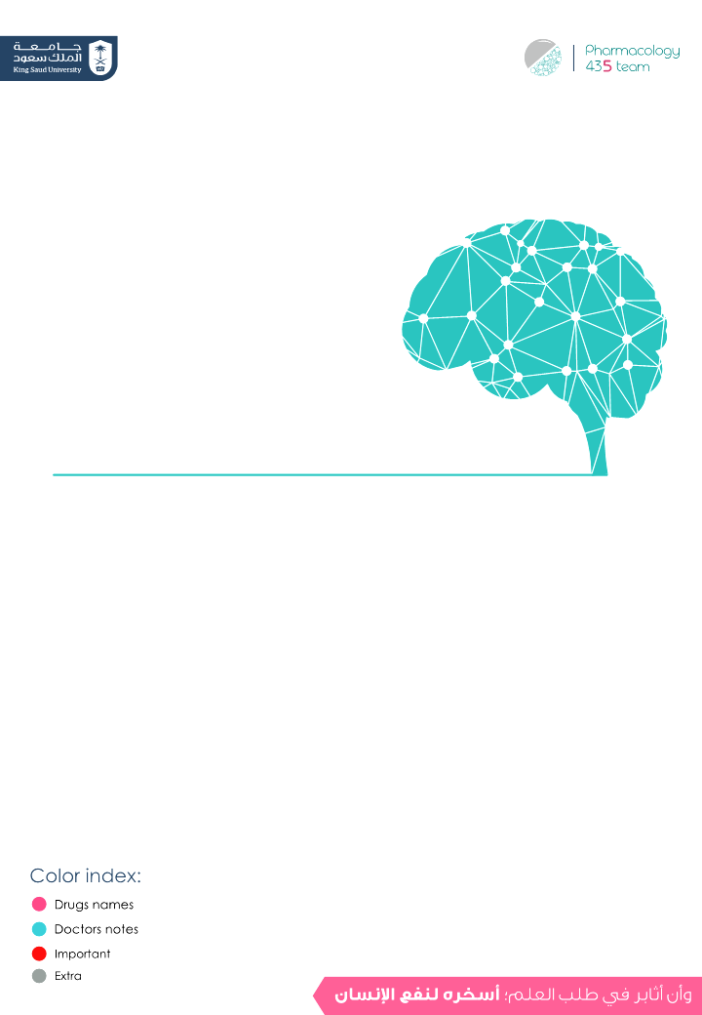
Drugs Used in Headache and Migraine
Objectives:
Differentiate between types of headache regarding
their symptoms, signs and pathophysiology.
Recognize drugs used to prevent migraine.
Identify drugs used to rescue and abort migraine.
Elaborate on the pharmacokinetics, dynamic and toxic
profile of some of these drugs.
Editing File

Slide 2
To Understand Better
Headache | Migraine
Pain anywhere in the region of the head or neck. It is caused by disturbance of the Pain – Sensitive Structures around the brain: 1. Within the cranium: (blood vessels, meninges, cranial nerves.) (intracranial) 2. Outside the cranium: (muscles, nerves, arteries, veins, subcutaneous tissues, eyes, ears and other tissues.) (extracranial) | -Recurrent attacks of throbbing headache, unilateral or on both sides. -Lasting from > 2 up to 72 hrs. + preceded (or accompanied) by AURA abnormal felling . -Aura: seeing flashes of light, blind spots or feeling tingling in arm. -pain is usually on one side of head with facial and neck pain and nausea and vomiting. -Curtain like effect over one eye
Perceptual disturbance of motor < sensory nature.
- Visual: Photophobia (↑ sensitivity to light)
- Auditory: Phonophobia (↑ sensitivity to sound)
- Olfactory unpleasant smell.
- Sensory; abnormal sensation of at face, extremities.
-Develops over 5-20 min. & last fewer than 60 min.
Types of migraine:
1- Common (without aura 80%.)
2- Classis (with aura 20%.)
داء الشقيقة متلازمة لها أعراض كثيرة لكن الصداع هو أشهرها ولا نقارنها بالصداع العادي
لشدته المحاضرة تركيزها الأساسي على علاج الصداع الناتج من الشقيقة
So headache ≠ migraine, headache is a symptom of migraine
Phases of Migraine: (self reading)
1-Pro-drom phase | a change in mood or behavior (irritability, neck stiffness) that starts hours or days before headache. It is experienced by 60% of migraineurs
2-Aura-phase | • Sensory > motor symptoms starts 5-20 min before the migraine attack. It is experienced by 20% of migraineurs.
3-Headache phase | • Moderate to severe pain, with activity increase anorexia, vomiting & anorexia • Intolerance to light, sounds, odors • Blurry vision, Blocked nose, Pale face, Sensations of heat or coldness, Sweating, Tenderness of the scalp
4-Post-drom phase | • Still not normal, either; More likely fatigued → irritability, impaired concentration, scalp tenderness, moodchanges, GIT symptoms,

Slide 3
Migraine Triggers:
Diet
Aged cheese (contains tyramine → constrict blood vessels → hypertension), Alcohol, Chocolate, Caffeine in high dose, Hot dogs, Avocado, Fermented or pickled foods, Yeast or protein extracts, Aspartame.
Therapy
Antibiotics, Antihypertensive, H₂ blockers, Vasodilators, Oral contraceptives.
Diseases
(e.g. hypertension).
Hormonal changes
Menstrual migraine (Most common) Because estrogen is neuroprotective & its declining during menstrual cycle.
Stresses, Climate & Lifestyle.
Migraine Causal Theories
Vascular, Cortical Spreading Depression, Neurovascular theory, Mediators [ Serotonin ], Dopaminergic Hypersensitivity.
Vascular theory: Triggers → Intracranial vasoconstriction → migraine aura → focal ischemia → ↑ mediators (damaging inflammatory mediators) → rebound vasodilation (cause of throbbing pain) → ↑ permeability & leak → inflammatory reaction → activates perivascular nociceptive nerves → migraine headache → It throbs as blood flow at these sensitive area with each heartbeat.
Triggers → Release K / glutamates (too much excitation) → (Neurovascular theory)Creates a slowly well-defined depolarizing wave → (Mediators Serotonin) depolarize adjacent tissues → propagating at a rate of 2-6 mm/min → vasoconstriction → migraine aura→ (Dopaminergic Hypersensitivity)activate trigemino-vascular complex →vasodilation → migraine headache
Stimulation of the trigeminal nerve causes the release of vasoactive peptides; this is responsible for the head pain, as well as the facial and neck pain, experienced during migraine.

Slide 4
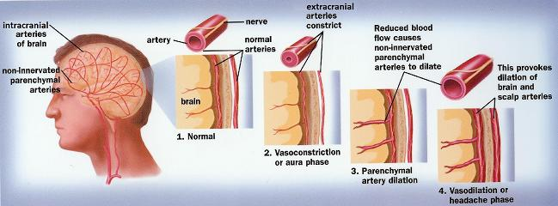
Treatment Strategy
Prevent recurrence
prophylactic
Acute attack
(Controls attack)
-Reduce recurrence frequency severity duration & / or disability
-increase responsiveness to abortive therapy. (drugs stops migraine )
N.B. Full effect of therapy needs several weeks to manifest & should continue for 6 m. & can be repeated.
ABORTIVE therapy (severe-disabling)
Treat the cause stop attack
RESCUE therapy
(mild to moderate)
Treat Symptoms
They specifically target pathways of migraine by reducing meningeal dilatation & reduces neural activation via 5HT1 agonist (serotonin constrict blood vessels) i.e stopping headache as it its evolving
- Abortive medication effective if taken early,just before the pain starts(before vasodilation) ,losing effectiveness once the attack has begun (may prevent further attacks only)
So they must be rapidly acting.
Non-specifically target individual
symptoms. i.e.
Alleviating Pain
emesis and associated
symptoms
الفكرة كلها ان الجسم اذا ضاقت الأوعية الداخلية للمخ ينخرش ويحاول يوسعها بسرعة فلما تتوسع تخرج السوائل وترفع الضغط الداخلي، فتقسيم الأدوية يعتمد هل هي راح تعالج السبب (التوسع) ولا الأعراض (الصداع والغثيان)
Step 1 USMLE Tutorial - All About Headaches
This video summarizes the whole lecture in a simple way

Slide 5
PREVENT RECURRENCE
Anti-epileptics
Antidepressants
Antihypertensives
Block Na⁺ channel & augment GABA at GABA-A receptors
Topiramate, Valproic
we can’t use phenytoin it is toxic
TCA; amitryptylin and nortryptyline.
Why TCA? Bc they have 5-HT & H1 actions, which are good for migraine
Β-blockers; propranolol
Ca²⁺ Channel Blockers Propranolol is commonly used in prophylaxis of migraine attack.
Acute attack (RESCUE THERAPY)
 | Analgesics | Anti-emetics (prevent nausea and vomiting)
 | 1- NSAIDs: • Acetaminophen • Aspirin (weaker) • Ibuprofen, Naproxen → (Drug of choice) for mild to moderate attack with no nausea & vomiting. 2- Narcotic analgesic (μ agonist): tramadol = (central analgesic) → causes tolerance. -Tramadol also inhibits serotonin reuptake | 1- Dopamine Antagonists A- Domperidone • Gastro-prokinetic effect (gastric empting) (increase gastric motility → Increase absorption of drug & reduce vomiting) → ↑ Absorption & bioavailability of abortive therapy. B- Phenothiazines (Promethazine): Has a sedative effect. 2- 5HT3 antagonists Ondanseteron, Granisetron:(the best drugs for vomiting ) For severe nausea and vomiting. 3- H1 antagonist Meclizine, diphenhydramine: Has anti-histaminic + sedative + Anti-cholinergic effect. → Safe for pregnancy.
Drug
Mech. of action
7:55 min

Slide 6
ACUTE ATTACK (ABORTIVE THERPY)
 | 1- Ergots
 | Ergotamine tartarate (rare clinical use due to sever adverse effects) (resticted use) | Dihydroergotamine (DHE) (preferred in clinical setting)
 | - Product of Claviceps purpurea; a fungus growing on rye/grains - Non-Selective - Partial agonism at 5HT1 (5HT-1D/1B found in cerebral And meningeal vessels) receptors. → - ↓ release of vasodilating peptides - ↓ excessive firing of nerve endings - At blood vessels → ↓ vasodilation & stretching of the pain endings - Partial agonist effect on α-adrenoceptors → vasoconstriction good for hypotensive patient
 | - Oral absorption (as Cafergot from caffeine) - Incomplete (erratic) + slow → low bioavailability. - T_{1/2} nearly 2 hours, ergotamine produces vasoconstriction → 24 hours or longer due to high and long tissue binding ability. - Can be taken sublingually, rectal suppository, inhaler. - Ergotamine tartrate -Reserve drug- has significant side effects, and may worsen the nausea and vomiting associated with migraine. | - Nasal spray, inhaler & injectable forms (good to use if patient is vomiting) - Given parenterally, and eliminated more rapidly than ergotamine, presumably due to its rapid hepatic clearance and has less adverse effects. * Better than Ergotamine tartarate bc of the P.K characteristics. * has an efficacy similar to that of sumatriptan, but nausea is a common adverse effect.
 | - They are only used to abort the attacks (Except Dihydroergotamine can be given for severe, recurrent attacks not responding to other drugs) - Their use is restricted to patients with frequent, moderate attack or infrequent but severe attacks.
 | GIT upset Feeling of cold and numbness of limbs, tingling Anginal pain due to coronary spasm, and disturbed cardiac rhythm (tachycardia or bradycardia) therefore its not safe for heart problem patients Prolong use → rebound headache due to vasodilation followed by vasoconstriction. Prolong use and high dose → paraesthesia (tingling or burning sensation)
 | Pregnancy; fetal distress and miscarriage (ergot is uterine stimulant and vasoconstrictor) Peripheral and coronary vascular diseases. Hypertension Liver and kidney diseases prophylaxis of migraine. because they have the same mechanism In concurrent use with triptans (at least 6 hrs from last dose of triptans or 24 hrs from stopping ergotamine and β-blockers)
Drug
Mech. of action
P.K
Indications
ADRs
C.I

Slide 7
ACUTE ATTACK (ABORTIVE THERAPY) Cont.
2- Triptanes
Selective Agonist at 5-HT₁ (5-HT1D/1B) receptors. → better than ergots. Similar to ergotamine except that triptans are more selective as serotonergic agonist. No α1, α2, β –adrenergic, dopamine or muscarinic receptors. All theses drugs are important to know it well, especially P.K
 | Sumatriptan Super fast. | Zolmitriptan | Naratriptan
 | oral, nasal spray, and injectable | nasal spray, and injectable | Oral preparations
 | - Triptans inhibit the release of vasoactive peptides, promote vasoconstriction, and block pain pathways in the brainstem . - Triptans inhibit transmission in the trigeminal nucleus caudalis.
 | Bioavailability: - Oral → low - Subcutaneous → 97%, peaks after 2 min & T_{1/2} nearly 2 hours (fast action with SC, subcutaneous, good for patient with vomiting) | Oral bioavailability 40%, peaks after 2 hrs & T_{1/2} nearly 3 hours. | Oral bioavailability 70%, peaks after 2 hrs & T_{1/2} nearly 6 hours (slower onset, less side effects)
 | To abort attacks in patients with frequent, moderate or infrequent but severe attacks. In cluster headache Sumatriptan → first-line therapy for acute severe migraine attacks
 | Most of adv are the same as with ergot but triptans are better tolerated. Mild pain and burning sensation at the site of injection. Vasospasm, Ischemic heart; Angina and Arrhythmias Zolmitriptan: Chest & neck tightness, Coronary vasospasm & Somnolence
 | Peripheral vasospastic diseases Uncontrolled hypertension History of ischemia Cerebrovascular disorders In concurrent use with ergots or others inducing vasospasm. In concurrent use with MAOIs, lithium, SSRIs, → (5HT increased to toxic level) Renal or hepatic impairment.
Drug
MOA
P.K
Indications
“Severe headache or pain mostly around the eyes’
ADRs
Sleepless +drowsiness
C.I

Slide 8
Deciding whether better with a triyptan or with DHE
migraines a day or less and need rapid relief
Triptans (they give rapid relief)
Patients:
pregnant women
paracetamol or intranasal sumitriptan and or diphenhydramin, meclizine are safe.
Patients with headache episodes lasting 2 or 3 days
DHE because it has longer T_{1\2}
The form of drug preparation could influence the choice,
Injectable Sumatriptan reaches T_{max} the fastest followed by DHE nasal spray and Rizatriptan.
Factors when Choosing a Triptans:
Medication | T_{max} (h) Give rapped effect | T_{1\2} (h) Reduce pain and prevent recurrence for longer time
DHE | 1 | 10
Sumatriptan SQ | 0.25 | 2
Rizatriptan | 1-1.5 | 2-3
Zolmitriptan | 2.5 | 3
Naratriptan | 2-3 | 6
Eletriptan | 2.8 | 4
Frovatriptan | 2-3 | 26
Differences in the time to peak blood concentration T_{max}, equates with faster relief of pain.
Differences in t_{1/2} → a clinical effect in terms of recurrence of headache.
For extremely fast relief within 15 min. injectable Sumatriptan is the only choice.
- If expected re-dosing is needed & / or recurrence of headache →
Naratriptan, frovatriptan, have slower onset, fewer side effects, and a
lower recurrence rate.
Menstraul migraine: Frovatriptan (longer T_{1\2}= 26hrs) 2.5 mg twice per day beginning two days before the anticipated onset of menstrual migraine and continuing for six days.

Slide 9
Summary
ACUTE ATTACK: A- Rescue therapy (to treat the symptoms)
 | Analgesics |  |  | Antiemetics used with analgesics in case of pain+vomiting
 | NSAIDs |  | Opioid | Dopamine Antagonists |  | Phenothiazines | 5HT3 antagonists | H1 antagonist
 | Aspirin - Acetaminophen (Paracetamol safe with Pregnancy) ibuprofen, naproxen |  | Tramadol | Domperidone |  | Promethazine | Ondanseteron Granisetron | Meclizine diphenhydramine (safe with Pregnancy)
 | Use alone in case of mild to moderate pain with no vomiting or nausea |  | μ agonist | Gastro-prokinetic: ↑ Absorption, bioavailability of abortive therapy |  | Dopamine antagonists Sedation (antipsychotic) | for severe nausea & vomiting | Antihistamine sedation Anticholinergic
Acute Attack: B- abortive therapy
 | Ergots (only in SEVERE cases) |  |  |  | Triprans
 | Ergotamine tartarate (restricted use) | Dihydroergotamine (DHE) ( preferred) |  |  | Sumatriptan (safe with Pregnancy) |  | Zolmitriptan | Naratriptan
 | Partial agonism at 5HT1 receptors (5HT-1D/1B found in cerebereal & menigeal vessels) (non-selective) |  |  |  | 5HT1 agonists (selective) No α1, α2, β –adrenergic , dopamine or muscarinic receptors.
 | ↓release of vasodilating peptides ↓excessive firing of nerve endings effect on α-adrenoceptors → vasoconstriction |  |  |  | inhibit the release of vasoactive peptides, vasoconstriction, block pain pathways in the brainstem. inhibit transmission in the trigeminal nucleus caudalis
 | erratic oral absorption → low bioavailability. high & long tissue binding ability: vasoconstriction effect last for long time. has significant S.E. |  | Eliminated rapidly, due to its rapid hepatic clearance & less S.E injectable (good to in of vomiting) (antiemetic) |  | Bioavailability: -Oral low -SC 97%, (for fast relief -15min- fast action with SC, good for patient with vomiting) |  | Oral bioavailability 40% | Oral bioavailability 70%, peaks after 2 hrs (slower onset, less side effects).
 | DHE can be given for severe, recurrent attacks not responding to other drugs and lasting 2-3 days. |  |  |  | Patient with migraines for a day or less and need rapid relief. In cluster headache.
 | GIT upset Cold & numbness of limbs Anginal pain & disturbed cardiac rhythm Rebound headache (Prolong use) Paraesthesia( Prolong & high dose ) |  |  |  | Same as with ergot but triptans are better tolerated. Mild pain & burning sensation at the site of injection. Vasospasm, Ischemic heart; Angina & Arrhythmias.
 | Pregnancy → miscarriage Hypertension. Liver & kidney diseases Prophylaxis of migraine Peripheral and coronary diseases. With Triptans |  |  |  | Peripheral vasospastic diseases uncontrolled hypertension History of ischemia cerebrovascular disorders with ergots or others inducing vasospasm with MAOIs, lithium, SSRIs → (5HT increased to toxic level) Renal or hepatic impairment.
Group
Drug
Note
Group
Drug
M.O.A
P.D
P.K
Uses
S.E
Zolmitriptan:
Chest & neck tightness - Coronary vasospasm - Somnolence
C.I

Slide 10
Questions
MCQs
1. Is the following statement true or false, Ergots are more selective than triptanes.
True
False
2. A pregnant woman is experiencing a mild headache with no nausea or vomiting what is the drug of choice?
Sumatriptan
Meclizine
Ergot tartarate
Domperidone
3. Which of the following has the fastest onset of action?
Rizatriptan
Frovatriptan
Sumatriptan
Meclizine
4. A patient with a moderate headache with no nausea or vomiting which drug would you prescribe?
Ergot tartarate
Zolmitriptan
Amitriptyline
Naproxen
5. Which of the following drugs causes rebound headaches with prolonged use?
Dihydroergotamine
Propranolol
Aspirin
Sumatriptan
MCQs answers:
B
B
C
D
A

Slide 11
Questions
MCQs
6. Which of the following drugs acts as a central analgesic?
Propranolol
Aspirin
Tramadol
Ibuprofen
7. A taxi driver is complaining of nausea what should we prescribe him?
Domperidone
Ergots
Sumatriptan
Aspirin
8. What is the MOA of ergots?
Increase firing rates of nerve impulses
Decrease firing rates of nerve impulses
Increase release of vasodilators
Decrease release of vasoconstrictors
MCQs answers:
6) C
7) A
8) B
SAQ
1.Explain when Dihydroergots should be prescribed and used.
Dihydroergotamine can be given for severe, recurrent attacks not responding to other drugs.
2.List the preventive drugs and an example of each.
Anti-spastic: Tizanidine
Antidepressants: nortytrptan
Antiepileptic: topiramate
Anti-hypertensive: propranolol

Slide 12
Team leaders:
Ghaida Saad Alsanad
Omar Alsuhaibani
Team Members:
Dana AlRasheed
Hind Aloraier
Aljoharah Alshunaifi
Alanoud Almansour
Sara Alsultan
Ghadah alhaidari
Alanoud Almufarrej
Noura Alothaim
Adel Alsuhaibani
Sultan Alnasser
References:
- Doctors’ slides and notes.
- Pharmacology Team 435.
Special thank for team 435
@Pharma4370
Pharm437@gmail.com

