Slide 1
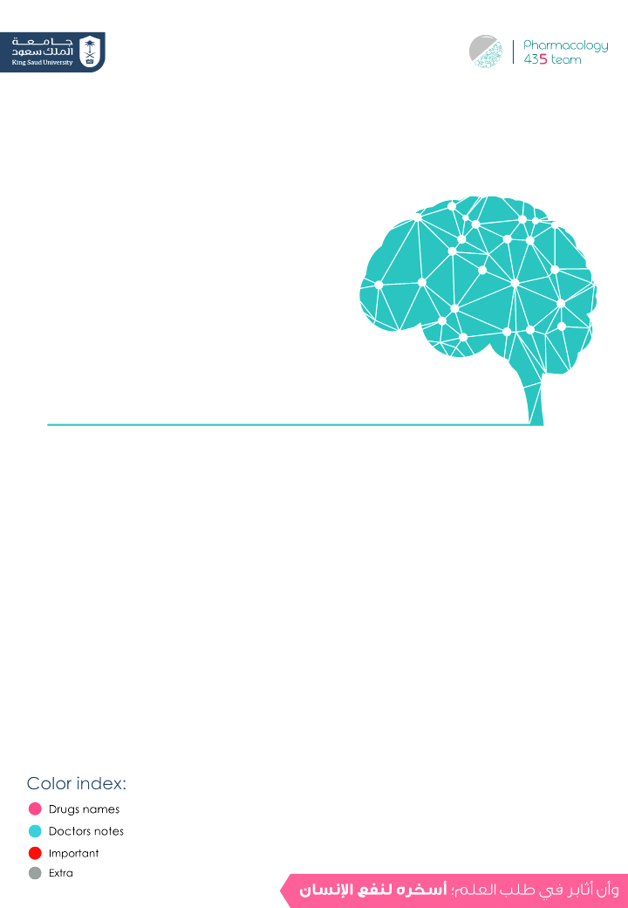
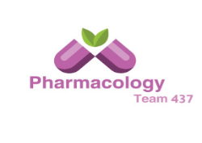
Pharmacology Of Drugs Acting On the Eye
Objectives:
Outline common routes of administration of drugs to the eye.
Discuss the pharmacokinetics of drugs applied topically to the eye.
Classify drugs used for treatment of disorders of the eye.
Outline ocular toxicity of some drugs.
Elaborate on autonomic drugs, anti-inflammatory drugs, and drugs used for glaucoma.
Editing File

Slide 2
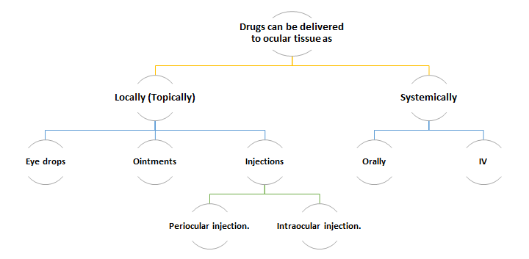
Overview
Eye |  | Sympathetic N.S. (far vision) | Parasympathetic N.S. (near vision)
Iris: | - radial muscle | Contraction (Mydriasis) (α1) Active mydriasis | No effect
 | - circular muscle | No effect | Contraction (miosis) (M3)
Ciliary muscle |  | Relaxation (β2) | Contraction (M3)
Lens |  | Thin, more flat | Thick, more convex
Suspensory ligaments |  | Contraction | relaxation
Conjunctival blood vessels |  | Conjunctival Vasoconstriction (α1) | Conjunctival Vasodilatation
Team 436

Slide 3
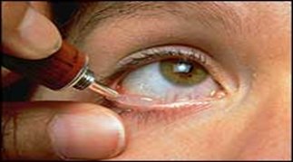
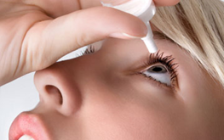
Pharmacology of drugs acting on the eye
Drugs can be delivered to ocular tissue as:
Locally (Topically): *more common* | Systemically:
- Eye drops. - Ointments. - Injections: Periocular injection. (the name referred to site of injection) Intraocular injection. Advantages: - Convenient (مريح), Economic (رخيص), Relatively safe. Disadvantages: - Compliance, Corneal & conjunctival toxicity. | - Orally - IV
First – locally:
 | Ointment (مرهم) | Eye drops (high frequency we want the drug to contact with ocular tissue)
 | Ointment is a smooth oily preparation, As a rule of thumb, an ointment base is more occlusive and will drive the medication into the skin more rapidly than a solution or cream base. (used once a day,because it has long time to contact with eye) | Eye drops are saline-containing drops “liquid” Most common route of administration. (have adherence) One drop = 50 µl / 4 hours (usually)
 | Increases the contact time of ocular medication to ocular surface → providing better effect. | -------
 | The drug has to be high lipid soluble(to penetrate) to have the maximum effect as ointment. (low molecular weight) | The contact time between the drug and the eye is low due to fast removal by tears. → Thus has to be used several times.
Definition
Advantages
Disadvantages

Slide 4
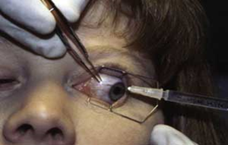
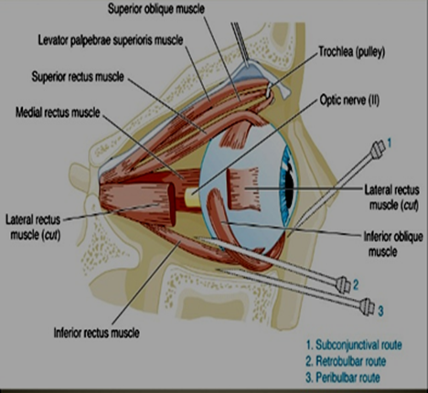
First – locally (cont.):
Eye injections:
 |  | 1-intra-cameral: “inside anterior or posterior chamber of the eye” | E.g. Intracameral acetylcholine or lidocaine during cataract surgery. | Uses | ADRs
 |  |  |  | -Anterior segment surgery -Infection -Retinitis | - Retinal toxicity. - Intraocular toxicity. - Corneal toxicity.
 |  | 2- Intra-vitreal "inside the eye"(vitreous humor) | E.g. Intravitreal antibiotics in cases of endophthalmitis (an inflammation of the internal coats of the eye) Intravitreal steroid in macular edema (the build-up of fluid in the macula, an area in the center of the retina.)
 |  | 1- Subconjunctival
 |  | 2- Retrobulbar “behind the eyeball”
 |  | 3- Peribulbar “above and below the orbit”
 |  | 4- Subtenon
 |  | Advantages: - Reach behind iris-lens diaphragm better than topical application. - Drugs penetration is generally weaker for low lipid-soluble drugs, however injections can bypass the conjunctival and corneal epithelium which is good for drugs with low lipid solubility (e.g. penicillins) [Hydrophilic drugs] - Steroid and local anesthetics can be applied this way. - Used for infection of anterior segment and inflammation of uvea. Disadvantages: - Local toxicity, tissue injury, globe perforation, optic nerve damage.
0:23 min
Intraocular Injections
Intra:Intra
3:06 min
Techniques
0:4 min
0:34 min
Periocular Injections
Peri:RSPS
0:41 min

Slide 5
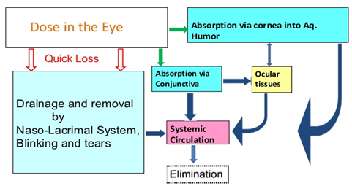
Pharmacokinetics of topical drugs:
 | Drug residence time → the rate of absorption is determined by the time drug remains in cul-de-sac, tear. It can be prolonged by plugging tear ducts or change formulation. (residence time = the time in which drug will still in the eye). Metabolism: Significant biotransformation takes place in the eye. Esterases activate pro-drugs, e.g.: - Dipivefrin(inactive form) →(adrenaline)(active form) - Latanoprost →( PGF2α) Elimination → by nasolacrimal drainage or binding to tear protein. Diffusion → across cornea & conjunctiva.
 | - After corneal absorption → the drug accumulates in the aqueous humor, intraocular structures or systemically distributed. - Melanin binding prolongs the effect of α -agonists in patients with dark pigmented iris. - Chloroquine binds to retinal pigment →↓ visual acuity.
Absorption
DipivefrIN: AdrenalINe
Distribution
Second- systemically:
Oral Or I.V. :
- Factors that can control systemic drug penetration into ocular tissue are :
lipid solubility of the drug:: more penetration with high lipid solubility.
(High lipid soluble drug → high absorption → high distribution).
Protein binding: more effect with low protein binding (inverse proportion).
Eye inflammation: more penetration with ocular inflammation.
(In case of inflammation (meningitis), it can affect the penetration ability of certain medications because it will affect the permeability even if the medication is polar)

Slide 6
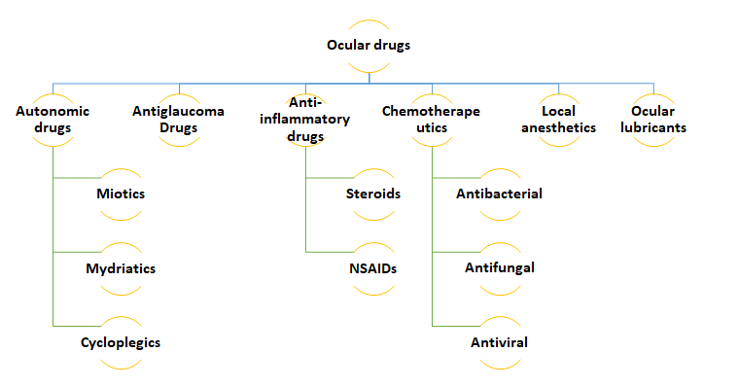
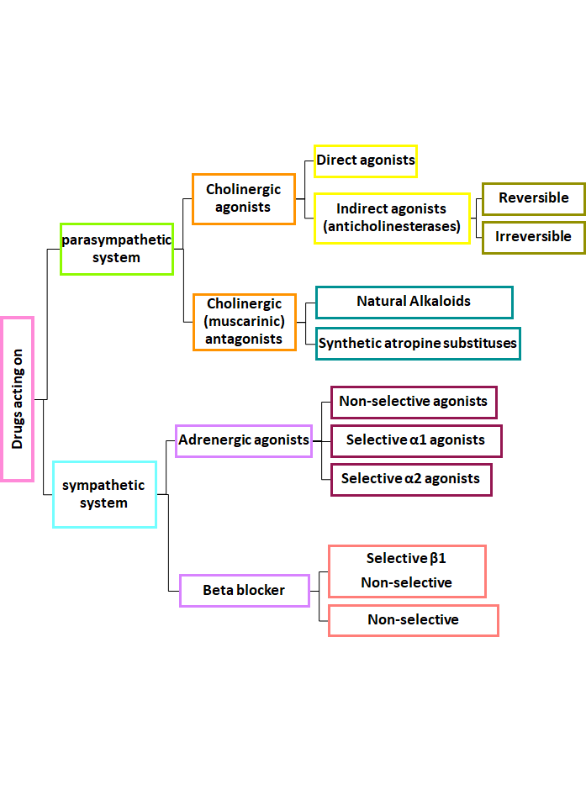
Overview
Team 436
+ Antimitotic

Slide 7
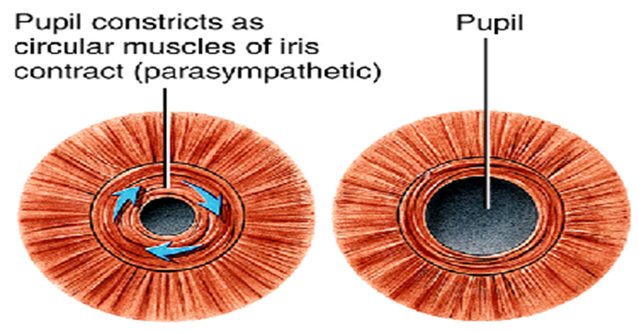
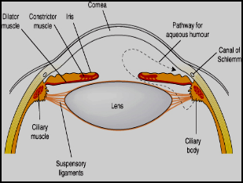
Ocular actions of cholinergic(parasympathetic) drugs:
1- Contraction of the pupillary sphincter muscle (miosis)
2- Contraction of the ciliary muscle (accommodation for near vision).
3- Decrease in intraocular pressure ↓ IOP.
4 -increases aqueous outflow through the trabecular meshwork into canal of Schlemm by ciliary muscle contraction.
5- Increased lacrimation
6- Conjunctival Vasodilatation
Miosis by parasympathetic drugs
Aqueous production and drainage:
The aqueous humor is secreted by the epithelium of ciliary body. Produced by a combination of active transport of ions and ultrafiltration of interstitial fluid. The fluid flows over the surface of the lens, out through the pupil into the anterior chamber. Flows through (Drainage by) 1- the trabecular meshwork into Schlemm’s canal 2- and uveoscleral drainage is collected in the scleral veins.
(Decrease in IOP by parasympathetic drugs)
By using the drug the iris pulled away + the ciliary muscles contract >> angle of filtration (drainage) increased >> more drainage

Slide 8
Drugs acting on parasympathetic system
Cholinergic agonists
 | Indirect agonists (anticholinesterases) |  |  |  | Direct agonists
 | Irreversible (phosphate ester) |  | reversible |  | Pilocarpine | Carbachol | Ach | Methacholine
 | Isofluorophate | Echothiophate | Physostigmine | Demecarium
 | Isofluorophate, Echothiophate, Physostigmine: Glaucoma Accommodative esotropia (نوع من الحول) → Ecothiophate. In lice infestation of lashes → Physostigmine. |  |  |  | Open angle glaucoma * The drug of choice in acute attack (closed or open glaucoma) | Carbachol, Methacholine: Induction of miosis in surgery. Open angle glaucoma. * Carbachol → causing pupillary contraction and a decrease in intraocular pressure. |  |  | Specific uses
 | Glaucoma (open & closed angle). Counteract action of mydriatics. To break iris-lens adhesions. (postoperative) In accommodative esotropia (Ecothiophate). (نوع من الحول) |  |  |  |  |  |  |  | General uses
 | Diminished vision (myopia). Headache. |  |  |  |  |  |  |  | ocular
Drug
0:23 min
Indications
ADRs

Slide 9
Drugs acting on parasympathetic system
Cholinergic (muscarinic) antagonists
 | Synthetic atropine substitutes |  |  | Natural alkaloids
 | Tropicamide | Cyclopentolate | Homatropine | Scopolamine (Hyoscine) | Atropine
 | 6 hours | 24 hours | 1-3 days | 3-7 days | 7-10 days
 | Short duration |  |  | Long duration
 | Passive mydriasis → due to relaxation of circular muscles. (passive = without any effect of sympathetic) Cycloplegia (loss of near accommodation) → due to relaxation of ciliary muscle. (This effect is due to blocking of paraS only!) Loss of light reflex. Increased IOP → glaucoma. (especially angle closure glaucoma) Decreased lacrimal secretion → sandy eye.
Drug
Duration of effect
M.O.A.
 | To prevent adhesion in uveitis & iritis. → bc they are doing mydriasis. Funduscopic examination of the eye. Measurement of refractive error. → (myopia, hyperopia) problem with focusing of light on the retina due to the shape of the eye.
 | Glaucoma (angle closure glaucoma) → Because there is no miosis→ which makes the filtration easier → IOP may rise dangerously → acute attack of eye pain.
Indications
C.I.
Extra:
Active vs. passive mydriasis:
Atropine (anticholinergic): Blocking muscarinic receptors→ relaxing circular muscles
→ Passive Mydriasis
Sympathetic stimulation: activation of α receptors in radial muscles → contraction → Active mydriasis
** in the sympathetic system, activation of α receptors leads to smooth muscle contraction, and activation of β2 receptors leads to smooth muscle relaxation.

Slide 10
Adrenergic agonists
 | Selective α₂ agonists Apraclonidine (ابرا خفيف دم يقلل الضغط ودقات القلب لكنه يسبب صداع) hypertention | Selective α₁ agonists phenylephrine (ابو فنيلة يرفع الضغط) vasopressin | Non-selective agonists (α₁, α₂, β₁, β₂) Dipivefrin (pro-drug of epinephrin) epinephrine
 | - ↓production of aqueous humor. - ↑ uveoscleral outflow of aqueous humor. - Inhibits sympathetic working. | Active mydriasis due to contraction of radial muscles of the eye (without cycloplegia) | - ↓ aqueous humor production through vasoconstriction of ciliary body blood vessels. - Increase uveoscleral outflow of aqueous humor. - Mydriasis (without cycloplegia)
 | Open angle glaucoma treatment Prophylaxis against IOP spiking after glaucoma laser procedures. | Fundoscopic examination of the eye. To prevent adhesion in uveitis & iritis. Decongestant in minor allergic hyperemia of eye. | -Used locally as eye drops → to minimize the ADRs in Open angle glaucoma. Dipivefrin has Long duration of action the epinephrine - Funduscopic examination of the eye. -To prevent adhesion in uveitis & iritis -Decongestant in minor allergic hyperemia of eye
 | Bradycardia. Hypotension. | May cause significant increase in blood pressure. Rebound congestion. | Headache. Arrhythmia. Increased blood pressure.
 | ---- | in patients with narrow angles as they may precipitate closed angle glaucoma
Drug
M.O.A.
Uses
ADRs
C.I

Slide 11
β Blockers
 | Selective β₁ (cardio-selective) betaxolol |  | Non-selective
 |  |  | carteolol | timolol
 | Act on epithelium of ciliary body to production of aqueous humor.
 | Given topically as eye drops.
 | Can be used in patients with hypertension & ischemic heart disease.
 | Open angle glaucoma. β-adrenergic blocker timolol, are effective in treating chronic glaucoma but are not used for emergency lowering of intraocular pressure.
 | Ocular effects: Irritation.
Drug
MOA
Mnemonics!!
*Carteolol: Carrots are good for your eyes
*Timolol:
Takes a long time
*Betaxolol:
Selective B1 Blockers
Route of administration
Advantages
Uses
ADRs

Slide 12
Treatment of open angle glaucoma (chronic)
The main goal is to decrease IOP by:
3:39min
1- Decreasing production of aqueous humor.
2- Increasing outflow of aqueous humor.
.Beta blockers
.Alpha-2 agonists
.Carbonic anhydrase inhibitors
Prostaglandins. Adrenergic agonists, nonspecific.
Parasympathomimetics.
Prostaglandins and Beta blockers are the most popular
 | Prostaglandin analogues E.g. latanoprost, travoprost | Carbonic anhydrase inhibitors* E.g. acetazolamide (oral) dorzolamide (topical)
 | ↑uveoscleral aqueous outflow -Latanoprost is preferred due to lesser adverse effects. - They have replaced beta blockers. “Better than beta blockers because it has a long duration → use it once a day” They are used topically as eye drops & once a day. | - ↓ production of aqueous humor by blocking carbonic anhydrase enzyme required for production of bicarbonate ions → (transported to posterior chamber, carrying osmotic water flow).
 | open angle glaucoma
 | Pigmentation of the iris (heterochromia iridis) | Myopia (Nearsightedness) , malaise, anorexia, GI upset, headache. Metabolic acidosis, renal stone.
 |  | Sulfa allergy Pregnancy, “ Affects fetus” Digitalis users.
Drug
M.O.A.
Uses
ADRs
Mnemonics!!
Prostaglandin analogues ADRs:
- "لا تأكل بروستد اكثر من مره باليوم" (Prost)
- "Irise up with Big Broast (Iris pigmentation, Prostaglandin)"
C.I
Mnemonics!!
Carbonic Anhydrase: (ADRs)
- "I can't see Any Cars (Carbonic Anhydrase) because I have Myopia"

Slide 13
Treatment of narrow closed angle glaucoma (acute)
Treatment of narrow closed angle glaucoma (acute)
- Acute, painful increases of intraocular pressure due to occlusion of the outflow drainage pathway.
- The only way to treat it → Surgery, but before surgery we give him treatment.
- emergency situation that require treatment before surgery (Iridectomy)
The main treatment is surgery but we give some medication that will make help until the surgery is scheduled (temporarily .. not for a long time)
Oral = Systemic Acetazolamide
Topical cholinomimetics
e.g. Pilocarpine
The use of drugs is limited to:
Osmotic agents
Hypertonic solution (Mannitol, Glycerol).
Analgesics
[Potent]
Pethidine or morphine (for pain).
Osmotic agents ( dehydrating agent ) → Systemic
 | - IV infusion of hypertonic solution (Mannitol, Glycerol). -Can rapidly ↓ IOP by ↓ vitreous volume prior to anterior surgical procedures. - Glycerol 50% syrup, orally (cause nausea, hyperglycemia). - Mannitol 20% IV (cause fluid overload and not used in heart failure).
 | Used only in acute situations to temporarily reduce high IOP until more definitive treatments can be rendered. (short term management)
 | - Diuresis, circulatory overload, pulmonary edema , heart failure, central nervous system effects such as seizure, and cerebral hemorrhage.
MOA
Indications
ADRs

Slide 14
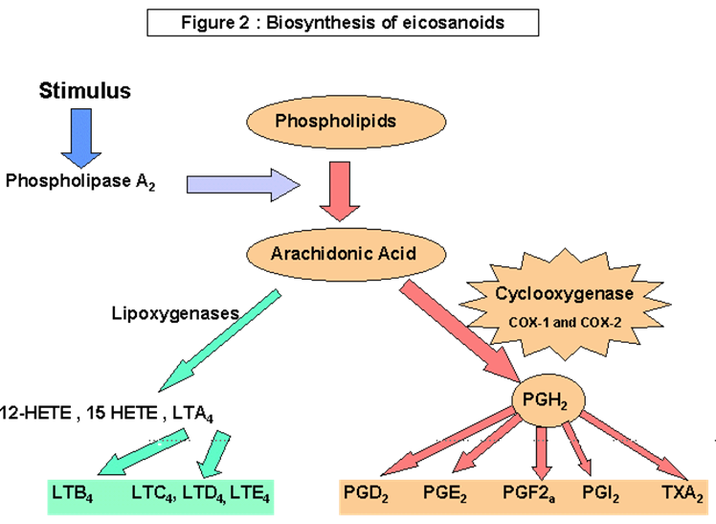
Anti-inflammatory drugs
Anti- inflammatory
corticosteroid
NSAID
Even if it’s used topically will cause glaucoma
Corticosteroids
 | - Inhibition of arachidonic acid release from phospholipids by inhibiting phosphlipase A2
 | Systemic E.g. prednisolone, cortisone | Topical E.g. prednisolone, dexamethasone, hydrocortisone
 | Uses: - posterior uveitis. - optic neuritis. | Uses: anterior uveitis, severe allergic conjunctivitis, scleritis , prevention and suppression of corneal graft rejection.
 | - Glaucoma, cataract, increase IOP→ especially if it used for a long time. - Skin atrophy. - Secondary infection. - Delayed wound healing. → (healing is slow bc it is an immune suppression)
, L,;# MM
MOA
Indications
ADRs

Slide 15
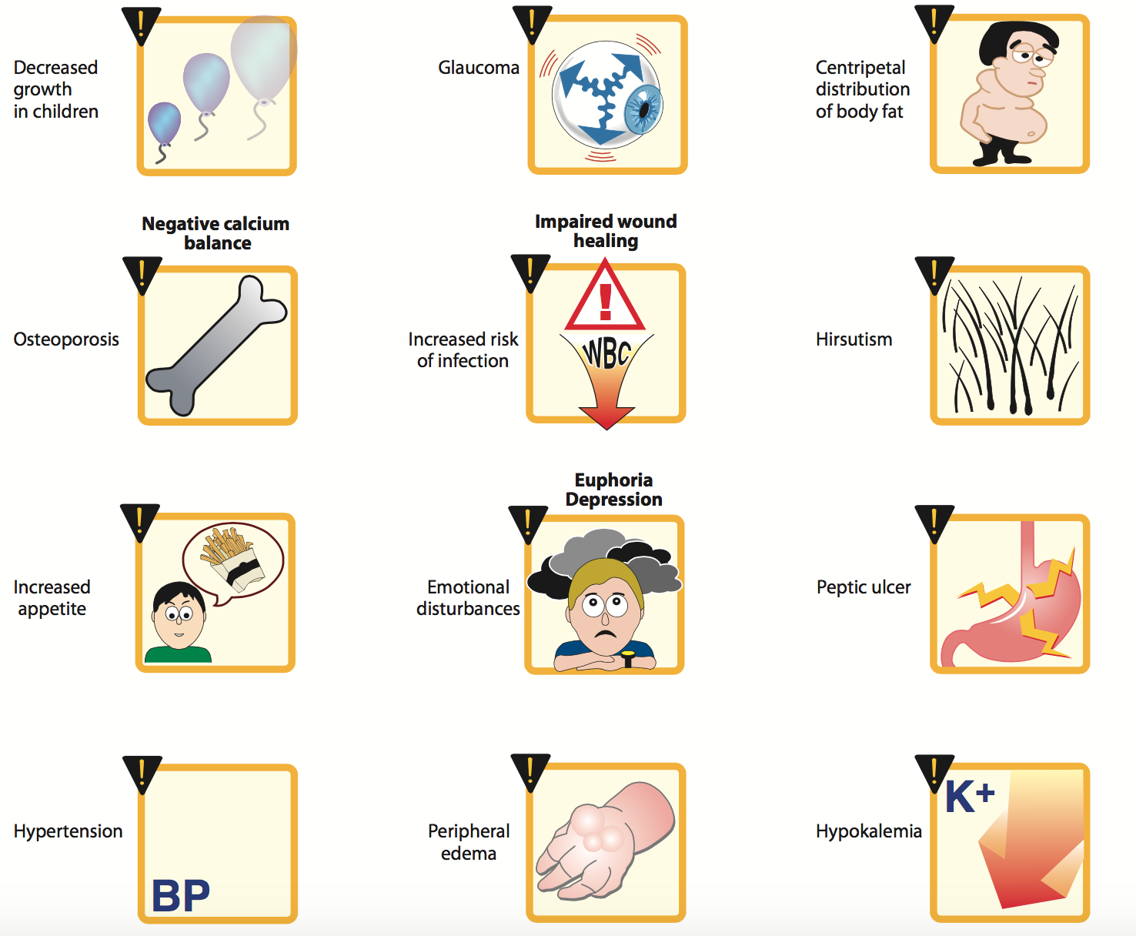
Corticosteroids side effect
* This pic is extra.
9:09 min
NSAID
 | Flurbiprofen | diclofenac | Ketorolac
 | COX (cyclo-oxygenase) - inhibitor
 | Pre-operatively to prevent miosis* during cataract surgery. * Bc they inhibit prostaglandins which produce miosis without action of cholinergic. | postoperative inflammation, mild allergic conjunctivitis, mild uveitis. | Cystoid macular edema occurring after cataract surgery.
 | Stinging (irritation), sterile corneal melt & perforation.
Drug
MOA
Indications
ADRs
Mnemonics!!
Ketorolac: after cataract
Flurbiprofen: during cataract

Slide 16
Drugs causing corneal deposits
Amiodarone, Chloroquine
“امي ملكة تلبس تاج لكنها مصابة بالعمى" -Cornea: تاج -Optic neuropathy: العمى
Pigmented deposits
of cornea (Deposition in eye lens >> optic neuropathy >> pigmentation)
.
Amiodarone,
Chloroquine
Retinopathy + Optic neuropathy¹,
digitalis
cardiac failure drug
ocular disturbances & chromatopsia
(with overdose objects appear yellow)
Drugs causing corneal deposits
Phenothizines
Brown pigmentary deposits in the cornea, conjunctiva & eyelid.
Steroids
cataract formation², elevated IOP & glaucoma
Ethambutol⁵
optic neuropathy characterized by gradual Progressive central scotomas and vision loss.
Ethambutol:
“اثم بتول سبب لها العمى"
Sildenafil
Causes a bluish haze & causing light sensitivity
Because it inhibits retinal (PDE6) as well as penile (PDE5) form of phosphodiesterase. → PDE6 controls the level of cyclic GMP in the retina → see Bluish haze
1 optic neuropathy: mild decreased vision + visual field defects.
2
3 TB medication.
Click here to see a picture explains it.

Slide 17
Summary
 |  | Cholinergic agonists |  |  |  |  | Cholinergic antagonists
 |  | 1- miosis -2- ↓ IOP. 3- Contraction of the ciliary muscle.. 4-↑ aqueous outflow. -5- ↑ lacrimation 6-Conjunctival Vasodilation |  |  |  |  | 1-Passive Mydriasis 2-Cycloplegia - 3-Loss of light reflex. 4-↑ I.O.P # glaucoma. 5-↓Lacrimal secretion.
 |  | 1- Glaucoma (open and closed angle) -2-Counteract action of mydriatics 3-To break iris-lens adhesions -4-in accommodative esotropia (ecothiophate) |  |  |  |  | 1-Funduscopic examination 2-To prevent adhesion in uveitis & iritis 3-Measurement of refractive error (myopia, hyperopia).
 |  | myopia, headache |  |  |  |  | -
 |  | Direct |  | indirect |  |  | Natural alkaloids | Synthetic atropine
 |  | - |  | Reversible |  | Irreversible | -
 |  | Carbachol methacholine | pilocarpine | Physostigmine demecarium |  | Ecothiophate Isoflurophate | Atropine Scopolamine (hyoscine) | Homatropine Cyclopentolate Tropicamide
 |  | miosis in surgery | - | Glaucoma, accommodative esotropia |  |  | -
 |  | Open angle glaucoma
 |  | Adrenergic agonist |  |  |  |  | β blockers
 |  | 1-Active mydriasis : α1 2-Relaxation of ciliary muscles: β2 3-Vasoconstriction of conjunctival blood vessels: α1 4- regulation of aqueous humour formation: α & β in the blood vessels of the ciliary processes
 |  | Non-selective α1, α2, β1, β2 | Selective α1 | Selective agonists α2 |  |  | Non-Selective blocker | Selective β1 blocker
 |  | epinephrine dipivefrin | phenylephrine | apraclonidine |  |  | timolol carteolol | betaxolol cardioselective
 |  | ↓ aqueous humor production ↑uveoscleral outflow | Active mydriasis (without cycloplegia) | ↓production of aqueous humor ↑uveoscleral outflow of aqueous humor |  |  | Act on epithelium of ciliary body to decrease production of aqueous humor.
 |  | eye drops, In open angle glaucoma | Funduscopic examination. prevent adhesion in uveitis & iritis. | open glaucoma prophylaxis against IOP |  |  | open glaucoma + can be used in patients with hypertension
 |  | headache arrhythmia elevated BP | ↑ in BP. Rebound congestion precipitation of acute angle closure glaucoma | Bradycardia hypotension |  |  | Ocular irritation
Function:
Uses:
S/E
Parasympathetic Drugs
Types:
Uses:
Function:
Types:
M.O.A:
Sympathetic Drugs
Uses:
S/E:

Slide 18
Summary
Treatment of open angle glaucoma (chronic):
by decreasing IOP:
A-Decreasing production of aqueous humor:
1-Beta blockers
2-Alpha-2 agonists
3-Carbonic anhydrase inhibitors
B-Increasing outflow of aqueous humor:
1-Prostaglandins
2-Adrenergic agonists, nonspecific
3-Parasympathomimetics
Prostaglandins and β blockers are the most popular
Treatment of narrow closed angle glaucoma
(Acute angle glaucoma)
The use of drugs is limited to :
•Oral Acetazolamide
•Topical cholinomimetics: pilocarpine
•Osmotic agents: Mannitol, Glycerol.
•Analgesics:pethidine or morphine (for pain)
Treatment of chronic open angle glaucoma
 | Carbonic anhydrase inhibitors |  | Prostaglandin analogues
 | Acetazolamide - dorzolamide |  | latanoprost - travoprost
M.O.A | ↓production of aqueous humor by blocking carbonic anhydrase enzyme required for production of bicarbonate ions |  | ↑ uveoscleral aqueous outflow.
S/E | Myopia, malaise, anorexia, GI upset, headache Metabolic acidosis, renal stone |  | heterochromia iridis
C.I | Sulpha allergy - pregnancy |  | -
Treatment of Acute angle glaucoma
Osmotic agents
 | Mannitol | Glycerol
M.O.A | Rapid lowering of IOP by decreasing vitreous volume
S/E | Diuresis, circulatory overload, pulmonary edema and heart failure,central nervous system effects

Slide 19
Summary
Ocular drugs
 | Corticosteroids |  | NSAID
M.O.A | inhibition of arachidonic acid by inhibiting phosphlipase A2 |  | inhibition of cyclo-oxygenase
Types: | Topical | Systemic
Drugs: | Prednisolone Dexamethasone hydrocortisone | Prednisolone cortisone | Flurbiprofen | Diclofenac | Ketorolac
Uses: | anterior uveitis severe allergic conjunctivitis scleritis | posterior uveitis optic neuritis | pre-operatively to prevent miosis | postoperatively, mild allergic conjunctivitis, mild uveitis | cystoid macular edema
S/E | Glaucoma, increase IOP, cataract |  | stinging
Drugs causing corneal deposits
Amiodarone & chloroquine | Ethambutol | Digitalis | Phenothizines | Steroids | Sildenafil
optic neuropathy |  | ocular disturbances & chromatopsia | brown pigmentary deposits cornea, conjunctiva & eyelid | cataract formation, elevated IOP & glaucoma | bluish haze & light sensitivity
Pigmented deposits of the corna

Slide 20
Questions
MCQs
1- Rate of absorption of a topical drug to the eye is determined by _____.
A- Dose.
B- Size of molecule.
C- Time of the drug staying in clu-de-sac.
D- Polarity.
2- chloroquine binds to retinal, which will result in?
A- Increase visual acuity.
B- Decrease visual acuity.
C- Loss of vision.
D- Relaxation of pupillary muscles.
3- ______ activates pro-drugs.
A- Chloroquine.
B- Estrases.
C- convertase.
D- Isomerase.
4- An ophthalmologist is going to perform a cataract surgery (which is related to the lens of the eye). What is the best route to administer acetylcholine?
A- Intracameral.
B- subconjunctival.
C- Intravitreal.
D- retrobulbar.
5- patient was given a drug orally, to treat glaucoma. What are the factors influencing this type of route administered?
A-Water solubility.
B- low protein binding.
C- ocular inflammation.
D- B and C.
6-patient is taking pilocarpine for treatment to open angle glaucoma. (1) which class does it belong to? (2) what is the mechanism of action?
1/ A-parasympathomimetic. B-alpha blocker. C-NSAIDS. D-none
2/ A-Increase IOP. B-Decrease IOP. C-Decrease Aqueous Humor production.
D-Increase lacrimation.
MCQs Answers:
1- C
2- A
3- B
4- A
5- D
6- A&B

Slide 21
Questions
MCQs
7- increases uveoscleral outflow of aqueous humor, is mechanism of which of the following drug classes used in open angle glaucoma treatment?
A- Adrenergic agonist.
B- parasympathomimetic.
C- Cholinergic antagonist.
D- Adrenergic antagonist.
8- Acts on ciliary body specifically targeting carbonic anhydrase, to decrease production of aqueous humor.
A- Beta blockers.
B- Alpha2 blockers.
C- Carbonic anhydrase inhibitors.
D- A and C
9- what is the main goal in treating open angle glaucoma ?
A- Decrease IOP.
B- Increase IOP.
C- prevent aqueous humor outflow.
D- A and C.
10- A patient has open angle glaucoma. After a while of taking medication, she was not able to see while driving. What is the drug that could cause myopia as a side effect?
A- Carbachol.
B- Apraclonidine.
C- Timolol.
D- Acetazolamide.
11- A patient with heart failure history and using digitalis for it. Recently he was diagnosed with open angel glaucoma. Which of the following drug classes is contraindicated in treating open angle glaucoma?
A- Beta-blockers.
B- Alpha-blockers.
C- Carbonic anhydrase inhibitor.
D- A and C
MCQs Answers:
7- A
8- C
9- A
10- D
11- C

Slide 22
Questions
MCQs
12- A patient with open angle glaucoma, her doctor prescribed her latanoprost. What could latanoprost cause as side effect?
A- Headache.
B- myopia.
C- Change in corneal color.
D- Change in Iris color.
13- A patient using digitalis. what could overdose result in?
A- Glaucoma.
B- colorless vision.
C- Retinopathy.
D- Optic neuropathy.
14- Retinopathy is a result of toxic level of which medication?
A- Ethambutol.
B- sildenafil.
C-Chloroquine.
D- A and C.
15- physiatrist prescribed chlorpromazine (Phenothiazines) to a schizophrenic patient. at a toxic dose, what do you expect the patient may manifest?
A- Brown pigment deposit to cornea.
B- Brown pigment deposit to conjunctiva.
C- Brown pigment deposit to eyelid.
D- A, B and C.
MCQs Answers:
12- D
13- B
14- D
15- D
SAQ
Q1/ How would you treat the eye for any underlying causes. What are the routes of administration. Give 2 examples each route. 2 disadvantages for each.
A1/ Topical/ eye drops, injections and ointments.
Disadvantage: corneal & conjunctival toxicity - compliance
Systemic/ oral and IV.
Q2/a patient is not able to read the journal, after measurement of refractive error procedure. the patient was administered with atropine. (1) Why? (2) why the patient can’t read?
1- atropine is an anti-cholinergic drug. One of its action is mydriasis (pupil
dilatation), which is necessary for the procedure.
2- Atropine causes cycloplegia (loss of near sight accommodation) result of
relaxation of ciliary muscles.

Slide 23
Questions
Cases
Case1
A 45 years old patient, came to the clinic complaining for several months of Hazy vision, nausea, vomiting, sudden loss of vision, severe headache and eye pain. The doctor diagnosed him with glaucoma.
Q1/ What type of glaucoma?
open angle glaucoma (chronic).
Q2/ Treatment goal(s)?
1-decrease IOP by: decrease aqueous humor production-increase outflow
of aqueous humor.
Q3 / Mention 2 Drug classes for each mechanism of Action?
1- decrease aqueous humor production:
Carbonic anhydrase. Side effects: (1) metabolic acidosis. (2) Anorexia.
Beta Blockers.
2- Increase outflow of aqueous humor:
Prostaglandins. Side effects: (1) Iris color change.
Adrenergic Agonists (non- specific).
Case2
A 52 years old patient came to ER, with profuse tearing. His complains were Severe eye pain, nausea and vomiting, headache. Blurred vision and halos around light. The doctor on call diagnosed him with glaucoma and started treatment.
Q1/ What type of glaucoma?
Acute glaucoma (close angle glaucoma).
Q2/ While preparing for surgery, what should you give the patient. mention 2
strategies, examples.
Dehydrating agent: administration of hypertonic IV solution (mannitol,
glycerol).
Oral Carbonic anhydrase: acetazolamide.
Topical cholinomimetics: Carbachol.
Analgesics: pethidine or morphine

Slide 24
Team leaders:
Ghaida Saad Alsanad
Mohammed Aggeel Bahatheg
Team Members:
Dimah Alarafi
Khalid Aldoseri
Nouf Alotaibi
Ghada Alqarni
Omar Saleh Alsuhaibani
Dawood Ismail
Khulood Alwehaibi
Hind Aloraier
Ghada Emad Almuhanna
Alanoud abdulaziz almufarrej
Sarah Alkathiri
Sara Alsultan
References:
- Doctors’ slides and notes.
- Pharmacology Team 435.
Special thank for team 435
@Pharma4370
Pharm437@gmail.com

