Slide 1
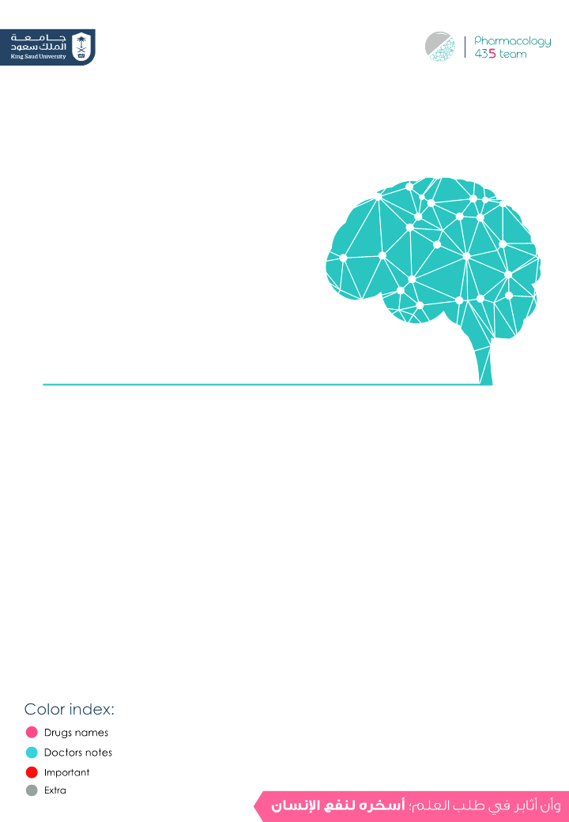
Alcohol and the brain
Editing File

Slide 2
Medically it’s only used topically as antiseptic drug
Ethyl Alcohol
Ethyl alcohol (ethanol):
most commonly abused drug in the world.
Pharmacokinetics
Small lipophilic molecule → readily crosses all biological membranes. Rapidly & completely absorbed from GIT Has large Vd (volume of distribution)(distributed to all body tissues) → Volume of distribution = Total body water (0.5-0.7 L/kg). “multi compartment distribution” Crosses placenta and excreted in milk. Acute alcohol consumption inhibits CYP450 2E1 → ↓ metabolism of other drugs taken concurrently as (warfarin, phenytoin).here patient might have bleeding if use warfarin Chronic alcohol consumption induces liver microsomal enzyme CYP450 2E1, which leads to significant increases in ethanol metabolism (Tolerance) & metabolism of other drugs as warfarin (Drug interactions). here patient might have DVT(deep vein thrombosis)
Metabolism in gastric mucosa & liver
Oxidation of ethanol to acetaldehyde via alcohol dehydrogenase or cyt-p450 (CYP2E1). Acetaldehyde is converted to acetate via aldehyde dehydrogenase which also reduces NAD+ to NADH. (Co-factor) Acetate ultimately is converted to CO₂ + water (to decrase the oxdtive stress) At low ethanol conc. → minor metabolism by MEOS (microsomal ethanol-oxidizing system) mainly cyt-p450 (CYP2E1). Upon continuous alcohol use, this enzyme is stimulated and contribute significantly to alcohol metabolism & tolerance.
Alcohol metabolism (major pathway)
90-98% in liver
Depends on cytosolic enzyme (alcohol dehydrogenase)
Oxidation reaction
Acetaldehyde is more toxic than alcohol
CH₃CH₂OH (Ethanol)
Alcohol dehydrogenase
CH₃CHO (Acetaldehyde)
cytosolic enzyme
NAD⁺
Aldehyde (acetaldehyde) dehydrogenase
NAD⁺
NADH
NADH
mitochondrial enzyme
CO₂ + water
CH₃COOH (Acetic acid)
* NAD+/NADH: nicotinamide adenine dinucleotide

Slide 3
Ethyl Alcohol
Hepatic cellular processing of alcohol (minor pathway):
Depends on the microsomal enzymes
If alcohol is taken in low conc. → minor pathway will start its function.
But if it taken for prolonged time, even in low conc. → chronic alcohol abuse → induction of liver enzymes → tolerance is developed → upregulation of microsomal enzymes → result in addiction. (psychological & physiological symptoms )
CH₃CH₂OH (Ethanol)
Cytosol
ER
(Endoplasmic reticulum)
O₂
CYP450
NAD+
NADPH
The same effect of alcohol dehydrogenase → converts Alcohol to Acetaldehyde
Alcohol dehydrogenase
NADP⁺
NADH
accumulation of acetaldehyde will lead to nausea and vomiting
Acetaldehyde
Mitochondrion
NAD+
Aldehyde dehydrogenase
NADH
Acetate
Extrahepatic tissue
Hepatic ethanol metabolism:
*Rate limiting step* which means it controls the whole pathway
Alcohol
Alcohol dehydrogenase
Acetaldehyde
NAD⁺
NADH
NAD⁺
Aldehyde dehydrogenase
NADH
Acetyl CoA
Acetate
Citric Acid Cycle
Energy
Fatty Acid synthesis
Fatty liver

Slide 4
Genetic variation of alcohol metabolism
Aldehyde Dehydrogenase polymorphism*:
- Asian populations (including Chinese, Japanese, Taiwanese, Korean) have genetic variation in aldehyde dehydrogenase resulting in a variant allele → Which means that acetaldehyde can NOT be converted to acetate due to aldehyde dehydrogenase deficiency.
- They metabolized alcohol at slower rate than other populations.
- Can develop “Acute acetaldehyde toxicity” after alcohol intake characterized by nausea, vomiting, dizziness, headache, vasodilatation, and facial flushing → it has a beneficial effect → This Strongly protect against alcohol-use disorders and prevent them from becoming alcoholic.
*Polymorphism is the existence of one gene in different forms.
Alcohol excretion:
- Excreted unchanged in urine (2-8%).
- Excreted unchanged via lung (basis for breath alcohol test).
- Rate of elimination is zero-order kinetic (not conc.-dependent)
i.e. rate of elimination is the same at low and high concentration →
Any change (increase) in its conc. → toxicity.
Mechanism of action of alcohol:
Alcohol is a CNS depressant
Acute alcohol | Chronic alcohol
- Enhancement the effect of GABA (inhibitory neurotransmitter) on its GABA receptors in brain → CNS depression. - Inhibition of glutamate action (excitatory neurotransmitter) on NMDA (N-methyl-d-aspartate) receptors → disruption in memory, consciousness, and alertness. that’s why it’s contraindicated for drivers | Up-regulation of NMDA receptors & voltage sensitive Ca²⁺ channels (Ca²⁺ influx to nerve cells).1 → Leading to alcohol tolerance & withdrawal symptoms (tremors, exaggerated response & seizures).1 - Chronic means low doses in prolonged time GABA will be down-regulated.
باختصار الفرق بين الاكيوت و الكرونك. ان الاكيوت للحين ما صار فيه تغيير بتركيب الريسيبتورز لمن يبدا الشخص يستخدم الكحول يصير فيه بلوك للقلوتاميت ريسيبتورز فيبدأ الجسم يحس انه فيه شي غلط فيزيد عدد الريسيبتورز حقت القلوتاميت علشان كذا لمن المدمن يوقف استخدام الكحول يكون عنده قلوتاميت ريسيبتورز كثير ولمن يرجع عمل القلوتاميت طبيعي يصير عندنا اوفر ستيميوليشن للقلوتاميت ريسيبتورز (لانها صارت كثيره) علشان كذا تطلع عنده اعراض ترك الكحول الميكانزم هذا كله اسمه (Up Regulation)

Slide 5
Acute actions of alcohol (depends on the conc.)
In mild-moderate amounts
CNS depression: - Relieves anxiety, euphoria (feeling of well-being). - Nystagmus, slurred speech, impaired judgment, and ataxia. - Sedation, hypnosis, loss of consciousness | CVS depression: - Myocardial contractility depression - Vasodilatation due to : vasomotor center depression & direct smooth muscle relaxation caused by acetaldehyde. → hypothermia may be marked in sever overdose that is why we see redness on their checks
In severe amounts
Severe CNS depression Respiratory depression. Most common cause of death Respiratory acidosis Nausea, vomiting, aspiration of vomitus CVS depression Volume depletion (dehydration Hypotension Hypothermia → in large doses. Coma, death if it combined with sleeping pills → CNS depression.
Gradual CNS depressing
Chronic actions of alcohol
T-DAB <o/
- Chronic ethanol abuse (alcoholism = addiction) is associated with many complications:
Tolerance
Dependence
Addiction
Behavioral changes
Liver
CVS
Hematology
hepatic cirrhosis & liver failure.caused by (RAAS)renin-angiotensin-aldosterone
Hypertension & myocardial infarction & damage blood vessels
Hematological disorders & neoplasia.
GIT
CNS
Endocrine
irritation, inflammation, bleeding, nutritional deficiencies
cerebral atrophy, cerebellar degeneration, and peripheral neuropathy. Wernicke encephalopathy or Korsakoff psychosis* may occur.
gynecomastia & testicular atrophy
Hematological disorders, neoplasia.
* Korsakoff syndrome is a chronic memory disorder caused by severe deficiency of thiamine (vitamin B1)

Slide 6
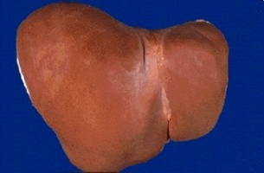
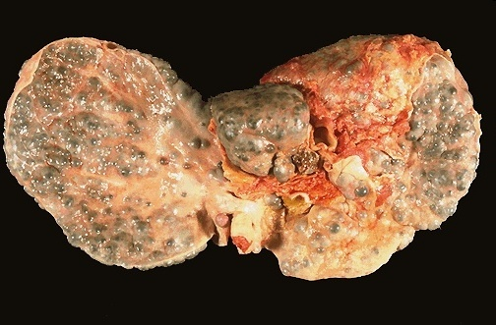
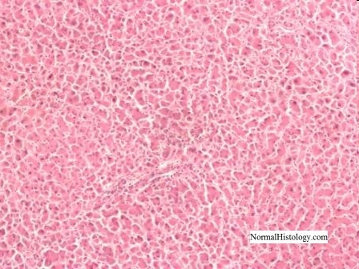
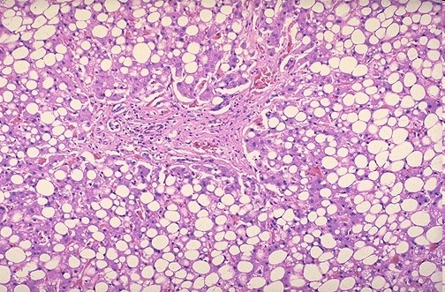
Complications Of Chronic Alcohol Use (Alcoholism)
 | The most common medical complication occurs with liver: 1-Reduction of gluconeogenesis (decrease glucose conc.) 2- Fatty liver/ alcoholic steatosis Reduction of gluconeogenesis → accumulation of Acetyl coA→ energy production from alcohol rather than from fat → accumulation of fat → (fatty liver) 3-Hepatitis 4- Hepatic cirrhosis: jaundice, Ascites, bleeding, encephalopathy. (liver metabolism not going properly → accumulation ammonia → enter brain → encephalopathy) 5- Irreversible liver failure. Acetate converted to other product Acetyl CoA “other than CO2+ H2O”. In over drinking → depletion of NAD will be in reduced form → all enzymes depend on NAD will not work → That lead to accumulation of Acetyl CoA → converted into fatty acid→ deposition in liver → first step injury happen in liver on drinking alcohol.
 | Healthy Liver vs Fatty Liver
 | -Alcoholic Liver Disease: Normal Liver Steatosis (infiltration of liver cells with fat) Steatohepatitis ( inflammation of the liver with concurrent fat accumulation in liver) Cirrhosis (a chronic disease of the liver marked by degeneration of cells, inflammation, and fibrous thickening of tissue) Fatty liver → inflammation→ hepatitis → fibrosis “liver not functioning” → cirrhosis.
 | Gastritis, Hemorrhagic esophagitis, Ulcer diseases, Pancreatitis (due to direct toxic action on epithelium) - It injures the small intestine, leading to: Diarrhea → decrease the absorption in the intestine. Deficiency of vitamins. Exacerbates nutritional deficiencies weight loss, and malnutrition (due to malabsorption) In heavy drinkers: increased risk of oral and esophageal cancer.
Healthy Liver
Liver in
chronic alcoholics
Liver
Acetaldehyde is more toxic than alcohol → causing inflammation and fat cell proliferation
mnemonics!!
Hassan Gave his Uncle a Pie
GIT System

Slide 7
Complications Of Chronic Alcohol Use (Alcoholism)
 | 1- Chronic alcohol abuse can lead to cardiomyopathy 2- Cardiac hypertrophy, fibrosis. 3- Congestive heart failure. 4- Arrhythmia → due to K⁺ and Mg²⁺ depletion as well as enhanced release of catecholamines. 5- Hypertension → due to increased Ca²⁺ & sympathetic activity. * Alcohol is the most common cause of reversible hypertension.
 | 1- Iron deficiency anemia (due to inadequate dietary intake “low absorption” & GIT bleeding).(microcytic anemia) 2- Megaloblastic anemia: (due to folate deficiency, malnutrition, impaired folate absorption).because of damage to gastric mucosa 3- Hemolytic anemia. because of oxidative stress 4- Bone marrow suppression 5- Thrombocytopenia (suppressing platelet formation, prolong bleeding times). 6- Impaired production of vitamin-K dependent clotting factors leading to prolonged prothrombin time.
 | 1- Hypogonadism (reduction or absence of hormone secretion or other physiological activity of the gonads (testes or ovaries)) : - In women: ovarian dysfunction, amenorrhea (in abnormal absence of menstruation) , anovulation, hyperprolactinemia (high prolactin) → infertility. - In men: gynecomastia(التثدي), decreased muscle & bone mass, testicular atrophy, sexual impotence due to inhibition of luteinizing hormone (LH), decrease in testosterone, estradiol, progesterone. in short term it increase sexual ability in long term (months or years)it cause impotence 2- Hypoglycemia & ketoacidosis due to impaired hepatic gluconeogenesis & excessive lipolytic factors, especially increased cortisol and growth hormone.
 | 1- Tolerance due to Up regulation 2- Physiological and psychological dependence Physiological Dependence refers to the process throughout which a body becomes dependent upon a foreign substance,Ex. person becomes addicted to alcohol or drugs. 3- Addiction: dopamine(major transmitter for drug addiction), serotonin and opioids are involved. 4- Neurologic disturbances 5- Wernicke-Korsakoff syndrome Vitamins deficiency→ A,D,B”B1”→ Wernicke encephalopathy or Korsakoff psychosis may occur.
Cardiovascular System
Hematological complications
Endocrine system
Central Nervous System

Slide 8
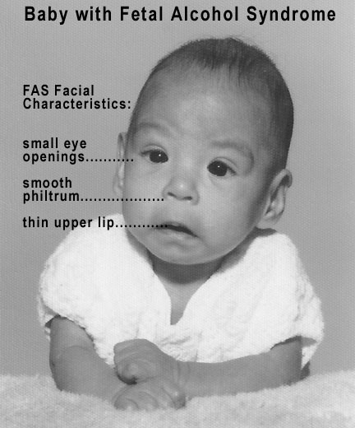
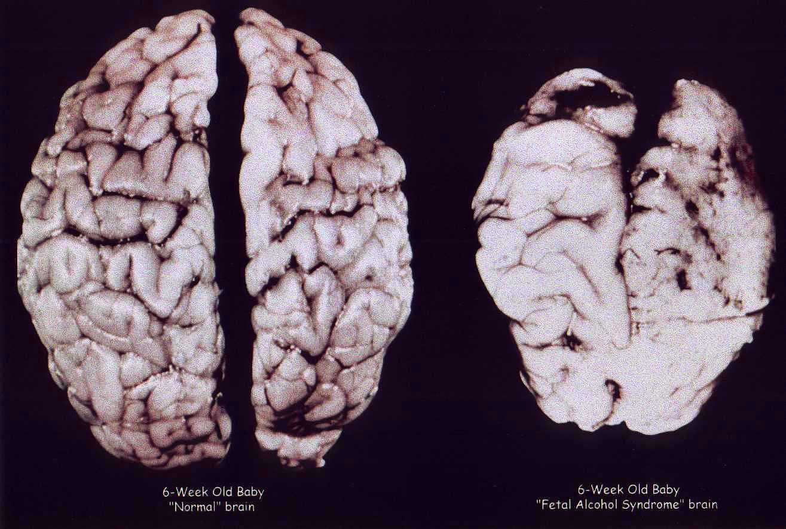
Chronic Alcoholism Associated Syndromes
Fetal Alcohol Syndrome (FAS): Irreversible
Alcohol is the leading cause of mental retardation and congenital malformation. Ethanol rapidly crosses placenta → the fetal liver has little or no alcohol dehydrogenase → fetus must rely on maternal & placental enzymes for elimination. Ethanol rapidly crosses placenta because it is highly lipid soluble and it is very small molecule Pre-natal exposure to alcohol causes: Intrauterine growth retardation (due to hypoxia) Congenital malformation (teratogenesis): Microcephaly Impaired facial development Congenital heart defects Physical and mental retardation.
The right brain is an infant’s brain that had pre-natal exposure to alcohol.
Wernicke-Korsakoff syndrome
It is a combined manifestation of 2 disorders:
- Wernicke's encephalopathy: characterized by: ocular disturbances. unsteady gait. changes in mental state as confusion, delirium(هذيان) ,ataxia. Nystagmus (All these symptoms is caused due to thalamus & hypothalamus damage) | - Korsakoff's psychosis: Impaired memory Cognitive and behavioral dysfunction.
Treated by: Thiamine + dextrose-containing IV fluids
Alcoholism Tolerance
Chronic consumption of alcohol leads to tolerance. develops due to:
Metabolic tolerance pharmacokinetic → Change in the absorption, distribution, metabolism, excretion. due to induction of liver microsomal enzymes e.g. CYP450 | Functional tolerance Pharmacodynamic → Change in the receptors. due to change in CNS sensitivity

Slide 9
Alcoholism withdrawal symptoms:
There symptoms result from high sympathetic activity & upregulation of the receptors
Autonomic hyperactivity & craving for alcohol
Vomiting, thirst
Profuse sweating, severe tachycardia
Vasodilatation, fever
Delirium(هذيان), tremors, anxiety, agitation, insomnia
Transient visual/ auditory illusions, violent behavior, hallucinations.
Grand mal seizures (after 7-48 hr alcohol cessation)1
Due to super-sensitivity of glutamate receptors
& Hypo-activity of GABA receptors are possibly involved.
-for treatment : we give them GABA agonist or glutamate antagonist
-major cause of withdrawal symptoms is high glutamate and low GABA
Mnemonic for Alcohol withdrawal (PAST NITE):
Psychomotor agitation Nausea
Anxiety Insomnia
Seizures Tremors
Transient hallucinations Excitability
Management of alcoholism withdrawal:
The Management of alcoholism withdrawal is substituting alcohol with a long-acting sedative hypnotic drug then tapering the dose.
as (chlordiazepoxide, diazepam) → long acting drug.
Or lorazepam that is preferable shorter duration of action
Benzodiazepines
incrase GABA
should be carefully adjusted to provide efficacy (via IV/po) & Manage withdrawal symptoms & prevent irritability, insomnia, agitation & seizures.
Avoid excessive dose that causes respiratory depression & hypotension
Fluoxetine
it's increase serotonin level
and decrease dopamine
(Serotonin reuptake inhibitors)
Management of Alcoholism Withdrawal
Clonidine Propranolol (nonselective beta-blocker)
Clonidine is a₂ agonist presynaptic
inhibits the action of exaggerated sympathetic activity
Acamprosate
بديل للكحول ولا يسبب الإدمان وله نفس effect
weak NMDA receptor antagonist & GABA activator → reduce psychic craving reduce risk of relapse

Slide 10
To prevent alcohol relapse:
Disulfiram therapy: 250 mg daily
Inhibits hepatic aldehyde dehydrogenase
increase blood level of acetaldehyde
Disulfiram
-induced symptoms render alcoholics afraid from drinking alcohol
Acetaldehyde produces extreme discomfort, vomiting, diarrhea, flushing, hotness, cyanosis, tachycardia, dyspnea, palpitations & headache
Alcohol and drug interactions
Acute alcohol use large dose
causes inhibition of liver enzyme, → decreases metabolism of some drugs and increases their toxicities e.g. bleeding with warfarin
Chronic alcohol use continuous use
induces liver microsomal enzymes → increases metabolism of drugs such as warfarin, propranolol
1
Acetaminophen + alcohol (chronic use)= risk of hepatotoxicity. → due to increased production of free radical metabolite of acetaminophen
→ High metabolism of high doses of acetaminophen
(بيأخذ كمية أكبر من الشخص العادي عشان يعطيه التأثير) → high free radicals (result from metabolism by microsomal enzymes) → hepatotoxicity
NSAIDs + alcohol = Increase in the risk of developing a major GI bleed or an ulcer.
Bc NSAIDs may causes ulcer and bleeding, so the combination increases the risk of ulcer & bleeding
2
Narcotic drugs (codeine and methadone → CNS depression drugs) + alcohol = risk of respiratory and CNS depression
3
* Alcoholic pts = chronic use
Alcohol suppresses gluconeogenesis, which may increase risk for hypoglycemia in diabetic patients.

Slide 11
Questions
MCQs
1- Which of the following is true about ethanol:
Lipophilic
Rapidly & completely absorbed from GIT
Cross placenta
All above
2- The deposition of ethanol is:
One-compartment
Two-compartment
Multi-compartment
None of these
3- Metabolism of ethanol mainly in:
Gastric mucosa
Liver
Small intestine
Large intestine
4- Which of the following is correct about acute alcohol use with warfarin ?
it decreases its metabolism and may cause thrombosis
it increases its metabolism and may cause thrombosis
it decreases its metabolism and may cause bleeding
it increases its metabolism and may cause bleeding
5- Acetate ultimately is converted to:
CO2 + water.
COOH + ester
O2 + water
None of these
MCQs Answers:
1- D
2- C
3- B
4- C
5- A

Slide 12
Questions
MCQs
6- Which of the following is cytosolic enzyme:
Alcohol dehydrogenase
aldehyde dehydrogenase
A & B
None of these
7- Which of the following is mitochondrial enzyme:
Aldehyde dehydrogenase
Alcohol dehydrogenase
A & B
None of these
8- Which of the following is a side effect of chronic alcoholism ?
Wernicke-Korsakoff syndrome
constipation
hyperglycemia
all
MCQs Answers:
6- A
7- A
8- A
SAQ
what is the major site of metabolism of ethanol ?
-metabolized mainly in the liver.
how is it metabolized (enzymes and products of ethanol metabolism) ?
-it gets converted by CYP2E1 into acetaldehyde and by acetaldehyde dehydrogenase
to acetate
what are the routes of excretion of ethanol and its rate of elimination ?
Excreted unchanged in urine - Excretion unchanged via lung
zero-order kinetic (not concentration-dependent)
why does the chronic effect of ethanol differ from its acute action ?
due to tolerance :
- Metabolic tolerance due to induction of liver microsomal enzymes
- Functional tolerance due to change in CNS sensitivity

Slide 13
Team leaders:
Ghaida Saad Alsanad
Omar Alsuhaibani
Team Members:
Adel Alsuhaibani
Sultan Alnasser
Khaled Aloqeely
Yazeed Alkhayal
Dimah Alaraifi
Razan Alhamidi
References:
- Doctors’ slides and notes.
- pharmacology Team 435.
Special thank for team 435
@Pharma4370
Pharm437@gmail.com

