Slide 1
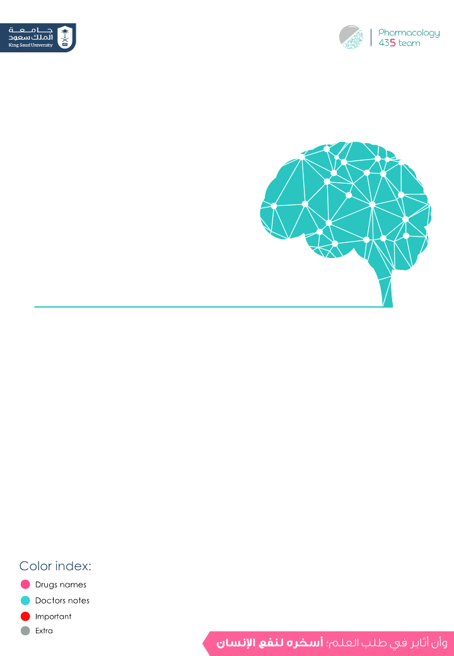
Drugs used in depression Old & New

Slide 2
Depression
Definition
Depression (major depressive disorder or clinical depression) is a common but serious mood affective disorder. It causes severe symptoms that affect how you feel, think, and handle daily activities, such as sleeping, eating, or working. To be diagnosed with depression, the symptoms must be present for at least two weeks.
Pathophysiology
- Neurotransmitter Imbalances & Dysregulation → creates a state of deficiency in monoamines → creates a state of deficiency in NTs (serotonin (5-HT), Dopamine, NE)
Changes in mood are associated with depression and/or mania.
Disorders of mood rather than disturbance in thought or cognition.
Incidence: Depression is a chronic and recurrent illness that can affect at least 20% of the population at some period in their lifetime.
An estimated 35-40 million Americans living today will suffer from major Depressive Illness during their lives.
Cost: 15-35 billions $ / year in USA only.
Notes:
added missing lines:
Changes in mood are associated with depression and/or mania.
Disorders of mood rather than disturbance in thought or cognition.
Incidence: Depression is a chronic and recurrent illness that can affect at least 20% of the population at some period in their lifetime.
An estimated 35-40 million Americans living today will suffer from major Depressive Illness during their lives.
Cost: 15-35 billions $ / year in USA only.

Slide 3
Classification of Depression
According to severity of symptoms:
According to
type:
Other forms of depression:
1. Mild depression self-limiting
2. Moderate depression difficulties at home and work
3. Severe depression serious, associated with suicidal thoughts
1.Psychotic
depression
2.Postpartum depression
3.Atypical depression
1- Unipolar depression (major depression):
2- Bipolar depression (manic-depression):
-mood swings are always in the same direction (depression)
-About 75% of cases are non-familial
accompanied by symptoms of anxiety and agitation
Associated with stressful life events
-25% familial
unrelated to external stresses.
endogenous depression
-In which depression alternates with mania -It is mainly hereditary and appears in early adult life

Slide 4
Just read it !!
Loss of energy and interest
Diminished ability to enjoy oneself.
Decreased -or increased- sleeping or appetite.
Symptoms of Depression
Difficulty in concentrating; indecisiveness; slowed or fuzzy thinking.
Exaggerated feelings of sadness, hopelessness, or anxiety.
Feelings of worthlessness.
Recurring thoughts about death and suicide.
If most of these symptoms last for two weeks or more, the person probably has Depressive illness
causes mood swings creating periods with the following symptoms:
A high energy level with decreased need for sleep.
Symptoms of Mania
Unwarranted or exaggerated belief in one's own ability.
Extreme irritability.
Rapid, unpredictable emotional changes.
Impulsive, thoughtless activity, with a high risk of damaging consequences (i.e., stock speculations, sudden love affairs, etc.).
Notes:
added symptoms of mania

Slide 5
Biochemical Theory of Affective Disorders
Treatment
Affective disorders
→ ↓ serotonin
NE
Mania
Drugs that↓NE
NE
Depression
Drugs that↑NE
the neurotransmitters (serotonin, dopamine,NE) are low they cause depression,so we need to increase the level of the neurotransmitters to treat it.
- What is the evidence to support this theory ?
Amphetamine make you alert it called”student drug” causes mania while reserpine antihypertensive it deplete NE storage in your body and methyldopa produce antihypertensive decrease NE
depression (these drugs depletes NE and dopamine storage).
Reserpine: antihypertensive causes depression because it lowers the monoamines in the synaptic cleft.
Amphetamine: drugs of addiction, release amounts of monoamines so causes mania and psychosis.
5-HT deficiency
may cause the sleep problems (Insomnia), irritability and anxiety associated with depression
Decreased level of NE
which regulates mood. alertness, arousal, appetite, reward & drives, may contribute to the fatigue and depressed mood of the illness
However, dopamine is important for pleasure,
sex & psychomotor activity.
What are the features of drugs that should be used for treatment of Depression? → Simply to increase the levels of these amines

Slide 6
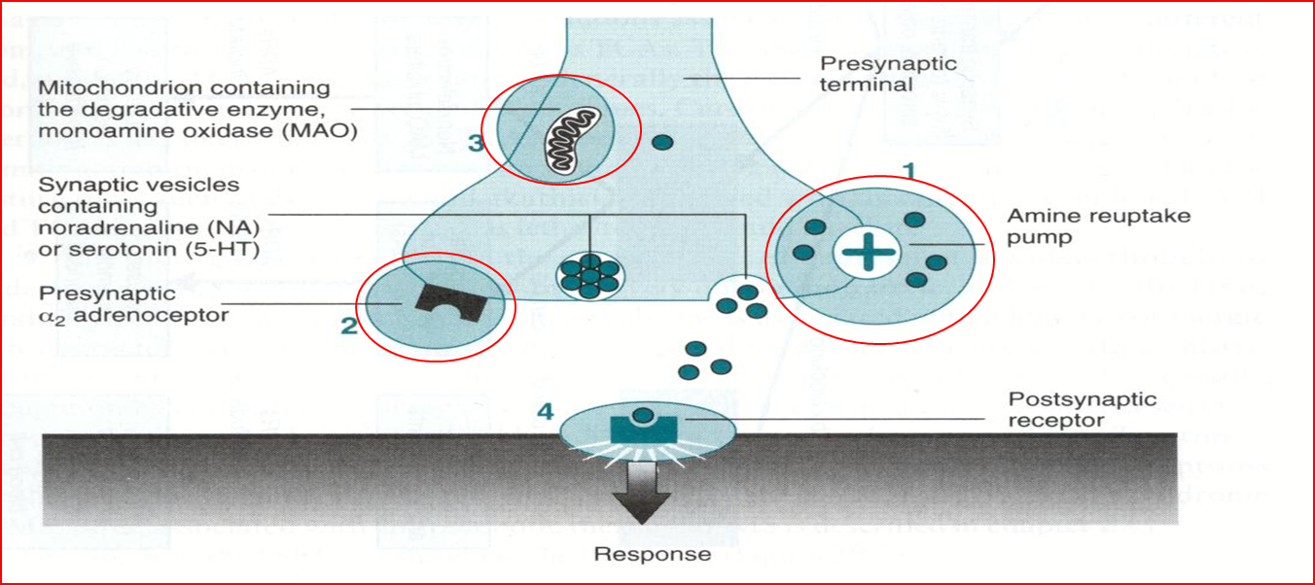
Antidepressants
Sites of Action for Antidepressants:
MAO metabolism degrdition to serotonin ,NE,Dopamine
1- Monoamine (NE or/and 5-HT) reuptake pump inhibitors
2- Blockade of presynaptic a₂ receptors
3- Inhibition of MAO enzyme
Drugs that block the reuptake of NE and 5-HT
e.g. Most tricyclics
(old Antidepressants)
Drugs that selectively block reuptake of 5-HT (SSRIs) (most common)
Fluoxetine; Paroxetine; Sertraline; Citalopram (New Antidepressants)
Classification of antidepressants based on site of action
e.g.:
Mirtazapine
Mianserin
Drugs that Block Presynaptic α₂- adrenoceptors
Drugs that Inhibit MonoAmine Oxidase
MAOIs, Phenelzine, Tranylcypraine, Moclobemide
(old Antidepressants)

Slide 7
Antidepressants available in the market (worldwide)
Class | Drugs
Tricyclics (TCAs) and Tetracyclics | Imipramine, Amoxapine, Maprotiline, Nortriptyline, Trimipramine, Clomipramine, Protriptyline, Desipramine, Amitriptyline
Monoamine Oxidase Inhibitors (MAOIs) | Tranylcypramine not used clinically, Phenelzine use for research not clinically, Moclobemide
Selective Serotonin Reuptake Inhibitors (SSRIs) | Fluoxetine, Fluvoxamine, Citalopram, Sertraline, Paroxetine, Escitralopram
Serotonin and Norepinephrine Reuptake Inhibitor (SNRI) | Venlafaxine, Duloxetine
Serotonin Antagonist and Reuptake Inhibitors (SARIs) | Nefazodone, Trazodone,
Norepinephrine and Dopamine Reuptake Inhibitor (NDRI) | Bupropion
Noradrenaline Reuptake Inhibitor (NRI) | Reboxetine
Noradrenergic and Specific Serotonergic Antidepressant (NaSSA) | Mirtazapine
this table contain both old & new antidepressant drugs
Notes:
serotonin reupatke enhancer is mentioned only in females slides

Slide 8
Slow onset of action
Antidepressants do not act immediately (show clinical effects after 3 weeks) indicating that secondary adaptive changes must occur before the benefit is gained.
The most consistent adaptive change seen with antidepressant drugs is the downregulation (Number of receptors decreases) of beta-, alpha-2 and 5-HT2 receptors these receptor up-regulated in depressed patients .
Desensitization (down-regulation) of β- adrenoceptors (decrease c-AMP) is very important and is related to clinical response that’s why antidepressants take 3 weeks to show effect .
Old Antidepressant
The oldest one
Tricyclic antidepressant
Monoamine
Oxidase inhibitors
Tricyclic (They have characteristic three-ring nucleus:
- Imipramine
- Desipramine
- Clomipramine
- Amitriptyline
- Nortriptyline
- Doxepin
- Trimipramine
Both TCAs & tetracyclic have the same MOA
- Maprotiline
- Amoxapine
Note: depression also comes in mild forms that do not require treatment with antidepressants. Treatment is only required to suffer from severe forms of depression mentioned above.
Tetracyclic

Slide 9
Old Antidepressant
 | Tricyclics (TCAs)
 | Imipramine anticholinergic, Amoxapine, Maprotiline, Nortriptyline, Trimipramine, Clomipramine, Protriptyline, Desipramine, Amitriptyline common
 | - All tricyclics block reuptake pumps for both 5HT (serotonin) and NE (norepinephrine) in nerve terminals by competing for binding site of the transport protein, so ↑ conc. of NE & serotonin in the synaptic cleft & at the receptor site. - Clomipramine, Imipramine, Amitriptyline have more potency for inhibition of 5HT uptake pump. - Nortriptyline, Desipramine have more potency for inhibition of NE uptake pump. - TCAs also block serotonergic, alpha-adrenergic, histaminic, and muscarinic receptors.
 | -Elevate mood -Improve mental alertness - Increase physical activity. Note: - The antidepressant effect may develop after several weeks of continued treatment (2-3 weeks). - In non-depressed patients: They cause sedation, confusion & motor incoordination.
 | - Peak levels: 2-6 hours. They are "lipophilic" in nature well absorbed from the GIT and cross the blood brain barrier to penetrate CNS. - Elimination: hepatic oxidation. - TCAs are metabolized in the liver by demethylation (Imipramine to Desipramine, Amitriptyline to Nortriptyline) and by hydroxylation into metabolites that retain the biological activity of the parent compounds. → This affects the T1\2 by increasing it.
 | Endogenous (Major) Depression → moderate to severe. Panic attack /acute episode of anxiety. Imipramine because it’s anticholinergic is used for treatment of nocturnal enuresis (bed wetting التبول اللا إرادي) in children and geriatric patients →(M.O.A) it constricts internal urethral sphincter (anti-muscarinic effect). Generalized Anxiety Disorder (GAD). Obsessive Compulsive Disorder (OCD) Attention Deficit Hyperkinetic Disorder (ADHD - فرط الحركة). Chronic neuropathic pains or unexplained body pains. → e.g. pain involved in diabetic pts, or any pain affecting the nerves.
Drug
Mechanism
of action
pharmacological
action
P.K
Indicatios

Slide 10
Drug | Tricyclics (TCAs) (cont.)
 | TCAs block: - α₁ adrenergic receptors - H1 histamines receptors - M1 cholinergic receptors - 5HT2 receptors - Anti-cholinergic: Dry mouth blurred vision, constipation & urine retention, aggravation of glaucoma ,(dental problem; xerostomia). - Anti-histaminic: Sedation, confusion. → H1 receptor effects. - Anti-adrenergic: Postural hypotension, arrhythmias, conduction defects. - Weight gain, sexual dysfunction & impotence. →the old group causes sexual dysfunction while most of new group doesn't cause . - Lower seizure threshold. - TCAs have narrow therapeutic index: toxicity can develop; excitement, delirium , convulsions, respiratory depression, coma, atropine-like effects, cardiac arrhythmias, sudden death. - TADs are highly protein bound and have a large volume of distribution → Therefore hemodialysis is not effective for treatment of TCA toxicity.
 | - TCA are strongly bound to plasma protein, therefore their effect can be potentiated by drugs that compete for their plasma protein binding site (Aspirin and Phenylbutazone). → increase their effect. - TCAs are metabolized by liver microsomal enzymes, therefore their effect can be reduced by inducers of liver microsomal enzymes (Barbiturates), or potentiated by inhibitors of liver microsomal enzymes (Oral contraceptives, Antipsychotics, and SSRIs). - TCAs (inhibitors of monoamine reuptake) should not be given with MAOIs ( inhibitors of monoamine degradation) → cause hypertensive crisis why?NA will cause vasoconstriction. - Additive to anti-psychotics and anti-parkinsonism (which have anti-cholinergic effect) → increase anti-cholinergic effects. - A helpful picture summarize there interactions.
 | - TCAs should not be used in patients with Glaucoma or with enlarged prostate because of their atropine-like action. - TCAs (given alone) are contraindicated in manic-depressive illness (Bipolar disease), because they tend to "switch" the depressed patient to the "manic" phase, therefore, they should be combined with "lithium salts". لو الشخص عنده bipolar disease وأعطيته أدوية مضادة للاكتئاب فقط، بتطلع لي حالته الثانية mania ، يعني في هذي الحالة أنا عالجت شيء وطلع لي شيء ثاني وكلهم ما أبيهم، في هذي الحالة لازم أعطي أدوية تضاد الاكتئاب، وأدوية تضاد الmood stabilizers) mania) مع بعض - Seizure disorders. → b/c they decrease its threshold.
ADRS
Drug Interaction
C.I
Notes:
why?NA will cause vasoconstriction. note taker might mean NE

Slide 11
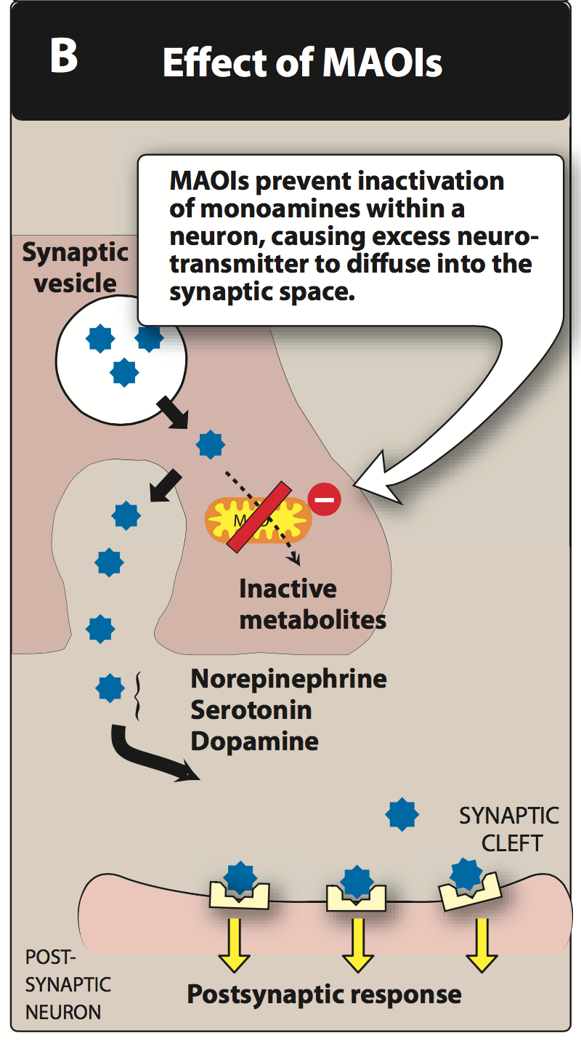
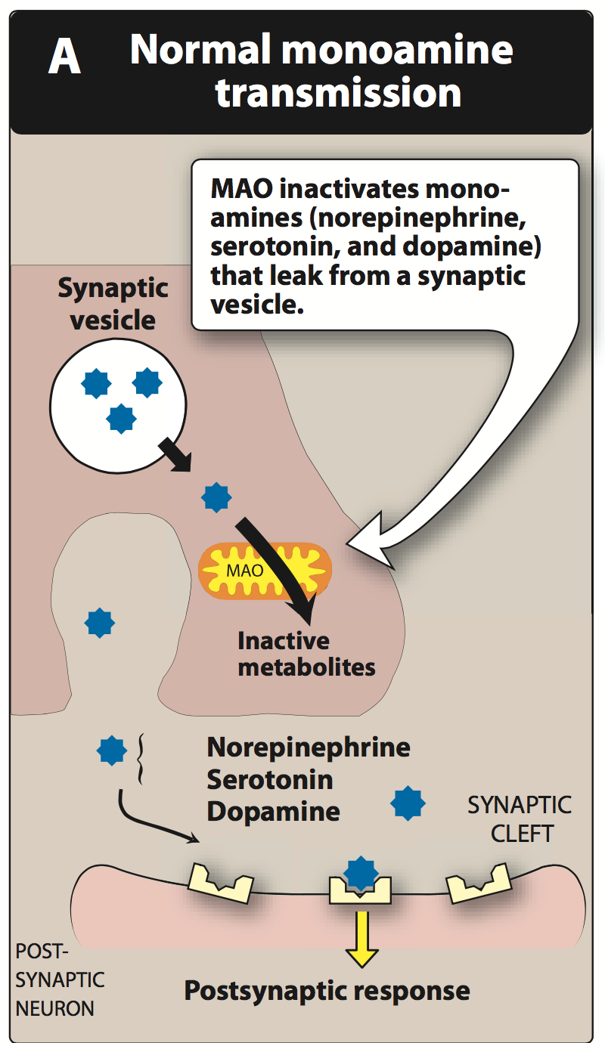
Monoamine oxidase
MAO is a mitochondrial enzyme found in nearly all tissues, and they exist in two forms:
MAO-A: responsible for NE, 5-HT catabolism. It also metabolizes tyramine of ingested food better for depression .
MAO-B: is more selective for dopamine metabolism these better for parkinson, they have risk factor for mania
Monoamine Oxidase Inhibitors (MAOIs)
Better than non-selective
Non-Selective Irreversible
Selective
Phenelzine (Irreversible) long acting
Moclobemide (A)
Tranylcypromine (reversible)
The drug of choice for the depression, because it is selective & reversible
→ The effect of irreversible MAOIs persists for a period of 2-3 weeks after stopping treatment, time needed by the body to synthesize new enzyme.
Selegiline (B)
Mnemonics:
- Maclobemide: maco (no more) mid (this why you won’t feel depressed but just for a short time bc the final is coming)
- Selegiline: seleg (سليق is a soft food therefore it’s good for parkinsonism since they'll have difficulty in eating hard food)
- M letter is before S letter so M would be acting on (A) while S on (B)
Mnemonics:
phen elzine (as the cute phen) is in a long distance relationship (long acting) w/ someone called trany
Notes:
435 had tranylcypromine as a non-selective IRREVERSIBLE MAOI

Slide 12
Monoamine Oxidase Inhibitors (MAOIs)
 | Phenelzine | Tranylcypromine | Moclobemide | Selegiline
 | Non- selective act on MAO A & B mostly in labs not for patients |  | Selective & Reversible
 | Irreversible long acting ( 2-3 weeks) | reversible | - Act on MAO-A - Anti depressant action. - Short acting | - Act on MAO-B - Used in the treatment of Parkinsonism.
 | Only used for refractory cases and in atypical depression where phobia and anxiety are prominent symptoms. -limited uses because: ADRs food and drug interactions low antidepressant efficacy
 | - Anti-muscarinic effects - Postural hypotension - Sedation - sleep disturbance - Weight gain.
 | 1- Pethidine: MAOIs interact with the opioid receptor agonist (pethidine) which may cause severe hyperpyrexia, restlessness, coma, hypotension. The mechanism still unclear – but it is likely that an abnormal pethidine metabolite is produced because of inhibition of normal demethylation pathway. 2- Levodopa: Precursor of dopamine can interact with MAOIs leading to hypertensive crisis. 3- Amphetamine and Ephedrine: Indirectly acting sympathomimetic can interact with MAOIs causing the liberation of accumulated monoamines in neuronal terminals leading to hypertensive crisis. 4- TCAs: (inhibitors of monoamine reuptake) can interact with MAOIs (inhibitors of monoamine degradation) leading to hypertensive crisis. 5- MAOIs & SSRIs: Serotonin syndrome. -When the doctor wants to switch drugs he has to stop the drug first and wait 2-3 weeks before switching to another drug (washout period)
Drug
Type
Clinical Uses
= Low benefit/risk ratio.
ADRs
Specific ADRs for(Phenelzine):
Sexual dysfunction
Hepatotoxicity
Drugs Interaction

Slide 13
MAOIs interaction with tyramine
- This occurs when Tyramine are taken with MAOIs
-Tyramine rich foods include old cheese, concentrated yeast products,
Pickled or smoked fish, Red beans, Red Wine, Chicken liver, Sausages).
-Tyramine in food is normally degraded in the in the gut by MAO-A.
-Since the enzyme is inhibited by MAOIs, tyramine from ingested food is absorbed, and then taken up into adrenergic neurons where it is converted into octopamine - a false transmitter which causes massive release of (NE) and may result in hypertensive crisis, severe hypertension, severe headache and fatal intracranial hemorrhage.
-Important Note: Moclobemide has No cheese reaction occurs with
its use.
New Antidepressant
The new groups are 6 in number:
1
Selective Serotonin Reuptake Inhibitors (SSRIs)
Noradrenergic and specific Serotonergic Antidepressant s (NaSSA)
2
3
Serotonin-2A Antagonist and Reuptake Inhibitors (SARI)
4
Serotonin and Noradrenaline Reuptake Inhibitors (SNRIs)
5
Norepinephrine and Dopamine Reuptake Inhibitors (NDRI)
6
NE Selective Reuptake Inhibitors (NRIs)

Slide 14
New Antidepressant
1. Selective Serotonin Reuptake Inhibitors (SSRIs)
The most widely utilized class of antidepressants in clinical practice
How does this group act?
By increasing the level of serotonin (5-HT) in the synaptic gap by
inhibiting its re-uptake within the brain.
→ Block 5HT transport → ↑ 5-HT levels in synapse.
Why do we call them SELECTIVE?
Because they affect only the reuptake pumps responsible for
Serotonin only.
Examples:
Fluoxetine, Paroxetine, Fluvoxamine, Sertraline, Citalopram, Escitalopram
Notes:
beginning of lec2

Slide 15
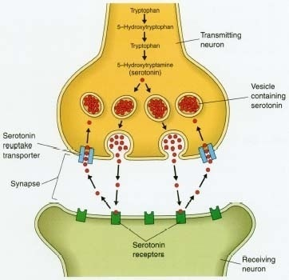
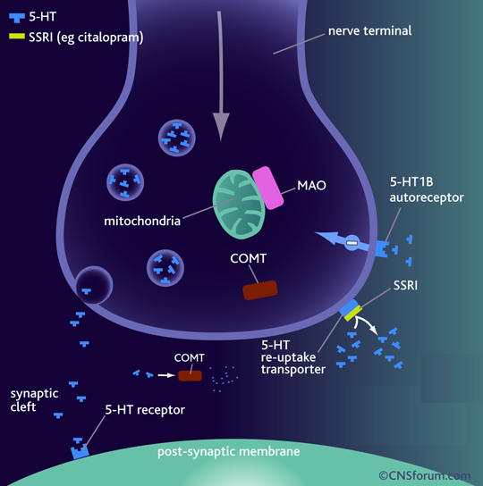
Mechanism of Action of SSRIs
Selective serotonin reuptake inhibitors (SSRI):
Binds to SERT→ Block 5HT transport➔ increase 5-HT levels in synapse.
They have No effect on NET (norepinephrine transporter) and they do not block mAch, H, or a1 Adrenoceptor ➔ so no antimuscarinic nor sedative effects Except Paroxetine → has sedative & anti-muscarinic effects.
They are nearly of comparable efficacy but of preferential response in each individual (the response differ from one to another)
Notes:
SERT transporter is mentioned as 5-HT transport in boys slides

Slide 16
SSRIs (cont.)
 | - The Most commonly prescribed antidepressants - Lacks cardiovascular and anticholinergic side effects compared to TCA (tricyclic antidepressants) - In contrast to MAOI (monoamine oxidase inhibitors), they do not cause ‘cheese’ reaction. - Safer (low risk of overdose) - Acute toxicity is less than that of MAOIs or TCAs
 | - T_{1/2}: → Too long (3-11 days)but the dose is for everyday: Fluoxetine (Prozac) → Moderate length (~24hr): Sertraline, Paroxetine, Citalopram. - Metabolized by P450 then conjugation. → They are enzyme inhibitors → Weak inhibitors → Sertraline, Citalopram → ↓ interaction → Strong inhibitors toxicity will increase → Fluoxetine, Paroxetine → ↓ metabolism of TCAs, neuroleptics, some antiarrhythmics, β-blockers.
 | - Same as for TCA, but it is effective in the following conditions - Depression. - Anxiety Disorder. - Eating disorders- bulimia nervosa (الرغبة في الأكل بشراهة) (fluoxetine), Anorexia nervosa (restricting eating).(they are opposite but the drug is for the psychological causes). - Post traumatic stress disorder. - Premenstrual dysphoric disorder. - Attention Deficit Hyperkinetic Disorder. - Treatment of premature ejaculation → by stimulation of 5-HT2A.
 | - GIT symptoms: Nausea, vomiting and diarrhea (due to 5-HT3 stimulation). → b/c of increased serotonergic activity in the gut. - Changes in appetite weight loss/gain (5-HT3 stimulation). - Sleep disturbances: Drowsiness with Fluvoxamine. - Anxiety & Tremors (if combined with other antidepressants). - Sexual dysfunction: Loss of libido (الرغبة) , delayed ejaculation (5-HT2A stimulation) → useful for treatment of premature ejaculation. (b/c of increased serotonergic tone at the level of the spinal cord and above)
 | Symptoms are headache, malaise & flu-like symptoms, agitation, irritability & nervousness
Advantages
P.K
Indications
ADRs
Discontinuation syndrome

Slide 17
Drug interactions of SSRIs
Important
SSRIs are potent inhibitors of liver microsomal enzymes. Therefore they should not be used in combination with TCAs because they can inhibit their metabolism increasing their toxicity if you want to combine with tricyclic choose drug selective for NE , also if combined with non selective tricyclic it will cause serotonin syndrome.
SSRIs should not be used in combination with MAOIs because of the risk of life-threatening "serotonin syndrome" (tremors, hyperthermia, cardiovascular collapse and death). Both drugs require a "washout" period of 6 weeks before the administration of the other.
Fluoxetine
It’s different from others members of this class in:
1- It has a longer t_{1/2} (50 hrs).
2- Available → as sustained release preparations الشركات تصنع هالنوع تجلس الجرعة لأسبوع في البداية اول ماتاكلة يعطي مفعول قوي ثمن يخف المفعول شوي شوي → once weekly.
3- Its metabolite norfluoxetine = potent as parent drug t_{1/2} =10 days.
2. Noradrenergic and specific Serotonergic Antidepressants (NaSSA)
Mirtazapine
Pharmacodynamic
- α₂ receptor antagonist - Increase NE and 5HT levels - Blocks 5HT_{2A ,} 5HT₃ and thus reduces side effects of sexual dysfunction and anxiety. - Blocking 5HT_{2C}, and H₁ receptors cause side effects: - Sedation → (H1 blocking effect) - weight gain → (5-HT2C blocking effect)
Preferred in cancer patients because:
1- It improves appetite 2- ↓ nausea & vomiting (by 5-HT₃ blocking) 3- ↑ body weight(5-HT2C blocking effect) 4- Sedation (H1 blocking effect) 5- Less sexual dysfunction (by 5-HT₂ blocking) 6- Has no anti-muscarinic effect.
Notes:
in the table citalopram isn't available it’s from 435

Slide 18
Other types of new antidepressant
3- Serotonin-2A Antagonist and Reuptake Inhibitors
4-Serotonin and NE Reuptake Inhibitors
5- NE and Dopamine Reuptake Inhibitors
6-NE selective Reuptake Inhibitors
Selective Blockage of 5HT to Reduce Depression
Selective Blockage of 5HT and NE
NE and DA Reuptake Inhibitor, With No Direct Action on 5HT
Block only NET
Trazodone, Nefazodone
Venlafaxine
Bupropion
Reboxetine
New antidepressant
 | 3. Serotonin-2A Antagonist and Reuptake Inhibitors (SARI) Trazodone, Nefazodone (Serotonin modulators) | 4. Serotonin and Noradrenaline Reuptake Inhibitors (SNRIs) Venlafaxine (effexor)
 | 1- Blocks 5HT uptake selectively but in a less potent manner than TCAs. This reduces depression. 2- However, they are powerful 5HT2A antagonists, blockade of 5HT_{2A} receptors stimulates 5HT1A receptors, which may help reduce depression. 3- 5HT_{2A} antagonism also reduces the risk of anxiety, sedation or sexual dysfunction which is normally associated with SSRIs. 4- Nefazodone: Structurally related to trazodone but has less sedative effect and does not block α- adrenoceptors , however; it likes most SSRI inhibit P450 3A4 isoenzyme. | 1- It is used primarily for the treatment of depression, generalized anxiety disorder, and social anxiety disorder in adults. Venlafaxine is the first and most commonly used SNRI. (it is more tolerable) 2- Selective 5HT and NE uptake blockers combines the action of SSRI and NRI, but without α1, M1 cholinergic or H receptor blocking properties. 3- Desvenlafaxine is a metabolite of Venlafaxine - Similar to TCAs, but they have better tolerability.
Drug
Mech. of Action

Slide 19
Class of drugs
 | 5. Norepinephrine and Dopamine Reuptake Inhibitors (NDRI) Bupropion | 6. NE Selective Reuptake Inhibitors (NRIs) Reboxetine
 | 1- Is unique in possessing significant potency as NE and DA reuptake inhibitor, with no direct action on 5HT. | 1- Block only NET (norepinephrine transporter) → No affinity for 5HT, DA, ADR, H, mAch receptors. So, has positive effects on the concentration and motivation in particular. → effects of NE.
 | Therapeutic uses: 1- Treatment of major depression and bipolar depression. 2- Can be used for smoking cessation. (because of DA release) → As it reduces the severity of nicotine craving & withdrawal symptoms. | ---
 | 1- No sexual dysfunction → (b/c no 5-HT blocking effect) given in young. (combination with SSRIs to avoid sexual dysfunction) 2- No weight gain [ No 5HT effect] 3- No orthostatic hypotension. | Safe to combine with SSRIs → Minimal side effects only related to activation of ADR system as tremor, tachycardia, and urinary hesitancy.
 | Seizures → it ↓ threshold of neuronal firing. (increases the stimulating NT) → Similar to TCAs. -contraindicated in epileptic patient. | ---
Drug
Mech. of Action
Indications
Advantages
ADRs

Slide 20
Clinical uses of Antidepressant Drugs
Endogenous depression → SSRIs (first choice), new generation and tricyclics can be used
1
2
Panic disorders (imipramine or SSRIs)
3
Obsessive Compulsive Disorders (SSRIs and Clomipramine), & Chronic pain (Amitriptyline)
4
Anorexia nervosa and Bulimia (SSRIs)
Schizo-Affective Disorders (Amoxapine or SSRI + Haloperidol) → you have to give him Anti-depressant + Anti-psychosis.
5
Anxiety disorders (Amitriptyline)
6
Migraine and Anxiety & IBS (Amitriptyline)
7
Nocturnal Enuresis in children e.g. Imipramine
8
Premature ejaculation (SSRI)
9
Neuropathic Pain (Dual NE and 5-HT reuptake Blockers)
10
Prof.Yieldez notes:
Very important to know the Mechanism Of Action of each drug (antidepressant Old&New).
Q: Which one do you prefer from the MAO inhibitors?
Moclobemide “ The Best” Why?
Selective,reversible , Also has:
- No severe sedative effect
- No anticholinergic effect
- No alpha blocking effect
هذا الدواء نبهت عليه بروف يلدز كثير واحتمال كبير يجي بال MCQs
Important to know drugs that works in reuptake transport , which are :
1- TCA→ work on both serotonin + NE.
2-SSAI→ work on serotonin.
3- venlafaxine→ work on serotonin + NE (more selective).
4- Reboxetine→ work on NE.
Bupropion→ work on dopamine .
Mirtazapine it’s important.

Slide 21
Summary of old antidepressants
 | TCA’s | MAOI
 | Inhibit reuptake of norepinephrine and serotonin = ↑ conc | Inhibits MAO which is responsible for NE, and 5-HT catabolism 1- Non Selective Inhibitors (MAO-A & MAO-B) Irreversible → Phenelzine, long acting Irreversible → Tranylcypromine 2- Selective Reversible Inhibitors → Moclobemide, (MAO-A) (antidepressant action, Short acting) ➔ Selegiline, (MAO-B) (used in the treatment of Parkinsonism)
 | - Lipophilic - Metabolized into metabolites that retain the biological activity - Strongly bound to plasma proteins Aspirin, and Phenylbutazone (compete for plasma protein binding site and increase potential) | Pethidine (severe hyperpyrexia, coma, hypotension) • Levodopa, amphetamines, Ephedrine, and TCAs(Hypertensive crisis) • SSRI (serotonin syndrome)
 | Used for major depression, chronic neuropathic pains or unexplained body pains. Imipramine is used for nocturnal enuresis in children and geriatric patients. | Refractory cases Atypical depression
 | TCAs have narrow therapeutic index - Anti-cholinergic effects (M1), Anti-histaminic effects (H1) Anti-adrenergic effects (a1) - Narrow therapeutic index -> toxicity + haemodialysis is not effective. Weight gain, sexual dysfunction & impotence | Cheese reaction: (MAOI + food containing tyramine → false neurotransmitter → Hypertensive crisis)*except for Moclobemide Antimuscarinic effects, Postural hypotension, Sexual dysfunction (phenelzine.), Sedation, sleep disturbance. Weight gain, Hepatotoxicity ( phenelzine).
 | - Glaucoma, Enlarged Prostate - Monotherapy in manic-depressive illness - Seizure disorders - TCAs should not be given with MAOIs "hypertensive crisis". | ------
Drug
Mechanism of Action
P.K +
Drug Interaction
Indications
ADRs
C.I

Slide 22
Summary of new antidepressants
 | SSRI’s | NaSSA | SARI
 | Fluoxetine, Paroxetine, Fluvoxamine, Sertraline, Citalopram, Escitalopram | Mirtazapine | Trazodone, Nefazodone
 | Inhibit reuptake of serotonin = ↑ conc | • Blocks presynaptic α2 • Blocks 5-HT3 & 5-HT2A | Blocks 5HT uptake 5HT2A antagonists
 | No antimuscarinic nor sedative effects Except Paroxetine. Shouldn’t use with: TCA (increase toxicity) MAOI (Serotonin syndrome) They are enzyme inhibitors | Preferred in cancer patients because: 1. Improves appetite 2- nausea & vomiting (5-HT3 blocking) 3- body weight 4- Sedation (potent antihistaminic) 5- Less sexual dysfunction (5-HT2 blocking) 6- Has no anti-muscarinic effect . | ---
 | Depression Eating disorders- bulimia nervosa (fluoxetine), Anorexia nervosa. Treatment of premature ejaculation (via stim of 5-HT2A). | Anti-depressant for cancer patients | ---
 | GIT symptoms (5-HT3 stimulation) Drowsiness (by fluvoxamine) Loss of libido, delayed ejaculation. (5-HT2A stimulation) Discontinuation syndrome | Blocking 5HT2C, and H1 receptors cause side effects: sedation, and weight gain. | ---
Group
Drug
MOA
General Information
Indications
ADRs

Slide 23
Summary of new antidepressants (cont.)
 | SNRIs | NDRI | NRIs
 | Venlafaxine | Bupropion | Reboxetine
 | Selective 5-HT and NE reuptake inhibitors But without α1, M1 cholinergic or H receptor blocking properties. | NE and DA reuptake inhibitor No action on 5HT | NE reuptake inhibitor
 | Venlafaxine is the first and most commonly used SNRI. Desvenlafaxine is a metabolite of Venlavaxine | No weight gain [No 5HT] No orthostatic hypotension | Safe to combine with SSRI
 | depression, generalized anxiety disorder, and social anxiety disorder in adults. | Treatment of major depression and bipolar depression. Can be used for smoking cessation. No sexual dysfunction -> given to young adults. | Limited to ADR system; Seizures, tachycardia, and urinary hesitancy.
 | --- | Seizures
Group
Drug
MOA
General Information
Indications
ADRs

Slide 24
Questions (old antidepressants)
MCQs
Q1/ according to symptoms classification of depression, mild depression is ____.
A-self-limiting
B-lead to suicide thoughts sometimes
C-difficulty dealing with surrounding environment.
D-A and C.
Q2/ Type of depression associated with (mania).
A-Unipolar depression. B-Bipolar depression. C-psychotic depression. D-Atypical depression.
Q3/ Hypertensive patient is under treatment plan, she’s taking reserpine. She came to psychiatry clinic complaining of depression.
Which of the follow effect is produced by this drug?
A-blocking of Alpha receptors B-Blocking beta receptors. C-inhibition of serotonin effect. D-depletion of serotonin and NE storage.
Q4/which of the following Drugs it’s mechanism of action to inhibit reuptake of serotonin and NE? A-moclobemid. B-Amoxapine. C-Fluoxetine. D-venlafaxine.
Q5/ mechanism of action of TAC (tricyclic antidepressant)
A- ↓ reuptake of serotonin. B-↓ reuptake of dopamine. C-↓reuptake NE. D-A&C
Q6/ True statement
A-TAC are lipophilic, excreted by kidneys.
B-TAC are lipophilic, Eliminated by Hepatic oxidation.
C-TAC are not lipophilic, excreted by kidneys.
D-TAC are lipophilic, Eliminated by hepatic demethylation.
MCQs Answers:
1-A
2-B
3-D
4-D Why? because it’s more selective
5-D
6-B

Slide 25
Questions (new antidepressants )
MCQs
Q1/ which of the following drugs is SSRI (serotonin selective reuptake inhibitor)?
A-mirtazapine.
B-Trazodone.
C-venlafaxine.
D-fluvoxamine
Q2/ which of the following SSRI (serotonin selective reuptake inhibitor) has sedation and anticholinergic side effects?
A-sertraline.
B-paroxetine.
C- fluvoxamine.
D- paroxetine and fluvoxamine.
Q3/ which of the following SSRI (serotonin selective reuptake inhibitor) used to treat OCD?
A-sertraline.
B-paroxetine.
C- fluvoxamine.
D-fluoxetine.
Q4/patient with premature ejaculation. What is the recommended treatment in this case?
A- drugs block 5HT2A receptor.
B-drugs block 5HT3 receptor.
C-drugs stimulate 5HT2A receptor.
D-drugs block D2 receptor.
Q5A patient recently had stroke. And now he is on warfarin (anticoagulant medications). After 3 hours patient showed in MRI, intra-abdominal bleeding.After taking history, patient is on antidepressant medication. What do you think the drug might be?
A-Trazodone.
B-Reboxetine.
C-Nefazodone.
D-venlafaxine.

Slide 26
Questions (new antidepressants )
MCQs
Q6/ which of the following is one of the therapeutic uses of Bupropion (NDRI)?
A-Anxiety.
B- OCD.
C-seizures preventions.
D-smoking cessation.
MCQs answer:
D
B
C
C
C
D
MCQs
SAQ
Q1/ patient with very severe depression. His uncle is an undergraduate medical student. He advised him to take Citalopram combined with Moclobemide.
Q1.1/ mention the mechanism of action of each drug?
Citalopram: SSRI.
Moclobemide: MAOI
Q1.2/ what will result in combining these 2 drugs?
Serotonin syndrome. marked by: tremors, hyperthermia, cardiovascular collapse and death
Q1.3/What is the recommended time to switch these drugs?
Washout period of 6 weeks
Q2/ patient was diagnosed with medulloblastoma recently. during chemotherapy she developed nausea, then vomited. Oncologist prescribed her Mirtazapine.
Q2.1/Which type this drug belongs to?
Antidepressants
Q2.2 What is the mechanism of action behind this drug+ targeted receptors?
NASSA (noradrenalin, specific serotonergic antidepressant).
-Alpha2 receptor -5HT2A receptor
-5HT3 receptor -5HT2C receptor -H1 receptor
Q2.3/ Give 3 reasons why it’s preferable with Cancer patients?
1-improves appetite.
2-increase Body weight.
3-sedation due to anti-histamine effect.

Slide 27
Questions
SAQ
Q1/ types of medication (According to site of action) used in depression?
1-TAC: Blocking presynaptic monoamine reuptake channel.
2-MAOI:inhibiting MAO Enzyme within presynaptic Terminal.
3-Alpha 2 blockers: By blocking presynaptic Alpha 2 receptor.
Cases
Q1/Patient was suffering from depression. His doctor prescribed antidepressant (Tranylcypromine). After two days, patient came ER by an ambulance suffering from severe hypertension symptoms. After taking History patient mention attending cheese-wine tasting party.
Explain by which mechanism the drug work and it where it takes place?
It acts on blocking presynaptic MAO enzyme.
Q1.2/Why do you think he developed hypertension in relation with patient history?
Cheese and wine contain Tyramine normally, and it’s degraded in the gut by MAO enzyme which was blocked by the Drug.
Q1.3/Which drug do you think would have been a better option for the patient, why?
Moclobemide. It does not have “cheese reaction”

Slide 28
Team leaders:
Ghaida Saad Alsanad
Omar Alsuhaibani
Team Members:
Adel Alsuhaibani
Sultan Alnasser
Dawood Ismail
Abdulrahman Alaujan
Rinad Alghoraiby
Munira Alhadlg
Razan Alhamidi
Alanoud Almansour
Saif Almeshari
References:
- Doctors’ slides and notes.
- pharmacology Team 435.
Special thank for team 435
@Pharma4370
Pharm437@gmail.com

