Slide 1
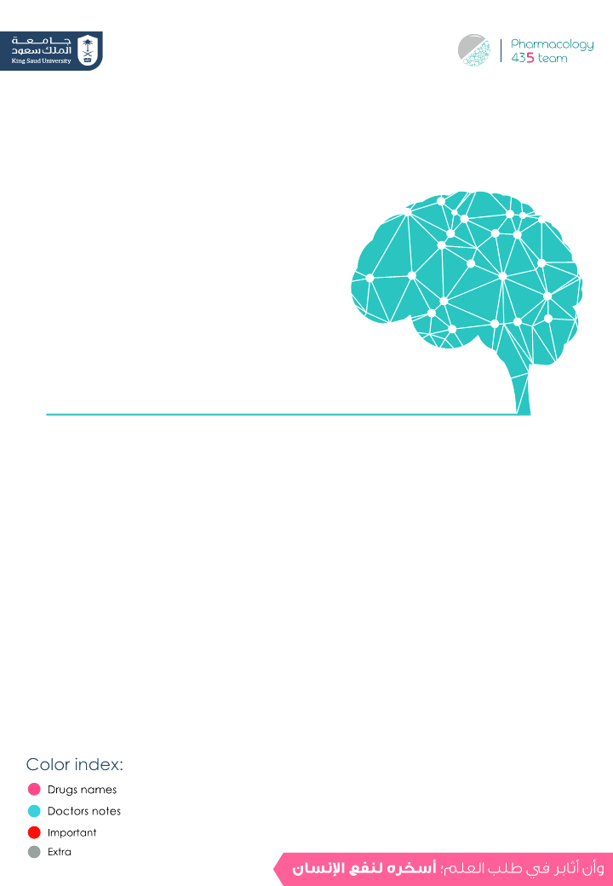
General Anesthetics
Objectives:
Define anesthesia, balanced anesthesia, and pre-anesthetic medications.
Be able to define MAC, potency, blood: gas partition coefficient and oil: gas partition coefficient.
Distinguish between inhalation and intravenous anesthetics.
Identify the pharmacokinetics, pharmacological actions, and side effects of inhalation anesthetics.
Identify the pharmacokinetics, pharmacodynamics, and side effects of intravenous anesthetics.
Know the difference between neuroleptanalgesia and neuroleptanesthesia.
Editing File

Slide 2
Important to know!!
يوجد اختلاف كبير بين سلايدات البنات والعيال!!
دكتور اشفاق حذف سلايدات كثيرة من عند العيال وقال اللي بيجي بالاختبار المشترك فقط.
اللون الوردي موجود بسلايدات البنات فقط.
جدول السميري مهم ، يحتوي على المعلومات المشتركة اللي ركزوا عليها الدكاترة من كلا الطرفين.
الهايلايت الرمادي: هو اللي اضافته او عدلت عليه بروف حنان بعد ما ارسلنا لها شغل التيم.
All inhalation anesthetics increase ICP contraidicated in head injuries.
All intravenous anesthetics decrease ICP except ketamine & opioids.

Slide 3
overview:
General Anesthesia
Inhalational
Intravenous
Can be used for induction
Volatile liquids
Gas
Methoxyflur-ane
Halothane
Enflurane
Isoflurane
Desflurane
Sevoflurane
Ether
Nitrous oxide
zenon
Slower acting
Faster
inducing agents
Dissociative anesthesia
Opioid analgesia
Benzodiazepines
Ketamine
Fentanyl
Diazepam
Lorazepam
Midazolam
Are halogenated hydrocarbons
Barbiturate
Ultra short acting
Propofol
Etomidate
Droperidol
Mnemonic:
The benzodiazepines family is small, happy, and hyperactive. They have 3 kids: Clara, Lora, and Dia.
Used as antidepressant bc they’re happy. But also bc they’re hyperactive they may fall, forget things, and run out of breath (respiratory effect)
Thiopental
methohexital
Mnemonic:
مها اندس في سنها سوس
م= Methoxyflurane
ها= Halothane
ان=Enflurane
دس:Desflurane
س= Sevoflurane
ن=Nitrous oxide

Slide 4
Introduction:
General Anesthetics: Drugs used to induce loss of pain sensation, loss of consciousness, skeletal muscle relaxation, analgesia, amnesia(فقد الذاكرة) and inhibitions of undesirable autonomic reflexes.
types of anesthesia
General anesthesia
Local anesthesia
stages of anesthesia
Stage I (analgesia)
Stage II (Excitement)
Stage III (Surgical anesthesia)
Stage IV (coma and death)
-Loss of pain sensation
-The patient is conscious and conversational.
-Increased respiratory rate.
-Increased, irregular blood pressure.
-Patient may experience delirium & violent behavior.
-Eye dilated & reactive.
-Hyperactivity + irregularity of most the autonomic N.S
- Regular respiration & relaxation of Sk. muscles.
- Eye reflexes decrease until the pupil is fixed.
-the most desire stage.
- Medullary paralysis.
-Severe depression of vasomotor
-Depression of respiratory centers.
- Death may occur.
divided into 4 planes:
1. Cortical centers
2. Basal ganglia
3. Spinal cord
4. Medulla
Girls slide

Slide 5
Introduction:
Characters of an ideal anesthetic drug
smooth & rapid induction
Rapid recovery
Wide safety margin
Minimal side effects
Ideal general anesthesia
Girls slide
Loss of pain sensation & unconsciousness
‘Amnesia-hypnosis’
Need for muscle relaxation
Analgesia
‘Loss of sensory & autonomic reflexes’
Loss of unwanted autonomic reflexes
Balanced Anesthesia
- Balanced anesthesia is achieved by a combination of I.V and inhaled anesthesia , Pre-anaesthetic medications and also sk. muscle relaxants .
- Thus it will increase the beneficial effects & decrease the adverse effects of general anesthetics which will fulfill the patient needs.

Slide 6
Pre-Anesthetic Medications
Calm the patient & relieve pain.
Protect against undesirable effects of the subsequently administered anesthetics or the surgical procedure.
Facilitate smooth induction of anaesthesia.
Lowered the dose of anaesthetic required.
 | Used to | Example
Opiates | Induce analgesia | morphine
Anticholinergics | Prevent secretion of fluids into the respiratory tract Protect the heart against vagal stimulation (bradycardia) | hyoscine
Sedatives & anxiolytics | Relieve anxiety | diazepam
Antihistamines | Allergic reactions | diphenhydramine
Antiemetics | Post surgical N&V. | metoclopramide & prochlorperazine
H2-receptor blockers | Reduce gastric acidity | ranitidine
Thiopental | Smooth induction
Neuromuscular blockers | Facilitate intubation & suppress skeletal muscle tone. | succinylcholine, vecuronium & atracurium

Slide 7
MOA of General Anaesthetics
MOA:
-Disruption of the function of ionic channels
-Disruption of lipids associated with ionic channels
Girls slide
Enhanced
GABA A
Inhibitory
*NB: General anesthetics do NOT combine with GABA receptors (they just enhance their action)
glycine
Girls slide
Receptors
nAch
n= Nicotinic
Excitatory
Inhibited
NMDA
N-methyl-D-aspartate
Enhance the action of GABA A and glycine receptors leading to greater entrance of chloride ion hyperpolarization thus decrease neuronal excitability.
-CNS depressant most of them act to stimulate or inhibit of exist neurotransmitter .
Inhalation anesthetics
The faster the better
induction : time elapsed between onset of administration of anesthetics(drug) and development of effective surgical anesthesia (stage no.3).
Maintenance : Time during which the patient is surgically anesthetized(keeping the patient stage 3).
Recovery: The time from discontinuation(stopping)of anesthetic drug until consciousness is regained
The faster the better

Slide 8
Inhalation anesthetics
Pharmacokinetics of Inhalation anesthetics:
Rate of induction
Depth of anesthesia and Recovery
Factors controlling induction & recovery :
1- The anesthetic concentration in the inspired air Direct
2- Blood solubility : Blood gas partition coefficient Inverse relation (means it need more time to reach CNS to produce an effect.)
3- Rate and depth of ventilation Direct
methoxyflurane | 12 |  | Slow
halothane | 2.3 |  | Slow
Enflurane | 1.8 |  | Medium
Isoflurane | 1.4 |  | Medium
Sevoflurane | 0.69 |  | Rapid
Desflurane | 0.42 |  | Poor & Rapid
Nitrious oxide | 0.47 |  | Rapid
Drugs
Solubility
Induction & Recovery
“Blood : gas partition coefficient”
Nitrous oxide has the lowest solubility,the fastest induction and recovery, the highest MAC and least potent

Slide 9
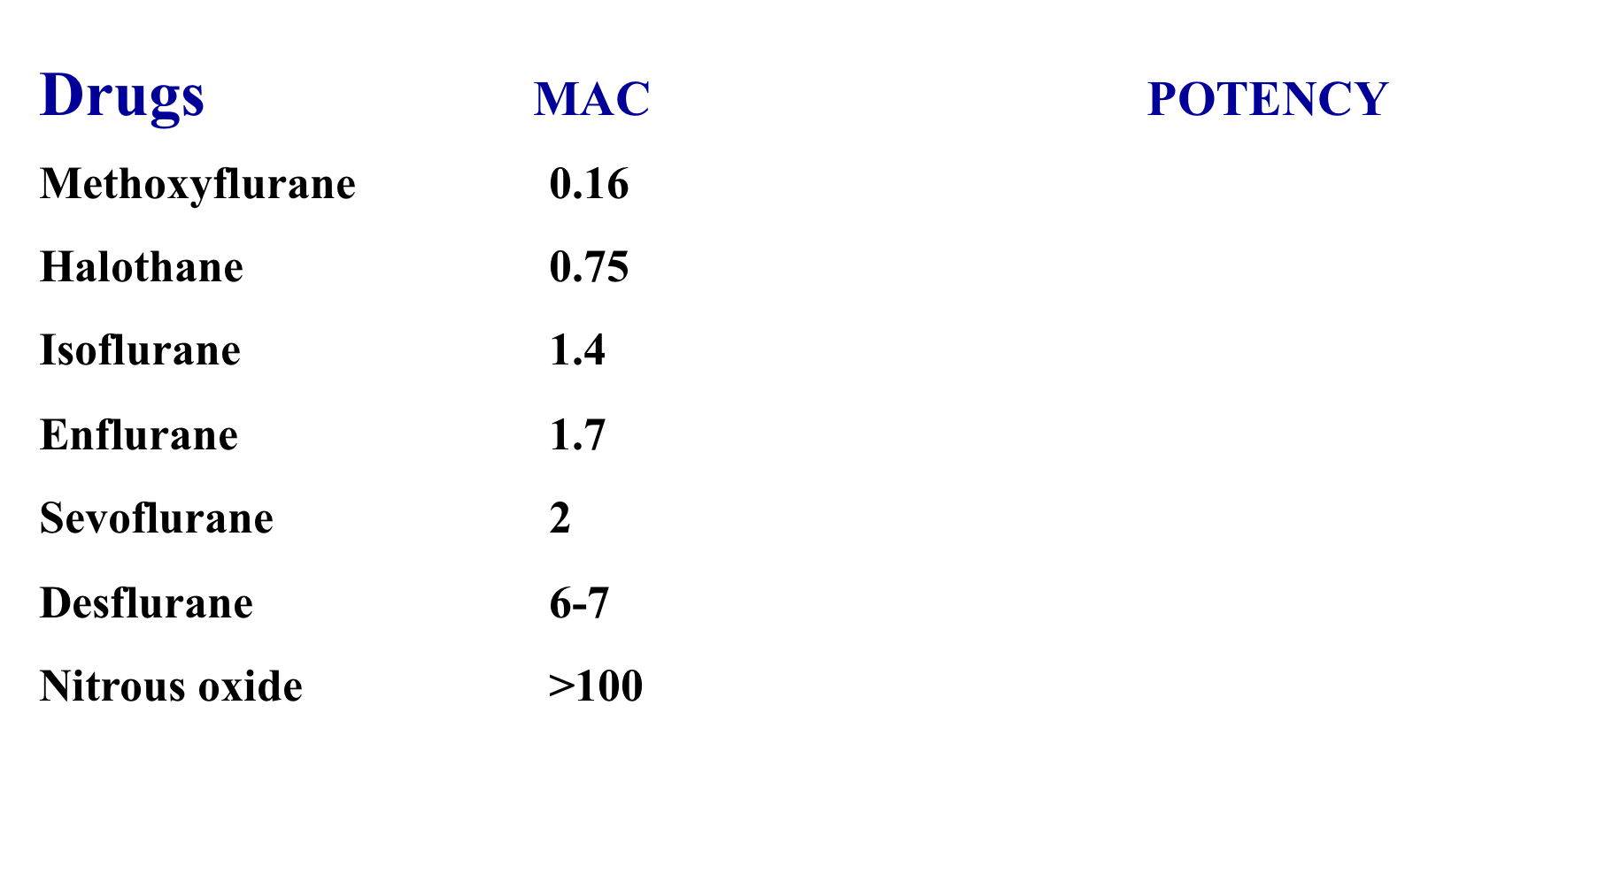
It is the concentration of inhalation anesthetic that produce immobility (affect) in 50 % patients in response to surgical incision.
Potency of anesthetic agents.
Oil: gas partition coefficient =lipid solubility =
(Direct with potency).
The lower the MAC value the more potent the drug.
Decreased by CNS depressants, old people.
Increased by CNS stimulants.
Potency is inversely proportional to MAC value of anesthetic agents.
Minimum alveolar concentration (MAC)
Girls slide
Drug | MAC value | Induction & recovery | Potency
Methoxyflurane | low MAC value 0.16 | slow induction & recovery | The most potent
Halothane (Pleasant odor) | 0.75 | Slow | Potent
Enflurane (Pungent odor) | 1.4 | Medium | Less potent
Isoflurane | 1.7 | Medium | Less potent
Sevoflurane (Better smell) | 2 | Rapid | Less potent
Desflurane (Pungent odor) | 6-7 | Rapid | Less potent
Nitrous oxide | >100 | Rapid | Least potent

Slide 10
Pharmacological actions of inhalation anesthetics
System | Pharmacological action
Central nervous | - ↓ metabolic rate. - ↑ ICP (due to cerebral vasodilatation) # in head injuries. - Dose -dependent EEG changes (Enflurane). - -Enflurane contraindicated in epilepsy
Cardiovascular | - Hypotension - Bradycardia Except (Isoflurane ,Desflurane & Sevoflurane ). - Myocardial depression (Halothane – Enflurane). -Sensitize heart to catecholamines (Halothane) Halothane contraindicated in pheochromochytoma
Respiratory | - All respiratory depressants -Airway irritation (Desflurane-Enflurane due to pungent odor).
Liver | - Decrease hepatic flow - Hepatotoxicity (Only halothane) only in adults
Uterus & skeletal muscle | -Uterine relaxation BUT Nitrous oxide has minimal relaxant effect (labor) - All are skeletal muscle relaxants. (of variable degrees)

Slide 11
Inhalation Anesthetics
 | Halothane | Enflurane | Isoflurane (Forane)
 | Potent | Less potent than Halothane | Potent, stable compound (2%)
 | Slow induction and recovery | More rapid induction and recovery than halothane | Rapid induction and recovery
 | Pleasant odor used in children | Pungent | Pungent
 | Metabolized to toxic metabolites (trifluoroethanol) hepatotoxic | Metabolized to fluoride (8%), excreted in the kidney (lead to nephrotoxicity) | Low biotransformation (Less fluoride)
 | Potent anesthetic, Weak analgesic, Weak skeletal muscle relaxant | Better muscle relaxation, Better analgesic properties | Potent anesthetic, Good analgesic action
 |  | --- | - No nephrotoxicity - No hepatotoxicity - No sensitization of the heart - No cardiac arrhythmias
 | - CVS depression: Hypotension, bradycardia (vagomimetic action) ↓Myocardial contractility, ↓Cardiac output - Hepatotoxicity (repeated use). (only in adults, not in children) - Malignant hyperthermia. (can’t be predicted) - Cardiac arrhythmias. - Sensitizes heart to action of catecholamines →arrhythmias. | Pungent (Less induction in comparison to other inhalation it’s slow Not for pediatrics) -CNS stimulation (Epilepsy-like seizure -abnormal EEG) | Pungent (Not for pediatrics)
 | - Pheochromocytoma | -Patients with seizure disorders (epilepsy) -Not for renal failures | ---
Drug
Potency
Induction & Recovery
Smell
Metabolization
Uses
Profs. Notes on Halothane:
1- Slow induction
2- Very potent
3- Hepatotoxicity in adults
4- Arrhythmias (sensitizes heart to catecholamines)
Advantages
ADRs / Disadvantages
CI.

Slide 12
Inhalation Anesthetics
 | Desflurane | Sevoflurane | Nitrous Oxide (N2O)
 | Less potent than Halothane | Less potent than Halothane | the Lowest potency
 | Rapid induction and fast recovery (Low solubility) | Rapid onset and recovery (Low solubility) | Rapid induction and recovery (Low solubility)
 | Pungent (worst odor) | Better smell | ---
 | Less metabolized (0.05%) Low boiling point (special equipment) | Less metabolized (3-5% fluoride) | ---
 | --- | No airway irritation (preferable for children) | Weak anesthetic (Low potency, combined) Potent analgesic - Outpatient anesthesia (Dental procedures). - Balanced anesthesia. - Neuroleptanalgesia - Delivery.
 | --- | Little effect on HR | No muscle relaxation, No respiratory depression Not hepatotoxic, minimal CVS adverse effects
 | Pungent odor (irritation - cough) | --- | - Diffusion Hypoxia: (respiratory diseases). - Nausea and vomiting. - Inactivation of B12 →megaloblastic anemia. - Bone marrow depression-Leukopenia (chronic use). - Abortion - Congenital anomalies with repeated exposure eg. nurses
 |  |  | - Pregnancy(uterine relaxant) - Pernicious anemia. - Immunosuppression.
Drug
Potency
Induction & Recovery
Smell
Metabolization
Uses
Advantages
ADRs / Disadvantages
CI.
All of the inhalation anesthetic drugs are contraindicated in head injury.

Slide 13
Intravenous Anesthetics
NO need for special equipments.
Rapid induction & recovery EXCEPT benzodiazepines
Injected slowly (rapid induction) compared with inhalation.
Recovery is due to redistribution from CNS.
Analgesic activity: Opioids & ketamine
Amnesic action: benzodiazepines & ketamine.
Can be used alone in short operation & Outpatients anesthesia.
Patient with hypovolemia or shock suffer from severe hypotension so I can’t give them Barbiturates, Propofol, Etomidate and Benzodiazepines since they decrease BP. We can give them Katamine because it’s the only one that increase sympathetic→↑BP.

Slide 14
Intravenous Anesthetics
 | Ultrashort acting barbiturates -Thiopental -Methohexital Ends with al or one, Hypnotic | Propofol Hypnotic(Non Barbiturate) Hypnotic | Benzodiazepines -Midazolam -Diazepam -Lorazepam Hypnotic anxiolytics
 | Rapid (1 min) (high lipid solubility) | Rapid | slower than other agent
 | Ultra short (15 - 20 min) they undergo Redistribution | short | ---
 | slowly by the liver . slow recovery. hangover. | Rapidly in liver ( 10 times - Elimination ½ = 30 – 60 min). Faster recovery than thiopental | Slow induction and recovery *reserved for preanesthetic
 | -Potent anesthetic. -Induction in major surgery. - Alone in minor surgery. -In head injuries : ICP. | -Antiemetic action. - ICP. | -No pain. -anxiolytic and amnesic action. -Induction of general anesthesia. -Alone in minor procedure (endoscopy). -In balanced anesthesia (Midazolam).
 | -CVS collapse and respiratory depression (laryngospasm,bronchospasm). -precipitate porphyria attack. (enzyme inducers) -hypersensitivity reaction. | -CVS collapse (Hypotension) -CVS and respiratory depression. -Excitation (involuntary movements). (like enflurane) - Pain at site of injection. -Expensive. -Clinical infections due to bacterial contamination. | - respiratory depression. -CVS collapse (Hypotension)
 | -Respiratory patients -COPD -Porphyria -severe hypotension (hypovolemic & shock patient) | --- | ---
Drugs
Onset
D.O.A*
Metabolization
Uses
ADR
C.I
*D.O.A =duration of action

Slide 15
Intravenous Anesthetics
 | Etomidate Ultrashort acting hypnotic (Non Barbiturates) | Ketamine given IV, IM (Children) | Opiate drugs -Fentanyl -Alfentanil -Sufentanil -Remifentanil
 | Rapid | rapid but in comparison to other I.V it’s slow | Rapid
 | short | short | Short
 | Rapidly in liver. fairly fast recovery less hangover | --- | ---
 | ---- | -Dissociative anesthesia (Analgesic activity, Amnesic action ,immobility, complete separation from the surrounding environment). -Used in (hypovolemic, shock & elderly) patients. -Potent bronchodilator (asthmatics). | - Potent analgesia. NOT anesthetic -Neuroleptanalgesia (Fentanyl+Droperidol ). -Neuroleptanesthesia (Fentanyl+Droperidol+ nitrous oxide).
 | -Minimal CVS and respiratory depressant effects. -Involuntary movements during induction (diazepam). -Postoperative nausea & vomiting. -Pain: at the site of injection. -Adrenal suppression | -Risk of hypertension and cerebral hemorrhage ICP -Postoperative: -hallucination vivid dreams & disorientation & illusions. - BP & cardiac output → (­ central sympathetic activity). Increases plasma catecholamine levels→ ICP ADRs: طبعاً على حسب استخدامنا لهم ممكن يكون سايد افيكت وممكن نستخدمه بطريقة تفيدنا | -Respiratory depression, bronchospasm . -(wooden rigidity). -Hypotension -nausea & vomiting -Increase in ICP -Urinary retention. -Prolongation of labor & fetal distress.
 | --- | -Head injuries -CV diseases (hypertension-stroke). But is the drug of choice in hypovolemic & shock patient | -Head injuries. -Pregnancy. -Bronchial asthma. -Chronic obstructive lung diseases. -Hypovolemic shock (Large dose only)
Drugs
onset
D.O.A
Metabolization
Uses
ADR
C.I

Slide 16
Opiate drugs
Girls slide only
Neuroleptanalgesia :
( Opiate drugs)
A state of analgesia, sedation and muscle relaxation without loss of consciousness.
used for diagnostic procedures that require cooperation of the patient.
Innovar (Fentanyl + Droperidol ). Blocks dopamine release
Contraindicated in parkinsonism.
Neuroleptanesthesia :
A combination of (Fentanyl + Droperidol + nitrous oxide).

Slide 17
Summary
*Prof. Hanan said it's important to know the characteristic of each drug that make it unique (summarized here)
النقاط المهمة واللي ركزوا عليها بروف حنان ودكتور اشفاق موجودة بالجدولين
Inhalation Anesthetics
Drug | Characters | S/E | C/I | Uses
Methoxy- flurane NOT USED | For veterinary use only | Slow induction, nephrotoxicity |  | No longer used | highest solubility, potency - slowest induction & recovery lowest MAC
Halothane (Pleasant odor) | non-irritant. Slow induction Very potent Weak analgesic. Can be used in children. | Hepatotoxicity (adult only) Malignant hyperthermia. Sensitization of heart to catecholamines → arrhythmias. | pheochromocytoma | since it does not cause hepatotoxicity in children and has pleasant smell, can be used with children
Enflurane (pungent odor) | Metabolized to fluoride (8%), excreted by kidney | Airway irritation CNS stimulation (Epilepsy-like seizure- abnormal EEG). | patients with seizure disorders. renal failures. Epilepsy patient
Isoflurane (Forane) (Pungent odor) | Stable compound. No nephrotoxicity. No hepatotoxicity.
Sevoflurane (better smell) | No airway irritation (preferable for children) |  |  | with children.
Desflurane (Powerful pungent odor) | Low boiling point (special equipment). | Its pungent odor lead to airway irritation and cough
Nitrous oxide (Pungent odor) | Potent analgesic. weak anesthetic. | Diffusion Hypoxia. Inactivation of B12→ megaloblastic anemia. Abortion - Congenital anomalies. leukopenia | Pregnancy. Pernicious anemia. Immunosuppression | Dental procedures Balanced anesthesia.(not used alone) Neuroleptanalgesia Delivery. | lowest solubility fastest induction & recovery highest MAC and least in potency

Slide 18
Summary
Intravenous Anesthetics
Drugs: |  | Characters | S/E | C/I | Uses:
 | Thiopental | Rapid onset of action Short duration (Redistribution) Potent anesthetic ↓ ICP | CVS & respiratory depression precipitate porphyria attack hypersensitivity reaction(sulfat) | Hypotensive patient porphyria patients chronic obstructive lung disease | induction in major surgery and alone in minor surgery. (dentistry) in head injuries
 | Methohexital
 | Propofol | ↓ICP Has Antiemetic action. | Excitation (involuntary movements)1 | --- | ---
 | Etomidate | Rapidly metabolized in liver (less hangover). Minimal CVS and respiratory depressant effects. | Involuntary movements during induction (like diazepam). Adrenal suppression | --- | a safe Cardiovascular and respiratory risk profile
 |  | Dissociative anesthesia (Analgesic activity Amnesic action) Can be given IV or IM (especially in children) ↑central sympathetic activity2 Potent bronchodilator. | Psychotomimetic effect after recovery ( hallucination vivid dreams) ↑ICP - salivation hypertension cerebral hemorrhage. | Head injury Hypertensive patient Cardiovascular disorders | hypovolemic, shock & elderly patients
 | fentanyl | Potent analgesia. | bronchospasm (wooden rigidity). Hypotension ↑ICP prolong labor and fetal distress Urinary retention. | Head injury. Pregnancy. Bronchial asthma +COPD Hypovolemic shock | Neuroleptanalgesia Neuroleptanesthesia
 | Alfentanil
 | Sufentanil
 | Remifentanil
 | diazepam | anxiolytic and amnesic action | --- | Respiratory patients | induction of general anesthesia. Alone in minor procedure (endoscopy). In balanced anesthesia (Midazolam)
 | lorazepam
 | Midazolam (pre-anesthetic)
Barbiturates
(Ultrashort acting)
Hypnotic(NonBarbiturate)
Ketamine
Opioids
Benzodiazepines

Slide 19
Questions
MCQs
1- Which of the following is an inhalation anesthetic?
Etomidate
Nitrous Oxide
Prochlorperazine
Diazepam
2- Which of the following can be used as an adjunct to general
anesthetics?
Succinylcholine
Ranitidine
Prochlorperazine
Diphenhydramine
3- The ____ the MAC, the ____ the Drug:
higher, more potent
higher, less potent
lower, more potent
lower, less potent
4- Which of the following is more potent?
Nitrous Oxide
Sevoflurane
Enflurane
Halothane
5- A patient with liver failure is undergoing surgery. Which of the
following should not be used?
Nitrous Oxide
Sevoflurane
Enflurane
Halothane
MCQs Answers:
1- B
2- A
3- C&B
4- D
5- D

Slide 20
Questions
MCQs
6- Which of the following has analgesic and amnesic actions:
Thiopental
Etomidate
Midazolam
Ketamine
7- A patient undergoing major surgery has a head injury. Which of the following is indicated?
Ultrashort acting barbiturates
Opioids
Benzodiazepines
Ultrashort acting hypnotics
8- Which of the following is contraindicated in asthmatics?
Ketamine
Diazepam
Fentanyl
Lorazepam
MCQs Answers:
6- D
7- A
8- C

Slide 21
Questions
SAQ
Name the adjuncts to general anesthetics with two examples:
Preanesthetics: Opiates (Morphine), Anticholinergics (Hyoscine)
Neuromuscular blocking agents (Succinylcholine, vecuronium)
Describe the mechanism of action of general anesthetics:
Info in the lecture

Slide 22
Team leaders:
Ghaida Saad Alsanad
Omar Alsuhaibani
Team Members:
Adel Alsuhaibani
Sultan alnasser
Rinad Alghoraiby
Alanoud Almansour
Sarah Alkathiri
Shahad Altayash
Sara Alsultan
Ghada Alqarni
Rahaf Althnayan
Rawan altamimi
Noura Alothaim
Aljoharah Alshunaifi
Alanoud Almufarrej
Razan Alhamidi
References:
- Doctors’ slides and notes.
- Pharmacology Team 435.
Special thank for :
Dimah Alaraifi - Hadeel Awartani
Renad Alswilmy - Laila Alsabbagh
@Pharma4370
Pharm437@gmail.com

