Slide 1
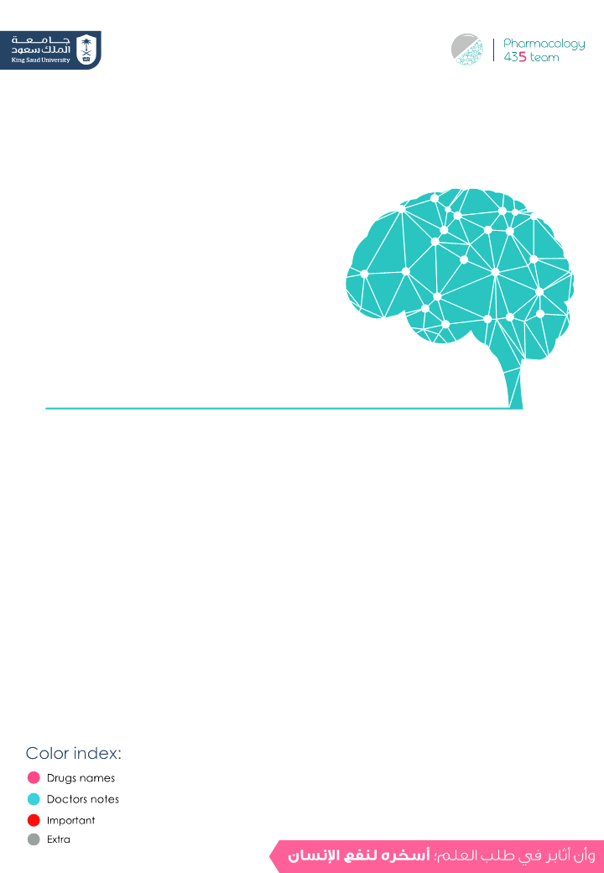
Pharmacology of central neurotransmitter
Objectives:
The main objective of this lecture to understand the role of
neurotransmitters in the etiology and treatment of CNS
diseases.
Editing File

Slide 2
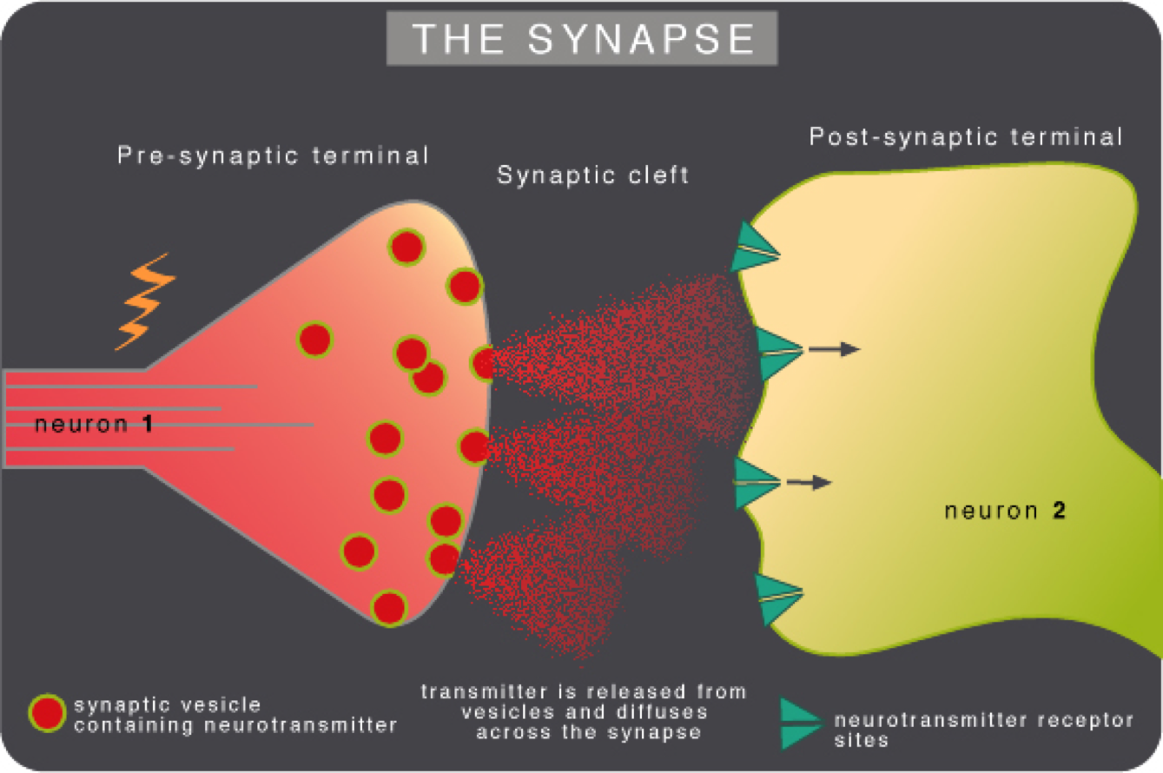
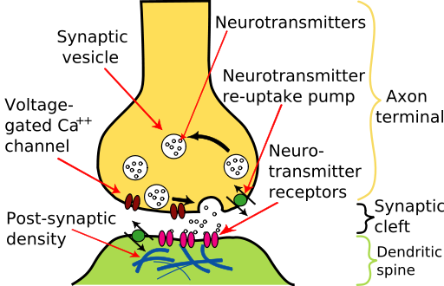
Neurotransmitters
What are they?
Endogenous chemicals or chemical messengers that enable neurotransmission that transmit signals from a neuron to
a target cell across a synapse.
- They packed into synaptic vesicles under the membrane in the axon terminal, on the presynaptic side.
- They are released into & diffuse across the synaptic cleft to bind to a specific receptors on the postsynaptic side.
A membrane action potential arriving at the terminal opens axonal Ca channels; Ca inflow releases neurotransmitter molecules from many vesicles by fusing the vesicle membranes to the nerve terminal membrane. Membrane fusion generates an opening through which the molecules are expelled into the synaptic cleft via exocytosis. | - The neurotransmitter-receptor interaction must be terminated quickly to allow rapid, repeated activation of receptors. One of the following can happen to neurotransmitters that have interacted with receptors: 1- They can be quickly pumped back into the presynaptic nerve terminals by active, ATP- dependent processes (reuptake). 2- They can be destroyed by enzymes near the receptors. 3- They can diffuse into the surrounding area and be removed. - Neurotransmitters taken up by the nerve terminals are repackaged in vesicles for reuse.
Girls slide

Slide 3
Glutamate (Glu), gamma aminobutryic acid (GABA)
Dr.Yieldz note : glycine is the main inhibitory neurotransmitter in the spinal cord
Amino acids:
Monoamines & other biogenic amines:
Dopamine (DA), Norepinephrine (NE), Serotonin (5-HT) & Histamine
Examples of neurotransmitter
Peptides:
Somatostatin & Opioid
3:30 min
Others:
Acetylcholine (Ach)
Neuropsychopharmacological science seeks to:
Understand how drugs can affect the CNS selectively to relieve pain, improve attention, induce sleep, reduce appetite, suppress disordered movements …. ect.
To provide the means to develop appropriate drugs to correct pathophysiological events in the abnormal CNS.
Importance of understanding neurotransmitters:
To understand the etiology of diseases.
1
To suggest the best drugs to be used.
2
To understand the other clinical uses of any particular drug.
3

Slide 4
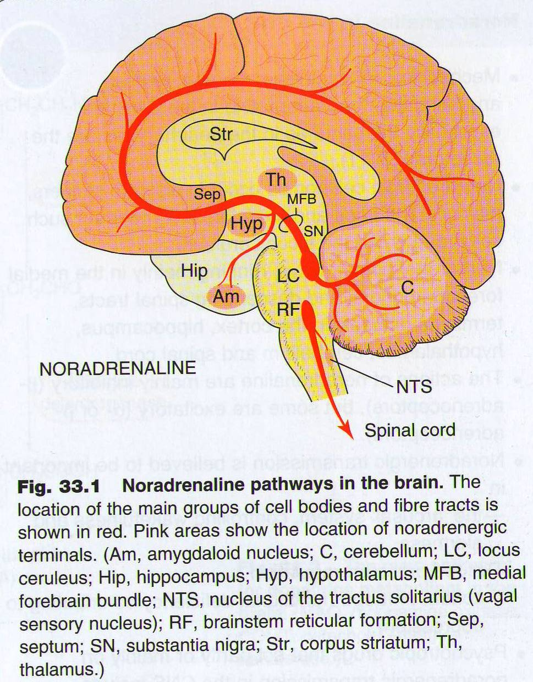
1- Norepinephrine (NE)
Pathway:
بروف يلدز قالت انو الباثوايز لكل النيوروترانزميتير تبع الفيسيولوجي واصلاً سوت لهم سكيب!!
1-Also called noradrenaline , belongs to catecholamines, the direct precursor of NE is dopamine.
2-The CNS effects of NE are manifested in alertness, arousal , and readiness for action.
3 -A variety of medically important drugs work by altering the actions of NE e.g., for treatment of CV problems and some of psychiatric conditions.
Girls slide
Mood disorders and NE:
Treatment
Affective disorders
↑ NE
Mania*
Drugs that↓NE
↓ NE
Depression
Drugs that↑NE
* Mania is characterized by: enthusiasm, rapid thought and speech patterns, extreme self-confidence, and impaired judgment.
Opposite of depression, الهوس

Slide 5
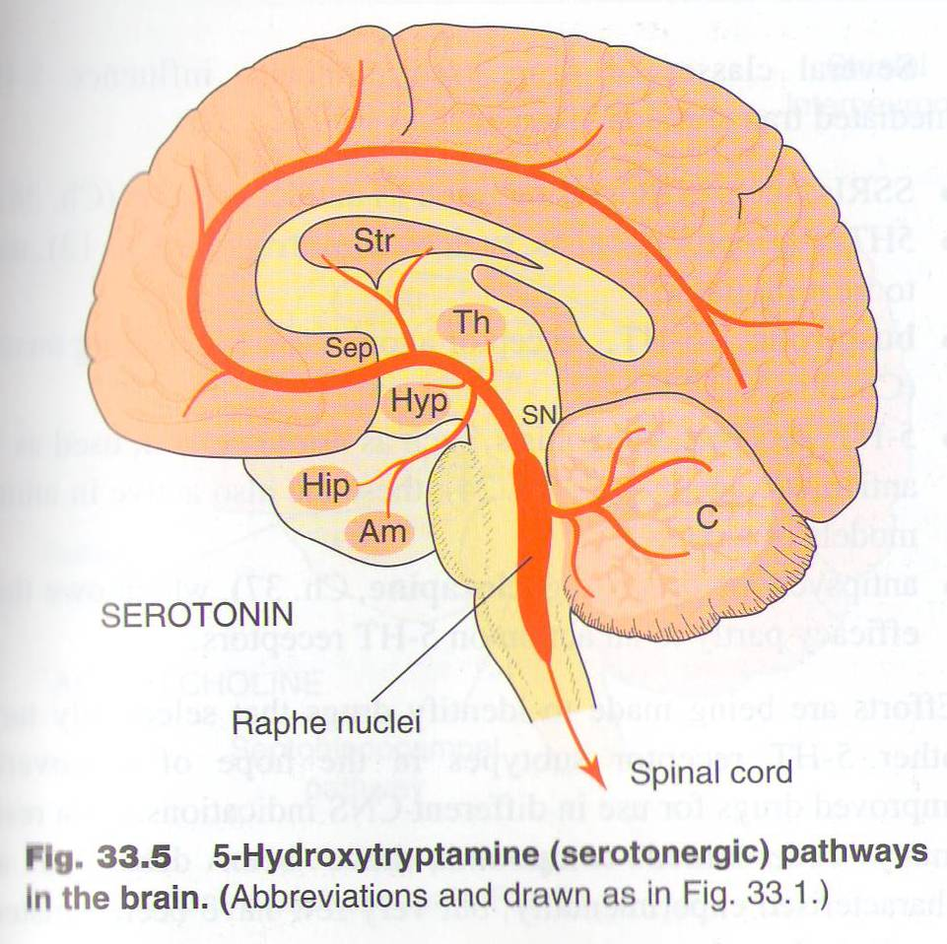
2- Serotonin (5-HT)
Pathway:
Facts:
Monoamine neurotransmitter, primarily found in the CNS, GIT, platelets, …
1
It is a popular thought that serotonin is responsible for feeling of well-being & happiness.
2
It plays an important role : in regulation of Mood, sleep, appetite and pain perception. and some cognitive functions, including memory and learning.
3
Modulation of serotonin at synapses is a major action of several classes of antidepressants eg selective serotonin re-uptake inhibitors (SSRIs).
4
Diseases that are influenced by changes in serotonin brain content:
Depression → w\ low serotonin
Social phobia
Schizophrenia →all involved (from most to least):
Dopamine , Glutamate , Serotonin , Ach
Vomiting→ bc its receptors are found in GIT & vomiting center of the medulla. (5-HT₃)
Obsessive compulsive disorders*(OCDS)
Generalized anxiety
* الوسواس القهري

Slide 6
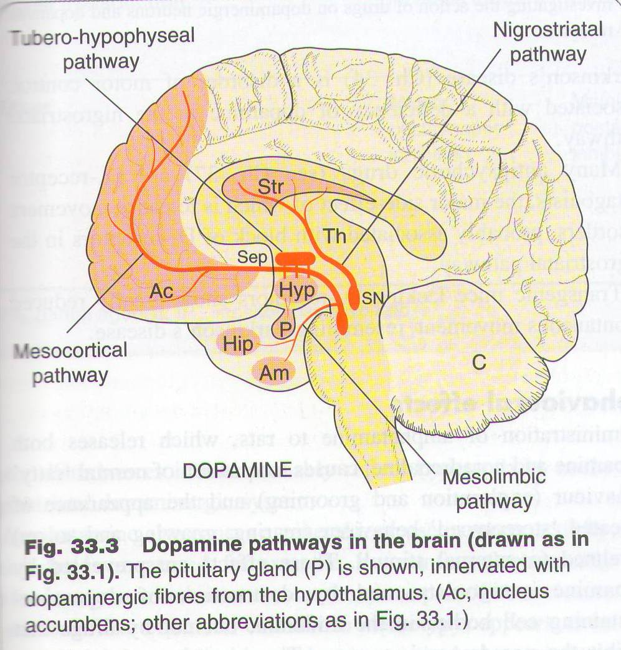
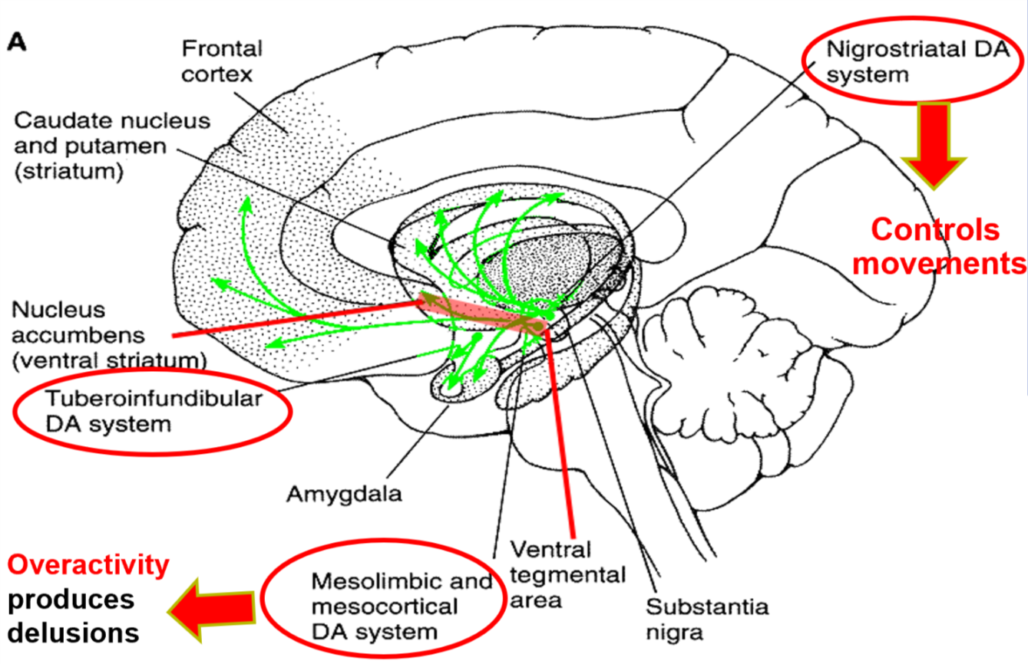
3- Dopamine:
Pathway:
Effects on dopaminergic synapses:
In chemoreceptor trigger zone (CTZ)
↓
Antiemetic effect (low dose)
In mesolimbic system
(reward pathway)
↓
Ameliorate schizophrenia (psychiatric effect)
Blockade of postsynaptic dopamine receptors
In nigrostriatal system (basal ganglia)
↓
Predispose to parkinsonism symptoms (neurologic)
In tuberoinfundibular pathway (hypothalamus – ant.-pituitary)
↓
↑ Release of prolactin (endocrinal effect)
(false positive pregnancy test, disturbed menstrual cycle and gynecomastia in males)
The same pharmacodynamic action may have distinct psychiatric ”neurologic” and endocrine effects.
Diseases that are influenced by dopamine level:
* فرط الحركة
Parkinson’s disease
Schizophrenia
Drug addiction
Depression
Attention deficit hyperactivity disorder*(ADHD)

Slide 7
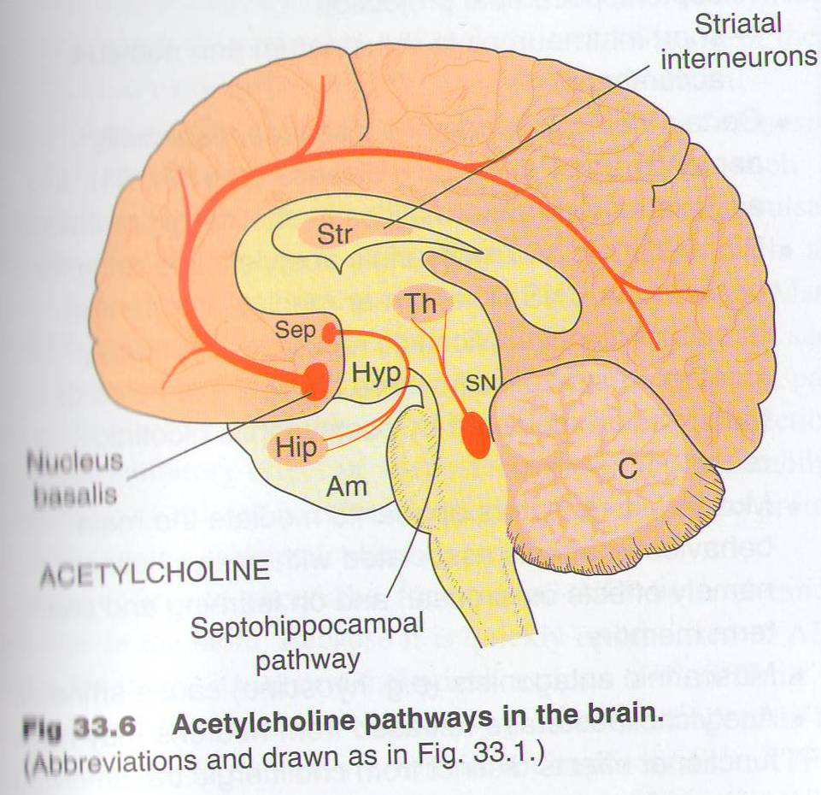
Acetylcholine
4:25 min
Overview
-Acetylcholine is the first neurotransmitter discovered. -Inside the brain Ach functions as a neuromodulator, which is a chemical that alters the way other brain structures process information rather than a chemical used to transmit information from point to point. -Is Ach an inhibitory or excitatory neurotransmitter? Ach is both excitatory and inhibitory. Depends on the action and the receptors it stimulates.
Role of Acetylcholine in the CNS
Ach is thought to be involved in cognitive functions such as: Memory Arousal الإثارة Attention انتباه
What are the CNS diseases linked to ACH derangement?
Damage to cholinergic (muscarinic) receptors is associated with memory deficits as in Alzheimer's disease. Muscarinic antagonists as hyoscine cause amnesia (deficit in memory) (Cholinomimetics (agonists) are used as therapy of alzheimer). Increased brain level of Ach predispose to Parkinson's disease* (anticholinergic drugs are used as therapy). Schizophrenia may be due to imbalance between Ach & dopamine brain levels. Depression may be a manifestation of a central cholinergic predominance.
* Dopamine & Ach work with each other → when you take a dopamine antagonist = Ach will take the upper hand → that’s why the increased level of Ach may be predispose to Parkinson’s disease.

Slide 8
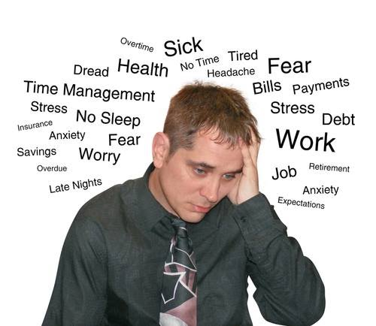
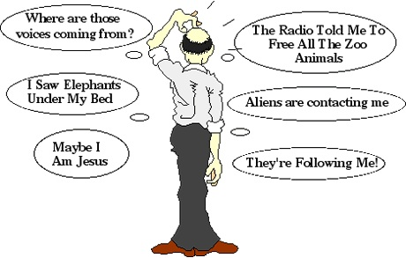
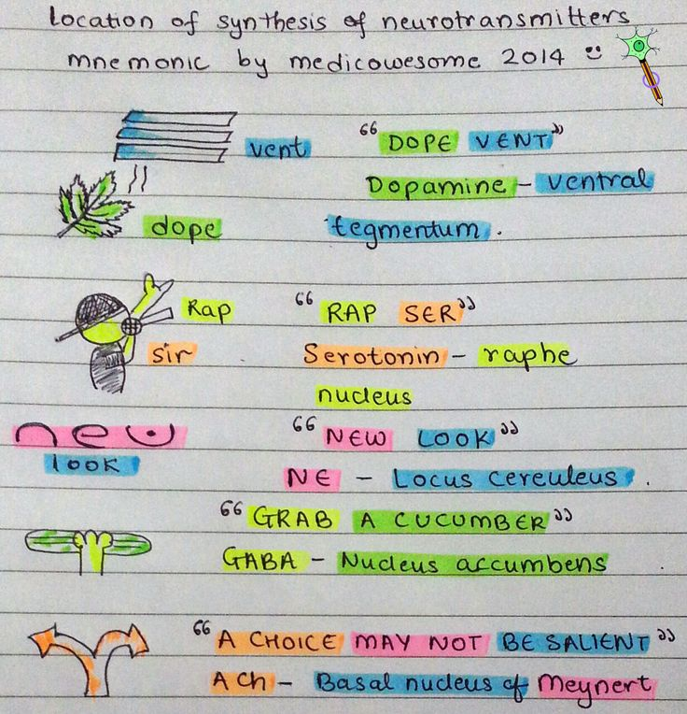
Glutamic acid & GABA
Glutamic acid | GABA
An excitatory neurotransmitter Increased levels predispose to Epilepsy Treatment of epilepsy Reduction of brain damage following strokes & head injury. Drug dependence Schizophrenia there isn't much evidence supporting the therapeutic use glutamate except in treatment of epilepsy. | It is the main inhibitory transmitter in the brain (in spinal cord = Glycin) It’s present throughout the brain; there is very little in peripheral tissue. Decreased GABA brain content is associated with: Epilepsy Anxiety Convulsions Insomnia Benzodiazepine (diazepam) enhances GABA function and used in treatment of above diseases.
AKA Glutamate
Glutamate antagonist* effects:
Schizophrenia: is a brain disorder that affects how people think, feel, and perceive.
Drug dependence is the body's physical need, or addiction, to a specific agent.
Extra, to help you remember the site of NTs production ☺

Slide 9
Summary
Trans- mitter | Role in CNS | Diseases that are influenced by NT | Drugs
 | Alertness, arousal , and readiness for action | Maina → ↑NE Depression → ↓NE | -
 | Plays a role in the regulation of: Mood Sleep Appetite Pain perception Some cognitive functions including memory and learning. | Depression Social phobia Obsessive Compulsive Disorders (OCDs) Generalized Anxiety Schizophrenia Vomiting | Modulation of 5HT at synapses is a major action of several classes of antidepressants eg selective serotonin re-uptake inhibitors (SSRIs).
 | - | Attention deficit hyperactivity disorder (ADHD) Schizophrenia Depression Drug addiction Parkinson's disease | -
 | Inside the brain functions as a neuromodulator. involved in cognitive functions such as: Memory Arousal Attention | Alzheimer's disease: Damage to muscarinic receptors. Amnesia: Muscarinic antagonists as hyoscine. Parkinson's disease: ↑ brain level of Ach. Depression. | Alzheimer: Cholinomimetics are used as therapy Parkinson's: anticholinergic drugs are used as therapy.
 | Excitatory neurotransmitter | Epilepsy : ↑ in its level. | Potential therapeutic effect of glutamate antagonists: -Reduction of brain damage following strokes & head injury. -Treatment of epilepsy. -Drug dependence. -Schizophrenia
 | Inhibitory neurotransmitter | ↓ GABA brain content is associated with: Epilepsy Anxiety Convulsions Insomnia | Benzodiazepine (diazepam) enhances GABA function and used in treatment of above diseases.
Norepinephrine
Serotonin(5HT)
Dopamine
Acetylcholine
Glutamic acid
Gamma amino-
butyric acid

Slide 10
To understand better-1
Trans-mitter | Anatomic distribution | Receptor subtype | Receptor mechanism
 | Cell bodies at all levels, short and long axons | - M1: blocked by pirenzepine and atropine - M2: blocked by atropine
 | Motoneurons – renshaw cells synapse | Nicotinic, N
 | Cell bodies at all levels, short, medium and long axons | D1: blocked by phenothiazine | Inhibitory: increase cAMP
 |  | D2: blocked by phenothiazine & haloperidol | - Inhibitory (presynaptic): decrease ca conductance - Inhibitory (postsynaptic) : increase K conductance, decrease cAMP
 | Cell bodies in pons and brainstem project to all levels | Alpha1: blocked by prazosin | Excitatory : decrease K conductance & increase IP3 & DAG
 |  | Alpha2: activated by clonidine | -Inhibitory(presynaptic): decrease ca conductance - Inhibitory (postsynaptic) : increase K conductance, decrease cAMP
 |  | Beta1 : blocked by propranolol | Excitatory : decrease K conductance & increase cAMP
 |  | Beta2 :blocked by propranolol | Inhibitory: ? increase in electrogenic sodium pumps & increase cAMP
 | Cell bodies in pons and midbrain project to all levels | 5-HT_{1A}: buspirone is a partial agonist | Inhibitory: increase K conductance, decrease cAMP
 |  | 5-HT_{2A}: blocked by clozapine , risperidone & olanzapine | Excitatory : decrease K conductance & increase IP3 & DAG
 |  | 5-HT₃: blocked by ondansetron | Excitatory: increase cation conductance
 |  | 5-HT₄ | Excitatory : decrease K conductance
الجدول هذا بروف يلدز قالت محذوف
Excitatory : decrease K conductance & increase IP3 & DAG
Inhibitory : increase K conductance & decrease cAMP
Acetylcholine
Excitatory: increase cation conductance
Dopamine
Norepinephrine
Serotonin (5- hydroxytryptamine )

Slide 11
الجدول هذا بروف يلدز قالت محذوف
To understand better-2
Trans-mitter | Anatomic distribution | Receptor subtype | Receptor mechanism
 | Supraspinal interneurons: spinal interneurons involved in presynaptic inhibition | GABAA: facilitated by benzodiazepine and zolpidem | Inhibitory: increase CL conductance
 |  | GABAb: activated by baclofen | - Inhibitory (presynaptic): decrease ca conductance - Inhibitory (postsynaptic): increase K conductance
 | Relay neurons at all levels | -Four subtypes: NMDA subtype blocked by phencyclidine - Metabotropic subtype | - Excitatory: increase Ca or cation conductance - inhibitory (presynaptic): decrease ca conductance & decrease cAMP -Excitatory (postsynaptic): decrease K conductance & increase IP3 & DAG
 | Interneurons in spinal cord and brainstem | Single subtype: blocked by strychnine | Inhibitory: increase CL conductance
 | Cell body at all levels | Three major subtypes: mu, delta & kappa. | Inhibitory (presynaptic): decrease ca conductance & decrease cAMP
 |  |  | Inhibitory (postsynaptic) : increase K conductance, decrease cAMP
GABA
Glutamate
Glycine
Opioid peptide

Slide 12
Questions
MCQs
1: What are the altered levels of the neurotransmitters Serotonin and NorEpinephren in Depression?
A- High levels of NE, low levels of 5HT B- low levels of 5HT , high levels of NE
C- Both are high D- Both are low
2: The Main intervention for antidepressant drugs is to
A- Increase NE B- Decrease NE
C- Increase Ach D- Decrease 5HT
3: One of the side effects of blocking the dopaminergic receptors
A- Galactorrhea B- Vomiting
C- Ameliorate Parkinsons D- Psychosis
4: An 85 year old man was having progressive memory loss, disorientation and alterations of mood for 10 years. Radiological examinations showed brain atrophy. what is the best drug to prescribe ?
A- Antimuscarinc drugs B- Hyoscine
C- Diazepam D- Cholinomimetics
5:Increased Level of Glutamic Acid predisposes to which of the following
A- hyperprolactinemia B- Epilepsy
C- Treat psychosis

Slide 13
Questions
MCQs
6:The main Inhibitory neurotransmitter in the brain
A- Acetylcholine B- NorAdrenaline
C- Gaba D- 5HT
7:Increased Brain level of Ach predisposes to
A- Alzheimar B- Parkinson
C- Depression D- Mania
8:Diseases that are influenced by the changes in 5HT in the brain
A- Depression B- OCDs
C- Vomiting D- All of them
MCQs Answers:
1- D
2- A
3- A
4- D
5- B
6- C
7- B
8- D
SAQ
Q1 - Is Ach an inhibitory or excitatory neurotransmitter?
Depends on its action and the receptor its binding to
Q2- Serotonin plays an important in?
Regulation of mood , sleep , appetite , pain, and perception.
some cognitive function ; memory and learning.

Slide 14
Team leaders:
Ghaida Saad Alsanad
Omar Alsuhaibani
Team Members:
Rinad Alghoraiby
Dana Alkadi
Rahaf Althnayan
Sara Alsultan
Munira Al-Hadlg
Rotana Khateeb
Ghada Almuhanna
Khuloud Alwehaibi
Sultan Alnasser
Adel Alsuhaibani
References:
- Doctors’ slides and notes.
- Pharmacology Team 435.
Special thank for team 435
@Pharma4370
Pharm437@gmail.com

