Slide 1
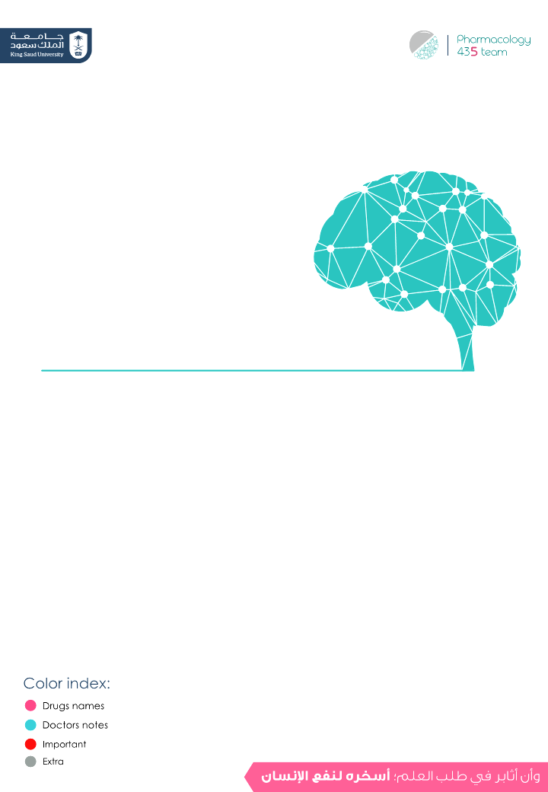
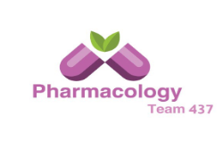
Drugs Used In Epilepsy
Objectives:
.Describe types of epilepsy
List the antiepileptic drugs.
Describe briefly the mechanism of action of antiepileptic drugs.
Enumerate the clinical uses of each drug.
Describe the adverse effects of each antiepileptic drug & treatment of status epilepticus.
Classify antiepileptic drugs according to the type of
epilepsy treated and generation introduced
Expand on pharmacokinetic and dynamic patterns of first and second generation antiepileptic drugs.
Editing File

Slide 2
Epilepsy
Epilepsy is a chronic medical condition characterized by 2 or more unprovoked seizures (within 6-12 months). It is a syndrome.
the difference between seizure & epileptic syndrome
Epilepsy: is a group of related disorders characterized by a tendency for recurrent seizures | Seizures: are abnormal movements or behavior due to unusual electrical activity in the brain, are a symptom of epilepsy
:The difference between a syndrome and a disease is A syndrome is a set of medical signs and symptoms that occur together and suggest the presence of a certain disease or an increased chance of developing the disease(Usually not curable, idiopathic & combination of symptoms). A disease is the actual diagnosed impairment of health or a condition of abnormal functioning (Usually curable , non- idiopathic & it's a combination of symptoms) .
Etiology(causes):
Congenital defects, head injuries, trauma, hypoxia
:Triggers
1
Infection ( bacteria or virus ) e.g. meningitis, brain abscess, viral encephalitis.
Fatigue
2
Concussion, depressed skull, fractures.
Stress
3
Brain tumors (including tuberculoma), vascular occlusion, stroke
Sleep deprivation
4
Drug withdrawal, e.g. CNS depressants, alcohol or drug abuse or drug overdose ,e.g. penicillin.
5
Poor nutrition
A poison, like lead
6
Fever in children (febrile convulsion). (Februs in Latin means fever)
Alcohol
7
8
Hypoglycemia
Triggers can cause an episode even under medication
PKU Phenylketonuria is a rare inherited disorder that causes an amino acid called phenylalanine to build up in body caused by absent or virtually absent phenylalanine hydroxylase (PAH) enzyme activity
9
Photo epilepsy is a type of epilepsy, in which all, or almost all, seizures are triggered by flashing or flickering light
Phenylalanine hydroxylase
10
Phenylalanine tyrosine

Slide 3
Classification of Epilepsy
Partial (focal)
Arise in one cerebral hemisphere
Primary Generalized
Both hemispheres + loss of consciousness.
[1] Simple:
consciousness is retained
[2] Complex (psychomotor): Altered consciousness
They are interconnected sometimes
Tonic-clonic (Grand mal): Stiffness (15-30 sec) followed by violent contractions & relaxation (1-2 minute)
Tonic: Muscle stiffness
Clonic: Spasms of contraction & relaxation
Atonic (loss of tone): Patients legs give under him & drop down
Myoclonic: Jerking movement of the body
Absence(Petit mal):Brief loss of consciousness with minor muscle twitches eye blinking In children
Status epilepticus: Re-occuring tonic-clonic seizure (30 min or more)(Emergency situation may lead to death by Resp. failure)
Secondarily generalized
Begins as partial (simple or complex) and progress into tonic- clonic (grand mal) seizure.
8:49 min | very helpful!
General rules for treatment of epilepsy:
- Epilepsy is usually controlled but not cured with medication.
- Up to 80% of pts can expect partial or complete control of seizures with appropriate treatment. 20% has resistance
- Antiepileptic drugs are indicated when there is two or more seizures occurred in short interval (6 m -1y) with no cause
- An initial therapeutic aim is to use only one drug (monotherapy).
Drugs are usually administered orally except in status epilepsy (IV).
Monitoring plasma drug level is useful
Triggering factors can affect seizure control by drugs.
Sudden withdrawal of drugs should be avoided.
Withdrawal considered
Seizure–free period of 2-5 years or longer
Normal IQ
Normal EEG prior to withdrawal
No juvenile myoclonic epilepsy (in children)
Relapse rate when antiepileptics are withdrawn is 20-40%.

Slide 4
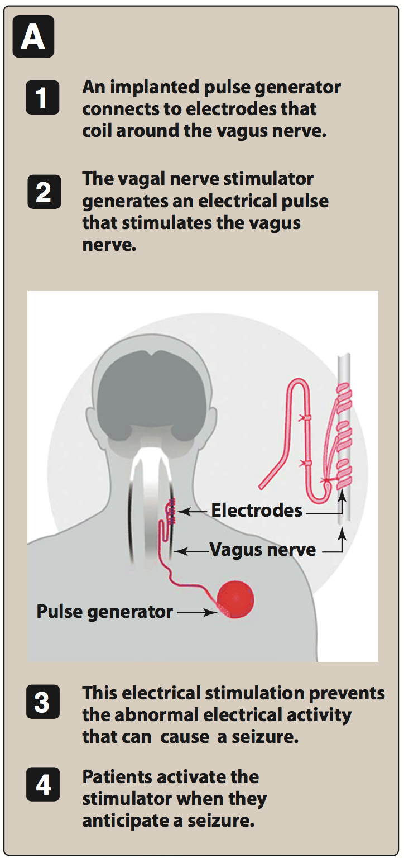
Treatment of Epilepsy
Drugs mainly
Vagal nerve stimulation
Surgery
Ketogenic diet
Ketogenic diet may help because it will lead to accumulation of Ketones which are acidic compounds and acidosis cause neuronal suppression
Mechanism of anti-epileptic
:inhibit depolarization of neuron by
Inhibition of excitatory NTs
(glutamate)
enhancement of
inhibitory NTs
(GABA)
Blockage of voltage-gated positive current
(Na,Ca)
Increase outward positive current
(K)
Vagal nerve stimulation
It is an alternative for patients who have been refractory to multiple drugs
Who are sensitive to many adverse effects of antiepileptic drugs
It is an expensive procedure
Not very effective

Slide 5
Important notes
Prof. Yieldez said :
important to know Mechanism of action, characteristic ADRs & uses for each drug .
Case: A boy was playing and suddenly he stopped,also he was staring , blinking and then he got back to normal , wath is this condition?
Absence(batite) seizure.
If we have to treat pregnant woman , We use the least harmful drug which is Topiramate
Valproate, phenytoin & Carbamazepine are contraindicated during pregnancy.

Slide 6
Classification of antiepileptic drugs
First generation
Seconds generation
Phenytoin
Lamotrigine
Carbamazepine
Topiramate
Valproate
Levetiracetam
Ethosuximide
Gabapentin
Phenobarbital & Primidone
Vigabatrin
Benzodiazepines
(e.g. Clonazepam, lorazepam and diazepam)
Felbamate
Zonisamide
Mnemonics:
-Phenytoin:
(ADRs:gingival) فيني؟ ب جينجيفال
-Carbamazepine:
تعطشين carbلما تأكلين
(ADRs: hyponatremia & water intoxication)
-Lamotrigine
(ADRs: skin rash) لمو(لمى) تستخدم كريم جونسون لبشرتها
-Topiramate
توبي(ثوبي) رميته لأنه صار وسيع
(ADRs: weight loss)
Differ from the 1st generation in the effect on microsomal enzymes, most of the 2nd gen drugs don’t have this effect

Slide 7
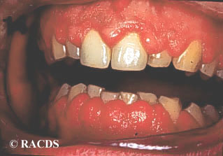
 | 1st Generation
Drug | Fosphenytoin | Phenytoin
 | - Blockade of Na⁺ & Ca²⁺ influx into neuronal axon. - Inhibit the release of excitatory transmitters . - Potentiate the action of GABA.
 | Parenteral form of phenytoin (IV & IM) A Prodrug. rapidly converted to phenytoin in the body. Advantage over phenytoin: more rapid IV administration than phenytoin may be administered by IM injection Lower local tissue and cardiac toxicity than phenytoin Less pain and phlebitis at injection site than phenytoin | Given orally, well absorbed from GIT.(most drugs here are taken orally) Also available as capsule & IV Enzyme inducer. (increase its metabolism → the action decreases) Metabolized by the liver to inactive metabolites. Half life approx. 20 hr. Excreted in urine.
 | Partial and generalized tonic-clonic seizures. Not in absence seizure. In status epilepticus, given IV.
 | Nausea or vomiting. Neurological like headache, vertigo, ataxia, diplopia , nystagmus. Sedation due to increased GABA Gum(gingival) hyperplasia. (very important) Hirsutism.(abnormal hair growth, not a good option in females ) Acne. (حب الشباب) Folic acid deficiency. (megaloblastic anemia) Vit D deficiency → (osteomalacia) Teratogenic effects. (very common side effect in all antiepileptics)
M.O.A is very important
Mech. of action
P.K
Therapeutic Uses
ADRs

Slide 8
1st Generation (cont.)
Drug | Carbamazepine
 | Blockade of Na⁺ & Ca²⁺ influx into neuronal axon. Inhibit the release of excitatory transmitters. Potentiate the action of GABA. (similar to Phenytoin in many things)
 | Available as capsule & syrup only orally. Well absorbed. Strong enzyme inducer. (including its own metabolism) Metabolized by the liver to active & inactive metabolites. T_{1\2}=18-35 hr. Excreted in urine.
 | Drug of choice in partial seizures. (Both simple & complex) Tonic-clonic seizures. (1ry & 2ry generalized) Not in absence seizures. → because it may cause an increase in seizures Other uses: Bipolar depression , Trigeminal neuralgia
MOA
P.K
uses
*carbamazepine will cause thirst >> excessive water intake >> disturbances in water-electrolytes balance >> water intoxication
ADRs
GIT upset.
Hypersensitivity reactions.
Drowsiness , ataxia, headache & diplopia.
Hyponatremia & *Water intoxication. (anti-diuretic effect, and thus it should not be given to children or old patients)
Teratogenicity.
Drug | Ethosuximide
MOA | Inhibits T- type Ca²⁺ channels in thalamocortical neurons.
P.K | Absorption is complete. Syrup & capsule forms. (to be easily taken for children) Not bound to plasma proteins or tissues. Metabolized in liver. T_{1\2} = 52-56 hr. 10-20% of a dose is excreted unchanged the urine.
uses | Absence seizures. Mainly given to children
ADRs | Gastric distress : Nausea vomiting Drowsiness, fatigue, hiccups, headaches.

Slide 9
 | 1st Generation (cont.)
Drug | Sodium Valproate
 | Blocks activated Na⁺ channels. Enhances GABA synthesis & reduces degradation. Suppress glutamate action. Blocks T-type Ca²⁺ channels. (that’s why it can be used for absence seizures)
 | Broad spectrum antiepileptic Available as capsules, Syrup, I.V. Metabolized by the liver. (to inactive form) Enzyme inhibitor. Inducers اللي قبل كانوا T_{1\2}=12-16 hr. Excreted in urine.
 | It is effective for all forms of epilepsy → very broad spectrum Generalized tonic-clonic seizures. (1^{ry} & 2^{ry} ) Absence seizures But Ethosuximide it's drug of choice in this coundiction, cause it’s selective . Complex partial seizures. Myoclonic. Atonic. photosensitive epilepsy.
 | GI (nausea, vomiting, heart burn). Weight gain (↑ appetite). Transient hair loss, with re-growth of curly hair. Thrombocytopenia decreased platelet.( not used with aspirin or coumadin “ antiplatelet drugs”) Hepatotoxicity(Transient increase in liver enzymes). (we do periodic assessment) Teratogenicity (neural tube defect) C.I in pregnancy
 | Bipolar disorder and mania. (as a mood stabilizer) (Sodium Valproate is more favorable to treat bipolar disorder than carbamazepine) Prophylaxis of migraine. Lennox-Gastaut syndrome. → The Lennox-Gastaut syndrome (LGS) is a type of epilepsy with multiple different types of seizures, particularly tonic (stiffening) and atonic (drop) seizures. Intellectual development is usually, but not always, impaired
MOA
P.K
Therapeutic Uses
ADRs
Other uses

Slide 10
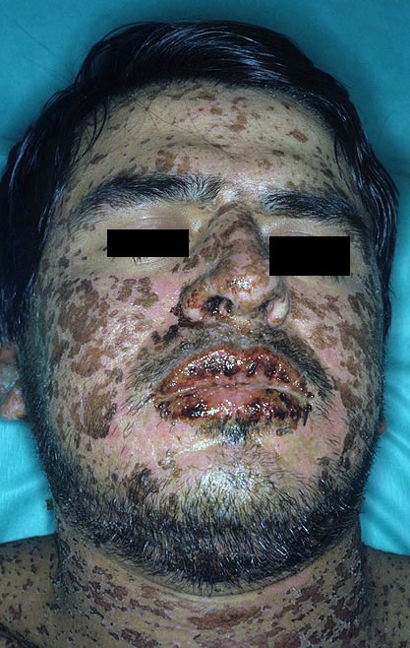
 | 2nd generation
Drug | Topiramate | Lamotrigine
 | Blocks Na⁺ channels (membrane stabilization) Potentiates the inhibitory effect of GABA. | Blockade of Na⁺ channels Inhibits excitatory amino acid release (glutamate & aspartate)
 | Well absorbed orally ( 80 % ) Food has no effect on absorption Has no effect on microsomal enzymes (most important difference from the first gen) 9-17 % protein bound (minimal) Mostly excreted unchanged in urine. Plasma t½ 18-24 hrs | Available as oral tablets Well absorbed from GIT Metabolized primarily by glucuronidation. Does not induce or inhibit C. P-450 isozymes (most important difference from the first gen) T_{1\2}= approx. 24 hr
 | Can be used alone for partial, generalized tonic-clonic, and absence seizures. Lennox- Gastaut syndrome ( or lamotrigine, or valproate ). | As add-on therapy or as monotherapy in partial seizures & generalized tonic-clonic seizures → to be more effective. Lennox-Gastaut syndrome Bipolar depression
 | Psychological or cognitive dysfunction Weight loss (can be desirable side effect) Sedation Dizziness Fatigue Urolithiasis (kidney stone) Paresthesias (abnormal sensation ) Teratogenicity (in animal but not in human) | Influenza-like symptoms. Skin rashes (may progress to Steven –Johnson syndrome ) Somnolence (sedation) Blurred vision Diplopia Ataxia (can be teratogenic)
MOA
P.K
Therapeutic Uses
ADRs

Slide 11
Treated by
1) carbamazepine
2) Phenytoin
3) valproate
4) lamotrigine
Partial
seizures
Tonic-clonic (grand mal)
Valproate or carbamazepine or phenytoin or lamotrigine
Type of seizure
Myoclonic
Valproate, clonazepam
Generalized seizures
Absence
Valproate, ethosuximide
Atonic
Valproate
Drugs used for treatment of Status Epilepticus
Most seizures last from few seconds to few minutes. When seizures follow one another without recovery of consciousness, it is called “status epilepticus”. It has a high mortality rate.
Death is from cardiorespiratory failure.
Antiepileptics used in status epilepticus
Through IV injection of:
Lorazepam Diazepam
(drug of choice)
|
|
|
Phenytoin
Phenobarbital
Fosphenytoin
Sodium Valproate
Lorazepam has a shorter pharmacokinetic half-life but stays in the brain longer than diazepam.

Slide 12
Pregnancy & anti-epileptics
Seizure is very harmful for pregnant woman.
No antiepileptic drug is safe in pregnancy.
Monotherapy usually better than drug combination.
Valproate , phenytoin & Carbamazepine are contraindicated during pregnancy.
Patient has to continue therapy.
(Summary (important
Epilepsy is classified into partial or generalized according to the site of lesion.
The exact mechanism of action of AED is not known.
Phenytoin is mainly used for treatment of generalized tonic-clonic seizures.
Carbamazepine is mainly used for treatment of partial seizures.
Sodium valproate is a broad spectrum antiepileptic drug.
Lamotrigine & levetiracetam are used as monotherapy or adjunctive therapy in refractory cases.
Lorazepam, diazepam, phenytoin are used intravenously for treatment of status epilepticus.
Notes:
اذكر لنا المصادر الإضافية اللي استخدمتها وأنت تسوي المحاضرة، كتب أو مواقع. ولو كتب يا ليت تكتب رقم الصفحة ورقم الedition

Slide 13
Summary of 1st Generation Drugs
Drug | Sodium valproate | Ethosuximide | Carbamazepine | Phenytoin
 | - Block Na⁺ and T type Ca²⁺ channels - Enhances GABA synthesis - Suppress glutamate action | Block T type Ca²⁺ channels | - Block influx of Ca²⁺ and Na⁺ into neuronal axon → potentiate the action of GABA - Inhibit the release of excitatory transmitters. | - Block influx of Ca²⁺ and Na⁺ into neuronal axon → potentiate the action of GABA. - Inhibit the release of excitatory transmitters.
 |  |  |  | Fosphenytoin
 |  |  |  | Parenteral form of phenytoin.
 | All types of epilepsy | Absence seizure | Partial and generalized tonic-clonic seizures | 1- status epilepticus 2- partial and generalized tonic-clonic seizures
 | Hair loss Thrombocytopenia Hepatotoxicity Weight gain teratogenicity | Hiccups Gastric distress drowsiness | Hyponatremia and water intoxication Teratogenicity Hypersensitivity Git upset | 1- Folic acid & vit.D deficiency (osteomalacia) 3- teratogenic effect 4- hirsutism 5- gum hyperplasia
 | Enzyme inhibitor Could be used in 1-bipolar disorder and mania 2-in migraine as prophylactic drug 3- lennox-gastaut | Has very long half life = 52-56 h | Strong enzyme inducer Drug of choice in partial seizures Strong drug inducer | Enzyme inducer Fosphenytoin is given I.V to treat status epilepticus its transformed rapidly into phenytoin
Mechanism of action
Indications
ADRs
Comments

Slide 14
Summery of 2nd generation drugs
Drug | Tobiramate | Lamotrigine
 | - Block Na⁺ channels - Potentiate the inhibitory effect of GABA | - Block Na⁺ channels - Inhibit glutamate and aspartate release.
PK | Has no effect on microsomal enzymes | Does not induce or inhibit C. P-450 isozymes
 | Lennux-gastaut syndrome
ADRs | - Urolithiasis - Paresthesia - Weight loss - Teratogenicity | -Influenza like syndrome - Skin rashes → may progress to Steven –Johnson syndrome - Somnolence (desire to sleep) - Ataxia
Extra info. |  | - Metabolized by glucuronidation - Does not induce or inhibit CP450 isoenzyme
Mechanism of action
Indications

Slide 15
Questions
MCQs
1 ) Which of the following drugs is an enzyme inhibitor?
A-Sodium Valproate
B-Carbamazepine
C-Phenytoin
D-Ethosuximide
2 ) Which of the following drugs is a broad spectrum antiepileptic?
A-Lamotrigine
B-Phenytoin
C-Sodium Valproate
D-Topiramate
3 ) Which drug has a minimum adverse effects?
A-Carbamazepine
B-Topiramate
C-Lamotrigine
D-Ethosuximide
4 ) Steven-Johnson syndrome is a possible adverse effect of?
A-Phenytoin
B-Lamotrigine
C-Sodium Valproate
D-Topiramate
5 ) What is the drug of choice in case of partial seizures?
A-Carbamazepine
B-Ethosuximide
C-Lamotrigine
D-Phenytoin

Slide 16
Questions
MCQs
6 ) Which of the following drugs may cause psychological effect ?
A-Topiramate
B-Sodium Valproate
C-Ethosuximide
D-Fosphenytoin
7 ) Which drug is contraindicated in females ?
A-Lamotrigine
B-Carbamazepine
C-Fosphenytoin
D-Topiramate
8 ) Which drug is the drug of choice in case of Status Epilepticus ?
A-Phenobarbital
B-Benzodiazepines
C-Fosphenytoin
D-Valproate
MCQs answers:
1-A
2-C
3-D
4-B
5-A
6-A
7-C
8-B
SAQ
Q1 ) a 5 years old epileptic boy came to the dentist suffering from enlargement of his gum due to antiepileptic drug.
Which drug did he use ?
Fosphenytoin
What is the mechanism of action of this drug ?
Block of Na and Ca influx
potentiate the action of GABA

Slide 17
Team leaders:
Ghaida Saad Alsanad
Omar Alsuhaibani
Team Members:
Dimah Alaraifi
Ghada Alqrni
Razan Alhamidi
Mohammed Nouri
Special thank to Afnan Almustafa
References:
- Doctors’ slides and notes.
- pharmacology Team 435.
Special thank for team 435
@Pharma4370
Pharm437@gmail.com

