Slide 1
Drugs used in schizophrenia
Objectives:
List the classification of antipsychotic drugs used in
schizophrenia.
Describe briefly the mechanism of antipsychotic action of
these drugs.
Describe the pharmacological actions of antipsychotic drugs.
Relate between pharmacological actions & adverse effects of
antipsychotic drugs.
Enumerate the clinical uses of antipsychotic drugs.
Describe the advantages of atypical antipsychotic drugs over
typical drugs.
Editing File

Slide 2
Psychoses
Schizophrenia
Mania
Psychoses
Affective Psychoses
Depression
Manic-depressive illness (Bipolar affective disease)
Schizophrenia
Definition: It is a thought disorder characterized by divorcement from reality in mind of patient. it may involve hallucinations, delusions , intense suspicion, feeling of persecution or control by external forces (paranoia) Feeling that someone is controlling you (Paranoia).
Positive symptoms(Related to dopamine): 1- hallucinations 2- Delusions 3- paranoia. Old group (typical) and new group are effective here
Negative symptoms (Related to serotonin) : 1- Social withdrawal 2- Anhedonia (absence of pleasure) 3-Emotional blunting -Old group won't work here, the new group only , also negative symptoms are more difficult to treat.
Dopamine system & receptors
Dopamine pathway in the brain:
1- Mesolimbic-mesocortical pathway
Behavior
2- Nigrostriatal pathway
coordination of voluntary movements
3- Tuberoinfundibular pat
endocrine effects
4- Medullary - periventricular pathway
metabolic effects
Dopaminergic pathways in the brain:
There are at least five subtypes of Dopamine receptors:
D1, D2, D3, D4, D5.

Slide 3
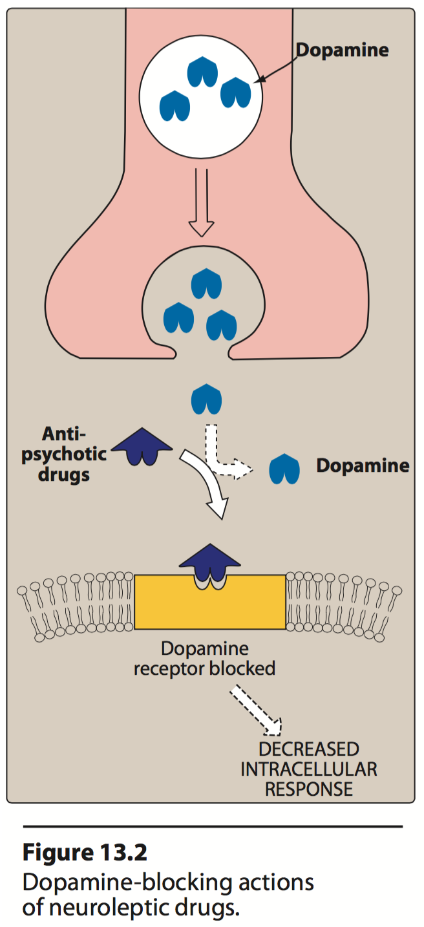
Antipsychotic drugs overview
- Drugs used in schizophrenia are classified according to chemical structures Into:
Typical
Atypical
discovered first, non selective, many side effects, rarely used nowadays.
more selective, less side effects, 1st line treatment for schizophrenia.
Classification of Antipsychotic
Typical Antipsychotic Drugs → affect D2 mainly → treat the +ve symptoms.
Phenothiazine derivatives Its chemical structure similarto TCAs → similar ADRs | Chlorpromazine, Thioridazine
Butyrophenones | Haloperidol
Thioxanthene | Thiothixene
Atypical Antipsychotic Drugs → Affect both DA & 5-HT receptors → treat +ve & -ve symptoms.
Dibenzodiazepines* | Clozapine
Benzisoxazoles* | Risperidone
Thienobenzodiazepines* | Olanzapine
Dibenzothiazepines* | Quetiapine
Benzisothiazoles* | Ziprasidone
piperazine/piperidine derivatives* | Cariprazine
*Prof.Yieldez said: it’s enough to know the drug name only like (Clozapine, Risperidone , …..)
The pharmacological actions of antipsychotic drugs result from:
- Blocking dopamine receptors at different areas in the brain.
- Blocking muscarinic receptors
- Blocking α-adrenergic receptors
- Blocking H1 receptors
Adverse effects on CNS | Advantages of Atypical drugs
They are due to blocking dopamine receptors at areas other than mesolimbic area (extrapyramidal effects) | They block both dopaminergic & serotonergic receptors. They are effective in refractory cases of schizophrenia. They produce few extrapyramidal effects.

Slide 4
Pharmacological actions of typical & atypical anti-psychoses
عشان تكون الصورة واضحة، الـpharmacological actions تشملtypical & atypical هي والأعراض الجانبية اللي راح تنذكر بعدها, أهم شي هنا ربط كل أثر مع ال receptor حقه لأنه بيسهل حفظ الوظائف والأعراض الجانبية مع بعض.
Before starting the pharmacological actions we need to be familiar with these concepts:
Psychomotor slowing: involves a slowing-down of thought and a reduction of physical movements in an individual.
Psychotic disorder: abnormal thinking and perceptions.
Agitation: a state of anxiety or nervous excitement.
Tardive dyskinesia: a neurological disorder characterized by involuntary movements of the face and jaw.
Galactorrhea: excessive or inappropriate production of milk.
Amenorrhea: an abnormal absence of menstruation.
Gynecomastia: enlargement of a man's breasts, usually due to hormone imbalance or hormone therapy.
Impotence: inability to develop or maintain an erection of the penis during sexual activity in humans.
Pruritus: severe itching of the skin.
CNS | ANS
Antipsychotic effect: (it’s the main use) Produce emotional quieting and psychomotor slowing. Decreasing hallucinations, delusions and agitation. Mechanism: blockage of dopamine receptors in the mesolimbic system. → treat +ve symptoms. Note: Atypical drugs exert their antipsychotic action through blocking serotonergic (5HT₂) and dopaminergic receptors.→ treat –ve symptoms also. | Anticholinergic effects: Blurred vision Dry mouth Urinary retention Constipation Mechanism: blockage of muscarinic receptors.
Extrapyramidal symptoms: - Abnormal involuntary movements such as tremors, parkinsonism, and tardive dyskinesia. Mechanism: blockage of dopamine receptors in the nigrostriatum. | Antiadrenergic effects: Postural hypotension Impotence failure of ejaculation. Mechanism: blockage of alpha-adrenergic receptors.
Endocrine effects: Galactorrhea Amenorrhea Gynecomastia & impotence. Mechanism: prevent dopamine from inhibiting prolactin release from pituitary gland and that will lead to hyperprolactinemia. → نتيجة لقلة الدوبامين، راح يكثر هرمون البرولاكتين، مما يسبب تأخر الحمل لو ما تعالج.
Ach more than dopamine

Slide 5
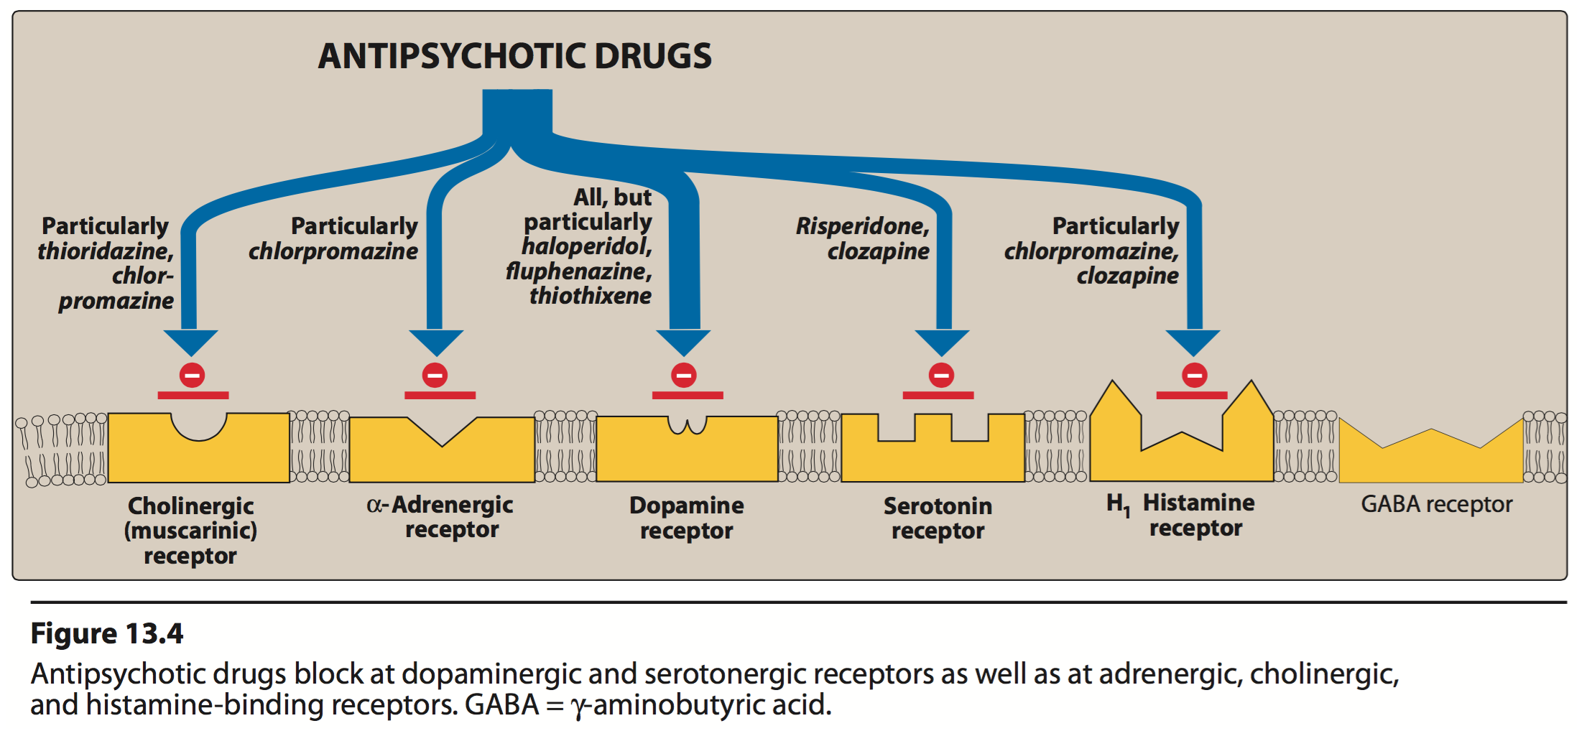
Pharmacological actions Cont.
CNS | Other
Metabolic effect: - Changes in eating behavior and weight gain. Mechanism: blockage of dopamine receptors in the medullary-periventricular pathway. | Temperature regulation: May cause lowering of body temp. Mechanism: heat loss as a result of vasodilation due to alpha-blocking or to central effect. (In major operations; open heart surgery)
Antiemetic effect: - Effective against drug and disease-induced vomiting. (not-motion sickness) Mechanism: blockage of dopamine receptors in the CTZ of the medulla. The chemoreceptor trigger zone (CTZ) is an area of the medulla oblongata that receives inputs from blood-borne drugs or hormones, and communicates with other structures in the vomiting center to initiate vomiting. | ECG changes: prolongation of QT interval, abnormal configuration ST segment and T wave. Too prolongation will lead to Torsades de pointes which may lead to ventricular fibrillation
 | Antihistaminic effect: sedation due to H1 receptor blockage.
 | Quinidine-like action
= postural hypotension
Chlorpromazineمين أكثر درق ماخذ أغلب الإفكتس؟

Slide 6
Adverse Effects
نفس الشي هنا كل الأعراض تشمل typical and atypical مع اختلاف في الدرجة وأغلبهم كانوا مذكورين مع الpharmacological action
So most of the pharmacological actions = adverse effects
Prof.Yieldez said: we will ask about the characteristic ADRs of each drug.
CNS
1- Sedation, drowsiness, fatigue → (haloperidol (typical) , Risperidone (atypical) )
2- Extrapyramidal symptoms: → Early occurring: Parkinson’s syndrome, late occurring:
A) Tardive Dyskinesia | B) Neuroleptic Malignant Syndrome
(from Latin tardus, slow or late coming) It is a disorder of involuntary movements (choreoathetoid movements of lips, tongue, face, jaws, and limbs ) Choreoathetosis: combination of chorea (irregular migrating contractions) and athetosis (twisting) | Rare but life threatening. → Symptoms are muscle rigidity and high fever (clinically similar to anaesthetic malignant hyperthermia). The stress leukocytosis and high fever associated with this syndrome may wrongly suggest an infection.
Neuroleptic malignant syndrome
ANS
1- Anticholinergic Effects : | 2- Antiadrenergic Effects :
- Blurred vision - Dry mouth - Urinary retention - Constipation → (Chlorpromazine (typical), Clozapine (atypical)) | - Postural hypotension - Impotence - Failure of ejaculation (Chlopromazine (typical), Thioridazine (typical))
Endocrine Effects
Gynecomastia
Galactorrhoea
Amenorrhoea

Slide 7
Adverse Effects Cont.
*These ADRs are not related to the drug itself , but related to the genetic susceptibility of person to have these ADRs when he/she take the drugs
Miscellaneous Effects *
Obstructive jaundice
Chlorpromazine
Granular deposits in cornea
Retinal deposits (thioridazine)
Weight gain
The only one
Clozapine
Agranulocytosis - About 1-2% - Usually happen after 6-18 weeks - Weekly WBC is mandatory (increase susceptibility to have infections) - Seizures | Agranulocytosis, also known as agranulosis or granulopenia, is an acute condition involving a severe and dangerous leukopenia (lowered white blood cell count)
Therapeutic uses
Psychiatric | Non-psychiatric
Schizophrenia (primary indication). | - Nausea and vomiting. → Prochloroperazine and benzquinamide are only used as antiemetics.
Acute mania. | Pruritus (الحكة)
Manic-depressive illness (bipolar affective disorder) during the manic phase. Bipolar affective disorder is characterized by periods of deep, prolonged, and profound depression that alternate with periods of an excessively elevated or irritable mood known as mania. | Preoperative sedation. (Rare use)
Pharmacokinetics:
How Do Antipsychotic Drugs Work? How Effective are Medications for Schizophrenia & Psychosis?
Incompletely absorbed.
Highly lipid soluble.
Highly bound to plasma proteins.
Undergo extensive first-pass hepatic metabolism.
Excretion by the kidney.

Slide 8
Atypical Antipsychotics
- 2nd Generation antipsychotics
- First line treatments for schizophrenia
- Little or no extrapyramidal side effects
- Effective in treatment of resistant schizophrenia.
- Are effective on both positive & negative symptoms.
- Block both dopaminergic & serotonergic receptors.
Clinical uses:
- Refractory cases of schizophrenia.
- To reduce the risk of recurrent suicidal behavior in patients with schizophrenia.
Risperidone | Ziprasidone |  | Cariprazine
MOA: Blocks D₂ & 5HT₂ receptors. Main adverse effects: - Postural hypotension - QT prolongation - Weight gain Contraindicated: Patients with long QT interval. | MOA: Blocks D2 & 5HT2 receptors. Main adverse effects: - Drowsiness, Akathisia (cant keep still) ,Headache ,Dizziness, Weight gain. Drug interactions: - Should not be used with any drug that prolongs the QT interval. - Activity decreased by carbamazepine (inducer of CYP3A4) - Activity increased by ketoconazole (antifungal) (inhibitor of CYP3A4) Important: It increases mortality in elderly patients with dementia-related psychosis. |  | - approved in 2015 by the FDA - has higher affinity at D3 receptor - has a positive impact on the cognitive symptoms of schizophrenia
Clozapine | Olanzapine | Quetiapine
MOA: Blocks both D₄ & 5HT₂ receptors. Main adverse effects: - Agranulocytosis - Seizures - Myocarditis - Excessive salivation (during sleep) | MOA: Blocks D₁- D₄ & 5HT₂ receptors. Main adverse effects: - Weight gain - Sedation - Flatulence, increased salivation & thirst. - Postural hypotension. | MOA: Blocks D₁-D₂ & 5HT₂ receptors. Main adverse effects: - Sedation - Hypotension - Sluggishness - Dry mouth - Increased appetite → (weight gain) - Abdominal pain - Constipation
Imp to know drug interactions
الدواء هذا مهم مرة أنكم تعرفون على أي دوبامين ريسيبتورز يأثر عليه ، الباقين مو مرة مهم

Slide 9
Summary
Pharmacological Actions | M.O.A | Effect | S/E
Antipsychotic effect | Block of DA receptors in the mesolimbic system. | Emotional quieting & psychomotor slowing. hallucinations, delusions and agitation. | -
Extrapyramidal effect | Block of DA receptors in the nigrostriatum | Abnormal involuntary movements | Tardive Dyskinesia Parkinson’s syndrome Neuroleptic Malignant Syndrome
Endocrine effects | Prevent DA from inhibiting prolactin release from pituitary → Hyperprolactinemia | Galactorrhea, Amenorrhea, Gynecomastia & impotence.
Metabolic effects | Blockade of DA receptors in the medullary – periventricular pathway | Changes in eating behavior and weight gain | -
Anti-emetic effect | Blockade of DA receptors in the CTZ of the medulla | Effective against drug & disease- induced vomiting (NOT motion sickness)
Anticholinergic Effects | Blockade of muscarinic receptors | - Blurred vision - Constipation - Dry mouth - Urinary retention
Antiadrenergic Effects | Blockade of α- adrenergic receptors | - Postural hypotension - Impotence - Failure of ejaculation
Temperature regulation | Heat loss as a result of vasodilation ( α- blocking ) Or due to central effect | May cause lowering of body temperature
ECG changes | Prolongation of QT interval Abnormal configuration of ST- segment & T wave. #cardiac patient
Antihistaminic effect | Sedation due to H1 receptor blockade |  | -
Quinidine –like actions | - | It causes arrhythmia | -
Miscellaneous Effects | - | - | Obstrucive jaundice. Granular deposits in cornea. Retinal deposits (thioridazine) Weight gain.
Prochlorperazine and Benzquinamide are only used as antiemetics
Caused mainly by Chlorpromazine , Clozapine
Caused mainly by Chlopromazine , Thioridazine
Uses: in major surgeries like open heart surgery
Like: Risperidone - Ziprasidone

Slide 10
Summary
Atypical Antipsychotics: acts on both dopaminergic & serotonergic - first line treatment
Duge | Clozapine | Risperidone | Olanzapine | Quetiapine | Ziprasidone | Cariprazine
 | Blocks D4 & 5HT2 receptors | Blocks D2 & 5HT2 receptors | Blocks D1- D4 & 5HT2 receptors | Blocks D1-D2 & 5HT2 receptors | Blocks D2 & 5HT2 receptors | D3 receptor
S/E | Agranulocytosis Seizures Myocarditis Excessive salivation (during sleep) | Postural hypotension QT prolongation Weight gain Sedation (also haloperidol) | Weight gain Sedation Flatulence, ↑salivation & thirst Postural hypotension | Sedation Hypotension Sluggishness Dry mouth Increased appetite (weight gain) Abdominal pain Constipation | Drowsiness Akathisia Headache Dizziness Weight gain
C/I | - | in patients with long QT interval cardiac patient | - | - | ↑mortality in elderly patients, with dementia- related psychosis
 | - | - | - | - | should not be used with any drug that prolongs the QT interval. Activity ↓ by carbamazepine(inducer of CYP3A4). Activity ↑ by ketoconazole (inhibitor of CYP3A4)
M.O.A
Drug interactions

Slide 11
Questions
MCQs
Q1/Side effects include anti-cholinergic, anti-adrenergic and extrapyramidal?
A-haloperidol
B-lithium
C-meprobamate
D-chloral hydrate
Q2/which of the following is the mechanism of action of Clozapine?
A-Blocks D1-D4 & 5HT2 receptor
B-Blocks D4 & 5HT2 receptor
C-Blocks D1-D2 & 5HT2 receptor
D-Blocks D2 & 5HT2 receptor
Q3/which of the following is an antiemetic effect in the CNS?
A-sedation due to H1 receptor blockage
B-Galactorrhea
C-Effective against drug and disease-induced vomiting. (not-motion sickness)
D-Blurred vision
Q4/ Which of the following is an advantage of atypical drugs?
A-they may cause lowering of body temperature
B-They are not effective in refractory cases of schizophrenia
C-They block both dopaminergic & serotonergic receptors
D-They don’t produce few extrapyramidal effects
Q5/which of the following drugs can produce constipation?
A-Risperidone
B-Thioridazine
C-Chlorpromazine
D-haloperidol
MCQs Answers:
1-A
2-B
3-C
4-C
5-C

Slide 12
Questions
MCQs
Q6/which of the following is a positive symptom of Schizophrenia?
A-Social withdrawal
B-Delusions
C-Emotional blunting
D-Anhedonia (absence of pleasure)
Q7/Which of the following is a atypical antipsychotic drug?
A-Thiothixene
B-Thiothixene
C-Chlorpromazine
D-Olanzapine
Q8/ which of the following is non-psychiatric therapeutic use?
A-Acute mania
B-Schizophrenia (primary indication)
C-Manic-depressive illness
D-Pruritus
MCQs Answers:
6-B
7-D
8-D
SAQ
Q1/A 17 year old male diagnosed with schizophrenia and was treated with haloperidol,can you name three adverse effects for this drug?
Sedation, drowsiness, and fatigue.
Q2/ A 35-year-old man with abnormal behavior has been diagnosed with schizophrenia
A-what is the definition of of schizophrenia?
It is a disorder characterized by divorcement from reality in mind of patient and it may involve hallucinations, delusions , intense suspicion, feeling of persecution or control by external forces (paranoia).
B-Can you name three negative and positive symptoms of schizophrenia?
Positive symptoms :1- hallucinations 2- Delusions 3- paranoia Negative symptoms :1- Social withdrawal 2- Anhedonia (absence of pleasure) 3-Emotional blunting.

Slide 13
Team leaders:
Ghaida Saad Alsanad
Omar Alsuhaibani
Team Members:
Dana Alkadi
Ghada Alqarni
Dimah Alaraifi
Sara Alsultan
Hind Aloraier
Alanoud Almufarrej
Alanoud Almansour
Shahad Altayash
References:
- Doctors’ slides and notes.
- Pharmacology Team 435.
Special thank for team 435
@Pharma4370
Pharm437@gmail.com

