Slide 1
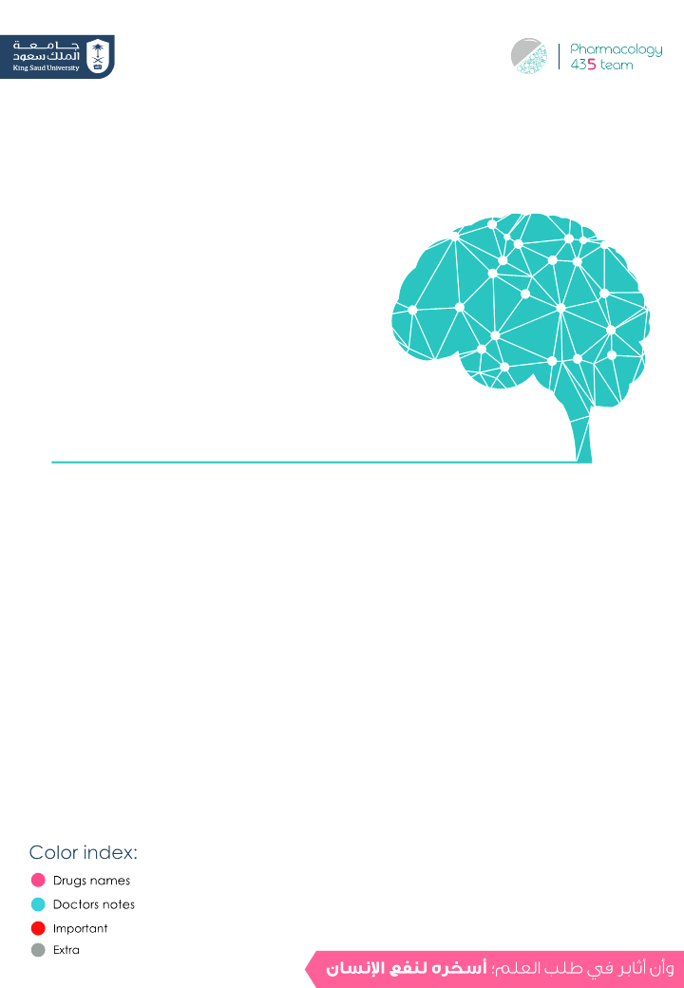
Drugs used in management of pain
Objectives:
Categorize the different classes of drugs used to relieve pain.
Detail on the mechanism of action,pharmacokinetics and
pharmacodynamic effects of morphine and its synthetic derivatives.
Hints on the properties and clinical uses of morphine antagonists.
Editing File

Slide 2
Drugs used in management of pain
What is pain?
Unpleasant sensory & emotional experience associated with actual & potential tissue damage, or described in terms of such damage
The 5th vital sign suggests that assessment of pain should be as automatic as taking a client’s BP and pulse.
Why should we treat pain?
Pain is a miserable experience
Pain is the most common reason patient seek medical advice
Impairs the patient functional ability & psychological well being
Pain increases sympathetic output → Increases myocardial oxygen demand (may lead to Myocardial infarction) and Increases BP, HR
Pain limits mobility
Increases risk for DVT (Deep vein thrombosis) and PE (Pulmonary embolism)
Drugs used in management of pain:
Adjuvant drugs
Opioids
Primarily indicated for clinical conditions other than pain
May modify the perception of pain & remove the concomitants of pain such as anxiety, fear, depression
Useful in neuropathic pain
e.g. Anxiolytics, Neuroleptics,Antidepressants Antiepileptics
Used to relief severe pain
Opium is derived from the juice of the opium poppy, Papaver somniferum
The natural products include morphine, codeine, papaverine and thebaine (the first two are the most widely used)
Opiates are drugs derived from opium and semisynthetic and synthetic derivatives
Endogenous opioid peptides, e.g. Endorphins, enkephalins , dynorphins
& b- endorphin (These are not enough in severe pain.)
Generally the first class of drugs used for controlling pain.
Work at site of tissue injury to prevent the formation of the nociceptive mediators (work peripherally)
Can decrease opioid use by ~30% therefore decreasing opioid-related side effects.
They neither cause tolerance or dependence
Has a ceiling effect to analgesia. (Maximum effect to analgesia, even when we increase the dose the efficacy is still the same)
NSAIDs

Slide 3
Mind Map
1st class of drugs used.
Prevent the formation of the nociceptive mediators.
Decrease opioid use by 30%.
Neither cause tolerance or dependence.
Has a ceiling effect to analgesia.
Anxiolytics
Neuroleptic
Antidepressants
Antiepileptics
NSAIDs
modify the perception of pain and remove the concomitants of pain such as anxiety, fear, depression.
Drugs used in management of pain
Adjuvant drugs
Opioids
RECEPTORS (G-protein coupled r.)
Mu (µ).
Kappa (ĸ).
Delta (δ).
ORL-1.
Classification (according to)
Natural → Morphine
Semisynthetic → Heroin
Synthetic → Pethidine, Methadone,
Tramadol & Fentanyl
Their source
Agonists
Morphine, Codeine, Pethidine, Methadone
agonistic/ antagonistic actions
Mixed
Pentazocine
Acts as an analgesic if given alone.If a patient has already taken morphine then we give him Pentazocine then it acts as an antagonist of morphine.
Antagonist
Nalaxone, Naltraxone
Only block opioid receptors, used as antidotes in addicts
Their specificity of
action on receptors
µ r. agonists → Morphine, codeine, heroin
agonist at k r. & antagonist at µ r. → Pentazocine

Slide 4
Opioids
Opioids exert their pharmacological receptors through 4 types of receptors:
Mu₁: Euphoria (pleasant floating sensation felt by addicts), supraspinal analgesia (brain), confusion, dizziness, nausea, low addiction potential.
μ (mu)
The strongest one
Mu₂: Respiratory depression, CVS & GIT effects, miosis, urinary retention.
κ (kappa)
Kappa: Spinal analgesia, dysphoria, psychomimetic effects, feedback inhibition of endorphin system
Opioids Receptors
δ (delta)
Delta: supra-spinal & Spinal analgesia, CVS depression, decreased brain & myocardial O₂
OLR-1
(opioid like receptor-1)
Nociceptin (an endogenous opioid peptide) receptor.
Antagonizes dopamine transport
- All of the 4 receptors are typical G-protein coupled receptors

Slide 5
Opioids
Mechanism of Action of opioids “morphine”
Binding to presynaptic opioid receptors coupled to Gi (inhibitory G protein) → ↓ AC (adenylate cyclase) & cAMP → ↓ voltage-gated Ca²⁺ channels (inhibit influx of Ca²⁺, → reduce release of neurotransmitter) → ↓ excitatory transmitter. Binding to postsynaptic receptors → ↑ opening of K+ channels (hyperpolarization) → ↓ neuronal excitability. Simple pic from Lippincotts explain its action.
Pharmacodynamic Actions “morphine”
Analgesia [in acute & chronic pain] Euphoria and sedation Respiratory depression → By reduction of the sensitivity of respiratory center neurons to carbon dioxide. Depression of cough reflexes → Some of the opioid drugs can be added to cough syrup (codeine and not morphine because morphine is strong) Nausea & vomiting → ↑ excitation CRTZ (chemoreceptor trigger zone) Pin point pupil (Miosis)→ How? It excites the EWN → enhance parasympathetic effect → constrict pupil. Releases histamine from mast cells → Causing: itching of skin, hypotension, bronchoconstriction → contraindicated w\ asthmatic pts. Effects on GIT:- ↑ in tone, ↓ motility of intestine by reducing release of Ach → severe constipation ↑biliary tract pressure due to contraction of the gallbladder and constriction of the biliary sphincter→ contraindicated in biliary colic. depress renal function and contract gallbladder.
Tolerance Vs Dependence “morphine”
Tolerance | Dependence
Tolerance occurs when the person takes a higher dose of the drug to achieve the same level of response achieved initially | Dependence develops when the neurons adapt to the repeated drug exposure and only function normally in the presence of the drug
Occurs rapidly with opioids (e.g. morphine 12–24 hours) Develops to respiratory depression, analgesia, euphoria and sedation Miosis doesn’t get affected by tolerance, so addicts’ pupils will still be constricted, which means that it can be an advantage in detecting addicts | Physical dependence(abstinence) → withdrawal manifestations develop upon stoppage. Addiction symptoms might appear after giving an antidote Lasts for a few days (8-10 days) in form of ↑ body ache, insomnia, diarrhea, goose flesh, lacrimation. Psychological dependence lasting for months / years → craving.

Slide 6
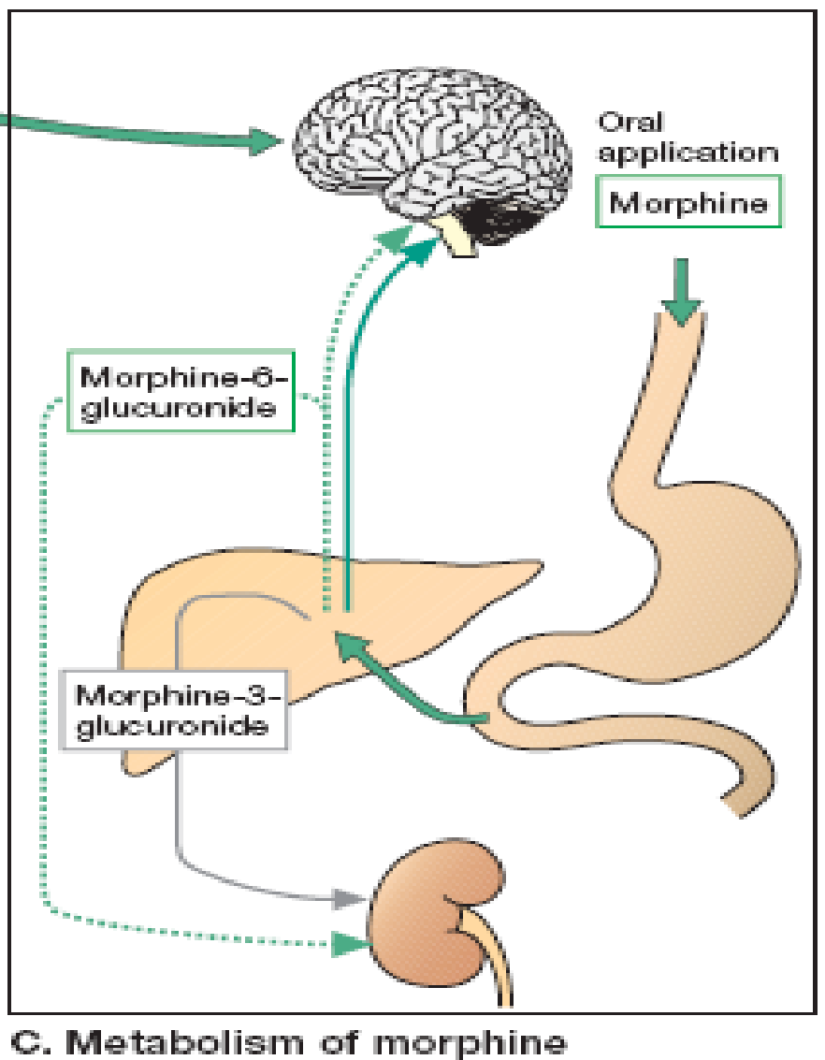
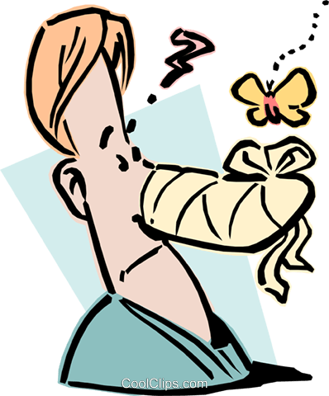
Opioids
Pharmacokinetics “morphine” :
1:49 min
T ½ is 2-3 h
It is slowly and erratically absorbed orally (bioavailability 20-40%) → Given SC, IM, or IV injection.
Metabolized by conjugation with glucuronic acid
Undergoes enterohepatic recycling →
Crosses BBB.
Crosses Placenta
Clinical Indications“morphine” :
*Because it causes venodilation
Pain Control
Acute Pulmonary Edema*
Myocardial Ischemia*
Stress Relief
e.g. heart failure (non painful conditions)
Pre- anesthetic medication
cancer pain, severe burns, trauma, Severe visceral pain
(not renal colics/biliary colics (because it constricts the sphincters) , acute pancreatitis)
Adverse Effects “morphine” :
I
Punched
Simon’s
Nose
Repeatedly *Crack*
*Crack*
Itching
Constricted Pupil
Sedation
Useful sometimes in preanesthesia
Nausea /Vomiting
Respiratory Depression
Constipation
CVS: Decrease BP, systole, diastole
5

Slide 7
Opioids
Contraindications “morphine”:
Head Injury → bc morphine depresses respiration → retention of CO₂ → dilatation of BV → increase intracranial pressure → patient may have hemorrhage.
Bronchial asthma or Impaired Pulmonary Function → bc it causes respiratory depression & bronchoconstriction due to histamine.
pancreatic pain and Biliary colic → bc it causes constriction of the sphincters
Elderly (more sensitive due to → ↓ Metabolism, lean body mass and Renal function)
Pts taking MAOIs (enzyme inhibitors) → increase morphine bioavailability and side effects.
Infants, neonates, or during childbirth → ↓ conjugating capacity → accumulate → ↓ respiratory level. → Because morphine gets metabolized by conjugation with glucuronic acid which is still not active in infants and neonates, so the morphine will accumulate and cause respiratory depression.
Opioid drugs:
- codeine, Tramadol, Pethidine (mepridine), Fentanyl
Drug | Codiene
Characteristics | μ Agonist Natural opioid Dependence < morphine
Indication | Used in mild & moderate pain (systemic) cough Diarrhea

Slide 8
Opioid agonists
 | TRAMADOL | PETHIDINE (mepridine) | FENTANYL
 | - Synthetic, μ (mu) agonist and less potent than Morphine. → so it is weak Analgesic. - Inhibits NE and 5HT (serotonin) reuptake. | Synthetic, more effective k (kappa) agonist. | Synthetic, μ (mu) agonist, more potent than Pethidine and Morphine About 100 times stronger than morphine, we can use very low dose of Fentanyl and get the same action as morphine.
 |  | Pharmacodynamics
 |  | - Works on k which isn’t as strong is μ so LESS. - Less analgesic, constipating, depressant on fetal respiration than morphine. - No cough suppressant effect. - Has atropine-like action (smooth muscle relaxant)
 | - Can be given orally → more oral bioavailability. | - | -
 | - Mild to moderate acute and chronic visceral pain. - During labor because it’s metabolized by alkylation | - As in Morphine but not in cough and diarrhea. - Better → preanaesthetic medication. - Used in obstetric analgesia (no decrease in respiration) can be used during labor - Used in severe visceral pain; renal and biliary colics (smooth muscles relaxant). | - Analgesic supplement during anesthesia (IV or intrathecal = injection into the spinal canal). - Induce and maintain anesthesia in poor-risk pts (stabilizing heart) - Used in combination with Droperidol (antipsychotic) as NEUROLEPTANALGESIA. - In cancer pain and severe postoperative pain; (transdermal patch changed every 72 hrs) - As an anesthetic in hunting, they cover the arrow tip with it.
 | - Seizures (not use w\ epileptics) - Nausea - Dry mouth - Dizziness - Sedation - Less ADRs on respiratory and CVS | - Tremors, convulsions, hyperthermia, hypotension. - Blurred vision, dry mouth, urine retention (atropine-like effects) - Tolerance and addiction. | - Respiratory depression (most serious)أقوى من المورفين - CV effects are less. - Bradycardia may still occur. so we have to monitor the patient
Drug
Mechanism of action
P.K
Indications
ADRs

Slide 9
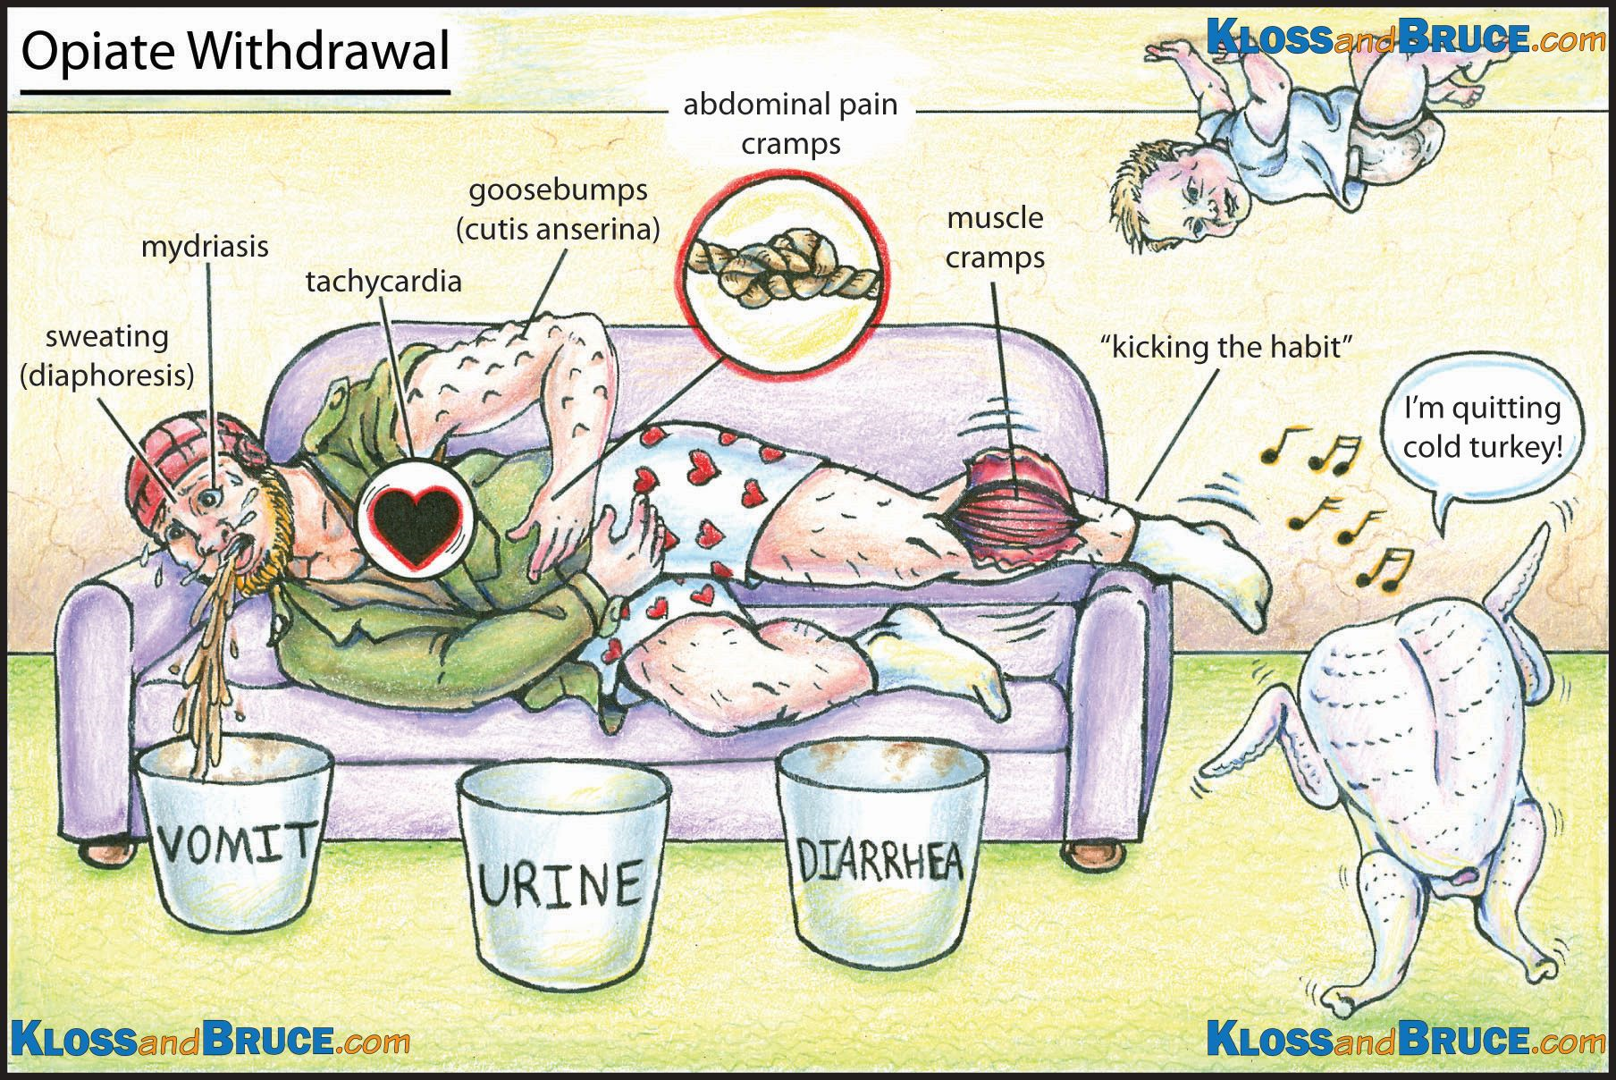
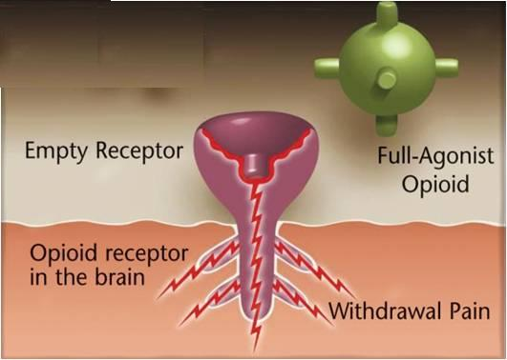
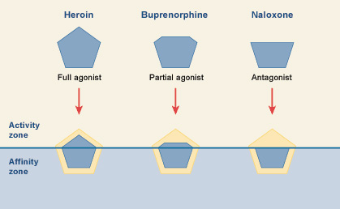
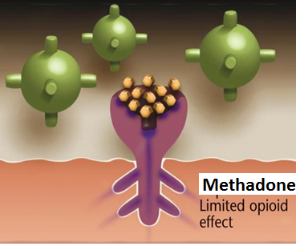
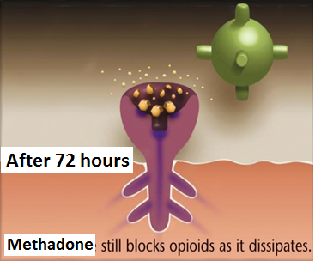
 | Opioid agonist | Opioid Antagonists
 | METHADONE | NALOXONE | NALTREXONE
 | - Weaker synthetic μ agonist. - antagonist of the N-methyl- D-aspartate (NMDA) receptor. | Pure opioid antagonist | Very similar to Naloxone
 |  | (Antidotes) Competitive antagonists that bind to the opioid receptors with higher affinity than agonists but do not activate the receptors. This effectively blocks the receptor, preventing the body from responding to opioids.
 | In non-addicts, it causes tolerance and dependence but not as severe as that of Morphine. | - | -
 | T1/2 = 55 hrs | Effects lasts only for 2-4 hrs. | Longer duration of action. T1/2 = 10hrs
 | Used to treat and control opioid withdrawal (as patches) It occupies the receptors وتشغلها so there won’t be pain and craving | - Used to treat and reverse respiratory depression caused by opioid overdose. - Reverse the effect of analgesia on the respiration of the new born baby. - Precipitates withdrawal syndrome in addicts. | -
 |  | OPIOID ANTAGONISTS
Drug
M.O.A
P.D
P.K
Indications
With addiction of opioid:
Morphine
Nalorphine
Naloxone
With mehadone:

Slide 10
Boy’s slide
Not important!
At-121
Experimental analgesic, 100 times more potent than morphine
A bifunctional analgesic, acting as an agonist at both the μ opioid receptor and the nociceptin receptor
the interaction with the nociceptin receptor blocks the abuse and dependence-related side effects

Slide 11
Summary
Morphine (natural)
M.O.A |  | μ receptor agonist. Binds to presynaptic opioid receptors to ↓ excitatory transmitter. and to postsynaptic receptors to ↓ neuronal excitability.
P.D |  | Analgesia (in acute & chronic pain). - Euphoria & sedation Respiratory depression - Depression of cough reflexes Nausea & vomiting increase → ↑CRTZ - Pin point pupil (Miosis) Releases histamine from mast cells Effects on GIT: ↓ motility → severe constipation. Constriction of biliary sphincter → ↑pressure in the biliary tract & biliary colic. Depress renal function & contract gallbladder
Disadvantage |  | Tolerance. - Psychological dependence
P.K |  | It’s slowly & erratically - crosses BBB & placenta Given by SC, IM or IV injection Metabolized by conjugation with glucuronic acid Undergoes enterohepatic recycling
Uses |  | Control pain; cancer pain, severe burns, trauma, Severe visceral pain Acute pulmonary edema (due to venodilation) Myocardial ischemia (due to venodilation) Non painful conditions e.g. heart failure (to relieve distress) Preanesthetic medication.
S.E |  | Constipation - Itching (due to histamine) Respiratory depression - miosis Nauseia, vomiting - Sedation CVS: ↓ blood pressure, (↓ both diastolic and systolic )
C. I |  | -Head injury ( ↑ ICP) -With MAOIs -Bronchial asthma & impaired pulmonary function . -Elderly -Renal/Biliary colic & pancreatic pain. - infants, neonates or during child birth
Opioid antagonists
 | Naloxone |  | Naltrexone
M.O.A | Pure opioid antagonist
P.D | Effect lasts only for 2-4 hours |  | Very similar to naloxone but with longer duration of action [t½=10h].
Uses | Treatment of respiratory depression caused by opioid overdose. To reverse the effect of analgesia on the respiration of the new born baby. |  | -
S.E | Precipitates withdrawal syndrome in addicts. |  | -

Slide 12
Summary
Opioid Agonist
Drug | M.O.A | P.D | USES | S.E | C. I
Codeine | Natural opioid μ agonist | Less dependence than morphine | In mild & moderate pain, cough, diarrhea.
 | Synthetic μ agonist. less potent than morphine | Inhibits also NE & 5HT reuptake Can be given orally; more oral bioavailability | Mild - moderate acute & chronic visceral pain During labor | Seizures Nausea, Dry mouth. Dizziness, Sedation Less adverse effects on respiratory & C.V.S | Epileptics
 | Synthetic, more effective k agonist | LESS analgesic, constipating, depressant on fetal respiration than morphine No cough suppressant effect Has atropine –like action (Smooth muscle relaxant) | As in morphine but not in cough & diarrhea Preanaesthetic medication (better) Used in obstetric analgesia. Used in severe visceral pain; renal & biliary colics (sm. relaxant). Delivery | Tremor Convulsions Hyperthermia Hypotension Blurred vision Dry mouth Urine retention Tolerance & Addiction
 | Synthetic, μ agonist. More potent than pethidine & morphine |  | Analgesic supplement during anesthesia To induce & maintain anesthesia in poor-risk patients (stabilizing heart) In combination with droperidol as neuroleptanalgesia In cancer pain & severe postoperative pain (transdermal patch changed every 72 hrs). | Respiratory depression (most serious) CV effects are less bradycardia may still occur.
 | Weaker synthetic μ agonist | t½ 55 h (Note that it is long) | Used to treat opioid withdrawal | In non addicts, it causes tolerance & dependence but not as severe as that of morphine
Tramadol
Pethidine
(mepridine)
Fentanyl
Methadone

Slide 13
Questions
MCQs
1-which of the following can be used to treat Opioid withdrawal symptoms?
a)Naloxone .
b) Methadone.
c) Naltrexone.
d) Fentanyl.
2- which of the following opioids can be used during labor?
Tramadol.
Fentanyl .
Methadone .
Naltrexone.
3-Mohammed underwent a surgery but suffered from severe postoperative pain. He was given transdermal patches of Fentanyl. which of the following is MOST LIKELY to develop?
respiratory depression.
biliary colic.
dry mouth.
seizures.
4-During labor , a patient was given pethidine. the new born suffered from Respiratory depression from the analgesia. which of the following can be given to REVERSE the effect of analgesia on the respiration of the new born baby?
Methadone.
Fentanyl.
Naloxone.
Tramadol.
5-which opioid is contraindicated in patients with epilepsy?
Fentanyl.
Morphine.
Codeine.
Tramadol.
MCQs answers :
b
a
a
c
d

Slide 14
Questions
MCQs
6- all of the following are opioid receptor agonists except :
morphine.
codeine.
naloxone.
methadone.
7- which combination is best used as neuroleptanalgesia ?
Droperidol + Fentanyl.
Haloperidol + methadone.
Droperidol + pethidine.
Haloperidol + Fentanyl.
8-which of the following best describes Pethidine ?
Mu receptor agonist.
effective in treating cough and diarrhea.
k ( kappa ) receptor agonist.
more potent than morphine.
MCQs answers :
6) c
7) a
8) c
SAQ
1- Khalid suffered from severe burns while playing with fireworks. he was rushed to the hospital and was given morphine intravenously. what is morphine’s mechanism of action in alleviating the pain?
Binding to presynaptic opioid receptors coupled to Gi (inhibitory G protein) → ↓ AC (adenylate cyclase) & cAMP → ↓ voltage-gated Ca²⁺ channels (inhibit influx of Ca²⁺, → reduce release of neurotransmitter) → ↓ excitatory transmitter.
Binding to postsynaptic receptors → ↑ opening of K+ channels (hyperpolarization) → ↓ neuronal excitability.
2- List 3 common side effects of opioid drugs like morphine?
- constipation
- Respiratory depression
- constricted pupil.

Slide 15
Team leaders:
Ghaida Saad Alsanad
Omar Alsuhaibani
Team Members:
Alanoud Almansour
Dana AlRasheed
Rinad Alghoraiby
Munira Al-Hadlg
Sara Alsultan
Khulood Alwehaibi
Noura Alothaim
References:
- Doctors’ slides and notes.
- Pharmacology Team 435.
Special thank for team 435
@Pharma4370
Pharm437@gmail.com

