Slide 1
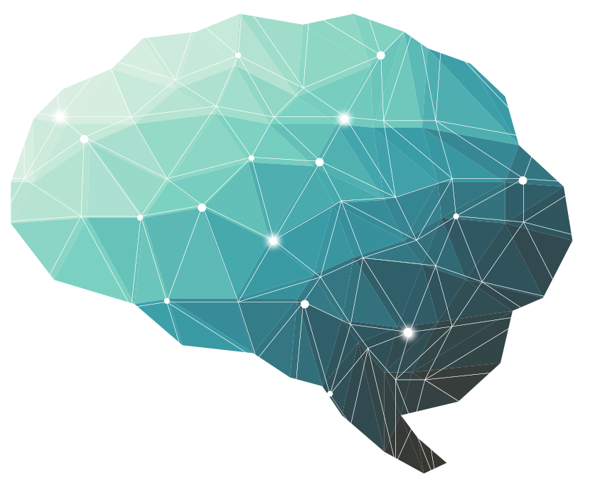
1st Lecture ∣ The Physiology Team
Synapses and Synaptic Transmission
Objectives:
Definition​ and Functions​ of synapses.
Structure and Types​ of synapses: anatomical & functional.
Synaptic transmission​ & neurotransmitters.
What neurotransmitters are, and how they are released and act on their receptors.
Fate​ of neurotransmitters.
Differentiate between neurotransmitter receptors (ionotropic and metabotropic).
Electrical events​ at synapses (EPSPs & IPSPs) and the differentiation.
Properties of synaptic transmission.
Factors affecting synaptic transmission.
Done by :
Team leader: Rahaf AlShammari, Fatima Balsharf, Abdulelah AlDossari, Ali AlAmmari.
Team members: Mohammed AlHasan, Hisham AlShaya, Afnan AlMustafa, Dana AlKadi, Noura AlKadi, Rahaf AlShunaiber, Reem AlQarni, Rinad AlGhurabib, Shahad AlTayyash, Shahad AlZahrani.
Colour index:
Important
Numbers
Extra
وَأَن لَّيْسَ لِلْإِنسَانِ إِلَّا مَا سَعَىٰ

Slide 2
Key words
Terminology | Definition
Chemical synapses | A one direction transmission of signals where a chemical substance (neurotransmitter) is secreted by the first neuron to act on receptors on the membrane of the next neuron.
Electrical synapses | A bidirectional transmission of signals where the cytoplasms of adjacent cells are connected by ion channels called gap junctions allowing movement of ions.
Neurotransmitters | A chemical transmitter substance secreted at the end of a nerve fiber that acts on receptor proteins in the membrane of the next neuron.
Presynaptic inhibition | A synaptic inhibition occurring when an inhibitory synaptic knob laying on the termination of a presynaptic excitatory fiber releases a transmitter which inhibits the release of excitatory transmitters.
Postsynaptic inhibition | A synaptic inhibition occurring when an inhibitory neuron (releasing inhibitory substances) acts on a postsynaptic neuron leading to hyperpolarization.
Temporal summation | The type of summation where the frequency of stimulation from the same presynaptic fiber is increased.
Spatial summation | Eliciting an action potential in a neuron with input from multiple presynaptic cells.
Synaptic vesicles | Vesicles that store various neurotransmitters that are released at the synapse.
Excitatory neurotransmitters | Neurotransmitters that increase the rate or likelihood of a neuron firing by depolarizing the neuron.
Inhibitory neurotransmitters | Neurotransmitters that decrease the rate or likelihood of a neuron firing by hyperpolarizing the neuron.
Ionotropic receptors | Neurotransmitter receptors that directly open gate ion channels.
Metabotropic receptors | Receptors that act through second messenger systems.

Slide 3
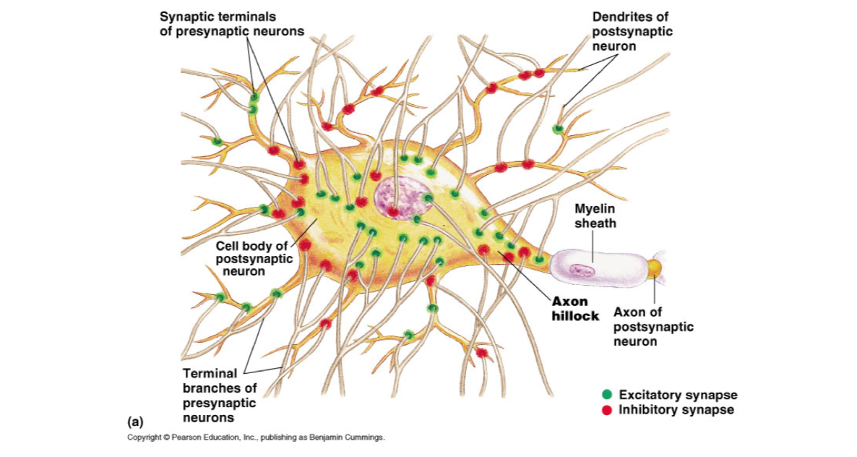
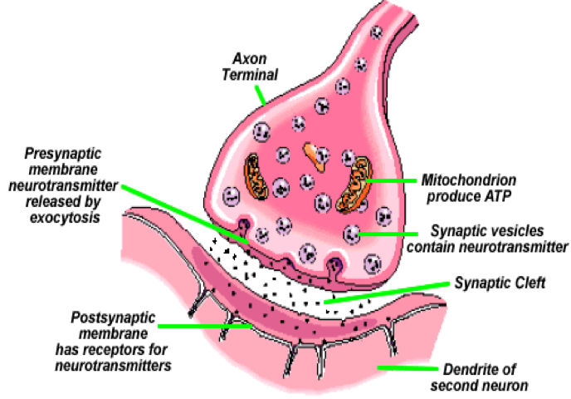
Definition and functions of synapses
General Facts about Synapses
It is a junction where the axon or some other portion of one cell (presynaptic cell) terminates on the dendrites, soma, or axon of another neuron (postsynaptic cell).
The CNS contains ​more​ than 100 billion neurons. The brain has ​86 billion neurons​​
Some CNS neurons receive 20,000 synapses.
Synaptic input is converted to a nerve impulse (AP) at the ​AXON HILLOCK
The output signal (AP) travels by way of a single axon leaving the neuron.
How brain functions?
Collecting of sensory input
Central integration
Motor output
Functions of synapse
In the CNS, this other cell is also a neuron.
In the PNS, the other cell may be either a neuron or an effector cell eg; gland or muscle.
The synapses determine the directions that the nervous signals will spread through the nervous system.
The synapses perform a selective action, often blocking weak signals while allowing strong signals to pass.

Slide 4
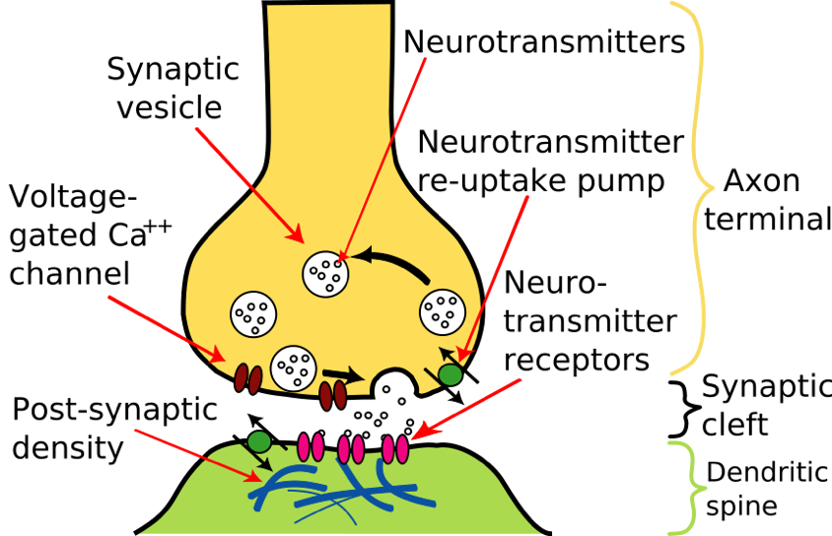
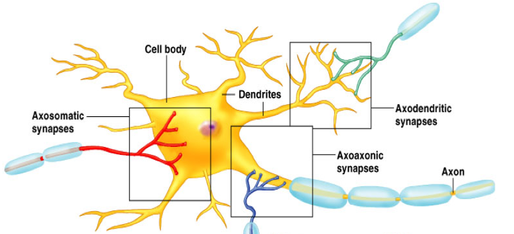
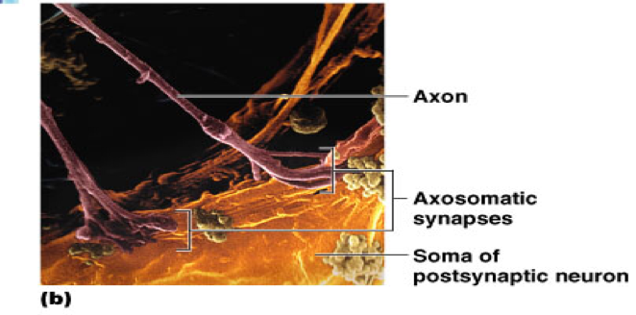
Structure and types of synapses
Structure of synapse
Synaptic knobs (presynaptic terminal): It has synaptic vesicles (neurotransmitters).
Synaptic cleft: It is the space between the axon terminal and sarcolemma. It has a width of 200-300 angstroms.
Postsynaptic membrane It has receptors for neurotransmitters or ion channels.
Looks like a button because of dilatation which helps to increase the surface area, thus, increase the efficiency
Anatomical Types of Synapses
Axodendritic
synapses between the axon of one neuron and the dendrite of another
Other types of synapses include:
Axosomatic
synapses between the axon of one neuron and the soma of another
Axoaxonic
(axon to axon)
Dendrodendritic
(dendrite to dendrite)
Dendrosomatic (dendrites to soma)

Slide 5
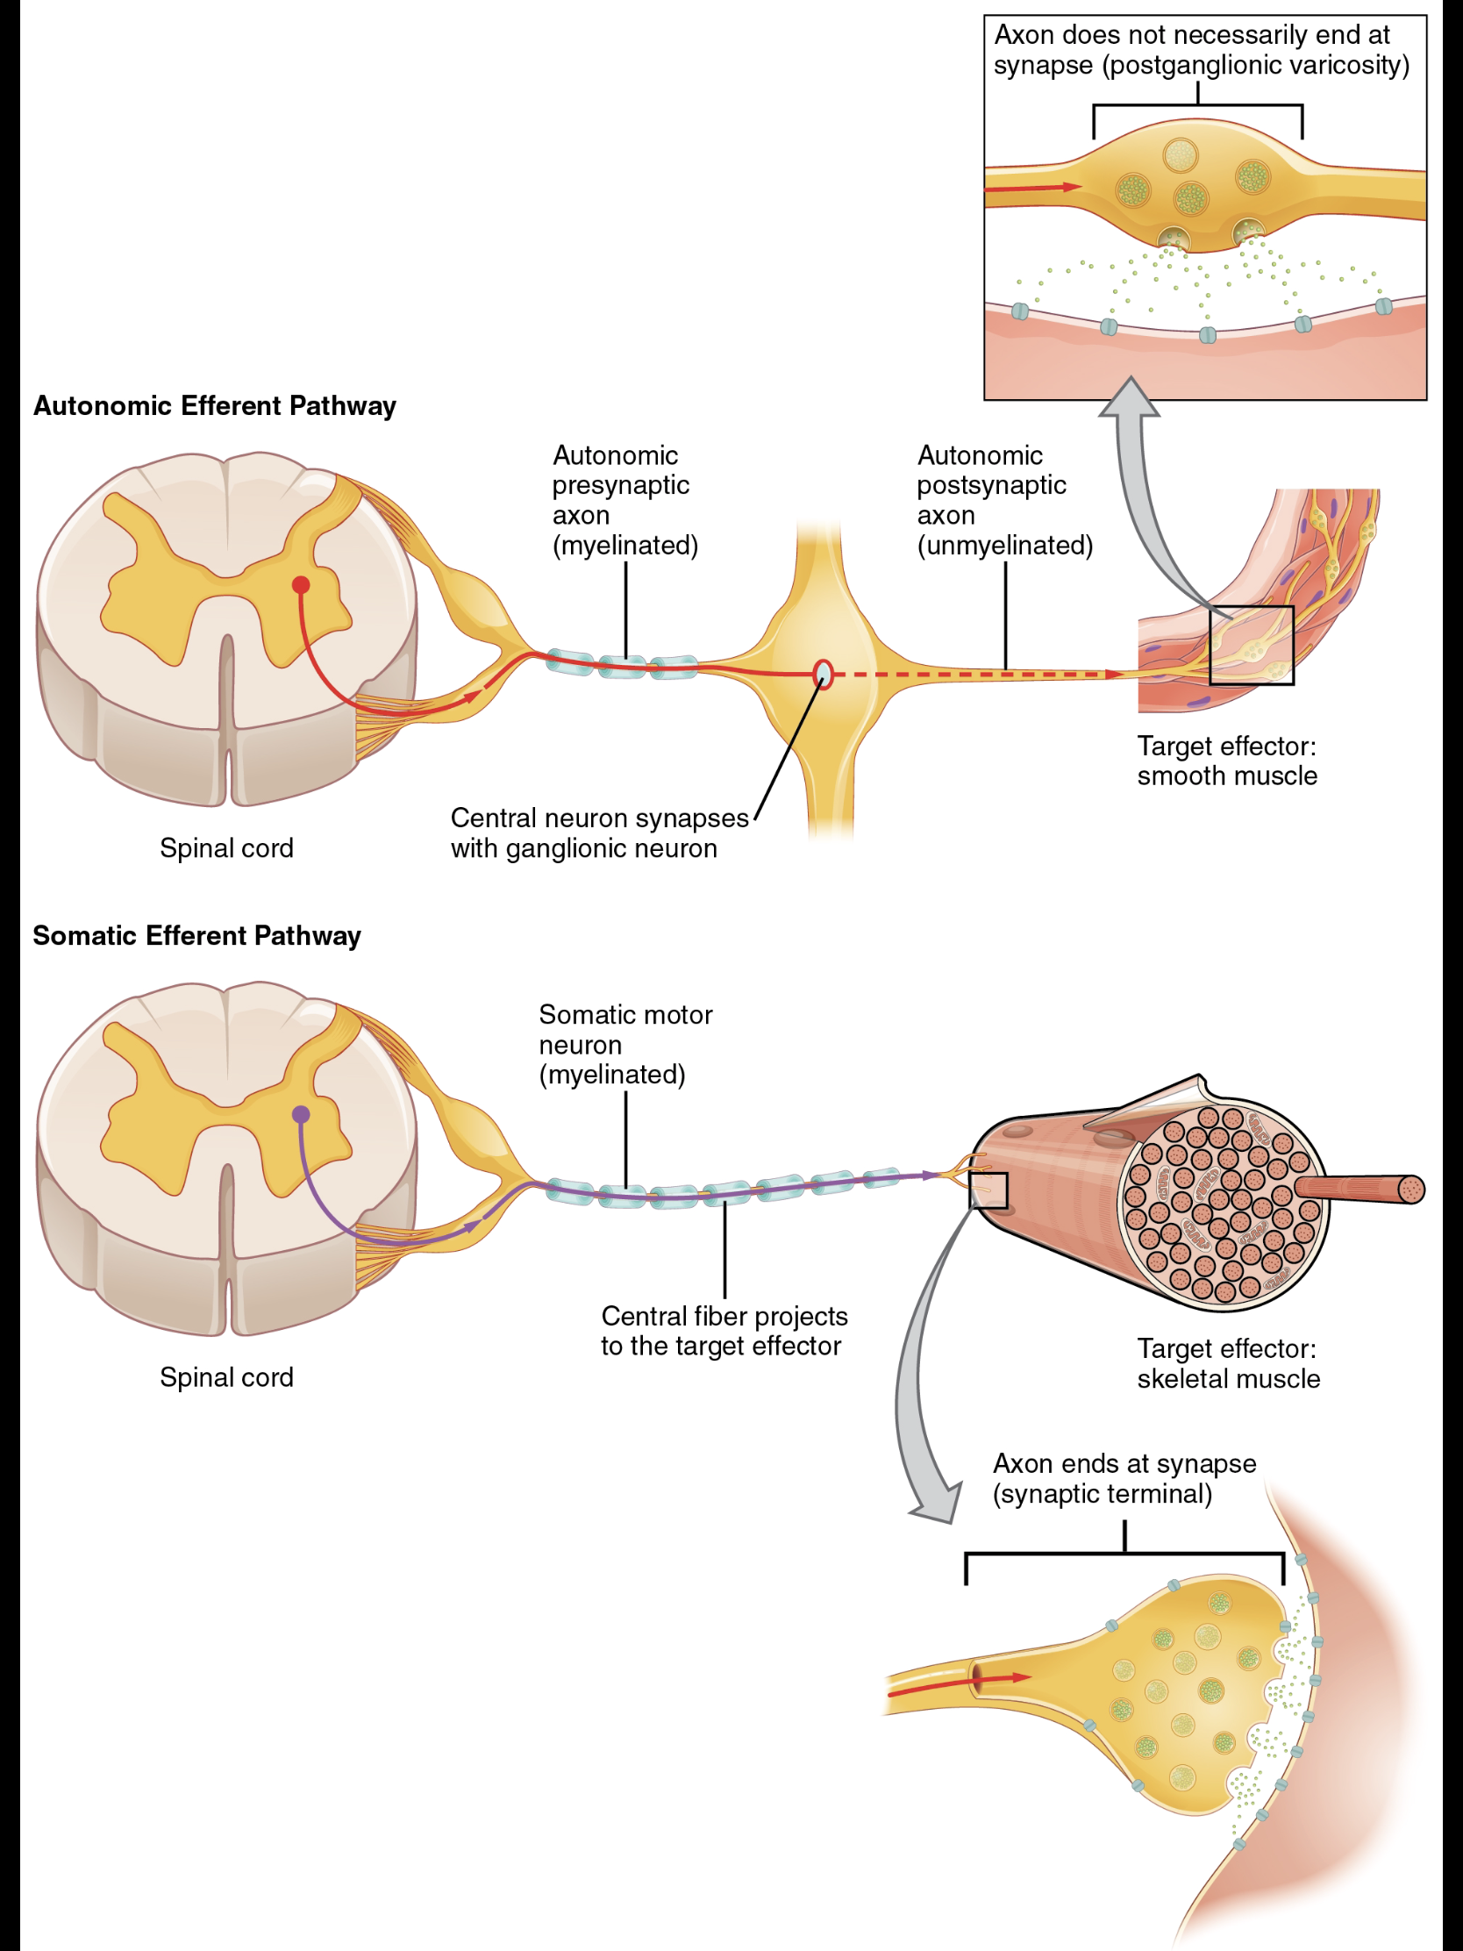
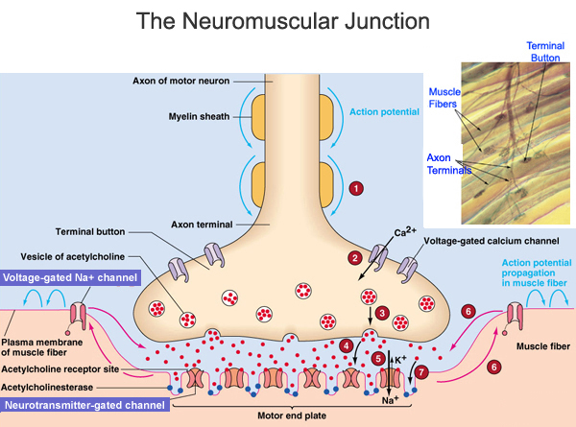
Examples of synapse outside the CNS
Neuromuscular junction
Contact between: autonomic neurons & smooth, cardiac muscles, & other effector cells.
Structure and types of synapses
Functional Types of Synapses
A. Chemical synapse
Almost all synapses in the CNS. (I.e. first neuron secretes a chemical substance called neurotransmitter at the synapse to act on receptor on the next neuron to excite it, inhibit or modify its sensitivity). One direction transmission*.
B. Electrical Synapses
*The transmission can occur in both directions. Which allows it to control the activities of large groups of interconnected neurons, and allow the synchronized firing.
Membranes of the pre- and postsynaptic neurons come close together and gap junctions forms → low membrane borders which allow passage of ions.
Are less common than chemical synapses
Correspond to gap junctions found in other cell types.
Each gap junction is composed of 12 connexin proteins.
Are important in the CNS in:
Mental attention
Emotions and memory
Arousal from sleep
Thus, if one cell is excited the other cells will be excited too. (Like the cardiac muscles)
C. Conjoint synapse
Relates to balance and equilibrium, and those are connected to sight, hearing, and muscle tone.
Both electrical and chemical.
Examples: neurons in lateral vestibular nucleus.

Slide 6
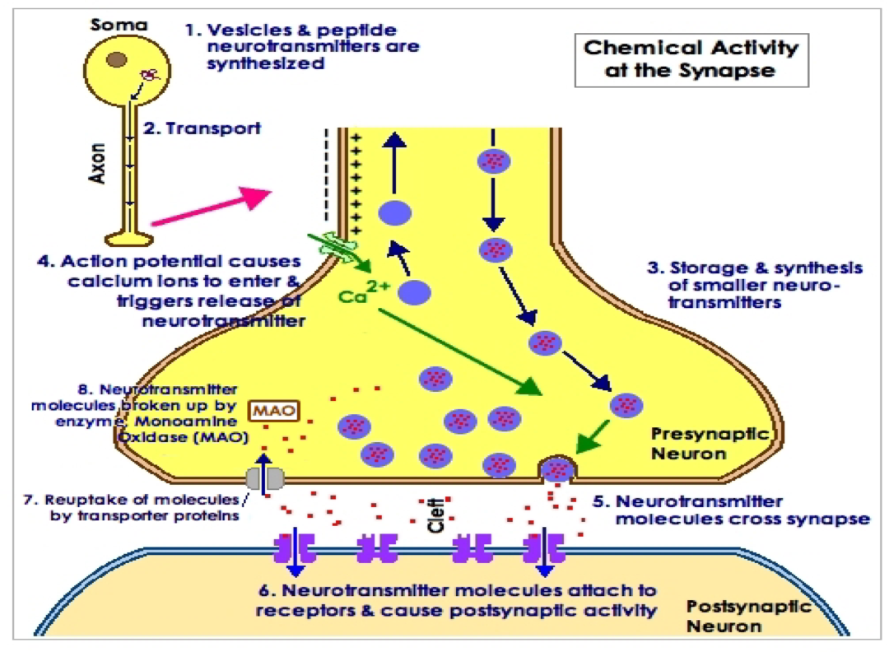
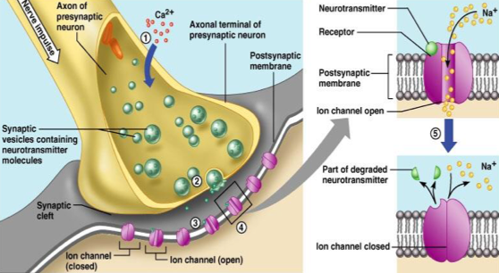
Synaptic transmission & neurotransmitters / Fate of neurotransmitters
Mechanism of Synaptic Transmission
AP Open of ca channel > NT release at docking site > Binding to postsynaptic receptors (inhibition or excitation) of the postsynaptic membrane (Depending on the type of the neurotransmitter, i.e. excitatory or inhibitory).
Ca activates calmodulin which activates (PK) protein kinase.
Information is transmitted in the central nervous system mainly in the form of nerve action potentials, called NERVE IMPULSES, through a succession of neurons, one after another.
Fate of Neurotransmitters
After a transmitter substance is released at a synapse, it must be removed by :
Diffusion out of synaptic cleft into surrounding fluid.
Enzymatic destruction e.g Ach esterase for Ach.
Active transport back into presynaptic terminal itself e.g norepinephrine.

Slide 7
Differentiate between neurotransmitter receptors (ionotropic and metabotropic).
These receptors have two components
1- Binding site that face the cleft to bind the neurotransmitter.
2- Ionophore : It passes all the way through the membrane to the interior.
It is of two types :
2nd messenger system in the postsynaptic neuron. This mechanism is important where prolonged postsynaptic changes are needed to stay for days, months.. years (memory).
Effects : intracellular Enzymes activation, gene transcription, etc…
Ion channel
Cation channels
Na+ (most common)
K+
Ca++
Opening of Na+ channels
membrane potential in positive direction toward threshold level of excitation ( + ) neuron
Anion channels
Cl⁻ mainly
Opening of Cl⁻ channels diffusion of negative charges into the membrane membrane potential making it more negative away from threshold level (-) neuron
Neurotransmitter receptors that directly gate ion channels are often called ionotropic receptors, whereas those that act through second messenger systems are called metabotropic receptors.
Ionotropic | Metabotropic
Mediate rapid PSPs | Mediate slower PSPs
Duration of PSPs is 10-30 ms or less | Duration from 100’s ms to minutes or longer
PSPs (EPSP or IPSP) develop within ​1­-2 ms after an AP reaching the presynaptic terminal | This is slowness is due to activation of second messengers leading to opening Ion channels.
A NT may activate both Ionotropic and Metabotropic receptors to produce both fast and slow postsynaptic potentials as the same synapse.

Slide 8
Electrical events at synapses EPSP & IPSP and the differentiation
2nd messenger system in the postsynaptic neuron acts in :
*** focus on the 4 ways
Electrical Events in Post-synaptic Neurons
There will be a question about this part
1- RMP of Neuronal Soma
-65 mV i.e. less than skeletal muscles (-70 to -90 mV).
If the voltage is less negative the neurons is excitable.
2- Excitatory Post-synaptic Potential (EPSPs)
When excitatory neurotransmitters binds to its receptor on post-synaptic membrane > partial depolarization (increase Na influx) of post-synaptic cell membrane immediately under presynaptic ending, i.e. EPSPs.
This summation will cause the membrane potential to increase from -65 mV to -45mV.
EPSPs = +20mV which makes the membrane reach the firing level AP develops at axon hillock.
How EPSPs differs from Action Potential ?
Proportionate to the strength of the stimulus
Can be summated
If large enough to reach firing level > AP is produced
3- Inhibitory Post-synaptic Potentials (IPSPs)
When an inhibitory NT binds to its receptor on post-synaptic membrane, it causes hyperpolarization of the post-synaptic membrane.
Increase membrane permeability to Cl⁻ of post-synaptic membrane (produced by inhibitory neurotransmitter) excitability and membrane potential (more negative).

Slide 9
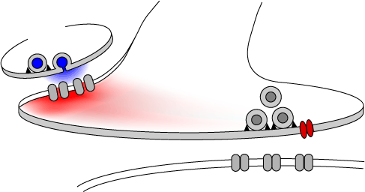
Properties of synaptic transmission
Synaptic Properties
“Chemical Synapses”
1. One-way conduction synapses generally permit conduction of impulses in one-way i.e. from pre-synapstic to post-synaptic neuron. “Bell-Magendie law”
2. Synaptic delay is the minimum time required for transmission across the synapse. It is 0.5 ms for transmission across one synapse.
This time is taken by: (why there is a delay?) it could come as MCQ
Discharge of transmitter substance by pre-synaptic terminal.
Diffusion of transmitter to post-synaptic membrane.
Action of transmitter on its receptor.
Action of transmitter to increase membrane permeability.
Increased diffusion of Na⁺ to increase post-synaptic potential.
Clinical Importance :
We can know how many synapses are involved in the pathway by the time lag.
3. Synaptic inhibition:
Types: Direct inhibition, Indirect inhibition, Reciprocal inhibition & Inhibitory interneuron
A. Direct inhibition: Occurs when an inhibitory neuron (releasing inhibitory substances) acts on a postsynaptic neuron leading to hyperpolarization due to opening of Cl¯ [IPSPs] and/or K+ channels. Example: Glycine at the level of the spinal cord to block pain impulses.
B. Indirect Inhibition (Presynaptic inhibition): This happens when an inhibitory synaptic knob lie directly on the termination of a pre-synaptic excitatory fiber. The inhibitory synaptic knob releases a transmitter which inhibits the release of excitatory transmitters from the pre-synaptic fiber. e. g. GABA (Pain modification).

Slide 10
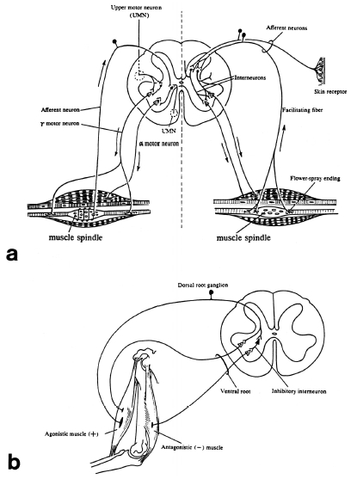
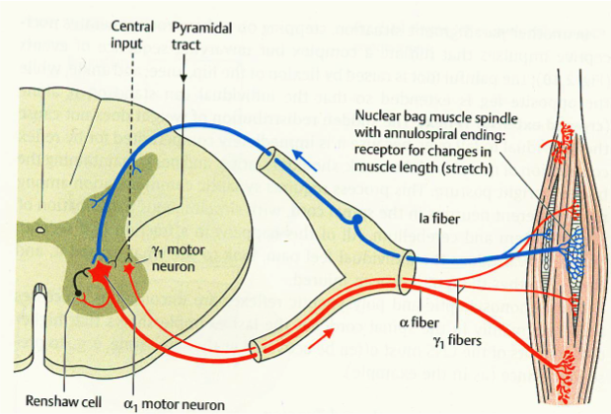
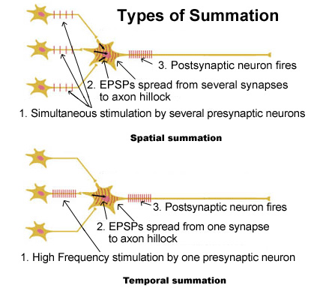
Properties of synaptic transmission
C. Reciprocal inhibition: Inhibition of antagonist activity is initiated in the agonist muscle. Impulses pass directly to the motor neurons supplying the same muscle and via branches to inhibitory interneurons that end on motor neurons of antagonist muscle.
D. Inhibitory interneuron (Renshaw cells) Negative feedback inhibitory interneuron of a spinal motor neuron (Control the strength of contraction)
Increase the efficiency of AP developed by the postsynaptic neuron
4. Summation:
A. Spatial summation.
Eliciting an action potential in a neuron with input from multiple presynaptic cells.
(Greater number of fibers)
B. Temporal summation.
When the frequency of stimulation increased from the same presynaptic fiber.
(Increase number of frequency of nerve impulses in each fibers).

Slide 11
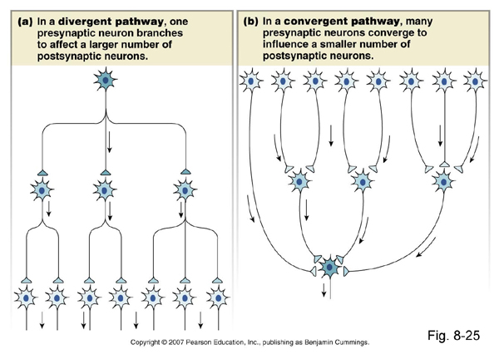
Properties of synaptic transmission / Factors affecting synaptic transmission
5. Convergence and divergence:
a. Divergence: Axons of pre-synaptic neurons divide into many branches that diverge to end on many post-synaptic neurons.
b. Convergence: When many pre-synaptic neurons converge on any single post-synaptic neuron.
6. Fatigue It is due to exhaustion of neurotransmitter. If the pre-synaptic neurons are continuously stimulated there may be an exhaustion of the neurotransmitter. Resulting in stoppage of synaptic transmission.
Despite giving the neuron a strong stimulus there is no AP
Factors Affecting Synaptic Transmission
Increases neuronal excitability.
Causes cerebral epileptic seizures (Increased excitability cerebral neurons).
e. g. overbreathing in person with epilepsy.
The over breathing blows off carbon dioxide and therefore elevates the pH of the blood momentarily
Alkalosis
Acidosis
Depresses neuronal activity.
pH around 7.0 usually causes a coma.
E.g. severe diabetic or uremic acidosis.
Drugs
Caffeine found in coffee, tea, increases neuronal excitability, by reducing the threshold for excitation of neurons.
Hypoxia
Depression of neurons.

Slide 12
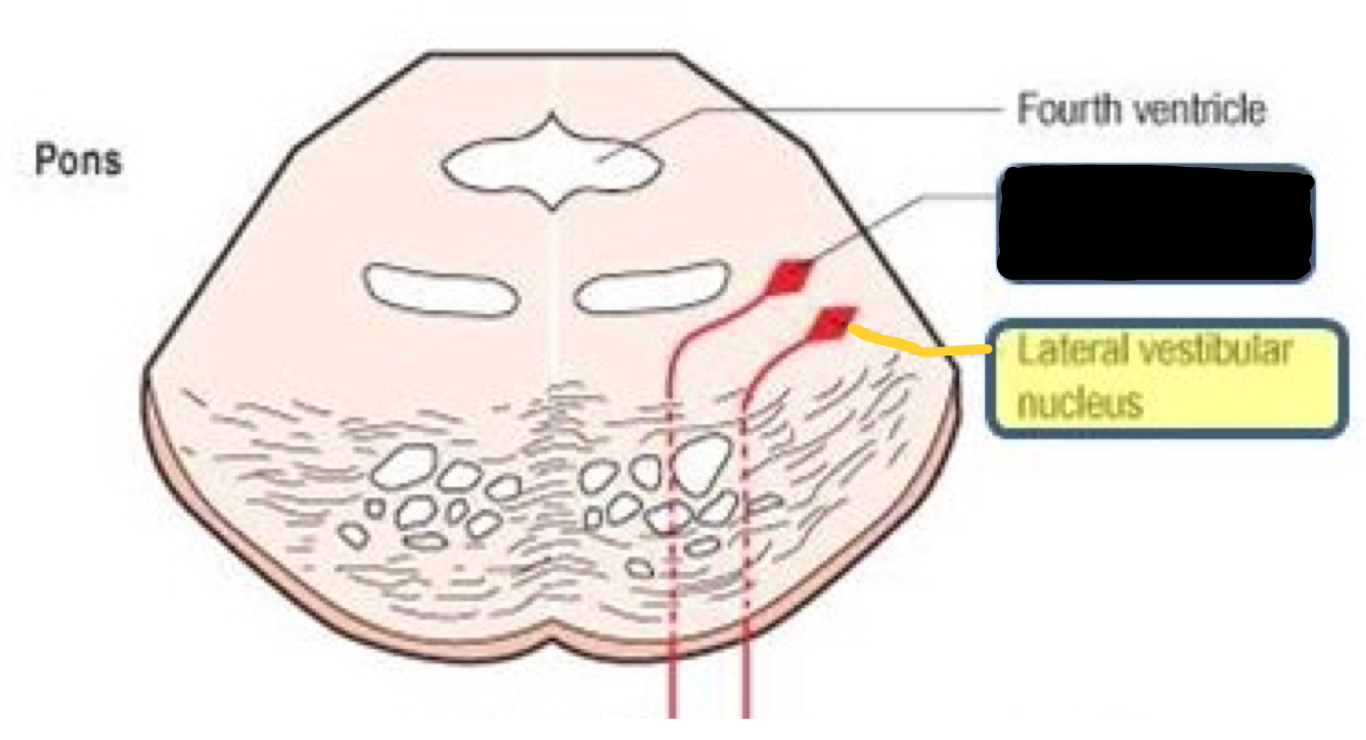
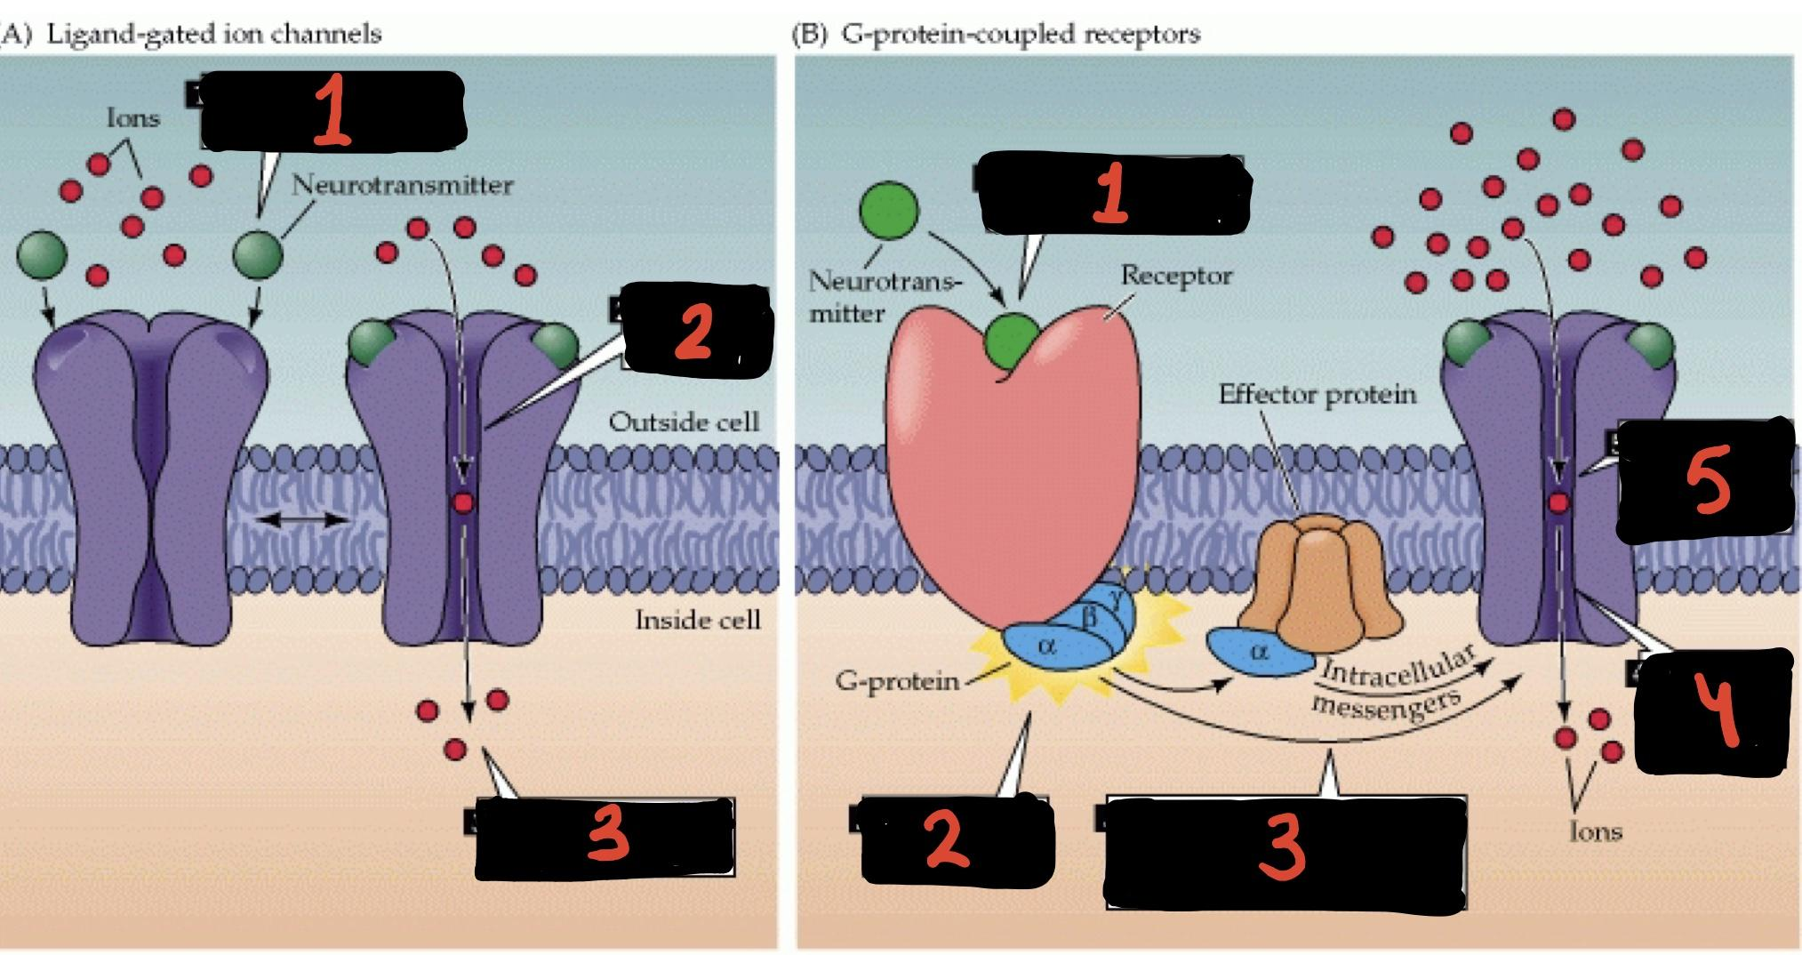
Almost all synapses in the CNS are chemical synapses
neurotransmitter is a chemical substance that is secreted by the first neuron at the synapse to act on receptor on the next neuron to excite it, inhibit or modify its sensitivity
Chemical synapse is One directional in transmission while electrical synapse transmission can occur in both directions .
Gap junction is the space between the pre- and postsynaptic neurons which allows the passage of ions
Electrical synapses Are important in the CNS in Mental attention,Emotions, memory and Arousal from sleep.
neurons in lateral vestibular nucleus¹ have conjoint synapse
Ach esterase is an enzyme that destroys Ach neurotransmitter in a process called Enzymatic destruction
Norepinephrine neurotransmitter is actively transported back into the presynaptic terminal.
Neurotransmitter receptors that directly open gate ion channels are often called ionotropic receptors, whereas those that act through second messenger systems are called metabotropic receptors.²
Important points you should focus on:
EPSPs | IPSP
1- Opening of Na channels to threshold level (Most Common). | 1- Opening of Cl ion channels through the postsynaptic neuronal membrane.
2- Decrease conduction through Cl or K channels, or both. | 2- Increase in conductance of K ions out of the Neuron
3- Various changes in the internal metabolism of the postsynaptic neuron to excite or, in some instances, to Increase excitatory membrane receptors or decrease inhibitory membrane receptors | 3- Activation of receptor enzymes that inhibit cellular metabolic functions that increase inhibitory membrane receptors or decrease excitatory membrane receptors.
Summary
*** ممكن يجي وحدة من خصائص EPSP أو خصائص الـ IPSP ويلخبط بينهم
1
2

Slide 13
Questions
1.All synapses are junctions But not all junctions are synapses.
False.
True.
2.Which one of these types has one direction transmission?
conjoint synapse.
Chemical synapse.
Electrical synapse.
3.The electrical synapse is important in:
Memory.
Emotions.
Both A+B.
4.How many types of neurotransmitters does the synaptic vesicle contains?
Each vesicle contains only one type.
Each vesicle contains 3 types.
Each vesicle contains 5 types.
5.Choose the correct answer:
Glutamate is excitatory, GABA is inhibitory.
Glutamate and GABA are excitatory.
Glutamate and GABA are inhibitory.
6.Axons of pre-synaptic neurons divide into many branches called:
Convergence .
Divergence .
None.
7.Glycine at the level of spinal cord is example for:
Direct inhibition.
Indirect inhibition.
Reciprocal inhibition.
8.Caffeine _____ threshold and _____ neural excitability.
Reduce, increase.
Reduce, reduce.
Increase, increase.
what are the two types of channel activities/affect produced in the postsynaptic membrane?
Excitatory postsynaptic potentials EPSP
Inhibitory postsynaptic potentials IPSP
What are the main two characteristics for end plate potentials EPPs?
Localized (they don’t spread)
Graded (you can grade them unlike action potential)
What are the reasons for synaptic delay?
Mentioned in slide 7
What are the two mechanisms of prolongation?
Long acting neurotransmitter
Reverberating circuits
Answers:
1.B
2.B
3.C
4.A
5.A
6.B
7.A
8.A

