Slide 1
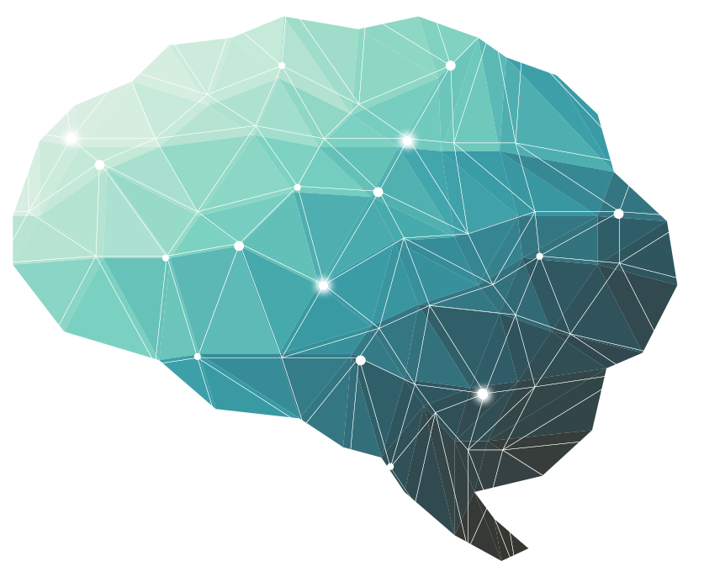
12th Lecture ∣ The Physiology Team
Vision Accommodation
Objectives:
Describe visual acuity
Contrast photopic and scotopic vision
To know visual pathway and field of vision
Describe the process of accommodation reflex and its pathway, contrasting the refraction of light by the lens in near vision and in far vision
Identify and describe pupillary light reflex and its pathway and relate these to clinical situations as argyll Robertson pupil
Identify the lateral geniculate body and visual cortex
Done by :
Team leaders: Abdulelah Aldossari, Ali Alammari
Fatima Balsharaf, Rahaf Alshammari
Team members:Saleh almoaiqel, Abdulmajeed Alwardi, mohammed alqahtani, Alanoud Almansour
Special thanks to: Sara AlTowireb
Colour index:
important
Numbers
Extra
وَأَن لَّيْسَ لِلْإِنسَانِ إِلَّا مَا سَعَىٰ
Notes:
لِلْإِنسَانِ إِلَّا مَا سَعَىٰ (39) وَأَنَّ سَعْيَهُ سَوْفَ يُرَىٰ
BETTER right

Slide 2
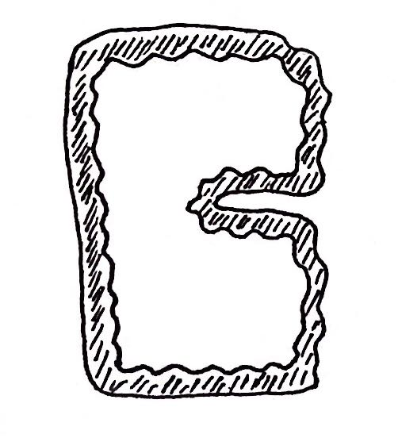
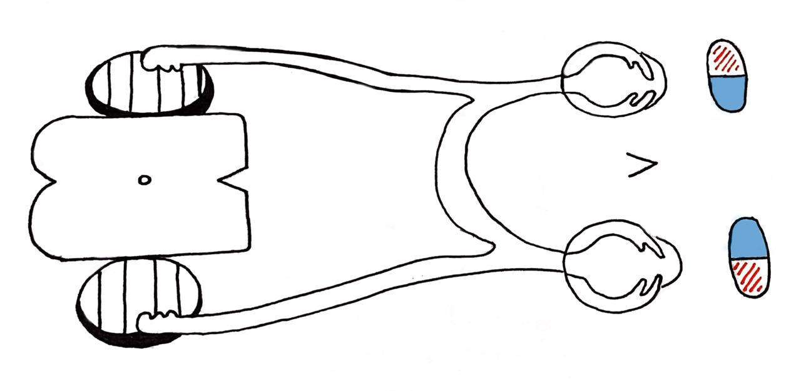
LGN
Left eye
Occipital lobe
L. visual field
Midbrain
R. visual field
Occipital lobe
LGN
Right eye
How the pupil respond to the light?
Right eye:
Light from the right visual field of the right eye will hit the nasal hemiretina ( ) → it has to go to the left side of the brain so it has to cross over (contralateral)
Light from the left visual field of the right eye will hit the temporal hemiretina ( ) → it has to go the right side of the brain but since it’s already on the right side then it won’t have to cross over (ipsilateral)
Left eye:
Light from the left visual field from the left eye will hit the nasal hemiretina → it has to go to the right side of the brain so it has to cross over (contralateral)
Light from the right visual field of the left eye will hit the temporal hemiretina → it has to go the left side of the brain but since it’s already on the left side then it won’t have to cross over (ipsilateral)
Lateral Geniculate Nucleus (LGN) is located on the thalamus and it has 6 layers that will receive the fibers:
Ipsilateral fibers go to (2,3 & 5) and contralateral fibers go to (1,4 & 6)
1) Then the information will come out of the LGN through superior and inferior retinal fibers which will go to the occipital lobe where the visual processing is going to occur.
2) Some fibers that exit the LGN will go to the midbrain:
In the midbrain we have a two superior colliculus ( ) on each side that are responsible for the movement of the head and eye responding to a visual stimulus
We also have a two pretectal nucleus ( ) in the midbrain and the information that comes to it from each sides can cross over and give fibers to to both the right and the left Edinger-Westphal Nucleus.( )
On the sides of the cerebral aqueduct we have somatic motor fibers for the 3rd nerve and also on the sides of the motor fibers we have the Edinger-Westphal Nucleus ( )
When the EWN is activated it will exit the midbrain and move with the oculomotor nerve → it will reach the ciliary ganglion ( ) → a group of postganglionic parasympathetic fibers which will be part of the short ciliary nerve will get out of these ciliary nerves → it will pierce through the sclera of the eye to give supply to the ciliary muscle and the sphincter pupillae.

Slide 3
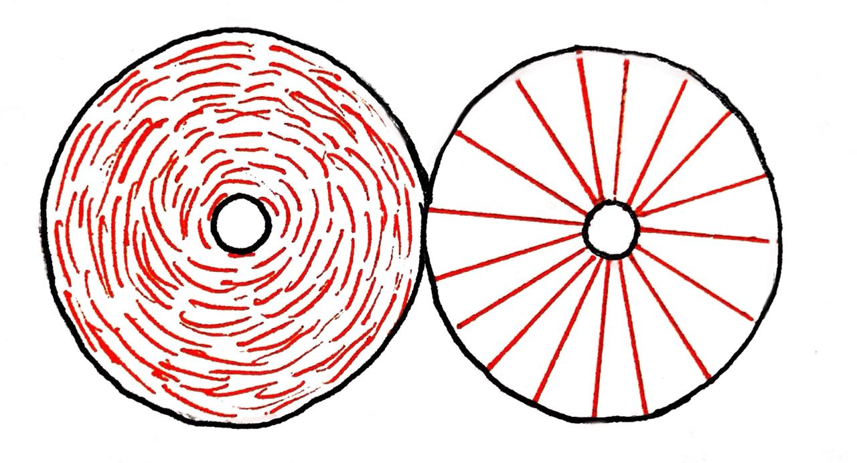
ciliary muscle
How would the ciliary muscle be affected by the parasympathetic fibers?
The ciliary muscle will contract.
The zonules will become loose (zonules are small strands of fibers that connect the lens to the ciliary body).
The lens will bulge.
Help with near point of vision
lens
zonules
How would the ciliary be affected by the sympathetic fibers?
The ciliary muscle will relax.
The zonules will become tight.
The lens will become flat.
Help with far distance vision
sphincter pupillae
How would the pupil be affected by the parasympathetic fibers?
The pupil will constrict through the sphincter pupillae muscle which have M3 receptors.
Then the short ciliary nerve will come and act on the M3 receptors to make them contract which will make the pupil smaller (constriction of the pupil).
Little light will come into the eye which will be focus the light through a specific point in the eye called fovea.
pupil
How would the pupil be affected by the sympathetic fibers?
The pupil will dilate through dilator pupillae muscle.
This muscle will try pull the pupil hole apart.
More light will come into the eye which will be focused on different parts of the retina.
Dilator pupillae

Slide 4
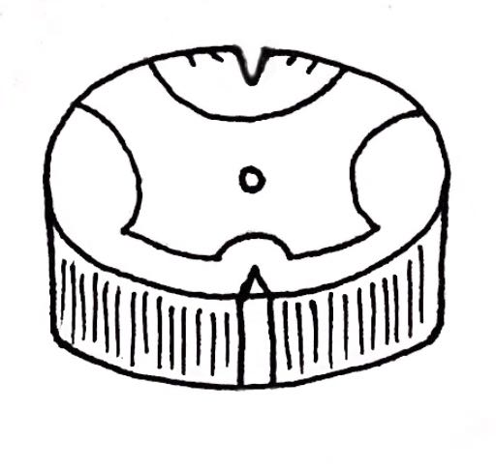
internal carotid artery
On the lateral grey horn of the spinal cord we have preganglionic sympathetic fibers, they will come out and go to a ganglion called superior cervical ganglion ( ) which is located within the PNS.
Then the postganglionic fibers will come out and it will form a carotid plexus around the internal carotid artery → some of the carotid plexus fibers will join the short ciliary nerve and supply the pupil and the ciliary muscle.
It can also join the long ciliary nerve which has the trigeminal nerve and pierce through the sclera to supply the pupil and the ciliary muscle.
lacrimal glands
lacrimal sac
Lacrimation (production of tears)
Lacrimal glands will produce the lacrimal fluid → goes from lateral to medial → moves to the lacrimal puncta ( ) → to the lacrimal canaliculi → to the lacrimal sac → reach the nasolacrimal ( ) duct → empties at the level of inferior meatus of the nasal cavity
nasal cavity
Myopia → The eyeball is too long
Can see near but can’t see far because the light is conversing too early as it forms the image in front of the retina.
This why we will give them a concave lens (diverging lens) to spread the light rays out to form the image a little farther away.
Hyperopia → The eyeball is too short
Can see far but can’t see near because the image will be forming behind the retina .
This why we will give them a convex (converging lens) to converse the light rays so it will form the image a little more anterior.

Slide 5
Duplicity Theory Of Vision
(2 kinds of vision under different conditions)
Q. Differentiate between cones & rods vision?
1- Photopic Vision (bright light vision):
Served by cones.
High visual acuity = Colors & details.
Low sensitivity to light = Needs high visual threshold to be stimulated.
2- Scotopic Vision (night vision, dim light vision):
Served by rodes.
Low visual acuity = No colors or details.
Great sensitivity to light = Low visual threshold.
Visual Acuity
- Definition:-
The degree to which the details and contours of objects are perceived,
- it is usually defined in terms of the shortest distance by which two lines can be separated and still be seen as 2 lines.
- (person can normally distinguish two separate points if their centers lie up to 2 micrometers apart on the retina, which is slightly greater than the width of a foveal cone).
Visual threshold:
Is minimal amount of light that elicit sensation of light.
Snellen Chart to Measure Visual Acuity:
Normal acuity = (d/D = d distance of Patient / D distance of normal person = 6/6).
A person of 6/12 has less vision than normal vision.
6/12 = patient can see from 6 meters away what is normally seen from 12 meters away
Crossing occurs in the optic chiasma.
Pituitary tumor leads to bitemporal hemianopia.
Vision loss in both lateral halves
Visual Pathway
Cones & rods
Bipolar cells
Optic nerve
(axons of ganglion cells)
Lateral geniculate body in thalamus
Optic tract
Optic chiasma
Axons of cells form geniculocalcarine tract send to optic radiation
Visual cortex in occipital cortex (Brodmann area 17)

Slide 6
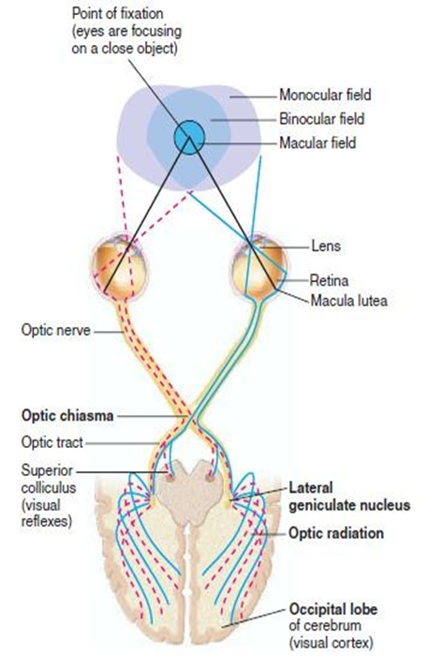
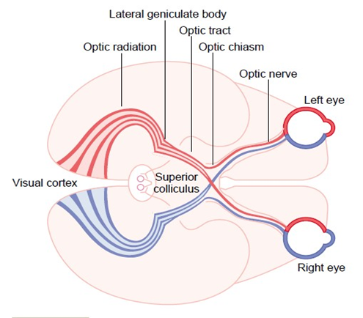
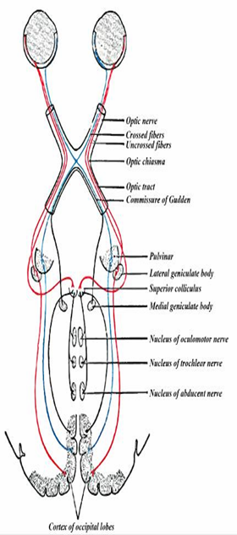
Visual Pathway & Field:
The nasal fibers (medial) cross to opposite side.
The temporal fibers (lateral) do not cross.
Nasal fibers conveys temporal field (outer) of vision.
Temporal fibers conveys nasal field (inner) of vision.
Some ganglion cells axons pass from optic tract to pretectal region of midbrain for pupillary reflexes & eye movement.
Some axons of ganglion cells from optic chiasma pass directly to hypothalamus for circadian rhythm (light-dark cycle) that synchronize various physiologic changes of the body with night and day.
Some axons from lateral geniculate body in thalamus to superior colliculus in midbrain for accommodation. R & its miosis component & to control rapid directional movements of the two eyes.
Optic Tract:
Includes:
1- Lateral Fibers
of the same side (nasal field (inner) of vision).
2- Medial Fibers
of the opposite side i.e temporal field of other eye(outer).
Exp//Left Optic Tract:
Conveys Lateral (temporal) fibers of the left eye + Medial (nasal fibers) of the right eye = Right half of visual field of left eye) & Right half of visual field of right eye), both form right half of visual field of both eyes.
N.B.:
The left optic tract corresponds to the right ½ of the visual field.
The right optic tract corresponds to the left ½ of the visual field.

Slide 7
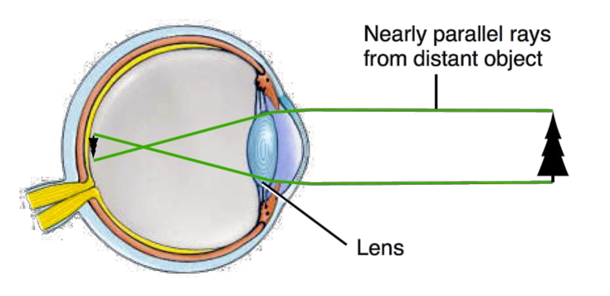
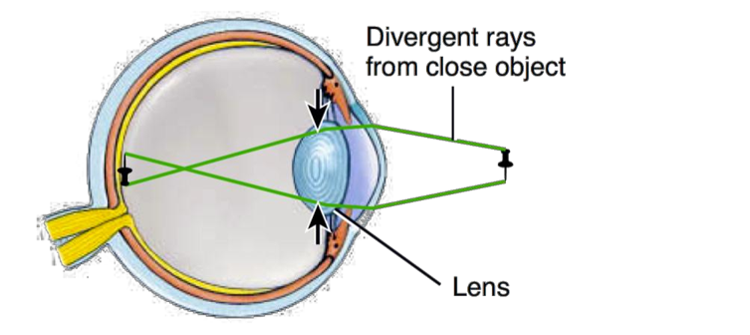
Accomodation (focusing)
When an object is 6m (20ft) or more away from the viewer, the light rays reflected from the object are nearly parallel to one another.
The lens must bend these parallel rays just enough to be focused on the central fovea, where vision is sharpest.
Because light rays that are reflected from objects closer than 6m (20ft) are divergent rather than parallel, the rays must be refracted more if they are to be focused on the retina.
This additional refraction is accomplished through a process called accommodation.
Accommodation (Focusing):
Is an active process for modification of the refractive power of the eye to view a nearby object by increasing the curvature of lens.
Ciliary muscle has two separate sets of smooth muscle fibers—longitudinal fibers and circular fibers.
Contraction of either set in the ciliary muscle relaxes the ligaments to the lens capsule, and the lens assumes a more spherical shape, because of the natural elasticity of the lens capsule & and increase its refractive power.
The ciliary muscle of accommodation is controlled by Parasympathetic Nerves transmitted to the eye through Oculomotor nerve.
At rest (looking at far objects):-
Ciliary muscles are relaxed + taut (tense) ligaments + flat lens.
(looking at near objects):-
from near (close) objects parallel rays focus behind retina (if ciliary muscles remain relaxed) → blurred vision.
Solution is to increase curvature & refractive power of lens by accomodation to bring focus on retina.

Slide 8
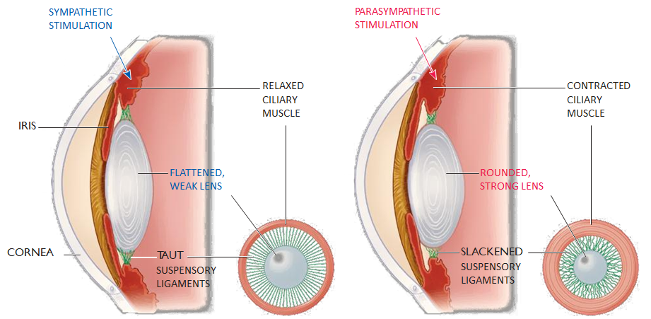
Accommodation reflex:-
Focusing at near object (increased anterior surface curvature of lens by ciliary muscles contraction, slack = relaxed ligaments & increased anterior surface curvature of lens.
Why?
to add 12D to refractive power of lens.
Both circular & longitudinal ciliary muscles contract to pull ciliary muscle forwards & inwards → ciliary muscles edges come close to each other to increase anterior surface curvature of lens.
Test//sanson purkinje image
At rest, the lens is held under tension by the lens ligaments.
Because the lens substance is malleable and the lens capsule has considerable elasticity, the lens is pulled into a flattened shape.
If the gaze is directed at a near object, the ciliary muscle contracts.
This decreases the distance between the edges of the ciliary body and relaxes the lens ligaments, so that the lens springs into a more convex shape

Slide 9
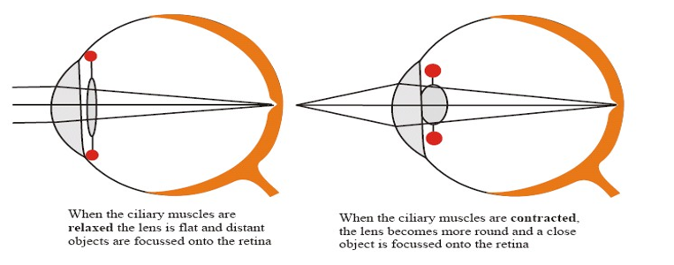
Looking at a close object (near response)
Convergence of both visual axis. Why?
Pupil constriction. Why?
Accommodation. Why?
Near point:-
Nearest point to eye at which object can brought into focus on retina by accommodation.
10 years = 9 cm
At 60 years = 80-100 cm, due to hardness of lens & loss of accommodation.
Presbyopia (Triade):-
Loss of accommodation & focus behind retina.
Loss of lens elasticity.
Near point recede.
Correction by biconvex lens.
Accommodation is the focusing of light in the retina.
We focus by changing the shape of the lens.
The lens is rounded for near objects.
The lens is flattened for distant objects.
Understanding of the pictures below is very important

Slide 10
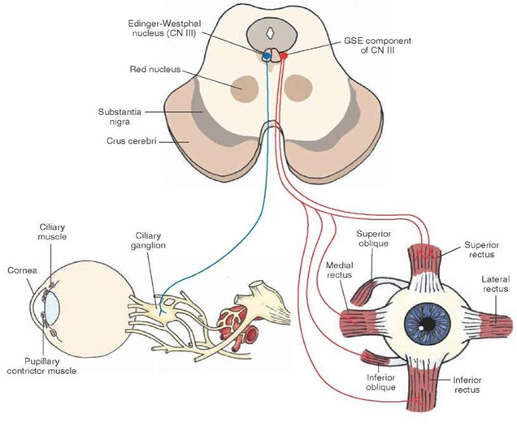
Near Point and Amplitude of Accommodation
Age (yrs) | Near point (cm) Increases w/ age | Amplitude of accommodation Decreases w/ age
10 | 9.0 | 11.0
20 | 10.0 | 10.0
30 | 12.5 | 8.0
40 | 18 | 5.5
60 | 83 | 1.2
70 | 100 | 1.0
Pathway of Accommodation
Light on eye
Retina
Optic nerve
Optic chiasma
EWN
Lateral geniculate body in thalamus & to superior colliculus in midbrain
Optic tract
Ciliary ganglion to oculomotor N
Bilateral ciliary muscle contraction (accommodation. R) & contraction of iris muscles for miosis of near response
Lens Accommodation

Slide 11
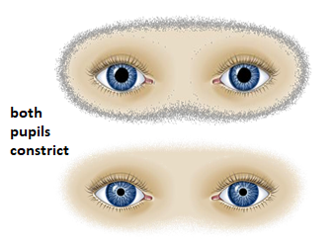
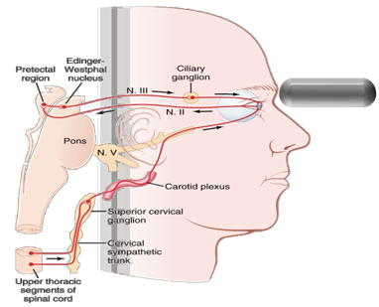
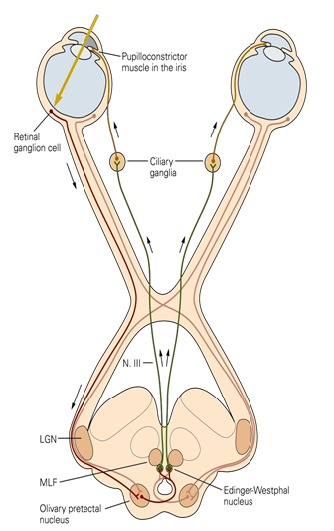
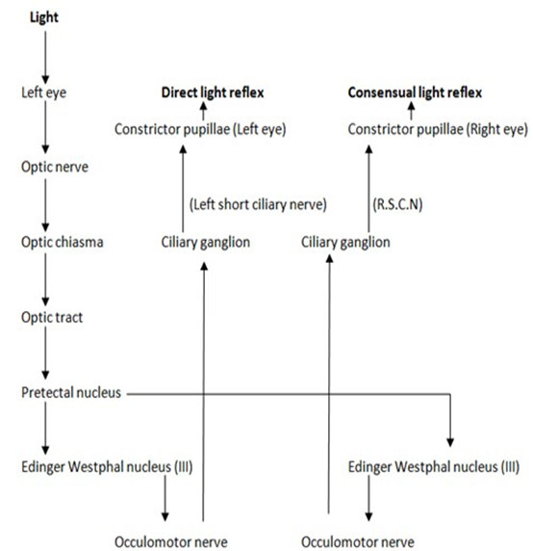
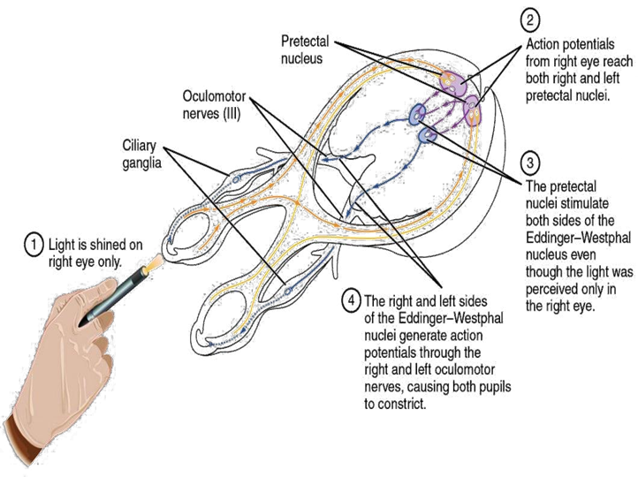
Pupillary light reflex:-
Light on one eye pupil → constriction of this pupil (direct) & the other pupil (indirect or consensual)
Pathway of consensual Pupillary light reflex (indirect):-
Light on eye
Retina
Optic nerve
Optic chiasma
Both oculomotor nerve nuclei (EWN)
Pass through superior colliculus to end in pretectal nucleus
Optic tract
Both ciliary ganglia
Supply both eyes by oculomotor nerves
(Short ciliary nerve to constrictor pupillae)
Miosis in both eyes
Conversely, in darkness, the reflex becomes inhibited, which results in dilation of the pupil.
Q. Argyll Robertson pupil? ARP : Accomodation Reflex Preserved
In syphilis tabes dorsalis which destroy pretectal nucleus.
Light .R is lost & accomodation .R remains.
Because lesion is in pretectal nucleus only, away from superior colliculus & fibers of accomodation.
Damage of transmission of visual signals from the retinas to the edinger-westphal nucleus, blocking the pupillary reflexes as in alcoholism, encephalitis.

Slide 12
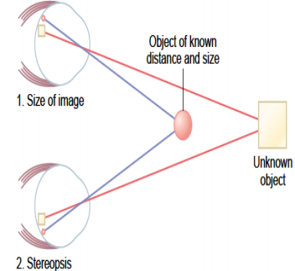
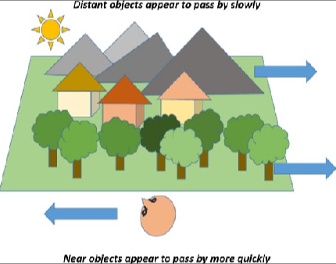
Autonomic Control of Accommodation and Pupillary Aperture:
Parasympathetic preganglionic fibers in the Edinger-Westphal nucleus to third nerve to the ciliary ganglion. Preganglionic fibers then synapse with postganglionic parasympathetic neurons, which send in ciliary nerves into the eyeball to:
1. The ciliary muscle that controls the focusing of the eye lens.
2. The Sphincter pupillae of the iris that constricts the pupil.
The sympathetic innervation of the eye originates in the lateral horn cells of the first thoracic segment of the spinal cord, to the sympathetic chain, to the superior cervical ganglion, synapses with postganglionic neurons.
Lateral horn cells -> Sympathetic chain -> Superior cervical ganglion -> Synapse with postganglionic neurons.
The sympathetic fibers spread along the surfaces of the carotid artery, to innervate the radial fibers of the iris; opens the pupil.
Determination of Distance of an Object from the Eye—“Depth Perception”:
A person normally perceives distance by three major means:
The size of the images of known objects on the retina.
The brain calculates distance of objects from image sizes
The phenomenon of moving parallax: when the person moves his head to one side or the other, the images of close-by objects move rapidly across the retinas, while distant images remain completely stationary.
The phenomenon of stereopsis or binocular vision: this binocular parallax (or stereopsis) that gives a person with two eyes far greater ability to judge distances.
1 & 2 are monocular means but 3 is binocular
Motion
Parallax

Slide 13
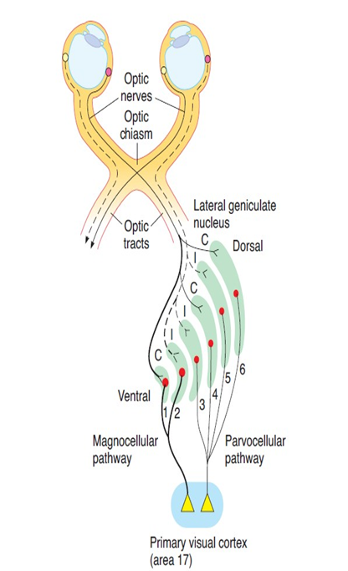
Lateral geniculate body LGB (6 layers):-
left LGB (similar to left optic tract) has all layers receive from RIGHT ½ of visual field
Right LGB (similar to right optic tract) has all layers receive from LEFT
½ of visual field.
Function of LGB:
Acts as a relay station for visual information from optic tract to cortex.
It has point to point transmission with high degree of (تحديد المكان بدقة spatial fidelity)
Acts as gate controls signal transmission to visual cortex i.e control how much signals reach visual cortex.
Color vision & detect shapes & texture.
N.B/- It receives gating control signals from two major sources:
Corticofugal fibers returning in a backward direction from the primary visual cortex to the lateral geniculate nucleus.
Reticular areas of the mesencephalon.
Both of these are inhibitory and, when stimulated, can turn off transmission through selected portions of the dorsal lateral geniculate nucleus.
LGB pathways to visual cortex
The magnocellular pathway, from layers 1 and 2 which have large cells and are called magnocellular, carries signals for detection of movement, depth, and flicker.
This magnocellular system provides a rapidly conducting pathway to the visual cortex. However, this system is color blind, transmitting only black- and-white information.
The parvocellular pathway, from layers 3,4,5,6 which have small cells and are called parvocellular, carries signals for color vision, texture, shape, and fine detail
Moderate velocity of conduction.

Slide 14
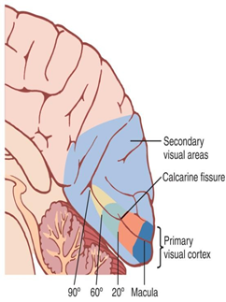
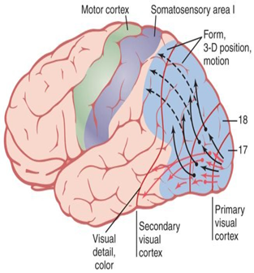
Visual cortex:
The Primary Visual Cortex Has Six Major Layers of cells arranged vertically each act as a separate functional unit for processing of informations.
The fovea is responsible for the highest degree of visual acuity, so it has larger representation in the primary visual cortex than the most peripheral portions of the retina.
Signals from the retinal fovea transmits its signals terminate near the occipital pole, whereas signals from the more peripheral retina terminate in concentric half circles anterior to the pole on the medial occipital lobe.
The upper portion of the retina is represented superiorly and the lower portion inferiorly.
1- Primary visual cortex (brodmann area 17):
Perceive sensation of vision (movement + shapes + stereoscopic vision + brightness) & has blobs for color detection
2- Association visual cortex (area 18&19) (secondary visual areas):
Located mainly anterior to the primary visual cortex
Function:
interpretation of visual stimuli.
the fixation mechanism that causes the eyes to “lock” on the object of attention is controlled by secondary visual center.
When this fixation area is destroyed bilaterally , causes difficulty keeping its eyes directed toward a given fixation point.
Effect of Removing the Primary Visual Cortex:
Removal of the primary visual cortex causes loss of conscious vision, (blindness).
(but patient react subconsciously to changes in light intensity, to movement in the visual scene.)
These reactions include turning the eyes, turning the head, and avoidance. This vision is believed to be subserved by neuronal pathways that pass from the optic tracts mainly into the superior colliculi.

Slide 15
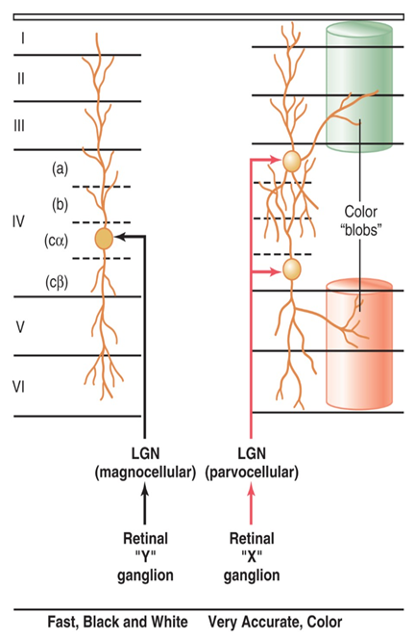
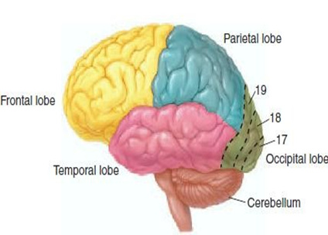
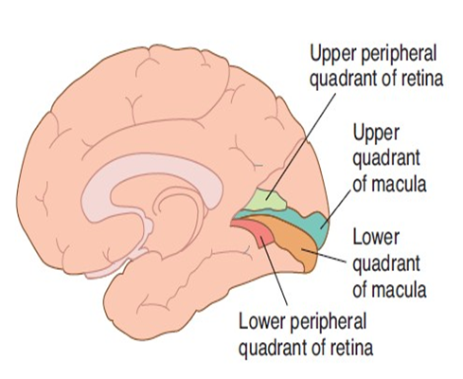
Color Blobs are in the Visual Cortex. Interspersed among the primary visual columns & among the columns of the secondary visual areas
Column-like areas called color blobs clusters of cells responsible for color detection
Simple cells detect color contrast details, bars of light, lines , borders and edges
Complex cells detect line orientation when a line is displaced laterally or vertically in the visual field (linear movements of a stimulus).
Dr.Salah said “you have to remember each ganglion pathway in this picture”
E.g (Y ganglion to magnocellular then to Ca)
Macular sparing = loss of peripheral vision with intact macular vision.
Because the macular representation is separate from that of the peripheral fields and is very large relative to that of the peripheral fields.

Slide 16
Dr. Salah Notes for lecture Vision 1
What is the site of synthesis and drainage of aqueous humor?
Synthesis: Ciliary processes
Drainage: Canal of Schlemm
If the trabecular meshwork or the canal are blocked what will occur?
Glaucoma
What are the functions of the aqueous humor?
Nutrition of avascular structures of eye e.g. cornea and maintenance of intraocular pressure 10-20mmHg which maintains the shape of the eyeball
What is myopia?
Eyeball is too long, image is formed in front of the retina referred to as shortsightedness, treated with a biconcave lens
What is hyperopia?
Eyeball is too short, image is formed behind the retina, treated with a biconvex lens.
What is astigmatism?
Person either only sees vertical lines clearly or horizontal lines clearly. It is treated with a cylindrical lens.

Slide 17
1.the minimal amount of light that elicit sensation of light is the definition of …?
.Visual Acuity
.Scotopic Vision
.Visual threshold
.Photopic Vision
2.the rodes is ….?
.high visual acuity +Great sensitivity to light
.Low visual acuity +Great sensitivity to light
.High visual acuity +Low sensitivity to light
.low visual acuity +Low sensitivity to light
3.Temporal fibers conveys ….?
.nasal field + temporal field
.50%of nasal field and 50% of temporal field
. temporal field
.nasal field
4.Which type of cell in the visual cortex responds best to lines and edges?
.Simple
.Complex
.Bipolar
.Hypercomplex
5.Lesions of which type of cells in the lateral geniculate body will result in only black and white vision ?
.Parvocellular
.Complex
.Magnocellular
.Simple
6.Which cells in layer IV of the primary visual cortex detect orientation of lines and borders?
.Parvocellular
.complex
.simple
.magnocellular
7.From which part of the brain stem there is fibers that inhibit Lateral geniculate nuclues ?
.midbarin
.pons
.Medulla
.Red nucleus
8.Lesion of the pretectal nuclues, result in ?
. Loss of accommodation
.Loss of pupillary reflex
.Loss of both pathways
.Loss EWN action
Answers:
1.C
2.B
3.D
4.A
5.A
6.B
7.A
8.B

