Slide 1
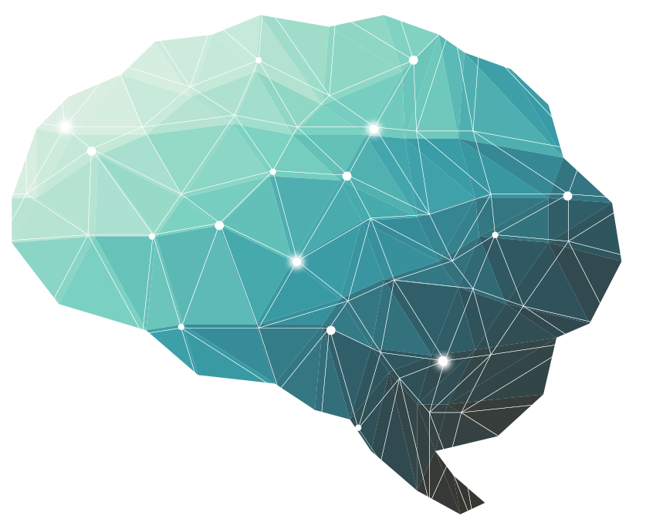
13th Lecture ∣ The Physiology Team
Color Vision
Objectives:
Identify and describe the mechanism of color vision and the three types of cones, including the range of spectral sensitivity and color blindness
Describe the electrical responses produced by bipolar cells and ganglion cells and comment on the function of each
Describe the topographic representation of the visual field within the primary and association visual cortex and describe the processing of information in the primary visual cortex
Done by :
Team leaders: Abdulelah Aldossari, Ali Alammari
Fatima Balsharaf, Rahaf Alshammari
Team members:
Colour index:
important
Numbers
Extra
Zeyad Alkhenizan,Faisal Alsaif, Saif Almeshari, Afnan AlMustafa
وَأَن لَّيْسَ لِلْإِنسَانِ إِلَّا مَا سَعَىٰ
Notes:
لِلْإِنسَانِ إِلَّا مَا سَعَىٰ (39) وَأَنَّ سَعْيَهُ سَوْفَ يُرَىٰ
BETTER right

Slide 2
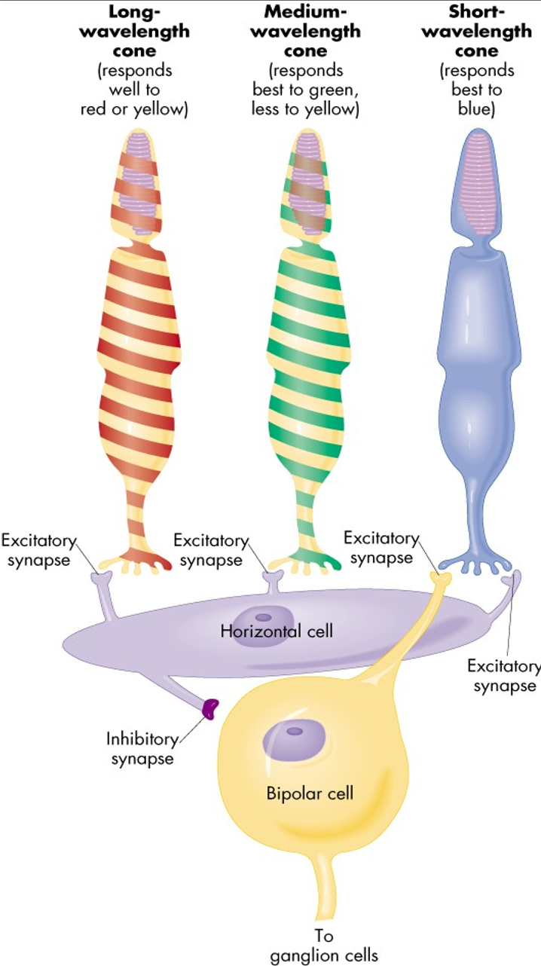
Color Vision
Color vision theory ( Young- Helmholtz theory)
1. We have 3 kinds of cones each has a specific photopigment (rhodopsin)& is sensitive to one of the 3 primary colors
It the ability to discriminate between different colors.
There are 3 primary colors( blue- red- green) sensed by cones in fovea & appreciated within photopic vision.
Sensation of extraspectral colors as white, yellow, orange, purple, can be produced by mixing properties of the blue & red & green in different combinations.
Black means absence of light ( not darkness because in dark we do not see black only).
Colors have three attributes :
Hue
Intensity
Saturation (degree of freedom from dilution with white).
For any color there is a complementary color that, when properly mixed with it, produces a sensation of white.
Black is the sensation produced by the absence of light, but it is probably a positive sensation because the blind eye does not “see black;” rather, it “sees nothing.”
Cone system type | Blue | Green | Red
Pigment type | S pigment ( blue sensation pigment) | M pigment ( green sensation pigment) | L pigment ( red sensation pigment)
Wavelength that responds to | short wavelength ( 440 nm senses the blue color) | middle wavelength ( 535 nm senses the green color & less to yellow) & absorb light at the green portion. | large wave length at or > 535 nm so senses the red & yellow color & absorb light at the red portion.

Slide 3
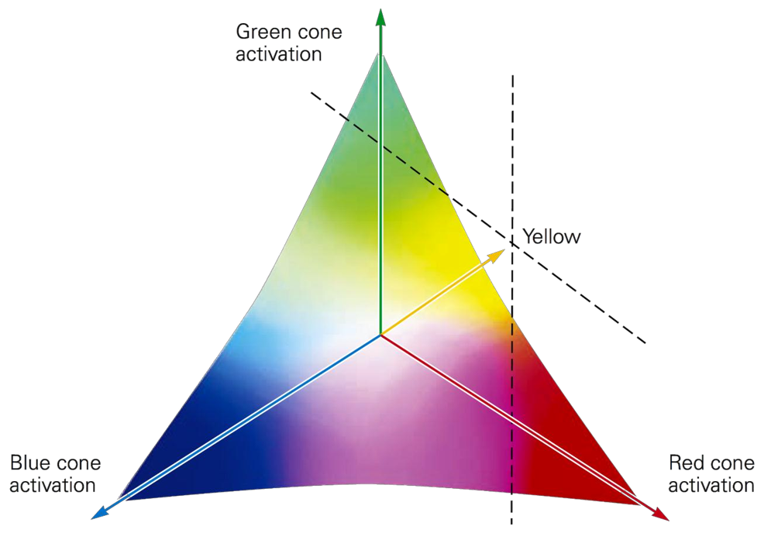
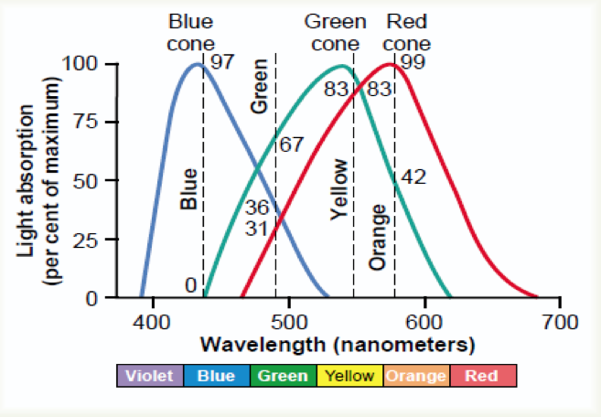
2. Sensation of any color determined by:
a- Wavelength of light
b- Amount of light absorbed by each type of cones
c- frequency of impulses from each cone system to ganglion cells which is determined by wavelength of light.
3. Each cone system respond to its color at a lower threshold than needed to sense other colors ( red cones respond to red or yellow color at a lower threshold than to green color)
4. Perception of white is due to equal stimulation of blue & red & green cones. There is no wavelength corresponds to white, white is a combination of all wavelengths.
There is no single wavelength of light corresponding to white; instead, white is a combination of all the wavelengths of the spectrum.
As can be seen in this vector diagram – white occupies the middle of the vector
5. Color vision is coded by :
a- Different responses in ganglion cells that depends upon the wavelength of stimulus which determine frequency of impulses in ganglion cells.
b- The color perception in the brain depends on the amount of activity in each of the 3 cone systems as mentioned above.
Light absorption by the pigments of three color-receptive cones of human retina.

Slide 4
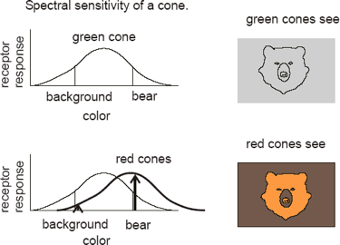
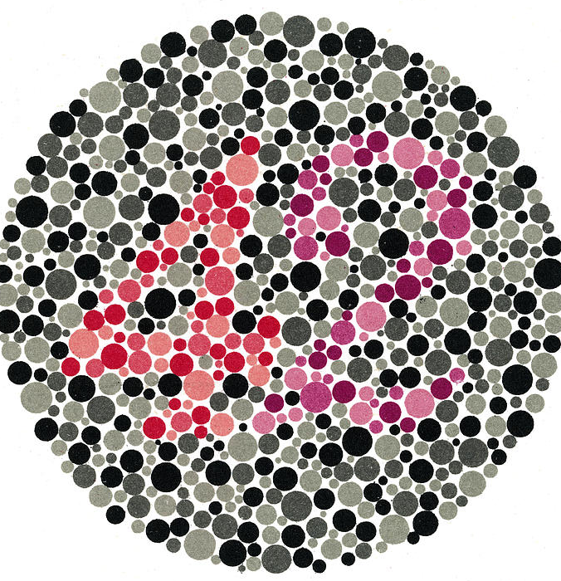
6. Perception of orange is due to stimulation of:
99% of red cones & 42% of green cones & 0% of blue cones (so ratio is 99:42:0)
7. Perception of yellow is due to stimulation of:
50% of red cones & 50% of green cones & 0% of blue cones (so ratio is 50:50:0)
8. Perception of blue is due to stimulation of
0% of red cones & 0% of green cones & 97% of blue cones (so ratio is 0:0:97)
Useful video
3:43
What is the advantage of colour vision?
Color is important for distinguishing an object from its background
What is ishihara chart?
ishihara charts are a set of plates covered with colored dots which the test subject views in order to find a number composed of dots of one color which a person with various defects of color vision will confuse with surrounding dots of color.

Slide 5
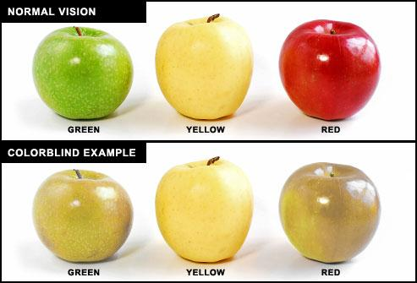
Color Blindness
There is gene for rhodopsin (a red pigment in the rods) on chromosome(3).
There is gene for blue sensitive S cone pigment on chromosome (7).
There is a gene for red and green sensitive cone pigment on X chromosome.
When a single group of color receptive cones is absent the person will not see or distinguish some color from others.
Red-green blindness
Green and red cones see different colors between wavelength 525-675 nm
If either of these cones are absent, the person can not distinguish 4 colors (red-green-yellow-orange) and can not distinguish red from green (primary colors) and this is called (Red-Green blindness)
It is x-linked disease transmitted from females to their male sons, never occur in females as they have 2 X chromosomes.
Males have one X & one Y chromosome so if this one X chromosome miss the gene for color vision, he will get red-green color blindness (their gene is on X chromosome).
Females show the disease only if both x chromosomes lack the gene.
Females from color blind fathers are carriers transmit the disease to ½ of their sons.

Slide 6
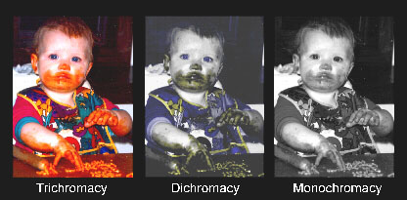
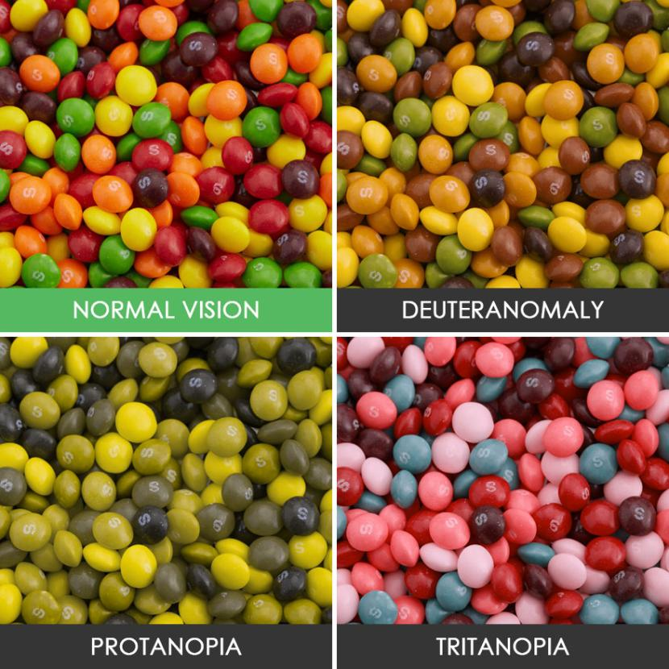
Red-Green blindness
Trichromats: have 3 cone pigments normal or have slight weakness in detecting red or green or blue color
Dichromats: have 2 cones pigment systems only so, he is completely blind to red or green or blue (so they have protanopia, deuteranopia, or tritanopia) they get color by mixing only 2 of primary colors.
Monochromats: have only one cone system or loss of all so, he can only see black or grey or have no color perception
Anopia = blindness
1-Protanopia (red-blindness): no red cones system so person has shortened spectrum wave length, if only weakness in red color its called protanomaly
Anomaly = weakness
2-Deutranopia (green-blindness): no green cone system so person see only long and short wave length if its weakness its deutranomaly.
3-tritanopia (blue - blindness): no blue cone system , if its weakness in blue color vision its tritanomaly

Slide 7
1.Which one of them is color attributes?
A.Hue
B.Intensity
C.saturation
D.All above
2.Blue cone system has ____ pigment.
A.S
B.M
C.L
3.Which one responses to middle waves?
A.Blue cone system
B.Green cone system
C.Red cond system
4.Perception of yellow is due to stimulation of:
A.99% red, 42% green
B.50% red, 50% green
C.97% red, 3% green
5.Chromosome 3 has gene for:
A.Blue sensitivity
B.Red and green sensitivity
C.Rhodopsin
D.Glutamate
6.Protanopia is:
A.No red cone system
B.No red and green cone system
C.Weakness in red color vision
D.Loss in red color vision
7. Patient with Deuteranopia can only see:
A.Long wavelength
B.Short wavelength
C.Long and short wavelength
8. Patient with monochromates can see:
A.Red, green & blue
B.Red & green
C.Black & grey
Answers:
1.D
2.A
3.B
4.B
5.C
6.A
7.C
8.C

