Slide 1
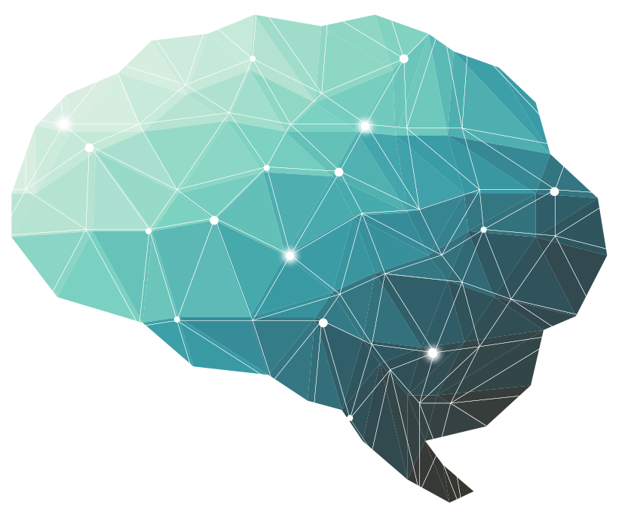
12th Lecture ∣ The Physiology Team
Cerebellum
Objectives:
Describe the divisions of the cerebellum
Describe the functional divisions of the cerebellum (vestibulocerebellum, spinocerebellum and cerebrocerebellum).
Understand cell types / nuclei of the cerebellum
Understand the functions of cerebellum in regulation of movement, tone and balance.
Understand the abnormalities associated with cerebellar disease.
Done by :
Team leaders: Abdulelah Aldossari, Ali Alammari
Fatima Balsharaf, Rahaf Alshammari
Team members: Arwa aljohany, Alanoud Almansour,Aysha AlSabbagh
Colour index:
important
Numbers
Extra
وَأَن لَّيْسَ لِلْإِنسَانِ إِلَّا مَا سَعَىٰ
Notes:
لِلْإِنسَانِ إِلَّا مَا سَعَىٰ (39) وَأَنَّ سَعْيَهُ سَوْفَ يُرَىٰ
BETTER right

Slide 2
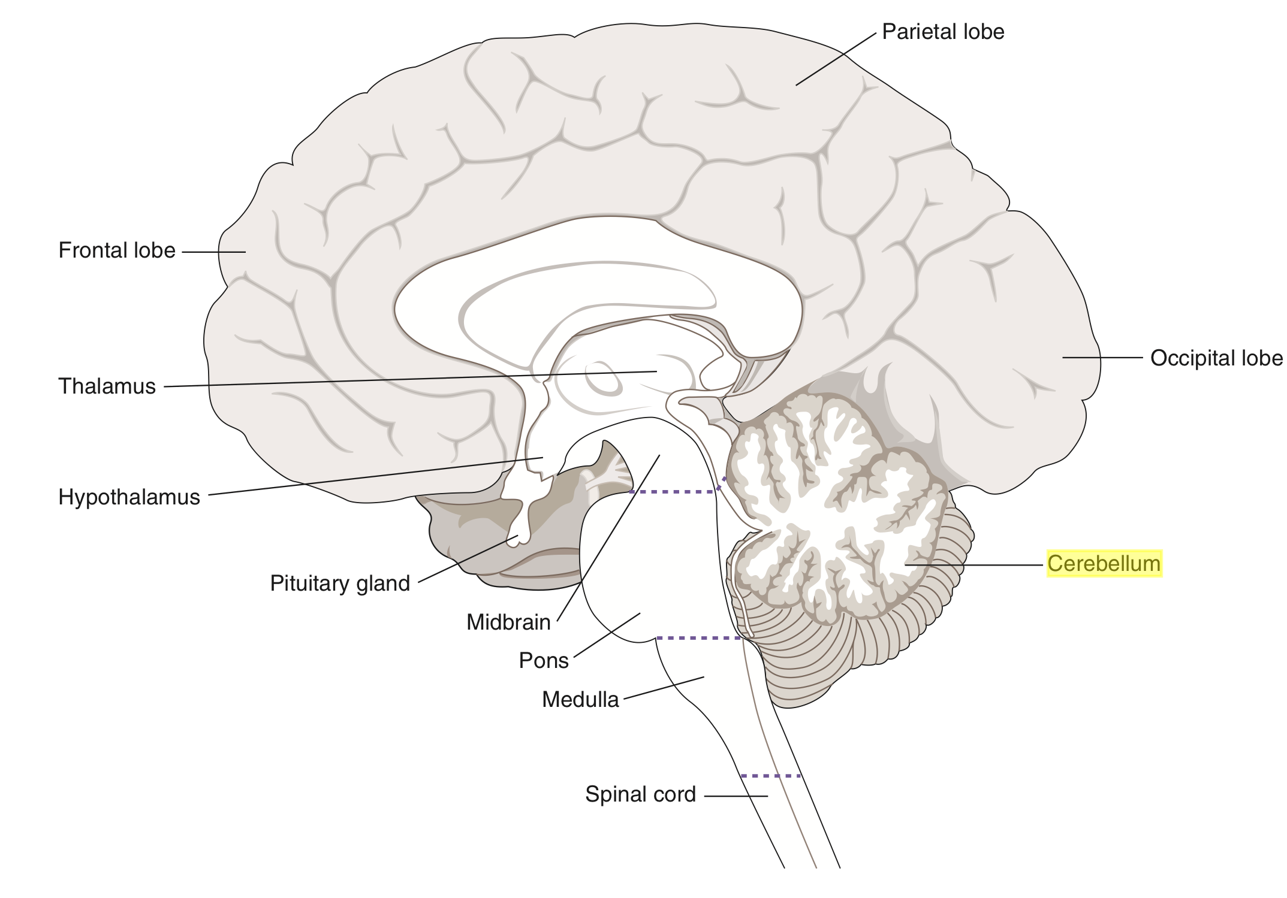
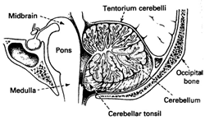
CEREBELLUM:
Cerebellum is derived from a Latin word means "little brain.“ Cerebellum is the largest part of the hindbrain, lies behind the pons and medulla Oblongata.
Shape: Oval shaped, with an approximate weight is 150 gm
Location: Situated in the posterior cranial fossa
Anteriorly: 4th ventricle, pons, and medulla oblongata
Superiorly: Covered by tentorium cerebelli
Posterio-inferiorly: Squamous occipital
The role of three
3 lobes | Flocculonodular Lobe Anterior lobe Posterior lobe
3 Cortical Layers | Molecular layer Purkinje cell layer Granular layer
3 purkinje’s cells afferent paths | Mossy fibers from all afferent fibers & help in voluntary movements Climbing fibers from the *ION & responsible for learning new movements Aminergic fibers
3 pairs of deep nuclei | Fastigial Interposed(globose & emboliform) Dentate
3 pairs of peduncles | Superior (pri.output) Middle (pri.Input) Inferior (pri.Input)
3 functional division | Vestibulocerebellum Spinocerebellum Cerebrocerebellum
*ION: inferior olivary nucleus

Slide 3
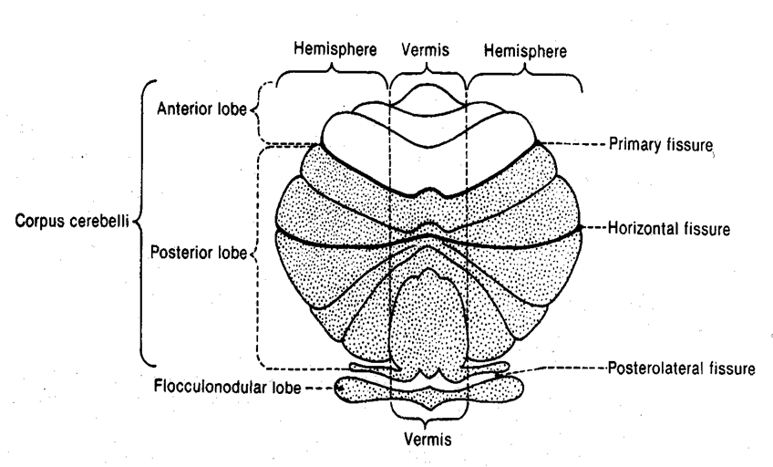
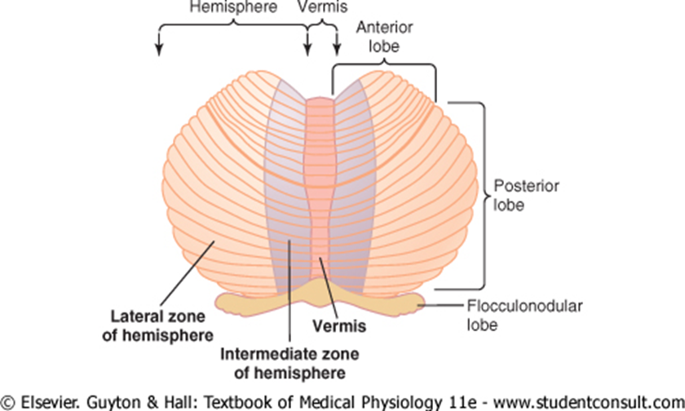
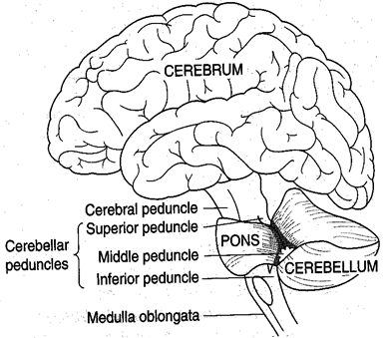
The cerebellum is anatomically and physiologically divided into three parts:
Paleocerebellum: Anterior lobe [Spinocerebellum]
Neocerebellum: Posterior lobe [Cerebrocerebellum]
Archicerebellum: Flocculonodular Lobe [Vestibulocerebellum]
“Physiologically” “Anatomically” “Functionally”
Vermis is a narrow band that separate the two cerebral hemispheres
CEREBELLAR PEDUNCLES: CARRY AFFERENTS FROM WHERE?
Superior Cerebellar Peduncle | Inputs to the Cerebellum from the cerebrum
Middle Cerebellar Peduncle | Inputs to the Cerebellum from from the Pons
Inferior Cerebellar Peduncle | Inputs to the Cerebellum from the Medulla Oblongata

Slide 4
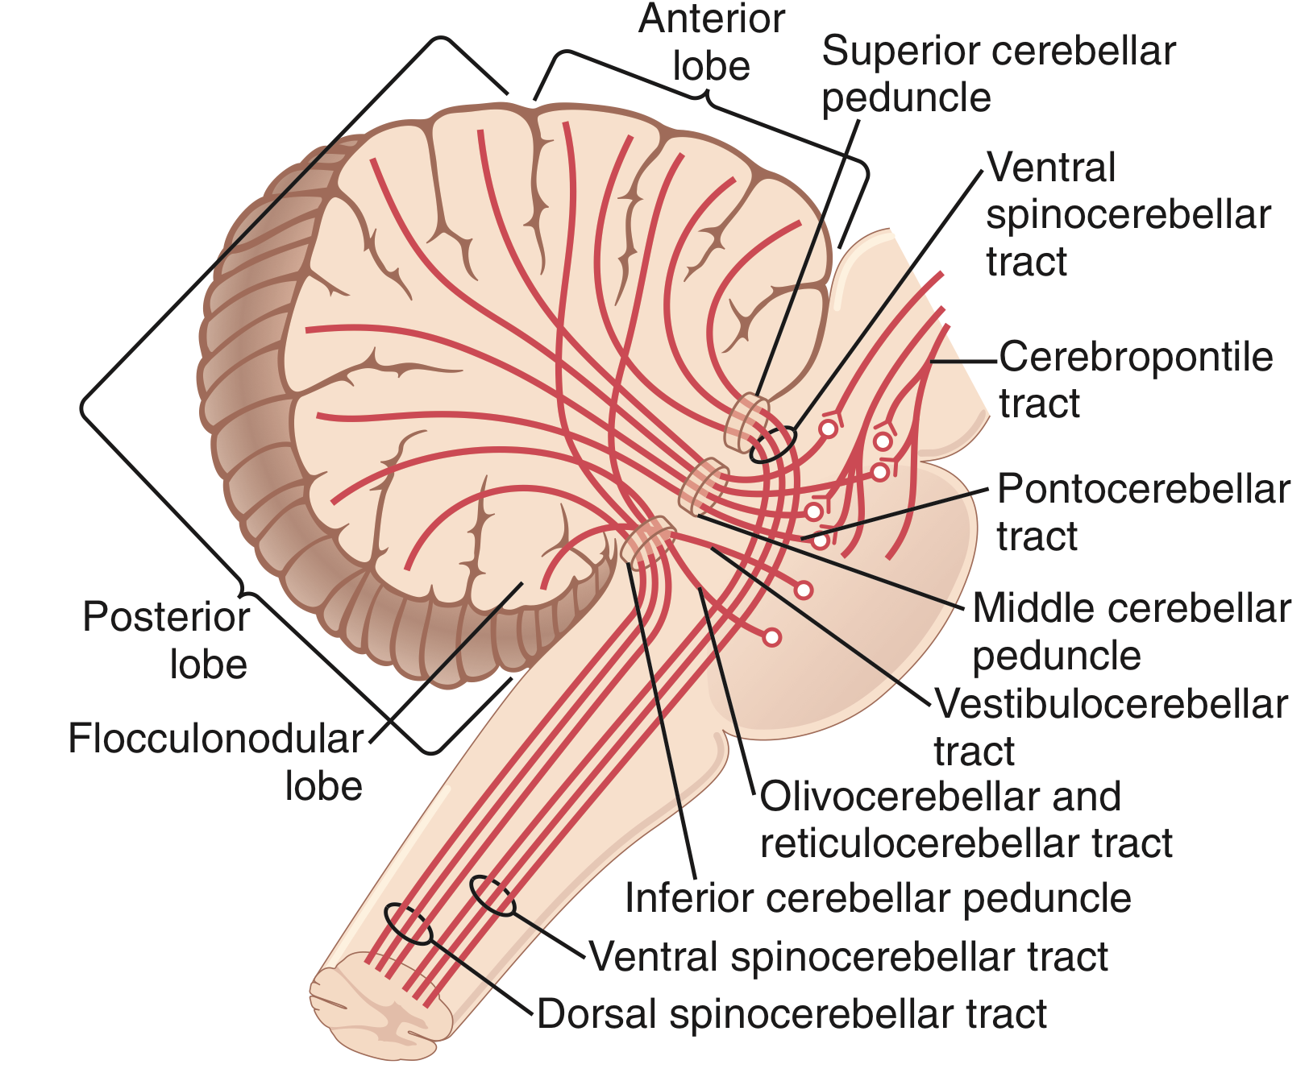
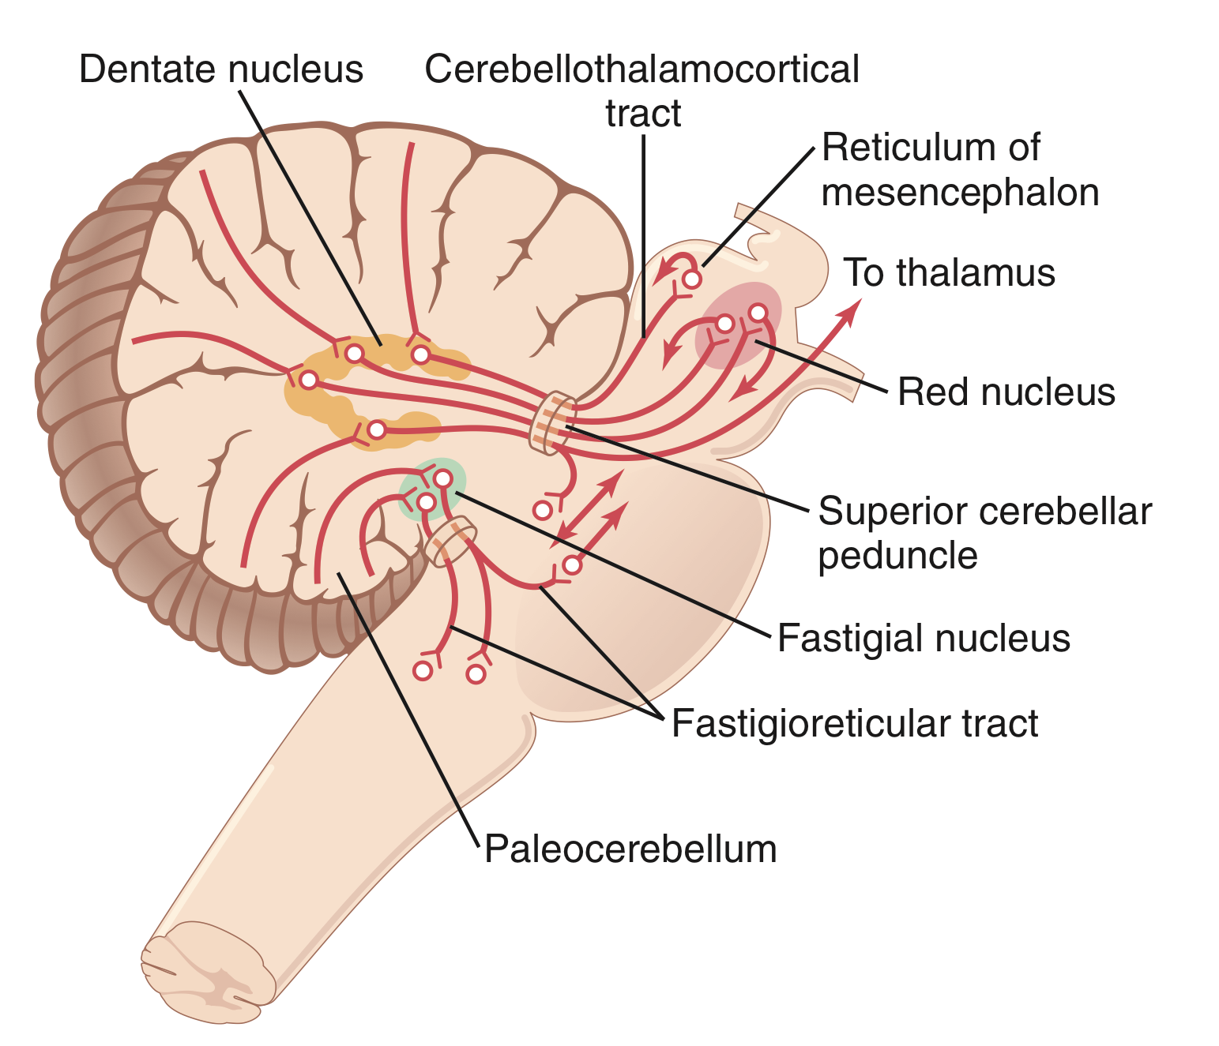
PRINCIPAL AFFERENT TRACTS TO THE CEREBELLUM
AFFERENT TRACTS | TRANSMITS
Vestibulocerebellar | Vestibular impulses from labyrinths, direct & via vestibular nuclei.
Dorsal Spinocerebellar | Proprioceptive & exteroceptive impulses from the body.
Ventral Spinocerebellar | Proprioceptive & exteroceptive impulses from the body.
Cuneocerebellar | Proprioceptive impulses, especially from the head and neck.
Tectocerebellar | Auditory & visual impulses via inferior and superior colliculi
Pontocerebellar | Impulses from motor and other parts of cerebral cortex via pontine nuclei
Olivocerebellar | Proprioceptive input from whole body via relay in inferior olive.
PRINCIPAL AFFERENT TRACTS TO THE CEREBELLUM :
PRINCIPAL EFFERENT TRACTS TO THE CEREBELLUM :

Slide 5
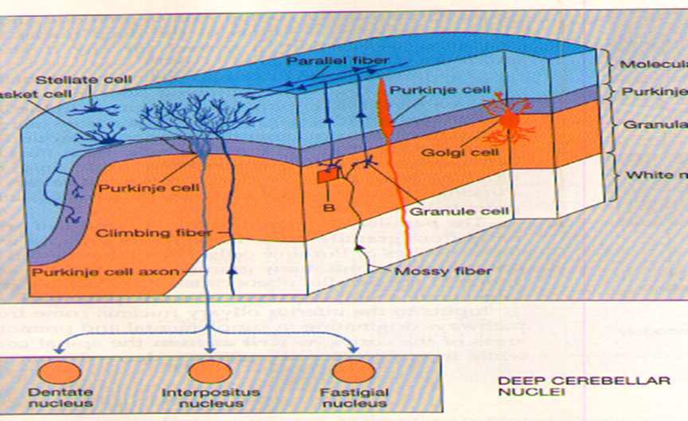
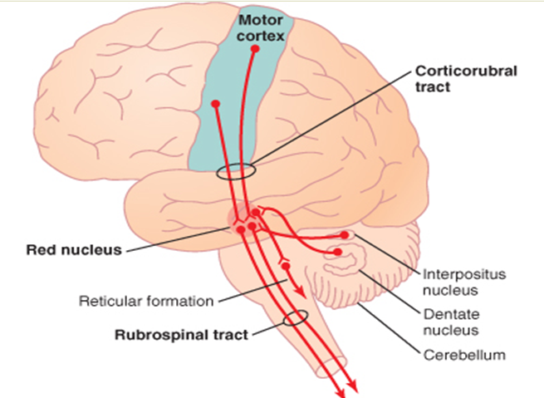
CEREBELLUM LAYERS
The cerebellum has an external cerebellar cortex separated by white matter from the deep cerebellar nuclei as follows:
Cerebellar cortex:
Molecular Layer | Purkinje cells (output cells) | GABA … Inhibition
Purkinje Cell Layer | Basket cells
 | Golgi cells
Granular Layer | Stellate cells
Cerebellar nuclei:
Granular cells are the only excitatory cerebral cortex cells.
Dentate Nucleus | Granular cells | Glutamate … Excitation
Globose Nucleus
Emboliform Nucleus | Stellate cells | Taurine …. .Inhibition
Fastigial Nuclei
Note: Globose and Emboliform also known as interpositus nucleus
TYPES OF THE CELLS IN THE CEREBELLUM
TYPES OF THE CELLS IN THE CEREBELLUM

Slide 6
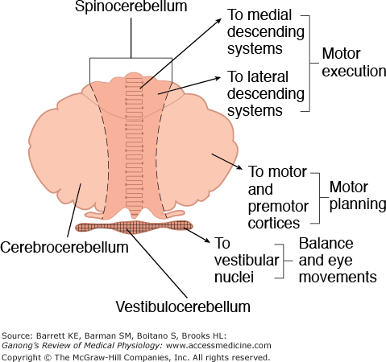
Functional division of the cerebellum
*this picture is important
Functional divisions of cerebellum:
1. Vestibulocerebellum:
- its main connection is with the vestibular apparatus
- its responsible for equilibrium, balance, and eye movement
2. Spinocerebellum:
- its main connection is with the spinal cord which control the movement of axial and peripheral muscles.
- its function is regulating muscle tone and coordination of skilled voluntary movement
3. Cerebrocerebellum:
- its main connection is with the cerebral cortex and basal ganglia to initiate voluntary movement
- its function is timing and planning which means how many muscles will cooperate in each movement, what is the type of function of each muscle and when will each muscle start working, etc.

Slide 7
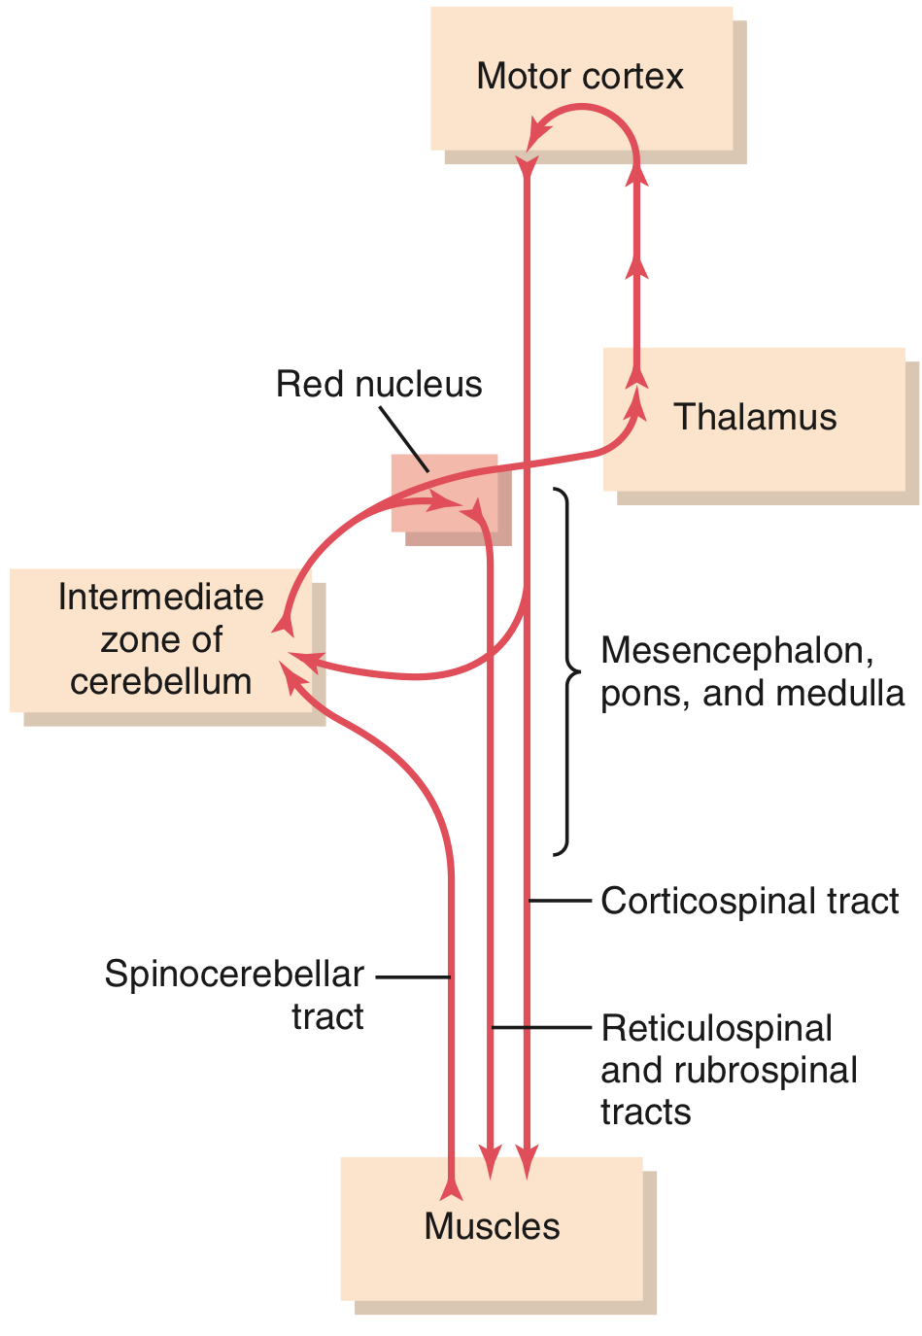
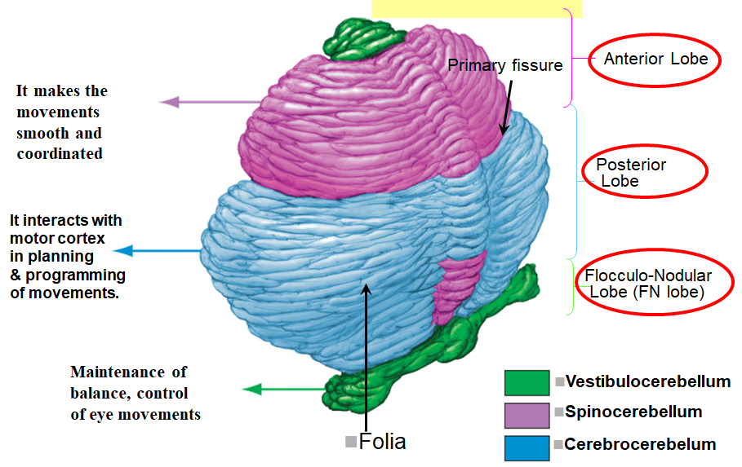
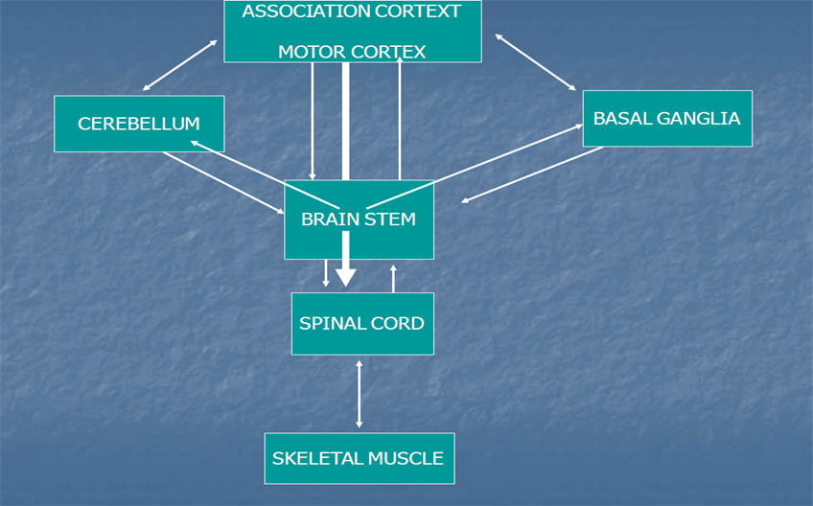
Cerebellum and voluntary motor control
Cerebral and cerebellar control of voluntary movements, involving especially the intermediate zone of the cerebellum.
1) As the motor cortex sends the descending discharge to the muscle to contract it will also send another copy of impulses to the spinocerebellum so now the spinocerebellum knows the plan of each movement.
2) Then the muscle will perform its own plan of the movement and after that it will send another copy of the plan to the spinocerebellum where it will compare between each plan.
3) If the plan was the same then the spinocerebellum will keep sending the same impulses to the motor cortex and if it was different then it will send different impulses to correct the action.
Cerebellum
Connections of the cerebellum

Slide 8
Summary: functions of cerebellum
Cerebellum Lobe | Nuclei | Cortex | Inputs | Outputs | Function
Paleocerebellum | Interpositus Fastigial | Vermis & Medial portions of Cerebellar hemispheres | Spinal and brainstem paths | SCP to Red Nucleus; Fastigial to RF | Muscle tone, posture & coordination of movements
Neocerebellum | Dentate | Lateral portions of Cerebellar Hemisphere | /Corticopontine pontocerebellar | SCP | Planning and executive of voluntary & skilled hand movements
Archicerebellum | Fastigial | Flocculonodular | Vestibular nuclei | Vestibular nuclei; RF | Balance, equilibrium

Slide 9
Abnormalities associated with cerebellar disease
Disorder | Description
Ataxia | Reeling, wide-based gait
Decomposition of movement | Inability to correctly sequence fine, coordinated acts
Dysarthria | Inability to articulate words correctly, with slurring and inappropriate phrasing
Dysdiadochokinesia | Inability to perform rapid alternating (opposite) movements
Dysmetria | Inability to control range of movement
Hypotonia | Decreased muscle tone due to loss of the facilitatory effect of the CB on the stretch reflex, and it is associated with pendular knee jerk.
Nystagmus | Involuntary, rapid oscillation of the eyeballs in a horizontal, vertical, or rotary direction, with the fast component maximal toward the side of the cerebellar lesion
Scanning speech | Slow enunciation with a tendency to hesitate at the beginning of a word or syllable
Tremor | Rhythmic, alternating, oscillatory movement of a limb as it approaches a target (intention tremor) or of proximal musculature when fixed posture or weight bearing is attempted (postural tremor)
Speech becomes staccato or scanning
caused by lesions in cerebrocerebellum & spinocerebellum b/c they increase the muscle tone
Tremor of the eye

Slide 10
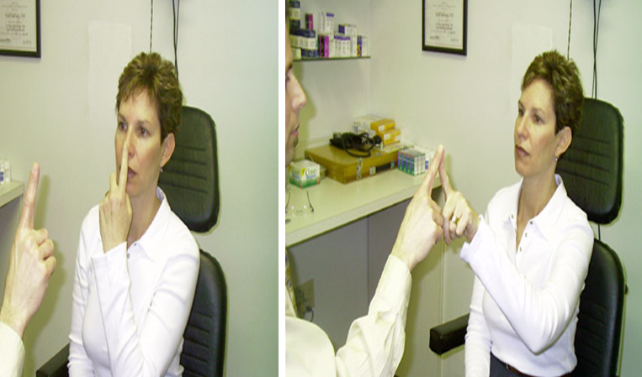
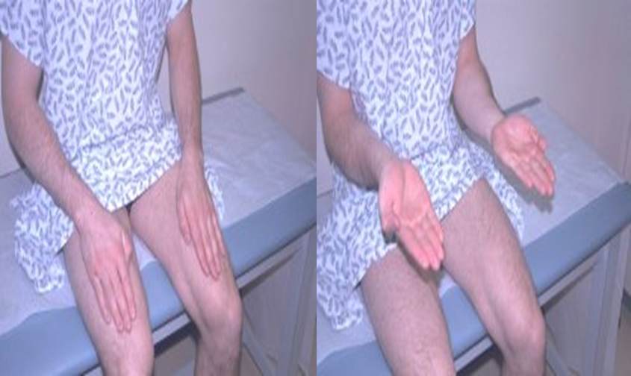
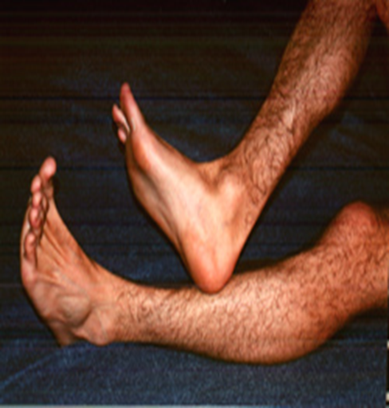
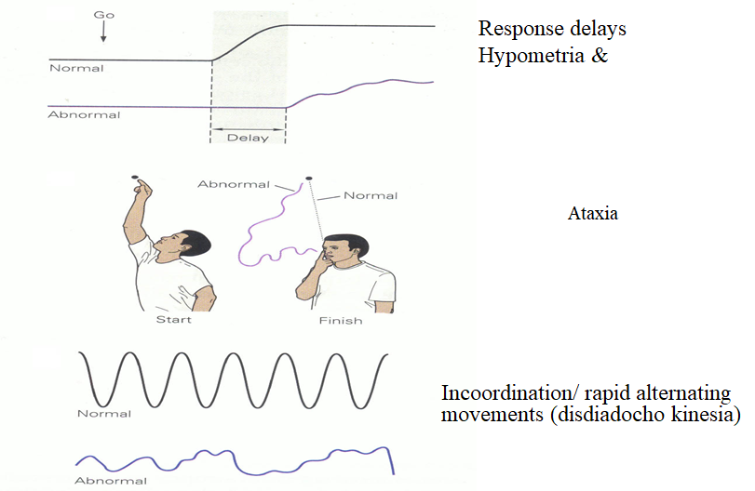
Finger nose test
While the examiner holds his finger at arm's length from the patient. Patient touches her nose and then touches the examiner's finger. After several sequences, the patient is asked to repeat the exercise with her closed eyes.
A patient with a cerebellar disorder tends to miss the target.
Dysdiadochokinesis:
“rapidly alternating movements”
dysdiadochokinesia: Inability to perform rapidly alternating movements. Is called. It is usually caused by multiple sclerosis in adults and cerebellar tumors in children. Patients with other movement disorders (e.g. Parkinson's disease) may have abnormal rapid alternating movement testing secondary to akinesia or rigidity, thus creating a false impression of dysdiadochokinesia.
Heel to shin test
The heel to shin test is a measure of coordination and may be abnormal if there is loss of motor strength, proprioception or a cerebellar lesion.
If motor and sensory systems are intact, an abnormal, asymmetric heel to shin test is highly suggestive of an ipsilateral cerebellar lesion.
Cerebellar Signs

Slide 11
1-Signals from motor areas of the cortex reach the contralateral cerebellum after first passing through which one of the following structures? A) Thalamus B) Caudate nucleus C) Red nucleus D) Basilar pontine nuclei
2-Neurological disease associated with the cerebellum produces which of the following types of symptoms? A) Resting tremor
B) Athetosis
C) Rigidity
D) Ataxia
3-Inability to perform rapid alternating movements?
A) tremor
B) Dysdiadochokinesia
C) Dysarthria
D) Ataxia
4-which of the following cells secrete excitatory neurotransmitter?
A)stellate
B)granular
C)basket
D)Purkinje cells
answers:
1-D
2-D
3-B
4-B

