Slide 1
10th Lecture ∣ The Physiology Team
Physiology of the eye and refraction
Objectives:
To Describe different components of the eye and function of each.
Describe the refraction of light as it passes through the eye to the retina.
Identifying the refractive media of the eye.
Know fluid system of eye & glaucoma.
binocular vision .
Know layers of retina, blind spot, and fovea.
Know principles of optics and errors of refraction.
Done by :
Team leaders: Abdulelah Aldossari, Ali Alammari
Fatima Balsharaf, Rahaf Alshammari
Team members: Anas alsaif, khalid almutairi, Faisal altahan, Yazeed alharbi
Colour index:
important
Numbers
Extra
وَأَن لَّيْسَ لِلْإِنسَانِ إِلَّا مَا سَعَىٰ
Notes:
لِلْإِنسَانِ إِلَّا مَا سَعَىٰ (39) وَأَنَّ سَعْيَهُ سَوْفَ يُرَىٰ
BETTER right

Slide 2
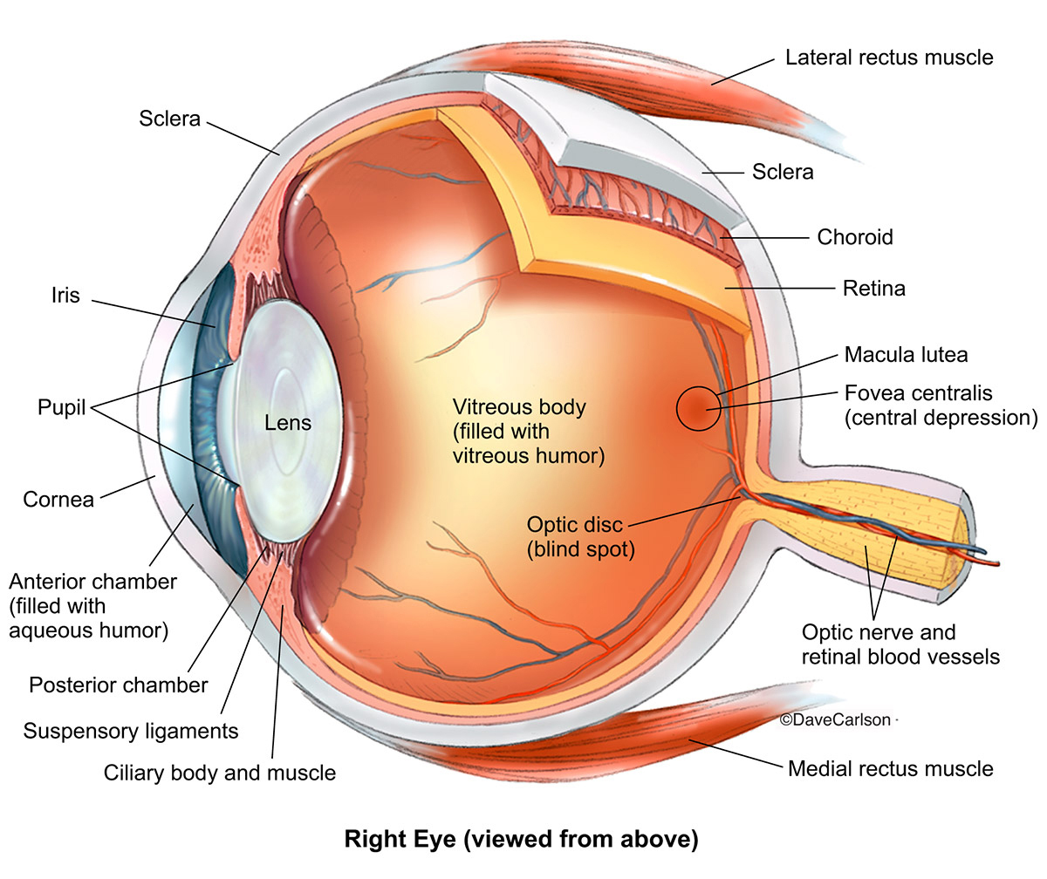
Introduction to the eye
Human vision is one of the most complex visual systems among animals.
The eye is a complex sensory organ, which capable of transduction physical stimuli of light rays into electrical and chemical signals that can be interpreted by the brain to construct physical images.
Functions of vision:
Discrimination (Light vs Dark)
Detection of movement
Detect colour (adaptive value of color vision)
Eye layers
Outer fibrous layer
Middle vascular layer
Iris: Is the colored part of the eye Has aperture (pupil) control & allow light to enter the eye. | ciliary body; Ciliary body consists of: Ciliary muscles Ciliary glands Suspensory ligaments which attached to the lens. | choroid
Sclera | Cornea
Retina
Outer pigmented part | inner neural part containing Photoreceptors called Rods and Cones Rods are best for vision in dim light (scotopic vision) are better than cones for detection of flicker ( sudden movements of objects ). Cones are best for: vision in daylight or bright light (photopic vision) . Color Vision ( color perception ). Perception of detail ( acuity of vision ) .

Slide 3
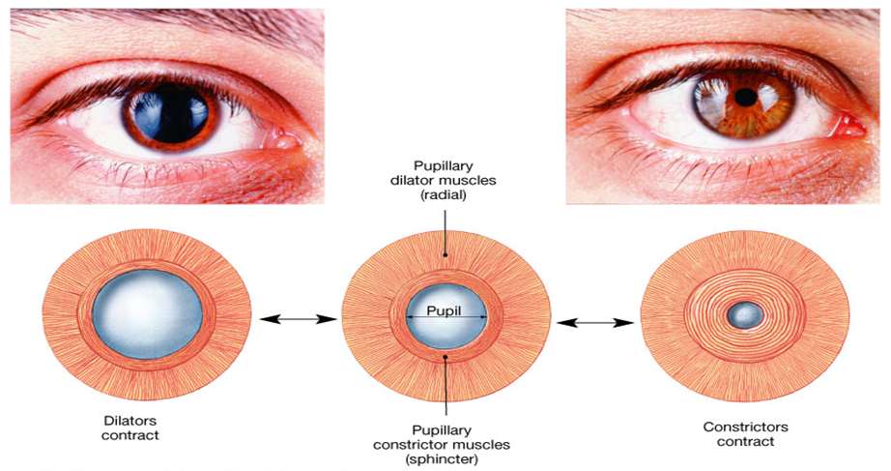
The Anterior & Posterior Cavities
The Ciliary Body (& its suspensory ligament ) and lens divide the eye into :
Anterior cavity:
which contains a fluid called Aqueous Humor.
In the front of the iris.
Posterior cavity :
which contains fluid called Vitreous Humor.
behind the iris: between the iris and lens.
Pupillary muscles
The Pupillary Muscles: consists of Radial and Circular parts

Slide 4
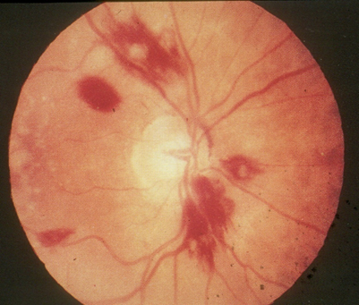
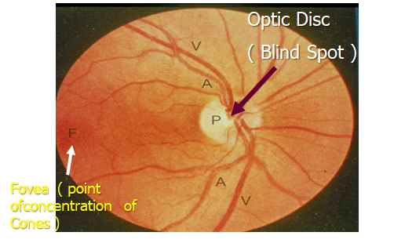
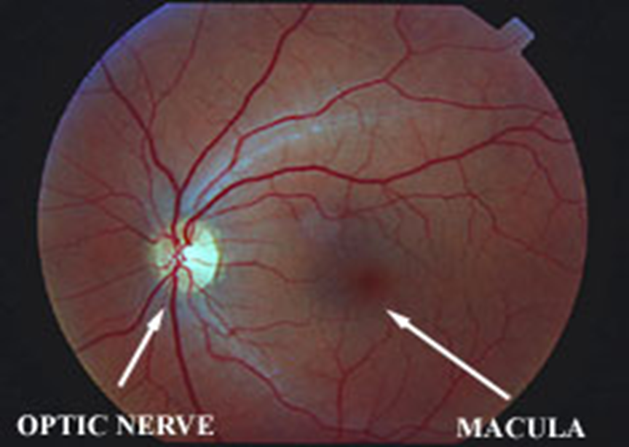
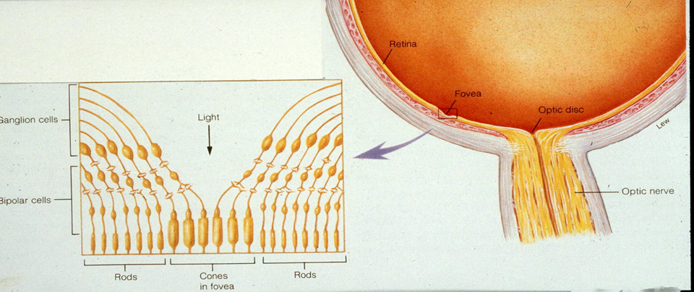
Macula & Fovea Centralis
An important part of the retina is the Macula Lutea .
At the center of the Macula we find the Fovea Centralis .
In the Fovea we find the maximum concentration of cones consequently the Fovea is the point of maximal visual activity in the retina .
Cones are densely packed at the Fovea .
When you turn your eye to look at an object you tend to place its image in the Fovea
Normal Ophthalmoscopic View of Eye

Slide 5
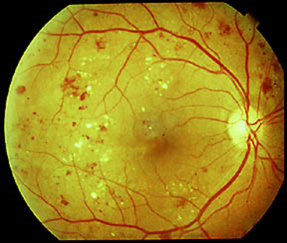
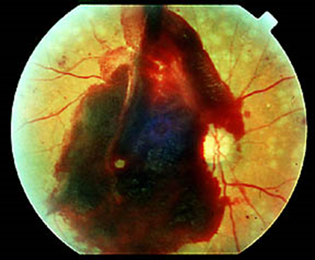
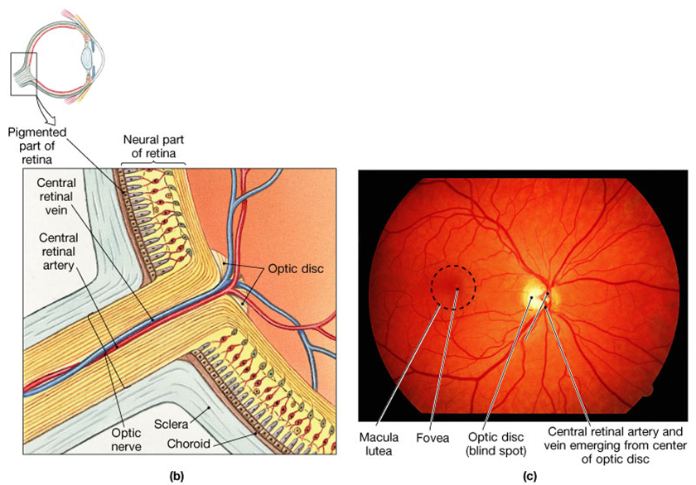
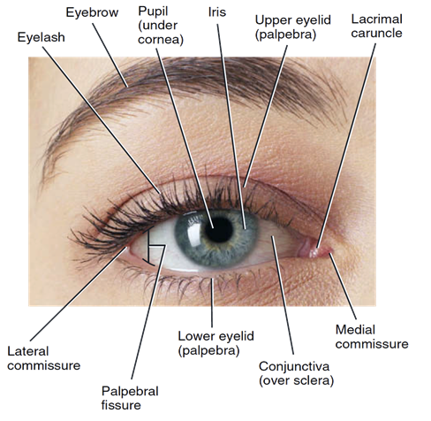
Disorders of the Eye and Vision
Retinopathy in diabetes
Vessels have weak walls – causes hemorrhaging and blindness
Organization of the Retina
External Protection of The Eye
Bony orbit
Eyelids with their lashes
Conjunctiva
Tears from lacrimal gland:
has antibacterial, lubricating effect keep cornea moist & clear.
provide nutrition to the cornea.

Slide 6
Image Formation
Principles of Optics
Term | Description
Principl focus point | Parallel rays strike biconvex lens refracted in this point.
Principle axis | PF lies on line pass through centers of lens curvatures
Principal focal distance | Distance between lens & PF. Biconvex lens(converge) & biconcave lens(diverge)
Biconvex lens → Converge
Biconcave lens → Diverge
Diopter : The distance beyond a convex lens at which parallel rays converge to a common focal point , It is the unit of measurement for Refractive Power ( R.P )

Slide 7
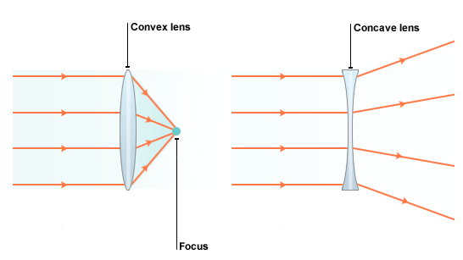
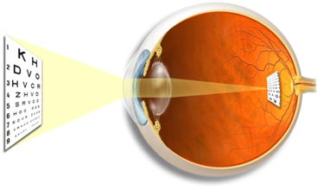
Lens-retina distance =15mm
Dioptre (s) = 1 / Focal length distance (in meters)
Dioptric power of the eye:
Cornea 40-45 D (max refraction)
Lens 15-20 D
Accomodation by lens +12 D
Example : If prinicipal focal distance of a lens is 25cm , then its R.P = 1 / 0,25 ( meter ) = 4D ( Diopter )
The greater the curvature of the lens → The greater the refractive power of the eye
If the lens has exactly the proper curvature, parallel light rays passing through each part of the lens will be bent exactly enough so that all the rays will pass through a single point, which is called the Focal point.
Concave lenses neutralize the refractive power of the convex lenses → therefore if we put a 1 Diopter concave lens immediately in front of the 1 D convex lens results in a lens system with zero refractive power
Emmetropic eye : Is the normal eye vision has image on retina , and has Diopteric power = 59D , It can see all distant objects clearly with its ciliary muscle relaxed & see close objects clearly with its ciliary muscle contracted , In other words Normal eye = Emmetropic eye

Slide 8
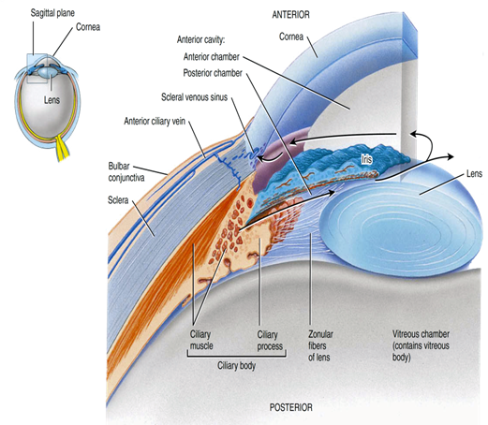
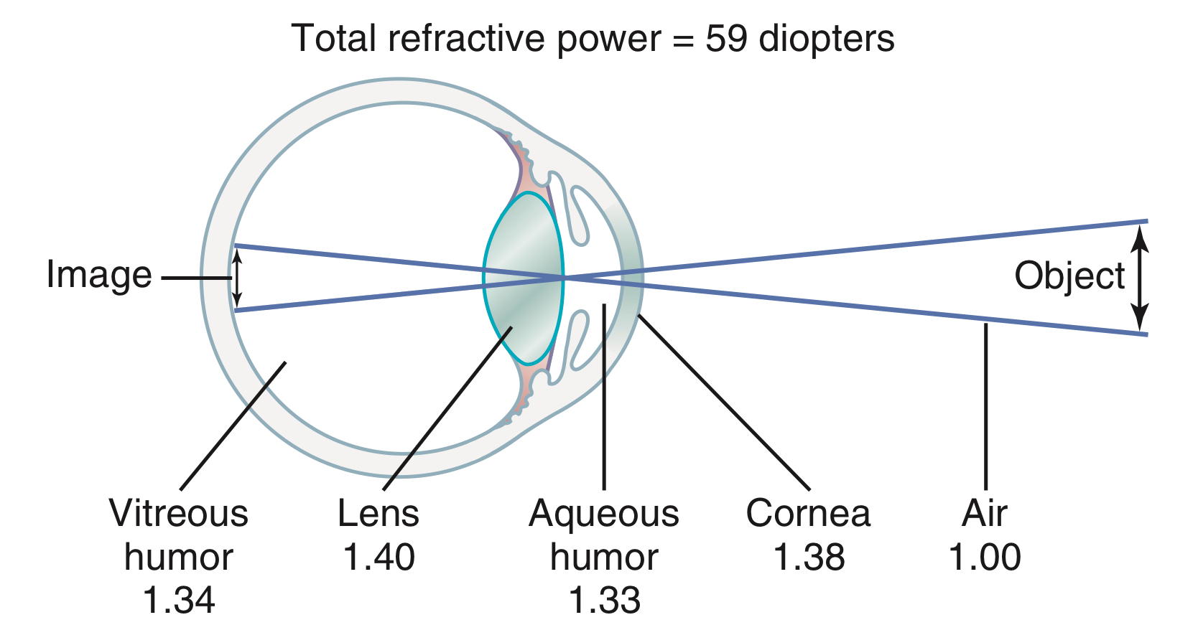
Refractive media of the eye
(1) The interface between air and the anterior surface of the cornea
(2) The interface between the posterior surface of the cornea and the aqueous humor
(3) The interface between the aqueous humor and the anterior surface of the lens of the eye
(4) The interface between the posterior surface of the lens and the vitreous humor.
A total refractive power of 59 diopters when the lens is accommodated for distant vision.
N.B/ The internal index of air is 1
- the cornea, 1.38
-the aqueous humor, 1.33
- the crystalline lens 1.40
-the vitreous humor 1.34

Slide 9
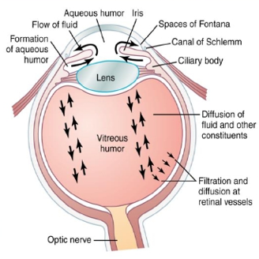
Cornea
Its dioptric power is 40-45 diopter at its anterior surface.
About two thirds of the 59 diopters of refractive power of the eye is provided by the anterior surface of the cornea
The principal reason for this is that the refractive index of the cornea is markedly different from that of air, (whereas the refractive index of the eye lens is not greatly different from the indices of the aqueous humor and vitreous humor).
2. The Aqueous humour:
aqueous humour is a transparent, slightly gelatinous (gel-like) fluid similar to plasma.
Is continually being formed and reabsorbed.
The balance between its formation and reabsorption regulates the total volume and pressure of the intraocular fluid.
Nourishes the cornea and iris
produced in the ciliary body by an active secretion by ciliary processes..
Go to posterior chamber to pupil Anterior chamber drained into canal of Schlemm in anterior chamber angle, which is a venous channel at the junction between the iris and the cornea (anterior chamber angle).
It causes intraocular pressure 10-20 mmhg
Obstruction of this outlet leads to increased intraocular pressure , a critical risk factor for glaucoma

Slide 10
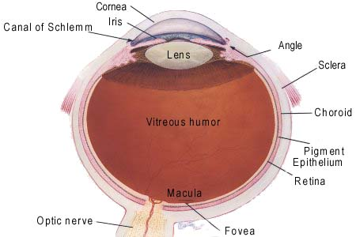
3. Lens
Has dioptric power 15-20D (1/3 refractive power of eye).
More important than the cornea, why?
In response to nervous signals from the brain, its curvature can be increased markedly to provide accommodation.
4. The Vitreous humour
Is the transparent, colourless, gelatinous mass, fills the vitreous chamber between the posterior surface of lens and the retina.
(for nourishing retina & keep spheroid shape of the eye)
the vitreous humour is clear and allows light to pass through
Vitreous humours remains from birth

Slide 11
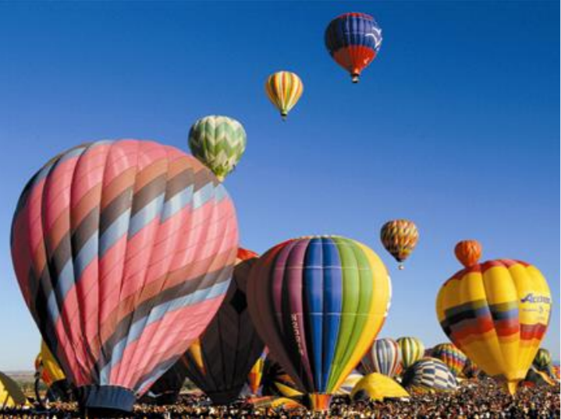
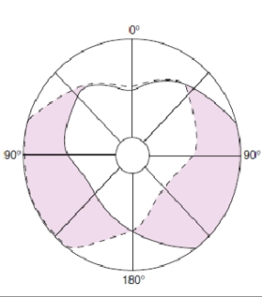
normal vision
glucoma
What is glucoma?
(intraocular pressure more than 20mm Hg)
Build up of Aqueous Humor Volume
Increases pressure in eye
Damages nerve Meds/surgery
Why it causes damage of optic nerve?
Obstruction of AQ H outlet leads to increased intraocular pressure.
Excessive aqueous humour pushes the lens backwards into vitreous,which pushes against the retina.
this compression causes retinal and optic nerve damage that can cause blindness if not treated?
the axons of the optic nerve are compressed at the optic disc.
This lack of nutrition of the optic nerve fibers,which causes death of the involved fibers & blindness
Glaucoma is an eye condition that develops when too much fluid pressure builds up inside of the eye. The increased internal pressure can damage the optic nerve, which transmits images to the brain. Without treatment, glaucoma can cause blindness within a few years. Glaucoma is most often inherited, meaning it is passed from parents to children. Less common causes of glaucoma include a blunt or chemical injury to the eye, severe eye infection, blockage of blood vessels in the eye and inflammatory conditions of the eye. Glaucoma usually occurs in both eyes, but it may involve each eye to a different extent.
what is the Binocular Vision?
Binocular Vision For :-
1- Large visual field
2- cancel the effect of blind spot
3- stereoscopic vision
4- one eye lesion does not affect
vision
Are the areas in the centre of visual field of the two eyes in which any object in this area will be seen by both eyes.
Monocular And Binocular Visual Fields.
The dashed line encloses the visual field of the left eye; the solid line, that of the right eye.
The common area (heart-shaped in the center) is viewed with binocular vision.
The colored areas are viewed with monocular vision.

Slide 12
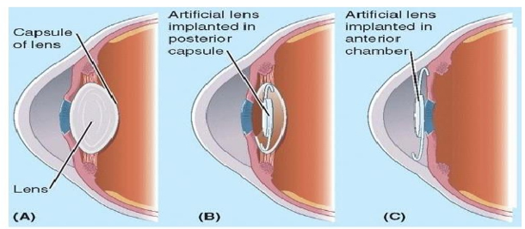
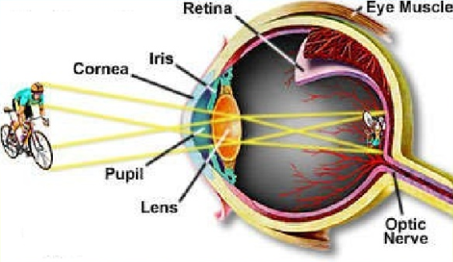
Cataracts:
is a cloudy or opaque area or areas in the lens.
occurs in older people.
the proteins in some lens fibers become denatured and coagulated to form opaque areas.
When a cataract has obscured light transmission so greatly that it impairs vision
The lens system of the eye will focus an image on the retina upside down
the image is
inverted and
reversed with
respect to the
object
.
however, the
brain perceives
objects in the
upright position despite the upside-down orientation on the retina
The reason does not look inverted and reversed is that the brain learns “early” in life to coordinate visual images with the orientations of objects

Slide 13
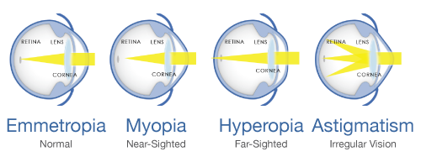
Errors of refraction
Name | Description | Correction
Hyperopia (Farsightedness ) | Small eye ball with weak lens system. Focus is behind retina Causes headache and blurred vision. Continuous accomodation to bring image on retina causes muscular effort on ciliary muscles & prolonged convergence, which will lead to headache and finally squint. | Biconvex lens
Myopia ( near-sightedness ) | Genetically large eyeball or too much R.P (refractive power ) of the lens system or cornea due to its curved surface , or due to long anterior-posterior diameter of the eye. Extensive close work , E.g : Studying. Focus will be IN FRONT of the retina. | Biconcave lens
Astigmatism : | Mainly due to Uneven and Nonuniform corneal curvature and very little due to uneven lens curvature Rays reflected to different foci resulting in ---> Blurred vision | Cylindrical lens

Slide 14
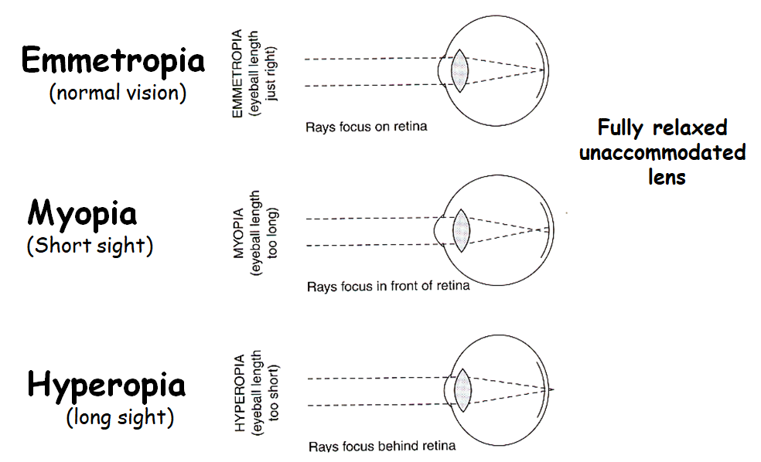
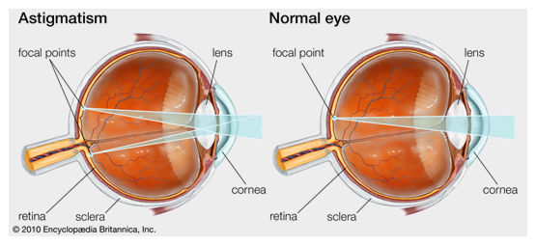
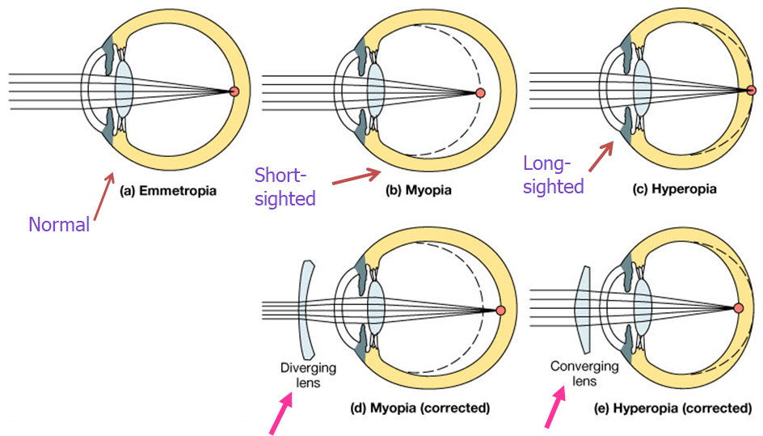
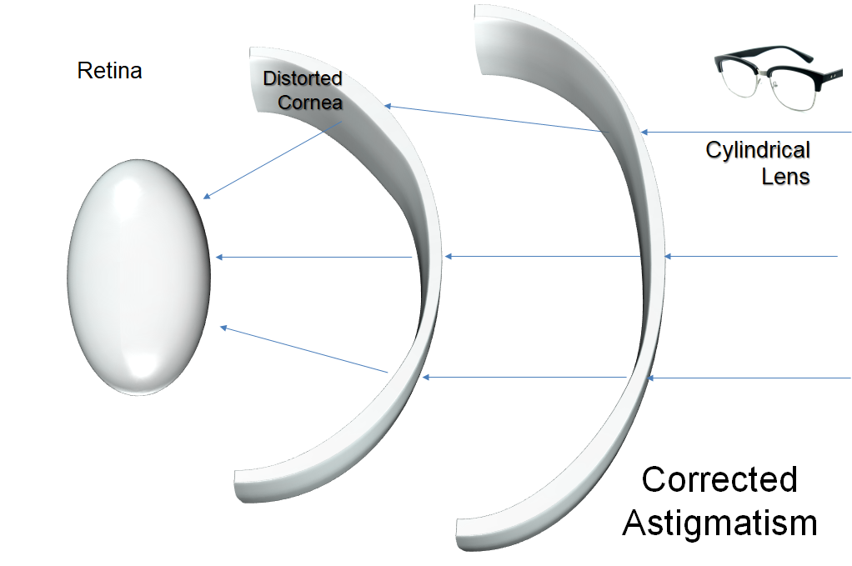
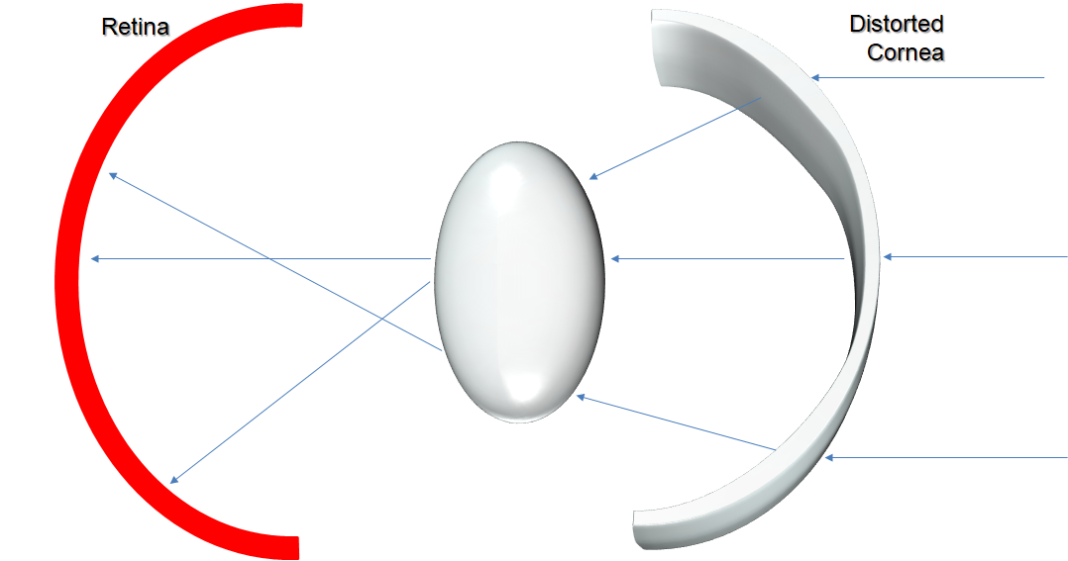
Image Focusing
Helpful illustrations
Visual Abnormalities
Astigmatism

Slide 15
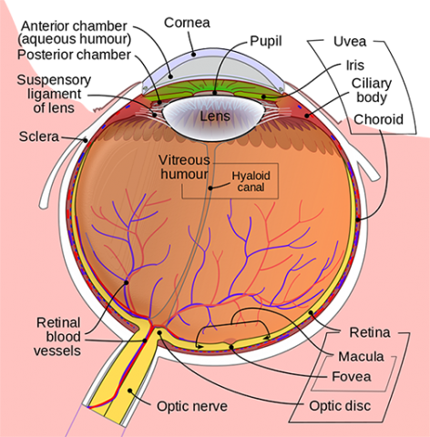
Light pathway in the eye :
After the light passes through the lens system of the eye and then through the vitreous humor , it enters the retina from inside the eye
It then first passes through the ganglion cells and then through the plexiform and nuclear layers before it finally reaches the the layers of rods and cones located all the way on the outer ridge of the retina
Then impulses pass from the rods and cones the rest of the layersinally to the ganglion cell layer and then to the Optic nerve
Light absorbed by the pigment cell layer contains Melanin pigment
The visual acuity is decreased by this passage through Non-homogenous tissue
However in the Central foveal region of the retina , the inside layers are pulled aside to decreases the loss of acuity . This allows light to pass unimpeded to the cones.
Watch this 3 min video → https://www.youtube.com/watch?v=Qpo66aqapsw

Slide 16
1.which of the following is the coloured part of the eye ?
.cornea
iris
.choroid
sclera
2.Q/the posterior cavity of the eyes contain a fluid called ?
A- Aqueous humuor
B- Ciliary fluid
C- Vitreous humuor
D- Conjunctival fluid.
3.Q/which one of the following situations are rod photoreceptors used rather than cons ?
A- in daylight
B- colour perception
C- Perception of detail
D- detection of flickers
4.Q/ if Principal focal distance of a patients lens is 13m what’s the refractive power of the lens and what is the normal dioptre?
A- 0,007:59
B- 7,69:56
C- 0,007:56
D- 7,69:59
5.Q/ an eye condition that develops when too much fluid pressure builds up inside of the eye is called?
A- Glaucoma
B- Conjunctivitis
C- Fuchs' dystrophy
D- Keratoconus
6.Q/which of the following Errors of refraction is corrected by a cylindrical lens?
A- Hypermetropia
B- Myopia
C- Astigmatism
D- None of the above
7.Q/most of the dioptric power of the eye (between 40-45) is found in the..?
A- Anterior part of lens
B- anterior part of cornea
C- posterior part of lens
D- anterior part of retina
8.Q/ which of the following is the region where the optic nerve and blood vessels leave the eye?
A- Fovea
B- Zonulas
C- Optic disk
D- Optic foramen
9.Q/ This is a thin, light-sensitive tissue that lines the back of the eye and acts much like film in a camera?
A- Cornea
B- Lens
C- retina
D- petal
10.Q/These are responsible for nourishing the inner layers of the retina.
A: eye tissues
B: pupil veins
C: cornea muscles
D: retinal blood vessels
Answers:
B
C
A
D
A
C
B
C
C
D

