Slide 1
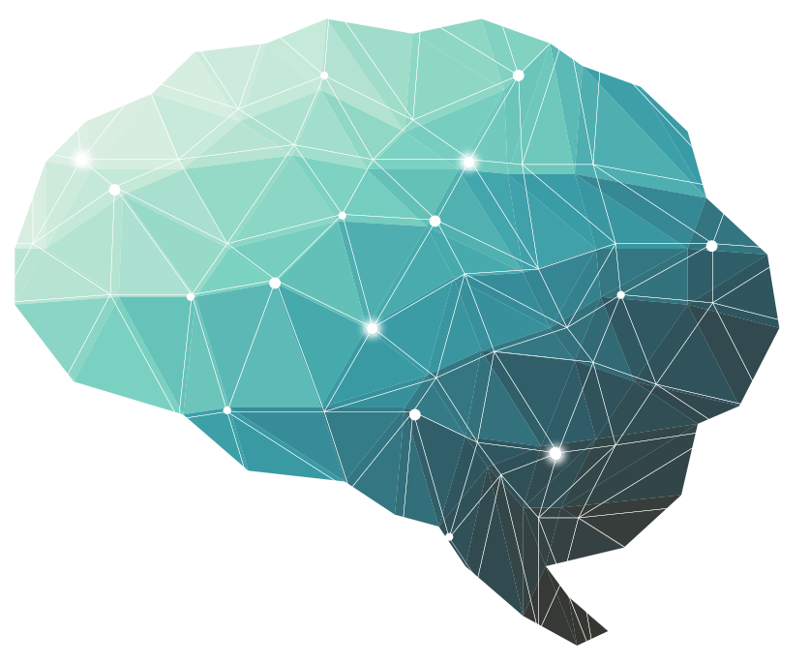
12Th Lecture ∣ The Physiology Team
Phototransduction of light
Objectives:
List and compare functional properties of rods and cones in scotopic and photopic vision
To know the convergence and its value
To describe the photosensitive compounds
To Contrast the phototransduction process for rods and cones in light and dark and the ionic basis of these responses
To know the process of rhodopsin regeneration
To know the meaning of nyctalopia
Contrast the dark and light adaptation
To know the visual cycle and rhodopsin regeneration
To recognize types of ganglion cells
Done by :
Bold & Italic objectives are included in the medical education guide
Team leader: Fatima Balsharaf , Rahaf Alshammari,
Abdulelah Aldossari, Ali Alammari.
Team members: Renad alsuelmi,Maha Alamri ,
Abdullah Alzaid, Esra’a alnazzawi,Haifa Alessa, Ebtesam Almutairi
Special thanks for drawings : Lubna - Aloufi
Colour index:
important
Numbers
Extra
Editing file
وَأَن لَّيْسَ لِلْإِنسَانِ إِلَّا مَا سَعَىٰ

Slide 2
Terminology
Terminology | Definition
Light | ‘elctromagnetic’ radiation that is capable of exciting the human eye’ and it’s extremely fast.Visible light spectrum extends from 397 to 723 nm
Convergence | “Physics”The act of converging and especially moving toward union or uniformity. Opposite of divergence.”Medicine” Inward movement of both eyes toward each other, usually in an effort to maintain single binocular vision as an object approaches.
Retina | Light sensitive nerve tissue in the eye that converts images from the eye's optical system into electrical impulses that are sent along the optic nerve to the brain. Forms a thin membranous lining of the rear two-thirds of the globe.
Rhodopsin | A visual pigment found in the rod photoreceptor cells of the retina, is responsible for converting photons into chemical signals that stimulate biological processes in the nervous systems of humans and other vertebrate animals, allowing them to sense light1. Rhodopsin is a member of class A of the G-protein-coupled receptor GPCR superfamily2, which is a large group of cell surface signaling receptors that transduce extracellular signals into intracellular pathways through the activation of heterotrimeric G proteins.
Fovea | Central pit in the macula that produces sharpest vision. Contains a high concentration of cones and no retinal blood vessels.
Macula | Small central area of the retina surrounding the fovea; area of acute central vision.
Accommodation | Increase in optical power by the eye in order to maintain a clear image (focus) as objects are moved closer.
Cones | Light-sensitive retinal receptor cell that provides sharp visual acuity and color discrimination
Rod | Light-sensitive, specialized retinal receptor cell that works at low light levels (night vision).
Chromophore | A chemical group (such as an azo group) that absorbs light at a specific frequency and so imparts color to a molecule; also : a colored chemical compound
Visual acuity | Assessment of the eye's ability to distinguish object details and shape, using the smallest identifiable object that can be seen at a specified distance (usually 20 ft. or 16 in.).
12th Lecture ∣ The Physiology Team

Slide 3
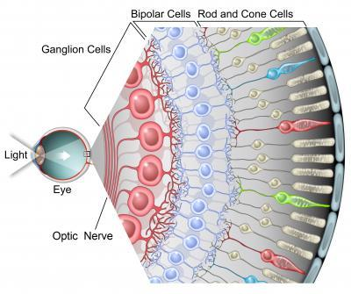
Overview of the lecture Phototransduction- Ninja channel
outer pigmented layer of retina consists of granules (melanin) | Photoreceptors layer | Ganglion layer
1- for absorbing the light waves, preventing it from reflection disturbing the normal visual pathway 2- provide nutritious supply to the retina 3- acting as barrier 4- phagocytosis Of any types debris from photoreceptors |  | That form optic nerve
12th Lecture ∣ The Physiology Team
Rods | Cones
have the same transduction
1- rods ( have specific type of pigments called rhodopsin = (retinal* + scotopsin) is *derivatives Of vitamin A . 2- Scotopic vision (night vision) 3- dark light or fuzzy dim light 4- Light in different shades of gray 5- Not accurate in vision: No color No detection of edges Less acuity | 1- cones have specific pigment called (iodopsine ) (Retinal + opsin) 2- Photopic vision can pick different waves of light : *Blue color - lowest wavelength *Red color - highest wavelength *Green color Color vision bright light vision Can detect edges
42 Min Follow him & use the sketch
If you don't have time start from 33:30 min he starts to recap

Slide 4
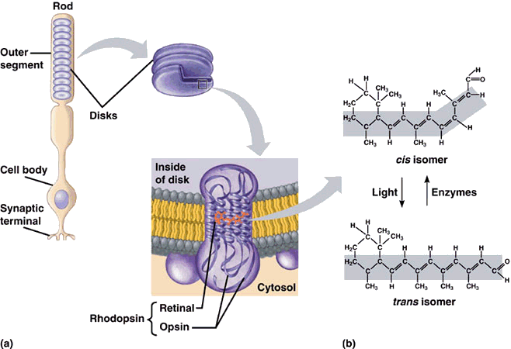
Overview of the lecture Phototransduction- Ninja channel This part starts from 18 MIN
We notice here he’s talking about Rod ( it will be the same process exactly in cones but different in the segment instead of rhodopsin is photopsin)
1- The light rays come in and hit special structure in rods’ disk ( rhodopsin ) 2- Transfer 11 cis retinal and convert to all Trans retinal
3- which will free up the opsin protein that perform specific function. 4- Then opsin will activate specific protein which is transducer protein and this will activate special enzyme ( PDE ) phosphodiestrase
5- Normally we have GTP being converted into C-GMP through guanylyl cyclase GC and this
C-GMP bind to the sodium and calcium channel keeping them open ( Na+ can come in ) 6 - So if -PDE -enzyme has been activated it will break down this C.GMP , if the C.GMP is broken down it won't be able to bind to the channel for Na + ca to come in -can’t keep the channel open ( the cell becomes less positive) = hyperpolarization = IPSP going down through the rods. what does this mean ? There is very little receptor potential moving down through rod which can lead to inhibit of voltage gated Ca++ channel which are located at the end of the rods (No / little Ca++ influx ) >> so there is no / little release of neurotransmitters ( glutamate )
So what happens if there is little release of glutamate? Something weird will happen here ! Even though it’s very little Glutamate but it’s going to stimulate the bipolar neuron . How this could happen ? if there is no/ little glutamate very little cation will leave the cell and the cell will remain positive and will become = depolarized which will produce EPSP which generate * receptor potential Not action potential !!!!!!!!!! The only cell generate AP is ganglion cell. This EPSP triggers through the axon of the bipolar cells which release a lot of glutamate And the glutamate will generate action potential in the ganglion cell And these action potential will move down the optic nerve then take to actual occipital lobe - primary visual cortex- which help us to perceive the actual image. How horizontal cells will participate in this process ? - will release GABA as result of glutamate release which comes from the Rods -GABA
will inhibit the photoreceptors again - that’s why it helps with adaptation of light and dark.
يعني لما يطلع الجلوتاميت مو بس يروح على البايبولار سيل لا كمان يعطي ال هورزينتال وإذا أعطاها
هي بتعطينا الجابا
How amacrine cells - between bipolar cell and ganglion cell- will participate in this process ? Amacrine cell release different type of chemicals such as : glycine , GABA , Dopamine, ACH. Which will inhibit the ganglion cell to modulate the action potential in the pathway.
12th Lecture ∣ The Physiology Team

Slide 5
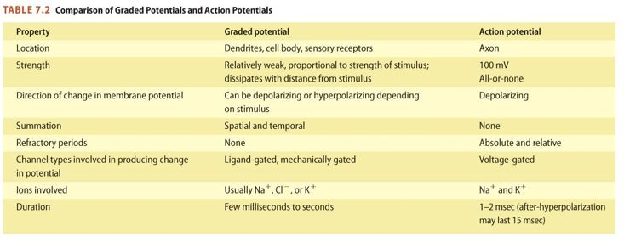
Overview of the lecture Phototransduction- Ninja channel
Let’s say there is no light waves -Dark- what will happen ? - simply the All Trans come back to 11 Cis retina - So the opsin will come back to 11 cis and rebind again. - So there no longer transducer , now it’s not going to activate (PDE) - And all the C-GMP break process will be inhibited , and we have high concentration of
C-GMP that can bind to the Na - ca channel and become open ( flow in ) = cell more positive - And start depolarization and going to generate EPSP and moving down the axon and ca will be super active and release more glutamate that affect the bipolar cell to generate IPSP ( less receptor potential moving down ) result in less glutamate and there will be very little action potential moving down the axon of the ganglion cell and down the optic nerve
12th Lecture ∣ The Physiology Team
في الصفحة اللي قبل لاحظنا التركيز على الفرق بين
Action potential & receptor potential
اللي مايذكرها هذا الجدول بيساعدنا

Slide 6
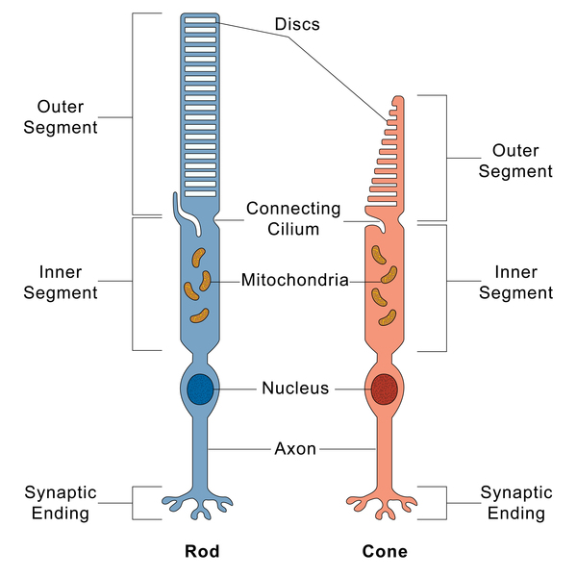
List and compare functional properties of rods and cones in scotopic and photopic vision
Visible light Spectrum:
- Extends from 397 to 723nm - Eye functions under two 2 conditions of illumination:
Duplicity theory of vision ▫ Bright light (Photopic vision)...Cones
▫ Dim light (Scotopic vision) ..Rods
Visual Receptors: Rods and Cones
Rods | Cones
Abundant in the periphery​ of the retina | Abundant in & around fovea
Best for low light(dimlight) conditions (night vision/scotopic vision) | Best for bright light conditions ( photopic vision)
See black/white and shades of gray | See all colors
100,000,000 | 5,000,000
12th Lecture ∣ The Physiology Team
Shape of rods & cones (receptors of vision):
Outer segment (modified cilia)
has disks full of photosensitive pigment (rhodopsin) react with light to initiate action potential
In cones is conical , small and contain 3 types of rhodopsin / photopsin (in small amount).فوتوبسين هي الأدق لأن الرودبسين تعبر بسيجمنت بشكل عام
in rods it is big, rod-like and contain one type of rhodopsin
There are Na channels in the outer segment which allow Na to enter the photoreceptors.
Inner segment
Full of mitochondria ( source of energy for Na-K pump), it is thick in cones
There is Na-K pump in inner segment

Slide 7
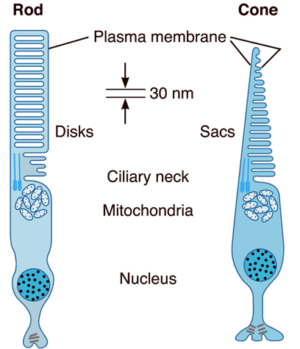
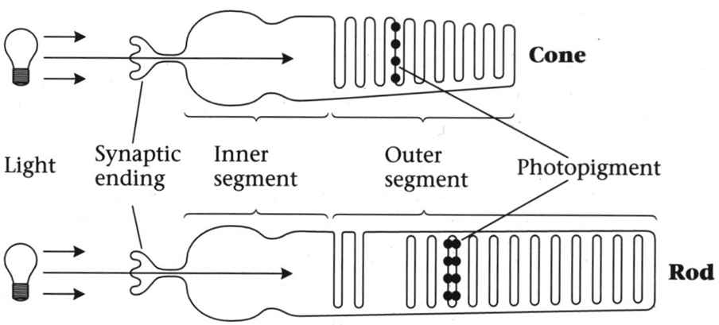
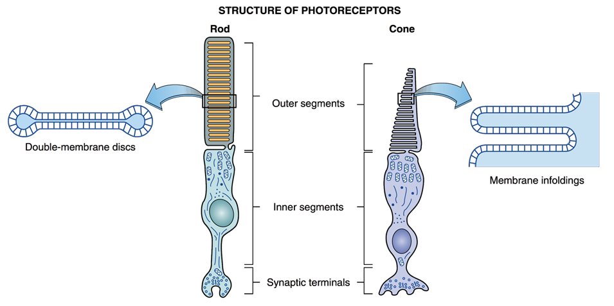
List and compare functional properties of rods and cones in scotopic and photopic vision
The inner and outer segments are connected by a ciliary stalk through which the photosensitive compounds travel from the inner segment (where they are manufactured) to the outer segment of the rods and cones (where they are used)
بالرغم صغر cones
إلا إنها تحتوي على ثلاث أنواع من الفوتوبسين/ الرودوبسين
Photosensitive compounds in Cones are arranged in saccules
Photosensitive compounds are arranged in discs in Rods.
12th Lecture ∣ The Physiology Team
each rod contains a stack of disk membranes that flattened membrane-bound intracellular organelles that have detached from the outer membrane,
disks are free floating
the saccules of the cones are formed by infolding of the membrane of the outer segment
The saccules and disks contain the photosensitive compounds that react to light initiating action potentials in the post synaptic cells

Slide 8
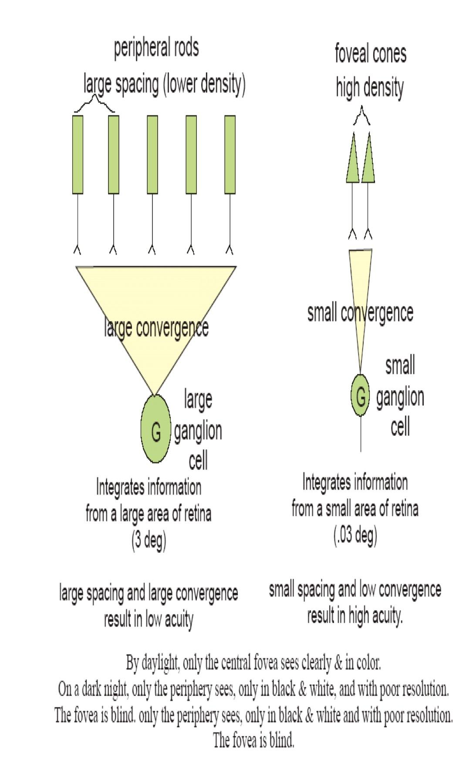
To know the convergence and its value
Convergence:
Rule: Convergence increases sensitivity to light and decrease acuity.
Low convergence | High convergence
In Cones | In Rods
each​ foveal cone synapse with →one​ bipolar cell →one​ ganglion cell →single​ optic nerve fiber “ peripheral 2-3 cones converge into one bipolar cell unlike foveal cones which transmit 1 to 1. Approximately 30000 cones concentrated in fovea centralis” | several rods (about 300) synapse with one​ bipolar cell & one ganglion cell
Value of low convergence​ “advantage” increases visual acuity​ → integrated information from small​ area of retina | Value of high convergence​ “advantage” increases sensitivity to light​ i.e so low light threshold stimulate the rods
Disadvantage: decreases sensitivity to light​ i.e need high threshold of illumination to stimulate cones | Disadvantage: decreases visual acuity, acuity​ = integrated information from large area of retina
120 million rods & 6 million cone converge on 1.2 million optic nerve fibers , (126 million reception on 1.2 million nerve fiber )so convergence is 105 receptor : 1 fiber.المقصود هنا أنه لو قسمنا ال ١٢٦ على على ١.٢ بيعطينا ال 105 وهي أنه كل ١٠٥ من الفوتوريسبتور ينقلون على وحدة من البايبولار وأغلبهم بيكون من الرود لأنهم أكثر
12Lecture ∣ The Physiology Team

Slide 9
To describe the photosensitive compounds
Photosensitive compound (rhodopsin ):
Cones | Rods
In cones rhodopsin ( iodopsine) formed of: Opsin ​protein (photopsin) Retinal​ (retinene 1 = aldehyde form of Vit A) | In Rods, rhodopsin, is formed of: Opsin ​protein (scotopsin) Retinal​ (retinene 1 = aldhyde form of Vit A) = visual purple (Rhodopsin of the rods most strongly absorb green-blue light​ and, therefore, appears reddish-purple, so called "visual purple”,this appearance is under the microscope)
There are 3 types of rhodopsin in cones (photopsine I,II,III​ )​ each respond to a certain wavelength ​of light for color vision | ● Rhodopsin forms 90% of rods protein, stored in disks ​of rods at outer segment ● At dark ”no light at all” ​rhodopsin is in 11-cisretinal form (inactive,​ but light sensitive form) which increase sensitivity of rods to light.
12th Lecture ∣ The Physiology Team
Photoreceptor pigments Composition:
Retinine1 (Aldehyde of vitamin A) , same in all pigments.
Opsin (protein) , Different amino acid sequence in different pigments.
Rhodopsin (Rod pigment): Retinine + scotopsin
Genesis of photoreceptor potential:
Rods & cones potentials are graded, local potential (generator potential) propagated as A.P in ganglion cells.
Ganglion cell action potential (all or none A.P) transmitted to optic nerve.
Cones respond to high levels of light intensity (illumination)
Rods respond to levels of light intensity (illumination) below threshold levels for cones, so rods are more sensitive.
Electric recording in Retinal cells: 1- Rods & Cones 2- Bipolar cells: Hyper- & Depolarization 3- Horizontal cells: Hyperpolarization 4- Amacrine cells: Depolarizing potential 5- Ganglion cells: Depolarizing potential
are stimulated by hyperpolarization

Slide 10
To Contrast the phototransduction process for rods and cones in light and dark and the ionic basis of these responses
12th Lecture ∣ The Physiology Team
قبل مانبدأ في الفكرة نقرأ الشرح من تيّم ٣٥

Slide 11
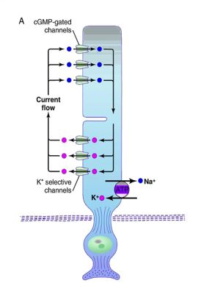
To Contrast the phototransduction process for rods and cones in light and dark and the ionic basis of these responses
ELECTROPHYSIOLOGY OF VISION (PHOTOTRANSDUCTION)
A-At Dark “No light at all”:
1-Rhodopsin in 11-cisretinal
( inactive form-light sensitive form which increase sensitivity of rods to light) in the outer segment.
بكل بساطة : الرودوبسین لما یكون في الاناكتف فورم التي هو ١١-سیسریتنال راح یزود تفاعل الرودز مع الضوء * عشان كذا الرودز highly sensitive to the light *
2- 5 –GPM of the outer segment Na channels is in the c-GMP form (c-GMP at c-GMP gated Na channels of the outer segment , it bound to proteins at Na channel membrane & keep them open) → opening of Na channels at outer segment → allow Na influx after its is pumped out from Na –K pump of the inner segment→ depolarization. (-40mvolt , instead of -80 mvolt in most receptors)
3-Dark current (Na current):
At the inner segment Na pumped by Na- Kpump to outside & re-entered through Na channels ( at outer segment ) → Depolarization flow to synaptic endings → steady increased release of glutamate at synapses with bipolar cells → which get depolarization potential (off-center bipolar cells)→ depolarize ganglion cells.
Synaptic mediators in retina:- Ach, glutamate, dopamine, serotonine,GABA, substance P,somatomedin, VIP, enkephalins, glucagons,neurotensin.
طيب لو حصل هذا الأكتيفيشن عن طريق لايت ايش راح يصير؟
12th Lecture ∣ The Physiology Team
at dark rhodopsin is inactive (11 cis-retinal needs light for its activation) / inactive rhodopsin is essential for depolarization
its inactivation keeps Na channels open by keeping cGMP& Na current occurs
Response in bipolar cells( OFF –center bipolar cells) (depolarization) → ganglion cells- → AP in optic nerve- → vision at dark. This Na current is continuous in dark, thus called “Dark current”. it causes a wave of depolarization.

Slide 12
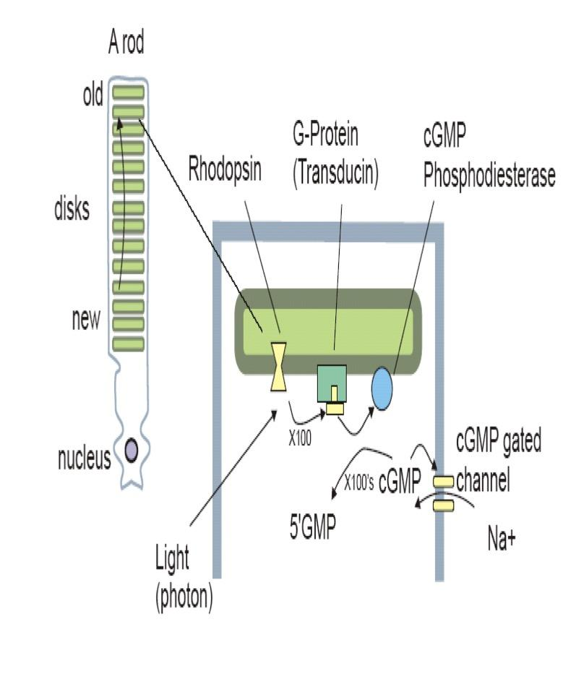
To Contrast the phototransduction process for rods and cones in light and dark and the ionic basis of these responses
B- Incident light ( PHOTOPIC VISION) :
Light → Conformational change of photopigment retinine-1 in rhodopsin ( a process known as bleaching​) (11-cisretinal form changed to → metarhodopsin→ all-trans isomer called metarhodopsin II which is an active rhodopsin) →Activation of G – protein (transducin) → activation of phosphodiestrase enzyme → conversion of c-GMP to 5- GMP → Decreased intracellular c-GMP → closure of Na channels in outer segment but still Na pump out of inner segment (Na-K pump)​ → Hyperpolarization of photoreceptors ( -70 ~ -80 millivolts) Hyperpolarization is caused by increased negativity, which is caused by the cations pumped out, accumulating in ECF and not re-entering through Na channels.
Hyperpolarization → Decreased release of synaptic transmitter “disinhibition concept which means you inhibit release of inhibitory neurotransmitter that results in stimulation of desired cell””→ Response in bipolar cells (hyperpolarization) ( off-center bipolar cells get hyperpolarized)(this cause decreased release of glutamate= gradual depolarization of on-center bipolar cells)الدكتور يقول هذه عليها اخلافات لأن glutamate في البراين يعتبر محفز وليس مثبط وفيه مصادر اخرى تضع GABA بدل glutamate → Generator potential in amacrine cells & ganglion cells (depolarize ) → AP → optic nerve → optic pathway.
NB/ these reactions occur in both rods & cones
but in rods occur at low illumination as in dim-light & in cones at high illumination.
in cones 4 times faster.(We took here rhodpsin as an example of photosensitive pigment which is really similar to iodopsin “photosensitive pigment of cones” but iodopsine is 4 times faster than rhodopsin.)
Doctor said:
Amacrine cells inhibit either bipolar cells or ganglion cells.
Horizontal cells inhibit photoreceptors cells to coordinate
transmission of specific photoreceptors .
12th Lecture ∣ The Physiology Team

Slide 13
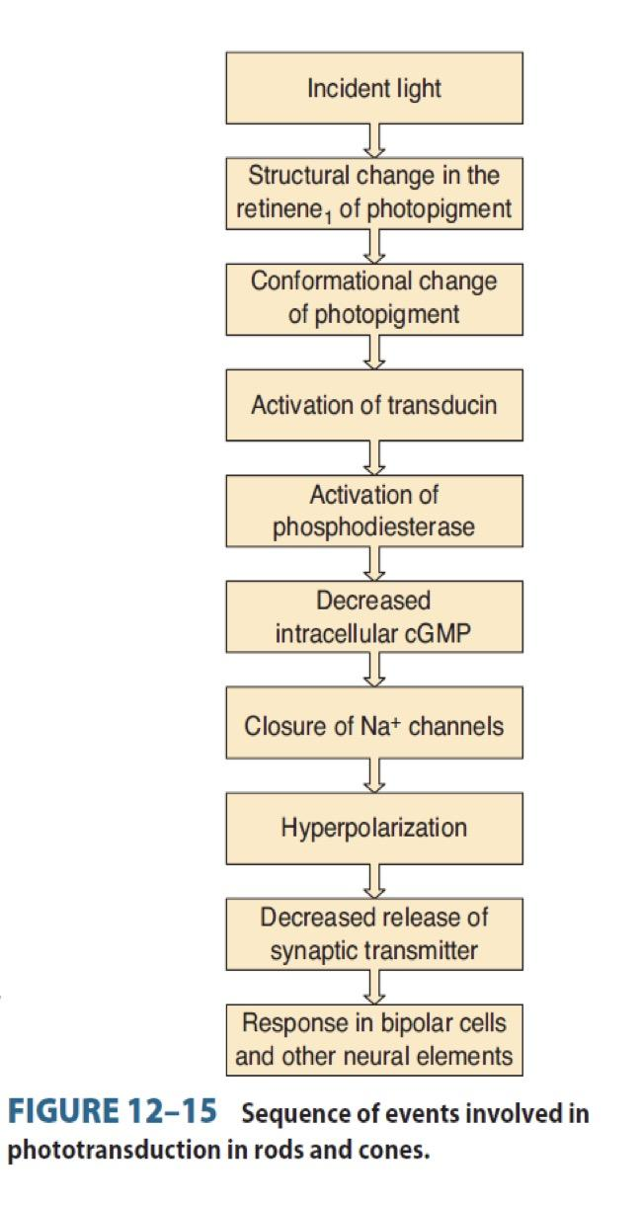
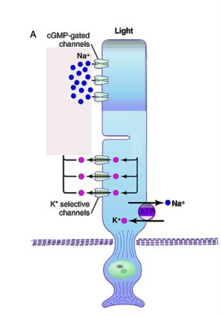
To Contrast the phototransduction process for rods and cones in light and dark and the ionic basis of these responses
In The Light “Summary”
With the cell hyperpolarized at about -70 to -80MV glutamate release is greatly inhibited.
Light exposure will lead to closure of the CGMP gated Na+ channels.
The inner segment still is continually pumping sodium from inside the rod to outside.
Despite potassium ions being pumped to the inside of the cell ,Potassium ions still leak out of the cell through non gated potassium channels in the inner segment of the rod (selective permeability of K along its concentration gradient)
therefore with loss of positively charged NA+ and K+ this creates a negative potential on the inside of the entire cell of about -70 to -80MV.
12th Lecture ∣ The Physiology Team

Slide 14
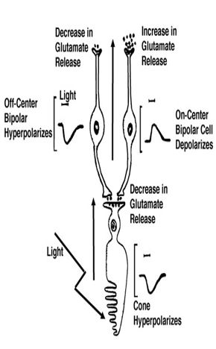
To Contrast the phototransduction process for rods and cones in light and dark and the ionic basis of these responses
We have 10 types of cones bipolar cells & one type of rod bipolar cell
Dark | Light
depolarize receptors ➞ increase glutamate at photoreceptor ends ➞ hyperpolarize ON- center bipolar cells . depolarize OFF-center bipolar cells​ (active) . | hyperpolarize the receptors ➞ decrease glutamate release at photoreceptor ends ➞ depolarize ON- center bipolar cells hyperpolarize OFF-center bipolar cells (inactive)
12th Lecture ∣ The Physiology Team
N.B/
ON- center bipolar( synaptic connection with center photoreceptors= cones , so light depolarize them to see in bright light).
OFF- center bipolar( synaptic connection with peripheral photoreceptors= rods , so dark depolarize them to see in dark).
All these help to sharpen signal from rods in dark and from cones in light.
لو ترجعون لسلايد ٩ راح تلاحظون أنه عند
bipolar cells
يحدث فيها Hyperpolarization & depolarization
فيعتمد هذا على حسب الحالة للتعرض هل في
light / dark
وأحتاج مين اللي يكون فعال الكونز ولا الرودز

Slide 15
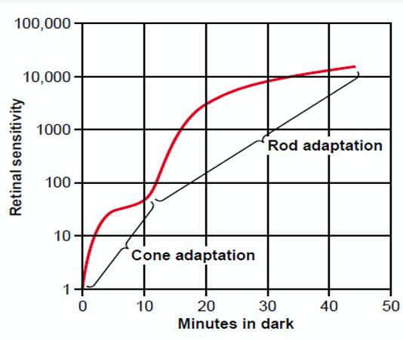
Contrast the dark and light adaptation
Dark adaptation عملية بناء = تأخذ وقت (٢٠د) |  | Light adaptation
-When a person moves from lighted environment → a dimly lighted environment, the retina becomes more sensitive to light & the person will see at dark ( accustomed to dark ) in about 20 min ( only gross features but no details or colors) . Rhodopsin in darkness is essential for depolarization of rodes to see in dark & for dark adaptation). The mechanism of dark adaptation: ​ increase Rhodopsin regeneration​ . Reaches max in 20 minutes First 5 minutes → threshold of cones. 5 to 20 mins → Sensitivity of rods. Dark adaptation has 2 components:- |  | عملية هدم = ما تأخد وقت(٥د) When light switched on again, the rods are knocked out of action ( they stop sending AP at high levels of light) & cones start to function to adjust & adapt to the level of brightness in 5 min this is called Light adaptation. ——————— Q- Why radiologists & aircraft pilots wear red goggles in bright light? A/ Light wavelength of the red stimulate the cones & stimulates rods to some extent, so red goggles for rods act as dimlight, so with it rods are adapted to darkness & form large amounts of rhodopsin while the person in bright light & when person enter dark places he can see well & not remain 20 minutes.
-rapid phase ( about 5 minutes): - drop in visual threshold . - Fast dark adaptation of cones , only in fovea - half of the cone rhodopsin regenerate in only 90 seconds This phase is rapid but the sensitivity of light increase partially in contrast to less rapid phase which the sensitive of light increases dramatically due to rhodopsin existence. | -less rapid phase ( till 20 min): - drop in visual threshold stimulates dark adaptation of rods in the peripheral retina. - sensitivity of rods to light increase, in 1 min increase 10 folds. -rods increase their sensitivity to light by convergence 300:1 ganglion cell , so summation at ganglion cells potential will increase sensitivity to light)
N.B ( 20 min for dark adaptation are for regeneration of rhodopsin → increase sensitivity of rods to light due to a drop in visual threshold

Slide 16
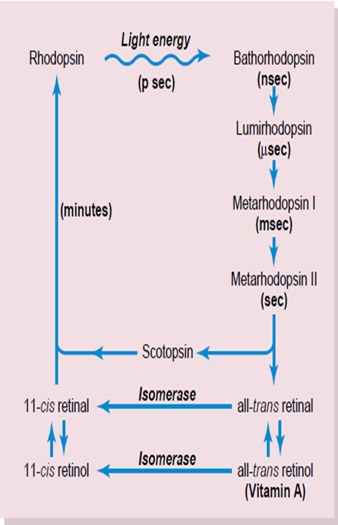
To know the visual cycle and rhodopsine regeneration
VISUAL CYCLE (bleaching & regeneration)
Retinal is produced in the retina from Vitamin A, from dietary beta-carotene( for instance carrots)
At light:
11-cis-retinal
Isomerization
Metarhodopsin I
Metarhodopsin II
Bleaching*
All-trans-retinal
+
Opsin
* conformational change.
All trans-retinal separate from opsin​ by light and opsin remains alone
Isomerization induced by light​.
At Dark:
All trans-retinal
via an retinal isomerase enzyme
11-cis-retinal
will combine with scotopsin
12th Lecture ∣ The Physiology Team
Rhodopsin
Trans-retinal is enzymatically re-converted to the 11 cis-Retinal form via retinal isomerase enzyme.
scotopsin is present alone (having been removed from the rhodopsin) it immediately will combine with 11-cis-retinal to regenerate new rhodopsin
At dark: 11 cis-Retinal in rods + scotopsin → rhodopsin Regeneration
Scotopsin retinal visual cycle
The amount of rhodopsin in the receptors therefore varies inversely with the incident light level.( decreases with light)
regenerate in dark​) الرودوبسین یتناسب عكسًیا مع كمیة الضوء المتوفرة لأنه مع وجود الضوء سیتكسر )degenerate
It is then stored in the pigment cell layer of the retina.
when there is excess retinal in the retina, it is converted back into vitamin A, thus reducing the amount of light-sensitive pigment in the retina.
Notes:
trans-retinal

Slide 17
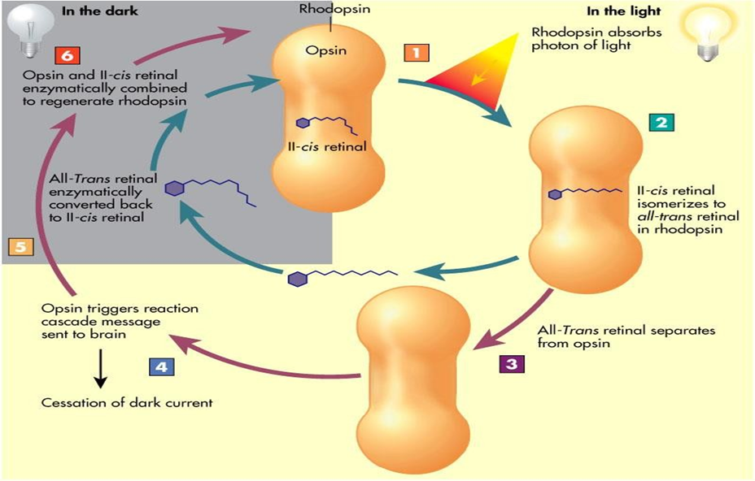
To know the visual cycle and rhodopsin regeneration
12th Lecture ∣ The Physiology Team
Photochemistry of Color Vision by the Cones
Photopsins Retinal Visual Cycle The cones are about 30 to 300 times less sensitive than rods to light
Notes:
trans-retinal

Slide 18
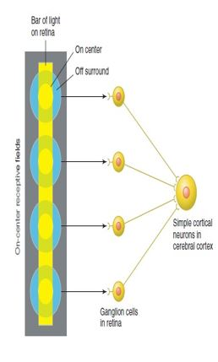
To recognize types of ganglion cells
Three Types of Retinal Ganglion Cells and Their Respective Fields (W, X, and Y cells)
1-W cells/ è sensitive for detecting directional movement in the field of vision, and they are probably important for much of our rod vision under dark conditions
2- X Cells / Transmission of the Visual Image and Color è Color Vision
3-Y Cells // to Transmit Instantaneous & rapid Changes in the Visual Image , either rapid movement or rapid change in light intensity
Convergence of ganglion cells
-The receptive field of a ganglion cell in the retina of the eye is composed of input from all of the photoreceptors which synapse with it
- A group of ganglion cells in turn forms the receptive field for a cell in the brain. This process is called convergence
12th Lecture ∣ The Physiology Team
Doctor said it is extra information*
To know the meaning of nyctalopia
NYCTALOPIA:- ( night blindness)
Vitamin A deficiency cause rods , cones & retinal degeneration & loss of rods, which are responsible for night vision.
Vitamine A (main source of retinal of rhodopsin)
اذا أهمل و لم یعالج سوف یتسبب في تدمر شبكیة العین و مستقبلات الضوء، ,ویعجز المریض عن الرؤیة في الظلام ثم حتى في النور مع تقدم الحالة.
Treatment : Intravenous vit A if receptors are well. It is not given orally because it breaks down in the GIT. IV also induces a faster effect.

Slide 19
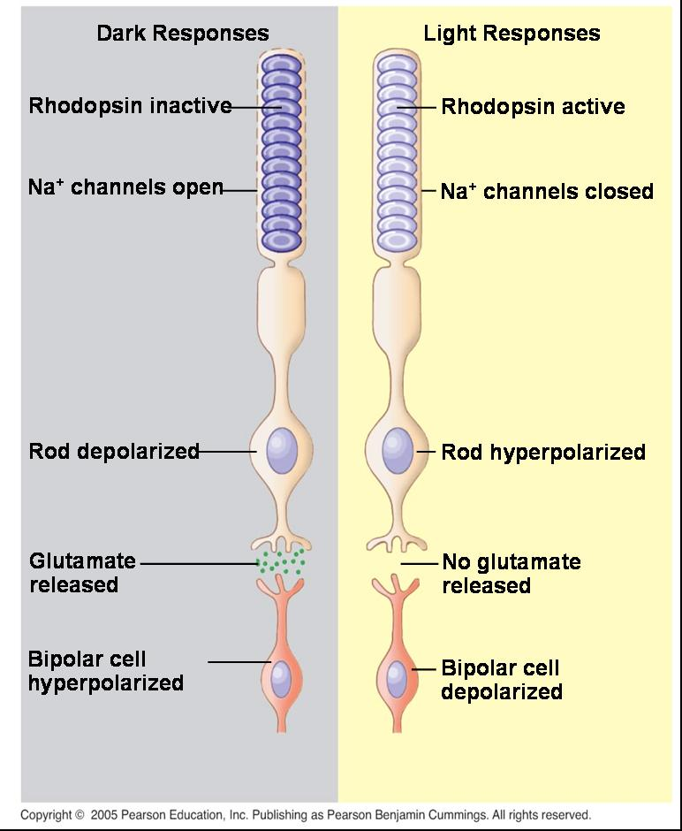
Quick review
12thLecture ∣ The Physiology Team
Outer segment of vision receptor react with light to initiate action potential.
Outer segment of vision receptor have NA channel
Inner segment of vision receptor have Na-k pump
Value of low convergence​ “advantage” increases visual acuity​ → integrated information from small​ area of retina but decreases sensitivity to light​ i.e need high threshold of illumination to stimulate cones
Value of high convergence​ “advantage” increases sensitivity to light​ iso low light threshold stimulate the rods but decreases visual acuity.
11-cisretinal form (inactive,​ but light sensitive form) which increase sensitivity of rods to light.
Photopic vision decrease intracellular C-GMP
Dark adaptation increase Rhodopsin regeneration​.Reaches max in 20 minutes (First 5 minutes → threshold of cones 5 to 20 mins → Sensitivity of rods.

Slide 20
Questions
Rhodopsin pigment is composed of opsin protein and Retinal which is:
Vitamin A derivative
Vitamin B derivative
Vitamin E derivative
Vitamin B12 derivative
2) The Na /k pump is located in :
A) Inner segment B) Outer segment C) Bipolar cells D) Ganglion cells
3) Where does the AP take place ? A) Rod B) Cons C) Ganglion cells D) Bipolar cells
4) Which neurotransmitter is going to be released at the synapse between photoreceptors and bipolar cells:
A) Glutamate B) Acetylcholine C) Dopamine D) GABA
5) As a result of Inactivation of 11-cis retinal :
A) Na channels remain closed B) Na channels keep open C) The receptors remain depolarized D) Both B & A #What is the cause of Nyctalopia? Vitamin A deficiency
# What are the advantages and disadvantages of low convergence in cone?
Advantage increases visual acuity​ .
Disadvantage decreases sensitivity to light.
#What happens to the excess retinal in the retina?
Converted back into vitamin A.
#What are the types of retinal ganglion cells and their function? Slide 17 #What happen when you move from a dark room in the house to a bright area ?light Adaptation slide 14
12th Lecture ∣ The Physiology Team
A
A
C
A
B

