Slide 1
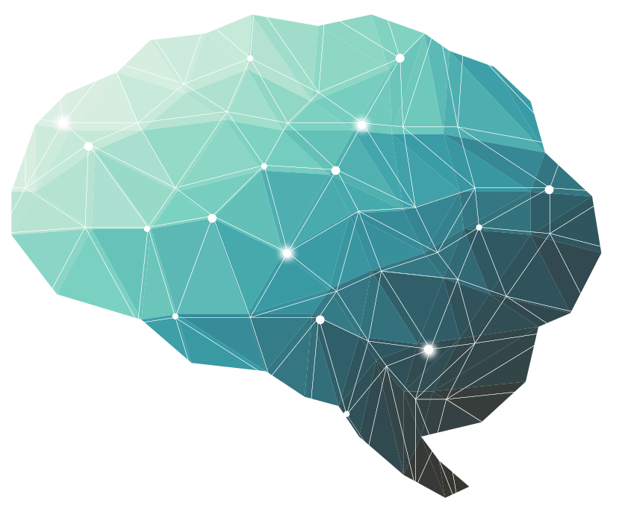
20th Lecture ∣ The Physiology Team
Physiology of consciousness
Objectives:
Define consciousness and explain the different states of consciousness .
Explain what is meant by the “ Reticular Activating System ”( RAS)
Define the location and function of the Bulboreticular Facilitatory Area .
Describe how the interaction between the Bulboreticular Facilitatory Area , Thalamus and Cerebral Cortex subserves & sustains consciousness
Explain how a medical person can differentiate between a conscious and unconscious person by means of outward behavior as and physical signs .
Describe the role of EEG and evoked potentials in differentiating between a conscious person ,a sleeping person , a comatose patient and brain dead patient
Bold & Italic objectives are included in the medical education guide
Done by :
Team leaders: Fatima Balsharaf , Rahaf Alshammari,
Abdulelah Aldossari, Ali Alammari.
Team members:
Renad AlMogren, AlFahdah AlSaleem, Ghadah Alhaidari, Hadeel Almackenzie, Moath Abdulghani, Alanoud Alessa, Ahad AlGrain
Colour index:
important
Numbers
Extra
Editing file
وَأَن لَّيْسَ لِلْإِنسَانِ إِلَّا مَا سَعَىٰ

Slide 2
Define consciousness and explain the different states of consciousness
Is the brain state in which a person is being aware of the self and surroundings. It is a product of electrical activity of the brain Meaning that a (flat EEG = unconscious).
Four levels of consciousness:
Normal consciousness:
State of normal arousal, being fully awake and aware of the self and surroundings. In general we have Two awake states: relaxed awareness and awareness with concentrated attention
Clouded consciousness:
person conscious but mentally confused e.g. in cases of drug or alcohol intoxication, High fever associated (malaria or septicemia , dementia”الجنون” , etc)
Sleep
person unconscious ( in relation to the external world & surroundings) but is arousable ( can be aroused ) .
Coma:
person unconscious and not arousable
20 th Lecture ∣ The Physiology Team

Slide 3
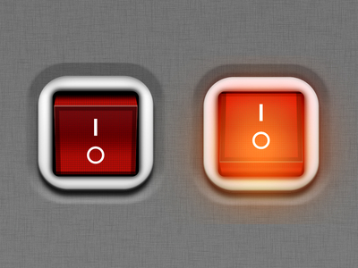
Introduction for RAS
RAS is one of the most important system in our Brain to keep us alert so let’s discuss it simply then go into details.
‏RAS : highly excitable neurons in reticular formation in brain stem that extends from spinal cord to > brain stem > thalamus > all area to cerebral cortex ‏Main function ( Arousal , consciousness , wakefulness, alerts) يعني هذا الجهاز هو اللي يخلينا مدركين للمكان والوقت والناس اللي حولنا والأحاسيس والأفكار وإلخ ... ‏
20 th Lecture ∣ The Physiology Team
what are the controls of RAS ? - sensory signals for example ( pain from face is the most strong stimulus ) after it is the proprioception sensations , visual stimulus , Etc... )‏
كيف نستخدم هذا الجهاز و يساعدنا وقت الدراسة ؟ نقرأ بصوت عالي ، نكتب ، نشوف صور ‏As much as you increase the stimuli you will increase the level of the consciousness!!
When you want to sleep you will decrease the stimulus around you : like light , cover yourself by a carpet because cold consider as stimulus , these will help you to sleep because you suppress the RAS
Sometimes even though you use all of these suppressant but you can’t sleep why?
because thinking is considered as arousal factor for activation of RAS
What are the neurotransmitter that control RAS ? ‏Sympathetic: Adrenaline, noradrenaline it’s ‏Lowering the threshold لهذا السبب لما نكون خايفين مانقدر ننام ‏Other example people who takes amphetamine to increase arousal level but this isn’t beneficial because only you will have high arousal without concentration!!! ‏In other hand : ‏Serotonin will inhibit the RAS ( that will be released by medullary RF ) it is preventing stimulation so it’s help in sleep
باختصار مثل مايقول د. نجيب هذا الجهاز عبارة عن ‏Off/ On buttons for cerebral cortex

Slide 4
Explain what is meant by the “ Reticular Activating System ”( RAS)
brain Structures involved in the conscious state:
Brain stem Reticular formation
Thalamus
Hypothalamus
Ascending projection pathways
Wide spread area in the cerebral cortex
Reticular formation (More details about RF will be in the next page here is general ) | Set of interconnected nuclei that are located throughout the brainstem (Pons, Midbrain, Upper medulla) and the thalamus Role in behavioral arousal Role in consciousness (sleep/awake cycle) Connect the brainstem to the cerebral cortex 1-Somatic motor control (Reticulospinal tracts) 2-Cardiovascular control: Through cardiac and vasomotor(constriction and dilatation) centers of the medulla. 3-Pain modulation: Pain signals from the lower body To the RF to cerebral cortex. RF is origin of the descending analgesic pathways • (act on the spinal cord”inhibitory signals” to block the transmission of some pain signals to the brain)”reduce the pain”, واحد انطعن بالشارع وعادي جالس يمشي” 4- Sleep and consciousness - The reticular formation has projections to the thalamus and cerebral cortex . It plays a central role in states of consciousness like alertness and sleep. Injury to the reticular formation can result in irreversible coma. 5- Habituation - This is a process in which the brain learns to ignore repetitive, meaningless stimuli while remaining sensitive to others. A good example of this is when a person can sleep through loud traffic in a large city, but is awakened promptly due to the sound of an alarm .
Thalamus | Located In the mid-part of the diencephalon Cholinergic projections from the thalamus are responsible for: - Activation of the cerebral cortex. - Regulation of flow of information through other thalamic nuclei to the cortex via projections into reticular nuclei. It is a relay station for impulses before reaching CC except for olfaction which goes directly to cortex
Hypothalamus | Tuberomammillary nucleus in the hypothalamus (posterior third) that contains histamine-releasing neurons projects to the cortex And is involved in maintaining the awake state
Functions of reticular formation:
20 th Lecture ∣ The Physiology Team

Slide 5
Explain what is meant by the “ Reticular Activating System ”( RAS)
In previous page we said that R.F plays a big role in the consciousness so let’s expand for more information about it
Reticular formation Consist of three parts:
Lateral Reticular Formation | Paramedics Reticular Formation | Raphe nuclei ( median RF)
Has small neurons Receives information from ascending tracts for touch and pain. Receives vestibular information from median vestibular nerve. Receives auditory information from superior olivary nucleus. Visual information from superior colliculus. Olfactory information via medial forebrain bundle olfaction can trigger memories because it is sent to RF “They initiate consciousness that's why you have to turn the lights off and sleep in comfortable place without any strong smell , to inhibit them “ | Has large cells. “​Magno​cellular nuclei”​ Receives signals from lateral reticular formation Contains: -noradrenergic (NA) Dopaminergic (DA) neurons, projects onto cerebral hemispheres. -Cholinergic (Chl) neurons project onto the thalamus | In the midline of the reticular formation Contain serotonergic projections to the brain and spinal cord“It's responsible for pain modulation”.. “Raphe is the place of synthesis of the neurotransmitter serotonin​.”
20 th Lecture ∣ The Physiology Team

Slide 6
Explain what is meant by the “ Reticular Activating System ”( RAS)
Anatomical components of RAS
The RAS is composed of several neuronal circuits connecting the brainstem to the cortex. Don’t mix between RF and RAS. RF is the tracts only
Originate in the upper brainstem reticular core and project through synaptic relays in the thalamic nuclei to the cerebral cortex
As a result, individuals with bilateral lesions of thalamic intralaminar nuclei are lethargic or drowsy
Lesion in the mid-pons -> unconsciousness, “coma due to the damage to RF”
Pons (uppers & middle) and midbrain are essential for wakefulness .
Sensory inputs to RAS
20 th Lecture ∣ The Physiology Team
Functions of RAS: notice the different between RF function & RAS function !!!
Regulating sleep-wake transitions
If inhibitory area activity increase-> reduce the activity of RAS -> less afferent signal to the CC -> sleep
2. Attention
RAS mediate transitions from relaxed wakefulness to of high attention.
3. RAS and learning
The RAS is the center of balance for the other systems involved in learning, self-control or inhibition, and motivation.
4. Provides the neural connections for processing and learning of information,
5. Selective attention (to the correct task) مثل لما تركز على التلفزیون وما تنتبه للي حولك
RAS dysfunction
If RAS is depressed: An under-aroused cortex,
Difficulty in learning,
Poor memory,
Little self-control lack of consciousness or even coma”if severe enough”.
If the RAS is too excited (like ADHD):
Over aroused cortex
Hyper-vigilance (sensory sensitivity ) Touching everything Talking too much Restless
Hyperactive

Slide 7
Define the location and function of the Bulboreticular Facilitatory Area .
Describe how the interaction between the Bulboreticular Facilitatory Area Thalamus and Cerebral Cortex subserves & sustains consciousness
Bulboreticular Facilitory (Excitatory):
Is Reticular Excitatory Area of the Brain Stem sends excitatory signals into Thalamus >>>> thalamus excites almost all areas of the cortex.
The Bulboreticular Facilitatory (Excitatory) Area + Thalamus = Reticular Activating System (RAS).
The RAS is the system which keeps our cortex awake and conscious.
Please note: Bulboreticular = reticulospinal tract.
Extra (Guyton):
20th Lecture ∣ The Physiology Team
This picture shows a general system for controlling the activity level of the brain. The central driving component of this system is an excitatory area located in the reticular substance of the pons and mesencephalon. مهمه!!
This area is also known by the name bulboreticular facilitatory area. it is the same brain stem reticular area that transmits facilitatory signals down- ward to the spinal cord to maintain tone in the antigravity muscles and to control levels of activity of the spinal cord reflexes. In addition to these downward signals, this area also sends a profusion of signals in the upward direction. Most of these signals go first to the thalamus, where they excite a different set of neurons that transmit nerve signals to all regions of the cerebral cortex, as well as to multiple subcortical areas. the signals passing through the thalamus are of two types. One type is rapidly transmitted action potentials that excite the cerebrum for only a few milliseconds.these signals originate from large neuronal cell bodies that lie throughout the brain stem reticular area. Their nerve endings release the neurotransmitter acetylcholine, which serves as an excitatory agent that lasts for only a few milliseconds before it is destroyed. the second type of excitatory signal originates from large numbers of small neurons spread throughout the brain stem reticular excitatory area. Again, most of these signals pass to the thalamus, but this time through small, slowly conducting fibers that synapse mainly in the intralaminar nuclei of the thalamus and in the reticular nuclei over the surface of the thalamus. From here, additional small fibers are distributed throughout the cerebral cortex. The excitatory effect caused by this system of fibers can build up progressively for many seconds to a minute or more, which suggests that its signals are especially important for controlling the longer term background excitability level of the brain.

Slide 8
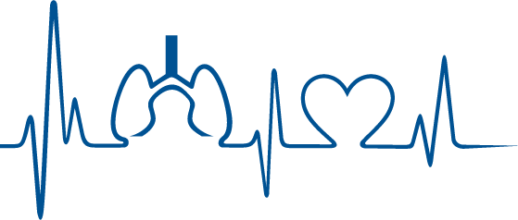
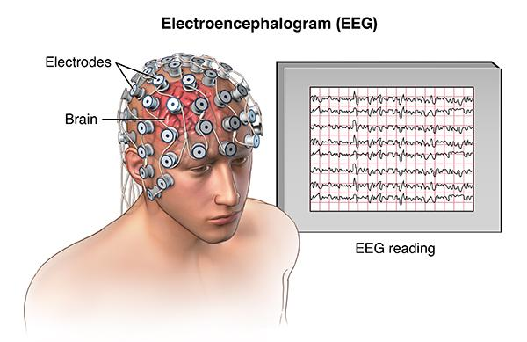
Explain how a medical person can differentiate between a conscious & unconscious person by means of outward behavior as and physical signs .
Indices of Level of Consciousness
Appearance & Behavior:
Posture (sitting, standing?)
Open eyes?
Facial expression? “معصب، يضحك؟”
Responds to stimuli (including the examiner’s questions about name, orientation in time and place? And other general questions like who is the president?)
Vital signs:
Pulse, BP, respiration, pupils, reflexes, particularly brainstem reflexes, etc.
EEG:
Each of these states (wakefulness, sleep, coma and death) has specific EEG patterns.
Evoked potentials:
(in cases of Brain Death). “Shows in the EEG” This potential is activated by a stimulus whether it’s auditory or visual (brainstem reflexes).
Extra ganong :What is evoked potential ? The electrical events that occur in the cortex after stimulation of a sense organ can be monitored with an exploring electrode connected to another electrode at an indifferent point some distance away.
20th Lecture ∣ The Physiology Team

Slide 9
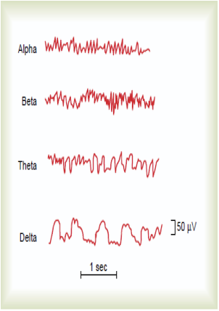
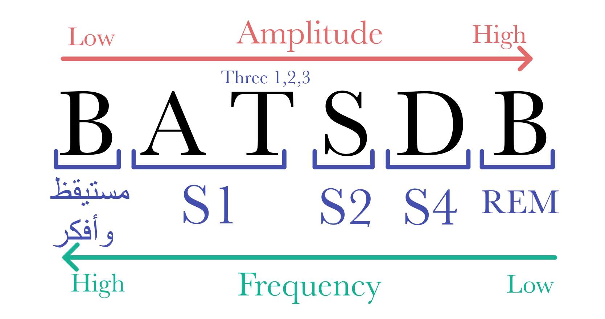
Describe the role of EEG and evoked potentials in differentiating between a conscious person ,a sleeping person ,a comatose patient and brain dead patient
Waveforms | Recorded From | Description | Frequency
Alpha | Recorded from the parietal and occipital regions. A: ارتاح | Awake and relaxed and eyes closed. الشخص في حالة استرخاء أو "بریك" بعد إكمال مهمة | 10 to 12 cycles/second.
Beta | Frontal lobes. بركز :B | Produced by visual stimuli and mental activity. شخص یلقي خطاب أو الدماغ فيه له نشاط | 13 to 25 cycles per second. Fastest
Theta | Temporal and occipital. | Normal in newborn. Theta waves in adults indicates severe emotional stress. | 5 to 8 cycles/second.
Delta | From the cerebral cortex. | Sleep (adults) and in an awake infant. In an awake adult indicates brain damage.”فاتح عينه” ”note that theta and delta waves are normal in awake newborns” | 1 to 5 cycles/second. “slowest”
20th Lecture ∣ The Physiology Team
To make it easier (mnemonic):
At night BATS Drink Blood:
B= Beta Wave (Conscious, full awake).
A= Alpha Wave
T= Theta (It starts with the letter T, so it can be found in these Three Stages (1,2,3)).
S= Sleep Spindle.
D= Delta Wave.
B= Beta Wave in REM Sleep.
Note: in the mnemonic the frequency starts from high to low (decreases), but the amplitude is the opposite, it starts from low to high (increases). (See arrows)

Slide 10
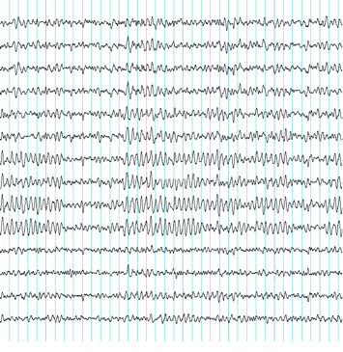
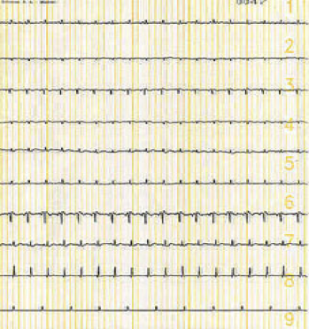
Describe the role of EEG and evoked potentials in differentiating between a conscious person ,a sleeping person , a comatose patient and brain dead patient
20 th Lecture ∣ The Physiology Team
Normal EEG (at normal magnification)
Brain Death (Flat EEG, at very high magnification)

Slide 11
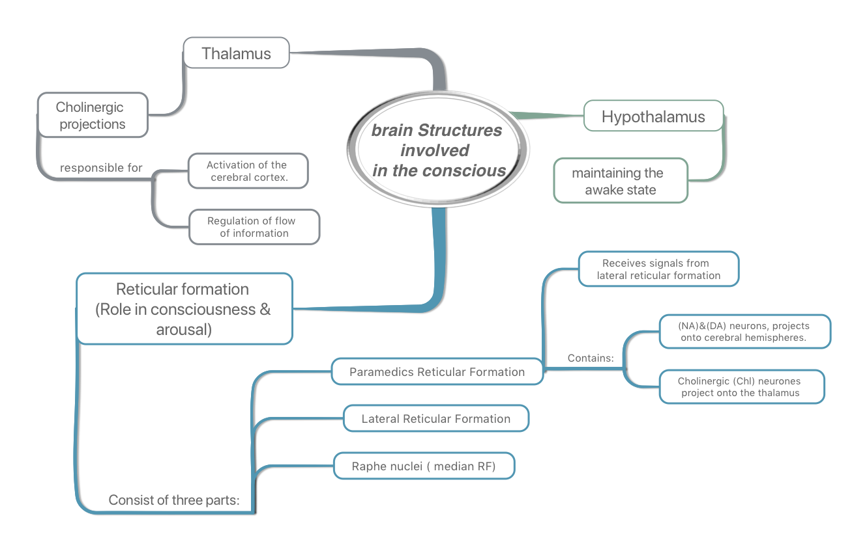
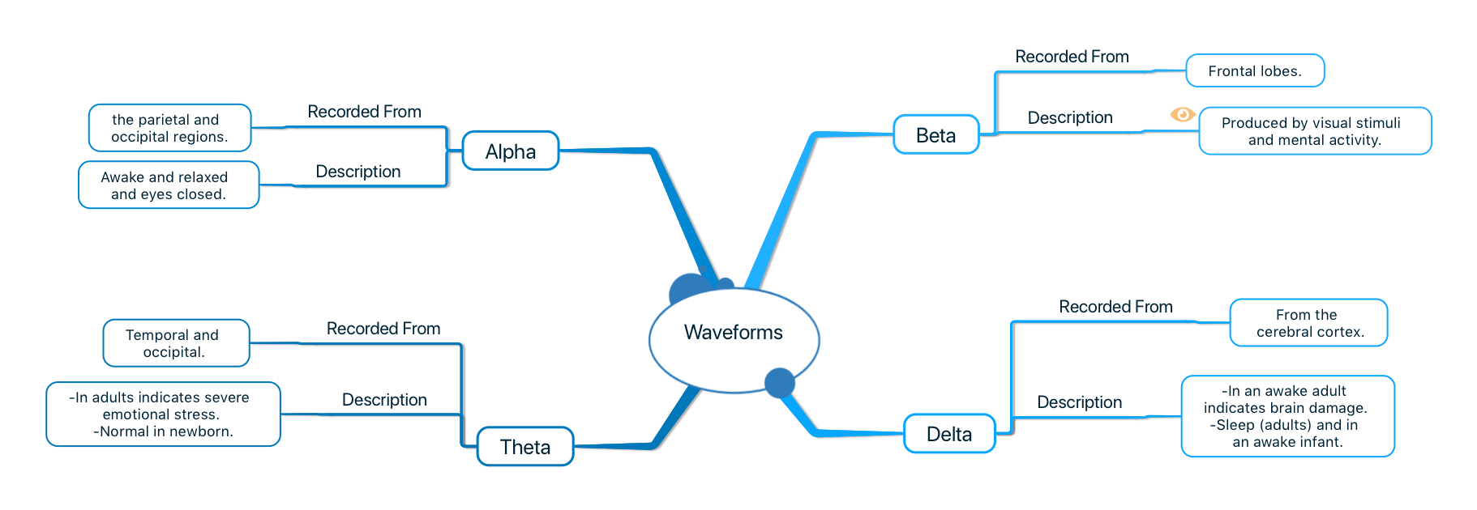
Quick review
levels of consciousness
Normal consciousness | Clouded consciousness | Sleep | Coma
being fully awake and aware of the self and surroundings.
person unconscious and not arousable
person conscious but mentally confused
person unconscious but can be aroused .
20 th Lecture ∣ The Physiology Team
The Bulboreticular Facilitory (Excitatory) Area + Thalamus = Reticular Activating System (RAS).
Function of RAS is Regulating sleep-wake transitions
Pons (uppers & middle) and midbrain are essential for wakefulness .

Slide 12
Questions
MCQs
1.Waves seen from the Parietal and Occipital regions with 10-12 cycles/second are:
Beta waves
Theta waves
Delta waves
Alpha waves
2.Someone who’s restless, hyperactive, and has no selective attention would be suffering from under-aroused cortex.
True
False
3. Regulating sleep-wake transitions, attention, learning are functions of which structure?
RAS
Spinal cord
Reticular formation
Hypothalamus
4. Thalamus, RF, cerebral cortex, hypothalamus and descending pathways are all involved in the conscious state.
True
False
5.A patient with bilateral lesions of thalamic intralaminar nuclei would be:
Fully awake
Lethargic
Unconscious but can be aroused
Unconscious and can’t be aroused
SAQ
6. In order to evaluate the patient’s level of consciousness we should look for:
7. What are the structures that make the Reticular Activating System?
8. Describe the type of waves that would be seen in an adult suffering from severe emotional stress.
9. What kinds of neurons does the Paramedian RF contain?
10. A 30 year old male came into the ER swaying and his speech was slurred. It became clear that he has alcohol intoxication, in which state of consciousness would he be in?
20 th Lecture ∣ The Physiology Team
Answers:
1.D
2.B
3.A
4.B
5.B
6.Appearance & behaviour, vital signs, perform EEG, evoked potentials.
7. The bulboreticular facilitatory area+Thalamus.
8. Theta waves, seen in the Temporal and Occipital regions, 5-8cycles/sec.
9. Noradrenergic, Dopaminergic and Cholinergic.
10. Clouded consciousness, conscious but mentally confused.

