Slide 1
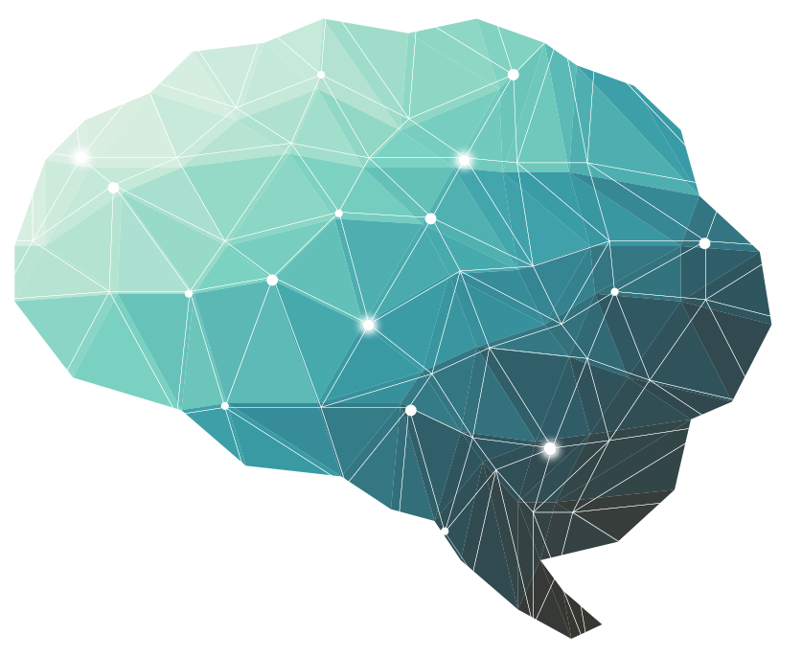
16th Lecture ∣ The Physiology Team
Inner ear in balance and equilibrium
Objectives:
Understand the sensory apparatus of the inner ear that helps the body maintain its postural equilibrium.
The mechanism of the vestibular system for coordinating the position of the head and the movement of the eyes.
The function of semicircular canals (rotational movements, angular acceleration).
The function of the utricle and saccule within the vestibule (respond to changes in the position of the head with respect to gravity (linear acceleration).
The connection between the vestibular system and other structure (eye, cerebellum, brain stem)
Done by :
Team leader: Rahaf AlShammari, Fatima Balsharf, Abdulelah AlDossari, Ali AlAmmari.
Team members: Abdullah AlSergani, Faisal AlTahan, Hisham AlShaya, Saif AlMeshari, Reem AlQarni, Shahad AlZahrani.
Colour index:
Important
Numbers
Extra
وَأَن لَّيْسَ لِلْإِنسَانِ إِلَّا مَا سَعَىٰ

Slide 2
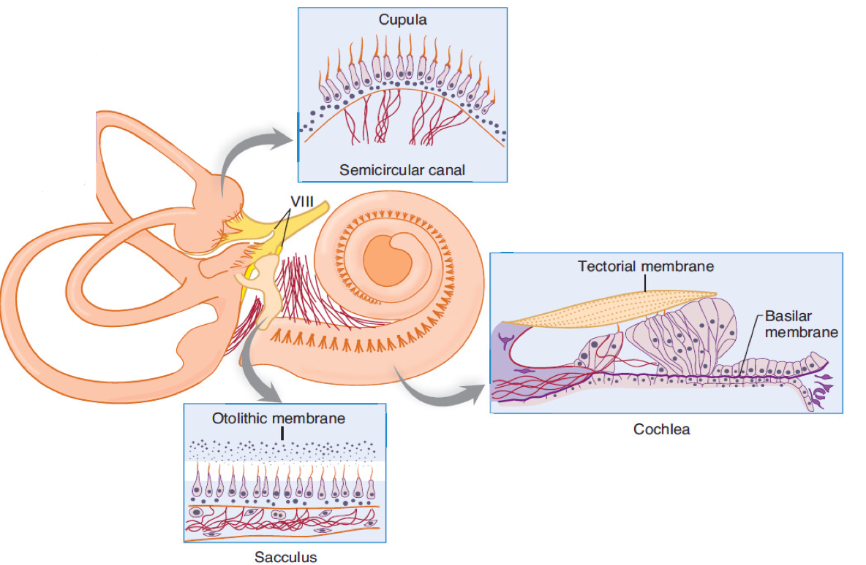
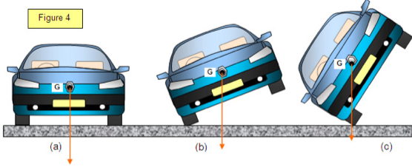
Overview of proprioception and balance
Static equilibrium
Utricle & Saccule
Static position sense (la)
Vestibular apparatus
Linear acceleration
Horizontal (Utricle)
Dynamic position sense (ll)
Chest wall proprioceptors
Equilibrium
Proprioception
Linear acceleration
Vertical (Saccule)
Neck proprioception
Air pressure against body
Angular acceleration
(SCCs)
Visual information (vestibulo ocular)
Footpads pressure
Predictive function
(SCCs)
Labyrinth components
Cochlea (organ of corti containing receptors for hearing)
Semicircular canals (Crista ampullaris containing receptors that respond to head rotation)
Utricle & Saccule (Macula contain otolith organs and receptors that respond to gravity and head tilt).
To balance the center of gravity must be above the support point at which the weight is evenly dispersed.

Slide 3
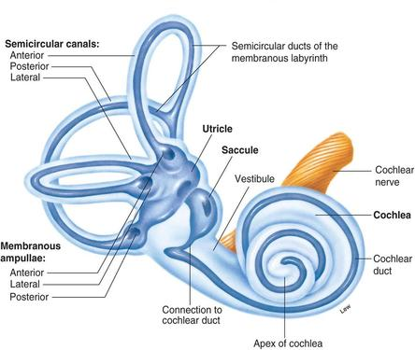
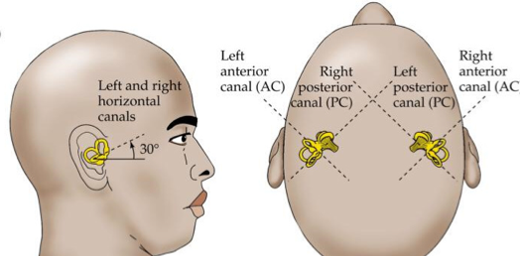
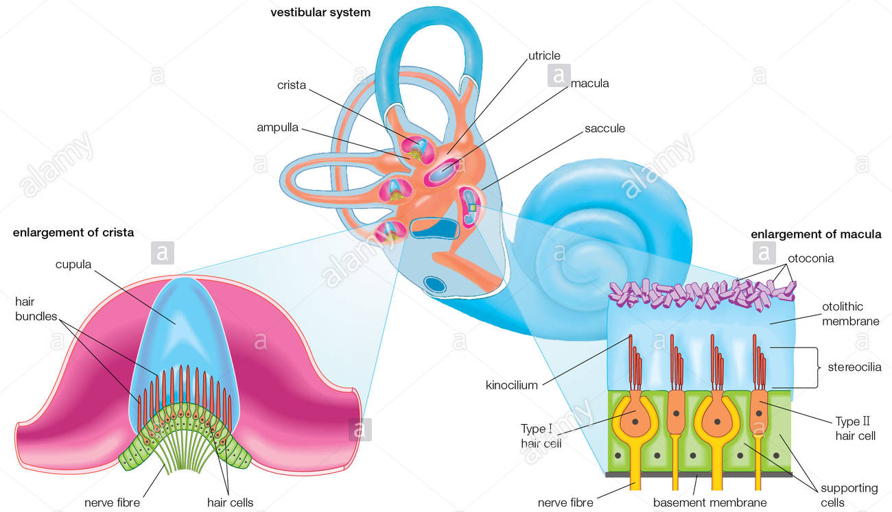
Balance and Equilibrium
Balance is the ability to maintain the equilibrium of the body.
Foot position affects standing balance.
Equilibrium is the state of a body or physical system at rest for in un accelerated motion in which the resultant of all forces acting on it is zero and the sum of all torques about any access is zero.
There are 2 types of Equilibrium:
Static Equilibrium
Dynamic Equilibrium
Keep the body in a desired position.
The Equilibrium is maintained in a Fixed position, usually while stood on one foot or maintenance of body posture relative to gravity while the body is still.
To move the body in a controlled way.
The Equilibrium must be maintained while performing a task which involves movement e.g. walking the beam - maintenance of the body posture (mainly the head) in response to sudden movements. Tracking a moving object.
Control of Equilibrium
Sensory inputs from:
Vestibular system
.Visual system
Proprioceptive system
Cutaneous sensations
Vestibular labyrinth
How is the SCCs are arranged?
Posterior canal shares plane with contralateral anterior canal.
Horizontal canals share plane.
Vestibular apparatus
Components: Three SCCs:
Anterior (superior)
Posterior (inferior)
Lateral
Vestibule (Utricle & Saccule).
Vestibular nerve and nuclei.

Slide 4
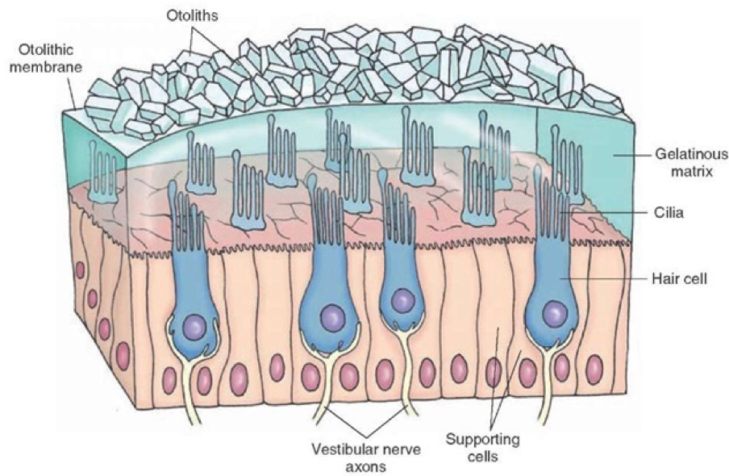
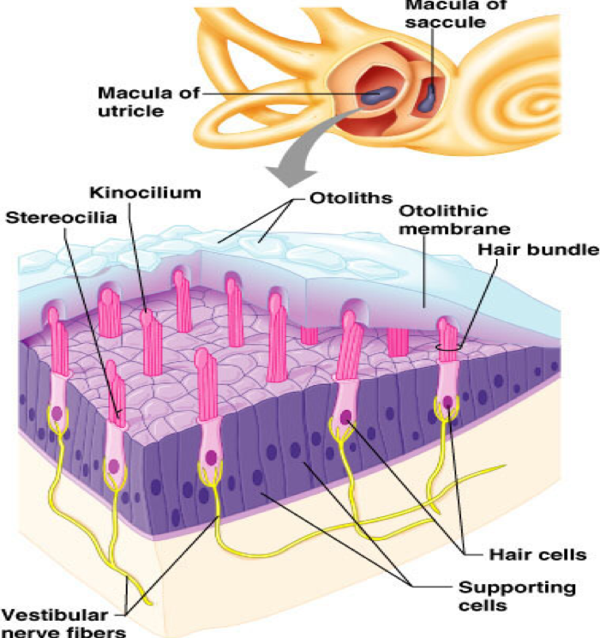
Maintaining Equilibrium
Semicircular canals (Ant. , post. , lat.) | Vestibule (Saccule & utricle)
Crista ampullaris Hair cells in each crista are oriented in the same direction Dynamic equilibrium and angular motion | Maculae Hair cells in each macula are oriented in all direction Otoliths (calcified carbonate crystals) Static equilibrium and linear acceleration
Macula (otolith organs) of utricle and saccule
hair cell synapse with endings of the vestibular nerve.
Hair cell has 30-150 (stereocilia) and one large cilium called (kinocilium)
Both connected with thin filamentous attachments”tip link”
All cilium membrane has positive potassium channels
Otolithes ( statoconia) of calcium carbonate suspended in gelatinous material.
Macula of utricle is IN horizontal plane if the head is vertical , so cilia point upwards
Stimulated when the head bends forward & backward & laterally

Slide 5
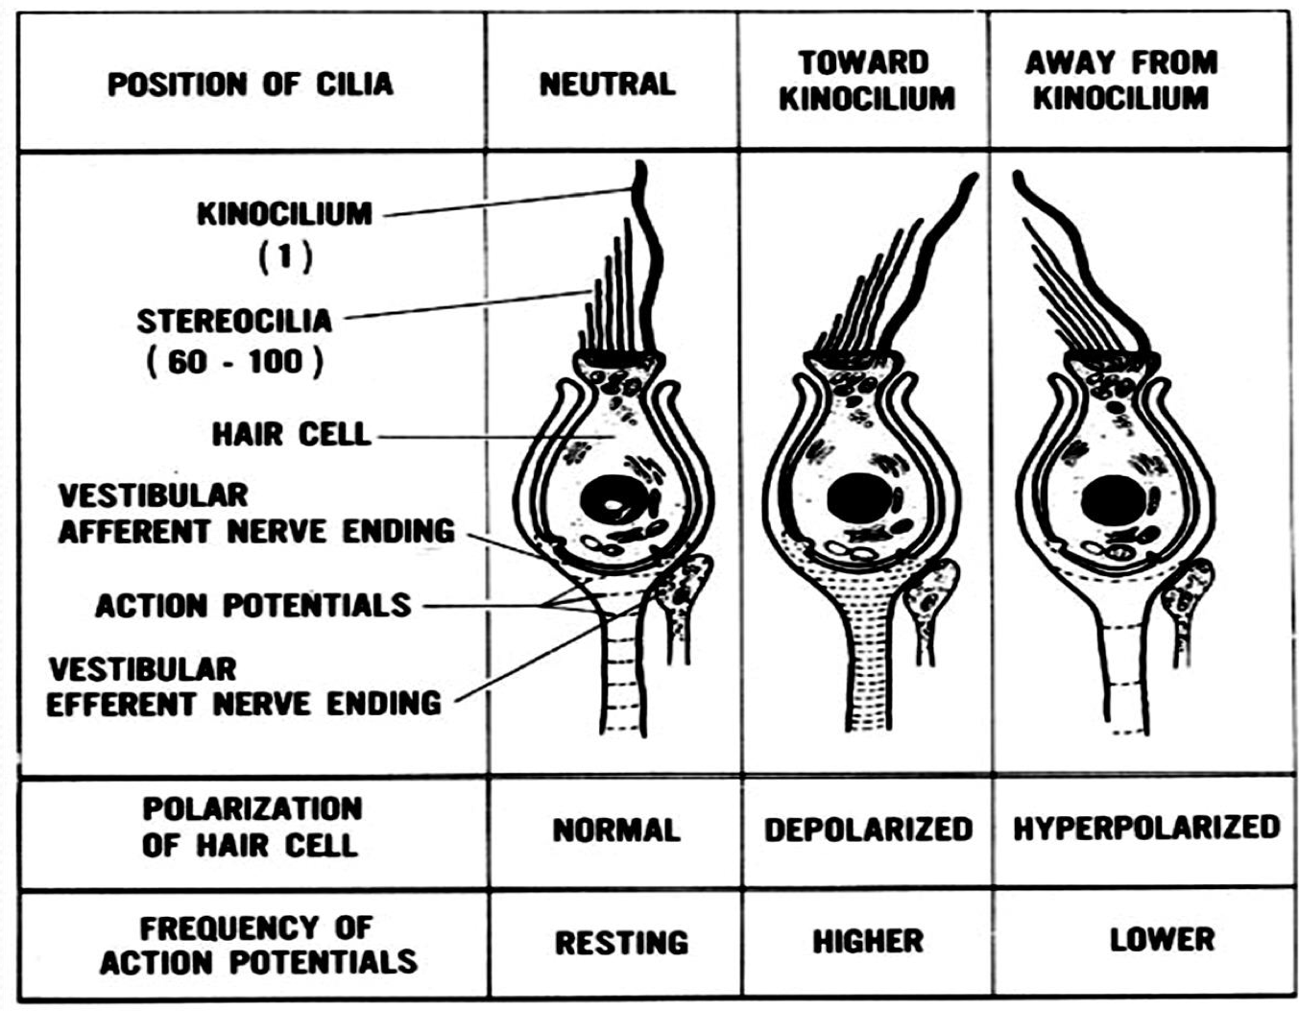
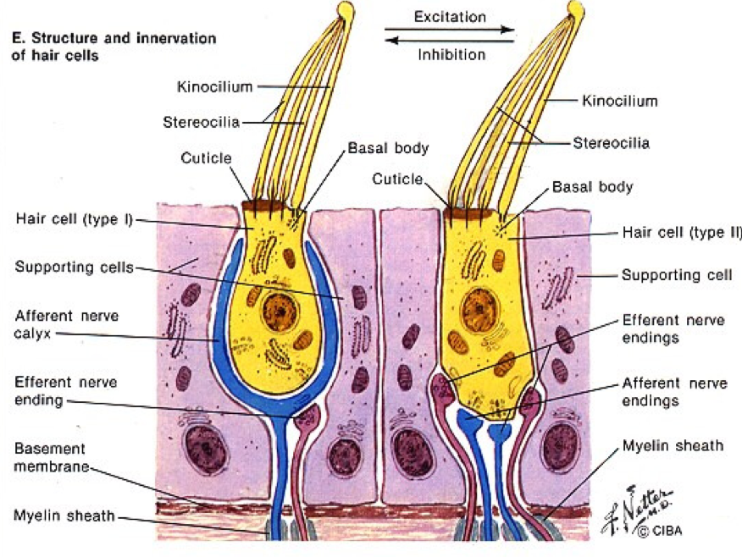
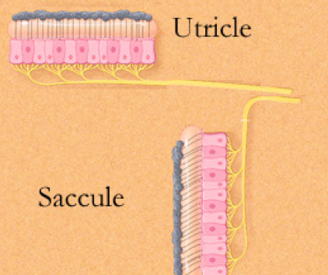
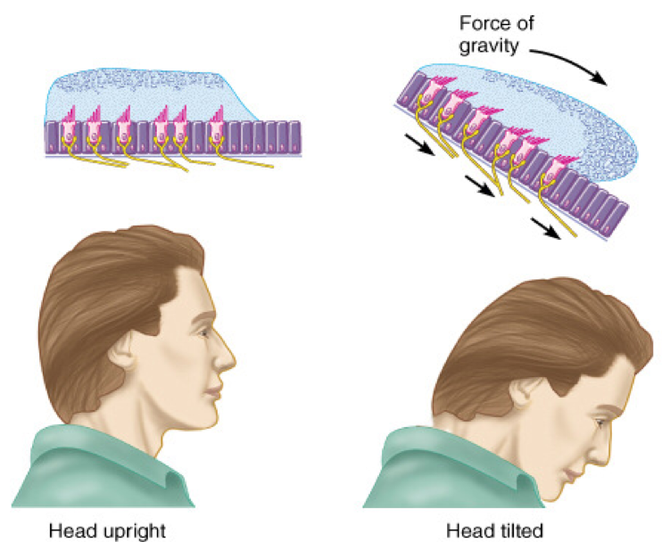
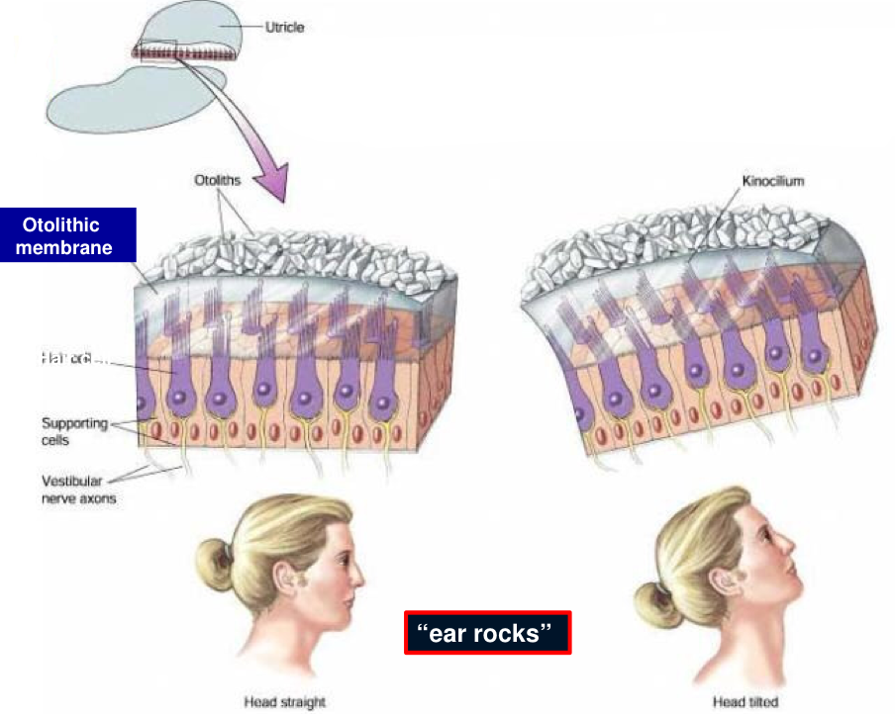
Hair cells in utricle | Hair cells in Saccule
Person in upright position: (Head vertical) | Person in upright position: (Head vertical)
Macula in horizontal plane | Macula in vertical plane
Hairs pointing upwards | Hairs pointing laterally
Hair cells signal head movements in any direction | Hair cells operate when one is lying down
Inform the brain of orientation of head in space
Utricle maculae defect > horizontal acceleration | Saccular maculae defect > vertical acceleration
In macula: hair cells are oriented in different direction and tilt of head in any direction is signaled.
Anatomy: Maculae of Utricle or Saccule
Physiology: Linear acceleration of head

Slide 6
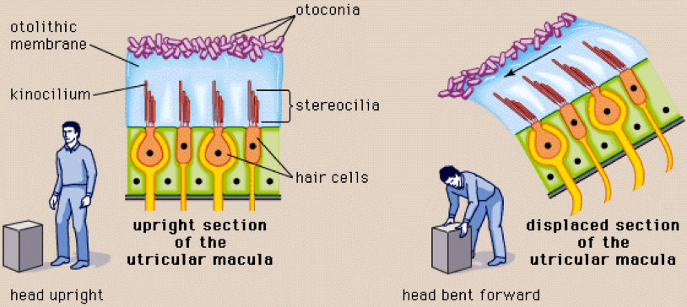
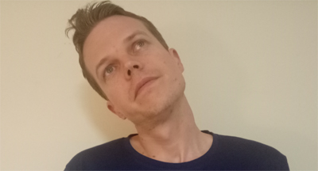
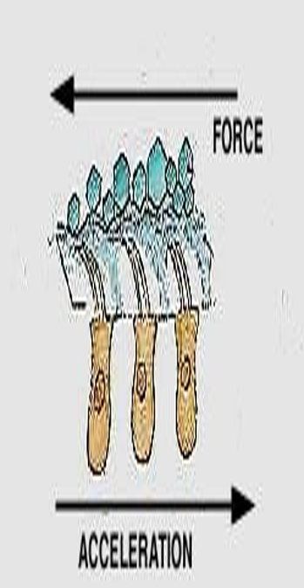
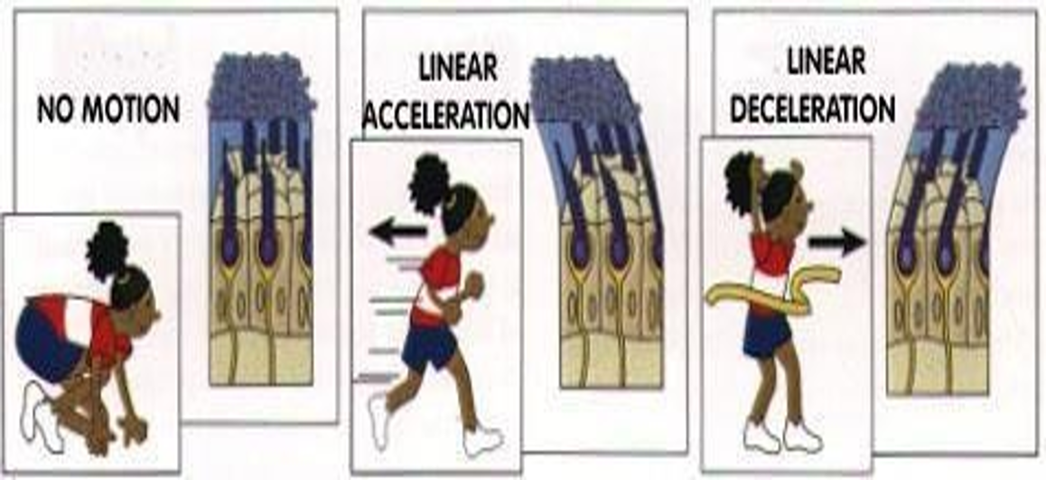
The two maculae, the utricle and saccule, are oriented in the horizontal and vertical planes and tell us how we are aligned relative to gravity.
Functions of macula (mainly the utricle)
Orientation of head in space & maintenance of static equilibrium :
In erect upright position ( Vertical position واقف ) :
RT & LT utricle impulses balance each other
NO sensation of male-equilibrium
B. Bending head to one side :
Statoconia crystals of hair cells fall to that
Side by their weight → Pulls stereocilia to
Move towards kinocilium → Depolarization (stimulation) occurs
Stereocilia of the other side moves away from kinocilium →Hyperpolarization (inhibition) occurs
2. Detection of linear acceleration :
Linear acceleration : As if you are running & standing in a bus
At the beginning of movement statoconia lag behind by its inertia (القصور الذاتي ) → Falls backwards → Cillia then moves backward → Person will feel he/she is falling backwards → Will try to correct this by leaning forward to shift statoconia & cillia anteriorly.
At deceleration (runner try to stop) → statoconia moves forward by its momentum → Person will feel as if he/she is falling anteriorly.

Slide 7
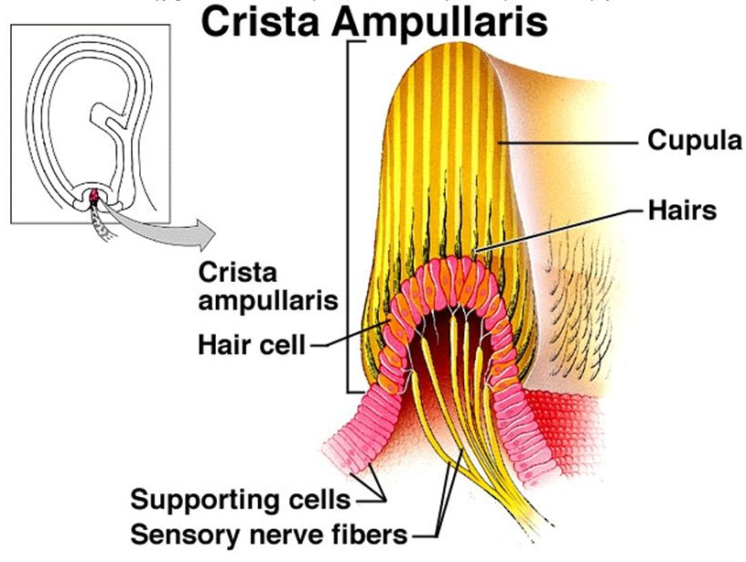
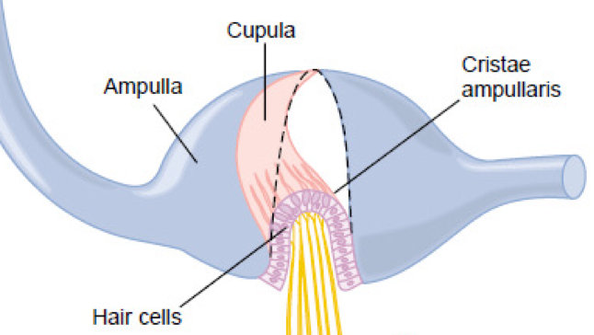
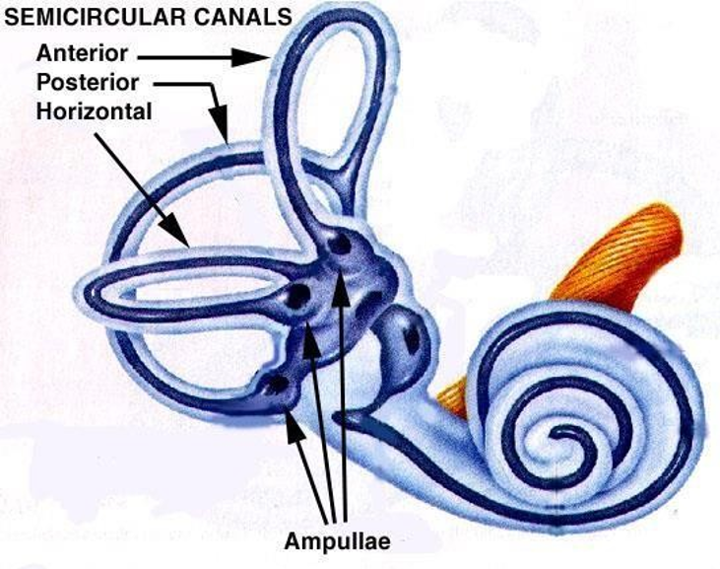
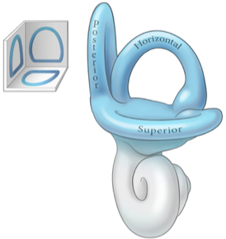
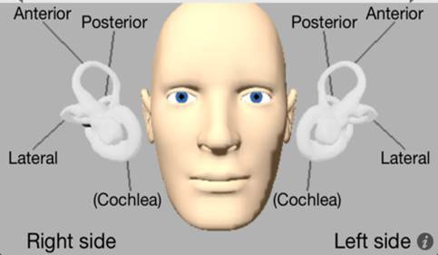
Semicircular canals
Horizontal ( Lateral ) semicircular canal
Anterior semicircular canal
Posterior semicircular canal
They are perpendicular to each other
Filled with endolymph
Dilated end of each canal is called Ampulla (as macula) , cilia is embedded in a gelatinous mass called Cupula
Sensory organ: Crista ampullaris
Detects angular changes
Hair cells: oriented in same direction unlike macula
Function of Semicircular duct system
in maintenance of equilibrium
SCCs detect ANGULAR ACCELERATION:
the beginning of rotation
End of rotation
Changes in rate of rotation (e.g. Joy riding)
& predictive function SCCs
Predict ahead of time that mal-equilibrium is going to occur -> send impulses to CNS for corrective measures before the start of all the fall.
The maculae of the utricle and saccule can’t detect that the person is off balance in angular acceleration until after the loss of balance has occurred.

Slide 8
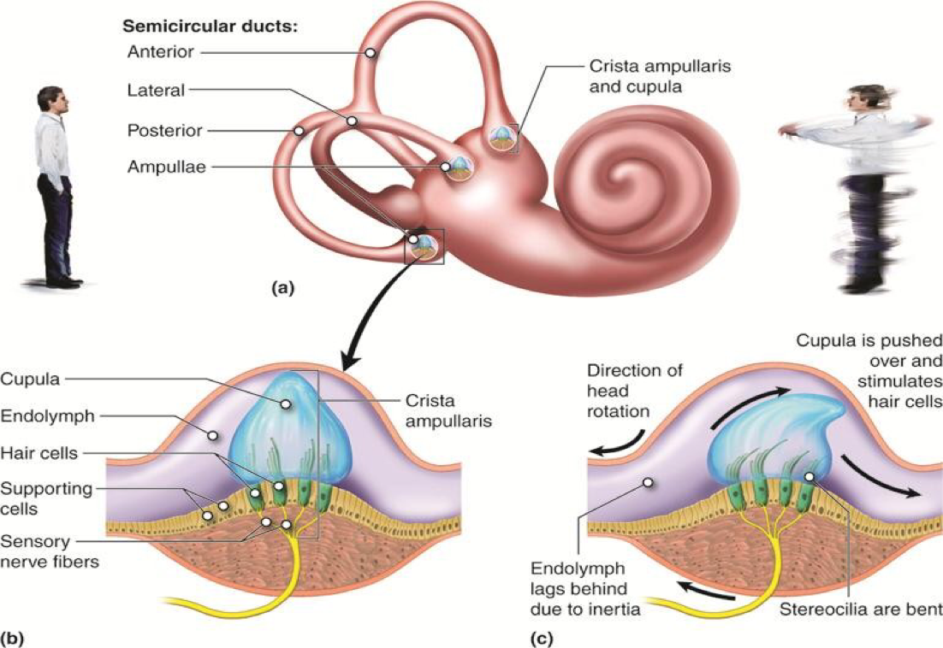
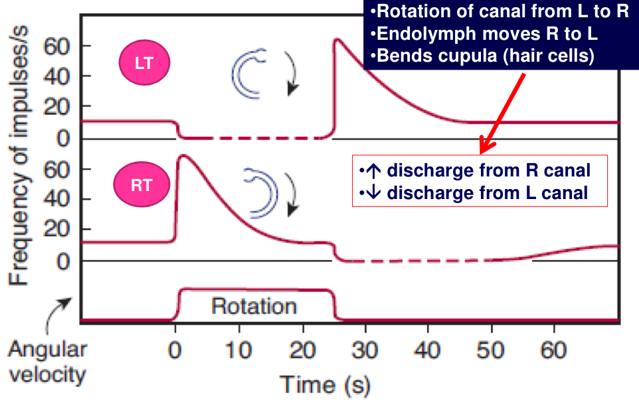
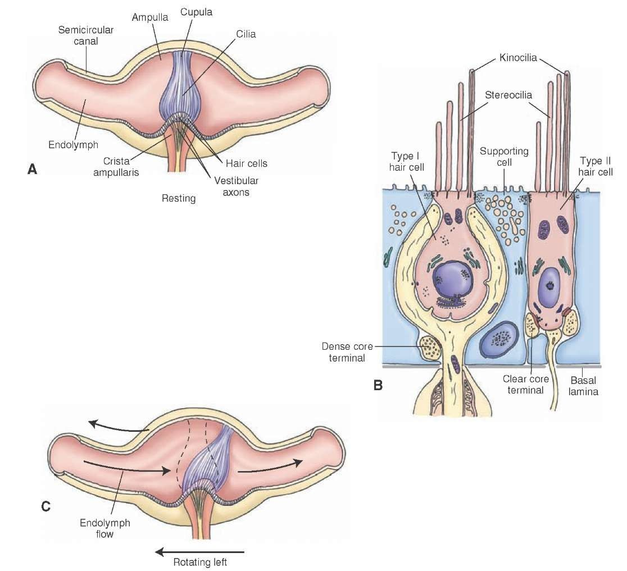
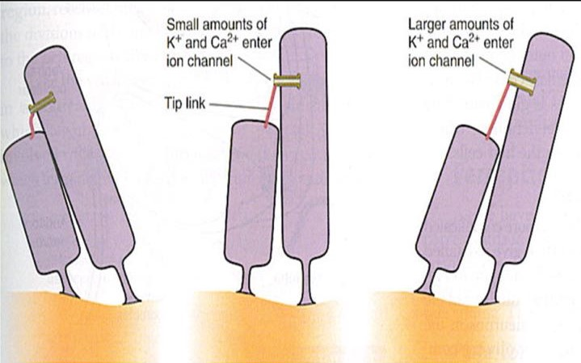
Plane of rotation determines the canal to be stimulated
Rotation of head on vertical axis > horizontal.
Lateral movement of head (AP axis) (approximate head to shoulder) > posterior.
Anterolateral or posterolateral head movement (oblique axis) > superior.
Angular (rotational) acceleration
Movement of endolymph → bending of hairs (opposite on two sides) → opposite discharge from two sides → Sensation of rotation in CSN
As rotation continues endolymph will soon rotate in the same direction (& speed) as the SCC → capsule being elastic returns to resting position → discharge from both sides returns to resting level.
No sensation of rotation as long as eyes are closed.
While stretching (Ca in, K out)
Stereocilium is pushed toward a taller one, the tip link is stretched and opens an ion channel in its taller neighbor.
Channel moves down by molecular motor and release tension.

Slide 9
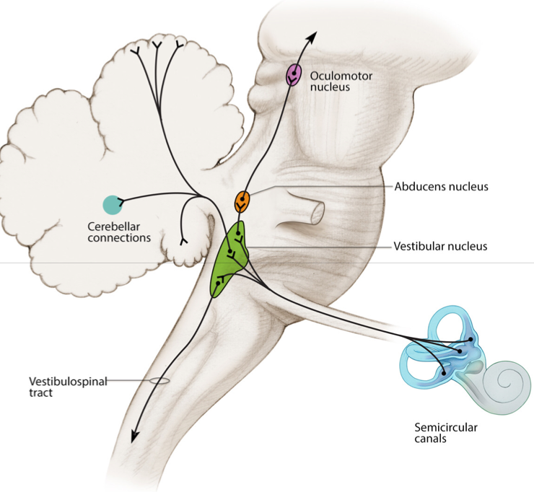
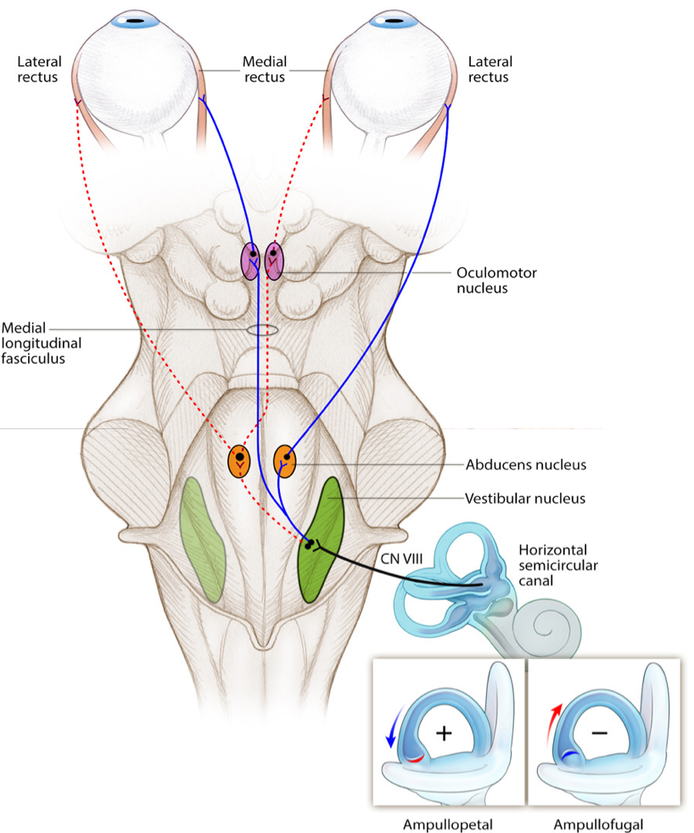
VESTIBULAR PATHWAY
Neural Connections:
●The vestibular nuclei on either sides of the brain stem send signal to:
●Cerebellum.
●Nuclei of cranial nerves III, IV, and VI
●Reticular formation (spinal cord)*
●Spinal cord (vestibulospinal tracts)*
●Thalamus
*impulses maintain equilibrium i.e. facilitate or inhibition the stretch reflex (regulate muscle tone)
Testing vestibular system
Calorie test
The semicircular canals are stimulated by instilling warm (40º C) or cold (30º C) water into the external auditory meatus.
The temperature difference sets up convection currents in the endolymph, with consequent motion of the cupula.
In healthy subjects, warm water causes nystagmus that bears toward the stimulus, whereas cold water includes nystagmus that bears toward the opposite ear.
Mnemonic COWS (Cold water nystagmus is Opposite sides, Warm water nystagmus is Same side).
In the case of unilateral lesion in the vestibular pathway, nystagmus is reduced or absent on the side of lesion.
Rotation test
To avoid nystagmus, vertigo and nausea when irrigating the ear canals in the treatment of ear infections, it is important to be sure that the fluid used is at body temperature.

Slide 10
Vestibular disorders (motion sickness)
Clinical signs:
Vertigo: feeling of rotation when body is not.
Nystagmus
Clinical signs:
Nausea
Sweating
Vomiting
Hypotension
Bradycardia
Vestibular disorders
Benign paroxysmal positional vertigo (BPPV)
Meniere disease
Otoconia from the Utricle separate from otolith membrane and become lodged in the canal or cupula of the SCC.
Canalith repositioning
Abnormality of the inner ear causing vertigo or severe dizziness, tinnitus, fluctuating hearing loss & the sensation of pressure or pain in the affected ear lasting several hours.
Labyrinthine sedative (Meclizine)
Motion sickness
Space motion sickness
Produced by excessive vestibular stimulation.
(In astronauts) develops when they are first exposed to microgravity and often wears off after a few days of spacing flight. Due to mismatches in neural input from vestibular apparatus and other gravity sensors.
Antihistamines or scopolamine, a cholinergic muscarinic receptor antagonist.

Slide 11
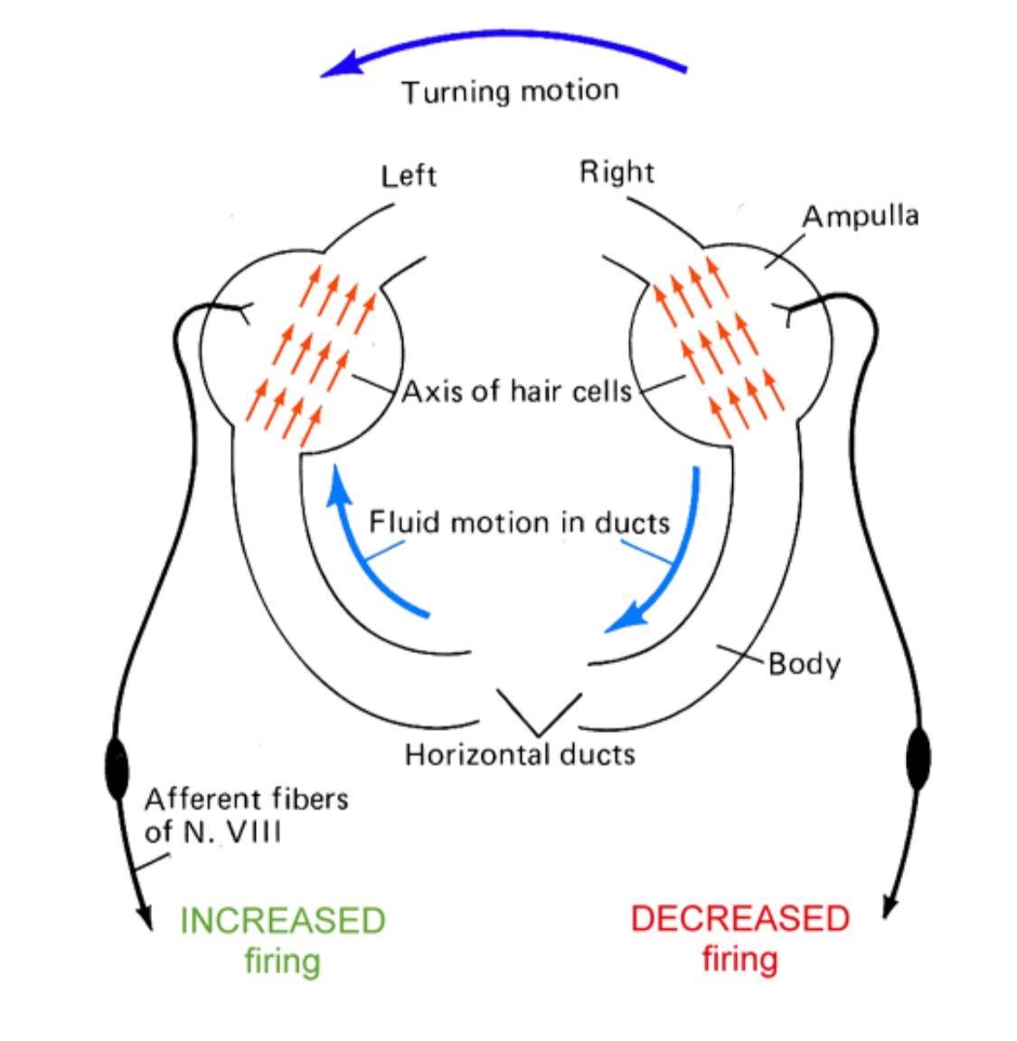
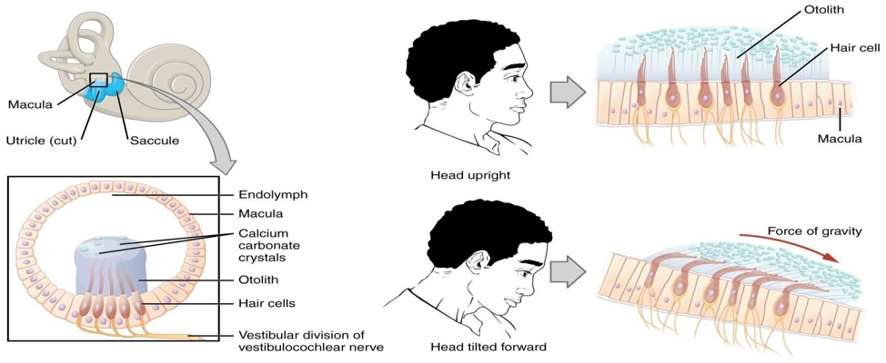
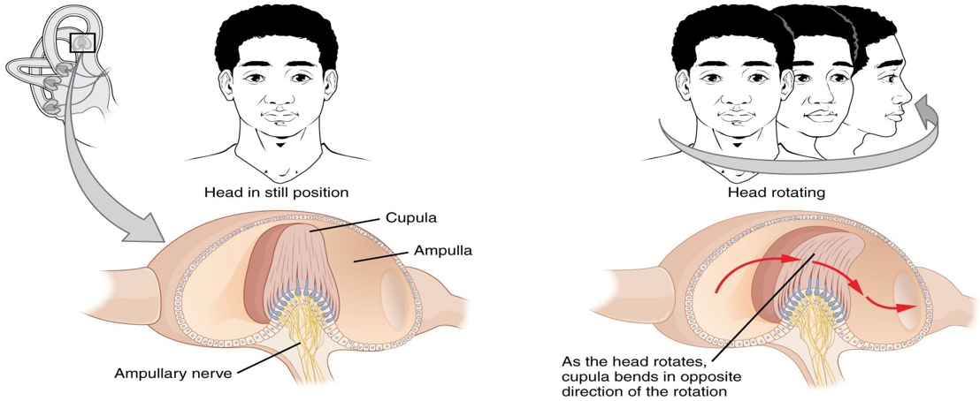
Important notes from Dr. Shahid:
Sensory organ of cochlea is known as Organ of corti.
Sensory organ of SSCs is known as Crista ampullaris
Center of gravity is where all the forces are concentrated.
The resting membrane potential for hair cells is -60 mV.
Extra pic. To understand

Slide 12
Summary
Cochlea | (organ of corti containing receptors for hearing)
Semicircular canals | (Crista ampullaris containing receptors that respond to head rotation) Arrangement: Posterior canal shares plane with contralateral anterior canal. Horizontal canals share plane Sensory organ: Crista ampullaris Hair cells: oriented in same direction unlike macula Function: SCCs detect ANGULAR ACCELERATION: the beginning of rotation End of rotation Changes in rate of rotation
Utricle & Saccule | (Macula contain otolith organs and receptors that respond to gravity and head tilt).

Slide 13
Questions
1.Which one of the following is a sensory organ that respond to gravity and head tilt?
Organ of corti
Crista ampullaris
maculla
Tectorial membrane
2.Which one of the following structure in the vestibular apparatus is responsible for the detection of angular acceleration ?
Macula
Semicircular canal
Saccule
Ampullae
3.Which one of the following is responsible of static equilibrium ?
Vestibule
Semicircular canal
Ampullae
cochlea
4.Which one of the following structures is maximally sensitive to linear head movement in the vertical line ?
Macula of the utricle
Macula of the saccule
Crista ampullaris of the anterior semicircular canal
Crista ampullaris of the horizontal semicircular canal
5.Which one of the following structure detect rotation of the lateral movement of the head “anterior-posterior axis”?
Utricle
Anterior semicircular canal
Posterior semicircular canal
Horizontal semicircular canal
6.All the hair cells in the crista ampullaris of the horizontal semicircular duct have their stereocilia and kinocilium oriented according to which of the following patterns?
Random pattern with progression from short to tall stereocilia such that the shortest is adjacent to the kinocilium
Same pattern with progressive decrease in length of stereocilia from tallest to shortest, with the shortest located adjacent to the kinocilium
Random pattern with random distribution of stereocilia of various lengths
Same pattern with progressive increase in length of stereocilia from shortest to tallest with the tallest located adjacent to the kinocilium
7.Which one of the following is an effect of the semicircular canal in rotation?
Hypertension
Tachycardia
Vertigo
Decrease muscle tone in the same side of the rotation and increase muscle tone in the opposite site
8.Which one of the following disorder is produced by excessive vestibular stimulation?
Meniere disease
Motion sickness
Deafness
Ataxia

Slide 14
Questions
9.Which statement concerning the transduction mechanism in vestibular hair cells is correct?
Movement that bends the stereocilia away from the kinocilium has a depolarizing in influence on the hair cell
The attachment of the stereocilia to the kinocilium is such that it activates voltage gated sodium channels in the membrane of the kinocilium
Depolarization of the hair cell is achieved by inward movement of sodium from the endolymph
Deflection of the cupula such that stereocilia move toward the kinocilium causes the hair cell to depolarize
10.Which one of the following happens when a person rotates toward the right?
The endolymph in the left and the right horizontal SCC moves in the same direction.
The stereocilia on the hair cell in the right posterior SCC bend inward the kinocilium.
The hair cells in the right horizontal SCC become depolarized.
The hair cells in the left posterior SCC become hyperpolarized.
Answers:
1.C
2.B
3.A
4.B
5.C
6.D
7.C
8.B
9.D
10.C

