Slide 1
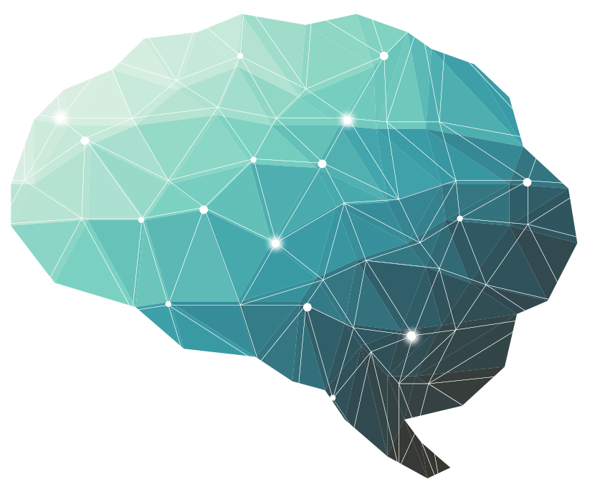
16th Lecture ∣ The Physiology Team
Physiology of Postural Reflexes
Abdulelah Aldossari, Ali Alammari
Fatima Balsharaf, Rahaf Alshammari
Objectives:
Able to define human posture
Explain/define the concepts of “ center of gravity ’’ and “ support base “.
Explain what are postural reflexes and their overall function .
Know the centers of integration of postural reflexes .
Explain the structure and function of the vestibular apparatus ( utricle, saccule & semicircular canals ) in maintenance of balance.
Describe decorticate rigidity and decerbrate rigidity and explain the mechanisms underlying them .
Done by :
Team leader: Abdulelah Aldossari, Ali Alammari
Fatima Balsharaf, Rahaf Alshammari
Team members: Khalid Almutairi, Faisal Altahan,
Anas Alsaif, Saif Almeshari
Colour index:
important
Numbers
Extra
وَأَن لَّيْسَ لِلْإِنسَانِ إِلَّا مَا سَعَىٰ

Slide 2
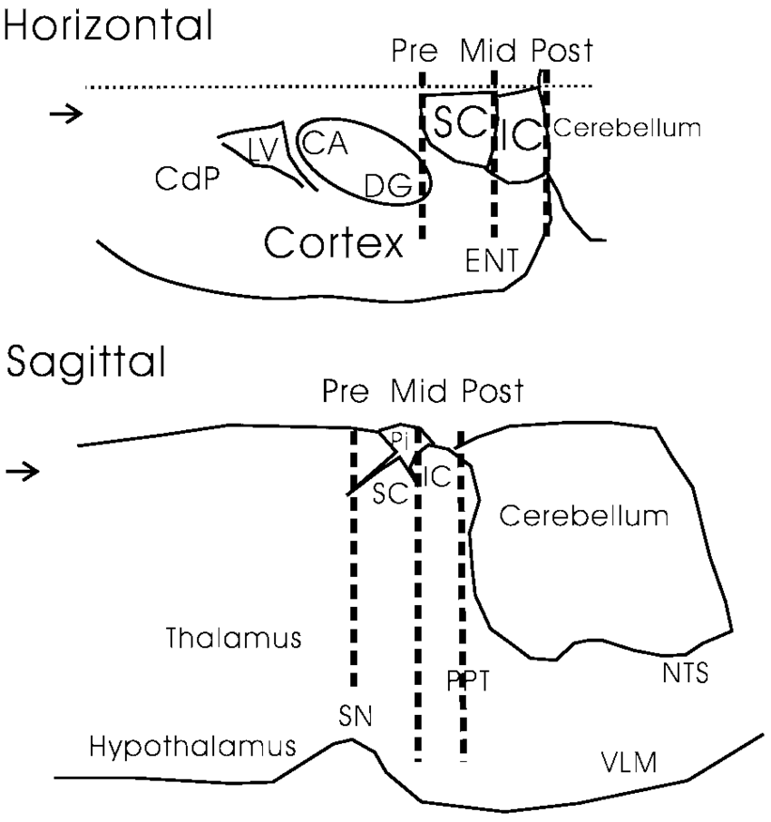
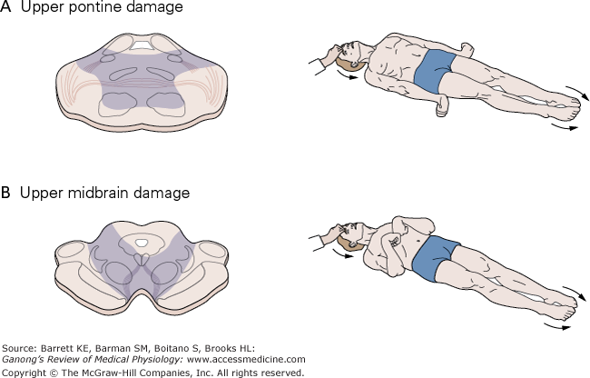
For better understanding
Decerebration is the elimination of cerebral brain function in an animal by removing the cerebrum, cutting across the brain stem, or severing certain arteries in the brain stem.
Generally lower decerebration (the cut is made above the upper border of the pons), middle decerebration (cut is made through the red nucleus) and upper decerebration (cut is made so the cortical area is removed).
As a result, the animal loses certain reflexes which are integrated in different parts of the brain.
Furthermore, the reflexes which are functional will be hyperreactive (and therefore very accentuated) due to the removal of inhibiting higher brain centers (e.g. the facilitatory area of the reticular formation will not receive regulating input from cerebellum, basal ganglia and the cortex).
Lower decerebration results in a "bulbospinal" animal: reflexes which are integrated within the spinal cord and medulla oblongata are functional, reflexes integrated in midbrain and cortex are absent.
The most obvious accentuation is seen in the tonic labyrinthine reflexes, the otolithic organs mediate input about the gravitational force exerted on the body and the labyrinthine reflex acts on the extensor muscles in order to resist this gravitational force. In an animal where the cortical areas or the midbrain have been "cut off" from the neural axis, this reflex is hyperactive and the animal will maximally extend all four limbs. This phenomenon is known as decerebrate rigidity. In humans true decerebrate rigidty is rare since the damage to the brain centers it might be caused by usually are lethal. However decorticate rigidity can be caused by bleeding in the internal capsule which causes damage to upper motor neurons. The symptoms of decorticate rigidity are flexion in the upper limbs and extension in the lower limbs.

Slide 3
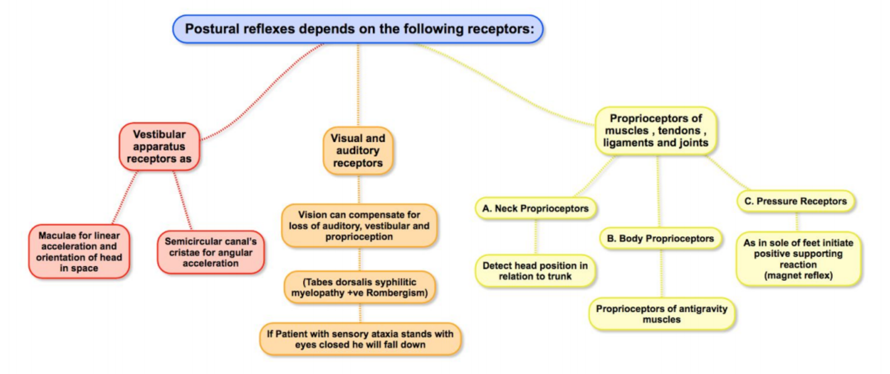
What is posture?
Posture is the attitude taken by the body in any particular situation like standing posture, sitting posture, etc.. even during movement, there is continuously changing posture.
The basis of posture is the ability to keep certain groups of muscles in sustained contraction for long periods. Variation in the degree of contraction and tone in different groups of muscle decides the posture of the individual.
Postural reflex
These reflexes resist displacement of the body caused by gravity or acceleratory forces, and they have the following functions:
What is posture?
It is maintenance of upright position against gravity (center of body is needed to be between the legs)
it needs anti-gravity muscles.
Upright posture need postural reflexes
Posture depends on muscle tone (static stretch reflex)
The main pathways concerned with posture are :
A- Medial (Anterior) tracts as vestibulospinal tract and medial (Anterior) corticospinal tract
“Control proximal limbs and axial muscles for posture and gross movements”
B- Lateral tracts as lateral corticospinal tract and rubrospinal tract
“Control distal limbs ex. fingers and toes”
1. Maintenance of the upright posture of the body.
2. Restoration of the body posture if disturbed.
3. Providing a suitable postural background for performance of voluntary movements.
Slide 2
خالد المطيري
Postural reflexes
depends on the following receptors
❖ Receptors of postural reflexes:
Postural Reflexes Depends upon the following receptors:
A-Vestibular apparatus receptors as: | -Maculae for linear acceleration and orientation of head in space. -Semicircular canal’s cristae for angular acceleration.
B-Visual and auditory receptors: | Vision can compensate for loss of Auditory, Vestibular and Proprioception [Tabes Dorsalis syphilitic myelopathy Positive Rombergism] If Patient stands with sensory ataxia stands with eyes closed, he will fall down.
C-Proprioceptors of muscles, tendons, ligaments and joints: | 1-Neck Proprioceptors: Detect head position in relation to trunk. 2-Body Proprioceptors: Proprioceptors of antigravity. 3-Pressure Proprioceptors: As in sole of feet initiate positive supporting reaction. (magnet reflex)
Questions from 434:
Q/ Posture depends on?
A. Gravity
B. Vision
C. Muscle tone
Q/ What are the structure needed to maintain coordination of Stretch reflexes & postural reflexes?
1. Spinal cord
2. Medulla
3. Midbrain
4. Cerebral cortex
5. Cerebellum
Q/ For efficient well-coordinated posture we need:
A. Vestibular apparatus.
B. Basal ganglia.
C. Cerebellum.
D. All of above.
vestibular apparatus receptors
visual (vision) & auditory (hearing) receptors
Proprioceptors of muscles, tendons, ligaments & joints
Maculae (utricle & saccule) & SCC ”Semicircular canals” cristae.
Macula for linear acceleration and orientation of head in space.
SCC Cristae for angular acceleration.
Vision can compensate for loss of auditory, vestibular & proprioception (tabes dorsalis +ve rombergism).
If a patient with sensory ataxia stands with eyes closed, he/she falls down.
+ve Rombergs sign when the posture maintenance is fully vision dependent
Neck Proprioceptors
Detect head position in relation to trunk
Body Proprioceptors
Proprioceptors of anti-gravity muscles
Pressure receptors
As in sole of feet initiate positive supporting reaction (magnet reflex)
Stretch reflexes and postural reflexes can be modified by coordinated activity of:
Spinal cord Medulla Midbrain Cerebral cortex Cerebellum

Slide 4
Postural reflexes
Static reflexes (at rest) (statotonic) Maintain posture at rest |  |  | Phasic reflexes “center in Cerebral Cortex” (with motion) (statokinetic reflex) Maintain posture during motion
Spinal Reflexes | Medullary Reflexes | Righting Reflexes Center: In the midbrain | A- Hopping Reaction when animal is pushed laterally hopping reflex occurs to keep limbs in position to support body. The receptors are in muscle spindles.
N.B: spinal receptors can be studied in spinal animal with cut at neck between the S.C & brain stem so all S.C is intact. |  |  | B- Placing Reaction When a blind folded animal suspended in air & moved towards a supporting surface, the feet will be placed firmly on the supporting surface (receptors are touch receptors & proprioceptors in soles of feet)
Supporting, Placing and Hopping Postural Reflexes

Slide 5
Spinal Reflexes “Center in Spinal Cord”
Studied in spinal animals; with cut between spinal cord and brain stem
Local Static Reflexes (in 1 limb) | Segmental Static Reflexes (in 2 limbs)
i. Stretch Reflexes (static): This is the most important local static reflex which controls the tone in those extensor muscles which keep the body upright (antigravity muscles). ii. Positive supporting reaction (magnet reflex): Receptors are proprioceptors of flexors (contraction of both flexors & extensors) (protective reflex). When you stand on one foot (contraction of both flexors & extensors AT THE SAME TIME, this is a against reciprocal innervation). It is the only reflex where there is contraction of both Agonist and Antagonist at the same time | Mediated by one segment of the spinal cord as: Crossed extensor reflex. Negative supporting receptor: It refers to disappearance of positive supporting reaction. It is initiated by stretch of the extensor muscles. Which release +ve supporting reaction ( receptors are proprioceptors of extensors of the released limb).

Slide 6
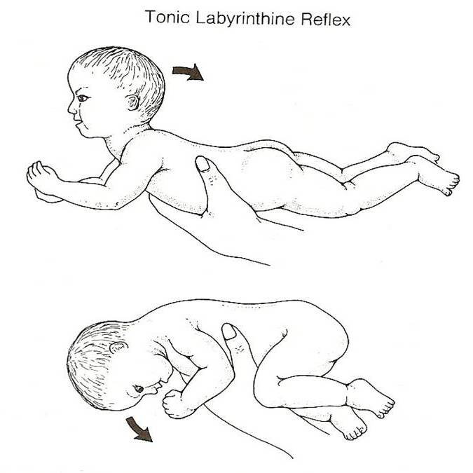
Medullary Reflexes “center in Medulla oblongata”
 | Neck Static Reflexes | Labyrinthine static reflex
Studied in | a decerebrated animal cut above medulla + labyrinth destroyed. | decerebrated animal + elimination of neck proprioceptors (labyrinth intact).
Stimulus | changing head position that (+) neck proprioceptors. | gravity
Receptors | neck proprioceptors. | otolith organs (maculae).
Responses | Ventroflexion of head: Flexion of forelimb (arms) + extension of hind limb (as in decortication). Dorsiflexion of head: Extension of forelimb (arms) + flexion of hind limb. Turning head to one side: Extension of limbs on that side + flexion of other side. | ventroflexion of head (or prone position) 4 limbs flexion dorsiflexion of head (or supine position) 4 limbs extended( as in decerebration)
Labyrinthine Static Reflex
00:17

Slide 7
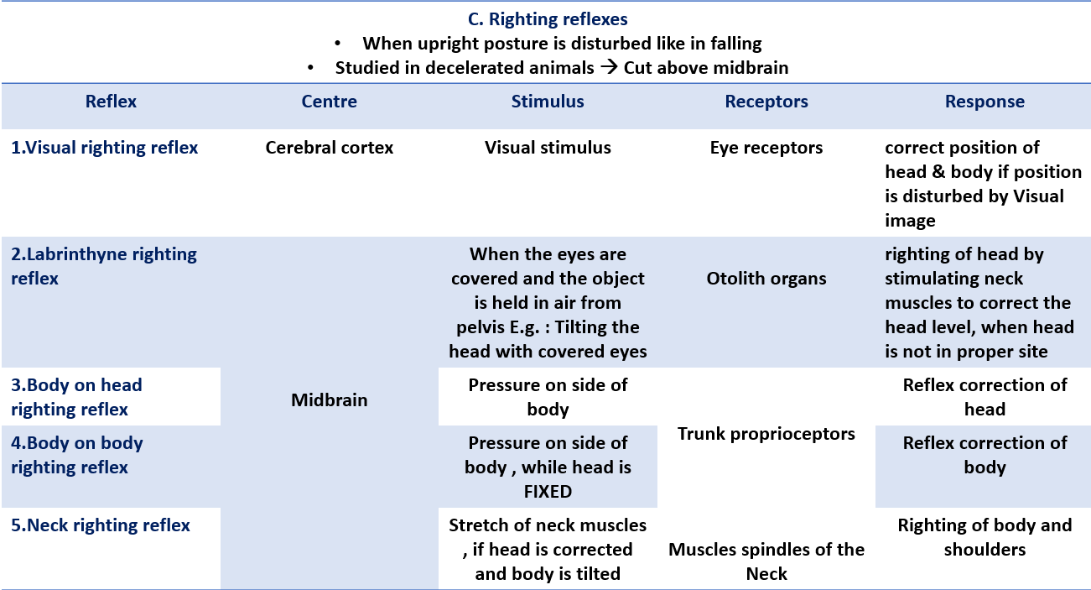
Righting reflexes
When upright posture is disturbed as is falling down Studied in a decerebrated animal → cut above midbrain “Upper decerebration”
Reflex | Center | Stimulus | Receptors | Response
A. Visual Righting reflex | Cerebral cortex | Visual stimulus | Eye receptors | Correct position of head & body
B1. Labyrinthine righting reflex | Midbrain | When the eyes are covered and the object is held in the air from pelvis. E.g: Tilting the head with covered eyes | Otoliths organs | Righting of head by stimulating neck muscles to correct the head level, when the head is not in proper site
B2. Body on head righting reflex |  | Pressure on side of body & head is free | Body pressure receptors | Reflex contraction of the head
B3. Body on body righting reflex |  | Pressure on side of body, while head is FIXED | Body pressure receptors | Reflex contraction of the body
B4. Neck righting reflex |  | “Correction of the head by B1 & B2 reflexes lead to twisting of the nick, this initiate reflex righting of the body”. Stretch of neck muscles, if head is corrected and body is tilted | Proprioceptors of neck muscles | Righting of body and shoulders
See the next slide for illustrative pictures & Video

Slide 8
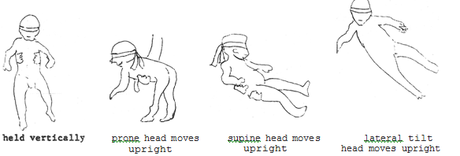
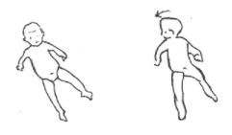
Righting/Equilibrium Reflexes
Righting Reflexes
“jump to the second half of video”
labyrinthine righting reflexes
Body on head + Body on body righting reflexes
Neck righting reflexes

Slide 9
Decerebrate Rigidity
Site of lesion: between the superior and inferior colliculi of the midbrain, lesion below Red Nucleus (e.g. mid-collicular lesion).
block normal inhibitory signals from brain & red nucleus in midbrain to tonically active pontile R.F & Vestibular nucleus causing:
Extensive extensor posture of all extremities → Rigidity of all 4 limbs.
All limbs extended, arms extended by the sides & rotated internally (outward).
Hallmark → elbows extended.
Head may be arched to the back, it is due to:
Increased general excitability of the motor neuron pool; especially Gamma efferent discharge (due to facilitatory effects of the un inhibited Vestibulospinal Tract) “Hyperactivity of gamma discharges”
In a decerebrated animal:
damage to level below red nucleus.
Features of decerebrate rigidity:
Hyperextension of all four limbs.
Dorsiflexion (hyperextension) of tail and head.
Extreme hyperextension of the spine (opisthotonus) produces concave configuration of the back.
The animal can be made to stand on four limbs but is easily toppled by slight push..
Reflexes that are lost/absent:
Optical (visual) righting Reflexes.
Reflexes that are retained / still present i.e. reflexes the do not depend primarily on cerebrum:
Maintained tonic static postural reflexes that support animal against gravity (medullary tonic neck & labyrinthine R).
Tonic Labyrinthine reflexes.
Tonic Neck Reflexes.
Other Righting Reflexes.

Slide 10
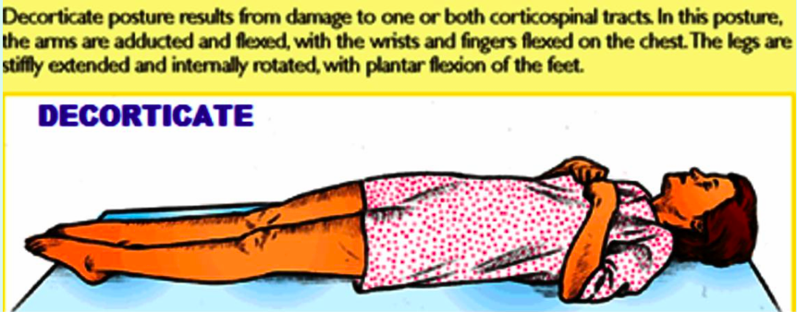
Decorticate Rigidity
In humans, where true decerebrate rigidity is rare, since the damage to the brain centers involved in it are lethal.
Decorticate rigidity more common in human than decerebate rigidity, due to: Lesion in cerebral cortex, but brain stem is intact. However decorticate rigidity can be caused by bleeding in the internal capsule which causes UMNL (damage to upper motor neurons). As seen in hemiplegic patients after hemorrhage of internal capsule.
Symptoms & Signs:
Flexion in the upper limbs. Because the Red nucleus is intact → send inhibitory signals
extension in the lower limbs. Why wouldn’t we have flexion in the Lower limbs as in the upper limbs? Because the excitatory influence in the LM is more than the inhibitory
In a decorticate animal:
Decorticate animal is one in whom the whole cerebral cortex is removed but the basal ganglia and brain stem are left intact.
Characteristic features: moderate rigidity is present
Cortex inhibit medullary reticulospinal tract. Therefore, removal of cortex results in facilitation of γ motor neuron discharge.
Reflexes that are lost/absent:
Placing reaction, hopping reaction
Visual righting reflex
Reflexes that are retained /still present i.e. Reflexes the do not depend primarily on cerebral cortex:
Tonic labyrinthine reflexes
Tonic neck reflexes
Other righting midbrain reflexes

Slide 11
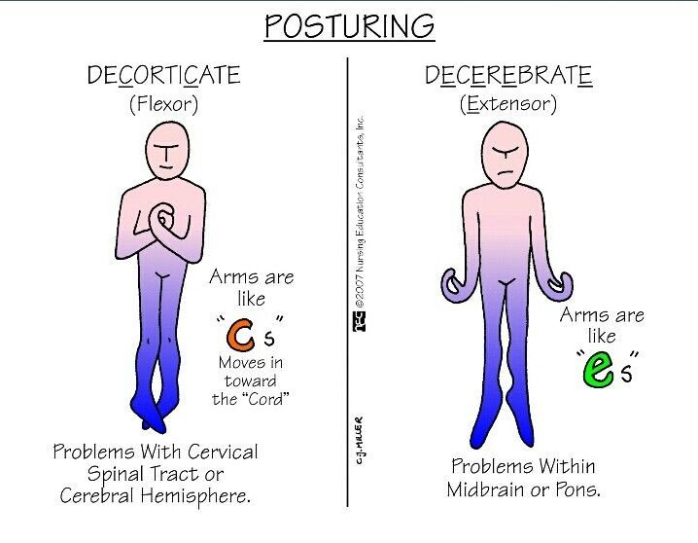
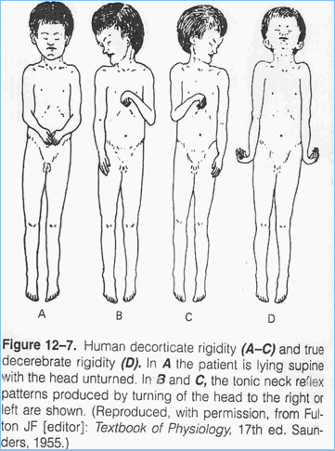
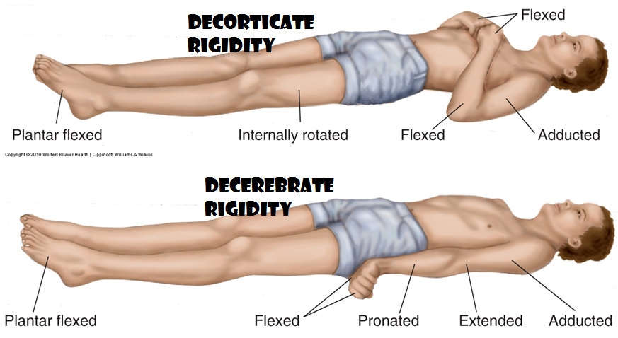
Decerebrate rigidity & decorticate rigidity

Slide 12
Summary

Slide 13
MCQ
SAQ
1-Which type of ridigity is possible to be seen on the hemiplegic side in humans after hemorrhages or thromboses in the internal capsule? Decorticate Rigidity. 2- What is the reason for the extension of all limbs in decerebrate rigidity? It is because the inhibitory signals from the brain and red nucleus are blocked, that will result in excitation of Medial Reticulospinal & Vestibulospinal tracts. 3- What are the clinical features of decorticate posture rigidity? -the hands are clenched into fists -the legs extended -feet turned inward. 4- What are the structure needed to maintain coordination of Stretch reflexes & postural reflexes? 1. Spinal cord 2. Medulla 3. Midbrain 4. Cerebral cortex 5. Cerebellum
1. Posture depends on:
. Gravity
. Vision
. Muscle tone
. Hearing
2. For efficient well-coordinated posture we need:
. Vestibular apparatus.
. Basal ganglia.
. Cerebellum.
. All of above.
3. Which of the following spinal reflexes is mediated by one segment of the spinal cord ?
. Stretch reflexes
. Segmental static reflex
. Local static reflex
. Negative supporting reflex
4. Which of the folowing is a stimulus of neck static reflex ?
. Changing in position of head
. Gravity
. Raising limbs
. Standing up
5. Study of Labyrinthine static reflex should be in a ?
. Decerebrated animal with a cut above medulla oblongata
. Live animal with spinal cord extraction
. Decerebrated animal with elimination of neck proprioreceptors
. Decerebrated animal with total spinal cord extraction
6. What are the structure needed to maintain coordination of Stretch reflexes & postural reflexes? 1. Spinal cord 2. Medulla 3. Midbrain 4. Cerebral cortex 5. Cerebellum
7. In labyrinthine static reflex there is an elimination of which type of proprioceptor , what it's function? Neck proprioceptor, it's function to detect head position in relation to the body.
8. Explain the phenomena of decerebrate rigidity?
Unopposed activity of the pontine reticular nucleus which lead to increase activity motor neuron that facilitate stretch reflex.
9. What is the reason for the extension of all limbs in decerebrate rigidity? It is because the inhibitory signals from the brain and red nucleus are blocked, that will result in excitation of Medial Reticulospinal & Vestibulospinal tracts.
10. Which type of ridigity is possible to be seen on the hemiplegic side in humans after hemorrhages or thromboses in the internal capsule? Decorticate Rigidity.
11. What are the clinical features of decorticate posture rigidity? -the hands are clenched into fists -the legs extended -feet turned inward.
Explain the phenomena of decerebrate rigidity Unopposed activity of the pontine reticular nucleus which lead to increase activity motor neuron that facilitate stretch reflex In labyrinthine static reflex there is an elimination of which type of proprioceptor , what it's function? Answer: Neck proprioceptor, it's function to detect head position in relation to the body.
Answers:
1.C
2.D
3.B
4.A
5.C

