Slide 1
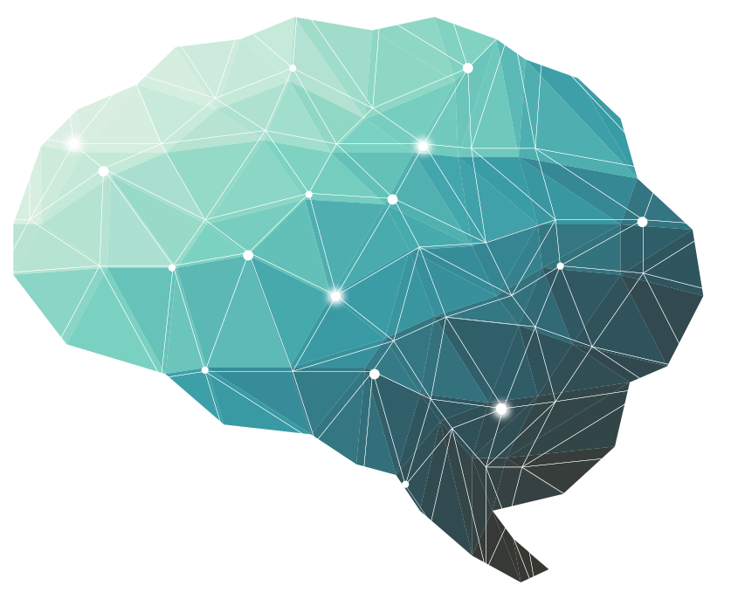
Spasticity and Increased Muscle Tone
22nd Lecture ∣ The Physiology Team
Objectives:
Appreciate that spasticity is an important conditions that is encountered in a broad spectrum of medical specialties such as neuropediatrics, adult neurology, orthopedics, rehabilitation medicine and others.
Be able to define the term spasticity and understand that it occurs in medical conditions frequently encountered in the Kingdom such as stroke, multiple sclerosis, cerebral palsy, traumatic spinal cord and brain injury, cerebral and spinal tumors, spinal cord disc lesions; and in less common but important & preventable conditions such as tetanus and spinal cord infections such as tuberculosis of the spine.
Explain the neurophysiological basis of clinical features associated with multiple sclerosis, cerebral palsy, traumatic spinal cord injury tuberculosis of the spine and tetanus.
Done by :
Team leader: Rahaf AlShammari, Fatima Balsharf, Abdulelah AlDossari, Ali AlAmmari.
Team members: Wejdan AlBadrani, Sara AlSultan.
Colour index:
Important
Numbers
Extra
وَأَن لَّيْسَ لِلْإِنسَانِ إِلَّا مَا سَعَىٰ

Slide 2
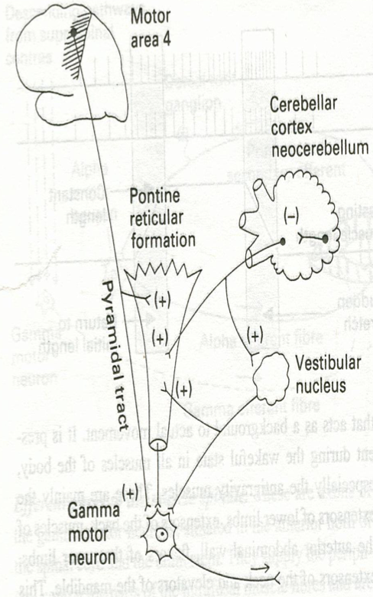
Introduction
These facilitatory supraspinal centers to gamma motor neurons Increased Gamma efferent discharge is the main cause of increased muscle tone. how?
Resistance of a muscle to stretch is often referred to as its tone or tonus.
Muscle tone is static component of stretch reflex .It is a continuous mild muscle contraction that acts as background to actual movement.
A hypertonic muscle is one in which the resistance to stretch is high because of hyperactive stretch reflexes.
Hypertonia refers to increased resistance to passive stretch (passive lengthening) of a muscle. This may mean increased stiffness of the muscle.
Hypertonicity could be due to a neural drive problem such as :-
Spasticity or Rigidity
1) Spasticity
velocity dependent :
Increased resistance to passive movement of the muscle due to (hypertonia) which varies with the speed of displacement of a joint.
The faster you stretch the muscle the greater the resistance.
Spasticity is clearly neural in nature and is associated with the UMNL due to Involvement of the corticospinal tract.
Spasticity is usually unidirectional
Flexor spasticity in the upper limb & extensor spasticity in the lower limb.
A simple way to assess spasticity is by fast flexion or extension of selected joint, typically the elbow or knee, to elicit a sudden increase in tone and demonstrate the velocity dependent nature of spasticity.
Involvement of the corticospinal tract is often associated with UMNL and spasticity.
Clinical features that are associated with spasticity:
Hyperreflexia
Clasp-knife spasticity in UMNL, describe a sudden release of resistance after an initial hypertonia of selected joint movement.
Spasticity with the increased muscle tone together cause a contraction and deformity of a limb.
مثل كسارة البندق ، مقاومة كبيرة في البداية، بعدها تروح المقاومة وتسهل الحركة.

Slide 3
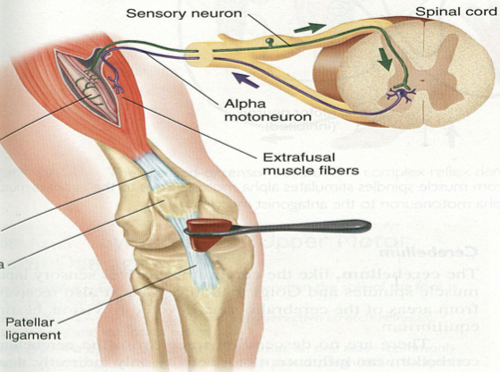
Spasticity & hypertonia is a feature of altered muscle performance.
Usually in Upper Motor Neuron Syndrome (UMNS).
Patients complain of stiffness & inability to relax
Muscles become permanently "tight" or spastic.
The condition can interfere with walking, movement, or speech.
When there is a loss of descending inhibition from the brain higher motor-inhibitory centers (medullary RF & basal ganglia & suppressor area 4) resulting in un-antagonized excitatory input from brain stem excitatory centers,As (pontine RF + vestibular N) through Vestibulospinal & reticulospinal excitatory tracts to gamma motor neurons causing hypertonia & spasticity of muscles.
This results in
State of ongoing (unremitting) contraction of muscles (due to hyperactive gamma activity).
decreased ability to control movement
increased resistance felt on passive stretch.
- Spasticity is characterised by hyper-excitability of both types of stretch reflex:
Increase in tonic static stretch reflexes
(muscle tone) as one component of the
upper motor neuron (UMN) syndrome.
Exaggerated tendon jerks, resulting
from hyper-excitability of the dynamic
stretch reflex as one component of the
upper motor neuron (UMN) syndrome.
Features of UMN Syndrome
Weakness and decreased muscle control.
No remarkable muscle wasting, but disuse atrophy.
Spasticity & hypertonia, frequently called “ Clasp-knife spasticity ”= increased resistance at the beginning of muscle stretch due to increased extensor muscle tone then a sudden collapse in resistance due to inhibition of extensor motor neurons by GTOs (golgi tendon organs).
Clonus Repetitive jerky motions (clonus), especially when limb moved & stretched suddenly.
Exaggerated tendon jerks.
Extensor plantar reflex = Babinski sign (dorsiflexion of the big toe and fanning out of the other toes).
Absent abdominal reflexes.
Sudden dorsiflexion results in jerky movements
Normally > plantar flexion

Slide 4
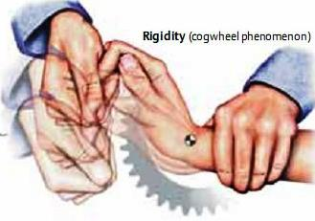
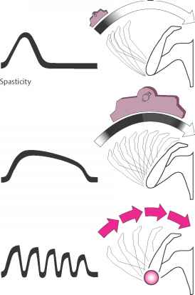
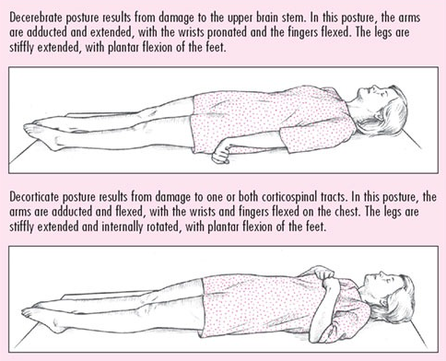
2) Rigidity
Increased resistance to the passive movement of a muscle which is constant throughout the movement and not related to the speed of movement (is not velocity dependent).
In Rigidity resistance is present in both agonist and antagonist. (is bidirectional).
Rigidity is usually extrapyramidal in origin & Rigidity includes other features of increased muscle tone .
Is often associated with basal ganglia disease such as Parkinson’s disease.
Stiffness is different from rigidity.
Stiffness is a principal symptom of the patient ( complain)
Rigidity in Parkinsonism
1. Lead-pipe rigidity: Passive movement of an extremity meets with a constant dead feeling resistance like a lead pipe throughout the range of movement.
2. Cog-wheel rigidity: resistance varies rhythmically when applying a passive movement. It is because of an underlying resting tremor associated with rigidity.
Other types of rigidity
3. Decerbrate rigidity: extension of head & 4 limbs extensors.
4. Decorticate rigidity: extensor rigidity in legs & moderate flexion of arms if head unturned

Slide 5
To test for rigidity, passively move the joint in both direction
A relatively uniform rigidity in both agonist and antagonist muscle group is known as lead-pipe rigidity;
If there is tremor superimposed with background increase of tone is Cogwheel rigidity. These rigidity is commonly seen in Parkinson’s disease.
N.B
Spasticity is resistance to passive stretch + an involuntary + velocity-dependent + unidirectional —leads to resistance to movement
Rigidity is resistance to passive movement + an involuntary + not velocity-dependent + bidirectional —leads to resistance to movement.
عمود من الحديد، المقاومة مستمرة طوال فترة الحركة
مثل حركة عقرب الساعة، مقاومة بعدين تفك
Spasticity | Rigidity
Resistance to passive stretch | Resistance to passive movement
Involuntary, Velocity-dependent | Involuntary, Not velocity-dependent
Unidirectional | Bidirectional
Leads to resistance to movement
Causes of spasticity
(UMNS) syndrome
Cerebral palsy
Multiple sclerosis
Spinal cord injury
Stroke
Acquired brain injury
Causes of rigidity
Parkinsonism
Decerebrate & decorticate rigidity

Slide 6
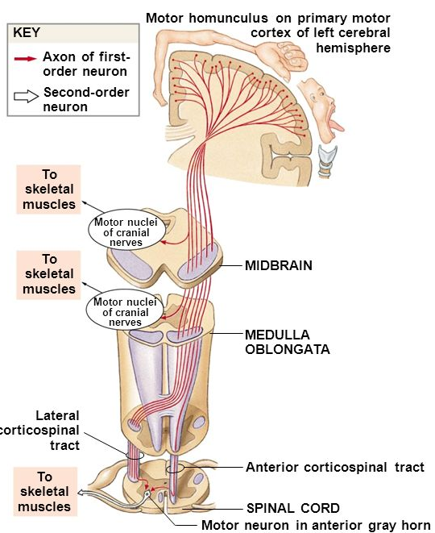
An autoimmune demyelinating disease, in which the body's own immune system attacks and damages the myelin sheath of myelinated nerves mainly of brain, SC, and optic nerve.
Loss of myelin sheath (demyelination) prevents axons from saltatory conduction of action potentials causing muscle weakness & wasting.
Disease onset usually occurs in young adults, and it is more common in females.
The disease can attack any part of the CNS, and when it causes demyelination of descending motor tracts in the brainstem & spinal cord, the subject develops spasticity and other signs of UMNS.
The disease frequently remits and relapses because of remyelination & restore of function.
During acute attacks intravenous corticosteroids can improve symptoms.
Cerebral palsy
Caused by brain damage due to lack of oxygen, as (near drowning or near suffocation) that cause damage to the motor control centres of the developing brain.
It can occur during pregnancy, during stressed childbirth (or after birth up to about age three by meningitis)
Multiple Sclerosis
Stroke
Causes:
Haemorrhagic stroke as in cerebral hemorrhage.
Ischaemic stroke as in thrombosis or embolism in brain blood vessels.
Both cause death of brain tissues
Gives the picture of upper motor neuron syndrome UMNL
Results in Hemiplegia in the
contralateral side of the body
A lesion in Corona Radiata on one side can cause Monoplegia in a contralateral limb (UL or LL, according to site).
A lesion in the Internal Capsule on one side may cause Hemiplegia or Hemiparesis on the contralateral side ( with the picture of upper motor neuron syndrome ).

Slide 7
Complete transaction of spinal cord
e.g. following tumor or trauma
The higher the level of the section, the more serious are the consequences.
1
Transection is in the upper cervical region
Immediate death follows
Due to paralysis of all respiratory muscles
2
In the lower cervical region below the 5th cervical segment
Diaphragmatic respiration is still possible
The patient suffers complete paralysis of all four limbs (quadriplegia).
3
Transection lower down in the thoracic region
Allows normal respiration
The patient ends up with paralysis of both lower limbs (paraplegia).
Stages:
Spinal shock ( 2-6 weeks )
Recovery of reflex activity
Paraplegia in extension

Slide 8
In the immediate period following transection there is :
Complete transaction of spinal cord
Stage 1:
Spinal shock ( 2-6 weeks )
(1) complete loss of spinal reflex activity below the level of lesion
(2) Loss of all sensations
(anaesthesia) and voluntary movement (paralysis) below the level of the lesion, due to interruption of all sensory and motor tracts.
(3) Loss of tendon reflexes and superficial reflexes
(abdominal , plantar & withdrawal reflexes ) =complete loss of spinal reflex activity below the level of the lesion
(4) Loss of muscle tone
(flaccidity) and absence of any muscle activity (muscle pump) lead to decreased venous return causing the lower limbs to become cold and blue in cold weather
(5) The wall of the urinary bladder becomes paralysed & urine is retained until the pressure in the bladder overcomes the resistance offered by the tone of the sphincters and dribbling occurs. This is known as (retention with overflow).
(6) Loss of vasomotor tone occurs, due to interruption of fibres that connect the vasomotor centres in the medulla oblongata with the lateral horn cells of the spinal Cord of sympathetic vasoconstrictor impulses to blood vessels. vasodilatation causes a fall in blood pressure, the higher the level of the section, the lower the blood pressure.
(7) Bedsores due to pressure of body-weight against underlining support
This stage varies in duration but usually lasts a maximum of 2-6 weeks, after which some reflex activity recovers.

Slide 9
Complete transaction of spinal cord
Stage 2:
Recovery of reflex activity
As the spinal shock ends , spinal reflex activity appears again this partial recovery may be due to Increase in degree of excitability of the spinal cord neurons below the level of the section, due to :
Disinhibition of motoneurons due to absence of inhibitory impulses from higher motor centres.
Sprouting of fibres from remaining neurons
Denervation supersensitivity to excitatory neurotransmitters.
Features of the stage of recovery of reflex activity :
تزيد التفرعات
(1) Gradual rise of arterial blood pressure
Due to return of spinal vasomotor activity in the lateral horn cells. But, since vasomotor control from the medulla is absent, the blood pressure is not stable.
Vasoconstrictor tone in arterioles and venules improve the circulation through the limbs.
(2) Return of spinal reflexes
Flexor tendon reflexes return earlier than extensor ones.
Babiniski sign (extensor plantar reflex) is one of the earliest signs of this stage +/- flexion reflex.
Flexor spastic tone causes the lower limbs to take a position of slight flexion, a state referred to as paraplegia in flexion.
The return of the stretch reflex (muscle tone), & vasoconstrictor tone in arterioles and venules, improves the circulation through the limbs.
(3) Recovery of visceral reflexes
return of micturition, defecation & erection reflexes.
However voluntary control over micturition and defecation , and the sensation of bladder and rectal fullness are permanently lost (automatic micturition).
(4) Sexual reflexes
consisting of erection or ejaculation on genital manipulation, recover.
(5) Mass reflex appears
A minor painful stimulus to the skin of the lower limbs will not only cause withdrawal of that limb but will evoke many other reflexes through spread of excitation (by irradiation) to many autonomic centres.
So the bladder and rectum will also empty, the skin will sweat, the blood pressure will rise
Patients with complete transection never recover fully. Voluntary movements and sensations are permanently lost; however, patients who are rehabilitated and properly managed may enter into a more advanced stage of recovery.

Slide 10
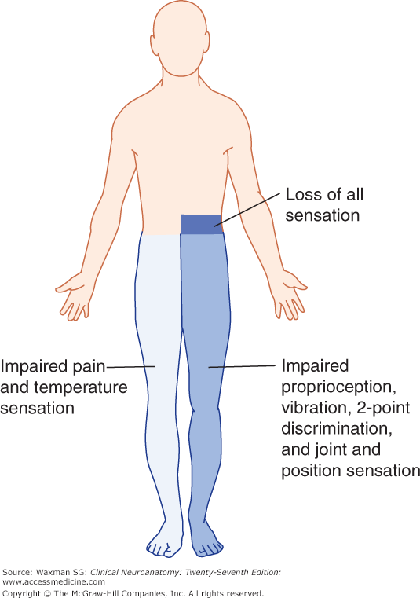
Complete transaction of spinal cord
Stage 3:
Paraplegia in extension
(1) During this stage the tone in extensor muscles returns gradually to exceed that in the flexors.
The lower limbs become spastically extended.
Extensor reflexes become exaggerated, as shown by tendon jerks and by the appearance of clonus.
The positive supportive reaction becomes well developed and the patient can stand on his feet with appropriate support.
(Magnet Reflex)
(2) The flexor withdrawal reflex which appeared in the earlier stage is associated during this stage with the crossed extensor reflex.
Hemisection of the Spinal Cord
(Brown-Sequard syndrome)
Occurs as a result of unilateral lesion or hemisection of the spinal cord (e.g. due to stab injury, bullet , car accident,or tumor).
The manifestations of the Brown-Sequard syndrome depend on the level of the lesion.
An example of such injury involving the thoracic spinal cord
On the same side at the level of lesion | 1. Paralysis of the lower motor neuron type, involving only the muscle supplied by the damaged segments.
 | 2. Loss of all sensations in the areas supplied by the afferent fibres that enter the spinal cord in the damaged segments +/- band of hyperesthesia
 | 3. Vasodilatation of the blood vessels that receive vasoconstrictor fibers from the damaged segment.
Ipsilaterally below the level of the lesion | 1. UMNL/spastic lower limb (spasticity) & CLONUS.
 | 2. Fine touch, two-point discrimination, position and vibration sense are lost. why?
 | 3. Vasodilation
Contralaterally below the level of the lesion | Pain and temperature sensations are lost, Why ?
ممكن يزيد الإحساس في منطقة معينة
Cut of the Dorsal column
Cut of spinothalamic

Slide 11
Important points you should focus on:
Summary
Spasticity | Rigidity
Resistance to passive stretch | Resistance to passive movement
Involuntary, Velocity-dependent | Involuntary, Not velocity-dependent
Unidirectional | Bidirectional
Leads to resistance to movement
Causes of spasticity
Causes of rigidity
(UMNS) syndrome
Parkinsonism
Decerebrate & decorticate rigidity
Spinal cord injury
Cerebral palsy
Stroke
Acquired brain injury
Multiple sclerosis
Complete transaction of spinal cord
Stages:
1
Transection is in the upper cervical region
Immediate death follows
Due to paralysis of all respiratory muscles
Spinal shock ( 2-6 weeks )
2
In the lower cervical region below the 5th cervical segment
Diaphragmatic respiration is still possible
The patient suffers complete paralysis of all four limbs (quadriplegia).
Recovery of reflex activity
3
Transection lower down in the thoracic region
Allows normal respiration
The patient ends up with paralysis of both lower limbs (paraplegia).
Paraplegia in extension
An example of such injury involving the thoracic spinal cord
On the same side at the level of lesion | 1. Paralysis of the lower motor neuron type, involving only the muscle supplied by the damaged segments.
 | 2. Loss of all sensations in the areas supplied by the afferent fibres that enter the spinal cord in the damaged segments +/- band of hyperesthesia
 | 3. Vasodilatation of the blood vessels that receive vasoconstrictor fibers from the damaged segment.
Ipsilaterally below the level of the lesion | 1. UMNL/spastic lower limb (spasticity) & CLONUS.
 | 2. Fine touch, two-point discrimination, position and vibration sense are lost. why?
 | 3. Vasodilation
Contralaterally below the level of the lesion | Pain and temperature sensations are lost, Why ?

Slide 12
Questions
1.which of the following causes rigidity?
A-Spinal cord injury
B-Multiple Sclerosis
C-Parkinsonism
D-Stroke
2.decrease Gamma efferent discharge is the main cause of increased muscle tone?
A- true
B-false
3.Occurs as a result of hemisection of the spinal cord?
A-quadriplegia
B-Brown-Sequard syndrome.
C-paraplegia
4.which of the following statement about spasticity is correct?
A- due to the involvement of extra-pyramidal system.
B-bi-directional.
C-associated with Parkinson’s disease.
D-related to the speed of movement.
5.After car accident the patient suffered from complete transaction of the spinal cord. What do we expect to see if the injury is below the 5th cervical segment?
A-paralysis of all respiratory muscles.
B-paraplegia
C-quadriplegia
D-Brown-Sequard syndrome.
6.Clasp-knife spasticity
Is one of the features of ?
A-UMN lesion.
B-Parkinsonism
C-LMN lesion.
D- MS.
7.how does paraplegia happens?
A- transection is in the upper cervical region.
B- hemisection in the lower part of the thoracic region.
C- transection is in the lower cervical region.
D- transection in the lower part of the thoracic region.
8.when does the mass reflex appears?
A-Stage of extensor paraplegia.
B-Recovery of reflex (stage 2)
C-spinal shock (stage 1)
9.Loss of vasomotor tone causes?
A- no effect.
B-vasoconstriction.
C-increase blood pressure.
D-decrease blood pressure.
10.A minor painful stimulus to the skin of the lower limbs in patient with complete transection of spinal cord will result in?
A-withdrawal reflex.
B-mass reflex.
C-stretch reflex.
D-no response.
1-C 4-D 7- D 10-B
2-B 5-C 8-B
3-B 6-A 9-D

