Slide 1
5th Lecture ∣ The Physiology Team
Upper motor neuron lesions & Lower motor neuron lesions
Objectives:
Describe the functional anatomy of upper and lower motor neurons
Describe the functional anatomy of upper and lower motor neurons
Explain features of Brown Sequard Syndrome
Correlate the site of lesion with pattern of loss of sensations
Describe facial, bulbar and pseudobulbar palsy
Done by :
Team leaders: Abdulelah Aldossari, Ali Alammari
Fatima Balsharaf, Rahaf Alshammari
Team members: Mohammed Alhassan, Rahaf Alshunaiber, Zeyad Alkhenizan, Abdulaziz Aldurgham
Colour index:
important
Numbers
Extra
وَأَن لَّيْسَ لِلْإِنسَانِ إِلَّا مَا سَعَىٰ
Notes:
لِلْإِنسَانِ إِلَّا مَا سَعَىٰ (39) وَأَنَّ سَعْيَهُ سَوْفَ يُرَىٰ
BETTER right

Slide 2
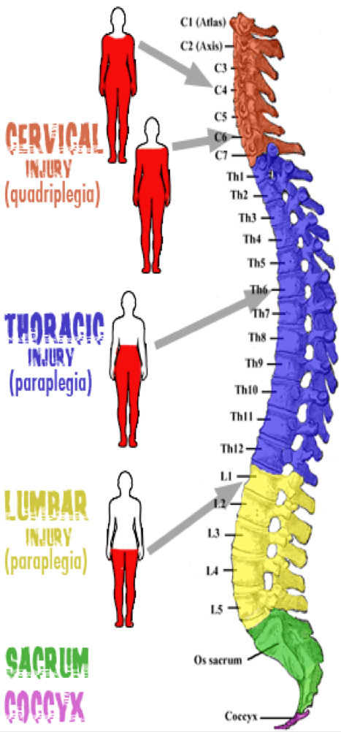
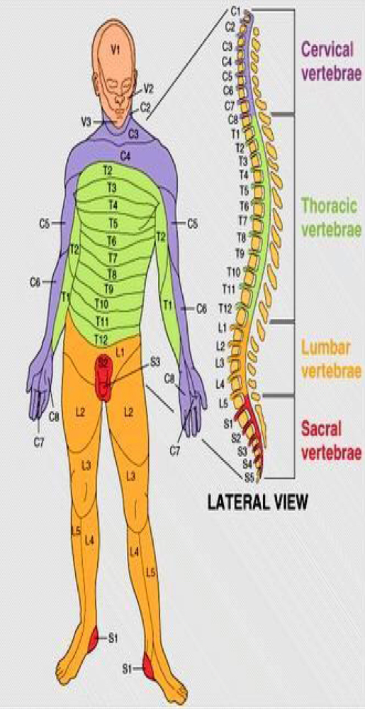
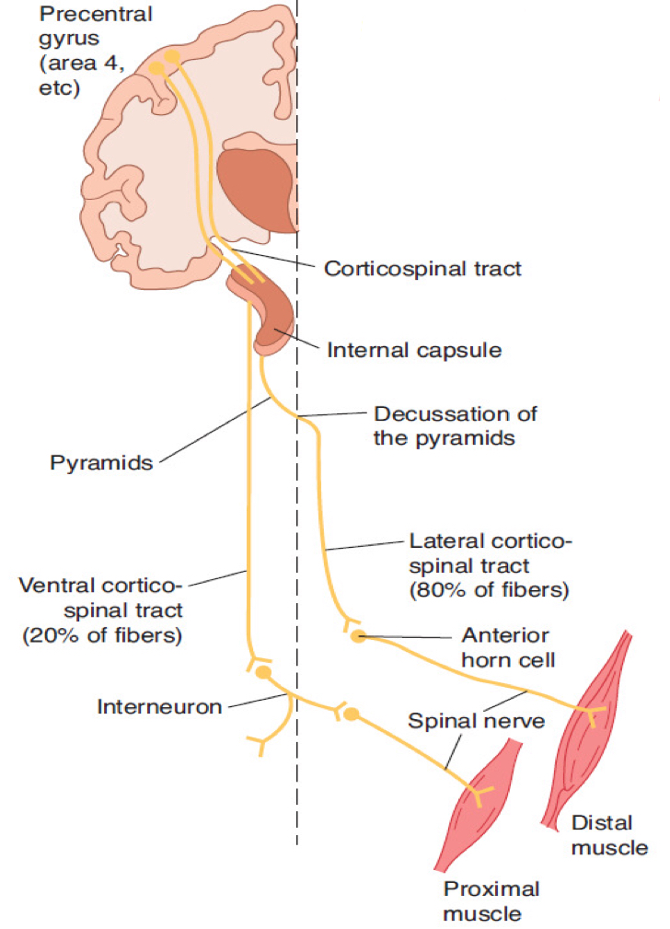
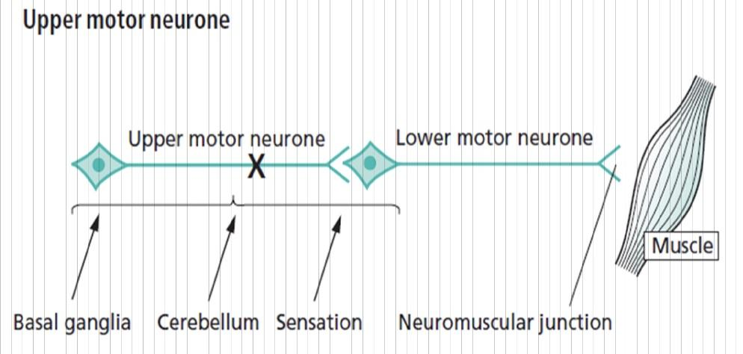
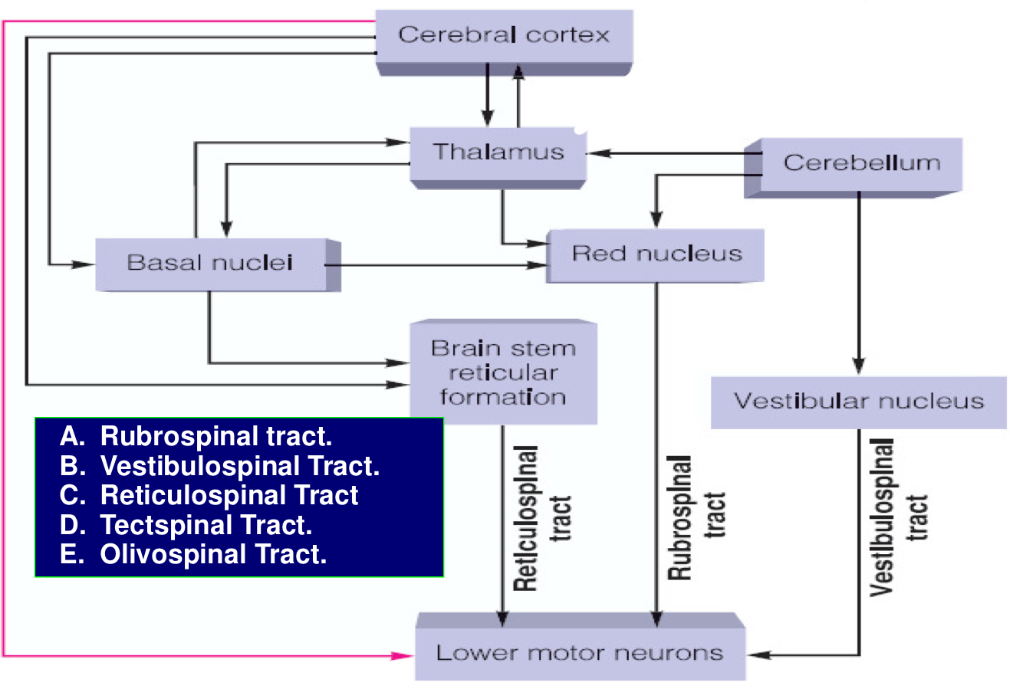
Spinal Cord
Embryological development — growth of cord lags behind— mature spinal cords ends at L1
It has 31 segments
Upper and lower motor neuron
UMNs control lower LMNs through two different pathways
Extrapyramidal motor system
Pyramidal system

Slide 3
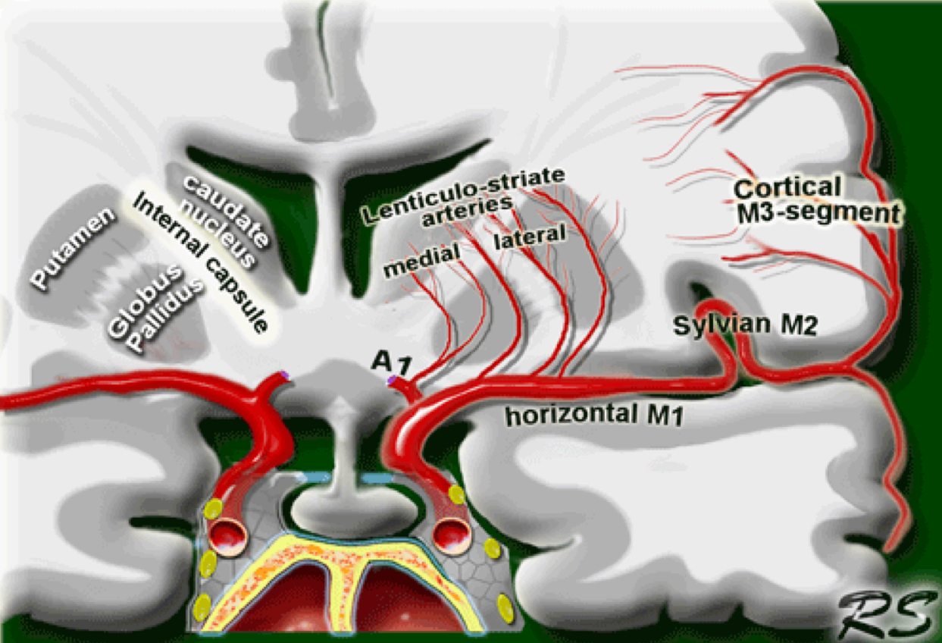
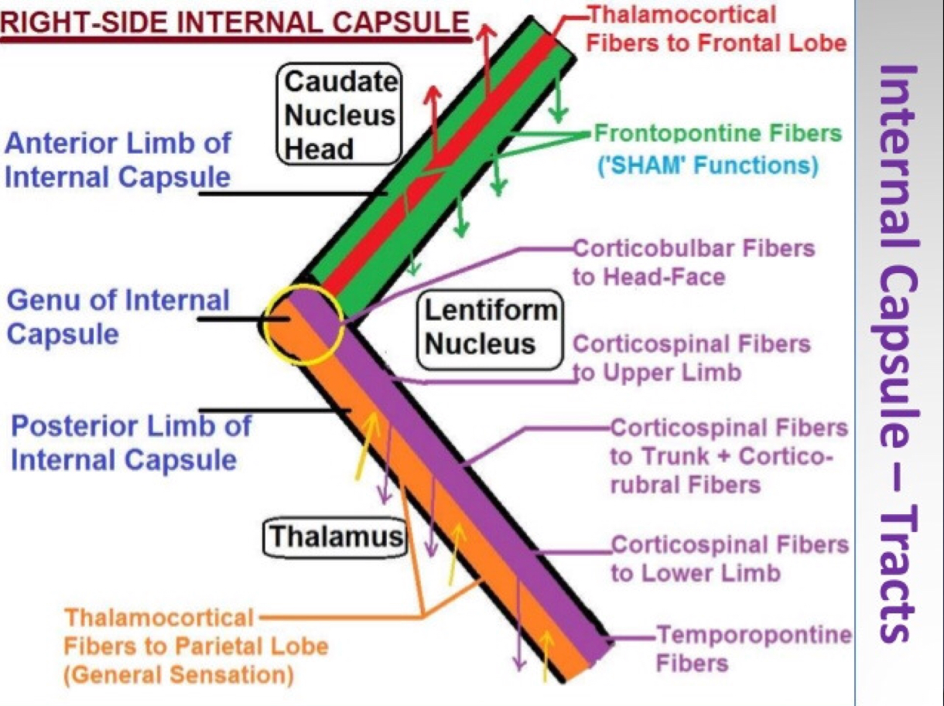
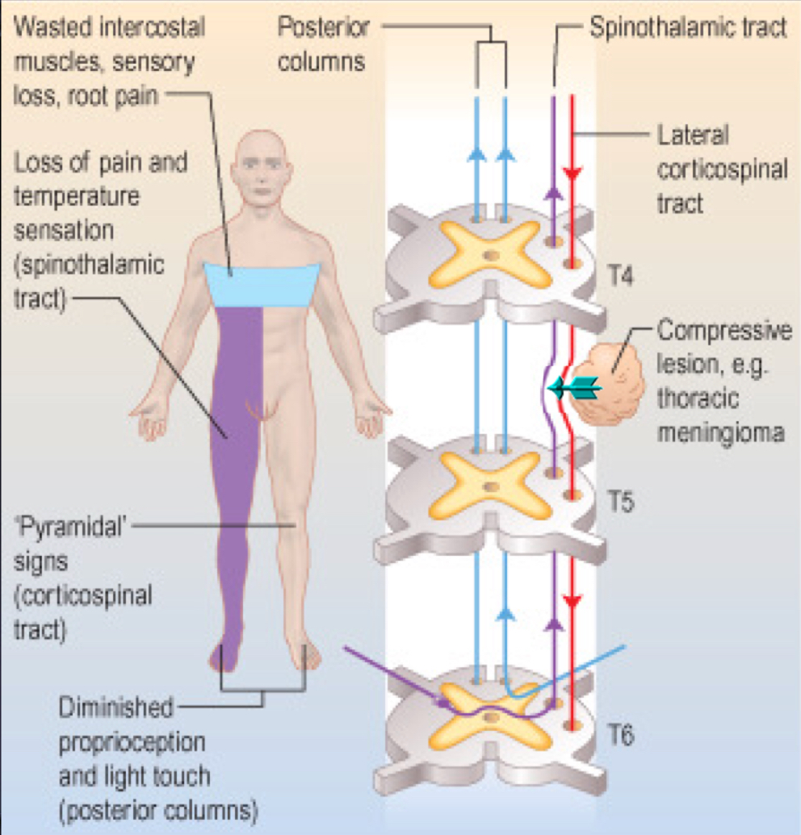
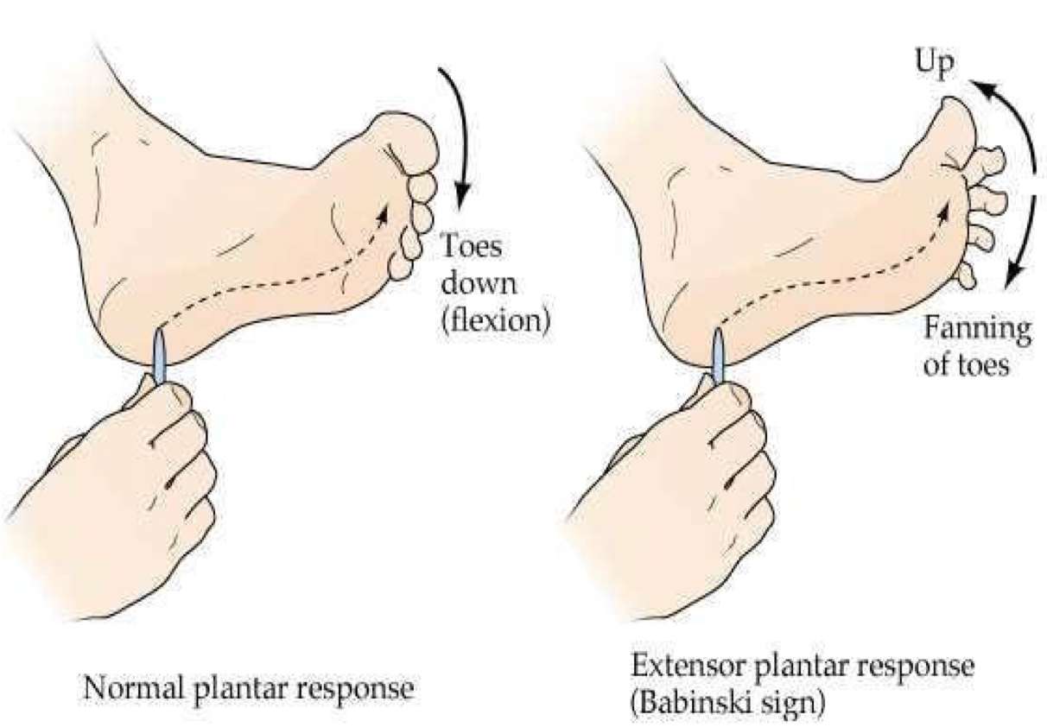
Lenticulostriate arteries from the middle cerebral artery
Internal capsule
Causes of UMNL and LMNL
Lower motor neuron lesion
Can result from :
Anterior horn cell lesions ( e.g. poliomyelitis,motor neuron disease
Spinal root lesion or peripheral nerve lesion ( e.g. nerve injury by trauma or compressive lesion
Upper motor neuron lesion
Can result from :
Cerebral stroke by hemorrhage, thrombosis or embolism
Spinal cord transection or hemisection
(brown-sequard syndrome)
Comparison upper and lower motor neuron lesions
 | UMN lesion | LMN lesion
Pattern | Paralysis affect movements (The hole muscles are affected) | Individual muscle or group of muscles are affected
Wasting | Not pronounced (70-80) (there is muscle waste due to disuse*but less than LMN) (Tropic) | Pronounced (20-30) (more wasted than UMN because the muscle supply is damaged) (non tropic)

Slide 4
Comparison upper and lower motor neuron lesions
 | UMN lesion | LMN lesion
Pattern | Paralysis affect movements (The hole muscles are affected) | Individual muscle or group of muscles are affected
Wasting | Not pronounced (70-80) (there is muscle waste due to disuse*but less than LMN) (Tropic) | Pronounced (20-30) (more wasted than UMN because the muscle supply is damaged) (non tropic)
 | UMN lesion | LMN lesion
Pattern | Paralysis affect movements (The hole muscles are affected) | Individual muscle or group of muscles are affected
Wasting | Not pronounced (70-80) (there is muscle waste due to disuse*but less than LMN) (Tropic) | Pronounced (20-30) (more wasted than UMN because the muscle supply is damaged) (atropic)
Tone | Spasticity muscles; hypertonic (clasp knife) (increase disinhibition) ** | Tendon reflexes diminished or absent
Tendon reflex | Brisk /increased (due to increases gamma discharge) | Diminished or absent
Superficial reflexes | Absent (because it’s polysynaptic)*** | Absent
NCV (nerve conduction velocity) | Normal | Decrease
Denervation potential(fibrillation) [on EMG ONLY ] (LMN) | Absent | Present
Fasciculation (visible) (LMN) | Absent | Present
Trophic changes | Less | Pronounced in skin and nails
Clonus (rapid repetitive contraction) (UMN) | Present | Absent
Babinski’s sign | Extensor plantar response (positive) | Flexor or absent plantar response
*disuse means that the muscle is active and can respond to reflexes but you can't use or control the muscle that's why the wasting is less in UMN.
**the intensity of a reflex is regulated by the higher centers so, if the UMN is damaged ,the reflex will still occur but it will not be lowered by the UMN
***UMN has a main role in polysynaptic reflexes so, damage in UMN will inhibit the superficial reflex

Slide 5
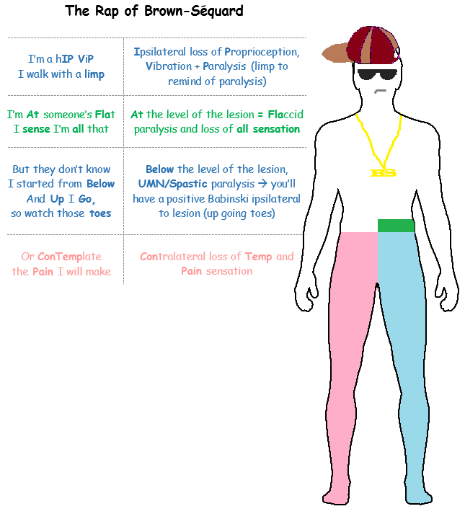
Brown sequard syndrome “Hemisection of spinal cord”
Ipsilateral loss :
fine touch , vibration , proprioception (dorsal column)
leg ataxia (dorsal spinocerebellar)
spastic paresis below lesion (lateral corticospinal)
flaccid paralysis (vent horn destruction)
dermatomal anesthesia (dorsal horn destruction)
Contralateral loss :
loss of pain and temp (lateral spinothalamic)
loss of crude touch and pressure ( vent spinothalamic )
minor contralat muscle weakness ( vent corticospinal )
leg ataxia ( vent spinocerebellar )

Slide 6
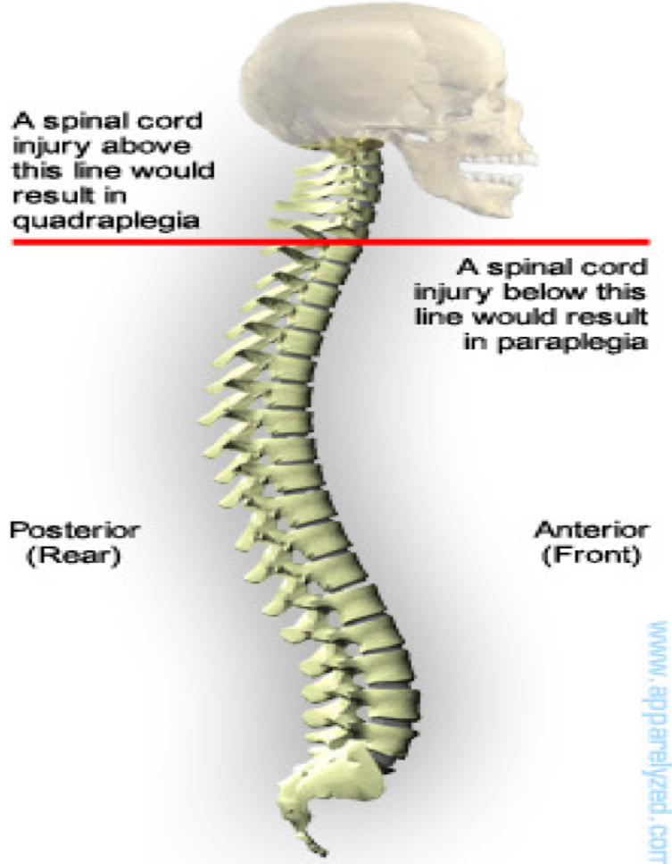
Brown sequard syndrome “Hemisection of spinal cord”
“Explained”
1- ipsilateral lower motor neuron paralysis in the segment of the lesion and muscular atrophy. These signs are caused by damage to the neurons on the anterior grey column and possibly by damage to the nerve roots of the same segment .
2- ipsilateral spastic paralysis below the level of the lesion an ipsilateral babinski sign is present,and depending on the segment of the cord damage,an ipsilateral loss of the superficial abdominal reflexes and cremasteric reflex occurs. All these signs are due to loss of the corticospinal tracts on the side of the lesion . Spastic paralysis is produced by interruption of the descending tracts other than the corticospinal tracts .
3- ipsilateral band of cutaneous anesthesia in the segment of the lesion . This result from the destruction of the posterior root and its entrance into the spinal cord at the level of the lesion
4- ipsilateral loss of tactile discrimination and of vibratory and proprioceptive sensation below the level of the lesion. These signs are caused by destruction of the ascending tracts in the posterior white column on the same side of the lesion.
5- contralateral loss of pain and temperature sensations below the level of the lesion. This due to destruction of the crossed lateral spinothalamic tracts on the same side of the lesion . Because the tracts cross obliquely,the sensory loss occurs two or three segments below the lesion distally.
6- contralateral but not complete loss of tactile sensation below the level of the lesion. This condition is brought about by destruction of the crossed anterior spinothalamic tracts on the side of the lesion . Here , again , because the tracts cross obliquely ,the sensory impairment occurs two or three segments below the level of the lesion distally . The contralateral loss of tactile sense is important because discriminative touch travelling in the ascending tracts in the contralateral posterior white column remains intact .
Lesions of the spinal cord
Upper cervical cord lesions produced quadriplegia and weakness of the diaphragm
Lesions at C4-C5 produce quadriplegia
Hemiparesis means weakness
Hemiplegia means total paralysis

Slide 7
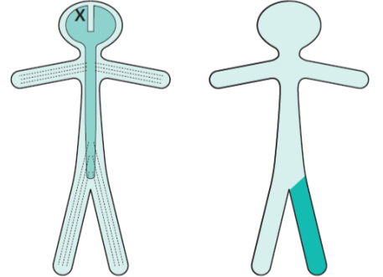
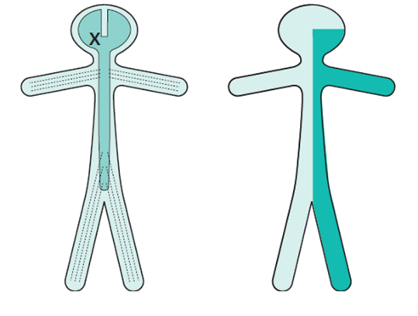
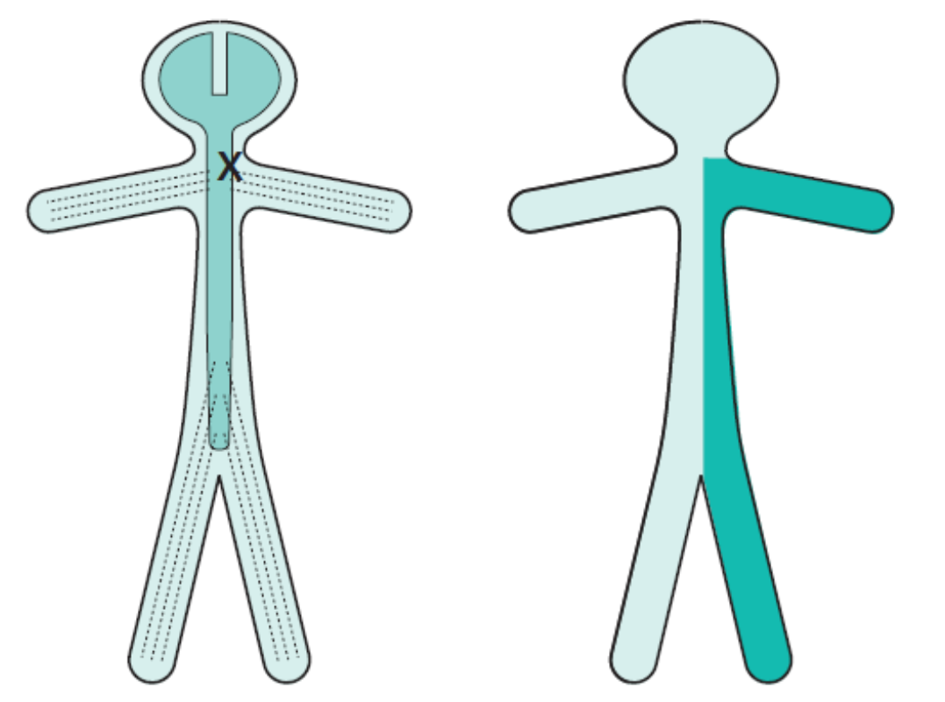
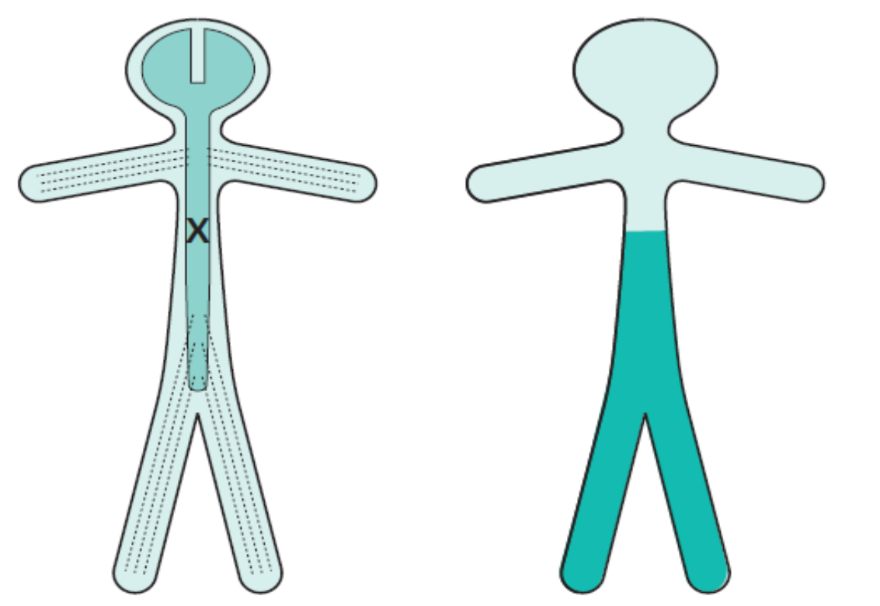
Comparison between lesions:
Contralateral monoparesis | A lesion situated peripherally in the cerebral hemisphere, i.e. involving part of the motor homunculus only, produces weakness of part of the contralateral side of the body, e.g. the contralateral leg. If the lesion also involves the adjacent sensory homunculus in the postcentral gyrus, there may be some sensory loss in the same part of the body.
Contralateral hemiparesis | Lesions situated deep in the cerebral hemisphere, in the region of the internal capsule, are much more likely to produce weakness of the whole of the contralateral side of the body, face, arm and leg. Because of the funnelling of fibre pathways in the region of the internal capsule, such lesions commonly produce significant contralateral sensory loss (hemianaesthesia) and visual loss (homonymous hemianopia), in addition to the hemiparesis.
Ipsilateral hemiparesis | A unilateral high cervical cord lesion will produce a hemiparesis similar to that which is caused by a contralateral cerebral hemisphere lesion, except that the face cannot be involved in the hemiparesis, vision will be normal, and the same dissociation of sensory loss (referred to above) may be found below the level of the lesion.
Paraparesis | Paraparesis, if the lesion is at or below the cervical portion of the spinal cord.

Slide 8
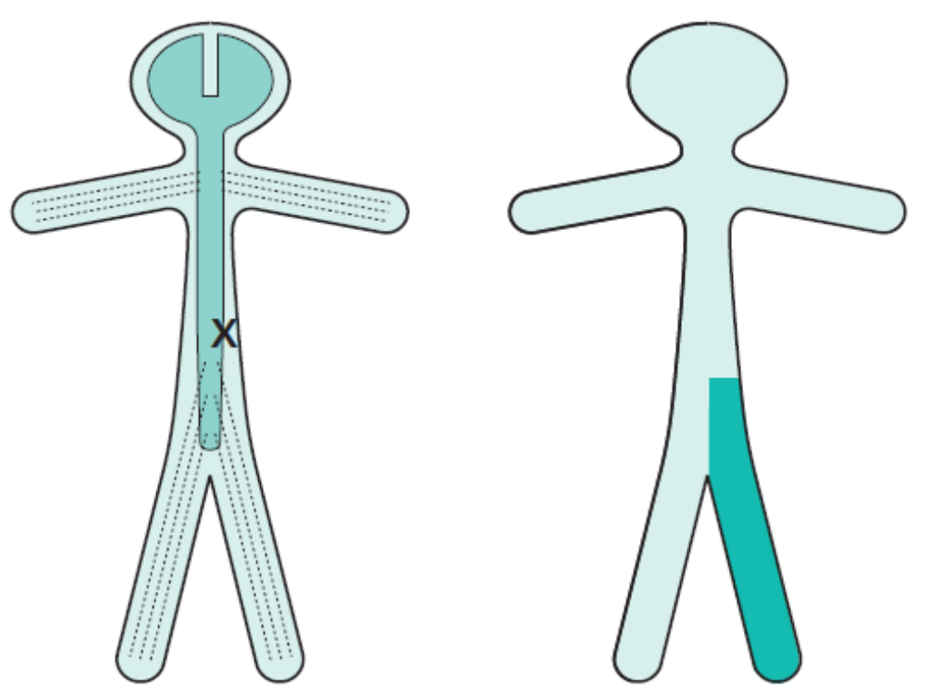
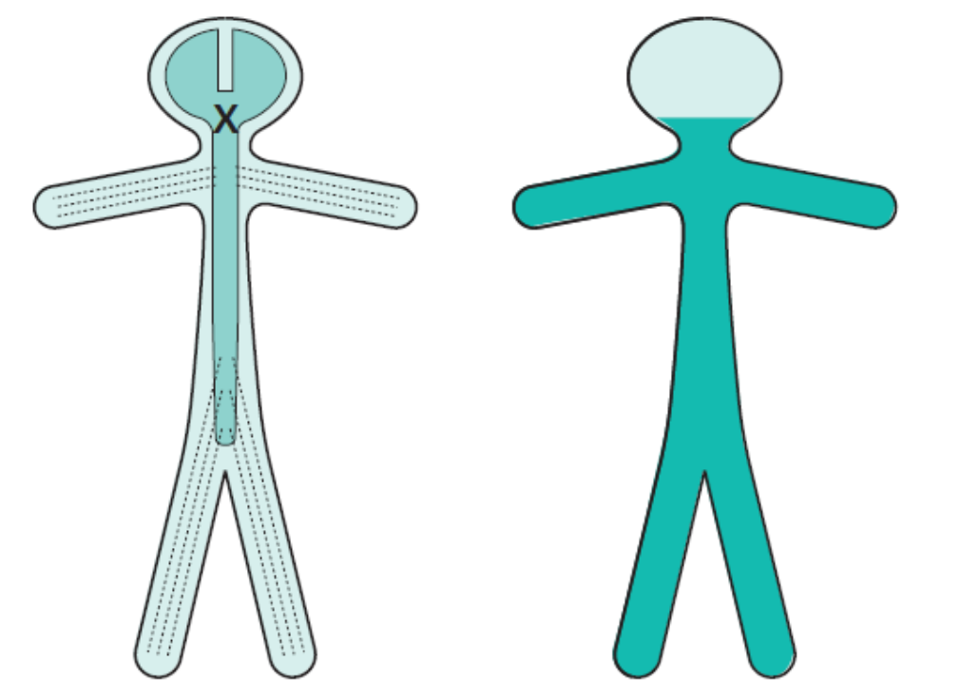
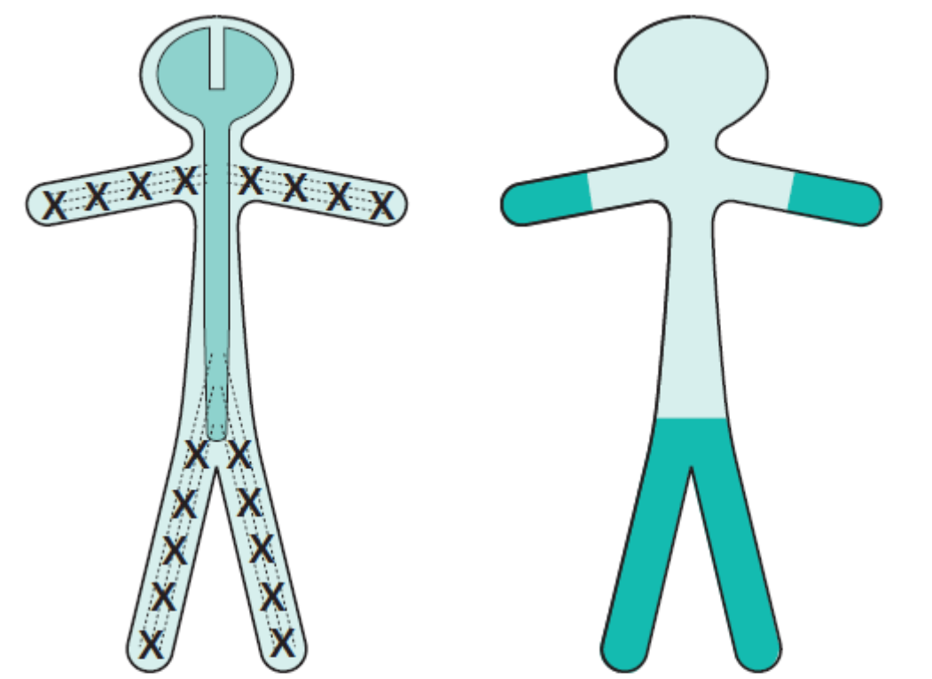
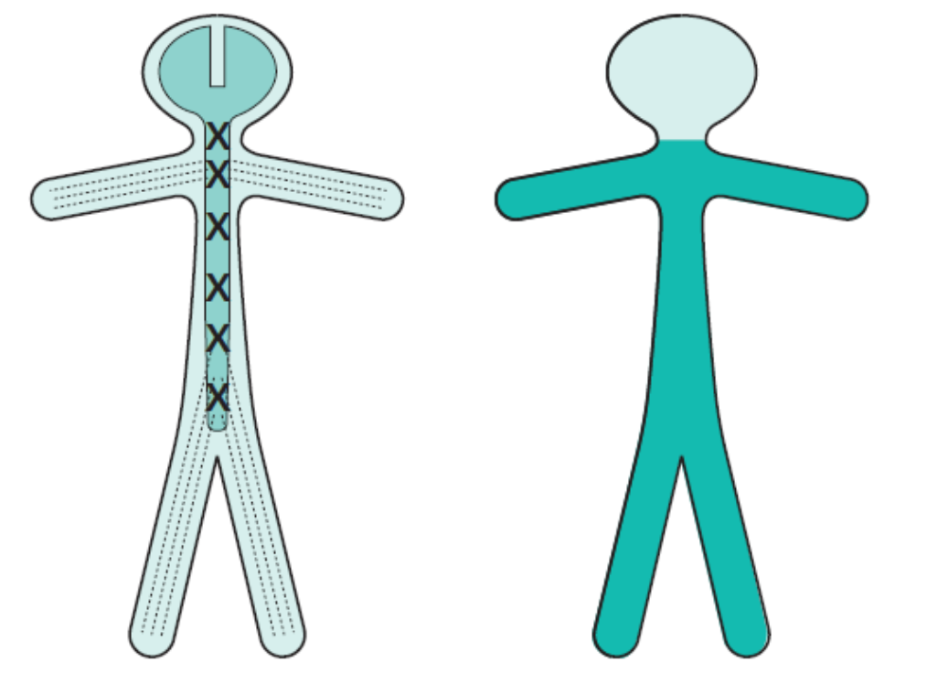
A spinal cord lesion more usually causes upper motor neuron signs in both legs, often asymmetrically since the pathology rarely affects both sides of the spinal cord equally.
Ipsilateral monoparesis | A unilateral lesion in the spinal cord below the level of the neck produces upper motor neuron weakness in one leg. There may be posterior column (position sense) sensory loss in the same leg, and spinothalamic (pain and temperature) sensory loss in the contralateral leg. This is known as dissociated sensory loss, and the whole picture is sometimes referred to as the Brown-Séquard syndrome.
Tetraparesis or quadriparesis | Tetraparesis or quadriparesis, if the lesion is in the upper cervical cord or brainstem.
Generalized LMN weakness | Generalized LMN weakness may also result from widespread damage to the axons of the LMNs. This is the nature of peripheral neuropathy (also called polyneuropathy). The axons of the dorsal root sensory neurons are usually simultaneously involved. The LMN weakness and sensory loss tend to be most marked distally in the limbs.
 | Generalized LMN weakness may result from pathology affecting the LMNs throughout the spinal cord and brainstem, as in motor neurone disease or poliomyelitis. Generalized limb weakness (proximal and distal), trunk and bulbar weakness characterize this sort of LMN disorder.

Slide 9
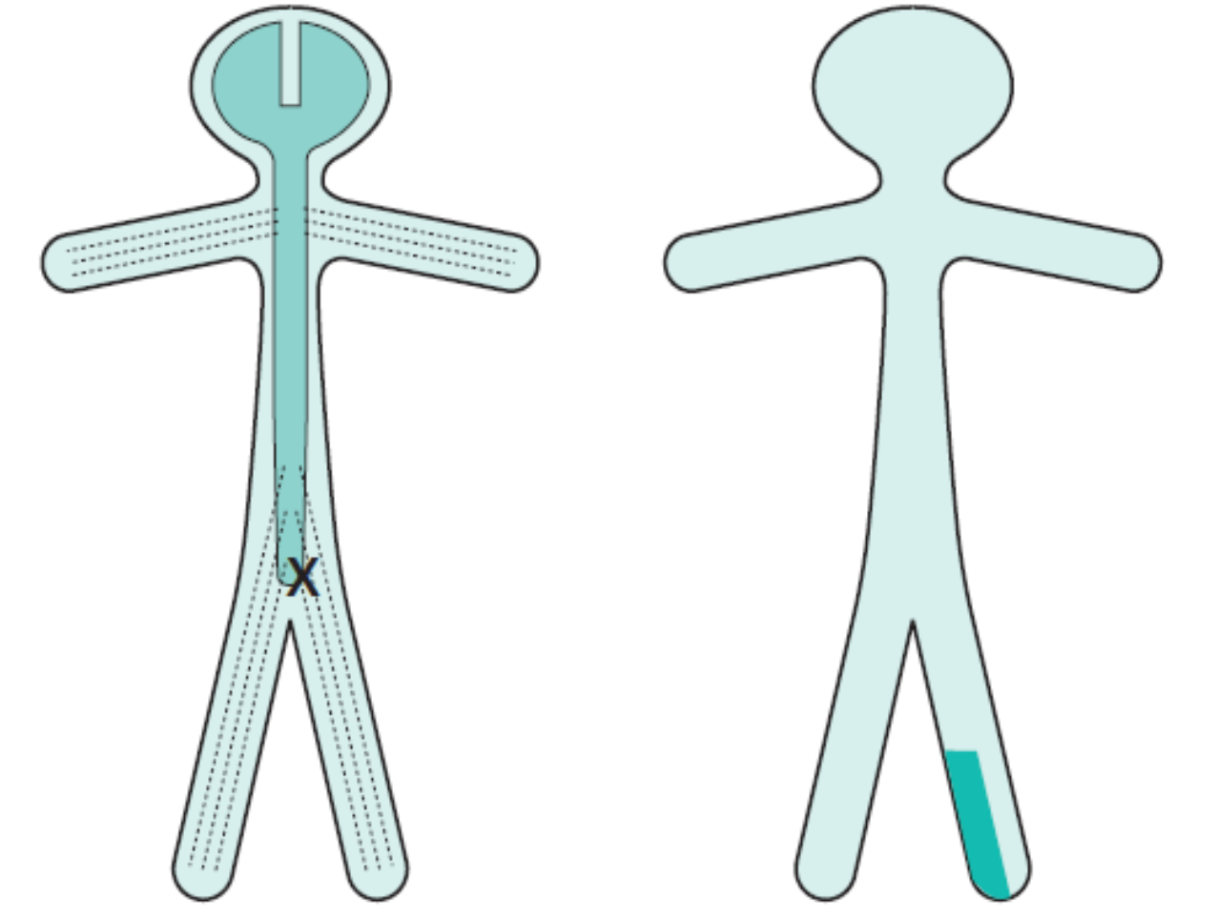
LMN weakness of one spinal root | LMN weakness may be confined to the distribution of one spinal root(above) or one individual peripheral nerve (below). In such circumstances, the LMN signs are found only in the muscles supplied by the particular nerve root or peripheral nerve in question. Almost always there is sensory impairment in the area supplied by the nerve or nerve root. Examples of such lesions are an S1 nerve root syndrome caused by a prolapsed intervertebral disc, or a common peroneal nerve palsy caused by pressure in the region of the neck of the fibula.
Motor neuron disease
Selectively affect motor neurons, that control voluntary muscle activity.
Types:
Amyotrophic lateral sclerosis UMN+LMN
Primary lateral sclerosis UMN
Progressive muscular atrophy LMN
Bulbar palsy-bulbar LMN
Pseudobulbar palsy-bulbar UMN
Dr. Shahid said that he won’t ask you about it.
Spinal cord
Transverse myelitis
Anterior spinal artery syndrome
Brown-Sequard syndrome
Upper sensory level for all sensations, LMN signs at the level of lesion, flaccid paralysis (spinal shock) UMN signs distally, Bladder/Bowel involved . | Upper sensory level for pain/temperature, sparing of posterior columns, UMN signs distally . | Ipsilateral spastic paralysis & loss of joint/position sense. contralateral loss of pain/temperature sensation.

Slide 10
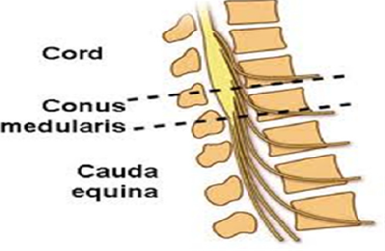
Bulbar and pseudobulbar palsy
Bulbar palsy | Pseudobulbar palsy
B/L LMN defect of IX,X,XI,XII cranial nerves | B/L UMN defect of IX,X,XI,XII cranial nerves
Dysphagia (liquid>solid), nasal regurgitation, slurred speech | Dysphagia, dysarthria, emotional lability
Nasal speech, wasted tongue with fasciculation, absent gag reflex | Slow indistinct speech, spastic tongue, brisk jaw jerk Frontal release signs
Unilateral facial weakness
Upper motor neuron lesion
cause weakness of the lower part of the face on the opposite side. Frontalis is spared: normal furrowing of the brow is preserved; eye closure and blinking are largely unaffected.
Lower Motor Neuron lesion
causes weakness (ipsilateral) of all facial expression muscles. The angle of the mouth falls; unilateral dribbling develops. Frowning (frontalis) and eye closure are weak. Corneal exposure and ulceration occur if the eye does not close during sleep.
Because it receives dual innervation (R & L)
Cauda equina and conus medullaris lesions
Conus medullaris | cauda equina
Bilateral saddle anaesthesia | asymmetric leg weakness and sensory loss
Prominent bowel, bladder symptoms, impotence | Relative sparing of bowel bladder function
Bulbocavernous ( S2-S4) and anal reflexes (S4-S5) are absent | Variable areflexia in lower extremities
Muscle strength largely preserved | Low back and radicular pain

Slide 11
Intramedullary and Extramedullary Syndromes
Extramedullary lesions | Intramedullary lesion
radicular pain is often prominent there is early sacral sensory loss (lateral spinothalamic tract) spastic weakness in the legs (corticospinal tract) due to the superficial location of leg fibers in the corticospinal tract Early UMN signs | Tend to produce poorly localized burning pain, rather than radicular pain Spare sensation in the perineal and sacral areas ("sacral sparing"), reflecting the laminated configuration of the spinothalamic tract with sacral fibers outermost; corticospinal tract signs appear later. Late UMN signs
BLADDER CONTROL
Cortical:
Spinal cord
LMN
Post-central lesions
cause loss of sense of bladder fullness.
Pre-central lesions
cause difficulty initiating micturition.
Frontal lesions cause
socially inappropriate micturition.
(e.g: urinate in front of people)
Bilateral UMN lesions
(pyramidal tracts) cause urinary frequency and incontinence.
The bladder is small
And hypertonic, i.e. sensitive to small changes in intravesical pressure.
Frontal lesions can also
cause a hypertonic bladder.
Sacral lesions
(conus medullaris, sacral root and pelvic nerve – bilateral) cause a flaccid, atonic bladder that overflows (cauda equina), often unexpectedly.

Slide 12
Clinical feature | Site of lesion
Ipsilateral LMN paralysis in the segment | Anterior horn cell
Ipsilateral spastic paralysis below the level | UMNL
Ipsilateral band of cutaneous anesthesia | Posterior root damage
Ipsilateral loss of tactile, vibratory and proprioceptive sensations below the level of the lesion | Dorsal column
Contralateral loss of pain and temperature sensations below the level | Lateral spinothalamic
Contralateral but not complete loss of tactile sensation | Anterior spinothalamic
Ipsilateral dystaxia | Dorsal spinocerebellar
Contralateral dystaxia | Ventral spinocerebellar
Bilateral pain and temperature loss upper limbs | Anterior commissure
All sensory lost | Dorsal horn
All motor lost | Anterior horn

Slide 13
Lower motor neuron lesion can result from :
Cerebral stroke by hemorrhage, thrombosis or embolism
Anterior horn cell lesions
Spinal cord transection or hemisection
Posterior horn cell lesion
2. NCV (nerve conduction velocity) in LMN lesion is :
Increased
Decrease
Normal
Absent
3. Hemiparesis means :
Partial paralysis
Complete paralysis
Weakness
Sensory impairment
4.contralateral loss of pain and temperature sensations below the level of the lesion is due to :
destruction of the crossed anterior spinothalamic tracts on the side of the lesion
destruction of the crossed lateral spinothalamic tracts on the same side of the lesion
destruction of the descending tracts
damage to the neurons on the anterior grey column
5. Tendon reflex in UMN lesion is :
Brisk /increased
Absent
Decreased
Lost
6. Bilateral lesion in the spinal cord lead to :
quadriplegia
monoplegia
paraplegia
hemiplegia
7. Which one of the following is a manifestation of brown sequard syndrome ?
Loss of dorsal column sensation above the level of lesion.
loss of all reflexes below the level of lesion
contralateral loss of pain and temperature below the level of lesion.
8.Contralateral hemianesthesia is:
Loss of sensation on some parts of the opposite side of the body
loss of sensation of both legs
loss of sensation on the upper part of the opposite of the body
loss of all sensation on the opposite side of the body.
9. A patient is having poliomyelitis, what type of lesion are you expecting him to have?
.Upper motor neuron lesion
.Lower motor neuron lesion
Answers:
B
B
C
B
A
C
C
D
B

