Slide 1
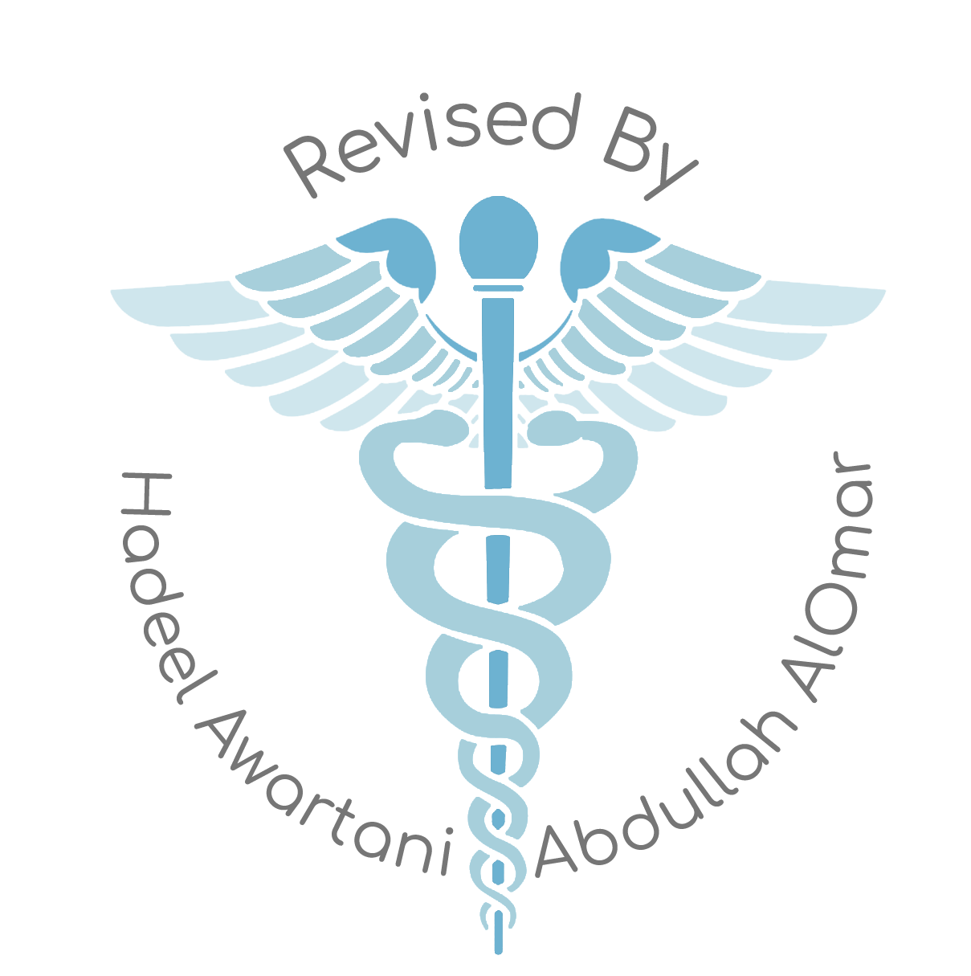
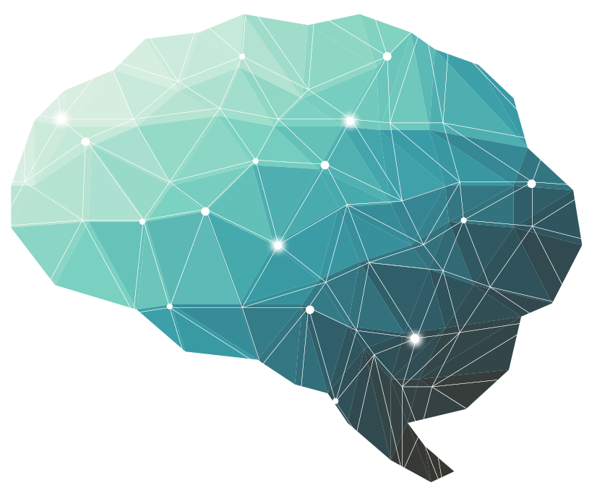
2nd Lecture ∣ The Physiology Team
The Autonomic Nervous System
Objectives:
The anatomy of somatic and autonomic nervous system.
Sympathetic and parasympathetic nerves.
Pre and postganglionic neurons.
Functions of sympathetic and parasympathetic nerves in head & neck, chest, abdomen and pelvis.
Neurotransmitters release at pre and postganglionic sympathetic / parasympathetic nerves endings.
Various responses due to stimulation of the sympathetic / parasympathetic nervous system.
Done by :
Team leaders: Abdulelah Aldossari, Ali Alammari
Fatima Balsharaf, Rahaf Alshammari
Team members: Abdulaziz Aldurgham, Fahad Alfaiz
Khalid Almutairi, Anas Alsaif, Majed Aljohani
Faisal Altahan, Hamdan Aldossari
Colour index:
important
Numbers
Extra
وَأَن لَّيْسَ لِلْإِنسَانِ إِلَّا مَا سَعَىٰ
Notes:
لِلْإِنسَانِ إِلَّا مَا سَعَىٰ (39) وَأَنَّ سَعْيَهُ سَوْفَ يُرَىٰ
BETTER right

Slide 2
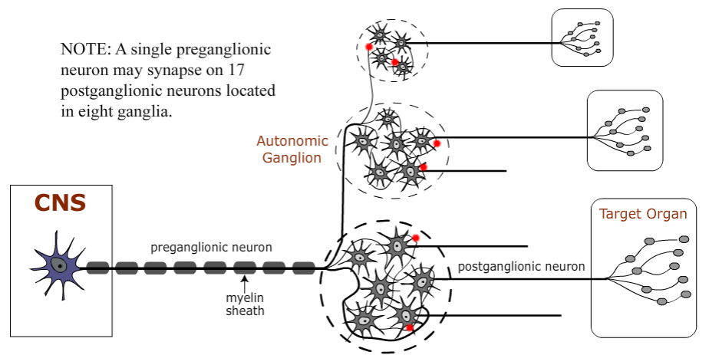
The Nervous system monitors and controls almost every organ / system through a series of positive and negative feedback loops.
The Central Nervous System (CNS): Includes the brain and spinal cord.
The Peripheral Nervous System (PNS): Formed by neurons & their process present in all the regions of the body.
It consists of cranial nerves arising from the brain & spinal nerves arising from the spinal cord.
The peripheral NS is divided into
Somatic Nervous system
Autonomic nervous system
Autonomic Nervous system
Visceral Efferent Two-Neuron Pathway
Visceral efferent (VE) pathways that innervate smooth muscle, cardiac muscle, and glands involve two neurons and a synapse within an autonomic ganglion. The cell bodies of the preganglionic neurons are in the brainstem or spinal cord of the central nervous system (CNS). The cell bodies of the postganglionic neurons are in autonomic ganglia located peripherally. Axon terminal of preganglionic neurons synapse on dendrites and cell bodies of postganglionic neurons. (In contrast, somatic efferent (SE) innervation of skeletal muscle involves only a single neuron; its cell body in the CNS.)
The advantage of two neurons is conservation of
space in the CNS, by shifting neurons into the
spacious periphery.
The small number of CNS neurons utilize divergent
circuits to drive the numerous peripheral neurons.
(This strategy has succeeded, in just gut wall alone
there are more neurons than in the entire spinal cord.)
The disadvantage of moving neurons out of the CNS
is reduced brain control, but decreased brain control is not a problem in the case of visceral organs which have a limited repertoire of actions. Preganglionic axons are myelinated, which means that they conduct more rapidly than do the numerous non-myelinated postganglionic axons. However, non-myelinated axons are metabolically more efficient and reduced conduction speed is not a problem in cases of smooth muscle contraction and gland secretion.
The following schematic image shows locations of a number of autonomic ganglia (yellow ovals) in the periphery. A bilateral chain of paravertebral ganglia is located beside vertebral bodies in thoracic and abdominal cavities. Prevertebral ganglia are located around major vessels within the abdomen. Cervical ganglia are located in the vicinity of the neck.

Slide 3
Visceral motor innervates non-skeletal (non-somatic) muscles :
Cardiac muscle
Smooth muscle (walls of viscera and blood vessels)
Internal organs
Skin
Basic anatomical difference between the motor pathways of the voluntary somatic nervous system (to skeletal muscles) and those of the autonomic nervous system:
Somatic division :
Cell bodies of motor neurons reside in CNS (brain or spinal cord).
Their axons (sheathed in spinal nerves) extend all the way to their skeletal muscles.
Note : somatic signaling is faster because it is heavily myelinated
Autonomic system :
chains of two motor neurons
1st neuron: preganglionic neuron (in brain or spinal cord).
2nd neuron: ganglionic neuron (cell body in ganglion outside the CNS).
Note : autonomic signaling is slower because it is lightly or unmyelinated
Basic concept: Autonomic nervous system is the subdivision of the peripheral nervous system that regulates body activities that are generally not under conscious control.
Subdivisions of the Autonomic nervous system:
Sympathetic
Parasympathetic
Enteric “Second Brain”

Slide 4
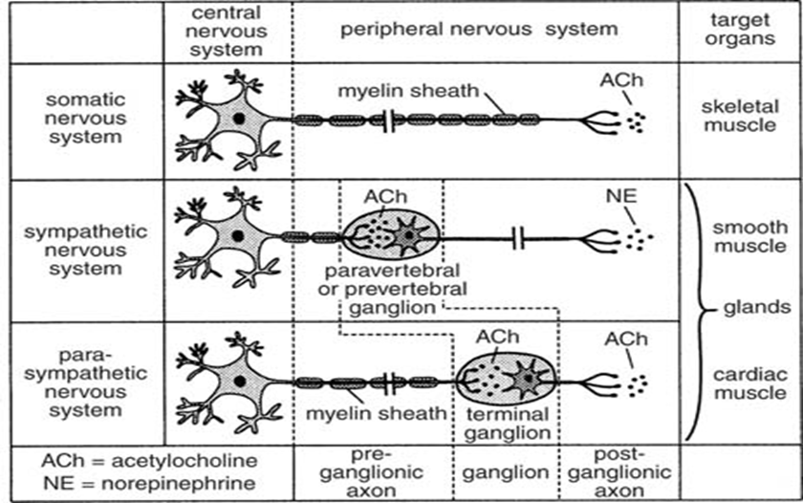
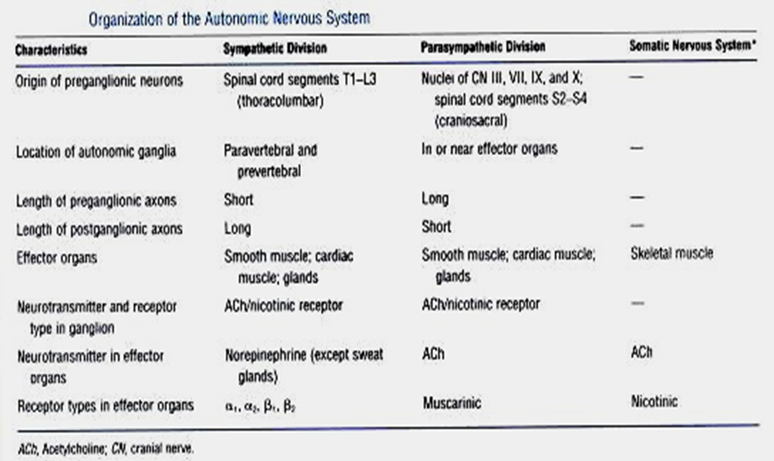
ANS activated by
ANS operates by
centers located in the spinal cord, brain stem, hypothalamus and also cerebral cortex especially the limbic cortex can transmit signals to the lower centers, influence autonomic control.
visceral reflexes. Subconscious sensory signals from a visceral organ enter the autonomic ganglia, brain stem or hypothalamus and then return subconscious reflex responses directly back to the visceral organ to control its activities.
DIFFERENCES IN SYMPATHETIC AND PARASYMPATHETIC DIVISIONS
organization of the autonomic nervous system

Slide 5
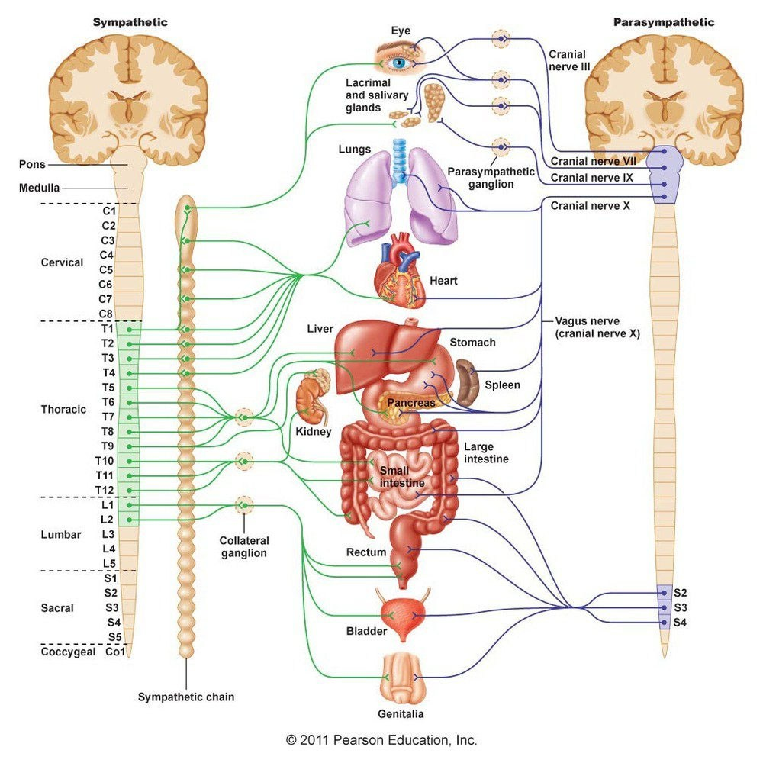
Axon of 1st (preganglionic) neuron leaves CNS to synapse with the 2nd (ganglionic) neuron
↓
Axon of 2nd (ganglionic) neuron extends to the organ it serves
Locations Of Autonomic Ganglia
Sympathetic Ganglia:
Trunk (chain) ganglia near vertebral bodies.
Prevertebral ganglia near large blood vessel in the gut: celiac, superior mesenteric & inferior mesenteric.
Parasympathetic Ganglia:
Terminal ganglia
In the wall of organ
Innervation Of Visceral Targets
Sympathetic:
Short, lightly myelinated preganglionic neurons
Long, unmyelinated postganglionic neurons
The sympathetic axons are Highly branched
note: Ganglia close to spinal cord
Parasympathetic:
Preganglionic neurons - long, & myelinated.
Postganglionic neurons - short & unmyelinated
The parasympathetic axons contain few branches
note: Ganglia close to or on target organs
See the Introduction to know why

Slide 6
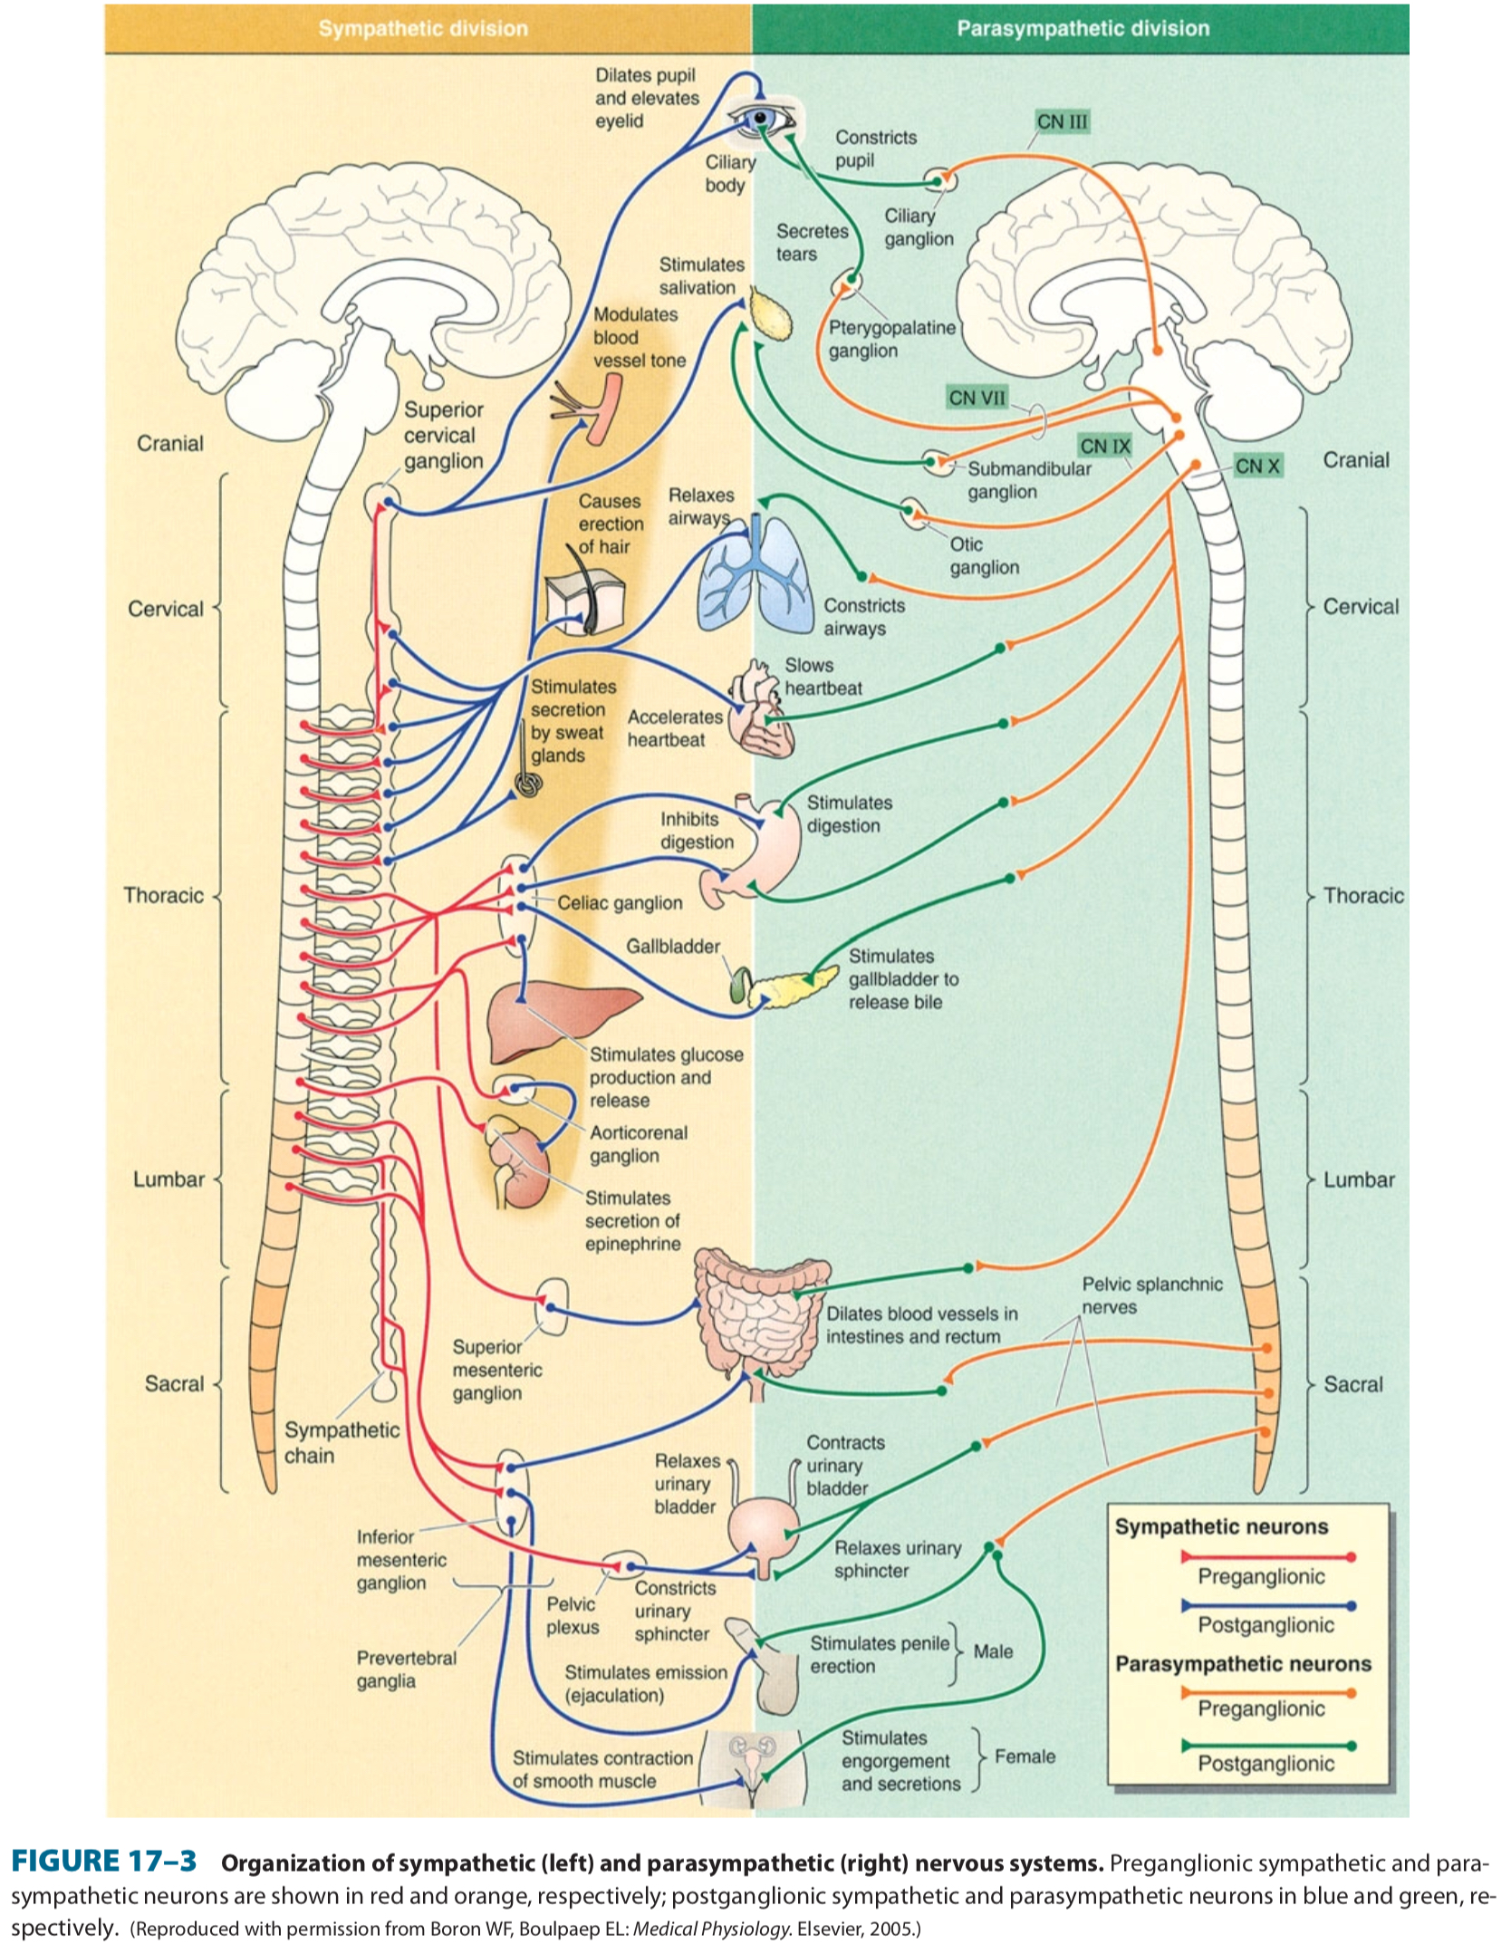
Sympathetic & parasympathetic nervous system origin:
Sympathetic - Origin:
Thoracolumbar lateral horns of the spinal segment T1 - L2.
Nerve fibers originate between T1 & L2.
Parasympathetic - Origin:
Craniosacral cell bodies of the motor nuclei of the cranial nerves III, VII, IX and X in the brain stem.
Second, third and fourth [S2-S4] sacral segments of the spinal cord.
Nerve fibers emerge from brain & sacrum forming craniosacral outflow.

Slide 7
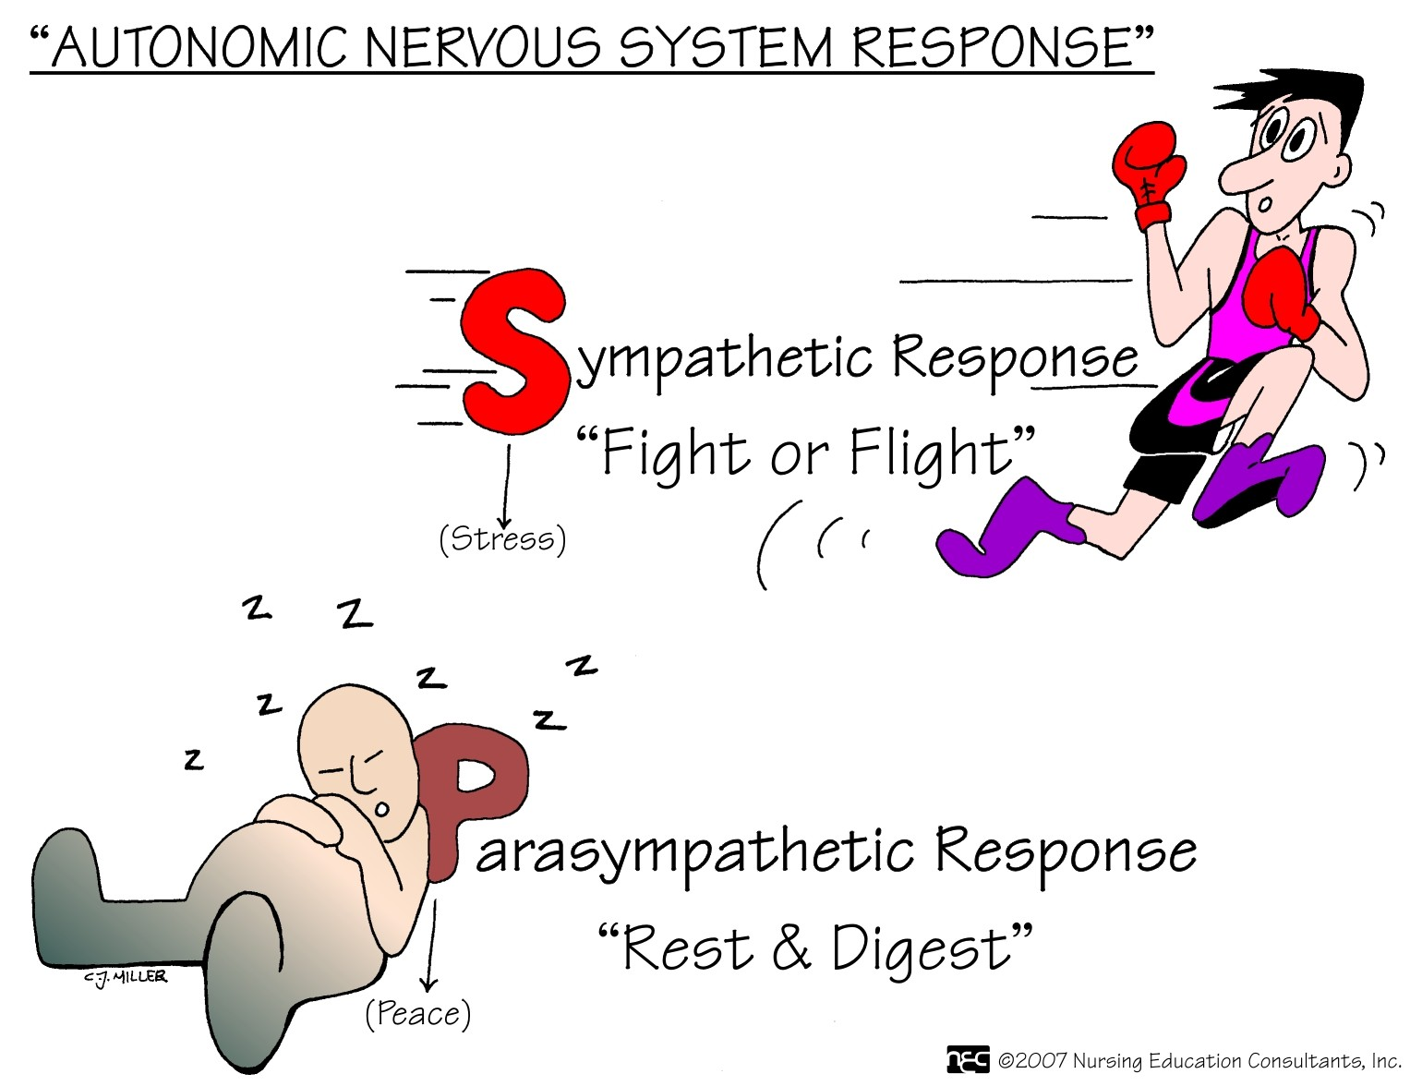
Parasympathetic Nervous system:
The cranial nerves III, VII and IX affect the pupil and salivary gland secretion.
Vagus nerve (X) carries fibres to the heart, lungs, stomach, upper intestine and ureter.
The sacral fibres form pelvic plexuses which innervate the distal colon, rectum, bladder and reproductive organs.
Autonomic nervous system divisions:
Sympathetic:
“Fight or Flight”
“Alarm Reaction”
“E” division (exercise, excitement, emergency, and embarrassment.)
Parasympathetic:
“Rest and digest”
“SLUDD” responses:
salivation, lacrimation, urination, digestion & defecation.
”D” division
Digestion, defecation, and diuresis
Paradoxical fear: when there is no escape route or no way to win causes massive activation of parasympathetic division
loss of control over urination and defecation

Slide 8
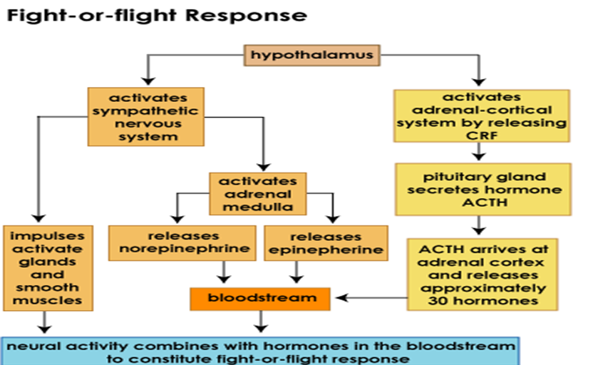
Functions of Sympathetic nervous system
Fear - Flight - Fight :
The sympathetic nervous system allows the the body to be prepared for the Fear-Flight-Fight situations.
Sympathetic responses also contribute to Increase in heart rate , blood pressure , and cardiac output.
It diverts blood flow away from the GIT “splanchnic vessels ”and skin via vasoconstriction.
Blood flow to skeletal muscles, lungs is not only maintained, but enhanced (by as much as 1200%), in case of skeletal muscles.
Increase pupil size , bronchial dilatation , and contraction of sphincters and metabolic changes such as the mobilisation of fat and glycogen.
Bronchioles dilate Increase alveolar oxygen exchange.
Increases heart rate and contractility of skeletal muscles (Myocytes) Will increase blood flow to skeletal muscles.
Dilation of the pupil and relaxation of lens Allow MORE light to enter through the eye.
Functions of Parasympathetic nervous system
Rest and Digest :
In physiological terms, the parasympathetic system is concerned with conservation and restoration of energy, as it causes a reduction in heart rate and blood pressure, and facilitates digestion and absorption of nutrients, and consequently the excretion of waste products.
The chemical transmitter at both pre and postganglionic synapses in the parasympathetic system is Acetylcholine (Ach).

Slide 9
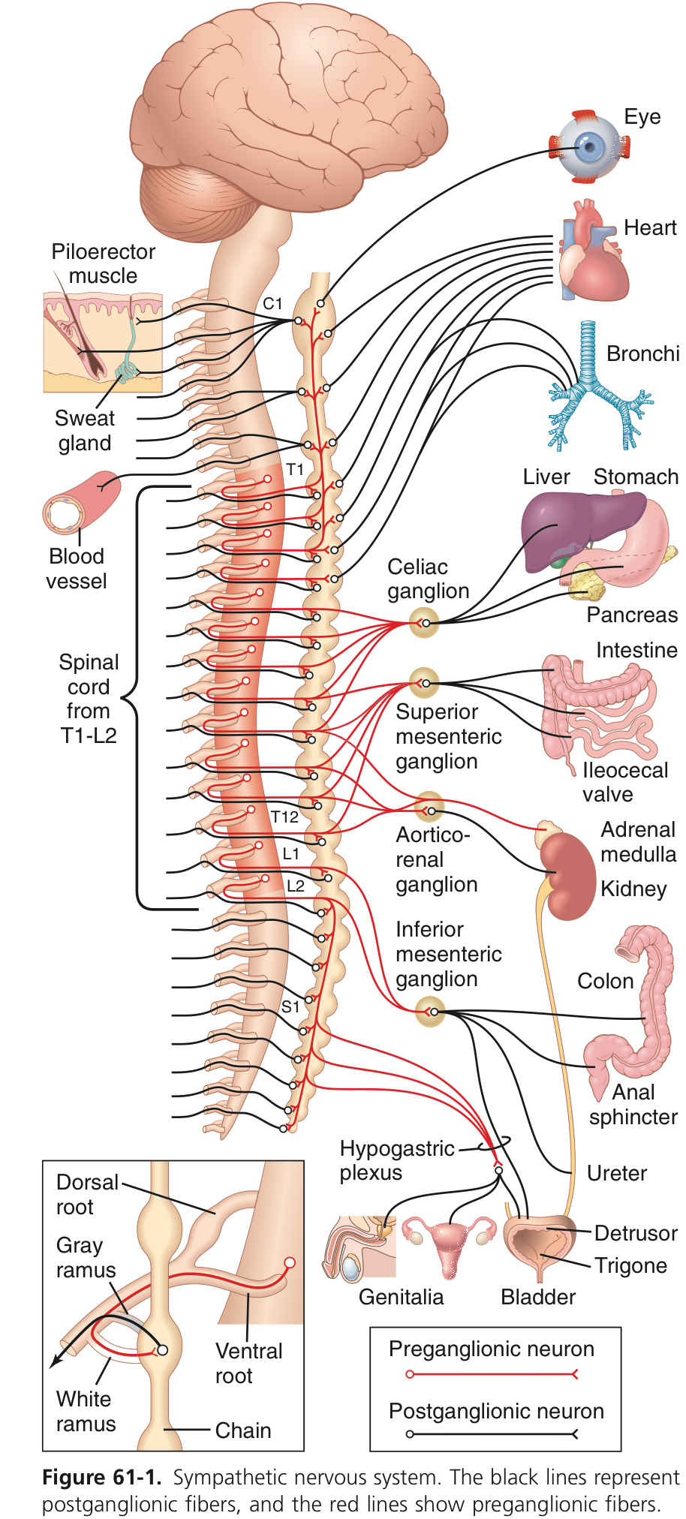
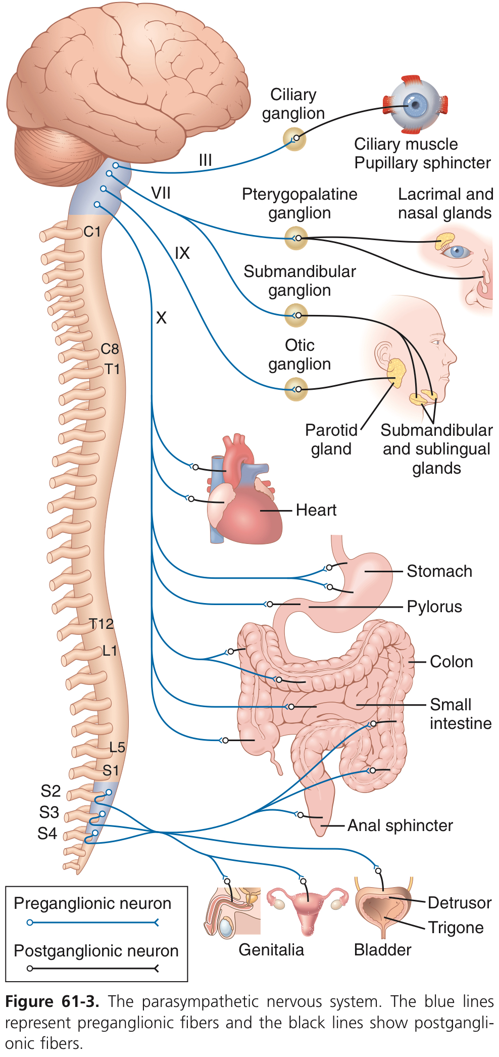
Autonomic nervous system
Subdivisions | Nerves Employed | Location of Ganglia | Chemical Messenger | General Function
Sympathetic | Thoracolumbar | Alongside vertebral column | Norepinephrine | Fight or flight
Parasympathetic | Craniosacral | On or near an effect organ | Acetylcholine | Conservation of body energy

Slide 10
Structure | Sympathetic Stimulation | Parasympathetic Stimulation
Iris (eye muscle) | Pupil dilation | Pupil constriction
Salivary Glands | Saliva production reduced | Saliva production increased
Oral/Nasal Mucosa | Mucus production reduced | Mucus production increased
Heart | Heart rate and force increased | Heart rate and force decreased
Lung | Bronchial muscle relaxed | Bronchial muscle contracted
Stomach | Peristalsis reduced | Gastric juice secreted; motility increased
Small Intes | Motility reduced | Digestion increased
Large Intes | Motility reduced “Constipation” | Motility increased
Liver | Increased conversion of glycogen to glucose | No effect
Kidney | Decreased urine secretion | Increased urine secretion
Adrenal medulla | Norepinephrine and epinephrine secreted | No effect
Bladder | Wall relaxed Sphincter closed | Wall contracted Sphincter relaxed
Doctor’s Notes:
Sympathetic overstimulation in liver =increased conversion of glycogen to glucose that lead to diabetes
Sympathetic overstimulation in large intes. leads to constipation
Notice that both E 80% + NE 20% released from adrenal medulla, while in neuromuscular junction only NE is released.

Slide 11
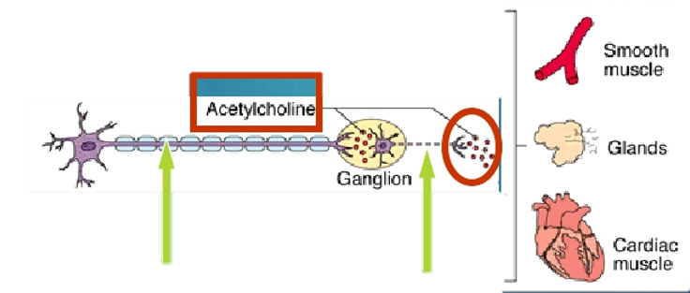
1-Sympathetic neurons Neurotransmitters
A- Preganglionic neurons
Cholinergic: release acetylcholine .
B-Postganglionic neurons:
Adrenergic: release norepinephrine at target organs. except Sweat glands and
blood vessels to skeletal muscles where they release Ach
2-Parasympathetic Neurotransmitters
Pre & Postganglionic neurons:
Cholinergic: release acetylcholine

Slide 12
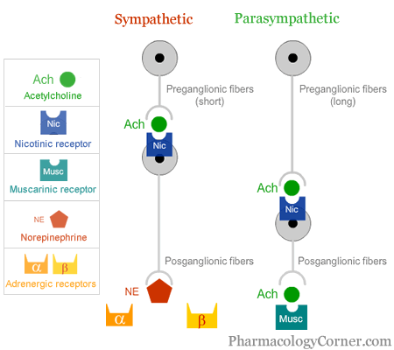
ANS Receptors
cholinergic
based upon the neurotransmitter released
adrenergic
Chemical or neural transmitter
All preganglionic fibers release acetylcholine (Ach).
All parasympathetic postganglionic release Ach.
All sympathetic postganglionic release noradrenaline except sweat glands & blood vessels to skeletal muscles
Receptors
The parasympathetic nervous system uses only acetylcholine (ACh) as its neurotransmitter. The ACh acts on two types of receptors, the muscarinic and nicotonic receptors.
Note:​ nicotine is agonist to nicotinic receptor , and antagonist to muscarinic receptor , and vise versa.
Muscarinic receptors are found on all effector cells that are stimulated by the postganglionic cholinergic neurons of either the parasympathetic nervous system or the sympathetic system.
Nicotinic receptors are found in the autonomic ganglia at the synapses between the preganglionic and postganglionic neurons of both the sympathetic and parasympathetic systems.
Most transmissions occur in two stages:When stimulated, the preganglionic nerve releases ACh at the ganglion, which acts on nicotinic receptors of the postganglionic nerve.
The postganglionic nerve then releases ACh to stimulate the muscarinic receptors of the target organ.

Slide 13
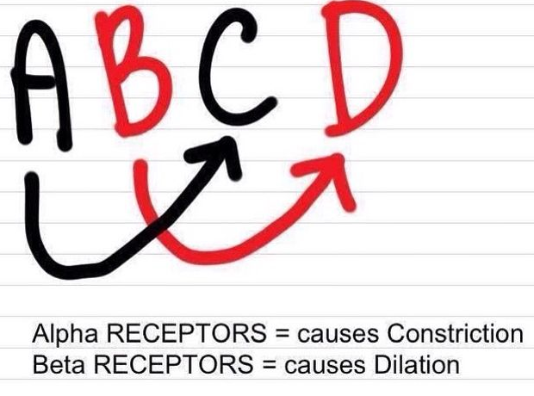
The Sympathetic NS Acts on two types of receptors
What do the receptors do?
α
β
β1
β2
smooth muscle contraction
smooth muscle contraction (especially in heart)
smooth muscle relaxation

Slide 14
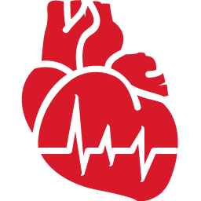
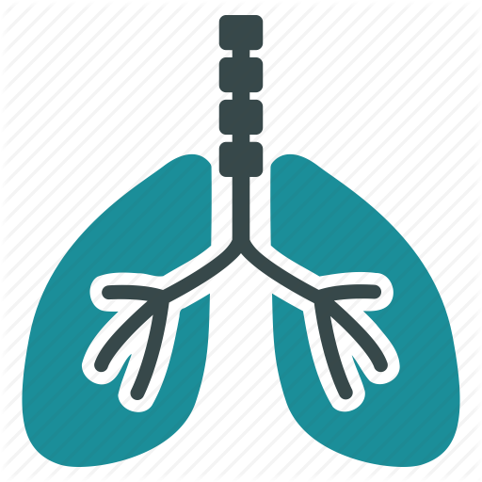
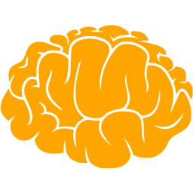
sympathetic
adrenergic
circulatory system
parasympathetic
muscarinic
cardiac output
SA node: heart rate (chronotropic)
cardiac muscle: contractility (inotropic)*
conduction at AV node
vascular smooth muscle**
platelets
mast cells-histamine
M1
increases
α2
increases
decreases
aggregates
β1
inhibits
M2
respiratory system
β2
relaxes (major contribution)
smooth muscles of bronchioles
contracts
contracts (minor contribution)
nervous system
M3
α1
relaxes
relaxes
pupil of eye ciliary muscle
contracts
*(atria only)
**has only sympathetic activity with the following receptors
M3: contracts; α = contracts; β2 = relaxes

Slide 15
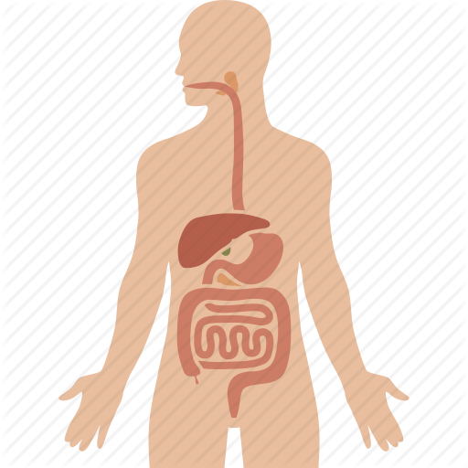
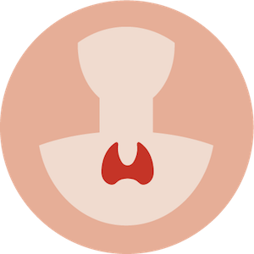
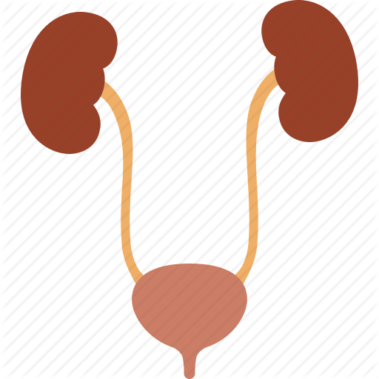
sympathetic
adrenergic
digestive system
parasympathetic
muscarinic
stimulates viscous, amylase secretions
salivary glands: secretions lacrimal glands (tears) kidney (renin) parietal cells liver GI tract motility smooth muscles of GI tract sphincters of GI tract
stimulates watery secretions
stimulates potassium cation
decreases
α1
secretes
increases
secration
M1
glycogenolysis, gluconeogenesis
α2
contracts
decreases
increases
increases
α:relaxes
M2
relaxes
relaxes
endocrine system
β1
pancreas (islets)
adrenal medulla
contracts
decreases secretion
N: secretes epinephrine
urinary system
bladder wall ureter sphincter sweat gland secretions
arrector pili
β2
relaxes
contracts
M3
contracts
relaxes
relaxes
relaxes
contracts
α1
stimulates(minor contribution)
stimulates
note: if there is only an arrow that means the effect has no specific receptor mentioned in the lecture

Slide 16
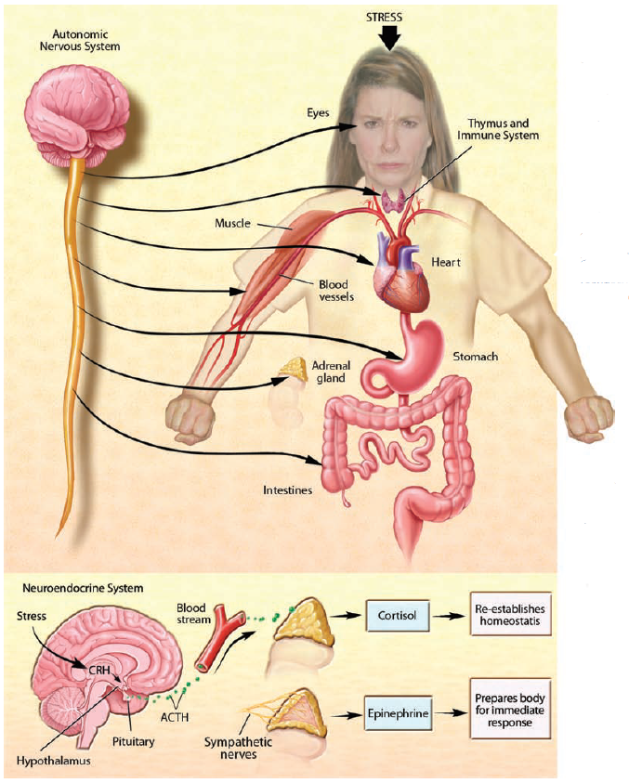
Postural orthostatic tachycardia syndrome:
Postural orthostatic tachycardia syndrome (POTS) is a condition characterized by too little blood returning to the heart when moving from a lying down to a standing up position (orthostatic intolerance). Orthostatic Intolerance causes lightheadedness or fainting that can be eased by lying back down. In people with POTS, these symptoms are also accompanied by a rapid increase in heart rate.
The stress reaction:
When stress occurs, the sympathetic nervous system is triggered. Norepinephrine is released by nerves, and epinephrine is secreted by the adrenal glands. By activating receptors in blood vessels and other structures, these substances ready the heart and working muscles for action. Acetylcholine is released in the parasympathetic nervous system, producing calming effects. The digestive tract is stimulated to digest a meal, the heart rate slows, and the pupils of the eyes become smaller. The neuroendocrine system also maintains the body’s normal internal functioning.

Slide 17
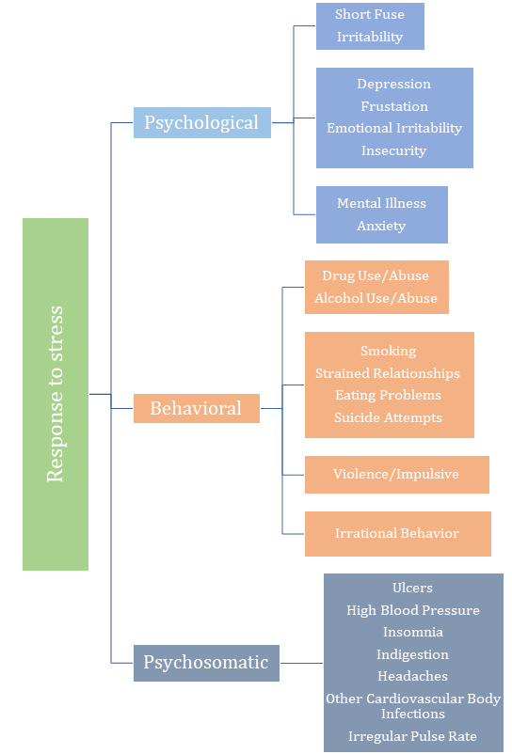
Chronic stress:
When glucocorticoids or adrenaline are secreted in response to the prolonged psychological stress commonly encountered by humans, the results are not ideal. Normally, bodily systems gear up under stress and release hormones to improve memory, increase immune function, enhance muscular activity, and restore homeostasis. If you are not fighting or fleeing, but standing frustrated in a supermarket checkout line or sitting in a traffic jam, you are not engaging in muscular exercise. Yet these systems continue to be stimulated, and when they are stimulated chronically, there are different consequences: Memory is impaired, immune function is suppressed, and energy is stored as fat.

Slide 18
Release of epinephrine from the adrenal medulla would initially cause
hepatic glycogen synthesis
decreased strength of heart contraction
contraction of ciliary muscle
decreased salivation
2. Targets of the autonomic nervous system include all of the following except
endocrine system
exocrine system
skeletal muscle
cardiac muscle
3. which of the following cranial nerves doesn’t contain preganglionic parasympathetic fibers?
II
III
VII
IX
4. somatic motor neurons have cell bodies located __ the CNS that project axons only to __; and are usually under __ control
inside, skeletal muscle, voluntary
outside. skeletal muscle, involuntary
inside, the viscera, involuntary
inside, the viscera, voluntary
5. Vagus nerve carries fibers to all the following except
Stomach
Ureter
Bladder
Heart
Answers:
1.D
2.C
3.A
4.A
5.C

