Slide 1
ما أبي أوزع بناء على الابجكتفز لأن مثلا اللي بياخذ الاوتورجيوليشن مثلا بيسوي 20 سلايد والثاني 10 بس :) وهذا فيه ظلم شوي، فقررت أخليها بناء على عدد السلايدات النص بالنص:
1-15 ماجد
16-30 رشيد
---------------------
ملاحظة:
لاتنسون تشيكون على:ش
أ- المرجع ---> صور واذا فيه جداول او نقاط شارحها بطريقة حلوة
ب- كتب ال High yield: e.g first aid, kaplan, linda لنفس السبب فوق
ج- التيم عشان تشيكون اذا فيه نقاط ناقصة ومهمة (موب حشو كلام) عشان نضيفها
الصورة في السلايدات وجودتها سيئة حاولوا تجيبون وحدة نفس الفكرة لكن أفضل جودة
--------------------------------------------------
المرجع هو قايتون وقانونج، اذا تبوني ارسلها لكم كلموني واتس
-------------------------------------
الله يوفقكم ويجزاكم خير على تعبكم
22th Lecture ∣ The Physiology Team
AUTOREGULATION OF CEREBRAL BLOOD FLOW
Objectives:
Describe cerebral circulation & circle of Willis
Explain main arteries that supply blood to brain
Normal Rate of Cerebral Blood Flow
Explain auto-regulation of cerebral blood flow
Explain the factors affecting the cerebral blood flow
Effects of impaired cerebral blood circulation
Done by :
Team leaders: Abdulelah Aldossari, Ali Alammari
Fatima Balsharaf, Rahaf Alshammari
Team members: Majed Aljohani, Rasheed Alballa
Colour index:
important
Numbers
Extra
وَأَن لَّيْسَ لِلْإِنسَانِ إِلَّا مَا سَعَىٰ
Notes:
لِلْإِنسَانِ إِلَّا مَا سَعَىٰ (39) وَأَنَّ سَعْيَهُ سَوْفَ يُرَىٰ
BETTER right

Slide 2
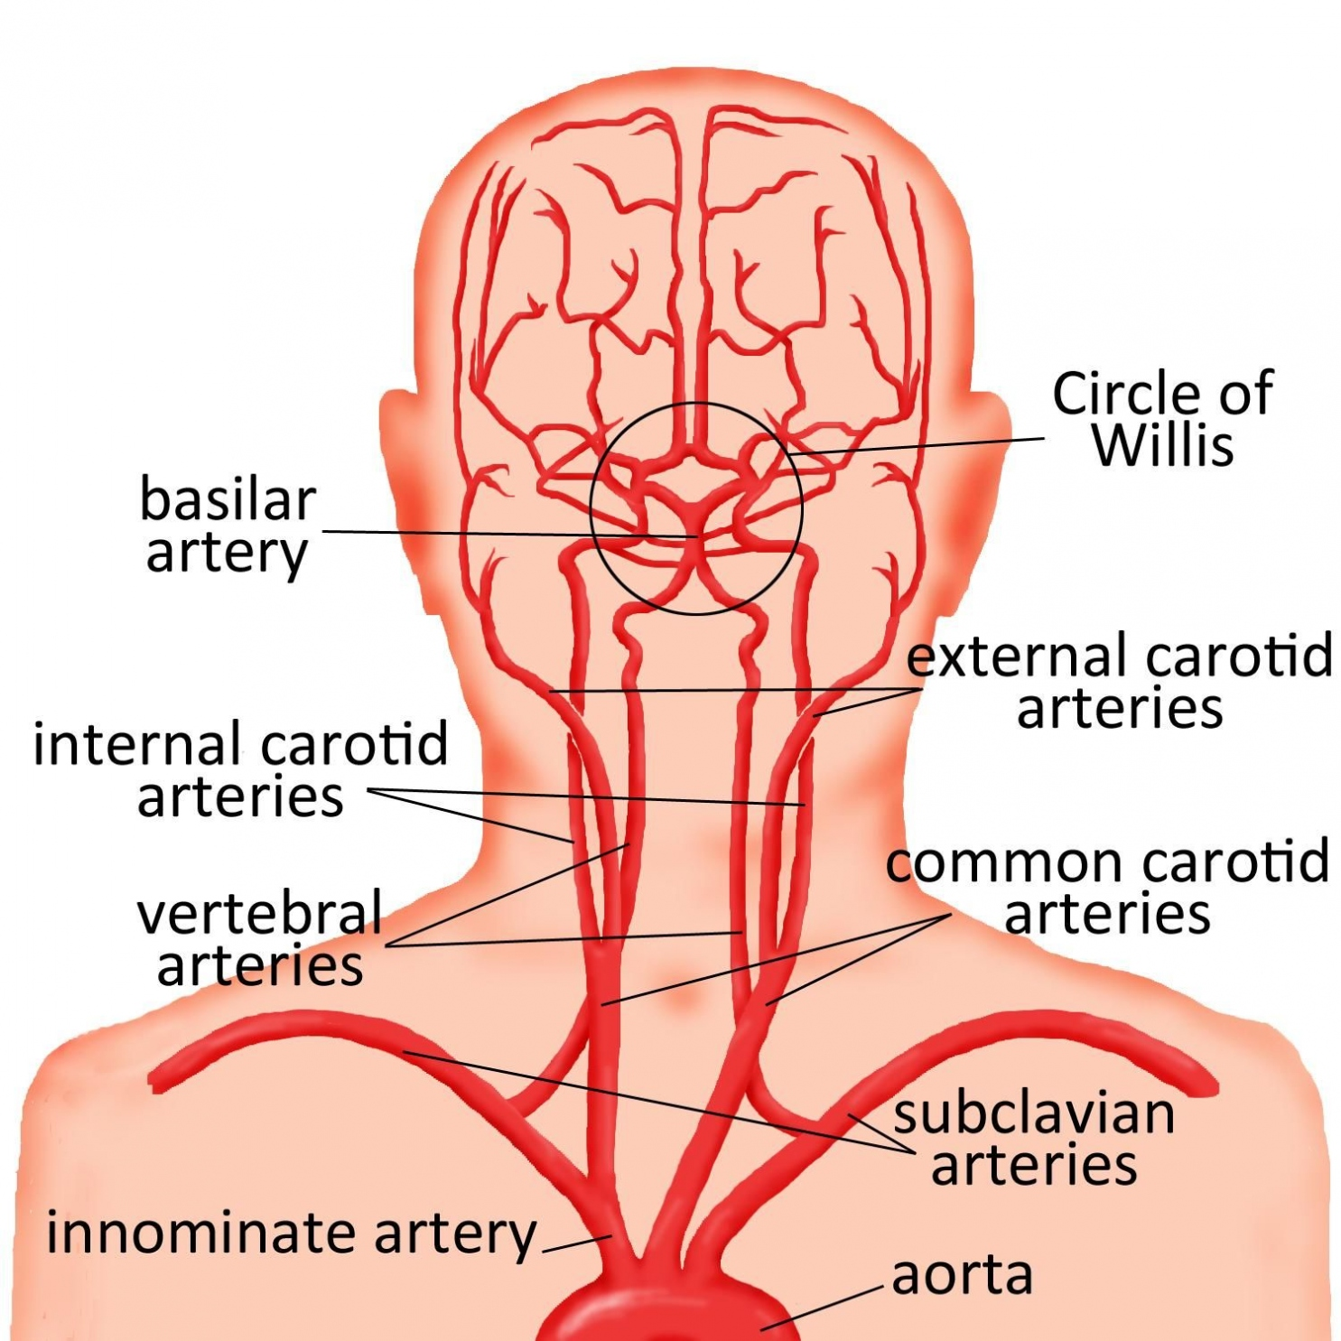
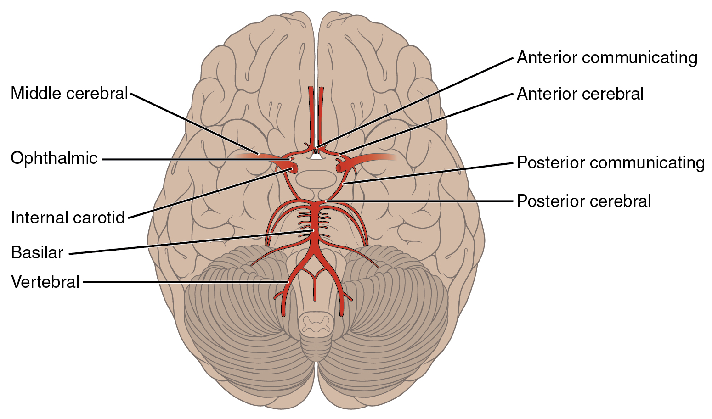
CEREBRAL CIRCULATION
Brain receive its blood supply from four main arteries: - Two internal carotid arteries - Two vertebral arteries.
The vertebral arteries unite to form Basilar artery.
The basilar artery and the carotids arteries form the circle of Willis.
The circle of Willis is origin of six large vessels
circle of Willis
basilar artery
internal carotid artery
vertebral artery
vertebral artery
internal carotid artery
Carotid artery injection
Clinical significance
The clinical consequences of vascular disease in the cerebral circulation is depend upon which vessels or combinations of vessels are involved.
Substances injected into one carotid artery distributed completely to the cerebral hemisphere on that side. Normally no crossing over occurs because of equal pressure on both sides.
Notes:
THE WORK IS NOT DONE YET

Slide 3
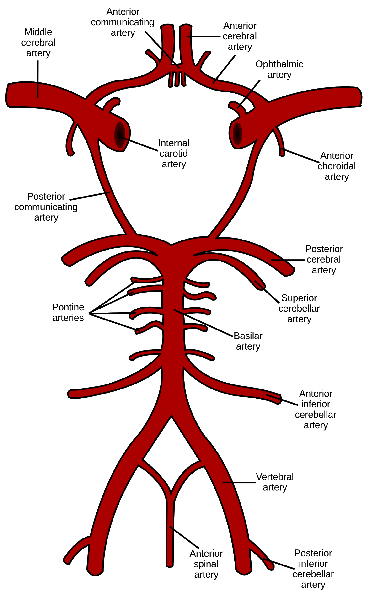
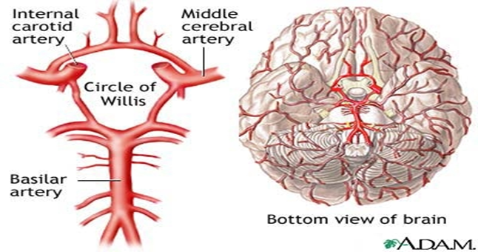
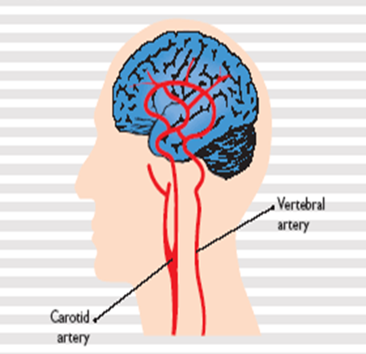
CEREBRAL CIRCULATION
The circle of Willis consists of six large Vessels:
1-Anterior cerebral artery (left and right) Anterior communicating artery
2-Internal carotid artery (left and right)
3-Posterior cerebral artery (left and right) Posterior communicating artery (left and right) Basilar artery
N.B: The middle cerebral arteries, supplying the brain, are not considered part of the circle.
Group of arteries near the base of the brain which is called the Arterial Circle of Willis. English physician, Thomas Willis, who discovered it and then published findings in 1664, on Cerebri anatomi
Notes:
THE WORK IS NOT DONE YET

Slide 4
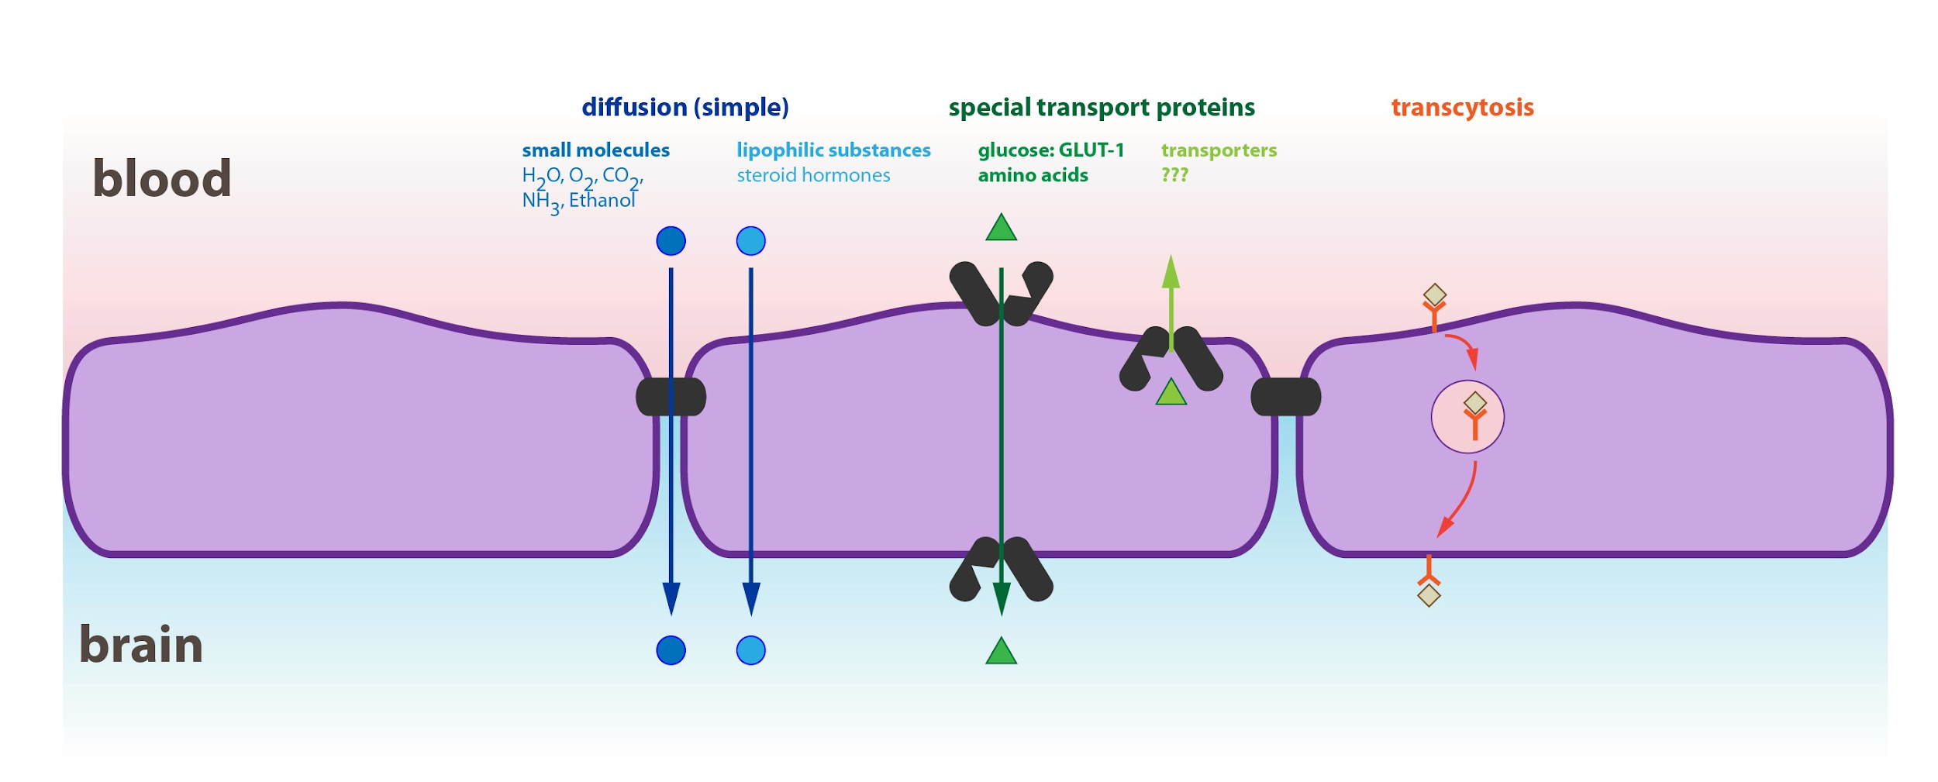
Innervation
Three systems of nerves innervate the cerebral blood vessels:
Sympathetic: Postganglionic sympathetic neurons have their bodies in the superior cervical ganglia. During acute hypertension it attenuates the increase in CBF.
Parasympathetic: Cholinergic neuron originate in sphenopalatine ganglia end on large arteries.
Sensory nerves.
Blood Brain Barrier
It is between blood & CSF & brain tissue
Choroid plexus epithelial cells (astro & pericytes).
At brain capillary membrane (endothelial cells ).
Penetration of substances into the brain
Functions of BBB
Molecules pass easily:
H2O, CO2, O2, lipid-soluble
substances(as steroid hormones). Molecules not pass:
proteins, antibodies, non- lipid soluble large molecules. Slight penetration: cl, Na, K Glucose : its passive penetration is slow, but is transported across brain capillaries by GLUT1
Maintains the constancy of the environment of the neurons in the CNS.
Protection of the brain from endogenous and exogenous toxins.
Prevent escape of the neurotransmitters into the general circulation.
Notes:
Girls slides only

Slide 5
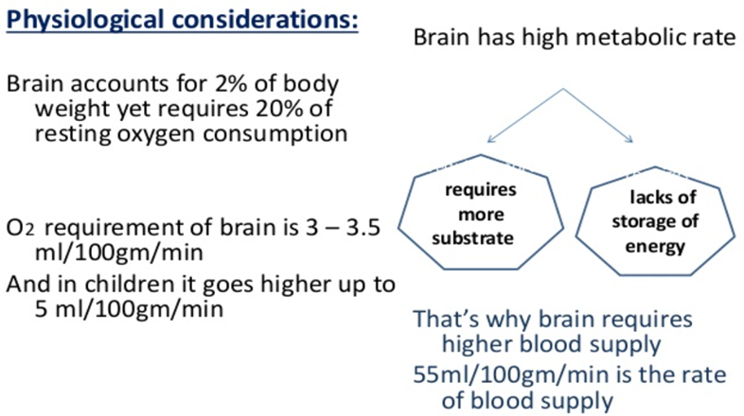
CEREBRAL BLOOD FLOW
CBF is tightly regulated to meet the brain's metabolic demands
Normal Rate of Cerebral Blood Flow
Brain: 1350 gm; 2% of Total Body Weight
Normal blood flow through the brain of the adult person average
50 to 65 ml/ per 100 grams of brain tissue per minute.
For entire brain: 750 to 900 ml/min, 15 percent of the resting cardiac output.
ischemia
It is important to maintain CBF within narrow limits because too much blood can raise intracranial pressure(ICP) which can compress and damage delicate brain tissue.
Too little blood flow causes ischemia.
Ischemia results if blood flow to the brain is below 18 to 20 ml / 100 g / min
Tissue death occurs if flow drops below 8 to 10 ml / 100 g / minute.
Notes:
THE WORK IS NOT DONE YET

Slide 6
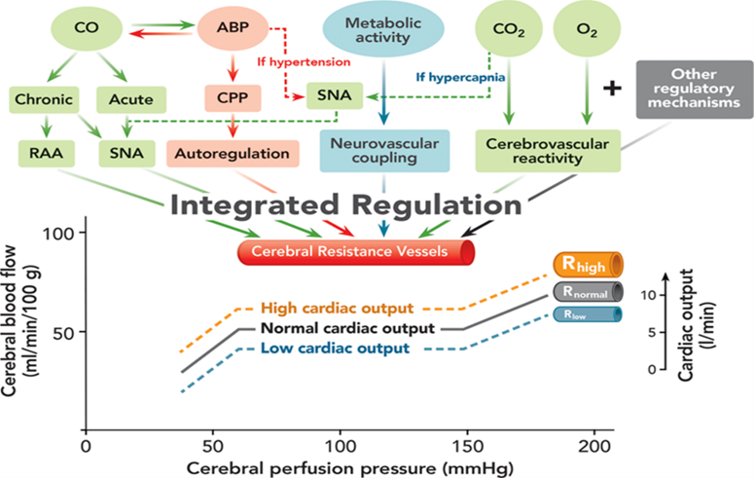
Cerebral perfusion pressure(CPP)
Cerebral perfusion pressure (CPP):-
The net pressure of blood flow to the brain. CPP can be defined as:
CPP is regulated by two balanced, opposing forces: 1-Mean Arterial pressure (MAP) is the force that pushes blood into the brain 2-intracranial pressure (ICP) force that pushes out.
CPP is normally between 70 - 90 mmHg in an adult human
CPP = MAP − ICP
REGULATION OF CEREBRAL BLOOD FLOW
For your understanding
Cardiac output (CO); Sympathetic nervous activity (SNA);Renin–angiotensin–aldosterone (RAA) system; Arterial blood pressure (ABP); Cerebral perfusion pressure (CPP); Carbon dioxide (CO2) and oxygen (O2) (R) Cerebral resistance vessels at high (Rhigh), normal (Rnorm), and low (Rlow)
Notes:
THE WORK IS NOT DONE YET

Slide 7
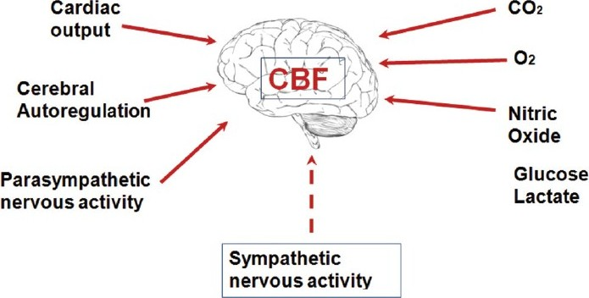
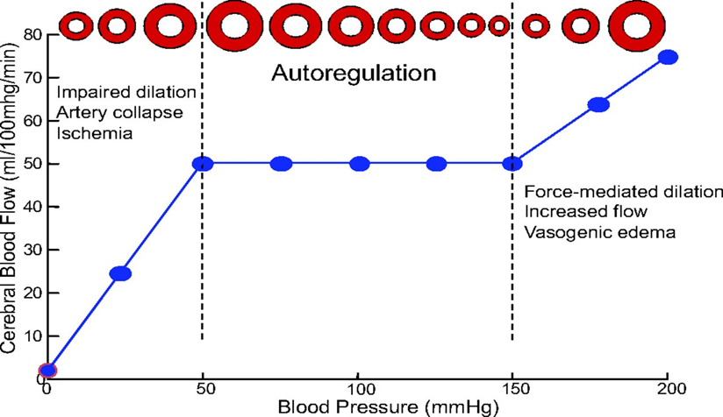
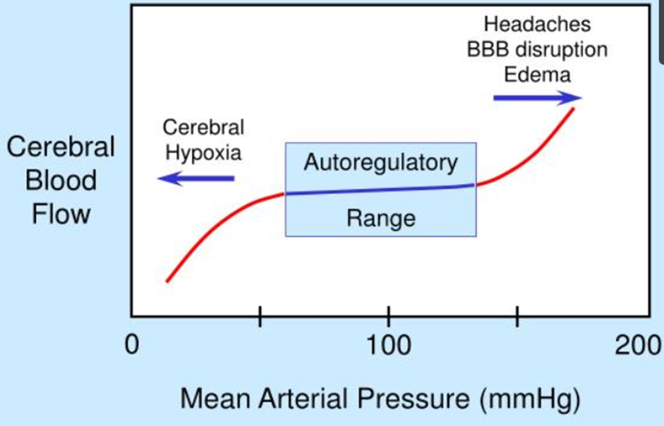
REGULATION OF CEREBRAL BLOOD FLOW
CBF is “auto-regulated” well between arterial pressure limits of 60 and 140 mm Hg.
Notes:
THE WORK IS NOT DONE YET

Slide 8
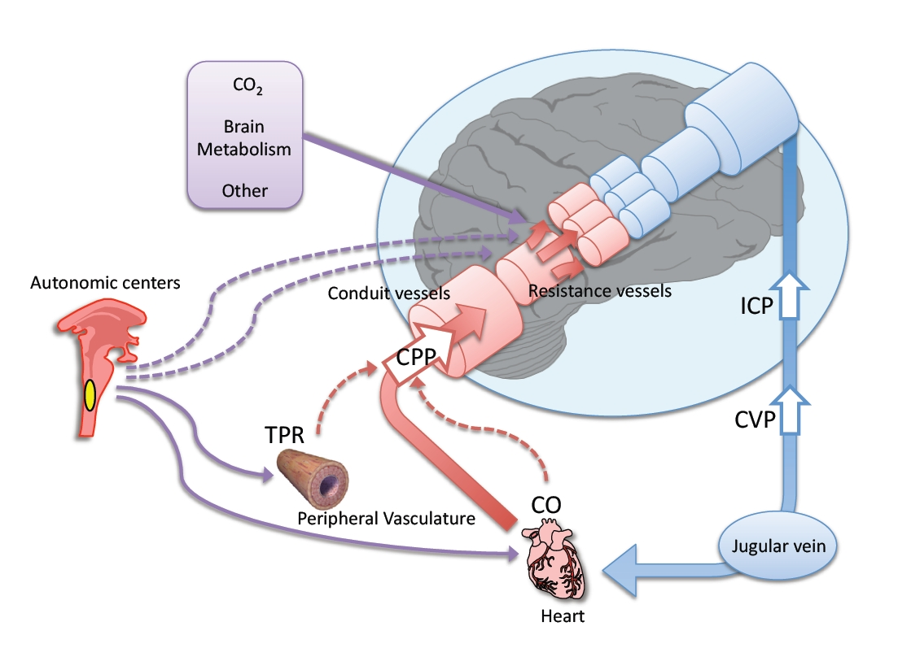
1- Myogenic/Pressure Autoregulation:
Arterioles dilate or constrict in response to changes in BP and ICP in order to maintain a constant CBF
Myogenic theory: The vascular smooth muscles are highly responsive to changes in pressure, a process called myogenic activity, that contributes to auto-regulation of cerebral blood flow.
Vascular smooth muscle within cerebral arterioles contract to stretch response, regulating pressure changes. Autoregulation of CBF completely BP-dependent
Cerebral blood flow is well extremely “auto-regulated” between arterial pressure limits of 60 and 140 mm Hg.
Mean arterial pressure can be decreased acutely to as low as 60 mm Hg or increased to as high as 140 mm Hg without significant change in cerebral blood flow.
Hypertension, auto-regulation of cerebral blood flow occurs even when the mean arterial pressure rises to as high as 160 to 180 mmHg. If arterial pressure falls below 60 mmHg, cerebral blood flow become severely decreased.
Notes:
THE WORK IS NOT DONE YET

Slide 9
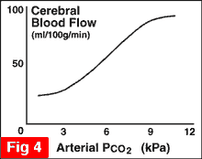
Arterioles dilate in response to potent chemicals that are by-products of metabolism such as lactic acid, carbon dioxide and pyruvic acid
Cerebral blood flow is highly related to metabolism of the tissue. Three metabolic factors have potent effects in controlling the cerebral blood flow. (1) Carbon dioxide concentration, (2) Hydrogen ion concentration, (3) Oxygen concentration.
2- Metabolic Autoregulation
Carbon dioxide concentration
CBF and CO₂
Carbon dioxide concentration
CO2 is a potent vasodilator
Increased CO2/decreased BP →vasodilation
Decreased CO2/increased BP →vasoconstriction
Increase Carbon dioxide (Hypercapnia) causes cerebral vasodilation.
As the arterial tension of CO2 rises, CBV and CBF increases
When it is decreased vasoconstriction is induced
70 % increase in arterial PCO2, approximately doubles the cerebral blood flow
Metabolic Autoregulation
Oxygen concentration.
Oxygen concentration.
The rate of utilization of oxygen by the brain tissue remains within narrow limits—almost exactly 3.5 (± 0.2) ml of oxygen per 100 grams of brain tissue per minute.
If blood flow to the brain insufficient to supply this needed amount of oxygen, the oxygen deficiency mechanism causing vasodilation, returning the brain blood flow and transport of oxygen to the cerebral tissues to normal.
Decrease in cerebral tissue PO2 below about 30 mm Hg (normal value is 35 to 40 mm Hg) immediately begins to increase cerebral blood flow.
Brain function becomes unbalanced at lower values of PO2, at PO2 levels below 20 mm Hg.
Oxygen mechanism for local regulation of cerebral blood flow is important protective response against diminished cerebral neuronal activity and therefore, against derangement of mental capability.

Slide 10
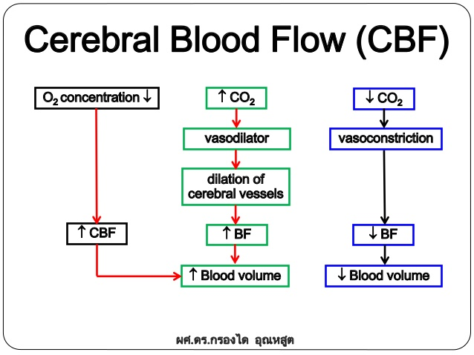
2- Metabolic Autoregulation
Metabolic Autoregulation
CBF: O2 and CO₂
ما اعرفت من وين اللقي صور مناسبه احطها هنا ممكن اذا لقينا صور نشيل شوي من هنا ونحطها تحت
Hydrogen ion concentration
Hydrogen ion concentration
Carbon dioxide increase cerebral blood flow by combining first with water in the body fluids to form carbonic acid, with subsequent dissociation of this acid to form hydrogen ions.
The hydrogen ions cause vasodilation of the cerebral vessels.
The dilation directly proportional to the increase in hydrogen ion concentration.
Increases Hydrogen ion concentration, increase CBF
Substance that increases the acidity of the brain tissue (Such as lactic acid, pyruvic acid) & increases hydrogen ion concentration, will increase cerebral blood flow..
Increased hydrogen ion depresses neuronal activity. It is fortunate that an increase in hydrogen ion concentration also causes an increase in blood flow, which in turn carries hydrogen ions, carbon dioxide, and other acid forming substances away from the brain tissues.
Loss of carbon dioxide removes carbonic acid from the tissues; this, along with removal of other acids, reduces the hydrogen ion concentration back toward normal. Thus, this mechanism helps maintain a constant hydrogen ion concentration in the cerebral fluids and thereby helps to maintain a normal, constant level of neuronal activity

Slide 11
Neurogenic Autoregulation
3- Neurogenic Autoregulation
The cerebral circulatory system has strong sympathetic innervation that passes upward from the superior cervical sympathetic ganglia in the neck and then into the brain along with the cerebral arteries.
ANS and Neurochemical control has minor role, Pressure and Metabolic Autoregulation is most important
دوت علي صور وما لقيت ممكن نحط النوتس هنا
During acute hypertension, sympathetic attenuates increase in CBF
The sympathetic nervous system normally constricts the large and intermediate-sized brain arteries enough to prevent the high pressure from reaching the smaller brain blood vessels. This is important in preventing vascular hemorrhages, preventing the occurrence of “cerebral stroke.”
Factors disturb the Autoregulation
Factors disturb the Autoregulation
Noxious stimuli such as:
Hypoxia due to occlusive cerebro-vascular disease
Trauma from head injury
Brain compression from tumors, hematoma, cerebral edema. These factors results in the loss of normal cerebral blood flow (CBF) autoregulation

Slide 12
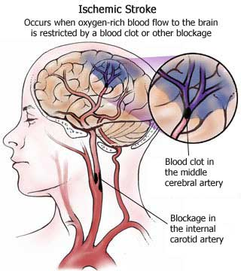
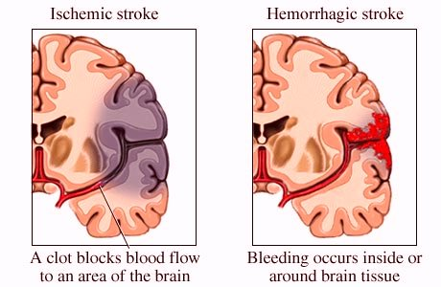
cerebral perfusion pressure
cerebral perfusion pressure
normal intracranial pressure is 10 mmHg
if the pressure is over 20 mmHg it is abnormal
increase in ICP will lead to a decrease in CBF and a decrease in cerebral perfusion
stroke
stroke
Occurs when the blood supply to a part of the brain is blocked resulting in the death of an area.
If a large vessel is blocked the outcome may be rapidly fatal or may lead to very severe disability.
The most common types of disability are the loss of functions of one side of the body and speech problems
stroke
Ischemic
-thrombus formation or embolism
-vasospasm (ET-1?) associated with subarachnoid hemorrhage
hemorrhagic
-ruptured aneurism
-vascular weakening due to chronic hypertension

Slide 13
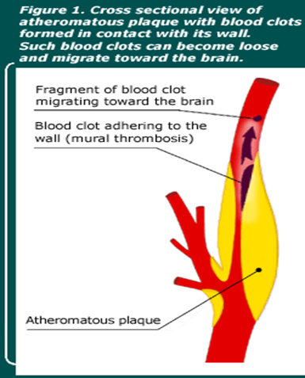
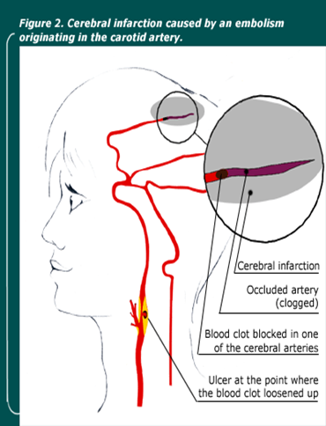
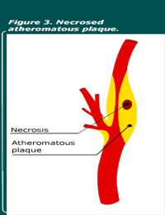
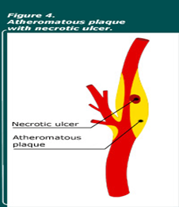
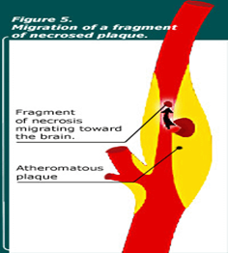
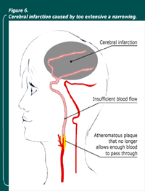
Fainting
Dementia
Fainting: Temporary loss of consciousness, weakness of muscles, and inability to stand up, caused by sudden loss of blood flow to the brain, changes in blood pressure.
Dementia: Result from repeated episodes of small strokes produce progressive damage to the brain over a period of time. The main clinical feature of dementia is a gradual loss of memory and intellectual capacity. Loss of motor function in the limbs and incontinence can also occur.
Infarction
First 2 pictures were in the lecture the other pictures are extra for illustration
Notes:
THE WORK IS NOT DONE YET

Slide 14
This fluid is present in the ventricles of the brain, cisterna around brain and in the subarachnoid space around both the brain and the spinal cord. All these chambers are connected with one another, and the pressure of the fluid is maintained at a constant level.
Cerebrospinal fluid
Volume = 150 ml
Rate of production = 500 ml/day
Lumbar CSF pressure = 70-180 mm hg
Absorption of CSF is proportionate to CSF pressure
At pressure of 112 mm (normal average): filtration and absorption are equal.
Below pressure of 68 mm
CSF, absorption stops.
Functions of the CSF
Protective function(cushioning):-In air brain weight =1400 gm, but in its water bath of CSF , brain weight = 50 gm, making it suspended and floated effectively.
Facilitation of pulsatile cerebral blood flow
Distribution of peptides, hormones, neuroendocrine factors and other nutrients and essential substances to cells of the body
Wash away waste products.
Notes:
Girls slides only

Slide 15
Composition of the CSF
The composition of CSF is nearly the same as brain ECF
osmotic pressure, approximately equal to that of plasma; -
sodium ion concentration is approximately equal to that of plasma;
chloride ion, about 15 percent greater than in plasma;
potassium ion, approximately 40 percent less
glucose about 30 percent less.
Substance | CSF | Plasma
Na+ | 147 | 150
K+ | 2.9 | 4.6
HCO3- | 25 | 24.8
PCO2 | 50 | 39.5
pH | 7.33 | 7.4
Osmolality | 289 | 289
Glucose | 64 | 100

Slide 16
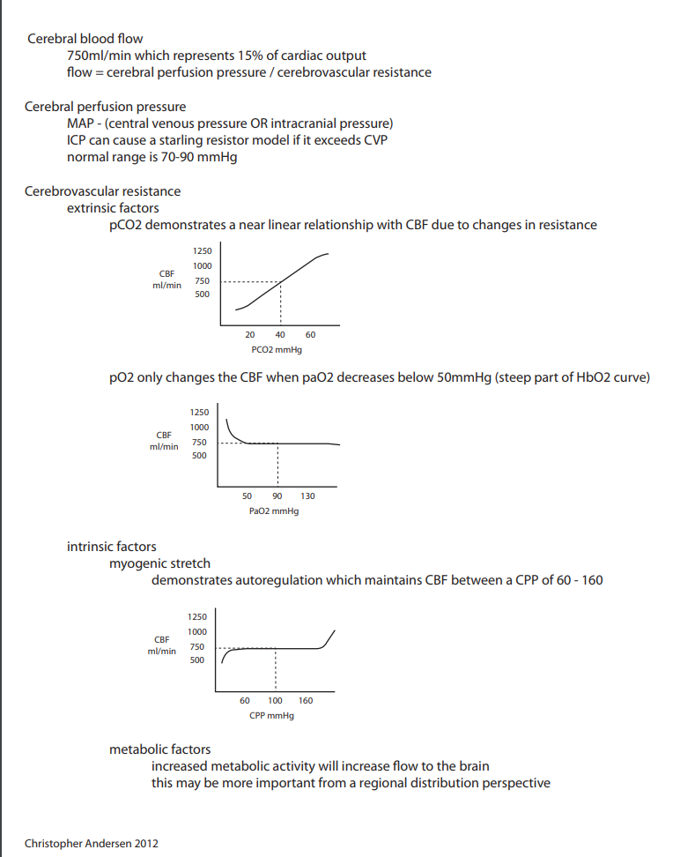
Brief Summary

Slide 17
1-which one of the following does not supply the brain with blood?
6-)which when of the following is the the primary stimulus that will cause vasodilatation?
a)H
b)CO₂
c)O₂
7-…........increase in arterial PCO2, approximately doubles the cerebral blood flow
a)70%
b)50%
c)75%
d)89%
8-ANS and Neurochemical control have a …....... Role and Metabolic Autoregulation has a ….......role ?
a)major .. minor
b)minor ...major
c)major ... major
d)miner ... minor
9-….. can dirctly penetrate the blood BBB while …... cant
a)O₂......CO₂
b)CO₂.....H
c)H.... CO₂
10- an increase in ICP will lead to a …...in CBF and a ….....in cerebral perfusion
a)decrease …. decrease
b)increase .... decrease
c)decrease ...increase
d)increase .....increase
A-internal carotid artery.
B-vertebral artery.
C-basilar artery.
D-external carotid artery.
2-The circle of Willis is origin of how many large vessels?
A-6
B-5
C-4
D-7
3- what results if blood flow to the brain is below 18 to 20 ml / 100 g / min
A-h
B-tissue death
C-normal blood flow
D-Ischemia
4-The net pressure of blood flow to the brain is.
A-extracranial pressure
B-Mean Arterial pressure
C-Cerebral perfusion pressure
D-intracranial pressure
5-The vascular smooth muscles are highly responsive to changes in pressure, a process called
Answers:
1-D
2-A
3-D
4-C
5-C
6-A
7-A
8-B
9-B
10-A
A-Neurogenic Autoregulation
B-Metabolic Autoregulation
C-myogenic activity
D-hydrogenic activity

