Slide 1
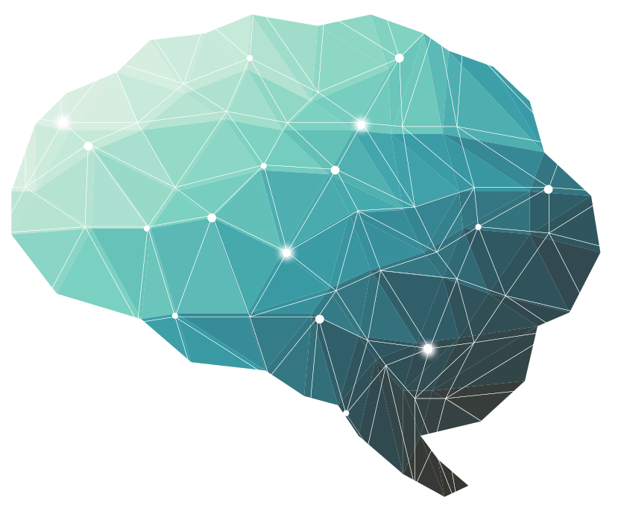
16th Lecture ∣ The Physiology Team
Proprioceptive pathway
Objectives:
to know about proprioceptors its definition and its role in body balance.
The muscle spindles and their role in stretch reflex.
Organization of spinal cord
Sensory receptor types
Identify the major sensory pathways to the cerebral - with consciousness- components, processes and functions & its damage(appreciate the dorsal column system in conscious proprioception)
Identify the major sensory pathways to the cerebellum - unconscious & its damage (describe the pathway of spinocerebellar tract in unconscious proprioception from muscles,tendons,and joints)
differentiate between sensory and motor ataxia
Done by :
Team leader: Fatima Balsharaf , Rahaf Alshammari,
Abdulelah Aldossari, Ali Alammari.
Team members: Renad alsuelmi,Maha Alamri ,Abdullah Alzaid, Esra’a alnazzawi,Haifa Alessa, Ebtesam Almutairi,Rawan Alharbi.
Colour index:
important
Numbers
Extra
Editing file
وَأَن لَّيْسَ لِلْإِنسَانِ إِلَّا مَا سَعَىٰ

Slide 2
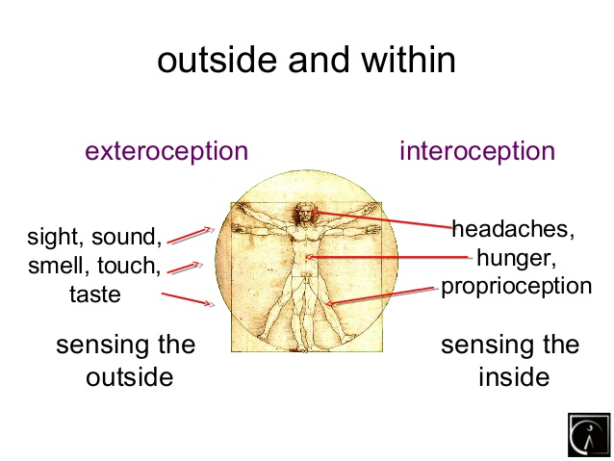
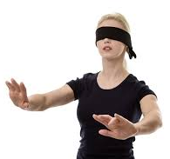
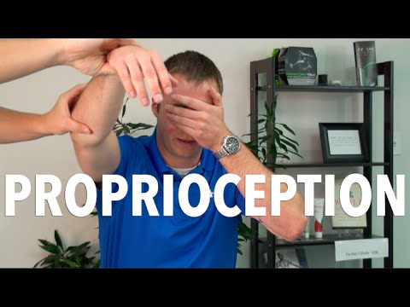
Terminology
Terminology | Definition
Proprioception | Proprioception in Latin means proprius which means "one's own" or "individual". Perception is the sense of the relative position of neighbouring parts of the body and strength of effort being employed in movement. Proprioception is defined as our body's ability to know where it is in space.
Exteroception | By which one perceives the outside world. Exteroception is the sensitivity to stimuli originating outside of the body.
Interoception | By which one perceives pain, hunger, etc., and the movement of internal organs. Interoception is a lesser-known sense that helps you understand and feel what's going on inside your body.
16th Lecture ∣ The Physiology Team

Slide 3
Receptors
Meaning of Receptors: Certain specialized structures are present at the interface of stimulus and afferent nerve fibers. These specialized structures convert any type of energy into electrical energy or action potential in afferent fiber. This action is known as transduction. Hence receptors act as biologic transducers.
Somatic receptors:
Somatic receptors are specialized structure present at the peripheral terminations of afferent fibers..
▪Receptors are detectors and transducers which transduce different form of energy into action potential
▪They are found in many parts of the body including the skin (cutaneous receptors), skeletal muscles, bones and joints (proprioceptors)
▪They differ from specific receptors that mediate the special senses of vision, hearing, smell, taste and equilibrium.
Classification of sensory receptors
A/Based on their location (Sherrington 1906)
1-Exteroceptors
2-interceptors
3-propriceptors
B/Based on their speed of adaptation 1-Slowly adapting (SA) or tonic receptors
2-Rabidly adapting (RA) or phasic receptors
3-Non adapting receptors: eg Free nerve endings for pain sensation
C/Based on their adequate stimulus
1-Mechanoreceptors
2-Thermoreceptors
3-Chemoreceptors
4-Electomangetic receptors
5-nociceptors

Slide 4
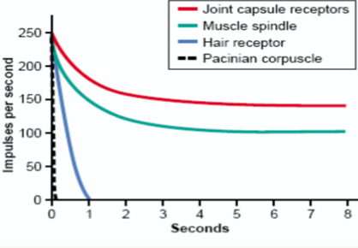
Classification of sensory receptor
A/Based on their location
1-Exteroceptors: concerned with the external environment • Found on the surface of the body • E.g. touch and temperature receptors 2-Interoceptors: concerned with the internal environment e.g. chemoreceptors ,osmoreceptors.
3-Proprioceptors: concerned with position of the body in the space. • Are found in joint, tendons and muscles.
B/Sensory receptor based on their speed of Adaptation
16th Lecture ∣ The Physiology Team
1-Slowly adapting (SA) or tonic receptors: Eg Muscle spindle, joint receptors, baroreceptor. 2-Rapidly adapting (RA) or phasic receptors: Eg meissner’s corpuscles(touch), pacinian corpuscles(vibration)
3-Non adapting receptors: eg Free nerve endings for pain sensation
When a continuous sensory stimulus is applied, the receptor responds at a high impulse rate at first and then at a progressively slower rate until finally the rate of action potentials decreases to very few or often to none at all.
Mechanisms by which Receptors Adapt
First, the pacinian corpuscle is a viscoelastic structure so that after stimulation within few hundredths of a second, the fluid within the corpuscle redistributes, so that the receptor potential is no longer elicited.
The second mechanism of adaptation of the pacinian corpuscle, but a much slower one, results from accommodation, which occurs in the nerve fiber itself. This probably results from progressive “inactivation” of the sodium channels in the nerve fiber membrane

Slide 5
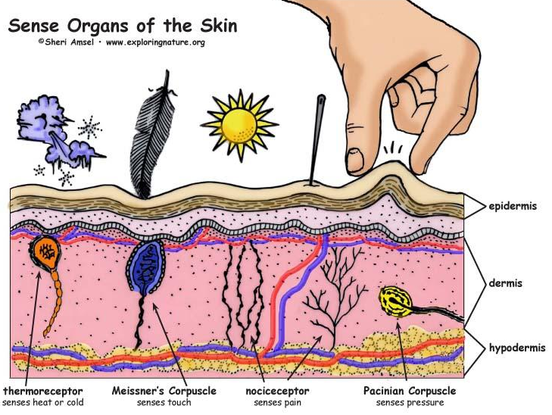
Classification of sensory receptor
C/Sensory Receptors Types Based on their adequate stimulus
MECHANORECEPTORS: which detect mechanical compression or stretching of the receptor or of tissues adjacent to the receptor eg proprioceptors
THERMORECEPTORS: which detect changes in temperature, some receptors detecting cold and others warmth.
NOCICEPTORS (pain receptors): which detect damage occurring in the tissues, whether physical damage or chemical damage eg free nerve endings
ELECTROMAGNETIC RECEPTORS: which detect light on the retina of the eye eg rods and cones
CHEMORECEPTORS: which detect taste in the mouth, smell in the nose, oxygen level in the arterial blood, osmolality of the body fluids, carbon dioxide concentration, and perhaps other factors that make up the chemistry of the body. Eg chemo R in carotid bodies
16th Lecture ∣ The Physiology Team

Slide 6
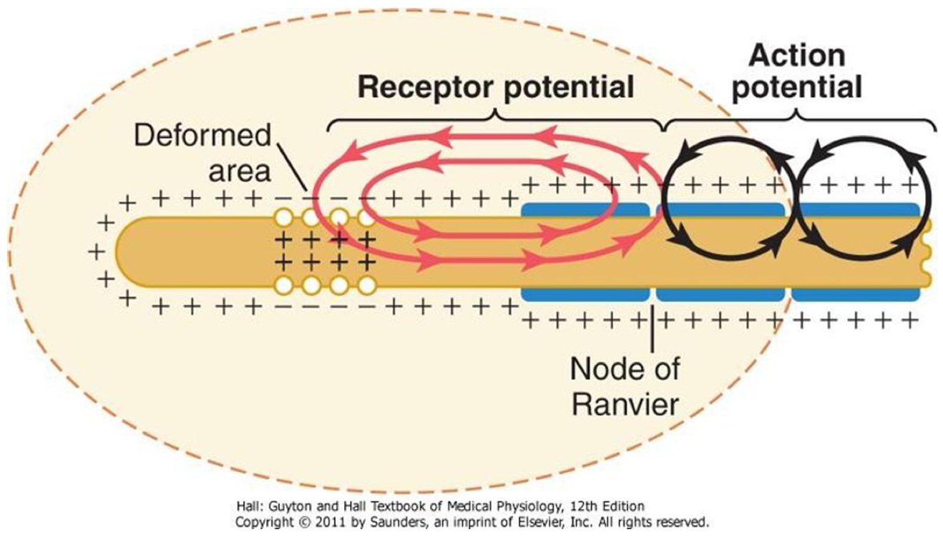
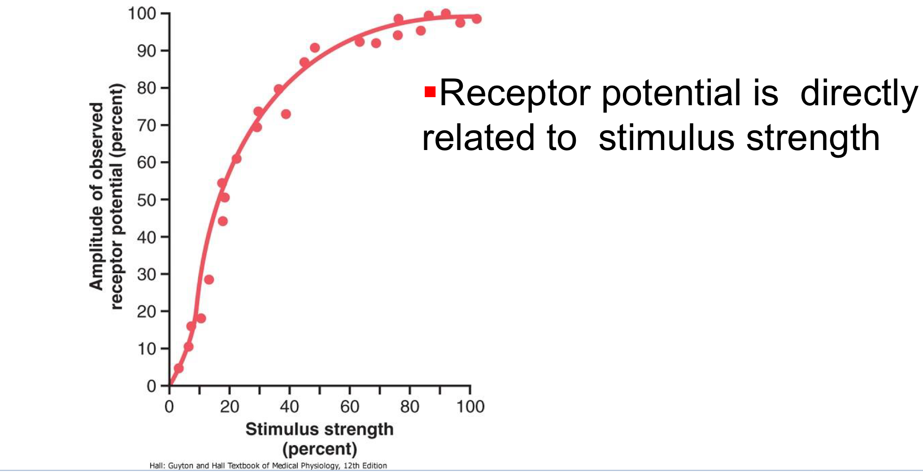
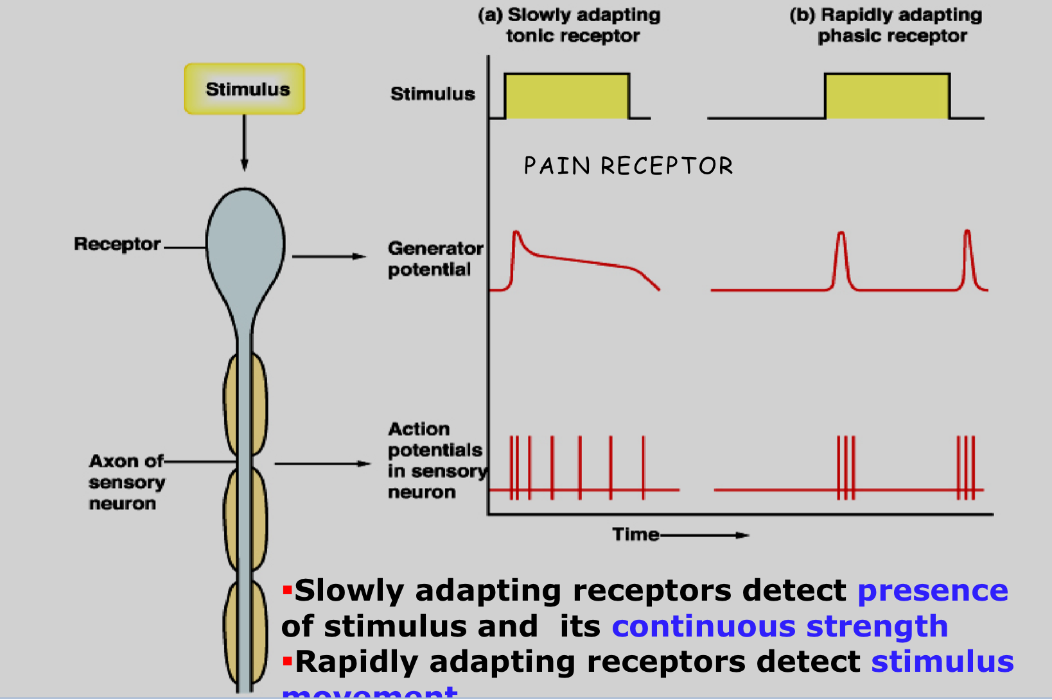
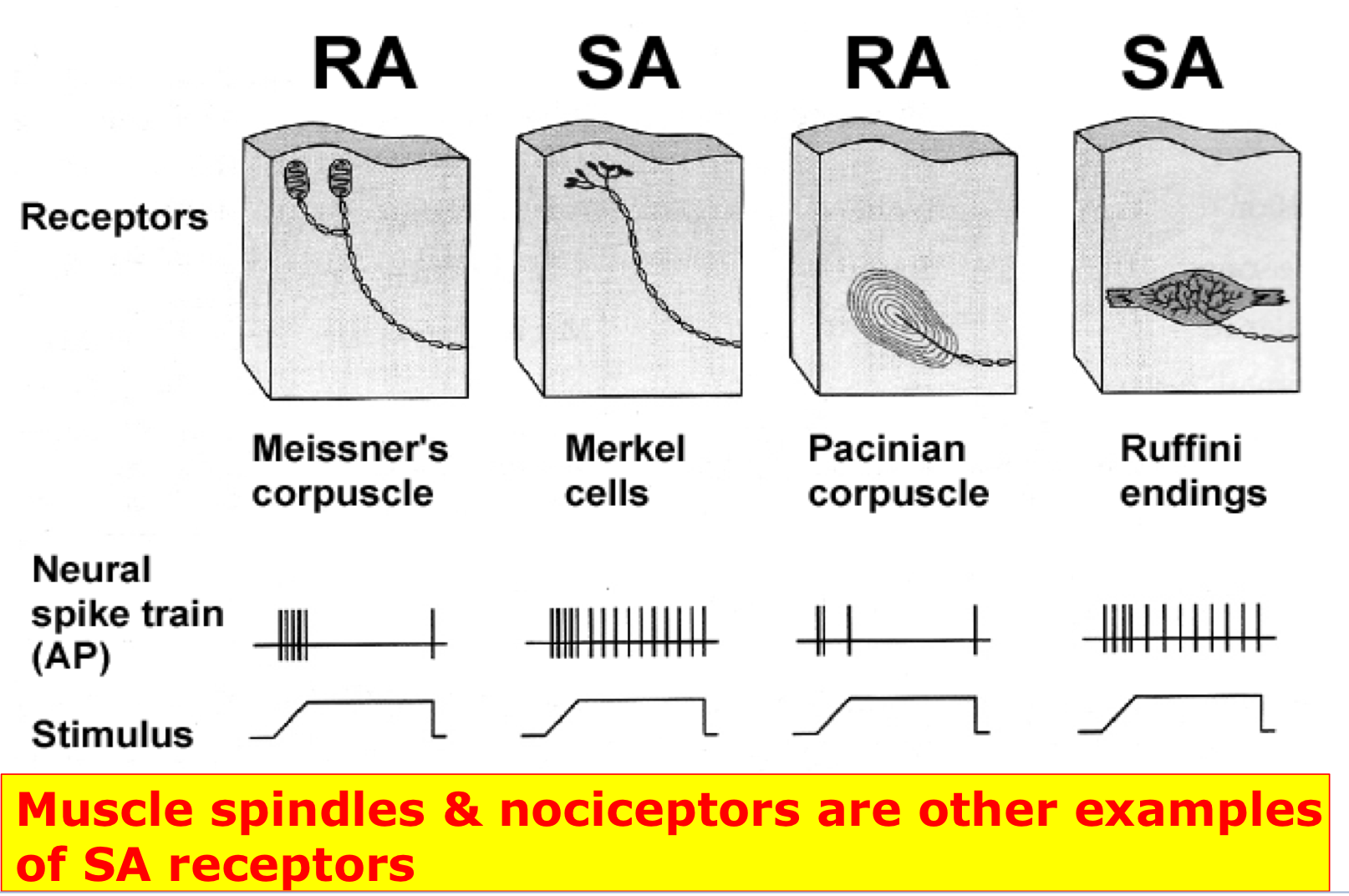
Activation of Sensory Receptors: Generation of Receptor Potential (RP)
Generation of Action Potential:
• Stimuli (mechanical, thermal, chemical) cause deformation in the sensory receptors
• This causes influx of positive ions and generation of RP
• RP induces a local circuit of current flow that spreads along nerve fiber and generates APs when threshold is reached
Relation Between Stimulus Strength & Receptor Potential Amplitude:
Dr’s note:
-Increase stimulus lead to increase amplitude of action potential generation.
-Increase stimulus lead to increase rate of frequency of generated action potential
Examples of RA and SA Receptors

Slide 7
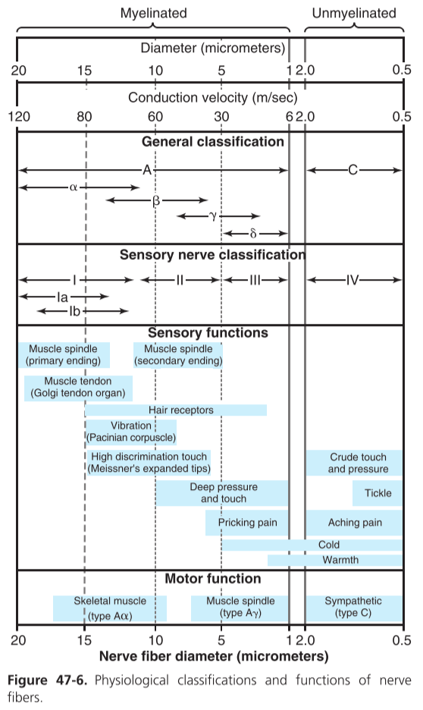
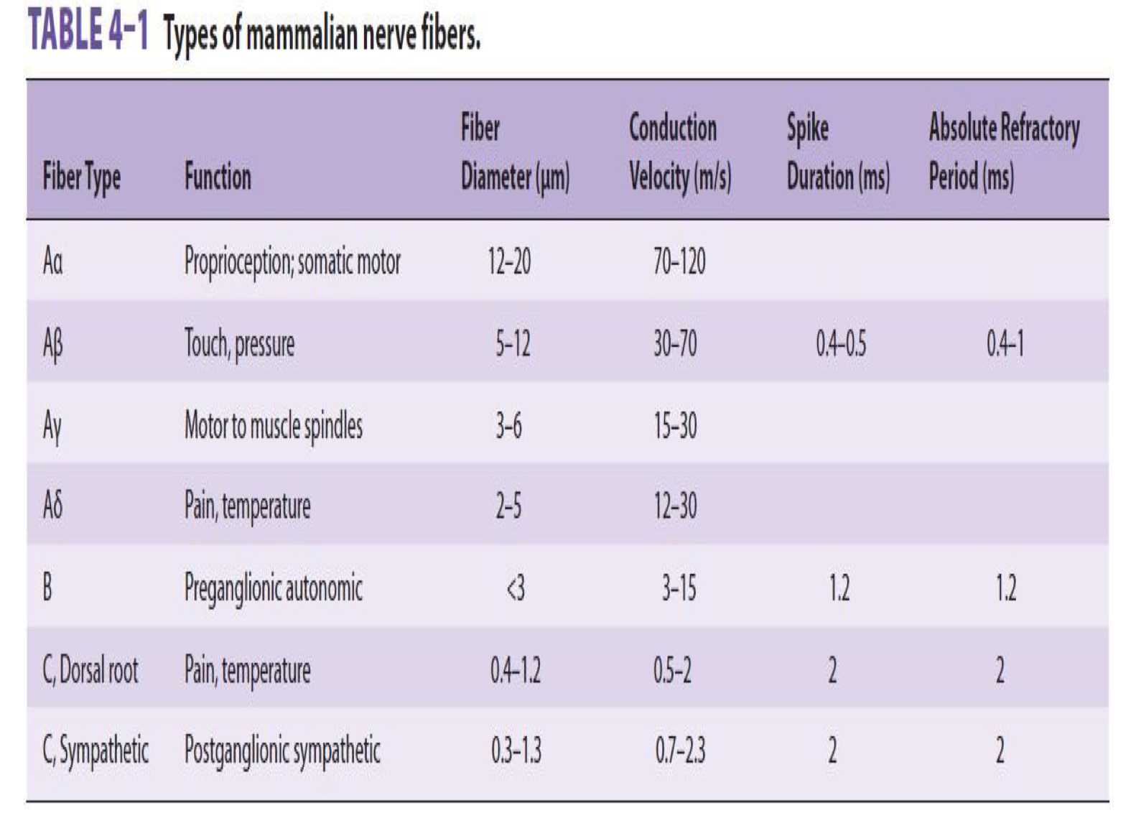
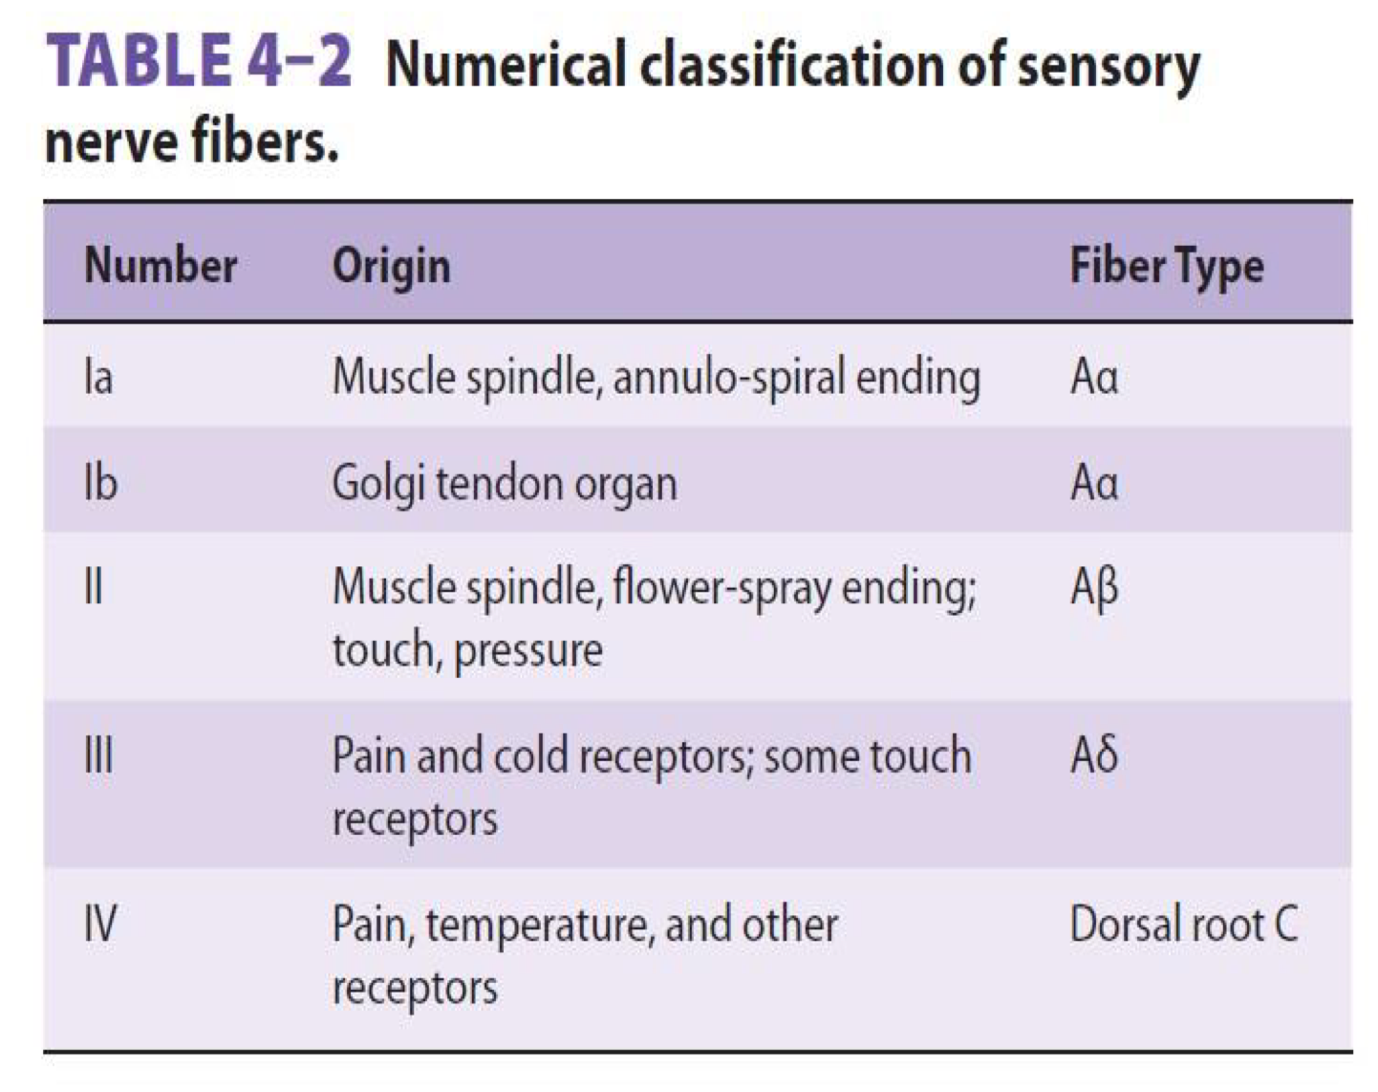
Classification of Nerve fibers
A/ General Classification
1-Myelinated (A- fiber) ▪ Αα (thickly myelinated)
▪ Aβ (intermediate m.) ▪ Aδ (thinly myelinated) 2-Unmyelinated (C-fiber)
B/ Numerical Classification
16th Lecture ∣ The Physiology Team

Slide 8
What Are the Stimulus Features That Are Mediated by Sensory Receptors?
Sensory receptors mediate 4 features of a stimulus:
1-Modality: is what we perceive after a stimulus.
-Examples of sensory modalities: vision, hearing, smell, taste, touch and temperature
-Each modality has many sub-modalities (e.g. taste can be sweet, bitter, sour, salty), Temperature sub-modalities: cold and heat
2-Intensity: depends on the stimulus strength and is encoded by action potential frequency.
3-Location: the site on the body or space where the stimulus originated.
4-Duration: time from onset to offset of a stimulus. -If persists for long time, the perceived intensity diminishes (adaptation)

Slide 9
To know about proprioceptors its definition and its role in body balance.
PROPRIOCEPTION
Perception about the relative positions of different body parts and strength of effort being employed in movements.
It can be divided into:
Static position sense: which means conscious perception of the orientation of the different parts of the body with respect to one another
Dynamic proprioception: rate of movement sense: also called kinesthesia or dynamic proprioception
هذا يعني اذا طلبت من المريض يغلق عيونه ورفعت اصبعه لأعلى او لأسفل وتسأله وين تحس اصبعك فيه فوق ولا تحت
وهذا يعني انك تمسك اصبع من اليد مثلاً وتحركه لأعلى واسفل بسرعة معينه وتسوي مره ثانية بسرعة مختلفة وتسأل المريض هل فرق في السرعة او نفس بعض
Structures concerned with proprioception:
Proprioceptors (spatial orientation, four inputs).
Brain Stem (Cortico, Rubro, Vestibulo, Reticulo, Olivo, Tectospinal).
vestibular system (apparatus, nuclei).
Ascending Tracts.
Visual system.
Cerebellum (flocculonodular lobe → dynamic equilibrium, Uvula → Static equilibrium).
Cerebral cortex (primary cortical center for equilibrium located in the parietal lobe deep in the sylvian fissure).
16th Lecture ∣ The Physiology Team
Types of Proprioception:
Conscious proprioception: reach the level of cerebral cortex sensory area via dorsal column tract.
Subconscious proprioception: reach the level of cerebellum via spinocerebellar tracts (Ventral & Dorsal) ,these are main ascending sensory pathways for proprioception
Role of Proprioception
Proprioception informs us about:
▪The location of a body part in relation to other parts
▪The rate of movement of a body part when it is moving
▪The degree to which our muscle are being contracted or stretched
▪The amount of tension created in our tendons
▪The head orientation in relation to the ground and in response to movement
Proprioceptive information is carried from periphery to the CNS by proprioceptors and other somatic receptors

Slide 10
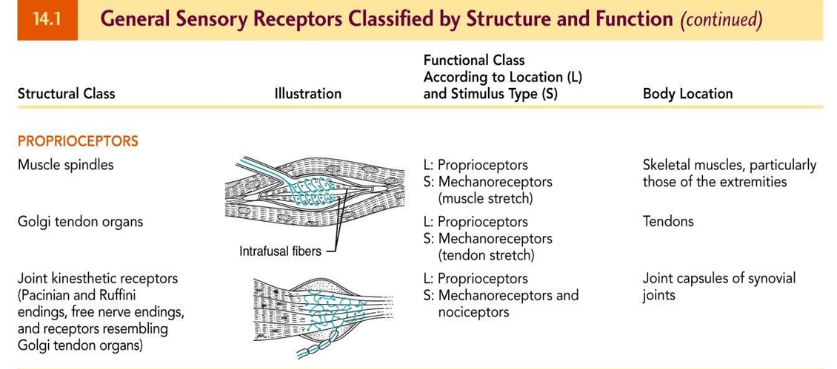
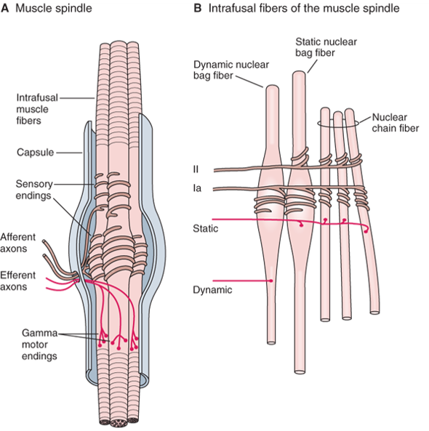
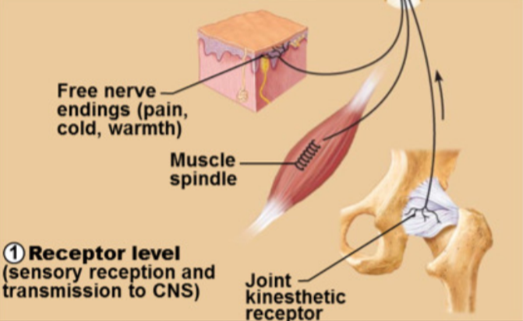
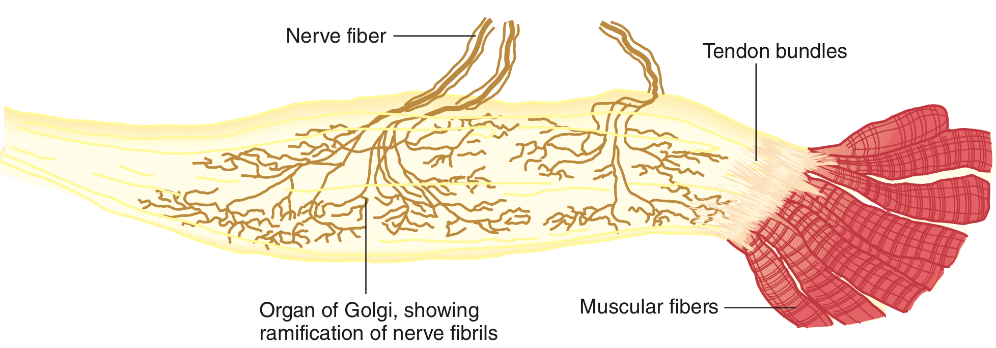
To know about proprioceptors its definition and its role in body balance.
Three Types of Proprioceptors:
Proprioceptors include the muscle spindles, Golgi tendon organs, and joint receptors. These provide a sense of body position and allow fine control of skeletal movements
1)Muscle spindles:
measure the changing length of a muscle
Imbedded in the perimysium between muscle fascicles
2)Golgi tendon organs:
located near the muscle-tendon junction
Monitor tension within tendons (locomotory organs )
3)Joint kinesthetic receptors:
Sensory nerve endings within the joint capsules
16th Lecture ∣ The Physiology Team
1
2

Slide 11
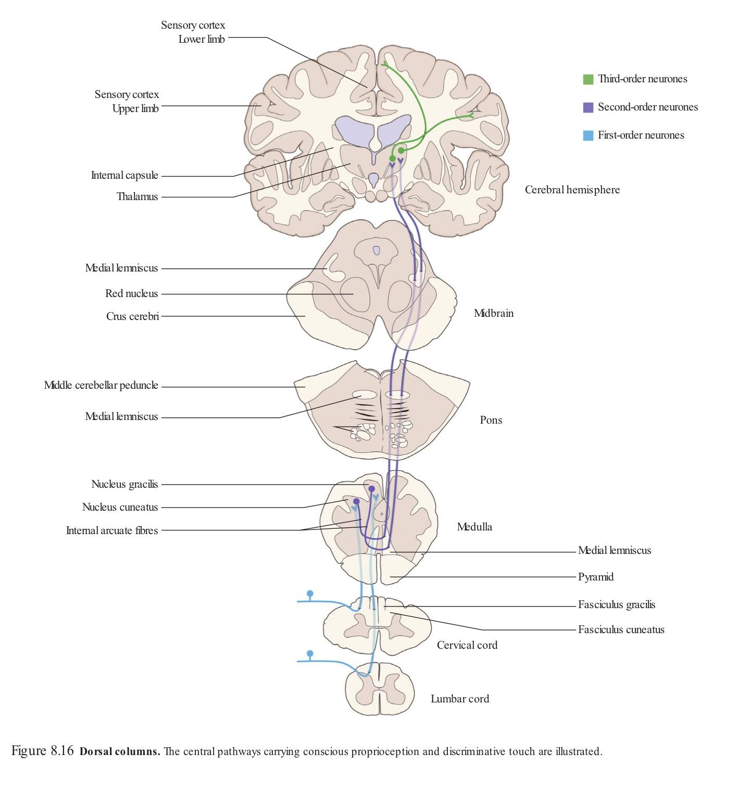
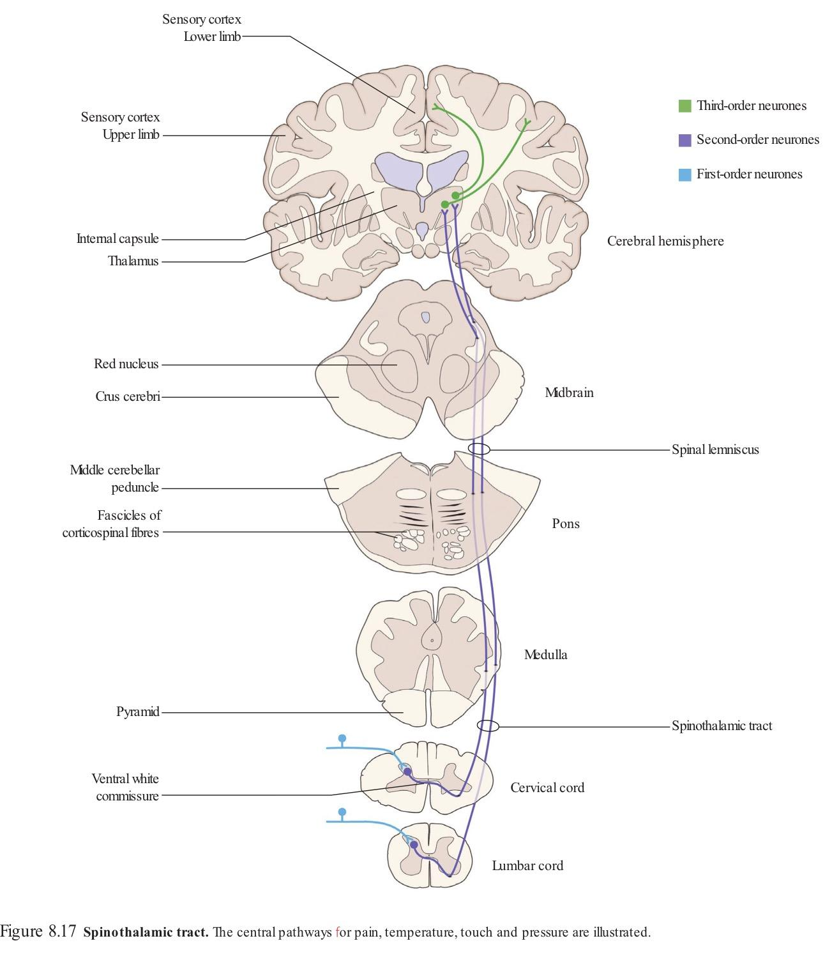
Identify the major sensory pathways to the cerebral - with consciousness-
SENSORY TRACTS
•DORSAL COLUMN SYSTEM
•ANTEROLATERAL SYSTEM
Each system carries different types of sensations which are known as MODALITIES like pain,temperature,finetouch,crude touch, vibration, proprioception etc
1. Dorsal column pathway
carries signal of fine touch(two point discrimination), pressure, vibration, stereognosis and proprioception,
2. Spinothalamic pathway
carries signals of pain, temperature, deep pressure, and crude touch.
3,4-Posterior and anterior spinocerebellar pathways
carry subconscious proprioception.Dorsal gray horn-to lateral column-to medulla oblongata-to pons–to cerebellum.
16th Lecture ∣ The Physiology Team
DORSAL COLUMN MEDIAL LEMNISCAL SYSTEM “Advanced types of sensations”
1.Touch sensations requiring a high degree of localization of the stimulus 2.Touch sensations requiring transmission of fine gradations of intensity
3.Phasic sensations like vibratory sensations
4.Sensations that signal movement against skin
5.Joints Position sensations (Proprioception)
6.Pressure sensations requiring fine degrees of judgment of intensity 7.Strereognosis
-Fine Touch
-Fine Pressure
-Vibration
-Position
ANTEROLATERAL SYSTEM (Ventral & lateral spinothalamic tracts)
1.Pain
2.Thermal sensations, (warmth & cold)
3.Crude touch and pressure sensations capable only of crude localizing ability on the surface of the body
4.Tickle and itch sensations
5.Sexual sensations
If you want Dr.Najeeb explanations for tracts click here
Mid term part

Slide 12
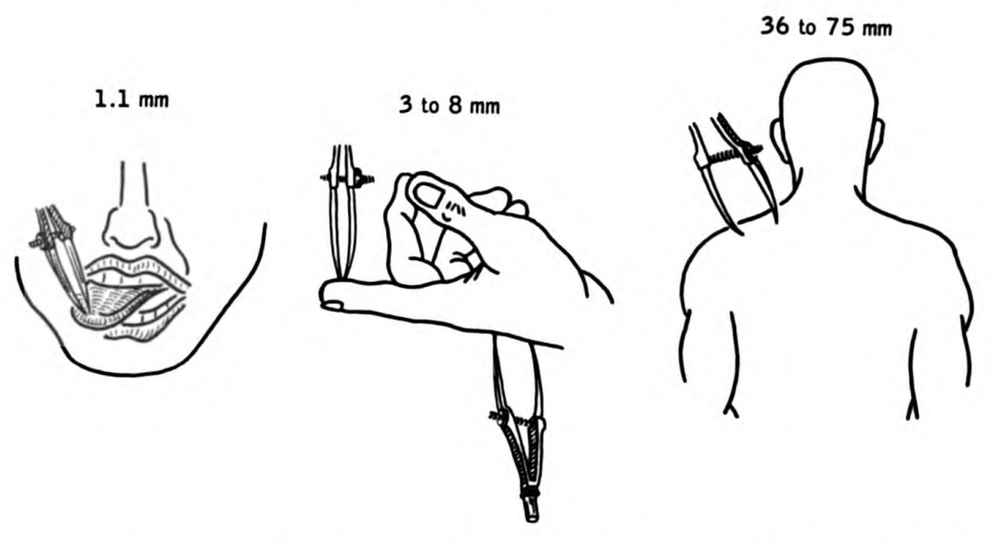
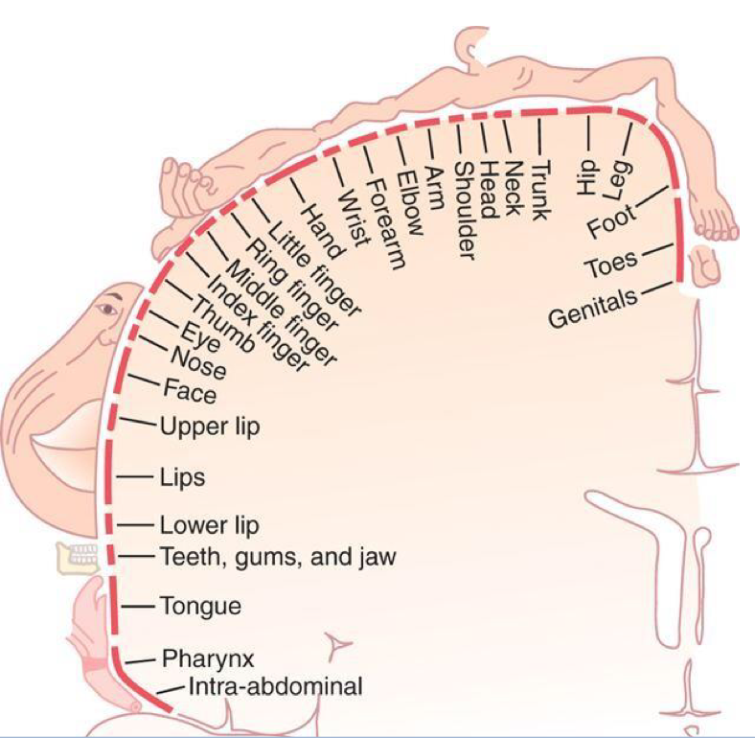
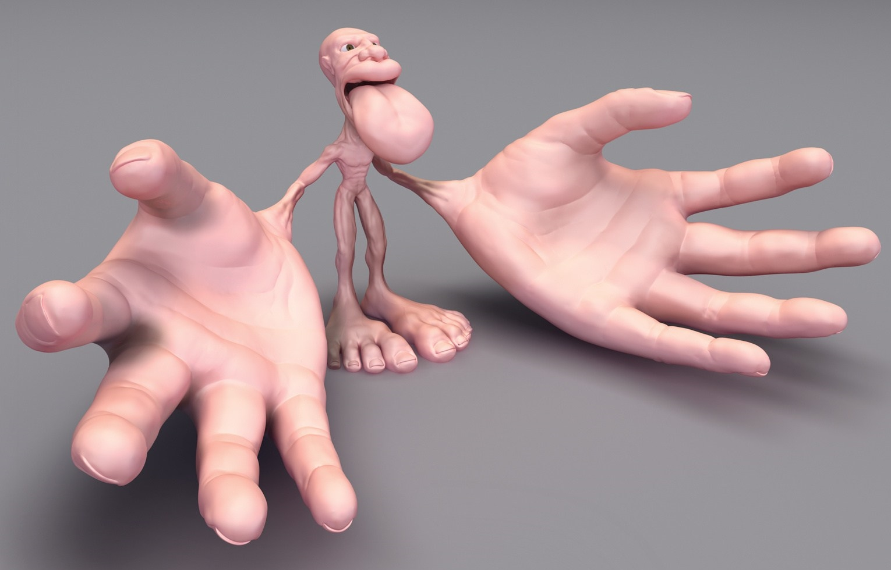
Two point discrimination in the dorsal column
1- معناها قدرة الجسم على الاحساس بان هناك جسمين يلامسانه وليس جسم واحد
في الكتف لو كان المسافة بين الجسمين ٣ مل متر الاحساس عندنا بيصير كأن جسم واحد يلامسنا
لكن في اليد لو كان بين الجسمين ٣مل متر راح يجينا احساس انها جسمين بعكس الكتف ليه ؟
Number of receptors
Area of representation
الدكتورة ركزت عليها
16th Lecture ∣ The Physiology Team
Sensory Homunculus (Little Man)
▪Body is represented upside-down, with large representation of hands & lips
▪The extent of representation is proportional to the density of sensory receptors

Slide 13
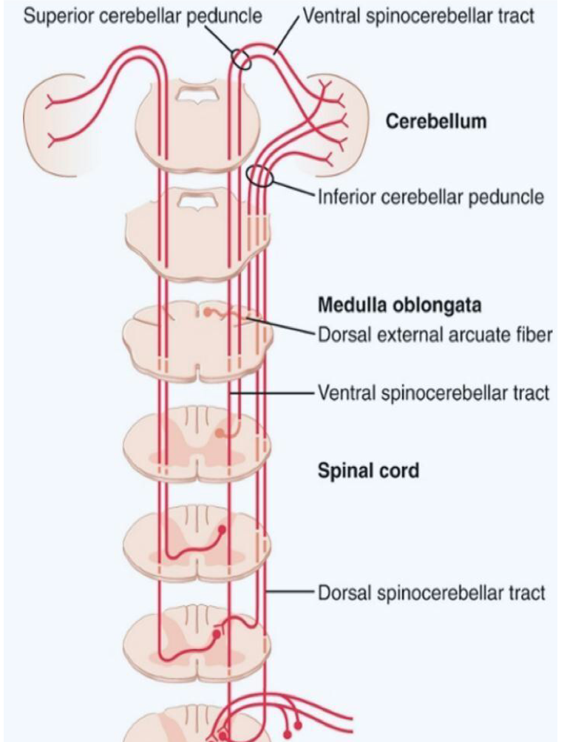
Identify the major sensory pathways to the cerebellum - unconscious & its damage
The Dorsal & Ventral Spinocerebellar Tracts
1-The Dorsal Spinocerebellar tract (dSCT) ▪ Carry signals directly to cerebellum at a speed of up to 120 m/s mainly from muscle spindles, but also from GTO, skin receptors & joint receptors
▪ Enter cerebellum through inferior cerebellar peduncle
▪ Terminate in vermis & intermediate zone
▪ Functions of dSCT are to informs the cerebellum about:
▪ Muscle length and contraction
▪ Degree of tension on tendons
▪ Position and rate movement of parts of body.
▪ Forces acting on the body surfaces
2-The Ventral Spinocerebellar tract (vSCT):
▪ Carry some signals from periphery (mainly from Golgi tendon organs) directly to cerebellum, but excited mainly by descending motor signals from brain (corticospinal & rubrospinal tracts) and from the spinal cord itself
▪ Enter cerebellum through superior cerebellar peduncle and terminate on both sides of cerebellum
▪ Functions of vSCT:
▪ informs the cerebellum about:
▪ Which motor signals have arrived to the spinal cord.
16th Lecture ∣ The Physiology Team

Slide 14
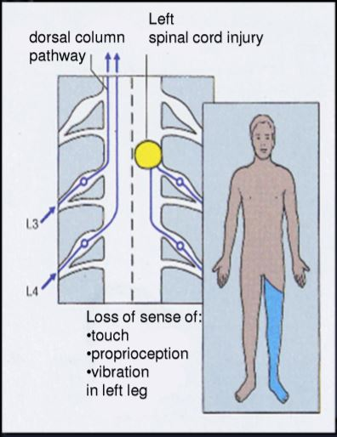
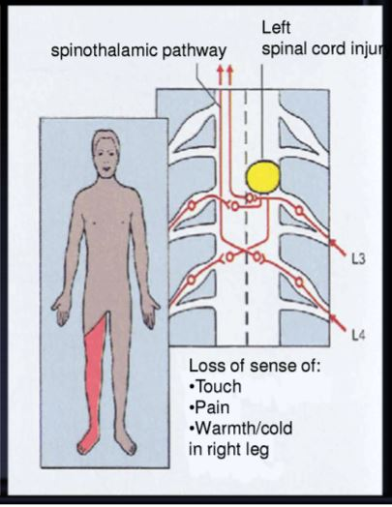
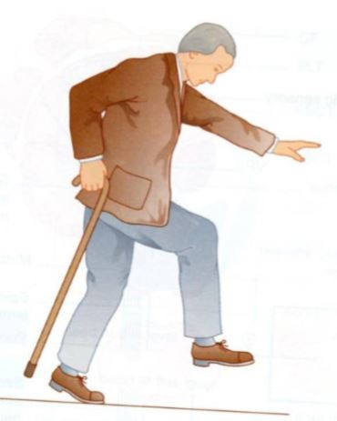
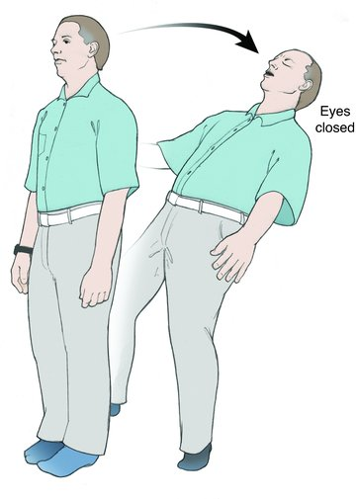
Damage of major sensory pathways to the cerebral - with consciousness-
16th Lecture ∣ The Physiology Team
Dorsal column lesion
Spinothalamic lesion
Dorsal column damage
•Sensory ataxia
•Patient staggers; cannot perceive position or movement of legs
•Visual clues help movement
Positive Romberg test (Ask the patient to close the eyes while standing: observe whether the patient becomes unstable )
The test depends on the integrity of proprioception from the joints of the legs.
If the damage above the decussation the abnormality will occur contralateral
Positive Romberg test

Slide 15
differentiate between sensory and motor ataxia
Ataxia and Gait Disturbances
Ataxia: inability to coordinate voluntary muscular movements that is due to nerve damage (CNS or PNS) and not due to muscle weakness (called also incoordination)
Pathophysiology
– Result from any condition that affects the central and peripheral nervous systems
– Ataxia Types :
•Motor ataxia
•Sensory ataxia
•Motor Ataxia
–Caused by cerebellar disorders
• Intact sensory receptors and afferent pathways
•Integration of proprioception is faulty
•Midline cerebellar lesions cause truncal ataxia
•Lateral cerebellar lesions cause limb ataxia
•Thalamic infarcts may cause contralateral ataxia with sensory loss
Features of Cerebellar ataxia
- Clumsy movements. –Incoordination of the limbs (intention tremor)
– Wide-based, reeling gait (ataxia) –Alcoholic intoxication produces similar effects!
SENSORY ATAXIA
•Peripheral sensory lesions (e.g. polyneuropathy) cause ataxia because there is loss of the sense of joint position proprioception.
Broad-based, high-stepping, stamping gait develops.
•This ataxia is made worse by removal of additional sensory input (e.g. vision) and is worse in the dark.
First described in sensory ataxia of tabes dorsalis, this is the basis of Romberg's test>> Ask the patient to close the eyes while standing: observe whether the patient becomes unstable (and prevent falling).
16th Lecture ∣ The Physiology Team

Slide 16
Quick review
Proprioception: Perception (sense) about the relative positions of different body parts and strength of effort being employed in movements. Can divide into: Static position sense & Rate of movement (sense kinesthesia or dynamic proprioception)
Types: 1- Conscious proprioception: reach the level of cerebral cortex sensory area via dorsal column tract 2- Subconscious proprioception: reach the level of cerebellum via spinocerebellar tracts
Proprioceptors: provide a sense of body position and allow fine control of skeletal movements. Types: 1-Muscle spindles: Imbedded in the perimysium between muscle fascicles measure the changing length of a muscle 2- Golgi tendon organs: located near the muscle-tendon junction Monitor tension within tendons 3- Joint kinesthetic receptors: Sensory nerve endings within the joint capsules
Adaptation of receptor (Types) 1- Rapid adapting or phasic receptors: eg meissner’s corpuscles(touch), pacinian corpuscles (vibration) 2- Slowly adapting or tonic receptors: eg ruffini’s (pressure ,skin stretch)
3- Non adapting receptors: eg Free nerve endings for pain sensation
Activation of Sensory Receptors: Stimuli (mechanical, thermal, chemical) → cause deformation in the sensory receptors → causes influx of +ve ions & generation of receptor potential → induces a local circuit of current flow → spreads along nerve fiber & generates action potentials when threshold is reached
Receptor potential is directly related to stimulus strength
16 Lecture ∣ The Physiology Team
Dorsal column damage
Spinocerebellar tract damage
Sensory ataxia
Patient staggers; cannot perceive position or movement of legs
Visual clues help movement
Positive Romberg test
Cerebellar ataxia Clumsy movements
Incoordination of the limbs (intention tremor)
Wide-based, reeling gait (ataxia)
*Alcoholic intoxication produces similar effects!
Ataxia: result from any condition that affects CNS & PNS
Sensory Ataxia
Motor ataxia
Peripheral sensory lesions (e.g. polyneuropathy) lesion in thalamus & sensory Made worse in the dark or no vision Romberg's test
Caused by cerebellar disorders Intact sensory receptors & afferent pathways Integration of proprioception is faulty Midline cerebellar lesions cause truncal ataxia Lateral cerebellar lesions cause limb ataxia

Slide 17
Questions
1) Which of these resembles encapsulated receptors? A- Hair follicles receptors B- Merkel disc C- pacinian corpuscles D- A&B 2) Tickle and itch sensation is carried by: A- Dorsal column B- Lateral spinothalamic tract C- ventral spinothalamic tract D- B&C 3) What type of receptors are located in carotid bodies? A- Thermoreceptors B- Mechanoreceptors C- Chemoreceptors D- Nociceptors 4) Thalamic infarcts may cause: A- Contralateral ataxia B- Contralateral ataxia with sensory loss C- Ipsilateral ataxia with sensory loss D- Ipsilateral ataxia 5) Which one is Rapid adapting receptor: A- Merkel’s disc B- krause’s end bulbs C- Meissner’s corpuscles(touch), D- Non
SAQ
6) what are the three types of proprioceptors?
*Muscle spindles *Golgi tendon organs *Joint kinesthetic receptors 7) What are the structures that are concerned with proprioception ?
Proprioceptors * Brain stem * Vestibular system * Ascending tracts 8) Mention the two types of proprioception 1-Conscious proprioception: reach the level of cerebral cortex sensory area via dorsal column tract. 2- Subconscious proprioception: reach the level of cerebellum via spinocerebellar tracts 9) Pacinian corpuscles’ Ruffini’s corpuscles are examples of ? Joint kinesthetic receptors 10) two point discrimination depend on *Number of receptors *Area of representation
16th Lecture ∣ The Physiology Team
*Visual system *Cerebellum *Cerebral cortex
C
D
C
B
C

