Slide 1
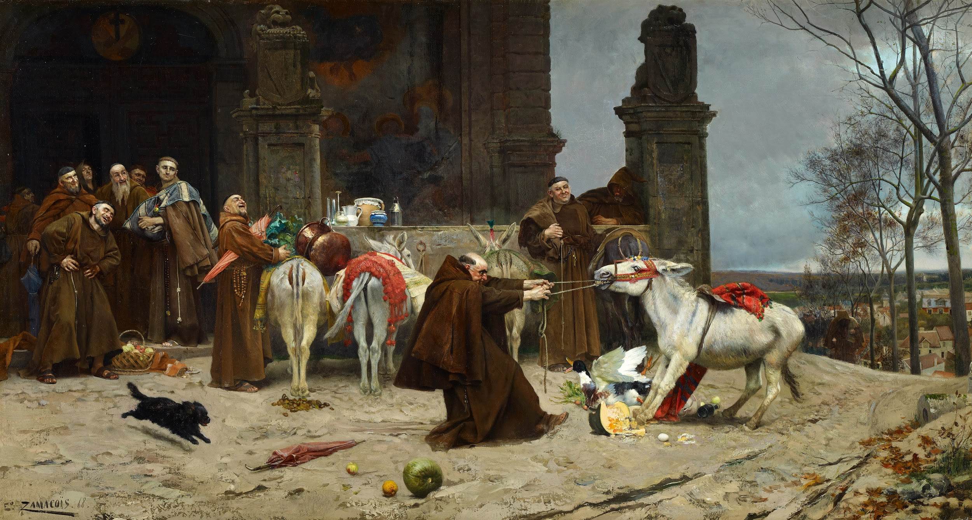
Physiology of speech
“Language is the house of being. In its home human beings dwell. Those who think and those who create with words are the guardians of this home.”
Martin Heidegger
Done by
عبدالله العمر
Objective
Describe brain speech areas as Broca’s,Wernicke’s and insula.
Explain sequence of events in speech production.
Explain speech disorders as aphasia with its types, dysarthria, and acalculia.
Explain difference between aphasia and dysarthria.
It’s very easy lecture and I tried my best to make the lecture more understandable and Remember: understand don’t memorize!
[ important | Explanation ]
Reference
437 slides (Boy’s & Girl’s)
Guyton
Gangon

Slide 2
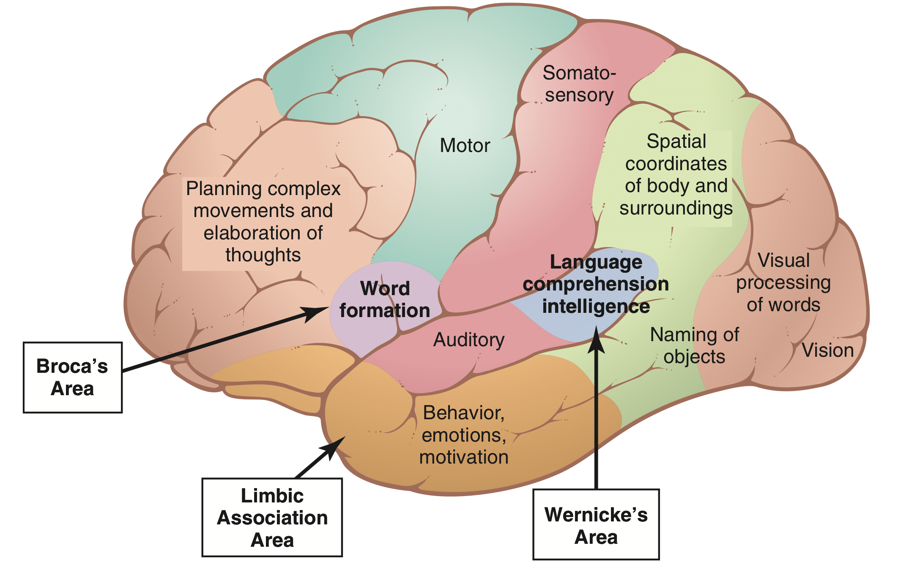
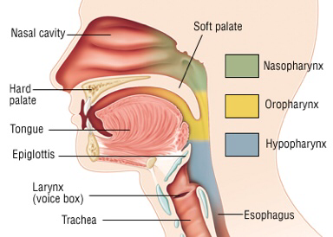
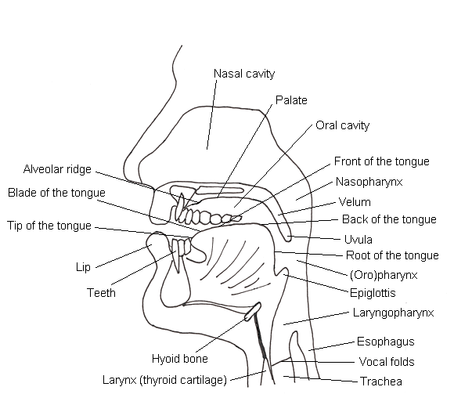
Introduction
Speech
It’s the means of communication between the two individual or group of individuals.
Speech and other intellectual functions are especially well developed in humans—the animal species in which the neocortical mantle is most highly developed.
Speech controlled by three centers:
1-specific speech nervous control centers in the cerebral cortex
2-respiratory control centers of the brain
3-the articulation and resonance structures of the mouth and nasal cavities.
There’s two means of communication:
Sensory Communication“Language input”
Auditory communication & Visual communication
Motor Communications “Language output”
Talking & Writing
Steps of communication :
Brain Areas Concerned with Speech and Language
Collection of sensory input
Integration
Motor execution
“Auditory and visual”
“Hearing and articulation mechanism”
Brain Areas Concerned with Speech and Language:
Wernicke's Area
Broca's Area
Speech articulation Area in Insula
Motor Cortex
Angular Gyrus
Auditory association area
Angular Gyrus
Speech structure:
Oral Cavity
Nasal Cavity
Pharynx
Larynx

Slide 3
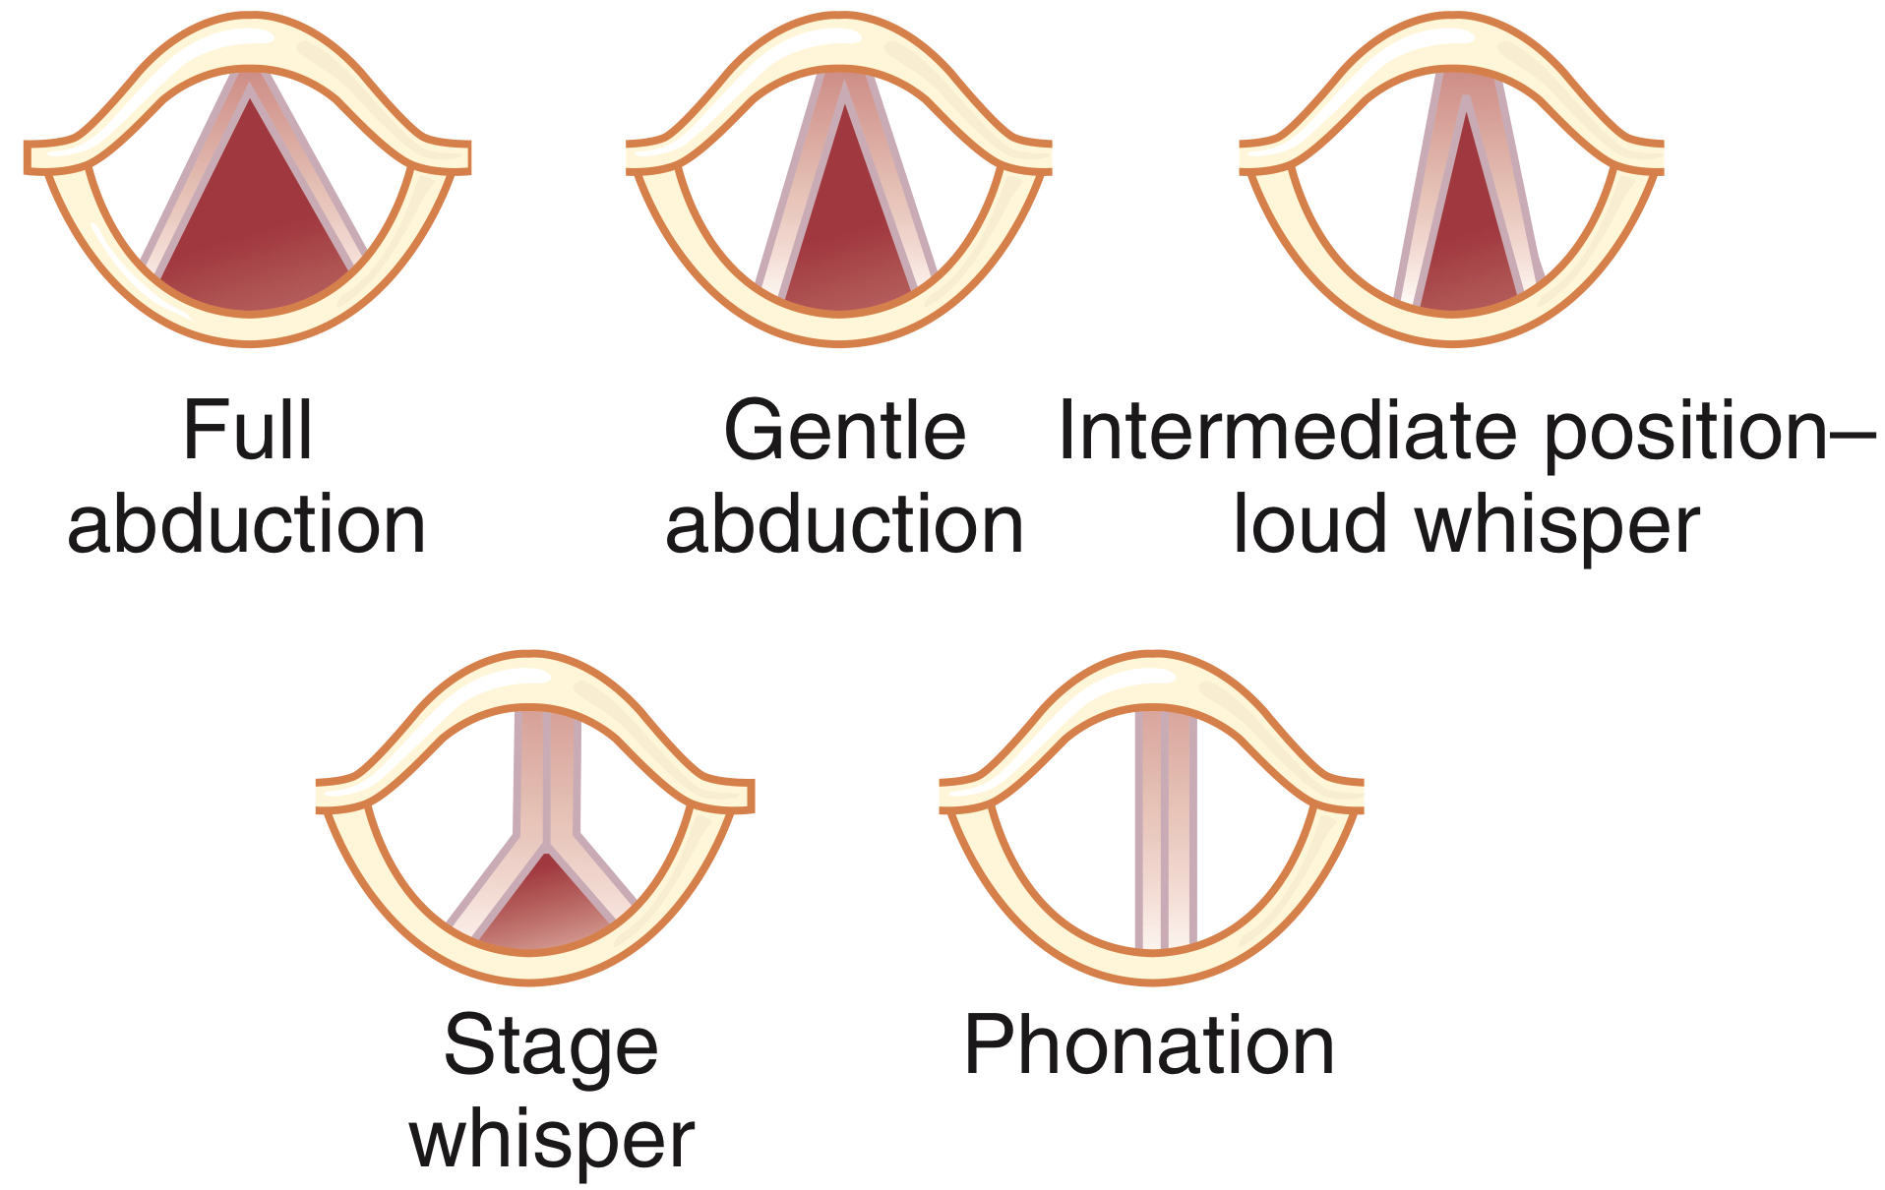
Aphasia:
are abnormalities of language functions that are not due to defects of vision or hearing or to motor paralysis. They are caused by lesions in the speech centers within the categorical hemisphere.
Speech production
Speech is composed of three mechanical functions:
Initiation
Action that initiates the flow of air which is achieved by the Lung and glottis and velum.
Initiation will Set the airstream in motion, Creating airstream is an essential process of sound production due to Change in pressure. there is three mechanisms of initiation:
Pulmonic: Pulmonic airstream mechanism: Lungs 95% of human speech sounds are produced in this way
Glottalic: Airstream mechanism via glottis
Velaric: Airstream mechanism via Velum
DIRECTION OF AIR FLOW
Egressive/pressure Sound Exhalation: Deflation of lungs and consequent compression of the air like saying “Hello…..Hello”
Ingressive/suction Sound Inhalation: Sucking air into the lungs like saying “Hi…..Hi”
phonation
Action that modulates the quality of sounds which is achieved by the larynx and vocal cords.
Phonation is a process of changing air stream Sound production by passage of air over the vocal cord Produce speech sounds, air stream distorted in one way or another Phonation is mainly achieved at Larynx, Vocal cords
Major components:
Vocal cords Glottis Epiglottis
Three cartilages:
Thyroid Arytenoid Cricoid

Slide 4
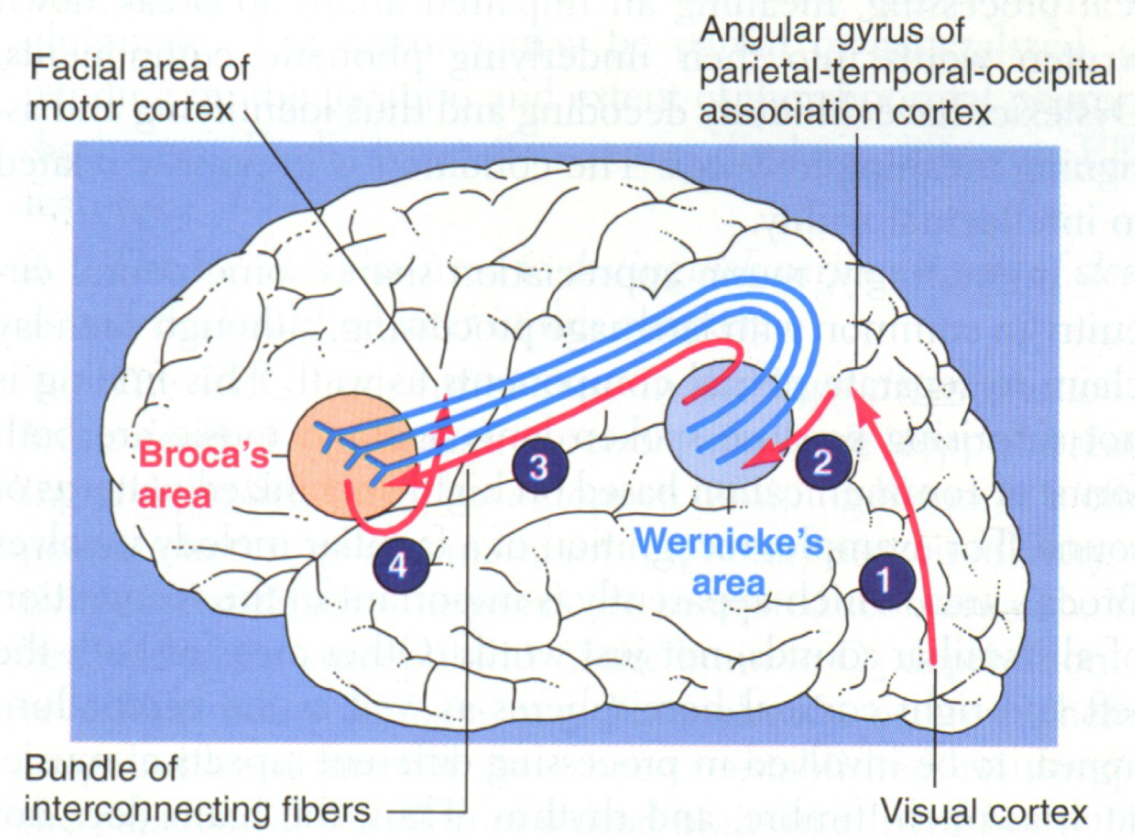
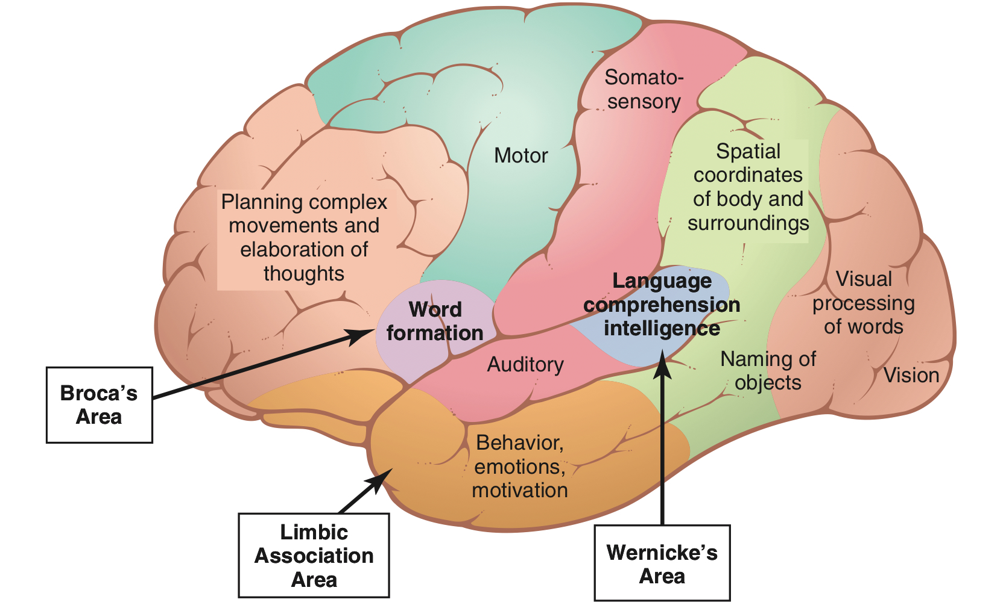
Speech production
articulation
Action that modulates or articulates which is achieved by the structures of the mouth.
Contribution by structures to shape airflow. A variety of speech sounds can be produced in terms of another way of air stream change Articulation Articulation is done mainly at vocal cord.
specific part of the vocal apparatus involved in the production of a speech sound Active articulators
Lips, tongue, lower jaw, velum
Muscular movements of the mouth, tongue, larynx, vocal cords
Responsible for the intonations, timing, and rapid changes in intensities of the sequential sounds.
Speech centers
Wernick’s Area:
Function:
- concerned with comprehension of auditory and visual information.
- Interpretations of sensory experience.
-Formation of thought in response to sensory experience.
- almost all such intellectual functions are language based.
Location:
at the posterior end of the superior temporal gyres.
course:
- It projects via the arcuate fasciculus to Broca’s area (area 44) in the frontal lobe immediately in front of the inferior end of the motor cortex.
Damage:
Wernicke's Aphasia: “Conduction aphasia”
Unable to interpret the thought.
Meaningless words with loss of comprehension / understanding .
Fluent

Slide 5
Broca's Area
“Motor Speech Area”
Location:
in the frontal cortex at the lower end of premotor area lying immedi­ately anterior to the primary motor cortex and immedi­ately above the sylvian fissure.
Function:
-Process information received from Wernick’s Area into detailed & co-ordinated pattern for vocalization.
-provides the neural circuitry for word formation.¹
-It is here that plans and motor patterns for expressing individual words or even short phrases are initiated and executed.
course:
Then project it to motor cortex to initiate the appropriate movement of the lips & larynx to produces speech.
Damage:
Motor Aphasia:
NonFluent.
Understanding normal but Voice production defective.
Angular Gyrus
Location:
is the most inferior portion of the posterior parietal lobe, lying immediately behind Wernikes area fused posteriorly into the visual cortex
Function:
interpretation of information obtained from reading from visual cortex
Damage:
Anomic: the patient is unable to name objects.
dyslexia “Word blindness”
the stream of visual experiences passing into Wernicke’s area from the visual cortex is mainly blocked. the person may be able to see words and even know that they are words but not be able to interpret.
1- It is interesting that in individuals who learn a second language in adulthood, fMRI reveals that the portion of Broca’s area concerned with it is adjacent to but separate from the area concerned with the native language. However, in children who learn two languages early in life, only a single area is involved with both. It is well known, of course, that children acquire fluency in a second language more easily than adults.

Slide 6
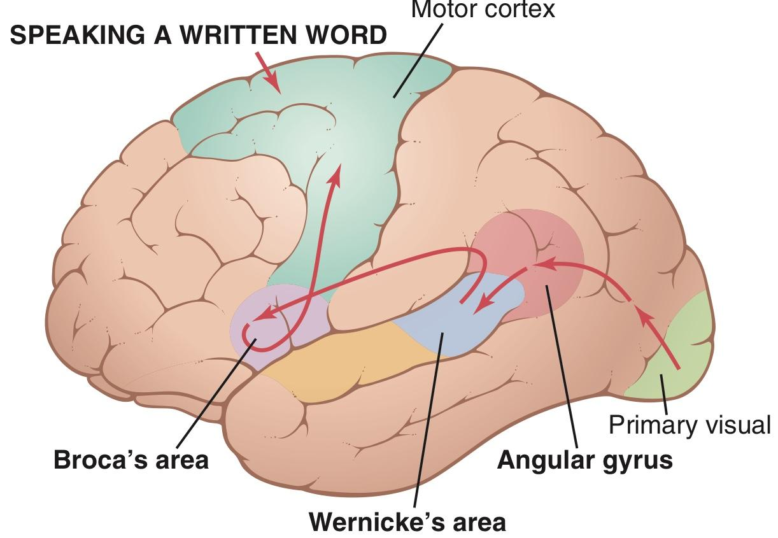
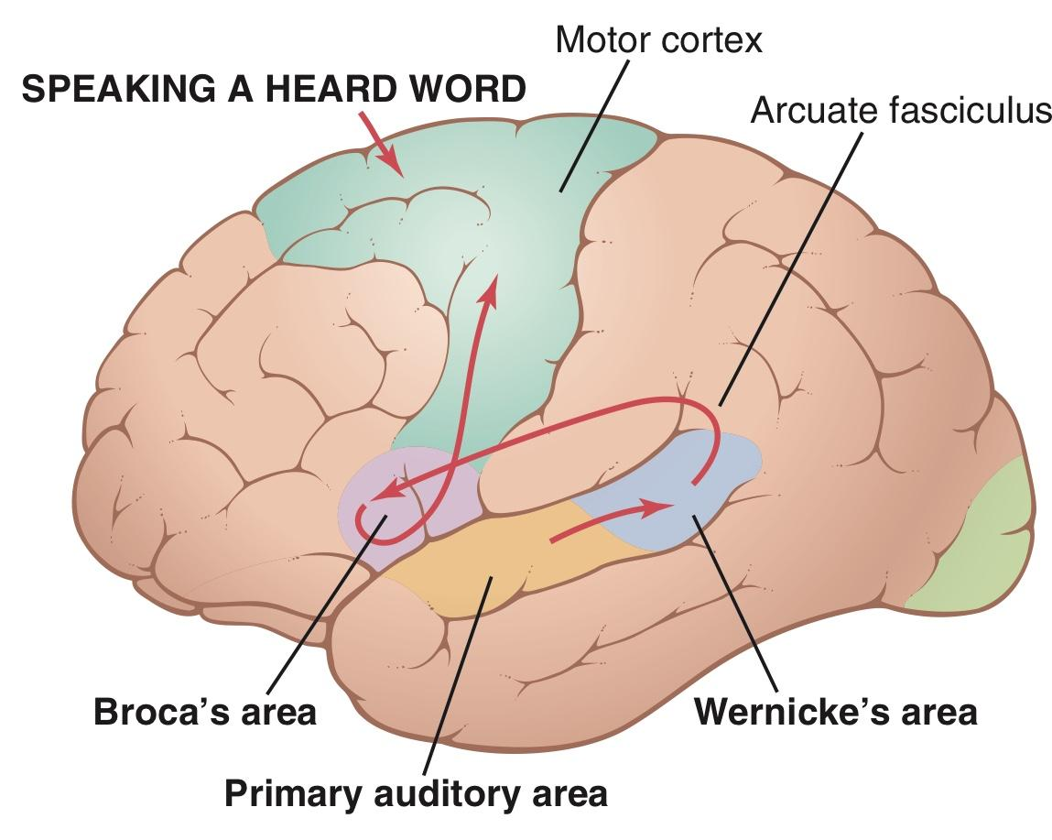
Insula
Location:
a portion of the cerebral cortex folded deep within the lateral sulcus.
Function:
Contains Speech articulation Area.
Hand and eye motor function.
initiates the appropriate movements of the lips, tongue, and larynx to produce speech.
The act of speech
The the act of speech divides into two aspects:
1-Sensory Aspects of Communication
2-Motor Aspects of Communication
So we are going to start with the sensory aspect. Because nothing happens without sensations:)
Sensory Aspects of Communication:
Visual Language Perception
“Reading”
Auditory Language Perception “Hearing-Talking”
It’s will start with the primary visual cortex because the stimuli here is preserved by vision center
It’s will start with the primary Auditory area because the stimuli here is preserved by Auditory area

Slide 7
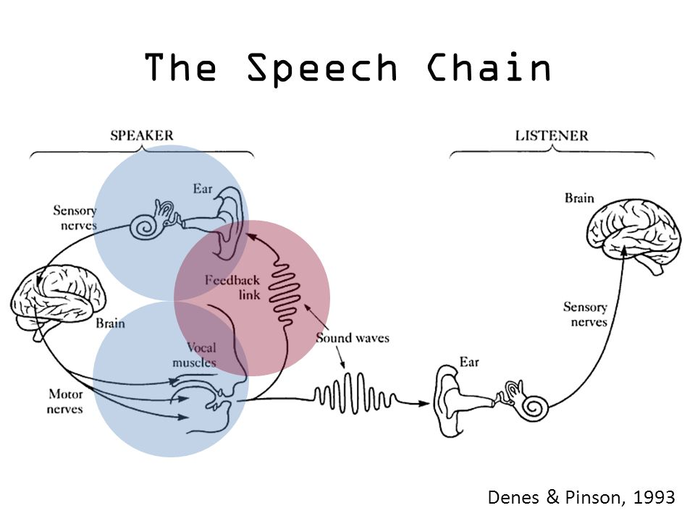
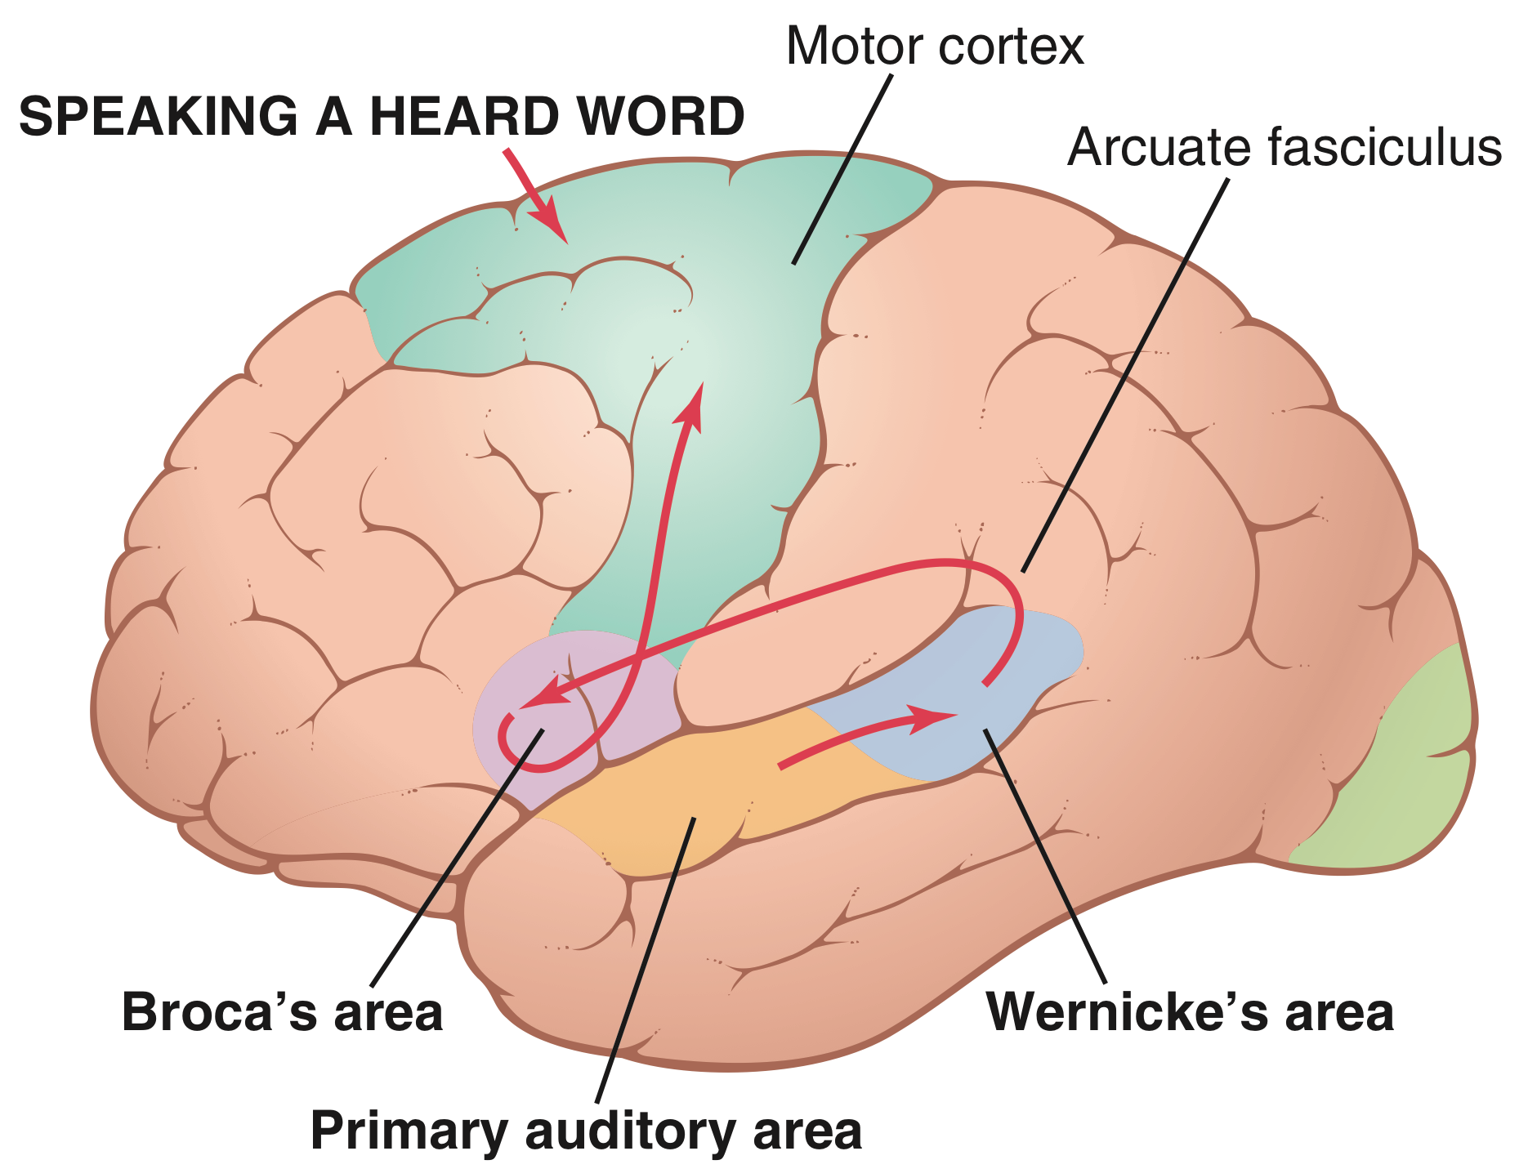
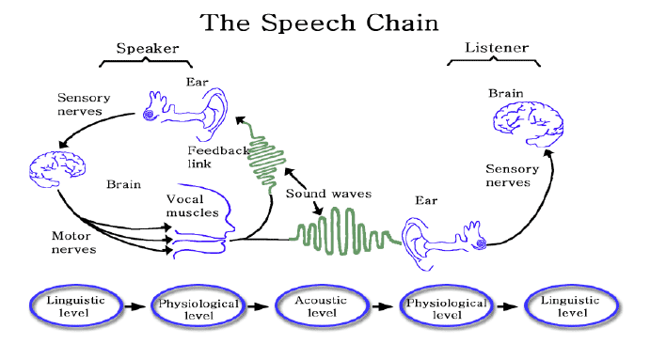
Motor Aspects of Communication
The process of speech involves two principal stages of mentation:
(1) formation in the mind of thoughts to be expressed, as well as choice of words to be used.
(2) motor control of vocalization and the actual act of vocalization itself. there’s two principal pathways for communication. The first pathway is involved in hearing and speaking response and the second pathway in reading and then speaking in response.
Auditory Language Perception “Hearing-Talking”
(1) reception in the primary auditory area of the sound signals that encode the words (2) interpretation of the words in Wernicke’s area (3) determination, also in Wernicke’s area, of the thoughts and the words to be spoken (4) transmission of signals from Wernicke’s area to Broca’s area by way of the arcuate fasciculus (5) activation of the skilled motor programs in Broca’s area for control of word formation (6) transmission of appropriate signals into the motor cortex to control the speech muscles.
Visual Language Perception
“Reading”
the comparable steps in reading and then speaking in response. The initial receptive area for the words is in the primary visual area rather than in the primary auditory area. The information then passes through early stages of interpretation in the angular gyrus region and finally reaches its full level of recognition in Wernicke’s area. From here, the sequence is the same as for speaking in response to the spoken word.
Association Areas
These areas receive and analyze signals simultaneously from multiple regions of both the motor and sensory cortices as well as from subcortical structures.

Slide 8
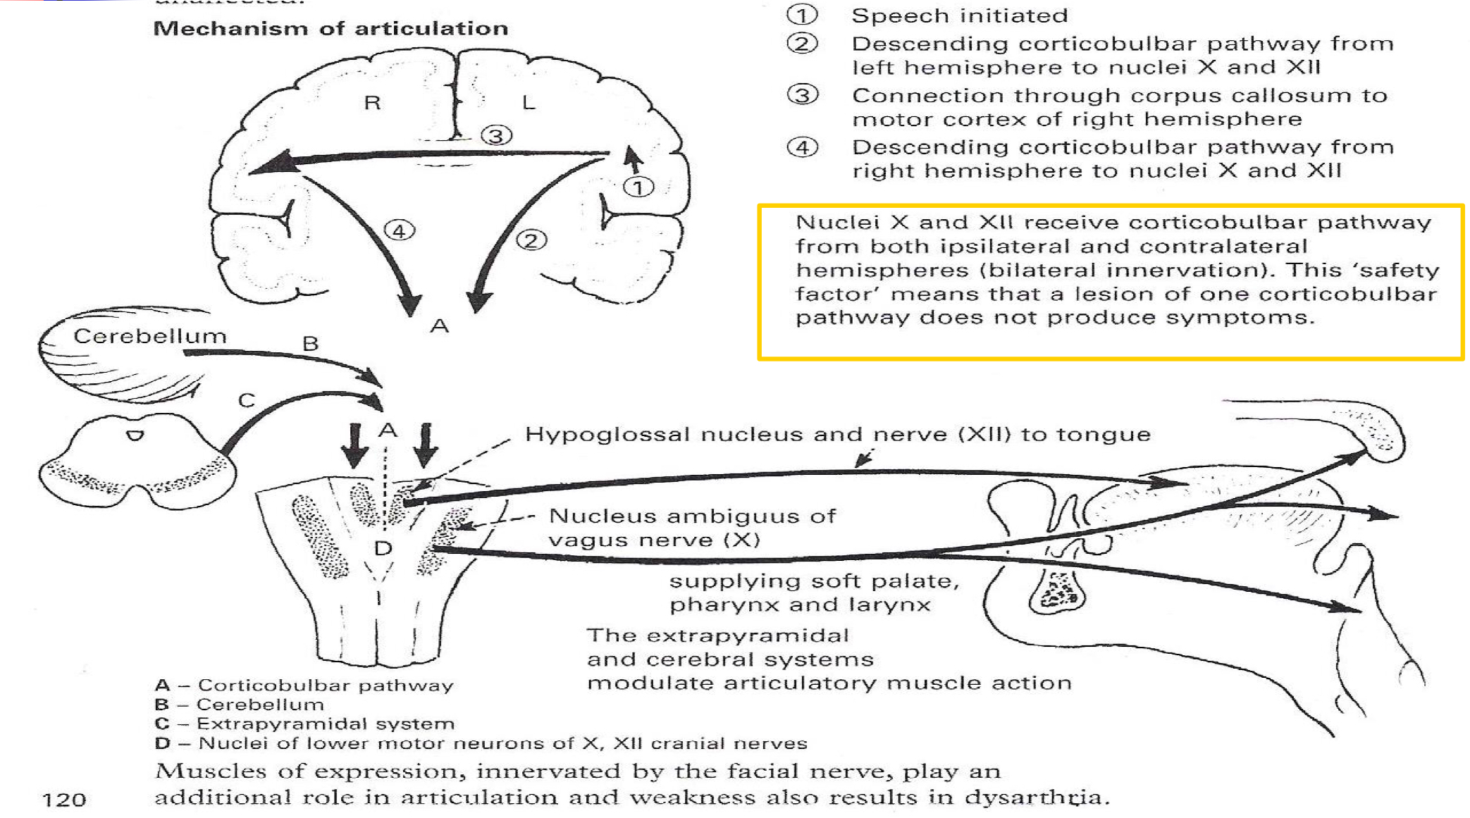
The most important association areas are:
Parietooccipitotemporal association area
Prefrontal association area
Limbic association area.
Parietooccipitotemporal association area :
1. Analysis of the Spatial Coordinates of the Body.
2. Area for Language Comprehension.
3. Area for Initial Processing of Visual Language (Reading).
4. Area for Naming Objects.
Speech chain
Mechanisms of articulation

Slide 9
Speech disorders
Area | Lesion feature
Auditory association areas | Word deafness
Visual association areas | Word blindness “dyslexia”
Wernicke's Aphasia | Unable to interpret the thought
Broca's Area Causes | Motor Aphasia
Global Aphasia | Unable to interpret the thought Motor Aphasia
Dysphasia:
is an acquired loss of production or comprehension of spoken and/or written language secondary to brain damage.
Dysarthria:
Disorder in articulation. E.g, Slurred Speech
It happens In some individuals who has no abnormality in the speech centre or in its pathways results in stuttering speech.
Language is intact, Paralysis, slowing or in coordination of muscles of articulation or local discomfort causes various different patterns of dysarthria.
“Slurred" speech
Speaking softly or barely able to whisper
Slow rate of speech
Rapid rate of speech with a "mumbling" quality
Limited tongue, lip, and jaw movement
Abnormal intonation (rhythm) when speaking
Changes in vocal quality ("nasal" speech or sounding "stuffy")
Hoarseness
Examples:
gravelly' speech of upper motor neuronal lesions of lower cranial nerves
jerky, ataxic speech of cerebellar lesions (Scannimg Speech)
the monotone of Parkinson's disease (Slurred)
speech in myasthenia that fatigues and dies away.
Many aphasic patients are also somewhat dysarthric.
Stuttering
Stuttering affects the fluency of speech.
Talking with involuntary repetition of sounds, especially initial consonants It begins during childhood and, in some cases, lasts throughout life.

Slide 10
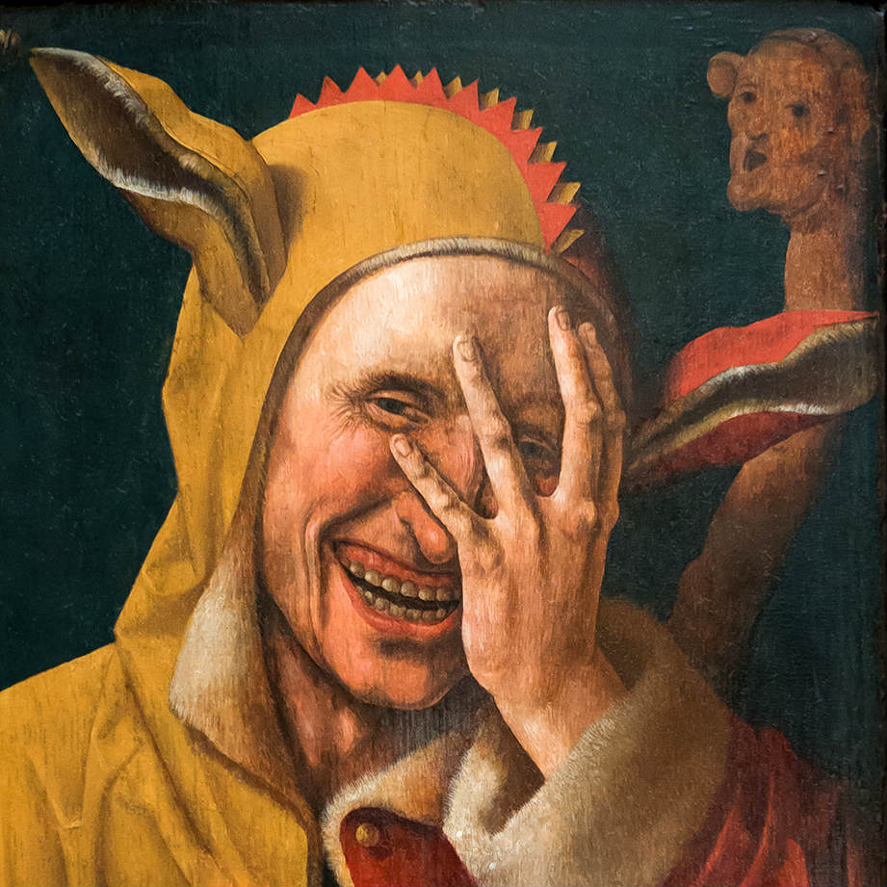
The disorder is characterized by disruptions in the production of speech sounds, also called “disfluencies”
Have right cerebral dominance and widespread overactivity in the cerebral cortex and cerebellum. This includes increased activity of the supplementary motor area.
Disordered phonation
Dysphonia:
Abnormal sound production due to problem in vocal cord
e.g., paralysis, Stroke “CVS”, other causes Causes:
Paralysis of both vocal cord e.g whispering sound and inspiratory stridor.
Paralysis of left vocal cord: The voice becomes weak and cough bovine. Mainly due to recurrent laryngeal palsy
Global Aphasia
“Central Aphasia”
This means the combination of the expressive problems of Broca's aphasia and the loss of comprehension of Wernicke's.
The patient can neither speak nor understand language.
It is due to widespread damage to speech areas and is the commonest aphasia after a severe left hemisphere infarct. Writing and reading are also affected.
In a nutshell
( Very important to know )
What is the manifestation of visual association area lesion ? What will happen if there is lesion of one of corticobulbar pathway ? What is the difference between auditory language perception and visual language perception ? “ you have to understand the pathway very clearly”
What is the speech centers ?
Good luck!

