Slide 1
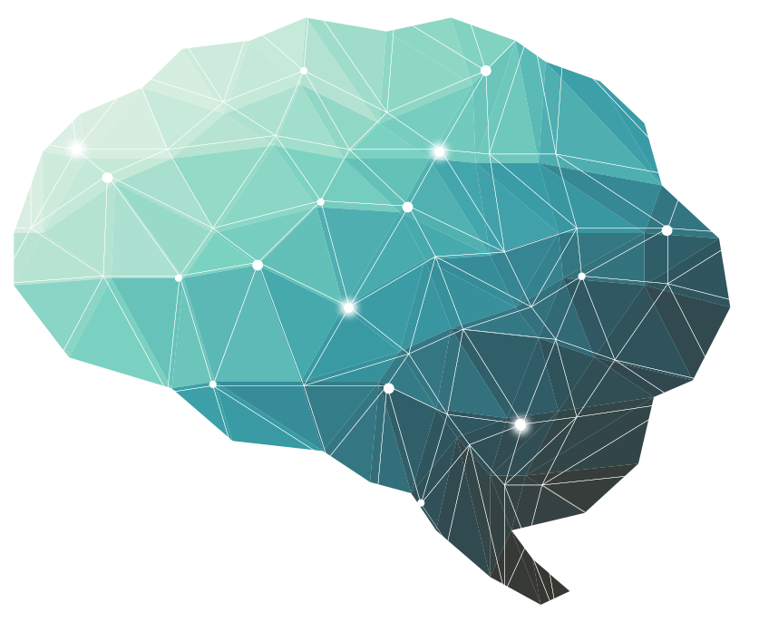
24 th Lecture ∣ The Physiology Team
Aging & Brain
Objectives:
Define Aging
Enumerate theories of aging
Describe body and brain changes in aging
Describe memory changes in aging
Explain carotid hypersensitivity
Disorders of the senses that associated with aging
Brief Geriatric Assessment Instruments
Bold & Italic objectives are included in the medical education guide
Done by :
Team leaders: Fatima Balsharaf , Rahaf Alshammari,
Abdulelah Aldossari, Ali Alammari.
Team members: Renad AlMogren, AlFahdah AlSaleem, Ghadah Alhaidari, Hadeel Almackenzie, Reham Al-Halabi, Alanoud Alessa, Ahad AlGrain
Colour index:
important
Numbers
Extra
Editing file
وَأَن لَّيْسَ لِلْإِنسَانِ إِلَّا مَا سَعَىٰ

Slide 2
Terminology
Term | Definition
Universal Aging | Changes everybody​ shares.(e.g.Grey hair & wrinkles)التغيرات اللي ممكن تحصل لكل احد بالعالم
Probabilistic Aging | Changes that may​ happen to some. (eg type two diabetes).ممكن تحصل ممكن لا بس كثير نشوفها بالكبار
Chronological Aging | Degrees​ of aging.(eg 50 decades different from 80).
Social Aging | Society's expectations​ of a person’s behavior as they grow older. يعني تأثیر المجتمع , مثلاً في المجتمعات العربیة ممكن الوحدة تصیر جدة وعمرها لم یتجاوز الـ35 فتحس نفسها عجزت , مع لو أنها أجنبیة ممكن تكون ما تزوجت للحین.
Biological Aging | Physical state​ of a person when he ages (Changes in tissues,heart,liver...)
circadian rhythm | biological process that displays an endogenous, entrainable oscillation of about 24 hours.
senescent cells | Cells that can’t divide
visuospatial deficits | inability to judge the spatial orientation of objects or lines in space.
Alzheimer’s Disease | premature aging of the brain, usually beginning in mid-adult life and progressing rapidly to extreme loss of mental powers similar to that seen in very, very old age.
Dementia | is a syndrome of progressive decline in which multiple intellectual abilities deteriorate, causing both cognitive and functional impairment.هنا كل وظائف الدماغ تبدأ تقل شوي بحیث كل سنة تقل أكثر من السنة التي قبلها ( الخرف
Delirium | is an acute state of confusion, Delirium may be the only manifestation of a life-threatening illness in the older adult. یصبح لدیه لحظة توهان فلا یستطیع تمییز أي شيء لكنه في فترة قلیلة (acute) غالبا يكون بسبب مشكلة في ال circulation cerebral example: cerebral stroke
24 th Lecture ∣ The Physiology Team

Slide 3
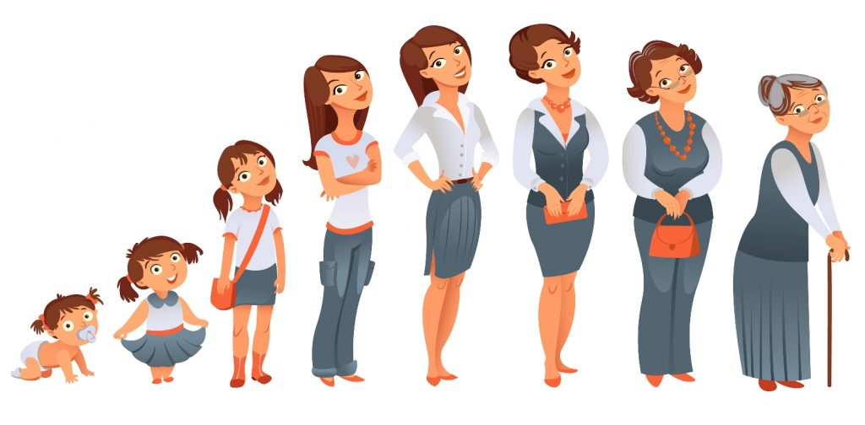
Define Aging
Aging
is the progressive, universal decline first in functional reserve and then in function that occurs in organisms over time.
Aging is not a disease; however, the risk of developing disease is increased, often dramatically, as a function of age
“Every organ in our bodies has capability and number of cells more than we need(functional reserve), so when we get (infection,stress,disease) day by day the functional capacity and the cells of the organ decrease, but it doesn’t affect us because we have more than we need! مثلا نقدر حتى نتبرع بالكلية وكل شيء تمام مانتأثر
As we get old changes in the function itself occur day by day”.كانت اكثر من اللي نببه ووصلت لأقل من اللي نحتاجه
24th Lecture ∣ The Physiology Team
AGEING IN THE DEVELOPMENT AGENDA “Ageing is a development issue. Healthy older persons are a resource for their families, their communities and the economy.” الجدات والجدان اللي بصحة كويسة نشوف قد ايش هم مفيدين للبيت اللي هم فيه
SUCCESSFUL AGING happens when
1. Active engagement with life يسوي اكتيفيتيز وعلاقاته كويسة
2. Low probability of disease or disability
3. High cognitive and physical function capacity

Slide 4
Enumerate theories of aging ليش ما نخلد طول العمر؟ فيه نظريات كثيرة اكتشفوها العلماء:
Hypothesis | How it may work
Genetic | Aging is a genetic program activated in post- reproductive life when an individual's evolutionary mission is accomplished یعني فیه علماء قالوا إن التقدم في العمر وسبب فقدان الكثیر من وظائف الجسم الطبیعیة یعتبر شيء متوارث وموجود بالجینات كمصیر للإنسان.
Oxidative stress | Accumulation of oxidative damage to DNA, proteins, and lipids interferes with normal function and produces a decrease in stress responses هذي النظرية ماشين عليها شركات التجميل
Mitochondrial dysfunction | A common deletion in mitochondrial DNA with age compromises function and alters cell metabolic processes and adaptability to environmental changeالمایتوكوندریا هي مصنع الطاقة بالخلیة، مع كبر السن ممكن انه یؤثر على وظائف الخلیة ویغیر فیها ویساهم في عملیة الـ Aging
Hormonal changes | The decline and loss of circadian rhythm in secretion of some hormones produces a functional hormone deficiency stateبعض الهرمونات لهم rhythm circadian بحیث ان بعضهم ما ینتج الا الصباح وباوقات بدري (مثل الكوتریكوستیرودز) وبعضهم ما یفرز إلا بأوقات متأخرة.. فلو صارت لخبطة بهال rhythm circadian ممكن انه یؤدي الى مشاكل بالهرمونات. كثير ناس صحتهم كويسة يكون السبب انهم مرتبين نومهم طول حياتهم(طبعا احنا برا الموضوع:))..
Telomere shortening | Aging is related to a decline in the ability of cells to replicate If the cells has the ability to replicate the functional reserve occursفلما يتأثر الريبلكيشن اللي حيفقد مارح يترجع
Defective host defenses | The failure of the immune system to respond to infectious agents and the overactivity of natural immunity create vulnerability to infection
Accumulation of senescent cells | Renewing tissues become dysfunctional through loss of ability to renewلخلایا العجوزة "اللي تشیخ" المفروض ان الشخص یتخلص منها علشان ماتكون عبء على الـtissue اللي هي فیه بحیث انها تاخذ من طاقة الخلیة وتشكل جزء منها.. هذي النظریة تقول ان الـ aging ماهو الا نتیجة ناتجة عن تراكم هالخلایا
24th Lecture ∣ The Physiology Team

Slide 5
Describe body changes in aging
OXYGEN - free radicals (FR) and reactive oxygen species (ROS)
Mitochondria produce ROS:
The respiratory chain (resp. chain) produces superoxide radicals (O2-·), which generate hydrogen peroxide (H2O2) and hydroxyl radicals (HO·). Mitochondrial nitric oxide synthase (NOS) produces nitric oxide (NO·), which combines with O2-· to generate peroxinitrite (ONOO-). All these ROS may cause mitochondrial and cellular damage if present in excess. MPT, Mitochondrial permeability transition.
1. Cell metabolism.
2. Environment. (Radiation) 3. Lifestyle. (Smoking)
4. Pollution.
5. Diet.
6. Infection.
24th Lecture ∣ The Physiology Team
Leading Causes of Death Age 65+ “ Medical Diagnoses”
Heart Disease 32%
Cancer 22%
Stroke 8%
Chronic respiratory 6%
Flu/Pneumonia 3%
Diabetes. 3%
Alzheimer’s. 3%
Age Related Changes: Important
Decreased heightالعظام بتفقد الماتيريال حقتها , lean body mass and body waterالكتلة العضلية تبدا تقل وبيجي مكانها فات
Increased body fat
Consequence Changes in pharmacokineticsعشان كذا ننتبه لجرعة الدواء حقت كبار السن
A lower metabolic rate يسمنون اسرع من لما كانو بشبابهم اذا استمروا على نفس نمط اكلهم اول
Longer reaction times “response to stimuli takes more time”
Declines in certain memory functions(especially the recent memory)
Declines in sexual activity and in women menopause
A functional decline in audition, olfaction, and vision
Declines in kidney, pulmonary, and immune functions, declines in exercise performance, and multiple endocrine changes

Slide 6
Describe brain changes in aging
Aging nervous system
Changes | Consequences
Decreased brain weight Decreased cerebral blood flow memory Alteration in CNS neurotransmitters Decreased vibratory sense | Drug toxicities delirium Altered mood Decreased IQ scores “Benign senile forgetfulness” Increased postural instability Altered gait Falls, accidents
24th Lecture ∣ The Physiology Team
Structure | Regional function
Basal ganglia | Becomes bright in appearance due to iron accumulation
Subarachnoid space | Increase in size due to brain shrinkage”because of the atrophy that happens to neurons the space will increase”.
Hippocampus | Reduction in size due to cell loss in the structure.
Ventricles | Increase in size due brain shrinkage.
White matter | Reduction in size due to neuronal atrophy in the deep brain.
Cerebellum | is the youngest brain region least affected by aging

Slide 7
CONGITIVE CHANGES IN AGING: MENTAL PROCESSING
“Any change that occurs in any step below will cause changes in the cognitive”
DECLARATIVE MEMORY OR EXPLICIT MEMORY EPISODIC MEMORY (Events) SEMANTIC MEMORY (Words, language) Late to HIPPOCAMPUS AND IS ASSOCIATED WITH CONSCIOUSNESS
SKILL MEMORY OR IMPLICIT MEMORY
IT DOES NOT INVOLVE AWARENESS. INVOLVES CEREBELLUM, MOTOR CORTEX, SENSORY CORTEX, VISUAL AREAS
24th Lecture ∣ The Physiology Team
Explicit memory (also called "declarative memory") is one of the two major subdivisions of long-term memory. (The other is implicit memory.) Explicit memory requires conscious thought—such as recalling who came to dinner last night or naming animals that live in the rainforest. It's what most people have in mind when they think of "memory," and whether theirs is good or bad. Explicit memory is often associative; your brain links memories together. For example, when you think of a word or occasion, such as an automobile, your memory can bring up a whole host of associated memories—from carburetors to your commute to a family road trip to a thousand other things.
Implicit memory is sometimes referred to as unconscious memory or automatic memory. Implicit memory uses past experiences to remember things without thinking about them. The performance of implicit memory is enabled by previous experiences, no matter how long ago those experiences occurred.EXTRA!!
There is decline in mental processing via reduction of attentional ability and decline in ability in forming working memory (mainly includes short term memory) There is decline in explicit memory that involves hippocampus (surroudings & Skills) and is associated with awareness & attention unlike implicit.

Slide 8
Describe brain changes in aging
Nervous System changes
Aging leads to increased cerebral amyloid
Average amount of brain protein is reduced with a marked loss in multiple enzymes (carbonic anhydrase and the dehydrogenases) but with a relative increase in abnormal proteins such as amyloid in tangles and plaques.
Loss of RNA (messenger and transcription)”responsible for protein and neurotransmitter synthesis” but not DNA
Loss of lipids, and lipid turnover rate, and a decrease in catabolism and synthesis.
Neuronal loss is normal in the aging brain but the ability to learn remains generally unchanged
There is loss of dendritic arborization”less communication between neurons”.
Recall memory is affected more than cognitive function in normal agingبينسى اللي قلته اكثر من انه مايفهم كلامك
Cerebral atrophy shows up on CTs and MRI scans
Reduced Sympathetic nervous system activity هي ميزة انهم يصيرون هاديين bradycardia وعندهم طولة بال بس بنفس الوقت لها ريسك فاكتور مهم هو ال
Reduced Neurotransmitter levels
Changes in sleep patterns
Abnormalities in EEG tracings لما نسوي لهم بيكون الاختلاف واضح في الاي جي جي بينهم وبين الاطفال والشباب
Increased risk of stroke “because of the changes that occur in cerebral blood vessels”.
24th Lecture ∣ The Physiology Team
Geriatric Syndromes
Dementia (gradual) and Delirium (sudden)
Falls
Urinary Incontinence
Pressure Ulcersالتقرحات غالبا تحصل عندما یكون الشخص ملازم للسریر فتتكون من الضغط المستمر للمنطقة (یكون الضغط بین العظم والسریر
Functional Decline

Slide 9
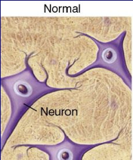
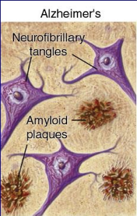
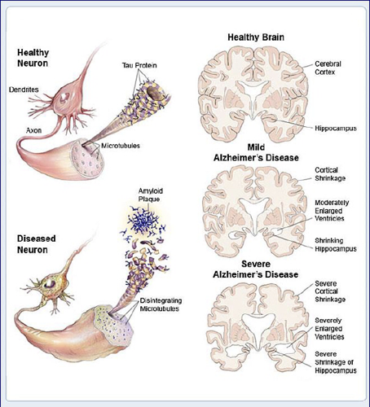
Describe memory changes in aging
Alzheimer’s Disease
Alzheimer’s disease is defined as premature aging of the brain, usually beginning in mid-adult life and progressing rapidly to extreme loss of mental powers similar to that seen in very, very old age.مثلا عمره ٤٠ والتغيرات اللي صارت له كانها بواحد عمره ٩٠
Features of Alzheimer’s disease:
an amnesic type of memory impairment.یبدأ ینسى ( ناس، اماكن، عناوین،طرق ) الخ
deterioration of language.ینسون بعض الكلمات وبعض اللغات ینساها یسمعها بس مایعرف معناها
visuospatial deficits.مثلا یطلع من البیت ولا یعرف طریق الرجوع الیه لانه نسى الاتجاهات
Motor and sensory abnormalities, gait disturbances, and seizures are uncommon until the late phases of the disease.
غالبا الزهایمر في بدایاته یؤثر على الـsensory والـfunctions brain higher ،اما الـfunctions motor یؤثر علیهم في المراحل المتقدمة من المرض
Amyloid Plaques
It is hallmark of Alzheimer's disease.
There is accumulation of amyloid plaques between nerve cells (neurons) in the brain. Amyloid is a general term for protein fragments that the body produces normally. Beta amyloid is a protein fragment snipped from an amyloid precursor protein (APP).
In a healthy brain, these protein fragments are broken down and eliminated. In Alzheimer's disease, the fragments accumulate to form hard, insoluble plaques.
24th Lecture ∣ The Physiology Team
Neurofibrillary Tangles
These are insoluble twisted fibers found inside the brain's cells.
Consist primarily of a protein called tau, which forms part of a structure called a microtubule. The microtubule helps transport nutrients and other important substances from one part of the nerve cell to another. In Alzheimer's disease, however, the tau protein is abnormal and the microtubule structures collapse.
AMAZING video 5 mins

Slide 10
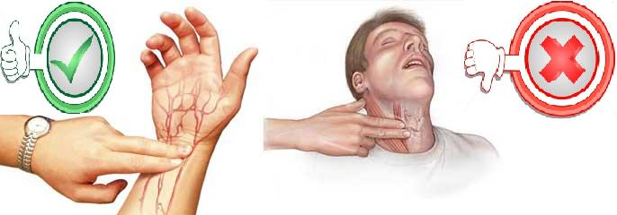
Explain carotid hypersensitivity
Baroreceptor Reflex
Quick operation (within few seconds).if we change our posture and sudden decrease in blood pressure happen the baroreceptors quickly return it to normal
Mediated through autonomic reflexes.
Adjusts CO ( cardiac output) and TPR (the peripheral resistance) to restore BP to normal.
Influences heart and blood vessels.
★ Since the baroreceptors reflex are receptors and the receptors affected by aging so it will develop hypersensitivity or hyposensitivity ,, here the problem is hypersensitivity for baroreceptors reflex so, if any pressure happened to the carotid sinus they will develop fall down or severe hypotension (severe vasovagal attack).
Carotid sinus hypersensitivity
Carotid sinus syncope occurs when there is an exaggerated vagal response to carotid sinus stimulation.
Provoked by wearing a tight collar, looking upwards or turning the head
Carotid sinus syndrome occurs in the elderly and mainly results in bradycardia.
Most common etiologies of atrioventricular block.(because of severe bradycardia).
Do not massage both carotids simultaneously.
لازم ننتبه لهم لما مثلا لما يحلقون او يلبسون شيء يغطي رقبتهم او لما لهم مساج اننا ما نضغط على منطقة الكاروتيد ارتري.
24th Lecture ∣ The Physiology Team

Slide 11
Disorders of the senses that associated with aging
Slide 31-35
تنسيق في جدول
Disorders Associated with Aging | Details
Vision | Loss of ability to see items that are close up begins in the 40’s (Presbyopia). Size of pupil grows smaller with age: focusing becomes less accurate. Lens of eye yellows making it more difficult to see red and green colors. Sensitivity to glare increases. Night vision not as acute.
Sensorineural Hearing Loss | Damage to the hair cells of the organ of Corti may be caused by: intense noise viral infections ototoxic drugs (e.g., salicylates, quinine and its synthetic analogues, aminoglycoside antibiotics, loop diuretics such as furosemide and ethacrynic acid, and cancer chemotherapeutic agents such as cisplatin) fractures of the temporal bone meningitis cochlear otosclerosis Ménière's disease aging.
Disorders of the Sense of Taste | Disorders of the sense of taste are caused by: transport loss sensory loss neural loss Sensory gustatory losses are caused by: inflammatory and degenerative diseases in the oral cavity. a vast number of drugs, particularly those that interfere with cell turnover such as antithyroid and antineoplastic agents. radiation therapy oral cavity and pharynx. viral infections. endocrine disorders. neoplasms. aging.
Pain and Sense of Touch | With age, skin is not as sensitive as in youth due to: Loss of elasticity Loss of pigments Reduced fat layer Safety Implications: Decreased ability to recognize dangerous levels of heat Decreased ability to maintain temperature Tendency to develop bruises, skin tears.
Sexual Dysfunction | Erectile dysfunction (ED) is not considered a normal part of the aging process. Nonetheless, it is associated with certain physiologic and psychological changes related to age. In the Massachusetts Male Aging Study (MMAS), a community-based survey of men between the ages of 40 and 70, 52% of responders reported some degree of ED. Complete ED occurred in 10% of respondents, moderate ED occurred in 25%, and minimal ED in 17%
2
24th Lecture ∣ The Physiology Team

Slide 12
Brief Geriatric Assessment Instruments
Slide 36
Domain | Instruments | Comments
Cognition | IQ
Dementia | MMSE (mini-mental state examination). Qs and we evaluate the score. | Widely studied and accepted.
 | Time and change (T&C) test. How much time he takes to do a specific task to move to the other one. | Sensitive and quick.
Delirium | CAM (confusion assessment method). | Sensitive and easy to apply.
Affective disorders | GDS 5-question form (Geriatric depression scale) Qs to evaluate the depression | Rapid screen.
Visual impairment | Snellen chart | Universally used.
Hearing impairment | Whispered voice | No special equipment needed.
 | Pure tone audiometry | Can be performed by trained office staff.
Dental health | DENTAL
Nutritional status | Weight loss of >4.5 kg (>10 lb) in 6 months or weight <45 kg (<100 lb) in general.
Gait and balance | "Timed Get Up and Go" test.قد ايش ياخذ وقت عشان يوقف | Requires no special equipment.
24th Lecture ∣ The Physiology Team

Slide 13
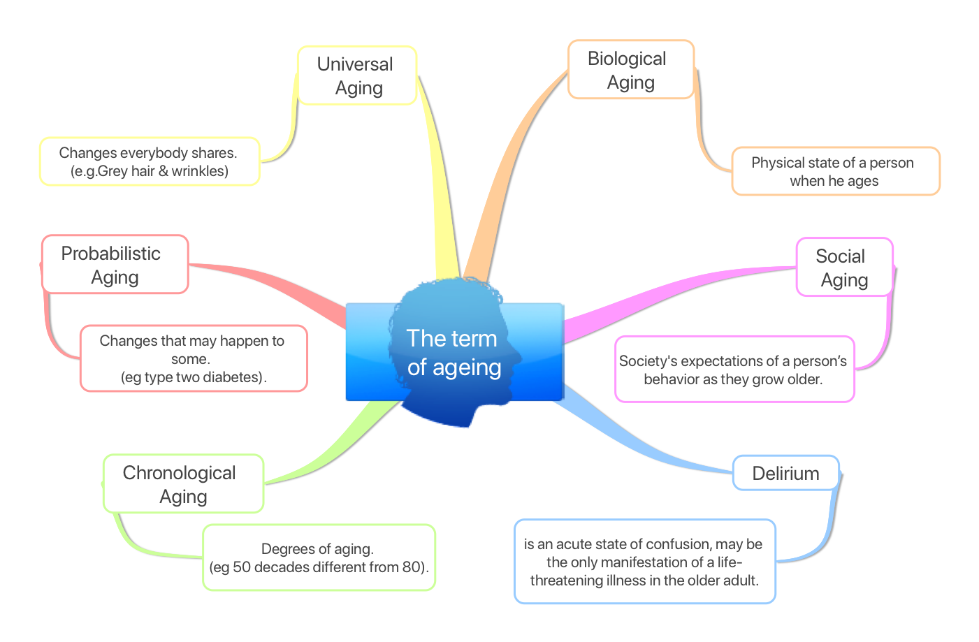
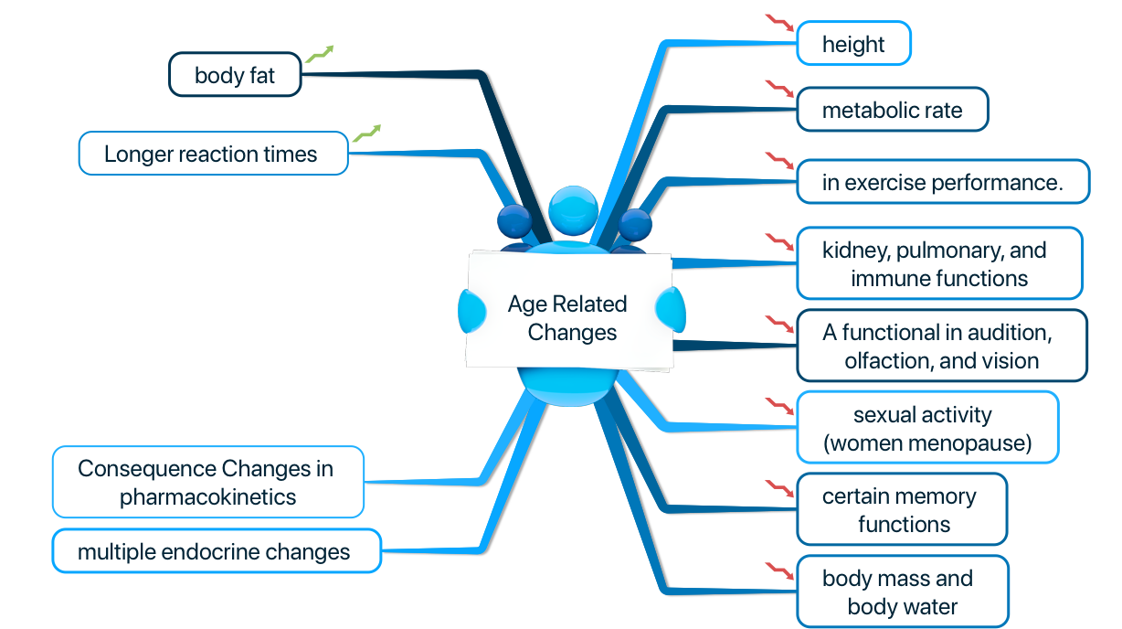
Quick review
24 thLecture ∣ The Physiology Team
Cerebellum is the youngest brain region least affected by aging
Recall memory is affected more than cognitive function in normal aging
Amyloid plaques is hallmark of Alzheimer's disease.
Carotid sinus syndrome occurs in the elderly and mainly results in bradycardia.
There is decline in mental processing via reduction of attentional ability and decline in ability in forming working memory (mainly includes short term memory) There is decline in explicit memory that involves hippocampus (surroudings & Skills) and is associated with awareness & attention unlike implicit.

Slide 14
Questions
MCQs
With age, skin isn’t as sensitive as in youth due to:
Reduced fat layer
Loss of elasticity
Loss of pigment
All of the above
2. Loss of the ability to see near objects begins in the …… as ………
50s, Myopia
40s, Presbyopia
30s, Presbyopia
40s, Nyctalopia
3. Delirium is a chronic state of confusion, it may be the only manifestation of a life threatening illness in older adult. .
True
False
4. One of the nervous system changes in old age is:
Increased Sympathetic nervous system activity
Decrease in the cerebral Amyloid
Loss of dendritic arborization
Normal EEG tracings
5. The Telomere shortening theory of aging links aging to the declined ability of cells to replicate.
True
False
SAQ
6. What are the safety implications regarding the pain and sense of touch in elderly people?
7. What are the main features of Alzheimer’s disease?
8. The Geriatric syndrome consist of:
9. What changes occur to the Basal Ganglia with aging?
10. Name two instruments we could use to assess hearing impairment in geriatric patients.
24th Lecture ∣ The Physiology Team
D
B
B
C
A
1-Decreased ability to recognize dangerous levels of heat. 2-Decreased ability to maintain temperature. 3-Tendency to develop bruises, skin tears
1-Amnesic type of memory impairment.2-Deterioration of language.3-Visuospatial deficit
1-Dementia and Delirium.2-Falls.3-Urinary incontinence.4-Pressure ulcers.5-Functional decline
Becomes bright in appearance due to iron accumulation
Whispered voice and pure tone audiometry

