Slide 1
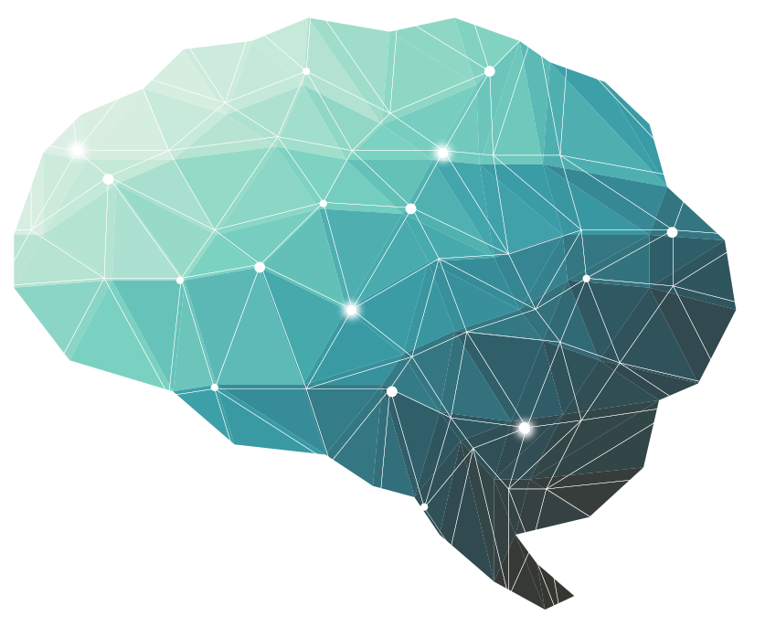
Cerebral hemisphere function
24th Lecture ∣ The Physiology Team
Objectives:
Cerebral hemisphere is divided into four lobes by central sulcus and lateral sulcus. E.g. frontal lobe, parietal lobe, temporal lobe and occipital lobe.
Know the terms categorical hemisphere and representational hemisphere.
Be able to summarize the difference between these hemispheres.
Done by :
Team leader: Rahaf AlShammari, Fatima Balsharf, Abdulelah AlDossari, Ali AlAmmari.
Team members: Reem AlQarni, Abdullah AlSergani, Shahad AlZahrani, Faisal AlTahan, Shahad AlTayash, Hisham AlShaya, Maha AlAmri, Saif AlMeshari.
Colour index:
Important
Numbers
Extra
وَأَن لَّيْسَ لِلْإِنسَانِ إِلَّا مَا سَعَىٰ

Slide 2
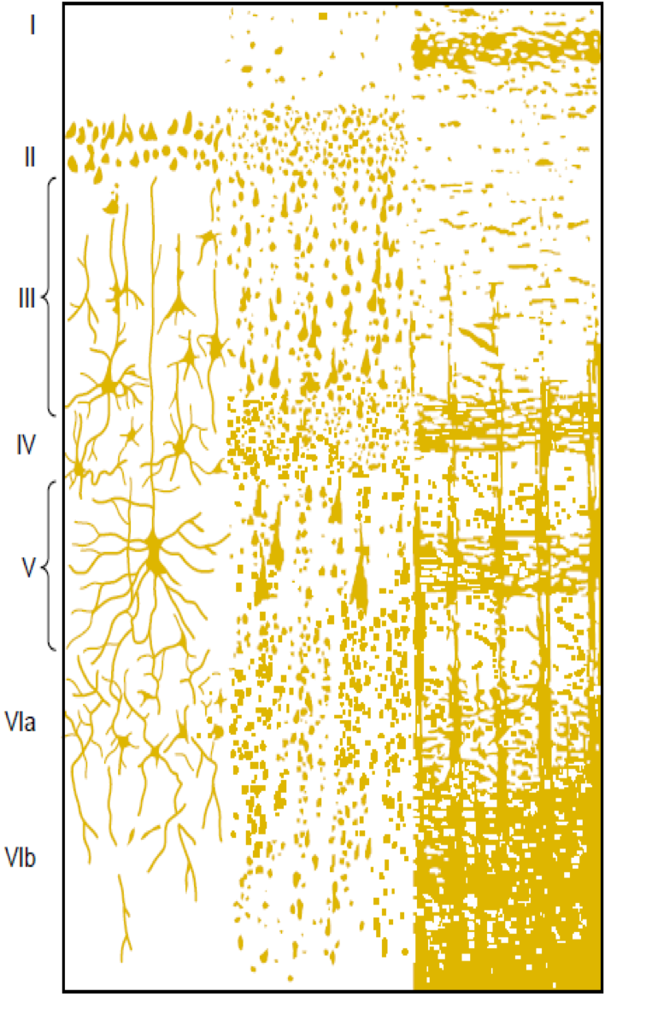
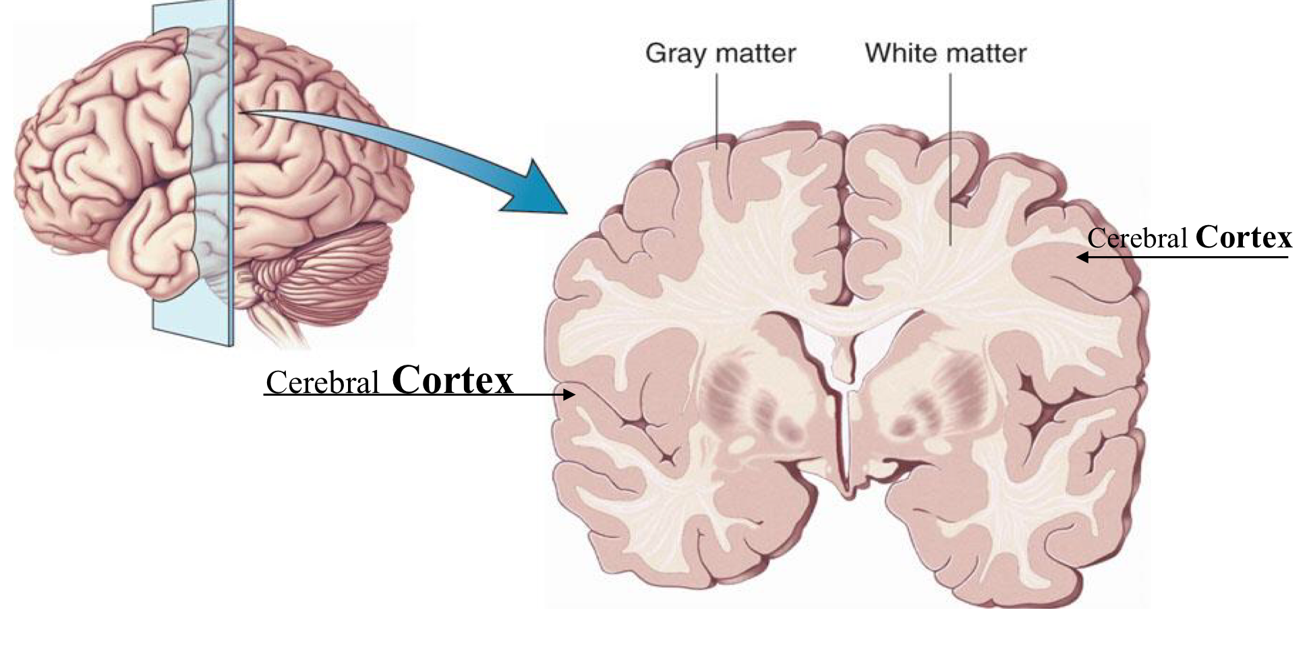
Introduction
The cerebrum is the largest part of the brain with two hemisphere, linked by commissural fibres of corpus callosum.
Each cerebral hemisphere contains externally highly convoluted cortex of grey matter and internal mass of
The cerebral hemispheres contains motor and sensory areas and the limbic system.
Cerebral Cortex
The outermost layer of gray matter making up the superficial aspect of the cerebrum.
Microscopically the cortex consists of six layers or laminae lying parallel to the surface.
From outside to inside the layers are:
Molecular layer
The external granular layer
Layer of pyramidal cell
Internal granular layer
Large pyramidal cell layer
Layer of fusiform or polymorphic cells.
Cerebral Cortex Layers
The incoming sensory signal excites neuronal layer IV first; then the signal spreads toward the surface of the cortex and also toward deeper layers.
Layers I and II & III perform most of intracortical association function.
The neurons in layers II and III making short horizontal connections with adjacent cortical areas.
The neurons in layers V and VI send output signals to brain stem, spinal cord (V) & thalamus (VI).

Slide 3
There are three main types of functional areas in the cerebral cortex
Primary Areas:
The primary motor areas have direct connections with specific muscles for causing discrete muscle movements.
The primary sensory areas detect specific sensations - visual, auditory, or somatic- transmitted directly to the brain from peripheral sensory organs.
Association Areas they receive and analyze signals simultaneously from multiple regions of both the motor and sensory cortices as well as from subcortical structures.
2) Associated areas:
These areas receive and analyze signals simultaneously from multiple regions of both the motor and sensory cortices as well as from subcortical structures.
The most important association areas are
Parieto-occipitotemporal association area
Prefrontal association area
Limbic association area.
Parieto-occipitotemporal association areas
Analysis of the Spatial Coordinates of the Body.
Language Comprehension.
Initials Processing of Visual Language (Reading).
Area for Naming Objects.

Slide 4
1. Parieto-Occipitotemporal association areas
Area | Site | Function
1) Analysis of the spatial coordinates of the body | Beginning in the posterior parietal cortex and extending into the superior occipital cortex | Computes the coordinates if the visual, auditory, and body surroundings.
2) Area for language comprehension | Wernicke’s area, lies behind the primary auditory cortex in the posterior part of the superior gyrus of the temporal lobe | Higher intellectual function
3) Area for Initial processing of visual learning (Reading) | Angular gyrus area | Make meaning out of the visually perceived words (lesion causes Dyslexia or word blindness)
4) Area for naming objects | Lateral portion of anterior occipital lobe and posterior temporal lobe | Naming objects

Slide 5
2. Prefrontal Association Area
Definition | Function | Lesion
Is the anterior pole of frontal lobe. | Planning of complex pattern of movements. Personality characteristics and social relationship. Production of deep, more abstract and logically sequenced thoughts which enable attainment of goals. Working memory (ability to tie thoughts together in a logical sequence by comparing many bits of information with appropriate stored knowledge and be able to instantly recall this information for future planning). | (Lesions in this area lead to change in personality and behavior)
3. Limbic Association Area
Definition | Function | Lesion
Anterior and inner portion of temporal lobe. | Is primarily concerned with emotion , behavior and motivational drive for different tasks most importantly learning. | (Lesion of this area may lead to decreased aggression, lack of emotion, hyper sexuality & hyperphagia)
Area of Recognition of Faces
Location | Function | Lesion
The underside of the brain on the medial occipital and temporal lobe | The occipital portion is contiguous with visual cortex , while the temporal one is closely associated with limbic system | Inability to recognize faces is called prosopagnosia (Patient with prosopagnosia can’t recognize faces even his or her own face in the mirror, they can recognize people with their voices)

Slide 6
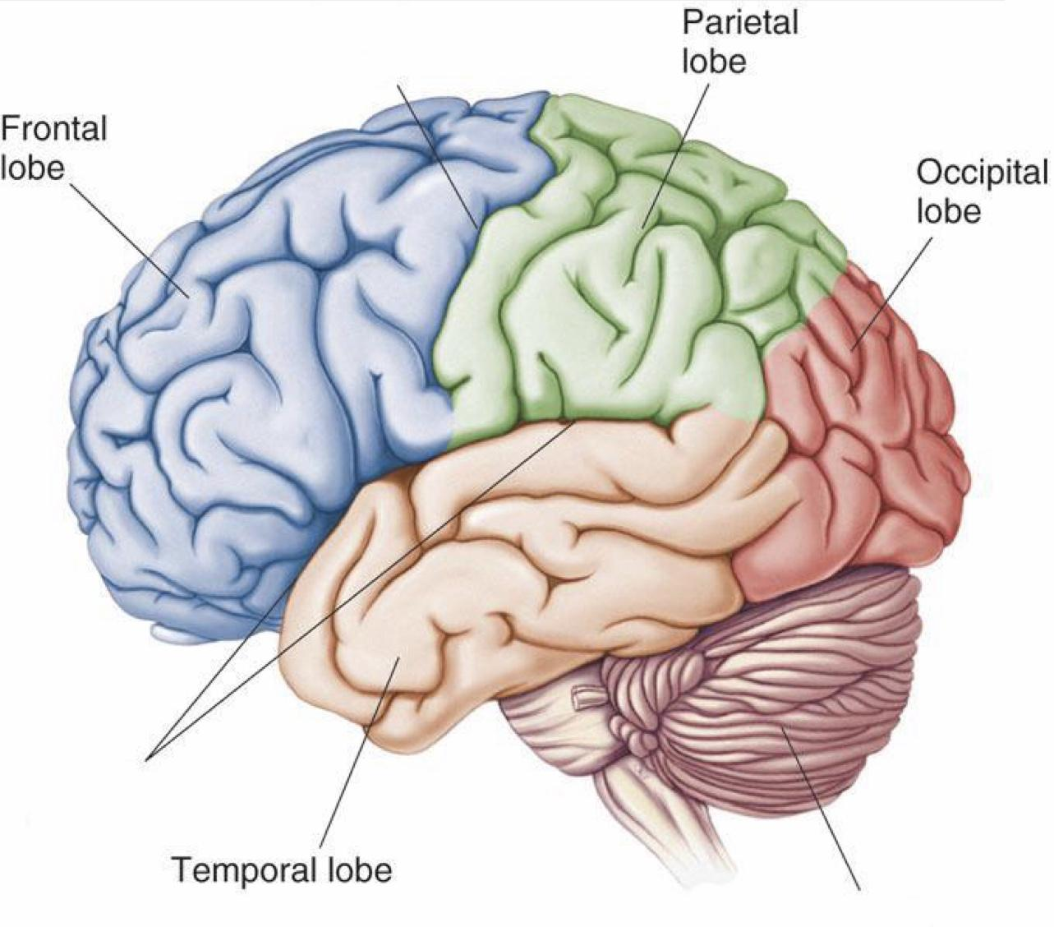
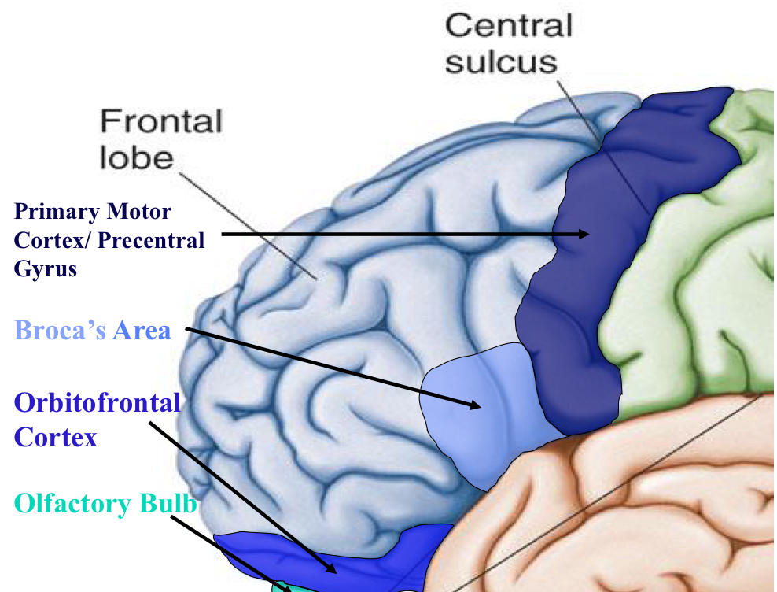
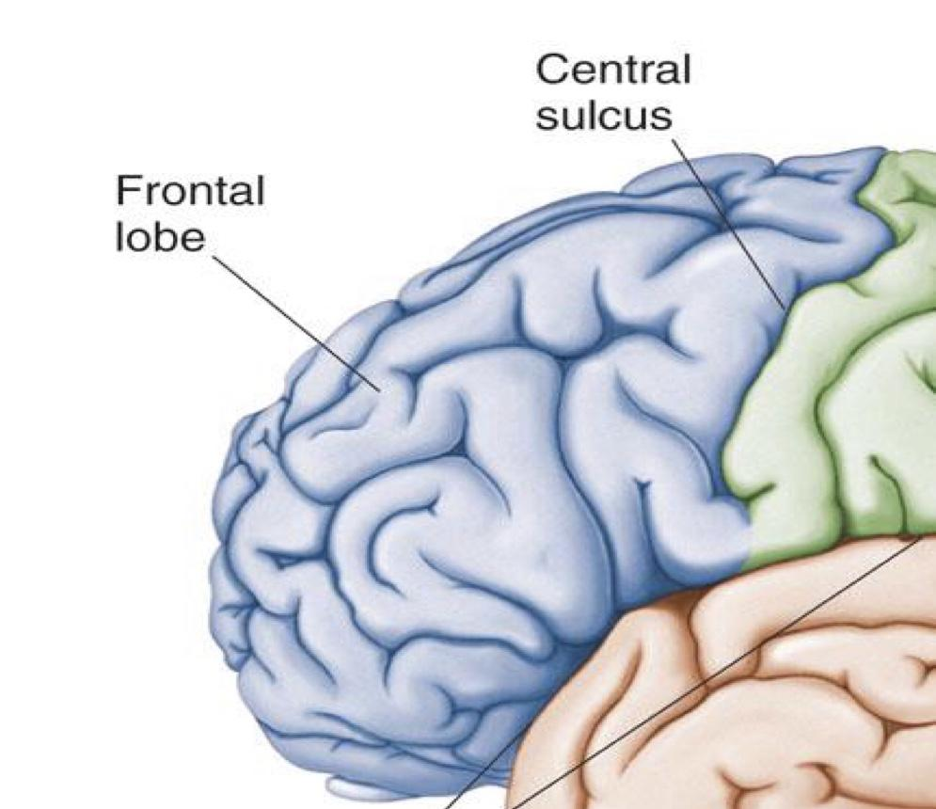
Lobes of the Brain
Frontal
Parietal
Occipital
Tempora
Frontal lobe
Location | Function | Cortical region
Deep to the Frontal Bone of the skull. | -Memory formation -Emotions -Decision making -Reasoning -Personality | Primary Motor Cortex (Precentral Gyrus) Cortical site involved with controlling movements of the body. Broca’s Area plan of motor pattern for expressing of individual words. Located on Left Frontal Lobe Broca’s Aphasia Results in the ability to comprehend speech, but the decreased motor ability (or inability) to speak and form words. Orbitofrontal Cortex Site of Frontal Lobotomies Olfactory Bulb Cranial Nerve I, Responsible for sensation of Smell
Frontal Lobotomies
Desired effects | Possible side effects
Diminished rage | Epilepsy
Decreased aggression | Poor emotional responses
Poor emotional responses | Perseveration (Uncontrolled, repetitive actions, gestures, or words)

Slide 7
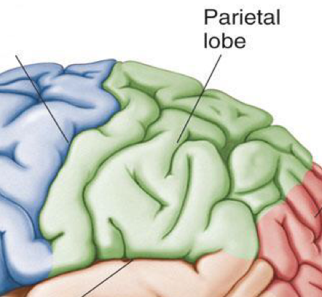
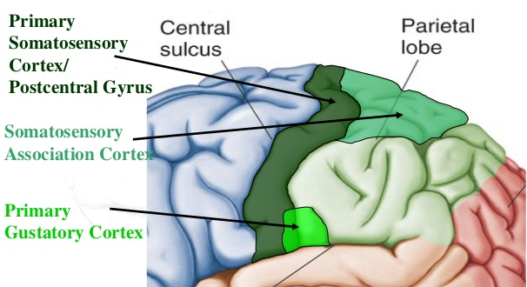
Parietal lobe
Located Deep inside the parietal bone of the skull
Function | Cortical region | Lesions
-Sensing and integration of the sensation. -Spatial awareness and perception → Proprioception which is awareness of the body or its parts in space and its relation to one another | Primary somatosensory cortex (Postcentral gyrus) :It is the site involved in processing tactile and proprioceptive information) (injury to this area causes loss of sensation ) Somatosensory association cortex Assists with the integration and interpretation of sensations relative to body position and orientation in space إذا كان الشخص مصاب في هذه المنطقة بالتالي هو يقدر يحس بس ما يقدر يفسر الاشياء الي حس بها وراح يكون عنده مشكلة بتنظيم وتنسيق الحركة Primary gustatory cortex The are involved in interpretation of the taste sensation | Parietal lobe is essential for our feeling of touch, warmth/heat , cold, pain , body position and appreciation of shapes of palpated objects When damaged , the person loses the ability to recognize shapes of complex objects by palpation ( Palpation = اللمس ) , also develops Sensory Inattention on opposite side (Astereognosis) Sensory Inattention The inability to feel a tactile stimulus when a similar stimulus, presented simultaneously in a homologous area of the body, is perceived.

Slide 8
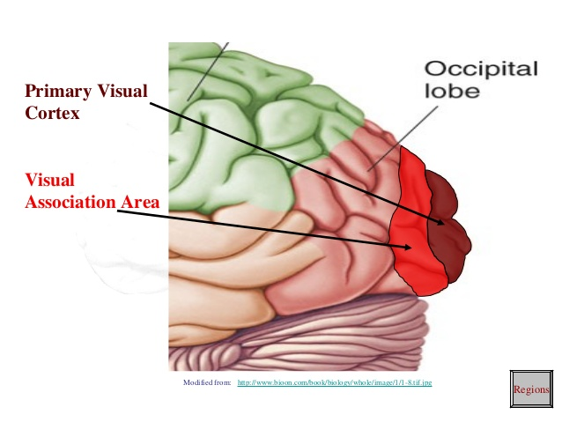
Occipital lobe
Location | Function | Cortical region
Deep inside the occipital bone of the skull | Its primary function is the processing, integration, interpretation of vision and visual stimuli | Primary visual cortex : This is the primary ( main ) area of the brain responsible for detection of the visual stimuli (injury to this area causes blindness) Visual association cortex : Interprets the visual information obtained from the primary visual cortex المريض لسى يقدر يشوف الأشياء بس للأسف ما يقدر يفهم او يفسر ايش الي قاعد يشوفه

Slide 9
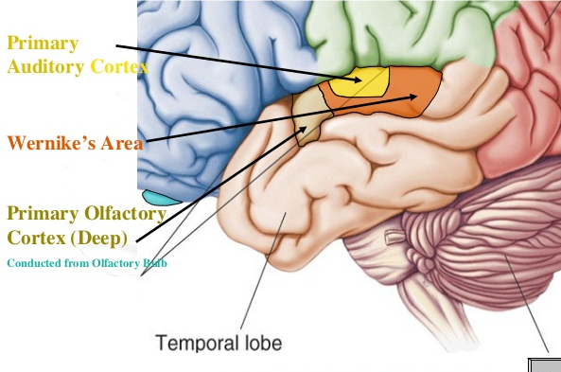
Temporal Lobe :
located on the sides of the brain deep to the Temporal Bones of the skull
Function | Cortical region | Lesions
- Hearing -Organization/ Comprehension of language Information Retrieval (Memory and Memory Formation) | Primary Auditory Cortex Responsible for hearing Primary Olfactory Cortex Interprets the sense of smell once it reaches the cortex via the olfactory bulbs. (Not visible on the superficial cortex) Wernicke’s Area – Language comprehension. • Located on the Left Temporal Lobe (dominant hemisphere). •Understand auditory and visual information and send them to Broca's area | Wernicke’s Aphasia Language comprehension is inhibited. The individuals have difficulty understanding written and spoken language Memory impairment Can be associated with temporal lobe epilepsy

Slide 10
Functional Principles of the Cerebral hemispheres
1. Each cerebral hemisphere receives sensory information from, and sends motor commands to, the opposite side of body.
2. The 2 hemispheres have somewhat different functions although their structures are alike.
3. Correspondence between a specific function and a specific region of cerebral cortex is not precise.
4. No functional area acts alone; conscious behavior involves the entire cortex.
Dominant & Nondominant Hemisphere
Functional differences between left and right hemispheres
In most people, left hemisphere (dominant hemisphere) controls:
reading, writing, and math, decision-making, logic, speech and language (usually).
Right cerebral hemisphere relates to:
Understanding & interpreting music
Non verbal visual Experience
Spatial relation between the person & their surroundings
Body language and intonation of peoples voices
A: Primary Motor Cortex
* This graphic representation of the regions of the Primary Motor Cortex and Primary Sensory Cortex is one example of a HOMUNCULUS:

Slide 11
Important points you should focus on:
Summary
Cerebral Cortex is The outermost layer of gray matter making up the superficial aspect of the cerebrum.
Cerebral area | Functional importance
Primary Areas | The primary motor areas have direct connections with specific muscles for causing discrete muscle movements.
Associated areas | These areas receive and analyze signals simultaneously from multiple regions of both the motor and sensory cortices as well as from subcortical structures.
If the primary gustatory cortex is damaged , the person loses the ability to recognize shapes of complex objects by palpation, also develops Sensory Inattention on opposite side (Astereognosis)
Q- conscious proprioception contains : somatosensory cortex, parietal lobe , dorsal column except the cerebellum. ~ Dr. fawzia

Slide 12
Questions
1.The neocortex, is composed of six layers tangential to the pial surface of the hemisphere. Which one of the following statement concerning the organization of these six layers is correct?
The neurons in layers II and III form connections with the basal ganglia
Specific incoming signals from the cerebellum terminate primarily in layer IV
The neurons in layer V have axons that extend beyond layer V to subcortical regions and the spinal cord
The neurons in layer VI send their axons to the hippocampus
2. Lesion of which of the following areas cause Dyslexia?
Visual cortex
Angular gyrus
Broca's area
Wernicke's area
3.A person who has had a traumatic brain injury seems to be able to understand the written and spoken word but cannot create the correct sounds to be able to speak a word that is recognizable. is person most likely has damage to which area of the brain?
Wernicke’s area
Angular gyrus
Broca’s area
Prefrontal lobe
4.Primary gustatory cortex is found in which lobe?
Frontal lobe
Parietal lobe
Temporal lobe
Occipital lobe
5.Damage to which of the following brain areas leads to the inability to comprehend the written or the spoken word?
Insular cortex on the dominant side of the brain
Anterior occipital lobe
Junction of the parietal, temporal, and occipital lobes
Medial portion of the precentral gyrusE) Most anterior portion of the temporal lobe
6.Dysfunction of which brain area will lead to behavior which is not appropriate for the given social occasion?
Amygdala
Corpus callosum
Fornix
Uncus
7.When a person lose the ability to identify an object by touch, this condition is called?
Dyslexia
Prosopagnosia
Astereognosis
Ataxia
8.Evaluation of a patient reveals the following deficits: (1) decreased aggressiveness and ambition, and inappropriate social responses; (2) inability to process sequential thoughts in order to solve a problem; and (3) inability to process multiple bits of information that could then be recalled instantaneously to complete a thought or solve a problem. Damage to which of the following brain regions might be responsible for such deficits?
Parieto-occipitotemporal association cortex.
Broca's area
Limbic association cortex
Prefrontal association cortex
C
B
C
B
C
A
C
D

