Slide 1
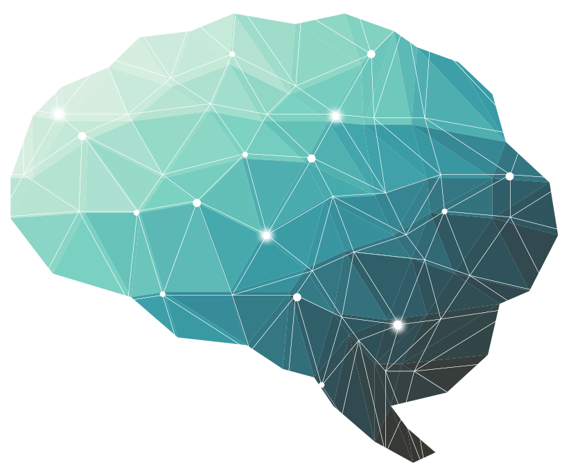
27th Lecture ∣ The Physiology Team
Basal Ganglia
Objectives:
Describe functional divisions of basal ganglia.
Elaborate Caudate and putamen circuit.
Explain different neurotransmitters that have a role in basal ganglia functions.
Appreciate general functions of basal ganglia.
Diagnose basal ganglial disorders.
Done by :
Team leaders: Abdulelah Aldossari, Ali Alammari
Fatima Balsharaf, Rahaf Alshammari
Team members: Abdulmajid alwardi, mohammed alhassan, Majed Aljohani, Fayez Aldarsouni, Saif Almeshari, Abdulaziz Aldurgam, Turki Alshammari
Special Thanks to: Dimah Alarifi
Colour index:
important
Numbers
Extra
وَأَن لَّيْسَ لِلْإِنسَانِ إِلَّا مَا سَعَىٰ
Notes:
لِلْإِنسَانِ إِلَّا مَا سَعَىٰ (39) وَأَنَّ سَعْيَهُ سَوْفَ يُرَىٰ
BETTER right

Slide 2
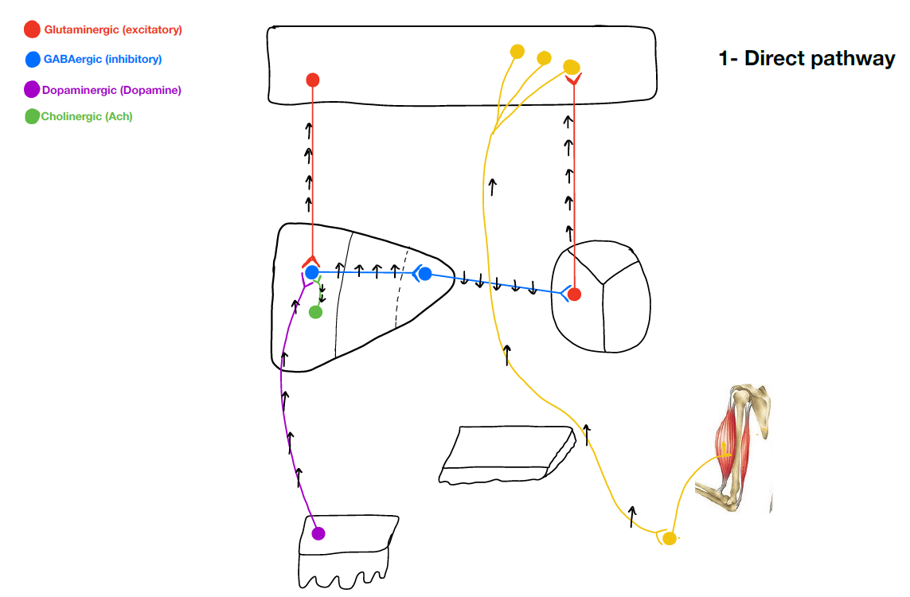
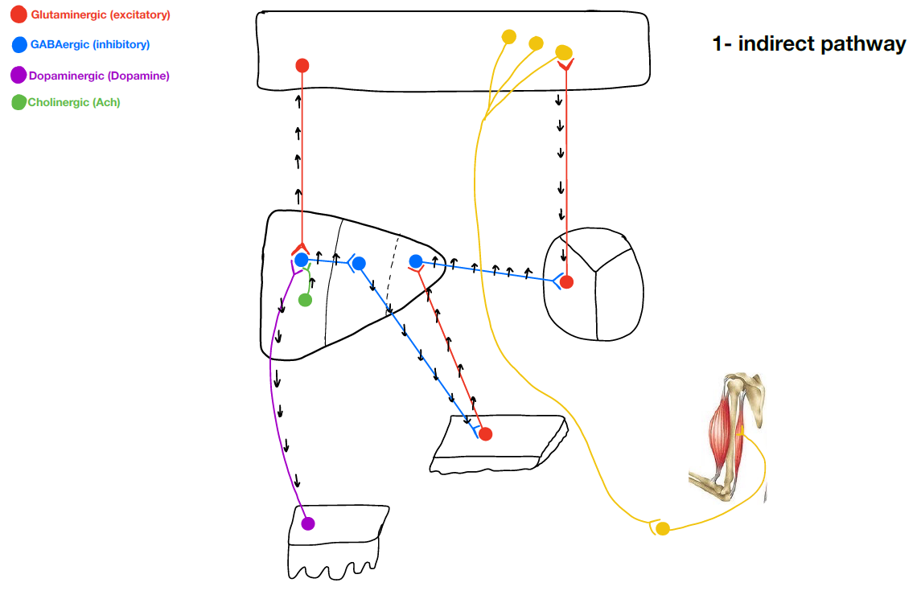
Dr. Najeeb
Basal Ganglia
They are also called basal nuclei
Basal ganglia : are masses of grey matter present at the base of cerebral hemispheres.
Lentiform nucleus which is one of the basal nuclei consist of:
1-putamen ( laterally )
2-globus pallidus ( medially )
The posterior part of Substantia nigra is composed of densely packed grey matter which called substantia nigra pars compacta and we call the less densely packed anterior part substantia nigra pars reticularis
There’s a special grey matter in the tail of caudate nucleus we call it amygdala
Basal ganglia are divided into :
1- traditional classification: caudate nucleus and its tail which is called amygdaloid + lentiform nucleus + claustrum
2- clinical classification: lentiform nucleus + caudate nucleus + subthalami + substantia nigra
We classified basal ganglia into 2 groups because there are some connections between the objects in each group.
Caudate nucleus + lentiform nucleus which is composed of ( putamen + Globus pallidus ) is called corpus striatum
Caudate nucleus + putamen of lentiform nucleus is called neostriatum
Globus pallidus of lentiform nucleus alone is called paleo striatum
Motor plans are stored and processed mainly in basal ganglia
Motor fibers coming from cerebral cortex like corticospinal tracts are in close association with basal ganglia for programming of voluntary movements , so if you want like for example to drink a coffee the motor tracts should consult the basal ganglia first before transmitting the signal to give her permission .
Glutamate is an excitatory neurotransmitter released from special nerves in the the brain like corticostriatal and thalamocortical fibers
Striatopallidal & pallidothalamic fibers release GABA + P SUBSTANCE
When you are not doing any movement Globus pallidus internus is actively firing

Slide 3
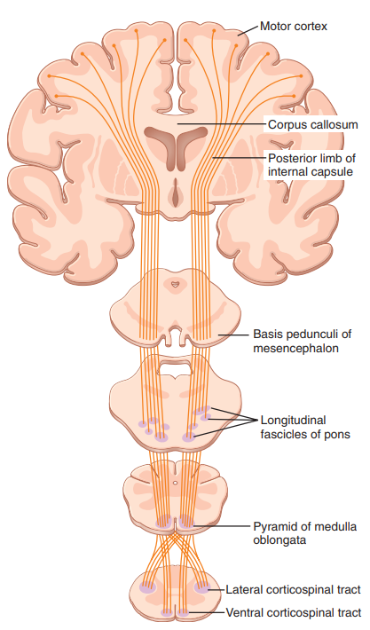
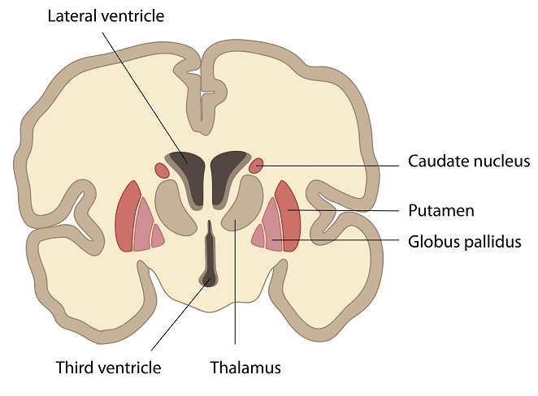
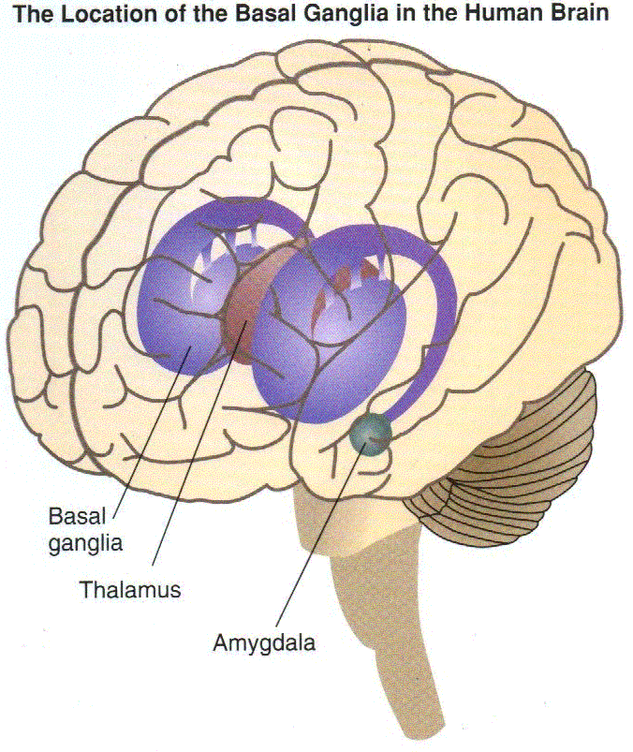
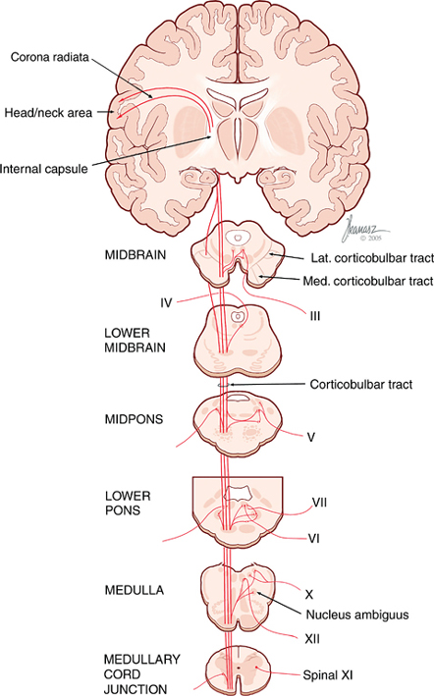
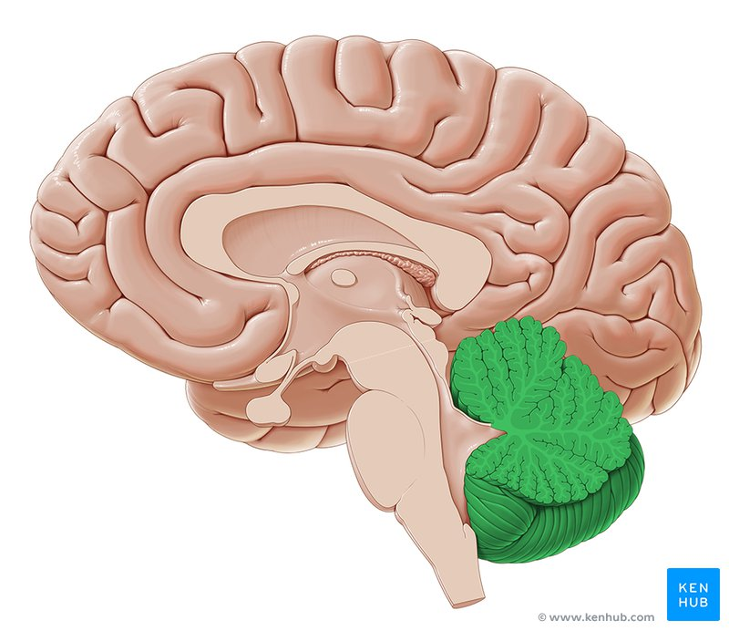
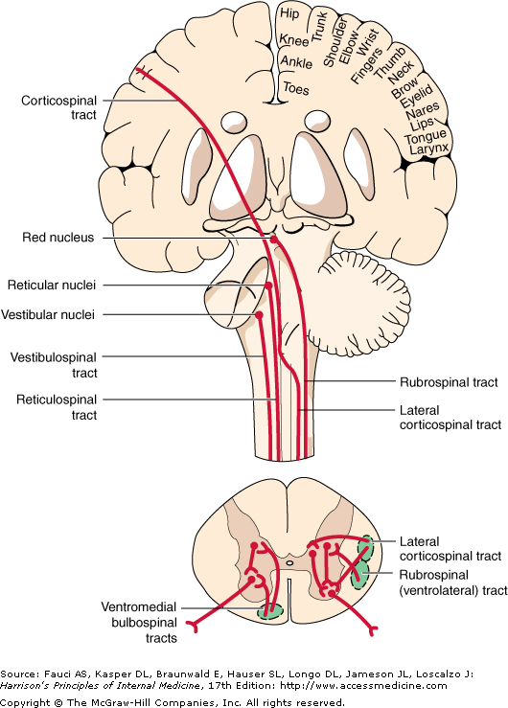
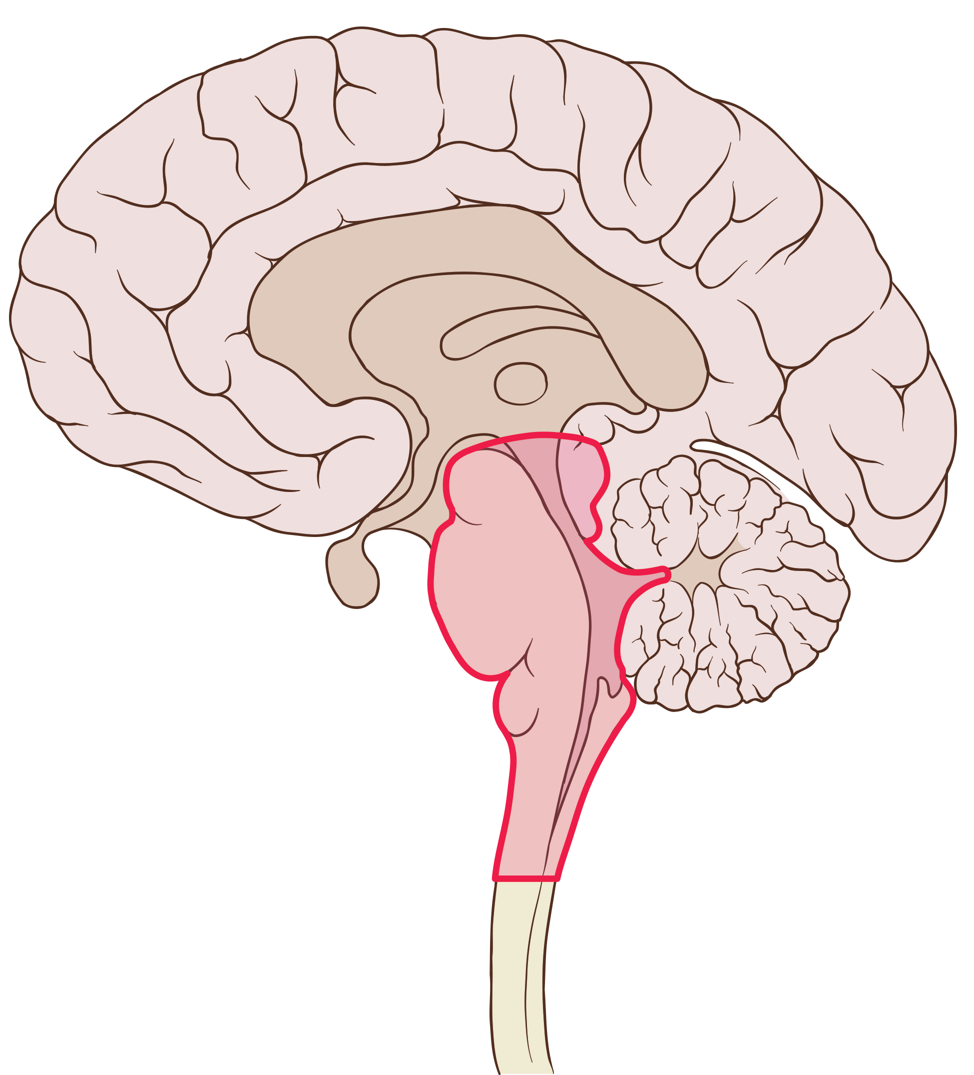
Overview of Motor Activity Control
Cerebral Cortex
Corticospinal Tracts
Basal Ganglia
Thalamus
Cerebellum
Corticobulbar Tracts
Brain Stem
Bulbospinal Tracts
(Vestibular + Reticular)
Spinal Cord
Sensory Input
Final Common Path

Slide 4
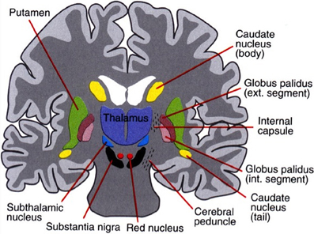
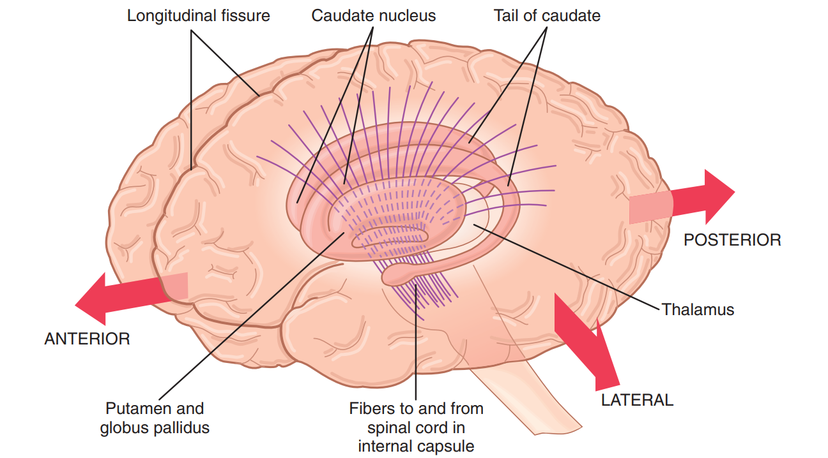
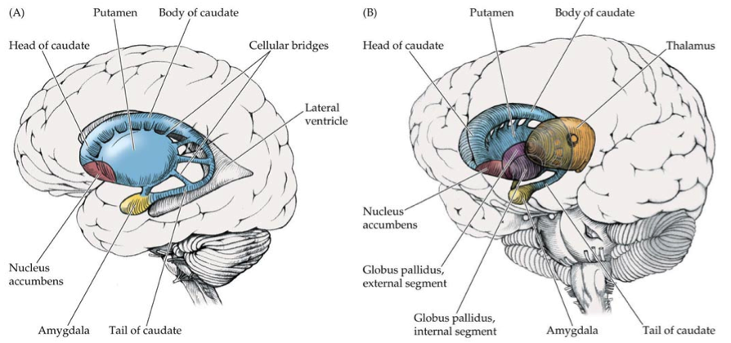
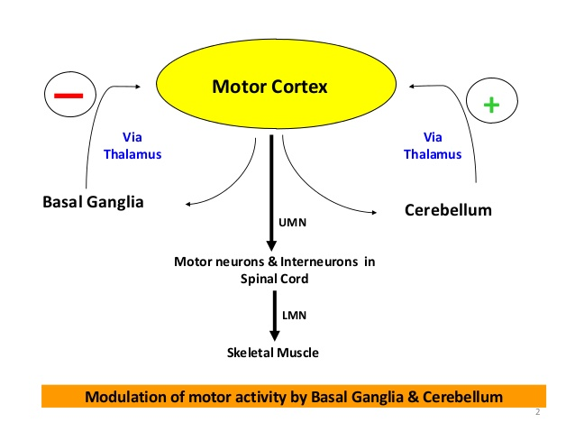
Basal Ganglia Components & Functional Anatomy
Basal Nuclei
Basal Ganglia Connections
Neostriatum
Lenticular Nucleus
Caudate Nucleus
Putamen
Globus Pallidus
Subthalamic Nucleus
Substantia Nigra
Corpus striatum = Caudate nucleus plus lentiform nucleus.
Neostriatum (striatum) = Caudate nucleus plus putamen.

Slide 5
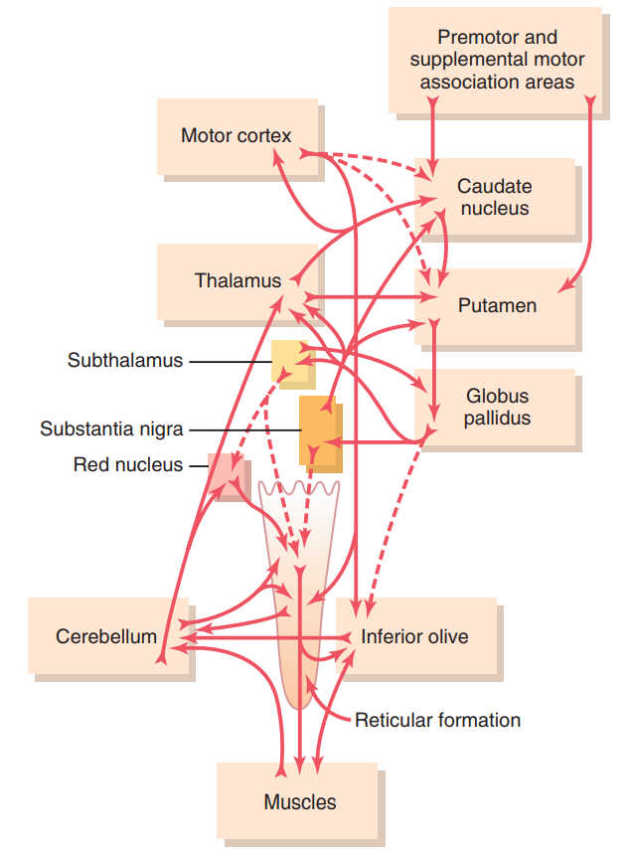
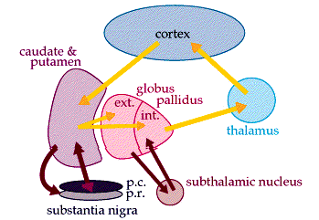
Basal Ganglia Connections
Complex Circuitry of Motor Control
Main Input & Output to The Basal Ganglia
3 Connections to Remember
1- Main input | To the basal ganglia
2- Main output | From the basal ganglia
3- Connections | Between parts of basal ganglia
Input | Output
Directly connected to cortex | Not Directly connected to cortex
Comes from the cerebral cortex (motor area) and projects to the NEOSTRIATUM (a term for the caudate nucleus and putamen) | Is via the thalamus to the cerebral cortex (motor area) Unlike cerebellum, which sends information directly to cortex

Slide 6
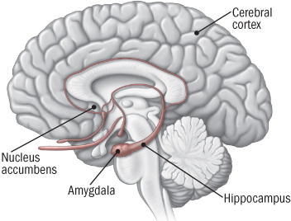
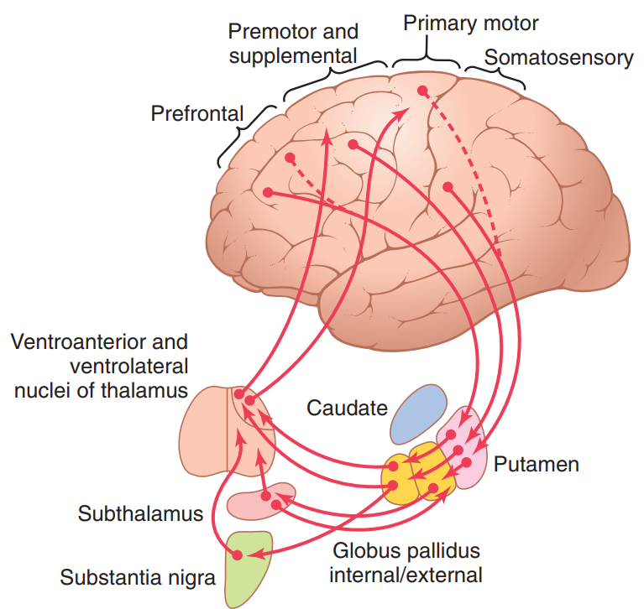
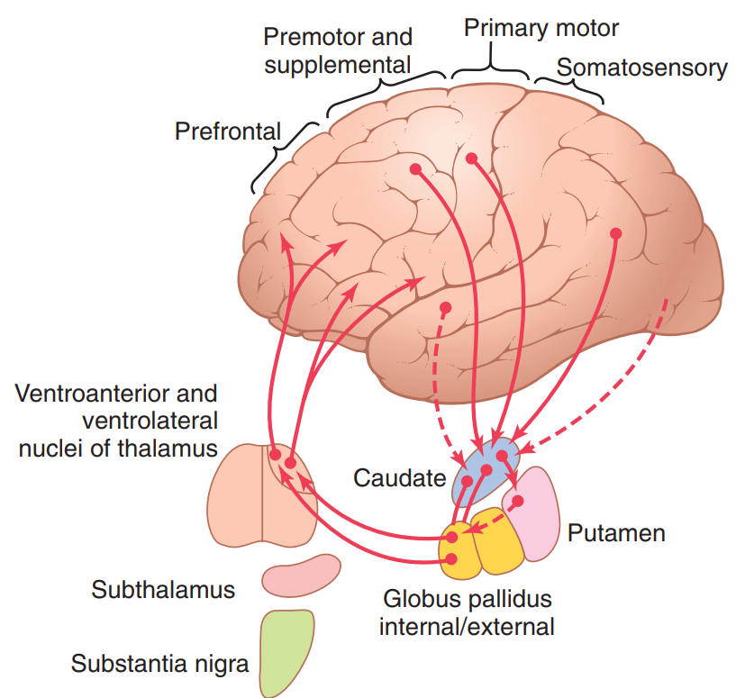
Basic Circuits of Movements Control
The Putamen Circuit
Loop | Description
Motor loop (Putamen Circuit) | Concerned with learned movement. Ex: When digging a nail into wood for a while, you get used to it and you don’t need to think every time, putamen circuit is involved in this type of movement.
Cognitive loop (Caudate circuit) | Concerned with cognitive control of sequences of motor pattern. Basically it’s concerned with motor intentions. Note: Cognition means thinking process using sensory input with information already stored in memory. Ex: when a Carpenter (نجّار) is asked to build a detailed decorate, he thinks a lot because it’s not a repetitive task, which needs a full thought process for every movement, caudate circuit is involved here.
Limbic loop | Involved in giving motor expression to emotions like, smiling, aggressive or submissive posture (via nucleus accumbens* reward circuit). * part of Limbic system near the head.
Oculomotor loop | Concerned with voluntary eye movement [saccadic movement]
*
The Caudate Circuit
2&3
1
8
8
4
5
5
7
8
6
8
8
Outputs | Inputs
1. Primary motor Cortex 2. Premotor 3. Supplemental motor Areas | 2. Premotor Cortex 3. Supplemental motor Areas 4. Somatosensory Cortex
Outputs | Inputs
5. Prefrontal 6. Premotor 7. Supplemental motor Areas | 8. Association Areas
This circuit has to be completed before movement is initiated

Slide 7
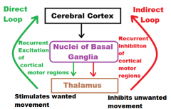
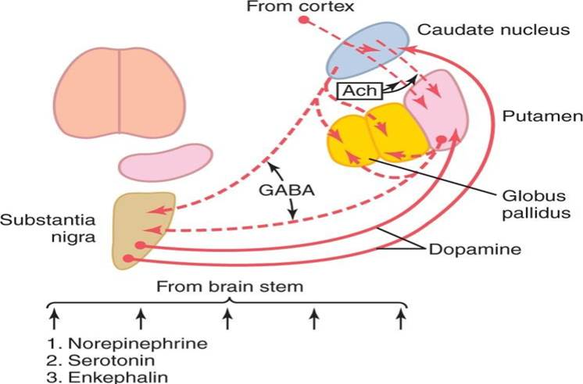
Basal Ganglial Neurotransmitters & Pathways
(Direct and Indirect)
Neurotransmitters in Basal Ganglia Circuits
Dopamine | GABA | Acetylcholine
From SN to Putamen and Caudate nucleus | From these nuclei to globus pallidus and SN | From cortex to caudate nucleus and putamen counterbalance DA.
Several NTs (NA, 5HT, Enk) from the brain stem.
Multiple excitatory glutamate pathways (not shown) that balance the inhibitory effects of GABA, Dopamine and 5HT.
Enkephalin are also present and may act as co-transmitters.

Slide 8
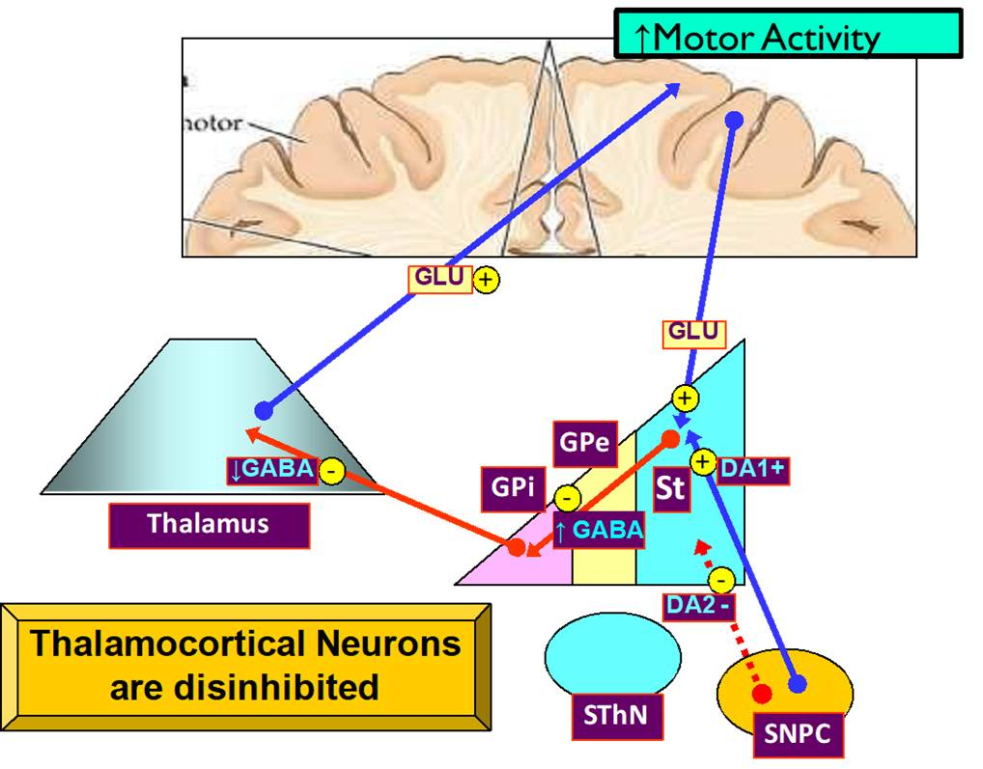
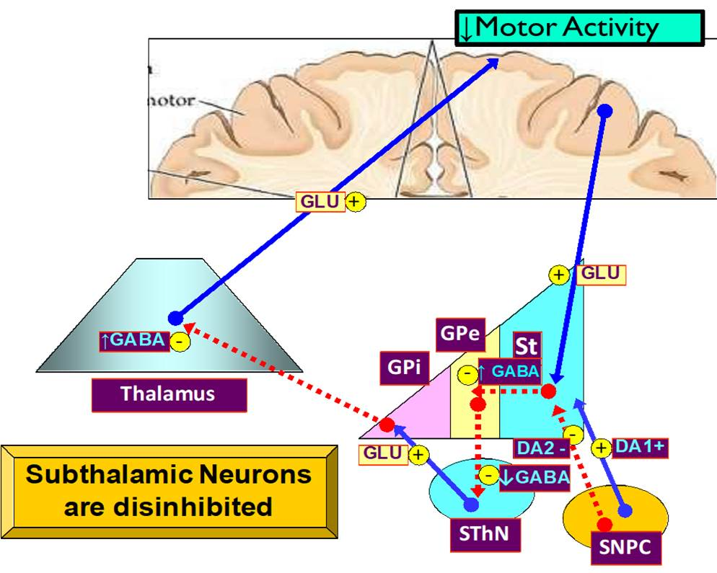
Direct Basal Ganglial Pathway
Result
Direct connection of basal ganglia and cortex via thalamus.
Cortico-striatal fibers
Decrease secretion of GABA
DA from the SNPC activates DA1 receptors in striatal Neurons of the direct pathway
Nigro-striatal fibers
subthalamic
substantia nigra pars compacta
Indirect Basal Ganglial Pathway
Result
DA from the SNPC activates DA2 receptors in striatal Neurons in the indirect pathway

Slide 9
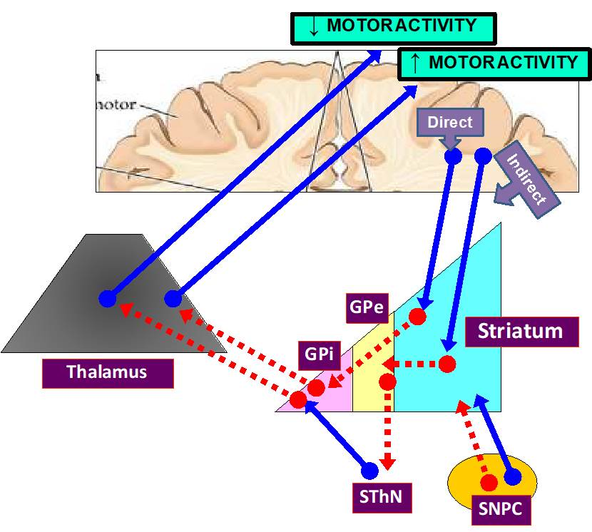
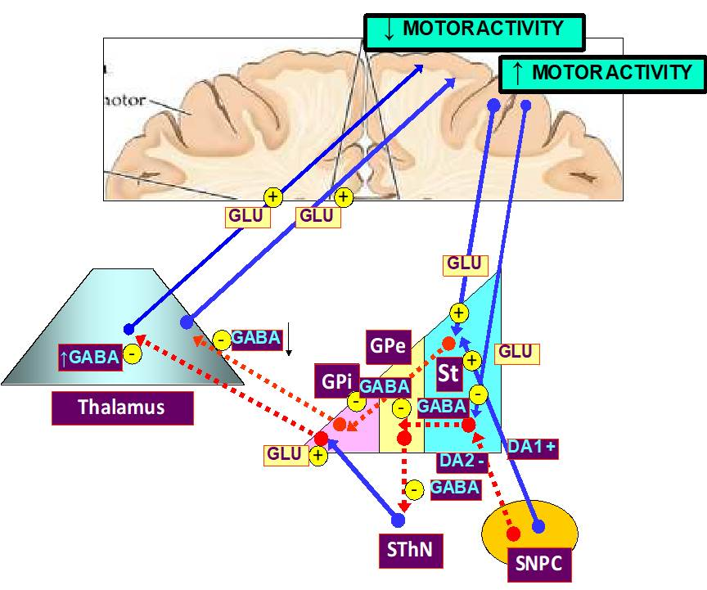
Both Direct & Indirect Basal Ganglial Pathway
Direct increase motor activity facilitate movement
Indirect decrease motor activity “suppress the movement”
Basal Ganglia Functions
Control of movements
Planning and programming of movements
Cognitive control in movements
The Putamen Circuit
Executes Learned Patterns of Motor Activity:
Basal ganglia function in association with the corticospinal system to control complex patterns of motor activity.
Examples are:
– writing of letters of the alphabet.
– cutting paper with scissors
– hammering nails
– shooting a basketball through a hoop
– passing a football
– throwing a baseball
– the movements of shoveling dirt
– most aspects of vocalization
– controlled movements of the eyes
– virtually any other of our skilled movements, most of them performed subconsciously.

Slide 10
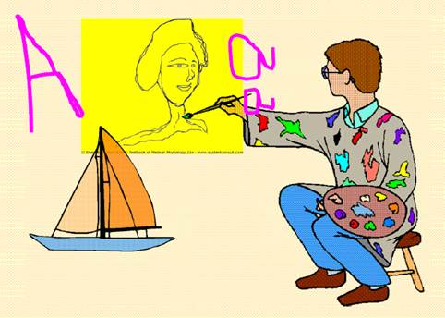
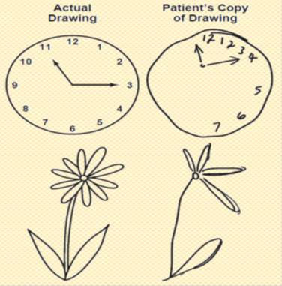
The Caudate Circuit
Cognitive Control of Sequences of Motor Patterns
Cognition means the thinking processes of the brain, using both sensory input to the brain plus information already stored in memory .Thoughts are generated in the mind by a process called cognitive control of motor activity.
Example: A person seeing a lion approach and then responding instantaneously and automatically by (1) turning away from the lion
(2) beginning to run
(3) even attempting to climb a tree.
Thus, cognitive control of motor activity determines subconsciously, and within seconds, which patterns of movement will be used together to achieve a complex goal
Change the Timing and to Scale the Intensity of Movements
• Two important capabilities of the brain in controlling movement are :
(1) to determine how rapidly the movement is to be performed and
(2) to control how large the movement will be.
For instance, a person may write the letter "a" slowly or rapidly. Also, he or she may write a small "a" on a piece of paper or a large "a" on a chalkboard. Regardless of the choice, the proportional characteristics of the letter remain nearly the same
Damage to Caudate Circuit Results in 4
Inability to organize pattern of movements to achieve a complex goal.
Inability to write or draw figures with fixed scale.
Loss of timing and scaling of movements.

Slide 11
BASAL GANGLIA
DISORDERS MOVEMENTS (ATAXIA Rate, Range, Force, Direction)
SPEECH
POSTURE
GAIT
MENTAL ACTIVITY OTHERS
Movement Disorders
Hyperkinetic
Chorea
•Huntington’s Disease
•Saint Vitus Dance (Sydenham’s Chorea) •Athetosis
•Dystonia •Hemiballismus/Ballismus •Tardive Dyskinesia
•Wilson‘s Disease
Hypokinetic
Parkinson’s Disease
• Drug Induced eg; MPTP induced
• Dopamine receptor blockers eg; Neuroleptics & antipsychotic drugs
Lesions affect Indirect Pathway Predominantly
Movement Disorder | Features | Lesion
Chorea | Multiple quick,random Movements,usually most Prominent in the appendicular muscles | Atrophy Of The Striatum. Huntington Chorea
Athetosis | Slow Writhing movements,which are usually more severe in the appendicular muscles | Diffuse Hypermyelination of corpus striatum and thalamus
Hemiballismus | Wild Flinging Movements Of half of the body | Hemorrhagic Destruction contralateral subthalamic. Hypertensive Patients
Parkinsonism | Pill Rolling tremor of the Fingers at rest ,leadpipe rigidity and akinesia | Degeneration of Substantia Nigra

Slide 12
Parkinson’s Disease
Described by James Parkinson
• Degeneration of dopaminergic nigrostriatal neurons (60-80 %).
• Phenothiazine (tranquilizers drugs)
.•Methyl-Phenyl-Tetrahydropyridine (MPTP). The oxidant MPP+ is toxic to SN.
Five cardinal features
– Tremor
– Rigidity
– Akinesia & Bradykinesia
– Postural Changes
– Speech Change
Metabolic characteristics Doctor Fawziah said:”It is for your information”
• High Oxygen consumption .
• High Copper content in Wilson’s disease (Copper intoxication):
• Autosomal Recessive
• Copper binding protein Ceruloplasmin is low
• Lenticular degeneration occurs and patient develops choreiform movements and dystonia

Slide 13
Q1a:in spasticity why there is clasp knife pattern?
A1a: increase muscle stretch initially causing difficulty in movement, once initiated the excessive stretch of the muscle stimulate golgi tendon which inhibit it.
“ B/c the brain will think that the muscle is going to be tear “
Q1b: why it doesn't happen to rigidity
A1b: b/c both agonist+antagonist are involved at the same time
Q2a: if corticospinal tract “only” is transitioned, what will happen to the tone of the muscle ?
A2a; hypotonia
Q2b: Why?
A2b: “pure” corticospinal tract lesions always cause hypotonia but clinically we don't see it B/C pure cortico spinal lesion is very rare , it will always involve Extrapyramidal tracts , and B/C of those tracts involvement , there is hypertonia
Shahid Qs

Slide 14
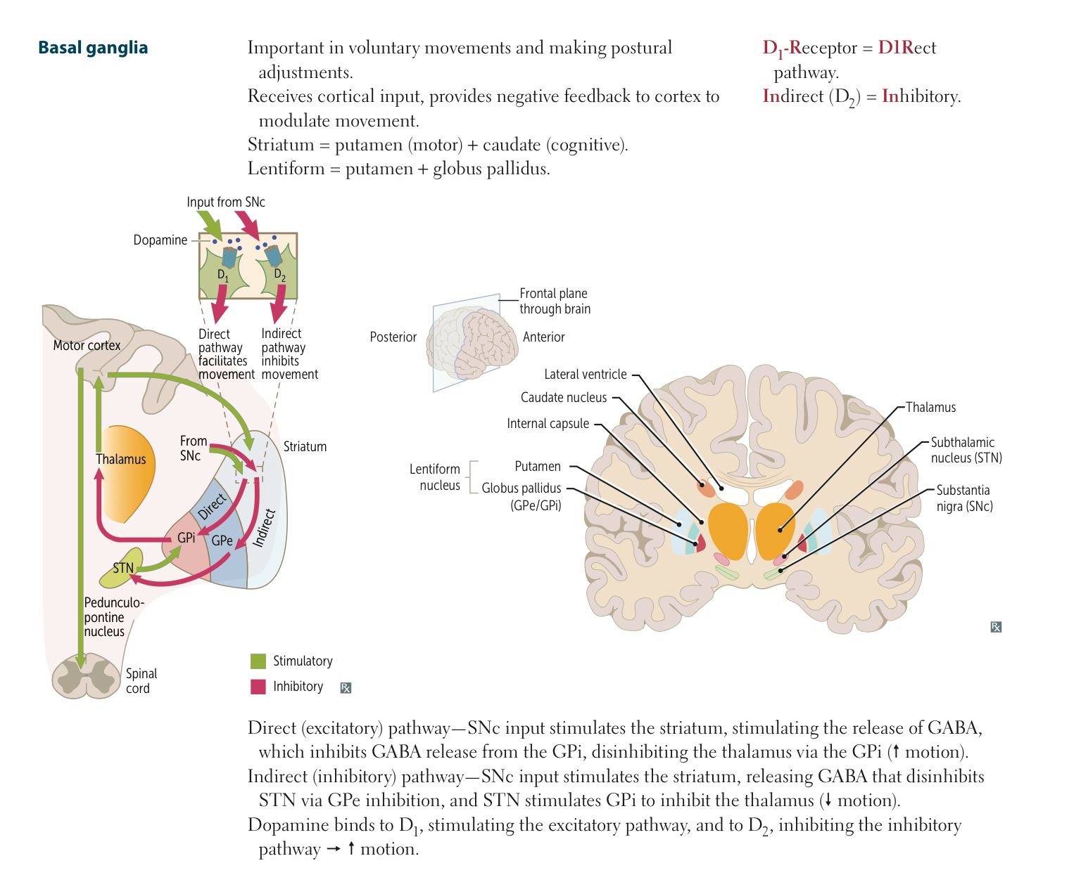
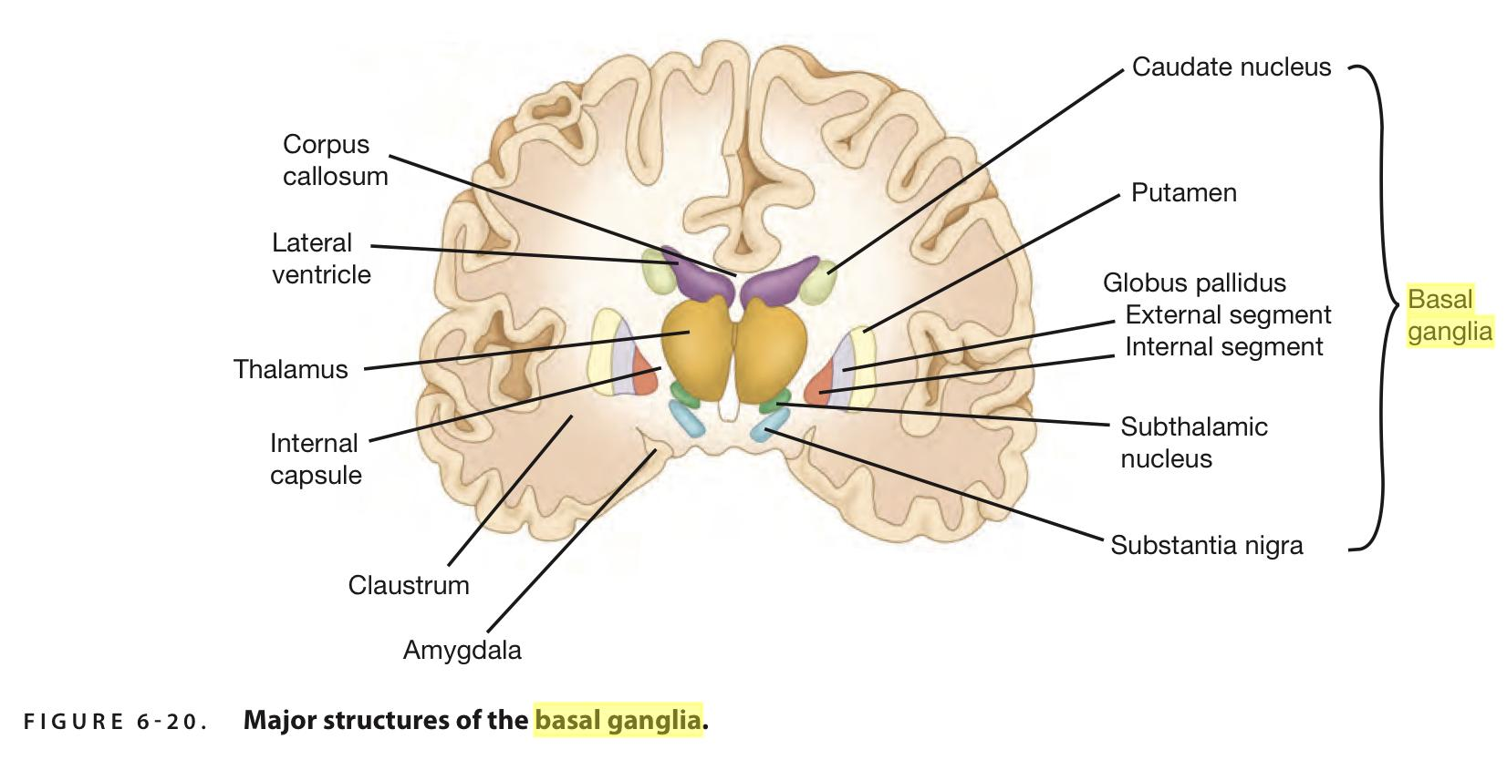
Read me! I will help you to remember important points
The Caudate Circuit. = Cognitive Control
For Parkinson remember ” TRAPS”
-Tremor
– Rigidity
– Akinesia & Bradykinesia
– Postural Changes
-Speech Change
Wilson’s disease (Copper intoxication):
لو قسمنا كوبر لكلمتين تطلع
بر (per)
بوك (poc) اقراها بالعكس
واللي بيبر ابوه هو الابن (son)
Dopamine | GABA | Acetylcholine
From SN to Putamen and Caudate nucleus | From these nuclei to globus pallidus and SN | From Cortex to caudate nucleus and putamen counterbalance DA.
Also when you study pharmacology don’t forget to park your benz!(one of park inson treatments is BENzoatropine

Slide 15
1.Which one of the the following is not considered to be part of the basal ganglia?
Caudate nucleus
Dentate nucleus
Substantia nigra
Globus pallidus
2.Which one of the following loop concern with learning movement?
Putamen circuit
Caudate circuit
Limbic loop
Oculomotor loop
3.Which one of the following NTs secreted by Substantia nigra to putamen and caudate nucleus?
Acetylcholine
Dopamine
GABA
Serotonin
4.Which component of basal ganglia plays a major role in the control of cognitive motor activity?
Globus pallidus
Substantia nigra
Caudate nucleus
Subthalamic nucleus
5.In the indirect basal ganglia pathway there is:
Increase in the motor activity
Decrease in the motor activity
6.In the direct basal ganglia pathway which one of the following neuron is disinhibited?
Cortico-striated neuron
Subthalamic neuron
Nigro-striated neuron
Thalamocortical neuron
7. Which of the following considered a hypokinetic Motor disorder?
Athetosis
Parkinson’s Disease
Chorea
Huntington’s Disease
8. A patient presented with Slow Writhing movements in the appendicular muscles the Movement Disorder is ?
Athetosis
Chorea
Hemiballismus
Tardive Dyskinesia
9.The condition of athetosis result when which one of the following areas of the brain is dysfunctional?
Globus pallidus
Substantia nigra
Ventral anterior complex of the thalamus
Putamin
10.Which one of the following considered as a feature of Parkinson's disease?
Multiple and Quick random movement
Spasticity
Wild flinging movement of half of the body
rigidity
Answers:
B
A
B
C
B
D
B
A
A
D

