Slide 1
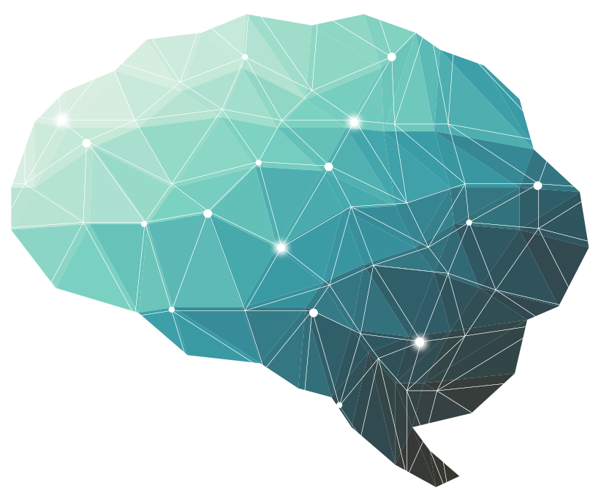
27th Lecture ∣ The Physiology Team
Brain Neurotransmitters
Objectives:
Describe the functions of glutaminergic system
Describe the functions of NTs of the brain (the noradrenergic & serotonergic cholinergic, dopaminergic, GABAergic systems)
Appreciate that many drugs and CNS disorders affect function of brain neurotransmitters
Done by :
Team leaders: Abdulelah Aldossari, Ali Alammari
Fatima Balsharaf, Rahaf Alshammari
Team members: Afnan Almustafa, Fayez aldarsouni, Majd Albarrak, Rinad Alghoraiby, Yazeed Alkhayyal
Colour index:
important
Numbers
Extra
وَأَن لَّيْسَ لِلْإِنسَانِ إِلَّا مَا سَعَىٰ
Notes:
لِلْإِنسَانِ إِلَّا مَا سَعَىٰ (39) وَأَنَّ سَعْيَهُ سَوْفَ يُرَىٰ
BETTER right

Slide 2
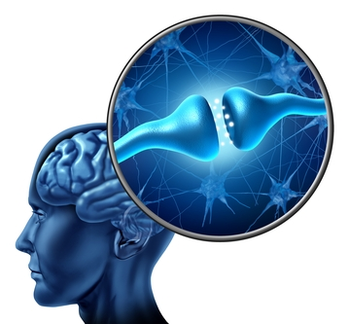
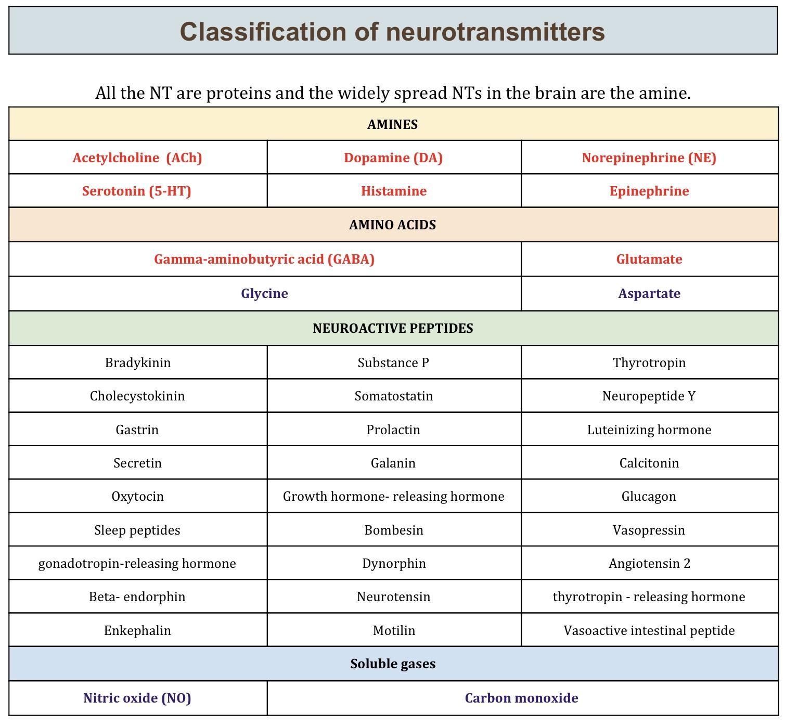
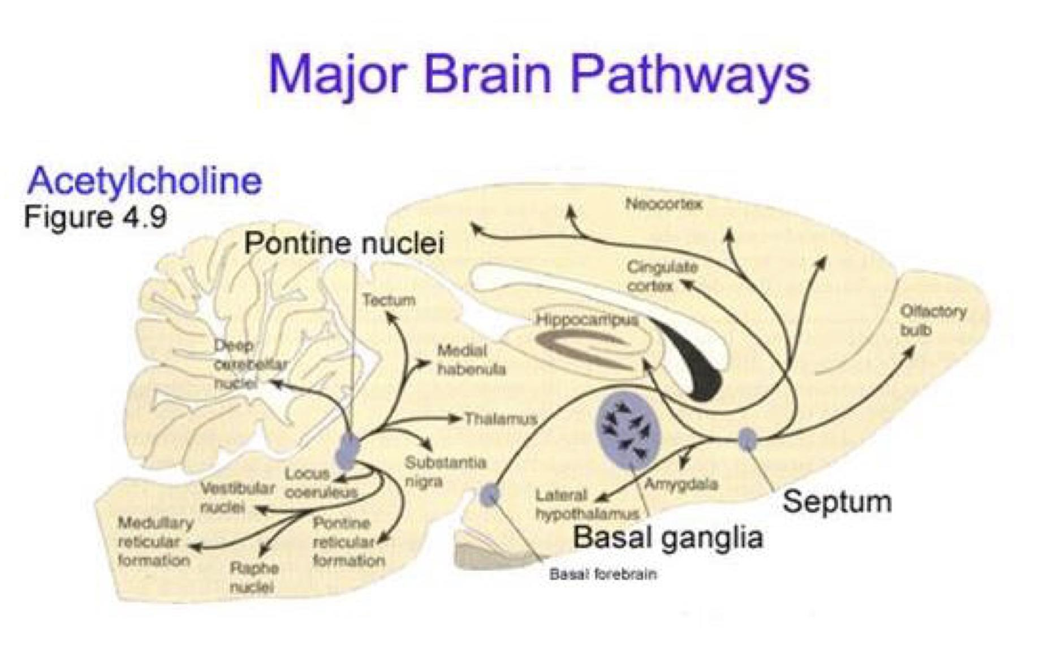
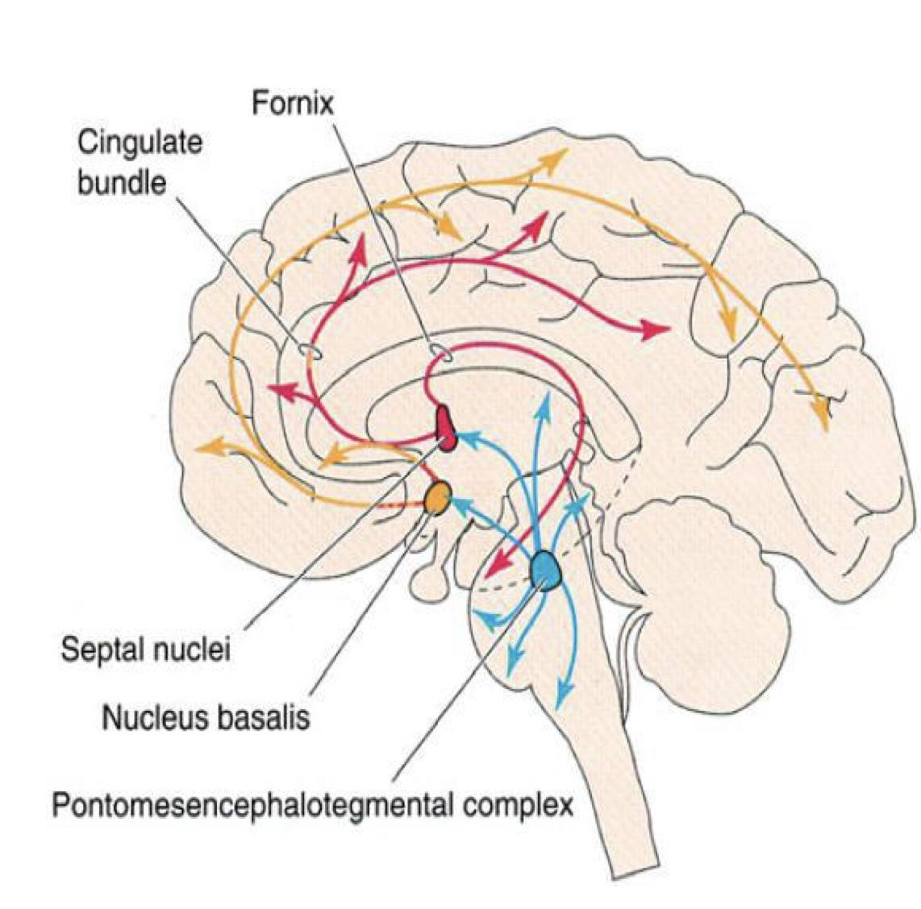
Brain Neurotransmitters:
Chemical substances released by electrical impulses into the synaptic cleft from synaptic vesicles of presynaptic membrane.
Diffuses to the postsynaptic membrane.
Binds to and activates the receptors.
Leading to ↝ initiation of new electrical signals
or inhibition of the postsynaptic neuron.
Result will be inhibitory or excitatory, depending on:
Neurotransmitter
Receptors
Examples:
Ach
Glutamate
GABA
Norepinephrine (NE)/Epinephrine
Serotonin
Dopamine
Classes of Receptors:
Team435
Metabotropic ↝ Transmembrane receptor acts through a secondary messenger
Ionotropic ↝ Ligand gated ion channel
Useful video to understand metabotropic R and ionotropic R (click on)
Cholinergic System:
Acetylcholine is the major neurotransmitter in the peripheral nervous system In the peripheral nervous system, cholinergic (ACh producing) neurons are present mainly in 2 areas:
Basal Forebrain (namely Nucleus Basalis of Myenert and septal nuclei)
Ponto-Mesencephalic Cholinergic Complex
*See Brainstem Bulboreticular Facilitatory Area in Consciousness & Sleep lectures.

Slide 3
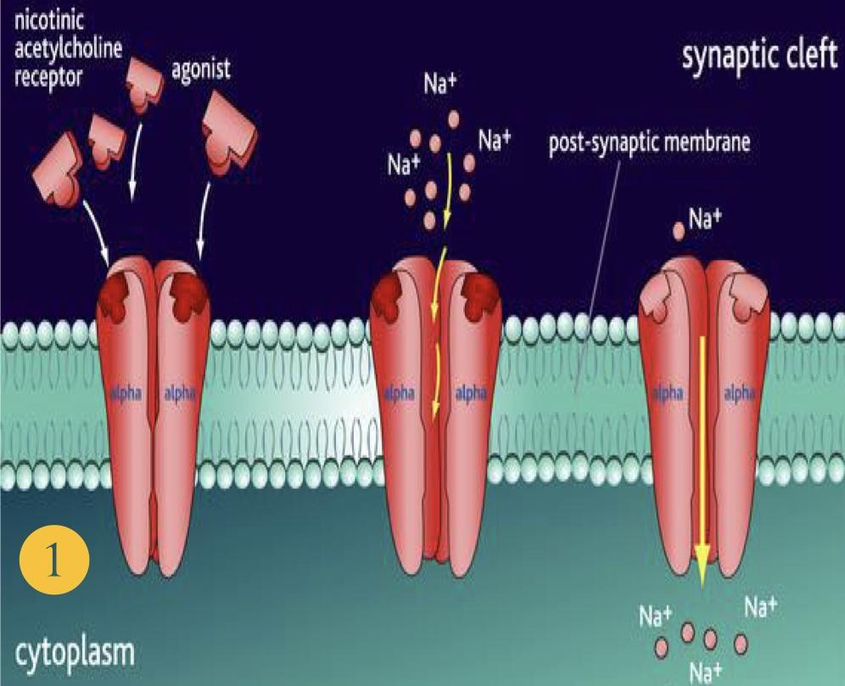
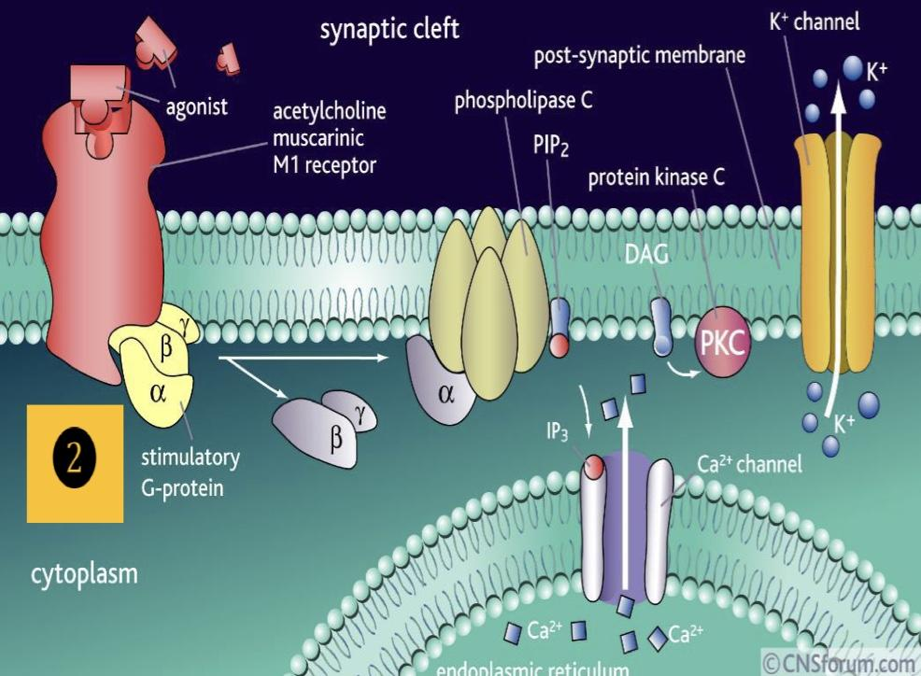
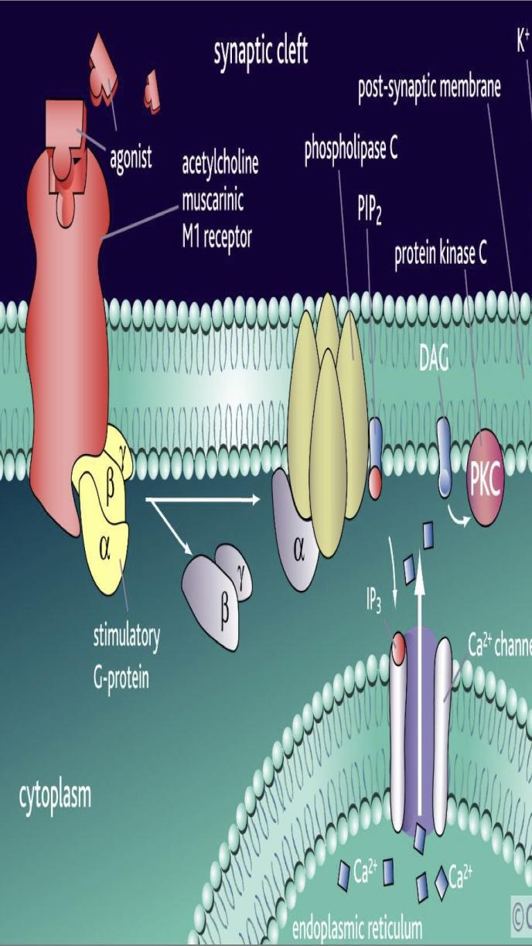
Acetylcholine Receptors:
Useful video to understand Ach
(Click on)
Acts on 2 cholinergic receptors:
Nicotinic (ionotropic) (antagonist-Curare): Excitatory (found in autonomic ganglia)
Muscarinic (metabotropic) (antagonist-Atropine): Excitatory or inhibitory
Five subtypes (M1-M5): all present in the brain but M1 is the most abundant
2
1
Muscarinic Receptors:
M1 receptors | Most involved in cognitive functioning (evidence from Knockout mice and pharmacologic human studies with M1 blocking drugs)
M2 receptors | Blocking agents may facilitate cognition in animals (but these drugs are not being used in humans at this point).
M3 receptors | Receptors do not seem to play much of a role in cognition (animal studies).
M4 and M5 receptors | Functions in the brain are unknown

Slide 4
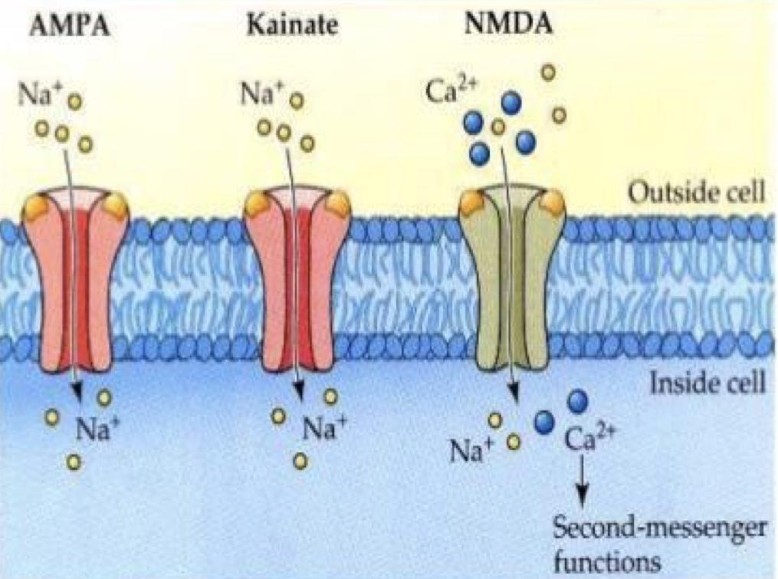
Prof. Laila said it’s important to know whether the effects are because of increase, decrease, or disturbance in the levels of the neurotransmitter.
ACh influences mental processes:
High levels during: Learning | Memory | Sleeping (REM) | Dreaming
Low levels during: Sleeping (Except REM)
Alzheimer’s Disease - the most common form of dementia that is associated with acetylcholine damage.
Damage to Ach producing cells in the basal forebrain leads to disturbed levels in:
Bipolar disorder | Mood swings | Depression | Mental Attention
Inhibitors of acetylcholinesterase in the brain are the main drugs used to treat Alzheimer’s disease.
Glutaminergic System:
Useful video to understand glutamates (click on)
Glutamate is the most commonly found NT in the brain (king of NTs, ~50% neurons). , it is always excitatory.
Glutamate (can cause excitotoxicity) is converted in astrocytes into glutamine (not toxic) and passed onto glutaminergic neurons.
Wide spread, but high levels in hippocampus; hypofunction of NMDA receptors in this area and prefrontal cortex is associated with schizophrenia.
Glutamate Receptors:
Extra
Are widely distributed in the brain, they are of two types:
Metabotropic receptors
(G protein coupled receptors): mGluR
Ionotropic receptors
(ligand-gated ion channels).
Found in hippocampus, cerebellum and the cerebral cortex.
Act through second messengers which activate biochemical cascades, leading to modification of other proteins such as ion channels.
Three types:
AMPA receptors (αamino-3hydroxy-5-methylisoxazole-4propionate)
Kainate receptors (kainite is an acid isolated from seaweed)
NMDA receptors (for Nmethyl D-aspartate); play a role in long term potentiation so they are involved in learning and memory.
Extra
Remember Metabotropic R from the first lecture

Slide 5
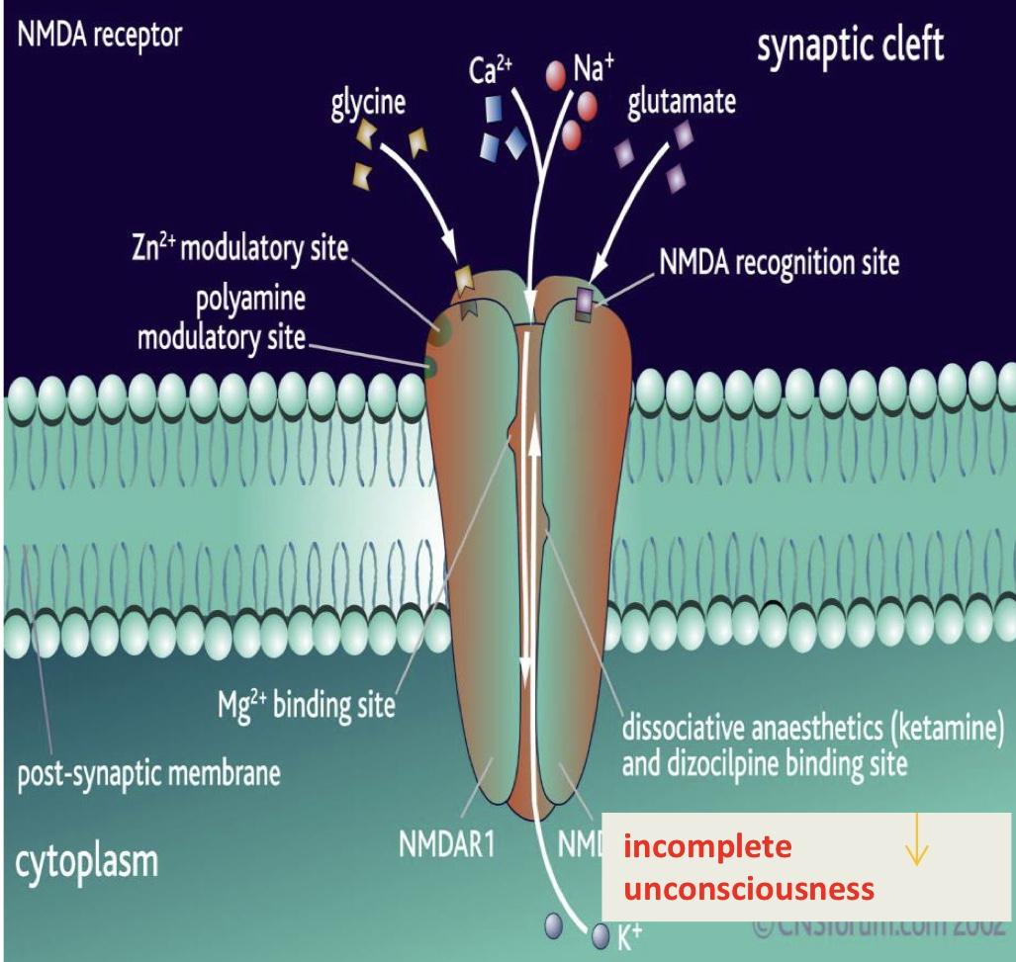
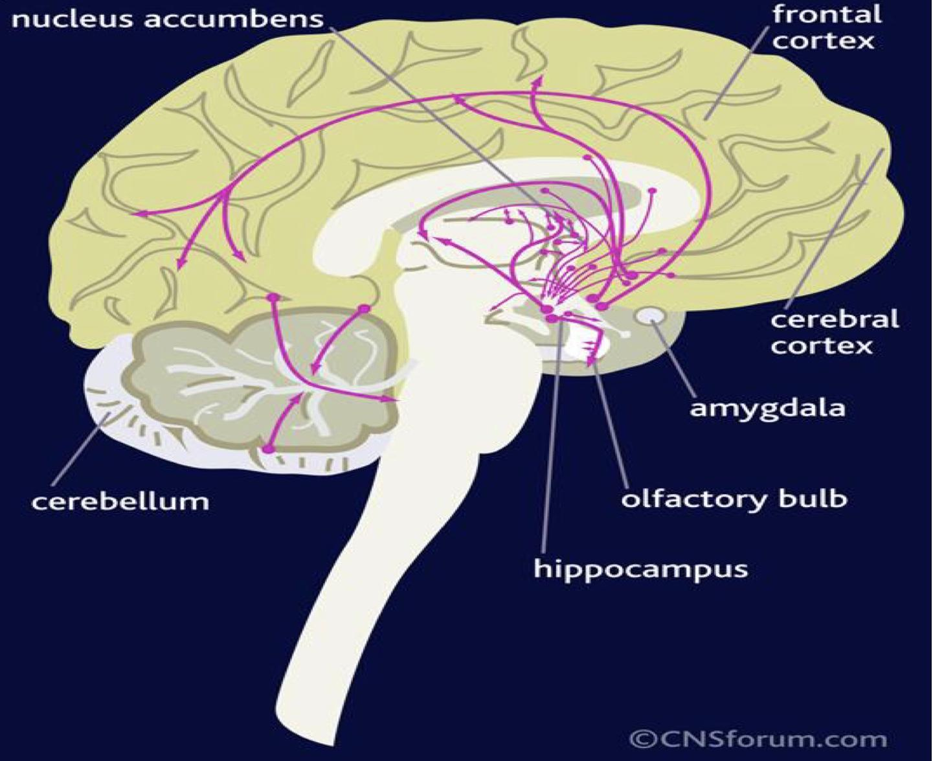
NMDA Receptors:
Permits passage of Na+ and large amounts of Ca2+. They are unique:
Glycine is essential for their normal response to glutamate.
The channel is blocked by Mg²+ ion at normal membrane potentials.
This blockade is removed by depolarization (caused by e.g. AMPA) NMDA Receptors
Excitatory postsynaptic potential induced by activation of NMDA receptor is slower than that elicited by activation of AMPA and kainate receptors.
Incomplete unconsciousness
Functions & Disorders Of Glutamate:
Glutamic acid (and aspartic acid): are major excitatory NTs in CNS.
Glutamate NMDA receptor involved in Long-Term Potentiation & memory storage.
Disorders:
Excess Glutamate activity is implicated in some types of epileptic seizures.
Under some pathological conditions, such Stroke, ALS (Amyotrophic Lateral Sclerosis), and Alzheimer's diseases, it acts as an excitotoxin, producing excessive influx of calcium into the neurons and causing neuronal death.
Reduced level in: Stroke | Autism | Intellectual disability | Alzheimer
Prof. Laila said we might ask: this neurotransmitter is most probably low in which of the following?
GABAergic system:
GABA is the main inhibitory neurotransmitter in the central nervous system (CNS).
GABAergic inhibition is seen at all levels of the CNS
(Hypothalamus, hippocampus, cerebral cortex and cerebellar cortex)
GABA interneurons are abundant in the brain, with 50% of the inhibitory synapses in the brain being GABA mediated.
Useful video to understand GABA

Slide 6
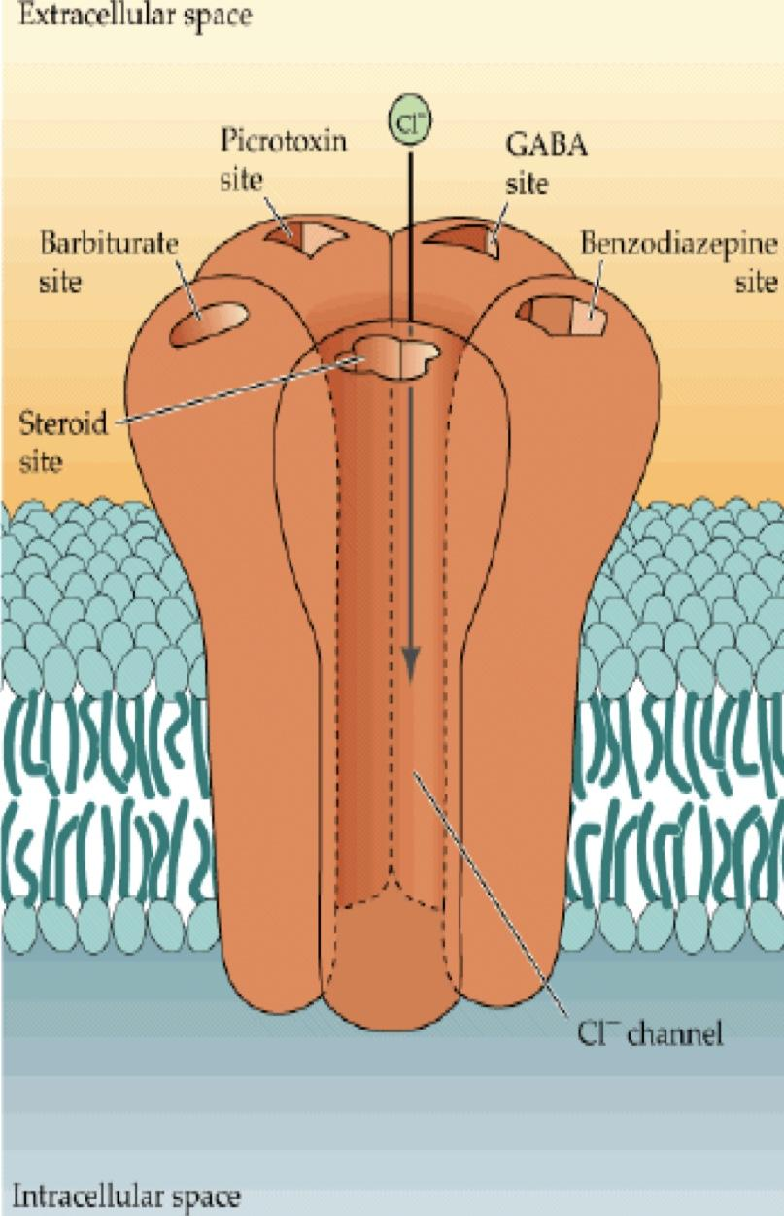
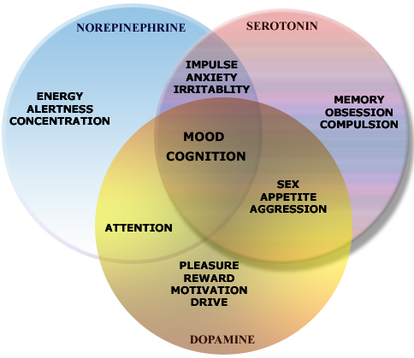
Gamma Aminobutyric acid (GABA):
GABAc=See=retina
Formed by decarboxylation of glutamate.
Related in structure and function to glutamate.
Three types of GABA receptors e.g. GABAA, B & C.
GABAA & B receptors
Are widely distributed in CNS.
GABAC
Are found in retina only.
GABAB
Are metabotropic (G Protein) in function.
GABAA & C receptors
(ionotropic) have multiple binding sides (for benzodiazepine and barbiturates). The channel is a Cl- channel (not Na+)*
*It will be hyperpolarized
Functions & Disorders of GABAergic System:
Functions:
Presynaptic inhibition.
GABAA receptors in CNS are chronically stimulated to regulate neuronal excitability.
Disorders:
Under-activity of GABA leads to seizures.
Depressant drugs (alcohol, barbiturates) work by increasing GABA activity.
- The neurotransmitters are interconnected.
- One function is related to more than one neurotransmitter.

Slide 7
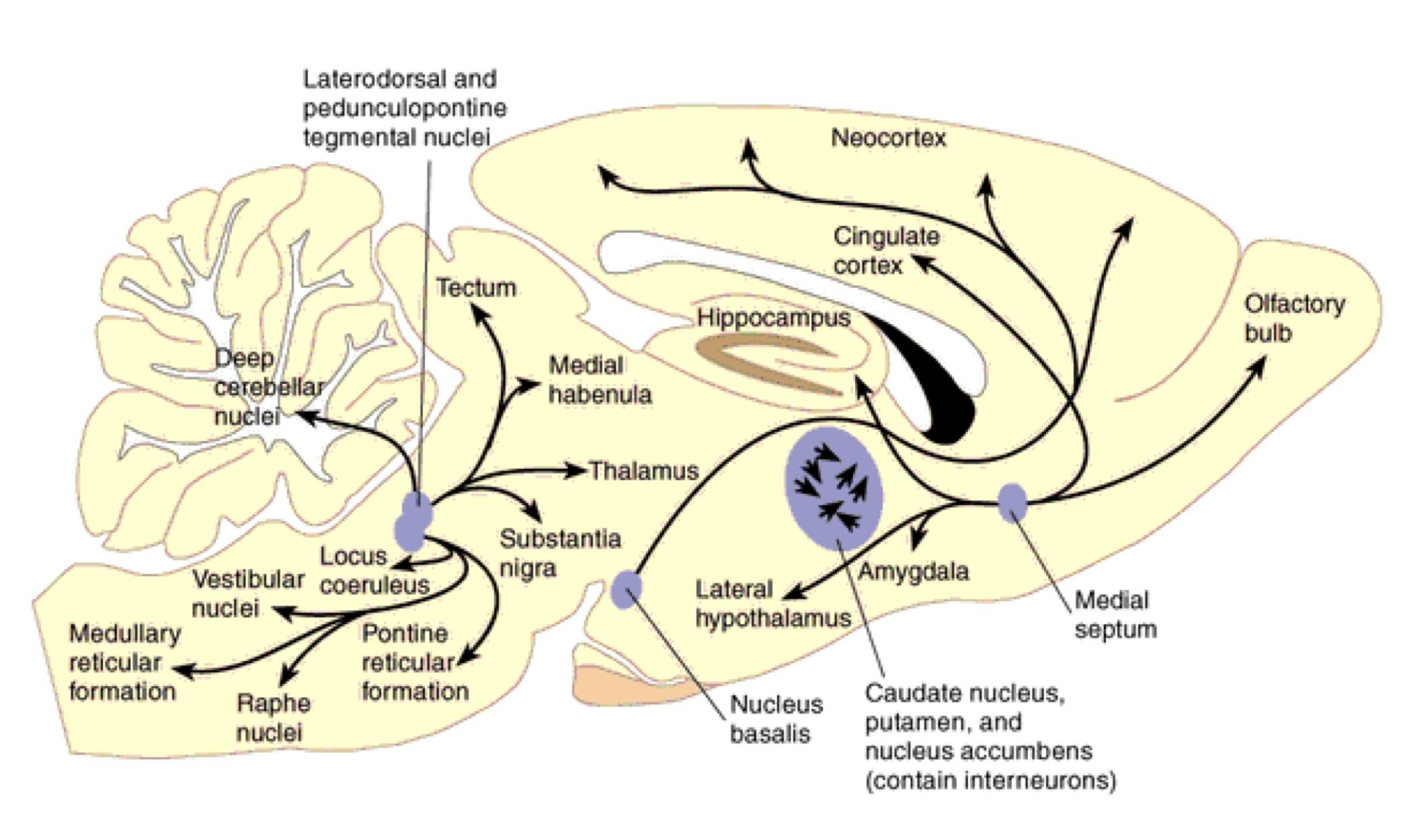
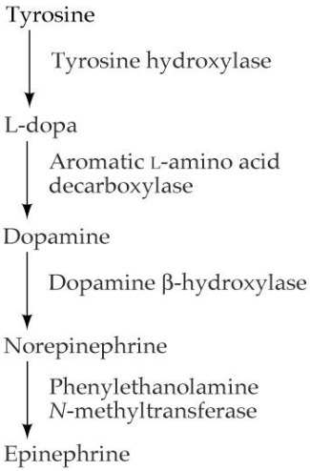
Noradrenergic System
NE is released from adrenal medulla through the sympathetic nervous system.
Norepinephrine(NE):
Is a catecholamine that is synthesized from Dopamine.
Is released from sympathetic, the adrenal medulla and brainstem neurons.
It acts on both α-and β-adrenergic receptors (G-protein-coupled receptors).
NE is believed to play a role in both learning and memory.
The Noradrenergic System has a very widespread projection system.
Locus Coeruleus is activated by stress and coordinates responses via projections to:
Cortex
Thalamus
Hypothalamus
Hippocampus
Amygdala
Autonomic brainstem centers
Spinal Cord
Locus Coeruleus neurons fire as a function of attention/vigilance and arousal.
Irregular firing during quiet wakefulness.
Sustained activation during stress.
Their firing decreases markedly during slow-wave sleep and virtually disappears during REM sleep.
↝ Produce NE

Slide 8
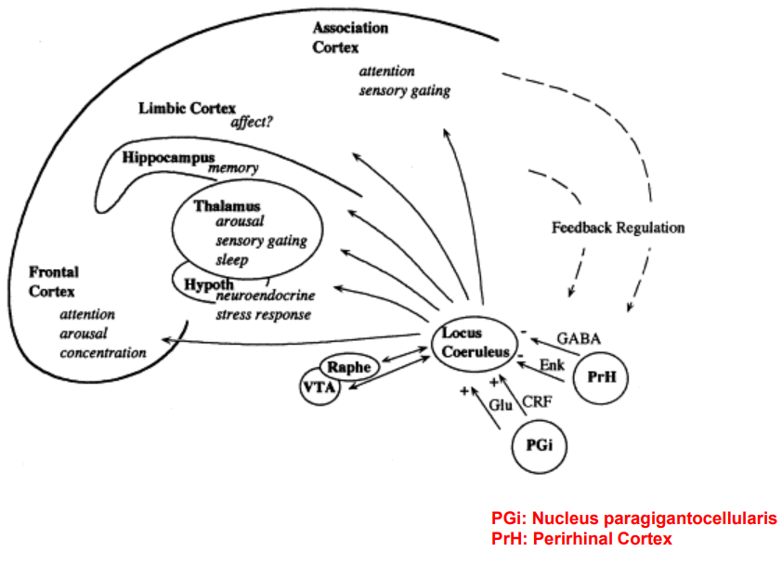
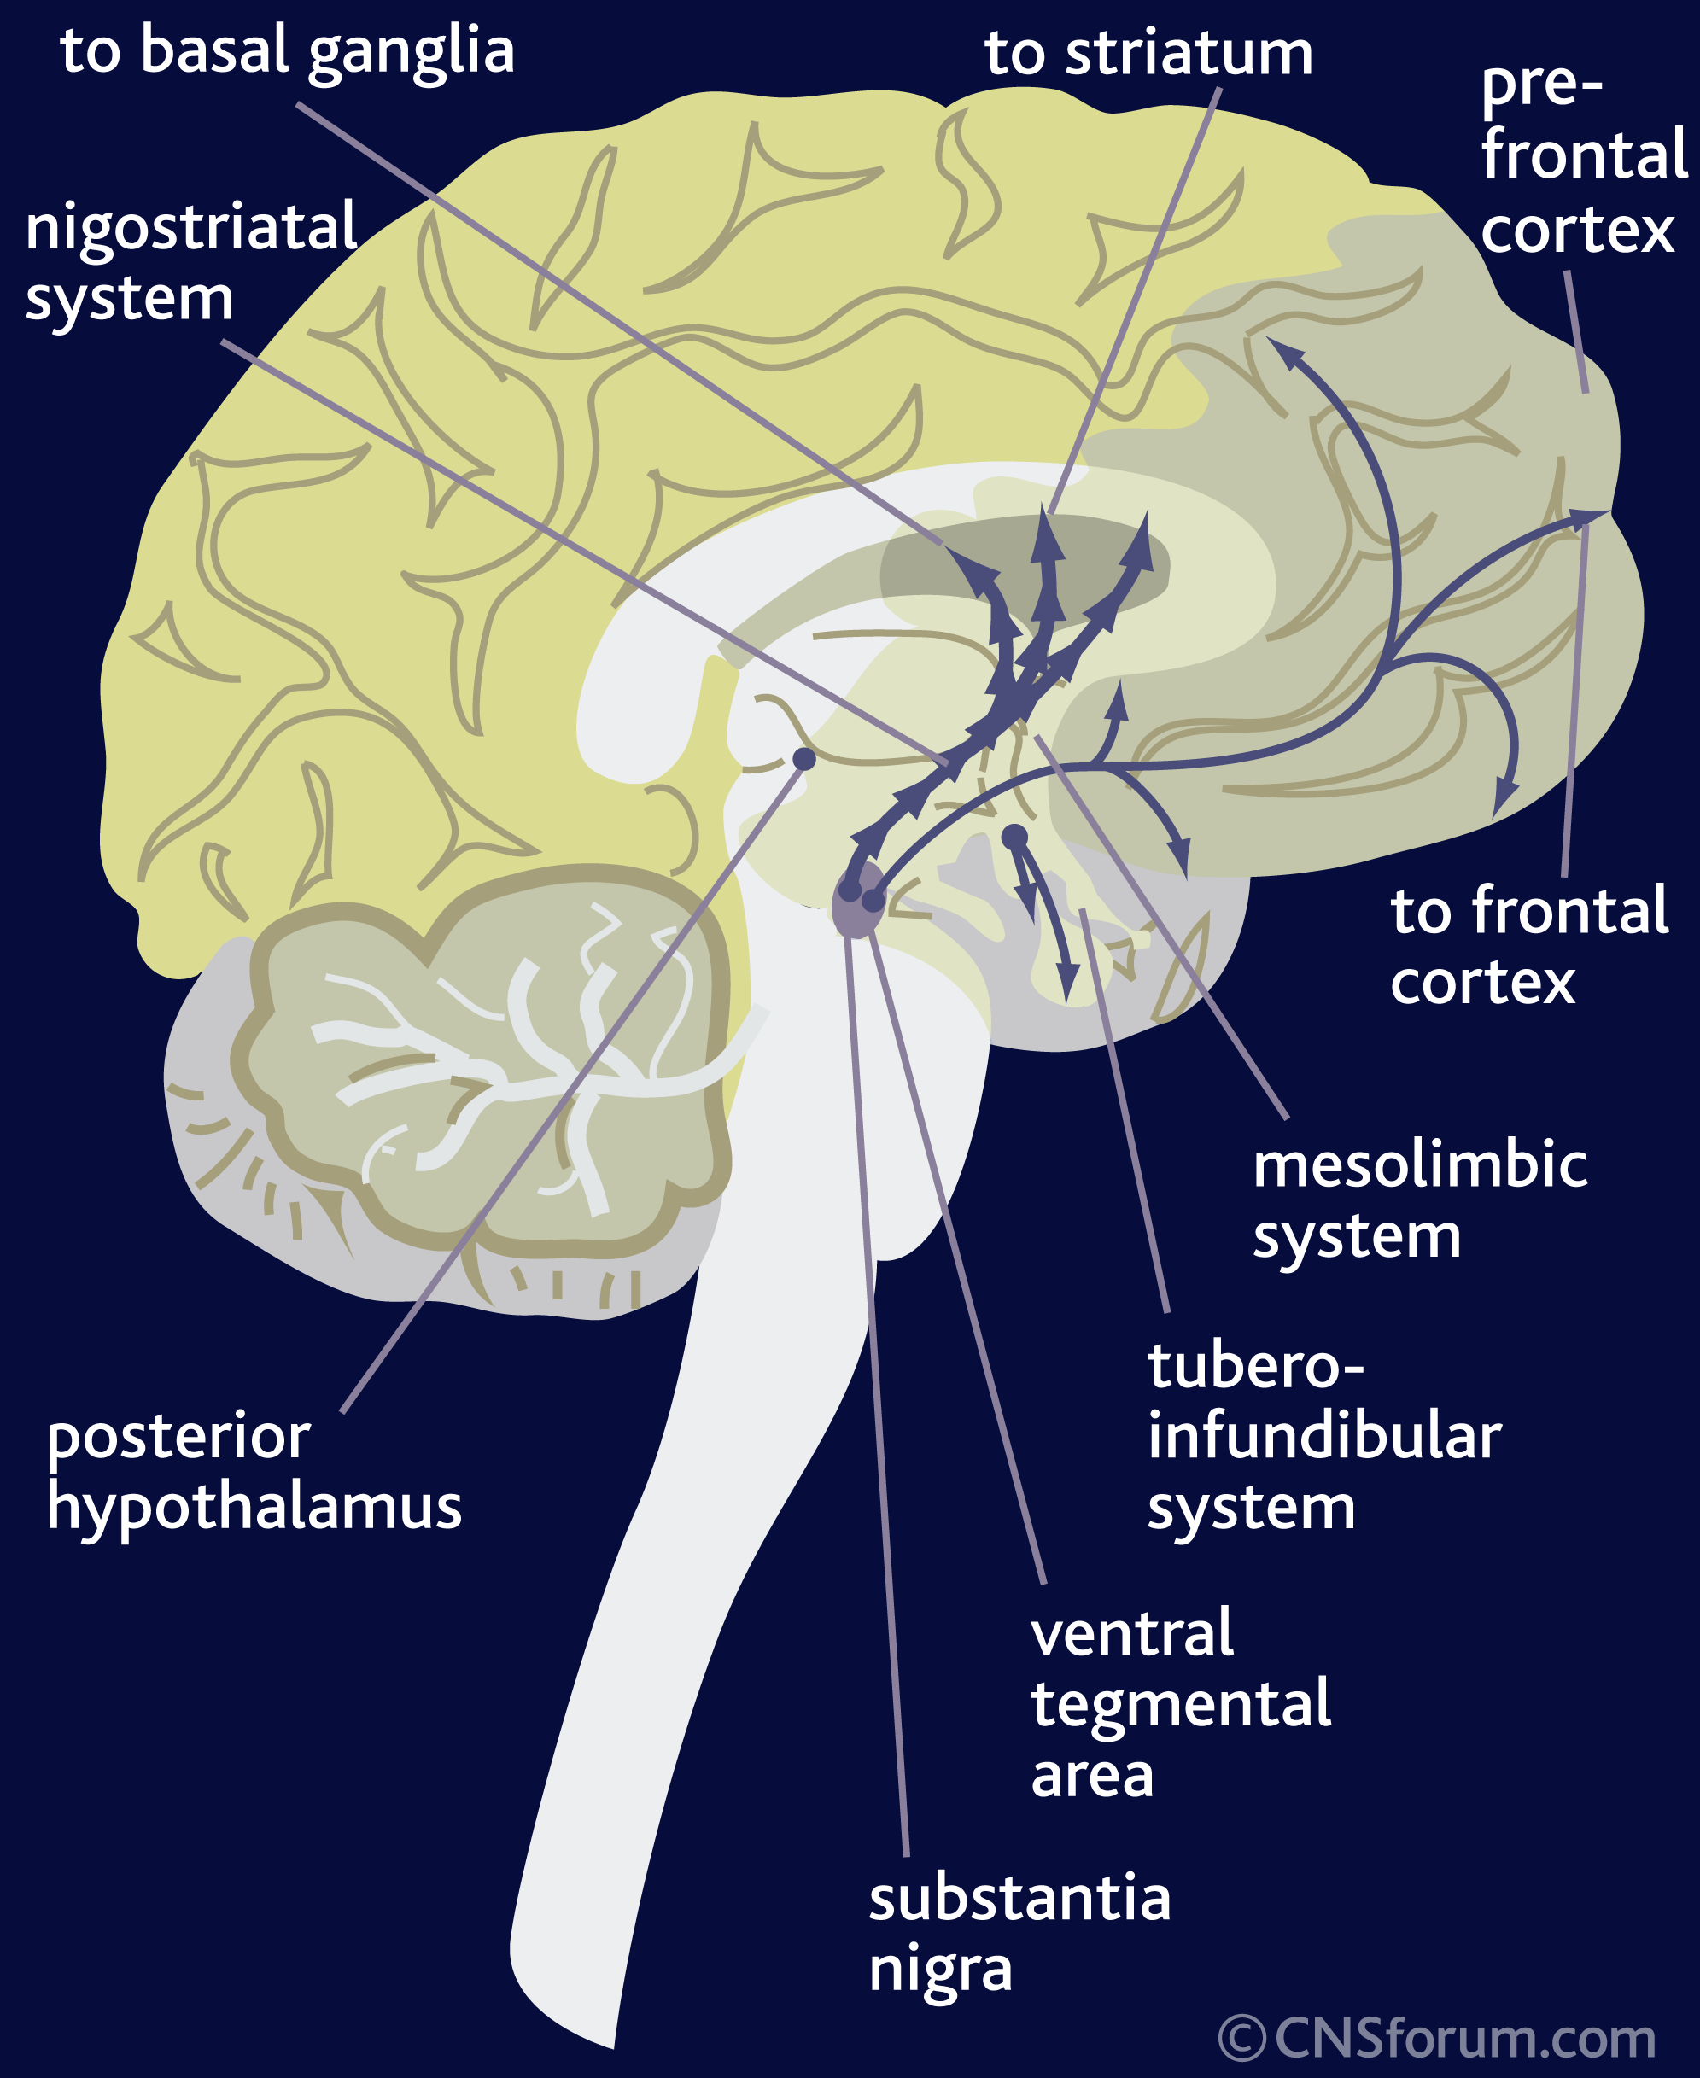
Functions of NE
It constitutes part of the RAS (Reticular Activating System)
Attention/Vigilance
Fight or flight response
Learning
Aggressive behavior
Norepinephrine (NE) Implicated in Stress Related Disorders:
Reduced level in: Depression
Withdrawal of some drugs of abuse (NE Imbalance + Other NT)
High level in: Anxiety panic disorder
Dopamine:
Dopamine is a catecholamine that is synthesized from tyrosine.
Five dopaminergic receptors (D1-D5).
Overstimulation of D2 receptors is thought to be related to schizophrenia.
Dopaminergic Pathway:
Dopamine is transmitted via three major pathways:
The first (nigro striatal system) extends from the substantia nigra to the caudate nucleus-putamen (neostriatum) and is involved in motor control.
The second pathway project to the mesolimbic forebrain.
Its related to cognitive, reward and emotional behavior and addiction.
Dysfunction is connected to hallucinations and schizophrenia.
The third pathway, known as the tuberoinfundibular system (pituitary gland) It is concerned with:
Regulation of secretion of prolactin* from the anterior pituitary gland
Maternal behavior (nurturing)
*Prolactin is mainly used to help women produce milk after childbirth.

Slide 9
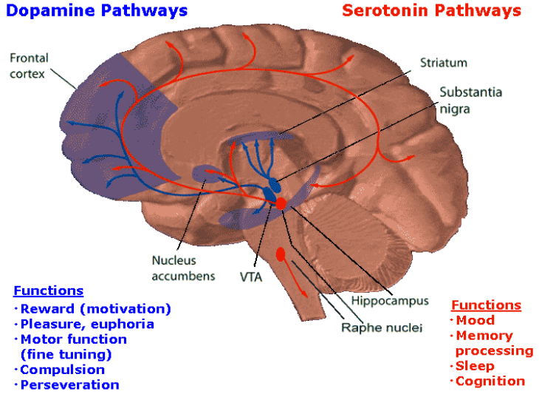
Dopaminergic Pathways/Functions
With limbic system
With mesolimbic
Unique for humans
Have similar functions, they’re interconnected and complement each other.
Dopaminergic neuron disorders:
Schizophrenia. (Disturbance)
Parkinson’s Disease. (Low)
Cocaine elevates activity at dopaminergic synapses
Serotonin
Synthesized from the amino acid Tryptophan, which is abundant in meat.
Our bodies can’t make tryptophan (Must get from diet)
Tryptophan deprivation alters brain chemistry & mood.
There are only a few 100,000’s of 5-HT neurons in the human brain.
There are 7 classes of serotonin receptors in different parts of the CNS (Most are metabotropic, except 5-HT3).
Mice in which the gene for 5-HT2C receptors have been knocked out are obese.
CO2
O2

Slide 10
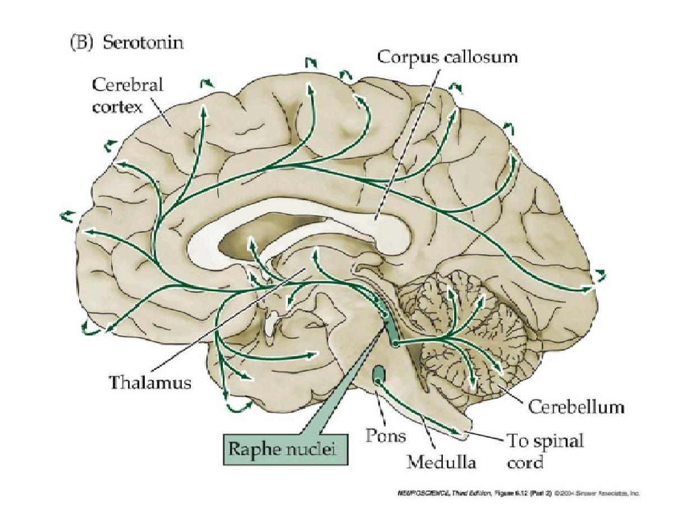
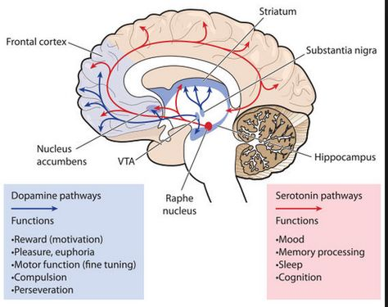
The serotonin pathways in the brain:
The principal centers for serotonergic neurons are the rostral and caudal raphe nuclei.
Raphe nuclei is located at midline of reticular formation, connecting spinal cord to cerebral cortex through thalamus.
Projections:
Axons ascend to the cerebral cortex, limbic & basal ganglia.
Serotonergic nuclei in the brain stem.
Descending axons terminate in the medulla & spinal cord.
*EXTRA
Functions & disorders:
Functions:
Improved mood.
Decreased appetite.
Sleep
Disorders:
Low level in Depression.
Anxiety.
*Drugs (e.g. Prozac) that prolong serotonin’s actions relieve symptoms of depression & obsessive disorders.

Slide 11
Summary
According to prof. Laila, you only need to know the effect, site, and function.
NT | Post-synaptic effect | Derived from | Site of synthesis | Postsynaptic receptor | Fate | Functions
1.Acetylcholine (Ach) | Excitatory | Acetyl coA + Choline | Cholinergic nerve endings Cholinergic pathways of brainstem | 1.Nicotinic 2.Muscarinic | Broken by Acetylcholinesterase | Cognitive functions e.g. memory Peripheral action e.g. cardiovascular system
2. Catecholamines I. Epinephrine (adrenaline) | Excitatory in some but inhibitory in other | Tyrosine produced in liver from phenylalanine | Adrenal medulla and some CNS cells | Excites both alpha α & beta β receptors | 1.Catabolized to inactive product through COMT & MAO in liver 2.Reuptake into adrenergic nerve endings 3.Diffusion away from nerve endings to body fluid | For details refer ANS. e.g. fight or flight, on heart, BP, gastrointestinal activity etc. Norepinephrine controls attention & arousal, sleep/wake cycle.
II. Norepinephrine | Excitatory | Tyrosine (Pons) Reticular formation (Locus Ceruleus, Thalamus, Midbrain) | Begins inside axoplasm of adrenergic nerve ending is completed inside the secretory vesicles | α1 α2 β1 β2
III. Dopamine | Excitatory | Tyrosine | CNS, concentrated in basal ganglia and dopamine pathways e.g. nigrostriatal, mesocorticolimbic and tuberohypophyseal pathway | D1 to D5 receptor |  | Sensory motor Cognitive/emotional behavior Endocrine Hypothalamic Decreased dopamine in parkinson’s disease. Increased dopamine concentration
3. Serotonin (5HT) | Excitatory | Tryptophan | CNS, Gut (chromaffin cells) Platelets & retina | 5-HT1 to 5-HT7 5-HT 2A receptor mediate platelet aggregation & smooth muscle contraction | Inactivated by MAO to form 5- hydroxyindoleacetic acid(5-HIAA) in pineal body it is converted to melatonin | Mood control, sleep, pain feeling, temperature, BP, & hormonal activity
4. Glutamate | Excitatory 75% of excitatory transmission in the brain | By reductive amination of Krebs cycle intermediate α – ketoglutarate. | Brain & spinal cord e.g. hippocampus | Ionotropic and metabotropic receptors. Three types of ionotropic receptors e.g. NMDA, AMPA and kainate receptors. | It is cleared from the brain ECF by Na + dependent uptake system in neurons and neuroglia. | Long term potentiation involved in memory and learning by causing Ca++ influx.
5. Gama Amino Butyric Acid (GABA) | Major inhibitory mediator | Decarboxylation of glutamate by glutamate decarboxylase (GAD) by GABAergic neuron. | CNS | GABA – A increases the Cl - conductance, GABA – B is metabotropic works with G – protein GABA transaminase catalyzes. GABA – C found exclusively in the retina. | Metabolized by transamination to succinate in the citric acid cycle. | GABA – A causes hyperpolarization (inhibition) Anxiolytic drugs like benzodiazepine cause increase in Cl- entry into the cell & cause soothing effects. GABA – B cause increase conductance of K+ into the cell.

Slide 12
Questions
1)Neurotransmitters are chemical substances released from: A)Presynaptic B)Postsynaptic C)Both D)Non 2)Norepinephrine increases in: A)Depression B)High level in anxiety panic disorder C)Withdrawal from some drugs D)All 3)What’s the major neurotransmitter in the peripheral nervous system? A)Glutamate B)Ach C)NE D)GABA 4)Ach become low during: A)Learning B)Memory C)REM D)SWS
5)Which one of the following reduceded in stroke? A)Glutamate B)Ach C)NE D)GABA 6)Where can we find GABA? A)CNS B)Retina C) cornea D)A+B 7)Raphe nuclei is the center of: A)serotonin B)Ach C)NE D)GABA 8)Dopaminergic neurons disorders has low level of dopamine: A)Parkinson’s Disease B)Schizophrenia C)Temporal lobe epilepsy D)Anterograde amnesia
Answers
1.A
2.B
3.B
4.D
5.A
6.D
7.A
8.A

