Slide 1
16th Lecture ∣ The Physiology Team
Physiology of the pain
Objectives:
To know about the receptor of pain.
The types of neuron responsible for conduction of impulses e.g A-delta and C- types.
Mechanism of the pain
Two types of pain e.g fast and slow.
Know the tracts involved and its functions.
Know the role of thalamus and cortex in the perception of pain.
Bold & Italic objectives are included in the medical education guide
This lecture you have to check the questions !!
Done by :
Colour index:
important
Numbers
Extra
Team leaders: Fatima Balsharaf , Rahaf Alshammari,
Abdulelah Aldossari, Ali Alammari.
Team members: Renad alsuelmi,Abdullah Alzaid, Esra’a alnazzawi,Haifa Alessa,Ahad alGrain
Special thanks for drawings : Sara AL Towireb
وَأَن لَّيْسَ لِلْإِنسَانِ إِلَّا مَا سَعَىٰ

Slide 2
Terminology
Terminology | Definition
Nociceptor (pain receptor) | primary afferent receptors that respond selectively to noxious stimuli.( subtype of sensory receptor )
spinothalamic tract | also known as anterolateral system or the ventrolateral system) is a sensory pathway from the skin to the thalamus
VP nucleus The ventral posterior nucleus. | is the somato-sensory relay nucleus in thalamus of the brain
topognosis | recognition of the location of a stimulus on the skin. Synonyms : topognosia
Sensory receptors | are specialized peripheral endings of primary afferent neurons.
Noxious stimulus | any stimulus (mechanical like exssive pressure , chemical exssive acidity or thermal exssive heat) that produces tissue damage or threatens to do so the oppisate (≠ innocuous).
Polymodal nociceptors: | respond to a combination of mechanical , chemical , thermal noxious stimuli.
Reception | Response of nerve receptors in the skin and tissues to stimuli resulting from actual or potential tissue damage. - when you only receive the pain
Perception | The process by which pain is recognized and interpreted by the brain.- when you are aware about the pain
Nociceptive pain | Is caused by the presence of a painful stimulus on nociceptors-
Neuropathic pain | Occurs as a result of damage to the nerve fibers with the pain impuls emanating from the nerve itself
4th Lecture ∣ The Physiology Team

Slide 3
To know about the receptor of pain
Pain & Nociception
What is nociception?
Refers to the transmission of signals evoked by activation of nociceptors (pain receptors) from periphery to the CNS.
What is pain?
Is perception of unpleasant sensation that originates from a specific body region.
Is an unpleasant sensory and emotional experience associated with actual or potential tissue damage.
4th Lecture ∣ The Physiology Team
Significance of pain: why do we feel pain?
If you don’t feel pain, you won’t protect yourself and try to escape from danger.
It is a protective mechanism meant to make us aware that tissue damage is occurring or is about to occur:-
1. Avoid noxious stimuli
2. Remove body parts from danger like withdrwal reflex
3. Promote healing by preventing further damage
4. Storage of painful experiences in memory helps us to avoid potentially harmful event in the future
The sensation of pain may be accompanied by behavioural”motor” responses (withdrawal, defense) as well as emotional responses (crying, anxiety or fear).
Pain is perceived at both the cortical & thalamic​ levels “two levels” but grading, scaling and location are features of cerebral cortex.If someone does not have cerebral cortex , he won’t describe the pain, he will just say that he feels pain.

Slide 4
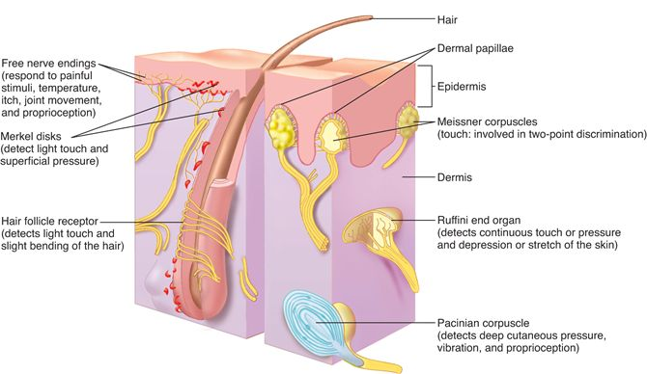
To know about the receptor of pain
Pain receptors (nociceptors)
Definition:
‘‘ Are special receptors that respond only to noxious stimuli and generate nerve impulses which the brain interprets as "pain".
Pain receptors characteristics:
Pain receptors are the most widely distributed.
1- Widespread​ ​in superficial ​layers of skin, 2- Fewer​ ​in deep tissue 3- absent in brain tissue
They are found in largest no. & density in skin, periosteum joint surface, arterial wall,skeletal muscle , parietal layer of serous membrane & duramatar.
It has a protective function
They are specific (have adequate stimulus) in that pain is not produced by overstimulation of other receptors.
They are high threshold receptors i.e. painful stimuli must be strong & noxious to produce tissue damage.
Pain sensation can by various type of stimuli mechanical , thermal , chemical will stimulate the pain receptor the strong stimuli will activate them
Localization of pain is less than other type of stimuli - it means we can point out exactly where is the pressure but the pain isn’t.
Do not adapt (or very little) to repetitive stimulation (it allows the pain to keep the person apprised of a tissue-damaging stimulus as long as it persists.)
All pain receptors are free nerve endings (is not enclosed in a capsule, Remember pacinian corpuscle is capsulated)of unmyelinated C fibers & small 1 diameter and myelinated Aδ fibers.
4th Lecture ∣ The Physiology Team
Pain receptors are activated by 3 types of stimuli: 1. Mechanical - they elicit fast pain. “Pen prick”, cutting , crushing , firm pressure
2. Thermal - they elicit also fast pain. “Heat or cold”
3. Chemical - they produce slow pain. “Acids or chemical substances”

Slide 5
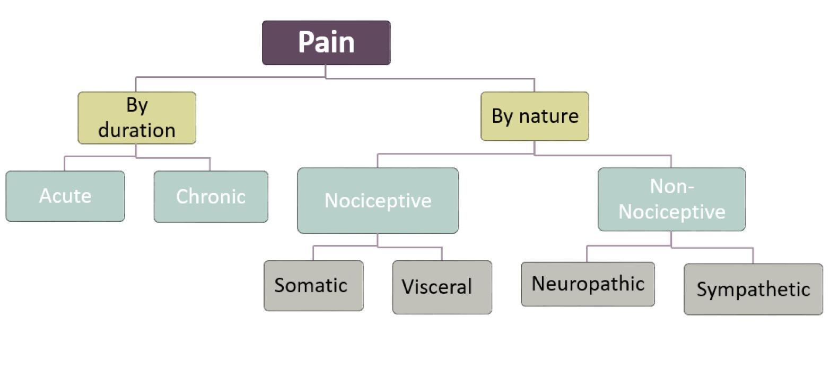
Types of pain
4th Lecture ∣ The Physiology Team
Team 35

Slide 6
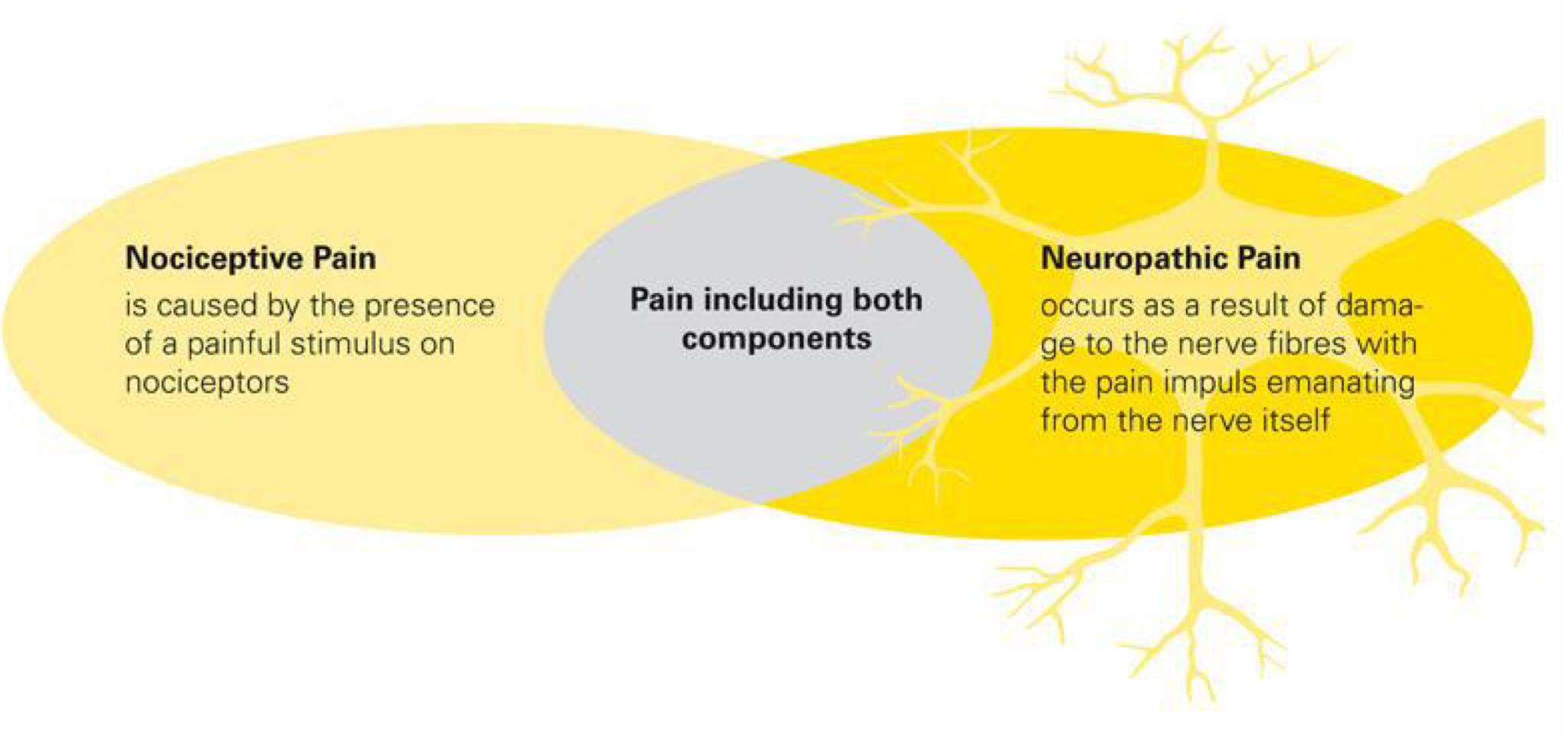
Classification of pain
Nociceptive pain occurs when nociceptors in the body detect noxious stimuli that have the potential to cause harm to the body. ... Neuropathic pain is caused by damage to the neurons that are involved in the pain signaling pathways in the nervous system.
1-Nociceptive Pain
2-Neuropathic Pain
• Sustained primarily by the nociceptive system
•Proportionate to the stimulation of the nociceptor”sharp or dull objects”
•When acute
–Serves a protective function
–Normal pain means proportional, localized and occurs at the time of damage
•Pathologic when chronic
•Responds to common analgesics Examples: acute burns, bone fracture, and other somatic and visceral pains. large fibers
•Sustained by aberrant processes in PNS or CNS
• Disproportionate to the stimulation of nociceptor
• Serves no protective function
• Pathologic pain
• Resistant to common analgesics Examples: painful diabetic & peripheral neuropathies, deafferentation and sympathetically-maintained pains, nerve inflammation, compression small-medium fibers
3- Idiopathic Pain
No underlying lesion found yet, disproportionate to the degree of clinically discernible tissue injury
4- Mixed Pain
Eg; Failed low-back- surgery syndrome Complex regional pain syndrome

Slide 7
Types of pain
Pain can be classified according to the site of stimulation into somatic or visceral
 | superficial pain •It arises from skin or other superficial structures. •It occurs in 2 phase of fast pricking followed by slow burning pain. •It can be well localized. •It may be associated with motor, autonomic, emotional reactions. | Deep pain •It originates from muscles, joints, periosteum, tendons & ligaments. •It is slow prolonged conducted by type C fibers. •It is diffuse (i.e. poorly localized). •It can initiate reflex contraction of nearby muscles. •It may be referred to other sites. •It is caused by: trauma, bone fracture & inflammation, arthritis, muscle spasm & ischemia.
 | There are few pain receptors in most viscera Some viscera are pain insensitive e.g. liver parenchyma, lung alveoli, brain tissue, visceral layer of peritoneum, pleura and pericardium.
 | Characters of visceral pain •It is slow pain conducted by C fibers (pain arising from parietal peritoneum, pleura and pericardium is sharp, pricking type). •It is diffuse, poorly localized, the patient feels pain arising from inside but he cannot pinpoint it exactly. •It is often associated with nausea and autonomic reactions. •It can be associated with rigidity of nearby muscles. •It often referred to other sites.
 | Causes of visceral pain 1-Distension of a hollow organs 2-Inflammation of an organ.3-Ischemia e.g. pain due to myocardial ischemia. N.B: Cutting, crushing are not painful when applied to viscera because the pain fibers are scanty, so whenever you cut , you will involve just few fibers. In contrasts, inflammation of viscera will cause distention of its wall that will involves broad pain fibers.
Somatic pain
4th Lecture ∣ The Physiology Team
visceral pain

Slide 8
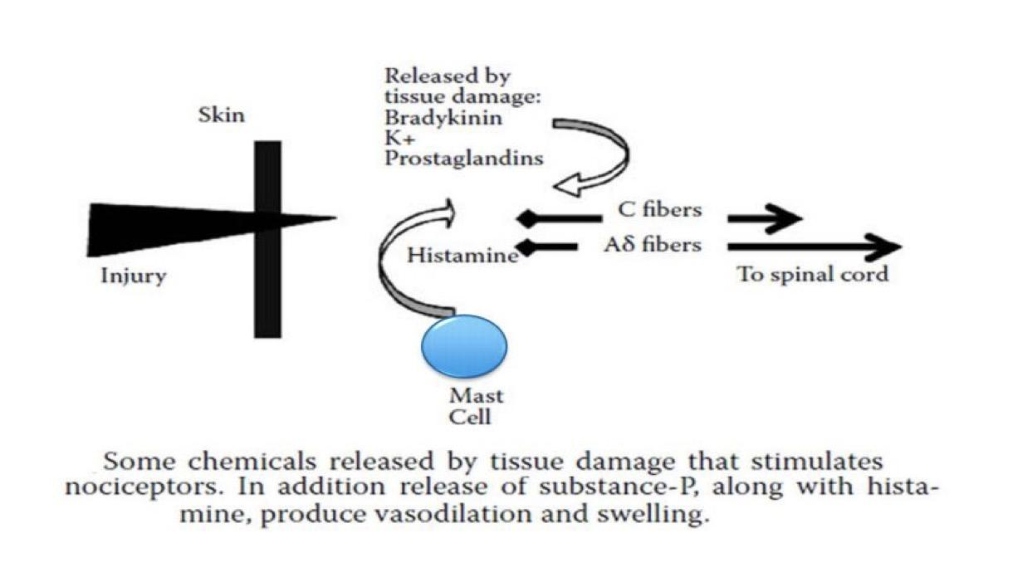
Mechanism of the pain
Mechanism of stimulation of pain receptors (nociceptors)
Pain receptors are depolarized either directly or through the production of pain producing substances from damaged tissues as a result of inflammation ( also called inflammatory mediators) e.g. bradykinin, histamine, substance P, calcitonin generelated peptide (CGRP), interleukins, prostaglandins, K+ , Ach, proteolytic enzymes.
Chemical substances released during tissue damage
Substance | Potassium | Prostaglandins | Leukotrienes | Serotonin | Bradykinin | Histamine | Substance P*
Source | Damaged cells |  |  | Platelets | plasma | Mast cells | Primary nerve afferents
* is secreted by nerves and inflammatory cells such as macrophages, eosinophils, lymphocytes, and dendritic cells.
Pain Producers
Bradykinin, serotonin, Histamine, K+ ion, Acids, proteolytic enzymes. calcitonin gene-related peptide (CGRP), interleukins, Ach.
Pain Sensitizers
PGs & substance – P
enhance the sensitivity of pain receptors.For instance, when a patch of your skin is burned , this area will be very sensitive.
4th Lecture ∣ The Physiology Team
Pain mechanism
Injured tissue releases bradykinin and PG that activate nociceptors, which in turn release substance P. Substance P acts on mast cells to cause degranulation and release of histamine which also activates nociceptors. Substance P causes extravasation and CGRP dilates blood vessels which result in edema. Then, edema causes additional release of bradykinin. Serotonin (5-HT) is released from platelets and activates nociceptors.
Damage and inflammation
Release chemical mediators activate or sensitize the receptor endings
Cytokines, bradykinin, prostaglandin, Substance p
Results in transduction
Conduction of nerve impulse
Histamine and substance
P are also responsible of edema and swelling.

Slide 9
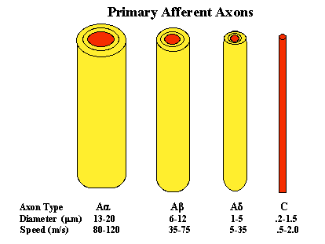
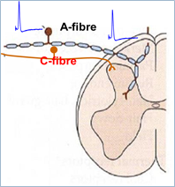
The types of neuron responsible for conduction of impulses
Classification of Nerve fibres
Type | I | II | III | IV
 | Aα | Aβ | Aδ | C
Diameter (µm) | 10-20 | 5-10 | 2-5 | 0.5-2
Conduction Velocity (m/s) | 70-120 | 30-70 | 5-30 | 0.5-2
4th Lecture ∣ The Physiology Team
In dorsal column
Type-A & Type-C Fibers
Small | Medium | Large
< 30 µm | 31-40 µm | > 40 µm
Nociceptors |  | Non-Nociceptors “Polymodal”

Slide 10
SAQ about the types of the pain
Qualities of the pain Important
(phenomenon of double pain)
type | Fast pain | Slow pain
Also called | Fast/Sharp/immediate (1st) pain. Intense , pricking | slow/diffuse/delayed (2nd) pain Burning , aching , throbbing “unbearable “ , dull , chronic pain
location | Usually Somatic not visceral | Can occur in skin or any internal organ\tissue.
onset | Very rapid felt within 0.1 sec | Slow felt after 1 second or more
Associated with: | Reflex withdrawal. | Destruction of tissue.
Localization: | Well localized | Diffuse (poorly localized) Responsible for“Emotional aspect pain” → misery
Fiber (mediated by:) | Type ​A​δ​ fibers nociceptors | Type ​C​ fibers nociceptors.
Terminate at: | I and V laminas | II and III laminas.
NT: | Glutamate | Substance P
4th Lecture ∣ The Physiology Team

Slide 11
Know the tracts involved and its functions
Pathway of pain
Pain sensation is carried by lateral spinothalamic tracts which includes 2 separate pathways:-
 | The neospinothalamic pathway | The paleospinothalamic pathway:
Transmits | This transmits fast pain. | this transmit slow pain sensation.
1st neurone | Are mainly A afferent nerves. They terminate at lamina I & V of dorsal horn. | They are mainly type C fibers. They enter spinal cord via dorsal roots, terminate at substantia gelatinosa in laminae II & III of dorsal horn(substantia gelatinosa).
2nd neurone | These constitute the tract. They start at dorsal horn, cross to opposite side and ascend in lateral column of spinal cord. The fibers ascend in brain stem to terminate in ventrobasal complex of thalamus. | They start at SGR(Substantia gelatinosa of rolando), cross to opposite side in front of central canal, ascend in lateral column of SC & terminate at: - Reticular formation of brain stem. Intralaminar nuclei of thalamus. Hypothalamus & adjacent region of basal brain. Impulses arriving these regions have strong arousal effects and can be perceived.
3rd neurone | These start at thalamus & most fibers project to somatosensory cortex. | These start at thalamus, Few fibers project to cerebral cortex.( somatosensory)
4th Lecture ∣ The Physiology Team
If you want Dr.Najeeb explanation notes & sketch click here

Slide 12
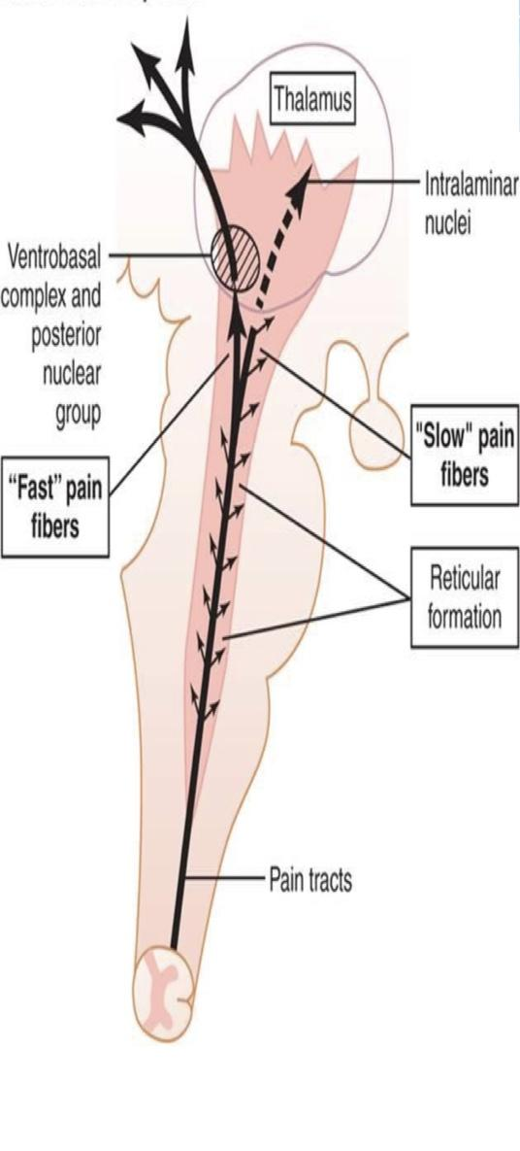
Know the role of thalamus and cortex in the perception of pain.
• Full perception of pain occurs when signals enter Reticular formation of brain stem, thalamus & basal regions. • Somatosensory cortex plays important role in topognosis i.e. localization & interpretation of pain quality. • Fast pain is localized better than slow pain because signals carried in neospinothalamic tract reach somatosensory cortex, while a small proportion of paleospinothalamic pathway reach there”usually terminates at thalamus”.
• Most of the slow pain fibers project to reticular formation & then proceed to thalamus (posterior nuclei) .
• Reticular system project to all parts of brain “especially slow pain” but specially to cerebral cortex therefore they cause arousal from sleep.
4th Lecture ∣ The Physiology Team

Slide 13
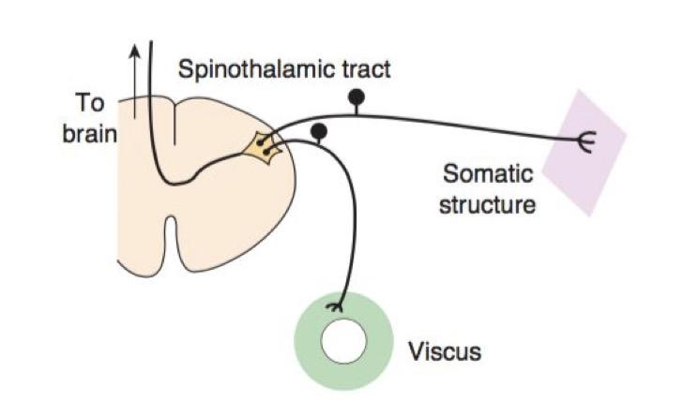
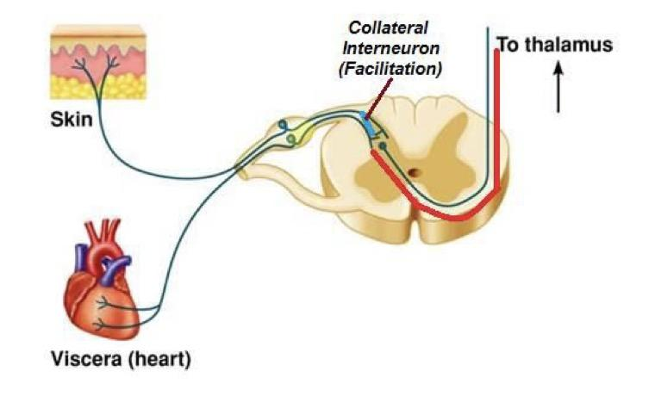
Referred Pain
•This is pain that is felt away from its original site.
•It is most frequent with visceral pain & deep somatic pain but cutaneous pain is not referred.
•Pain is referred according to dermatomal rule.
•When pain is both localized and referred it is called radiating pain
Convergence theory | Facilitation theory
•Afferent pain fibers from skin area & diseased viscera that develop from same embryonic segment converge on same 2nd order neuron and finally stimulate the same cortical neuron. •The brain interprets the information coming from visceral nociceptors as having arisen from cutaneous nociceptors, because this is where nociceptive stimuli originate more frequently Afferent fiber that come from the skin and the afferent fiber that come from the diseased viscus (both developed from the same embryonic segment) have distinct first order neuron, both of the fibers will synapse on the same second order neuron “converge” and finally stimulate the same neuron in the cortex.- The brain misinterprets the information (thinking that the inputs come from the skin rather than the diseased viscus because normally the nociceptive stimuli originating more frequently in the skin) resulting in feeling the pain in the original site of the stimulus (viscera) and the skin (referred pain) | •Pain fibers from skin are always carrying impulses, not enough to produce pain. •Impulses from diseased viscus pass through afferents which give collaterals to ST ( somatic tract ) neurons receiving pain fibers from skin. •As a result, ST neurons' excitability is raised (they are facilitated) to reach a threshold level. •The signals reaching the brain are projected to skin area and pain is felt in skin dermatome Normally, pain afferent fibers of the skin are always sending impulses but not enough to produce pain. - What happens then ? visceral afferent pain fibers give collaterals to the neuron that receives pain from a certain area of the skin (viscera and the area of skin that developed from the same embryonic segment). - So when there is impulses coming from the diseased viscera through visceral afferent pain fibers, it well raise the excitability of the neuron that receive pain from the skin to reach the threshold level → signals will reach the brain and projected to the skin causing pain
4th Lecture ∣ The Physiology Team

Slide 14
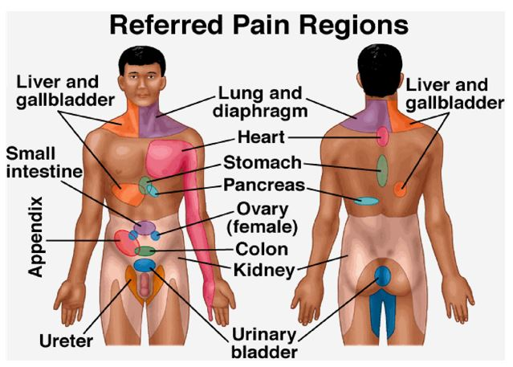
Types of pain
Organ | Site of referred pain
Meninges | Back of head &neck
Heart | Central chest, left inner side arm,Jaw,left shoulder
Diaphragm | Shoulder tip
Esophagus | Behind sternum
Stomach, duodenum | Epigastrium
Small bowel, pancreas | Around umbilicus
Large bowel, bladder | Lower abdomen
Kidney | Loin
Ureter | Testicles
Trigone of bladder | Tip of penis
Hip | Knee
Uterus | Low back
Appendix | Umbilicus
4th Lecture ∣ The Physiology Team
اللي عليها هايلات تكلمت عنها الدكتورة

Slide 15
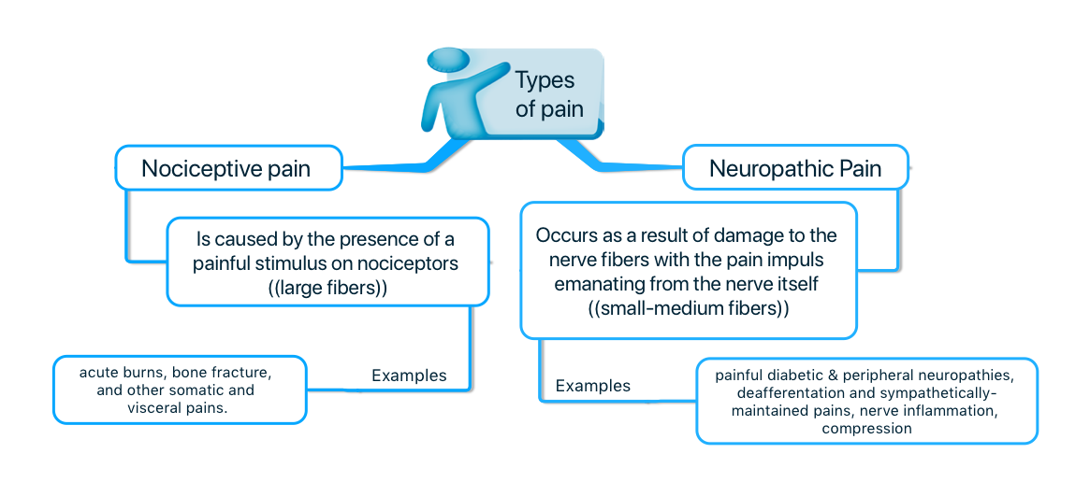
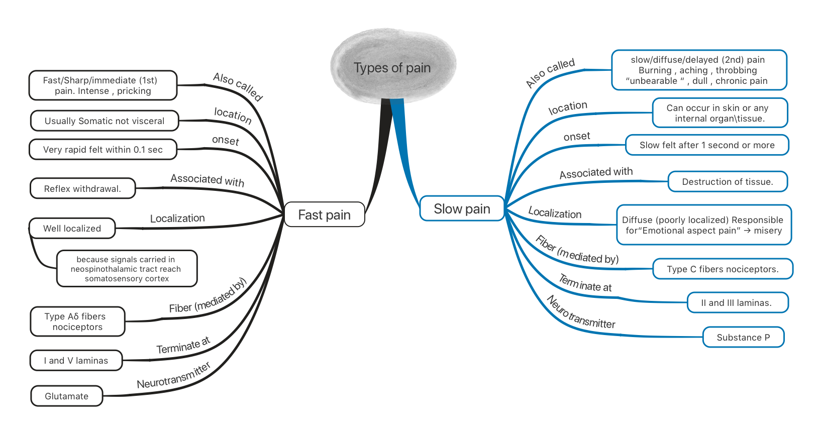
Quick review
PAIN
Is perception of unpleasant sensation that originates from a specific body region.
is perceived at both the cortical & thalamic​ levels “two levels” but grading, scaling and location are features of cerebral cortex.
NOCICEPTION
Refers to the transmission of signals evoked by activation of nociceptors (pain receptors) from periphery to the CNS.
Do not adapt (or very little) to repetitive stimulation
All are free nerve endings (is not enclosed in a capsule, Remember pacinian corpuscle is capsulated)
4th Lecture ∣ The Physiology Team
Pain Producers Bradykinin, serotonin, Histamine, K+ ion, Acids, proteolytic enzymes. calcitonin gene-related peptide (CGRP), interleukins, Ach.
Sensitizers PGs & substance – P enhance the sensitivity of pain receptors.
When pain is both localized and referred it is called radiating pain

Slide 16
1. Pain receptors in the skin are typically classified as which of the following? A)Encapsulated nerve endings. B) A single class of morphologically specialized
C)he same type of receptor that detects position D) Free nerve endings
2.A 43-year-old man sustained a lower back injury that causes severe chronic pain. His physician prescribes benzodiazepine sedation medications to help him sleep. Which response best describes why this man has difficulty sleeping without medication?
A)Depression of the amygdala B) Depression of reticular formation
C)Excitation of the amygdala D) Excitation of reticular formation
E) Loss of somatic sensations F) Loss of visceral sensations
3.Which substance enhances the sensitivity of pain receptors but does not directly excite them? A) Bradykinin. B) Serotonin. C) Potassium ions. D) Prostaglandins.
4. Which of the following is an important functional parameter of pain receptors?
A) Exhibit little or no adaptation B) Not affected by muscle tension
C) Signal only lexion at joint capsules D) Can voluntarily be inhibited
5.Which of the following substances is not considered mainly as a pain producer?A)Substance P B)Leukotrienes C)Potassium ions D) Histamine
4th Lecture ∣ The Physiology Team
6. Pain from the stomach is referred to which area of the body? A) Upper right shoulder area B) Abdominal area above the umbilicus C) Proximal area of the anterior and inner thigh
D) Abdominal area below the umbilicus
7. Which of the following is the basis for referred pain?
A) Visceral pain signals and pain signals from the skin synapse with separate populations of neurons in the dorsal horn.
B) Visceral pain transmission and pain transmission synapse with separate populations of neurons in the dorsal horn from the skin are received by a common set of neurons in the thalamus.
C)Visceral pain signals are rarely of sufficient magnitude to exceed the threshold of activation of dorsal horn neurons.
D) Some visceral pain signals and pain signals from the skin provide convergent input to a common set of neurons in the dorsal horn.
8.Which statement concerning visceral pain signals is correct? A) They are transmitted along sensory fibers that course mainly with sympathetic nerves in the abdomen and thorax B) They are not stimulated by ischemia in visceral organs C) They are transmitted only by the lightly myelinated δ-type A sensory fibers D) They are typically well localized
1)D
2)D
3)D
4)A
5)A
6)B
7)D
8)A

Slide 17
SAQ: Please fill up the gaps on the table below which is comparison between fast and slow pains?!
type | Fast pain | Slow pain
Also called
onset
Localization:
Fiber (mediated by:)
Terminate at:
NT:
4th Lecture ∣ The Physiology Team
1. What will happen if sensory area SI”somatosensory cortex” is removed?
2.Why patient with chronic pain syndrome have difficulty in sleeping?
person's ability to interpret the quality of pain & precise location of pain will be affected.
Paleospinothalamic pathway sends information to reticular formation and thalamic nuclei which are part of brain activating / alerting system, therefore chronic pain syndrome causes difficulty in sleep.

