Slide 1
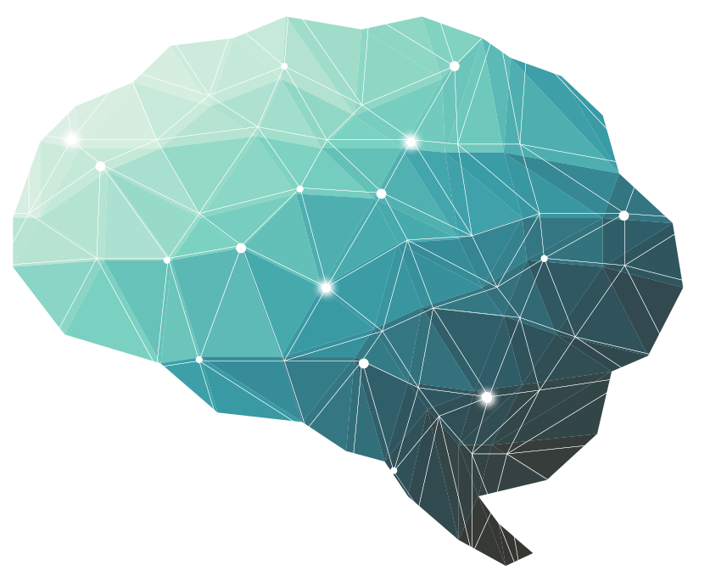
28th Lecture ∣ The Physiology Team
Pain Modulation
Objectives:
Intensity of the pain can be altered by various extrinsic and intrinsic mechanisms
know gate-control hypothesis(spinal modulation )and role of body’s own morphines, the opioid peptides
Supra spinal modulation (Special pain control analgesic system).
know about opioid receptors and are formed in the mid brain, brainstem and spinal cord.
Appreciate that pain can also be facilitated
Know the sites & mechanism of pain relief
Bold & Italic objectives are included in the medical education guide
Done by :
Team leaders: Fatima Balsharaf , Rahaf Alshammari,
Abdulelah Aldossari, Ali Alammari.
Team members: Renad alsuelmi,Abdullah Alzaid,Esra’a alnazzawi,Haifa Alessa, Ebtesam Almutairi ,Ahad AlGrain
Special thanks for drawings : Lubna - Aloufi
Colour index:
important
Numbers
Extra
Editing file
وَأَن لَّيْسَ لِلْإِنسَانِ إِلَّا مَا سَعَىٰ

Slide 2
Terminology
Terminology | Definition
Pain modulation | a decrease or an increase in the sensation of pain caused by inhibition or facilitation of pain signals
Inhibition | Inhibition: •Spinal (segmental) inhibition: Gate control theory •Supraspinal (descending) inhibition
Facilitation | Facilitation: •Peripheral sensitization (release of chemicals after tissue injury) •Central sensitization (Dis-inhibition)
Hyperalgesia | Hyperalgesia Excessive Pain (e.g due to sun burn) Primary hyperalgesia: at receptor level “ receptor dependent” -Secondary hyperalgesia: at tract level”the tract is hypersensitive”“tract dependent”
Allodynia | clinical feature of many painful conditions, such as neuropathies, complex regional pain syndrome, postherpetic neuralgia, fibromyalgia, and migraine Muscular Pain: Less blood flow in the muscles (ischemia). you feel pain from stimuli that don't normally cause pain. For example, lightly touching your skin or brushing your hair might feel painful.
Muscular Pain | Less blood flow in the muscles (ischemia).
Causalgia | Burning pain.
Stress induced analgesia | Pain suppression response that occurs during or following exposure to a stressful or fearful stimulus.
Phantom pain sensations | Perceptions that an individual experiences relating to a limb or an organ that is not physically part of the body.
Thalamic Syndrome | It is a neurological condition that results from a brain stroke affecting the thalamus Patient suffers from prolonged severe pain Cause: Obstruction of the thalamogeniculate branch of the posterior cerebral artery. • Affects posterior thalamic nuclei.
Trigeminal neuralgia | It is excruciating intermittent pain by stimulation of trigger area in the face.It results from compression of trigeminal nerve root by blood vessels.
Neuropathic pain | Pain caused by a primary lesion or dysfunction in the nervous system.
28th Lecture ∣ The Physiology Team

Slide 3
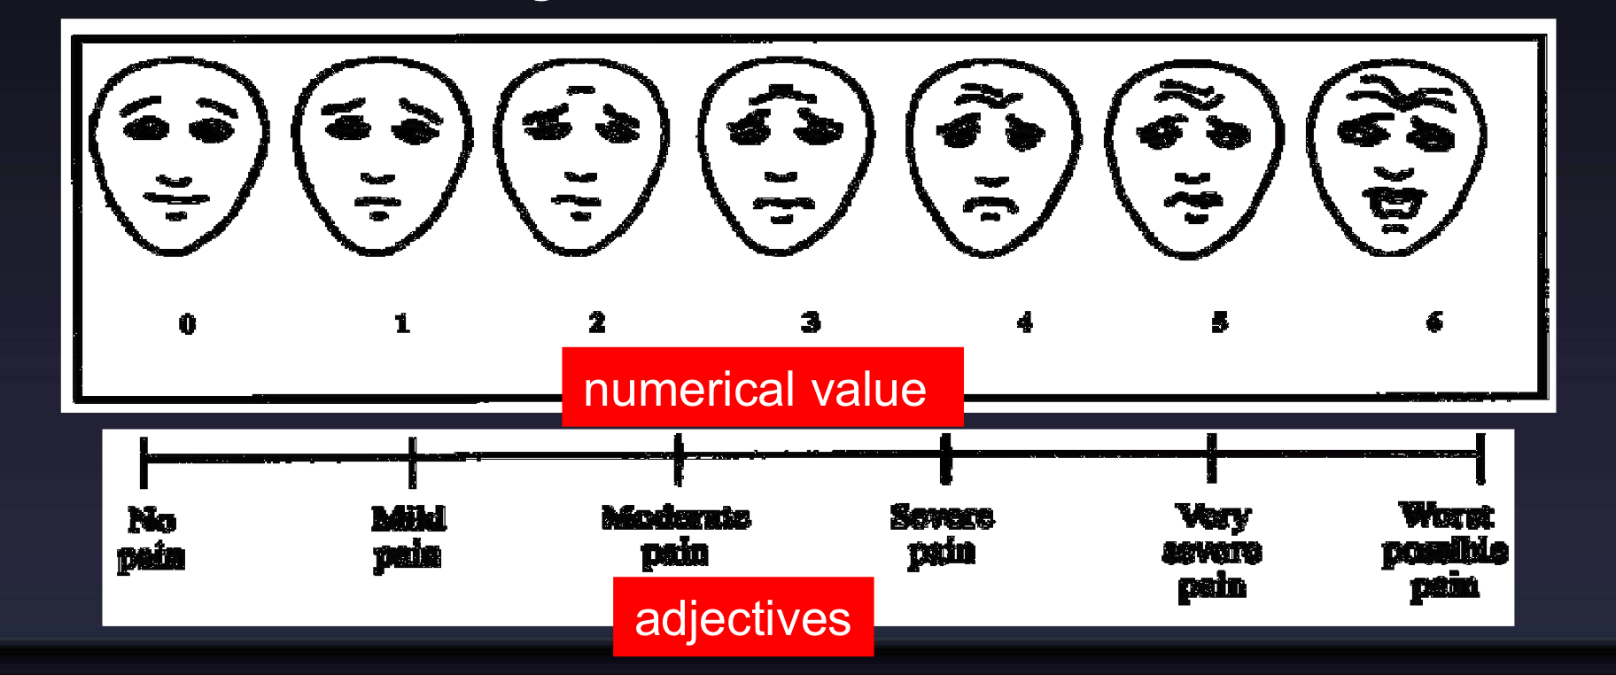
Introduction of Pain Modulation
Definition of Pain Modulation:
-To change the pain perception or density by any means.
Pain is modulated by two primary types of drugs that work on the brain: analgesics and anesthetics.
Nociception consists of four basic processes:
1. Transduction—nociceptors free nerve endings “Stimulation of nociceptors”
2. Transmission
3. Perception of Pain -At cortical Level
4. Modulation of Pain, Changing or inhibiting pain impulses in the descending tract (brain spinal cord) [norepinephrine and serotonin] or ascending tract.
-To modulate the pain, you should know firstly the grade or scale of the pain by whether numerical value or adjective chart. Because if you don't know the grade or scale of pain , how can you know that you have modulated the pain.

Slide 4
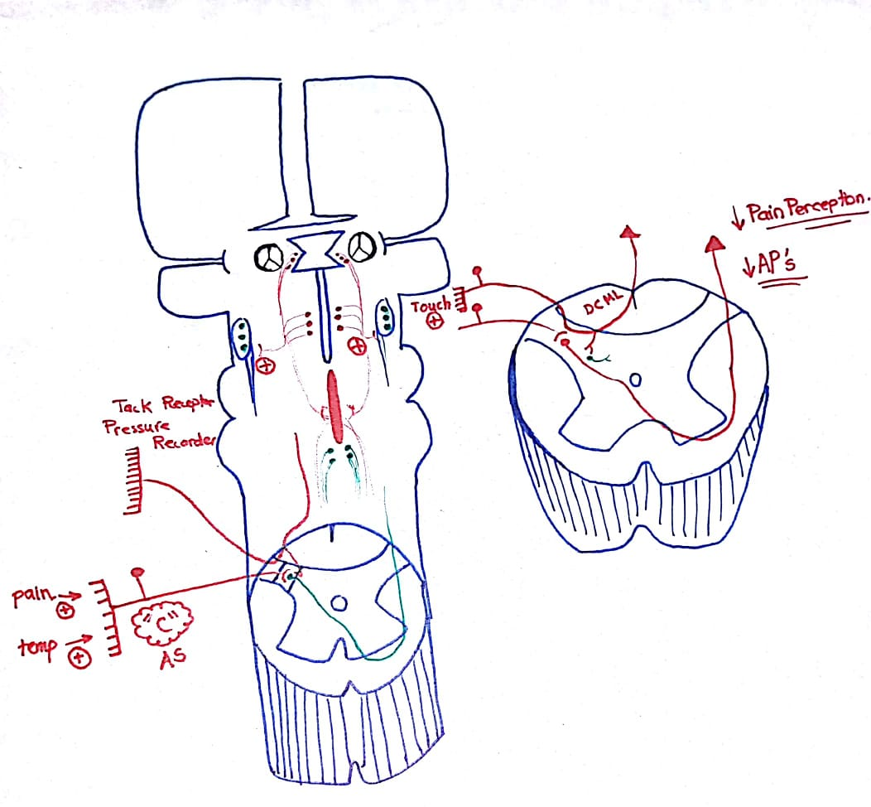
Gate of the pain theory & descending analgesic system - Ninja channel explanation
3rd ventricle
Periventricular gray matter
Periaqueductal gray matter
Locus coeruleus rich with epinephrine
paragigantocellular nucleus
Rich with serotonin
raphe magnus nucleus rich with serotonin
28 Lecture ∣ The Physiology Team
Pain modulation
1- Gate control theory
First of all if we have pain we start to rubbing the area to decrease the pain but how this work ?
Remember in the dorsal horn we have 2 different afferent : first one is for the pain & second one is touch afferent , so these touch fibers gives collateral to the inhibitory interneurons and start release GABA ( which will inhibit the cell body in the subtia gelatinosa )
Or inhibit the action synaptic terminal of dorsal ganglia
So now we inhibit the pathway and will decrease the action potential so if we decrease AP will decrease the severity of the pain.
2- descending Analgesic system -
All the three nucleus ( paragigantocellular nucleus that
Rich with serotonin , raphe magnus nucleus rich with serotonin, Locus coeruleus rich with epinephrine) secreted special chemicals called endogenous opioids (endorphins,Enkephalins,dynorphins into the inhibitory neuron so then inhibit subtina gelatinosa which will lead to decrease the action potential.
How these nuclei know when to fire to stimulate the periaqueductal gray matter\periventricular gray matter ?
1 - through Ascending lateral system there are spinomesencephalic fibers coming out from it so they can stimulate periaqueductal gray matter
2- through limbic nuclei
3-sensory cortex
24 minutes | Gate control theory

Slide 5
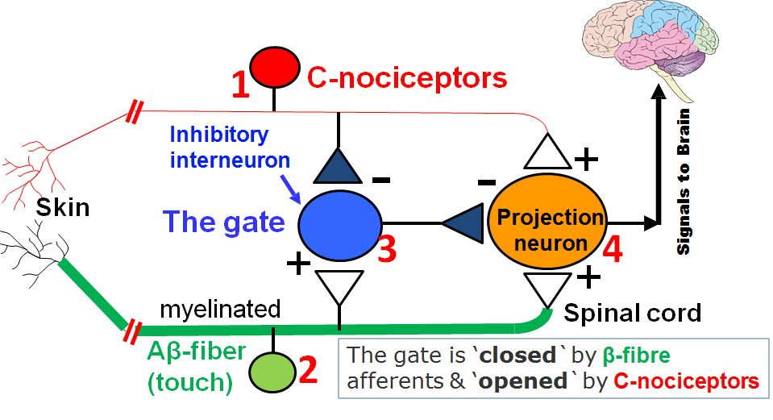
The Gate theory of pain control
Special neurons in the the dorsal horn of spinal cord (SGR) subtnia gelatinosa of Ronald form the gate through which pain impulses must pass to reach brain.
Four variables control this gate:
Type C- fibres (slow pain). unmyelinated -> open the gate.
Type A-β fibres (light touch). ​“Myelinated - dorsal column system -> close the gate .
Inhibitory interneurons.​between C-fibers and 2nd order neuron - When they’re stimulated they inhibit the transmission of pain signals - when they’re inhibited they allow transmission “inhibition of inhibition.
Projection neuron.Second order neuron of the spinothalamic tracts.
Gate opened or closed by 3 factors:
Activity in pain nerves opens the gate
+
Messages from the brain
To the brain
28th Lecture ∣ The Physiology Team
Activity in other sensory nerves closes the gate (e.g. Rubbing the affected area
-
Gate
Transmission nerve cells
Conditions that open or close the gate:
 | Conditions that open the gate | Conditions that close the gate
Physical Conditions | Extent of the injury | Medication
 | Inappropriate activity level | Counterstimulation, eg massage
Emotional Conditions | Anxiety or worry | Positive emotions
 | Tension | Relaxation
 | Depression | Rest
Mental Conditions | Focusing on the pain | Intense concentration or distraction
 | Boredom | Involvement and interest in life activities

Slide 6
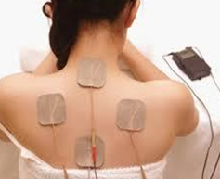
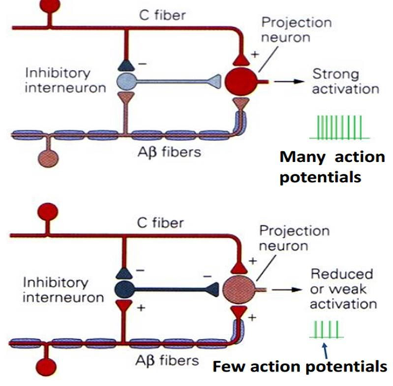
Gate of the pain theory
The gate theory explains the pain relief by:
Skin rubbing, Shaking the painful part, Transcutaneous Electrical Nerve Stimulation (TENS), Acupuncture
All are supposed to stimulate mechanoreceptors that activate neurons of dorsal column, the collaterals relieve pain.
Explanation:
Projection neuron receives input from both C-fibers and Aβ fibers.
Impulses coming along type C pain fibers cause the release of substance P from these fibers and inhibits the inhibitory interneuron (open the gate).
While impulses coming along Aβ fibers tend to keep the gate closed by activating the inhibitory interneuron.
This theory implies that a non-painful stimulus can reduce transmission of a noxious stimulus.
28th Lecture ∣ The Physiology Team
Central Control Trigger:
Specialised nerve impulses arise in the brain itself and travel down the spinal cord to influence the gate.
It can send both inhibitory and excitatory messages to the gate sensitising it to either C or A-β fibres.
The inhibitory neurons make a pain blocking agent called enkephalin.
Enkephalin is an opiate substance similar to heroin which can block substance P, the neurotransmitter from the C fibers, and this keeps the gate closed.

Slide 7
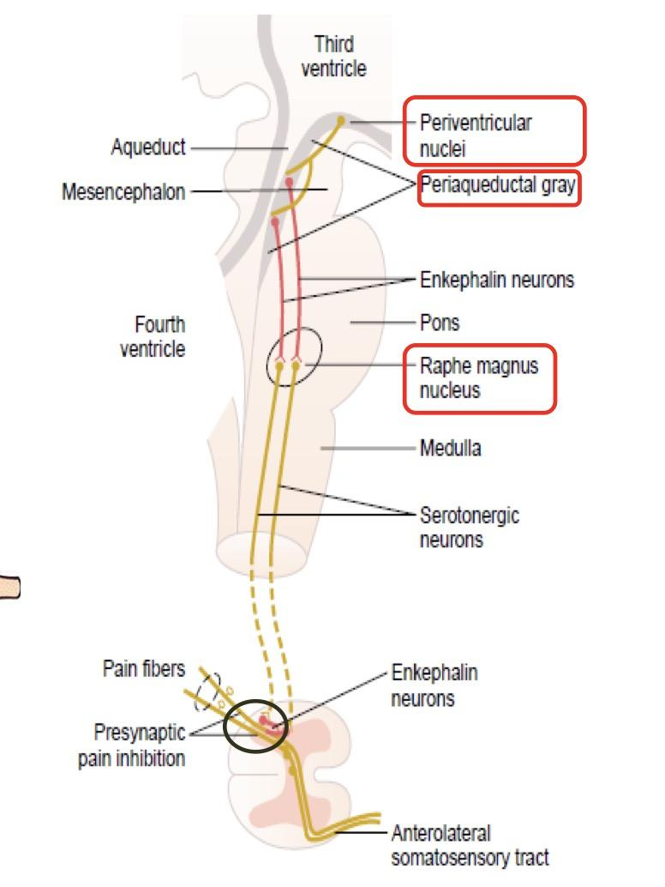
Supra spinal modulation
(Special pain control analgesic system)
This is a specific system that blocks pain transmission in CNS.
Its major constituents are:
1 | The periventricular and periaqueductal gray areas | of the mesencephalon and upper pons surround portions of the third and fourth ventricles and the aqueduct of Sylvius
2 | Raphe magnus nucleus: | a thin midline nucleus located in the lower pons and upper medulla
3 | Pain inhibitory complex: | In ​dorsal horn of SC​. - It consists of: multiple short enkephalinergic neurons that terminate on central endings of pain conducting afferent fibers. ● When stimulated the release enkephalin cause pre & postsynaptic inhibition ​of pain transmission. ● It prevents the release of substance P from pain nerve endings.
28th Lecture ∣ The Physiology Team
Analgesia occurs as follows:
Periventricular nucleus projects to PAG( periaqueductal gray matter)
PAG projects neurons containing aspartate & glutamate that stimulate raphe magnus nucleus (RMN)
RMN projects serotonergic neurons, this in addition to noradrenergic neurons project from locus coeruleus in medulla to dorsal horn.
They block pain signals by activating PIC( pain inhibitory complex)

Slide 8
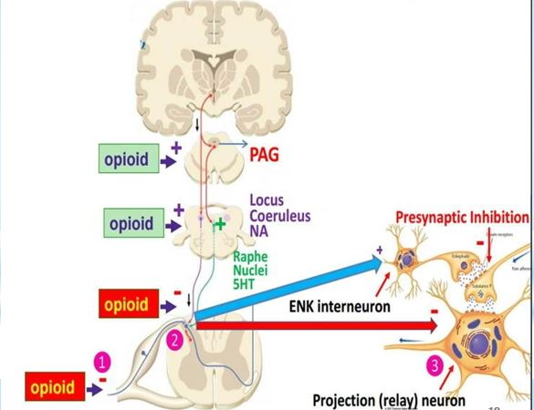
Opioid Peptides and Pain Modulation
Opioid peptides are morphine-like substances present in body.
They are natural analgesic substances that act by binding to opiate receptors in analgesic system and dorsal horn of SC on central ending of pain conducting pain fibers.
Site of release of opioid peptides:
Endorphin: Are found in PAG where
they inhibit GABAnergic interneurons
that normally suppress the
anti-nociceptor neurons
تلخبطتوا ؟ ببساطة احنا نثبط عمل الجابا
اللي كانت تسوي تثبيط في
Anti -nociptor
Encephalin: It is used by interneurons
in lamina II responsible for inhibiting
the nocioceptor-specific spinothalamic
neurons
Dynorphin: In hypothalamus, PAG, reticular formation, and dorsal horn.
Endogenous morphine: In terminals forming synapses with neuron having μ-opioid receptors in pain modulating pathways.
Mechanism of actions of Opioid peptides on pain transmission
They exerts their analgesic effects by acting at various sites in peripheral & CNS
28th Lecture ∣ The Physiology Team
Direct effect | Indirect effect
Inhibiting discharge of nociceptor neurons | Activating the descending inhibitory pathway be exciting PAG neurons
Inhibiting release of substance P from central terminal of nociceptor neurons | Activating neurons in the brain stem which release NE​ and serotonin which suppress pain transmission directly or indirectly via activation of enkephalinergic containing inhibitory interneurons
Cause inhibition of dorsal horn spinothalamic neuron. Via K channel causing hyperpolarization.

Slide 9
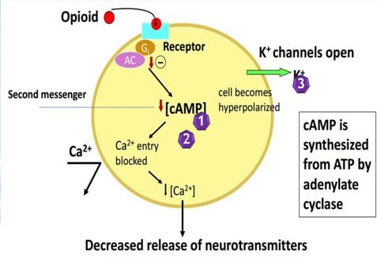
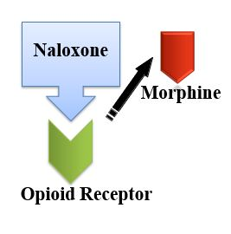
Opioid Peptides and Pain Modulation
Cellular actions of Opioid peptides
Reduction of cAMP (second messenger) synthesis by inhibiting Adenyl cyclase
Inhibition of transmitter release by inhibiting opening of Ca⁺⁺ channels
Hyperpolarization by facilitating opening of voltage gated K⁺ channels
Opioid Antagonist: Naloxone
Used to reverse opioid Overdose
Displaces receptor-bound opioids
Good for overcoming respiratory and
CV depression
هو بكل بساطة یتنافس مع الاوبیودز زي المورفین على نفس الریسبتور، فیقل تأثیر المورفین و الاوبیودز بشكل عام.
28th Lecture ∣ The Physiology Team

Slide 10
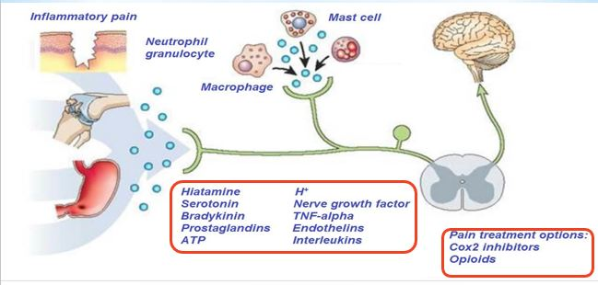
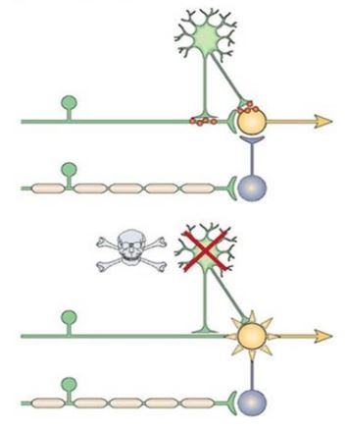
Pain Facilitation
Pain Facilitation: Peripheral Sensitization
28th Lecture ∣ The Physiology Team
Inflammatory mediators can directly activate nociceptors or cause their sensitization (decrease threshold)
Pain Facilitation: Dis-inhibition
Pain transmission is controlled by inhibitory interneurons
Loss of these inhibitory interneurons after excessive release of glutamate results in increased excitability of projection neurons (second order neurons of spinothalamic tracts) and thus enhanced pain sensation

Slide 11
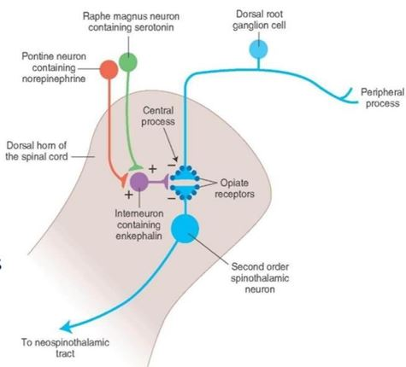
Neurotransmitters for Pain Modulation
Serotonin
Noradrenaline
Encephalin
•The serotonergic and noradrenergic neurons are crucial in the supraspinal modulation
•Destroying these neurons with neurotoxins blocks the their analgesic actions
28th Lecture ∣ The Physiology Team
mechanism of pain relief
Block production of inflammatory mediators .e.g. Aspirin & nonsteroidal anti-inflammatories.They block prostaglandins.
Exogenously administration of opioid like drugs.
Sympathectomy can be useful.
Electrical stimulation of the dorsal column.
Selective activation of large diameter afferent fibers by transcutaneous electrical nerve stimulation.
Stimulation of brainstem sites or administration of drugs which can modify serotoninergic or adrenergic neurons e.g. antidepressants

Slide 12
Questions
1. A 10-year-old boy cuts his finger with a pocketknife and immediately applies pressure to the damaged area with his other hand to partially alleviate the pain. Inhibition of pain signals by tactile stimulation of the skin is mediated by which type of afferent neurons from mechanoreceptors?
A) α-type A. B) β-type A. C) δ-type A. D) Type C
2. Stimulation of which brain area can modulate the sensation of pain?
A) Superior olivary complex. B) Locus ceruleus
C) Periaqueductal gray area. D) Amygdala
3.Which of the following is a group of neurons in the pain suppression pathway that uses enkephalin as a neurotransmitter? A) Postcentral gyrus B) Nucleus raphe magnus
C) Periaqueductal gray area D) Type AB sensory fibers
4. Which of the following conditions can open the gate which means the pain pathway will not be inhibited?
A)Focusing on the pain. B) Rest C) Medications D) Positive emotions
28th Lecture ∣ The Physiology Team
1)B 2)C 3)C 4)A

