Slide 1
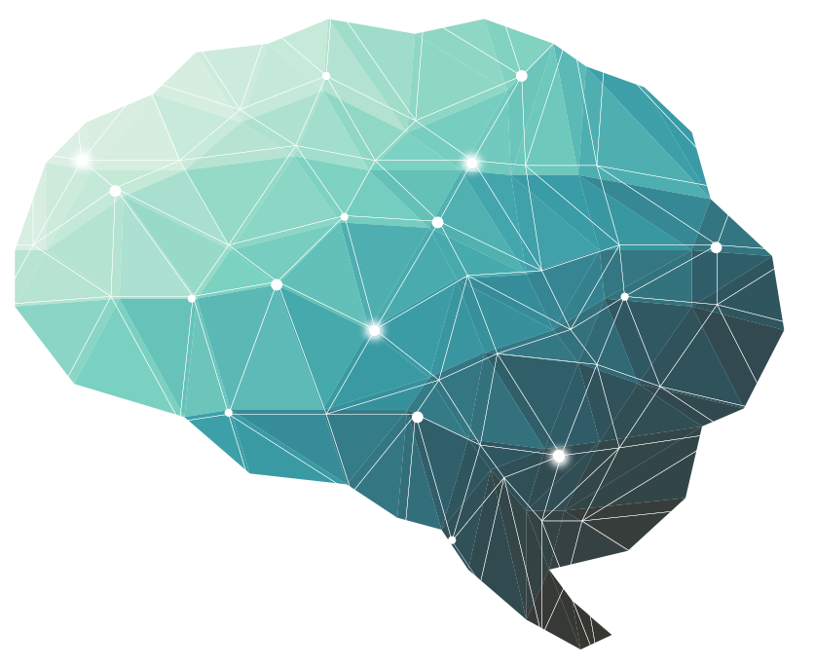
Epilepsy
Lecture 30 ∣ The Physiology Team
Objectives:
Define Epilepsy
Etiopathology of Epilepsy
Types of Epilepsy
Role of Genetic in Epilepsy
Clinical Features
Role of Electrophysiological tests in the diagnosis of Epilepsy
Done by :
Team leader: Rahaf AlShammari, Fatima Balsharf, Abdulelah AlDossari, Ali AlAmmari.
Special thanks for Saif AlMeshari
Colour index:
Important
Numbers
Extra
وَأَن لَّيْسَ لِلْإِنسَانِ إِلَّا مَا سَعَىٰ

Slide 2
Definition of seizure and Epilepsy
Seizures
Clinical manifestation of synchronised electrical discharges of neurons.
Seizures are symptoms of a disturbance in brain function, which can be due to epilepsy or other causes.
A seizure is a sudden surge in electrical activity in the brain that causes an alteration in sensation, behavior, or consciousness.
Epilepsy
Present when 2 or more unprovoked seizures occur at an interval greater than 24 hours apart.
Sudden recurrent episodes of sensory disturbance.
Loss of consciousness, or convulsions.
Associated with abnormal electrical activity in the brain.
Abnormal, excessive electrical discharge of a group of neurons within the brain.
When a person has recurrent (2 or more), unprovoked seizures → “ epileptic “.
Hence seizures can be a symptom of epilepsy .
Provoked seizures Seizures induced by somatic disorders originating outside the brain. E.g. fever, infection, syncope, head trauma, hypoxia, toxins, cardiac arrhythmias.
Classification of seizure
Partial or focal seizures
Generalized seizures
Simple partial seizures
“Jacksonian seizures”
Awareness not impaired
Absence (most common)
“Petit Mal epileptic seizure”
Typical
Atypical
Complex partial seizures
Awareness impaired/lost
Tonic-clonic
“Grand Mal epileptic seizure”
Parietal seizures secondarily generalizing
Myoclonic
Clonic
Jerky movement
Atonic
Hypotonic - flaccid
Tonic
muscle tone

Slide 3
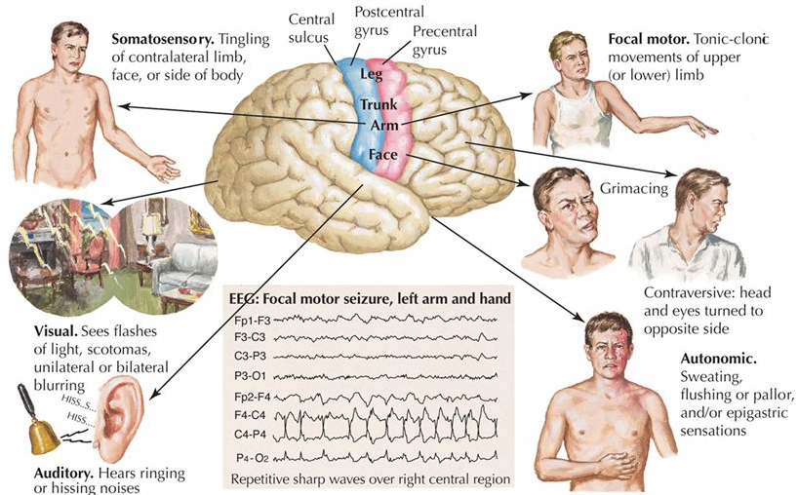
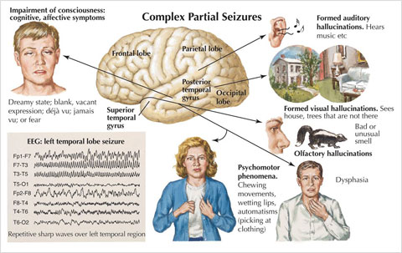
Partial or focal seizures
Onset (start) is limited to part of the cerebral hemisphere
Simple partial seizures
“Jacksonian seizures”
Awareness not impaired
manifest motor, somatosensory,
and psychomotor symptoms without
impairment of consciousness
Partial psychomotor (temporal lobe) seizure
Epileptic seizures which originate in the temporal lobe of the brain.
The seizures involve sensory changes, for example smelling an unusual odour that is not there, and disturbance of memory.”amnesia”
Visual , auditory , olfactory or visceral hallucinations, déjà vu (over familiarity)
The most common cause is mesial temporal sclerosis. (Sclerosis of the hippocampus)
Jacksonian epilepsy
Focal motor seizures begin in motor areas of cerebral cortex, usually begins with
twitching of the thumb or finger, toe or the angle of the mouth. “Ascend marching”
Complex partial seizures
Awareness impaired/lost
manifest impairment of consciousness with or without simple partial symptoms (twitching of the thumb and fingers “”)

Slide 4
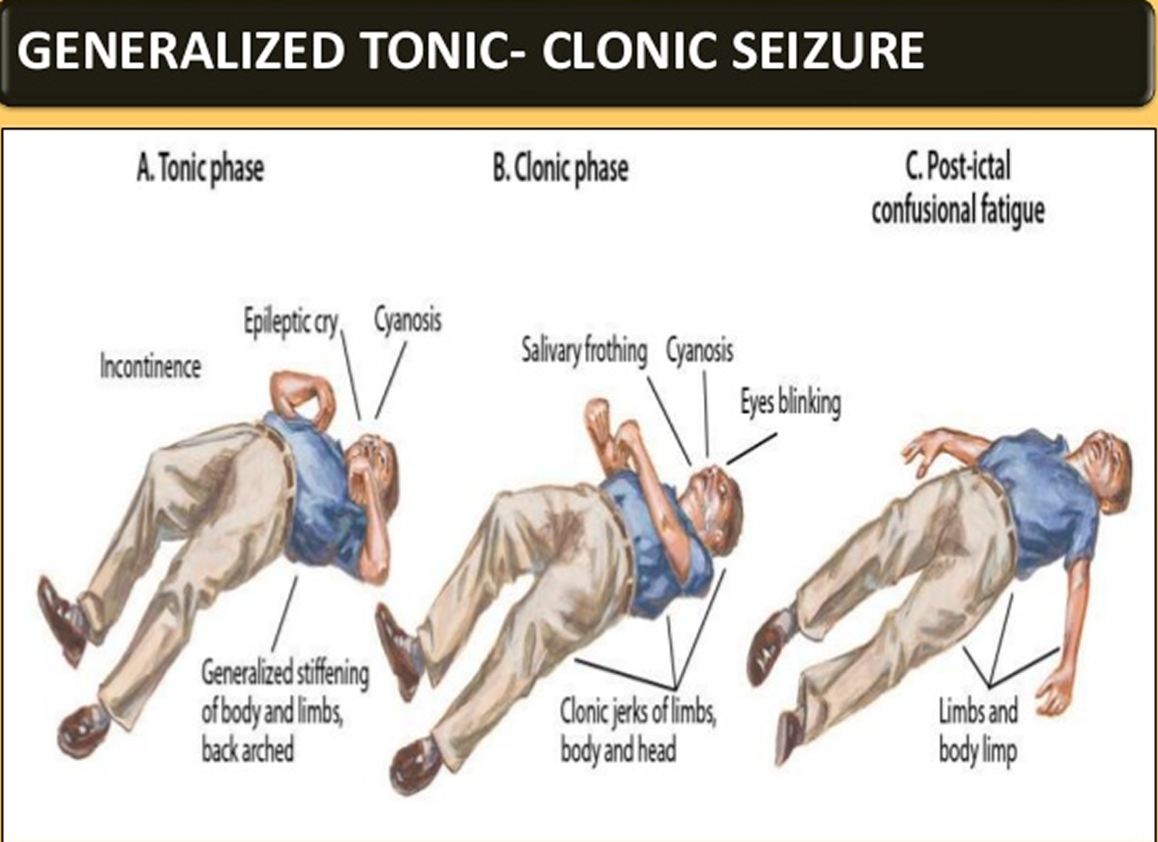
Generalized seizures
Involve the cerebral cortex diffusely ( whole of it ) from the beginning.
Manifest a loss of consciousness
Convulsive or non-convulsive.
The onset of a seizures: Small group of abnormal neurons undergo:
Prolonged depolarizations
Rapid firing of repeated action potentials
Spread to adjacent neurons or neurons with which they are connected into the process.
Simple partial seizures can progress to complex partial seizures, and complex partial seizures can secondarily become generalized. (if invade the thalamus).
Seizures affect all ages. Most cases of epilepsy are identified in childhood, and several seizure types are particular to children.
Generalized epilepsy is abnormal cerebral activity an all the cortex and usually there’s involvement of the thalamus.
A clinical seizure occurs when the electrical discharges of a large number of cells become abnormally linked together, creating a storm of electrical activity in the brain.
Seizures may then spread to involve adjacent areas of the brain or through established anatomic pathways to other distant areas.

Slide 5
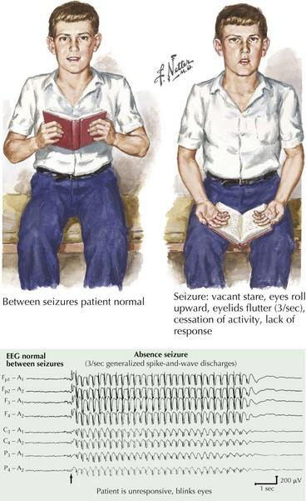
Generalized seizures
Very important
Tonic-clonic
“Grand Mal epileptic seizure”
convulsive
Very important Q: what are the phases of grand mal seizure?
+/- Aura (abnormal sensation sensed by the patient himself)
(peculiar sensation or dizziness aware sign; then sudden onset of seizure with loss of consciousness).
Tonic phase
Rigid muscle contraction in which clenched jaw and hands; eyes open with pupils dilated; lasts 30 to 60 seconds. will cause cyanosis
Clonic phase
Rhythmic, jerky contraction and relaxation of all muscles in with incontinence and frothing at the lips; may bite tongue or cheek, lasts several minutes.
Postictal state
Sleeping or dazed for up to several hours.
Absence
“Petit Mal epileptic seizure”
Non-convulsive
Loss of contact with environment for 5 to 30 seconds.
Appears to be day dreaming or may roll eyes, nod head, move hands, or smack lips.
Resumes activity and is not aware of seizure.

Slide 6
Clinical manifestations of a seizure
The clinical manifestations of a seizure reflect the area of the brain from which the seizure begins (i.e., seizure focus) and the spread of the electrical discharge.
Clinical manifestations accompanying a seizure are numerous and varied, including:
Generally
indescribable bodily sensations
"pins and needles" sensations
smells or sounds
fear or depression
hallucinations
momentary jerks or head nods
staring with loss of awareness
Convulsions → i.e., involuntary muscle contractions lasting seconds to minutes.
The manifestation depends on the site of seizure.
Aetiology of seizures
Epileptic
▪ Idiopathic (70-80%) ▪ Cerebral tumor ▪ Neurodegenerative disorders ▪ Secondary to: 1. Cerebral damage, e.g. congenital infections, intraventricular hemorrhage 2. Cerebral dysgenesis/malformation, e.g. hydrocephalus
Non-Epileptic
▪ Febrile convulsions ▪ Metabolic: -Hypoglycemia -HypoCa, HypoMg, HyperNa, HypoNa ▪ Head trauma ▪ Meningitis ▪ Encephalitis ▪ Poisons/toxins
Electroencephalogram ( EEG)
EEG is helpful for establishing the diagnosis, classifying seizures correctly, and making therapeutic decisions.
In combination with appropriate clinical findings, epileptiform EEG patterns termed spikes or sharp waves strongly support a diagnosis of epilepsy
Focal epileptiform discharges indicate focal epilepsy
Generalized epileptiform activity indicates a generalized epilepsy.
Most EEGs are obtained between seizures, and interictal abnormalities alone can never prove or eliminate a diagnosis of epilepsy.
Epilepsy can be definitely established only by recording a characteristic ictal discharge during a clinical attack. ❖ 3Hz spike-and-wave activity occurs specifically in petit mal.
(If you find 3Hz wave -> it is typical absent; there’s no 3Hz wave -> Atypical absent)
See the pictures in the next page.

Slide 7
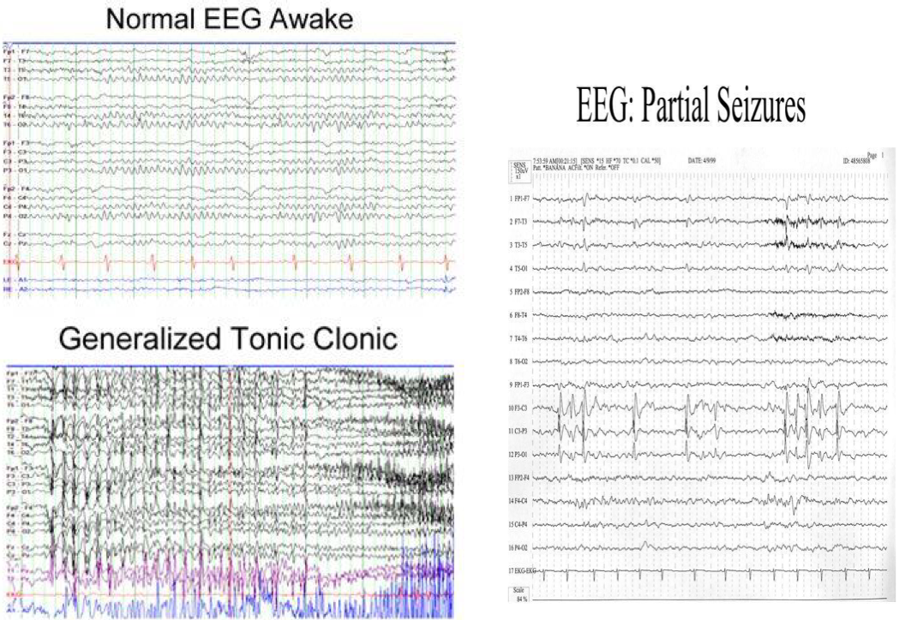
3 Hz wave
The most important thing that you have to do EEG during the attack.
Pathophysiology of Epilepsy
(at molecular level)
Cortical cell membrane level ➢ Instability of the nerve cell membrane → Polarization abnormalities (excessive polarization, hypopolarization, or lapses in repolarization), allowing the cell to be more susceptible to activation → Hypersensitive neurons with lowered thresholds for firing and firing excessively, related to →
Very important
Excess of Excitatory (Acetylcholine -or Glutamate- related activity)
Decreased inhibitory (GABA –related activity)
Together and/or (2) above → leading to instability of cell membrane & lowered threshold for excitation → excessive polarization, hypopolarization allowing the cell to be more susceptible to activation spontaneously or by any ionic imbalances in the immediate chemical environment of neurons.
Genetic & Epilepsy
Some types linked to genes (run in families).
Genetic abnormalities ›››› increasing a person's susceptibility to seizures that are triggered by an environmental factor.
Several types of epilepsy have now been linked to defective genes for ion channels, the "gates" that control the flow of ions in to and out of cells and that regulate neuron signaling.
Example:
Lafora's disease, has been linked to a gene that helps to break down carbohydrates.
Benign neonatal convulsions -> 20q and 8q
Juvenile myoclonic epilepsy -> 6p
Progressive myoclonic epilepsy -> 21q22.3

Slide 8
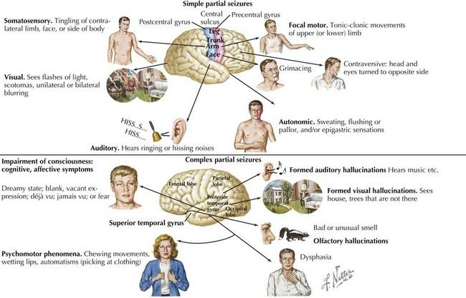
Important points you should focus on:
Test yourself
What are the cause of seizures?
What is epilepsy?
Is it a disease or symptom?
What are the classification of epilepsy?
What are the phases of grand mal seizures?
Remember not all the seizures are motor

Slide 9
Questions
MCQs
SAQ
1.sclerosis of the hippocampus cause which one of the following condition?
Temporal lobe seizures
Jacksonian epilepsy
Complex seizures
Grand mal epileptic seizures
2.which one of the following grand-mal phases is characterized with jerk contraction and all muscle relaxation?
Tonic phase
Clonic phase
Absence seizure
Non convulsive
3.which one of the following is a clinical manifestation of seizures?
Pins and needle sensation
Hallucination
Convulsion
All above
4.which one of the following types of seizures is associated with spike and dome EEG pattern during seizures activity?
Grand mal seizures
Temporal seizures
Jacksonian seizures
Petit mal seizures
5.Epilepsy is characterized by.
Increase excitatory activity of the neuron.
Decrease excitatory activity of the neuron
Increase inhibitory activity of the neuron
Increase the threshold
6.which epileptic condition involves a postictal depression period lasting from several minutes to perhaps as long as several hour?
Gal mal seizures
7.Classifi seizures.
Partial seizures
Generalized seizures
8.Write 3 non-epileptic etiology of seizures
Meningitis
Hypoglycemia
Head trauma
9.Explain how epilepsy happens at molecular level.
Increase excitatory activity of the neuron
and/or decrease inhibition which lead to lowering threshold and that lead to the cell more susceptible to activation by any ion imbalance.
A
B
D
D
A

Slide 10
دَقّاتُ قَلبِ المَرءِ قائِلَةٌ لَهُ إِنَّ الحَياةَ دَقائِقٌ وَثَواني فَاِرفَع لِنَفسِكَ بَعدَ مَوتِكَ ذِكرَها فَالذِكرُ لِلإِنسانِ عُمرٌ ثاني
أعضاء فريق علم وظائف الأعضاء لمقرر الجهاز العصبي
تحية طيبة لكم ،،، من النبل أن نخبر عن إحسانكم وتفانيكم بإخراج هذا العمل بدءًا من الإجازة الصيفية حتى نهاية هذا المقرر.
يسر الله خطاكم، ورفع قدركم وكتب أجركم في الدنيا والآخرة ❤ ولا ننسى من شكرنا القادة الأكاديميين لحرصهم على رفع جودة العمل فجزاكم الله عنا خير الجزاء
كونوا بخير دائماً ،،، القادة
عبدالإله الدوسري - علي العماري - رهف الشمري - فاطمة بالشرف
خلال فترة الإجازة الصيفية
رناد السويلمي، عبدالله الزيد، إسراء النزاوي، هيفاء العيسى
شهد الزهراني، ريم القرني، رهف الشنيبر، محمد الحسن، هشام الشايع
فهد الفايز، فيصل الطحان، خالد المطيري، أنس السيف، عبدالله السرجاني، عبدالعزيز الضرغام
عبدالعزيز الدخيل، فيصل السيف، عبدالجبار اليماني، زياد الخنيزان، صالح المعيقل، سيف المشاري، عبدالمجيد الوردي، محمد القحطاني، يزيد الخيال.
خلال فترة الدراسة
ابتسام المطيري ، مها العَمري، ريناد المقرن، الفهدة السليم، غادة الحيدري، هديل المكينزي، رهام الحلبي، رناد السويلمي ، العنود العيسى، عهد القرين، أروى الجهني، عائشة الصباغ، العنود المنصور، معاذ عبدالغني. ، عبدالله الزيد ، روان الحربي
أفنان المصطفى، بلقيس الراجحي، دانة القاضي، مجد البراك، نورة القاضي، رهف الشنيبر، ريم القرني، ريناد الغريبي، سارة السلطان، شهد الطياش، شهد الزهراني، وجدان البدراني، هشام الشايع.
فيصل الطحان، خالد المطيري، أنس السيف، سيف المشاري، تركي الشمري، عبدالعزيز الضرغام، ماجد الجهني، رشيد البلاع، محمد الحسن، عبدالمجيد الوردي، فايز الدرسوني.
عبدالعزيز الدخيل، عبدالجبار اليماني، زياد الخنيزان، صالح المعيقل، سيف المشاري، محمد القحطاني، يزيد الخيال.
شكر خاص إلى: يزيد الحربي❤️

