Slide 1
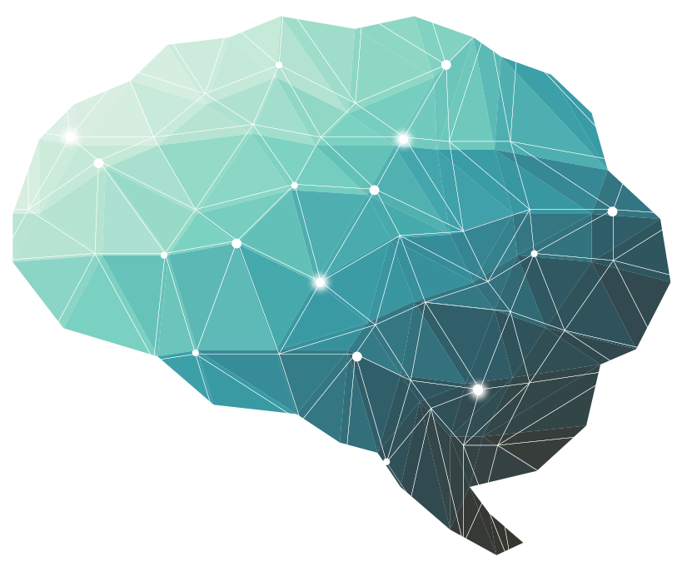
3rd Lecture ∣ The Physiology Team
Spinal Cord Functions
and Spinal Reflexes
Objectives:
Appreciate the two-way traffic along the spinal cord.
Describe the organization of the spinal cord for motor functions (AHC, Interneurons & neuronal pool).
Describe the physiological role of the spinal cord in spinal reflexes & reflex arc components.
Classify reflexes into superficial & deep, monosynaptic & polysynaptic.
Describe withdrawal reflex and crossed extensor reflex.
Recognize the general properties of spinal cord reflexes.
Done by :
Team leader: Rahaf AlShammari, Fatima Balsharf, Abdulelah AlDossari, Ali AlAmmari.
Team members: Mohammed AlHasan, Hisham AlShaya, Noura AlKadi, Rahaf AlShunaiber, Reem AlQarni, Rinad AlGhurabi, Sara AlSultan, Shahad AlTayyash, Shahad AlZahrani, Wejdan AlBadrani
Colour index:
Important
Numbers
Extra
وَأَن لَّيْسَ لِلْإِنسَانِ إِلَّا مَا سَعَىٰ

Slide 2
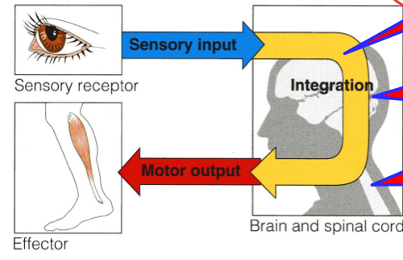
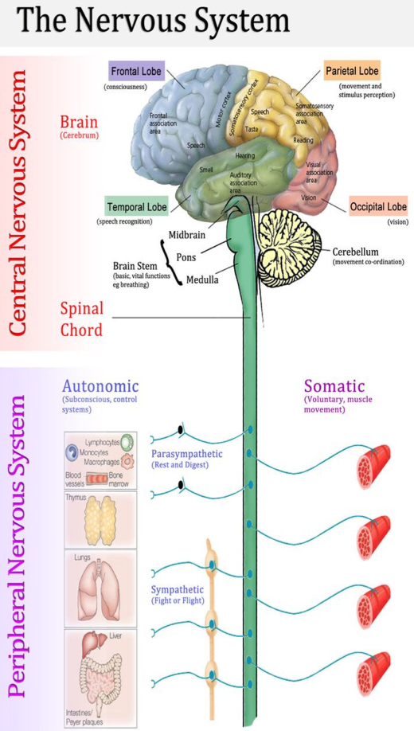
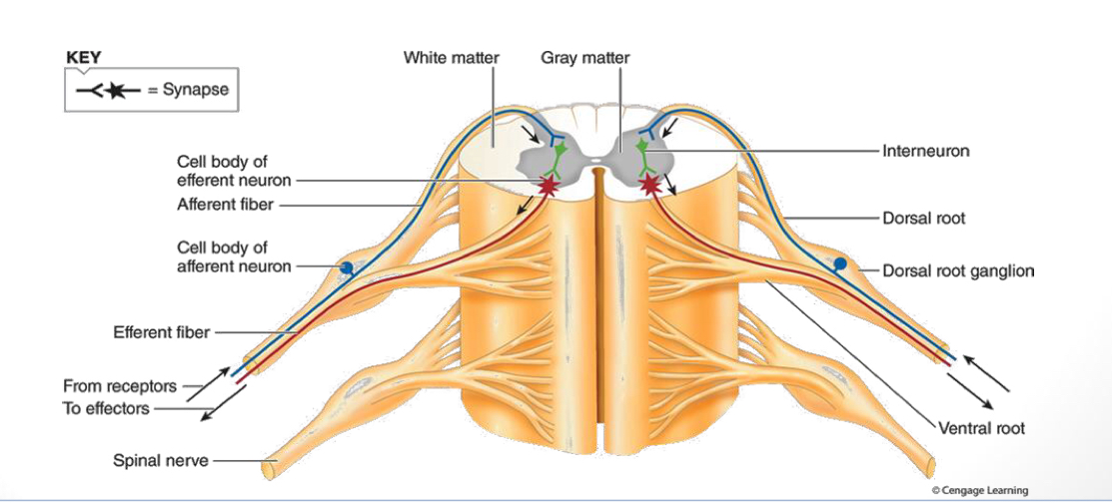
How nervous system functions?
Higher brain or cortical level
Lower brain or subcortical level
Spinal cord level
Collection of sensory input
Central integration
Motor output
Higher brain or cortical level | Control all lower centers, thought processes, memory
Lower brain or subcortical level | Subconscious activities of the body are controlled in the lower areas of the Brain; the medulla, pons, mesencephalon, hypothalamus, thalamus, cerebellum, and basal ganglia.
Spinal cord level | walking reflexes withdrawal reflexes anti gravity reflexes Reflexes that control of blood vessels gastrointestinal, urinary/defecation.
All are conscious
subconscious
All are reflexes without thinking
The Spinal Cord
The spinal cord has 31 pairs of spinal nerves Each spinal nerve has has ventral & dorsal roots :
The dorsal (posterior) root contains afferent (sensory) nerves coming from receptors.
The cell body of these neurons is located in dorsal (posterior) root ganglion ( DRG).
The ventral (anterior) root carries efferent (motor) fibers.
The cell-body of these motor fibres is located in the ventral (anterior) horn of the spinal cord.

Slide 3
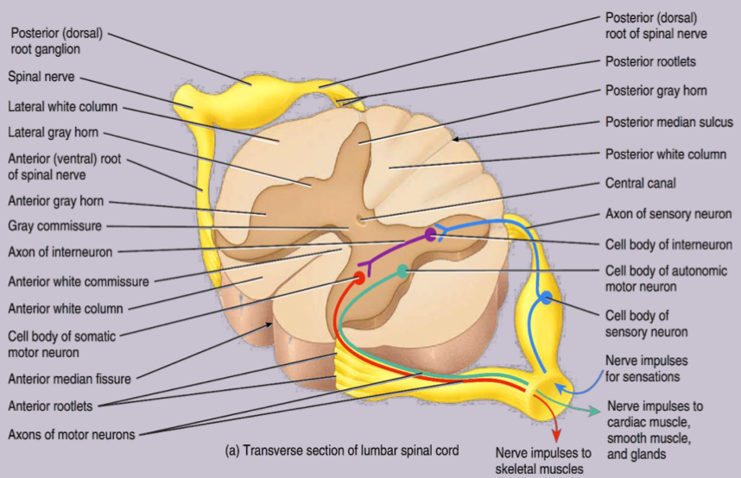
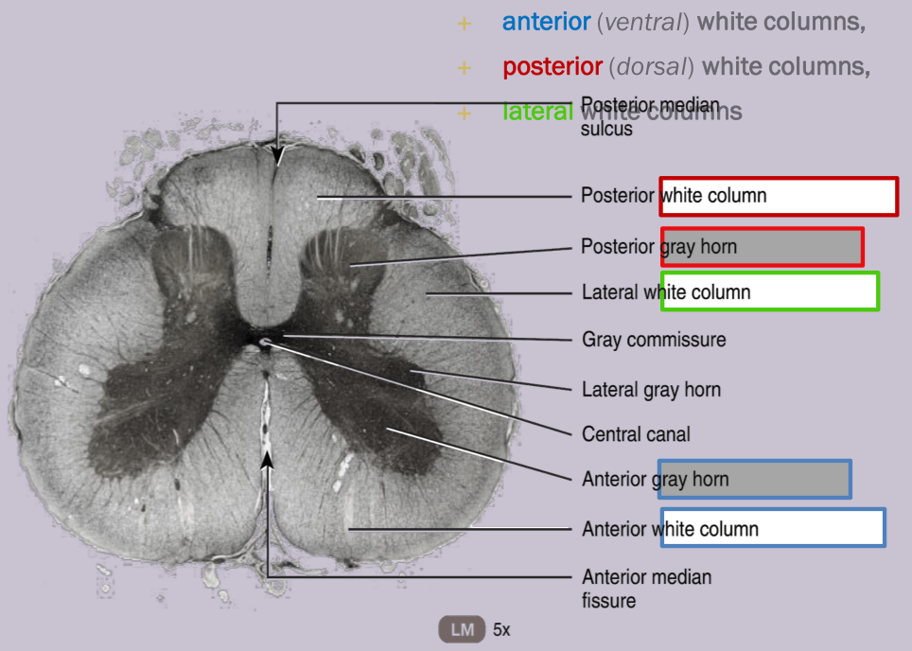
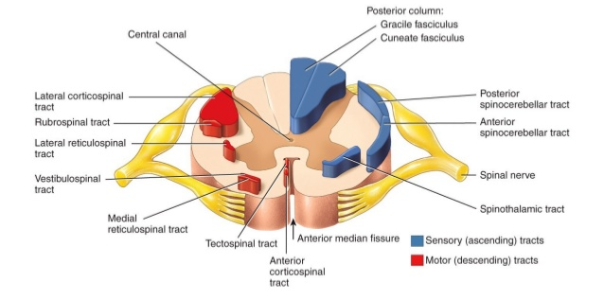
Grey matter
White matter
In the grey matter of the spinal cord and brain, clusters of neuronal cell bodies from functional groups called nuclei
Each column in turn contains distinct bundles of axons having a common origin or destination and carrying similar information.
Sensory nuclei receive input from receptors via sensory neurons
These bundles, which may extend long distances up or down the spinal cord, are called tracts.
Recall that tracts are bundles of axons in the CNS, whereas nerves are bundles of axons in the PNS.
Motor nuclei provide output to effector tissue via motor neurons
The posterior grey horn contains axons of sensory neurons and cell bodies of interneurons.
The lateral grey horn contains cell bodies of autonomic motor neurons.
The anterior grey horn contains cell bodies of somatic motor neurons.
Sensory (Ascending) Tracts consists of axons that conduct nerve impulses toward the brain.
Tracts consisting of axons that carry nerve impulses from the brain are called Motor (Descending) Tracts.
Sensory and motor tracts of the spinal cord are continuous with sensory and motor tracts in the brain.
The white matter of the spinal cord contains sensory and motor tracts.
Motor tracts are the highway for conduction of nerve impulses from the brain toward effector tissue.
Sensory tracts are the highways for conduction of sensory nerve impulses toward the brain.
Spinal nerves and the nerves that branch from the spinal cord connect the CNS to the sensory receptors, muscles, and glands in all parts of the body.

Slide 4
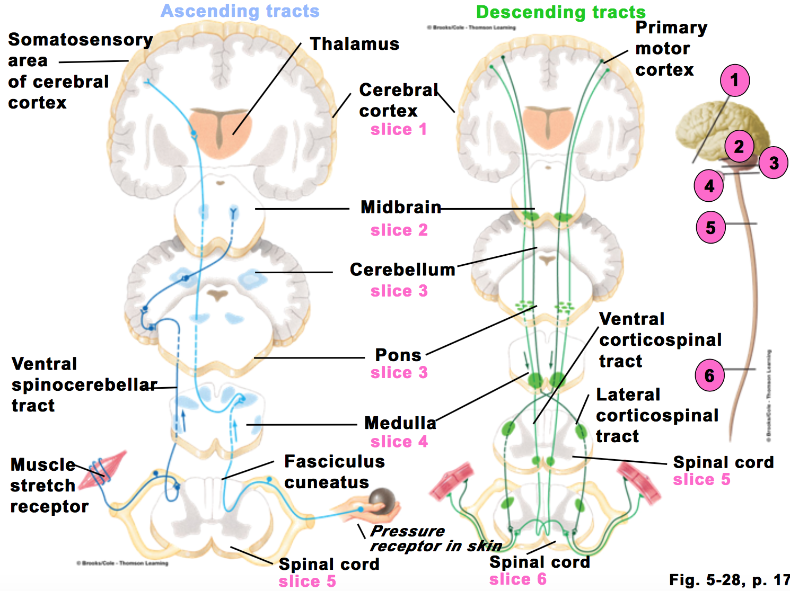
Functions of the Spinal Cord
Gateway and conduction pathway for all tracts.
The two-way traffic along the spinal cord
Sensory signals from receptors enter the cord through the sensory (posterior) roots, then every sensory signal travels to two separate destinations:
One branch of the sensory nerve terminates in the gray matter of the cord and elicits local segmental cord reflexes
Another branch transmits signals to higher levels in the cord , or to the brain stem, or even to the cerebral cortex through spinal ascending sensory tracts as:
Dorsal Column Tracts ( Gracile & Cuneate )
Lateral & Anterior Spinothalamic Tract
Spinocerebellar Tracts
Motor signals & brain motor commands pass through descending motor tracts & then to spinal efferent motor nerves to skeletal muscles to execute motor functions.
2. Center of spinal cord reflexes (somatic & autonomic).
3. Gateway for pain control systems.
Touch, pressure, proprioception
Pain sensation
Subconscious
First gate for pain system

Slide 5
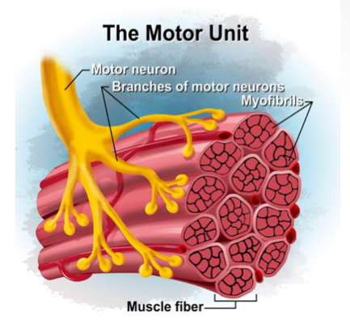
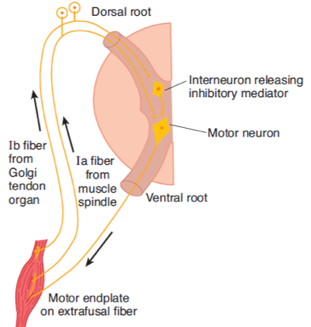
The Organization of The Spinal Cord for Motor Functions (anterior horn cells & interneurons & neuronal pools)
Located in each segment of the anterior horns of the cord gray matter, several thousand neurons that are 50 to 100 percent larger than others neurons .They give rise to the nerve fibers that leave the cord in the ventral roots and directly innervate the skeletal muscle fibers.
Alpha motor neurons
They give rise to large type A alpha (Aa) motor nerve fibers.
14 micrometers in diameter.
Innervate the large skeletal muscle fibers called extrafusal fibers.
Gamma motor neurons
Smaller gamma motor neurons, along with alpha motor neurons.
They transmit impulses through much smaller type A gamma motor nerve fibers. (Increase the sensitivity of the muscle spindle)
5 micrometer in diameter.
Go to special skeletal muscle fibers called intrafusal fibers.
Q-What is the motor unit?
Group of neurons and the muscles they supply.
Spinal Reflexes
What is a reflex?
Functional unit of CNS, rapid, predictable ,autonomic (involuntary) response to a stimulus that involve spinal neurons only.
example/pinprick causes withdrawal R
Stretch reflex is the pathways responsible for the stretch reflex and the inverse stretch reflex.

Slide 6
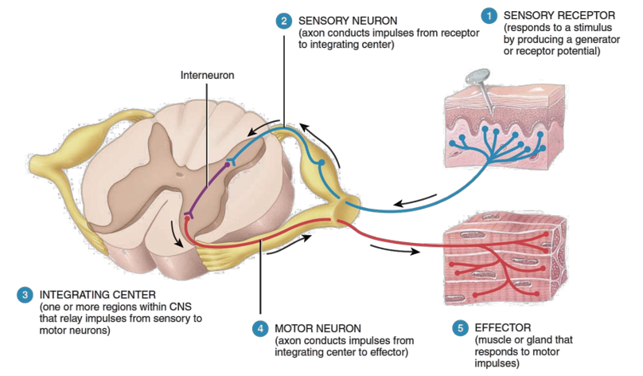
Components of The Reflex Arc
Reflex Arc is the pathway followed by nerve impulses that produce a reflex (Reflex Circuit)
A REFLEX ARC INCLUDES FIVE FUNCTIONAL COMPONENTS :
SENSORY RECEPTOR
SENSORY NEURON
INTEGRATING CENTER
MOTOR NEURON
EFFECTOR
SENSORY RECEPTOR |1|
SENSORY NEURON |2|
It responds to a specific stimulus - A change in the internal or external environment- by producing a graded potential called a generator (or receptor) potential.
The nerve impulses propagate from the sensory receptor along the axon of the sensory neuron to the axon terminals, which are located in the grey matter of the spinal cord or brain stem.
If the generator potential reaches the threshold level of depolarization, it will trigger one or more nerve impulses in the sensory neuron.
Relay neurons send nerve impulses to the area of the brain that allows conscious awareness that the reflex has occurred. Or it send to motor neuron or interneuron.

Slide 7
INTEGRATING CENTRE |3|
In the simplest type of reflex, the integrating centre is a single synapse between a sensory neuron and a motor neuron termed monosynaptic reflex ARC.
A reflex pathway having only one synapse in the CNS is termed a monosynaptic reflex arc.
More often, the integrating center consists of one or more interneurons which may relay impulses to other interneurons as well as to a motor neuron.
A polysynaptic reflex ARC involved more than two types of neurons and more than one CNS synapse.
One or more neurons grey matter within the spinal cord acts as an integrating center.
Interneurons & Interneuron Pool
Interneurons are present in the gray matter in the dorsal horns, the anterior horns, and the intermediate areas between them.
30 times as numerous as the anterior motor neurons, small and highly excitable, often exhibiting spontaneous activity.
Different types of neuronal circuits are found in the interneuron pool (parallel and reverberating circuits).
They are (excitatory or inhibitory).
Renshaw Cells
Small interneurons located in the anterior horns of the spinal cord, in close association with the motor neurons.
AHCs axon leaves the body of the neuron, sends collateral branches to adjacent Renshaw cells.
These are inhibitory cells that transmit inhibitory signals to the surrounding motor neurons BY Lateral inhibition.
This lateral inhibition helps to focus or sharpen the signals from each motor neuron.
Most important inhibitory interneurons.

Slide 8
Efferent Neuron
Impulses triggered by the integrating center propagate out of the CNS along a motor axon to the part of the body that will respond.
MOTOR NEURON |4| (Efferent Neurons)
- Anterior Horn Cells (Motor Neurons) of spinal cord supplying skeletal muscle:
Alpha motor neurons
large cells, with large myelinated fibres (axons) form 70% of ventral root supply extrafusal muscle fibres (2/3 Of Skeletal muscle fibers).
Gamma Motor Neurons
smaller cells-with thinner axons form 30%of ventral root-supply intrafusal muscle fibres (muscle spindles=1/3 Of skeletal muscle fibers).
EFFECTOR |5|
The part of the body that responds to the motor nerve impulse, such as a muscle is the effector.
Its action is called a reflex.
If the effector is skeletal muscle, the reflex is a somatic reflex. If the effector is smooth muscle, or a gland, the reflex is an autonomic (visceral) reflex.
Describe The General Properties of Reflexes and Their Neuronal Pools such as:
Convergence
Divergence
Irradiation
Recruitment
Reverberating Circuits
After-Discharge
Minimal Synaptic Delay
Central Delay
Reflex time

Slide 9
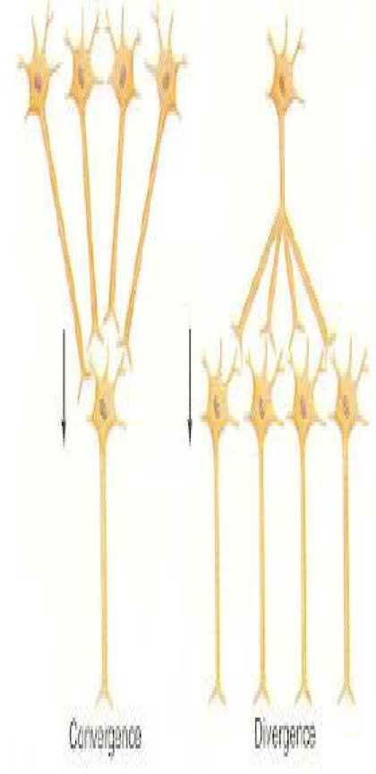
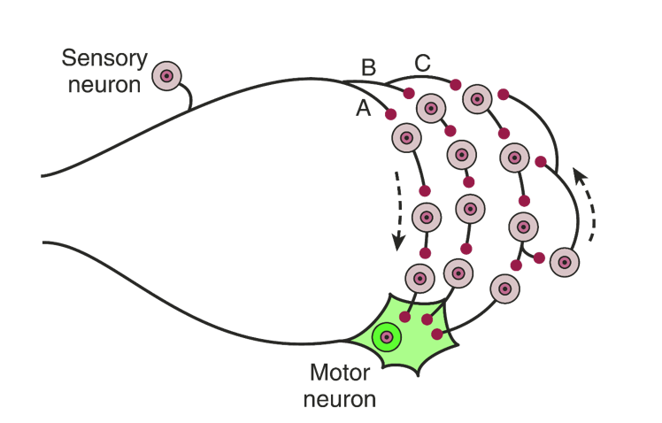
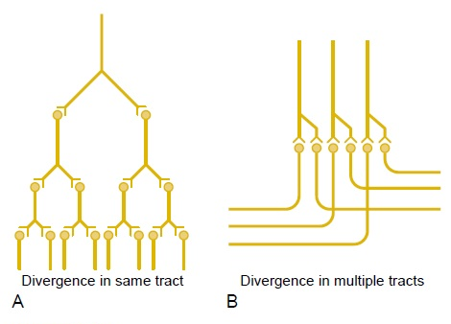
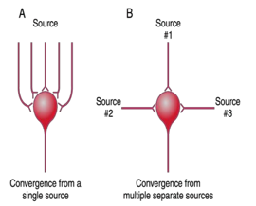
- Sensory afferent enter spinal cord via dorsal (posterior) root, as they enter the neuronal pool undergo:
Divergence
Help to spread a single stimulus to a wide area of the spinal cord (amplification of signal)
It is important for weak signals to excite far greater numbers of nerve fibers leaving the pool.
Convergence
Signals from multiple inputs unit to excite a single neuron.
Multiple action potentials converging on the neuron provide enough spatial summation to bring the neuron to the threshold required for discharge.
(multiple stimuli summate & collect together at the same time)
Sharpening of the signal / more powerful and focused.
Output from one neuron onto many
Divergence
Each postsynaptic neuron receives input from the same presynaptic neuron, but may react to it differently.
Convergence
In a divergent neural circuit, the axon of one neuron branches to send information to multiple target neurons.
Divergence
Divergent output allows the same signal to reach many different neurons.
Divergence within a pathway to cause amplification of the signal.
Divergence into multiple tracts to transmit the signal to separate areas.
Convergence
Convergence of multiple input fibers onto a single neuron.
Multiple input fibers from a single source.
Input fibers from multiple separate sources.

Slide 10
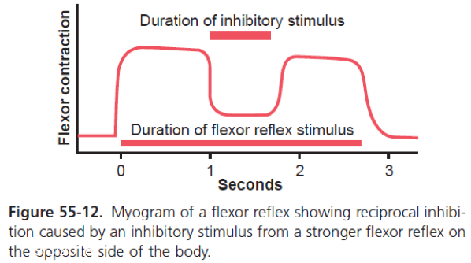
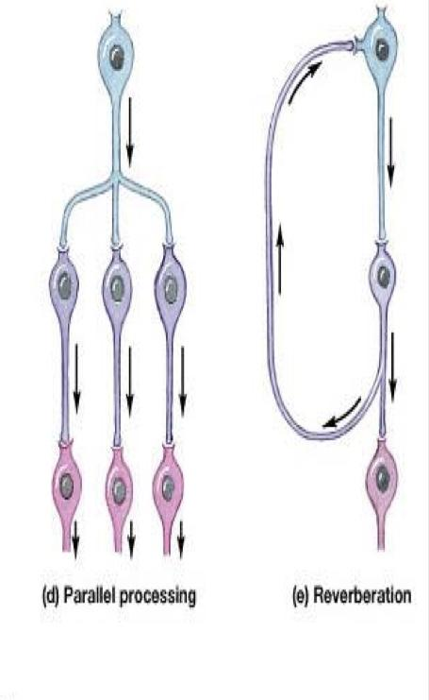
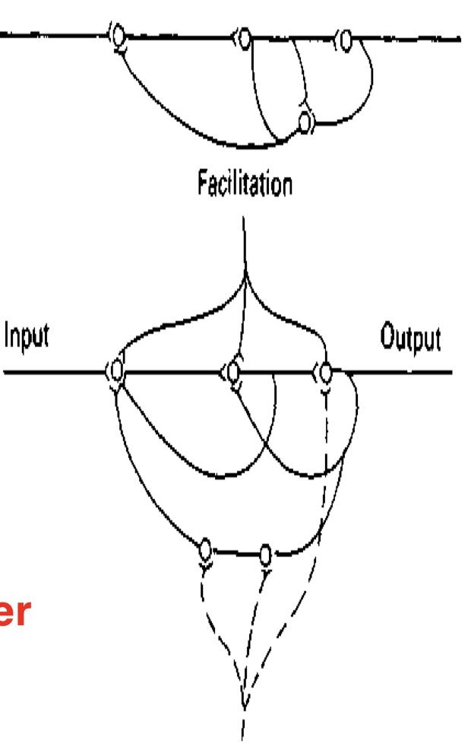
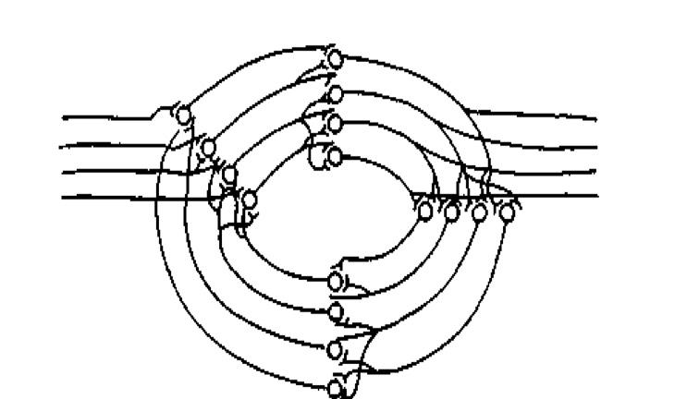
3. Reciprocal Inhibition Circuits
Stimulation of flexors muscle accompanied by inhibition of extensors through inhibitory interneurons , the neuronal circuit that causes this reciprocal relation is called reciprocal innervation.
Reflex contraction of an agonist muscle is accompanied by inhibition of the antagonist.
The input fiber directly excites the excitatory output pathway, but it stimulates an intermediate inhibitory neuron (neuron 2), which secretes a different type of transmitter substance to inhibit the second output pathway from the pool. (3)
Value/ preventing over activity in many parts of the spinal cord.
Reciprocal inhibition is required with the monosynaptic reflex.
E.g. stimulation of the biceps accompanied by inhibition of the triceps.
But it is polysynaptic reflex.
Neuronal Pool Circuits
Results in powerful and longer signal caused by reactivation of the input neuron.
1- Parallel
2- Reverberating
Parallel circuits //afferent and efferent are parallel to each other (input parallel to output)
The same direction

Slide 11
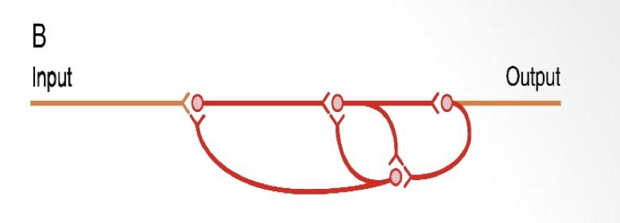
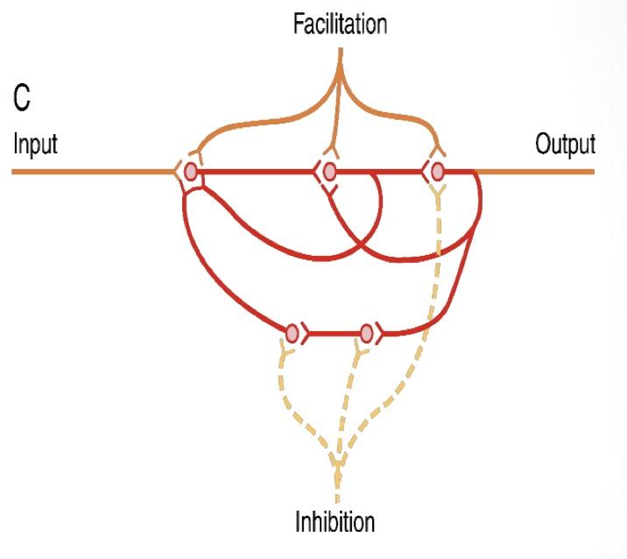
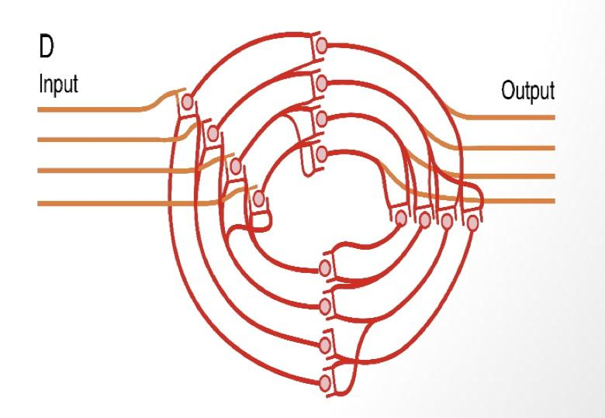
4. Reverberatory (Oscillatory) Circuit
The simplest reverberatory circuits involves only a single neuron.
The output neuron sends a collateral nerve fiber back to its own dendrites or soma to restimulate the input neuron itself & so the circuit may discharge repetitively for a long time called long term potentiation and causes signal prolongation (Allow prolonged discharge of the same motor neurons by a single stimulus).
A more complex circuits in which both facilitatory and inhibitory fibers involved on the reverberating circuit.
A facilitatory signal enhances the intensity and frequency of reverberation, whereas an inhibitory signal depresses or stops the reverberation.
Most reverberating pathways are constituted of many parallel fibers.
B shows a few additional neurons in the feedback circuit, which causes a longer delay between initial discharge and the feedback signal.
C shows a still more complex system in which both facilitatory and inhibitory fibers interact in the reverberating circuit.
A facilitatory signal enhances the intensity and frequency of reverberation.
An inhibitory signal depresses or stops the revelation
D shows that most reverberating pathways are constituted of many parallel fibers.
In such a system, the total reverberating signal can be either weak or strong, depending on how many parallel nerve fibers are momentarily involved in the reverberation.

Slide 12
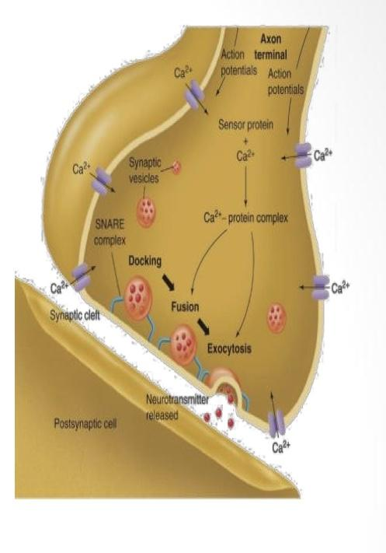
5. After-discharge
After stoppage of the stimulus, the output signals continue.
A prolonged maintained output discharge of AHCs called after discharge, lasting a few milliseconds or many minutes after the incoming signal is over.
After- discharge occurs due to the following:-
The already released neurotransmitters.
1- Synaptic After-discharge:
When excitatory synapses discharge on the surfaces of dendrites or soma of a neuron, a postsynaptic electrical potential (PSP) develops in the neuron and lasts for milliseconds.
It can continue to excite the neuron, causing it to transmit a series of repetitive discharges, this cause maintained reflex action & response continue for some time after cessation of stimulus)
2- Reverberating circuits:
Presence of reverberating circuit restimulate AHCs.
6. Synaptic Delay (Central Delay)
Is the time of reflex to pass through neurons of the spinal cord
The minimal period of time required for transmission of a neuronal signal from a presynaptic neuron to a postsynaptic neuron, is SYNAPTIC DELAY.
Equals 0.5 ms /synapse ( it is long in polysynaptic Reflex)
It is > 2 ms in the withdrawal R (polysynaptic Reflex)
Number of synapses in a reflex = central delay/0.5ms
For knee jerk it equals 0.6 msc = one synapse
Clinical use of reflex time :
Nerve conduction study.
7. Reaction (reflex) time
Reflex time = central delay + time spent in conduction of impulses along the afferent and efferent nerves.
The time between the application of the stimulus and the response is called the reaction time.
In humans, the reaction time for a stretch reflex such as the knee jerk is 19-24 ms.
The conduction velocities of the afferent and efferent fiber types are known and the distance from muscle to the spinal cord can be measured
This is responsible for most of the reaction time. .

Slide 13
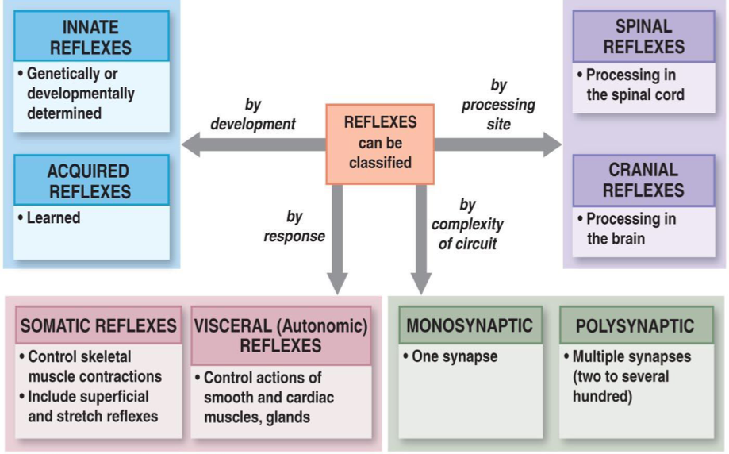
Classifications of Reflexes
Somatic reflexes integrated in spinal cord
Stretch
Flexor
Extensor
Rhythmic
Maintain muscle tone
Withdrawal
Standing/ posture/ stepping
Walking/ scratching
Autonomic (visceral) integrated in spinal cord
Vasomotor
Micturition/ defecation
Vascular tone
Bladder/Bowl

Slide 14
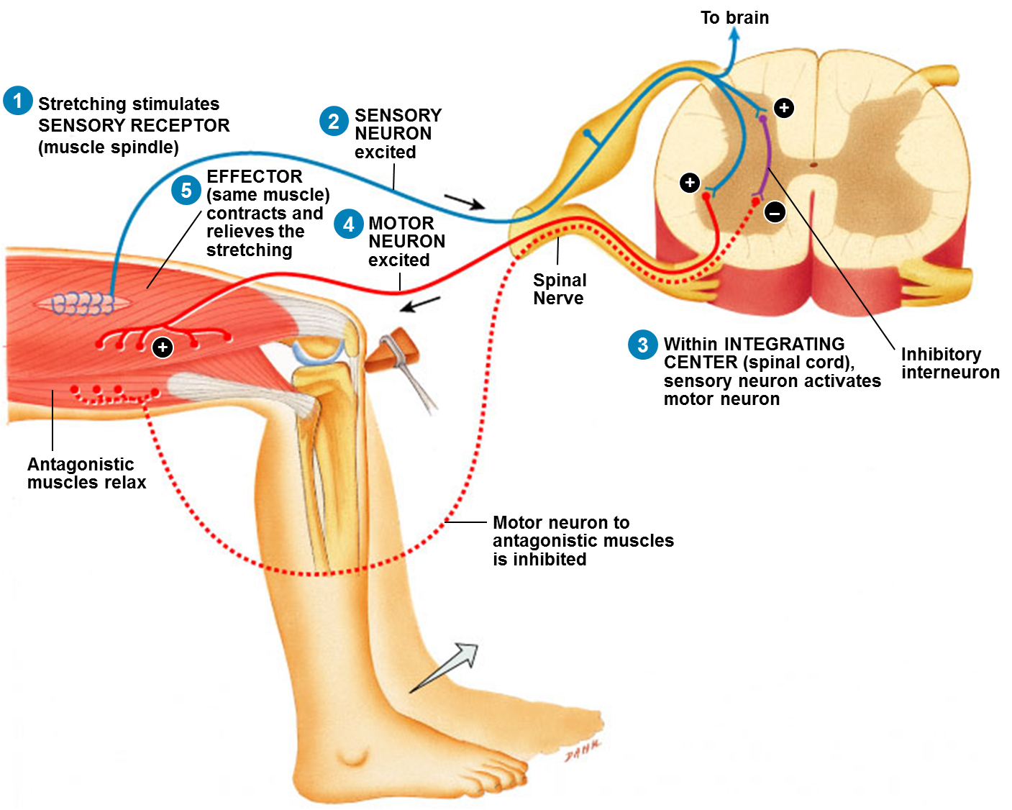
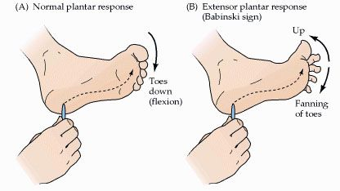
Types of Spinal Reflexes
-According to number of neurons:-
01
Monosynaptic
Sensory axon (afferent) synapse directly with anterior horn cell- (No interneuron )
Ex.Stretch reflex
02
Polysynaptic
Sensory axon (afferent)synapse with one or more interneuron.
Ex.Withdrawal, abdominal reflexes, visceral and plantar reflex.
Monosynaptic reflex
As Knee reflex
In the simplest type of reflex, the integrating center is a single synapse between a sensory neuron and a motor neuron.
When a reflex arc consists of only two neurons in an animal (one sensory and one motor neuron) it is defined as monosynaptic.
Types of Reflexes
-According to site of the receptor:-
(A) Deep Reflexes:- by stimulation of receptors deep in muscle and tendons.
Stretch Reflexes (Tendon jerks) ,they are monosynaptic :
such as knee-jerk ( patellar reflex ) and ankle jerk.
The receptor for all these is the muscle spindle
(is located deep within the muscle itself)
Inverse Stretch Reflex ( Golgi Tendon organ reflex )
polysynaptic : The receptor is called Golgi Tendon
Organ present deep in the muscle tendon.
Also there are :
Extensor-standing/ posture/ stepping.
Rhythmic-walking/ scratching.
(B) Superficial Reflexes:-
Are polysynaptic reflexes .
The receptor are superficial in the skin or mucous.
Examples are:
Withdrawal, abdominal and plantar reflex, corneal and conjunctival reflexes.
(C) Visceral:-
Are the reflexes where at least one part of the reflex arc is autonomic nerve.
by stimulation of receptors in the viscera as micturition, defecation, pupillary reflex and carotid sinus reflex.

Slide 15
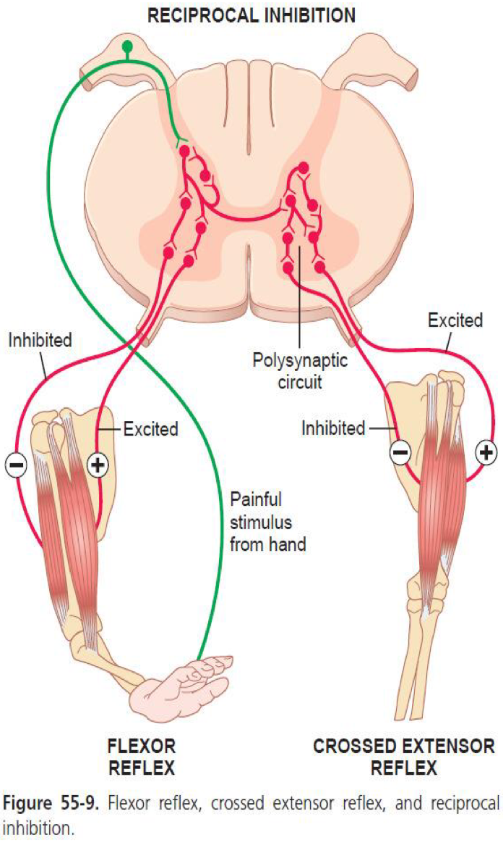
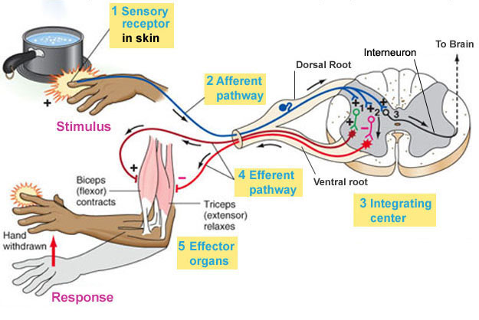
Withdrawal Reflex (Flexor reflex) (Nociceptive Reflex)
A superficial polysynaptic reflex.
Stimulation of pain receptors of hand (a pin- prick, heat, or a wound) >> impulses to SC in A delta or C fibres >> interneurons pool >> motor neurons >> stimulate hand flexor muscles >>move the hand away from the injurious stimulus.
Characterized by
Diverging circuits
To spread the reflex to the necessary muscles for withdrawal.
Reciprocal inhibition circuits
Circuits to inhibit the antagonist muscles
Stimulation of flexors muscle accompanied by inhibition of extensors through inhibitory interneurons
Recruitment
Gradual activation of more number of motor neurons (AHCS) on stim of afferent nerve in a reflex arc by maintained, repetitive stimulus.
Cause
different conduction velocities of afferents.
different number of interneurons with short & long pathways to the motor neurons (AHCs ).
Motor unit recruitment : If a repetitive & stronger stimulus is maintained, there will be gradual increase in the force of the muscle contraction until the maximum force is reached, due to gradual recruitment/activation of more and more motor neurons.
The distance between the motor neurons and the interneurons differs. Some are nearer than others and they will be activated before.

Slide 16
4. After-discharge Circuits
Circuits to cause afterdischarge lasting many fractions of a second after the stimulus is over.
The duration of after-discharge depends on the intensity of the sensory stimulus that elicited the reflex.
Cause :
Presence of reverberating circuit restimulate AHCs
Value / prolong the protective response of reflex
5. Irradiation
Spread of impulses up & down to different segments and motor neurons in the S.C.
A strong stim in sensory afferent irradiate to many segments of S.C due to divergence.
The extent of the response in a reflex depends on the intensity of the stimulus.
The more intense the stimulus >> greater spread of activity in the spinal cord >> involving more & more motor neurons >> more response.
Weak stim----> irradiates to small number of neurons, so it causes weak flexion of limb.
Strong stim----> irradiates to large number of neurons, so it causes withdrawal of affected limb & extension of opposite limb. (as in crossed extensor reflex).

Slide 17
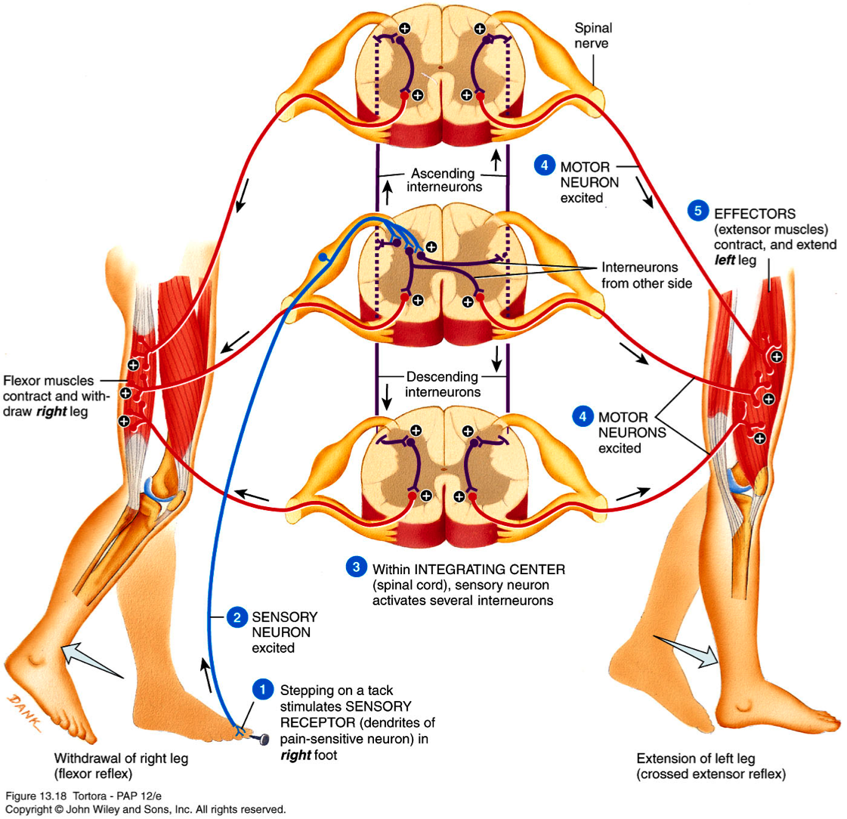
The Withdrawal Reflex
Reflex | Flexor reflex or withdrawal reflex
Clinical test/stimulus | Sharp painful stimulus (stepping on nail)
Response | Limb is rapidly withdrawn
Sensory receptor | Cutaneous skin and pain receptors
Synapses involved | Polysynaptic (via interneuron)
Effects on muscle | Contracts flexor muscle
Other effects | Relaxes (-) extensor muscle of same limb | Reverse effect on opposite limb (crossed extensor reflex)
Function | Protective - withdrawal from painful stimulus | Cross extensor aids in maintaining posture when opposing leg is lifted

Slide 18
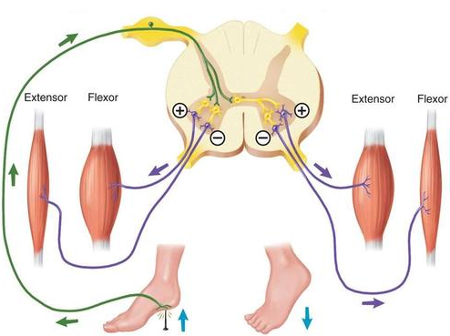
Crossed Extensor Reflex
Crossed extensor reflex supporting the body weight against gravity While pushing the body away from the injurious agent by withdrawal R.
Flexion and withdrawal of the stimulated limb >> extension of the opposite limb.
Occurs with strong stimulus only. why?
Signals from sensory neurons as it activates withdrawal reflex in the stimulated limb, cross to the opposite side of the cord by irradiation & divergence to excite excitatory interneurons to activate motor neurons of extensor muscles neurons & send collaterals to inhibitory interneurons to inhibit motor neurons of the flexors (all in the other limb).
It does not begin until 200 to 500 milliseconds after onset of the initial pain stimulus, because many interneurons are involved in the circuit between the incoming sensory neuron and the motor neurons of the opposite side of the cord.
After the painful stimulus is removed, the crossed extensor reflex has an even longer period of afterdischarge, results from reverberating circuits. This of benefit in holding the pained area of the body away from the painful object & support balance.
Mostly in the lower limb to support balance.
Reciprocal innervations occurs also in crossed extensor reflex. How?
flexors in the opposite limb are inhibited while extensors are excited because while pushing the body away from the injurious agent by withdrawal R.
The crossed extensor reflex supporting the body weight against gravity.
Because of the central delay.

Slide 19
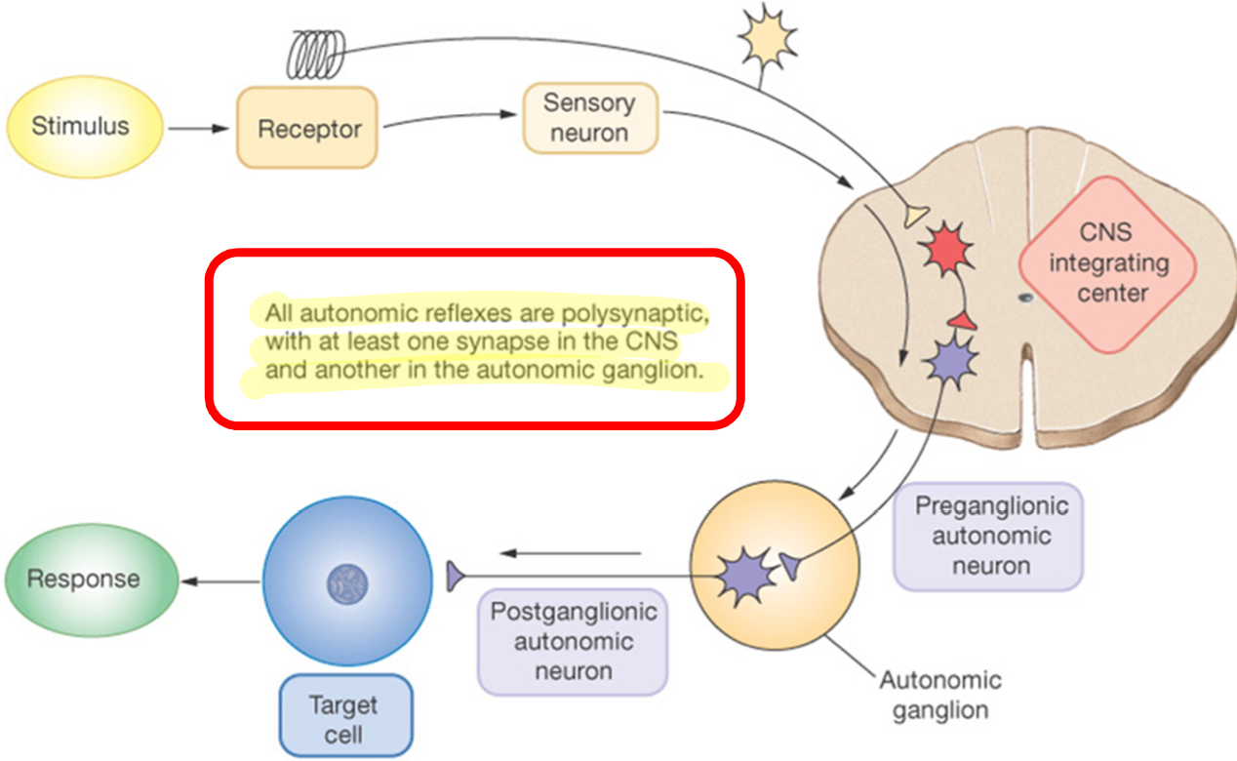
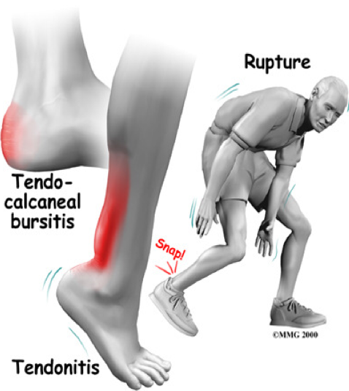
Important
Reflex of posture and locomotion
Stepping and walking movements
Positive Supportive Reaction.
Cord “Righting” Reflexes.
Rhythmical Stepping Movements of a Single Limb.
Reciprocal Stepping of Opposite Limbs.
Diagonal Stepping of All Four Limbs—“Mark Time”Reflex.
Galloping reflex.
Scratch Reflex
Spinal cord reflexes that cause muscle spasm
Position sense that allows the paw to find the exact point of irritation on the surface of the body and
A to-and-fro scratching movement.
Muscle Spasm Resulting From a Broken Bone.
Abdominal Muscle Spasm in Persons with Peritonitis.
Muscle Cramps.
Segmental autonomic reflexes are integrated in the spinal cord
changes in vascular tone resulting from changes in local skin heat.
sweating, which results from localized heat on the surface of the body.
intestinointestinal reflexes that control some motor functions of the gut.
peritoneointestinal reflexes that inhibit gastrointestinal motility in response to peritoneal irritation.
evacuation reflexes for emptying the full bladder.
Mass Reflex
In a spinal animal or human being, sometimes the spinal cord suddenly becomes
excessively active, causing massive discharge in large portions of the cord by painful stimulus

Slide 20
All autonomic and superficial reflex are polysynaptic.
All tendon jerks are monosynaptic reflex.
Reciprocal inhibition is not a monosynaptic effect.
Renshaw cells are inhibitory cells that transmit inhibitory signals to the surrounding motor neurons BY Lateral inhibition( helps to focus or sharpen the signals from each excited motor neuron.
Renshaw cells Allow transmission of the primary signal in the desired direction & suppressing the tendency for signals to spread laterally.
Alpha motor neurons
large cells, with large myelinated fibres (axons) form 70%of ventral root supply extrafusal muscle fibres (2/3 Of Skeletal muscle fibers).
Gamma Motor Neurons
smaller cells-with thinner axons form 30%of ventral root-supply intrafusal muscle fibres (muscle spindles=1/3 Of skeletal muscle fibers).
long term potentiation In reverberatory circuit is the output neuron sends a collateral nerve fiber back to its own dendrites or soma to re-stimulate the input neuron itself & so the circuit may discharge repetitively for a long time.
Most reverberating pathways are constituted of many parallel fibers.
Withdrawal reflex is superficial polysynaptic reflex That is stimulated by pain receptors of hand >> impulses to SC in A delta or C fibres >> interneurons pool >> motor neurons >> stimulate hand flexor muscles >> move the hand away from the injurious stimulus.
In irradiation The extent of the response in a reflex depends on the intensity of the stimulus.
Crossed extensor reflex supports the body weight against gravity while pushing the body away from the injurious agent by withdrawal R. Then in result of reverberating circuit ;the crossed extensor reflex has an even longer period of afterdischarge
Summary of Important Points

Slide 21
Questions
1.Types of motor neurons?
Alpha and beta motor neurons.
Alpha and gamma motor neurons.
Gamma and beta motor neurons.
2.If sensory neuron synapses with more than 2 motor neurons we called this synapse?
Monosynaptic.
Polysynaptic.
Both.
3.Renshaw cells is considered as?
Motor neurons..
Sensory neurons.
Interneurons.
4.A person responded to pinprick by withdrawing his hand. This is called?
Somatic reflex.
Autonomic reflex.
Visceral reflex.
5.Choose the correct answer:
Deep reflexes are always monosynaptic.
Ankle jerk is polysynaptic reflex.
Inverse stretch reflex is polysynaptic.
6.withdrawal reflex is?
Superficial Monosynaptic.
Deep Polysynaptic.
Superficial polysynaptic.
What is the role of renshaw cells?
Inhibitory cells transmit inhibitory signals to the surrounding motor neurons by lateral inhibition to help focus and sharpen the signals from each motor neuron.
After discharge occurs due to?
1- synaptic after-discharge
2- reverberating circuits.
Small kid stepped on sharp needle he immediately left his foot off the ground. His movement is a type of reflex, what is the reflex and what kind of circuits are involved?
Withdrawal reflex (flexor reflex) (nociceptive reflex) 1- diverging circuits
2- reciprocal inhibition circuits.
What are the results of withdrawal reflex.
In the ipsilateral side | In the contralateral side
Flexor: excited | Flexor: inhibited
Extensor: inhibited | Extensor: excited
1.B
2.B
3.C
4.A
5.C
6.C

