Slide 1
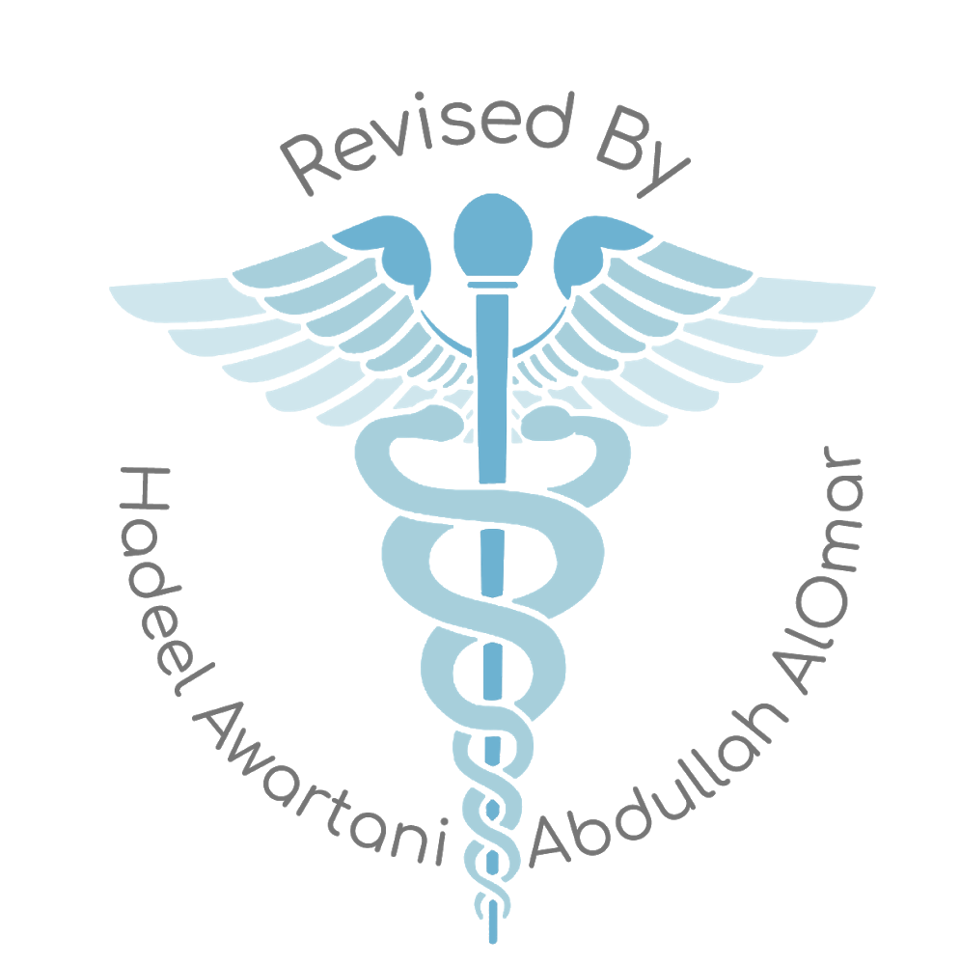
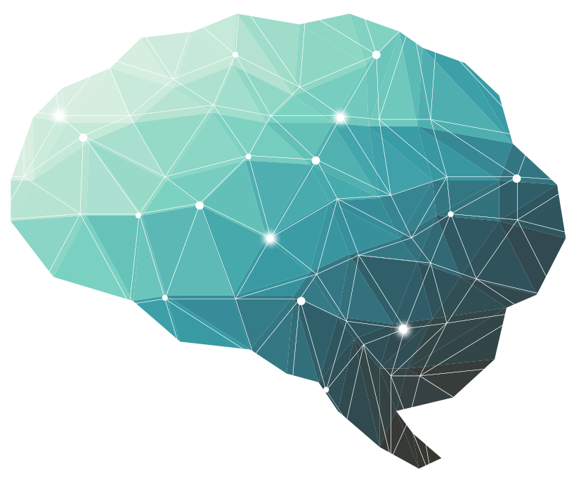
physiology of motor tract
4th Lecture ∣ The Physiology Team
Objectives:
What is upper motor neuron and lower motor neuron
The main differences between the pyramidal and extrapyramidal systems .
Explain the origin, course and functions of the following motor tracts; (Corticospinal, tectospinal, rubrospinal, vestibulospinal, reticulospinal, olivospinal)
Done by :
Team leaders: Abdulelah Aldossari, Ali Alammari
Fatima Balsharaf, Rahaf Alshammari
Team members:
Special thanks to: Aljohara bukhari
Yazeed Alkhayyal, Zeyad alkhenizan Saleh almoaiqel, Fayez Aldarsouni
Colour index:
important
Numbers
Extra
وَأَن لَّيْسَ لِلْإِنسَانِ إِلَّا مَا سَعَىٰ
Notes:
لِلْإِنسَانِ إِلَّا مَا سَعَىٰ (39) وَأَنَّ سَعْيَهُ سَوْفَ يُرَىٰ
BETTER right

Slide 2
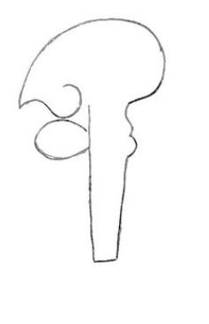
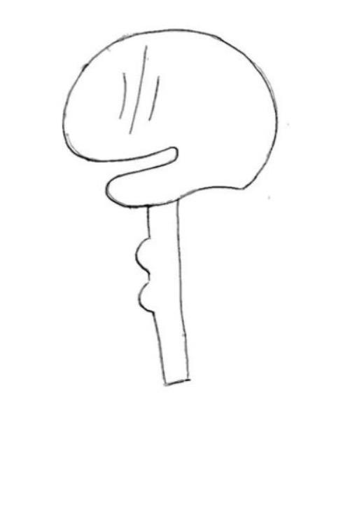
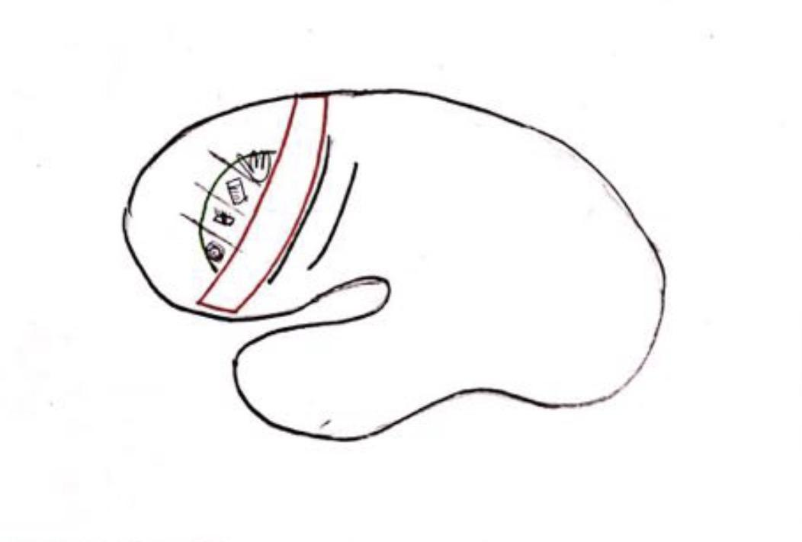
Motor system & descending tracts part 1
Descending tracts are bundles of axons that transmit information from higher centres (e.g cortex).
They may target skeletal muscles (voluntary motor response) or may target gland,heart and viscera (autonomic nervous system).
Motor area is anterior to central sulcus and sensory area is posterior to it.
There is two tools they used to determine the activity in the cerebral cortex:
electrical stimulation by an electrode
neurological deficits produced by destructive lesion.
There are three motor areas
1-Primary motor cortex
is the precentral gyrus present on the superolateral surface in front of the central sulcus and its extension medialy on the cerebral hemisphere.
2-Premotor area
plans the motor activity, and it doesn't have a direct connection with muscles, it has some specific areas such as:
Broca’s area that control talking
Frontal eye field located above Broca’s area in the frontal lobe, it is concerned with eye movement if it got irritated/stimulated your eyes will be looking in the other direction but if it got destroyed (e.g tumor) eyes will be toward the lesion
Head rotation area
Skilled hand movements
3-Supplementary motor area
plans very primitive movement bilaterally
The primary motor neuron cannot plan themselves they have to be orchestrated by the premotor cortex
Proprioception in unconscious level will be controlled by cerebellum and in conscious level the cerebrum will control.

Slide 3
Motor system & descending tracts part 2
Corticospinal tract fibers start from:
30% from primary motor area
30% from premotor and supplementary area
40% sensory cortex
Motor cortex has six layers of neurons.
Neurons of Betz are very large cell body neurons and their axons are very heavily myelinated and thick it connects directly to the lower motor neuron unlike other cells will connect with interneurons (internuncial neurons) only found in primary motor cortex.
All the the nerve fibers will be compacted in the posterior limb of internal capsule.
The artery which supplying the posterior limb of internal capsule (lenticulo striate artery) gets blocked in old age then many fibers will be destroyed,that is equivalent to destroying all the cerebral cortex and all movement in the contralateral body will be disturbed (hemiplegia) but if the lesion is above so not all fibers are destroyed the muscle become weak (hemiparesis) MIN22.

Slide 4
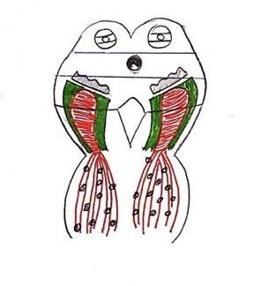
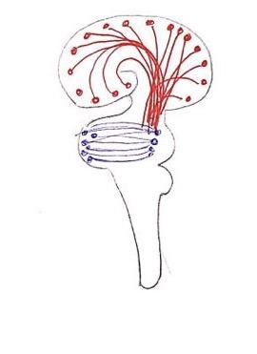
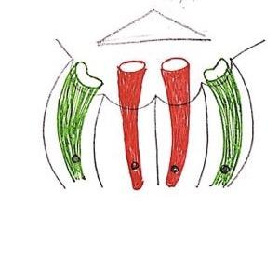
Motor system & descending tracts part 2
-Parkinson’s disease is caused by the damage of Substantia nigra.
-Superior colliculus its concerned with eye movement and reflexes (that’s why we drew the eyes) MIN30
Many fibers extend from the cerebral cortex and end up in pontine nuclei these are called corticopontine fibers then it goes to the cerebellum.
When the corticospinal fibers reach the pons it will be scattered by pontine nuclei and pontocerebellar fibers, so now when there is a lesion it will make a little damage. MIN34
Corticospinal tract are also called “pyramidal tract”.
Most of the Corticospinal fibers will decussate in the junction of medulla and spinal cord, if the damage is above it contralateral side will be losing the motor control but if it after it will be ipsilateral side.
Lateral corticospinal tract | Anterior corticospinal tract
important in fine hand movements. | concerned with axial movements

Slide 5
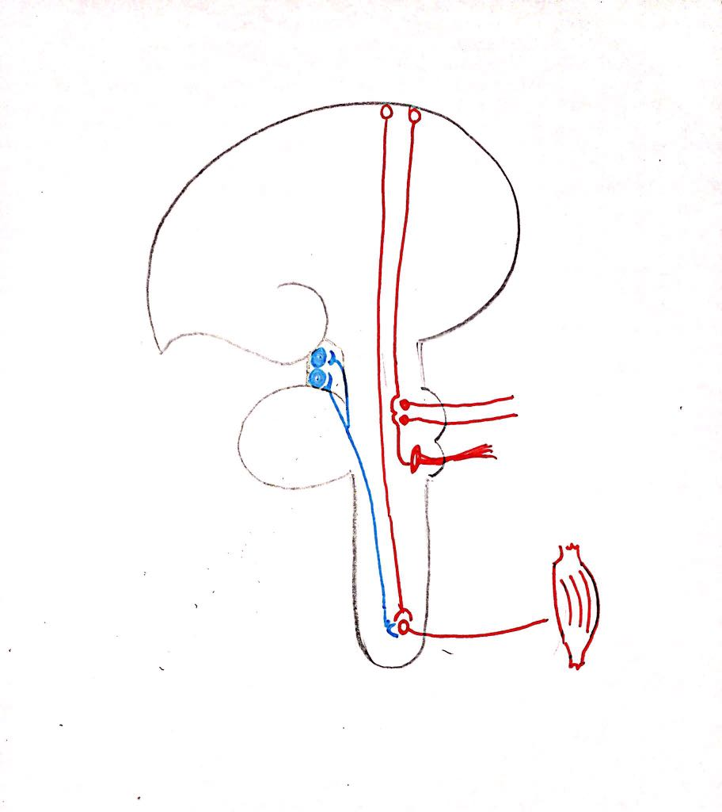
Motor system & descending tracts part3
Motor neurons type:
1-Lower Motor neuron
that is come from CNS to the neuromuscular junction.
2- Upper motor neuron
all upper level of CNS neuron come from the upper and modifying the activity of Lower motor neuron and divide into :
cortical origin ( pyramidal tract ) :
- Corticospinal tract (connect cortex to Lower motor fiber ) - Corticonuclear fiber ( connect cortex to nucleus in brain stem )
a- corticomedullary /corticobulbar
b- corticopontine c- cortico cephalic tract
subcortical ( extrapyramidal tract ) :
A- Tectospinal tract B- Rubrospinal tract C- Reticular spinal D- Vestibular spinal tract E- Olivo spinal tract

Slide 6
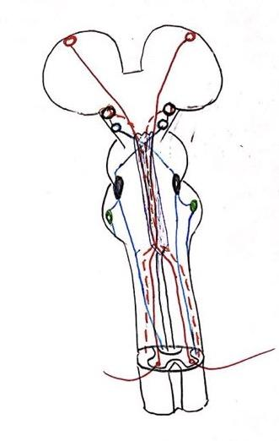
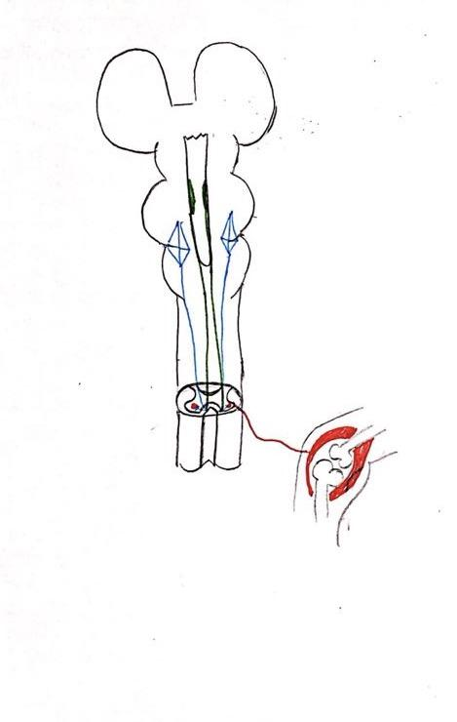
Motor system & descending tracts part 3
When you wake up you are using extensor muscle because they are anti-gravity muscles
We have vestibular nuclear complex the fibers reach anterior column to increase tone of the extensor muscle In the reticular formation have (ponto reticulospinal tract) act as vestibular nuclear complex * but the master is vestibular spinal tract
When someone is VIP you stand up right ? To make it easier to remember V= is stand to vestibular nuclear complex & p= ponto reticulospinal tract
Know when you sit down we use the word
* Sit in rubber mat to remember it :
sit down > 2 tracts 1- Rubrospinal tract is mainly for flexor muscles help in initiation of voluntary movement 2- medullary reticular-spinal

Slide 7
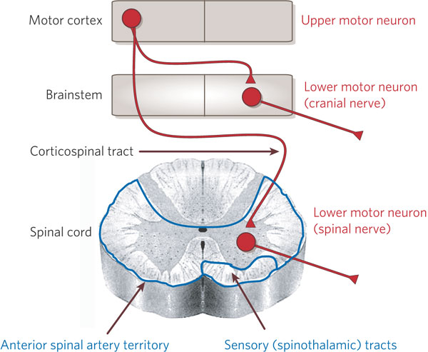
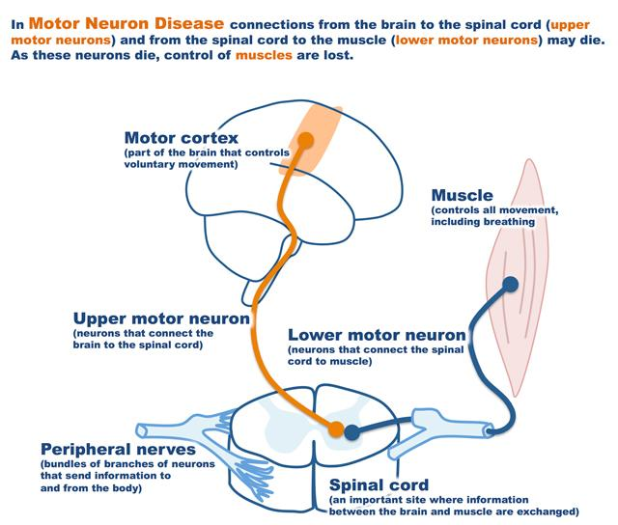
In order to initiate any type of voluntary movement there will be 2 levels of neuron that your body will use
and they are:
1 -Upper motor neurons (UMN)
2 -Lower motor neurons: (LMN)
-Upper motor neurons (UMN)
These are the motor neurons whose cell bodies lie in the motor cortex, or brainstem, and they activate the lower motor neuron
-Lower motor neurons: (LMN)
These are the motor neurons of the spinal cord (AHCs) and brain stem motor nuclei of the cranial nerves that innervates skeletal muscle directly.
Classification of descending motor systems:
-pyramidal:
originates from the cerebral cortex and descends to the spinal cord (the corticospinal tract) passes through the pyramids of the medulla and therefore has been called the “the pyramidal tract”.
-extrapyramidal:
The rest of the descending motor pathways do not travel through the medullary pyramids, and are therefore collectively gathered under the heading: “the extrapyramidal tracts”.
-Responsible for subconscious gross movements(swinging of arms during walking)

Slide 8
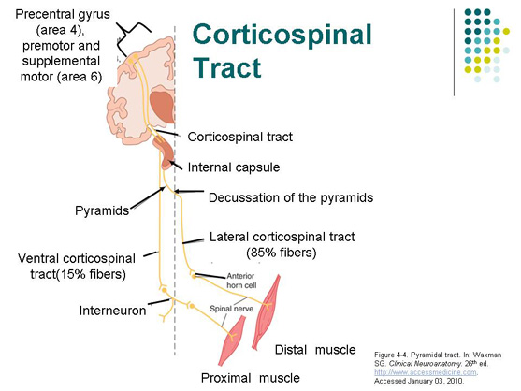
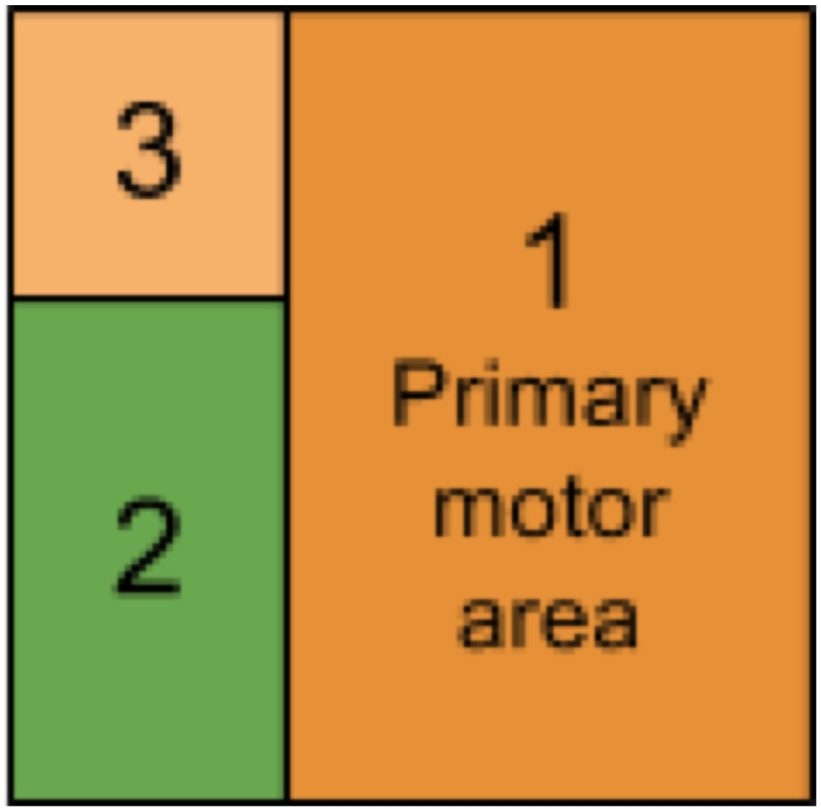
The descending motor system (pyramidal,Extrapyramidal) has a number of important sets these are named according to the origin of their cell bodies and their final destination;
pyramidal
Corticospinal tract
Corticobulbar tract
Extrapyramidal
Rubrospinal tract
Olivspinal tract
Reticulospinal tracts
Tectospinal tract
Vestibulospinal tracts
1-Corticospinal (pyramidal tracts) & corticobulbar tracts
Origin
1- 30% motor area 4 ( the primary motor area). (M1) occupies the precentral gyrus
2- 30% from the premotor areas & supplementary cortex
What is Premotor area?
(motor association area) lies in :
front of the primary motor area
& below supplementary motor area.
Its stimulation produces complex coordinated
movements, such as :
setting the body in a certain posture
to perform a specific task.
Extra
Supplementary cortex:
located on the lateral side of the brain
in front of area 4 and above the
pre-motor area:
extends on medial side of the cerebral hemisphere.
• Concerned with planning and programming motor sequences.
• 3- 40% parietal cortex (somatic sensory area 3,1,2)

Slide 9
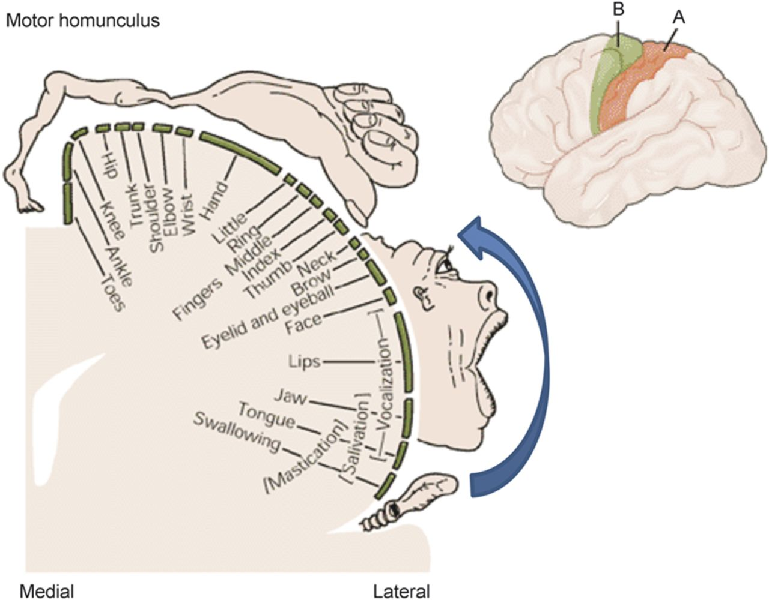
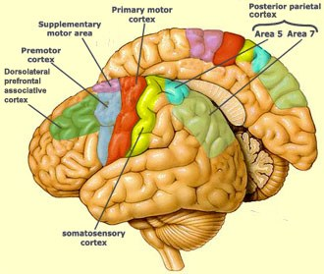
Motor Areas:
The Primary Motor Area (MI. Motor Area 4)
Occupies the Precentral Gyrus & contains large, giant highly excitable Betz cells.
MI of one side controls skeletal muscles of the opposite side of the body.
Facial area is represented bilaterally, but rest of the representation is generally unilateral
Area of representation is proportional with the complexity of function done by the muscles. Therefore muscles of the hands & speech occupy 50% of this area.
The neurons of this area are arranged in vertical columns, each column has 6 distinct layers of cells, the pyramidal cells that give rise to the corticospinal fibers all lie in the 5th layer.
3% of the pyramidal fibres are large myelinated, derived from giant, highly excitable pyramidal
Betz cells in motor area 4.
The Betz cells fibers transmit nerve impulses to the spinal cord at a velocity of ~70m/s, the most rapid rate of transmission of signals from the brain to the cord.
Betz cells axons send short collaterals back to the cortex to inhibit adjacent regions of the cortex when the Betz cells discharge, thereby ”sharpening” the excitatory signal.
MI
2) The Premotor Area (Area 6)
Lies in front of the primary motor area & below supplementary motor area.
Simulation of the premotor area produces complex coordinated movements, such as setting the body in a certain posture to perform a specific task. Example: when writing, your body sits in a specific posture to aid. + playing piano
It works in association with the supplementary motor area, establishing the motor programs necessary for execution of complex movements.

Slide 10
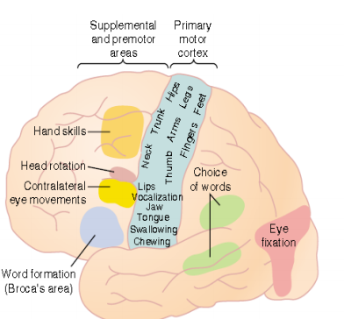
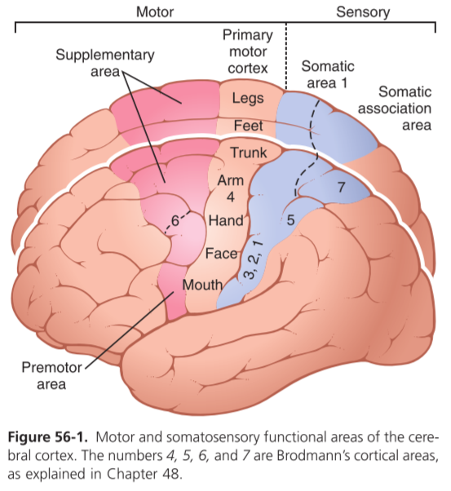
A few highly specialized motor centers have been found in the premotor areas of the human cerebral cortex:
Premotor Area | Location: | Function:
Broca’s Area for speech | Broca’s Area | Speech
Frontal Eye Movements Area | Above Broca’s area in the frontal lobe | Controls voluntary movements of the eye
Head Rotation Area | Just above the eye movement area in the motor cortex | Directing the head toward different visual objects
Hand Skills Area | Above the head rotation area | Hand skills
3) The Supplementary Motor Area:
Located on the lateral side of the brain in front of area 4 and above the premotor area & extends on the medial side of the cerebral hemisphere.
Concerned with planning & programming primitive motor sequences
Simulation of this area leads to bilateral (bimanual) grasping movements of both hands simultaneously.
This area make motor programs for
*axial muscles. It provides background
adjustment for finer motor control of
the arms and the hands by
the premotor area and
primary motor cortex.

Slide 11
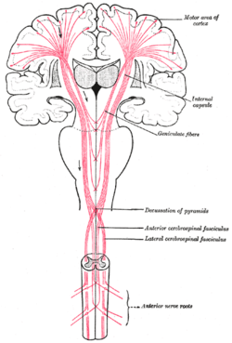
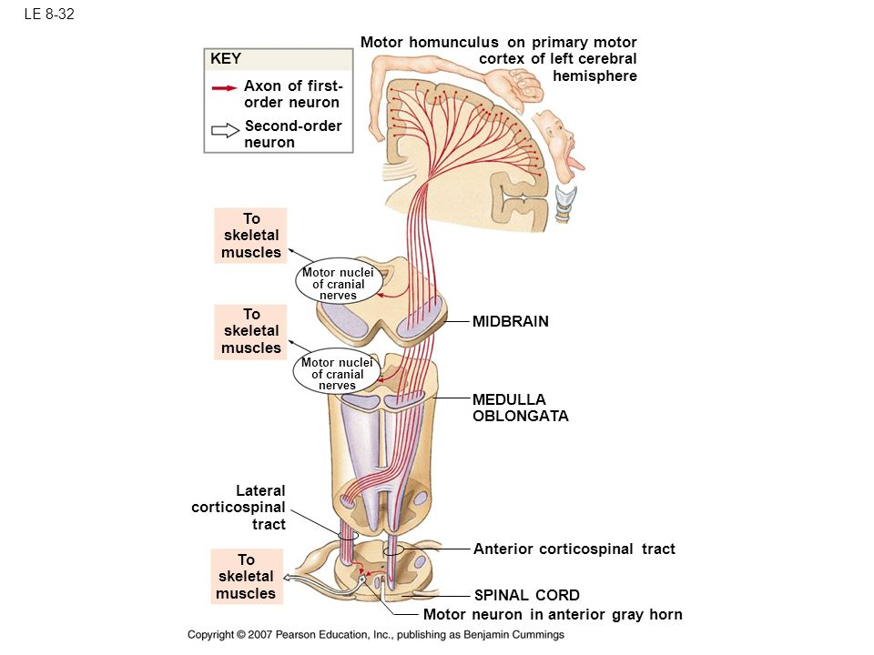
Corticospinal (Pyramidal Tracts) & Corticobulbar Tracts
Origin:
30% Motor area 4 (Primary motor area) (M1)
30% Premotor areas & supplementary cortex
40% Parietal cortex (Somatic sensory area 3,1,2)
- 3% of the fibres are large myelinated fibres, derived from the large , highly excitable pyramidal Betz cells of M1 . These fibers form monosynaptic connections with motor neurons of the spinal cord.
Fibers from the cerebral cortex descend in *Corona Radiata to Internal Capsule Genu, and the anterior ⅔ of the posterior limb, then to Brain Stem (Midbrain, Pons, Medulla Oblongata).
Knowing the distribution of the tracts is important
يشبه شعاع الشمس
30%
30%
40%
In the Brainstem (Midbrain, Pons, Medulla Oblongata):
Corticobulbar tract
carries information to motor neurons of the cranial nerve
(terminates on cranial nerve nuclei of opposite side)
(decussating just before they reach their target nuclei)
Corticospinal tracts (Pyramidal)
Descends through the midbrain and pons, Then in the lower medulla oblongata the fibers form pyramids so called pyramidal tract
Same side
Opposite side

Slide 12
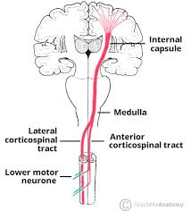
Corticospinal tracts (Pyramidal)divides into:
1- lateral corticospinal tracts:
- 80% of fibers
- cross midline in pyramids
- Pass laterally in spinal cord white matter
- Ends directly ( not via interneurons = monosynaptic connections) on motor neurons (AHCs) of the opposite side here the lower motor neurons (LMNs) of the corticospinal cord are located.
-Then peripheral motor nerves carry the motor impulses from the anterior horn to the voluntary muscles
- The fibers pass laterally in spinal cord white matter, so they control distal limb muscles
Function//- controls and initiates fine discrete skilled movements of fingers and toes.
2- Ventral (anterior) corticospinal tracts:
- Remaining 20% fibers does not cross midline
- Cross at level of their termination to synapse with interneurons , that synapse with motor neurons (AHCs) of opposite side.
-Pass medially in ventral horn so control axial & proximal limb muscles.
So corticospinal tract( ANT& LAT) supply skeletal muscles of the opposite side
-These fibers control the axial and proximal limbs muscles so it concern with control of posture.
Origin – Sensory cortex, primary Motor Cortex, premotor & supplementary cortex
Lat.Cross & Vent. Uncross White matter in spinal cord
Pyramidal Decussation
Lat.Cross & Vent. Uncross White matter in spinal cord
Internal capsule
Medullary Pyramid
Cerebral Peduncle ( midbrain )
pons
Ant. Horn of spinal cord through a interconnection
α motor neuron of opposite side

Slide 13
Excitation of the Spinal Cord Motor Control Areas by the Primary
Motor Cortex and Red Nucleus
-Vertical Columnar Arrangement of the Neurons in the Motor Cortex.
-Function of Each Column of Neurons:
-Each column has six distinct layers of cells, The pyramidal cells that
give rise to the corticospinal fibers all lie in the fifth layer of the
cortical surface.
-Function of Each Column of Neurons;
-Each column of cells functions as a unit & as integrative processing
system, using information from multiple inputs to determine the output
response from the column.
- Each column can function as an Amplifying system to stimulate
large numbers of pyramidal fibers to the same muscle or to
synergistic muscles simultaneously.
-Dynamic and Static Signals Transmitted by the Pyramidal Neurons.;
Each column of cells excites two types of pyramidal cell neurons;
1-The dynamic neurons are excited at a high rate for a short period at the beginning of a contraction, causing the initial rapid development of contraction.(start the action)
2- The static neurons fire at a much slower rate, but continue firing at this
slow rate to maintain the force of contraction as long as the contraction is required.
-The neurons of the red nucleus have similar dynamic and static characteristics, -Greater percentage of dynamic neurons is in the red nucleus and a greater percentage of static neurons is in the primary motor cortex.
-Functions of corticospinal tracts:-
1- Initiation of fine ,discrete, skilled voluntary movements
(on which side?)
2- lateral corticospinal tracts (main bulk of the tract) control
distal muscles of limb as fingers & thumb & toes which concerned with fine skilled movement) e.g Painting ,writing, picking up of a small object etc.
3- Ventral corticospinal tracts control posture of axial & proximal limb muscle for balance, climbing, walking
4- Effect on stretch reflex:-
- Facilitate muscle tone through gamma motor neurons
5- Fibers originate from parietal lobe are for sensory-motor coordination
6- Corticobulbar tracts control face & neck muscles (+eye) &
facilitate their tone, and are involved in facial expression mastication
and swallowing.

Slide 14
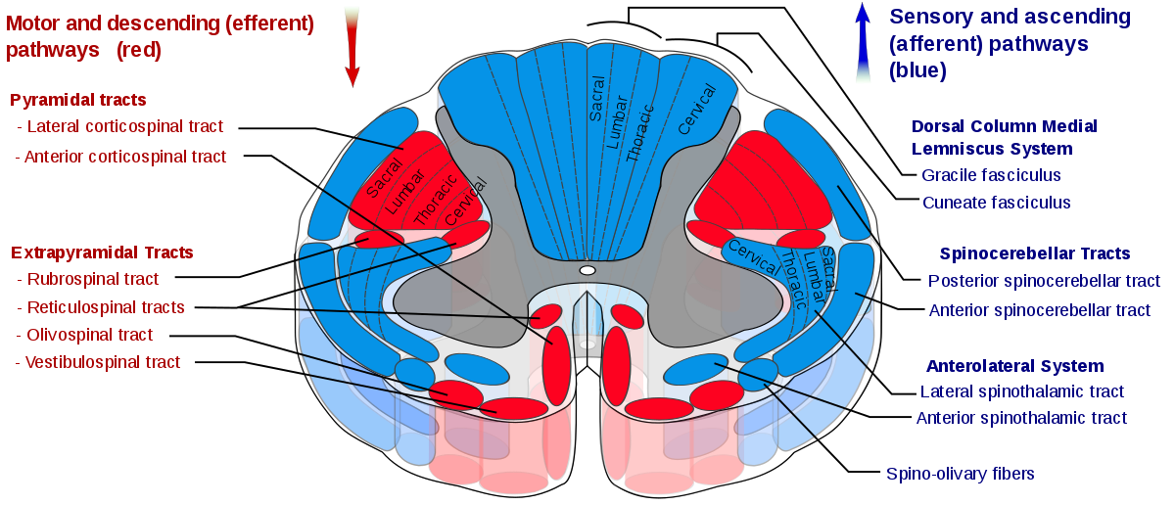
Removal of (Area Pyramidalis) of the Primary Motor Cortex
-Removal of a the area that contains the giant Betz pyramidal cells (Area Pyramidalis) causes loss of voluntary control of discrete movements of the distal segments of the limbs, especially of the hands and fingers (This does not mean that the hand and finger muscles themselves cannot contract ( paralysis) rather, the ability to control the fine movements is gone).
-That is because area pyramidalis is essential for voluntary initiation of finely controlled movements, especially of the hands and fingers
Extrapyramidal tracts :-
Tracts other than corticospinal tract & are outside pyramids
Origin/ motor area 4, premotor area 6, Suppressor area 4 CORONA RADIATA to INTERNAL CAPSULE to BASAL GANGLIA to BRAIN STEM BULBOSPINAL TRACTS descend to spinal cord as :
-Extrapyramidal system :
1-sets the postural background needed for performance of skilled movements .
2- controls subconscious gross movements .
Effects of Lesions in the Motor Cortex or in the Corticospinal Pathway(The stroke):
- The motor control system can be damaged by the “stroke “
-Muscle Spasticity Caused by Lesions That Damage Large Areas Adjacent to the Motor Cortex.
-Most lesions of the motor cortex, especially those caused by a stroke, involve the primary motor cortex & adjacent parts of the brain such as the basal ganglia.
A- Rubrospinal tract.
B- Vestibulo-Spinal Tract.
C- Reticulospinal Tract
D- Tectspinal Tract.
E- Olivospinal Tract

Slide 15
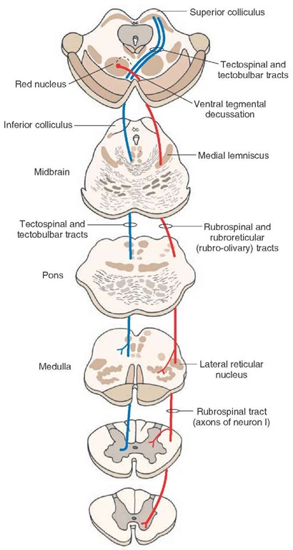
1-Rubrospinal tracts:
-The red nucleus located in the mesencephalon (in the pic).
-It receives fibers from Ipsilateral cortical motor area (corticobulbar pathway)
-It receives direct fibers from the primary motor cortex through the corticorubral tract & some branching fibers from the corticospinal tract (These fibers synapse in the lower portion of the red nucleus, the magnocellular portion)
- The rubrospinal tract, which crosses to the opposite side in the lower brain stem into the lateral columns of the spinal cord together with corticospinal tract
- The rubrospinal fibers terminate mostly on interneurons of the cord gray matter, along with the corticospinal fibers, but some of the rubrospinal fibers terminate directly on anterior motor neurons
Remember that nucleus is a collection of cell body with in CNS
If it was in peripheral Nerves system it will be a ganglia
Function of the Corticorubrospinal System: (as same as corticospinal thats if the there is a damage in corticospinal tract this will do the function)
-The corticorubrospinal pathway serves as an accessory route for transmission of discrete signals from the motor cortex to the spinal cord. When the corticospinal fibers are destroyed, discrete fine control of the fingers movements can still occur but impaired..
- This tract is excitatory for flexors & inhibitory for extensors (anti-gravity muscles).
-Rubrospinal tract lies in the lateral columns of the spinal cord, along with the corticospinal tract. Therefore, together are called the
lateral motor system of the cord, in contradistinction to a vestibulo-reticulospinal system, which lies mainly medially in the cord and is called the medial motor system of the cord

Slide 16
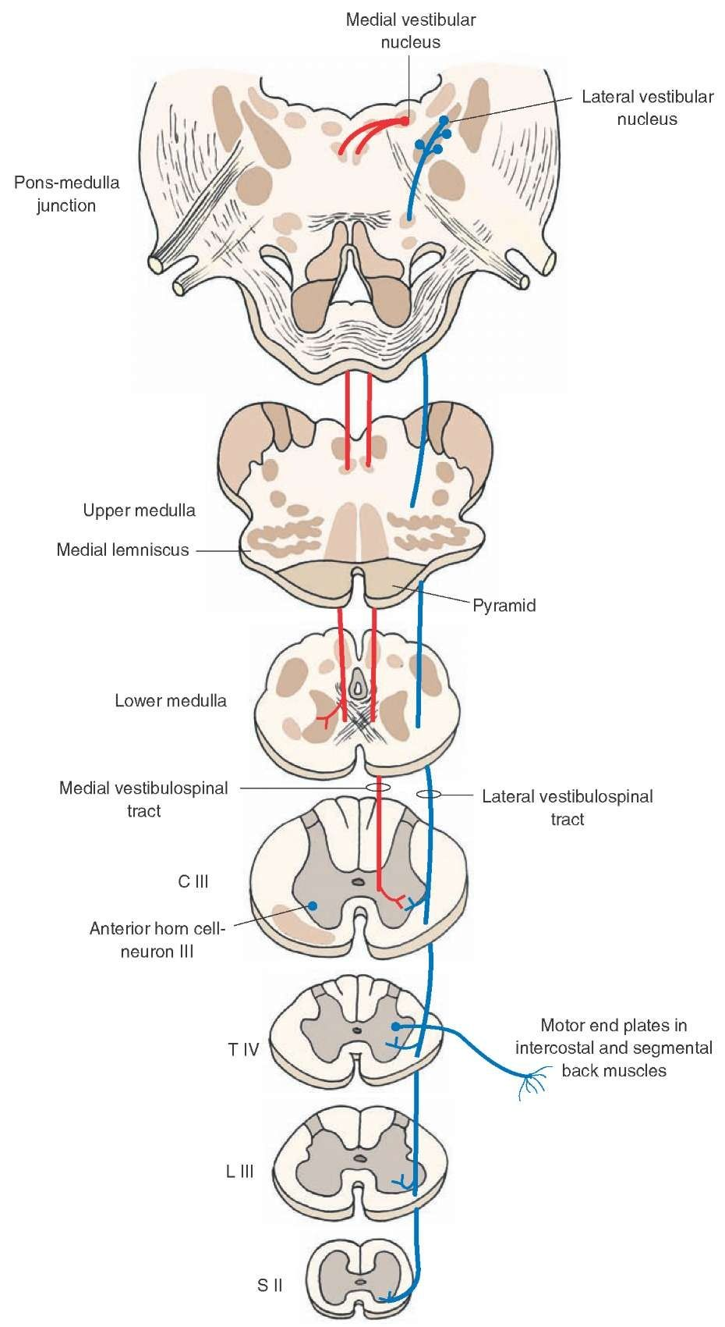
Functions of Vestibulospinal Tracts:
A- The lateral vestibulospinal
Cells of origin: Lateral Vestibular Nucleus
Axons descend in the ventral white column of the spinal cord
This tract mediates excitatory influences upon extensor motor neurons to maintain posture & righting reflexes
B- The medial vestibulospinal tract:
Cells of origin: Medial Vestibular Nucleus
As its axons descend in the ventral white column of spinal cord to end at the cervical segments of the spinal cord, some fibers form part of the Medial Longitudinal Fasciculus fibers in brain stem that link vestibular nuclei to nuclei supplying the extraocular muscles
(تتحكم بالعين بدل ما كل عين تتحرك لحالها)
Function: for coordination of head and eye movements
Role of the vestibular nuclei to excite the Antigravity muscles:
-The vestibular nuclei, function in association with the pontine reticular
nuclei to control the antigravity muscles.
- The vestibular nuclei transmit excitatory signals to the antigravity
muscles by way of the lateral and medial vestibulospinal tracts
-Without this support of the vestibular nuclei, the pontine reticular system
would lose much of its excitation of the axial antigravity muscles.
2- Vestibulospinal tracts:
- Fibers originate in vestibular nuclei in pons (which receive inputs from inner ear, Vestibular Apparatus and cerebellum)
-Axons descend in the ipsilateral ventral white column of spinal cord
- General Functions:-
Controls Postural & righting reflexes.
Excitatory to ipsilateral spinal motor neurons-that supply axial & postural muscles
Control eye movements

Slide 17
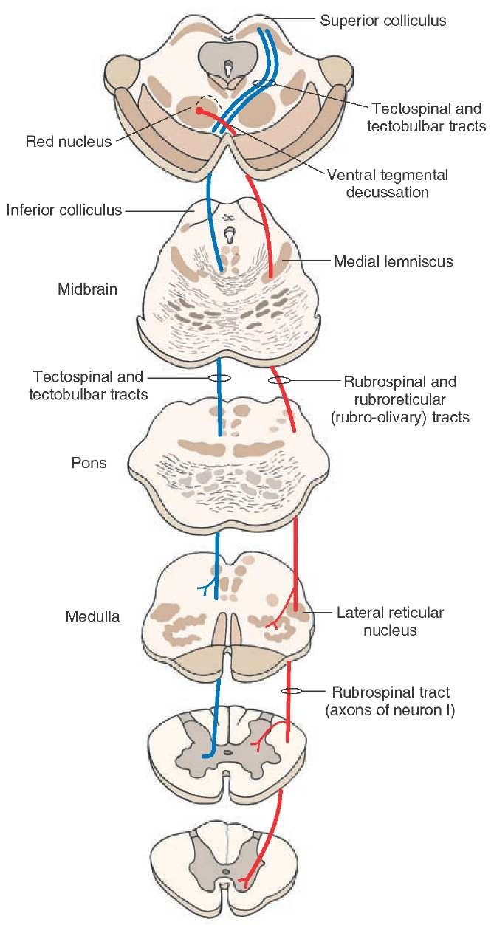
4- Reticulospinal Tract :
-Tract arises from The reticular formation which makes up a central core of the brainstem
-It contains sensory & motor neuronal groups
-Pontine and medullary nuclei project to the AHC of the spinal cord via Reticulospinal Tract
Types of reticulospinal tracts:-
1. Pontine (Medial) Reticulospinal Tract:
• Cells of origin: Pontine Reticular Formation which has high excitability & they receive strong excitatory signals from the vestibular nuclei .
• Axons descend in anterior(ventral )white column of spinal cord
• Pontine Reticulospinal Tract increases Gamma efferent activity ( excitatory to axial & antigravity, extensor muscles of the body & inhibitory for flexores & increases muscle tone)
-it causes powerful excitation of antigravity muscles
3- Tectospinal tracts:
-From superior colliculi in the tectum of midbrain (for VISUAL reflexes) & from inferior colliculi of midbrain (for AUDITORY reflexes)
- Ends on Contralateral cervical motor neurons (that's why it supply the head and neck)
Function: Mediate/facilitate turning of the
head and neck in response to visual or Auditory stimuli (the response will be toward the stimulus)

Slide 18
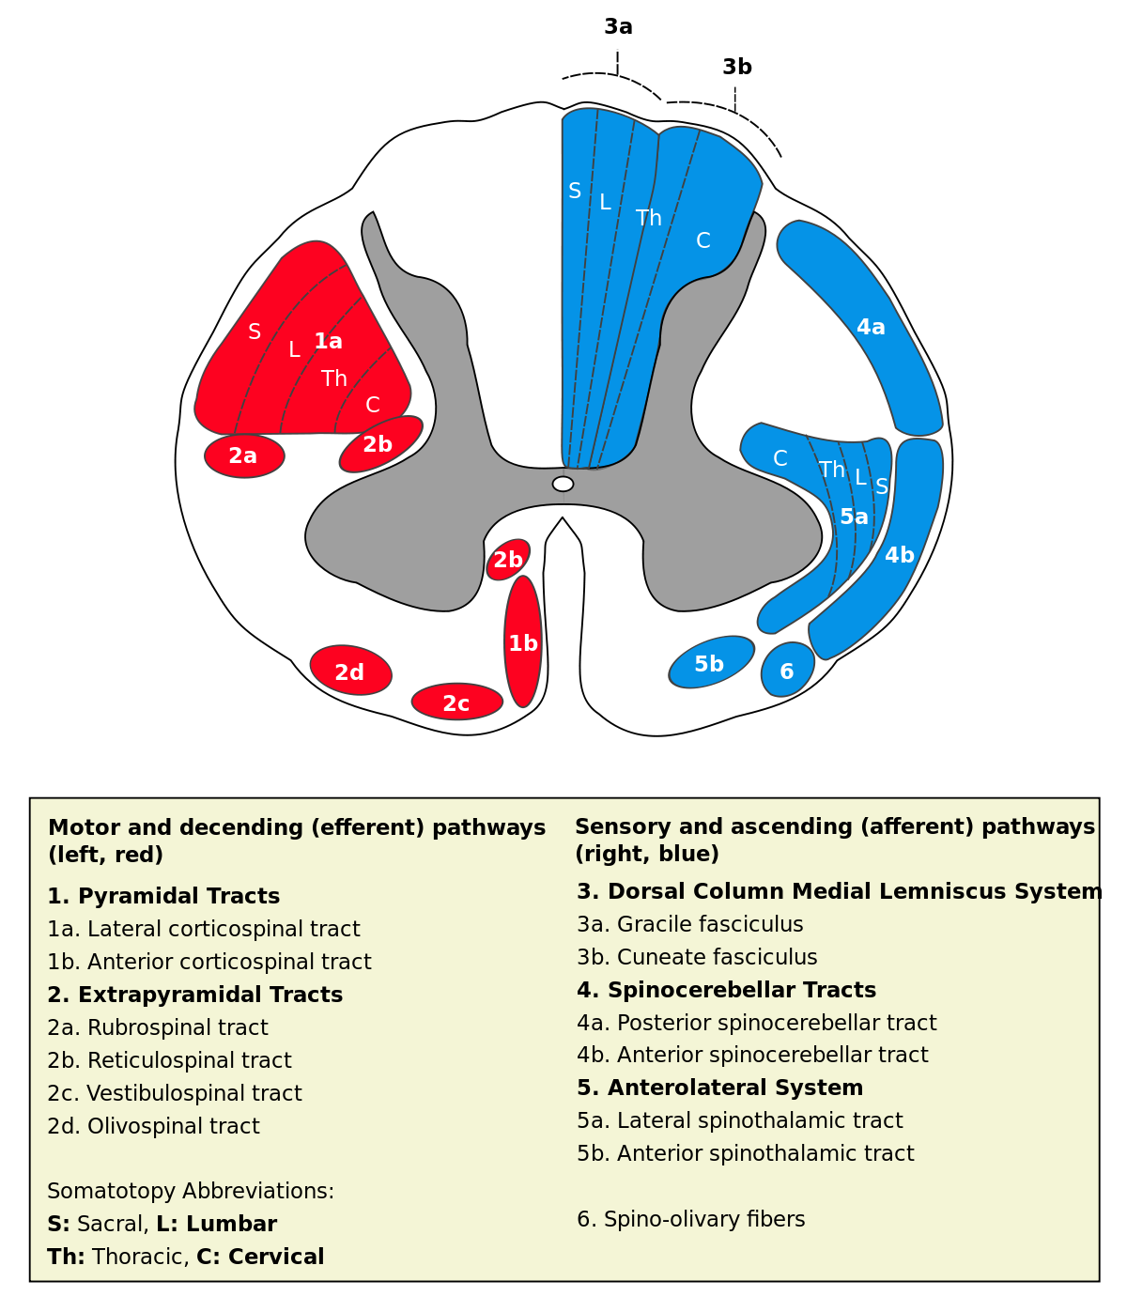
2. Medullary (Lateral) Reticulospinal Tract:
• Cells of origin: Medullary Reticular Formation
• Axons descend in lateral white column of spinal cord on both sides
-It receives strong input from
(1) the corticospinal tract
(2) the rubrospinal tract and
-These activate the medullary reticular inhibitory system to counterbalance the excitatory signals from the pontine reticular system,
- Medullary Reticulospinal Tract inhibits Gamma efferent activity
( transmit inhibitory signals to antigravity extensor muscles & decreases
muscle tone ) .
5- Olivospinal tract:
- It arises from inferior olivary N of the medulla & is found only in the cervical region of the spinal cord (supplies neck muscles) of unknown function
-Secondary olivocerebellar fibers transmit signals to multiple areas of the cerebellum

Slide 19
Quick review
All extra pyrimidal tracts upper neurons emerge from?
subcortical areas
Theoretically, if we remove the primary motor cortex what will happen?
Hypotonia (due to loss of muscle tone). This doesn’t normally happen.
What does occur is stroke which affects pyramidal fibers and extrapyramidal fibers which causes?
Hypertonia/spasticity, e.g. vestibular spinal tract and pontine reticulospinal tract which are excitatory for muscle tone are normally inhibited by another cortical area. When a stroke occurs the inhibitory area is damaged and tracts are free from inhibition. Most strokes occur in the internal capsule in which all fibers are close together so both Pyramidal and extrapyramidal tracts are usually affected together.
We must know the function of each tract:
Tectospinal tract:
tectospinal reflex
Pontine reticulospinal tract:
Stimulation of extensors and inhibition of flexors
Corticospinal spinal tract + medullary reticulospinal:
Stimulation of flexors inhibition of extensors
Excite Flexors | Excite Extensors
Lateral(medullary) Reticulospinal | Medial(pontine) Reticulospinal
Rubrospinal | Vestibulospinal

Slide 20
1.where can we find betz cells?
.primary area
.premotor area
.supplementary cortex
.somatic sensory area
2.where can you find broca’s area?
.primary area
.premotor area
.supplementary cortex
.somatic sensory area
3.what does broca’s area do?
.control walking
.control hearing
.control eye movement
.control speaking
4.parkinson’s disease is caused by a damage in?
.tectospinal tract
.neuron of betz
.Substantia nigra.
.Superior colliculus
5.if there is a nerve damage under the medulla then that damage will be?
.contralateral
.ipsilateral
.answer A and B
.none
6.where does Corticospinal originate from ?
.30% Motor area 4
.30% Premotor areas & supplementary cortex
.40% Parietal cortex (Somatic sensory area )
all of them
7.which tract cross in the lower medulla?
.Corticobulbar tract
.lateral corticospinal tract
.vestibulospinal
.Ventral (anterior) corticospinal tract
8.which tract descend with the lateral corticospinal tract ?
.Rubrospinal tracts
.Vestibulospinal tracts
.Tectospinal tracts:
.Reticulospinal Tract
9.coordination of head and eye movements is function of ?
. medial vestibulospinal tract
. Pontine (Medial) Reticulospinal Trac
.Tectospinal tracts
.The lateral vestibulospinal
10.what is the function of Pontine (Medial) Reticulospinal Tract?
.inhibitory signals to antigravity extensor muscles & decreases muscle tone
.coordination of head and eye movements
.excitatory to axial & antigravity, extensor muscles of the body & inhibitory for flexores & increases muscle tone
excitatory for flexors & inhibitory for extensors
Answers:
1.A
2.B
3.D
4.C
5.B
6.D
7.B
8.A
9.A
10.C

