Slide 1
5th Lecture ∣ The Physiology Team
Stretch reflex and tendon jerks
Objectives:
Describe the structure, innervation and function of the muscle spindle.
Describe the components of monosynaptic muscle stretch reflexes, including the role of alpha (α) and gamma (γ) motorneurons.
Distinguish between a static and dynamic stretch reflex.
Describe the spinal and supra-spinal regulation of the stretch reflex.
Describe the structure and function of the Golgi tendon organ and the inverse stretch reflex.
Appreciate the clinical importance of the stretch reflexes.
Done by :
Team leaders: Abdulelah Aldossari, Ali Alammari
Fatima Balsharaf, Rahaf Alshammari
Team members: Abdurhman Alhayssoni
Abdulaziz Aldurgham
Abdullah Alsergani, Rasheed Albalaa
Colour index:
important
Numbers
Extra
وَأَن لَّيْسَ لِلْإِنسَانِ إِلَّا مَا سَعَىٰ
Notes:
لِلْإِنسَانِ إِلَّا مَا سَعَىٰ (39) وَأَنَّ سَعْيَهُ سَوْفَ يُرَىٰ
BETTER right

Slide 2
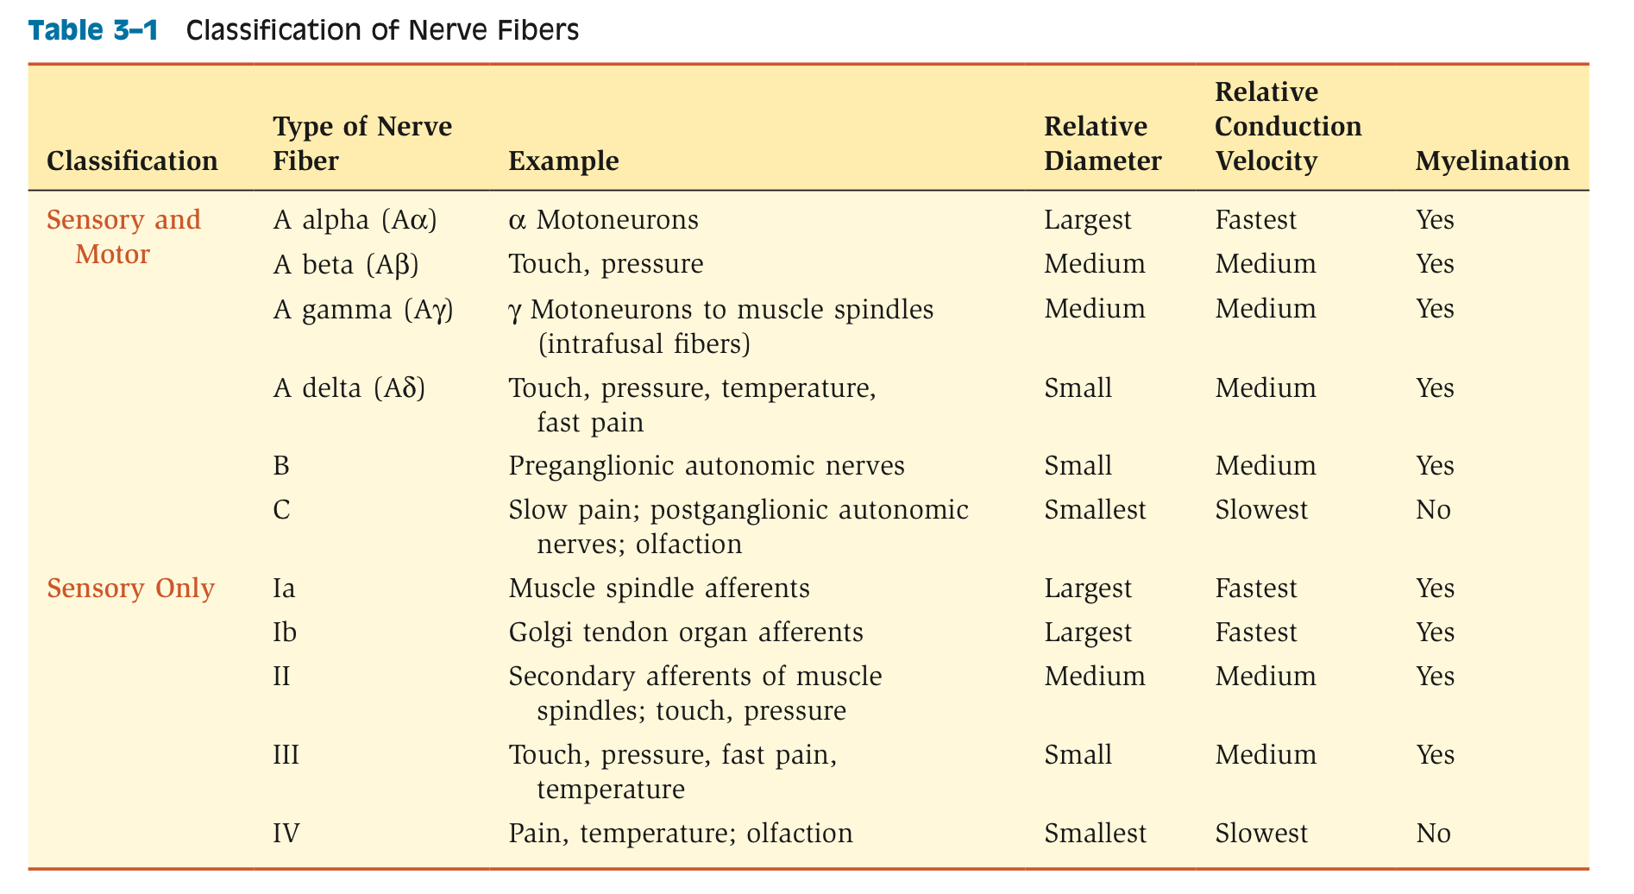
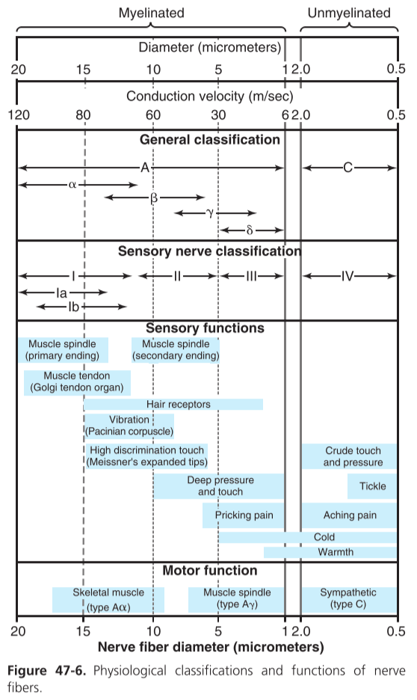
Classification of Receptors

Slide 3
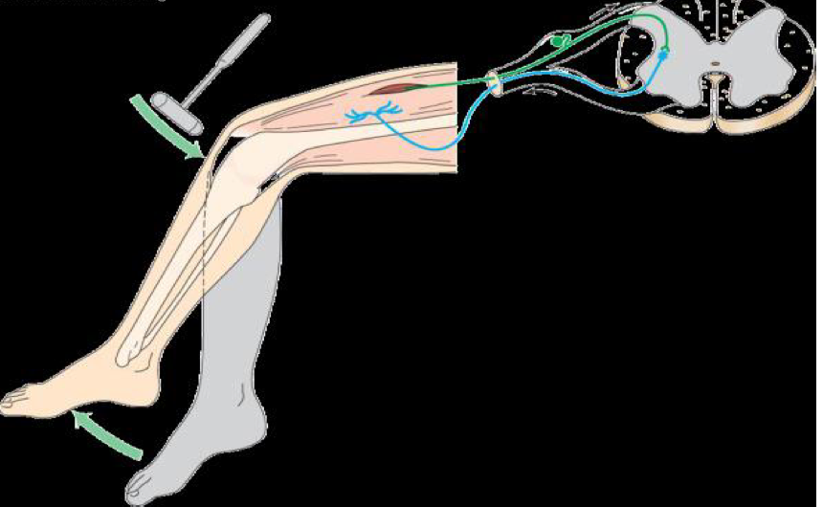
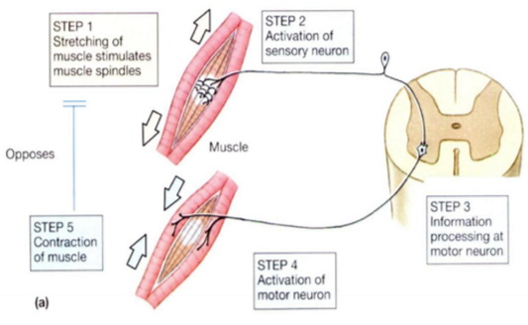
The stretch reflex :
Reflex | Stretch “myotatic” reflex
Clinical stimulus | Rapid stretch of of muscle (tap on muscle tendon)
Response | Contracted rapidly “i.e knee jerk”
Sensory Receptor | Muscle spindle
Synapse involved | Mono-synaptic
Effector muscle | Contract same muscle & synergistic muscles
Other effects | Relax antagonist muscles
Function | Aids in maintaining Posture, Avoiding muscle rupture, Counter sudden loads
What is the stretch reflex “myotatic reflex” ?
It is reflex contraction of muscle when it is moderately stretched.
it has two components:
dynamic stretch reflex
patellar-tendon or knee jerk reflex
static stretch reflex
muscle tone
IT IS :
Deep monosynaptic reflex .
The simplest ;it involves only 2 neurons & one synapse.
Pathway Of the Stretch Reflex “Reflex Arc”:
Sensory Receptor : muscle spindle
Afferent fibers (group Ia & II afferents)
Integrating center: spinal cord
Efferent fibers include/ axons arise from α-and γ-spinal motor neurons
alpha motor efferent from alpha motor neurons to supply extrafusal muscle fibers
gamma efferent (from gamma motor neurons to supply intrafusal muscle fibers
Effector: Skeletal muscles
Doctor’s note:
•stretch reflex is the only monosynaptic reflex in the body (direct synapse between the afferent and efferent neurons) •because it is the only monosynaptic that means it is very fast
Doctor’s note:
•the reflex is very fast because
1)sensory afferent is type 1A
2)center is monosynaptic
3)efferent is alpha motor neuron

Slide 4
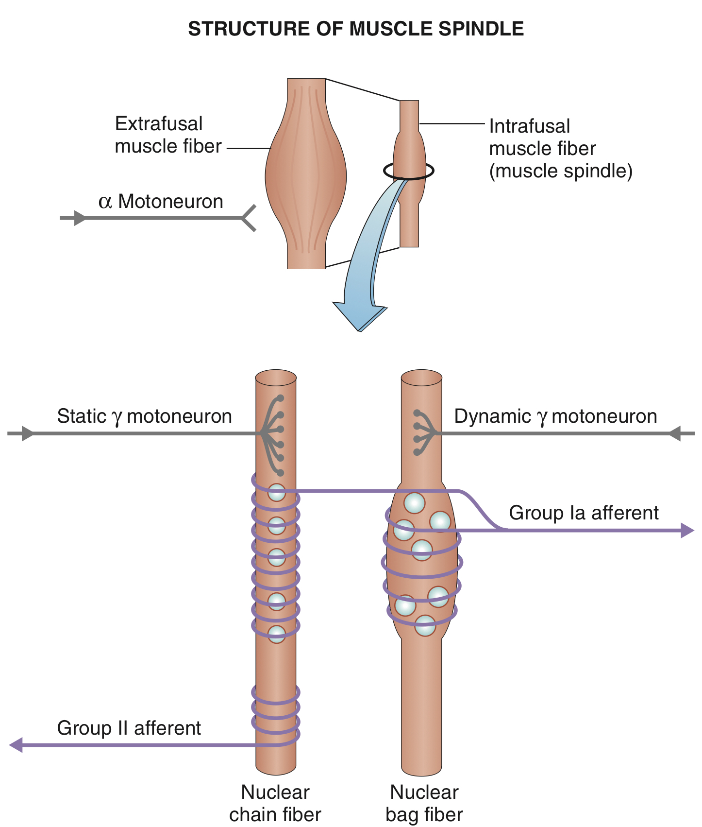
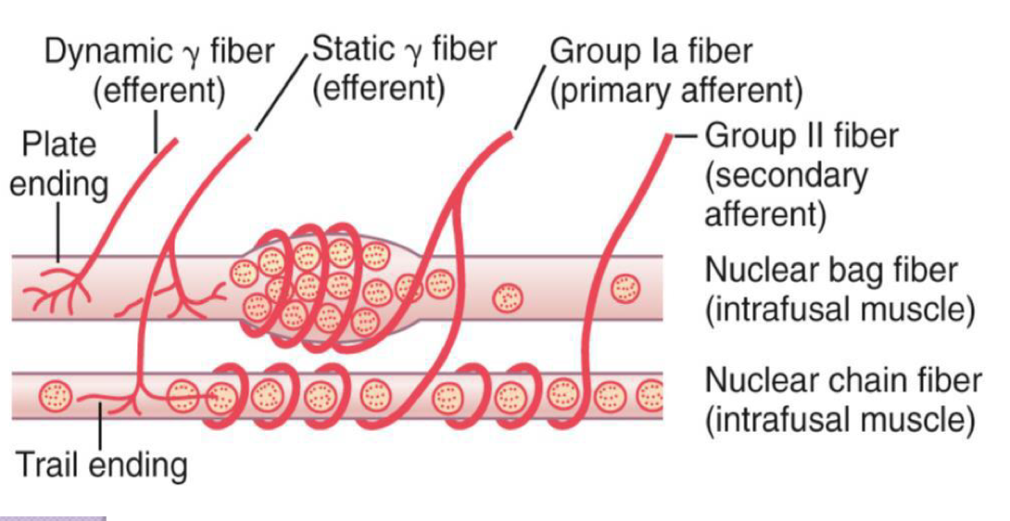
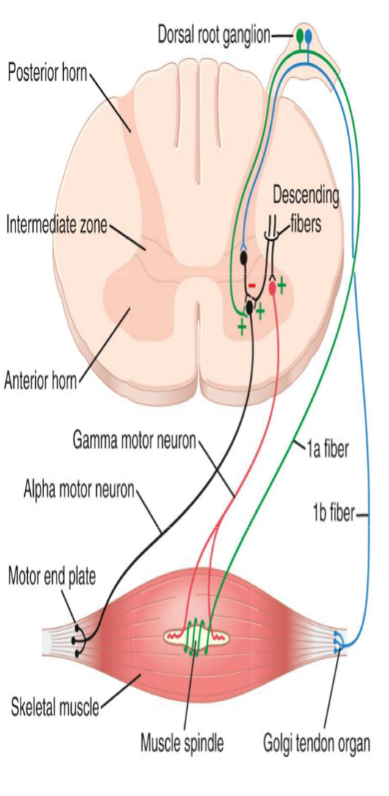
1-Stretch reflex receptor (Muscle Spindle):
is located in the fleshy part of the muscle
consist of 3-12 small intrafusal fibers within a capsule
each intrafusal fiber has a central “non-contractile” area (receptor), and a contractile area on each side. the contractile area has myosin & actin so that’s why it can contract.
There are two types of intrafusal muscle fibers :
Nuclear bag fibers :
have a dilated central area filled with nuclei
are 1-3 of these fibers per spindle
Nuclear chain fibers :
have nuclei which are arranged as a chain in
the receptor area
are 4-9 of these fibers per spindle
2-Sensory “Afferent” innervation of the muscle spindle The Central receptor area of the intrafusal muscle fibres is supplied by
TWO types of afferent fibres:
GROUP Ia
GROUP II
A-primary ( annulospiral ) ending :
GROUP Ia fiber: 17 micrometers diameter, transmits
sensory signals to the spinal cord at a velocity of
70 to 120 m/sec.
encircle receptor areas of both nuclear bag (mainly)
but also with nuclear chain fibres.
discharge most rapidly if the muscle is suddenly stretched
“dynamic response” and less rapidly (or not ) during
sustained stretch “Static response”.
measures the rate & or velocity of change in muscle length
of nuclear bag fibers.

Slide 5
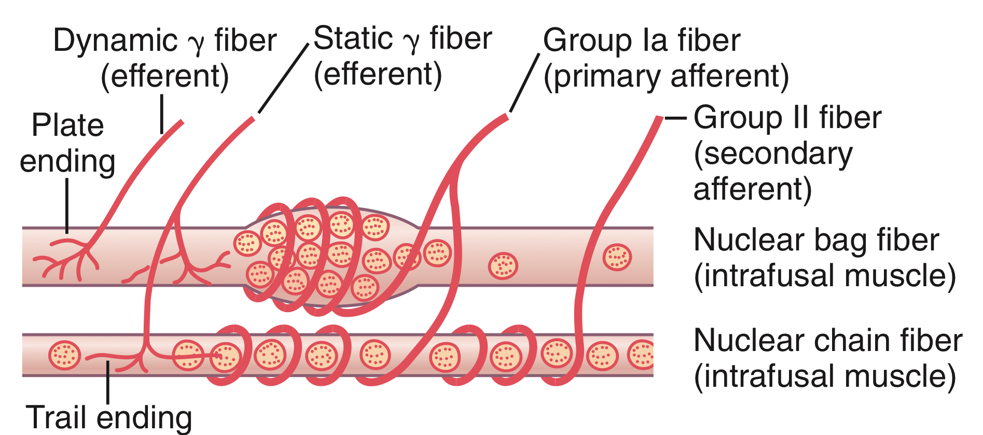
B-Secondary (flower-spray) ending:
Group II fibers “diameter of 8 micrometers”, innervate ONLY the nuclear chain receptor.
Discharge at an increased rate throughout the period of muscle stretch, (sustained stretch) (measure mainly muscle length).
directly proportional to the degree of stretch.
N.B:
Nuclear bag fibres are supplied by primary endings only, & responsible for the dynamic response.
Nuclear chain fibres are supplied by both primary and secondary endings & responsible for the static response.
2-Efferent innervation of the muscle spindle
Gamma (γ) efferent endings terminate on the peripheral contractile parts of the intrafusal fibers as:
plate endings: end mainly on the nuclear bag fibers “called dynamic gamma efferent”
Trail endings: end mainly on the nuclear chain fibers “called static gamma efferent”
The function of γ-motor neurons is to regulate the sensitivity of the intrafusal muscle fibers, but HOW? by increasing of muscle spindle sensitivity.
they adjust the muscle spindle sensitivity.
↑ γ-MNs cause contraction of the peripheral parts of intrafusal fibers → stretch of central parts of muscle spindle → ↑ the sensitivity of the muscle spindle to stretch → muscle spindle needs a small amount of passive stretch to be stimulated.
Doctor’s note:
•they are smaller than alpha but they are very important (they represent around 30% of all motor neuron in the spinal cord)
•if we increase gamma we will increase the sensitivity of the muscle e.g. If I want to contract a muscle through the corticospinal tract I need for example 5 impulses for contraction if gamma discharge we will need 2 impulses
Functions of muscle spindle
keep CNS informed about muscle length & rate or velocity of change in muscle length.
provide information about position, that is called PROPRIOCEPTION.
muscle spindle act to oppose stretch & maintain muscle length against rupture.

Slide 6
How Muscle Stretch Is detected?
stretching of the muscle also stretches the spindle.
this sends impulses to the spinal cord.
the number of impulses sent are proportional to the stretched length of the muscle.

Slide 7
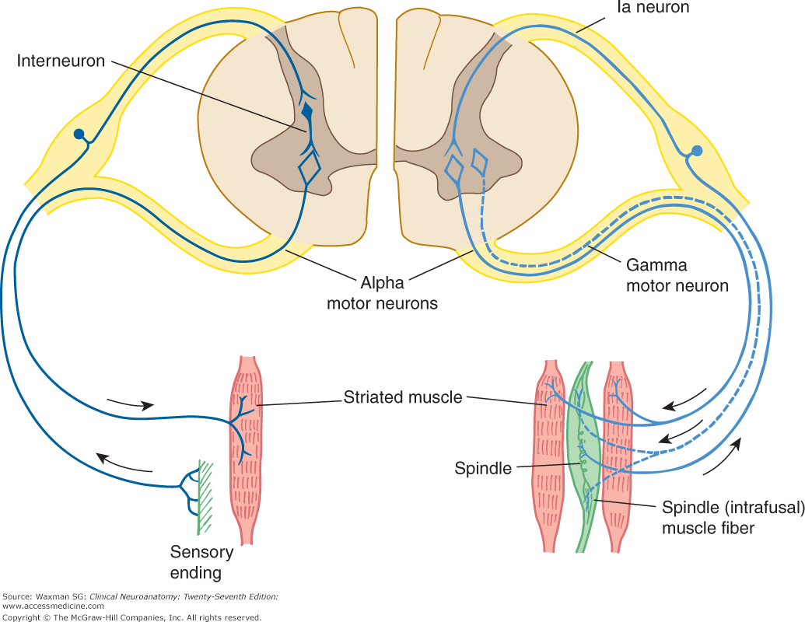
Stretch reflex .cont:
Stretching of the muscle → Stretching extrafusal muscle fibers → Stretching intrafusal peripheral contractile fibers → stretching receptor zone (central) in intrafusal fiber → stimulation of sensory afferent endings encircling receptor area → Afferent impulses → spinal cord → stimulate:
alpha motor neurons (70% of supply) which send impulses to extrafusal ordinary muscle fibres → muscle to contract.
gamma motor neurons (30% of supply) which send impulses to intrafusal peripheral contractile fibers causing contraction of the peripheral contractile parts of the intrafusal fibres & stretch central area “receptor”.

Slide 8
Dynamic stretch reflex
sudden “phasic” rapid stretch of a muscle causes synchronous strong burst of excitatory discharges from Nuclear bag fibers in annulospiral “Primary” afferents to the alpha motor neuron.
this causes the latter to send strong motor excitatory impulses to extrafusal fibers → causing sudden, jerky “brief” muscle contraction (Jerky movement).
as the muscle shortens → the spindle becomes lax → and ceases to discharge → no more stimulation of alpha motor neuron → no more excitatory impulses from alpha motor neuron to the extrafusal fibers → muscle relaxes.
This is the basis of Tendon Jerks “Dynamic stretch reflexes”.
Static stretch reflex
Maintained “Tonic” stretch of muscle →
impulses from Nuclear chain fibers travel through spindle afferent fibers (mainly along Flower Spray “secondary” ending) to alpha motor neuron, stimulating it to produce muscle contraction.
Causing sustained “continuous” contraction of the muscle as long as it is stretch.
The static stretch reflex is the basis of muscle tone; which is defined clinically as resistance to muscle stretch.
Types of Responses of muscle spindle to stretch
(Types of Stretch Reflexes)
 | Dynamic response | Static response
Stimulus | Sudden stretch | Maintained “steady” stretch
Receptors | Nuclear bag | Nuclear chain
Afferent | Primary ending | Primary & Secondary ending
Efferent | Dynamic γ efferent | Static γ efferent
Center | Spinal cord “AHC” | Spinal cord “AHC”
Response | Rapid contraction followed by rapid relaxation | Maintained subtetanic contraction
Examples | Tendon jerk | Muscle tone

Slide 9
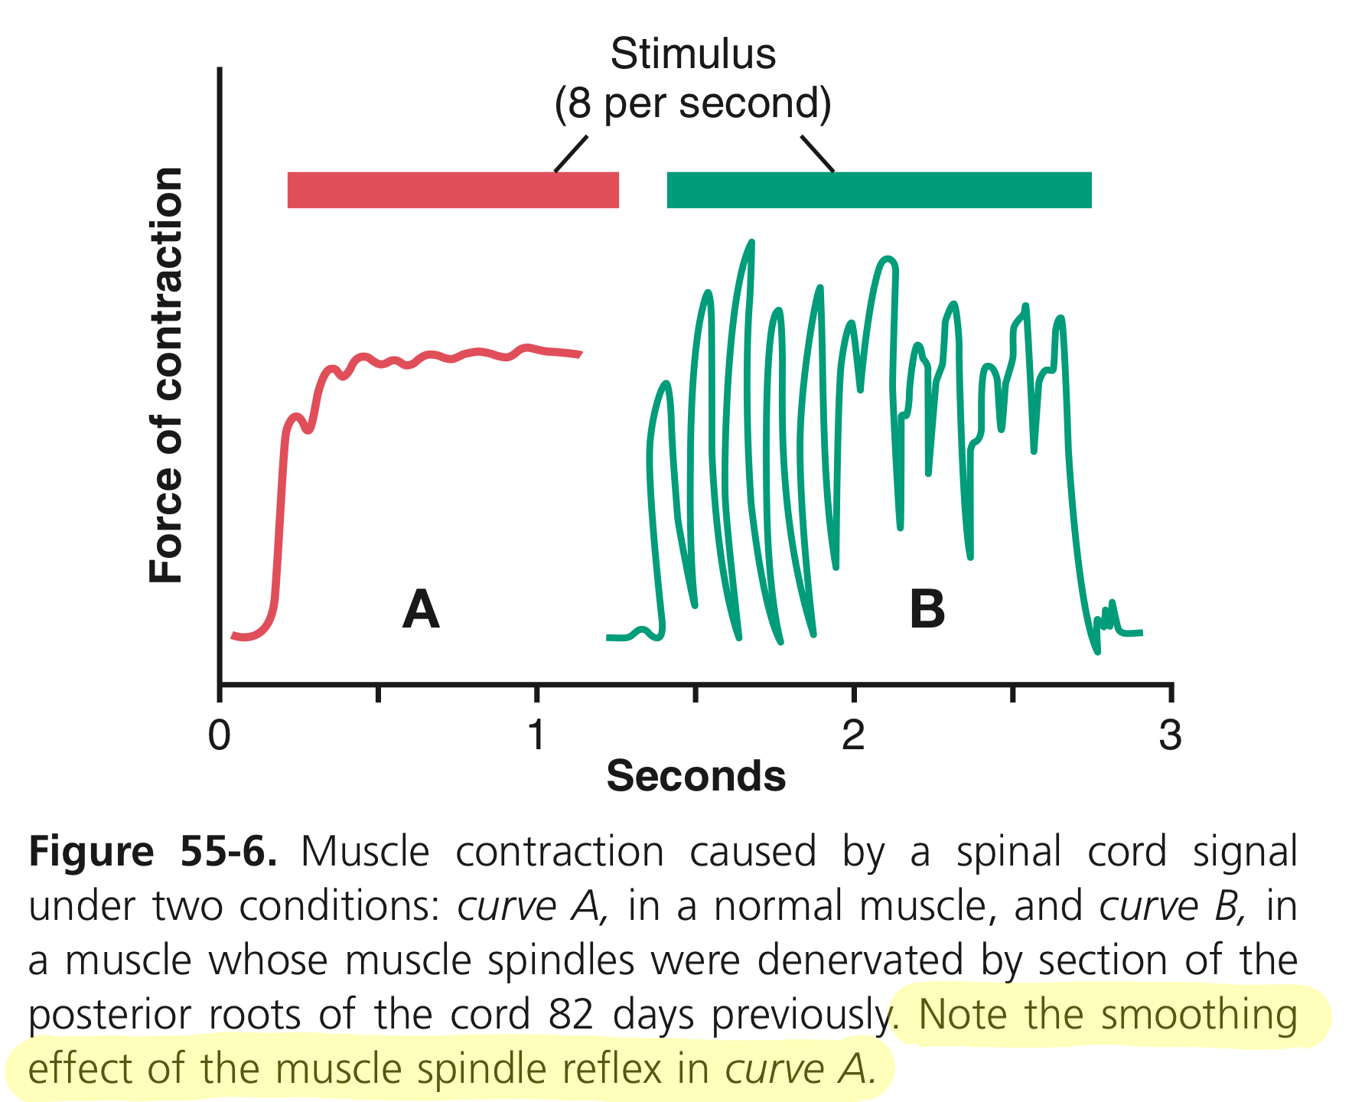
Muscle Tone
is defined as a state of continuous partial “mild” contraction of skeletal muscle during rest.
it is present in all skeletal muscle but specially in the antigravity muscles:
extensors of LL, back, neck
Flexors of UL
Muscles of abdominal wall and elevator of mandbile
if lost by low gamma efferent discharge to muscle → hypotonic muscle or flaccidity.
if increased by high gamma efferent discharge to muscle → hypertonic muscle , spastic muscle.
Functions of Muscle tone:
postural control.
help in heat production and maintain of body temperature.
it helps both the venous return & lymph flow.
keeps viscera in position.
Doctor’s question & answer
Q: why there’s a muscle tone?
A:
1- muscles are always shorter than their origin-insertion distance, so the always will be contracted
2- Gravity
3- Gamma motor neuron discharges from higher centers
“Damping” or smoothing function of Stretch Reflexes
Is the stretch reflex ability to prevent oscillation or jerkiness of body movements.
Motor Signals from the motor area are transmitted to the muscle in an unsmooth form, with increasing or decreasing intensity for few milliseconds.
this causes irregularities or oscillation of movements
the signals discharged from from the muscle spindle cause partial activity of a-MNs of the muscle.
So, the motor signals find a-MNs in state of partial activity, so they cause continuous activation of them → cause smooth muscle contraction.
Doctor’s note about the figure:
•when the cut the posterior root of the spinal cord (denervation)(that supply the muscle spindle ) → we will have irregular jerking or oscillations (that means that the muscle spindle will smooth contraction (damping) → the theory of the cause is that when we have muscle contraction the muscle will shorten and then we will have relaxation → the muscle will stretch → activation of gamma motor neuron will do the contraction (the area in B we wont have activation of gamma that will fill the space make and make it smooth )

Slide 10
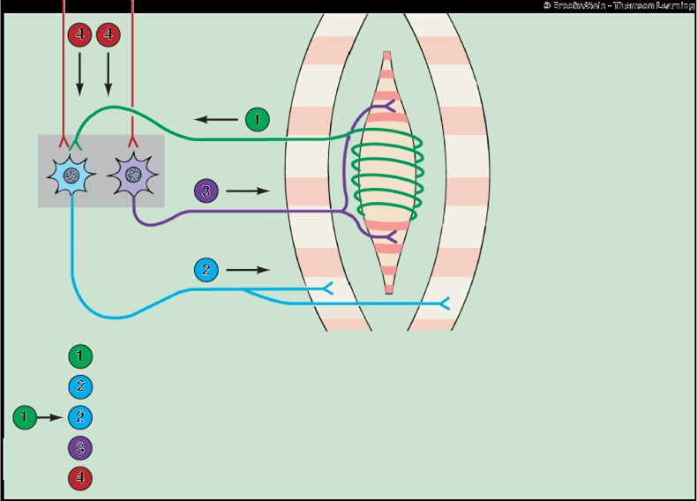
How Are Muscle Spindles Stimulated?
Passive stretch of the whole muscle:
it causes stretch of muscle spindle which lies parallel to muscle fibers
Activation of the γ-MNs:
by supraspinal centers or reflexely
it causes contraction of the peripheral part of the intrafusal fibers → stretch of receptor area
Co-activation of α-and γ-Motor Neurons “ α-γ Linkage”:
Signals from motor cortex to the alpha motor neuron, mostly transmitted to the gamma motor neurons simultaneously, an effect called Coactivation.
what is the significance of this coactivation?
Regulate the sensitivity of the spindle by keeping its length constant
oppose sudden changes in muscle length.
CONSCIOUS AWARENESS
Axon collaterals of the muscle spindle sensory neuron also relay nerve impulses to the brain over specific ascending pathways, to allow conscious awareness that the reflex has occurred.
In this way, the brain receives input about the state of stretch or contraction of skeletal muscles to coordinate.
Afferent input from sensory endings of muscle spindle fiber
Alpha motor neuron output to regular skeletal-muscle fiber
Stretch reflex pathway (Arc)
γ-motor neuron output to the contractile end of spindle fiber
Descending pathways co-activate α- and γ- motor neurons

Slide 11
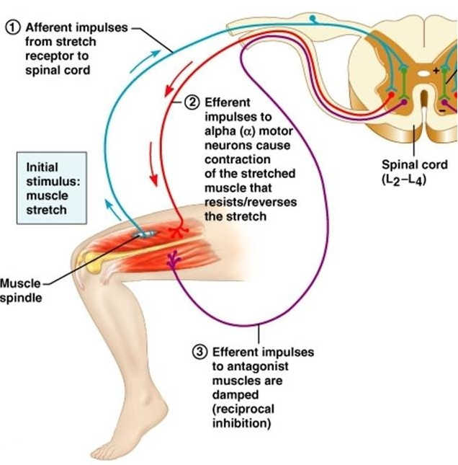
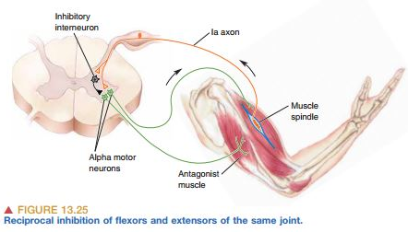
Reciprocal inhibition with stretch reflex (Reciprocal innervation)
as in a knee jerk
Contraction of EXTENSOR of thigh cause Relaxation of FLEXORS
Reflex contraction of an agonistic muscle is accompanied by inhibition of the antagonist
Impulses from stretched muscle reach spinal cord to cause:
stimulate the motor neurons of the stimulated muscle to contract ( by glutamate)
send collaterals to the inhibitory interneurons synapse on the AHCs of the antagonistic muscle & inhibit them (by GABA)
Reciprocal innervation prevents conflict between opposing muscles and is vital in coordinating body movements.

Slide 12
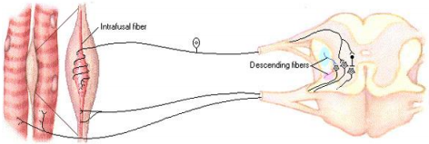
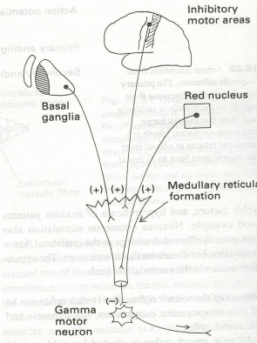
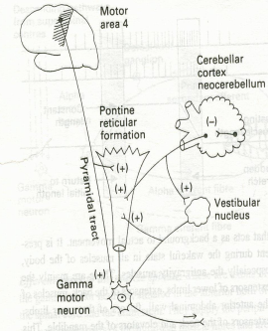
SUPRASPINAL REGULATION OF THE STRETCH REFLEX Stretch reflexes are subject to strong regulation by supraspinal centres, especially certain motor centres in the brainstem and cerebral cortex.
These supraspinal centres send to gamma motor neurons through descending fibres.
Inhibitory supra spinal centers to gamma motor
Facilitatory supra spinal centers to gamma motor neurons

Slide 13
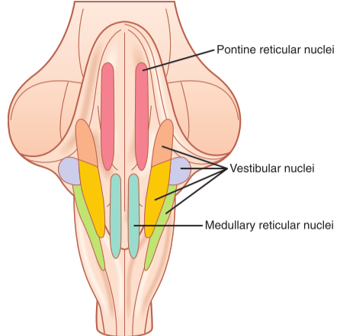
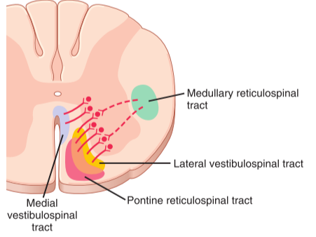
Factors influence stretch reflex “all act on gamma motor neurons”
Enhances | Inhibits
Supraspinal: Primary motor area 4 Vestibular N Pontine RF Neocerebellum “Cortex” | Supraspinal - Cortical: (suppressor area 4 & Area 6) Basal ganglia Medullary RF Red nucleus paleocerebellum “Deep”
Spinal mechanisms: Noxious “painful” stimuli Anxiety Jendrassik maneuver | Spinal mechanisms: Excessive muscle stretch (stimulation of golgi tendon organ) Muscle contraction
Doctor’s note:
•Jendrassik-maneuver e.g. if you do the stretch reflex and don’t find a response (could be problem with the reflex arc to make sure it Is not we do the maneuver) → I will tell the patient to clenches his teeth and flexes both sets of fingers into a hook-like form, and interlocks those sets of fingers together → this will increase the gamma discharge → facilitate the stretch reflex

Slide 14
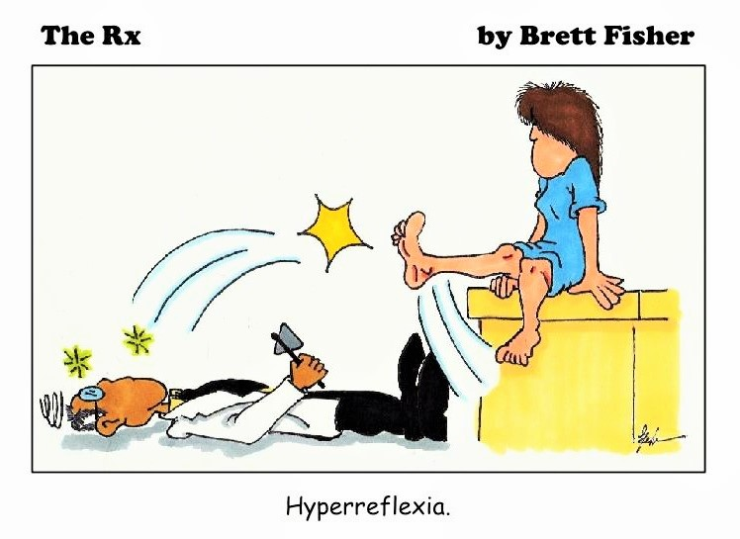
Clinical application of stretch reflex: Knee Jerk Reflex
contraction of the muscle being stretch “Quadriceps”.
Reciprocal inhibition of the antagonist muscle “Hamstring” through reciprocal innervation.
What is the Clinical Significance of Tendon Reflexes ? They are carried out clinically to test the integrity of reflex arc.
Areflexia or hypo-reflexia (hypo-tonia) indicates that the reflex arc is interrupted at one of its components by:
Lesions of lower motor neuron, e.g. poliomyelitis
Peripheral nerve lesions e.g. peripheral neuropathy, Diabetic neuropathy
Neuromuscular junction disorder e.g. myasthenia gravis
Primary muscle disorder e.g. myopathy
Hyper-reflexia (hyper-tonia): exaggerated deep reflexes.
Upper motor neuron lesion.
Anxiety

Slide 15
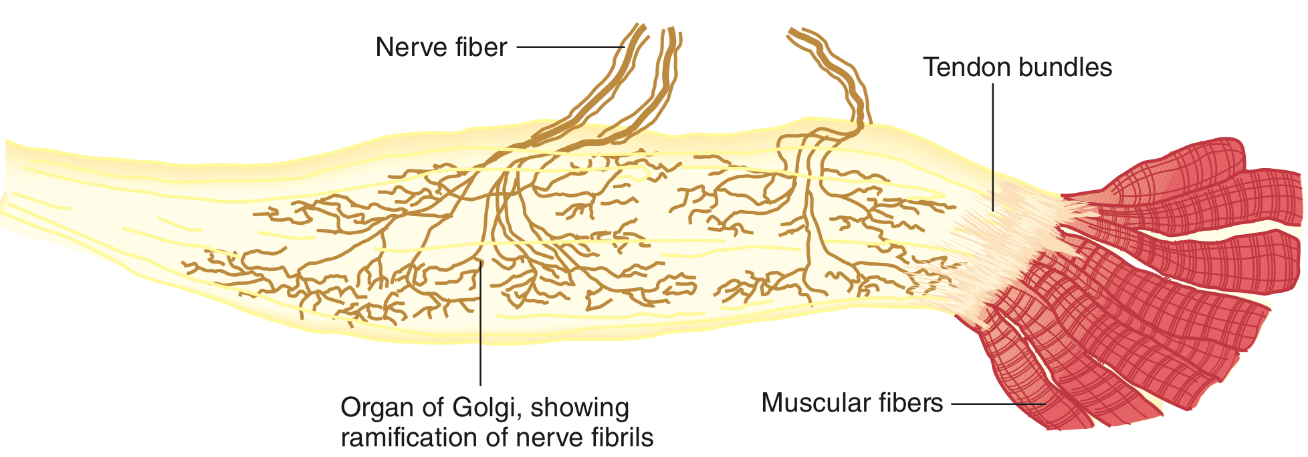
Inverse Stretch Reflex
(Golgi Tendon Reflex)
up to a point, the harder a muscle is stretched, the stronger is the reflex contraction.
however, when the tension becomes great enough, contraction suddenly ceases and the muscle relaxes.
This relaxation in response to strong stretch is called Inverse Stretch Reflex.
The Receptor for the inverse stretch reflex is in the Golgi Tendon Organ.
The inverse stretch reflex:
Reflex | Golgi tendon or inverse stretch reflex (autogenic inhibition)
Clinical test stimulus | increased tension by large force on tendon (pull on muscle when rested)
Response | Muscle tendon decreases (calsped knife reflex)
Sensory receptors | Golgi tendon organ “ at the tendon, not the fleshy part”
Synapses involved | Polysnaptic (via interneuron)
Afferent | Type Ib afferent fibres
Effects on muscle | Relaxes same muscle Relaxes synergistic muscles
Other effects | Contraction(+) of an antagonistic muscle
Function | Protective (prevents damage to tendon)

Slide 16
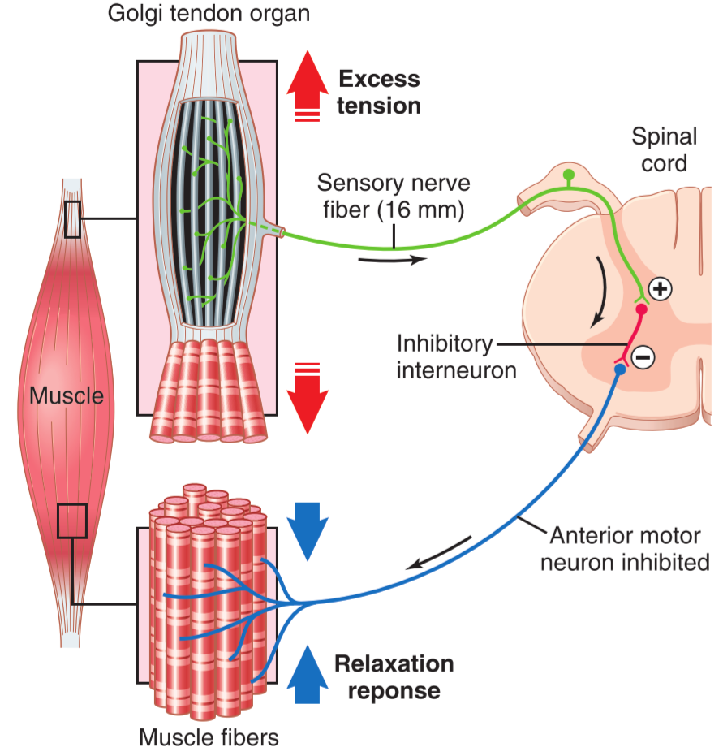
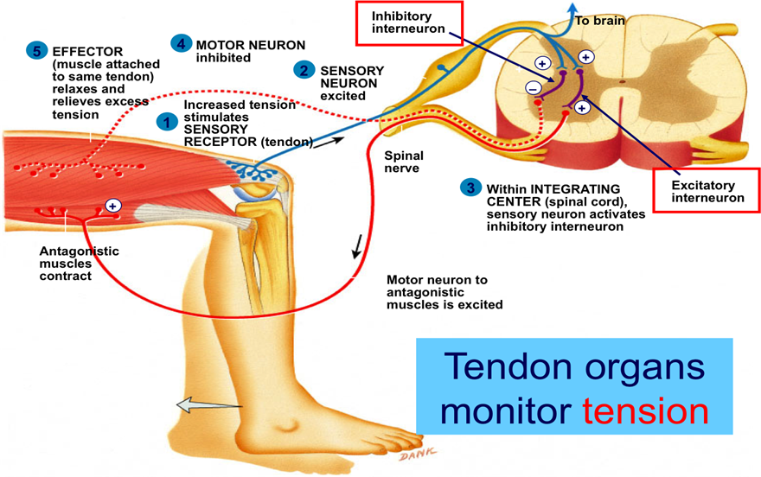
Receptor Golgi tendon organs
The golgi tendon reflex (Inverse stretch reflex):
It is a deep and polysynaptic reflex
Opposite response to stretch reflex
mechanism:
excessive tension in the muscle (By passive over stretch of
tendon or severe active muscle contraction)
causes muscle relaxation
Golgi tendon organs(3-25): They are present in
tendons and encapsulated sensory receptors
through which muscle tendon fibers pass.
About 10 to 15 muscle fibers are usually connected to each golgi tendon organ
they Transmit information about tendon tension or rate of change of tension.
the organ is stimulated when this small bundle of muscle fibers is “tensed” by severe contraction.
Thus, the major difference in excitation of the Golgi tendon organ versus the muscle spindle is that the spindle detects muscle length and changes in muscle length, whereas the tendon organ detects muscle tension as reflected by the tension in itself.
Inhibitory Nature of the Tendon Reflex and Its Importance:
Stimulated golgi tendon organ by an increase in muscle tension impulses via fast Ib nerve fibers, large, rapidly conducting fibers that average 16 micrometers in diameter SC The local cord signal excites inhibitory interneuron (secrete Glycine) inhibit alpha motor neuron negative feedback mechanism muscle relaxation (lengthening reaction)
Also stimulate excitatory interneuron to antagonist (Reciprocal Innervation)
Value: Protects muscles from rupture and tendon avulsion and tear

Slide 17
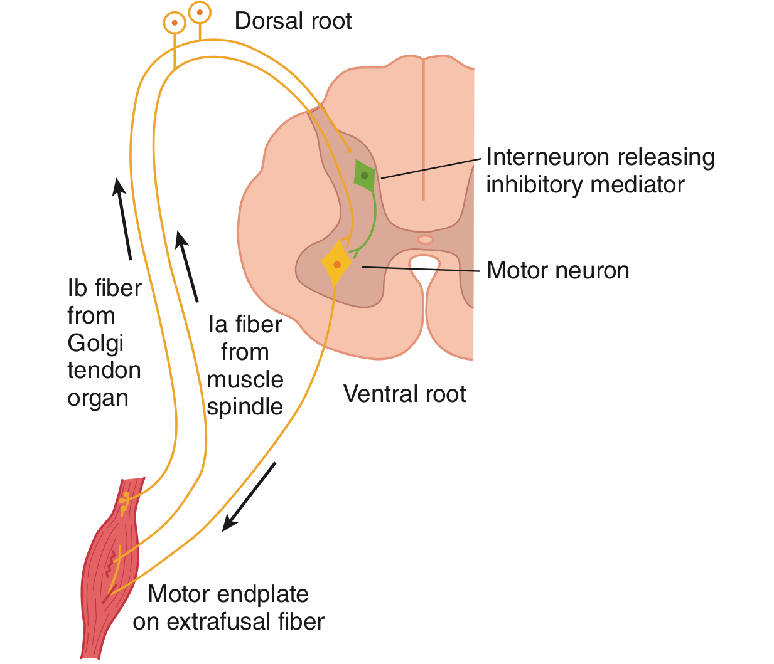
Comparison Between Stretch & Inverse Reflexes:
 | Stretch reflex | Inverse stretch reflex
Stimulus | Increased muscle length | Increased muscle tension
Response | Muscle contraction | Muscle relaxation
Receptor | Muscle spindles | Golgi tendon organs
Afferents | Type IA and Type II fibers | Type IB fibers
Synapses | Mono-synaptic | Poly-synaptic
Reciprocal Innervation Regulation | Inhibit antagonists through inhibitory interneurons | Excites antagonistic muscles through excitatory Interneurons
Physiological significance | Regulate muscle length Genesis of muscle tone | Regulate muscle tension to prevent excessive tension increase
Clinical assessment | Sudden tap of muscle causes brisk contraction muscle jerk | Over stretch of muscle-sudden muscle relaxation (lengthening reaction)

Slide 18
 | Withdrawal reflex | Crossed extensor reflex | Stretch reflex | Inverse stretch reflex
Stimulus | Sharp pain | Associated with (withdrawal reflex) | Increased muscle length | Increased muscle tension
Response | Limb is rapidly withdrawn, Contracts flexor muscle | Contract of the extensor | Muscle contraction | Muscle relaxation
Receptor | Cutaneous skin and pain receptors |  | Muscle spindles(3-12) | Golgi tendon organs (10-15)
Afferents | A delta or C fibres |  | Type IA and Type II fibers | Type IB fibers
Synapses | Polysynaptic (via interneuron) | Polysynaptic | Mono-synaptic | Polysynaptic
Reciprocal Innervation Regulation | Relaxes (-) extensor muscle of same limb | inhibit motor neurons of the flexors | Inhibit antagonists through inhibitory interneurons | Excites antagonistic muscles through excitatory Interneurons
Physiological significance | Protective - withdrawal from painful stimulus | supporting the body weight against gravity | Regulate muscle length | Sudden tap of muscle causes brisk contraction muscle jerk
Clinical assessment | Sharp painful stimulus (stepping on nail) |  | Sudden tap of muscle causes brisk contraction muscle jerk | Protective (prevents damage to tendon)
Synapses | Polysynaptic (via interneuron) | Polysynaptic | Mono-synaptic | Polysynaptic
Reciprocal InnervationRegulation | Relaxes (-) extensor muscle of same limb | inhibit motor neurons of the flexors | Inhibit antagonists through inhibitory interneurons | Excites antagonistic muscles through excitatory Interneurons
Physiological significance | Protective - withdrawal from painful stimulus | supporting the body weight against gravity | Regulate muscle length Genesis of muscle tone | Regulate muscle tension to prevent excessive tension increase
Clinical assessment | Sharp painful stimulus (stepping on nail) |  | Sudden tap of muscle causes brisk contraction muscle jerk | Over stretch of muscle-sudden muscle relaxation (lengthening reaction)

Slide 19
The number of synapses in the stretch reflex are:
. One (monosynaptic)
. Two (disynaptic)
. Three (trisynaptic)
. B&C
2. the spindles can send to the spinal cord in:
. Positive signals
. Negative signals
. No signal
. A&B
3. Which of the following is not a factor INHIBIT the stretch:
. Anxiety
. Basal ganglia
. excessive stretch reflex of muscle
. medullary RF
4. The response of golgi tendon reflex is:
. Muscle contraction
. no response
. muscle relaxation
. A&C
5. Muscle spindle is:
. sensory neuron
. motor neuron
. effector
. sensory receptor
6. motor neuron of stretch reflex:
. Alpha
. Type II
. Gamma
. A&C
7. Which of the following is NOT a factor enhance the stretch:
. Anxiety
. Jendrassik-manuver
. Excessive stretch of muscle
. Noxious painful stimuli
8. muscle spindles detect:
. Length
. Tension
. nothing
. A&B
9. golgi tendon organ activates group:
. Ib afferent nerves
. II afferent nerves
. Ia afferent nerves
. A&B
10. When a person steps on a tack with their left foot, flexor muscles on the right leg and extensor muscles on the left leg will be stimulated:
. True
. False
Answers:
1.A
2.D
3.A
4.C
5.D
6.D
7.C
8.A
9.A
10.B

