Slide 1
6th Lecture ∣ The Physiology Team
Hearing
Objectives:
Appreciate the functions of outer, middle and inner ear.
Describe nature of sound & its characteristics.
Function of semicircular canals & utricle & saccule.
To understand the role of middle ear in sound transmission, magnification and tympanic reflex effect.
Recognize the function of hair cells of inner ear.
Auditory pathway
Differentiate between conductive and perceptive deafness.
Hearing tests
Done by :
Team leader: Rahaf AlShammari, Fatima Balsharf, Abdulelah AlDossari, Ali AlAmmari.
Team members: Mohammed AlHasan, Hisham AlShayea, Afnan AlMustafa, Maha AlAmri, Rahaf AlShunaiber, Reem AlQarni, Shahad AlTayyash, Shahad AlZahrani
Colour index:
Important
Numbers
Extra
وَأَن لَّيْسَ لِلْإِنسَانِ إِلَّا مَا سَعَىٰ

Slide 2
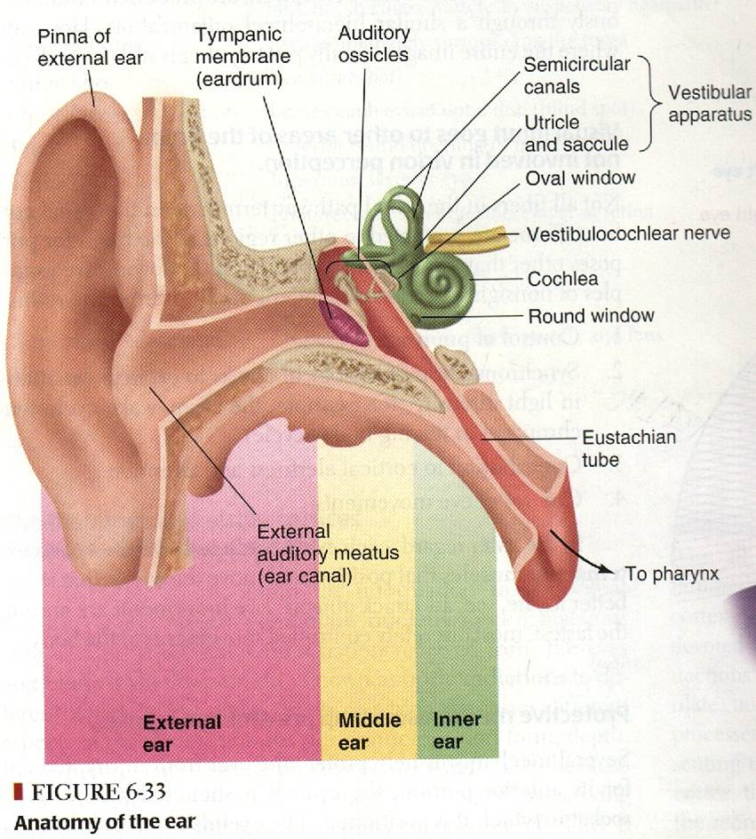
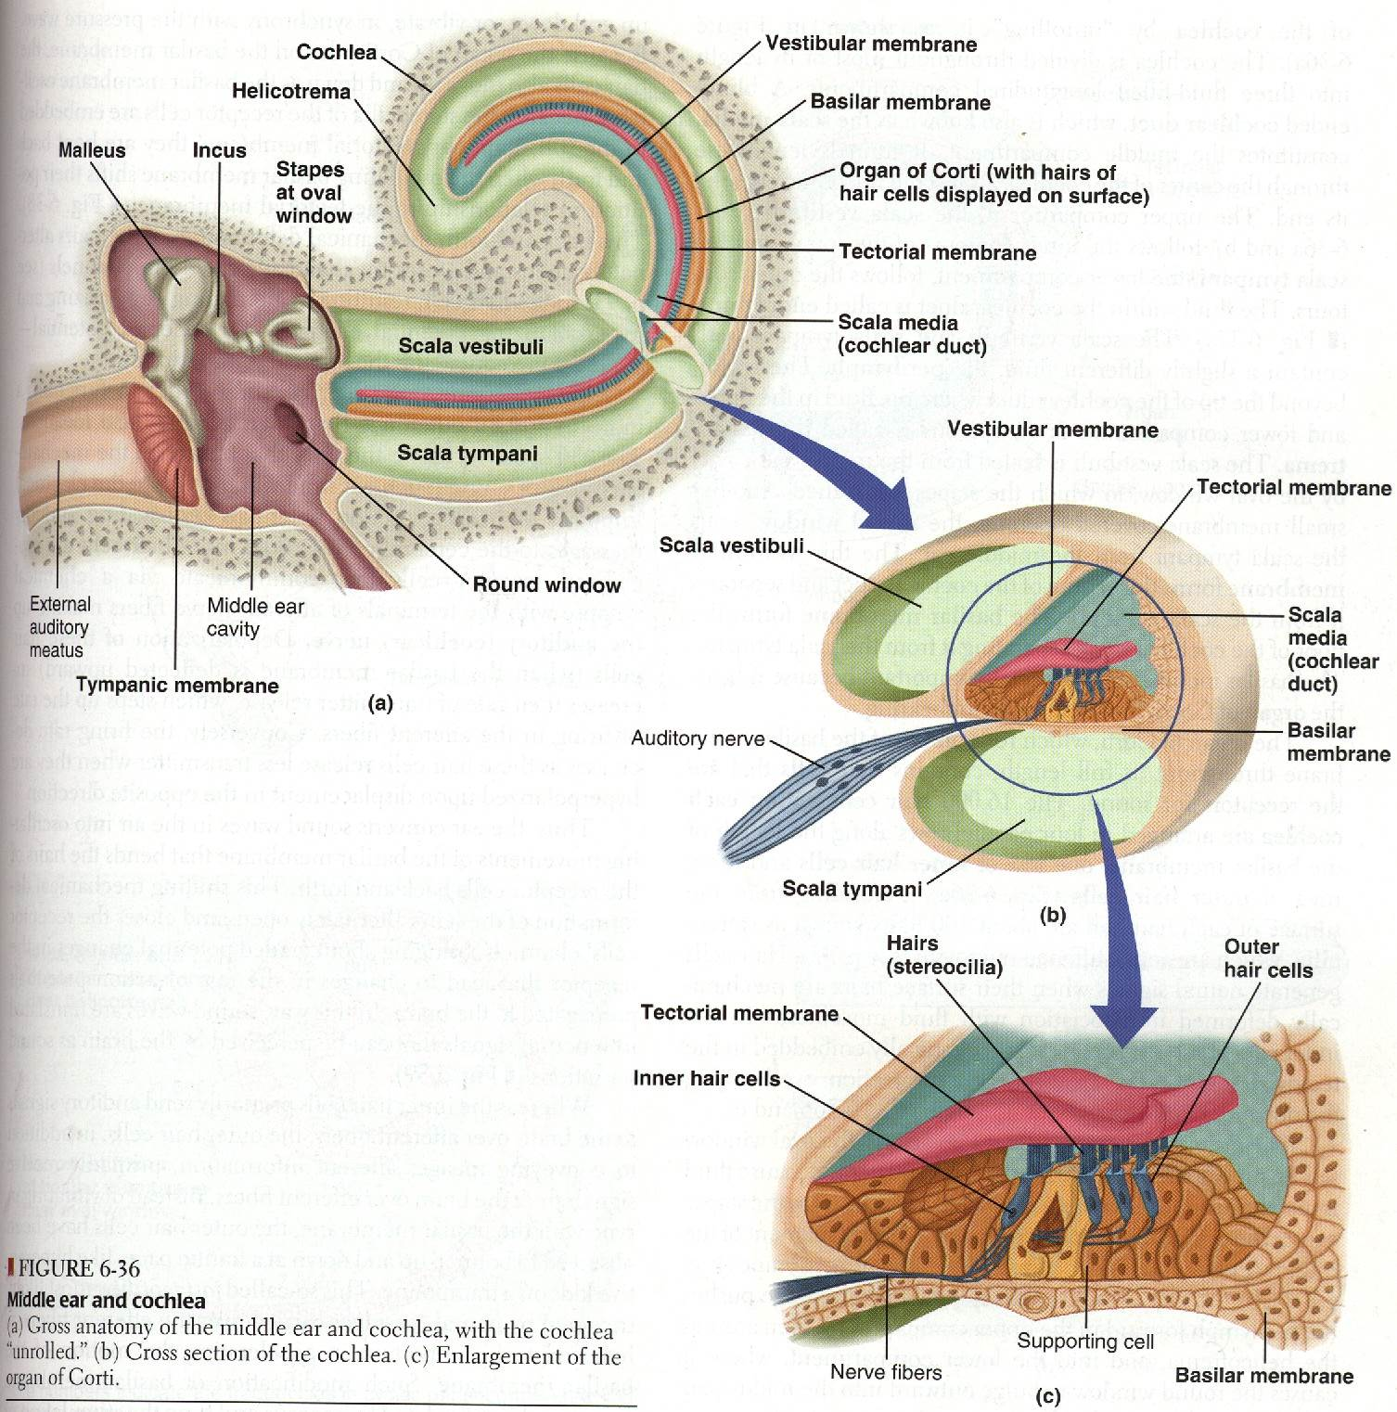
Functions of The Ear
Hearing (Parts involved):
External ear
Middle ear
Internal ear
Equilibrium sense (Parts involved):
Internal ear
Anatomical Consideration
Outer ear:
Pinna
External canal
Tympanic Membrane (funnel shaped, pointing inward)
Middle ear:
Air filled cavity
Three bones:
Malleus
Incus
Stapes (with its foot sitting on the oval window of the inner ear)
Inner ear:
Bony and membranous labyrinth

Slide 3
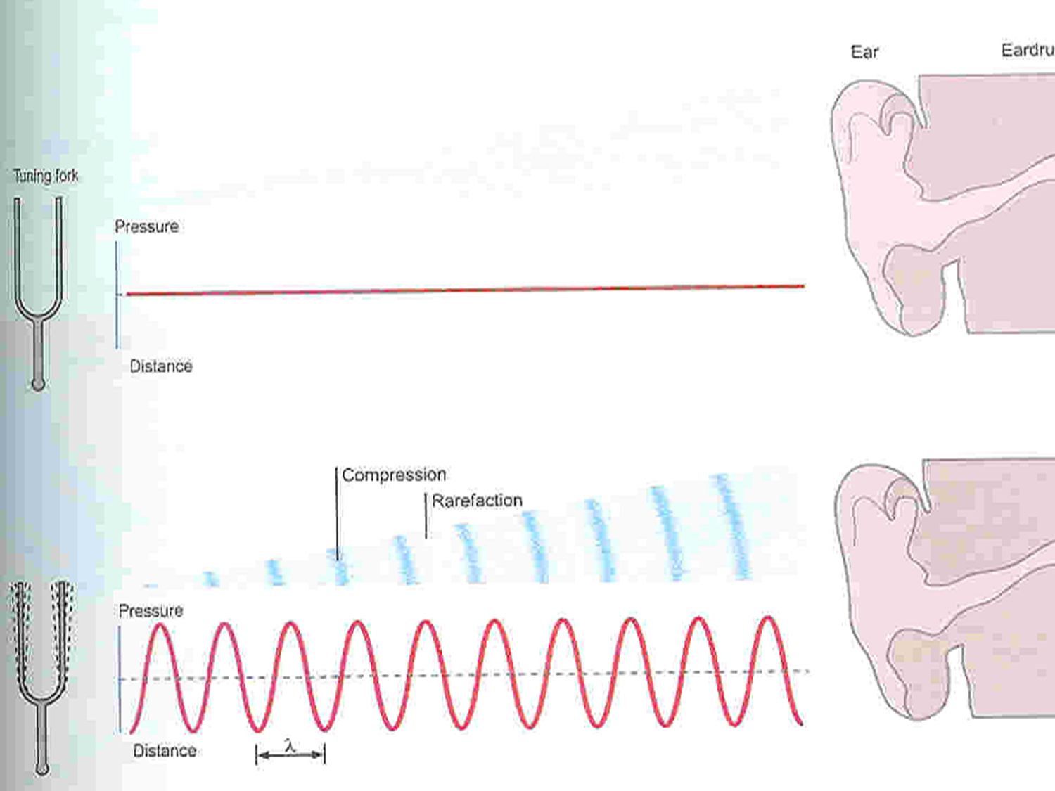
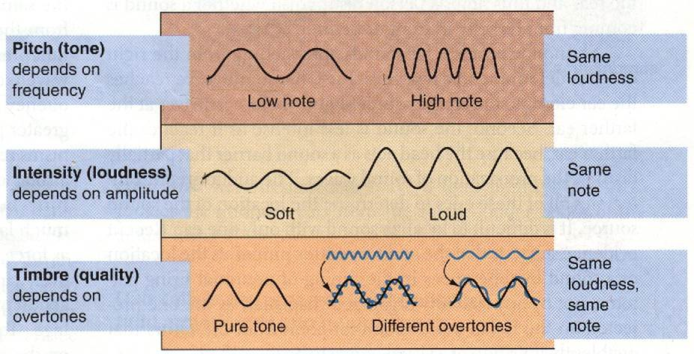
Describe nature of sound & its characteristics
Nature of Sound
Sound is a vibration that propagates as an audible wave of the pressure, through a transmission medium such as gas, liquid or solid.
Sound is produced from alternate compression and rarefaction of air molecules by vibrating body.
Compression- انضغاط
Rarefaction- تخلخل
Characteristics of Sound
Pitch (Tone) depend on No. of cycle/sec. (Human ear can detect sound waves with freq.. 20-20000 cycle /sec)
Intensity (Loudness) depend on amplitude.
Quality depend on the overtone or interference.

Slide 4
Functions of The Ear
1- External ear:
Act as funnel to collect sound
Sound localisation (front, back, high, low)
Alter amplitude (Pinna)
Protection Filtration by hair
Wax
Also, humidification and warming the air entering the ear
2- Middle ear:
It is a space between tympanic membrane and the inner ear (opens via Eustachian tube into nasopharynx)
Content:
Air
Ossicles: Malleus, Incus, Stapes. (Magnify the sound waves)
Manubrium Of the malleus attached to the back of the tympanic membrane and its short process attached to the incus.
The incus then articulates with the head of the stapes, and its foot plate attached to the oval window
Muscles: Tensor tympani, Stapedius.
Muscles contract reflexly in response to loud sound (over 70 dB)
Contraction of the tensor tympani pulls the manubrium & makes the tympanic m. tens. Thus decreasing the vibration.
Contraction of the stapeduispull the foot plate outward so that vibration are reduced
(protection from constant loud noise, but not sudden noise, latency of 40-80 msec.
Appreciate the functions of outer, middle and inner ear.
Connected to the atmospheric pressure
Loud noise anything over 80 dB; feel pain 140dB
Normal conversation 40 dB
Whispering 20-15 dB
3- Inner ear:
Anatomy:
Cochlea (snail like, coiled tubular system laying deep in the temporal bone)
Bony labyrinth
Membranous labyrinth

Slide 5
Transmission of Sound Through The Middle Ear
Sound waves vibrate the tympanic m.
Tympanic m. moves the handle of malleus
Incus moves
Stapes move in & out of the oval window. The pressure transmitted through cochlea cause stimulation of hair cells in the organ of corti, which will stimulate the auditory nerve
G
effect
The role of middle ear in sound transmission, magnification and tympanic reflex effect.
Middle Ear Magnifying
The force from a large surface area (Tympanic m.) are concentrated to a small (oval window) the ratio is 17=1
Lever action of ossicles= the lever action of ossicles increase the force of movement 1.3 times
▲ the total increase 17 X 1.3 = 22 times
Inner ear
It is a system of three coiled tubes through its length.
The basilar m. & the reissner's m. divide it into three canals:
Scala Vestibuli
Scala Media
Scala Tympani
Composition
Scala Vestibuli | Na high | K low
Scala Tympani | Na high | K low
Scala Media | Na low | K high

Slide 6
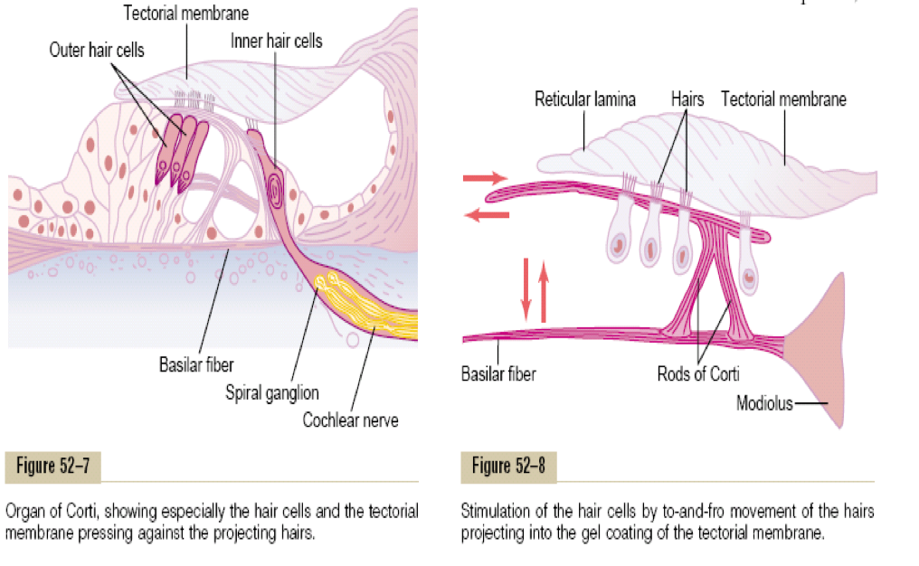
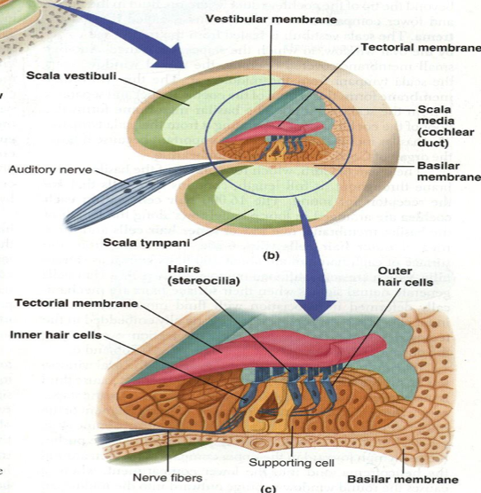
Recognize the function of hair cells of inner ear.
Organ of Corti
Located (resting) on the basilar m.
Contain inner & outer hair cells.
Extend from base to apex
Hair Cells
Stereocilia extend from the top
Arrangement:
Three rows of outer hair cells (attached to the reticular lamina or tectorial m.)
One row of inner hair cells (not attached to tectorial m.)
Function of Inner Hair Cells | Function of Outer Hair Cells
Striocellia not embedded in tectorial m. but bent by fluid movement under the tectorial m. | Large number, but stimulate only small fraction of nerve fibres in the cochlear nerve.
They are primary receptors for sound, transducing fluid movement in cochlea into action potential in the auditory nerve | If damaged, significant loss of hearing (they control the sensitivity of inner hair cells to particular sound frequency)
by controlling the tension of the basilar membrane
Receptors & Endocochlear Potentials
Sound transmission into the inner ear cause upper & lower movements of the reticular m. (tectorial m.)
» produce bending of stereocilia of the hair cells alternatively open & close cation channels at the tip of the stereocilia
» (inward current) depolarization
» (outward current) hyperpolarization
» the net results is depolarization
Production of cells receptors potentials
» release of neurotransmitter
»production of action potentials

Slide 7
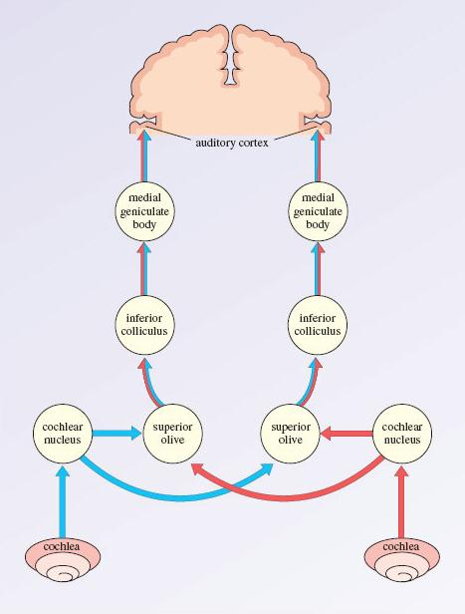
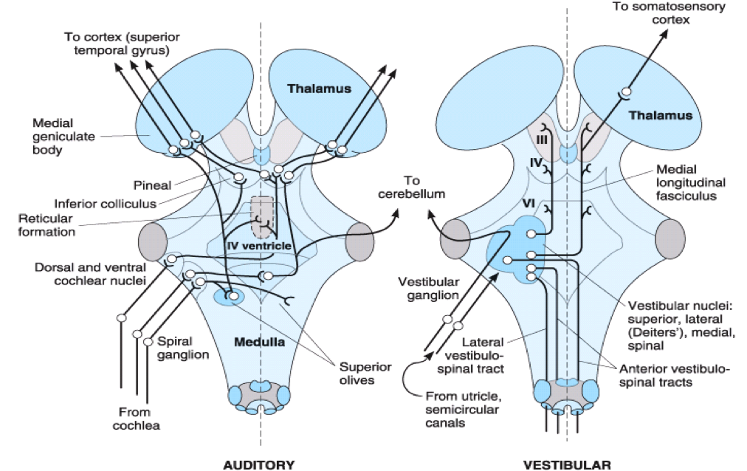
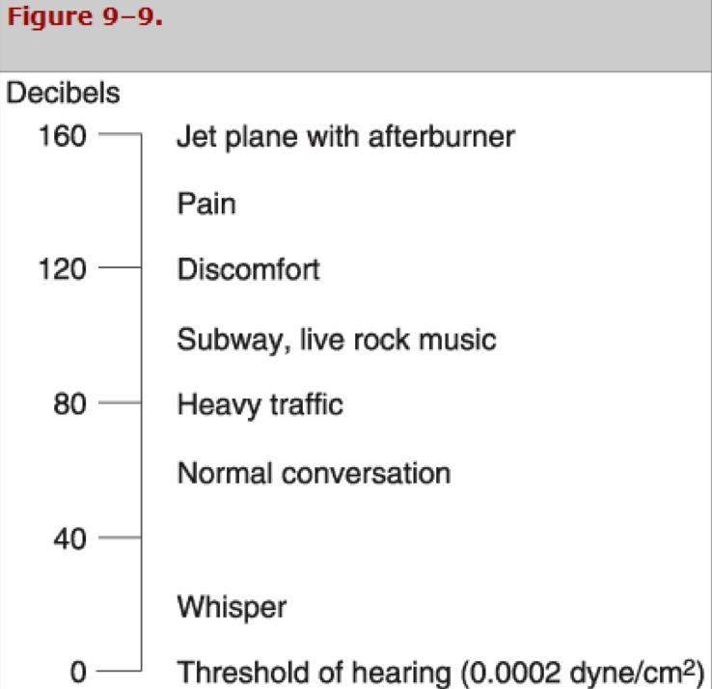
Auditory pathway
The Central Auditory Pathway
This pathway begins in the organ of corti.
End in the primary auditory cortex (are 41 & 42, superior temporal gyrus in the temporal lobe of the brain)
Fibres end in the auditory area, where it is heard, then interpretation occurs in the auditory association areas (wernicke area)
There is a bilateral cortical connection of auditory area
Thus damage to one side only slightly reduces hearing
Complete hearing loss is inherited & unlikely
Sound Localization
Differences in the time arrival of the sound wave at the ears (time-lag)
Differences in the loudness
Masking Effect
Presence of one sound decreases an individual’s ability to hear other sounds. This phenomenon is known as Masking.
Presence of background noise affect the ability to hear another sound, due to some receptors are in refractory period
Masking is more clear if two sound are having the same frequencies.
Note: In children, their cochlea for a particular sound waves frequency is producing AP, therefore any sound waves will come in the same freq. will not be perceived by this organ of corti because the nerve here is in refractory period, it will not be able to receive any impulses (they will not hear if you call them until you change your tone of voice).
Noise pollution
Noise pollution is an environmental hazard.
Exposure to sound intensity above 80 db. may damage outer hair cells.

Slide 8
Differentiate between conductive and perceptive deafness.
Conduction of Sound Wave
Air conduction | Bone conduction
Normal situation of hearing, sound travel in air causes vibration of Tympanic m., transmitted by ossicles to the oval window | Sound cause vibration of skull bones directly transmitting the sound vibration to the cochlea (eg when placing tuning fork on the head or mastoid process)
Deafness
Conductive Deafness
Perceptive Deafness
Impairment of sound transmission through external or middle ear due to:
Wax
Repeated infection
Perforated drum
Destruction of ossicles
Osteosclerosis (pathological fixation of stapes on the oval window)
All sound frequencies are equally affected
Bone conduction is better than air conduction
Due to congenital or damage to cochlea or auditory nerve pathway due to:
Toxins (antibiotics, gentamicin)
Inflammation
Vascular
Tumour
Both air and bone conduction are affected

Slide 9
Hearing tests
Hearing tests
Audiometer
Weber test
Rinnes test
Weber Test
Tuning fork is placed on the patient's forehead (or in the middle line)
Rinnes Test
The base of the tuning fork placed on mastoid process until the sound is not heard
Then the prongs of the fork held in air near the ear
Normal subject continue to hear near ear (positive test)
If not reveres the test (if heard near the mastoid process, negative test)
Common tests with a tuning fork to distinguish between nerve and conduction deafness.
 | Weber | Rinne | Schwabach
Method | Base of vibrating tuning fork placed on the vertex of skull | Base of vibrating tuning fork placed on mastoid process until subject no longer hears it, then held in air next to ear | Bone conduction of patient compared with that of normal subject
Normal | Hears equally on both sides | Hears vibration in air after bone conduction is over
Conduction deafness (one ear) | Sound louder in diseased ear because masking effect of environment noise is absent on diseased side | Vibrations in air not heard after bone conduction is over | Bone conduction better than normal (conduction defect excludes masking noise)
Nerve deafness (one ear) | Sound louder in normal ear. | Vibration heard in air after bone conduction is over, as long as nerve deafness is partial | Bone conduction worse than normal

Slide 10
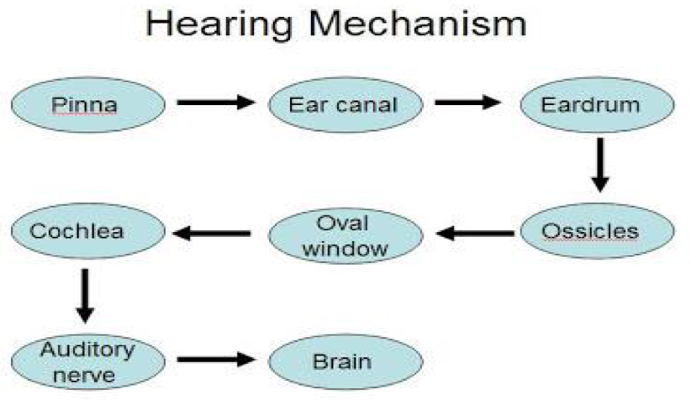
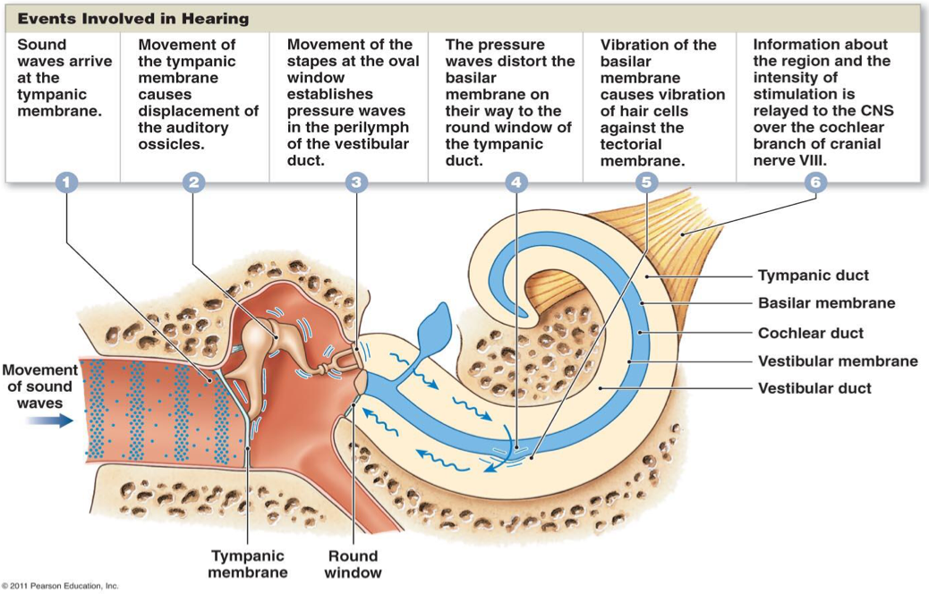
Summary
Very important info. (Will asked about)
Each frequency will be received by special area in the cochlea.
High frequency is likely to stimulate the organ of corti in the base of cochlea.
Lower frequency sound waves stimulates the area on the apex.

Slide 11
Questions
1.Which part of Ear maintain the equilibrium?
A)External Ear
B)Middle Ear
C)Inner Ear
2.The quality of sound depends on:
A)No. of cycle/sec
B)Overtone
C)Amplitude
3.Sound is produced from alternate compression and rarefaction by vibrating body.
A)True
B)False
4.Which one of the following isn’t a cause of perceptive deafness?
A)Wax
B)Toxin
C)Inflammation
5.All sound frequencies are equally affected in:
A)Perceptive deafness
B)Conductive deafness
6.Arrangement of hair cells:
A)5 rows of outer hair cells, 2 rows inner
B)3 rows of inner hair cells, 1 row outer
C)3 rows of outer hair cells, 1 row inner
7.How many type of conductive pathways?
A)2 types
B)3 types
C)4 types
8.If the patient has damage in his outer hair cells, that means he exposed to sound intensity :
A)above 80 dB
B)above 50 dB
C)above 35 dB
9.A man comes to hospital complains of pain in his ear.
A)Mention the parts of ear:
External (outer) ear , Middle ear , Inner ear.
B)Which tests can we do to him?
Audiometer , Weber test , Rinnes test
C)What are the conductive pathway of sound waves?
Air and Bone
Answers
1.C
2.B
3.A
4.A
5.B
6.C
7.A
8.A

