Slide 1
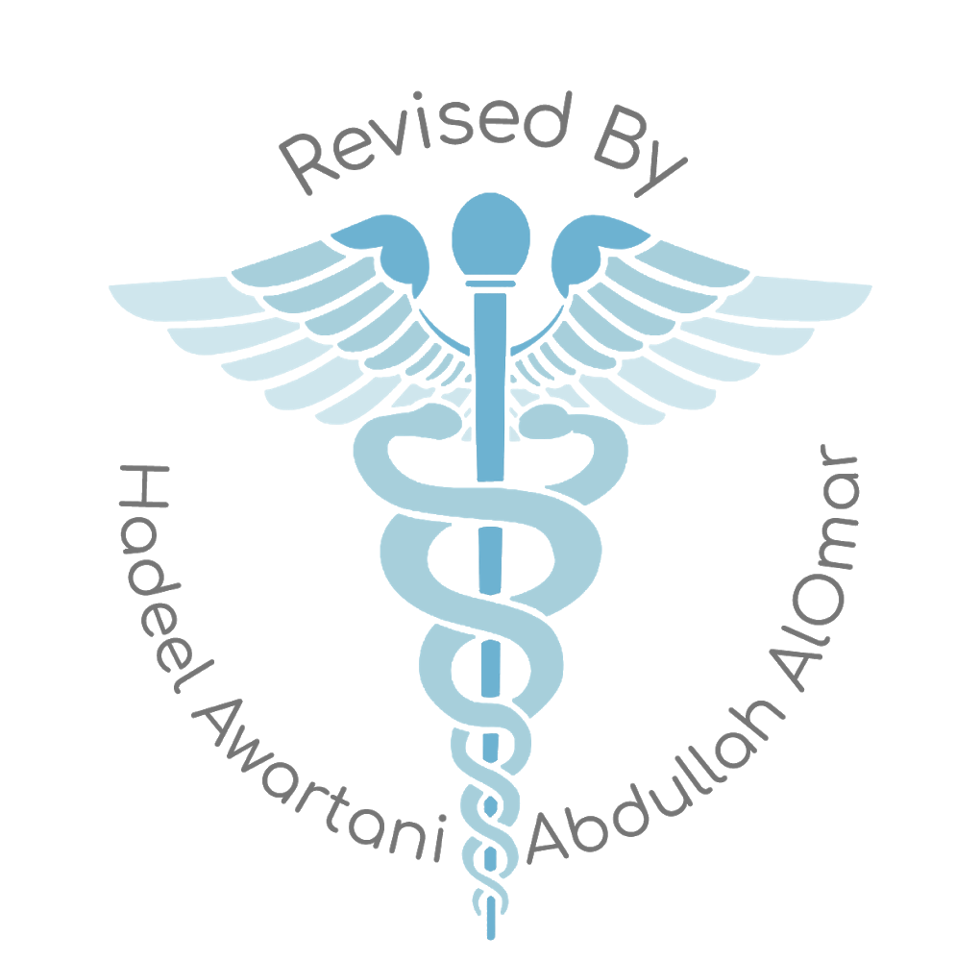
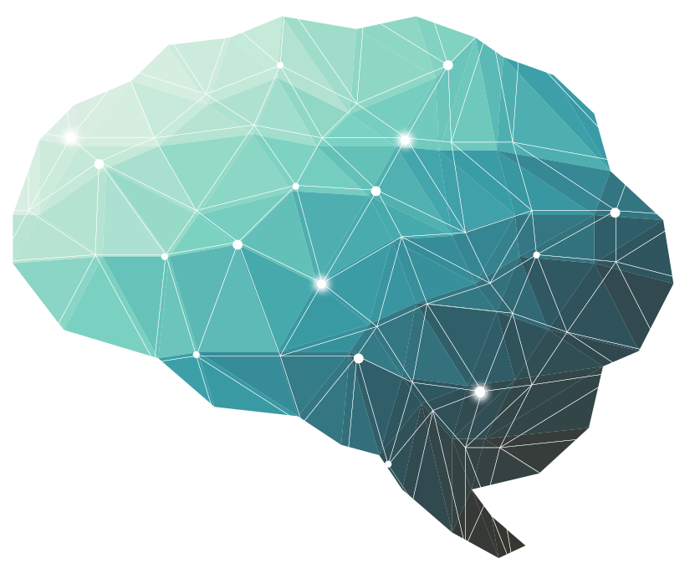
6th Lecture ∣ The Physiology Team
Physiology of brainstem
Objectives:
What is brainstem
What are its internal structures
What are its functions
What will happen if damaged e.g brain death.
Done by :
Team leaders: Abdulelah Aldossari, Ali Alammari
Fatima Balsharaf, Rahaf Alshammari
Team members:
Colour index:
important
Numbers
Extra
Faisal Alsaif, Abdulmajeed Alwardi, Abdulaziz Aldukhayel, saif almeshari, mohammed alqahtani
وَأَن لَّيْسَ لِلْإِنسَانِ إِلَّا مَا سَعَىٰ
Notes:
لِلْإِنسَانِ إِلَّا مَا سَعَىٰ (39) وَأَنَّ سَعْيَهُ سَوْفَ يُرَىٰ
BETTER right

Slide 2
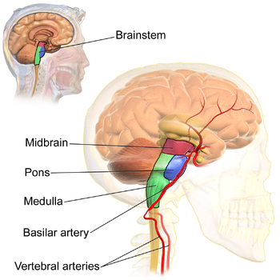
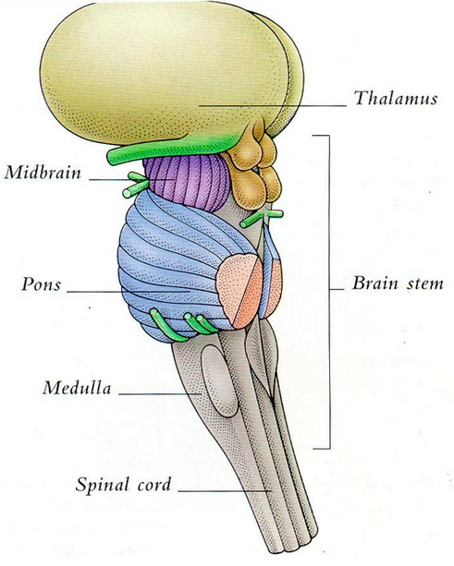
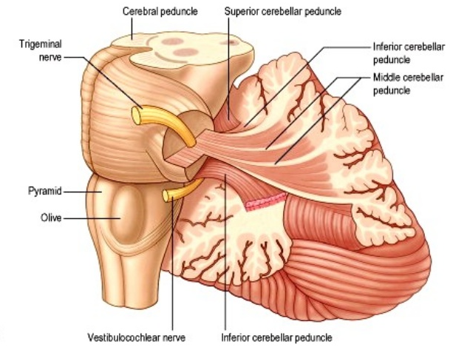
The Brainstem
The brainstem is the lower part of the brain.
It is adjoining and structurally continuous with the spinal cord.
Components of Brainstem
Midbrain.
Pons.
Medulla Oblongata.
The midbrain, pons and medulla connect to the cerebellum via the superior, middle and inferior peduncles respectively.

Slide 3
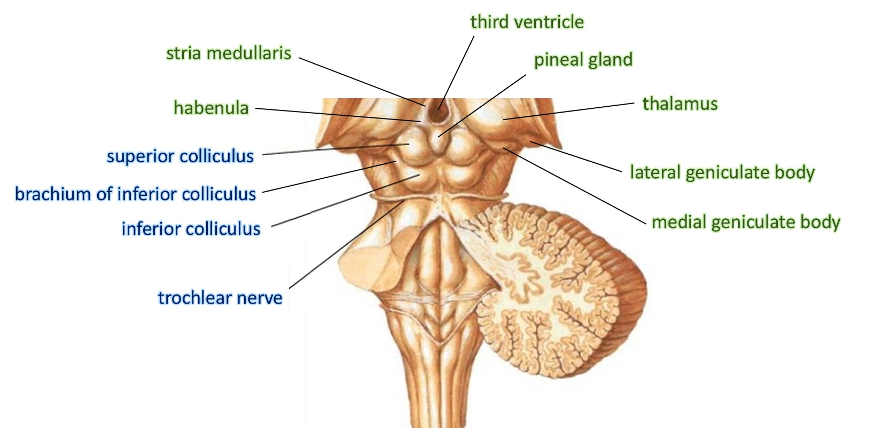
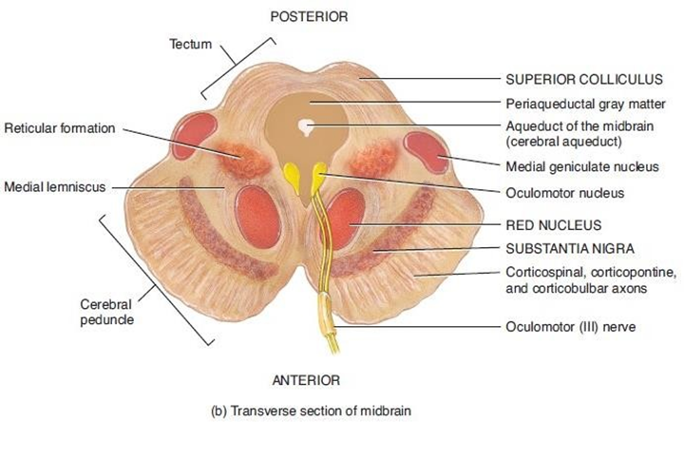
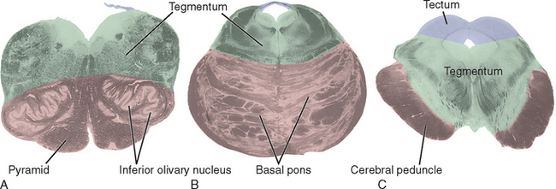
The Midbrain
Is divided into three parts:
1. The Tectum ("roof" in latin), includes: |  | 2. The Tegmentum | 3. Cerebral Peduncles
A) The superior colliculus: - It constitutes center for visual reflexes. - It sends its superior brachium to the lateral geniculate body of the thalamus. | B) The inferior colliculus: - It is associated with auditory pathway - It sends its inferior brachium to the medial geniculate body of the thalamus. - The cerebral aqueduct runs through the midbrain, beneath the colliculi. | - Ventral to the cerebral aqueduct. - Several nuclei, tracts and the reticular formation is contained here. | - The ventral side of midbrain is comprised of paired Cerebral Peduncles - These transmit axons of UMN (Upper Motor Neuron).

Slide 4
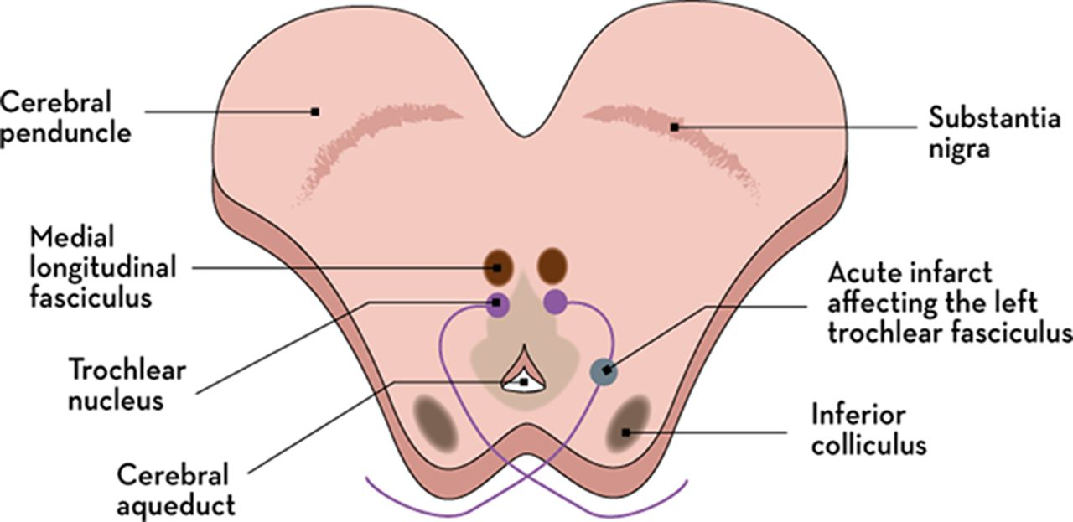
Midbrain Internal Structures
Reticular Formation:
- A large area that is involved in various important functions of the midbrain:
It contains LMN.
It is involved in the pain desensitization pathway.
It is involved in the arousal and consciousness systems.
It contains the locus ceruleus, which is involved in intensive alertness modulation and in autonomic reflexes.
Periaqueductal Grey matter: | Oculomotor Nerve: | Red Nucleus: | Substantia Nigra: | Central Tegmental Tract:
Around the cerebral aqueduct, contains neurons involved in the pain desensitization pathway. | (CN III) nucleus. | This is a motor nucleus that sends a descending tract to the lower motor neurons. | - A concentration of neurons in the ventral portion of midbrain. - It is involved in motor function. | - Directly anterior to the floor of the 4th ventricle. - It is a pathway by which many tracts project up to the cortex and down to the spinal cord.
 | Trochlear Nerve:
 | (CN IV) nucleus.

Slide 5
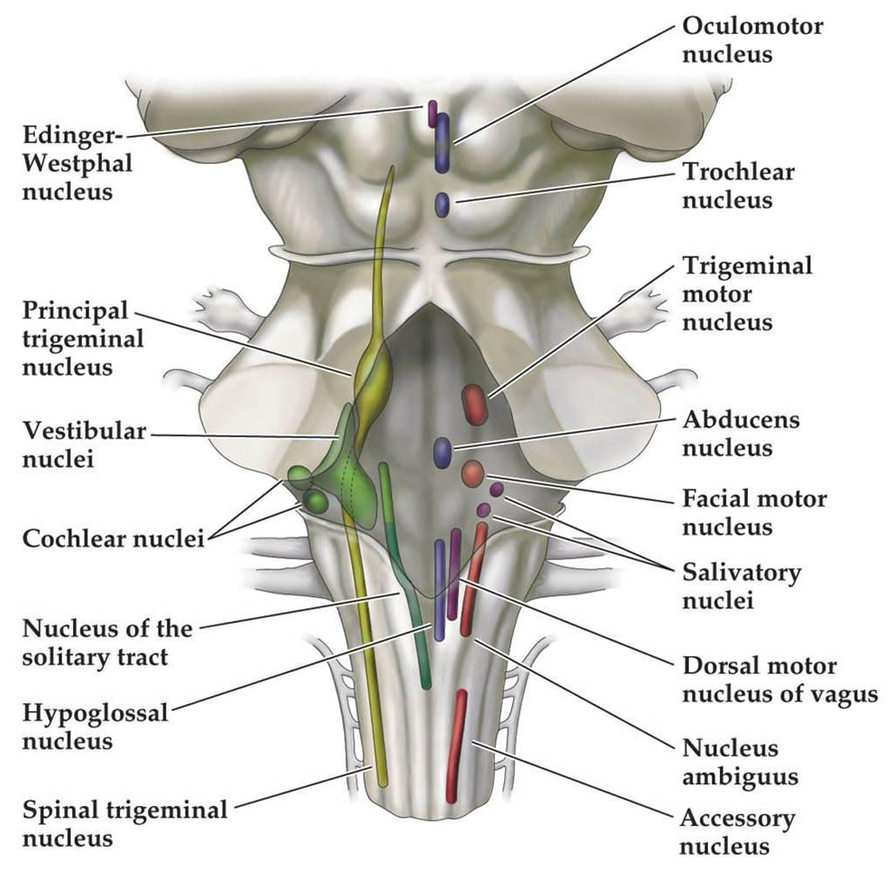
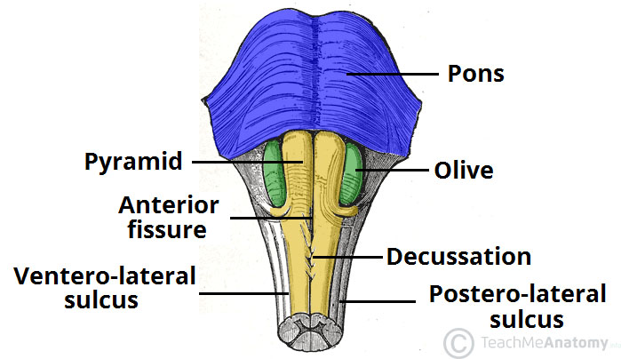
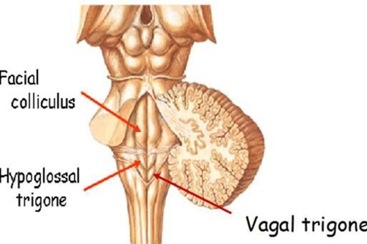
The Pons
At the level of the mid pons:
Trigeminal nerve (CN V) emerges.
Between the basal pons:
Cranial nerve 6 (abducens), 7 (facial) & 8 (vestibulo- cochlear) emerge (medial to lateral).
The Medulla
Ventral view
Dorsal view
The most medial part of the medulla is the anterior median fissure.
Moving laterally on each side are the pyramids.
They contain the fibers of the corticospinal (pyramidal) tract as they head inferiorly to synapse on lower motor neuronal cell bodies within the ventral horn of the spinal cord.
The most medial part of the medulla is the posterior median fissure.
Moving laterally on each side is the fasciculus gracilis.
Lateral to that is the fasciculus cuneatus.
Superior to each of these, are the gracile and cuneate tubercles, respectively.
Underlying these are their respective nuclei.
In the midline is the vagal trigone and superior to that is the hypoglossal trigone.
Underlying each of these are motor nuclei for the respective cranial nerves.
The anterolateral sulcus is lateral to the pyramids.
Emerging from the anterolateral sulci are the hypoglossal nerve (CN XII) rootlets.
Lateral to the anterolateral sulci are the olives containing underlying inferior olivary nuclei and afferent fibers).
Lateral (and dorsal) to the olives are the rootlets for glossopharyngeal (IX) & vagus (X) cranial nerves.

Slide 6
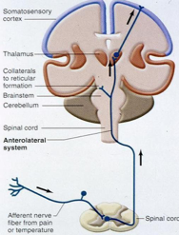
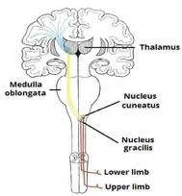
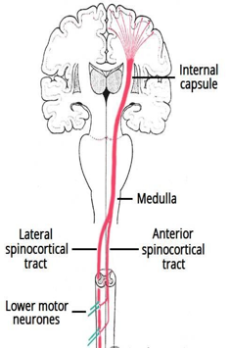
Brain Stem function
Though small, brain stem is an extremely important part of the brain:
1.Conduct functions.
2.Provides the origin of the cranial nerves (CN-III-XII).
3.Conjugate eye movement.
4.Integrative functions.
1. Conduct functions
All information related from the body to the cerebrum and cerebellum and vice versa, must traverse the brain stem.
The ascending sensory pathways
coming from the body to the brain includes:
Descending tracts
Corticospinal tract (UMN) | Upper motor neurons
The spinothalamic tract for pain and temperature sensation | The dorsal column, fasciculus gracilis, and cuneatus for touch, proprioceptive and pressure sensation.
runs through crus cerebri (the anterior portion of the cerebral peduncle), basal part of pons and medullary pyramids; 70-90 % of fibers cross in pyramidal decussation to form the lateral corticospinal tract, synapse on LMN in ventral horn of spinal cord. | originate in brain stem's vestibular, red, and reticular nuclei, which also descend and synapse in the spinal cord.

Slide 7
2.Provides the origin of the cranial nerves (CN III-XII)
The brain stem provides the main motor and sensory innervation to the face and neck via the cranial nerves (CN III-XII).
The fibers of cranial nerve nuclei except for olfactory & optic nerve either originating from, or terminating in the cranial nerve nuclei in brainstem.
Origin and function of the cranial nerve
Origin
Midbrain
Pons
Medulla
CN number
Function
CN III(oculomotor)
CN IV(trochlear)
Both moves eyes; CN III constricts the pupils, accommodates.
CN V (trigeminal) | Chews and feels front of the head.
CN VI (abducens) | Moves eyes
CN VII (facial) | Moves the face, tastes, salivates, cries.
CN VIII (acoustic) | Hears, regulates balance.
CN IX (glossopharyngeal) | Tastes, salivates, swallows, monitors carotid body and sinus.
CN X (vagus) | Tastes, swallows, lifts palate, talks, communication to and from thoraco- abdominal viscera.
CN XI (accessory) | Turns head, lifts shoulder.
CN XII (hypoglossal) | Moves tongue.
*Note that the origin of CN I and II are not in the brain stem

Slide 8
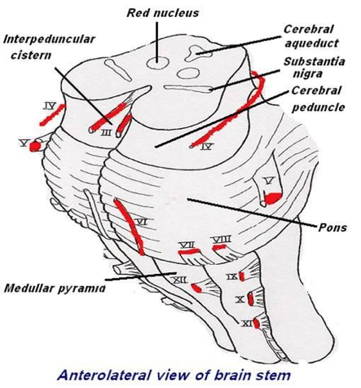
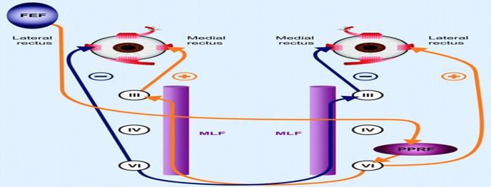
Classification of the cranial nerve according to function
(Motor-Sensory-Mixed)
Function
Sensory
Motor
Both (mixed)
Cranial nerve
CN I (Olfactory)
CN II (Optic)
CN VIII (acoustic)
CN III (oculomotor)
CN IV (trochlear)
CN VI (abducens)
CN XI (accessory)
CN XII (hypoglossal)
CN V (trigeminal)
CN VII (facial)
CN IX (glossopharyngeal)
CN X (vagus)
Mnemonic :
Some Say My Mother Bought My Brother Some Bad Beer My My
S: sensory. M: motor. B:both.
3.Conjugate eye movement
It refers to motor coordination of the eyes that allows for bilateral fixation on a single object.
The frontal eye field (FEF) projects to the opposite side at the midbrain-pontine junction, and
then innervates the paramedian pontine reticular formation (PPRF).
From there, projections directly innervate the lateral rectus (contralateral to FEF) and the
medial rectus muscle (ipsilateral to FEF).
The left FEF command to trigger conjugate eye movements to the right.

Slide 9
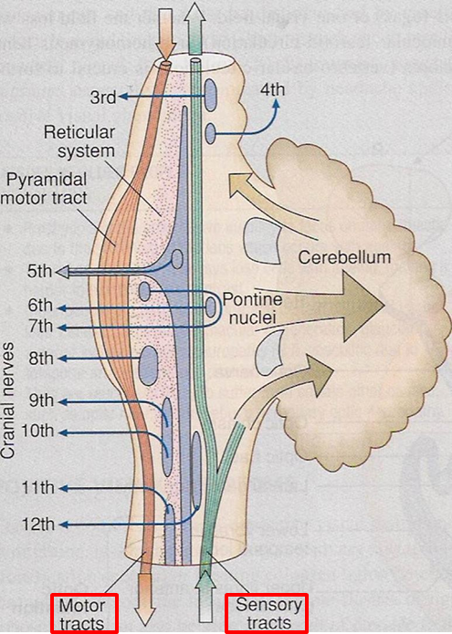
4. Integrative functions
It controls consciousness & sleep cycle (alertness and arousal) through reticular formation.
It has got center for cardiovascular, respiratory & autonomic nervous system.
It has centers for cough, gag, swallow, and vomit.
Sense of body balance (Vestibular functions)
Plays role in motor control:
Substantia Nigra ( which is a part of the basal ganglia ) is involved in control of movement.
Red nucleus in Midbrain which regulate the motor activity through cerebellum.
Pain sensitivity control: Periaqueductal grey matter of mesencephalon is an area which is rich in endogenous opioid and is important in modulation of painful stimuli.
auditory & visual processing required for head movements, in the Inferior and superior colliculi which are situated on the dorsal surface of the midbrain.
Functional organization of the Brain stem
1- Ventral :
•Motor in function
2- Middle:
•Sensory in function
•Contains medial lemniscus which conveys sensory information from dorsal column.

Slide 10
Brainstem IMPORTANT!!
Part
Function
Cranial nerves
Signs and symptoms of lesion
Midbrain
Pons
Medulla oblongata
1- Nerve pathway to cerebral hemispheres.
2- Auditory and Visual reflex centers.
•Respiratory Center.
1. Crossing of motor tracts.
2. Cardiac Center.
3. Respiratory Center.
4. Vasomotor Center (nerves having muscular control of the blood vessel walls)
5. Centers for cough, gag, swallow, and vomit.
Two:
•CN III -Oculomotor [motor]. (Related to eye
movement).
•CN IV -Trochlear [motor]
(Superior oblique muscle of the eye which rotates the eye down and out).
Four:
•CN V - Trigeminal [motor and sensory]. (Skin of face, tongue, teeth; muscle of mastication).
•CN VI - Abducens [motor]. (Lateral rectus muscle of eye which rotates eye outward).
•CN VII - Facial [motor and sensory]. (Muscles
of facial expression).
•CN VIII - Acoustic [sensory]. (Hearing)
Four:
•CN IX - Glossopharyngeal [mixed]. (Muscles & mucous membranes of pharynx, the constricted openings from the mouth & the oral pharynx and the posterior third of tongue).
•CN X - Vagus [mixed]. (Pharynx, larynx, heart, lungs, stomach).
•CN XI - Accessory [motor]. (Rotation of the head and shoulder).
•CN XII - Hypoglossal [motor]. (Intrinsic muscles of the tongue).
•Cranial Nerve (CN) deficits: Ipsilateral CN III,
CN IV palsy and ptosis (drooping).
•Pupils:
- Size: Midposition to dilated.
- Reactivity: Sluggish to fixed.
•Movement: Abnormal extensor.
•Respiratory: Hyperventilating.
•Loss of consciousness (LOC): Varies
•CN Deficits: CN V, CN VI, CN VII, CN VIII.
•Pupils size: Pinpoint
•Movement:
Abnormal extensor.
•Respiratory:
-Apneustic (Abnormal respiration marked by
sustained inhalation).
-Hyperventilation.
•LOC: Semi-coma
•Movement:
Ipsilateral paralysis.
•Pupils:
- Size: Dilated.
- Reactivity: Fixed.
•Respiratory:
Abnormal breathing patterns
•CN Palsies: Inability to control movement. Absent cough, gag.
•LOC: Comatose.

Slide 11
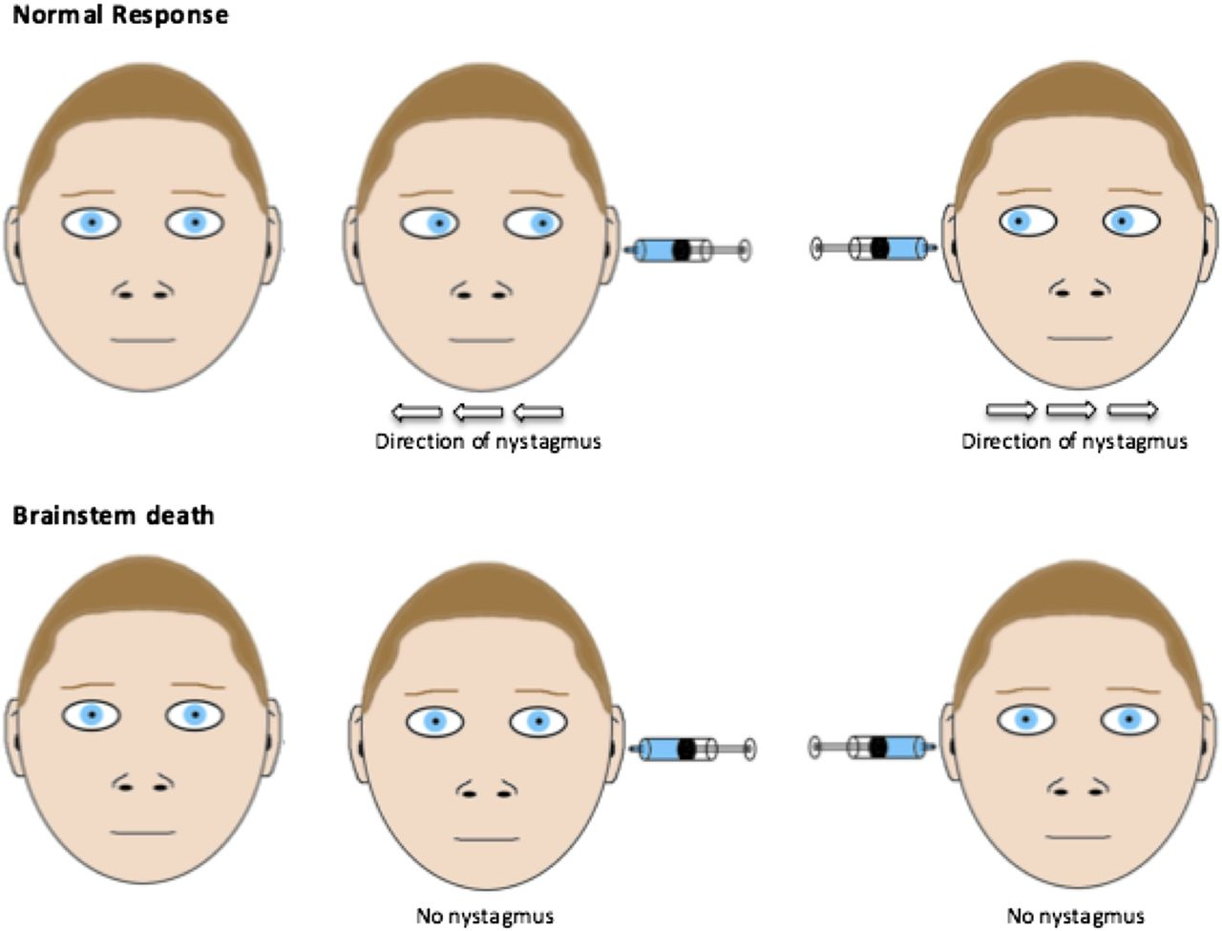
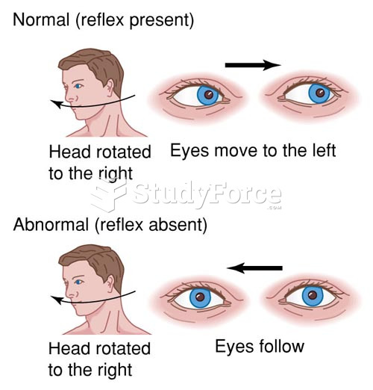
Brainstem function tests
To test reticular formation:
Alertness, Consciousness & Sleep.
Corticospinal tract: by Motor power, reflexes.
Pain response: Facial grimacing on firm pressure over the supraorbital ridge.
To test respiratory center:
Look for the normal pattern of respiration.
To test Cardiovascular center:
Look for normal circulatory function.
To test brainstem reflexes:
Pupillary and corneal reflexes.
Vestibulo-ocular reflex: Injection of iced water into the ear will produce eyes movement.
Oculocephalic reflex: Eyes will be fixed when head is moved in one or another directions.
Gag reflex.
Cough reflex.
Vestibulo-ocular reflex
Oculocephalic reflex

Slide 12
Deficits of Brainstem Structures
*All of them are ipsilateral except 3
Motor pathway
(Corticospinal Tract)
Contralateral weakness
Glossopharyngeal CN9
Deficit
Deficit
Deficit
Medial lemniscus
Contralateral proprioception/ vibration loss
Ipsilateral pharyngeal sensory loss
Midline Structures
Vagus CN10
Medial longitudinal fasciculus
Ipsilateral internuclear ophthalmoplegia
Deficit
Deficit
Ipsilateral palatal weakness
Motor nucleus
and nerve
Deficit
Ipsilateral CN function loss
4 Cranial Nerves In Medulla
Spinocerebellar pathway
Ipsilateral ataxia
Spinal accessory CN11
Deficit
Deficit
Deficit
Spinothalamic
Contralateral pain/ temp sensory loss
Ipsilateral shoulder weakness
Lateral Structures
Sensory nucleus of CN5
Ipsilateral pain/ temp loss in face
Hypoglossal CN12
Deficit
Deficit
Sympathetic pathway
Deficit
Ipsilateral Horner’s syndrome
Ipsilateral weakness of tongue

Slide 13
Deficits of Brainstem Structures Cont.
Trigeminal CN5
Ipsilateral facial sensory loss
Deficit
Abducens CN6
Deficit
Ipsilateral eye abduction weakness
4 Cranial Nerves
In Pons
Facial CN7
Ipsilateral facial weakness
Deficit
Auditory CN8
Deficit
Ipsilateral deafness
Olfactory CN1
Not in midbrain
Deficit
Optic CN2
Deficit
Not in midbrain
4 Cranial Nerves Above Pons
Oculomotor CN3
Eye turned out
and down
Deficit
Trochlear CN4
Deficit
Eye unable to look down when looking towards nose

Slide 14
Sample Cases
Sample case 1:
A 58 y/o female patient was referred to you because of recent onset of left hemiparesis, left-sided loss of proprioception and right-sided tongue Deviation.
Answers:
- Medial medullary syndrome (R) - Vertebral artery, medullary branch (R)
History | Fiber | Location
58 year old woman |  | Medial
Left hemiparesis | motor (corticospinal tract), right | Medial
Left-sided loss of proprioception | medial lemniscus, right | Medulla
Right-sided tongue deviation | CN12, right | Medial
Sample case 2:
A 58 y/o female patient was referred to you because of recent onset of Left sided miosis, anhydrosis, ptosis, left-sided ataxia, Uvula deviated to right.
Answers:
- Lateral medullary syndrome (L) - Posterior inferior cerebellar artery (L)
History | Fiber | Location
58 year old woman | Sympathetic tract, Left | Side, left
Left-sided meiosis, anhydrosis, ptosis Left-sided ataxia. | Spinocerebellar | Side, left
Uvula deviated to right. | CN10, Left | Medulla

Slide 15
1.structure in midbrain is associated with auditory pathway?
Inferior colliculus
Superior colliculus
Tegmentum
Substantia nigra
2.Which one of the following Cranial Nerves is pure Sensory?
Abducents
Accessory
Trochlear
Olfactory
3.Which of the following is rich in endogenous opioid?
Substantia nigra
Red nucleus
Periaqueductal grey matter
Superior rectus
4.Pinpoint pupil size, hyperventilation and sustained inhalation is a characteristic of?
Lesion in medulla oblongata
Lesion in cerebral peduncles
Lesion in midbrain
Lesion in pons
5.A patient with a lesion in Trochlear nerve , which muscle nerve supply is affected?
Superior oblique
Inferior oblique
Lateral rectus
Superior rectus
6.which of the following cranial nerve is responsible of rotation of head?
Optic nerve
Trigeminal nerve
Accessory nerve
hypoglossal nerve
7.Which brainstem structure is a center for gag reflex?
Midbrain
Pons
Medulla oblongata
Thalamus
8.which of the following muscle is contracted as a part of the pupillary reflex?
Ciliary muscle
Pupillary dilator muscle
Pupillary sphincter muscle
Superior oblique muscle
9.if there is a lesion in the Vagus cranial nerve it will cause…...?
Contralateral palatal weakness defect
Ipsilateral palatal weakness defect
Contralateral pain loss in the face
Ipsilateral pain loss in the face
Answers:
1.A
2.D
3.C
4.D
5.A
6.C
7.C
8.C
9.B

