Slide 1
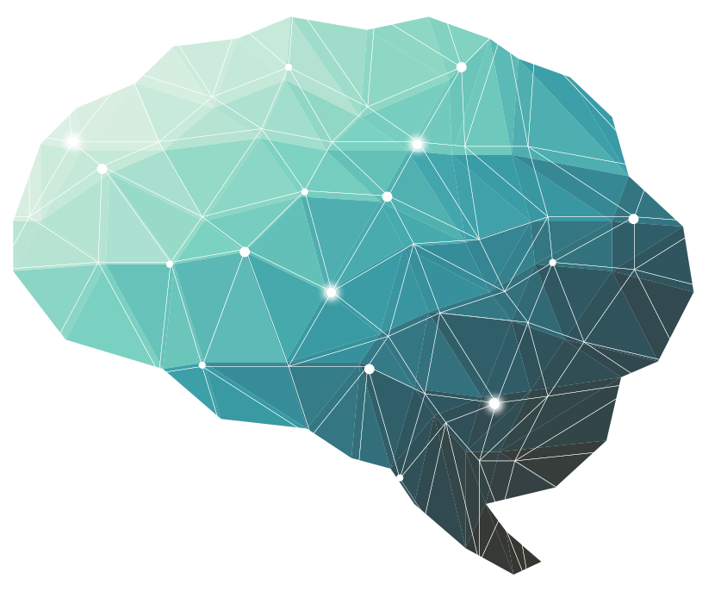
Physiology of the sleep
8thLecture ∣ The Physiology Team
Objectives:
Explain the difference between sleep and coma.
Define what is meant by NREM (non-rapid eye movement, SWS) and REM (rapid eye movement) sleep.
Describe how NREM and REM sleep are distributed during a normal night sleep in the average adult human
Describe the behavioral and autonomic features associated with NREM and REM sleep.
Describe how the EEG, as a physiological tool, is being used to delineate in which stage of sleep (or wakefulness) a person is.
Appreciate how the total sleep duration and different sleep stages vary with different ages in normal humans.
Describe the current theories about the neural basis of sleep.
Sleep disorder
Physiological mechanism of sleep and waking
Bold & Italic objectives are included in the medical education guide
Done by :
Team leaders: Fatima Balsharaf , Rahaf Alshammari,
Abdulelah Aldossari, Ali Alammari.
Team members: Renad AlMogren, AlFahdah AlSaleem, Ghadah Alhaidari, Hadeel Almackenzie, Moath Abdulghani, Reham Al-Halabi, Alanoud Alessa, Ahad AlGrain
Colour index:
important
Numbers
Extra
Editing file
وَأَن لَّيْسَ لِلْإِنسَانِ إِلَّا مَا سَعَىٰ

Slide 2
Terminology
Terminology | Definition
R.E.M “Rapid eye movement” | a kind of sleep that occurs at intervals during the night and is characterized by rapid eye movements, more dreaming and faster pulse and breathing.
NREM “Non rapid eye movement” | Also called “SWS (Slow-Wave Sleep)” A stage where sleep EEG waves are generally of low frequency, and is not associated with rapid eye movements . Waves are generally of low frequency
Sleep | State of unconsciousness from which a subject can be aroused by appropriate sensory or other stimuli. a normal, periodic, inhibition of the reticular Activating system.
Awake | State of readiness/alertness & ability to react consciously to various stimuli.
Coma | State of unconsciousness from which a person cannot be aroused by any external stimuli.
8th Lecture ∣ The Physiology Team

Slide 3
Introduction
Why do we sleep?
Sleep theory #1- To Rest: to gain relief from this hyperactive state
Sleep theory #2 - To Heal : sleep also allows us to heal our bodies. The immune system ( our ability to fight disease) sleep deprivation affects our metabolism ( our internal chemical reactions). It may also help us save energy for when most need it.
Sleep theory #3- To Learn: sleep may help the human brain get better organized - by filing away important memories and discarding unwanted information.
Sleep theory #4 - To Dream : Dreaming appears to be a by-product of REM sleep. So is it possible that the main reason why we sleep is to dream? If so, why do we dream?
8th Lecture ∣ The Physiology Team
Ultimate:
sustains our ability to reproduce successfully, by maintaining good health.
Sleep has been postulated to serve many functions:
neural maturation
facilitation of learning or memory
cognition
clearance of metabolic waste products
conservation of metabolic energy.
Theories of sleep:
Preservation & protection theory
Sleep preserves energy and it provides protection.
* For example, both body temperature and caloric demand decrease during sleep,as compared to wakefulness
Restoration theory:
Body wears out during the day and sleep is necessary to put it back in shape.This is supported by findings that many of the major restorative functions in the body like muscle growth, tissue repair, protein synthesis, and growth hormone release occur mostly, or in some cases only, during sleep

Slide 4
Describe how the EEG is being used to delineate in which stage of sleep a person is
EEG (electroencephalogram) waves: Before you start you have to know these different types of wave generally
Alpha activity | smooth electrical activity of 8–12 Hz |  | generally associated with a state of relaxation.
Beta activity | Irregular electrical activity of 13–30 Hz |  | generally associated with a state of arousal (when you’re thinking or concentrated).
Theta activity | EEG activity of 3.5–7.5 Hz |  | that occurs intermittently during early stages of SWS & REM sleep.
Delta activity | Regular, synchronous electrical activity of <4 Hz recorded from the brain |  | occurs during deepest stages of SWS.
8th Lecture ∣ The Physiology Team
هذا الجدول يوضح اختلاف الموجات بشكل عام لو نشوفها بأي
والأرقام حفظMonitor
Awake and attentive - low amplitude, fast, irregular beta waves
EEG WAVES In wakefulness
Awake, but non-attentive, large, regular alpha waves

Slide 5
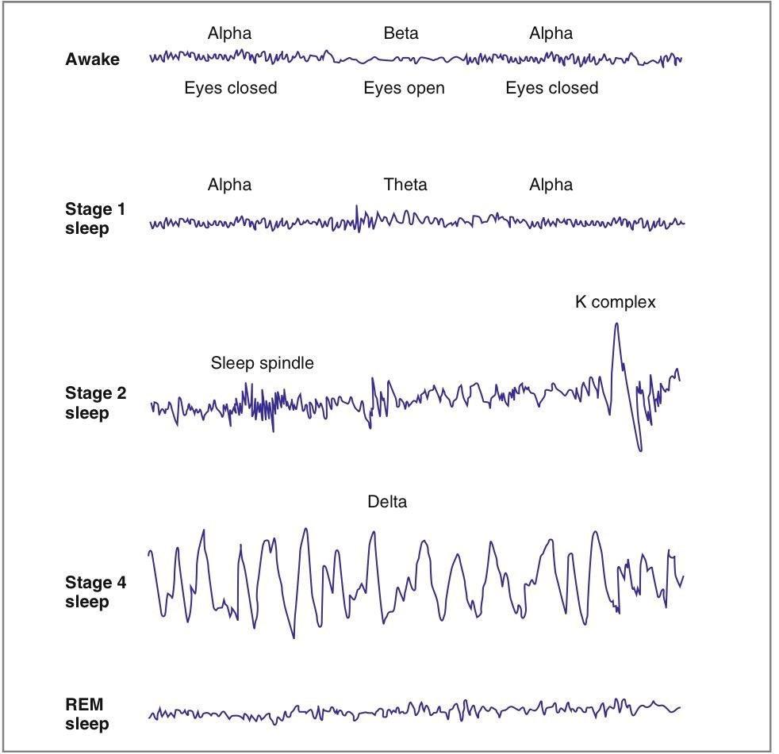
Describe how the EEG is being used to delineate in which stage of sleep a person is
8th Lecture ∣ The Physiology Team
The electroencephalogram (EEG) records electrical activity of the cerebral cortex via electrodes placed on the skull. The EEG waves originate from alternating excitatory and inhibitory synaptic potentials that produce sufficient extracellular current flow across the cortex to be detected by surface electrodes. (EEG waves are not action potentials. Electrodes on the surface of the skull are not sufficiently sensitive to detect the small voltage changes of single action potentials.) The normal EEG (Fig. 3-35) comprises waves with various amplitudes and frequencies. In a normal, awake adult with eyes open, the dominant frequency recorded over the parietal and occipital lobes is the beta rhythm (13–30 Hz), which consists of desynchro- nonous low-voltage, high-frequency waves. With eyes closed, the dominant frequency is the alpha rhythm (8–13 Hz), which has more synchronous waves of higher voltage and lower frequency. As a person falls asleep, he or she passes through four stages of slow-wave sleep.
In Stage 1, the alpha waves seen in an awake adult with eyes closed are interspersedيتخللها- with lower-frequency theta waves. In Stage 2, these low-frequency waves are interspersed with high-frequency bursts called sleep spindles and large, slow potentials called K complexes. In Stage 3 (not shown in the figure), there are very low-frequency delta waves and occasional sleep spindles. Stage 4 is characterized by delta waves. Approximately every 90 minutes, the slow-wave sleep pattern changes to rapid eye movement (REM) sleep, in which the EEG becomes desynchronized, with low-voltage, high- frequency waves that resemble those in an awake person. REM sleep is sometimes called paradoxical sleep:Even though the EEG is most similar to that of the awake state, the person is (paradoxically) most difficult to awaken. REM sleep is characterized by loss of muscle tone, notably in the eye muscles resulting in rapid eye movements, loss of temperature regulation, pupillary constriction, penile erection, and fluctuations in heart rate, blood pressure, and respiration. Most dreams occur during REM sleep. The proportion of slow-wave sleep and REM sleep varies over the life span. Newborns spend half of their sleep in REM sleep; young adults spend about 25% of sleep in REM sleep; and the elderly have little REM sleep.
Over view from Costanzo-Physiology book

Slide 6
Describe how the EEG is being used to delineate in which stage of sleep a person is
8th Lecture ∣ The Physiology Team
When the awake person’s attention is directed to some
specific type of mental activity, the alpha waves are replaced
by asynchronous, higher frequency but lower voltage beta
waves. Note that the visual sensations cause immediate cessation
of the alpha waves and that these waves are replaced
by low-voltage, asynchronous beta waves.
EEG patterns from a typical person in different stages of wakefulness and sleep. Alert wakefulness is characterized by high-frequency beta waves,whereas quiet wakefulness is usually associated with alpha wave.
Do you notice the similarity between awake & REM sleep waves?
It is often difficult to tell the difference between this brain
wave pattern and that of an awake, active person. The waves are irregular and of high frequency, which are normally suggestive of desynchronized nervous activity as found in the awake state. Therefore, REM sleep is frequently called desynchronized sleep because there is lack of synchrony in the firing of the neurons despite significant brain activity.
Notes from guyton to understand it better

Slide 7
Describe how the EEG is being used to delineate in which stage of sleep a person is
Sleep Classification is Based on EEG Features
 | A)NREM sleep
 | Stage 1 | Stage 2 | Stage 3&4
Experience | Falling asleep and transition stage between waking & sleep. | Base line of sleep This is the first stage of true sleep. | Deep sleep
duration | 1-5 minutes. ~2.5% of a normal night sleep. | 90 minutes. - ~45-60% of a normal night sleep | - 15-30 minutes. - ~40% of all sleep.
signs | Eye begins to roll slightly | - | Slowing of heart rate, breathing rate, and brain activity Body temperature begin to fall. BP decreases. Difficult to awaken the person.
waveform | Irregular, jagged, low-voltage wave | - Sleep spindles These are bursts of alpha-like 10-14 z, 50 uV waves . -K-complex
 | Alpha waves& theta waves appear on EEG
notes | Start when sleep has just begun, brain activity begins to decline Lasts 1-7 mins. (if you ask, person will say he is awake |  | As the night goes on there is progressive reduction in stages 3 and 4 sleep and progressive increase in REM sleep.
8th Lecture ∣ The Physiology Team
Stage 3 | Stage4
This stage occurs about 20-25 min after falling asleep.Lower frequency (mainly theta), higher amplitude EEG waves. | Still slower frequency (mainly delta) & still higher amplitude waves

Slide 8
Describe how the EEG is being used to delineate in which stage of sleep a person is
 | B)REM sleep
Experience | Very active stage of dream Vivid dreams can occur
duration | 20-25% of normal night sleep
waveform | Irregular, low-volatge and fast activity
 | Beta waves
Notes | Length of REM stages increases as the night progresses (it means the duration of REM increases every cycle during long night sleep). Heart rate and respiration become irregular The difference is that the dreams in SWS are not remembered but in REM, dreams can be remembered too important !!
8th Lecture ∣ The Physiology Team

Slide 9
Describe how NREM and REM sleep are distributed during a normal night sleep in the average adult human
Distribution of Sleep Stages
SWS occupies most of the total night sleep time ( around 75-80% ) , it is interrupted by intervening REM sleep periods, approximately every 90 minutes .
In a typical night of sleep:
young adult first enters NREM sleep, passes through stages 1 , 2 , 3 and 4 SWS, then, 60-100 min from sleep onset, goes into the first REM sleep episode
This cycle is repeated at intervals of about 90 min throughout the 8 hours of night sleep.
There are 4-6 sleep cycles per night (& 4-6 REM periods per night)
As the night goes on there is progressive reduction in stages 3 & 4 sleep and a progressive ↑ in REM sleep .
REM Sleep (Paradoxical Sleep) because it is a paradox that a person can still be asleep despite the presence of marked activity in the brain.
8th Lecture ∣ The Physiology Team
In a normal night of sleep,
episodes of REM sleep lasting 5 to 30 minutes usually appear on the average every 90 minutes.
REM sleep is not as restful as SWS .
When the person is extremely sleepyمرهق), each episode of REM sleep is short, and it may even be absent.
Conversely, as the person becomes more rested through the night, the durations of the REM episodes increase.
Characteristics of REM sleep:
There are rapid eye movements .(Neurons of the pons)
Muscle tone throughout the body (except eye muscles) is exceedingly depressed
How the occurrence of REM sleep increase?. Acetylcholine secreting neurons activate many portions of the brain.Even though the signals are not channeled appropriately in the brain to cause normal conscious awareness that is characteristic of wakefulness-drugs that mimic the action of acetylcholine
REM sleep is a type of sleep in which the brain is quite active, but this brain is:
is not aware cut-off the external world.
its activity is not channeled into purposeful external motor activity.

Slide 10
Appreciate how the total sleep duration and different sleep stages vary with different ages in normal humans.
Normal sleep cycle at different ages:
 | REM step occupies ( explain percent of total sleep time in R.E.M. Sleep)
Premature infants | 80% of total sleep.
Full-term neonates | 50% of total sleep.
Elderly from 20-69ys | 20% of total sleep.
Children | More sleep time and stage 4 than adults.
8th Lecture ∣ The Physiology Team
This table explains how many hours do we need to sleep ?
New born | 15 - 20 hours
Children | 10 - 15 hours
adult | 6 - 9 hours
Old age | 5 - 6 hours
For your information

Slide 11
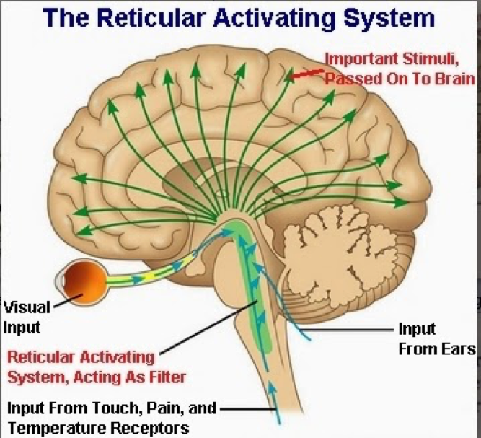
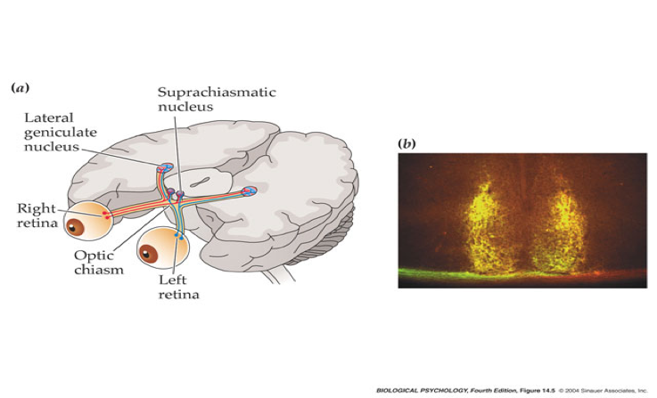
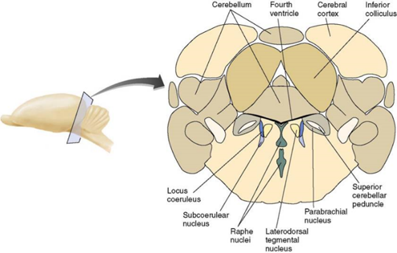
Describe the behavioral and autonomic features associated with NREM and REM sleep (Dr Nervana said just read the table).
8th Lecture ∣ The Physiology Team
A diffuse network of nerve pathways in the brainstem connecting the spinal cord, cerebrum, and cerebellum, and mediating the overall level of consciousness. RAS is the primary centre of sleep

Slide 12
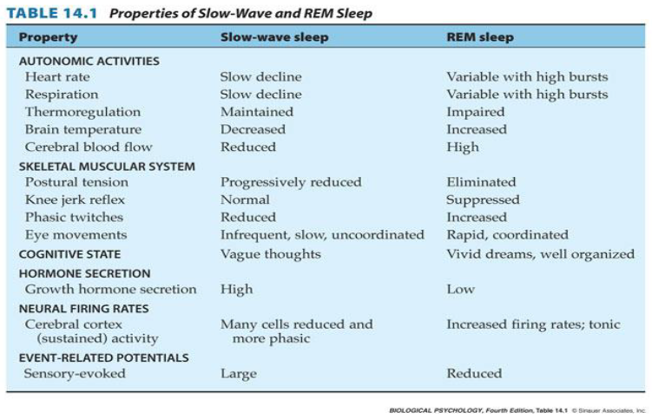
Describe the behavioral and autonomic features associated with NREM and REM sleep. This is important.
PHYSIOLOGICAL CHANGES IN SLEEP
CVS: | Pulse Rate, cardiac output, blood pressure & vasomotor tone are decreased but the blood volume is increased
Respiration | Tidal volume & respiratory rate are decreased. BMR is decreased 10-15%.
Urine volume: | decreased.
Secretions | Salivary/lacrimal secretions are reduced, gastric/sweat secretions are increased
8th Lecture ∣ The Physiology Team
These are the overall changes during sleep, REM sleep can be different
كلهم معنا لكن الدكتورة كانت حاطة أسهم على المربعات الحمراء

Slide 13
Describe the current theories about the neural basis of sleep. (DR. Nervana said just read them)!
Theories of Sleep
Although several theories of sleep have been proposed, most current evidence is in favor of the following:
Serotonin, produced by the Raphe Nuclei, induces SWS sleep.
The mechanism that triggers REM sleep is located in the Pontine Reticular Formation & the Ponto-Geniculo-Occipital circuit is instrumental in generation of REM sleep.
The hormone Melatonin (released from Pineal Gland) plays an important role in day-night alternation of sleep.
Role of Serotonin & Melatonin in SWS:
Raphe nucleus(secret serotonin):
Stimulation of Raphe Nuclei (in the lower pons & medulla) induces SWS
Destruction of the Raphe Nuclei renders the animal sleepless for several days until it dies.Administration of drugs that block serotonin formation make the animal sleepless for several days.
Transecting the brainstem at the level of the mid pons, leaves the animal in a state of intense wakefulness for a period of days.(The transection cuts the nerves going from the inhibitory serotonin-secreting Raphe Nuclei to the Bulboreticular Facilitatory area of the RAS).
Indication that the serotonin-secreting Raphe fibers normally inhibit the Bulboreticular Facilitatory area to produce sleep.In other words a center located below mid pontine level is required to cause sleep by inhibiting other parts of the brain
Injections of melatonin induce sleep.
8th Lecture ∣ The Physiology Team
Stimulation of the y-chiasmal Nucleus (SCN) of hypothalamus by light falling on the retina
inhibits Melatonin release from Pineal gland & produces wakefulness.
Melatonin as a Circadian Controller of Sleep-Wake Cycles:
Alternating “Sleep-Wake Cycles” are under marked Circadian Control.
“Circadian Control/Rhythm”: is the regulation of a biological rhythm (e.g. sleep-wakefulness, hormone secretion , etc) by day- night cycles .
Darkness/night stimulates the Pineal Gland to secrete melatonin hormone.
Melatonin inhibits the RAS & thereby induces SWS.
Daylight falling on the retina stimulates the Suprachiasmal Nucleus (SCN) of hypothalamus.
SCN inhibits melatonin secretion by the Pineal Gland, & thereby it inhibits sleep and promotes wakefulness.

Slide 14
Disorder of sleep فقط بالأحمر الباقي قراءة
Sleep Disorder | Definition/About
Insomnia | Definition: habitual sleeplessness; inability to sleep. Reported to affect approximately 25% of the population occasionally, and 9% regularly. No single definition of insomnia. One of the most important causes of insomnia is sleep medications. Insomnia is not a disease, but rather may be a symptom of pain, discomfort or other physical ailment.
Drug dependency insomnia | An insomnia caused by the side effects of ever increasing doses of sleeping medications.
Sleep apnea | Cessation of breathing while sleeping (people who are overweight).
Somnolence | Extreme sleepiness
Narcolepsy | A sleep disorder characterized by periods of irresistible sleep, attacks of cataplexy, sleep paralysis, and hypnagogic hallucinations.Orexin (also called hypocretin) is produced by neurons in the hypothalamus that provide excitatory input to many other areas of the brain.Orexin neurons are most active during waking and almost stop firing during slow wave and REM sleep.Loss of orexin signaling as a result of defective orexin receptors destruction of orexin-producing neurons causes narcolepsy
Sleep attack | A symptom of narcolepsy; an irresistible urge to sleep during the day, after which the person awakes feeling refreshed.
Cataplexy | A symptom of narcolepsy; complete paralysis that occurs during waking.Patients with narcolepsy may also experience a sudden loss of muscle tone (cataplexy)
Sleep paralysis | A symptom of narcolepsy; paralysis occurring just before a person falls asleep.
Hypnagogic hallucination | A symptom of narcolepsy; vivid dreams that occur just before a person falls asleep; accompanied by sleep paralysis.
REM sleep behavior | A neurological disorder in which the person does not become paralyzed during REM sleep and thus acts out dreams.
8th Lecture ∣ The Physiology Team

Slide 15
Physiological mechanism of sleep and waking فقط بالأحمر الباقي قراءة
Neural Control of Arousal
Acetylcholine | One of the most important neurotransmitters involved in arousal. Two groups of acetylcholinergic neurons are located in pons & basal forebrain, produce activation & cortical desynchrony when they are stimulated.
Murmyl peptide | induces sleep
Norepinephrine | Catecholamine agonists produce arousal & sleeplessness effects appear to be mediated by the locus coeruleus in the dorsal pons.
Locus ceoruleus | A dark-colored group of noradrenergic cell bodies located in the pons near the rostral end of the floor of the fourth ventricle; involved in arousal and vigilance.
Serotonin (5-HT) | Appears to play a role in activating behavior; almost all of the brain’s serotonergic neurons are found in the Raphe nucleus, located in the medullary and pontine regions of the brain.
Raphe nucleus | A group of nuclei located in the reticular formation of the medulla, pons & midbrain. Situated along the midline, contain serotonergic neurons.
Histamine | A neurotransmitter implicated in control of wakefulness and arousal; a compound synthesized from histidine, an amino acid.
Tuberomammillary nucleus | A nucleus in the ventral posterior hypothalamus, just rostral to the mammillary bodies; contains histaminergic neurons involved in cortical activation and behavioral arousal.
Neural Control of Slow-Wave Sleep
Ventrolateral preoptic area (VLPA) | A group of GABAergic neurons in the preoptic area whose activity suppresses alertness and behavioral arousal and promotes sleep. Destruction of this area has been reporter to result in total insomnia, coma, and eventual death in rats.
Neural Control of REM sleep
PGO wave (Pontine, Geniculate, Occipital) | Bursts of phasic electrical activity originating in the pons, followed by activity in the lateral geniculate nucleus and visual cortex, a characteristic of REM sleep.
8th Lecture ∣ The Physiology Team

Slide 16
Physiological mechanism of sleep and waking just read it !!
The Executive Mechanism
Peribrachial area | The region around the brachium conjunctivum, located in the dorsolateral pons; contains acetylcholinergic neurons involved in the initiation of REM sleep.
Carbachol | A drug that stimulates acetylcholine receptors.
Medial pontine reticular formation (MPRF) | A region that contains neurons involved in the initiation of REM sleep; activated by acetylcholinergic neurons of the peribrachial area.
Magnocellular nucleus | A nucleus in the medulla; involved in the atonia (muscular paralysis) that accompanies REM sleep.
Biological Clocks
Suprachiasmatic nucleus | A nucleus situated atop the optic chiasm. It contains a biological clock responsible for organizing many of the body’s circadian rhythms.
Melanopsin | A photopigment present in ganglion cells in the retina whose axons transmit information to the SCN, the thalamus, and the olivary pretectal nucleus.
Intergeniculate leaflet (IGL) | A part of the lateral geniculate nucleus that receives information from the retina and projects to the SCN; terminals release neuropeptide Y at the SCN.
8th Lecture ∣ The Physiology Team

Slide 17
Quick review
REM a kind of sleep that occurs at neurons of the pons and is characterized by rapid eye movements, more dreaming and faster pulse and breathing. Dreams can be remembered
episodes of REM sleep lasting 5 to 30 minutes usually appear on the average every 90 minutes.
In REM Muscle tone throughout the body is exceedingly depressed except eye muscles
In REM the brain is quite active but is not aware & cut-off from the external world.
NREM (SWS) A stage where sleep EEG waves are generally of low frequency, and is not associated with rapid eye movements. Dreams can’t be remembered, is more restful than REM
The difference between sleep and coma is the sleep can be aroused by appropriate sensory or other stimuli. While the coma can’t
Alpha activity (waves) : Awake, but non-attentive, large, regular. Generally associated with a state of relaxation.
Beta activity (waves) :Awake and attentive - low amplitude, fast, irregular. generally associated with a state of arousal
Physiological change in sleep. It decreases: pulse rate, cardiac output, blood pressure, vasomotor tone, tidal volume, respiratory rate, BMR 10-15%, urine volume & salivary/lacrimal secretions ). And increases blood volume & gastric/sweat secretions
Insomnia is habitual sleeplessness; inability to sleep.
Sleep Apnea is the cessation of breathing while sleeping (people who are overweight).
8thLecture ∣ The Physiology Team

Slide 18
Questions
1. In a typical night of sleep for adults, there are about:
3-6 cycles
2-4 cycles
4-5 cycles
4-6 cycles
4. Which of the following statements concerning electroencephalogram activity is correct? A) Delta waves occur in normal adults who are awake but in a quiet, resting state B) Alpha waves occur at 14 to 80 cycles per second during periods of heightened excited activity or high tension C)Theta waves are associated with a state of arousal D) Delta waves occur during the deepest stages of SWS
2. Which of the following statements about sleep is correct? A) Although fast-wave sleep is frequently referred to as “dreamless sleep,” dreams and sometimes nightmares do occur at this time B) Individuals rarely will awaken spontaneously from rapid eye movement (REM) sleep C) Muscle tone throughout the body is markedly depressed during REM sleep (except for eye muscles)
D) Heart rate and respiratory rate typically become very regular during REM sleep
8th Lecture ∣ The Physiology Team
5. The state of unconsciousness from which a person can not be aroused by any external stimuli, is known as:
A)Awakeness
B)Coma
C)Sleep
D)Death
3. Beta waves indicate:
Deep sleep
Awake, non-attentive
Awake, attentive
REM
6. As the person becomes more rested through the night, the duration of:
SWS increases.
REM decreases.
REM remains the same.
REM increases.
Answers:
1.D
2.C
3.C
4.D
5.B
6.D
7.B
8.D
9.D
10.B

Slide 19
Questions
7. REM sleep accupies …. of the total sleep of full-term neonates:
25%
50%
80%
15%
10. During SWS, all the body’s secretions are reduced.
True
False
8. The cessation of breathing while sleeping is also known as:
Sleep attack
Cataplexy
Narcolepsy
Sleep apnea
8th Lecture ∣ The Physiology Team
9. Which property can be seen in Slow-wave sleep?
Impaired thermoregulation
Increased brain temperature
Rapid, coordinated eye movements
Reduced cerebral blood flow.
Answers:
1.D
2.C
3.C
4.D
5.B
6.D
7.B
8.D
9.D
10.B

