Slide 1
7th Lecture ∣ The Physiology Team
Physiology of the smell and taste
Objectives:
Appreciate the physiology of olfaction & taste
Describe the olfactory & taste pathways
Appreciate some pathophysiological conditions related to olfaction & taste
Done by :
Team leaders: Abdulelah Aldossari, Ali Alammari
Fatima Balsharaf, Rahaf Alshammari
Team members: Abdulaziz Aldurgham, Fahad Alfaiz
Colour index:
important
;)
Extra
وَأَن لَّيْسَ لِلْإِنسَانِ إِلَّا مَا سَعَىٰ
Notes:
لِلْإِنسَانِ إِلَّا مَا سَعَىٰ (39) وَأَنَّ سَعْيَهُ سَوْفَ يُرَىٰ
BETTER right

Slide 2
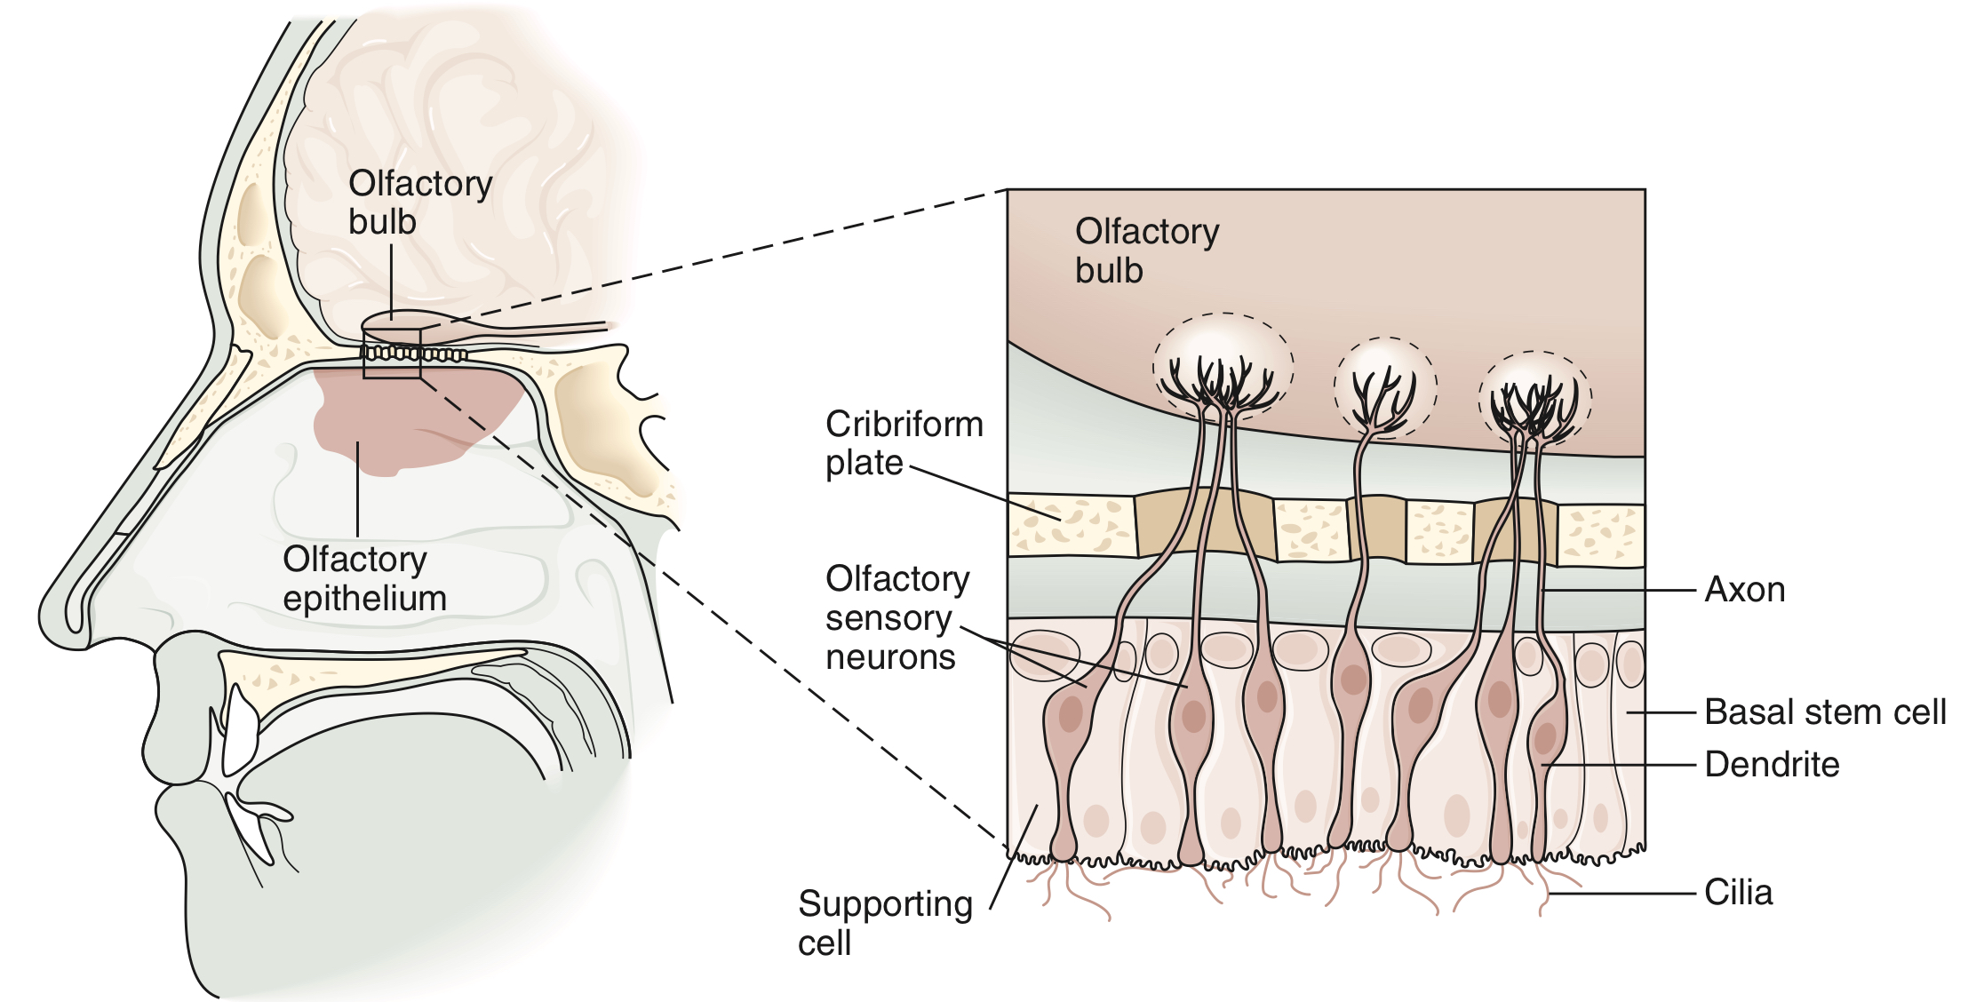
Anatomy of olfaction
Olfactory epithelium “mucus”: in the roof of nasal cavity near the septum
Contain olfactory receptors (bipolar neurons)
Axons collected in bundles called fila olfactoria
Physiology of olfaction
Power of perceiving odors is called smell
Olfactory receptors present in the roof of nasal cavity
Neurons with long cilia (olfactory hairs)
Chemicals must dissolved in mucus for detection
Impulses transmitted via the olfactory nerve
Interpretation of smells is made in the olfactory cortex of the brain
Human can differentiate between 2000-4000 odours
Adaptation can occur to pleasant and nasty smells due to changes both in receptors and central connections

Slide 3
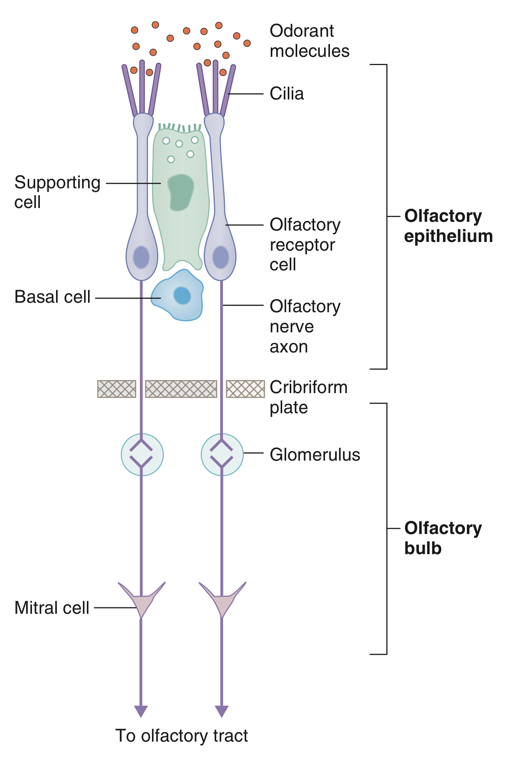
Olfactory Transduction
Molecules dissolve in mucus layer ➡ combine with receptors on cilia ➡ stimulate adenylate cyclase ➡increase intracellular cAMP ➡opening of Na channels ➡receptors potential ➡AP in olfactory pathway

Slide 4
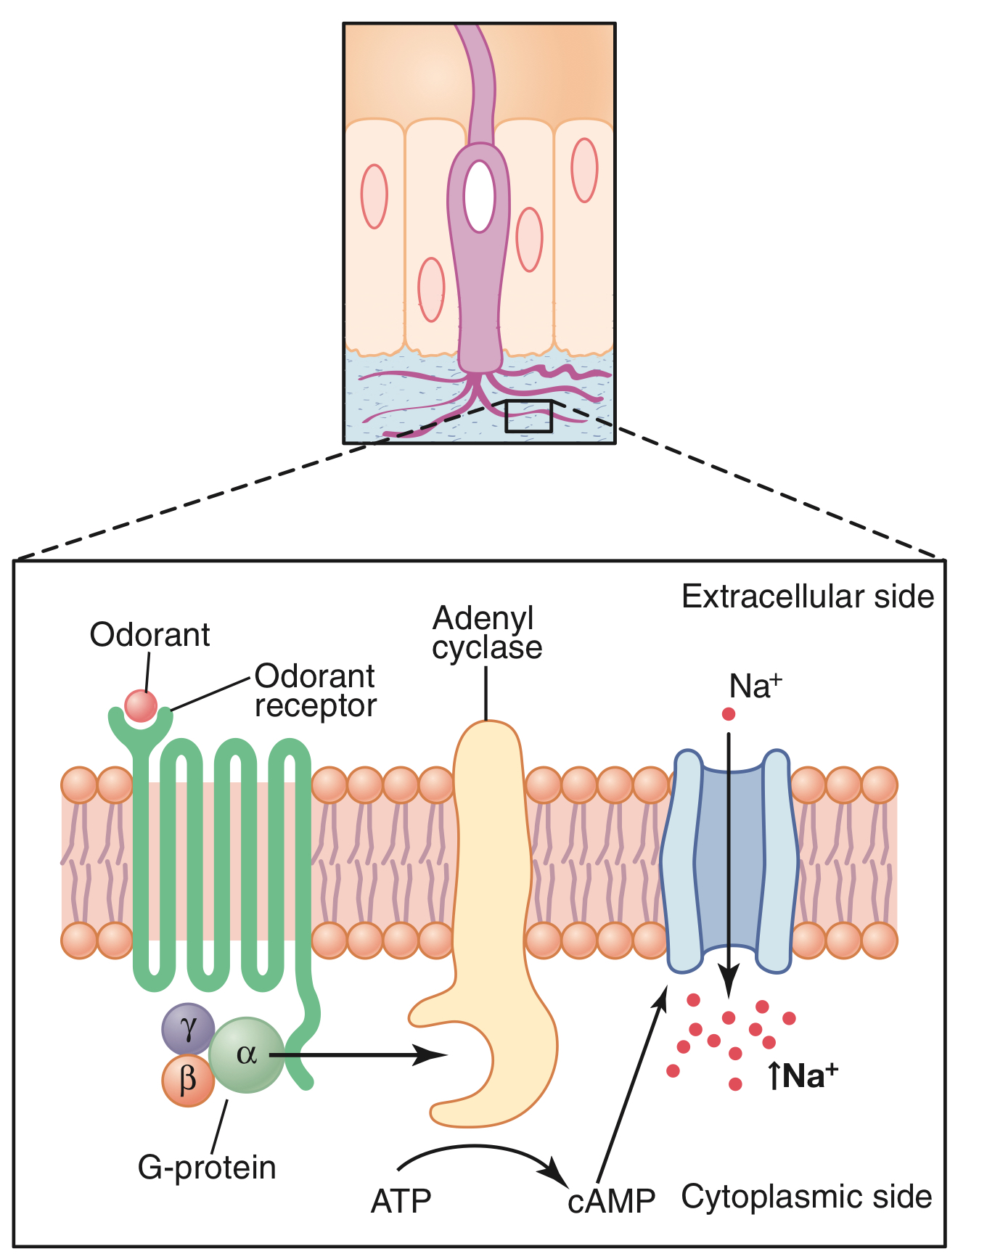
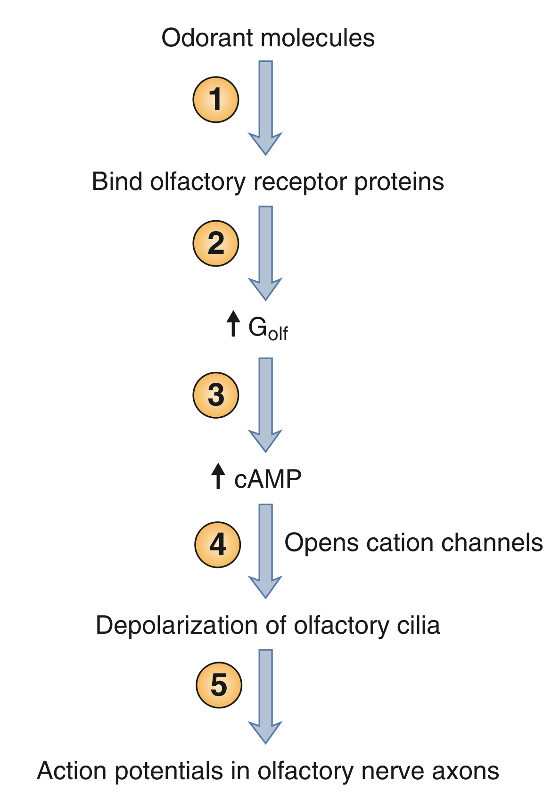
Olfactory pathway
• Fila olfactoria enter olfactory bulb ➡ synapse with mitral and tufted cells
from mitral cells lateral and intermediate stria start ➡end on ipsilateral cortex
from tufted cells medial stria start then cross the midline & end on granular cells in opposite side (contralateral)
Impulses travel along the olfactory tracts to the limbic system – (also involved in emotions and memory)
Impulses are interpreted in olfactory cortex – Deep in temporal lobe and base of frontal lobe
Mechanism of olfactory cell stimulation:
Oduran + receptor protein ➡ Activation of G protein ➡ Activation of adenylate cyclase ➡ ATP to cAMP ➡ Opening of Na+ channels ➡ Na+ influx ➡ depolarization

Slide 5
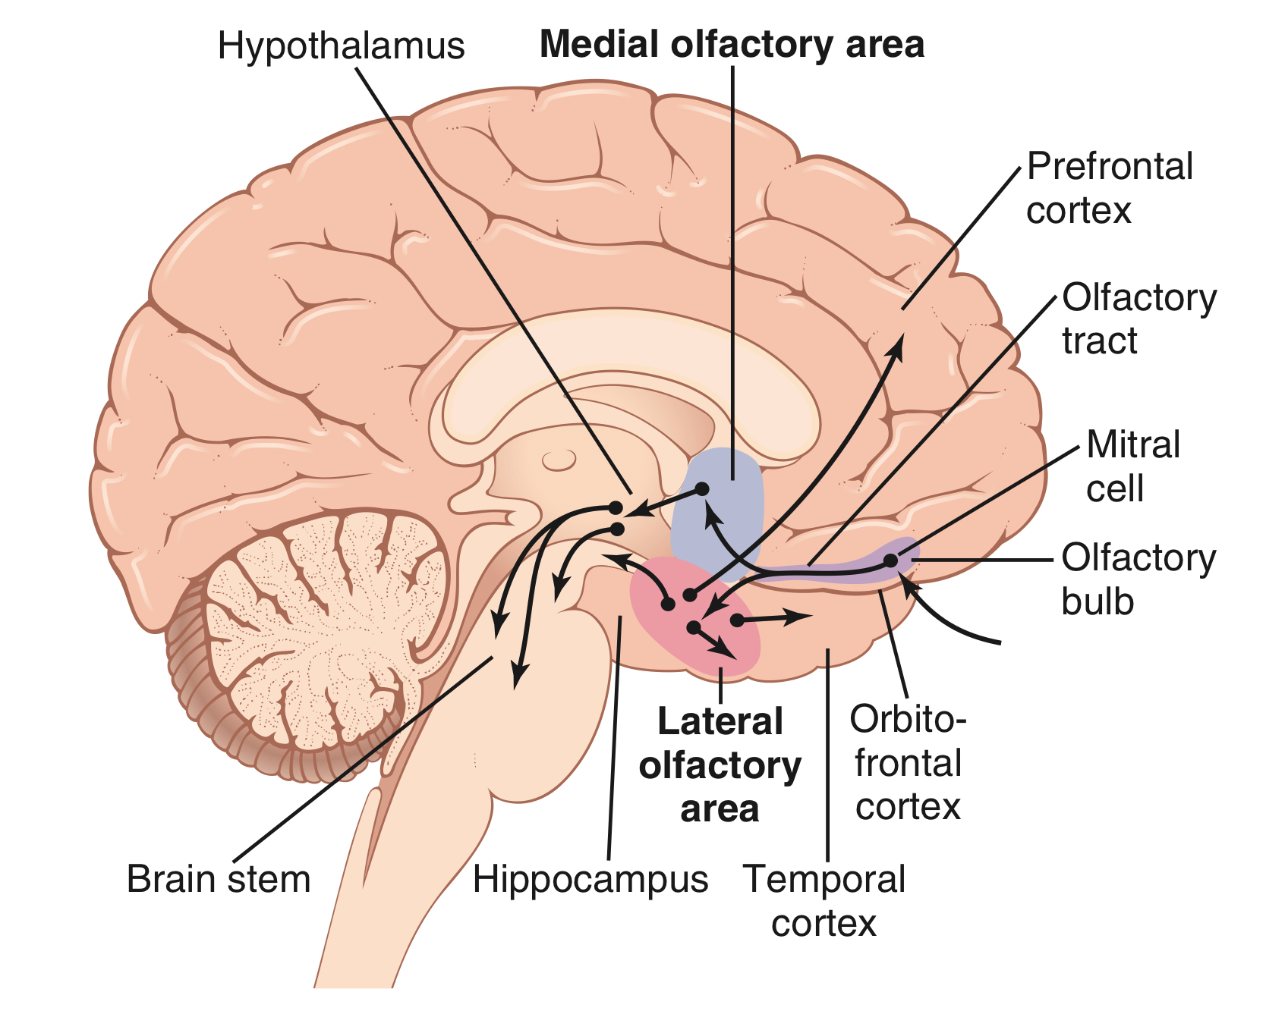
Olfactory receptor cell ➡ olfactory nerve ➡ olfactory bulb ➡ olfactory tract
Medial olfactory area
Lateral olfactory area
Septal Nuclei
Prepyriform cortex
Pyriform cortex
Amygdala
Thalamus
Hypothalamus
Limbic system
(primitive parts)
Primitive olfactory system
Limbic System
(hippocampus)
(Less old olfactory system)
Orbitofrontal Cortex
(Newer system)
important for learning to like or dislike certain foods depending on one’s experiences with them.
helps in the conscious analysis of odor.
Primitive reflexes, such as licking the lips, salivation, and other feeding responses caused by the smell of food or by basic emotional drives associated with smell.
An important feature of the lateral olfactory area is that many signal pathways from this area also feed directly into an older part of the cerebral cortex called the paleo- cortex in the anteromedial portion of the temporal lobe. this area is the only area of the entire cerebral cortex where sensory signals pass directly to the cortex without passing first through the thalamus.

Slide 6
Pathophysiology
Disorder | Description
Anosmia | loss of smell sensation Due to damage to olfactory Epithelium
Dysosmia | Distorted sense of smell
 | Parosmia | Phantosmia | Agnosia
 | Alteration in smell sensation | Perception of smell without an odor present | Inability to classify or contrast odors, although able to detect odors
Hyperosmia | increase in smell Sensation Adrenal insufficiency
Hyposomia | decreased smell Sensation Vitamin A deficiency

Slide 7
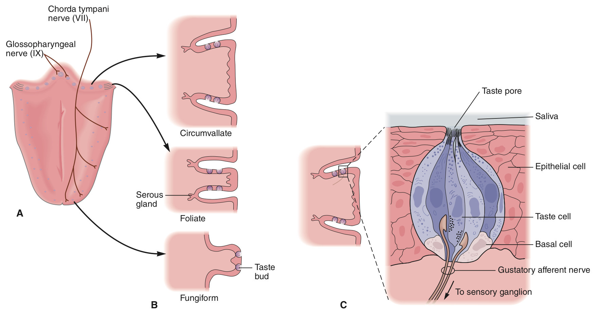
Taste is the sensation produced when a substance in the mouth reacts chemically with taste receptors.
Taste buds are specialized receptors widely scattered throughout the oral cavity:
Tongue
Soft palate
Inner surface of cheeks
Types of Papillae:
The tongue is covered with 3 types of projections called papillae:
Filiform: Sharp – no taste buds
Fungiform: Rounded with moderate number of taste buds
Circumvallate: Large papillae with numerous number of taste buds
Foliate: located in the folds along the lateral surfaces of the tongue.
No taste buds on the mid dorsum of the tongue
Structure of taste buds:
Gustatory “Taste” cells with long microvilli (gustatory hair cells).
They are receptor cells with cilia projected through taste pore between the supporting cells.
Hairs are stimulated by chemicals dissolved with saliva and transmit impulses to the brain.
Impulses are carried to the gustatory complex by cranial nerves as taste buds are found in different areas:
Facial nerve (VII)
Glossopharyngeal nerve (IX)
Vagus nerve (X)

Slide 8
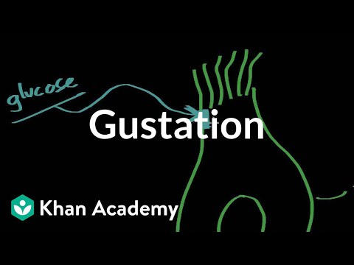
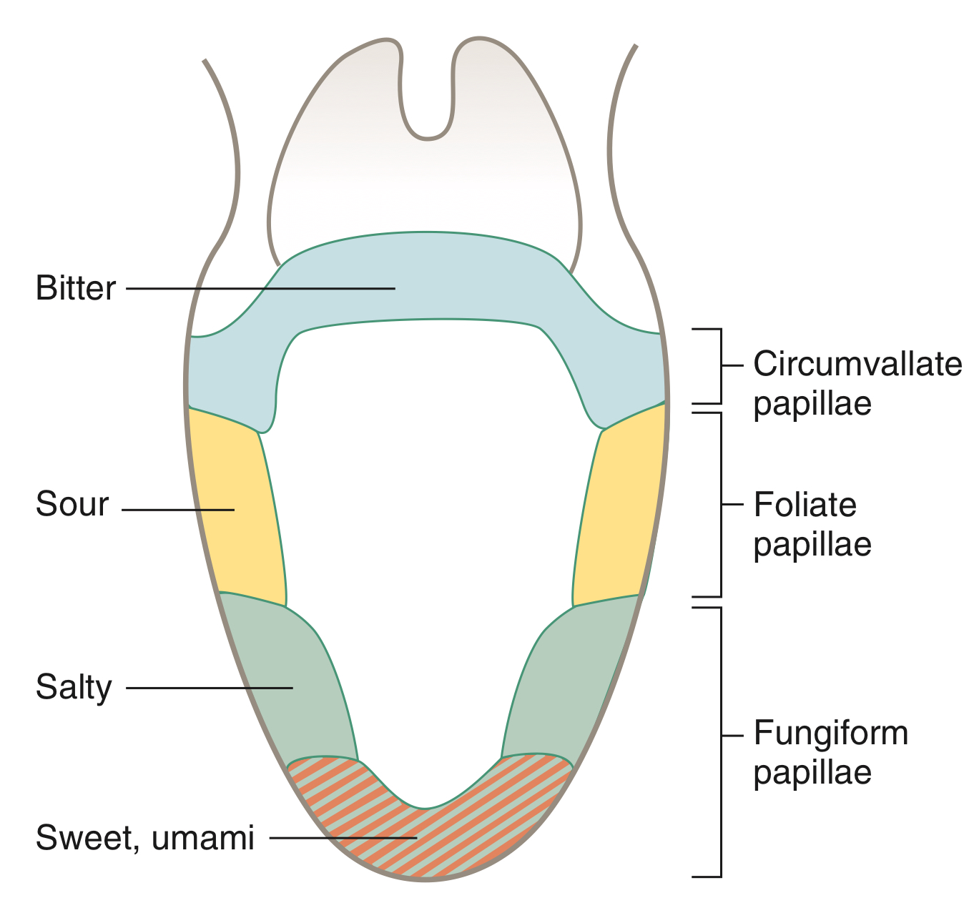
Distribution of taste buds:
Distribution of taste buds on the tongue is not uniform:
Sweet - tongue tip
Sour - tongue margins
Bitter - back of tongue
Salty - widely distributed
Taste sensations:
5 established tastes:
Sweet receptors respond to:
Sugars
Saccharine
Some amino acids
Sour receptors respond to:
H+ ions
Acids
Bitter receptors respond to:
Alkaloids
Salty receptors respond to:
Salt, ions, metal
Umami receptors respond to:
Glutamate - “beef taste” of steak
Umami, a Japanese word meaning “delicious,”
Taste pathway:
First order neuron:
Taste fibres from the three cranial nerves form “tractus solitarius “ end in the nucleus of tractus solitarius “TS”(medulla).
Second order neuron:
From TS cross the midline to ascend in the medial lemniscus to the ventral posterior medial nucleus of the thalamus.
Third order neuron:
From thalamus project the cerebral cortex through thalamic radiation.
Molecules dissolve in the saliva » attach to receptors on cillia of gustatory cells » receptors potential » action potential.
Combination between molecules and receptors are weak (since taste can be easily abolished by washing mouth with water).
When stimulated produce nerve impulse to specific brain area through:
Anterior 2/3 of the tongue » VII
Posterior 1/3 of the tongue » IX
Palate, pharynx, epiglottis » X

Slide 9
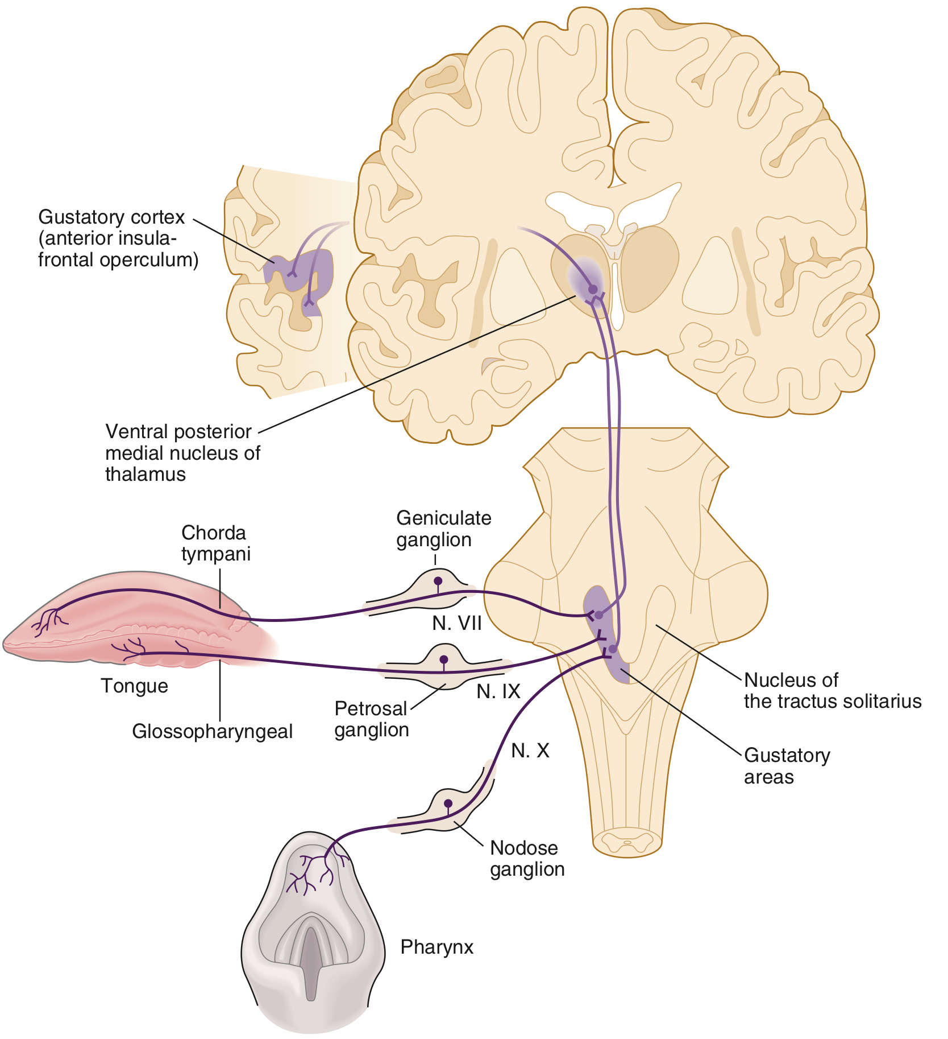
Pathophysiology:
Ageusia (complete loss of taste).
Dysgeusia (disturbed taste).
Caused by a damage to cranial nerves VII, IX, X.
Hypergeusia
Caused by adrenal insufficiency
Hypogeusia
Many diseases can produce hypogeusia. In addition, drugs such as captopril and penicillamine—which contain sulfhydryl groups—cause temporary loss of taste sensation.

Slide 10
medial stria starts from
. mitral cells
. tufted cells
. basal cells
. taste receptors
2. Vitamin A Deficiency causes
. Ageusia
. Dysgeusia
. Anosmia
. Hyposomia
3. Which of the following described as Primitive olfactory system?
.Thalamus
. Pyriform cortex
.Hypothalamus
.Amygdala
4. “Perception of smell without an odor present”; is a definition of which of the following?
.Phantosmia
.Parosmia
.Hyperosmia
.Agnosia
5. Each of the following is part of Lateral olfactory area except:
.Septal Nuclei
.Amygdala
.Thalamus
.Prepyriform cortex
6. Taste buds can be found on all of the following except?
Tongue
Soft palate
Hard palate
Inner surface of the cheek
7. Umami receptors respond to:
Alkaloids
Glutamate
Some amino acids
H+ ions
8. Taste from the posterior ⅓ of the tongue is sensed by:
Glossopharyngeal nerve
Vagus nerve
Hypoglossal nerve
Facial nerve
9. Tractus Solitarius is formed by the _, _, and _ cranial nerves.
IX, X,XI
VII, IX, X
VIII, X, XI
VIII, IX, X
10. Which of the following is a pathophysiological manifestation caused by adrenal insufficiency?
Ageusia
Hypogeusia
Dysgeusia
Hypergeusia
Answers:
1.B
2.D
3.C
4.A
5.A
6C
7B
8A
9B
10D

