Slide 1
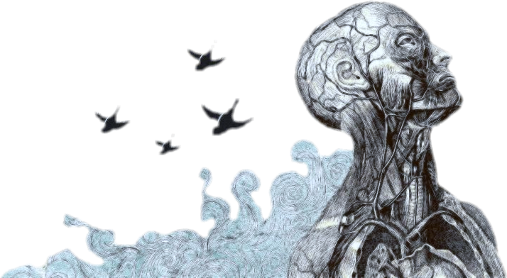
Objectives
Depressive disorders
To understand what depression is.
To know the various types of depression.
To recognize features of depression.
To be aware of pathophysiology/etiology of depression.
Important
Notes
Boys’ slides only

Slide 2
Introduction
Ms. Amal is a 27-year-old single woman works as a teacher. She has a five-week history of low mood, chest tightness, poor appetite, disturbed sleep, excessive guilt feelings, and loss of interest in her social activities.
• Healthy people:
have a wide continuum range of feelings with normal variations.
[ usual sadness < < < - - - - - - - -> > > usual happiness ].
• Patients with depression have :
Prolonged unusual sadness/lack of pleasure/others features that have adverse effect on functioning.
Body physiology is adversely affected (HPT axis).
Boys’ slides

Slide 3
About depression
Definitions
01
The most common psychiatric illness.
Mood:
01
is the sustained and pervasive feeling tone that
influences a person's behavior and perception of the world. It is internally experienced.
Mood can be normal, depressed, or elevated “mania”.
Lifetime prevalence of nearly 17% for major depression and about 2% for bipolar I and II disorders
02
Most important NT for mood: 5HT, NE and dopamine
03
More common in women than in men
04
Mean age is around 32 yrs.*
Affect
*Locally it Usually starts before 30, if 20 something came in the choices you choose it
Usually in if the patient reaches 30 years old, it is rare to develop sporadic mental illness
02
is the person's present transient emotional
state. It represents the external expression of
mood.
10:35

Slide 4
Etiology and Pathophysiology of Mood Disorders
Genetics factors
Social and Environmental Factors
Neurobiology
(catecholamine hypothesis, decrease of norepinephrine) \ serotonin.
Neuroimaging Studies
(subgenual prefrontal cortex (SGPFC) ↓ blood flow “MRI or CT”
Abnormalities in Neuroendocrine Function
(abnormal diurnal variation in cortisol production , hypothalamic-pituitary-adrenal axis, GH.
Biopsychosocial
Neurotransmitter disturbances: 5HT-NE-Dopamine

Slide 5
Depressive disorders ( DSM-V)
DSM-V it is the reference that psychiatrist use to diagnosis
recommended video
4:28
Primary depression:
1. Major Depressive Disorder ,Single and Recurrent Episodes
2. Persistent Depressive Disorder “مزمن”
dysthymic Disorder “عسر المزاج” “the patient reports persistent unhappiness, but the level of depression is lesser than major depressive disorder”
chronic major depressive disorder
3. Disruptive Mood Dysregulation Disorder (in children). “Usually appear as Behavioral disorder“
4. Premenstrual Dysphoric Disorder
5. Substance/Medication-Induced Depressive Disorder
6. Depressive Disorder Due to another Medical Condition such as HTN or DM
7. Depressive episodes of bipolar disorder
Secondary depression
1. Medical disease (e.g. hypothyroidism)
2. Medications (e.g. OCPs)
3. Substance abuse
4. Brain insult (e.g. CVA)

Slide 6
Epidemiology of Major Depressive Disorder (MDD)
Boys’ slides
Lifetime prevalence is in the range of 15 - 25​ %
The mean age of onset is about 40 years (25 - 50 years) .
It may occur in childhood or in the elderly
In adolescents, it may be precipitated by substance abuse.
The risk increase with age
More common in those who lack confiding relationship (e.g. divorced, separated, single).
Episodes
Episodes:​ discrete periods of abnormal mood; low, high, or mixed mood :
Major depressive episode (MDE) :​
​≥ 2 weeks of low mood/loss of interest + other features.
There has never been a manic episode. Severity varies (mild-moderate- severe).
Mixed episode :​ ​
≥ 1 week of both depressed and manic mood + other features Severity varies:
(mild-moderate- severe).
Depression might come as a part of bipolar disorder, If you treat a bipolar person presenting with depression symptoms with antidepressants he will develop mania

Slide 7
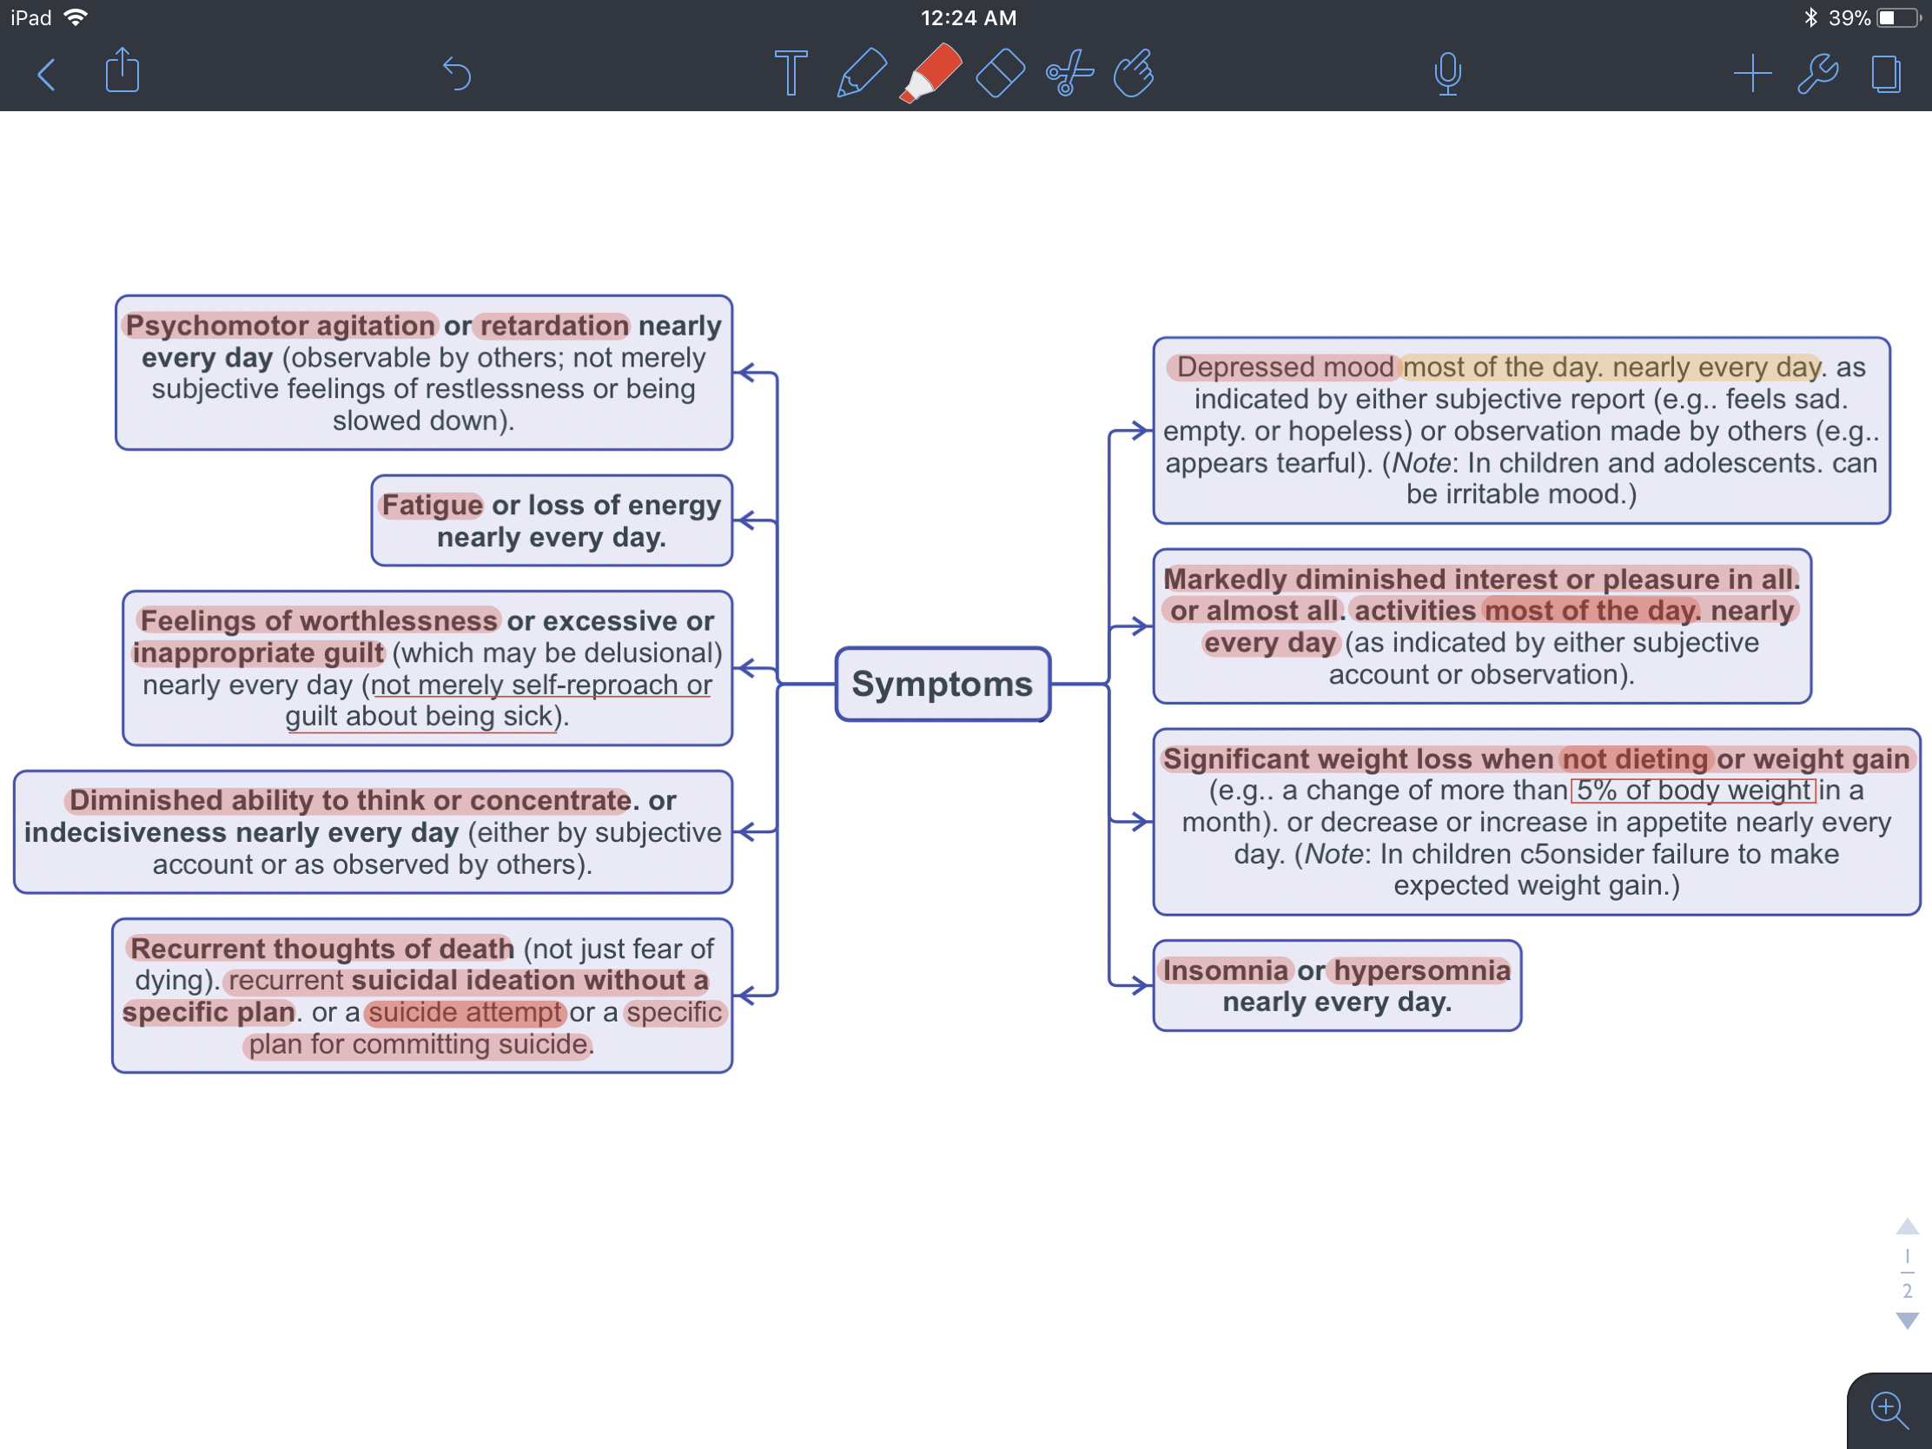
Criteria For Major Depressive Episodes
Criteria are very IMPORTANT
A. Five (or more) of the following symptoms have been present during the same 2-week period and represent a change from previous functioning; at least one of the symptoms is either:
depressed mood.
loss of interest or pleasure.
“One of these Along with 5 of the symptoms written on the right is diagnostic”
Note: Do not include symptoms that are clearly attributable to another medical condition.
٥ من الأعراض المذكورة تحت يوميًا لمدة اسبوعين وما يكون لها علاقة لأي مرض أو خلل وظيفي
B. The symptoms cause clinically significant distress or impairment in social. occupational. or other important areas of functioning.
C. The episode is not attributable to the physiological effects of a substance or another medical condition.
Subjective report: what the patient says
Observation: made by other people or by the psychiatrist
دائما يقول : انا ما استاهل. عشان كذا دايم يفكر بالانتحار. يفكرون انهم ما يقدرون يسوون شي ومحد يقدر يساعدهم
دائما مترددين بأبسط الأمور
This is very significant to MDD
ما يكون من طبيعة الشخص (تغير مُلاحظ في طبيعة نومه)
Note: Criteria A-C constitute a major depressive episode. Major depressive episodes are common in bipolar l disorder but are not required for the diagnosis of bipolar I disorder.

Slide 8
Depressive Features and Clinical Findings
Mood Changes | Appearance & Behavior | Cognitive Functions & Thinking | Biological Features (Neurovegetative Signs)
Unusual sadness (low mood). Anhedonia “reduced motivation or ability to experience pleasure.” Feeling lonely Irritability. | ​Neglected dress and grooming. Facial appearance of sadness: Turning downwards of corners of the mouth​. Downcast gaze. tearful eyes and reduced rate of blinking. Head is inclined forwards. Psychomotor retardation (in some patients agitation occurs): Lack of motivation and initiation. Slow movements/slow interactions. Social isolation and withdrawal. | Subjective poor attention, concentration, decision making and memory In elderly this may be mistaken as dementia (pseudodementia). Depressed thinking process which is pessimistic thoughts about : Present: patient sees the unhappy side of every event (discounts any success in life, no longer feels confident, sees himself as failure). Past: unjustifiable guilt feeling and self-blame. Future: gloomy preoccupations; hopelessness, helplessness, death wishes (may progress to suicidal ideation and attempt). | Change in appetite (usually reduced but in some patients increased). Change in sleep (usually reduced but in some patients increased). Fatigability, low energy level (simple task is an effort). Low libido and /or impotence. Change in bowel habit (usually constipation). Change in menstrual cycle (amenorrhea). Pain threshold becomes low (gate theory/serotonin) Several immunological abnormalities (e.g. low lymphocytes) increasing the risk to infection.
Boys’ slides

Slide 9
Clinical Findings
Criteria in slide 7 are more significant in diagnosing, more important to memorize
Alteration of mood
Vegetative (or somatic) symptoms, such as decreased appetite or insomnia, weight loss
Feeling chronically tired \ lack of energy
Psychomotor retardation\ agitation
Feelings of worthlessness and guilt \ hopeless
Complaints of difficulty in concentrating or thinking clearly
Depressed patients may think a great deal about death or dying
Diurnal variation يكون مزاجهم بأسوأ وقت الصباح
Decrease sex drive
Psychotic Features Associated with Severe Depression
Hallucinations (mood-congruent) | Delusions (mood-congruent) fixed false beliefs
Usually second person auditory hallucinations​* (addressing derogatory repetitive phrases) more common. Visual hallucinations​ (e.g. scenes of death and destruction) may be experienced by a few patients very rare. * second person: شخص ثاني يكلمه Third person: يسمع شخصين يتكلمون مع بعض | Delusion of guilt​ (patient believes that he deserves severe punishment) Nihilistic delusion​ (patient believes that some part of his body ceased to exist or function, e.g. bowel, brain or heart). Delusion of poverty and impoverishment ​. Persecutory delusion​ (patient accepts the supposed persecution as something he deserves, in contrast to schizophrenic patient). يحس انه هو السبب بأي شي يحصل له وأنه يستحق هالشي الي حصل

Slide 10
Course and Outcome
A depressive episode may begin either suddenly or gradually
Duration of an untreated episode may range from a few weeks to months or even years ( 6-9 months )
20% will develop a chronic form of depression.
suicidal risk increases with:
being divorced or living alone
having a history of alcohol or drug abuse
being older than 40
​having a history of a prior suicide attempt​ “ it is the most important and significant suicidal risk factor”
expressing suicidal ideation (particularly when detailed plans have been formulated).

Slide 11
Treatments
Antidepressants:
Have proven to be very useful in the treatment of severe depression.
They shorten the duration in most cases.
Desirable therapeutic antidepressant effect requires a period of time, usually 3-5 weeks.
Side effects may appear within the first few days.
Tricyclics/ Tetracyclics:
Avoid in suicidal patient because of cardiotoxicity in overdose.
Selective Serotonin Reuptake Inhibitors (SSRIs):​e.g. fluoxetine, paroxetine.
Selective serotonin – Norepinephrine Reuptake Inhibitors (SNRIs): e.g. venlafaxine, duloxetine.
Other new agents e.g. mirtazapine.
After a first episode of a unipolar major depression, treatment should be continued for six months after clinical recovery​, to reduce the rate of relapse​. نحسب ال٦ اشهر من بداية التحسن مو من بداية اعطاء العلاج
If the patient has had two or more episodes​, treatment should be prolonged for at least a year after clinical recovery to reduce the risk of relapse​.
Lithium Carbonate can be used as prophylaxis​ in recurrent unipolar depression. It has low therapeutic index

Slide 12
Management of Major Depression: ​(Biopsychosocial Approach)
Hospitalization:​ ​is indicated for:
Suicidal or homicidal patient. Patient could kill his family thin kill himself “such cases has been reported”
Patient with severe psychomotor retardation ​ who is not eating or drinking (for ECT).
Diagnostic purpose (observation, investigation).
Drug resistant cases (possible ECT).
Severe depression with psychotic features (possible ECT).
Electroconvulsive therapy ( ECT ) : for severe psychosis and suicidal patients
The effect of ECT is best seen in severe depression​ especially with marked biological (neurovegetative), suicidal and psychotic features. It is mainly the speed of action that distinguishes ECT from antidepressant drug treatment. In pregnant depressed patient ECT is safer than antidepressants​.
Psychosocial:
Supportive therapy. Family therapy. Cognitive-behavior therapy (CBT) for less severe cases or after improvement with medication​.
Prognosis of Unipolar Depression Disorder
About 25 % of patients have a recurrence within a year.
About 10 % will eventually develop a manic episode.
Be careful about antidepressants
A group of patients have chronic course with residual symptoms and significant social handicap.

Slide 13
Differential Diagnosis of (MDD)
Important!
1- Depression secondary to medical diseases | Hypothyroidism Diabetes mellitus Cushing’s disease Parkinson’s disease. Stroke​. Carcinoma (especially of the pancreas and lungs). Autoimmune diseases; SLE, multiple sclerosis.
2-Depression secondary to medications | Antihypertensives (e.g. beta-blockers, methyldopa, reserpine & Ca-channel blockers). Steroids. Bromocriptine and L- dopa. Indomethacin. Isotretinoin (Roaccutane); treatment of acne. Progestin-containing contraceptives (compared to estrogen-containing contraceptives, which can reduce depression risk). Tamoxifen (estrogen-receptor antagonist used in breast cancer): it may induce depression that can be difficult to treat with antidepressants. Chemotherapy agents e.g. vincristine, interferon (may induce severe depression with suicidal ideas). Antipsychotics.
3. Depression secondary to substance abuse | (upon discontinuation of stimulants / cannabis).
4. Psychiatric disorders: | Dysthymic disorder (chronic & less severe depression - see later-).However, both may occur together; dysthymic disorder complicated by major depressive episodes (double depression) Adjustment disorder with depressed mood better than depression اضطراب التأقلم Schizophrenia, schizoaffective disorder. Somatization disorder. Anxiety disorder.
Girls’ slides

Slide 14
Persistent Depressive Disorder (Dysthymia)
This disorder represents a consolidation of DSM-IV-defined chronic major depressive disorder and dysthymic disorder.
Depressed mood for most of the day, for more days than not, as indicated by either subjective account or observation by others, for at least 2 years. “≥ 2 years history of chronic low mood​.”
Note: In children and adolescents, mood can be irritable and duration must be at least 1 year.
Symptoms:
Presence, while depressed, of TWO (or more) of the following:
1. Poor appetite or overeating.
2. Insomnia or hypersomnia.
3. Low energy or fatigue.
4. Low self-esteem.
5. Poor concentration or difficulty making decisions.
6. Feelings of hopelessness.
سنتين أغلب الأيام تظهر عليه ٢ من الأعراض أو أكثر
Recall:
do you remember how many symptoms are required to diagnose MDD? :)
Note that there is NO suicidal or death thoughts

Slide 15
Diagnostic Criteria for Persistent Depressive Disorder (Dysthymia)
During the 2-year period (1 year for children or adolescents) of the disturbance, the individual has never been without the symptoms for more than 2 months at a time.
Criteria for a major depressive disorder may be continuously present for 2 years.
There has never been a manic episode * or a hypomanic episode, and criteria have never been met for cyclothymic disorder. * مجرد ما يكون عنده نوبات هوس يتغير التشخيص
The disturbance is not better explained by a persistent schizoaffective disorder, schizophrenia, delusional disorder, or other specified or unspecified schizophrenia spectrum and other psychotic disorder.
The symptoms are not attributable to the physiological effects of a substance (e.g., a drug of abuse, a medication) or another medical condition (e.g. hypothyroidism).
The symptoms cause clinically significant distress or impairment in social, occupational, or other important areas of functioning.
سنتين أغلب الأيام تظهر عليه ٢ من الأعراض أو أكثر فترة التحسن ما تكون أكثر من شهرين
Not related to any other psychotic disorders , medical conditions or effect of substance and drugs.
There is NO suicidal thoughts or plans, NEVER.
In case of death or suicidal thoughts , most likely the diagnosis is Major Depression Disorder (MDD)

Slide 16
Course and Prognosis of Persistent Depressive Disorder (Dysthymia)
Some patients may consider early onset dysthymic disorder as part of life.
The onset is usually insidious before age 25
Patients often suffer for years before seeking psychiatric help.
About 25% never attain a complete recovery.
chronic
Treatment of dysthymic disorder
The most effective treatment is the combination of ​pharmacotherapy and cognitive or behavior therapy ​(CBT).
A. Pharmacological:
Selective serotonin reuptake inhibitors (SSRI)​.
Selective serotonin – Norepinephrine Reuptake Inhibitors(SNRIs):​ Venlafaxine,duloxetine.
Monoamine oxidase inhibitors (MAOI): Avoid combining with SSRI or tricyclic antidepressants.
These groups may be more beneficial than tricyclic drugs in the treatment of dysthymic disorders.
B. Psychological:
Supportive therapy​.
Cognitive therapy: to replace faulty negative self-image, negative attitudes about self, others, the world, and the future.
Behavior therapy: to enable the patient to meet life challenges with a positive sense by altering personal behavior through implementing positive reinforcement.

Slide 17
Peripartum Depression (Perinatal/Postpartum Depression)
مجرد تفكير الأم بأذية طفلها على طول لازم نتدخل
About 10 - 15 %.
The peripartum onset specifier identifies those patients who experience a depressive, manic, or hypomanic episode during pregnancy “late pregnancy” or within the first 4-6 weeks postpartum, (10–14 days after delivery*).
50% of “postpartum” depressive episodes actually begin prior to delivery.
It is associated with increasing age, mixed feelings about the baby, physical problems in the pregnancy and prenatal period, family distress and past psychiatric history.
May be associated with irritability, self-blame and doubt of being a good mother, excessive anxiety about the baby’s health and death wishes, accompanied by severe anxiety and even panic attacks and irritable mood.
If not treated may continue for 6 months or more and cause considerable family disruption.
Counseling, additional help with child-care may be needed. Antidepressants or ECT are indicated if there are biological features of depression.
يعني هو نوع محدد من أنواع الإكتئاب "يندرج تحت مسمى الإكتئاب"، يصيب النساء اللي تعرضوا depression, manic or hypomanic خلال فترة الحمل الاخيرة او بعد الولادة.
Feeling a bit depressed after delivery is common (postpartum blue)
Full mood syndrome that require medical attention (postpartum depression)
Extra information:
Hypomanic episodes have the same symptoms as manic episodes, the different is in hypomanic the mood usually isn't severe enough to cause problems with the person working or socializing with others and it don’t require hospitalization.
*introductory textbook of psychiatry “fifth edition”:
With in the first 4 weeks.
Boys’ slides:
6 weeks (10-14) days.

Slide 18
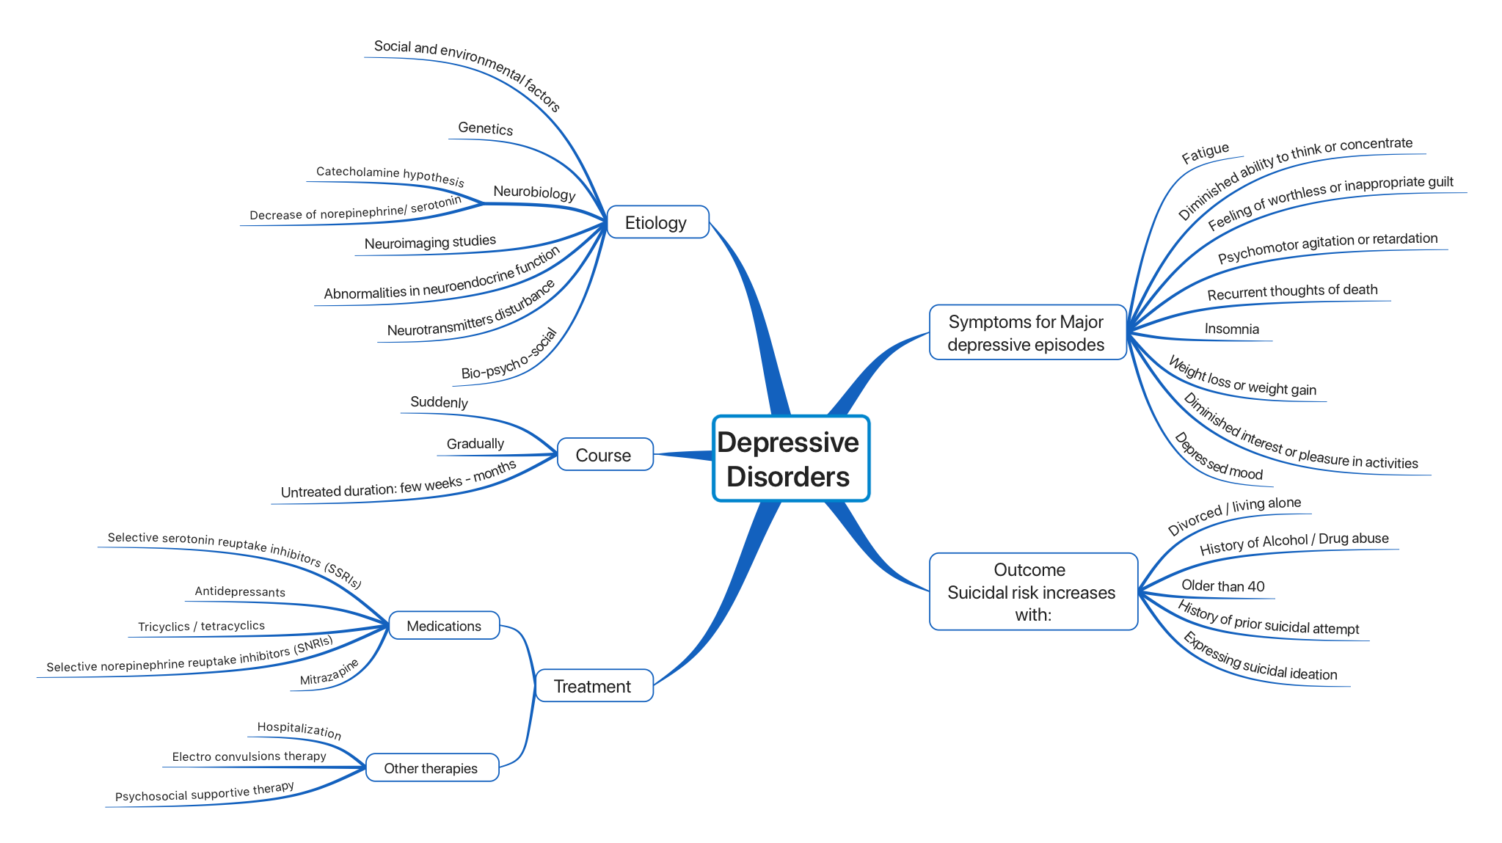
Summary

Slide 19
Quick Revision
The most significant suicidal risk is: having a history of a prior suicide attempt
The Most important pharmacological treatment is: Selective Serotonin Reuptake Inhibitors (SSRIs) e.g. fluoxetine, paroxetine.
Major Depression disorder can be secondary to:
1- medical disease: Hypothyroidism, DM, SLE, strokes and carcinomas (lung + pancreas) 2- medications: antihypertensive drugs (beta blockers p), steroids, isotretinoin (roaccutane) 3- substance abuse 4- psychiatric disorders: dysthymic disorder, schizophrenia, anxiety.
Treatment should be continued after 6 months of clinical recovery.
Major depression disorder | Persistent Depressive Disorder (Dysthymia)
Presence of 5 or more criteria. | Presence of 2 or more criteria.
Every day for 2 weeks or more | most of the day, for more days than not for at least 2 years.
It might be secondary to medical disease, medications, substance abuse or other psychiatric disorders | Not related to any other psychotic disorders , medical conditions or effects of substance and drugs.
Thought of death or suicidal attempts/ plans | No suicidal thoughts

Slide 20
MCQs
1-Which one of the following is a major symptom of depression?
A-Fatigue
B- Weight loss.
C- Loss of interest.
D. Alogia
2- A normal mood is called :
A-Euthymia
B- Euphoria
C- Dysthymia
D- Non
3- Which one of the depressive disorders is more in children ?
A- Disruptive Mood Dysregulation Disorder
B- Premenstrual Dysphoric Disorder
C- Major Depressive Disorder
D- Persistent Depressive Disorder
4- living alone is related to:
A- relaxing and getting better
B- increase suicidal risk
C- no effect on depressed patients
5- which of the following is used as pharmacological treatment:
A- Beta Blockers
B- amphetamine
C- Selective Serotonin Reuptake Inhibitors
D- Electroconvulsive therapy
6- 26 years old patient complained from severe change in his mood from depressed mood to manic mood for 9 days, the best diagnose is:
A- Dysthymia
B- Major depression disorder
C- schizophrenia
D- mixed episode of depression
7- 24 years old patient known case of rheumatoid arthritis, he came to psychiatric complaining of low mood. The best diagnose is:
A- Dysthymia
B- Major depression disorder
C- schizophrenia
D- mixed episode of depression
1- C 2- A 3- A 4- B 5- C 6- D 7- B

Slide 21
Thank you for checking our work
Team Leaders
Contact us:
Abdulaziz Aljohani
Laila Alsabbagh
@medicine437
Medicineteam437@gmail.com
Team Members
Waiting for Your feedback
Reham Alhalabi
Razan Alhamidi
Reference: Girls’ & Boys’ Slides

