Slide 1
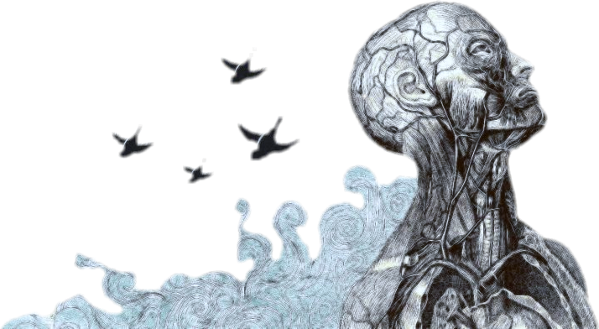
Objectives
Schizophrenia
Appreciate that Schizophrenia is a serious, brain illness that needs early intervention and comprehensive management approach.
Enhance knowledge of schizophrenia including epidemiology, etiology, diagnosis and management.
Acquire preliminary skills to evaluate and intervene adequately to manage schizophrenia patients.
Important
Notes
Boys’ slides only

Slide 2
Introduction
Case of Mr. Schi
Mr. Schi is a 28 year-old single male who was brought to Emergency room by his family because of gradual changes in his behavior started 9 months ago. Since then, he became agitated; eat only canned food but not cooked food made by his family, afraid of being poisoned. He talks to himself and stares occasionally on the roof of his room.
He had two brief psychiatric hospitalizations in last 3 years that were precipitated by anger at his neighbor and voices commenting about his behavior.
His personal history indicated that he was a healthy child, but his parents reported that he was a bed wetter and seemed slower to develop than his brothers and sisters.
Schi smokes tobacco frequently to calm himself. During his early adolescence he used to smokes Hash heavily plus occasional use of amphetamine. He stopped both Hash and Amphetamine use 5 years ago.
Boys’ slides

Slide 3
Schizophrenia
Is defined by a group of characteristic symptoms, such as hallucinations, delusions, or negative symptoms:
(i.e., affective flattening 1 , alogia 2, avolition 3 ); deterioration in social, occupational, or interpersonal relationships; and continuous signs of the disturbance for at least 6 months.
psychotic disorders
are mental illnesses characterized by gross impairment in reality testing ما يفرق بين الحقيقة وما يتوهمه and personal functioning.
Its symptoms include dysfunctions in nearly every capacity of which the human brain is capable—perception, inferential thinking, language, memory, and executive functions.
It is not split personality ليس إنفصام الشخصية وإنما الفصام
The illness is called “schizo” (fragmented or split apart) “phrenia” (mind)
In DSM-V*: psychotic spectrum
Positive symptoms: presence of thing should not be present هي شي ظاهر انا اقدر اشوفه زي الهلاوس Negative symptoms: absent of things should be present. Such as: 1) affective flattening بمعنى انه ما يظهر تفاعل 2) alogia يفتقر الى الكلمات او ما يسمى بالحديث التلقائي، زي لما تسأله متى بدأ معك يقول من زمان ما يعطي تفاصيل اكثر وايضا لو ما سألته ما رح يتكلم 3) avolition يفقد المبادرة في الشيء، مثلا لو يجلس اسبوع ما تروش ما عنده مشكله
*DSM-V it is the reference that psychiatrist use to diagnosis
08:14

Slide 4
Schizophrenia
DSM-5 schizophrenia spectrum and other psychotic disorders:
◦ Schizotypal personality disorder 1
◦ Delusional disorder 2
◦ Brief psychotic disorder 3
◦ Schizophreniform disorder 4
◦ Schizophrenia 5
◦ Schizoaffective disorder 6
◦ Substance/medication-induced psychotic disorder 7
◦ Psychotic disorder due to another medical condition
◦ Catatonia associated with another mental disorder (catatonia specifier) 8
◦ Catatonic disorder due to another medical condition
◦ Unspecified catatonia
◦ Other specified schizophrenia spectrum and other psychotic disorder
◦ Unspecified schizophrenia spectrum and other psychotic disorder
هو ‏اضطراب الشخصية يكون المريض خيالي بس ما فيه ‏خلل وظيفي وما يسمع هلاوس 1 ما يسمع هلاوس وايضا مافي خلل وظيفي بس يكون شكاك وغالبًا عندهم غيرة مَرَضية 2
3 Brief psychotic disorder( it mostly happened with severe stress ) they usually recover and the prognosis is good 4- لو طالت مدة المرض رقم 3 اكثر من ٣ أشهر بتطور لهذا المرض
5 Schizophrenia : 6 months or more of Schizophreniform disorder
Brief psychotic disorder, Schizophreniform disorder, Schizophrenia are the same disease but the difference is the duration
6 It’s mean that the patient has schizophrenia and mood symptoms غالبا تكون مع متعاطين الامفيتامينات7 8 Catatonia بمعنى التخشب أي كل العضلات متخشبة
catatonia
03:31

Slide 5
Epidemiology
◦ Worldwide prevalence of schizophrenia is about 0.5%–1%. (0.6 – 1.9 %).
◦ Age at first psychotic episode is typically 18–25 years for men and 21–30 years for women.
◦ Peak age of onset are 10-25 years for men and 25-35 years for women.
◦ About one-third attempt suicide.
◦ Annual incidence of 0.5 – 5.0 per 10,000.
◦ Found in all societies and countries with equal prevalence & incidence worldwide.
Functional Impairments Work/School - Interpersonal relationships - self care - activities of daily living
Positive symptoms | disorganization | Cognitive deficits | Mood symptoms | Negative symptoms
Delusions hallucinations | Speech behavior | Attention Learning and Memory Verbal fluency Executive Function “abstraction” | Depression/ Anxiety Aggression/ Hostility suicidality | Anhedonia انعدام اللذة Affective flattening Avolition عدم الرغبة Social withdrawal Alogia قلة الكلام

Slide 6
Clinical features:
01
Psychotic symptoms Positive symptoms
delusion & hallucinations.
Mood symptoms
Depression , Anxiety , Suicidal behavior, Hostility , Aggression.
05
Negative dimension
-The absence of something that should be present, such as volition [lack of motivation].
-Diminished emotional expression (affective flattening or blunting).
-Alogia is characterized by a diminution in the amount of spontaneous speech.
-Anhedonia is the inability to experience pleasure.
-Social withdrawal.
Other Symptoms
◦Lack insight; they do not believe they are ill and reject the idea that they need treatment.
◦Non localizing neurological soft signs such as abnormalities in stereognosis, balance
◦Inactive sex drive
◦Substance abuse is common and includes alcohol and other drugs As nicotine (cigarettes) It is thought that many schizophrenic patients abuse substances in an attempt to lift their mood, boost their level of motivation, or reduce their medication side effects
◦Patient's history & mental status examination are essential for diagnosis.
◦Premorbid history includes schizoid or schizotypal personalities, few friends & exclusion of social activities.
◦Prodromal features include obsessive compulsive behaviors , attenuated positive psychotic features.
02
06
The disorganized dimension تصرفات غريبه ومالها معنى
Includes disorganized speech and behavior and inappropriate affect.
03
Cognitive deficits مشاكل في الوظائف المعرفية بالتخطيط، الانتباه، الذاكرة
Attention, Learning and Memory.
Verbal fluency. الكلام يكون غير مفهوم مافيه تسلسل
Executive Function “abstraction”
04

Slide 7
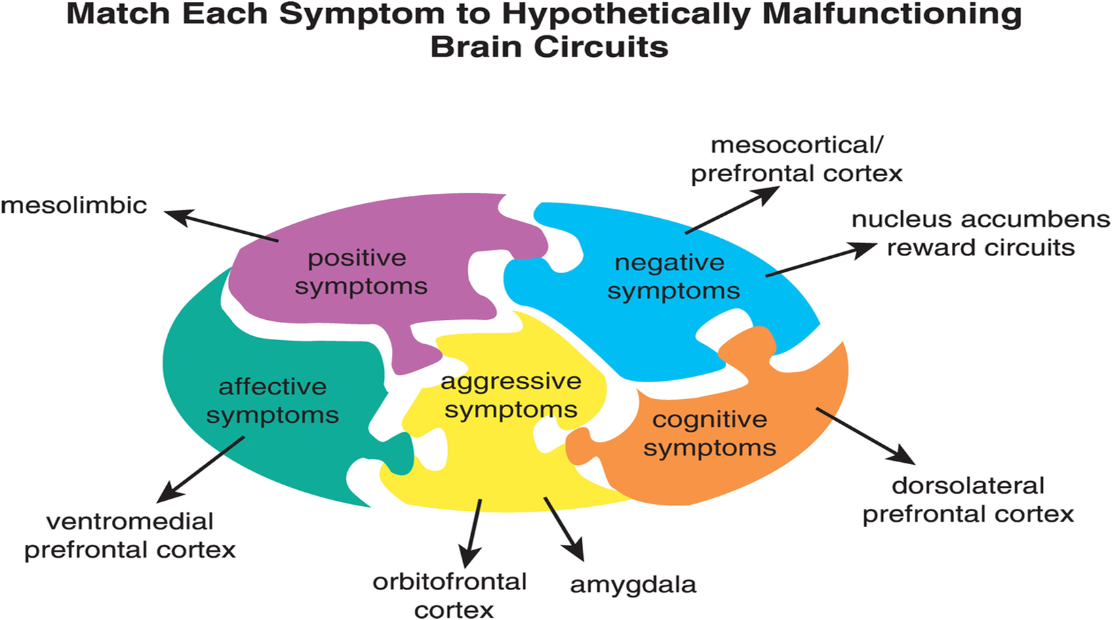
Clinical features:
-Patient's history & mental status examination are essential for diagnosis.
-Premorbid history includes schizoid or schizotypal personalities, few friends & exclusion of social activities.
-Prodromal features include obsessive compulsive behaviors , attenuated positive psychotic features.
Picture of schizophrenia includes positive and negative symptoms.
- Positive symptoms like: delusions & hallucinations.
- Negative symptoms like: affective flattening or blunting, poverty of speech, poor grooming, lack of motivation, and social withdrawal.
*
Don’t have motivation
No single clinical sign or symptom is pathognomonic for schizophrenia
Picture of schizophrenia includes positive and negative symptoms.
Boys’ slides

Slide 8
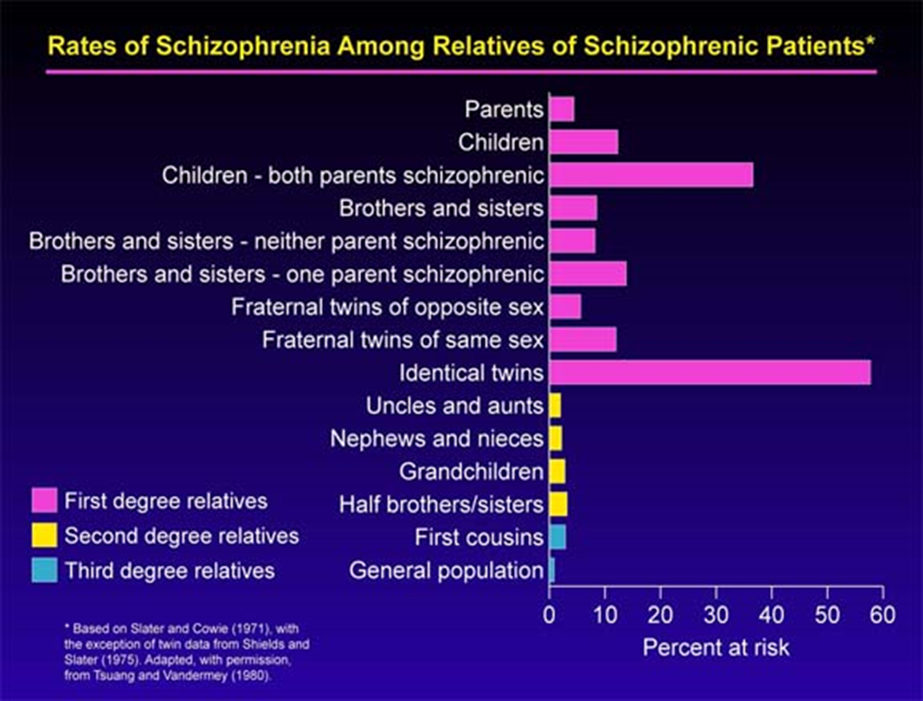
Etiology The exact etiology is UNKNOWN
Schizophrenia is mostly caused by various possible combinations of many different genes (which are involved in neurodevelopment, neuronal connectivity and synaptogenesis and excessive pruning of neuronal connections ) plus stressors from the environment conspiring to cause abnormal neurodevelopment.
There is also abnormal neurotransmission at glutamate synapses, possibly involving hypofunctional NMDA receptors .
Risk factors:
Primary illness
1. Genetics
◦ A wide range of genetic studies strongly suggest a genetic component to the inheritance
of schizophrenia that outweights the environmental influence.
◦ These include: family studies, twin studies and chromosomal studies.
◦ siblings of schizophrenic patients have about a 10% chance of developing schizophrenia.
◦ children who have one parent with schizophrenia have a 5%–6% chance.
◦ 17% for persons with one sibling and one parent with schizophrenia.
◦ 46% اعلى نسبة for the children of two schizophrenic parents.
◦ monozygotic twins—an average of 46% اعلى نسبة, compared with 14% concordance in dizygotic twins.
بالصورة النسبة قريبة للستين لكن الدكتورة أكدت لنا أن النسبة حسب النسخة الجديدة للكتاب هي ٤٦٪؜
Notes:
Numbers are important

Slide 9
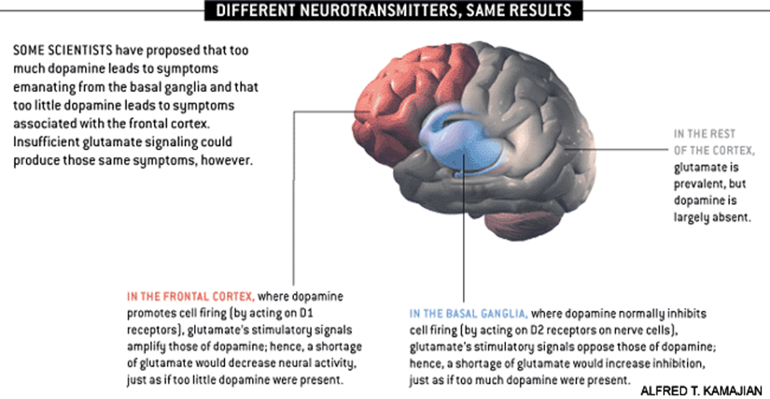
Etiology The exact etiology is UNKNOWN
2. Neurobiology
Certain areas of the brain are involved in the pathophysiology of schizophrenia:
The limbic system, The frontal cortex, Cerebellum, and the Basal ganglia.
a- Dopamine Hypothesis
Too much dopaminergic activity.
Whether it is:
↑ release of dopamine
↑ dopamine receptors
hypersensitivity of dopamine receptors to dopamine
combinations is not known
C- Psychoneuroimmunology
↓ T-cell interlukeukin-2 &
lymphocytes.
Abnormal cellular and humoral
reactivity to neurons and
presence of antibrain
antibodies.
These changes are due to
neurotoxic virus
or endogenous autoimmune
disorder.
d- Psych neuroendocrinology
-Abnormal dexamethasone-suppression test
-↓ LH/FSH
-A blunted release of prolactin and growth hormone on stimulation.
b- Other Neurotransmitters
-Serotonin
-Norepinephrine
-GABA
-Glutamate (hypofunction in NMDA receptors)
-Neuropeptides
Notes:
Color editing

Slide 10
Etiology The exact etiology is UNKNOWN
3. Neuroimaging and Neuropathology ◦Cerebral ventricular enlargement.
◦ Sulcal enlargement and cerebellar atrophy.
◦decreased thalamus size.
◦ Abnormalities have been reported in the brain particularly in the limbic system, basal ganglia and cerebellum. Either in structures or connections.
هذي الاعراض ممكن اشوفها بأمراض اخرى زي ال Dementia فبتالي هي تعتبر نظرية وليست سبب دقيق
4. Psychosocial Factors
◦ In family dynamics studies, no well-controlled evidence indicates specific family pattern plays a causative role in the development of schizophrenia.
◦ High Expressed Emotion family : increase risk of relapse. لانها تضغط على المريض فبتالي تزيد من احتمالية الانتكاسة
5. Stress-Diathesis Model الشخص ممكن يكون عنده قابلية للفصام لكن الأعراض خاملة, وبسبب التوتر تبدأ تظهر أعراض الفصام
◦ Integrates biological, psychosocial and environmental factors in the etiology of schizophrenia.
◦Symptoms of schizophrenia develop when a person has a specific vulnerability that is acted on by a stressful influence.

Slide 11
Clinical Course
Acute exacerbation with increased residual impairment most common
Full recovery: very rare
Longitudinal course: downhill
Feature | Good outcome | Poor outcome
Onset | Acute | Insidious
Duration of prodrome | Short | Since childhood
Age at onset | Late 20s to 30s | Early teens
Mood symptoms | Present | Absent
Psychotic or negative Symptoms | Mild to moderate | Severe
الأفكار الوسواسية Obsessions الأفعال القهرية compulsions | Absent | Present
Gender | Female | Male
Premorbid functioning الأداء الوظيفي قبل المرض | Good | Poor
Marital status | Married | Never married
Psychosexual functioning | Good | Poor
Neurological functioning | Normal | +Soft signs
Structural brain abnormalities | None | Present
Intelligence level | High | Low
Family history of schizophrenia | Negative | Positive
Stage | Typical features
Prodromal phase خامل | Insidious onset occurs over months or years; subtle behavior changes include social withdrawal, work impairment, blunting of emotion, avolltion, and odd ideas and behavior.
Active phase | Psychotic symptoms develop, including hallucinations, delusions, or disorganized speech and behavior. These symptoms eventually lead to medical intervention
Residual phase | Active-phase symptoms are absent or no longer prominent. There is often role impairment, negative symptoms, or attenuated positive symptoms. Acute-phase symptoms may reemerge during the residual phase ("acute exacerbation").

Slide 12
Diagnosis
DSM-5 Diagnostic Criteria for Schizophrenia:
A. ≥ two characteristic symptoms for one month, at least one of them is (1),(2) or (3).
اثنتان من الأعراض التالية تكون موجودة لمدة لا تقل عن شهر كامل ولكن اللخبطه والخلل الوظيفي تكون موجودة في فترة لا تقل عن ستة أشهر زي ما بنشوف بالنقطة سي
1- Delusions.
2- Hallucinations.
3- Disorganized speech (frequent derailment or incoherence).
4- Grossly disorganized or catatonic behavior.
5- Negative symptoms ( diminished emotional expression or lack of drive (avolition)).
B. Social, Occupation or self-care dysfunction.
C. Duration of at least 6 months of disturbance (include at least one month of active symptoms that meet Criterion A; in addition of periods of prodromal and residual symptoms).
D. Schizoaffective & mood disorder exclusion.
E. The disturbance is not due to Substance or another medical condition.
F. If there is history of autism spectrum disorder or a communication disorder of childhood onset, schizophrenia diagnosis is made only if delusion or hallucinations plus other criteria are present.
F. لو المريض أصلا عنده توحد ما نقدر نحكم بظهور 2 من الأعراض الي فوق بأنه مصاب بالفصام لازم يكون عنده delusion or hallucinations مع وجود أعراض أخرى

Slide 13
Mental Status Examination (MSE)
- Appearance Unkempt dressing & behavior as aggressive behaviour ( variable presentations).
- Mood, feelings & affect ( reduced emotional responsiveness, inappropriate emotion).
- Perceptual disturbances ( hallucinations, illusions ).
- Impulsiveness, violence, suicide & homicide
- Cognitive functioning الوظائف المعرفية Mechanism: Abnormality in Ach, 5HT, Dopamine, Abnormal connectivity or neurodegeneration
- Poor insight and judgment.
- Thought:
perseveration
01:24
1. Thought content ( delusions)
2. Form of thought ( looseness of association)
3. Thought process ( thought blocking, poverty of thought content, poor abstraction, perseveration They answering different questions with same answer,).

Slide 14
Differential diagnosis
Primary Psychiatric disorders:
Schizophreniform disorder | Brief psychotic disorder | Delusional disorder | Schizoaffective disorder | Mood disorders | Personality disorders (schizoid, schizotypal and borderline personality) | Factitious disorder | Malingering
Secondary psychiatric disorders:
Substance-induced disorders
Psychotic disorders due to another medical disorder : CNS diseases, Epilepsy (complex partial), Trauma and Others Such Autoimmune disease Like SLE
Other Psychotic Disorder
Delusional disorder
(delusion only >1m)
Brief psychotic disorder:
< 1 month of disturbance
Schizoaffective disorder:
An uninterrupted period of illness during which there is a major mood episode (major depressive or manic) concurrent with Criterion A of schizophrenia.
There is Delusions or hallucinations for 2 or more weeks in the absence of a major mood episode during the illness course.
Extra explanation
ايش الفرق بين Schizophreniform disorder و Schizoaffective disorder ؟
Schizoaffective disorder راح يكون المريض عنده اعراض تغيير المزاج(mood disorders) أما اكتئاب او هوس (mania)
طبعًا مريض Schizophreniform disorder ممكن جدًا انه يعاني من أعراض تغيير المزاج لكن اول شي ما تكون واضحة عليه ثاني شي مدتها ما تكون طويلة
اما Schizoaffective disorder patient يكون يعاني منها نص او اكثر مدة مرضه وتكون جدًا واضحة على شخصيته
Schizophreniform disorder;
1-6 month of disturbance

Slide 15
Treatment
Reasons to hospitalize patients with schizophrenia:
01
When the illness is new, to rule out alternative diagnoses and to stabilize the dosage of antipsychotic medication.
02
For special medical procedures such as electroconvulsive therapy”ECT”. We use it in severe and suicidal cases mainly
03
When aggressive or assaultive behavior presents a danger to the patient or others.
04
When the patient becomes suicidal.
05
When the patient is unable to properly care for himself or herself (e.g, refuses to eat or take fluids).
06
When medication side effects become disabling or potentially life threatening (e.g, neuroleptic malignant syndrome).

Slide 16
Treatment
Psychosocial Interventions | Biological Therapy
◦ Assertive community treatment (ACT) programs: careful monitoring of patients through mobile mental health teams. ◦ Family oriented therapy. ◦ Cognitive rehabilitation involves the remediation of abnormal thought processes known to occur in schizophrenia, using methods pioneered in the treatment of brain-injured persons. ◦ Social skills training (SST) aims to help patients develop more appropriate behavior. ◦ Psychosocial rehabilitation serves to integrate the patient back into his or her community rather than segregating the patient in separate facilities. ◦ Vocational rehabilitation may help a patient obtain supported employment, competitive work in integrated settings, and more formal job training programs. ◦Individual psychotherapy ◦Group therapy individual psychotherapy | Antipsychotic medications are the mainstay of the treatment of schizophrenia. Generally, they are remarkably safe. Two major classes: -Conventional, (1st generation) e.g. haloperidol, chlorpromazine. -Atypical, 2nd generation (Serotonin-dopamine receptor antagonists) (e.g. Risperidone, clozapine, olanzapine). Depot forms which is given by injection of antipsychotics eg. Risperidone Consta is indicated for poorly compliant patients. Electroconvulsive therapy (ECT) for catatonic or poorly responding patients to medications
Doctor said: know the names only ;)
Notes:
في صورة بسلايدز الدكتورة بلا عنوان:/

Slide 17
Side Effects of Antipsychotics
High Potency typical antipsychotics: Neurological side effects
Low Potency typical and atypical antipsychotics: many other side effects

Slide 18
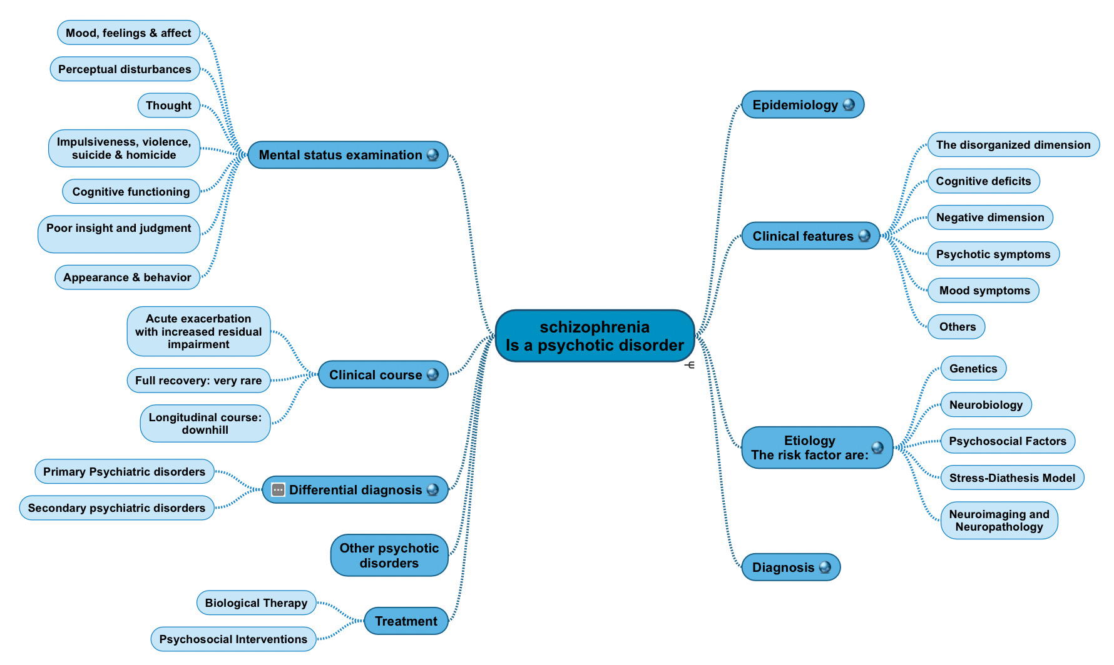
Summary

Slide 19
Quick Revision
Schizophrenia is defined by a group of characteristic symptoms continuous for at least 6 months.
Worldwide prevalence of schizophrenia is about 0.5%–1%.
Risk factors
1- genetics “please memorise the numbers”
2- Neurobiology: brain area involved in schizophrenia: the limbic system, The frontal cortex, Cerebellum, and the Basal ganglia.
3- Neuroimaging and Neuropathology
4- Psychosocial Factors
5- Stress-Diathesis Model
Diagnostic Criteria
- ≥ two characteristic symptoms for one month
1- Delusions. 2- Hallucinations. 3- Disorganized speech 4- Grossly disorganized or catatonic behavior. 5- Negative symptoms
- Social, Occupation or self-care dysfunction.
- Duration of at least 6 months of disturbance
- The disturbance is not due to Substance or another medical condition.
- If there is history of autism schizophrenia diagnosis is made only if delusion or hallucinations plus other criteria are present.
Malfunctioning Brain Area | Related Symptoms
Mesolimbic | Positive symptoms: delusion & hallucinations.
-Mesocortical/ prefrontal cortex -Nucleus accumbens reward circuits | Negative symptoms : Volition, Diminished emotional expression, Alogia, Anhedonia Social withdrawal.
Amygdala + Orbitofrontal | Aggressive symptoms
Management and treatment:
Hospitalization: newly diagnosed, aggressive or suicidal patients.
Biological therapy: Antipsychotic medications are the mainstay of the treatment of schizophrenia.
Psychological therapy:Family oriented therapies
Electroconvulsive therapy (ECT) for catatonic or poorly responding patients to medications

Slide 20
MCQs
1) Positive symptoms of schizophrenia?
A. Depression
B. Alogia
C. Hallucinations
D. Executive
2) The main etiology of schizophrenia:
A. Genetics
B. Epilepsy
C. Children who have one parent with schizophrenia
D. Non
3) children of two schizophrenic parents have about ___ chance to developing schizophrenia.
A. 10%
B. 17%
C. 6%
D. 46%
4) When the patient is poorly responding to the medication, we usually use:
A. Depot forms
B. Electroconvulsive therapy (ECT)
C. Hospitalize the patient
D. Social skills training (SST)
5) aggressive symptoms on the patient due to malfunctioning of:
A. Mesolimbic system
B. Dorsolateral prefrontal cortex
C. Orbitofrontal & amygdala
D. Nucleus accumbens
6) Which one is involved in pathophysiology of schizophrenia?
A. Limbic system
B. Spinal cord
C. Medulla oblongata
D. Glial cells 7) What is the mainstay treatment of schizophrenia?
A. ECT
B. Hospitalization
C. Antipsychotic medication
D. Antidepressants medication
8) which of the following features is associated with poor outcome in schizophrenia?
A. Female patient
B. Early teens patients
C. Acute onset
D. Mood symptoms presentation
1- C 2- D 3- D 4- B 5- C 6- A 7- C 8-B

Slide 21
Thank you for checking our work
Team Leaders
Contact us:
Abdulaziz Aljohani
Laila Alsabbagh
@medicine437
medicineteam437@gmail.com
Team Members
Waiting for Your feedback
Shahad Aljebreen
Reference: Girls’ & Boys’ Slides

